Slide 1
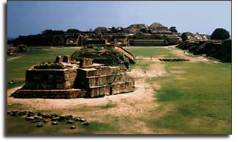
Overview of the Zapotec Training Course
Computational Shock and Multi-Physics (1431)
Sandia National Laboratories
Albuquerque, NM
The Zapotecs were an ancient civilization that thrived in the Oaxaca Valley between 500 BC and 1500 AD. They were the first to develop the Mesoamerican calendar.
Monte Alban Ruins
SAND2017-8477 TR
Unclassified; further dissemination unlimited
Sandia National Laboratories is a multimission laboratory managed and operated by National Technology and Engineering Solutions of Sandia, LLC., a wholly owned subsidiary of Honeywell International, Inc., for the U.S. Department of Energy's National Nuclear Security Administration under contract DE-NA0003525.
Notes:
The Zapotecs were an ancient civilization that thrived in the Valley of Oaxaca in western Mexico between 500 BC and 1500 AD. The civilization began its decline around 700 AD for unknown reasons.
Before getting started, give administrative remarks:
- Restroom location
- Coffee, juice, food, ...

Slide 2
Export Controlled Information
CTH, Sierra/SM, and Zapotec have been designated as Export Controlled Information (ECI)
  Export is defined as transmission of information to citizens of foreign countries (including U.S. allies)
  Dissemination of CTH, Sierra/SM, and/or Zapotec is regulated via their respective Software Licensing Agreements and by all applicable United States laws, regulations, rules, and decrees, including, but not limited to, the U.S. Foreign Corrupt Practices Act, the Export Administration Act, the U.S. Anti-Boycott Laws, and the International Traffic in Arms Regulations (ITAR)
  Violations of the export control laws are subject to administrative, civil, and criminal penalties
The software is ECI; however, this class is unlimited release

Slide 3
Objectives
Introduction to Zapotec
Overview of the coupling algorithm
Problem development and typical applications

Slide 4
What are we coupling with Zapotec?
CTH: Eulerian shock physics code
Sierra/SM: Explicit, Lagrangian finite element code
Zapotec couples interaction between Lagrangian and Eulerian materials
Notes:
There are many implementations of coupled methods. With Zapotec, we tightly couple two existing, production codes: CTH and Sierra/SM.
In the problem development, we define materials as Lagrangian or Eulerian. The coupling algorithm then handles the interaction between the two material types.

Slide 5
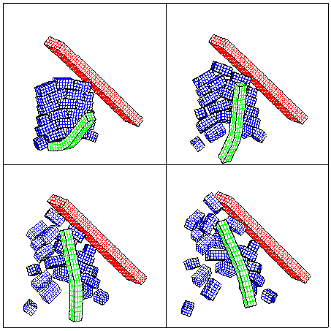
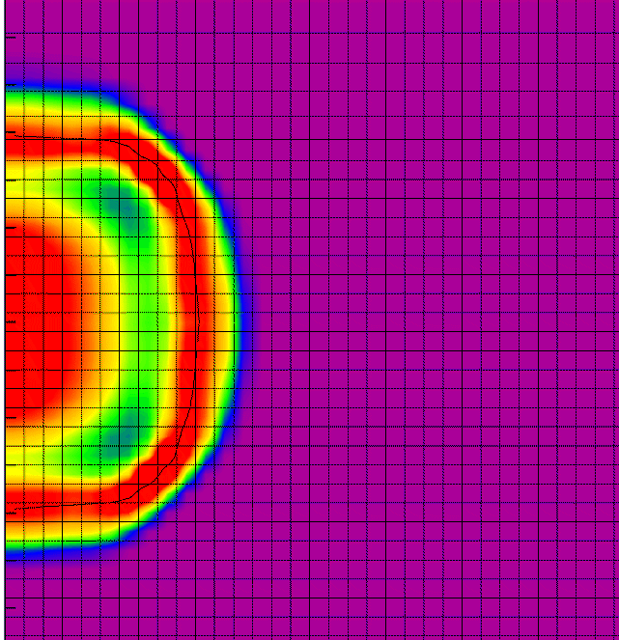
Lagrangian vs. Eulerian
Lagrangian
  Treatment of a continuum variable from a frame of reference fixed w.r.t. the material
  In a Lagrangian mesh, nodes and material points are coincident, i.e., the mesh moves with the material
Eulerian
  Treatment of a continuum variable from a fixed frame of reference with the reference mesh chosen to coincide with the spatial coordinates
  In an Eulerian mesh, nodes are fixed in space while material points move through the reference mesh
Notes:
Before discussing Zapotec further, it is useful to first define Lagrangian and Eulerian methods.
There are a number of Lagrangian methods (e.g., finite elements, finite difference, meshless methods). Throughout this course, when we refer to Lagrangian methods, we are really referring to the finite element method. The same holds for Eulerian methods, where references to Eulerian really mean a reference to CTH.

Slide 6
Why consider a coupled approach?
Lagrangian methods
  Strengths
    Material interfaces explicitly defined → well-suited for contact-impact problems
    Ideal for complex, structural response applications
  Weakness
    Large material deformations → large mesh distortions → degrades solution accuracy and can stop the calculation
Eulerian methods
  Strengths
    Can handle large material deformations and/or mixing of materials
    Ideal for hydrodynamic applications
  Weaknesses
    Modeling constitutive response for structural analysis problems
    Treatment of multi-body contact
We use coupled methods to solve problems not readily handled by either Lagrangian or Eulerian methods alone
Notes:
Here are some strengths and weaknesses of Lagrangian and Eulerian methods.
Strength of Lagrangian methods:
Material interfaces are explicitly defined. This allows us to correctly enforce the contact conditions between materials, i.e., enforcement of the no penetration condition and frictional effects.
Lagrangian methods are well suited for large, complex, multi-body structural analysis applications.
Also, since the mesh moves with the material, there are advantages for material modeling since the history of deformation is known.
Speed of computation
Weakness of Lagrangian methods:
Mesh distortion degrades solution accuracy, potentially leading to a negative volume computation that stops the calculation
Mesh generation is difficult and time consuming. Specification of boundary and initial conditions can also be time consuming.
Strength of Eulerian methods:
With Eulerian methods, the material flows through the mesh. Thus, these methods are well suited to model large material deformations and mixing.
They are ideal for hydrodynamic applications, which is from where they originated.
Problems are easy to setup.
Weakness of Eulerian methods:
Material interfaces are reconstructed, not tracked. This poses difficulties in treatment of contact-impact problems since the contact conditions cannot be explicitly enforced.
Material modeling is not well done for structural response applications (e.g., elastic-plastic material response), especially when the problem involves history-dependent materials.
Calculations are expensive – large memory requirements, slow execution
Why coupled?
With Zapotec, we are targeting certain classes of problems that are not readily solved using Euler or Lagrangian methods alone. We generally encounter these problems when the constituent materials exhibit vastly differing strengths (or degrees of deformation). E.g., consider an earth penetration example. The penetrator is a stiff structure, exhibiting low to moderate deformations. The target is soft by comparison and will exhibit large material deformations and flow. With a coupled approach, we can choose the best solution method for modeling various material in the problem. For earth penetration, the penetrator is modeled as Lagrangian because deformations are moderate and structural response is of primary interest to the analyst. We model the target (earth) as Eulerian since this solution method best handles the large material deformations.

Slide 7
Zapotec Background
The Coupled Algorithm in Time
CTH and Sierra/SM are run sequentially, cycle by cycle
Algorithm permits Sierra/SM subcycling
Δt_{CTH}
CTH
Δt_{Sierra/SM}
Sierra/SM
t_{n}
t_{n+1}
t
Zapotec Coupling
Sierra/SM and CTH Calculation
Notes:
Before discussing the details of the coupling algorithm, it is first useful to look at the coupled treatment in time. At time t_{n}, we get data from CTH and Sierra/SM, work on that data, then send back the updated data to the two codes. CTH and Sierra/SM then move forward in time independently to t_{n+1}. In general, CTH will have a larger stable time step. We permit Sierra/SM subcycling to improve efficiency and accuracy.

Slide 8
The Zapotec Coupling Algorithm
Conducted in two steps:
Material insertion step updates CTH data
Force application step updates Sierra/SM data
Notes:
Zapotec performs two steps in the coupled treatment. We refer to these as material insertion and force application.

Slide 9
The Zapotec Coupling Algorithm
Material Insertion Step
Remove pre-existing Lagrangian material from the CTH mesh
Get updated Lagrangian data
Insert Lagrangian material into CTH mesh
  Compute volume overlaps
  Map Lagrangian data – mass, momentum, sound speed, stress, internal energy
Lagrangian
Material
t_{n}
L2
L1
CTH Mesh
P _{L,inserted} = (V_{O,L1} P_{L1} + V_{O,L2} P_{L2}) / V_{O}
V _{overlap} = V_{O} = V_{O,L1} + V_{O,L2}
Notes:
At the beginning of the coupled treatment, we have Lagrangian material that was previously inserted into the CTH mesh. We remove this material so that the CTH mesh contains only Eulerian materials. Once this is done, we get the current (updated) Lagrangian data and insert it into the CTH mesh. Material insertion first involves computing the overlap of Lagrangian elements with CTH cells. After the element/cell overlaps are determined, we insert the Lagrangian data (mass, momentum, sound speed, stress, internal energy) into the CTH mesh. In general, we have CTH cells that are overlapped by several Lagrangian elements. We weight the Lagrangian data, usually by volume, for cell insertion. For example, consider pressure where we weight the Lagrangian pressures by their volume-fraction overlap prior to insertion.

Slide 10
The Zapotec Coupling Algorithm
Force Application Step
Remove pre-existing Lagrangian material from the CTH mesh
Get updated Lagrangian data
Insert Lagrangian material into CTH mesh
  Compute volume overlaps
  Map Lagrangian data
Compute external force on Lagrangian surface
  Determine surface overlaps
  Compute surface tractions based on Eulerian stress state
  Compute normal force on element surface (element-centered force)
  If friction, compute tangential force
    f_{t} = μf_{n}s
  Distribute forces to nodes
Lagrangian
Material
t_{n}
CTH Mesh
f_{n} = (t · n_{L} ) A_{overlap} n_{L}
f_{I} = N_{I} f_{n}
Notes:
With the material insertion step, we have updated the CTH data. Now we need to assess the loading on the Lagrangian materials.
First determine the overlap of Lagrangian surface elements with cells in the CTH mesh. For a given surface element, we compute the surface tractions based on the stress state in the neighboring Eulerian material. The surface normal and element area is known, allowing us to readily compute the normal force on a surface element. These forces are element-centered. We distribute these forces to the nodes in standard FE fashion. Once this is done for all surface elements, we pass the data back to Sierra/SM as a set of external nodal forces.

Slide 11
Highlight of Zapotec Capabilities
Supports two Sierra/SM element types for material insertion
  8-node hexahedral element
  4-node shell element
Compatible with CTH-AMR capability
Can model response of complex, thin-shell structures
Element death (a.k.a. erosion) accounted for in the force application step
Donation
  Material from “dying” Lagrangian elements contributed to CTH
  “Donated” material treated as Eulerian for duration of calculation
Parallel implementation

Slide 12
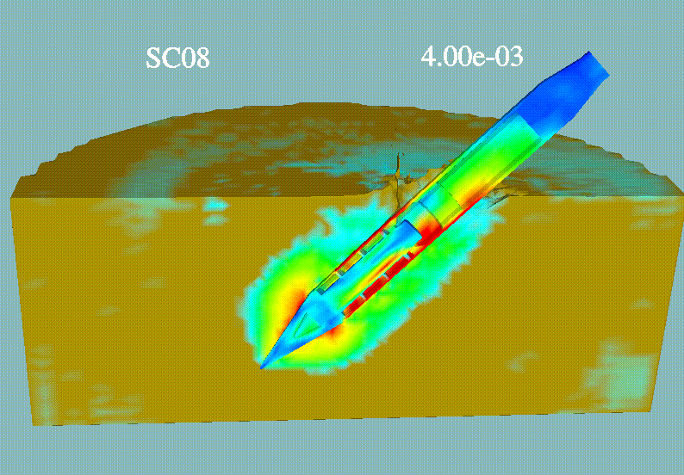
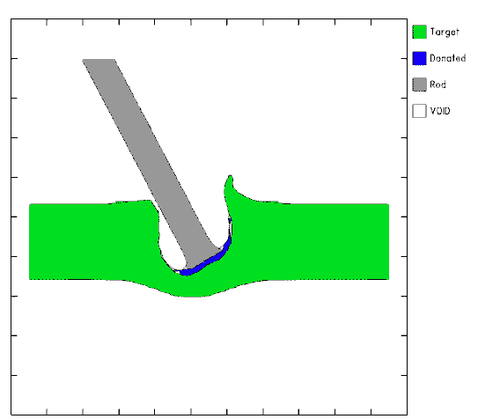
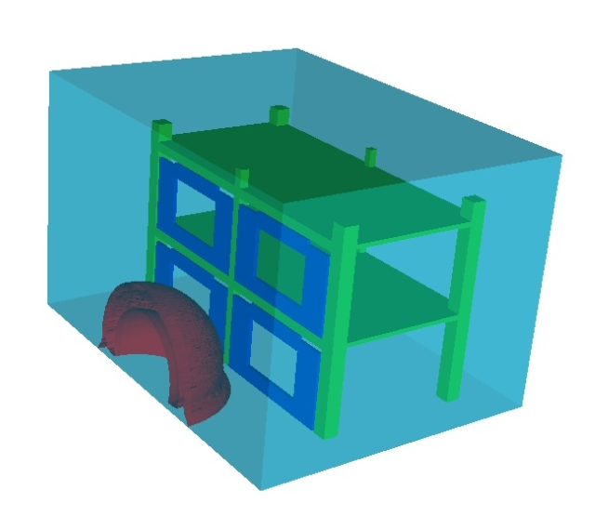
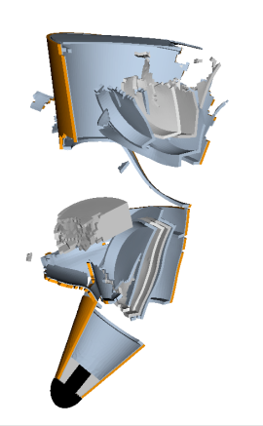
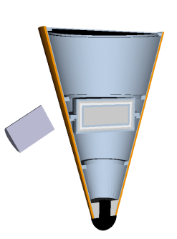
Typical Zapotec Applications
Earth Penetrating Weapons
Anti-Armor Applications
(Eroding Rods)
Air Blast Loading on a
Reinforced Concrete (RC)
Building
Hypervelocity Impact
Notes:
The class of problems solved with Zapotec usually involves materials of vastly differing strengths. For example, consider an earth penetration problem. The loading on the penetrator can lead to significant deformation and potentially high shock levels on any on-board components. In turn, the penetrator deformation affects the stress field in the neighboring target material.

Slide 13
Problem Development
Zapotec Data
Input File
List of coupling files
Sierra/SM Data
Input File (*.i)
Model File (*.g)
CTH Data
Input File
Zapotec
Results Data
CTH Results (spcth, hscth)
Sierra/SM Results (*.e, *.h)
Notes:
Data development for Zapotec is complex. There are three sets of input data, inputs for CTH, Sierra/SM, and Zapotec. There is also a zapotec list file that lists the names of each of the core input files. The Zapotec input file describes the relationship between the Eulerian and Lagrangian materials in the problem. Once these inputs are developed, the user can then run Zapotec. Because we are using off-the-shelf codes (i.e., Sierra/SM and CTH), it is implied the user has extensive working knowledge of CTH and Sierra/SM.
CTH and Sierra/SM have vastly differing plotting databases. Paraview is rhe recommended visualization tool, since it can read both CTH and Sierra/SM outputs.
Need to make point that Sierra/SM is linked to a separate CTH source. Knowledge of the location of this source is important in setting the CTHPATH variable, required for all runs.

Slide 14
Coupling File List
Input for Zapotec:
  sierra zapotec -i <zapotec file list>
File syntax:
  cth input deck = <name> CTH input
  cth run id = <name>
  sierra input deck = <name> Sierra/SM input
  zapotec input deck = <name> Zapotec input

Slide 15
Zapotec Command File
Name specified in coupling file list (e.g., zapotec.inp)
Simple, free-field format using keyword inputs
Provides overall program control
  termination time, plot frequency…
Defines relationships between Eulerian and Lagrangian materials in the problem
  The user must set up CTH and Sierra/SM input separately

Slide 16
Example Zapotec Command File
*
num_eul = 1
*
material_map
eulerian 2 = lagrangian 10
*
max_subcycles = 20
*
force
sset 200 210
material 10
*
plot
time = 0.0 interval = 5.0e-6
*
restart
time = 5.0e-6 interval = 5.0e-6
stop_time = 20.0e-6
Notes:
This is representative of a typical Zapotec input file. Commands in this file define relationships between Euler and Lagrange materials in the problem as well as provide some directives for overall program control. For the remainder of this training module, we will discuss individual Zapotec commands.

Slide 17
Control Data
Code termination based on time
Set termination times in CTH and Sierra/SM to a large value
  CTH command file:
  Sierra/SM command file:
Can limit Sierra/SM subcycling (default is 50)
stop_time = 20.0e-6
control
tstop = 999.0
endcontrol
termination time = 999.0
max_subcycles = 20
Notes:
Code termination (or analysis duration) can be controlled by Zapotec. To do so, the user must set the termination times in CTH and Sierra/SM to values greater than the Zapotec stop time/cycle.
Zapotec permits Lagrangian subcycling to improve computational efficiency and accuracy. The user can control the amount of subcycling using the max_subcycles command.

Slide 18
Control Data (Cont’d)
coupling keyword set can be used to terminate the CTH coupling at a prescribed time, allowing Sierra/SM to run independently
Useful for applications involving air blast loading on structures
multistep option provides more generality
  Options: Independent, coupled, Lagrangian, Eulerian
  Can toggle analysis on/off as desired
F
coupling
tcutoff = <time>
ncutoff = <no. steps>
Reduce force linearly
over ncutoff time steps
t_{cutoff}
t
multistep
time = 0.0 type = independent
time = 20.0e-6 type = coupled
time = 100.0e-6 type = lagrangian
Notes:
Useful for applications involving air blast on structures:
the duration of the positive phase pressure pulse is small compared with the structure’s time to respond
Avoid late time mixing of air and explosive products in CTH portion of calculation. This mixing can lead to unstable behavior and a sudden increase in material specific energies, which in turn, lead to non-physical pressure states.

Slide 19
Output Control
Zapotec can control the frequency of spatial results data output to CTH and Sierra/SM plot files
Zapotec cannot control the data written to the plot files
  The user must specify what data are written in the CTH and Sierra/SM input files
  In CTH, this is done with the spy command block. The spy block must duplicate the output frequencies specified in the Zapotec coupling file (hope to fix this soon)
  In Sierra/SM, this is done with the results output command block, but does not need any output frequency specified, since Zapotec controls the output
Zapotec cannot control history/tracer data
  The user must specify history data in the CTH and Sierra/SM input files
  In CTH, use spyhis commands within the spy command block
  In Sierra/SM, use the history output block
plot
time = 0.0 interval = 5.0e-6
Notes:
Zapotec can control plot frequency, but it cannot control what data is plotted.

Slide 20
Restart Control
Zapotec can also control the frequency of writing restart data, e.g.,
Dummy restart input must be specified in the CTH and Sierra/SM input files
  Sets aside internal memory for writing restart data
  In CTH, use the restt command with a large value
  In Sierra/SM, use restart data command block, but no frequency of output is required
restart
time = 5.0e-6 interval = 5.0e-6

Slide 21
Material Assignments
Euler and Lagrange materials must be defined separately in CTH and Sierra/SM input files, respectively
In the CTH input file
  Materials are categorized as
    Permanent CTH material
    Donated material: Lagrangian material converted to a CTH material via element death in Sierra/SM
    Placeholder material: Sets aside internal memory in the CTH database for inserted Lagrangian materials
  Require sequential ordering of these materials
    Permanent CTH materials 1 ≤ m ≤ n_{perm}
    Donated materials n_{perm}+1 ≤ m ≤ n_{euler}
    Placeholder materials n_{euler}+1 ≤ m ≤ n_{total}
  Constitutive data must be specified for all materials
    See eos, epdata, and pfrac command documentation in CTH User Manual

Slide 22
Material Assignments
In the Sierra/SM input file
  Materials can be associated with a unique block ID
  Constitutive data must be specified for all Lagrangian materials
In the Zapotec input file
  The user must specify the number of Eulerian materials in the problem (n_{euler})
    n_{euler} = n_{perm} + n_{donated} < n_{total}
  The user must specify the relation between Euler and Lagrange materials in the problem. This is done using the material and donation maps
    Material map – maps Lagrangian materials into CTH placeholder locations
    Donation map – maps donated Lagrangian materials into CTH donated material locations
  Not all Lagrangian materials have to be mapped into the CTH mesh
    Map only those Lagrangian materials that can interact with Eulerian materials – but make sure not to leave anything important out!
  Multiple Lagrangian materials can be mapped into the same CTH placeholder location

Slide 23

An Example of Material Assignments
Hypervelocity impact of a long rod into a finite thickness target
Lagrangian rod: Sierra/SM block ID = 10
Eulerian target: CTH material ID = 1
  CTH Placeholder material ID = 3
Element death in Sierra/SM with criterion based on failure strain
  Dead elements are donated to CTH
  CTH donated material ID = 2
Lagrangian
Rod
Donated
Material
Eulerian
Target
num_eul = 2 *n_{total} = 3, n_{perm} = 1, n_{donated} = 1, n_{placeholder} = 1
material_map
eul = 3 lag = 10 *maps Lagrangian mat 10 to CTH mat 3
donation_map
eul = 2 lag = 10 *maps donated Lagrangian mat 10 to CTH mat 2

Slide 24
Force Application Data
The user must specify the Lagrangian materials that can interact with (or contact) Eulerian materials in the problem
Lagrangian material surfaces are specified as block IDs
  The block IDs provide a list of Lagrangian surface elements on the exterior surface of a Lagrangian material
  These surface definitions are automatically generated within Zapotec and are updated as Lagrangian elements die
  Currently requires that a contact block including all blocks to be coupled exist within the Sierra input (simplest to include all blocks)
  Sideset surfaces are not currently supported
force
material = 10
Notes:
Euler-Lagrange contact problem; not to be confused with Lagrange-Lagrange contact problem…

