Slide 1
Sierra Structural Dynamics
SD/SM Handoff Example
Sierra/SD Team
SAND2018-13267 TR
Unclassified; further dissemination unlimited
SAND2022-4007 TR

Slide 2
Overview
SAW (Sandia Analysis Workbench):
Workflow
Sierra/SD: Linear structural analysis
Sierra/SM: Nonlinear structural analysis
Paraview: Results Visualization
This lesson will demonstrate a few advanced features of Sierra/SM and Sierra/SD
Implicit preload of a structure
Handoff of preload state from Sierra/SM to Sierra/SD
Eigen and transient analysis around preloaded state
Sensitivity of result to material properties in Sierra/SD

Slide 3
Here is What We Will Do
This problem has an approximated solution. Step through the codes and deck step by step to verify and understand this solution.
Learn ways to use and enhance code outputs to understand results
Understand where code results match (and diverge) from simple mathematical models
Notes:
Provide a brief preview of the course structure and then go over the details of the agenda (refer to agenda handout).

Slide 4

Start SAW
> /projects/dart/wb/wb
Click Here

Slide 5
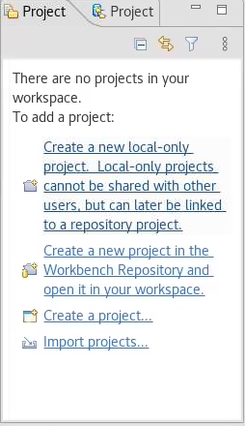
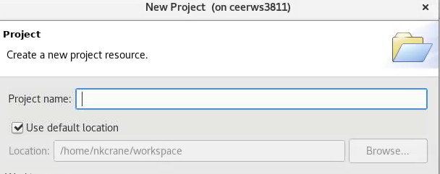
Create a project (if you don’t have one already)
2) Give it a name (like sierra100_sm_sd)
1) Click Here

Slide 6
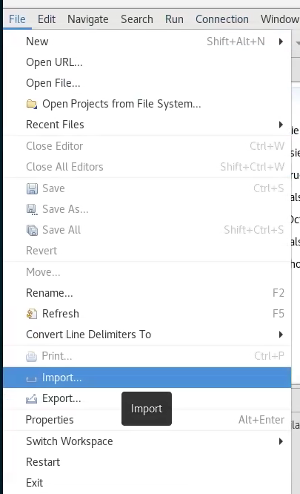
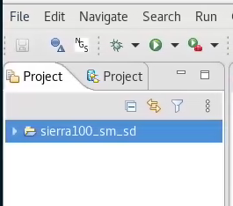
Import example files (if not already done)
1) Click File
2) And Import

Slide 7
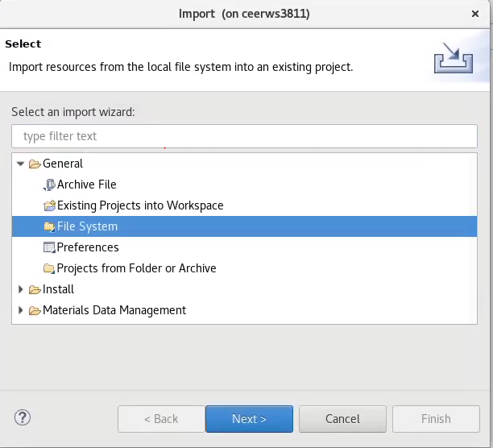
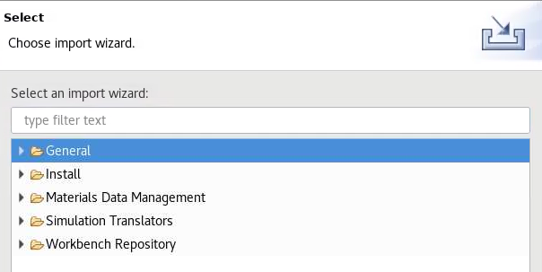
Import example files
1) Click General
2) And Filesystem
3) And Next

Slide 8
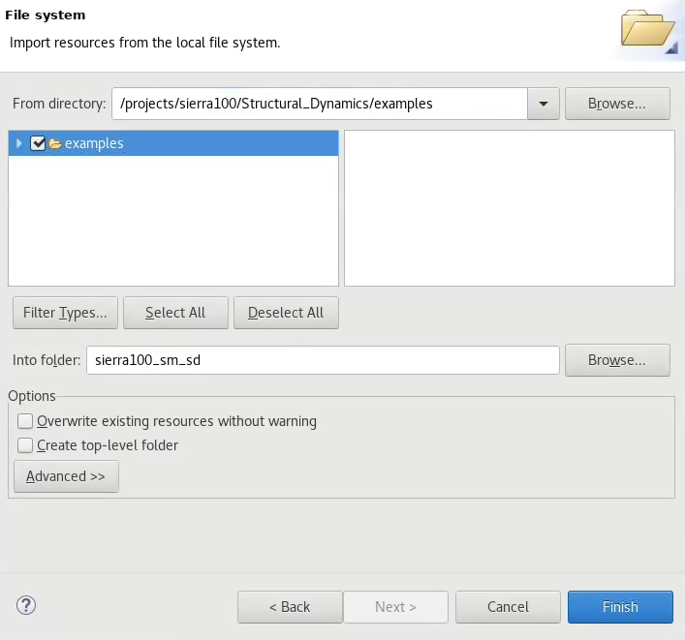
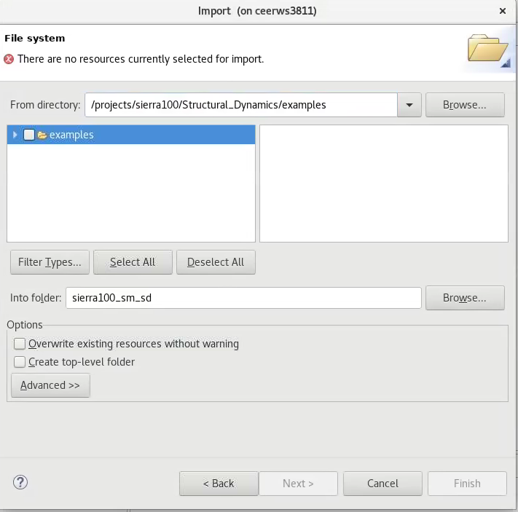
Import example files
3) Click this box
1) Type path here
2) Then Click Here
4) And finish

Slide 9
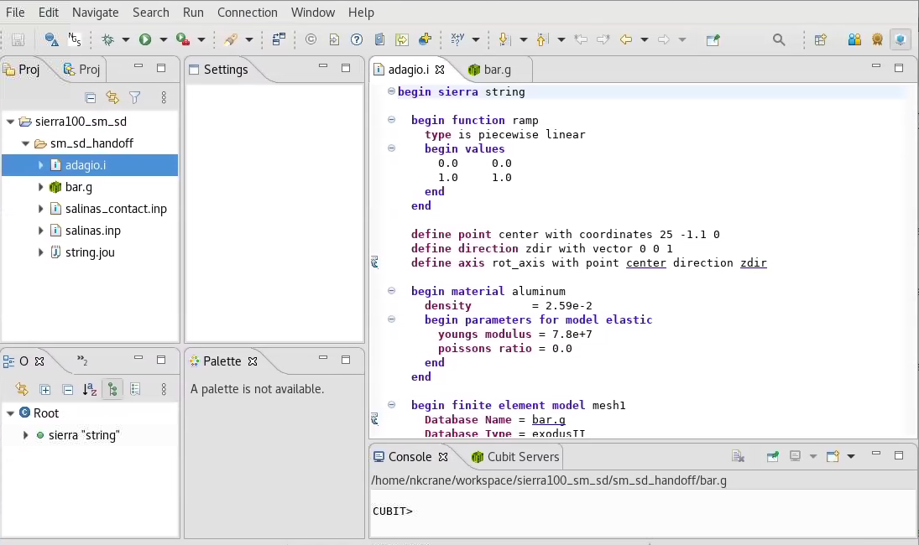
Explore Sierra/SM Inputs
Double click
input deck
2) And mesh

Slide 10
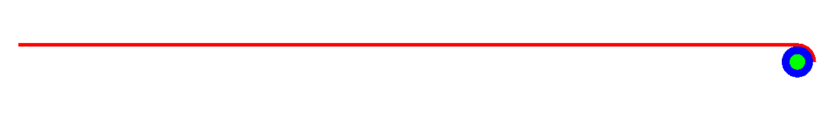
Sierra/SM Problem Objective
Explore the Sierra/SM deck, it is rotate pin to tension ‘string’
Fixed BC
Contact
Tension
Prescribed BC
Notes:
Provide a brief preview of the course structure and then go over the details of the agenda (refer to agenda handout).

Slide 11
What do we expect to happen
Material Props:
E = 7.8e+7
density = 2.59e-2
stringArea = 0.01
Geometry:
stringLength = 50
rollerRadius = 1.0
rollerRotation = 3.14 radians
Notes:
Provide a brief preview of the course structure and then go over the details of the agenda (refer to agenda handout).

Slide 12
Overview Expected Results
extension = rollerRadius*rollerRot = 3.14
strain = extension/stringLength = 0.0628
stress = E*strain = 4.898*10^6
tension = stress*stringArea = 4.898*10^4
waveSpeed = sqrt(tension/(stringArea*density)) = 13752
1st Frequency = 1*waveSpeed/(2*stringLength) = 137 Hz
2nd Frequency = 2*waveSpeed/(2*stringLength) = 275 Hz
3rd Frequency = 3*waveSpeed/(2*stringLength) = 412 Hz
4th Frequency = 4*waveSpeed/(2*stringLength) = 550 Hz
Notes:
Provide a brief preview of the course structure and then go over the details of the agenda (refer to agenda handout).

Slide 13
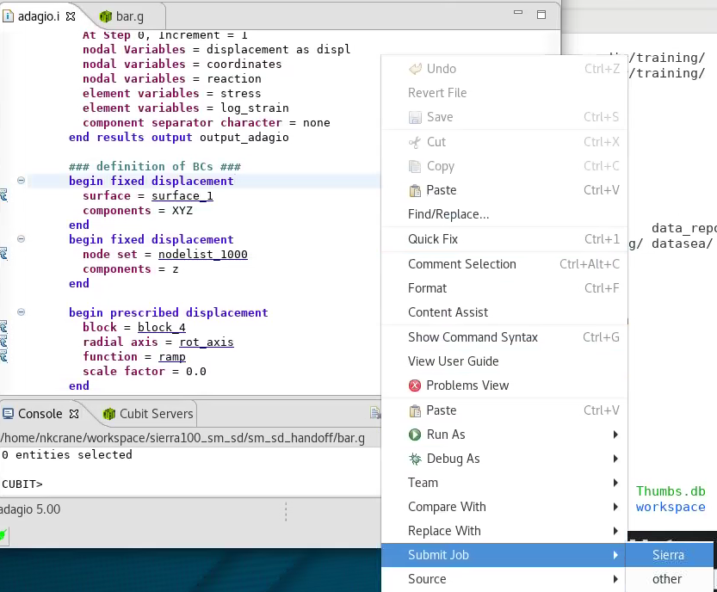
Run the Sierra/SM Deck
Right click in input deck window
2) “Submit Job”
3) “Sierra”
Notes:
Provide a brief preview of the course structure and then go over the details of the agenda (refer to agenda handout).

Slide 14
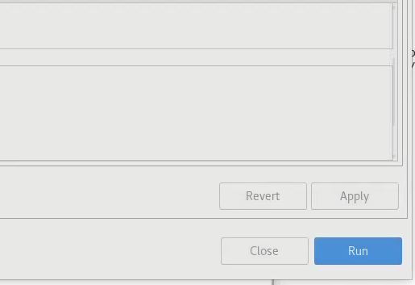
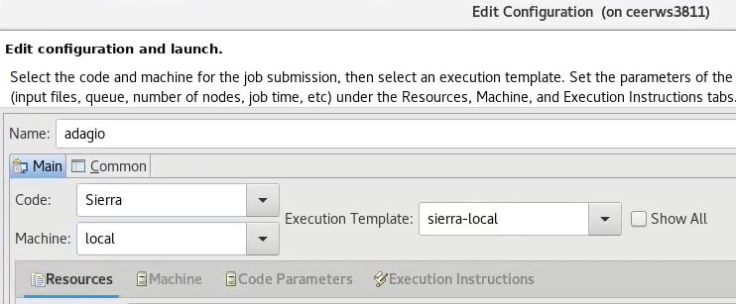
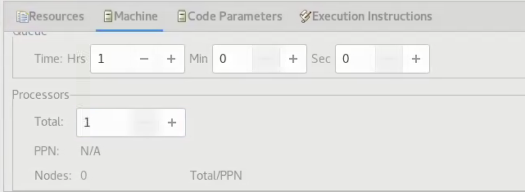
Run the Sierra/SM Deck
Make sure “local” is selected
4) And click run
2) Click “Machine”
3) Make sure “processors” is “1”
Notes:
Provide a brief preview of the course structure and then go over the details of the agenda (refer to agenda handout).

Slide 15
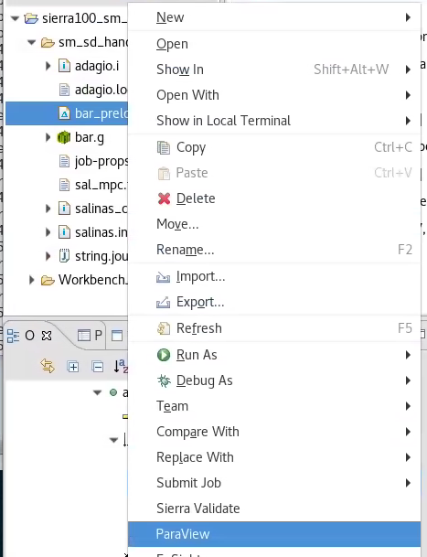
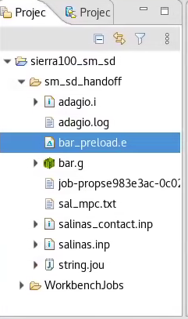
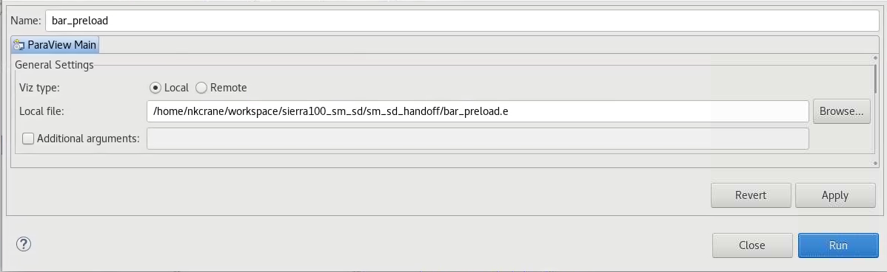
Open Paraview
New result file
2) Right click and open
in Paraview
3) Just hit run
Notes:
Provide a brief preview of the course structure and then go over the details of the agenda (refer to agenda handout).

Slide 16
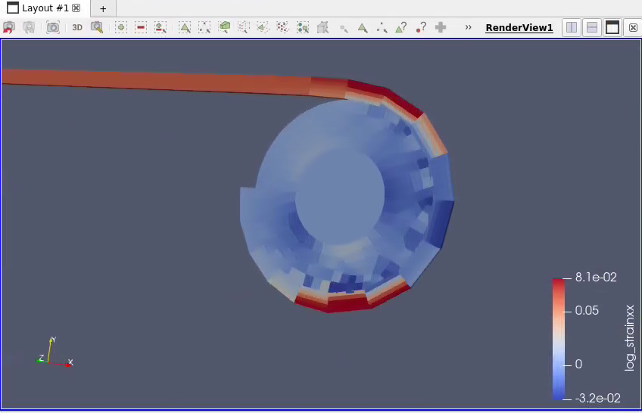
Investigate results in Paraview
Some things to look at:
Deformed shape
Stress_xx
Log_Strain_xx
Notes:
Provide a brief preview of the course structure and then go over the details of the agenda (refer to agenda handout).

Slide 17
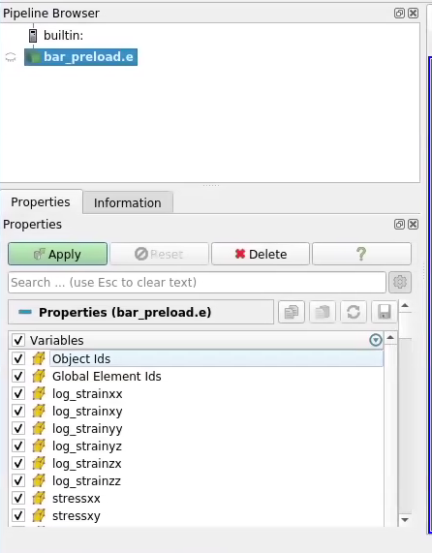

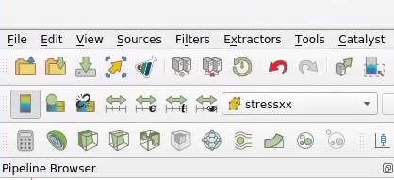
Investigate results in Paraview
3) Move forward and
backward in time
2) And apply
Click “Variables” box
Display different
quantities on mesh
Notes:
Provide a brief preview of the course structure and then go over the details of the agenda (refer to agenda handout).

Slide 18
Extension
extension = rollerRadius*rollerRot = 3.14
How shall we check this?
Does the code match our expected result?
Notes:
Provide a brief preview of the course structure and then go over the details of the agenda (refer to agenda handout).

Slide 19
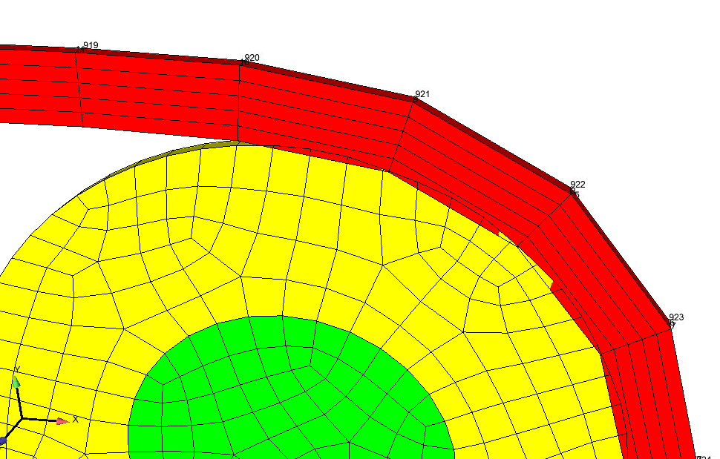
Extension
extension = rollerRadius*rollerRot = 3.14
How shall we check this?
Get displacement at node at end of bar
Does the code match our expected result? Why Not?
Contact facetization
Slight deformation of roller
Displ_x at node 920
Notes:
Provide a brief preview of the course structure and then go over the details of the agenda (refer to agenda handout).

Slide 20
Stress/Strain
strain = extension/stringLength = 0.0628
stress = E*strain = 4.898*10^6
How shall we check this?
Does the code match our expected result?
Notes:
Provide a brief preview of the course structure and then go over the details of the agenda (refer to agenda handout).

Slide 21
Stress/Strain
strain = extension/stringLength = 0.0628
stress = E*strain = 4.898*10^6
How shall we check this?
Pick it off a contour plot
Grab stress/strain at an element at bar
Average stress/strain over a set of elements
Extrapolate to nodes and pick off a node
Does anyone see a fundamental flaw in the assumptions used in the SM analysis vs. reality.
Notes:
Provide a brief preview of the course structure and then go over the details of the agenda (refer to agenda handout).

Slide 22
Tension
tension = stress*stringArea = 4.898*10^4
How shall we check this?
Does the code match our expected result?
Notes:
Provide a brief preview of the course structure and then go over the details of the agenda (refer to agenda handout).

Slide 23
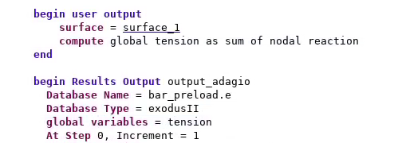
Tension
tension = stress*stringArea = 4.898*10^4
How shall we check this?
Integrate stress in post processor
Sum reaction in post processor
Sum reaction in code
Add these lines to input
deck
Notes:
Provide a brief preview of the course structure and then go over the details of the agenda (refer to agenda handout).

Slide 24
Rerun the Sierra/SM Deck
Right click in input deck window
2) “Submit Job”
4) And click run
3) “Sierra”
Notes:
Provide a brief preview of the course structure and then go over the details of the agenda (refer to agenda handout).

Slide 25
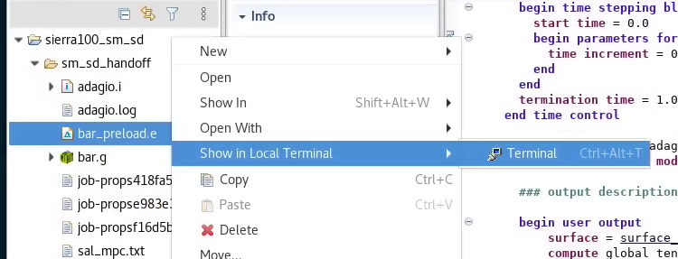
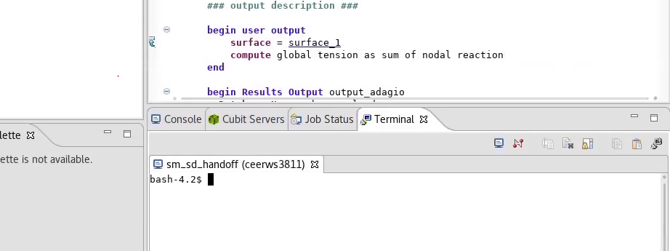
SEACAS tools to look at results files
Once run open and
show in terminal
2) Click on “Terminal” tab
Notes:
Provide a brief preview of the course structure and then go over the details of the agenda (refer to agenda handout).

Slide 26
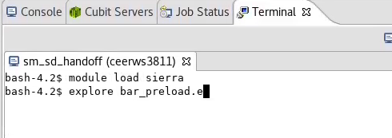
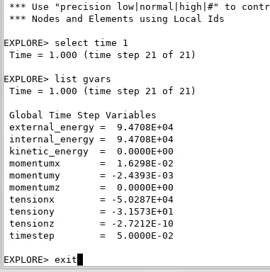
Run the Sierra/SM Deck
Type “module load sierra” and
“explore bar_preload.e”
In explore type:
  select time 1
  list gvars
tension = stress*stringArea = 4.898*10^4
Does the code match our expected result? Why Not?
Compounding effect of extension/stress/strain discrepancy
Notes:
Provide a brief preview of the course structure and then go over the details of the agenda (refer to agenda handout).

Slide 27
Defining Handoff
What will Sierra/SD need for the modal solution?
Deformed shape
Stress for geometric stiffness
Need variables with names Sierra/SD will recognize (example displx, disply, displz)
nodal Variables = displacement as displ
element variables = stress
component separator character = none
Notes:
Provide a brief preview of the course structure and then go over the details of the agenda (refer to agenda handout).

Slide 28
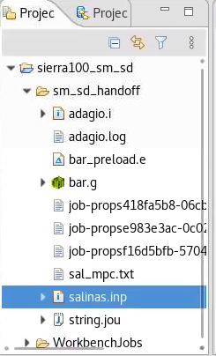
Open Sierra/SD Deck
1) Double click “salinas.inp”
2) Explore the deck
Load Cases
Boundary conditions
Materials
MPC inclusions
Notes:
Provide a brief preview of the course structure and then go over the details of the agenda (refer to agenda handout).

Slide 29
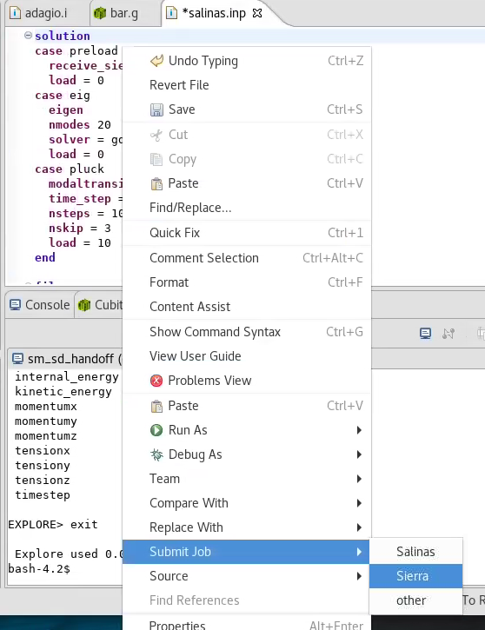
Run the Sierra/SD Deck
Right click in input deck window
2) “Submit Job”
3) “Sierra”
Notes:
Provide a brief preview of the course structure and then go over the details of the agenda (refer to agenda handout).

Slide 30
Run the Sierra/SM Deck
Make sure “local” is selected
4) And click run
2) Click “Machine”
3) Make sure “processors” is “1”
Notes:
Provide a brief preview of the course structure and then go over the details of the agenda (refer to agenda handout).

Slide 31
Frequencies
1st Frequency = 1*waveSpeed/(2*stringLength) = 137 Hz
2nd Frequency = 2*waveSpeed/(2*stringLength) = 275 Hz
3rd Frequency = 3*waveSpeed/(2*stringLength) = 412 Hz
4th Frequency = 4*waveSpeed/(2*stringLength) = 550 Hz
How shall we check this?
Does the code match our expected result?
Notes:
Provide a brief preview of the course structure and then go over the details of the agenda (refer to agenda handout).

Slide 32
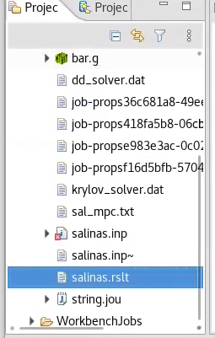
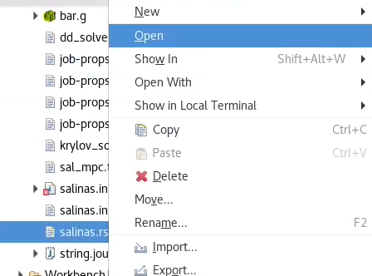
Look at the SD log file
Right click “salinas.rslt”
2) And select “Open”
Notes:
Provide a brief preview of the course structure and then go over the details of the agenda (refer to agenda handout).

Slide 33
SD Log File
Expected Frequencies:
1st Frequency = 1*waveSpeed/(2*stringLength) = 137 Hz
2nd Frequency = 2*waveSpeed/(2*stringLength) = 275 Hz
3rd Frequency = 3*waveSpeed/(2*stringLength) = 412 Hz
4th Frequency = 4*waveSpeed/(2*stringLength) = 550 Hz
In log file:
Input deck echo
Mass Properties
Contact information
Sensitivity information (will come back to this)
Eigen frequencies
Notes:
Provide a brief preview of the course structure and then go over the details of the agenda (refer to agenda handout).

Slide 34
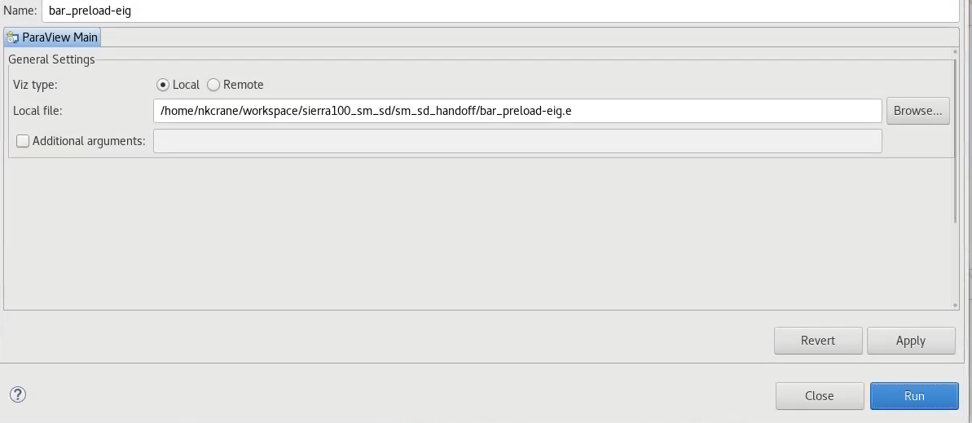
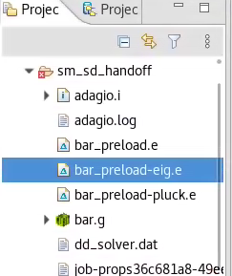
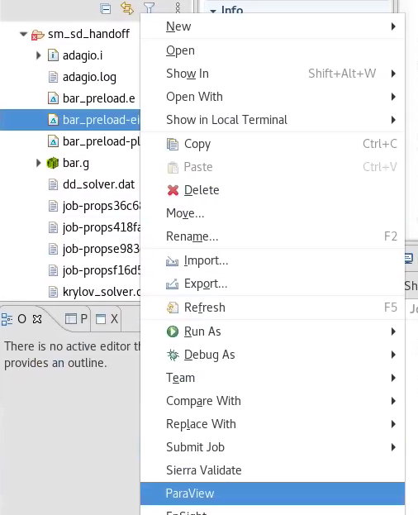
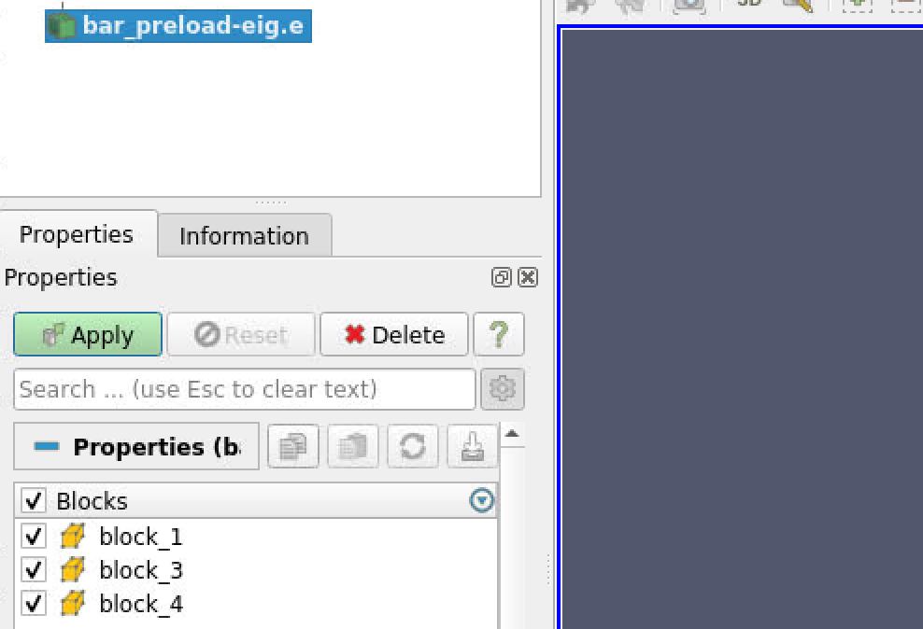
Open Eigen Result in Paraview
Right click “bar-preload-eig.e”
3) And hit “Run”
4) Hit apply
2) Select “Paraview”
Notes:
Provide a brief preview of the course structure and then go over the details of the agenda (refer to agenda handout).

Slide 35
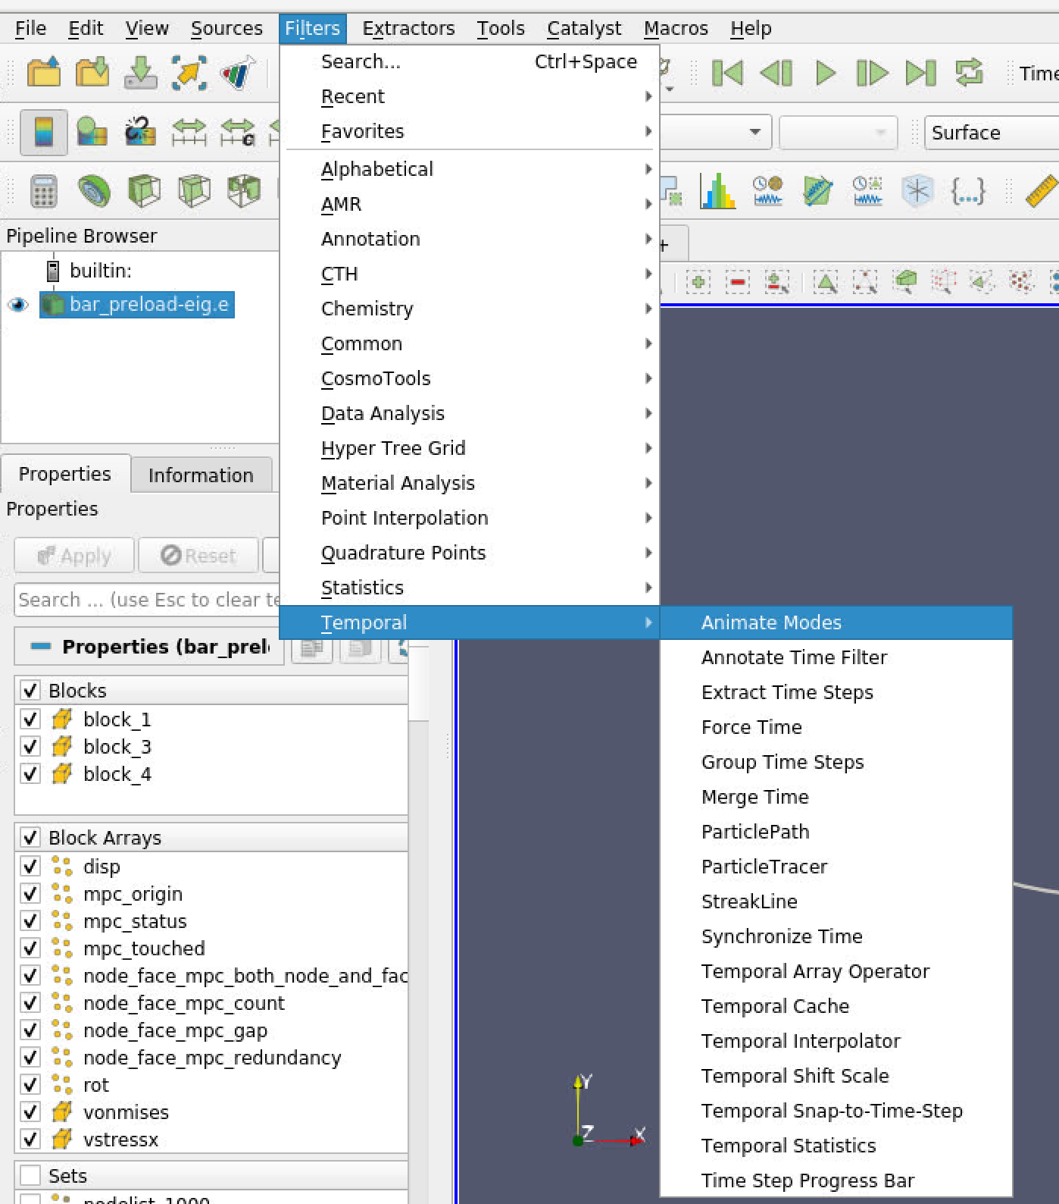
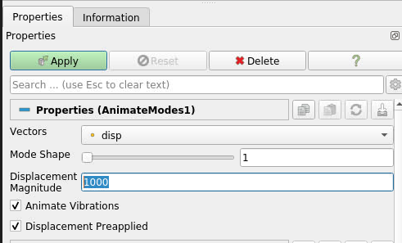
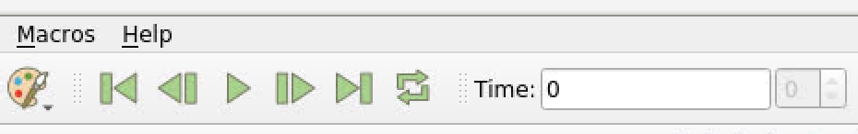
Eigen Modes
Create a mode shape filter under
Filters->Temporal->Animate Modes
2) Set “Displacement Magnitude” to 1000
3) And hit ‘Apply’
4) Hit ‘Loop’ and ‘Play’ to animate the mode shape
5) Try selecting a different mode shape, and hitting ‘Apply’ again
Notes:
Provide a brief preview of the course structure and then go over the details of the agenda (refer to agenda handout).

Slide 36
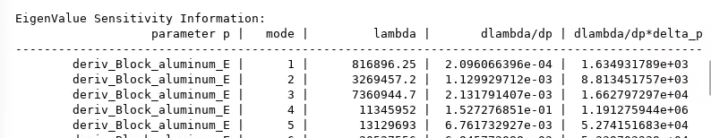
Sensitivity Output
Go back to the “salinas.rslt” file and look for the sensitivity information
This column is an estimate of how much “lambda” (the eigen value, proportional to vibrational
frequency squared) would change if the stiffness changed by 10%
Based on the mode shapes can you guess why the 4th mode is much more sensitive to the material
Young’s modulus than the 1st , 2nd , or 3rd , or 5th modes?
Notes:
Provide a brief preview of the course structure and then go over the details of the agenda (refer to agenda handout).

Slide 37
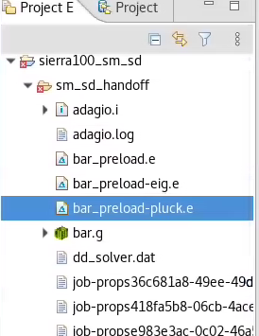
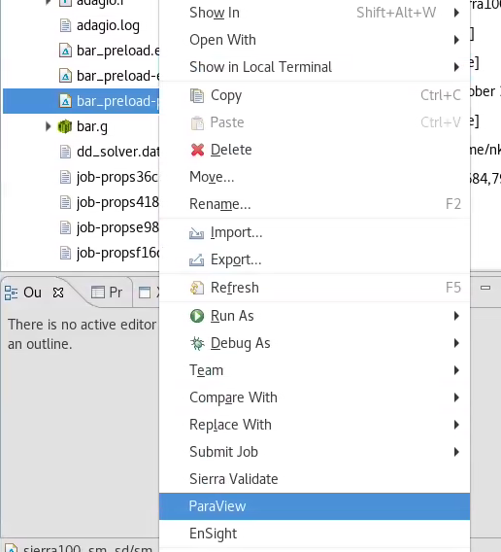
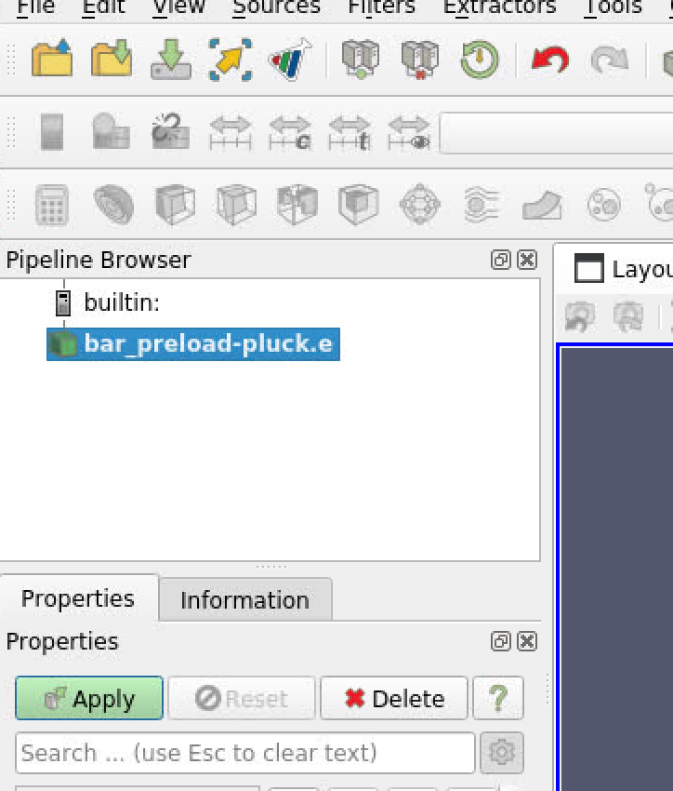
Open Eigen Result in Paraview
Right click “bar-preload-pluck.e”
3) And hit “Run”
4) Hit apply
2) Select “Paraview”
Notes:
Provide a brief preview of the course structure and then go over the details of the agenda (refer to agenda handout).

Slide 38
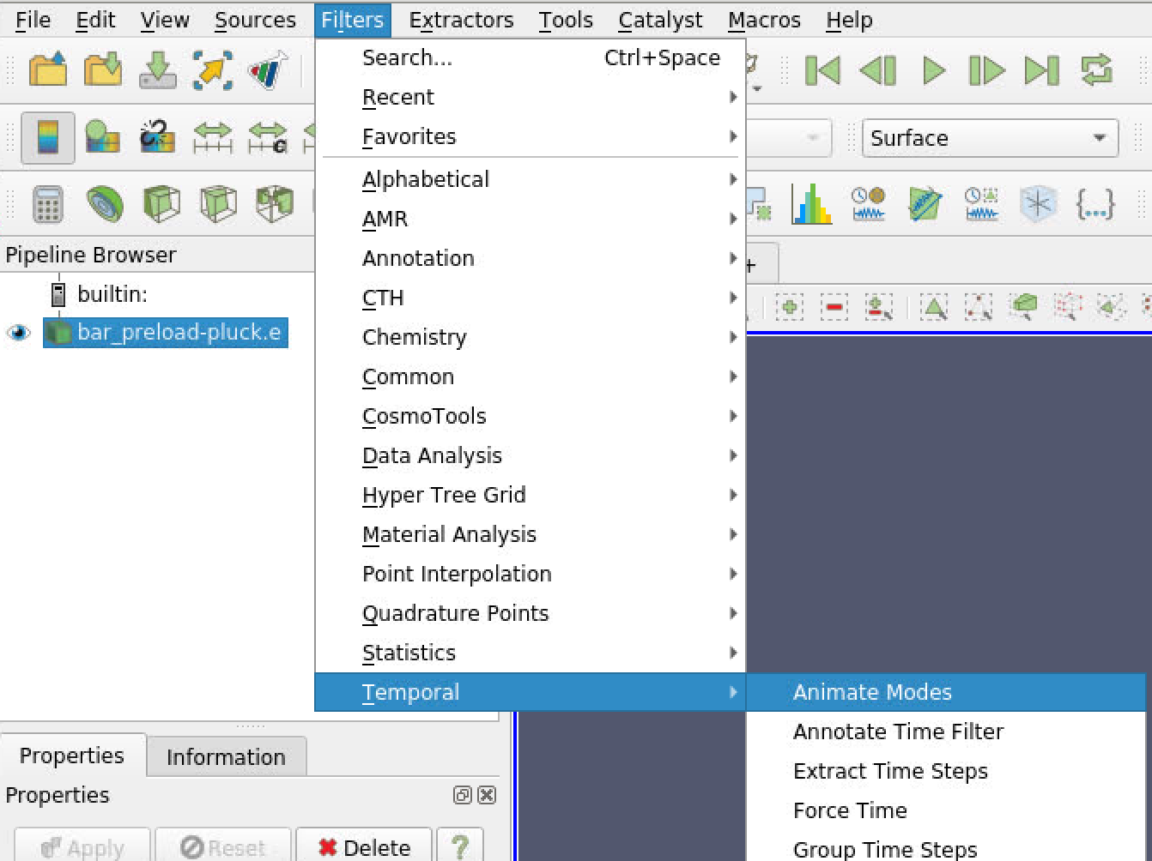
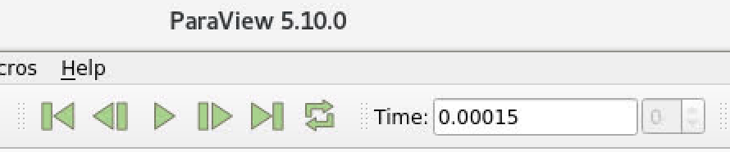
Eigen modes
Create the Animate Modes filter
2) Animate displaced shape
Notes:
Provide a brief preview of the course structure and then go over the details of the agenda (refer to agenda handout).

Slide 39
Going further
If the aluminum string was replaced with “steel” string how would results change?
What happens if we don’t include preload in the SD analysis
How would direct transient compare to modal transient?
How far can we rotate the pin in SM and still solve the model?
How would the runtime of plucking the string in a SM explicit dynamics analysis compare to the SD modal analysis
Notes:
Provide a brief preview of the course structure and then go over the details of the agenda (refer to agenda handout).

