Slide 1

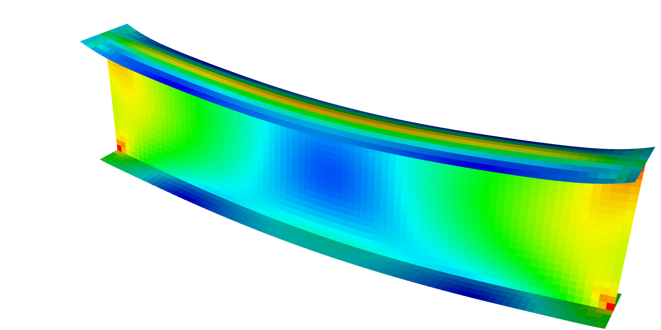
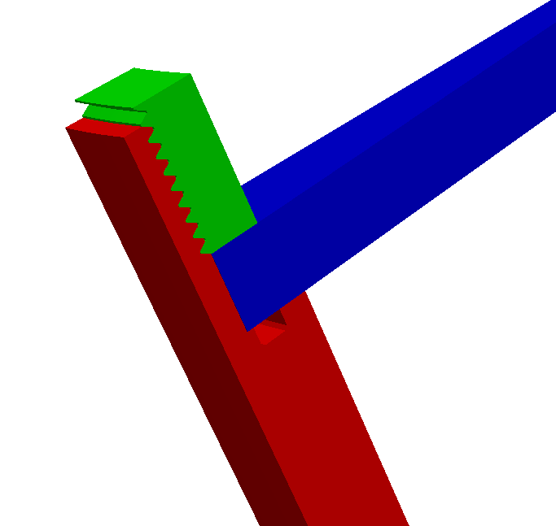
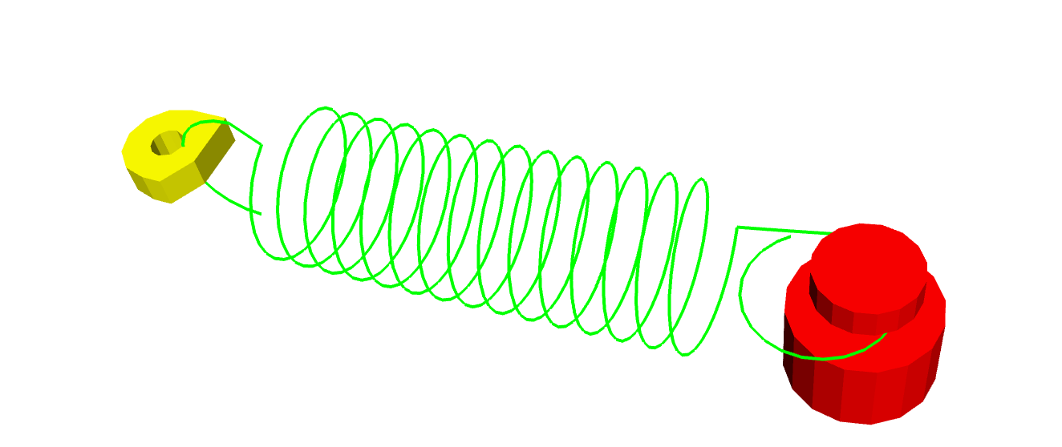

SIERRA203:
SIERRA/SM Implicit Training
Solving Implicit Statics and Dynamics Analyses with SIERRA/SM
SIERRA Solid Mechanics Team
Presented By: Kevin Manktelow, 8755
Date: Feb. 26-29, 2023
Location: SNL/CA, Building 926/Room 253
Controlled by: Sandia National Laboratories, Kevin Manktelow
SAND2023-13271PE

Slide 2
Release Notes
Date | Slide Version | Release | Notes
8/17/2023 | 1.0 | 5.14 | Initial version
10/11/2023 | 1.1 | 5.16 | Add CUI Markings; version for 11/27 class.

Slide 3
Course Description
This hands-on course introduces solid mechanics analysts to the implicit solver in SIERRA/SM. The course begins with foundational descriptions of implicit problems and how they are fundamentally different from explicit problems. We then progress into more complex topics to include time stepping, the core implicit solver, and the multi-level solver with some focus on contact problems. The course concludes with a few special topics including implicit dynamics solutions as well as some troubleshooting techniques and tricks to get a converged solution. We hope that the training provides new users with the skills and confidence to solve implicit problems with SIERRA/SM, while experienced users may gain a new perspective on their existing analysis techniques, debugging strategies, and time to ask questions.
Course Outline
Day 1: (4 hours, ~50 slides, ~7 examples)
Introduction to implicit problems in finite element analysis
Implicit problem solving: linear and nonlinear
Day 2: (4 hours, ~60 slides, ~4 examples)
Time stepping in implicit
Deep dive into the core solver
Day 3: (4 hours, ~40 slides, ~3 examples)
Introduction to the multi-level solver and implicit contact
Introduction to implicit dynamics
Day 4: (4 hours, ~50 slides, ~1 example)
Troubleshooting, tips and tricks for implicit problems
Closing thoughts, and time for questions

Slide 4
Class survey
By a show of hands …
Do you have experience with both explicit and implicit numerical integration methods?
Have you ever programmed finite element methods?
Have you used nonlinear solution methods before?
Have you used implicit FEM solvers in other codes?
I’ve used other codes, but I don’t know what kind of solver they used?

Slide 5


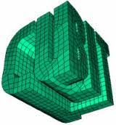
Prerequisites
Previous SIERRA experience (SIERRA100 level)
Read/understand a SIERRA input deck
Execute SIERRA/SM (adagio)
Visualize results (ParaView/EnSight)
Applications used throughout training
MATLAB
module load apps/matlab
Software familiarity
Familiarity with MATLAB (useful but not necessary)
Linux environment or Workbench (edit input decks, run code and visualize results)
SIERRA
module load sierra
ParaView
module load viz
CUBIT
<no module needed>
You are welcome to execute the examples using SAW or a Linux terminal as desired

Slide 6
Class overview
We are going to start simple and build up complexity
This class focuses on implicit solutions using the SIERRA/Solid Mechanics code.
The SIERRA/Solid Mechanics code has many names. Let’s address that.
SIERRA/Solid Mechanics = SIERRA/SM
SIERRA/SM ➔ adagio
adagio is the executable name
presto ➔ typically means “explicit” (e.g. “begin presto region”)
We’re working on clarity for this…

Slide 7
Class overview
We take a practical approach
Minimal (but sufficient) theory to introduce and anchor concepts
Examples of syntax and their connection to theory
Hands-on examples throughout the course (so get ready to work!)
  Many examples contain additional exercises to allow more advanced users to explore the capabilities and potential of the code.
Tips, tricks, and commentary on practical usage interleaved throughout
Class materials are mostly standalone, but are intended to be accompanied with live presentation and discussion.

Slide 8
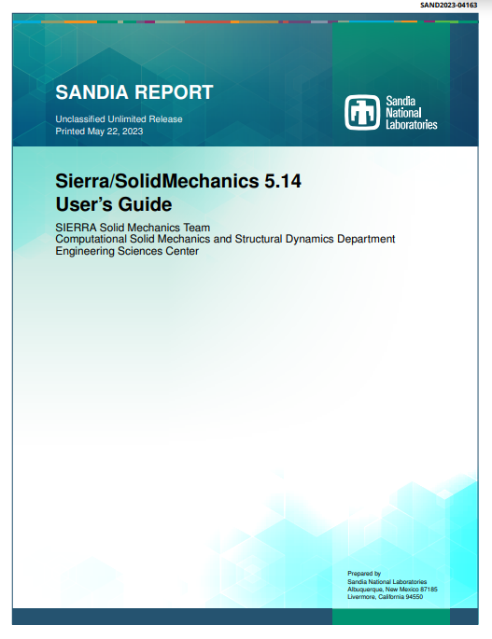
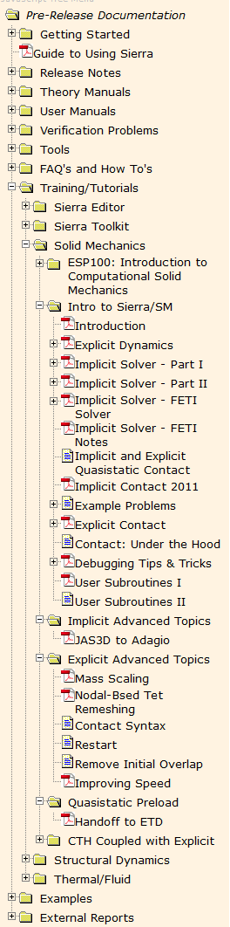

Other training materials are available and fantastic!
There are many additional training materials accessible, some outdated but still very relevant
https://compsim.sandia.gov/compsim/Docs/Sierra/preRelease/GeneralRelease/index.html
Look under “Intro to SIERRA/SM”
A few recommended to start with:
Implicit Solver – Part I
Implicit Solver – Part II
Implicit Solve r– FETI Solver
Implicit and Explicit Quasistatic Contact
Contact: Under the Hood
User’s Guide:
Syntax and usage guidelines
Theory Manual:
Feature background and explanation of capabilities and limitations

Slide 9
MODULE 1:
Motivation: Why Implicit?

Slide 10
Section overview
We will …
Discuss why we want to use implicit methods
Get a hands-on comparison between implicit an explicit solution methods
Briefly see how to convert between implicit and explicit
Review available documentation

Slide 11
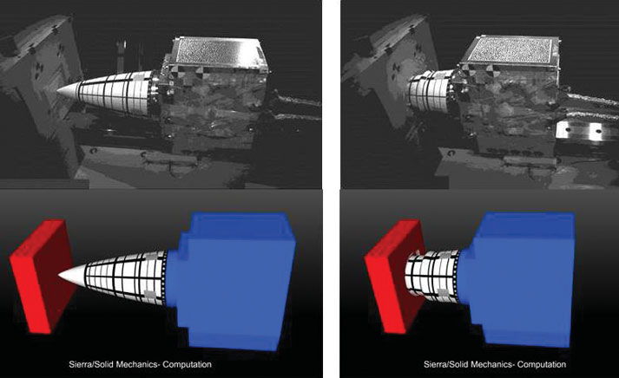
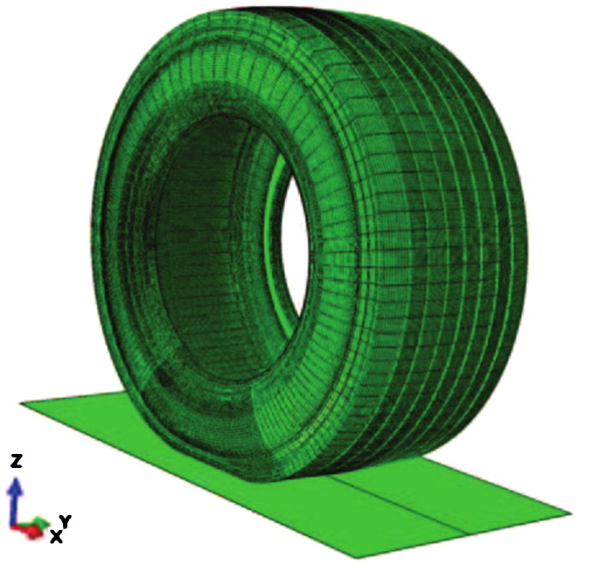
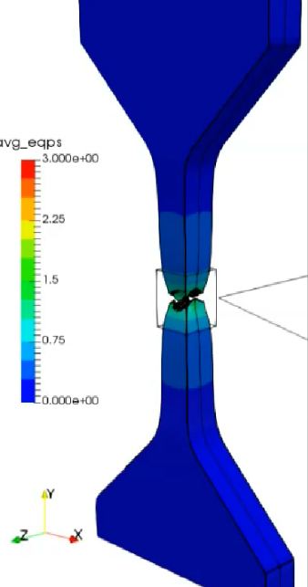

Implicit vs. explicit, what to use and when (notional)
Explicit
Implicit
(High mesh refinement)
Full system model environment analyses
Explicit with mass scaling
High speed impact
Implicit
A few contributors to model complexity:
Number of elements
Nonlinearities
Contact constraints
Complex materials
Model complexity
Simple/toy problems
Rolling tire under load
Other factors:
Element size is critical!
Is a static solution state important?
Is quantifying error important?
How resolved do fields need to be? (smaller elements become increasingly problematic for explicit)
ns
$μ$s
ms
s
min.
hr.
days
Time scale of event to be simulated
Testing a component

Slide 12
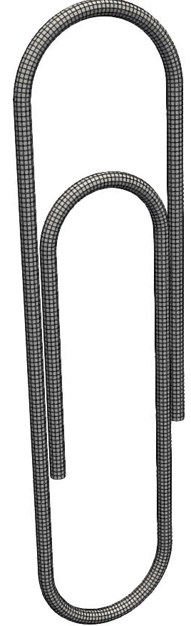



Let’s start off with a hands-on motivating example
Ex01: Compare explicit and implicit solvers
Find the final displacement from the applied load $F(t)$. Run in serial (np=1).
Run SIERRA on the explicit input deck. Look in the log file to estimate the time to completion. (Hint: CTRL+C to kill the job if you don’t want to wait for it to finish)
>> adagio -i paperclip_explicit.i
Run SIERRA on the implicit input deck. Look in the log file to see the total time to completion.
>> adagio -i paperclip_implicit.i
Visualize the results output file in paraview. Determine what the maximum tip displacement is. How does it change over time?
>> paraview output.e
Extra credit: Try to get an explicit solution through any means necessary.
$$F(t)$$
fixed
t
$$F(t)$$

Slide 13
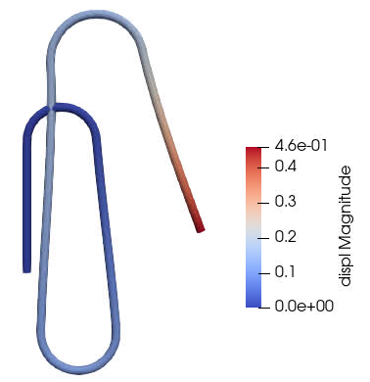
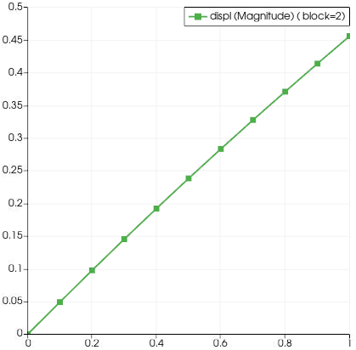
Example 01: Results and discussion (implicit solution)
Analysis Type | Wallclock Time
Explicit | ~160 hr.
Implicit | 25 sec.
Tip Displacement
Time

Slide 14
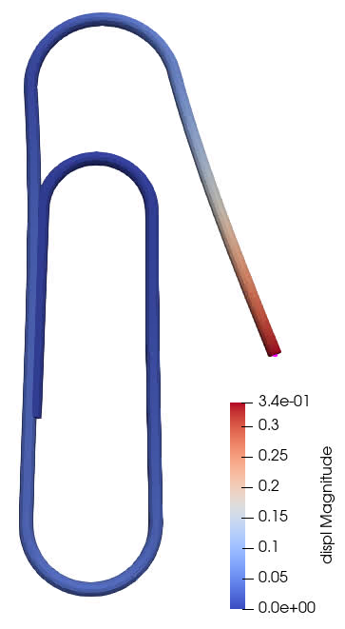
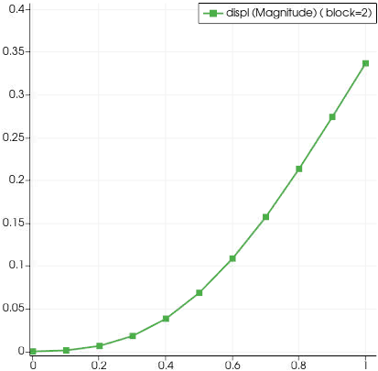
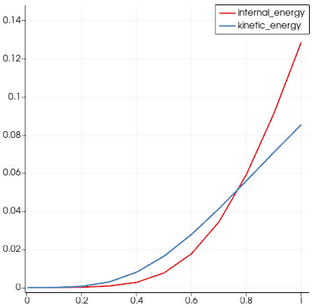
Example 01: Results and discussion (explicit “solution”)
Density x 1,000,000
Solution time: ~10 minutes
Too much kinetic energy for a static solution!
Tip Displacement
Energy
Time
Time
Be cautious when using explicit time integration to solve static problems! It will give you “an answer”.

Slide 15
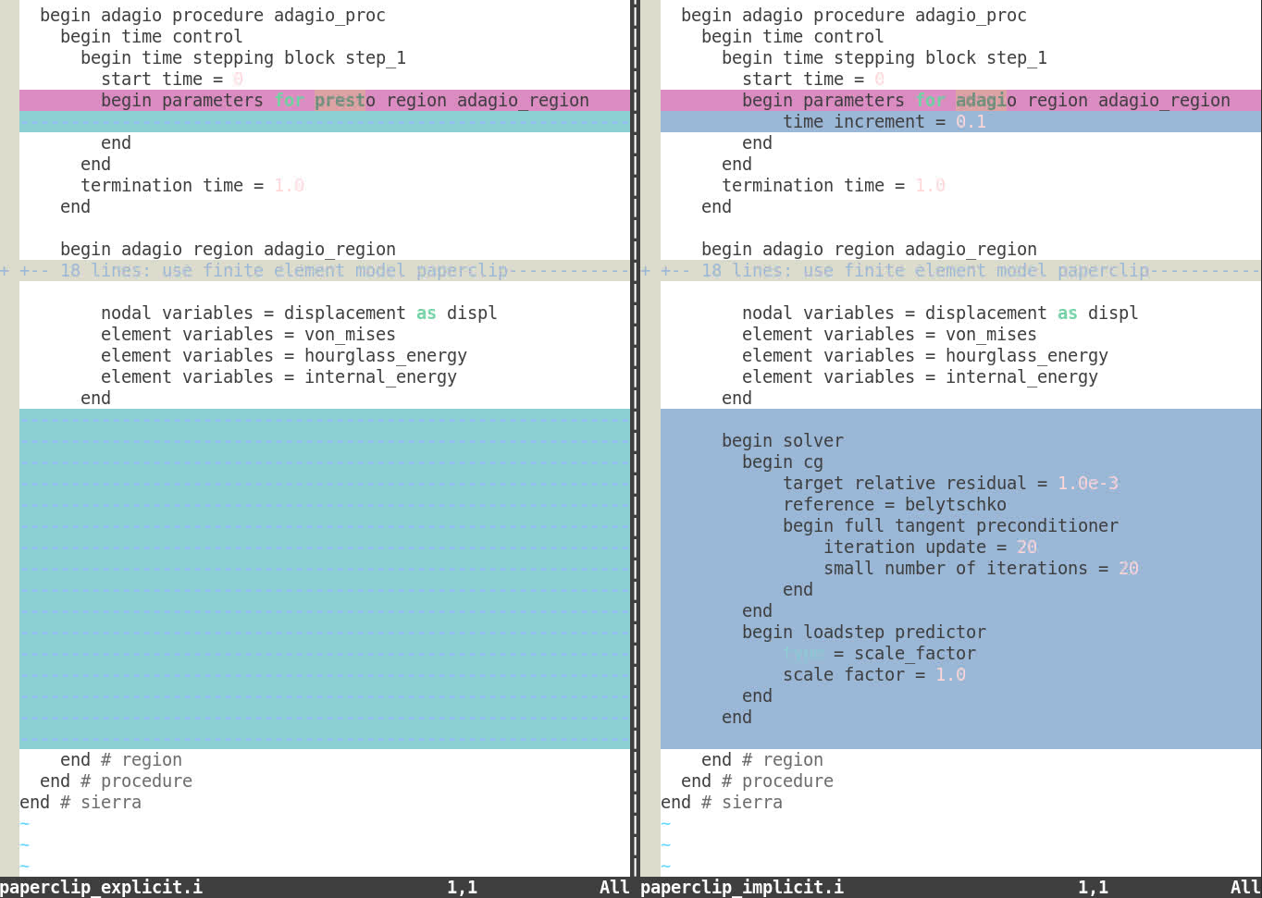
A rapid tour of converting between explicit and implicit
Different time stepping blocks.
Implicit must specify either the NUMBER of steps or the time increment SIZE.
We declare specific instructions on how to solve the problem, via a solver command block.
More detail on all of this later …

Slide 16
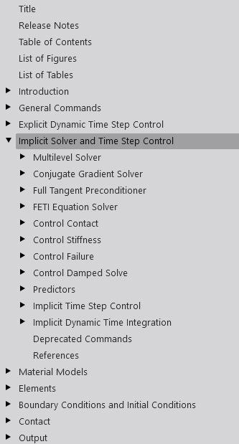

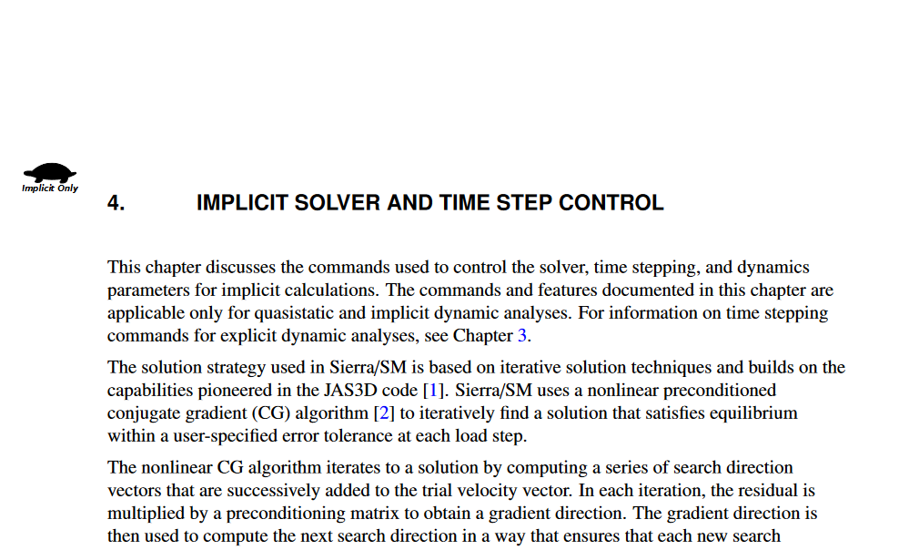
Where to find more information
Access latest manuals at compsim.sandia.gov
Go to “Documentation Portal”
Select release version
Access “User Manuals/Solid Mechanics/User’s Guide”

Slide 17


A note on the nomenclature we’re using
“adagio” and “presto” are musical terms meaning “slow” and “fast” tempo, respectively
Initially, probably referred to time scales of problems to be solved
Adagio implies “implicit”
Presto implies “explicit”
Historically, adagio and presto were two different codes excuted with commands:
  >> adagio –i implicit_input_deck.i
  >> presto –i explicit_input_deck.i
Around ~2010, the SIERRA/SM team consolidated the executables to improve code re-use, among other things. We were left with a single executable (adagio).
adagio executable ⬄ SIERRA/SM (but not necessarily implicit!)
The terminology still persists and can cause confusion (we are working on this).
For example:
  begin adagio {region|procedure} and begin presto {region|procedure} are synonyms in the code and do exactly the same things.
  Suggest using a convention and sticking to it for simplicity.
Our user guide annotates some features with the rabbit and turtle to indicate contents that may only be relevant to one analysis type.

Slide 18
In summary…
SIERRA/SM
(adagio)
Use for slow rate analyses
Requires solving a system of equations to move rapidly through time.
Use for rapid loading rates
Model complexity is more easily handled
Implicit solver
(adagio)
Explicit solver
(presto)
Bottom line: Implicit and Explicit solvers serve different purposes. Selecting the correct solver is a critically important part of the analysis process.

Slide 19
MODULE 2:
Back to Basics – Part 1:
Implicit Problem Solving

Slide 20
Section overview
We will …
Use a simple 1D example
Learn about implicit and explicit solvers
Learn about different types of implicit solution
Solve our 1D example in SIERRA/SM

Slide 21

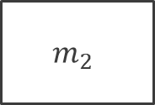











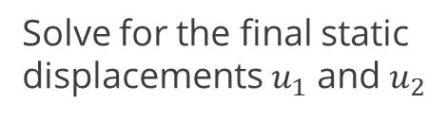



Solving a simple mass-spring system
$$F$$
Equations of motion
$$F$$
$$m_{1}$$
$$u_{1}$$
$$m_{1}$$
$$m_{1}{\ddot{u}}_{1}=k_{1}\left(u_{2}−u_{1}\right)−F$$
$$m_{1}{\ddot{u}}_{1}+k_{1}\left(u_{1}−u_{2}\right)=−F$$
$$k_{1}$$
$$k_{1}\left(u_{2}−u_{1}\right)$$
$$u_{2}$$
$$m_{2}$$
$$k_{1}\left(u_{2}−u_{1}\right)$$
$$k_{2}$$
$$m_{2}$$
$$m_{2}{\ddot{u}}_{2}={−k}_{1}\left(u_{2}−u_{1}\right)−k_{2}u_{2}$$
$$m_{2}{\ddot{u}}_{2}+k_{1}\left(u_{2}−u_{1}\right)+k_{2}u_{2}=0$$
Solve for the final static displacements $u_{1}$ and $u_{2}$
$$k_{2}u_{2}$$

Slide 22



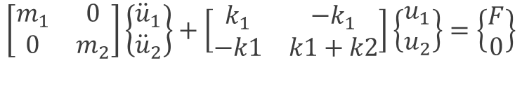
Solving a simple mass-spring system
$$F$$
$$m_{1}{\ddot{u}}_{1}+k_{1}\left(u_{1}−u_{2}\right)=−F$$
$$u_{1}$$
$$m_{1}$$
$$m_{2}{\ddot{u}}_{2}+k_{1}\left(u_{2}−u_{1}\right)+k_{2}u_{2}=0$$
$$k_{1}$$
$$\left[\begin{matrix}m_{1} & 0 \\ 0 & m_{2}\end{matrix}\right]\left\{\begin{matrix}{\ddot{u}}_{1} \\ {\ddot{u}}_{2}\end{matrix}\right\}+\left[\begin{matrix}k_{1} & −k_{1} \\ −k1 & k1+k2\end{matrix}\right]\left\{\begin{matrix}u_{1} \\ u_{2}\end{matrix}\right\}=\left\{\begin{matrix}F \\ 0\end{matrix}\right\}$$
$$u_{2}$$
$$m_{2}$$
$$k_{2}$$
$$M\ddot{u}+Ku=f$$
$$f_{inertial}(\ddot{u})+f_{int}(u,\dot{u})=f_{ext}$$
Solve for the final static displacements $u_{1}$ and $u_{2}$
Expressed as a linear system of equations
Expressed more generally as vectors

Slide 23


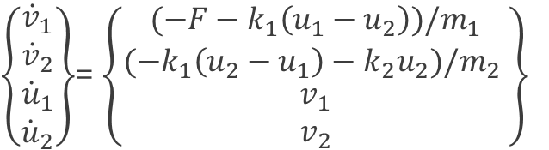

The explicit solve (a very brief over-simplification)
$$F$$
$$f_{inertial}(\ddot{u})+f_{int}(u,\dot{u})=f_{ext}$$
$$u_{1}$$
$$m_{1}$$
$\left\{\begin{matrix}{\dot{v}}_{1} \\ {\dot{v}}_{2} \\ \begin{aligned}{\dot{u}}_{1} \\ {\dot{u}}_{2}\end{aligned}\end{matrix}\right\}$= $\left\{\begin{matrix}(−F−k_{1}\left(u_{1}−u_{2}\right))/m_{1} \\ (−k_{1}\left(u_{2}−u_{1}\right)−k_{2}u_{2})/m_{2} \\ \begin{aligned}v_{1} \\ v_{2}\end{aligned}\end{matrix}\right\}$
Re-write in 1st-order form (only first time derivative appears)
$$k_{1}$$
$$u_{2}$$
$$m_{2}$$
$$k_{2}$$
Make approximation for time derivatives and integrate
$${\dot{u}}_{n+1}={\dot{u}}_{n}+\dot{v}Δt$$
$$u_{n+1}=u_{n}+vΔt$$
pick initial conditions and time step…
march forward in time ...

Slide 24
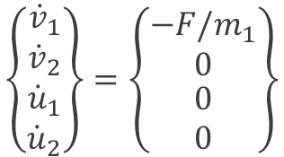


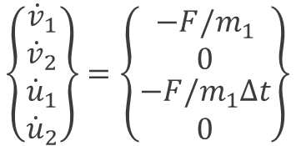



The explicit solve (a very brief over-simplification)
Step 0
$$F$$
$$\left\{\begin{matrix}{\dot{v}}_{1} \\ {\dot{v}}_{2} \\ \begin{aligned}{\dot{u}}_{1} \\ {\dot{u}}_{2}\end{aligned}\end{matrix}\right\}=\left\{\begin{matrix}−F/m_{1} \\ 0 \\ \begin{aligned}0 \\ 0\end{aligned}\end{matrix}\right\}$$
$$u_{1}$$
$$m_{1}$$
Step 1
$$\left\{\begin{matrix}{\dot{v}}_{1} \\ {\dot{v}}_{2} \\ \begin{aligned}{\dot{u}}_{1} \\ {\dot{u}}_{2}\end{aligned}\end{matrix}\right\}=\left\{\begin{matrix}−F/m_{1} \\ 0 \\ \begin{aligned}−F/m_{1}Δt \\ 0\end{aligned}\end{matrix}\right\}$$
$$k_{1}$$
$$u_{2}$$
$$m_{2}$$
$$u_{1}$$
$$k_{2}$$
Step 2
$$u_{2}$$
$$Δt$$
$$2Δt$$
$$3Δt$$

Slide 25

Example 02: A concrete example for explicit integration
Ex02: Solve using explicit time integration
File: two_dof_system.m
Use MATLAB to perform numerical integration of the 2-DOF system.
Try different time steps. What happens for $Δt=0.01$? $Δt=0.1?Δt=1.0$?
What are the likely final static displacements $u_{1}$ and $u_{2}$?
Extra credit: Add damping into the solution to reach a quasi-static state. Hint: damping forces are often proportional to velocity.
$$F$$
$$u_{1}$$
$$m_{1}$$
$$k_{1}$$
$$u_{2}$$
$$m_{2}$$
$$k_{2}$$
Let $m_{1}$= $m_{2}=$0.5, $k_{1}=k_{2}=1, F=−0.1, Δt=0.01$

Slide 26
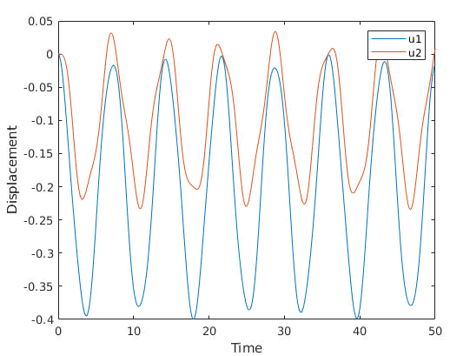
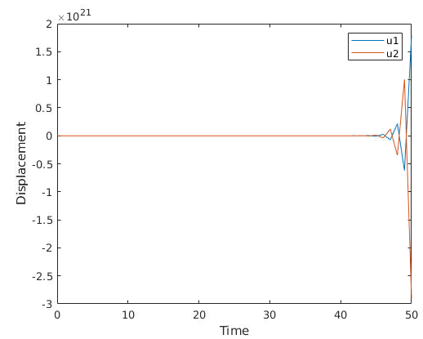


The explicit solve: a numerical solution
dt = 0.01
dt = 1.0

Slide 27
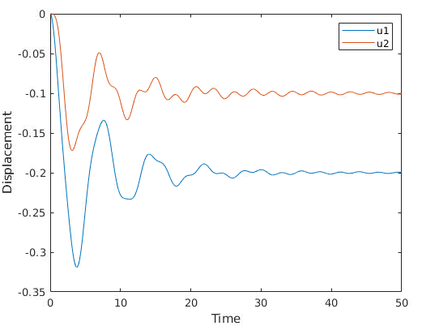
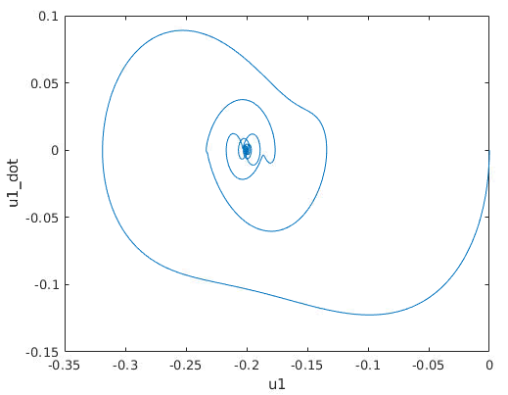

The explicit solve: reaching “steady state”
Damped solution
Phase portrait for $u_{1}$
The solution we want
Observe that a solution with some damping reaches a “quasi-static” solution.
Some form damping is necessary to eliminate “ringing.”
Solution time must be long enough to reach steady-state.

Slide 28



The implicit solve: straight to the point!
$$F$$
$$\left[\begin{matrix}m_{1} & 0 \\ 0 & m_{2}\end{matrix}\right]\left\{\begin{matrix}{\ddot{u}}_{1} \\ {\ddot{u}}_{2}\end{matrix}\right\}+\left[\begin{matrix}k_{1} & −k_{1} \\ −k1 & k1+k2\end{matrix}\right]\left\{\begin{matrix}u_{1} \\ u_{2}\end{matrix}\right\}=\left\{\begin{matrix}F \\ 0\end{matrix}\right\}$$
$$u_{1}$$
$$m_{1}$$
$$M\ddot{u}+Ku=f$$
We seek static solutions, so time derivatives are all zero.
$$k_{1}$$
$$u_{2}$$
$$m_{2}$$
$$u=K^{−1}f$$
Solve the linear system of equations. Done!
$$k_{2}$$
(… but this is often easier said than done.)

Slide 29


Example 03: A direct solution approach
Ex03: Solve implicitly using MATLAB
File: two_dof_system_direct.m
Run the example to obtain a static solution.
How is this similar to our explicit solution?
How is this different than our explicit solution?
Extra credit: Experiment with different values of $k_{2}$. What happens with:
$k_{2}=1x{10}^{−6}$ (very soft)
$k_{2}=0?$ (no spring)
$k_{2}=1x{10}^{20}$ (very stiff)
$$F$$
$$u_{1}$$
$$m_{1}$$
$$k_{1}$$
$$u_{2}$$
$$m_{2}$$
$$k_{2}$$
Let $m_{1}$= $m_{2}=$0.5, $k_{1}=k_{2}=1, F=−0.1$

Slide 30



The implicit solve: example 03 discussion
$$F$$
Typical output:
$$u_{1}$$
$$m_{1}$$
The answer is exact.
There is no time-dependence.
Our system must be “well-conditioned”
  … Large disparities in stiffness are bad and make numerical solution challenging or impossible.
Our system must be non-singular
  … Or else a unique solution does not exist
$$k_{1}$$
$$u_{2}$$
$$m_{2}$$
$$k_{2}$$
Equivalent MATLAB statement. The “\” operator is magic. It simply solves the linear system. We will not explore how.
Analytic solution
$$u=K^{−1}f$$
$$u=K\backslash F$$

Slide 31
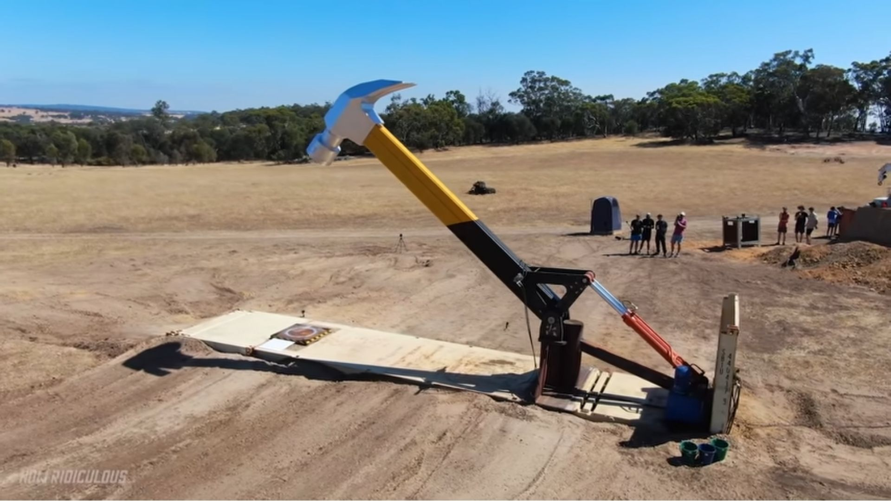
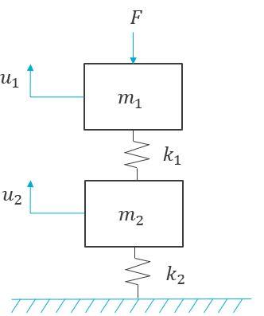
Solving our 2DOF with SIERRA/SM

Slide 32
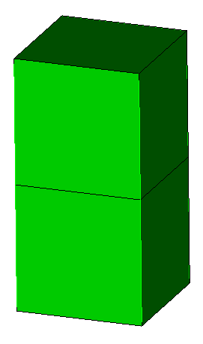





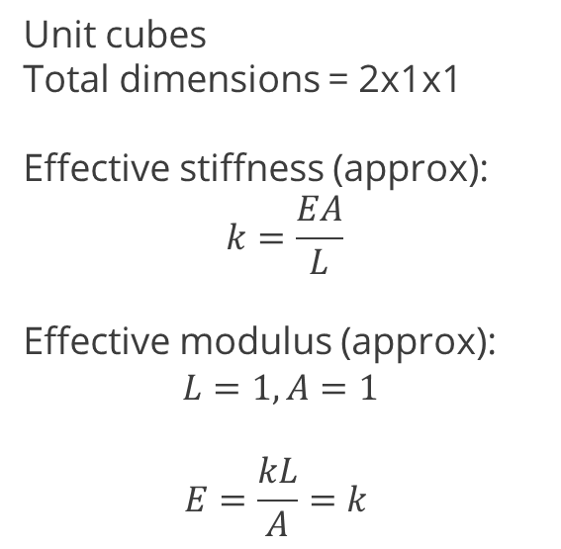


Solving our 2DOF with SIERRA/SM Implicit
It turns out our system represents discretization of a continuum that parallels a finite-element analysis.
Let’s derive some comparable parameters for our SIERRA/SM analysis
$$F$$
Unit cubes
Total dimensions = 2x1x1
Effective stiffness (approx):
$$k=\frac{EA}{L}$$
Effective modulus (approx):
$$L=1, A=1$$
$$E=\frac{kL}{A}=k$$
$$u_{1}$$
$$m_{1}$$
$$k_{1}$$
$$u_{2}$$
$$m_{2}$$
$$k_{2}$$

Slide 33
Solving our 2DOF with SIERRA/SM Implicit: Input Deck
begin sierra
begin material generic
density = 1.0
begin parameters for model elastic
youngs modulus = 1
poissons ratio = 0.0
end
end
begin finite element model two_bricks
database name = two_dof_bricks.g
begin parameters for block block_1
material = generic
model = elastic
end
begin parameters for block block_2
material = generic
model = elastic
end
end
begin adagio procedure proc1
begin time control
begin time stepping block tb1
start time = 0.0
begin parameters for adagio region region1
time increment = 1.0
end
end
termination time = 1.0
end
Define a material equivalent to our springs. Note, we must specify a density, even though we seek a static solution!
Density is used to compute mass for output in the log file and some boundary conditions (e.g. gravity)
Required for implicit analyses!
Unlike our analytical solution, we must specify time in SIERRA/SM implicit analyses.
This is more important in highly-nonlinear analyses, where we need to apply the boundary conditions or loads slowly.
Our problem is nearly linear by construction
Start time = 0.0 (arbitrary)
Termination time = 1.0 (arbitrary, no rate effects)
Time increment = 1.0 (attempt to solve in a single “load step”)

Slide 34
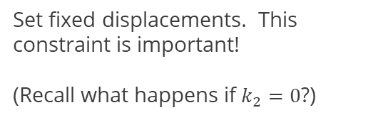

Solving our 2DOF with SIERRA/SM Implicit: Input Deck
begin adagio region region1
use finite element model two_bricks
begin distributed force
surface = top
function = sierra_constant_function_one
component = x
scale factor = -0.1
end
begin fixed displacement
surface = bottom
component = x y z
end
begin solver
end
begin results output
database name = output.e
at step 0, increment = 1
nodal displacement
end
end #region
end #procedure
end #sierra
Define the force $F(t)$
Set fixed displacements. This constraint is important!
(Recall what happens if $k_{2}=0$?)
Required for implicit analyses!
This is the simplest possible solver definition and uses all default options.
A solver is the most critical component in implicit analyses and tells SIERRA/SM how to find a solution which satisfies equilibrium.
There are many options we will explore later
There are options because there are many types of solid mechanics problems.
There is unfortunately not a magic solver setting that will solve all of our problems.

Slide 35


Example 04: Solve the 2DOF with SIERRA
Ex04: Solve implicitly using SIERRA
File: solve_2dof.i
Run the example to obtain a static solution.
  >> adagio -i solve_2dof.i
Visualize the results in ParaView.
  >> paraview output.e
Do the results make sense? How are they similar/different?
Extra credit: Modify the input deck to use different materials for block_1 and block_2. Experiment with different elastic moduli for block_2. What happens with:
$E_{2}=0.1$ (soft)
$E_{2}=0.01?$ (very soft)
$$F(t)$$
Let $m_{1}$= $m_{2}=$0.5, $k_{1}=k_{2}=1, F=−0.1$

Slide 36
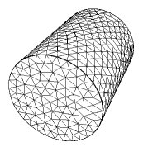

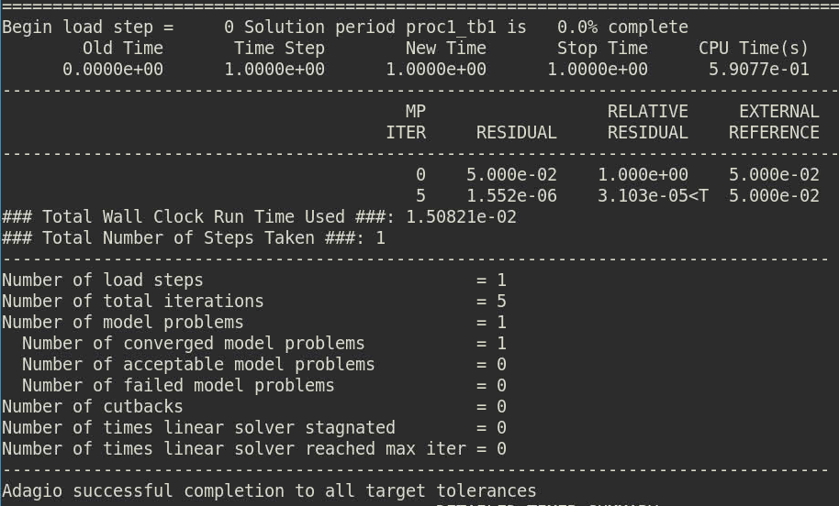
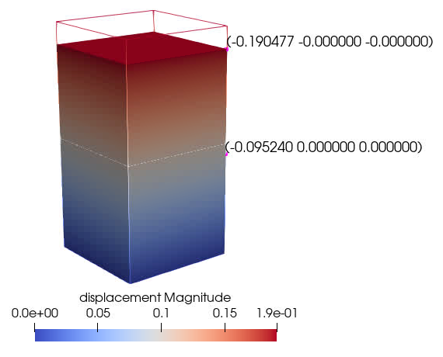


Example 04: Results and discussion
output.e
solve_2dof.log
$$u_{1}$$
$$u_{2}$$
The log file is essential to understanding how to solve implicit problems.
We will explore what all of this means in more detail later
Our results are different than the MATLAB solution! Why?

Slide 37




Example 04: Results and discussion continued
Why was our answer different than we expected?
$$σ=Eε$$
$$F=σA$$
Our approximation for an equivalent Young’s modulus (in lieu of a spring constant) came from linear elasticity assumptions
$$ε=\frac{Δu}{L}$$
$F=\left(\frac{EA}{L}\right)$ $Δu$
SIERRA/SM is a fully nonlinear code. The nonlinear geometry and deformation causes the answer to differ from our intuition derived from linear principles. It is not possible to disable this nonlinear behavior.

Slide 38




Example 04: Results and discussion continued
Extra credit solution: Why couldn’t we solve the problem with softer materials?
E1=E2=1.0
E1=1.0
E2 = 0.1
E1=1.0
E2 = 0.1
$$F$$
Too soft! The force $F$ causes an element to invert (effectively become inside-out).
This is a primary cause of the “ComputeInternalForce” error you may encounter.
Implicit solutions algorithms need to “search” for the solution. Occasionally they find displacement configurations that they cannot recover from.
block_1
$$F$$
$$F$$
block_1
block_2
block_1
block_2
block_2

Slide 39


In summary…
Explicit Solver
We can’t see very far ahead.
Take many small steps so you don’t run into something.
Implicit Solver
We’re blindfolded and searching for the target
Get to any solution, then take the blindfold off and check how you did.

Slide 40
MODULE 3:
Back to Basics – Part 2:
The Nonlinearity Problem
And how iterative solution can help!

Slide 41
Section overview
We will …
Explore what nonlinearity means for solution techniques
Extend our mass-spring example to include nonlinearity
Solve our 1D example in MATLAB iteratively
Learn about SIERRA’s iterative solvers

Slide 42
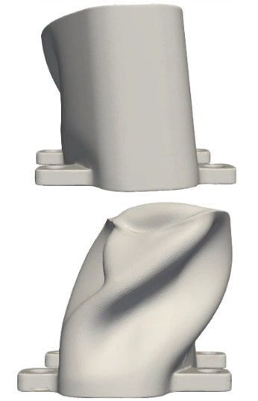
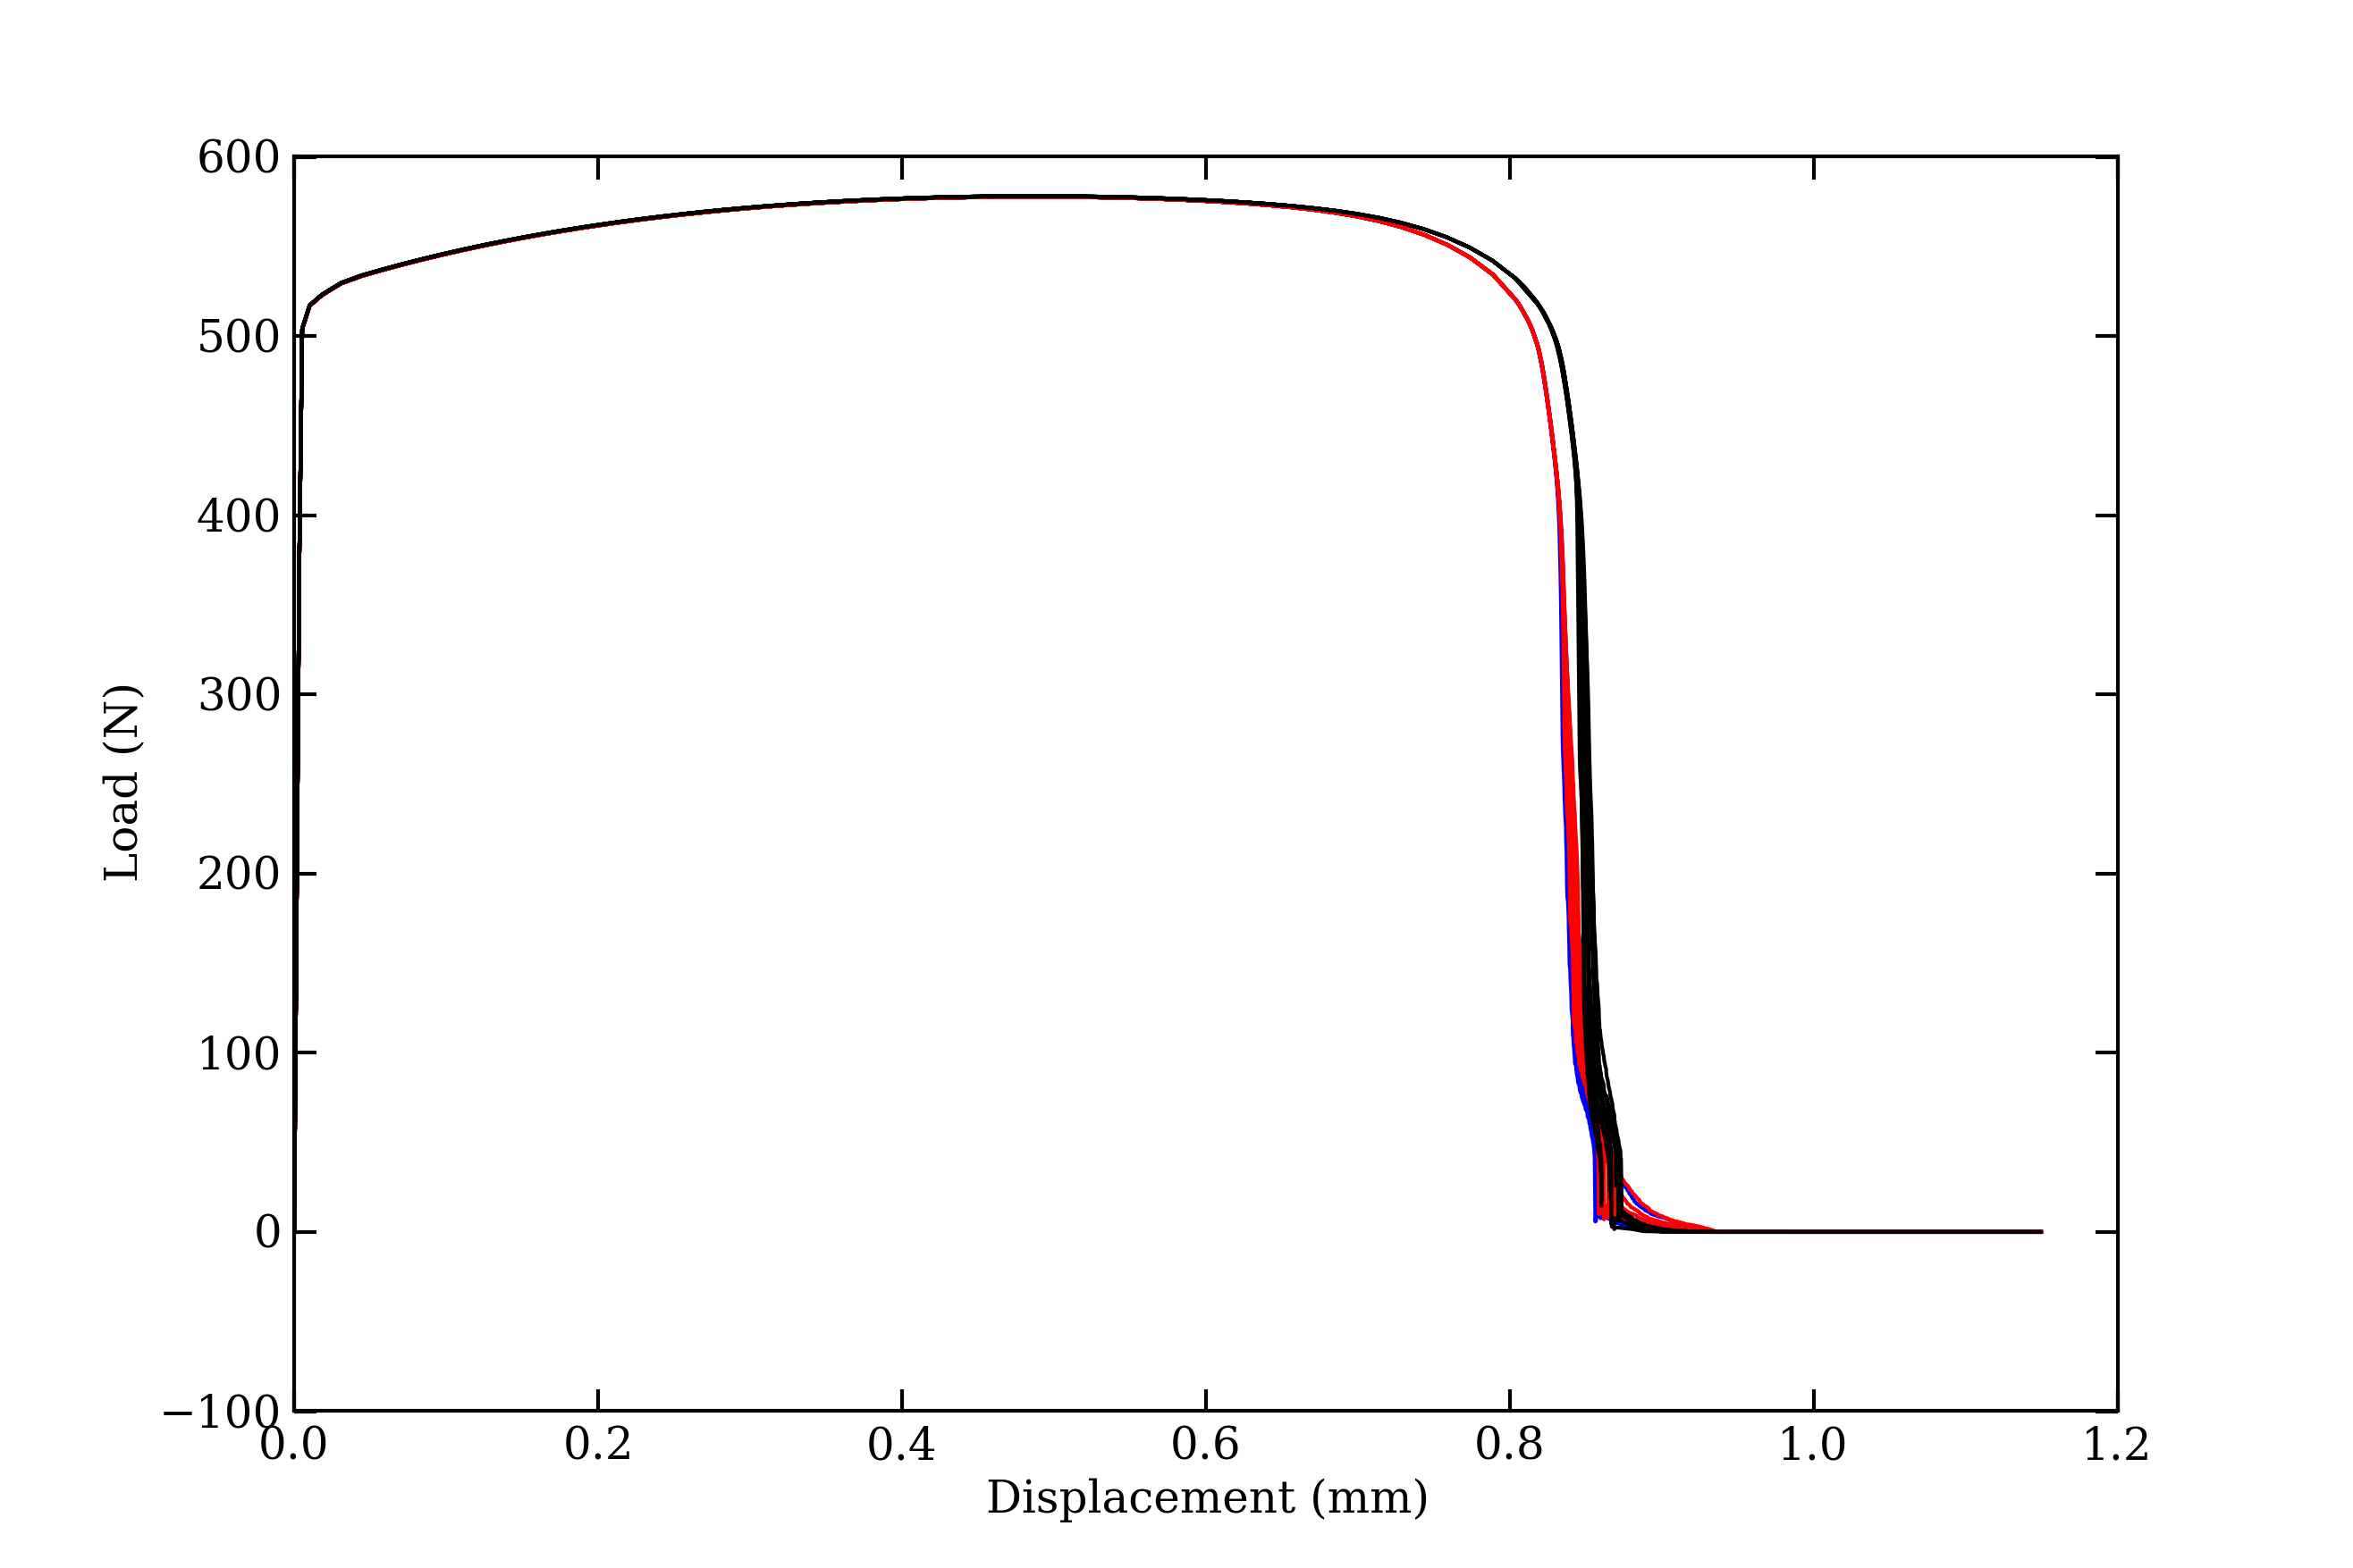
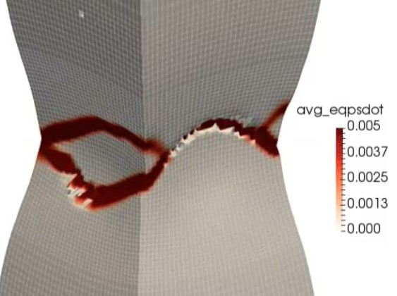
Nonlinearity comes in all shapes and sizes
(and it makes solving a lot harder)
Large Deformations and Rotations
Cause nonlinear terms in governing equations
Material Nonlinearity
Constitutive laws that cannot be expressed with linear operators
Material failure
Fracture and/or removal of material during analysis
… and contact, constraints, buckling, …. the list goes on.

Slide 43
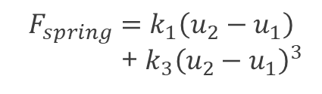
Nonlinearity in our 2DOF spring-mass system
$$F$$
$$m_{1}{\ddot{u}}_{1}+k_{1}\left(u_{1}−u_{2}\right)+k_{3}{\left(u_{1}−u_{2}\right)}^{3}=−F$$
$$u_{1}$$
$$m_{1}$$
$$m_{2}{\ddot{u}}_{2}+k_{1}\left(u_{2}−u_{1}\right)−k_{3}{\left(u_{1}−u_{2}\right)}^{3}+k_{2}u_{2}=0$$
This nonlinear term prevents us from expressing this as a linear system of equations!
$${F_{spring}=k}_{1}\left(u_{2}−u_{1}\right)$$
+ $k_{3}{\left(u_{2}−u_{1}\right)}^{3}$
$$u_{2}$$
$$m_{2}$$
$$k_{2}$$
Because we cannot express the system using linear operators, we cannot use linear solution techniques and instead must try something else.

Slide 44
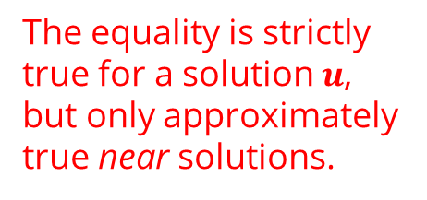


Nonlinearity: Defining the residual
$$F$$
$$m_{1}{\ddot{u}}_{1}+k_{1}\left(u_{1}−u_{2}\right)+k_{3}{\left(u_{1}−u_{2}\right)}^{3}=−F$$
$$u_{1}$$
$$m_{1}$$
$$m_{2}{\ddot{u}}_{2}+k_{1}\left(u_{2}−u_{1}\right)−k_{3}{\left(u_{1}−u_{2}\right)}^{3}+k_{2}u_{2}=0$$
$${F_{spring}=k}_{1}\left(u_{2}−u_{1}\right)$$
+ $k_{3}{\left(u_{2}−u_{1}\right)}^{3}$
We instead express as a vector-valued function
$$f_{inertial}(\ddot{u})+f_{int}(u,\dot{u})=f_{ext}$$
$$u_{2}$$
$$m_{2}$$
We define a “residual” vector for a static solve
$$f_{int}\left(u\right)−f_{ext}≜r\left(u\right)=0$$
$$k_{2}$$
The equality is strictly true for a solution $u$, but only approximately true near solutions.

Slide 45
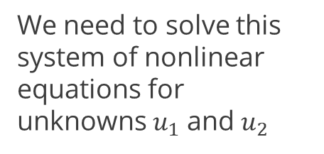

The residual guides us to a solution
$$f_{int}\left(u\right)−f_{ext}≜r\left(u\right)=0$$
We need to solve this system of nonlinear equations for unknowns $u_{1}$ and $u_{2}$
$$r_{1}\left(u\right)=−F−k_{1}\left(u_{1}−u_{2}\right)−k_{3}{\left(u_{1}−u_{2}\right)}^{3}$$
$$r_{2}\left(u\right)= −k_{1}\left(u_{2}−u_{1}\right)+k_{3}{\left(u_{1}−u_{2}\right)}^{3}−k_{2}u_{2}$$
The residual provides us a measure of how force imbalance between the internal and external forces. We require equality for equilibrium.
The residual also informs our solver algorithm how to iterate.
“Large” residuals are bad. “Small” residuals are good!

Slide 46
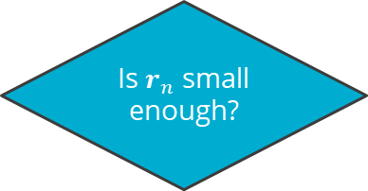
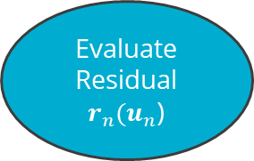
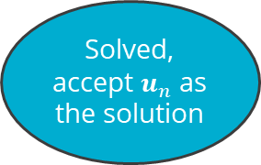


The residual is a critical ingredient for nonlinear solvers
Practically speaking, all solution strategies for nonlinear equations are “iterative” in nature. Some examples:
Newton-Raphson methods
Trust Region methods
Conjugate-Gradient methods
Arc-Length methods
SIERRA/SM primarily employs Conjugate Gradient (CG) methods, but has some capability for Newton and Trust-Region methods.
Arc-Length methods can be useful in buckling and “softening” type nonlinearities. SIERRA/SM currently does not offer this solver type.
Pick initial conditions $u_{n}$
Evaluate Residual $r_{n}(u_{n}$)
Is $r_{n}$ small enough?
Solved, accept $u_{n}$ as the solution
yes
Strategically update the solution $u_{n}^{(i)}→u_{n}^{(i+1)}$
no
Most methods follow an iterative pattern that looks approximately like this

Slide 47

An example of residual evolution (a generic problem)
Check initial conditions,
update solution
Because the residual is so important to solving nonlinear problems, it is almost always viewable in solver output somewhere.
Check residual, update
Check residual, update
Check residual, update
Check residual, update
Residual is less than tolerance, accept as our solution!
User-specified tolerance

Slide 48


Residual field on a SIERRA/SM tension specimen
Update load, check residual imbalance
“Residual” is a nodal vector field in SIERRA/SM, available for output in any analysis
Every (solid) node has 3 values: residual_{x,y,z} beams and shells have rotational components.
Can be useful to visualize which parts of the model may be struggling to converge
Use “iteration plot” command in “begin cg” block to visualize residual and solution iterations.
Solver iterations
Residual norm for whole model less than tolerance, solution accepted

Slide 49


Example 05: Solve the nonlinear 2DOF system in MATLAB
Ex05: Solve nonlinear system with iterative solver
File: two_dof_system_implicit_iterative.m
Run the MATLAB script to solve the nonlinear system.
Find the solver output. Do the values for f(x) make sense? (Hint: f(x) is the residual squared).
What tolerance do you need to obtain a solution in 3 iterations?
Extra credit: Explore what a softening nonlinearity does to the solution process by setting $k_{3}=−50$. How does the solve change when we reduce the load to $F=−0.05$?
$$F$$
$$u_{1}$$
$$m_{1}$$
$$F_{spring}$$
$$u_{2}$$
$$m_{2}$$
$$k_{2}$$
Let $m_{1}$= $m_{2}=$0.5, $k_{1}=k_{2}=1, k_{3}=50, F=−0.1$

Slide 50



The implicit iterative solve: results and discussion
How many times we had to evaluate our nonlinear function (why is this important?)
Residual squared
Solver-specific details
Solver output for each iteration
Explanation of why the solver thinks it’s done. These checks can be quite complex.
The analyst must interpret this!
Our solution. Note $u_{1}$ has displaced less due to “hardening” of the spring

Slide 51




Nonlinear solutions: hardening vs. softening nonlinearity
Hardening nonlinearity $k_{3}>0$
…
Force (Stress)
Softening nonlinearity $k_{3}>0$
Displacement (Strain)
The softening nonlinearity wreaks havoc! This is very similar to material failure, negative hardening, or some rate-dependence schemes in complex constitutive models in SIERRA/SM.

Slide 52

A quick look at solver tolerances in SIERRA/SM
Solution acceptance is controlled by two residual tolerance metrics
Residual: L2 norm of the nodal residual field
Relative Residual = Residual normalized by some measure of force (“reference” force)
The reference force is typically one of:
External: L2 norm of the externally-applied force vector (or boundary reaction forces)
Internal: L2 norm of the internal force vector (useful for thermally-loaded structure, e.g. bi-material strip)
Belytschko: max($\left\|f_{ext}\right\|$, $\left\|f_{react}\right\|$,$\left\|f_{int}\right\|$, $\left\|f_{inertial}\right\|$)
begin adagio region <region_name>
begin solver
begin cg
target residual = <real>
target relative residual = <real>
reference = <external|internal|belytschko>(external)
end
end
end
The solution is immediately accepted when either of the target residual values is reached.
Belytschko reference is a safe alternative to the default External and is recommended.

Slide 53
Example 06: Add a simple CG solver block
Ex06: Add a conjugate gradient solver to the SIERRA input deck
File: solve_2dof.i
Find the “begin solver” command block.
  Add a “begin cg / end cg” command block to the solver
  Inside the “begin cg” block, specify a “target relative residual = 1.0e-12”
  Inside the “begin cg” block, specify “iteration print = 1”
Run adagio on the input file. Review the solution and the log file. (Hint: use the “-o” option to save log files to different names)
  Set “target relative residual = 1.0e-6”. Is the solution still acceptable?
  Set “iteration print = 100”. How is the log file different?
Extra credit: Output the “force_external” nodal variable to the results file and prove that the residual reference in the log file is consistent.
$$F(t)$$
Let $m_{1}$= $m_{2}=$0.5, $k_{1}=k_{2}=1, F=−0.1$

Slide 54

Example 06: Results and discussion
"iteration print” controls how frequently information is printed
The solution is terminated after we’ve reached our target relative residual, annotated with a “<T”
The number of iterations in a single CG load step can easily be 1000+ for real applications. The number of iterations required generally scales with the number of nodes (among other things). Limiting the printing of the residual information can make it more readable.

Slide 55




Example 06: Results and discussion
Load is distributed over 4 nodes
Our initial iteration must have started with zero displacements
The residual reference is derived from the L2 norm of the external nodal forces
$$R_{ext}=\sqrt{\sum_{i=1}^{N_{nodes}}{\sum_{k=1}^{3}{{f_{ext}^{i,k}}^{2}}}}$$
$$R_{ext}=\sqrt{{4∗(0.025)}^{2}}=0.05$$
The relative residual is usually the most useful quantity for assessing convergence because it alleviates us from thinking about the unit system of the analysis.

Slide 56
Example 07: Watch the CG solver work
Ex07: Use “iteration plot” to watch the solver work
File: paperclip_implicit.i
Find the “begin solver” command block.
  Inside the “begin cg” block, specify “iteration plot = 10”
Run adagio on the input file. Review the solution and the log file.
  >> adagio -i paperclip_implicit.i
Visualize the output. Animate the solution to watch the CG solver iterate.
>> paraview paperclip.e
Extra credit: How big of a time step can you take? Play with the maximum number of iterations preconditioner update frequency to start with. (Hint: it’s possible to solve this in a single step, but it’s difficult!)
Extra extra credit: SIERRA/SD is capable of solving a linearized variation of this problem with very little user input. Run salinas on the included *.inp file. Compare the results.
$$F(t)$$
fixed
t
$$F(t)$$

Slide 57

Example 07: Results and discussion
Iteration plot provides a useful tool to visualize the “path” the solver takes to the solution.
Use iteration plot to identify the possible source of convergence issues:
  Regions with high nodal residual are suspect
  Elements that are nearly inverted (output shape fields)
Beware that the output can become quite large!
Tip deflection
Tip deflection
(zoom on step 0)

Slide 58




Example 07: Results and discussion
$$λ_{max}=1.94e16$$
Eigenvalues of the paperclip (undeformed configuration, computed with SIERRA/SD)
$$λ_{min}=0.91e6$$
$$\frac{λ_{max}}{λ_{min}}≅O(1x{10}^{10})$$
A “rule of thumb”: convergence of iterative methods becomes more difficult as the spectral spread increases.
Typically this includes “thin” structures (e.g. beams) and is less of an issue for thick structures (e.g. an engine block)
You will typically not compute this ratio. However, being aware of the consequences is useful.

Slide 59
Extra credit solutions
(Text hidden in box)
Strategy #1
begin solver
begin cg
target relative residual = 1.0e-3
maximum iterations = 1000
iteration reset = 20
line search secant 1.e-3
begin full tangent preconditioner
iteration update = 20
end
end
end
p
Getting an implicit solution can sometimes feel like solving a puzzle.
This doesn’t change.
This class won’t change that ☹.
… but with practice and awareness, solving the implicit puzzle becomes easier.
r
e
b
e
g
i
n
c
d
o
n
d
i
begin solver
begin newton solver
target relative residual = 1.0e-3
maximum iterations = 25
end
end
t
Strategy #2
i
o
n
e
begin solver
begin cg
target relative residual = 1.0e-3
maximum iterations = 25
beta method = newton
begin full tangent preconditioner
iteration update = 1
end
end
end
r
Strategy #3

Slide 60


Extra credit solution… the search for convergence

Slide 61

Extra, extra credit: Solve the linear variant and compare
Nonlinear solution (SIERRA/SM)
Solved implicitly.
Solve time ~60 sec.
Tip displacement ~0.46 [in]
Linear solution (SIERRA/SD)
Solved implicitly.
Solve time ~0.07s
Tip displacement ~0.48 [in]
SIERRA provides both linear and nonlinear implicit solvers. Consider your options and needs to select the best tool for the job.

Slide 62

In summary…
Nonlinearities make life harder
  The residual is a key metric
  Iterative solver strategies
The conjugate gradient method is the primary solver in SIERRA/SM
  Read the Sierra/SM Theory Manual, Ch. 13 for details on solver theory and implementation
We specified a basic solver block in SIERRA/SM
  Tolerances and references
  Definition of convergence
We saw how to visualize and debug the solver
  Iteration plot
  Iteration print

Slide 63
MODULE 4:
Implicit Time Stepping
What it means, how to do it, and improving robustness

Slide 64
Section overview
We will …
See what time stepping means for a “static” solution
Learn about configuring the time stepping
Learn about the “DURING” keyword for fine-tuning our line commands
Learn about how time stepping influences results and performance
Configure and try adaptive time stepping to improve robustness

Slide 65




Solving implicit [quasi-]static problems with SIERRA/SM
Nonlinearities introduce path-dependence, constraints, and nonlinear evolution (e.g. plasticity) that require solving at multiple points in time to get to our final solution.
Displacement
Reaction Force
$$Δt_{1}$$
$$Δt_{2}$$
$$Δt_{3}$$
$$Δt_{4}$$
Time
Time
Most nonlinear problems of interest cannot be solved directly to the final solution.

Slide 66
The role of time-stepping in SIERRA/SM Implicit
Load Step 1
Load Step 2
Load Step 3
Step = $Δt$
Step = Δ𝑡
Evaluate loads and BCs at t
Step = $Δt$
Step = Δ𝑡
Evaluate loads and BCs at t
Step = $Δt$
Step = Δ𝑡
Evaluate loads and BCs at t
Load Step N
Step = $Δt$
Step = Δ𝑡
Evaluate loads and BCs at t
…
t=0.0
t=0.1
t=0.2
t=1.0
The analyst sub-divides time into segments based on the nonlinearities present in the model. These segments are referred to as Load Steps in SIERRA/SM.
Time need not start at 0.0
Time “t” is often non-physical and simply regarded as a load parameter
  Implicit dynamics and rate-dependent materials are exceptions
  Common to ramp load linearly from 0 to 1
A very common time range to solve static problems is t = [0, 1] simply for convenience
The multi-level solver capability further divides a load step into multiple “model problems”

Slide 67
The role of time-stepping in SIERRA/SM Implicit
Load Step 1
Load Step 2
Load Step 3
Step = $Δt$
Step = Δ𝑡
Evaluate loads and BCs at t
Step = $Δt$
Step = Δ𝑡
Evaluate loads and BCs at t
Step = $Δt$
Step = Δ𝑡
Evaluate loads and BCs at t
Load Step N
Step = $Δt$
Step = Δ𝑡
Evaluate loads and BCs at t
…
t=0.0
t=0.1
t=0.2
t=1.0
begin sierra
begin adagio procedure myImplicitSolve
begin time control
begin time stepping block step_1
start time = <real>
begin parameters for adagio region adagioRegion
time increment = <real>
number of time steps = <int>
end
end
termination time = <real>
end
...
end
end

Slide 68




Time blocks can be used strategically
Simple plasticity evolution. Solve with moderate step size.
begin sierra
begin adagio procedure myImplicitSolve
begin time control
begin time stepping block step_1
start time = 0.0
begin parameters for adagio region adagioRegion
number of time steps = 40
end
end
begin time stepping block step_2
start time = 5.0
begin parameters for adagio region adagioRegion
number of time steps = 100
end
end
begin time stepping block step_3
start time = 5.1
begin parameters for adagio region adagioRegion
number of time steps = 10
end
end
termination time = 10.0
end
...
end
end
Shear band formation, difficult to solve. Take many small steps.
Total failure, no load. Take large steps for visualization

Slide 69
The “DURING” keyword for input decks
Syntax:
begin adagio region <region_name>
begin solver
begin cg
target residual = <real> DURING <time_period_list>
target relative residual = <real> DURING <time_period_list>
reference = <external|internal|belytschko>(external) DURING <time_period_list>
end
end
end
The DURING keyword can be append to most solver-related line commands.
Such commands can appear multiple times.
“step_3” is primarily rigid body motion with no loading. It would have a very low “reference” value and might cause unnecessary solver iteration with a relative residual.
step_1
step_2
step_3
begin adagio region r1
begin solver
begin cg
target relative residual = 1.0e-3 DURING step_1 step_2
reference = belytschko DURING step_1 step_2
target residual = 0.5 DURING step_3
reference = residual DURING step_3
end
end
end
Example usage:
Tip: Use this strategy to optimize your solver-related settings when you’ll be running a similar problem repeatedly:
Uncertainty analyses
Multiple design iterations
Multiple mesh refinements

Slide 70






Time step size is important
Load Step 1
Load Step 2
Load Step 3
Step = $Δt$
Step = Δ𝑡
Evaluate loads and BCs at t
Step = $Δt$
Step = Δ𝑡
Evaluate loads and BCs at t
Step = $Δt$
Step = Δ𝑡
Evaluate loads and BCs at t
Load Step N
Step = $Δt$
Step = Δ𝑡
Evaluate loads and BCs at t
…
t=0.0
t=0.1
t=0.2
t=1.0
All of our time steps must converge! If a step fails to solve, adagio terminates with an error message. Time step size plays a key role in achieving convergence.
A good starting point
A few large timesteps
More solver iterations per step, harder to solve
Risk of not resolving phenomena of interest
May solve faster (but may fail a lot, resulting in wasted iterations!)
Many small timesteps
Solve each step faster
Resolve nonlinearities better
May take longer to solve (but may be faster!)
$Δt$ spectrum
$$N>100$$
$$N≅50$$
$$N<10$$

Slide 71
Handling failed time steps: adaptive time stepping
Error or failed to converge, cut back and try again
Load Step 1
Load Step 2
Load Step 3
Load Step 3
Load Step 4
…
Load Step N
t=0.0
t=0.1
t=0.2
t=0.25
t=0.35
t=1.0
begin sierra
begin adagio procedure myImplicitSolve
...
begin adagio region region_1
begin adaptive time stepping
cutback factor = 0.5
maximum failure cutbacks = 10
end
end
...
end
end
Factor of 0.5x is usually a good starting point.
A simple recipe for failed timesteps
This is not default behavior
If still not progressing after 10 cutbacks, usually an indication of model form error
Bad material model
Badly-shaped elements
Loss of stability

Slide 72
Adaptive time stepping basics
Solve a load step
Success?
Increment time
yes
no
Review convergence. Too easy?
Reduce timestep
no
Hold timestep
just right
Grow timestep
yes
The “begin adaptive time stepping” command block allows advanced configuration of the time step growth strategy. A simple cutback strategy is often very effective.

Slide 73

Adaptive time stepping options
More advanced usage of adaptive time stepping is possible (but will not be discussed at this time)
Recommended reading for adaptive time stepping is section 4.10.2 of the user manual
(5.14 Manual)

Slide 74


Example 08: Adaptive time stepping to the rescue
Prescribed axial displacement
Given this notional “soda/pop/coke/beer” can, determine the load-displacement relationship for the given axial deformation.
4.8 in
2.6 in

Slide 75
Example 08: Adaptive time stepping to the rescue
Ex08: Use adaptive time stepping to get through a hard solve
File: cylinder_crush.i
Run adagio on the input file. Review the log file to see why it failed.
>> adagio -i cylinder_crush.i
Adjust the time step size, or use an adaptive time stepping command block of your choosing to solve the problem to 100% completion. Watch the log file as it solves. Visualize the results:
>> paraview output.e
3. Look in the log file to see how many converged
Extra credit: Turn off the fixed rotational displacements boundary condition on the “top” sideset. Are your results any different? Do we need this boundary condition? Adjust solver settings you are familiar with to optimize the solve.
Extra extra credit: Make your paraview results look “nice” by applying two successive filters: ExtractSurface->Generate Surface Normals. Adjust the feature angle to your liking in the final filter.

Slide 76


Example 08: Results and discussion – the log file
Time stepping information
Load step information, percent complete
“>A” indicates our residual is greater than what is acceptable, once we hit the maximum number of iterations (100)
Typical “failure to converge” message

Slide 77



Example 08: Results and discussion – some deformation
(Two of several possible shapes you may have seen)
Both of the above solutions, among others, are valid solutions. Buckling can happen in many structures of interest, and can lead to multiple solutions or solutions which are sensitive to solver settings and boundary conditions.

Slide 78

Example 08: Results and discussion – some deformation
Last load step takes us from 98.8% to 100% completion
Analysis speed: completed 44 (successful) steps in 14.8 seconds
Summary of load steps.
Tip: Make sure number of acceptable problems is acceptable!
Timing summary: Often this can guide you to how to speed up your analysis.

Slide 79

In summary…
Nonlinear analyses apply the loads and boundary conditions incrementally.
Time step size is a key ingredient for achieving convergence.
The “DURING” keyword helps tailor our solver to different regimes in our analysis.
Adaptive time stepping allows us to adjust the time step size based on the difficulty of the problem.
  Re-trying with a smaller timestep is simple and effective.
Implicit time stepping plays a direct role in achieving converged solutions.

Slide 80
MODULE 5:
The Solver: Inputs and Outputs
Basic solver details and dialing in the settings

Slide 81
Section overview
We will …
Learn a little about SIERRA/SM’s core solver
Review some of the most relevant implicit solver input deck sections
Review some of the most relevant log file outputs
Try some implicit settings out

Slide 82


What a new staff member feels when approaching an implicit solver
Implicit contact switchboard
Acceptable residual dial
Target residual dial
The analyst’s ergo-chair
Target relative residual dial
Call Nate and Kendall

Slide 83
Getting the settings “right” can be hard work
SIERRA/SM is used for a wide array of modeling needs.
Unfortunately, solution techniques and needs vary.
The default settings are good for a large class of problems, but may not be sufficient or optimal for your analysis.
Understanding the controls available to you is critically-important to success.

Slide 84

SIERRA/SM’s solver: Preconditioned conjugate gradient
SIERRA/SM solves each load step (model problem) with a nonlinear preconditioned conjugate gradient (NL-PCG or NLPCG) method.
This module will only scratch the surface.
Recommend reading:
  Solid Mechanics Theory Manual, Ch. 13 “Nonlinear Equation Solving” for more information
  “An Introduction to the Conjugate Gradient Method Without the Agonizing Pain” – Jonathon Richard Shewchuk – strongly recommended reading for CG.
We will summarize salient topics in Ch. 13 here
We will focus on high-level concepts and practical usage topics (informed by theory – hence the utility in some background of how the solver works)

Slide 85

The iterative solution of nonlinear problems
We are generally interested in solving a system of equations in the form:
$$r\left(d_{n+1}\right)=F^{ext}\left(d_{n+1}\right)−F^{int}\left(d_{n+1}\right)=0$$
The path to a solution is an iterative process, which always leaves questions:
How many iterations do we need?
How close is “close-enough”?
How do we update displacements from iteration “j” to “j+1”?

Slide 86



Methods for updating our displacement each iteration
Newton-Raphson Method (13.4)
Steepest-Descent Algorithm (13.5)
Conjugate Gradient Methods (13.6)
Uses local tangent stiffness to update displacements
Robust in most cases
Memory requirement grows quickly with model size
Forming tangent stiffness is time consuming
“In-development” solver available in SIERRA/SM
Displacement update iterates seek direction that minimizes energy
Low memory requirement
Inefficient
Highly-sensitive to conditioning
Can be reproduced in SIERRA/SM with appropriate solver commands
Displacement updates are “conjugate” to one-another
Low memory requirement
Evolved from steepest-descent, but more efficient per-iteration
Sensitive to conditioning
Practical use requires a preconditioner
Primary solver in SIERRA/SM

Slide 87
Methods for updating our displacement each iteration
Newton-Raphson Method (13.4)
Steepest-Descent Algorithm (13.5)
Conjugate Gradient Methods (13.6)
begin adagio region region_1
begin solver
begin newton solver
end
end
end
begin adagio region region_1
begin solver
begin cg
iteration reset = 1
end
end
end
begin adagio region region_1
begin solver
begin cg
end
end
end
This is a “developer” solver. It is unsupported, but exists and is documented in the in-development manual.
** Also possible to do with CG solver block **
Mostly of academic interest. Transforms CG-algorithm into steepest-descent.
Simple, but powerful, default NL-PCG solver.

Slide 88
Solver configuration – setting target residuals
Define what “solved” means. This is critical! Too high and the solution is wildly inaccurate; too low and we may never reach a solution (or be way too accurate for practical usage)
A relative residual of 1.0e-3 is typically sufficient for most engineering analyses.
A target (absolute) residual is usually not necessary, except for some cases with rigid body modes present or no external forcing.
Acceptable residuals provide a mechanism to permit a larger residual once the maximum number of solver iterations is achieved. This prevents solver failure by accepting the fact that a particular model problem was “hard”.
begin adagio region region_1
begin solver
begin cg
# CONVERGENCE COMMANDS
target residual = <real>
target relative residual = <real>
acceptable residual = <real>
acceptable relative residual = <real>
reference = external|internal|belytschko|residual
minimum iterations = <int>
maximum iterations = <int>
iteration print = <int>
iteration plot = <int>
end [cg]
end [solver]
end [adagio region]

Slide 89

Solver configuration – setting a reference
begin adagio region region_1
begin solver
begin cg
# CONVERGENCE COMMANDS
target residual = <real>
target relative residual = <real>
acceptable residual = <real>
acceptable relative residual = <real>
reference = external|internal|belytschko|residual
minimum iterations = <int>
maximum iterations = <int>
iteration print = <int>
iteration plot = <int>
end [cg]
end [solver]
end [adagio region]
Define what quantity normalizes our [absolute] residual. EXTERNAL is default. BELYTSCHKO is often a better option.
$$R_{rel}= \frac{\left\|R_{abs}\right\|}{\left\|F_{ref}\right\|}$$
$\left\|R_{abs}\right\|$ = L2 norm of absolute residual
$\left\|F_{ref}\right\|$ = L2 norm of specified reference force vector
$R_{rel}$ = Scalar relative residual measure used for convergence test
The RESIDUAL option uses the initial value of the residual on iteration 1 for a reference. Can be useful for loading/unloading situations.

Slide 90
Solver configuration – limiting the iterations
begin adagio region region_1
begin solver
begin cg
# CONVERGENCE COMMANDS
target residual = <real>
target relative residual = <real>
acceptable residual = <real>
acceptable relative residual = <real>
reference = external|internal|belytschko|residual
minimum iterations = <int>
maximum iterations = <int>
iteration print = <int>
iteration plot = <int>
end [cg]
end [solver]
end [adagio region]
Define how many iterations are permitted.
Setting a minimum is usually not helpful. Setting a MAXIMUM can be critically-important in achieving convergence and solving efficiently.
Too few iterations and the load step won’t converge.
Too many iterations and “hard” problems may iterate for a long time before testing against an acceptable residual (and still not converge).

Slide 91
Solver configuration – diagnostic output
begin adagio region region_1
begin solver
begin cg
# CONVERGENCE COMMANDS
target residual = <real>
target relative residual = <real>
acceptable residual = <real>
acceptable relative residual = <real>
reference = external|internal|belytschko|residual
minimum iterations = <int>
maximum iterations = <int>
iteration print = <int>
iteration plot = <int>
end [cg]
end [solver]
end [adagio region]
Iteration Print: Only effects how often the residual and iteration information is printed to the log file for the core CG solve. Default is 25.
Adjusting this value up/down can help with visualizing the log file and assessing the effectiveness of the preconditioner.
Iteration Plot: Diagnostic use only! Writes out the state of the model to the results file(s) every “N” iterations. Useful for debugging and understanding how the solver is attempting to iterate to a solution.

Slide 92









The preconditioned conjugate gradient
SIERRA/SM always uses a pre-conditioner to improve the effectiveness of the iterative CG solver.
What does a preconditioner do?
$$M^{−1}Ax=M^{−1}b$$
Hard to solve, potentially ill-conditioned system
Precondition with $M$
(…Because of fancy math, see recommended reading for details)
$$Ax=b$$
$$M={EE}^{T}$$
(We’re glossing over all kinds of conditions here, like M should be symmetric positive-definite, etc.)
$$E^{−1}AE^{−T}\hat{x}=E^{−1}b$$
First solve this, better-conditioned system of equations for $\hat{x}$
$$\hat{A}\hat{x}=\hat{b}$$
$$\hat{x}=E^{T}x$$
Then solve this for $x$
A “good” preconditioner makes the system of equations easier to solve by improving the conditioning of the system (eigenvalue spread, eigenvalue clustering). Note: the actual implementation of preconditioner in SIERRA/SM requires computing $M^{−1}r$.

Slide 93
Preconditioner options in SIERRA/SM
A preconditioner is always used in SIERRA/SM. A good preconditioner in our context “looks” like the local tangent stiffness matrix.
A good preconditioner will:
Reduce the number of iterations required for convergence
Might be expensive to compute (memory + cpu)
Might be re-usable between load steps
SIERRA/SM has two types of preconditioners:
nodal preconditioner – fastest and “cheapest” available. ON by default.
full tangent preconditioner – most effective option, but most expensive. OFF by default. May not be effective for very large (“system” type) models.
SIERRA/SM offers multiple preconditioner options, but the best option is problem-dependent.
(best := fastest to solve and/or the one that converges)

Slide 94
Preconditioner options in SIERRA/SM
Nodal Preconditioners
Full Tangent Preconditioner
begin adagio region region_1
begin solver
begin cg
... other cg commands ...
preconditioner = ELASTIC|PROBE|BLOCK_INITIAL(ELASTIC)
end
end
end
begin adagio region region_1
begin solver
begin cg
... other cg commands ...
preconditioner = tangent
begin full tangent preconditioner
... configuration ...
end
end
end
end
Option A: “quick and dirty”
Option B: allows for more tailoring.
Prefer this method.
Elastic: Use current elastic material properties. Updated each model problem. May be useful if material properties are evolving (e.g. temperature-dependent)
Probe: Numerical probing of the stress-strain constitutive law to form a nodal stiffness matrix. May be useful if constitutive models have considerable plasticity/nonlinearities. Slightly more expensive than Elastic.
Block_Initial: Like Elastic, but only updated once at the beginning of the analysis. Very inexpensive, but typically less effective.
(Other options available but not shown)
Preconditioner = tangent: Quickly-specify a full tangent preconditioner in abbreviated syntax. Not terribly useful, prefer the full syntax.
Begin full tangent preconditioner / end: Specify a full tangent preconditioner command block which allows further configuration of the preconditioner. Further configuration can be used to tailor efficiency and accuracy of the preconditioner.

Slide 95

The “Full Tangent” preconditioner and its log file output
The full tangent preconditioner is highly-effective at reducing the residual when compared with a nodal preconditioner:
Comes at a cost of both -- memory and CPU
Can be tailored to specific problems (update frequency, when to use)
Can be mixed with the nodal preconditioners
Colloquially referred to as “FETI” (Finite-Element Tearing and Interconnectivity solver) – “Are you using FETI?” (FEH-TEE)
The preconditioner was updated during this iteration. You may notice a temporary performance reduction while this occurs.
The goal is to update as little as possible, while reducing the residual as quickly as possible.
The full tangent preconditioner is sensitive to rigid body modes in a “coarse” system. If any are detected, they are reported here.
The preconditioner was applied, and it only took 1 linear iteration (a direct solve) to “apply” it (compute $M^{−1}r$). In parallel, this requires an iterative solve and the number of iterations is reported here.

Slide 96

The “Full Tangent” preconditioner and its log file output
The full tangent preconditioner annotates the log files with a status. The only good status is “U”.
Good
Bad
Bad
Tip: If you consistently see “M500” appearing in your log file, there is likely something wrong in your model. Alternatively, you need to adjust FETI’s linear solver settings to allow additional iterations or increase FETI’s internal solver tolerance.

Slide 97
The “Full Tangent” preconditioner
A common subset of options available for the full tangent preconditioner is listed below
begin full tangent preconditioner
iteration print = <int>
iteration update = <int>
small number of iterations = <int>
minimum smoothing iterations = <int>
adaptive strategy = switch|update|none(switch)
tangent diagonal scale = <real>
... many other options not shown ...
end
Same as in the CG solver block. Defaults to 1 when the full tangent preconditioner is used.
Can be used in combination with iteration printing commands for the CG solver.
Example usage:
Print every 100 iterations when using the nodal preconditioner, but print ever 5 iterations when using the full tangent preconditioner.

Slide 98
The “Full Tangent” preconditioner
A common subset of options available for the full tangent preconditioner is listed below
begin full tangent preconditioner
iteration print = <int>
iteration update = <int>
small number of iterations = <int>
minimum smoothing iterations = <int>
adaptive strategy = switch|update|none(switch)
tangent diagonal scale = <real>
... many other options not shown ...
end
Update frequency. This controls how often the “U” appears in the log file.
Each update requires forming the tangent stiffness matrix for the current model configuration (memory-intensive) and then application of the preconditioner to the system (cpu-intensive).
Updating frequently can improve robustness at the expense of performance.

Slide 99
The “Full Tangent” preconditioner
A common subset of options available for the full tangent preconditioner is listed below
begin full tangent preconditioner
iteration print = <int>
iteration update = <int>
small number of iterations = <int>
minimum smoothing iterations = <int>
adaptive strategy = switch|update|none(switch)
tangent diagonal scale = <real>
... many other options not shown ...
end
Controls re-use of the currently-available preconditioner. If a model problem solves in fewer than <int> iterations, the preconditioner is judged as effective and will be re-used in the subsequent model problem.
This saves us from expensive preconditioner calculations, and can easily decrease solve times by 2x-3x.
The trade-off is a risk that not frequently updating the preconditioner may lead to convergence difficulty in some difficult problems.

Slide 100
The “Full Tangent” preconditioner
A common subset of options available for the full tangent preconditioner is listed below
Allows mixed use of the nodal preconditioner and full tangent preconditioner.
When specified, apply the default “nodal” preconditioner <int> number of times before switching to the full tangent preconditioner.
Two common use-cases:
Use the nodal preconditioner for very simple problems, often without need to form a full tangent preconditioner (performance)
Get the model into a “better state” such that the full tangent preconditioner is more effective.
begin full tangent preconditioner
iteration print = <int>
iteration update = <int>
small number of iterations = <int>
minimum smoothing iterations = <int>
adaptive strategy = switch|update|none(switch)
tangent diagonal scale = <real>
... many other options not shown ...
end

Slide 101
The “Full Tangent” preconditioner
A common subset of options available for the full tangent preconditioner is listed below
If the full tangent preconditioner becomes ineffective (as measured by iteration-to-iteration convergence rate), we can either:
Update the preconditioner
Switch to a nodal preconditioner
Do nothing and hope it gets better
In practice, once a model begins converging so badly that this is necessary it’s usually more effective to just cut the time step with adaptive time stepping.
begin full tangent preconditioner
iteration print = <int>
iteration update = <int>
small number of iterations = <int>
minimum smoothing iterations = <int>
adaptive strategy = switch|update|none(switch)
tangent diagonal scale = <real>
... many other options not shown ...
end

Slide 102
The “Full Tangent” preconditioner
A common subset of options available for the full tangent preconditioner is listed below
“Tangent diagonal scale” is a technique used to adjust the preconditioner by introducing some additional stiffness to the diagonal of the preconditioner matrix.
This can be an effective technique when rigid body modes are present (e.g. in contact problems before constraints become sufficiently “active” to constrain motion).
Values here in the range [1.0e-3, 1.0e-7] are typical.
This can occasionally increase robustness at the expense of decreasing the convergence rate, but effectiveness is not guaranteed!
begin full tangent preconditioner
iteration print = <int>
iteration update = <int>
small number of iterations = <int>
minimum smoothing iterations = <int>
adaptive strategy = switch|update|none(switch)
tangent diagonal scale = <real>
... many other options not shown ...
end

Slide 103

Example 09: Fun with solver settings
The customer needs to form a thin bracket by bending an initially-flat plate.
We need to help determine the maximum plastic strain and final deformation.
Prescribed displacement causes bending and plastic deformation in the plate
Fixed top of bar
A bar introduces constraints (MPCs) that help localize the forming process
Plate dimensions (inches): 10x5x0.125

Slide 104
Example 09: Fun with solver settings
Ex09: Experiment with different solver settings to achieve convergence
File: plate_with_hole.i
Review the input deck. Find the “INITIAL MESH MODIFICATION” and “TIED MPC” sections. Is their purpose clear?
Add a simple CG solver that uses a maximum of 300 iterations. Solve. Did it converge? Feel free to experiment with the solver settings further.
Add full tangent preconditioner and set the maximum iterations to 100. Solve. Did it converge? Feel free to experiment with the solver settings further.
Add a hybrid preconditioner. Configure the full tangent preconditioner to use 200 smoothing iterations, followed by up to 25 iterations using the full tangent preconditioner.
Visualize the results. Are they beautiful? Does the deformation look right?
Extra credit: Try your solver settings on the refined mesh (plate_with_hole_refined.g):
Does the refined mesh produce a better-looking solution?
Use the included selective-deviatoric section (named “sd”) for block_1 and solve again. How does this impact performance? How does it impact the solution?

Slide 105

Example 09: Results and discussion – Nodal Preconditioner
begin adagio region region_1
begin solver
begin cg
target relative residual = 1.0e-3
maximum iterations = 300
iteration print = 50
end
end
end
Maximum iterations
“>A” designates we did not reach our acceptable residual
The CG solver with nodal preconditioner is ineffective here. Possibly due to the conditioning of the system.

Slide 106

Example 09: Results and discussion – Tangent Preconditioner
begin adagio region region_1
begin solver
begin cg
target relative residual = 1.0e-3
maximum iterations = 100
begin full tangent preconditioner
end
end
end
end
Update FETI
Switches to nodal preconditioner
The CG solver with full tangent preconditioning is ineffective. After 8 iterations, we switch to the nodal preconditioner and eventually cutback and fail to converge.

Slide 107

Example 09: Results and discussion – Hybrid configuration
begin adagio region region_1
begin solver
begin cg
target relative residual = 1.0e-3
maximum iterations = {200 + 25}
iteration print = 50
begin full tangent preconditioner
minimum smoothing iterations = 200
end
end
end
end
Switches to FETI
“<T” indicates converged
A combined preconditioner is highly-effective here. An initial timestep cuts back, but then solves to completion. After some “smoothing iterations”, the full tangent preconditioner drops the residual by 4 orders of magnitude in 11 iterations.

Slide 108



Example 09: Our coarse and refined solutions
This is truly terrible deformation that is a result of hourglassing.
Confirm by checking the hourglass_energy and internal_energy element variables.
Well, it’s solved.. But 100 elements weren’t enough.
Hybrid settings solve time = 6 sec.
Default settings solve time = 22 sec.
Well, it’s solved.. but it’s still not quite right.
Hybrid settings solve time = 64 sec.
Default settings solve time = Painfully slow

Slide 109


Example 09: Extra credit – an SD hex solution
UG Hex, Refined Mesh (24 sec)
SD Hex, Refined Mesh (540 sec)
There’s a long-standing rule in FEA: get at least 3 elements through the thickness. This example should convince you that might not be a sufficient condition. The SD hex can help, but we pay the price in solve time!

Slide 110

Example 09: Log file information
The Internal Force calculation is the primary algorithm effected by the element type.
Using an SD hex element type increases the time spent here by a factor of ~8x due to having 8 integration points instead of 1.

Slide 111
Example 09: Fine-tuning the solver settings
An observation: Every second time step was failing. After cutting back once, the load step succeeded.
Load step 1
X
Load step 1, attempt 2
C
X
Load step 2
Load step 2, attempt 2
C
X
Load step 3
Load step 3, attempt 2
C
X
Load step 4, and so on ...
A truth: The implicit performance is driven primarily by the number of iterations required of the solver to achieve the desired convergence.
A remedy: Adjust the time step so that we are more likely to succeed in converging, thus eliminating wasted effort (iterations):
Increase number of time steps to 40
Decrease number of CG iterations:
  50 nodal preconditioner
  50 full tangent preconditioner
  New solve time = 190 sec
  Old solve time = 540 sec
Discussion: We may need to solve this problem multiple times to optimize it. When is the time and effort worth it?

Slide 112


Predictors and line searching: the final ingredients
The Predictor
The Line Search
Our initial point $x_{0}$ plays a large role in efficient CG iteration. Our previous solution can predict a starting point.
This only happens once at the beginning of the load step.
Each iteration, we choose a direction. We must also choose a step length.
This needs to happen once per CG iteration.
Gradient descent (green) vs. conjugate gradient (red)
[Image from Wikipedia]

Slide 113
The predictor: options and syntax
Secant: Default predictor scheme computes an optimal “scale factor” in the direction of the predicted configuration.
Scale_Factor: Manual setting of the scale factor, extrapolated from current velocity field.
Off: Not a real option – use “Scale_Factor” type with a specified scale factor of 0.0.
Velocity field at step 1
Syntax:
begin adagio region region_1
begin solver
begin load step predictor
type = scale_factor|secant(secant)
scale factor = <real>(1.0)
end
begin cg
...
end
end
end
Step 1 solution
Step 2 predicted configuration
Tip: Occasionally the default (“secant”) may not work well; manually setting or turning the predictor off can sometimes help. This can often be the case with contact problems for which the predictor is totally agnostic.

Slide 114


The predictor: when things go wrong
Predictor is evaluated nominally at this point in the analysis, after load step information is printed.
The predictor can fail by inverting elements. This will lead to an error and a failed timestep.
Example
Tip: Occasionally the default secant may not work well; manually setting or turning the predictor off can sometimes help. This can often be the case with contact problems.

Slide 115




The line search: options and syntax
Next displacements along this vector
Syntax:
begin adagio region region_1
begin solver
begin cg
line search secant (<real>scale_factor)
line search backtrack (...options...)
end
end
end
$$x_{0}$$
$$x_{1}$$
Secant: Default strategy. Usually very effective.
Backtrack: An alternative, more configurable option. Can be more robust in some cases.
(Other options available but not shown)
System energy contours, given coordinates $x$
Energy evaluated along the “search direction”. We want to find the minimum: the “line search” algorithm helps with this.
Tip: Occasionally the default line search will fail, this is usually accompanied by an error message about “maximum cutbacks” reached. Modifying the line search strategy can sometimes help resolve errors or improve convergence. Using “line search secant 1.0e-3” or “line search secant 1.0e-6” can help in some problems.

Slide 116




The line search: when things go wrong
Multiple attempts to find a step length if the solution at $x_{1}$ is inverted
Current solution: Hex/quad element patch with a severely distorted element.
(Hex Shape = 0.01)
$$x_{0}$$
$$x_{1}$$
SIERRA/SM, by default, makes attempts (20) to find a solution without inverted elements along the search direction. However, if you see this message it’s likely a clue that something else in the analysis may need further inspection. Use “iteration plot” and various element shape metrics to further diagnose. Even if an uninverted solution is found, it usually means the step size is so small that future solution progress may be minimal.
Line search result:
Increased distortion causes element inversion
(Hex Shape = -0.05)

Slide 117


Example 10: Predictors and tension specimens
Prescribed displacements
Our system model requires material constitutive models to be fit, and we’re using tension specimen models to reduce testing requirements.
Quarter symmetry model boundary conditions
Units are:
Force: Newtons
Distance: Meters
Time: Seconds

Slide 118
Example 10: The effect of a load step predictor
Ex10: Experiment with predictor settings
File: tension_specimen.i
The predictor is disabled this input deck by default. Run the input and watch the log file as it progresses. (Kill the run with CTRL+C if you get tired of watching it).
  Open the file with “less <filename>” at a command prompt
  Press “SHIFT+F” to follow the log file (or hold down “END”)
Enable the predictor by setting “SCALE FACTOR = 1.0” in the “LOADSTEP PREDICTOR” command block. How does the convergence change?
Extra credit: The constitutive model used in this example is rate-dependent. Investigate how “time” plays a role in the quasi-static solution here by changing the loading rate. The input deck has an APREPRO variable at the top of the file called “load_rate_scale”:
Run an analysis with load_rate_scale = 10.0
Run an analysis with load_rate_scale = 0.1
How do the results differ from the nominal scale factor of 1.0? Did this impact convergence?

Slide 119




Example 10: Results and discussion
No load step predictor: 190 sec., 31k iterations
~160 iter/sec.
With load step predictor: 17 sec., 2.5k iterations
~150 iter/sec.
The load step predictor can dramatically increase the effectiveness of CG solvers.

Slide 120


Example 10: Extra credit – rate-dependence
1094 iters
(0 failed mp)
Rate-dependence means something – a material constitutive model in this case – depends on time.
Therefore, the same displacement applied over different time ranges will produce different results.
We often refer to implicit as a quasi-static solution because of this.
3334 iters
(2 failed mp)
5949 iters
(8 failed mp)
Time stepping does matter to the solution when there is rate-dependence!

Slide 121
Build your own solver!
One of the beautiful aspects of the SIERRA/SM solver structure is that it provides considerable flexibility to compose unique “solvers” with behavior that caters to a specific problem. Here are a few:
This will solve many of your problems, and is a good place to start. Get rid of that old input deck you’ve been copying a solver block from. Delete it, it’s causing you more harm than good!
The target residuals are set to reasonable values for engineering needs.
The maximum number of iterations is adjusted based on the number of nodes in the problem, permitting more iterations for larger problems.
Sometimes useful for:
Simple models
Quick analyses that do not need optimizing
begin solver
begin cg
end
end
begin adaptive time stepping
maximum failure cutbacks = 5
cutback factor = 0.5
end
There is almost no reason not to include adaptive time stepping. Really. More than 5 or 10 cutbacks is usually unnecessary. If after 10 cutbacks you’re not converged, you probably aren’t going to.

Slide 122
Build your own solver!
Sometimes useful for:
Most small to medium sized models
begin solver
begin cg
target relative residual = 1.0e-3
acceptable relative residual = 5.0e-3
reference = belytschko
maximum iterations = 40
begin full tangent preconditioner
small number of iterations = 20
end
end
end
begin adaptive time stepping
maximum failure cutbacks = 5
cutback factor = 0.5
end
The full tangent preconditioner is powerful and can reduce the residual quickly, but it’s expensive.
A moderate “small number of iterations” (20) allows re-use of the full tangent preconditioner across model problems, increasing efficiency.
The “small number of iterations” (20) is set relative to the “maximum iterations” (40).

Slide 123
Build your own solver!
begin solver
begin cg
target relative residual = 1.0e-3
acceptable relative residual = 5.0e-3
reference = belytschko
maximum iterations = {400 + 50}
iteration print = 50
begin full tangent preconditioner
iteration print = 5
minimum smoothing iterations = 400
small number of iterations = 420
adaptive strategy = update
end
end
end
begin adaptive time stepping
maximum failure cutbacks = 5
cutback factor = 0.5
end
Sometimes useful for:
Hard-to-converge models which are potentially ill-conditioned.
Small to medium sized models; some large models.
A nodal preconditioner will be applied for the first 400 iterations, followed by a full tangent preconditioner for 50 iterations (maximum). APREPRO is used to make this algebra clearer.
If convergence is reached within the first 420 iterations, we will reuse the preconditioner.
If the full tangent preconditioner becomes ineffective, we’ll update it again.
Iteration print commands help limit the printing so we can see progress in the residual reduction at a glance.

Slide 124
Build your own solver!
Sometimes useful for:
Large system models
Badly-conditioned models
Models with feature sets that do not “play nicely” with FETI.
  Spot welds
  Line welds
  Some constraints
begin solver
begin cg
target relative residual = 1.0e-3
acceptable relative residual = 5.0e-3
reference = belytschko
maximum iterations = 2000
iteration print = 200
end
end
begin adaptive time stepping
maximum failure cutbacks = 5
cutback factor = 0.5
end
A simple nodal preconditioner can be very effective by itself.
This isn’t much different than default settings. However we limit the maximum number of iterations to 2000: this allows us to cut back the timestep if convergence appears unlikely so we don’t waste time on ineffective solver iterations.

Slide 125
Build your own solver!
An increased residual is potentially more forgiving of hard-to-converge problems.
We allow some nodal preconditioner smoothing iterations (200), which can be increased depending on model size.
A full tangent preconditioner then takes over, updating after every 20 iterations.
We allow up to 10 time step cutbacks in the event of convergence issues.
Finally, a “backtrack” line search strategy may add robustness; but try “line search secant” (default) as an alternative.
begin solver
begin cg
target relative residual = 2.0e-3
acceptable relative residual = 1.0e-2
reference = belytschko
maximum iterations = 300
iteration print = 20
line search backtrack
begin full tangent preconditioner
minimum smoothing iterations = 200
iteration update = 20
iteration print = 1
end
end
end
begin adaptive time stepping
maximum failure cutbacks = 10
cutback factor = 0.5
end
Sometimes useful for:
Medium-sized models that may be hard to converge.
Performance issues caused by frequent full tangent updates are not an issue.

Slide 126

In summary…
SIERRA/SM primarily uses a conjugate gradient solver
  It’s the most efficient for problems of interest to SNL
The SM solver has a few key ingredients
  Convergence measures
  Preconditioner
  Load step predictor
  Line search method
There are no “silver-bullet” solver settings that will work for every type of problem
A few strategies to monitor and improve solver speed and convergence rate
Solving an implicit problem can often be a bit of an art.

Slide 127
MODULE 6:
The Multilevel Solver and Implicit Contact
Solving the real problems

Slide 128
Section overview
We will …
Learn about SIERRA’s multi-level solver from the perspective of implicit contact
Scratch the surface of SIERRA’s contact implementation
Learn relevant input deck syntax and log file output
Practice solving some implicit contact problems

Slide 129

An example of the multilevel solver in action: open die forging
Kevin after paying his dues on the floor
Steel dies
Kevin in a former life
Really hot metal

Slide 130

Implicit quasistatic solution of open die forging
Total analysis time: ~3 minutes (1 proc)
Total simulated time: ~1 minute
Nearly real-time analysis (as configured)!
Likely intractable for explicit solution, despite simplicity
Still too long to use as a training example, but:
See “ex20_multilevel_solver_contact_open_die_forging” for input deck details.

Slide 131












A quick review of a simple nonlinear solve
Given an applied force of $F_{0}$, what is the displacement $u_{0}$ of the spring?
$$F_{0}$$
$${F_{0}=k}_{(j)}u^{(j)}$$
$$R^{(j)}$$
$$R^{(j+1)}$$
$$R^{(j+2)}$$
$$u$$
$${F=k}_{1}u+k_{3}u^{3}$$
Iterative solution variables
$R^{(j)}$= Residual at iteration $j$
$u^{(j)}$= Displacement at iteration $j$
$k^{(j)}$= Tangent stiffness at iteration $j$
$$u^{(j)}$$
$$u^{(j+1)}$$
$$u^{(j+2)}=u_{0}$$
($R^{(j+2)}$within tolerance)
In a “Multi-level Solver”, this iterative process is a model problem solution.

Slide 132

What’s a “multilevel solver?”
Two ways of viewing the multilevel solver:
Applied loads
Load step 0
Model problem 0
“Controlled” behavior
Level 1 updates
Model problem 1
Real
behavior
Model problem 2
…
Model problem N
The traditional “user guide” view
Alternative perspective
Complex nonlinearities/discontinuities are not amenable to more direct solution approaches.
In short, “multilevel” solver just means solving a bunch of simpler problems and building complexity.

Slide 133



What’s a “multilevel solver?”
Two ways of viewing the multilevel solver:
$$ΔT_{0}$$
$$ΔT_{1}$$
$$ΔT_{2}$$
Load step 0
Load step 1
Load step 2
Model problem 0
Model problem 0
Model problem 0
Model problem 1
Model problem 1
Model problem 1
Model problem 2
Model problem 2
Model problem 2
…
…
…
Model problem N
Model problem N
Model problem N
The traditional “user guide” view
Alternative perspective (multiple time steps)
Complex nonlinearities/discontinuities are not amenable to more direct solution approaches.
In short, “multilevel” solver just means solving a bunch of simpler problems and building complexity.

Slide 134


What’s a Level 1 solve?
Load step 0
Load step 1
Load step 2
Model problem 0
Model problem 0
Model problem 0
A single time step is composed of multiple simpler Level 0 Model Problems. These are solved using the “Core” CG solver.
Model problem 1
Model problem 1
Model problem 1
$$ΔT_{0}$$
Model problem 2
Model problem 2
Model problem 2
…
…
…
Load step 0
Model problem N
Model problem N
Model problem N
Level 1 Update: Depending on the control Type, some quantity is slightly changed or updated.
Model problem 0
Model problem 1
Unlike simpler analyses, we need not fail the solve for large residuals. We simply accept high residuals in hopes that subsequent updates lead to better model problems.
A single time step is composed of multiple smaller model problems.
Think of the performance impact of adding a level 1 solver control!
Model problem 2
…
Model problem N
We check overall residual for Level 1 convergence after each model problem.

Slide 135
The multi-level solver has considerable flexibility
There are several solver controls available:
  Control Contact: Holds the potential contact set constant. Helps adjust for discontinuity introduced by contact.
  Control Failure: Restrict the amount of material allowed to fail (via element death) in a single time step. (Remove the most damaged element first).
  Control Damped Solve: Temporary elastic constraints are inserted into the model that gradually fade away, assisting with implicit contact seating.
  Control Stiffness: Adjust material volumetric response each model problem. Used for nearly-incompressible materials and disparate stiffnesses.
Multiple solver controls can be updated at the same level
Potentially 100’s of solver controls and options to fine-tune according to analysis needs
Up to 2 different levels of control.

Slide 136


Why does implicit contact need a level 1 update?
Each model problem, we examine a set of contact constraints and determine how much force needs to be applied to enforce our constraint (zero penetration)
iterate
Prescribed Displacement
Coulomb Friction
Model Problem 0:
We prescribe the given displacements
Elastic-Plastic Material
Rigid Platen
At model problem 0, we don’t know if this node should actually be in contact in our final solution at N+1!
Model Problem 100:
Converged → We now know the solution at N+1
Contact is a chicken-and-egg problem. We need to know the final solved state to know what’s in contact… but we need to know what’s in contact to solve any model problem. So we iterate.

Slide 137
“Level 1 Solver controls” vs. “Level 1 controls”
Contact is a “Level 1” control (or Level 2, just not a Level 0)
Contact enforcement, the interactions, and various implementation details are all controlled in the “begin contact definition” command block.
  The details of control contact and its implementation are regretfully beyond the scope of this training.
  The configuration of contact has an intimate connection to the ability to solve contact.
The Level 1 Solver controls are configured in the “begin control contact” command block. Here, we configure things like:
  How many iterations are allowed for the level 1 solver?
  What tolerance do we want to converge to?

Slide 138
Level 1 solver controls (a few of many)
Define a solver settings for each model problem. The level 0 model problems should be solved to a tighter/lower residual than the level 1 problem. Recommended is 10x lower.
The acceptable residual should be arbitrarily large so that badly-posed model problems are “accepted” and thus permit the level 1 solver to update and try again.
begin solver
begin cg
# core model problem convergence and solve
target relative residual = <real>
acceptable relative residual = <real>
...
end
begin control contact
# convergence commands
target residual = <real>
target relative residual = <real>
acceptable residual = <real>
acceptable relative residual = <real>
lagrange acceptable gap = <real>
lagrange acceptable relative gap = <real>
# iteration limits
minimum iterations = <int>
maximum iterations = <int>
# diagnostic output
iteration plot = <int>
end control contact
end
Level 0
Define what “solved” means for the load step. These commands mean the same thing as the core solver, but are checked after each level 1 update. Additionally, we can require convergence on the “contact gap.”
Level 1
Set practical limits on the number of iterations (model problems) to solve each load step. If we reach the maximum iterations without achieving convergence, the load step fails.
Some of the most common syntax for a control contact configuration
Debug. Same as CG solve. Optionally output model state every “N” level 1 solve iterations.

Slide 139



Additional resources on compsim.sandia.gov
Strongly recommend browsing the additional training resources available for additional perspective

Slide 140

Example 11: Implicit contact with the multilevel solver
M10 bolts
Top plate
Bottom plate
5.2cm
Compliant structure:
Implicit helps to preload these bolts. It’s very difficult to estimate stiffness of the structure being preloaded a priori.

Slide 141
Example 11: Implicit contact with the multilevel solver
Ex11: Preload the bolted joint
File: bolt_preload.i
Use the default solver. Run the input and watch the log file as it progresses.
  How many model problems does the first load step take?
  What tolerance did the level 0 solver converge to? What about the level 1 solver?
  Optionally, visualize the results.
“Loosen” the level 1 relative tolerance to 0.05. Compare with default solver settings.
  Add a level 1 solver block to the solver (begin control contact / end)
  Set target relative residual = 0.05 for the level 1 solver. Set it to 0.005 for the cg solver.
  Optimize the solve speed by using a full tangent preconditioner.
Extra credit: The multilevel solver can sometimes be avoided. Use Tied MPCs combined with a Procedural Transfer to further optimize the preload calculation by first preloading in a “tied” state (procedure 1), and transferring the results for a final solve with contact enabled (procedure 2). You should be able to improve the solution speed by at least 50%.

Slide 142


Example 11: Results and discussion – default solver
Level 1 solver summary. Details, in this case, refer to the contact controls.
Model problem converged to default 1.0e-4 relative tolerance
11 model problems to solve load step 0
Load step 0: converged to default 1.0e-3 relative tolerance
Level 1 converged, so start next load step.
Summary of solver performance

Slide 143


Example 11: Results and discussion – loosen tolerance
Optimized solver syntax for this problem
exodiff file1.e file2.e diff.e
begin solver
begin cg
target relative residual = 0.005
begin full tangent preconditioner
small number of iterations = 10
end
end
begin control contact
target relative residual = 0.05
end control contact
end
Level 1 Tolerance | Solve Time
0.05 | 10 sec
0.001 | 30 sec
Solution for both relative tolerance of 0.05 and 0.001 look very similar.
Solution difference between relative tolerances obtained by subtracting solution (tol=0.001) from solution (tol=0.05).

Slide 144
Example 11: Extra credit – procedural transfer optimization
First procedure:
Remove contact definition
Remove control contact from solver block
Remove or rename results output file
Add TIED MPCs to replace contact constraints:
Second procedure:
Basically a duplicate of the original problem
Remove preload command block
Use a different region name
One time step to let contact “settle”
Add a procedural transfer command block:
begin tied mpc
tied faces = bottom_plate
tied nodes = top_plate
end
begin tied mpc
tied faces = bottom_plate
tied nodes = bolt_thread
end
begin tied mpc
tied faces = bolt_head
tied nodes = top_plate
end
begin adagio procedure proc2
begin procedural transfer
include all blocks
end
...
other procedural commands
...
end
50% speed improvement by strategically setting up the analysis to eliminate the level 1 solver iterations.
Very likely a much larger speed-up could be had on a bigger problem.
Description | Solve Time
One procedure | 10 sec
Two procedures, initially solve with MPCs | 5 sec

Slide 145

In summary…
Level 1 Solver controls
The multilevel solver …
  Converts difficult nonlinear problems into a series of easier-but-still-nonlinear problems
  Adds nested level of solves
Adding a multilevel solve control increases the amount of iteration necessary to solve a problem
Increases time necessary to solve
Convergence depends strongly on all of the inner solves working well
  Example: badly-behaved material models can appear as “contact convergence issues”
Level 0 core Solver
Preconditioner Update
Element formulation
Material model solver
(Nesting minions, for sale on Etsy)
Extremely nonlinear problems require a multi-level solver in SIERRA/SM

Slide 146
MODULE 7:
Implicit Dynamics
Bridging the gap between explicit and implicit

Slide 147
Section overview
We will …
Learn about the differences between implicit dynamics and implicit statics
Learn how to enable implicit dynamics in SIERRA/SM
Learn about implicit dynamics input deck settings
Practice using implicit dynamics

Slide 148

A gratuitous example of implicit dynamics
Simulation Description:
Free-falling block on a stack of 1/16” thickness aluminum cans.
Gravity loading
300ms total time
3 hr. simulation
Two time blocks:
  Free fall: 5ms
  Crush event: 0.5ms
Solid elements, UG Hex

Slide 149

Another example of implicit dynamics
Simulation Description:
Free-falling rubber chain links
Gravity loading
30 min. simulation time
General contact
Fictitious rubber-like neohookean material
Solid elements, composite tetrahedral

Slide 150




What is “implicit dynamics?”
Recall our toy mass-spring system example, where perhaps we also have damping terms
$$F$$
$$M\ddot{u}+C\dot{u}+Ku=f$$
$$M\ddot{u}+f_{int}(u,\dot{u})=f_{ext}$$
$$u_{1}$$
$$m_{1}$$
Expressed as a linear system of equations
Expressed more generally as vectors
$$k_{1}$$
$$u_{2}$$
$$m_{2}$$
Delete!
Statics:
$$M\ddot{u}+f_{int}(u,\dot{u})=f_{ext}$$
$$k_{2}$$
Dynamics:
$$M\ddot{u}+f_{int}(u,\dot{u})=f_{ext}$$
Keep!
Implicit dynamics solutions keep the inertial force term which, among other things, is responsible for wave propagation. Moreover, the system of equations is solved implicitly through time.

Slide 151

The many types of dynamics solutions
Basic analysis need
Determine relevant physics
Determine solution strategy
Select time integration method
Explicit
Uncommon
Direct Methods
“I need to solve a dynamics problem…”
Standard SIERRA/SD “direct transient”, but also a form of “implicit dynamics”
Implicit
Linear
SIERRA/SD
Modal Methods
Implicit
Standard SIERRA/SD “modal transient”
Dynamic
Solutions
Nonlinear
SIERRA/SM
Explicit
Standard SIERRA/SM “explicit dynamics”
Direct Methods
Implicit
Standard SIERRA/SM “implicit dynamics”

Slide 152
Basic types of dynamics solutions in SIERRA/SM
Linear, Implicit Dynamics
Nonlinear, Explicit Dynamics
Physics are approximately linear (e.g. some structural shock/blast environments)
Fast solution, need only solve a linear system
Good for short to moderate duration events (typical usage ~1ms – 10s)
Somewhat limited damping capability
Includes all frequencies in the response, numerically damps non-physical high frequency response
Best solution type for highly-nonlinear events (e.g. crash/impact events)
Typical usage is short duration events (~1ns – 1s)
No implicit solve, but time step is constrained by numerical stability limits
Limited damping options – damping decreases the stable time step.
“High frequency noise” is unavoidable due to lack of numerical damping in time integration
Linear, Modal Transient
Nonlinear, Implicit Dynamics
Linearized physics are further approximated within a limited low-frequency range (e.g. vibration testing of a component/structure)
Requires an eigenvector solution type first
Very fast time integration
Best for longer time durations
(typical usage ~1s – 100s)
Customized damping possible
Best solution type for moderately complex nonlinear events of longer duration (e.g. blast wave response of a nonlinear structure)
Typical usage is long duration events (1s – 10hr)
Nonlinear implicit solve limits solution speed
Can sometimes be used to help obtain quasi-static solutions by eliminating rigid body mode issues

Slide 153




A cursory theory of time integration
$$M\ddot{d}+f_{int}(d,\dot{d})=f_{ext}$$
Start with some spatial discretization of the underlying PDE
(note: still continuous in time)
$$Ma_{n+1}+\left(1+α\right)f_{n+1}^{int}−αf_{n}^{int}=\left(1+α\right)f_{n+1}^{ext}−αf_{n}^{ext}$$
HHT Discretization
$$d_{n+1}=d+Δtv_{n}+\frac{Δt^{2}}{2}\left[\left(1−2β\right)a_{n}+2βa_{n+1}\right]$$
Discretize time. Multiple strategies here – some well-known include:
Newmark-Beta
Hilbert-Hughes-Taylor (default in SIERRA/SM)
Generalized Alpha (available in SIERRA/SM)
$$v_{n+1}=v_{n}+Δt\left[\left(1−γ\right)a_{n}+γa_{n+1}\right]$$
$d_{n}≔$ displacement at time step ‘$n$’
$v_{n}≔$ velocity ($\dot{d})$
$a_{n}≔$ acceleration ($\ddot{d}$)
Explicit (notional)
$$d_{n+1}=d_{n}+v_{n}Δt$$
The time integration scheme above creates three new parameters: ($α$, $β$, $γ$). These parameters control some important properties of the time integration scheme.

Slide 154


The time integration coefficients
By strategically discretizing time into smaller increments $n$, $n+1$, $n+2$, …. we introduced three new coefficients:
$$α, β, γ$$
These coefficients control properties of the time integration scheme:
Second-order accuracy (we want this)
Numerical dispersion (undesirable)
Numerical dissipation (desirable at high frequencies)
Implicit vs. explicit solution (based on need)

Slide 155



Additional references
SIERRA/SM User’s Guide and Theory Manual. Practical usage guidelines and implementation theory. See also references therein.
SIERRA/SD Theory Manual. Outline of the generalized alpha method available in both SIERRA/SM and SIERRA/SD.
“Fundamental Principles Defining the Implicit Dynamics Context”. A nice write-up from previous trainings with some very practical discussions.
The Finite Element Method (Ch. 9). A widely-available textbook with detailed discussion and development of time integration schemes.

Slide 156


The time integration coefficients (continued)
Recall the HHT Discretization (other discretization strategies such as the Generalized Alpha Method are not presented in detail), reproduced here for reference:
$$Ma_{n+1}+\left(1+α\right)f_{n+1}^{int}−αf_{n}^{int}=\left(1+α\right)f_{n+1}^{ext}−αf_{n}^{ext}$$
HHT
$$d_{n+1}=d+Δtv_{n}+\frac{Δt^{2}}{2}\left[\left(1−2β\right)a_{n}+2βa_{n+1}\right]$$
$$v_{n+1}=v_{n}+Δt\left[\left(1−γ\right)a_{n}+γa_{n+1}\right]$$
Coefficients | Scheme | Unconditionally Stable | Properties
$$\left(α=0,β=0,γ=\frac{1}{2}\right)$$ | Central Difference | No | SIERRA/SM explicit time integration. Stability limited by time step size.
$$\left(α=0,β=\frac{1}{4},γ=\frac{1}{2}\right)$$ | Trapezoid rule (HHT) | Yes | Simple implicit time integration, default in SIERRA/SD. No high frequency damping.
$$\left(α=−0.1,β=0.0325,γ=0.6\right)$$ | HHT | Yes | Default time integration scheme in SIERRA/SM. Balanced damping and dispersion.
$$\left(α=−\frac{1}{3},β=0.0325,γ=\frac{4}{9}\right)$$ | HHT | Yes | Maximal high frequency damping settings. Can be useful in quasi-static analyses.

Slide 157
Enabling implicit time integration in SIERRA/SM
Select a time integration scheme. HHT provides good performance as a default. It is typically not necessary to adjust this.
Common syntax options
Select integrator coefficients. Typically the defaults work well. Coefficients may be selected to optimize numerical dissipation or numerical damping in specialized cases. Incorrect parameters can effect the accuracy of the time integration. Relationships exist between parameters; see user manual for details.
begin adagio region <region_name>
begin implicit dynamics
use {HHT|GENERALIZED ALPHA INTEGRATION}(HHT)
alpha = <real>(-0.1)
beta = <real>(0.3025)
gamma = <real>(0.6)
contact timestep = {on|off}(on)
end
end
Link timestep with contact. This line command enables the time integrator to limit the time step in hopes of resolving contact accurately. On by default, but may be turned off provided the results are confirmed accurate.
*see user manual for additional syntax details
Most analyses need only an empty implicit dynamics command block.

Slide 158


Selecting an implicit dynamics time step size
Considerations for time step size
Time step dictates algorithmic damping and dispersion at each frequency
Too small of a time step might introduce error due to high frequency noise and round-off
Too large of a time step might accumulate error and suppressing true response
An overly-simple rule of thumb: Aim for 100x-1000x the explicit critical time step.
Additional considerations:
Consider the frequency of interest or forcing frequency content, $f.$
  $T=\frac{1}{f}$ (period of interest)
  $Δt≅\frac{T}{20}$ (a different “rule of thumb”)

Slide 159








Example 12: Pseudo-blast wave propagation scenario
Fictitious weapon case
A blast wave $P(t)$ passes over a weapon case.
A component is to be mounted inside, estimate the displacement as a result of the blast.
Determine displacement here
4 in.
~16 in.
$$P(t)$$

Slide 160
Example 12: Implicit dynamics
Ex12: Use implicit dynamics to predict the dynamics of a weapon case
File: case_blast.i
Add implicit dynamics to the input deck.
  Run the analysis
  Visualize the results. The pressure wave can be visualized in ParaView by loading the sideset named “case_exterior” as well as the face variable “pressure”.
  Select a node and plot the displacement vector in ParaView
Determine the case frequency that has been excited.
  Find two or more displacement peaks to estimate the period of oscillation
  Divide the period of oscillation by ~10 or 20 to estimate a minimum time increment.
  If desired, re-run the analysis using a larger or smaller time step to see how the results compare.
Why might using a BELYTSCHKO reference here be useful over the default EXTERNAL?
Extra credit: Add a viscous damping block. Use a mass damping coefficient of 600 and a stiffness damping coefficient of 10.0e-6 as a starting point. Re-run the analysis. What advantage does and implicit dynamics solver give compared to an explicit solver?

Slide 161







Example 12: Results and discussion – time increment
$$t_{1}=175μs$$
$$t_{2}=425μs$$
Plot time history somewhere in the middle of the case
$$2T$$
$$T≅\frac{2T}{2}=\frac{(425μs −175μs)}{2}=125μs$$
$$⇒ f=\frac{1}{T}≅8 kHz$$
$$t=220μs$$
A minimum implicit dynamics timestep to capture an 8kHz response is $\frac{T}{10}=12.5μs$. We need to know something about our structure and/or loading to estimate this.

Slide 162

Example 12: Results and discussion – log file
Log file annotation that we are using implicit dynamics
Blast wave traversing.
External force vector from applied blast loading gives reference of ~340lb
Convergence in 3 iter.
Using belytschko reference results in:
190 fewer iterations
20% - 30% faster
Trade-off: larger converged absolute residual
Blast wave traversal nearly complete. External force vector from applied blast loading gives reference of ~48lb
Convergence in 4 iter.
Blast wave has passed.
No external forcing or reactions. Default behavior results in unit reference of 1lb.
Convergence in 6 iter.

Slide 163



Example 12: Results and discussion
A feature of implicit dynamics is that time integration is unconditionally stable. A practical benefit of that is the ability to apply nearly any type of damping.
In contrast, explicit time stepping methods are typically used without damping because of the dramatic decrease in stable time step size as damping is increased.
Damped results
($Δt=5μs$)
Solve time: ~160s
Undamped results ($Δt=10μs$)
Solve time: ~80s
begin viscous damping
include all blocks
mass damping coefficient = 600
stiffness damping coefficient = 10e-6
end cg

Slide 164



In summary…
Implicit dynamics integrates the equations of motion in time by including inertial forces.
Time stepping schemes are unconditionally stable (provable for linear systems)
Implicit dynamics is very easy to toggle on/off in SIERRA/SM
  Useful for exploring the effects of inertia in a particular problem.
  Useful for handling rigid body modes
Implicit dynamics can be computationally expensive when paired with a multilevel solver.
  Typically need many small time steps
  Each time step typically needs many level 1 solver iterations! This adds up quickly!
Implicit dynamics is another tool in the analyst toolbox to solve specific types of problems.

Slide 165
MODULE 8:
Pitfalls, Debugging, Tips & Tricks
Making sure the model is fit for implicit

Slide 166
Section overview
We will …
Learn about some common pitfalls, and how to deal with them
Review techniques for debugging using the log file
Learn about implicit solutions for large models
Explore debugging strategies and solutions through example
Well will re-iterate some previously discussed topics

Slide 167
Common pitfalls for implicit quasi-statics
P
Snap Through
Buckling
Displacement
Zone of solution difficulty
Load
Potential Failure
Thread Disengagement
Nearby Failure Conditions
Displacement
P
Zone of solution difficulty
Load

Slide 168
Common pitfalls for implicit quasi-statics
Friction coefficient μ
Impact ‘door stop’
P_{t}
Slip
Displacement
Stick
Zone of solution difficulty
P_{n}
Stick/Slip
P_{t}
Rate-dependent material models
Multiple constraints on nodes (e.g. where contact intersects kinematic BC’s)
Sharp material non-linearity and/or incompressible materials
P-delta effects
Poorly-shaped elements in input mesh
Initial overlap in input mesh (use “Overlap Removal”; inspect mesh after)
Thermal-Mechanical coupling

Slide 169

Example 13: Failure to converge on a simple mesh!
Ex13: Figure out why a simple solution fails
File: column.i
Run the input file for both meshes. The input deck is parameterized using APREPRO to easily run both meshes individually from the command line:
  >> adagio -i column.i -D ‘mesh=beam1.g’ -o column.beam1.log
  >> adagio -i column.i -D ‘mesh=beam2.g’ -o column.beam2.log
Look at the log file element shape quality metrics. Find the section titled ELEMENT SHAPE QUALITY INFORMATION and note the ORIGINAL MESH MIN QUALITY value for both meshes.
Extra credit: Fix the input deck so it works with both meshes. Some potential solutions:
Use a uniform gradient solid section
Use a smaller time step
Edit the mesh in CUBIT by using the volume smoothing tool. Export the fixed mesh.
beam1.g
beam2.g
Extra extra credit: Use the CG solver line command “developer command: iteration plot on failure” to write out the results of the mesh at a failed time step. Visualize the results in ParaView by selecting the “element_quality” field. Can you see why the solve is failing more clearly now?

Slide 170


Example 13: Results and discussion – mesh quality
column.beam1.log
“Good quality” mesh is more likely to converge without issues. Best quality is 1.0
On average we have a very high quality mesh, but just a few bad elements in the wrong place at the wrong time can trigger failure.
column.beam2.log
“Bad quality” mesh is likely to trigger solve failures. Worst quality is <= 0.0

Slide 171


Example 13: Results and discussion – what’s going on
Original mesh starts with terribly-distorted elements. The SD Hex is less forgiving of this situation than the UG hex, which only requires an integration point in the center of the element.
Once boundary conditions are applied, the mesh distortion becomes so bad that the elements are inverted (“negative volume”).

Slide 172

Beware of “Solver DNA”
There exist many (~100) additional solver commands and options, E.g.:
Alter how aggressively Lagrange multipliers (constraint stiffness) are updated
Alter how difficult it is for constraints to change state from captured to released
Reset tolerances, Line search options, beta methods, etc.
However, Beware of ‘Solver DNA’
Often complex solver parameters are moved from one analysis to the next where the original reason for the option is lost
Many times better convergence is obtained going back to simple defaults
Often simplifying physical setup is more effective for convergence (adding constraints, staging loads to limit non-linearity, displacement rather than force control, etc.)
Don’t copy your neighbors solver settings!

Slide 173

Working with large models (1/2)
Large and complex models pose some particular challenges for implicit
Memory requirements:
  Full tangent preconditioner may run out of memory
  Potential remedy: use fewer processes per node (“--ppn“ option to sierra script)
Solve speed – full tangent preconditioner:
  Full tangent preconditioner may be very slow to update or apply (“U” in the log file)
  Typically run on multiple processors, and more processors increase the number of linear iterations required to solve the coarse grid in FETI. More iterations ➔ More time ➔ Less efficient solution.
Solve speed – Nodal preconditioner
  More nodes may require more CG iterations.
  More iterations ➔ More time ➔ Less efficient solution.

Slide 174
Working with large models (2/2)
Large models with complexity (e.g. contact, many blocks):
  Anything that’s hard already is made worse by adding contact.
  Likelihood of very poor conditioning (very large, very small elements)
  Overlap is very likely.
  Potential for issues multiplies with number of blocks.
Recommendations:
  Start small. Build and test individual subassemblies using simpler loads and boundary conditions to verify no issues.
  Combine assemblies and build incrementally.
  Use restart files if solution speed is too slow to complete in queue time.

Slide 175
Use the log file for debugging
The log file should be a primary source for debugging
Look for error and/or warning messages. Eliminate them!
  Warning messages almost always indicate a problem
If using adaptive time stepping, look for cutbacks
  Search the log file for “cutting back”
  This is often where the trouble started: inverted or poorly-shaped elements, contact lost, loss of static equilibrium, etc.
Look for acceptable tolerances (“<A”) achieved instead of target tolerances (“<T”)
  Why?
  Can it be avoided somehow?

Slide 176
Log file debugging: model problem solve
===========================================================================================================
Begin load step = 0 Solution period Apst_Procedure_p1 is 0.0% complete
Old Time Time Step New Time Stop Time CPU Time(s) Wall Time(s)
0.0000e+00 1.0000e+00 1.0000e+00 1.0000e+00 8.1388e-01 2.0306e-02
-----------------------------------------------------------------------------------------------------------
LINEAR MP RELATIVE EXTERNAL
RBM ITER ITER RESIDUAL RESIDUAL REFERENCE ENERGY DISPLACEMENT
-----------------------------------------------------------------------------------------------------------
- - 0 1.534e+11 9.714e-01 1.579e+11 - -
0 U 1 1 5.045e+10 6.957e-01 7.252e+10 5.301e+08 7.486e+00
0 1 2 2.802e+10 4.079e-01 6.870e+10 1.865e+08 5.993e-01
0 1 3 8.507e+09 1.272e-01 6.690e+10 1.025e+06 1.696e-01
0 1 4 1.399e+09 2.112e-02 6.621e+10 3.374e+03 1.777e-03
0 1 5 6.609e+08 9.969e-03 6.630e+10 6.803e+03 1.677e-04
0 1 6 2.010e+08 3.031e-03 6.632e+10 8.050e+01 4.362e-05
0 1 7 7.116e+07 1.073e-03 6.631e+10 4.210e-01 9.116e-06
0 1 8 3.546e+07 5.348e-04 6.630e+10 4.855e-02 1.109e-06
0 1 9 1.414e+07 2.133e-04 6.631e+10 1.567e-02 2.213e-07
0 1 10 4.935e+06 7.443e-05<T 6.631e+10 1.533e-03 2.833e-08
Rigid body modes of preconditioner
Tangent re-calculation (“U”pdate)
Alternative Convergence Criteria
2-norm of nodal force imbalance
convergence status
Reference quantity (external force, energy, etc.)
Residual normalized by reference quantity

Slide 177
Log file debugging: model problem solve
===========================================================================================================
Begin load step = 0 Solution period Apst_Procedure_p1 is 0.0% complete
Old Time Time Step New Time Stop Time CPU Time(s) Wall Time(s)
0.0000e+00 1.0000e+00 1.0000e+00 1.0000e+00 8.1388e-01 2.0306e-02
-----------------------------------------------------------------------------------------------------------
LINEAR MP RELATIVE EXTERNAL
RBM ITER ITER RESIDUAL RESIDUAL REFERENCE ENERGY DISPLACEMENT
-----------------------------------------------------------------------------------------------------------
- - 0 1.534e+11 9.714e-01 1.579e+11 - -
0 U 1 1 5.045e+10 6.957e-01 7.252e+10 5.301e+08 7.486e+00
0 1 2 2.802e+10 4.079e-01 6.870e+10 1.865e+08 5.993e-01
0 1 3 8.507e+09 1.272e-01 6.690e+10 1.025e+06 1.696e-01
0 1 4 1.399e+09 2.112e-02 6.621e+10 3.374e+03 1.777e-03
0 1 5 6.609e+08 9.969e-03 6.630e+10 6.803e+03 1.677e-04
0 1 6 2.010e+08 3.031e-03 6.632e+10 8.050e+01 4.362e-05
0 1 7 7.116e+07 1.073e-03 6.631e+10 4.210e-01 9.116e-06
0 1 8 3.546e+07 5.348e-04 6.630e+10 4.855e-02 1.109e-06
0 1 9 1.414e+07 2.133e-04 6.631e+10 1.567e-02 2.213e-07
0 1 10 4.935e+06 7.443e-05<T 6.631e+10 1.533e-03 2.833e-08
Rigid Body Modes (RBM’s):
If =0: no rigid body modes detected by solver
If >0:
  Add BC’s to constrain free DOF’s in one or more element blocks
  Use ITERATION PLOT to find any missed RBM’s
  If loss of contact, element death, etc. cause static problem to become dynamic: try using explicit dynamics, implicit dynamics, or control damped solve

Slide 178
Log file debugging: model problem solve
===========================================================================================================
Begin load step = 0 Solution period Apst_Procedure_p1 is 0.0% complete
Old Time Time Step New Time Stop Time CPU Time(s) Wall Time(s)
0.0000e+00 1.0000e+00 1.0000e+00 1.0000e+00 8.1388e-01 2.0306e-02
-----------------------------------------------------------------------------------------------------------
LINEAR MP RELATIVE EXTERNAL
RBM ITER ITER RESIDUAL RESIDUAL REFERENCE ENERGY DISPLACEMENT
-----------------------------------------------------------------------------------------------------------
- - 0 1.534e+11 9.714e-01 1.579e+11 - -
0 U 1 1 5.045e+10 6.957e-01 7.252e+10 5.301e+08 7.486e+00
0 1 2 2.802e+10 4.079e-01 6.870e+10 1.865e+08 5.993e-01
0 1 3 8.507e+09 1.272e-01 6.690e+10 1.025e+06 1.696e-01
0 1 4 1.399e+09 2.112e-02 6.621e+10 3.374e+03 1.777e-03
0 1 5 6.609e+08 9.969e-03 6.630e+10 6.803e+03 1.677e-04
0 1 6 2.010e+08 3.031e-03 6.632e+10 8.050e+01 4.362e-05
0 1 7 7.116e+07 1.073e-03 6.631e+10 4.210e-01 9.116e-06
0 1 8 3.546e+07 5.348e-04 6.630e+10 4.855e-02 1.109e-06
0 1 9 1.414e+07 2.133e-04 6.631e+10 1.567e-02 2.213e-07
0 1 10 4.935e+06 7.443e-05<T 6.631e+10 1.533e-03 2.833e-08
Tangent Update:
Benefits: much better convergence rate when problem is non-linear
Drawbacks: computationally expensive
When to try more frequent updates: no RBM’s but residual is stagnating
Indicator that it is beneficial: residual drops significantly at each update
Tips:
  Try changing ITERATION UPDATE: controls tangent update frequency
  Try changing SMALL NUMBER OF ITERATIONS: avoids updates at start of load step when previous load step converged quickly

Slide 179
Log file debugging: model problem solve
===========================================================================================================
Begin load step = 0 Solution period Apst_Procedure_p1 is 0.0% complete
Old Time Time Step New Time Stop Time CPU Time(s) Wall Time(s)
0.0000e+00 1.0000e+00 1.0000e+00 1.0000e+00 8.1388e-01 2.0306e-02
-----------------------------------------------------------------------------------------------------------
LINEAR MP RELATIVE EXTERNAL
RBM ITER ITER RESIDUAL RESIDUAL REFERENCE ENERGY DISPLACEMENT
-----------------------------------------------------------------------------------------------------------
- - 0 1.534e+11 9.714e-01 1.579e+11 - -
0 U 1 1 5.045e+10 6.957e-01 7.252e+10 5.301e+08 7.486e+00
0 1 2 2.802e+10 4.079e-01 6.870e+10 1.865e+08 5.993e-01
0 1 3 8.507e+09 1.272e-01 6.690e+10 1.025e+06 1.696e-01
0 1 4 1.399e+09 2.112e-02 6.621e+10 3.374e+03 1.777e-03
0 1 5 6.609e+08 9.969e-03 6.630e+10 6.803e+03 1.677e-04
0 1 6 2.010e+08 3.031e-03 6.632e+10 8.050e+01 4.362e-05
0 1 7 7.116e+07 1.073e-03 6.631e+10 4.210e-01 9.116e-06
0 1 8 3.546e+07 5.348e-04 6.630e+10 4.855e-02 1.109e-06
0 1 9 1.414e+07 2.133e-04 6.631e+10 1.567e-02 2.213e-07
0 1 10 4.935e+06 7.443e-05<T 6.631e+10 1.533e-03 2.833e-08
Solution Iterations:
When to increase maximum iterations: residual still dropping at max
When to decrease maximum iterations: residual bottoming out before max
When to use minimum iterations >0: residual <T but still substantially decreasing (in this case, increasing min iterations can convergence of subsequent steps)

Slide 180
Log file debugging: model problem solve
===========================================================================================================
Begin load step = 0 Solution period Apst_Procedure_p1 is 0.0% complete
Old Time Time Step New Time Stop Time CPU Time(s) Wall Time(s)
0.0000e+00 1.0000e+00 1.0000e+00 1.0000e+00 8.1388e-01 2.0306e-02
-----------------------------------------------------------------------------------------------------------
LINEAR MP RELATIVE EXTERNAL
RBM ITER ITER RESIDUAL RESIDUAL REFERENCE ENERGY DISPLACEMENT
-----------------------------------------------------------------------------------------------------------
- - 0 1.534e+11 9.714e-01 1.579e+11 - -
0 U 1 1 5.045e+10 6.957e-01 7.252e+10 5.301e+08 7.486e+00
0 1 2 2.802e+10 4.079e-01 6.870e+10 1.865e+08 5.993e-01
0 1 3 8.507e+09 1.272e-01 6.690e+10 1.025e+06 1.696e-01
0 1 4 1.399e+09 2.112e-02 6.621e+10 3.374e+03 1.777e-03
0 1 5 6.609e+08 9.969e-03 6.630e+10 6.803e+03 1.677e-04
0 1 6 2.010e+08 3.031e-03 6.632e+10 8.050e+01 4.362e-05
0 1 7 7.116e+07 1.073e-03 6.631e+10 4.210e-01 9.116e-06
0 1 8 3.546e+07 5.348e-04 6.630e+10 4.855e-02 1.109e-06
0 1 9 1.414e+07 2.133e-04 6.631e+10 1.567e-02 2.213e-07
0 1 10 4.935e+06 7.443e-05<T 6.631e+10 1.533e-03 2.833e-08
Convergence Status:
When to tighten target: residual still dropping; or, later step fails to converge
When to loosen target: current target is small and never achieved
When to tighten acceptable: CG is outer loop of single-/multi-level solve
and observably bad solution(s) accepted;
later step fails
When to loosen acceptable: CG is inner loop of multi-level solve
(e.g. to avoid erroring-out when control
contact has a bad model problem)

Slide 181
Log file debugging: model problem solve
------------------------------------------------------------------------------------------
LINEAR MP RELATIVE EXTERNAL
RBM ITER ITER RESIDUAL RESIDUAL REFERENCE ENERGY DISPLACEMENT
------------------------------------------------------------------------------------------
0 1 1 2.616e-06 2.677e-02 9.772e-05 4.940e-24 7.156e-34
0 1 2 2.616e-06 2.677e-02 9.772e-05 4.940e-24 7.156e-34
0 1 3 2.616e-06 2.677e-02 9.772e-05 4.940e-24 7.156e-34
0 1 4 2.616e-06 2.677e-02 9.772e-05 4.940e-24 7.156e-34
0 1 5 2.616e-06 2.677e-02 9.772e-05 4.940e-24 7.156e-34
Residual / Relative Residual:
If stagnating at a large value:
  Another indicator of potential RBM’s
  Add BC’s to constrain free DOF’s in one or more element blocks
  Use ITERATION PLOT to find any missed RBM’s
  If loss of contact, element death, etc. cause static problem to become dynamic: try using explicit dynamics, implicit dynamics, or control damped solve

Slide 182
Log file debugging: control contact
Max gap/overlap in any captured interaction
Max gap/overlap compared to face size
----------------------------------------------------------
MAX GAP = 8.096e-01 PREVIOUS = 0.000e+00
MAX RELATIVE GAP = 1.457e+00 PREVIOUS = 0.000e+00
NUM INTERACTIONS = 82
RELEASED INTERACTIONS = 52
CAPTURED INTERACTIONS = 30
DUBIOUS INTERACTIONS = 0
RELATIVE LMULT CHANGE = 1.000e+00
ACTIVE SET CHANGE
----------------------------------------------------------
CONTACT ITERATION = 0, STEP 0
ABSOLUTE RESIDUAL = 6.587e+10
RELATIVE RESIDUAL = 5.414e-01
Number of evaluated interactions (constant over load step)
Released = open no stiffness
Captured = closed, have stiffness
Dubious = changing states
Indicates change in dubious / captured / released interactions
Max change in constraint force among all active interactions
2-norm of linear solve residual +
contact gap residual (gap times stiffness)

Slide 183
Log file debugging: control contact
----------------------------------------------------------
MAX GAP = 8.096e-01 PREVIOUS = 0.000e+00
MAX RELATIVE GAP = 1.457e+00 PREVIOUS = 0.000e+00
NUM INTERACTIONS = 82
RELEASED INTERACTIONS = 52
CAPTURED INTERACTIONS = 30
DUBIOUS INTERACTIONS = 0
RELATIVE LMULT CHANGE = 1.000e+00
ACTIVE SET CHANGE
----------------------------------------------------------
CONTACT ITERATION = 0, STEP 0
ABSOLUTE RESIDUAL = 6.587e+10
RELATIVE RESIDUAL = 5.414e-01
Max Gap / Max Relative Gap; Lagrange Multiplier Change:
If oscillating or stagnating at a large value:
  Use smaller load step
  Eliminate discontinuous or large changes in BC’s
  Evaluate log file and visualize previous load steps to see if the cause is a previously poor contact solution
  Try solver settings that help avoid inherently discontinuous behavior of contact: e.g. Lagrange multiplier settings in control contact, AL penalty factor in contact interactions

Slide 184
Log file debugging: control contact
----------------------------------------------------------
MAX GAP = 8.096e-01 PREVIOUS = 0.000e+00
MAX RELATIVE GAP = 1.457e+00 PREVIOUS = 0.000e+00
NUM INTERACTIONS = 82
RELEASED INTERACTIONS = 52
CAPTURED INTERACTIONS = 30
DUBIOUS INTERACTIONS = 0
RELATIVE LMULT CHANGE = 1.000e+00
ACTIVE SET CHANGE
----------------------------------------------------------
CONTACT ITERATION = 0, STEP 0
ABSOLUTE RESIDUAL = 6.587e+10
RELATIVE RESIDUAL = 5.414e-01
Interactions:
If # dubious interactions never converges to zero and/or, # released/captured interactions continuously change over many contact iterations:
  Use smaller load step, smoother BC’s, different AL settings
  Evaluate log file and visualize previous load steps to see if the cause is a previously poor contact solution
  Previously static contact solution could be going dynamic: try explicit dynamics, implicit dynamics, more BC’s to maintain static equilibrium, and/or control damped solve

Slide 185
Log file debugging: control contact
----------------------------------------------------------
MAX GAP = 8.096e-01 PREVIOUS = 0.000e+00
MAX RELATIVE GAP = 1.457e+00 PREVIOUS = 0.000e+00
NUM INTERACTIONS = 82
RELEASED INTERACTIONS = 52
CAPTURED INTERACTIONS = 30
DUBIOUS INTERACTIONS = 0
RELATIVE LMULT CHANGE = 1.000e+00
ACTIVE SET CHANGE
----------------------------------------------------------
CONTACT ITERATION = 0, STEP 0
ABSOLUTE RESIDUAL = 6.587e+10
RELATIVE RESIDUAL = 5.414e-01
Contact Iterations:
Reasonable # of iterations: ~5 to ~50
When to increase max. iterations:
  Residual still steadily decreasing at max. iterations
  Contacts are unstable or frequently changing over time
  Other aspects of problem are temporally non-linear: boundary conditions, thermal conditions, plasticity, failure, …
How to decrease iterations necessary for convergence:
  Smaller load step size
  Come into current load step with a good initial state (evaluate solutions from previous load steps)

Slide 186
Log file debugging: control contact
----------------------------------------------------------
MAX GAP = 8.096e-01 PREVIOUS = 0.000e+00
MAX RELATIVE GAP = 1.457e+00 PREVIOUS = 0.000e+00
NUM INTERACTIONS = 82
RELEASED INTERACTIONS = 52
CAPTURED INTERACTIONS = 30
DUBIOUS INTERACTIONS = 0
RELATIVE LMULT CHANGE = 1.000e+00
ACTIVE SET CHANGE
----------------------------------------------------------
CONTACT ITERATION = 0, STEP 0
ABSOLUTE RESIDUAL = 6.587e+10
RELATIVE RESIDUAL = 5.414e-01
Absolute / Relative Residual:
Recommendation is to place Control Contact at the outer-most loop (highest level) of the multi-level solve
Therefore, these residuals represent the quality of the solution of each load step
  This impacts: solution state and contact interactions used for subsequent load steps, amount of gap/overlap, etc.

Slide 187
Other debugging tools
Every problem is different but almost all require one or more of the following in addition to log file parsing:
Visualization. What to look for:
  Unintended gaps and overlaps
  Objects passing through each other where contact is expected
  Non-smooth contact_status and/or contact_force fields
Use ITERATION PLOT in solver command blocks
  This outputs fields for each solution iteration
  Look for when & where the problem is first going awry
Try explicit dynamics to separate implicit solver issues from other issues: contact, BC’s, mesh, material model stability, etc.
Output mesh after INITIAL OVERLAP REMOVAL to detect possible poorly-shaped or inverted elements from the removal process (see user guide for debug output syntax)
Problem simplification/isolation: coarsen mesh, remove blocks, use elastic materials, create restart checkpoints, etc. This can really expedite finding a resolution and simplify communication with the SIERRA/SM support team.

Slide 188


Additional troubleshooting tips in User Guide: Appendix F

Slide 189


Debugging example 1: Resistance forge weld
Applied displacement on top surface in –z direction
Original problem experiencing issues:
Simplified problem for debugging
Fixed surface
Modeled Physics & Numerics
  Elastoviscoplastic material model
  Electrical-thermal-mechanical coupling
  Curved contact interface
  Multiple constraints (some nodes in symmetry plane also in contact)
  Material softening due to heating
  Contact interactions transitioning from frictional to glued

Slide 190




Debugging example 1: Resistance forge weld
Issue: run crashes
Explore the log file:
  Error caught in material model
  Multiple time step cutback attempts due to inverted elements before crash
  No issue with electrical-thermal
Visualize results
  Last converged solution looks wrong
  Finding first occurrence of time step cutbacks can point you to the first accepted bad result
Attempted fixes:
  Increase max iterations of model problem (no noticeable improvement).
  Tighten contact solver tolerance(no noticeable improvement).
  Ungroup interactions (big improvement)
Possibly triggered by a bad solution on the previous step or sudden increase in time step? Code fails to recover from error and run crashes
Time step cutbacks seen also early on in the simulation but code recovered. Time step too big?

Slide 191


Debugging example 1: Resistance forge weld
Issue: run crashes
Explore the log file:
  Error caught in material model
  Multiple time step cutback attempts due to inverted elements before crash
  No issue with electrical-thermal
Visualize results
  Last converged solution looks wrong
  Finding first occurrence of time step cutbacks can point you to the first accepted bad result
Attempted fixes:
  Increase max iterations of model problem (no noticeable improvement).
  Tighten contact solver tolerance(no noticeable improvement).
  Ungroup interactions (big improvement)
Load step = 45
Last converged state
Load step = 6
Bad solution early on cascades into other potentially bad solutions

Slide 192
Debugging example 1: Resistance forge weld
Issue: run crashes
Explore the log file:
  Error caught in material model
  Multiple time step cutback attempts due to inverted elements before crash
  No issue with electrical-thermal
Visualize results
  Last converged solution looks wrong
  Finding first occurrence of time step cutbacks can point you to the first accepted bad result
Attempted fixes:
  Increase max iterations of model problem (no noticeable improvement).
  Tighten contact solver tolerance(no noticeable improvement).
  Ungroup interactions (big improvement)
Load step = 45
Last converged state
Load step = 6
Bad solution early on cascades into other potentially bad solutions

Slide 193


Debugging example 1: Resistance forge weld
Issue: run crashes
Explore the log file:
  Error caught in material model
  Multiple time step cutback attempts due to inverted elements before crash
  No issue with electrical-thermal
Visualize results
  Last converged solution looks wrong
  Finding first occurrence of time step cutbacks can point you to the first accepted bad result
Attempted fixes:
  Increase max iterations of model problem (no noticeable improvement).
  Tighten contact solver tolerance(no noticeable improvement).
  Ungroup interactions (big improvement)
Load step = 6
Begin Interaction mech_int1
surfaces = block_1, block_2
friction Model = nfd
developer command: group interactions = false
End
begin nodal field dependent friction model nfd
contact transition reduction method = min
initial contact transition value = 0.1 # not bonded
End
Load step = 6

Slide 194

Debugging example 1: Resistance forge weld
Issue: run crashes
Explore the log file:
  Error caught in material model
  Multiple time step cutback attempts due to inverted elements before crash
  No issue with electrical-thermal
Visualize results
  Last converged solution looks wrong
  Finding first occurrence of time step cutbacks can point you to the first accepted bad result
Attempted fixes:
  Increase max iterations of model problem (no noticeable improvement).
  Tighten contact solver tolerance(no noticeable improvement).
  Ungroup interactions (big improvement)
Load step = 45
Last converged state
Load step = 79
Last converged state

Slide 195

Debugging example 1: Resistance forge weld
The option to ungroup interactions is still in development
Our tests have not justified making it the default
It improves the contact solution for some problems, such as this one with non-planar faces in contact.
Issue: run crashes
Explore the log file:
  Error caught in material model
  Multiple time step cutback attempts due to inverted elements before crash
  No issue with electrical-thermal
Visualize results
  Last converged solution looks wrong
  Finding first occurrence of time step cutbacks can point you to the first accepted bad result
Attempted fixes:
  Increase max iterations of model problem (no noticeable improvement).
  Tighten contact solver tolerance(no noticeable improvement).
  Ungroup interactions (big improvement)
Bonded interface
Load Step = 79

Slide 196

Debugging example 2: Stiff block on soft block
Modeled Physics & Numerics
Implicit quasi-statics
Large difference in stiffness between contacting blocks
Different mesh sizes between contacting blocks
Large deformation contact
Corner contact
Stick-slip transition
Mean-quadrature hex8
Hyperelastic hourglass control
Initial setup:
contact lost & solver fails at 33% of simulation

Slide 197

Debugging example 2: Stiff block on soft block
Final setup:
better contact enforcement & simulation runs to completion
Debugging Process
Observed that corners of cube were penetrating the most
  Changed from face_face to node_face for better corner contact
Aided contact by manually defining most robust side a and side b surfaces:
  Coarse mesh → side a
  Fine mesh → side b
Observed intermittent loss of force_contact of some nodes
  Manually increased search tolerance on interaction (“normal tolerance = <real>”)

Slide 198


Debugging example 3: Pressurized can
lid
fastener
Modeled Physics & Numerics
Mean-quadrature hex8
Elasto-visco-plastic constitutive model
Thermal-mechanical (temp-dependent material)
External heating above lid
Ramped internal pressure
Frictional contact between all parts
Contact seating
Transition from static to dynamic as lid/threads disengage due to pressure & thermal softening
Multiple stick-slip transitions
P(t)
plastic strain
Final state:
threads disengaged
wall

Slide 199
Debugging example 3: Pressurized can
Input Deck Settings of a Successful & Efficient Analysis
begin implicit dynamics
# switch from statics to dynamics
# before lid starts disengaging
active periods = p2
end
begin adaptive time stepping
cutback factor = 0.5
maximum failure cutbacks = 4
end adaptive time stepping
begin contact definition sliding
skin all blocks = on
begin friction model const_friction
friction coefficient = 0.3
end friction model const_friction
begin interaction defaults
general contact = on
self contact = off
friction model = const_friction
al penalty = 0.005
end interaction defaults
end contact definition sliding
### continued ...
begin solver
begin loadstep predictor
type = scale_factor
scale factor = 0.0
end loadstep predictor
begin control contact
target relative residual = 1.0e-4
acceptable relative residual = 1.0e-3
maximum iterations = 50
end control contact
begin cg
target relative residual = 5.0e-5
acceptable relative residual = 1.0e3
maximum iterations = 30
reference = belytschko
begin full tangent preconditioner
nodal preconditioner = probe
minimum smoothing iterations = 5
small number of iterations = 20
end full tangent preconditioner
end cg
end solver

Slide 200
Debugging example 3: Pressurized can
Input Deck Settings of a Successful & Efficient Analysis
begin implicit dynamics
# switch from statics to dynamics
# before lid starts disengaging
active periods = p2
end
begin adaptive time stepping
cutback factor = 0.5
maximum failure cutbacks = 4
end adaptive time stepping
begin contact definition sliding
skin all blocks = on
begin friction model const_friction
friction coefficient = 0.3
end friction model const_friction
begin interaction defaults
general contact = on
self contact = off
friction model = const_friction
al penalty = 0.005
end interaction defaults
end contact definition sliding
### continued ...
begin solver
begin loadstep predictor
type = scale_factor
scale factor = 0.0
end loadstep predictor
begin control contact
target relative residual = 1.0e-4
acceptable relative residual = 1.0e-3
maximum iterations = 50
end control contact
begin cg
target relative residual = 5.0e-5
acceptable relative residual = 1.0e3
maximum iterations = 30
reference = belytschko
begin full tangent preconditioner
nodal preconditioner = probe
minimum smoothing iterations = 5
small number of iterations = 20
end full tangent preconditioner
end cg
end solver
In the following slides we explore what happens if these settings are used but with one command modified.

Slide 201

Debugging example 3: Pressurized can
Implicit Dynamics vs. Quasi-statics When Threads Disengage
begin implicit dynamics
active periods = p2
end
# begin implicit dynamics
# active periods = p2
# end
runs to completion
fails: immediately before threads disengaging
last converged solution

Slide 202

Debugging example 3: Pressurized can
Non-default AL Penalty vs. Default
begin interaction defaults
…
al penalty = 0.005
end interaction defaults
begin interaction defaults
…
# default [al penalty = 1.0]
end interaction defaults
runs to completion
fails: contact seating unsuccessful in first step
last solver iteration from iteration plot

Slide 203


Debugging example 3: Pressurized can
Skin All Blocks w/ General Contact vs. Specifying Surface-Surface Interactions
begin contact definition sliding
skin all blocks = on
begin interaction defaults
general contact = on
...
contact surface cs5 contains surface_5
contact surface cs6 contains surface_6
begin interaction threads
master = surf_5
slave = surf_6
friction model = const_friction
end interaction threads
... [ring-lid and lid-wall interactions]
runs to completion
fails: inverted elements in first step
last solver iteration from iteration plot

Slide 204

Debugging example 3: Pressurized can
Not Using Predictor vs. Using Predictor
begin loadstep predictor
type = scale_factor
scale factor = 0.0
end loadstep predictor
begin loadstep predictor
type = scale_factor
scale factor = 1.0
end loadstep predictor
runs to completion
fails: 2 steps before threads disengage
last converged solution

Slide 205

Debugging example 3: Pressurized can
Using Smoothing Iterations vs. Not Using Smoothing Iterations
begin cg
...
begin full tangent preconditioner
...
minimum smoothing iterations = 5
end full tangent preconditioner
end cg
begin cg
...
begin full tangent preconditioner
...
# default [minimum smoothing iterations = 0]
end full tangent preconditioner
end cg
runs to completion
run time = 1300 sec.
runs to completion
run time = 5000 sec.
~4X slowdown

Slide 206
Debugging example 3: Pressurized can
Using Small Number of Iterations vs. Not Using Small Number of Iterations
begin cg
...
begin full tangent preconditioner
...
small number of iterations = 20
end full tangent preconditioner
end cg
begin cg
...
begin full tangent preconditioner
...
# default [update tangent every step]
end full tangent preconditioner
end cg
runs to completion
run time = 1300 sec.
runs to completion
run time = 2700 sec.
~2X slowdown

Slide 207

In summary…
Implicit solvers are demanding:
  Have good element quality
  Should be well-conditioned
  Proper constraints and BCs
  No mesh overlap
Implicit solvers can be finicky
  Every problem is like a new puzzle
  Solver settings for one problem will likely not be applicable to another.
The log file is your #1 source for understanding and debugging implicit solutions.
,
implicit
Implicit solvers are powerful, but demanding tools.

Slide 208
Closing thoughts
We’ve covered a lot of topics and you should have a better feeling for a few things
What an implicit analysis is doing
The difference between explicit and implicit solvers
“Implicit dynamics” vs. “implicit quasi-statics”
Some strategies for configuring the implicit multi-level solver
Some techniques available for troubleshooting
We’ve made several recommended references for further reading about these topics.
We encourage you to familiarize yourself with these references
Background knowledge of the theoretical underpinnings is very useful

Slide 209
Closing thoughts – When all else fails…
Even though we’ve done an amazing job presenting this material, we expect you’ll still have trouble from time to time!
Please contact us: sierra-help@sandia.gov
Even better – include a small minimum “failing” example by narrowing down the issue for us. Convince yourself there is an issue by removing complexity from your model. We want this to be a partnership to find resolutions as quickly as possible.
Include an input file (*.i) and mesh file (*.g). Optionally, a log file.
Avoid “include” files if possible when requesting help – they’re often forgotten and can delay resolution.
Avoid sending complex workflows if at all possible. We want to help debug your issue, but we might get stuck trying to understand a custom workflow of complex pre/post-processing scripts or processes.
We’re constantly trying to improve the SIERRA/SM product, help us help you!

Slide 210
Closing thoughts
There are still dozens of topics we’d love to cover in the future!
Adaptive time stepping advanced configuration and usage techniques
Element death and control failure in implicit solutions
Implicit contact implementation details and options
Level 1 solve options: control failure, control damped solve
More …
We hope you’ve found the class useful for your work!

Slide 211
Thank you for your participation!
Any unanswered questions?

