Slide 1
SIERRA 100: Solid Mechanics
Capabilities Overview
SIERRA/Solid Mechanics Team
April 2022
Kevin Manktelow, Multiphysics Modeling & Simulation (klmankt@sandia.gov)
SAND2021-13862 TR

Slide 2
Unless talking, mute your microphone please.
(Don’t make us mute it for you.)
Suggest turning off camera and other incoming video if bandwidth is an issue.
Use the chat to ask questions! One of us will help.
Notes:
Put questions in the chat or raise hand, assistant will help

Slide 3
Sierra 100 Landscape
SAW (Sandia Analysis Workbench):
Workflow
Cubit: Mesh Generation
Sierra/SD: Linear structural analysis
Sierra/SM: Nonlinear structural analysis
Sierra/Fuego: Low Mach flow analysis
Sierra/Aria: Thermal/fluid analysis
Paraview: Results Visualization

Slide 4
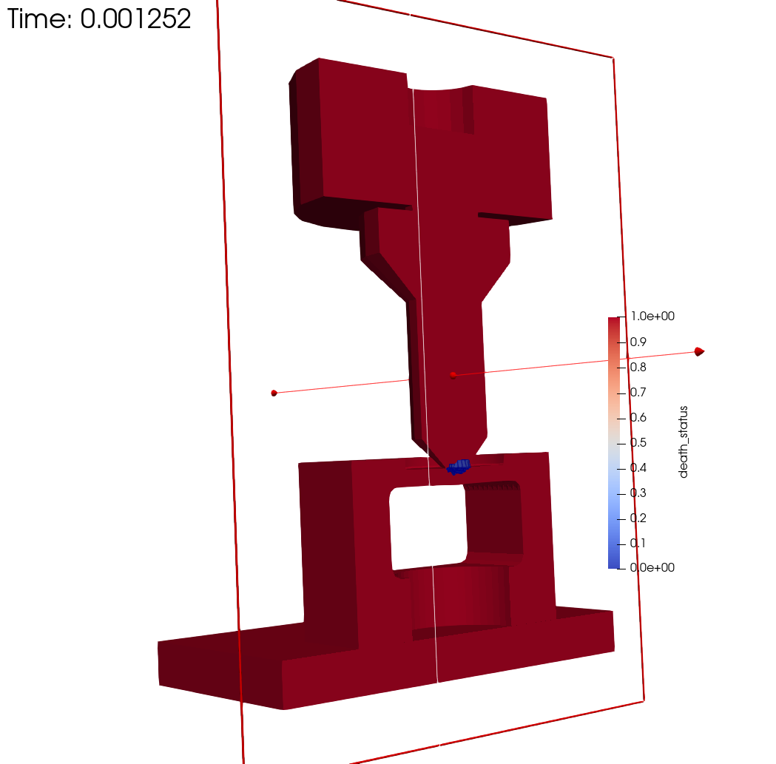
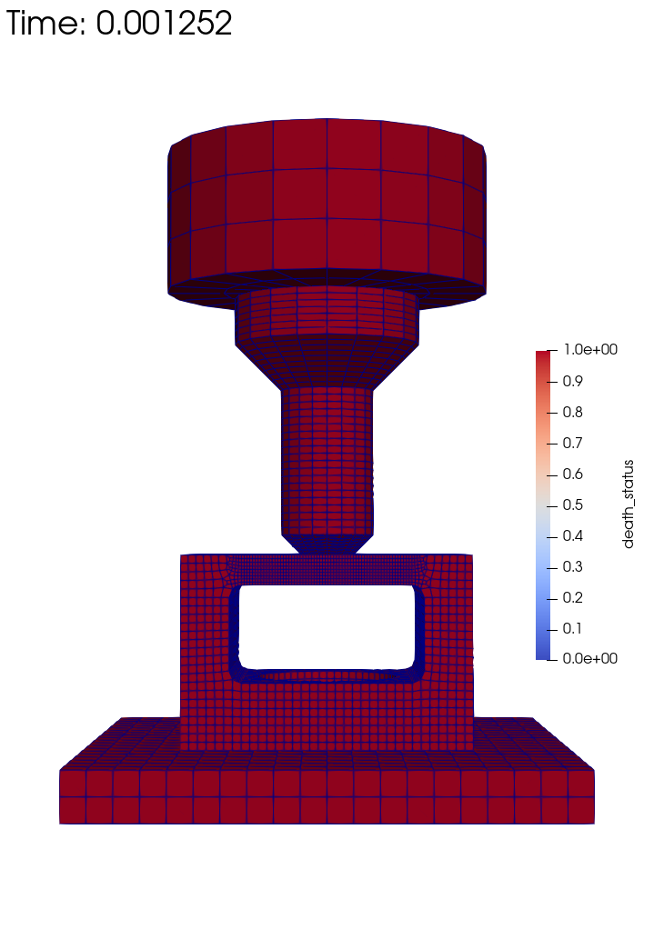
Welcome to SIERRA 100: Solid Mechanics – Capabilities Overview
Sierra/SM is a Sandia-developed massively parallel nonlinear solid mechanics finite element code.
Capabilities and features include:
Explicit (dynamic) and implicit (quasistatic and
dynamic) analysis
Geometric, material, and contact nonlinearities
Coupled physics simulations
Wide variety of supported element types
Broad selection of material models
Fracture and material failure modeling
Performant and scalable on HPC systems
Customizable outputs
User subroutines for additional capabilities
Comprehensive documentation
4
Notes:
Welcome participants to Sandia and provide a general introduction to course.
Image: Sandia Fracture Challenge 4 punch problem – cutaway shows element death

Slide 5

Who Uses SIERRA/SM?
A solid mechanics analyst at Sandia National Labs answering questions about mechanical design.
A DoD analyst investigating blast-on-structure effects on military vehicles and structures.
A university student working on failure modeling research.
A structural dynamics analyst interested in the effects of preload.
5

Slide 6
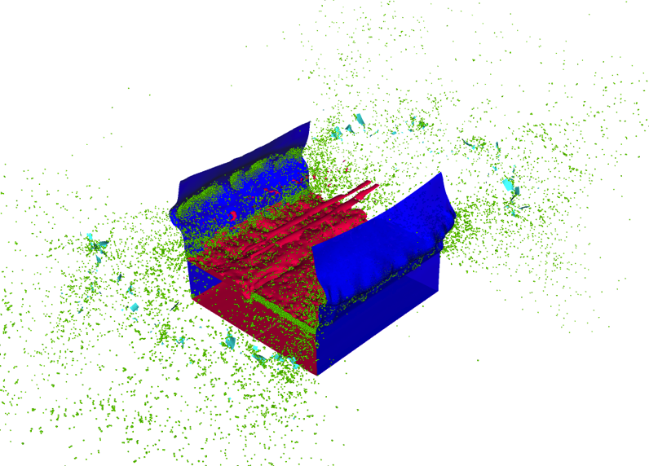
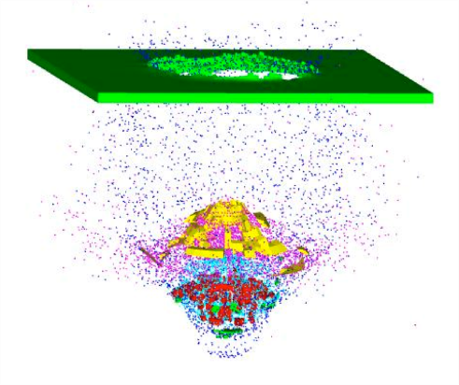
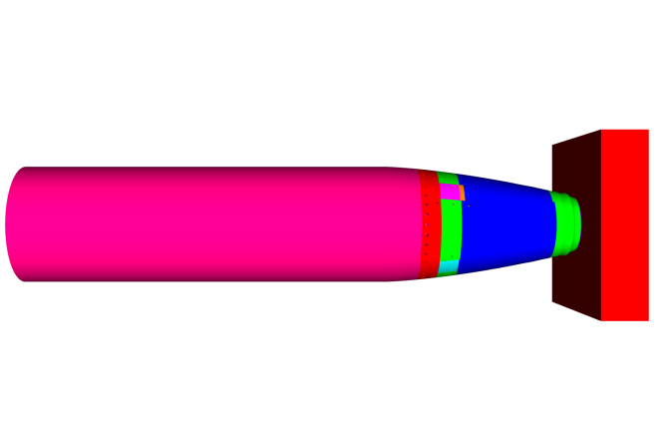
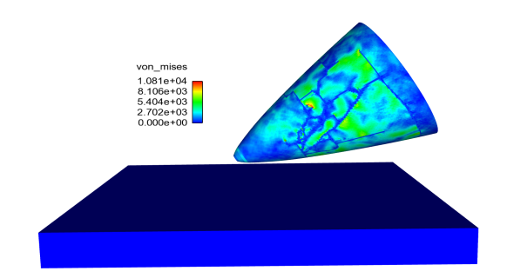
SIERRA/SM: Use Cases
Fragmentation
Impact
Crush
Preload
Failure prediction
Blast-on-structure
Crush
Impact Analysis
6

Slide 7
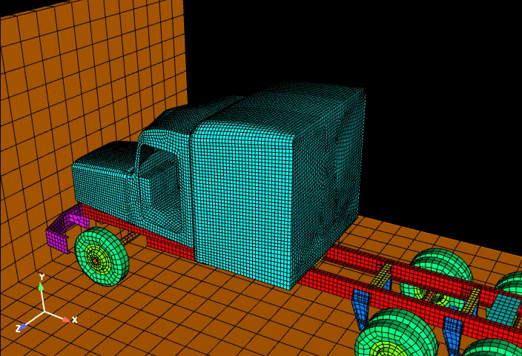
SIERRA/SM: Use Cases
Vehicle Impact Simulation
7

Slide 8
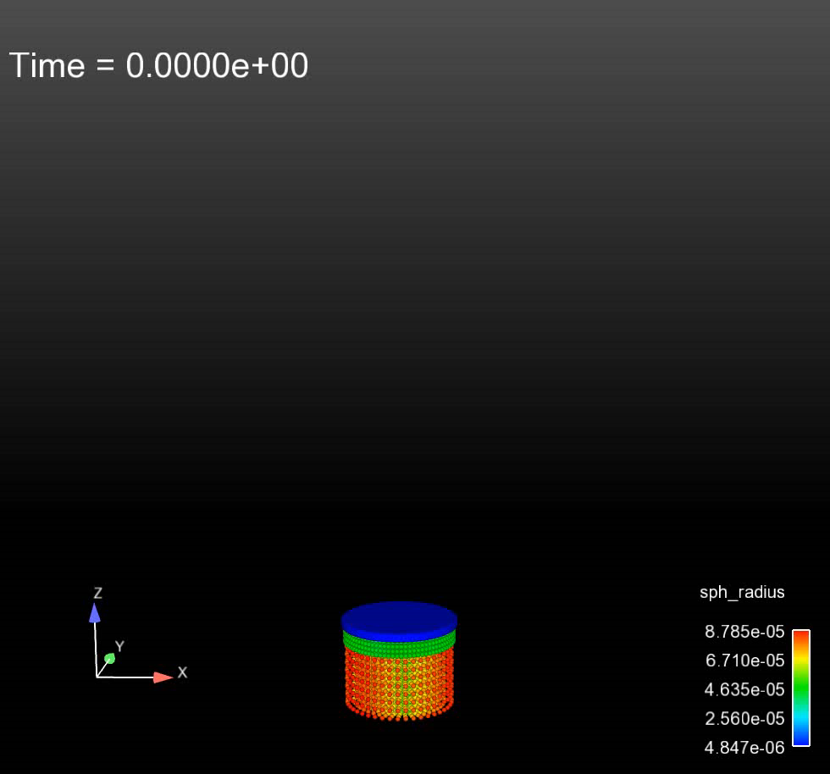
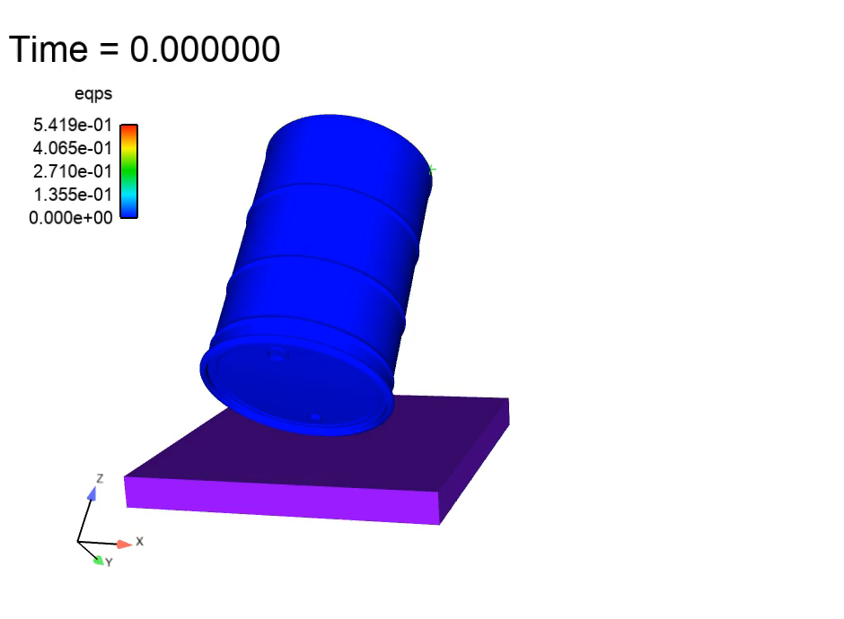
SIERRA/SM: Use Cases
Drum Safety
8
Notes:
NOTE: Ask team about video to the right: what is it showing?

Slide 9
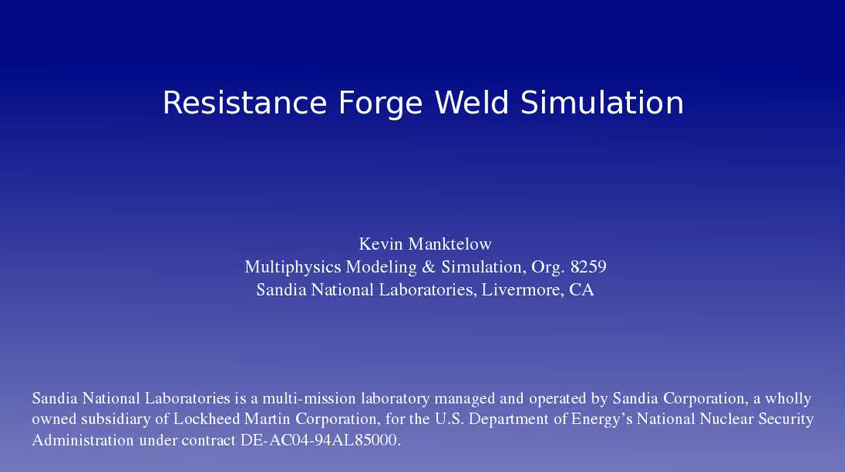
SIERRA/SM: Use Cases
Resistance Forge Weld
9
Notes:
A resistance forge weld using a remeshing technique. Two parts are welded together via electric current over several milliseconds. Left subset shows pressure contours, while right subset shows the current mesh and evolving mesh distortion.

Slide 10
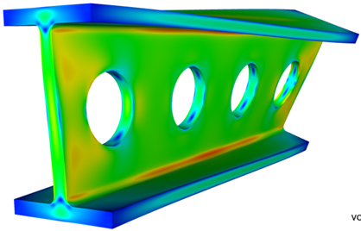

SIERRA/SM: Modeling capabilities
Fracture/Failure
Multiscale submodeling
Rigid bodies
Shells
Particle methods
Coupling with other Sandia codes
  CTH (Blast-on-Structure)
  SIERRA/TF (Thermal-mechanical)
Kinematic Boundary Conditions
  Displacement, velocity, acceleration (fixed and prescribed)
  Spatial, temporal, analytic functions, and user subroutines
Loads
  Pressure
  Gravity
  Tractions
User-defined functions
  Spatial and/or temporal
  Analytic
  User subroutines
10
Notes:
Removed Explicit QS mode, since we moved it to in-development manual

Slide 11
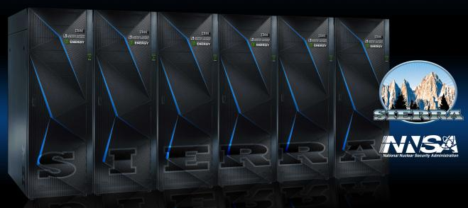
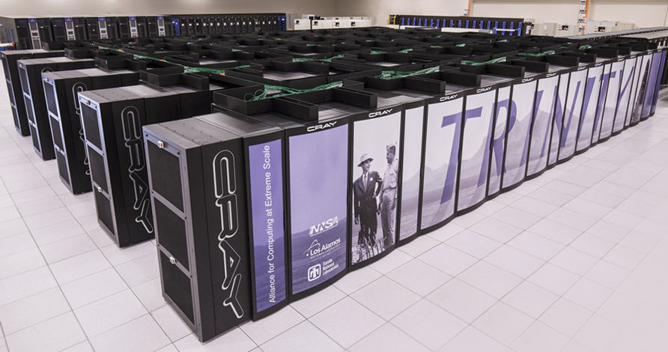
SIERRA/SM Performance and Testing
ATS-2/Sierra
Massively parallel C++ implementation
Optimized for vectorization instructions on a variety of CPU platforms
Some GPU-accelerated capabilities available
Over 4000 nightly tests, ~100 performance, ~500 verification
Developed in federal national security complex
Protected, Secure, EAR99, ITAR
Trinity
11

Slide 12
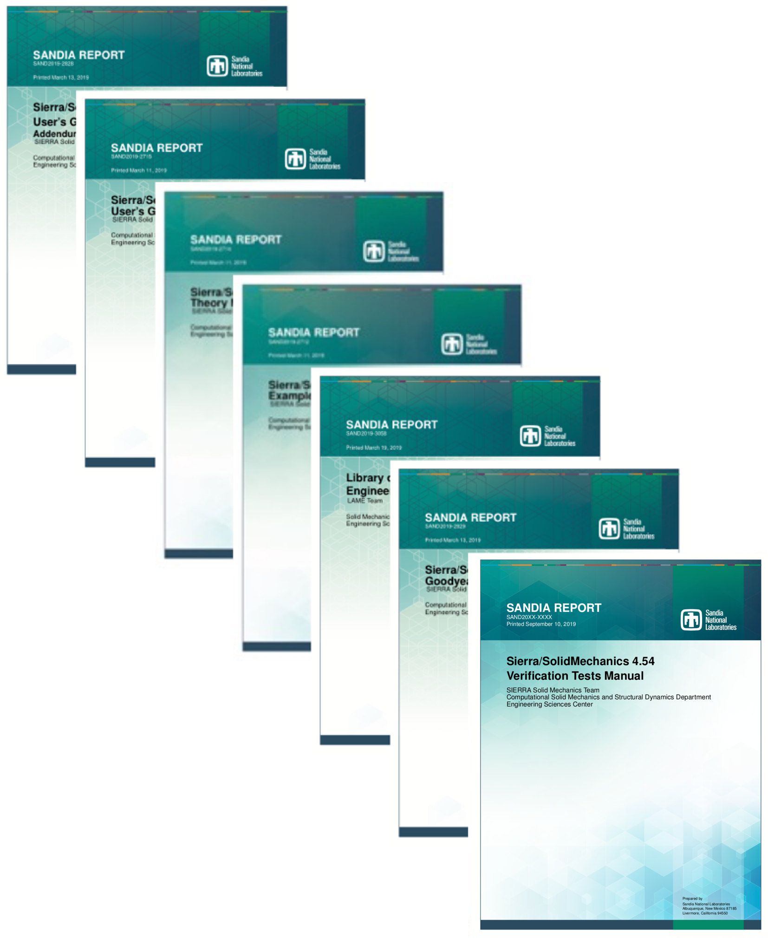
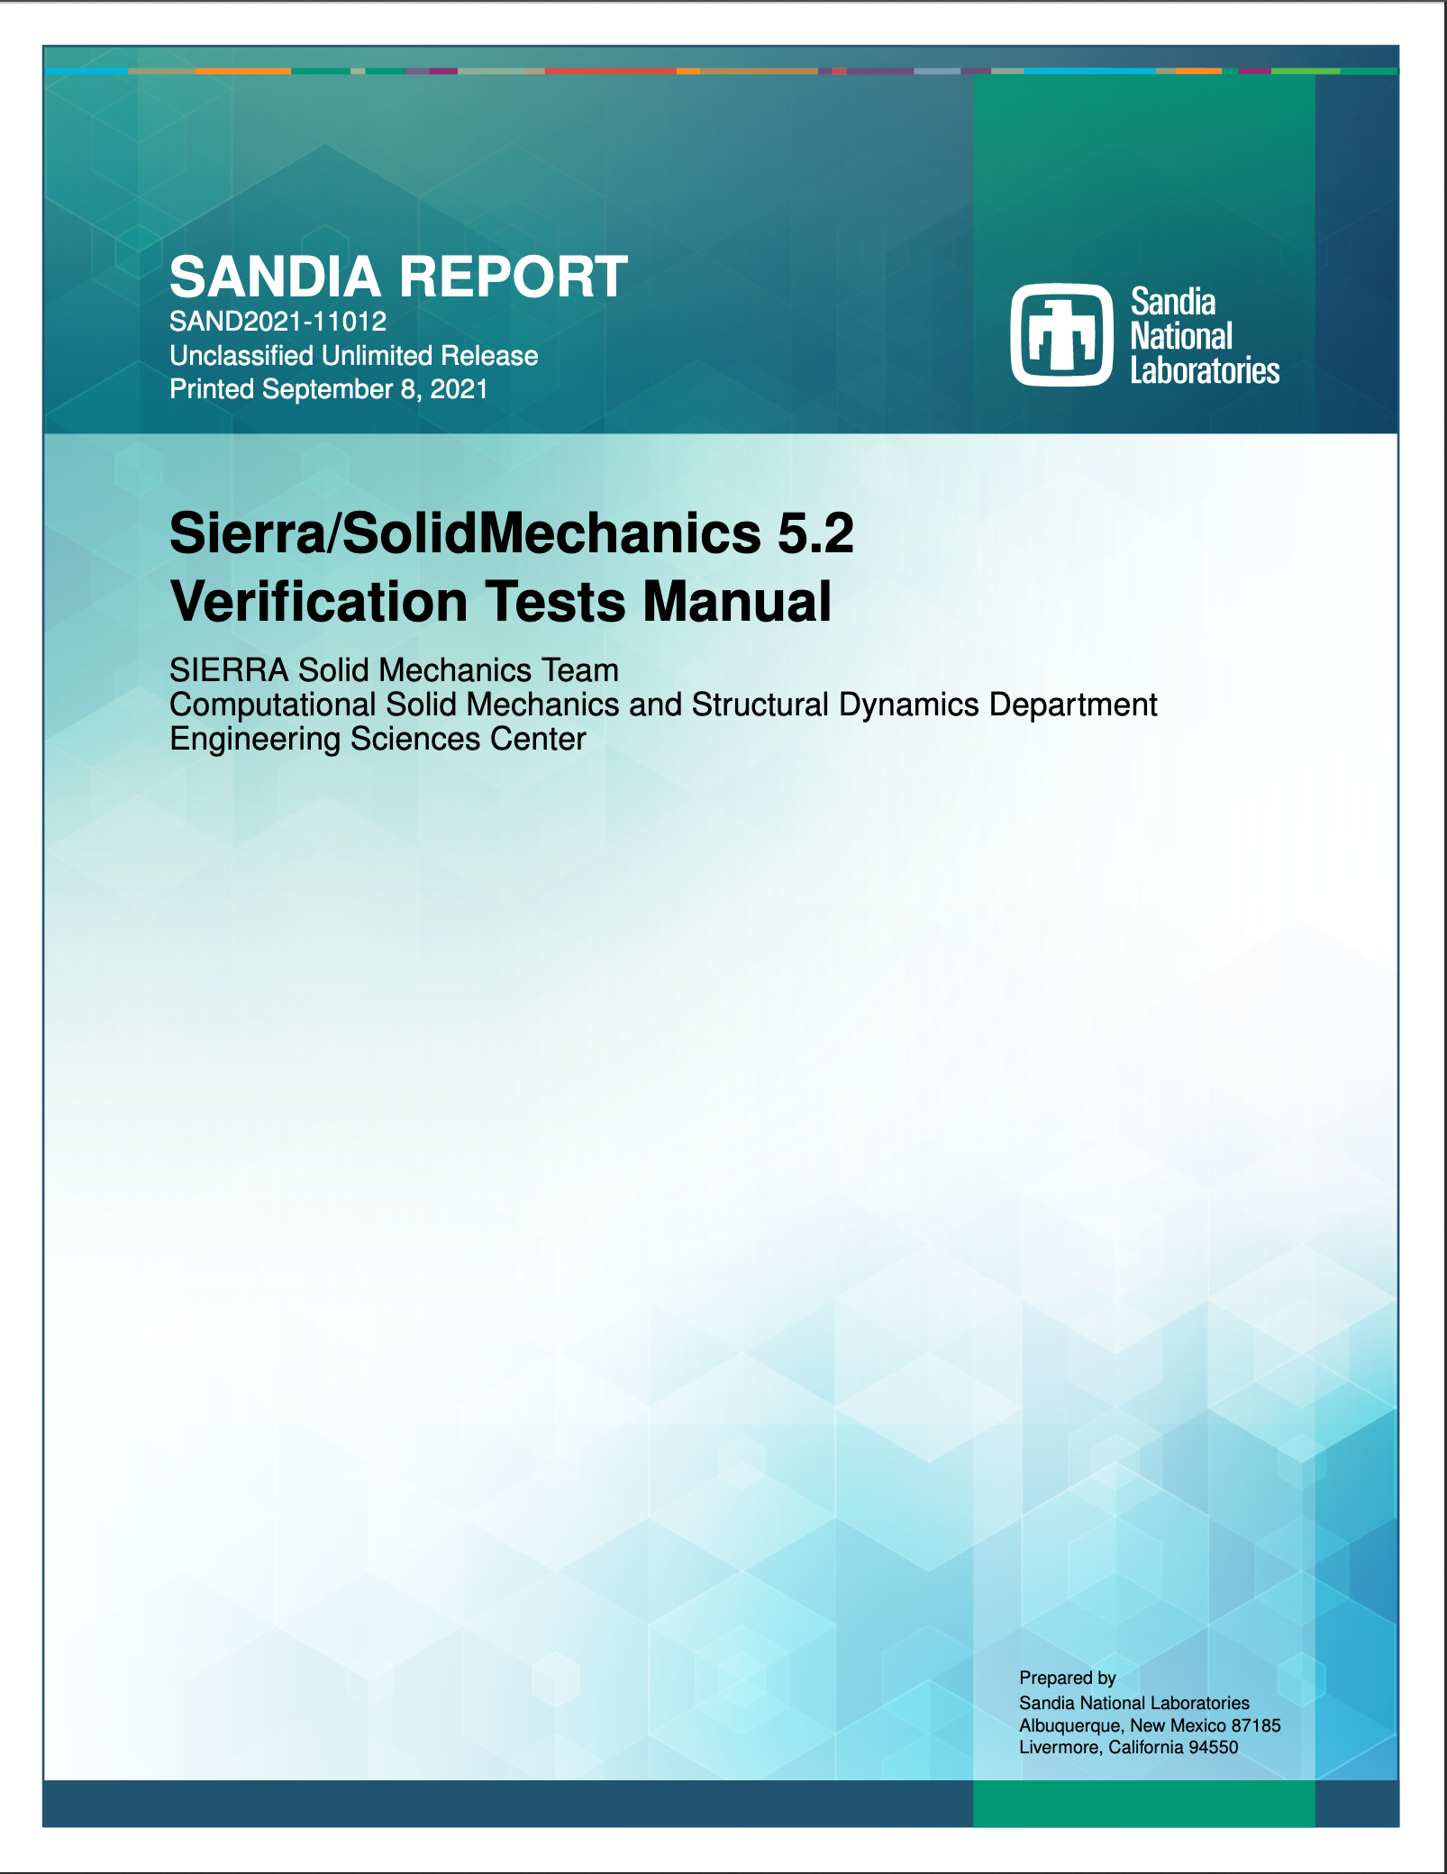
Strongly suggested: Get the current user manuals
General release (5.6 as of today) is always supported and recommended (because of stringent testing requirements)
Version of the Day (VOTD/daily) is also tested and can be used
  Email sierra-help@sandia.gov if you see unexpected behavior
Updated User’s Manuals are your friend
  compsim.sandia.gov > Documentation > General Release > User Manuals > Solid Mechanics
  or https://compsim.sandia.gov/compsim/Docs/Sierra/5.6/GeneralRelease
Start with User’s Guide
Then check out Shock Addendum, Capabilities in Development, Theory Manual, Verification Tests Manual, Example Problems Manual, Zapotec Manual, LAME Manual
Notes:
replace this

Slide 13
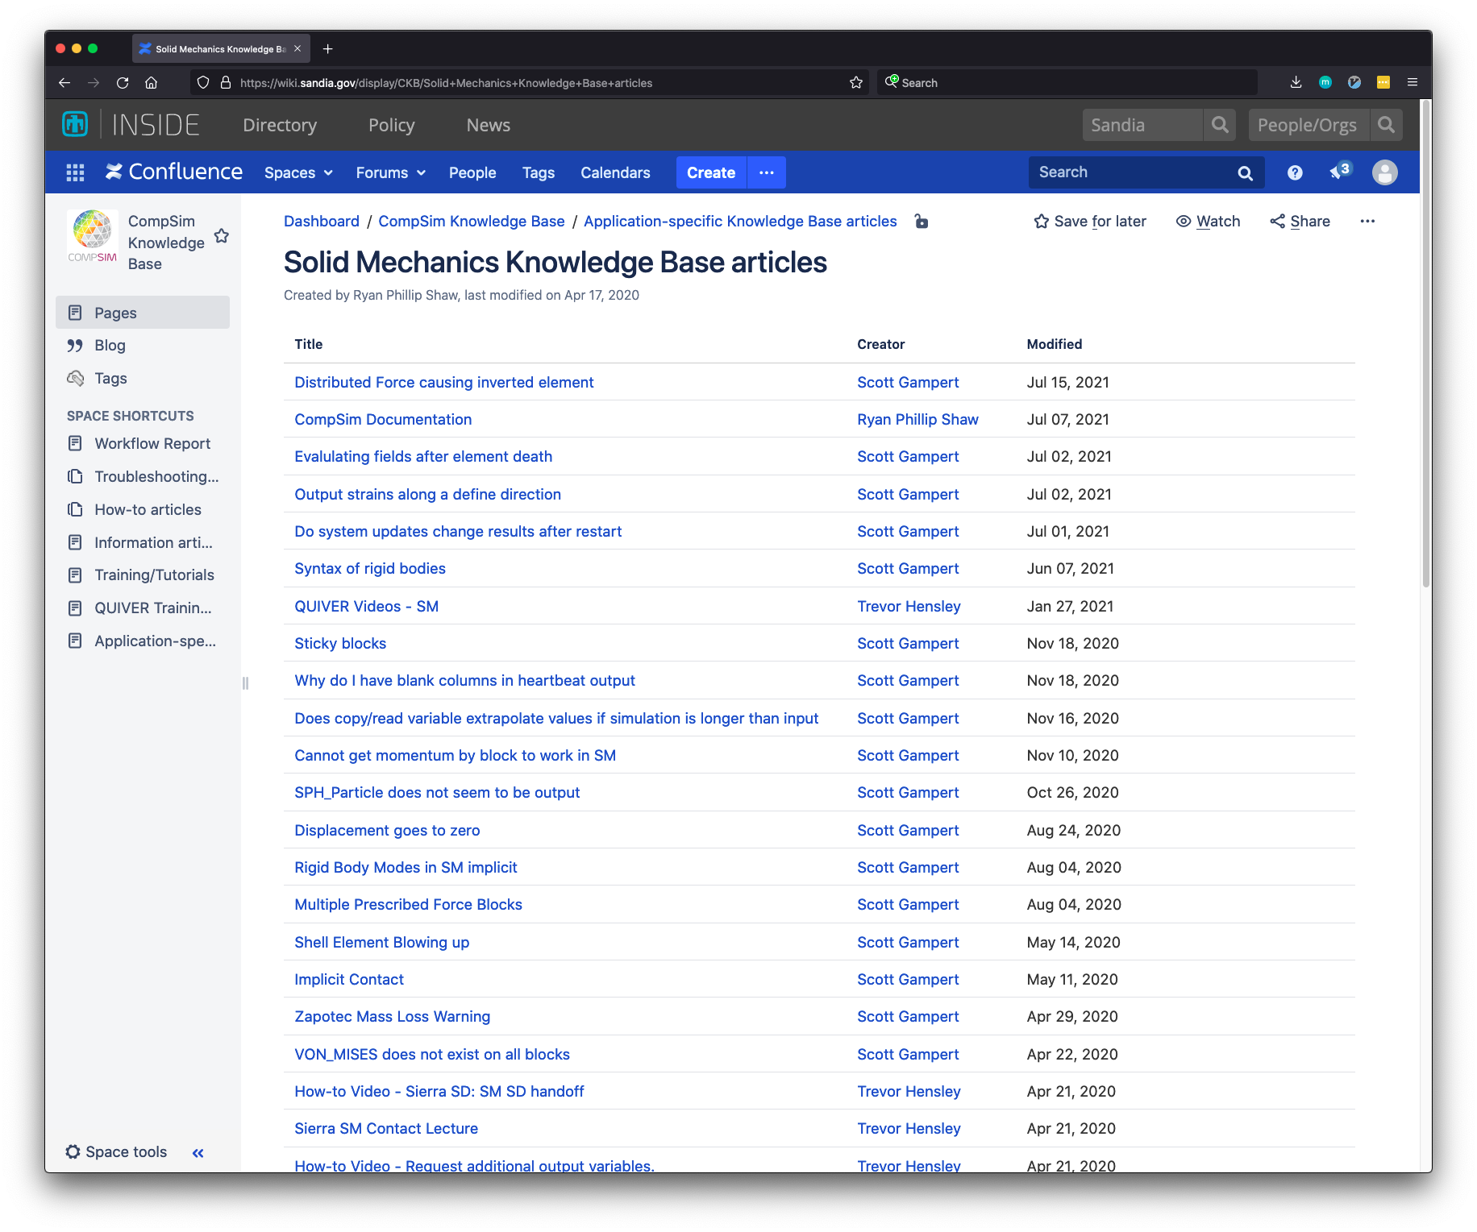
SIERRA/SM: Resources
External Resources
SIERRA user support: sierra-help@sandia.gov
  for obtaining help, reporting issues/bugs
SIERRA/Solid Mechanics users manuals are updated with each release (4x/year)
Internal Resources
SIERRA CompSim: http://compsim.sandia.gov
Confluence Solid Mechanics Knowledge Base articles:
https://wiki.sandia.gov/display/CKB/Solid+Mechanics+Knowledge+Base+articles
13
Notes:
Last slide! Any questions?

