Slide 1
SIERRA 100: Solid Mechanics
Cantilever Beam and Plate Blast Examples
SIERRA Solid Mechanics Team
July 2023

Slide 2
Instructor
Mike Veilleux
  Computational Solid Mechanics and Structural Dynamics
  mgveill@sandia.gov
Answering Questions
Tim Shelton
  Computational Solid Mechanics and Structural Dynamics
  trshelt@sandia.gov
Scott Gampert
  Scientific Apps & User Support
  sgamper@sandia.gov
Matt Rand
  Scientific Apps & User Support
  mgrand@sandia.gov
User Manuals
PDFs: compsim.sandia.gov/compsim/Docs/Sierra/5.14/GeneralRelease/index.html
Web Interface: adagio.sandia.gov/docs/
2
Notes:
Each instructor briefly introduces himself/herself.

Slide 3
Unless talking, mute your microphone please.
(Don’t make us mute it for you.)
Suggest turning off camera and other incoming video if bandwidth is an issue.
Use the chat to ask questions! One of us will help.

Slide 4

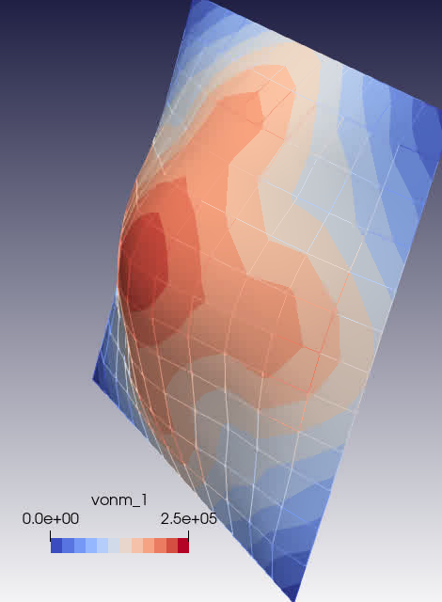
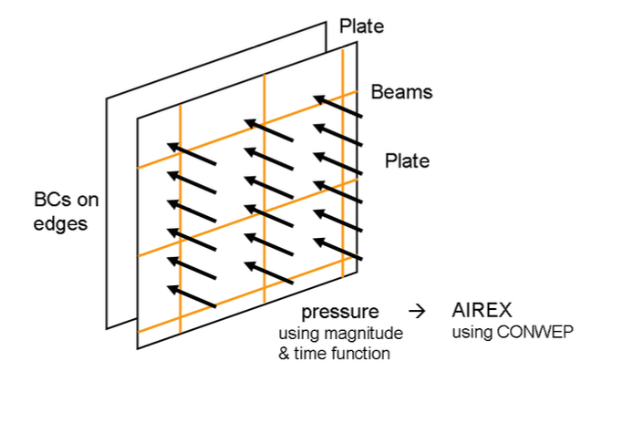
Training focus – Two examples
Cantilever Beam: Getting started with SIERRA Solid Mechanics
Plate Blast: Incrementally add complexity to demonstrate capabilities in SIERRA Solid Mechanics
  Non-linear material response
  Contact
  Failure modeling
  Structural elements
Also, learn how to use tools:
  SAW
  Cubit (through SAW)
  Paraview

Slide 5
Files for the example problems
/projects/sierra100/Solid_Mechanics/training_plate_blast/problems/
case00_hello_beam Cantilever beam; input deck tour
case01_plate_basic Plate mesh w/ quad4 shell elements
case02_plate_function Time-varying pressure load
case04_plate_elastic_plastic Elastic plastic material model
case05_plate_material_library Parameters from material library
case06_plate_beams Plate mesh with shell and beam elements
case07_plate_bcs Modify BCs, define and use gravity load
case08_plate_output Request additional results and history output
case09_plate_contact Contact with side a / side b
case10_plate_general_contact General contact
case11_plate_failure_death Failure modeling with element death
case12_plate_failure_disconnect Failure modeling with element disconnection
case13_plate_failure_particle Failure modeling with conversion to particles
case15_plate_xfem Failure modeling with XFEM
covered in this training
Notes:
replace this

Slide 6
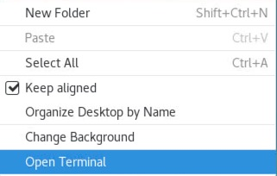

Copy these files to a local directory
Create a directory and copy files using a UNIX terminal (more on the “terminal” later!)
  Open a terminal window:
  Right-click on the Desktop -> Select “Open Terminal”
  Go to your home (“~”) directory;
  create a ”training/adagio_training” sub-directory;
  and, copy the training files there
Notes:
replace this

Slide 7
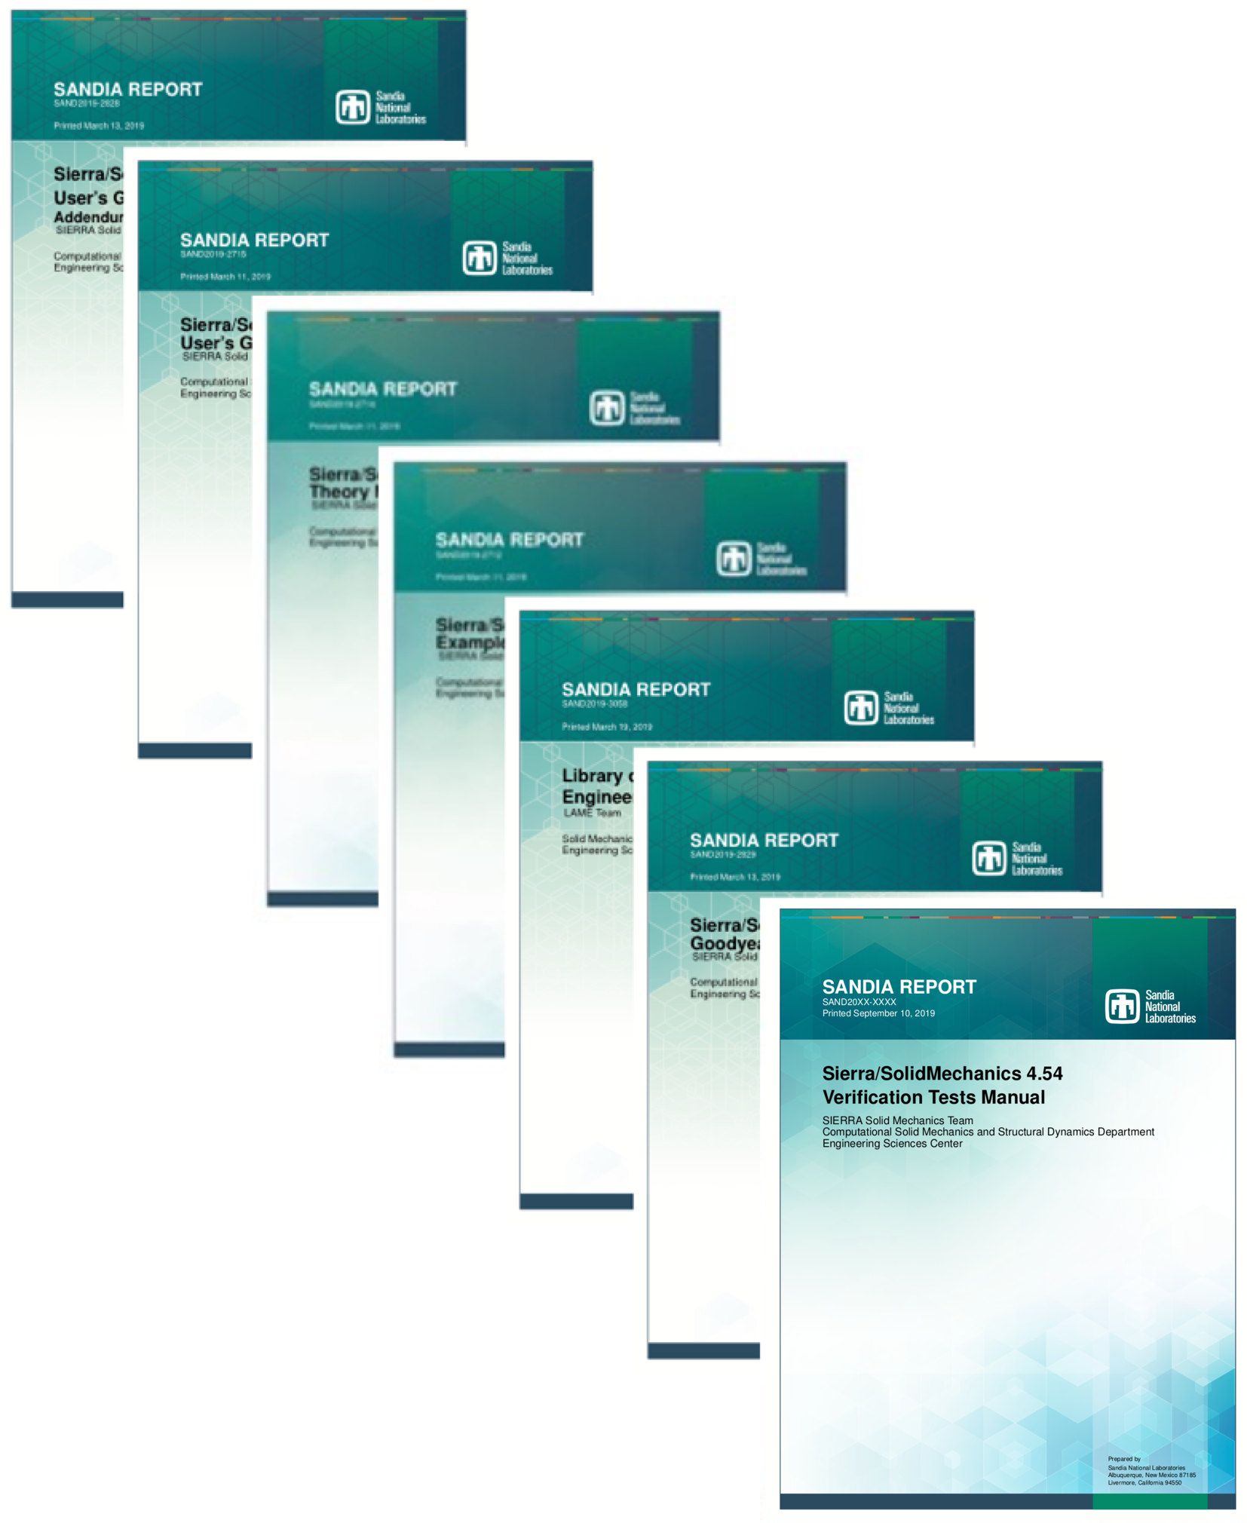
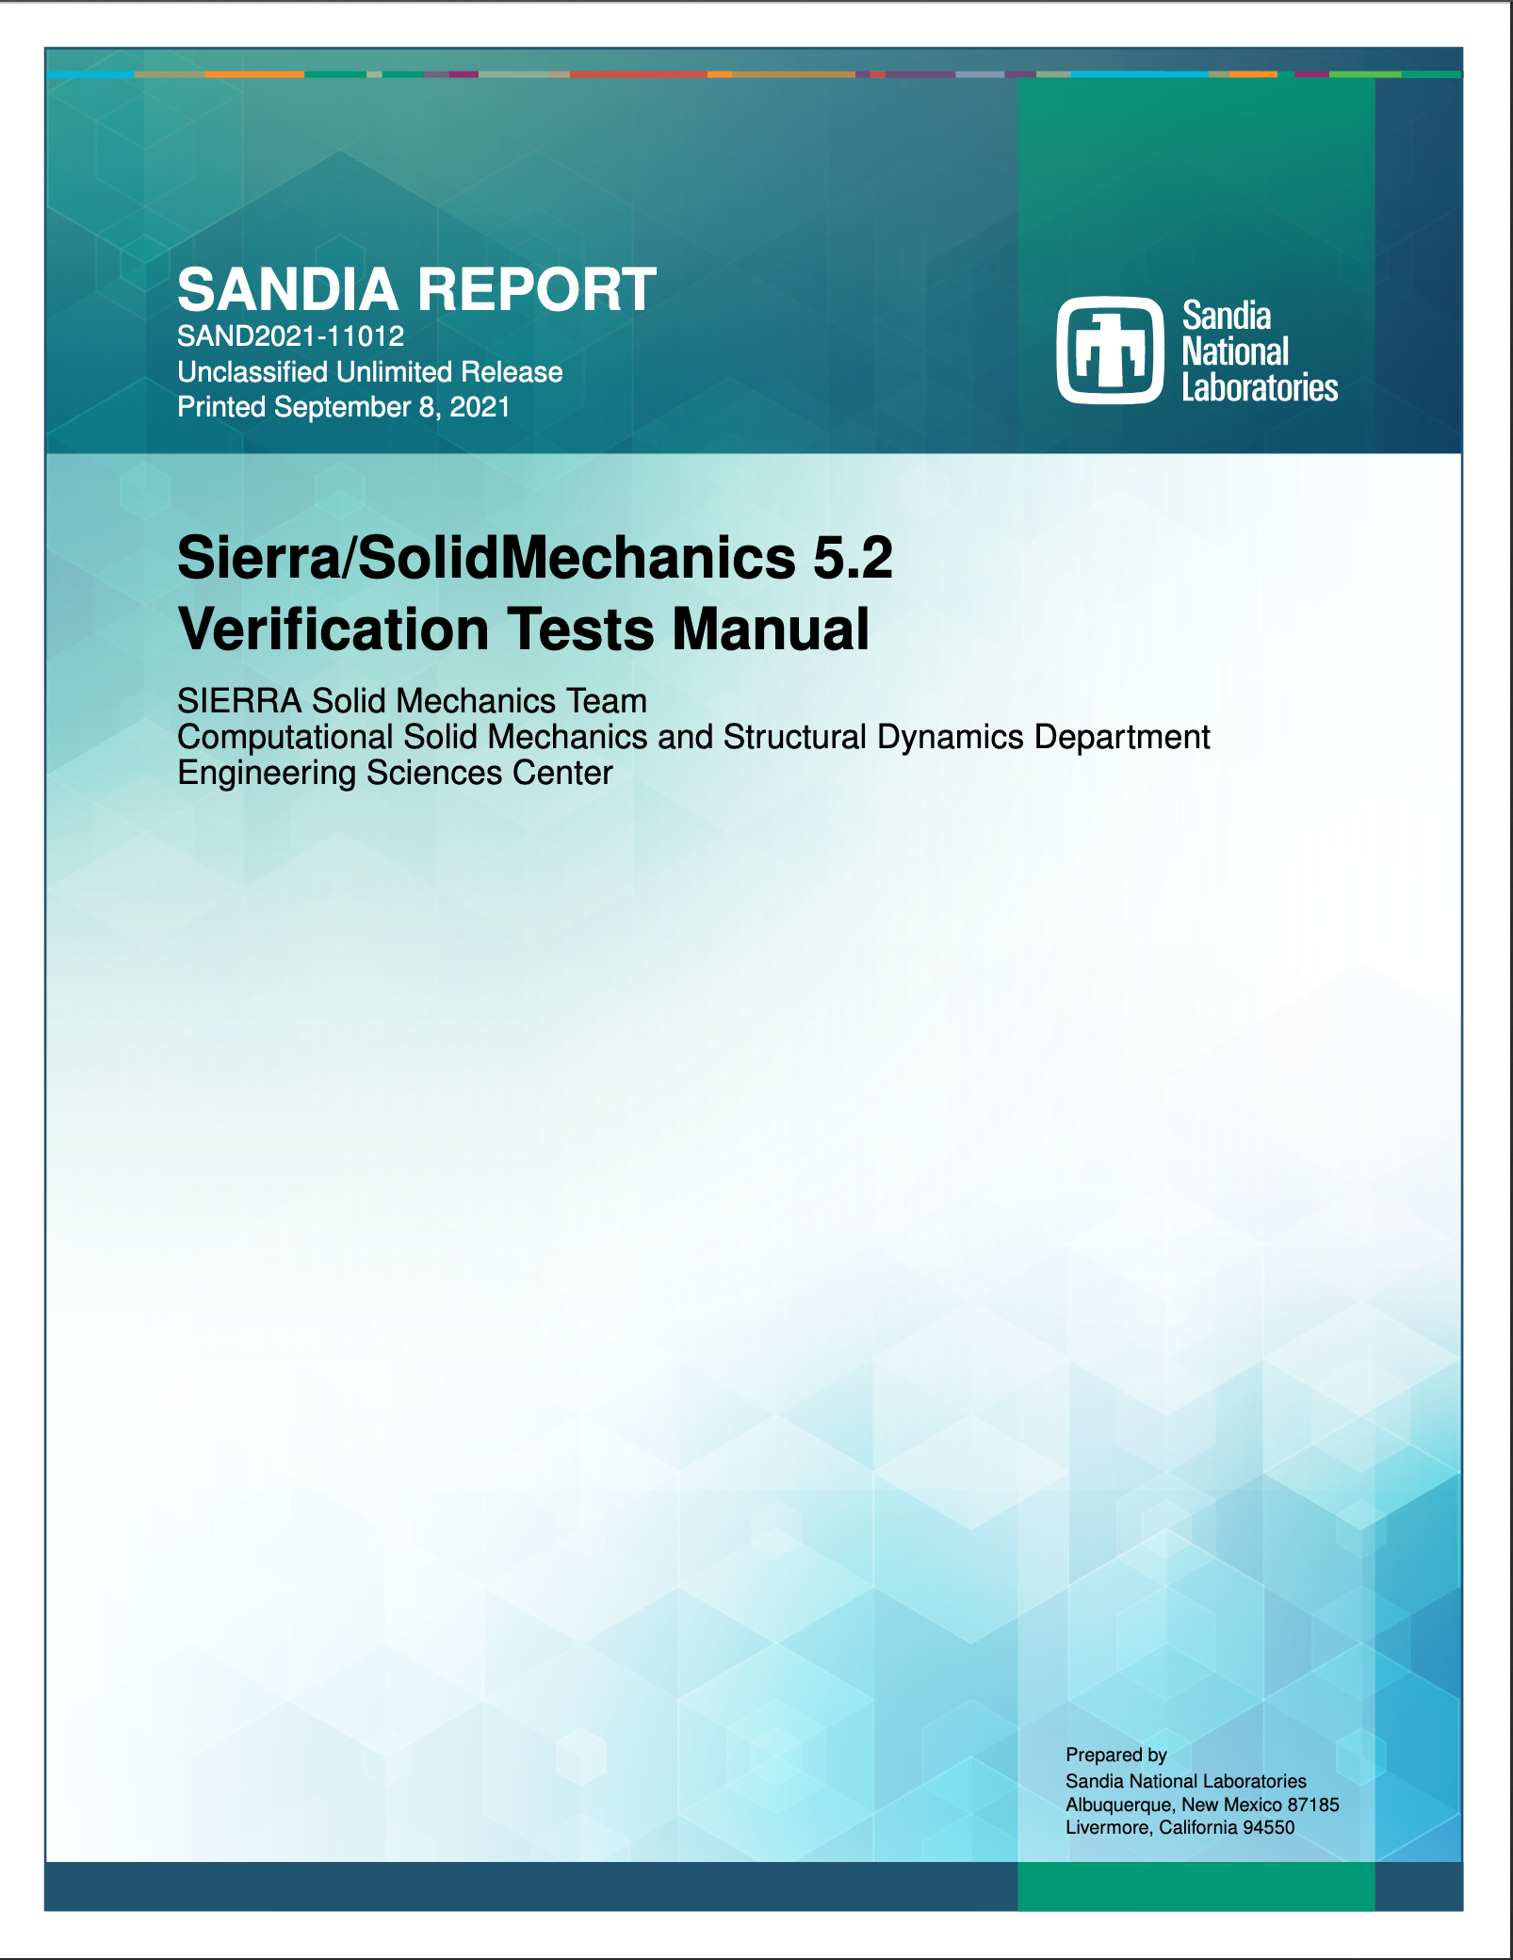
Optional, strongly suggested: Get the current user manuals
General release (5.10 as of today) is always supported and recommended (because of stringent testing requirements)
Version of the Day (VOTD/daily) is also tested and can be used
  Email sierra-help@sandia.gov if you see unexpected behavior
Updated User’s Manuals are your friend
  compsim.sandia.gov → Documentation → General Release → User Manuals → Solid Mechanics
  or https://compsim.sandia.gov/compsim/Docs/Sierra/5.4/GeneralRelease
Start with User’s Guide
Then check out Shock Addendum, Capabilities in Development, Theory Manual, Verification Tests Manual, Example Problems Manual, Zapotec Manual, LAME Manual
Notes:
Moved to 20m introduction powerpoint, but if you wish to reiterate, unhide this slide

Slide 8
How to Add a SAW Project

Slide 9
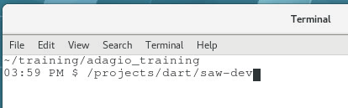
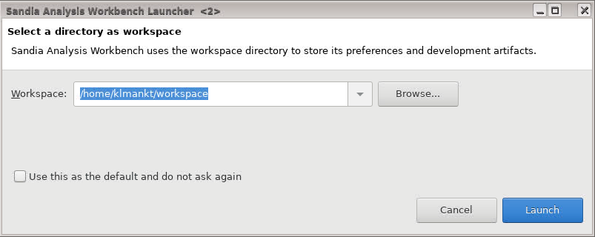
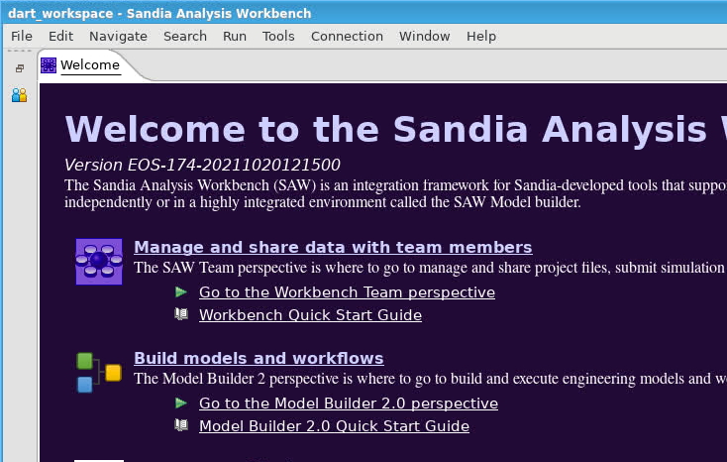
Starting the Sandia Analysis Workbench (SAW) for the first time
Launch the SAW application from a terminal
Create a working directory. Select Launch
Select Manage and share data with team members
Notes:
Trevor says we should use
/projects/dart/saw-dev
(as of October 27)
do not use eos – some features will be missing
dev has a few missing features (e.g. aprepro parameters) but should be fixed by training

Slide 10
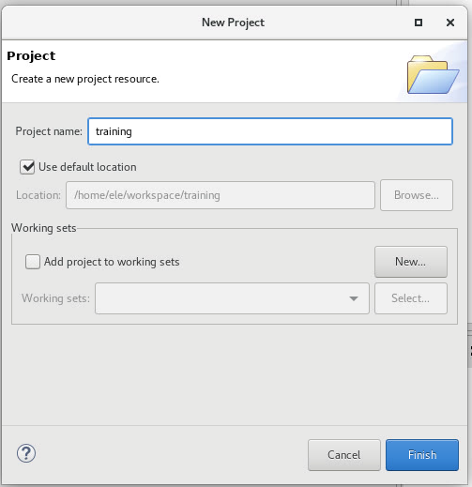
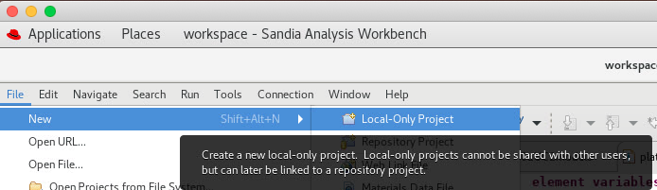
How to Add a SAW Local-Only Project
File > New > Local-Only Project. In Project name type “training.” Click Finish.
SAW

Slide 11
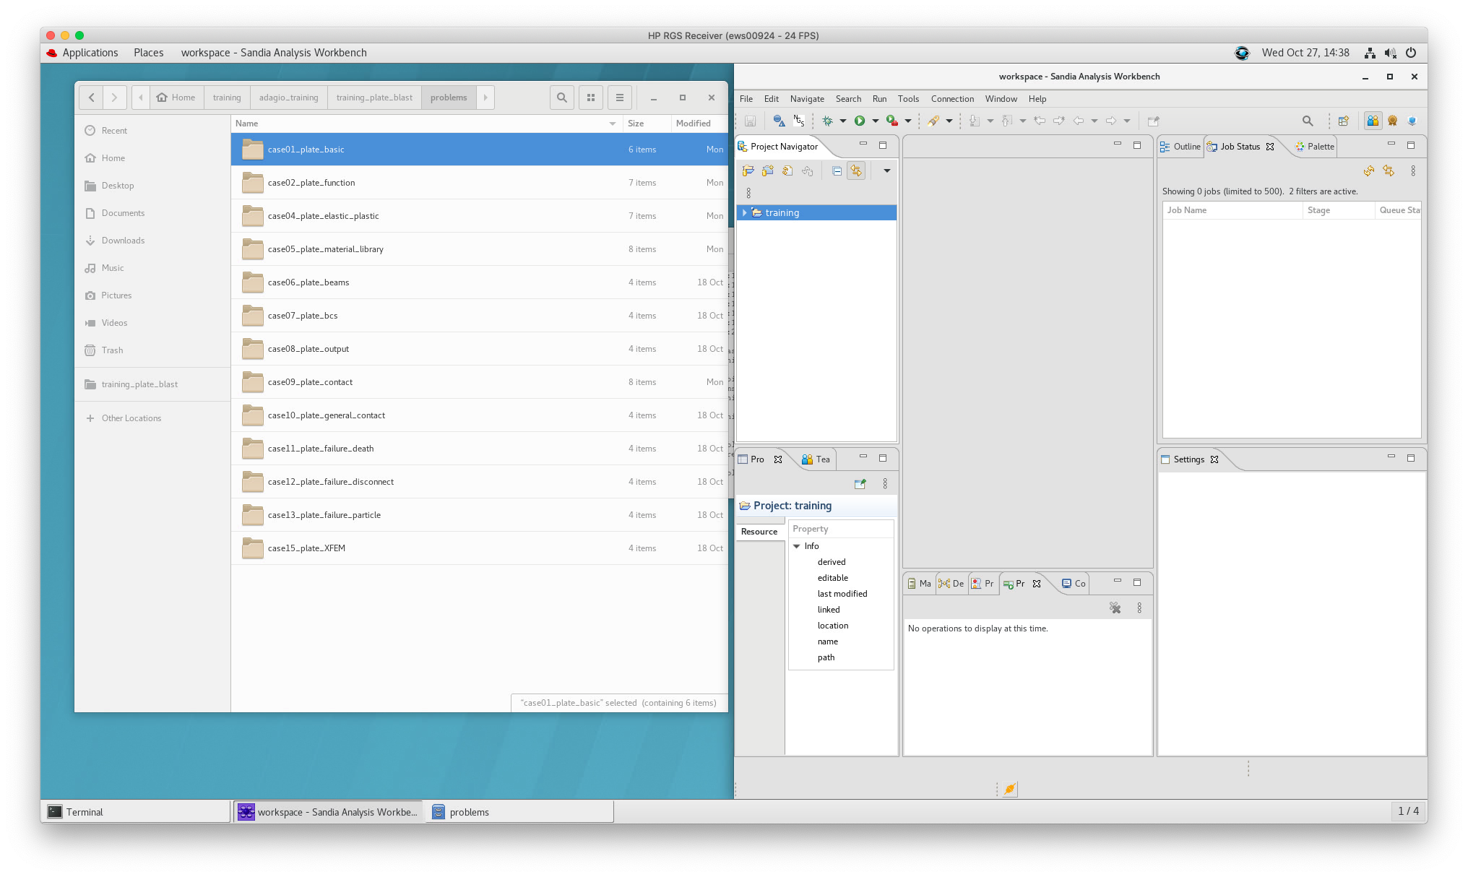
How to add example files to your SAW project – Drag and drop
Open file browser and go to training files that you previously copied to your local directory
Select example folders (case00 through case15) and drag to the training folder in SAW:

Slide 12
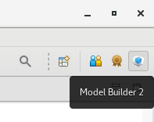
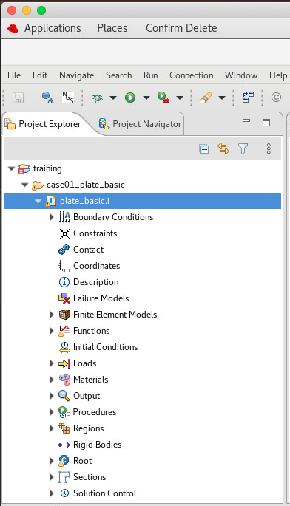
Working with SIERRA in SAW
All the relevant training directories and files should now be available!
Left-click the Model Builder 2 button (blue box in a box in top right):
In the Project Explorer tab on the left, expand the folder training > case01_plate_basic > plate_basic.i
We’ll come back to this example later, but first some more fundamentals of running Sierra Solid Mechanics…

Slide 13
Hands-On Session 0: Hello Cantilever!

Slide 14
In this session, we will:
Use the terminal
Learn about the input deck
Run an analysis
Review results in ParaView
Session 0: Hello Cantilever!

Slide 15
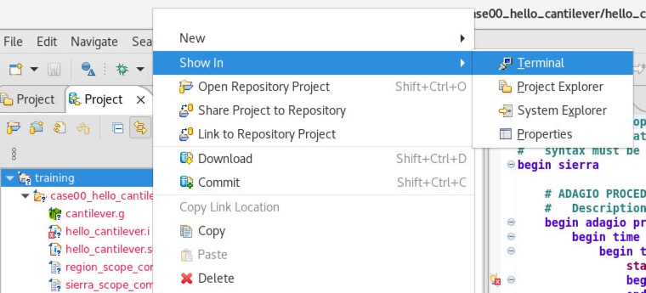
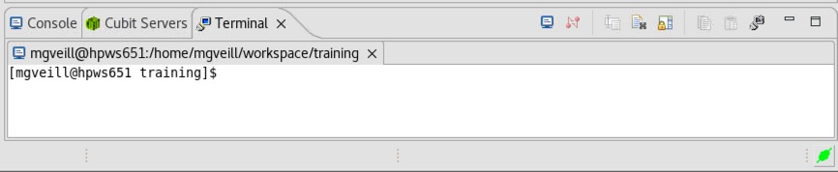
SIERRA/SM fundamentals: The terminal
SIERRA/SM is a program built, and generally executed, within a UNIX environment
  Program name: adagio
  Analyses can be launched by typing a UNIX command to run the program
SAW provides access to a terminal window:
Right click on “training” project
-> Show In
-> Terminal
This window appears:

Slide 16
SIERRA/SM fundamentals: Terminal commands
Some basic UNIX commands (practice a few in the terminal window):
Command | Description
pwd | Print the ‘present working directory’
cd <dir> | Change directory to <dir>
mkdir <dir> | Make a directory named <dir>
ls | List files/directories in the current directory
ls -l | List files/directories in the current directory, in a list format
touch <file> | Creates an empty file named <file>
rm <file> | Delete a file
rm -r <dir> | Delete a directory (and all files within it)
cp <src> <dest> | Copy a file from <src> to <dest>
mv <src> <dest> | Move a file from <src> to <dest>
echo <str> | Print <str> to the terminal
less <file> | Quickly view a file <file> in a lightweight viewer
vi <file> | Open a file <file> for editing in the console; create if it doesn’t exist
Operating ‘vi’ effectively is a training session in itself; a useful editor, but skipped here

Slide 17
SIERRA/SM fundamentals: The application/program
The application/program “adagio” is accessed by loading a “module”
  A “module” sets up various paths, environment variables, etc. needed to run a program
  Different modules are available that represent different versions of the code
Practice:
  Open a terminal in SAW*
  Load the sierra module
  Expand the vertical size of the terminal window
  Execute adagio help function
  Scan through the output; find the command describing how to supply the required input file.
$ module load sierra
$ adagio -h
*sierra applications (e.g. adagio) can also be run through a system terminal, like the terminal window we opened to copy files at the beginning of this training. SAW is an optional, useful interface.

Slide 18
SIERRA/SM fundamentals: Run an analysis (and experience an ERROR)
Adagio is an MPI application; MPI = Message Passing Interface
  This just means it can run on multiple processors, including large compute clusters
  Requesting multiple processors requires telling the program how many processors to use
  The “sierra” script is a useful tool provided by the sierra module
    It can be used to specify the number of processors:
$ sierra [--np <num_procs>] adagio -i <input_file>
Practice:
  Open a console with the sierra module loaded
  Change directory to case00_hello_cantilever (cd <dir>)
  List the files to find the input file (ls –l *.i)
  Run the sierra script on the adagio application with the input file as an argument
$ sierra --np 1 adagio -i hello_cantilever.i

Slide 19
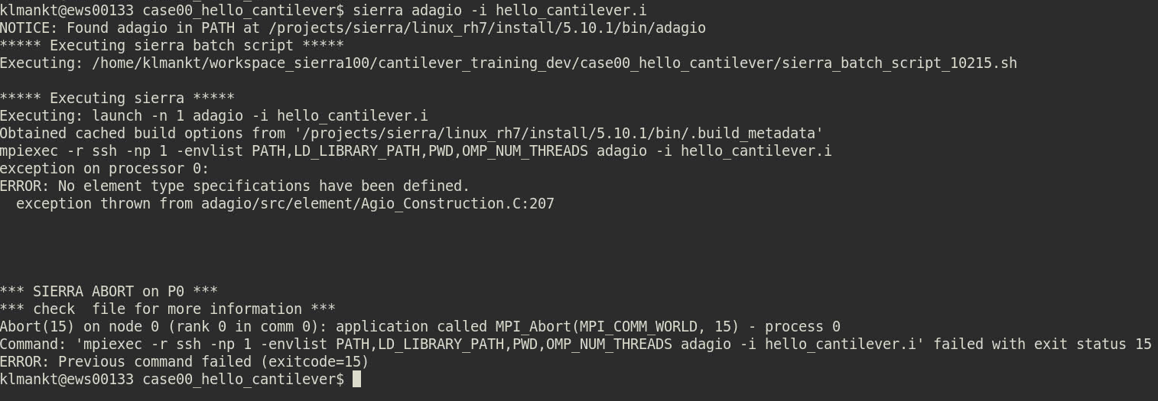
SIERRA/SM fundamentals: Standard output (stdout) and detecting errors
Execute command
Error message
Standard output is the text written to your terminal/screen after you execute a program

Slide 20
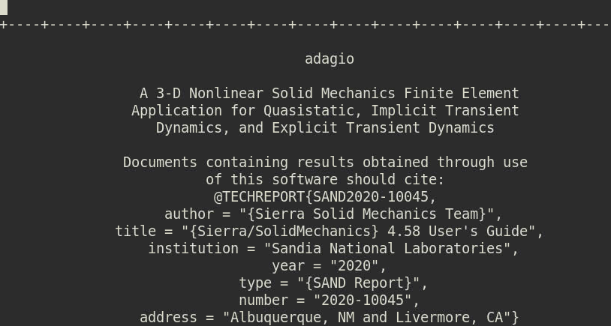
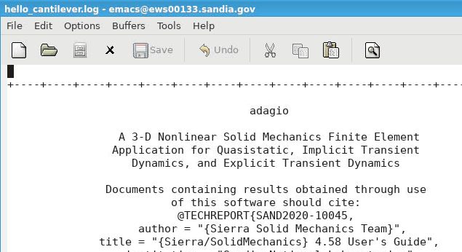
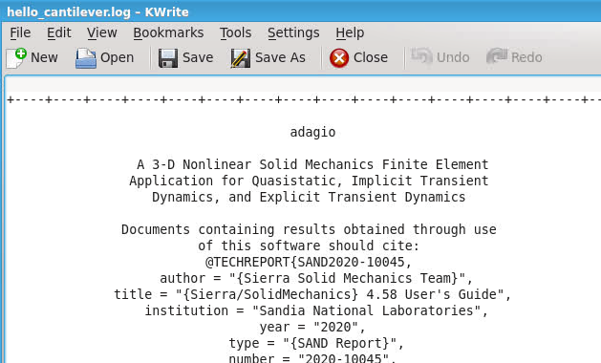
SIERRA/SM fundamentals: Viewing the log file
Adagio generates a “log file” when it’s run which provides:
  Information – A copy of your input file, progress while running, some results output
  Warnings – Non-terminal issues present in your analysis which may not be desirable
  Errors – Something was not configured correctly; something went wrong while running.
Practice:
  Find the log file by listing the *.log files (ls *.log)
  Use any text viewer/editor for the log file (lets select gedit today)
  Navigate to the end of the file; find the error text
$ less <file>
$ vi <file>
$ emacs <file>
$ gedit <file>
Fast, simple text-based viewing
More advanced editing features
More advanced editing features
Graphical editing, heavy windows users will find these most friendly

Slide 21
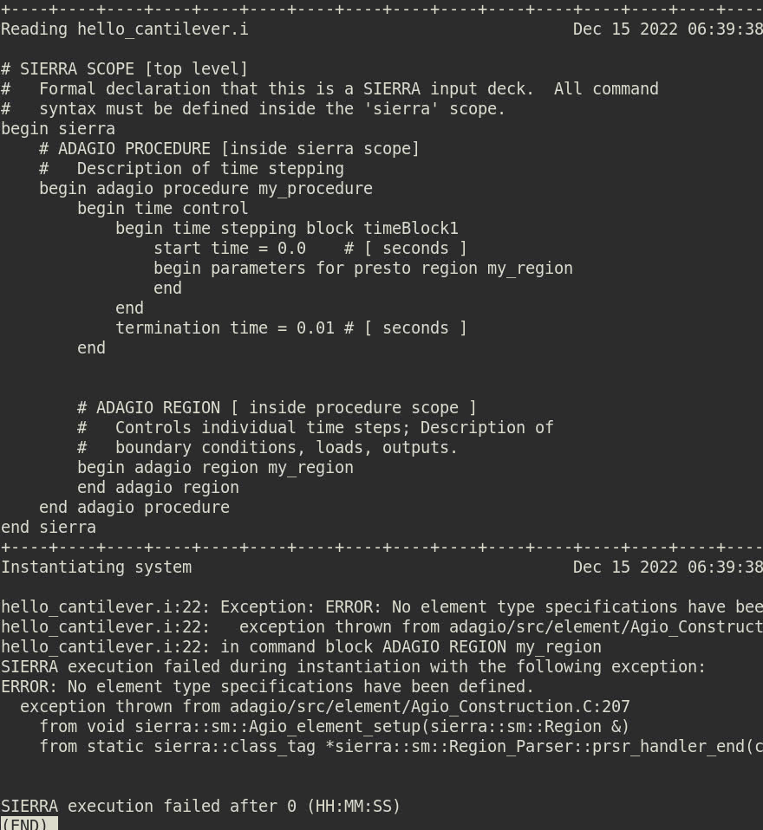
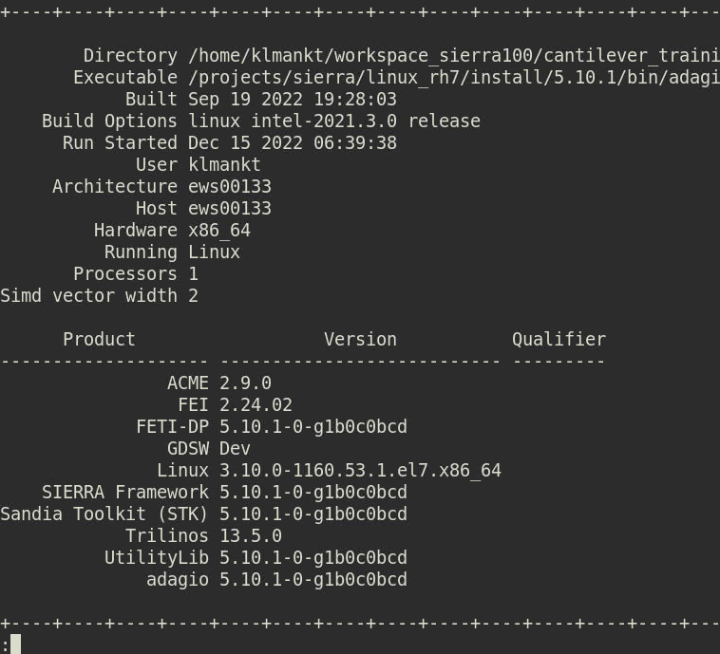
SIERRA/SM fundamentals: The log file
Log file header
Hardware information
Software information
Main error text

Slide 22
SIERRA/SM fundamentals: The input deck
Optional arguments indicated with brackets [ ]
Input Deck Structure
The Input Deck is a set of commands that describe the analysis
All SIERRA/SM input decks …
  Use the idea of “scoping” with begin/end statements
  Have three basic scopes: (1) sierra, (2) procedure, and (3) region
  Are plain text files
  Ignore white space/indentation
  Use ‘#’ as a comment character
SIERRA products generally use the “.i” extension for input deck files
Refer to User Manual, Chapter 1: Overall Input Structure for additional information
begin sierra [sierra_name]
… Material definitions
… Function definitions
begin adagio procedure <proc_name>
… Define time stepping
begin adagio region <region_name>
… Define boundary conditions
… Define contact
… Define results output
end [adagio region]
end [adagio procedure]
end
Required arguments indicated with angle brackets <>
Scope is terminated with “end” statement

Slide 23
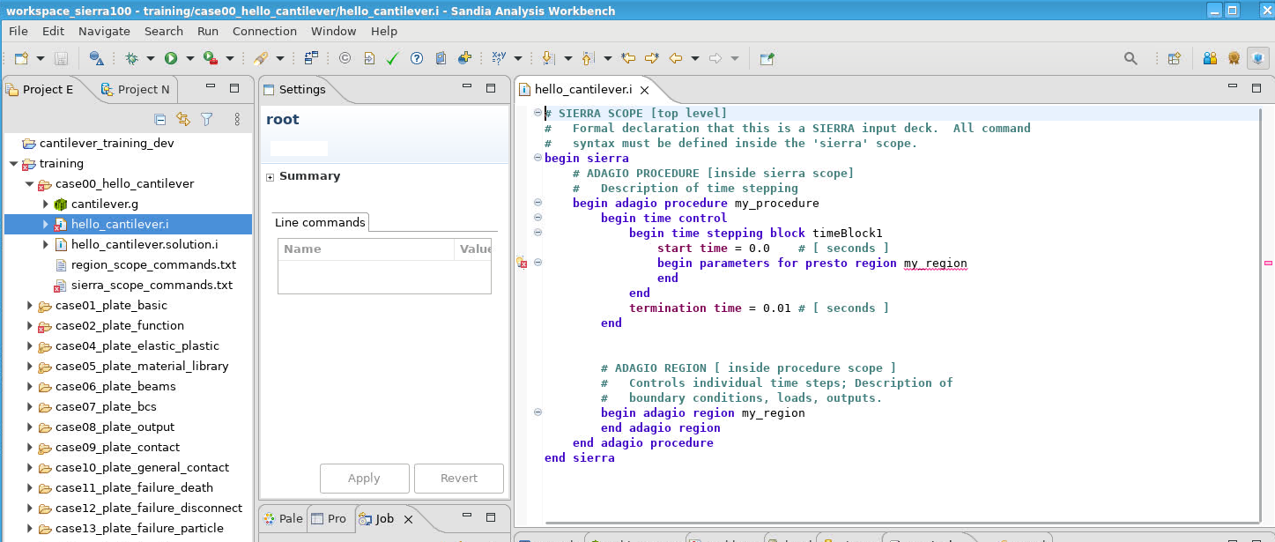
SIERRA/SM fundamentals: Building an input deck (1/3)
Let’s fix the input deck so it runs correctly; using SAW to navigate this time:
  Go to “case00_hello_cantilever” in the Project window
  Locate the input file “hello_cantilever.i”; double-click to open it in the SIERRA Editor
  Take a minute to review the scopes and information in the input deck
SIERRA Editor

Slide 24
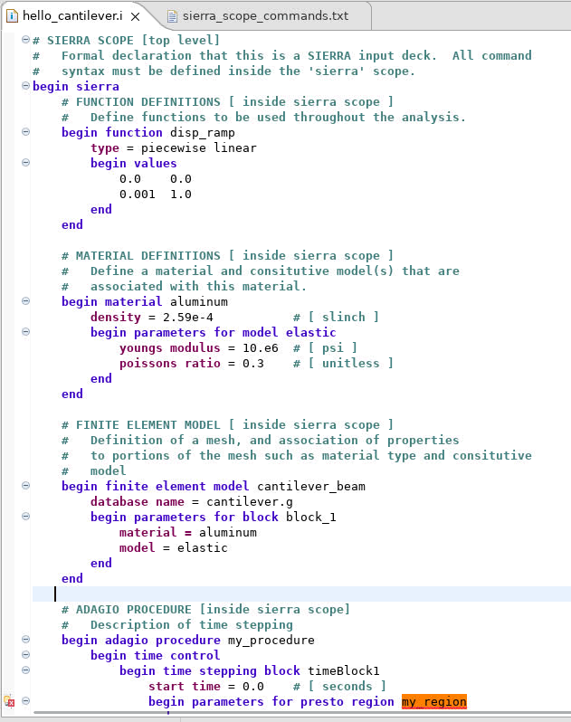
SIERRA/SM fundamentals: Building an input deck (2/3)
Add information to the “sierra” scope:
  Open the “sierra_scope_commands.txt” file
  Copy the entire contents of the “sierra_scope_commands.txt” file and insert it into the “sierra” scope of “hello_cantilever.i”
“sierra” scope commands:
  May be used in multiple procedures
  Includes primarily materials, functions, axes, directions, finite element models, and analysis restart controls.
Note the syntax highlighting of the SIERRA Editor.
  Bolded/colored text are key words
  Plain text is user-specified
Define a function
Define a material
Define a model

Slide 25
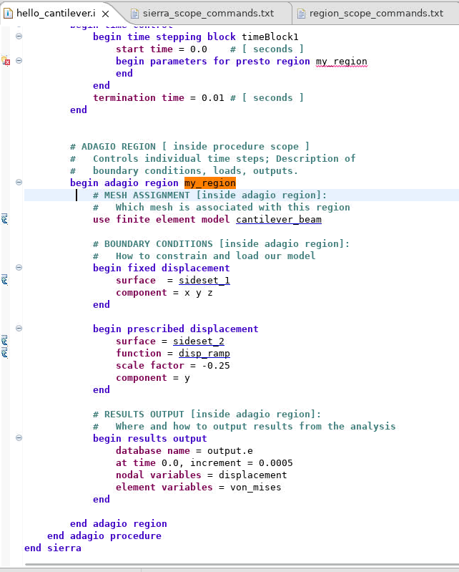
SIERRA/SM fundamentals: Building an input deck (3/3)
Add information to the “region” scope:
  Open the “region_scope_commands.txt” file
  Copy the entire contents of the “region_scope_commands.txt” file and insert it into the “adagio region” scope of “hello_cantilever.i”
“region” scope commands:
  Define many core analysis features including boundary conditions, initial conditions, results output, contact definitions, and much more.
  Acts only on the finite element model referenced by use finite element model
Save the input file (ctrl+s)
Which model
Boundary conditions
Results output

Slide 26
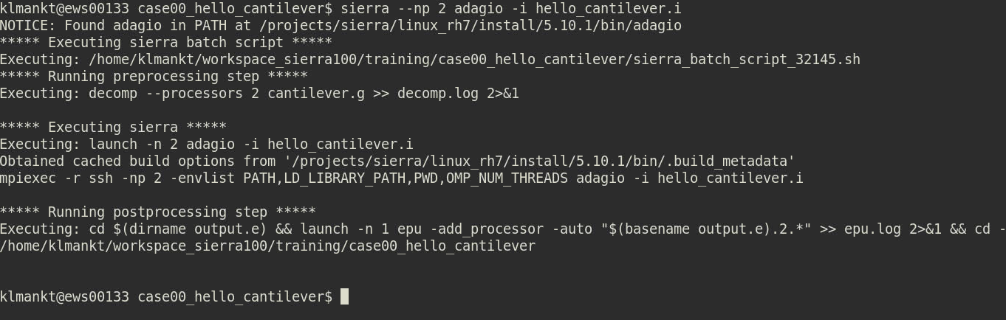
SIERRA/SM fundamentals: Running an analysis [that succeeds]
Re-run the analysis on 2 processors after editing the input file
Practice:
  Open a console with the sierra module loaded; ensure working directory is case00_hello_cantilever
  Launch adagio using the sierra script
$ sierra --np 2 adagio -i hello_cantilever.i
Launch command
Pre-processing: decompose the mesh among processors
Running SIERRA/SM successfully
SIERRA script transparently handles these steps, in parallel and serial
Post-processing: put the mesh (with analysis results) back together

Slide 27
Viewing SIERRA/SM results in ParaView (1/2)
ParaView is one program for viewing and exploring results output from a SIERRA analysis
ParaView is an open source visualization tool which can:
  Read the ExodusII format
  Process visualizations in parallel (analyses on 1000+ processors can produce terabytes of results)
  Generate movies and images of analyses
ParaView is accessible by loading the “viz” module and launching the “paraview” application.
Practice:
  In a console, load the “viz” module
  Ensure current directory is the same directory where the analysis was run.
  List files to find the results output file (typical file extension is *.e)
  Launch ParaView to open the results file (output.e)
$ module load viz
$ paraview output.e

Slide 28
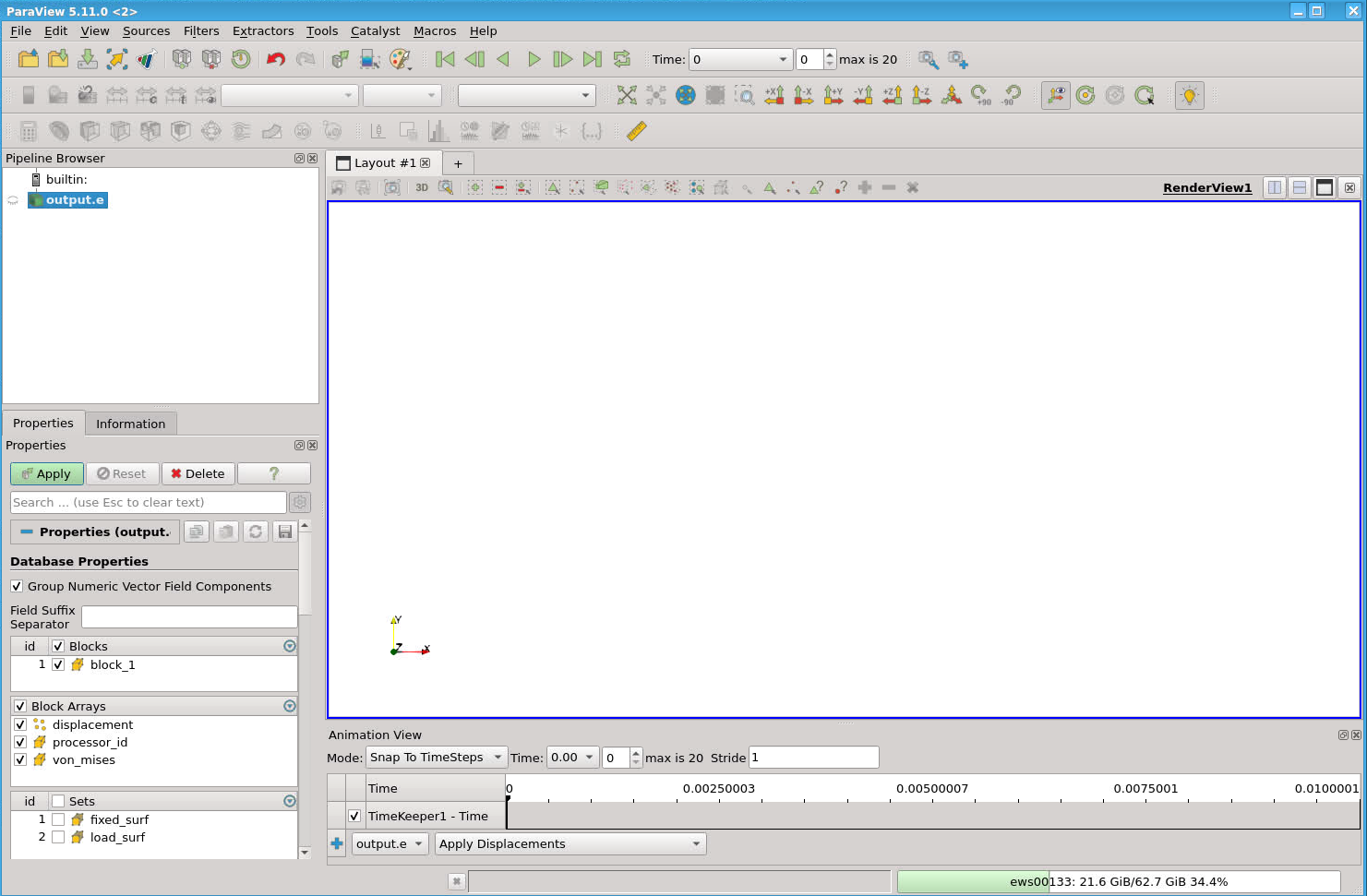
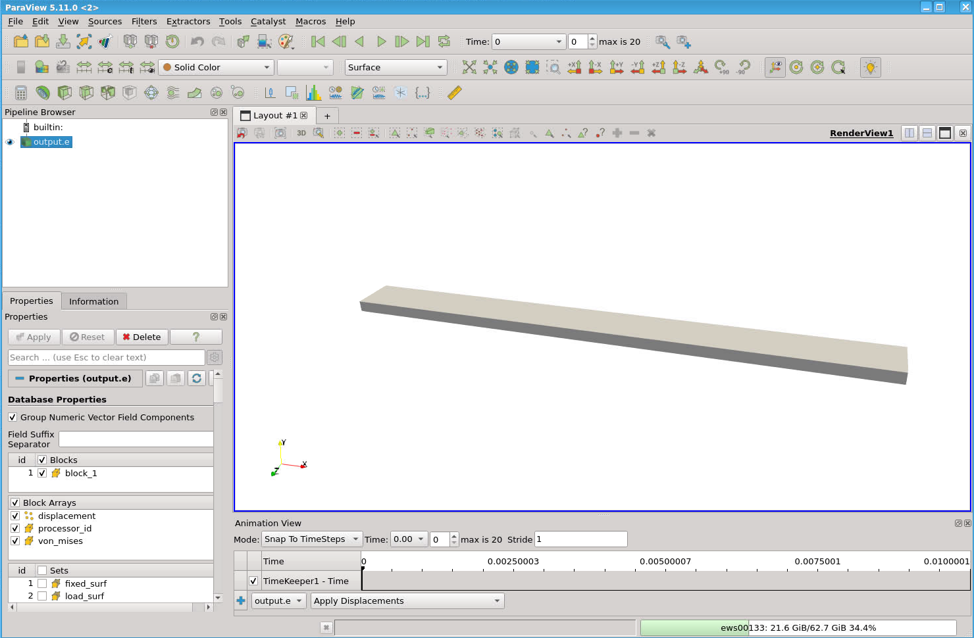
Viewing SIERRA/SM results in ParaView (2/2)
3. Click “Play” Button
7
6
4. Color model by “von mises” element variable
5. Rescale color map
6. Add mesh lines by selecting “Surface with Edges”
7. Use time controls to advance forward or backward in time
1. Click Apply
2. Left mouse “drag” to orient viewport
5
4

Slide 29
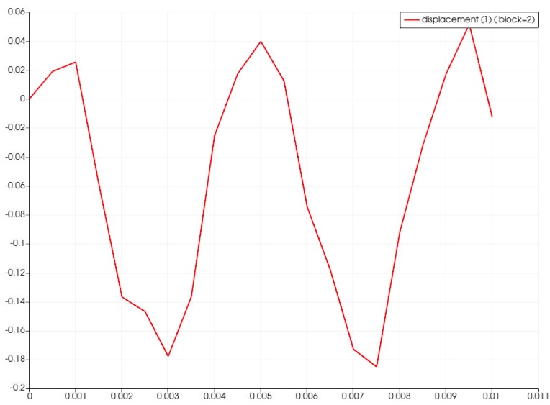
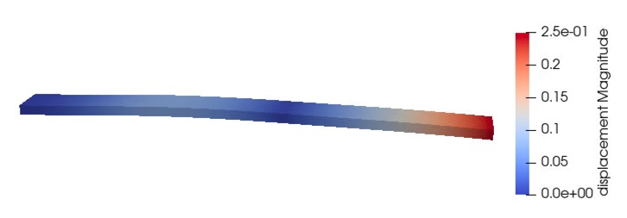
Interpreting the results
Was this the expected solution? Why is the solution wavy?
This Sierra/SM analysis solved for the (explicit) transient dynamics solution
  The time scale is quite short
  Dynamic stress/displacement waves result (like a “tuning fork”)
displacement at center of beam over time

Slide 30
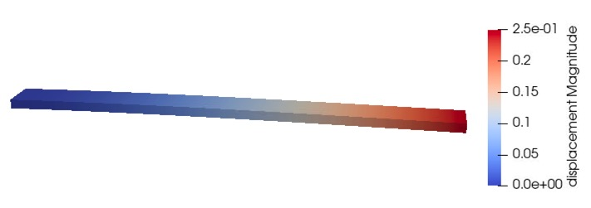
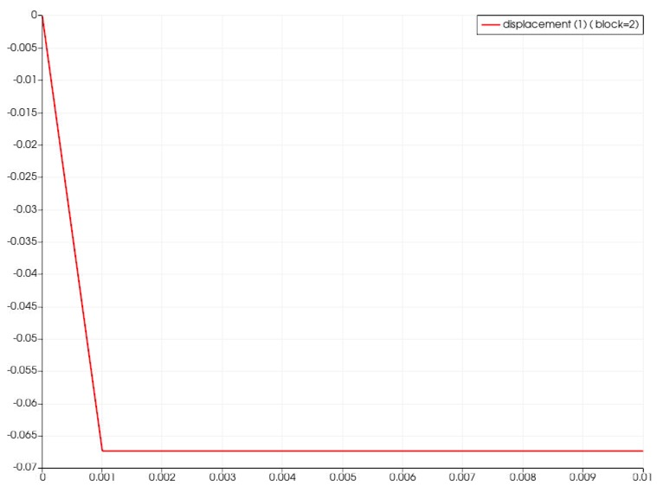
Solving for the static solution
Question: How do we get the (quasi-)static solution for bending of a cantilever beam?
Possible answers:
  Increase the time scale in the dynamics problem, and/or
  Increase the mass of the beam in the dynamics problem, and/or
  Add viscosity/damping terms in the dynamics problem; OR
  Tell SIERRA/SM to solve for the quasi-static solution
displacement at center of beam over time
Next slide!

Slide 31
Instructor demo: implicit quasi-statics in SIERRA/SM
Follow the instructor (but feel free to try applying what you learned)
The input file hello_cantilever_implicit.i has the following modifications:
  Implicit solver command block added to the adagio region scope
  Time-stepping changed to increment the load over 10 steps (helps the solver converge)
Launch adagio using this input file
Visualize the results file output_implicit.e in ParaView
﻿begin solver
begin cg
begin full tangent preconditioner
iteration update = 10
end
end
end
﻿begin time stepping block timeBlock1
start time = 0.0
begin parameters for adagio region my_region
number of time steps = 10
end
end
termination time = 0.01

Slide 32
SIERRA/SM fundamentals: Summary
A typical SIERRA analysis consists of a mesh file and input deck
  Mesh file – often generated using CUBIT; may pre-exist from other projects
  Input deck – created “by hand”, copy/paste from other input decks, or generated by a GUI (e.g. SAW)
Given an input (*.i) and mesh (*.g), launching and visualizing an analysis in parallel is as simple as:
Load multiple modules at once
Load
$ module load sierra viz
$ sierra –-np <num_procs> adagio -i <input_deck_file>
$ paraview <output_file>
Run
View
ASIDE: running SIERRA/SM on the Sandia HPC clusters
  Sandia HPC clusters require submitting analyses to a “Job Queue”
  The sierra script requires an <account> and <time-limit> for queueing on HPC resources
$ sierra --account <account> --time-limit <HH:MM:SS> --np <#> adagio ...

Slide 33
Hands-On Session 1: Pressure-Loaded Plate

Slide 34
In this session, we will:
Generate and visualize a mesh
Run an analysis
Review results in ParaView
Session 1: Pressure-Loaded Plate

Slide 35
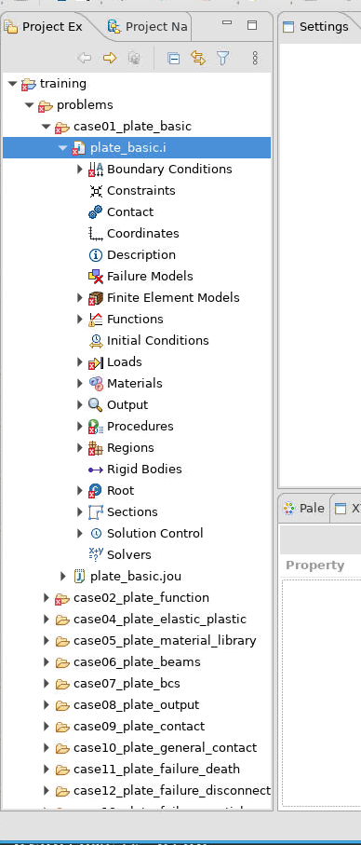
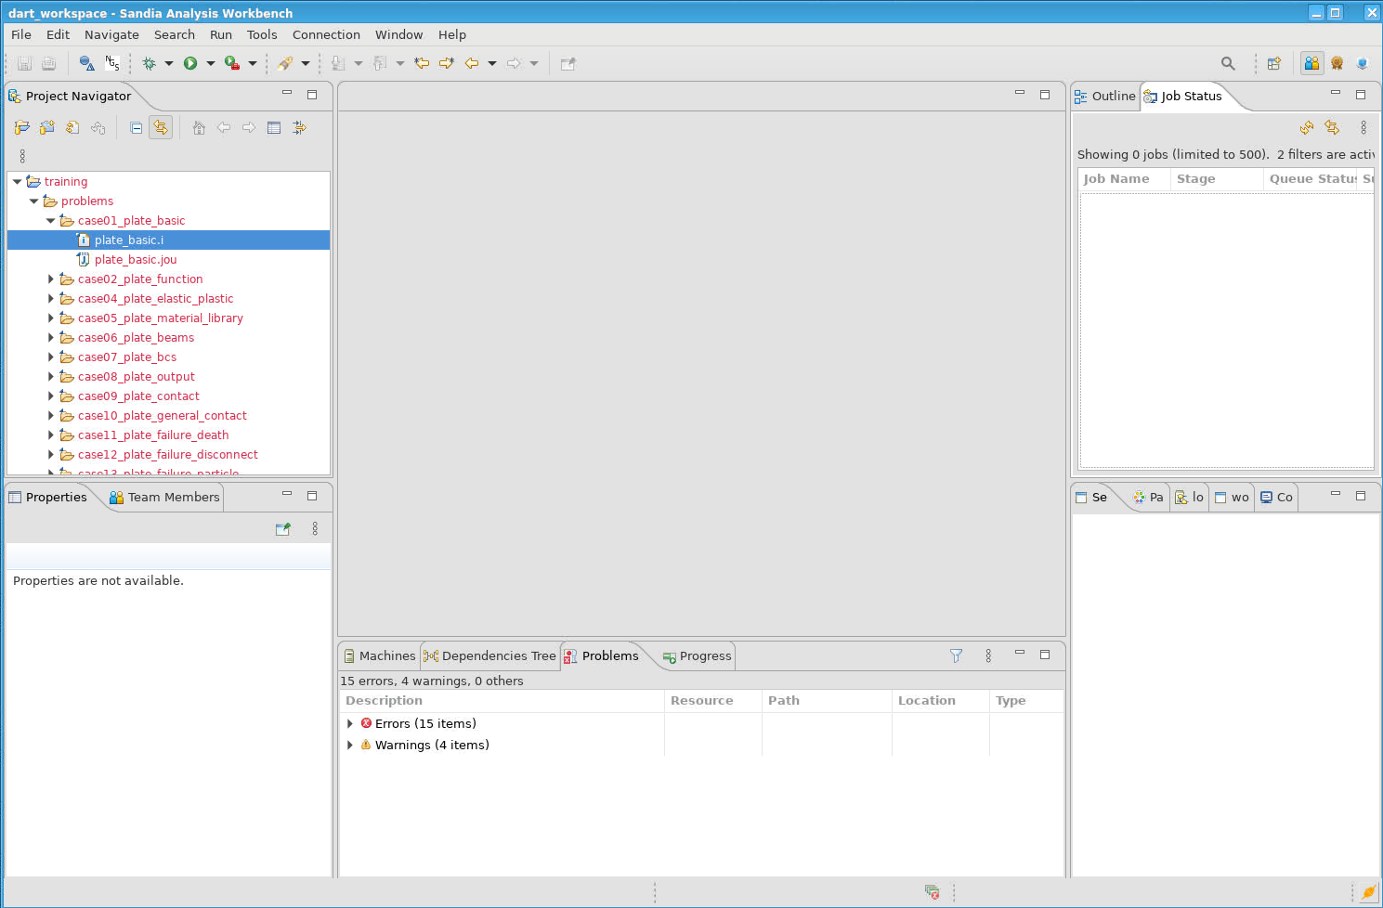
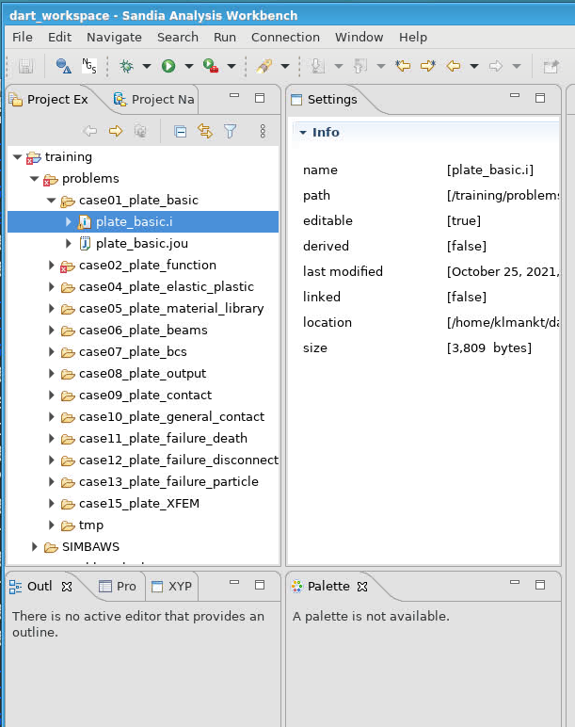
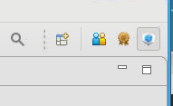
Session 1: SAW – Navigate to the Model Builder 2.0
Left-click Model Builder 2 icon in SAW to open the Model Builder “Perspective”
  The Model Builder Perspective opens
  The “Project Explorer” tab appears in the left window pane
  Re-arrange windows as desired.
Expand the input file plate_basic.i to see an outline of the contents

Slide 36
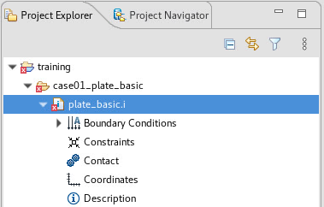
Session 1: plate_basic
Purpose: to revisit the fundamentals
Examine analysis input file in SAW (or choice of available text editor)
Run Sierra/SM analysis with the Sierra script
Run Sierra/SM analysis through SAW
Visualize results with ParaView
Double-click “case01_plate_basic/plate_basic.i”
Take some time to review this new input deck (plate_basic.i)
Find a couple of items we will revisit a little later:
Termination time = 1.0e-2
Constant pressure load with magnitude 50.0 on every element face in sideset 1002
Sideset (surface): A collection of finite-element faces, usually referenced by name or numerical ID
Notes:
Note: the SIERRA editor does not recognize “nodelist_1”, “nodelist_2”, etc. in the case01_plate_basic file.

Slide 37
Session 1: SAW vs. Terminal
Some users prefer a GUI (SAW) while others prefer command lines (terminal)
This session shows each step using both SAW and a terminal
For the sake of time:
  Everybody will perform the steps in SAW
  The instructor will demonstrate the alternative of using the terminal
Notes:
Note: the SIERRA editor does not recognize “nodelist_1”, “nodelist_2”, etc. in the case01_plate_basic file.

Slide 38
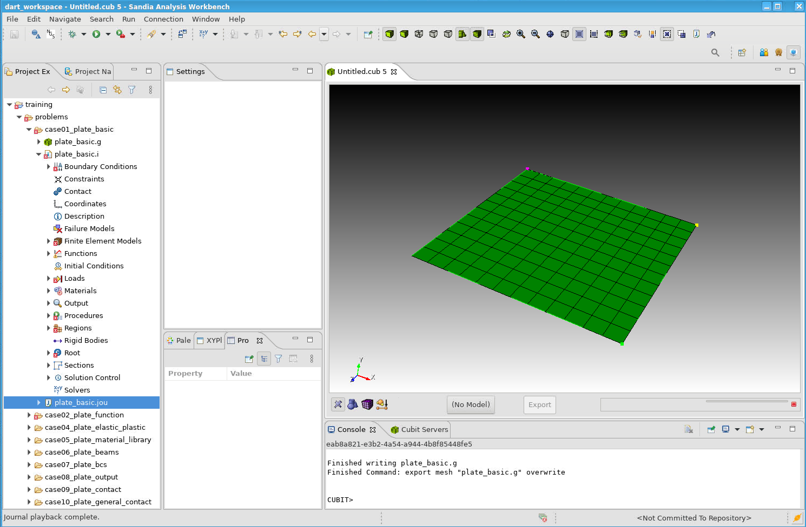
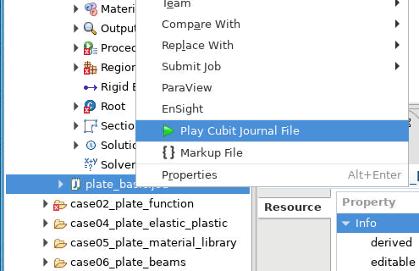

Session 1: SAW - Generating and visualizing a mesh
This example starts from an input file (*.i) and a Cubit journal file (*.jou)
Last training session we had a pre-existing mesh file (*.g); this time we will generate one
Generate a mesh by right-clicking plate_basic.jou and select Play Cubit Journal File
  An exodus mesh named plate_basic.g is generated in the working directory
  The new mesh appears in a Cubit window; rotate by click-and-drag to visualize
Notes:
If a popup asks for a server just click ok

Slide 39
Session 1: Terminal - Generating a mesh (without visualization)
Meshes can also be generated by calling Cubit through the terminal
Open a terminal window in SAW if you don’t have it open already
From adagio_training/training_plate_blast/problems, go to first example:
$ cd case01_plate_basic
List files in directory:
$ ls
plate_basic.i
plate_basic.jou
Before running input file, create mesh file (plate_basic.g):
$ cubit -nographics -batch plate_basic.jou
Same process can be applied to other training examples
Omit “-nographics -batch” to open the Cubit GUI for visualizing the mesh as it is created

Slide 40
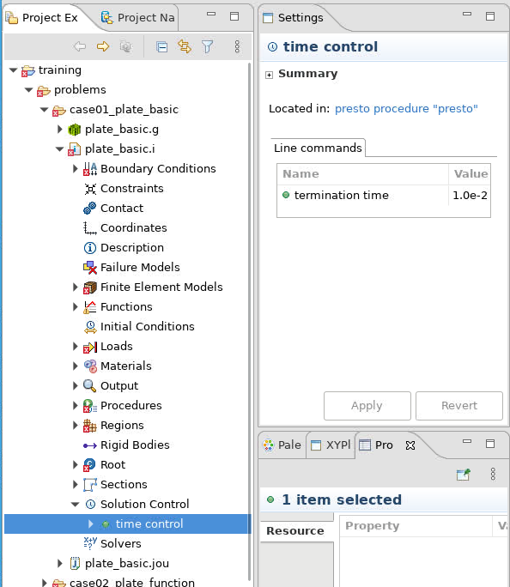
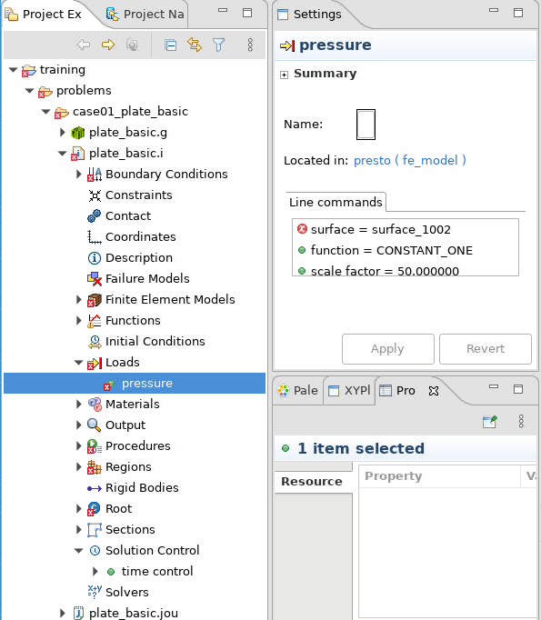
Session 1: SAW - Explore model
Expand plate_basic.i in Project Explorer tab
Expand Solution Control
Select time control node; details displayed in Settings view
Expand Loads
Select pressure node; details displayed in Settings view, and corresponding surface highlighted in Model View

Slide 41
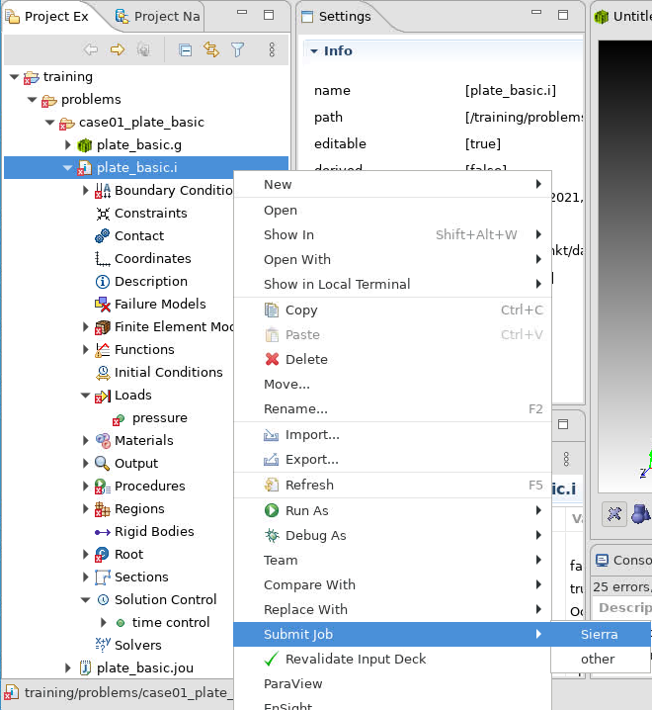
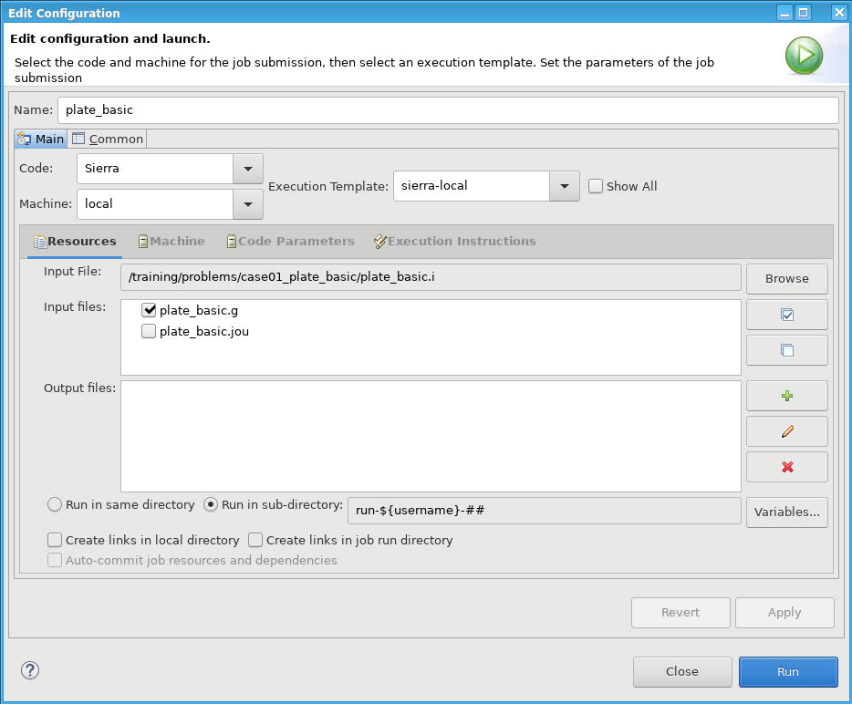
Session 1: SAW – Submit adagio run
Right click input deck plate_basic.i
  Select Submit Job > Sierra
  The job submission dialog box opens
Under Job Submission, set:
  Machine: local
  Execution template: sierra-local
  Select plate_basic.g under Resources
  Run in sub-directory
Select Run to launch the analysis
Select Yes to Show Job Status View

Slide 42
Session 1: Terminal – Submit adagio run
Same as we did for the cantilever beam example
After creating plate_basic.g mesh file, run local job:
$ module load sierra
$ sierra adagio -i plate_basic.i

Slide 43
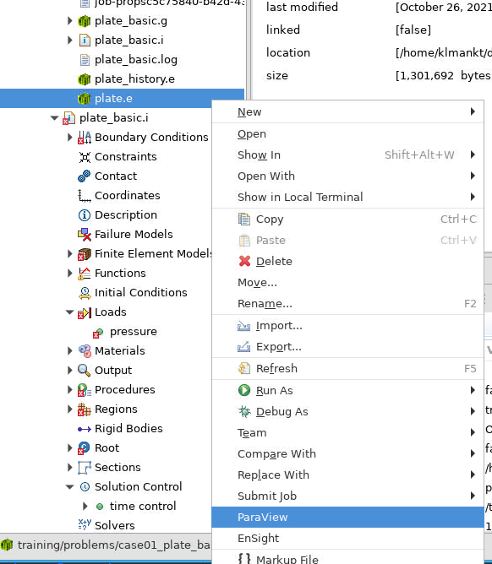
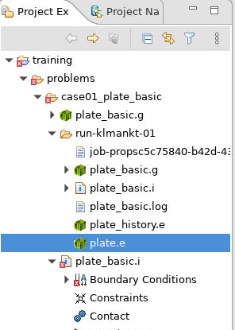
Session 1: SAW – Visualize output (*.e) with ParaView
Locate working directory in the Project Explorer. Expand to find plate.e
  (There are multiple ways to locate the files generated by the job submission)
Select plate.e file, right-click and select ParaView
Select Run in launch dialog
ParaView will now launch and load the result file

Slide 44
Session 1: Terminal – Visualize output (*.e) with ParaView
Alternatively, from terminal:
$ module load viz
$ paraview plate.e

Slide 45
Hands-On Session 2: Modified Input and Log File

Slide 46
In this session, we will:
Modify an input file
Visualize the model
Run analysis
Review log file
Session 2: Pressure-Loaded Plate
Modifying Input and
Parsing the Log File

Slide 47
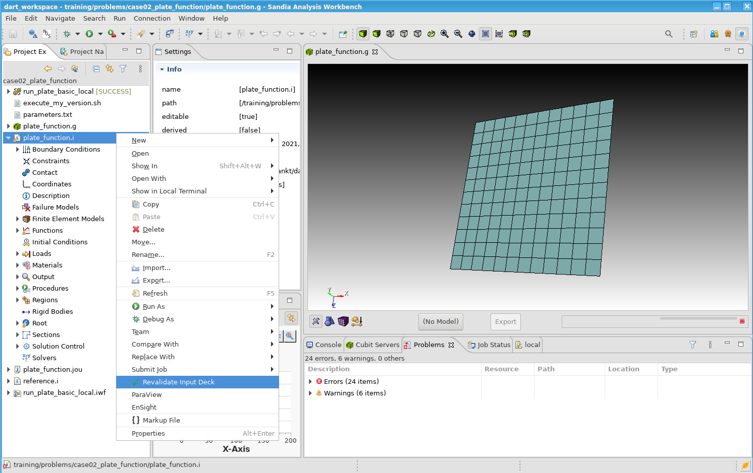
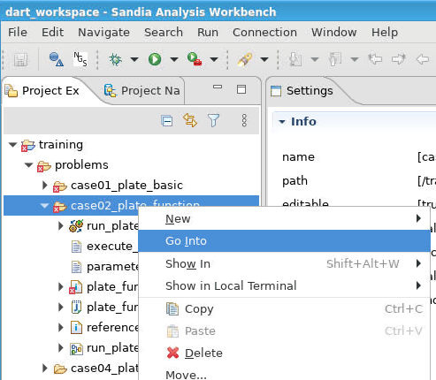
Session 2: SAW – Configure Case 2 in Project Explorer
Right-click case02_plate_function and select Go Into
Right-click plate_function.jou and Play Cubit Journal File to generate plate_function.g
Right-click plate_function.i and select Revalidate Input Deck
  This instructs SAW to recognize the newly-generated exodus file and resolve linkages between the mesh and input deck, such as boundary conditions.

Slide 48
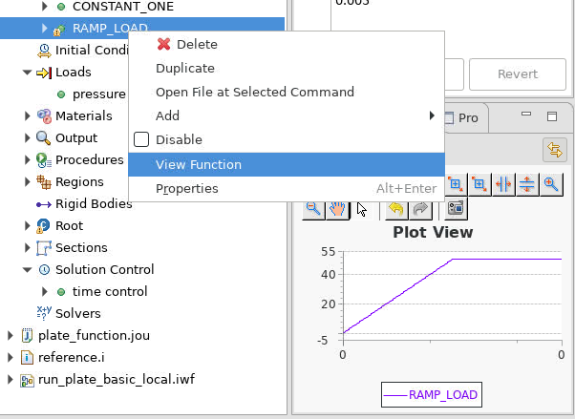
Session 2: SAW – Modify the Termination Time & Applied Pressure
Double-click plate_function.i to view the input
In Project Explorer, expand Solution Control, and select time control
Change termination time to 5.0e-3
In Project Explorer, expand Loads, and select pressure
Change pressure:
function = RAMP_LOAD
scale factor = 1.0
In Project Explorer, expand Functions and right-click RAMP_LOAD > View Function
Right-click input deck plate_function.i and select Submit Job > Sierra to run the simulation

Slide 49
Session 2: Sierra/SM Input File
begin time control
begin time stepping block period_1
start time = 0.0
begin parameters for presto region presto
step interval = 10
end
end time stepping block period_1
termination time = 5.0e-3
end time control
begin pressure
surface = surface_1002
function = RAMP_LOAD
scale factor = 1.0
end

Slide 50
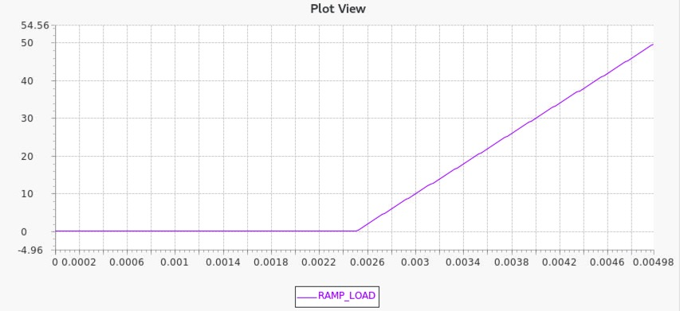
Session 2: Change the loading function
Try to change the ramp loading function to this:
Re-run the analysis and visualize this new solution

Slide 51
Session 2: SAW – Sierra/SM Log File
In Project Explorer, locate and double-click plate_function.log
Inspect the section after “Executing procedure”. This shows timestep, energies, CPU, time, etc.:
time – current simulation time
time step – current stable explicit time step
KE – current global value of kinetic energy
IE – current value of internal energy
EE – current value of external energy
ERROR % – shows current percentage of energy imbalance
Inspect the resource summary at end of log file:
Timing summary – where CPU time was spent
Memory summary – memory usage of analysis

Slide 52
Hands-On Session 4: Nonlinear
Materials

Slide 53
In this session, we will:
Modify input file
Run analysis
Compare input files
Session 4: Pressure-Loaded Plate
Nonlinear Materials

Slide 54
Session 4: Overview
Purpose: Demonstrate nonlinear material response
Define and use an elastic-plastic material model
Demonstrate SAW capability
  Select and insert a command block and options
  Compare two input files using SAW (to highlight differences)

Slide 55
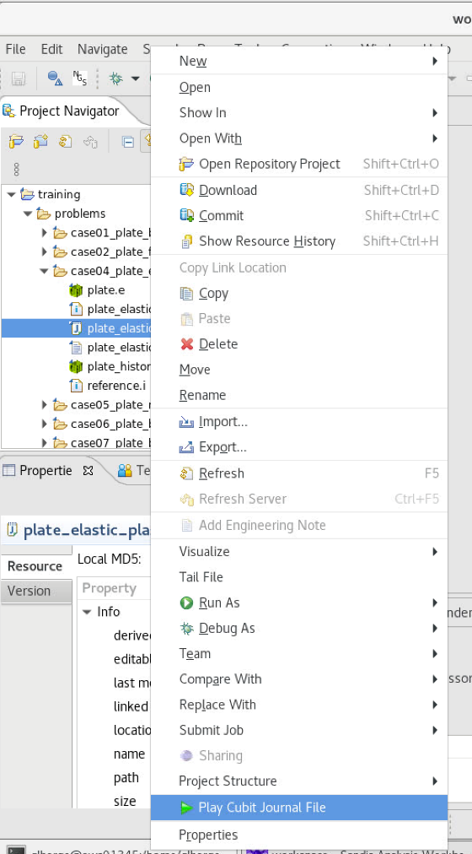
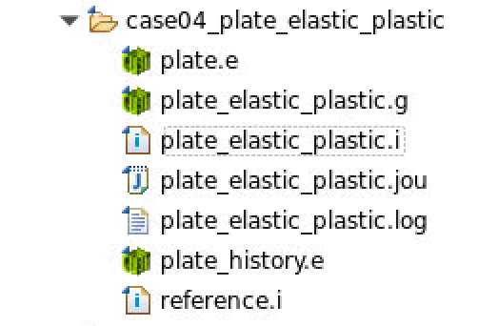
Session 4: SAW – Model building
Creating a new SAW model from the Case 4 training example files
Create mesh from CUBIT journal file by right-clicking plate_elastic_plastic.jou, then clicking Play Cubit Journal File
  Confirm that the mesh file plate_elastic_plastic.g was generated

Slide 56


Session 4: SAW – Model building
In Project Explorer node: left-click (expand) plate_elastic_plastic.i > Materials > material_100.
Right-click material_100 and select Add > parameters for model elastic-plastic. Select elastic_plastic inside material_100.
Right-click inside the Line commands window in the Settings view and Add the parameters shown:
Notes:
Optional: with each parameter, follow along with corresponding changes in the input file to the left of the outline. Eventually, editing the input file directly will be the fastest way for you to make changes!

Slide 57
Session 4: SIERRA/SM input file – Add elastic-plastic material
Add material definition for elastic_plastic material:
############### Material Definitions ########################
begin material material_100
density=0.000259
begin parameters for model elastic
youngs modulus=1e+07
poissons ratio=0.33
end parameters for model elastic
begin parameters for model elastic_plastic
beta = 1
poissons ratio = 0.33
yield stress = 45.0e3
youngs modulus = 10.0e6
hardening modulus = 28695
end parameters for model elastic_plastic
end material material_100

Slide 58

Session 4: SAW – Model building
Associate Block 13 with the material model
  Navigate to plate_elastic_plastic.i > Finite Element Models > fe_model.
  The Settings view will show a table. (If there is no table, you may need to generate the mesh file).
  In the model column, select elastic_plastic for block_13 and click Apply.
Check that the following parameters block was added to block_13:
Begin parameters for block block_13
section = SHELL_13
material material_100
solid mechanics use model elastic_plastic
End parameters for block block_13

Slide 59



Session 4: SAW – Model building
Save input file (CTRL+S; Save toolbar button; or File->Save)
Compare input file before/after changes to see history; Select a version to compare
Added lines
Changed Lines

Slide 60


Session 4: SAW – Model building
Run SIERRA input deck by right-clicking on plate_elastic_plastic.i and clicking Submit Job and Sierra. Select the options shown with arrows below. Run.

Slide 61

Session 4: SAW – Model building
Once job runs to completion, browse to the bottom of plate_elastic_plastic.log file to confirm successful completion.

Slide 62
Hands-On Session 5: Material Management

Slide 63
In this session, we will:
Modify an input file
Run an analysis using SIERRA/SM
Review results in ParaView
Session 5: Pressure-Loaded Plate
Material Management and
Introduction to Aprepro

Slide 64
case05 plate material library
Goal: Learn to manage multiple material definitions, and introduce Aprepro syntax
  Nonlinear material models are given in separate file
  “Include” the file’s contents with Aprepro and then use material models in that file
  Plan:
  Add a material library
  Use the elastic plastic power law hardening model (from material model library) for the plate
  Add hourglass control
  Modify time-stepping

Slide 65
Case 5: SIERRA/SM input file
Inspect material_100_UC2models. This file contains the following specifications for material MAT_100_IPS:
Begin parameters for model elastic plastic
youngs modulus = 10.0e6
poissons ratio = 0.33
yield stress = 45.0e3
beta = 1.0
hardening modulus = 28695
End parameters for model elastic plastic
Begin parameters for model ep power hard
youngs modulus = 10.0e6
poissons ratio = 0.33
yield stress = 45.0e3
hardening constant = 1.0e4
hardening exponent = 0.25
luders strain = 0.002
End parameters for model ep power hard
Define as many material models as you need, including EOS models
(if using presto_itar).

Slide 66


Case 5: SAW – Include a material model library
Add the include statement in the input file.
  Open the input file by double-clicking case05’s plate_material_library.i
  On a new line after the “begin material material_100” block, after “end material material 100”,
    Type the string {include(“material_100_UC2models”)}. (Check no non-ASCII quotes!) Save.
  In Project Explorer: Two new material models should appear under Materials
  Generate the mesh using the included journal file (“plate_material_library.jou”).
  Associate block 13 with the MAT_100_IPS and the ep_power_hard model. Apply. Save.
Notes:
Be careful of copying code snippets from Microsoft Powerpoint or Word – often likes to convert quotes and double dashes to NON-ASCII Characters, which Sierra syntax does NOT allow. When in doubt just type in, don’t copy-paste these characters.

Slide 67
Case 5 (optional): SIERRA/SM input file – Include a material model library
########## Material Definitions ###########
Begin material material_100
density = 0.000259
Begin parameters for model elastic
youngs modulus = 1.0e7
poissons ratio = 0.33
End parameters for model elastic
Begin parameters for model elastic_plastic
beta = 1.0
hardening modulus = 28695
poissons ratio = 0.33
yield stress = 45.0e3
youngs modulus = 10.0e6
End parameters for model elastic_plastic
End material
{include(“material 100 UC2models”)}
...
Begin parameters for block block_13
section = SHELL 13
material MAT_100_IPS
solid mechanics use model ep_power_hard
End parameters for block block_13
Use the elastic plastic power law hardening material model.

Slide 68

Case 5: SAW - Use Aprepro to help parameterize your input file
Aprepro provides a script interface to perform text substitutions and basic mathematical operations in the input deck.
Adding hourglass control parameters with Aprepro. Define Aprepro parameters in SAW:
  In Project Explorer: Expand Finite Element Models > fe_model > block_13. Select block_13.
  In Settings tab, right-click inside Line Commands box > Add > hourglass. Select viscosity in drop-down menu. Set the value to 0.001.
  Right-click the field and select create parameter. Name the parameter hg_param.
  Add another hourglass parameter. Select stiffness. Set the value to {10.0*hg_param}.
Notes:
Currently create parameter is missing in SAW dev – may need to stop at step 2.
If this is the case, the next slide shows what you can just copy and paste into the input file instead! No worries!

Slide 69
Case 5 (optional): Edit SIERRA/SM input file directly - Use Aprepro to help parameterize your input file
Aprepro provides a script interface to perform text substitutions and basic mathematical operations in the input deck.
#{hg_param = 0.001}
...
Begin parameters for block block_13
section = SHELL_13
material material_100
solid mechanics use model ep_power_hard
hourglass stiffness = {10.0*hg_param}
hourglass viscosity = {hg_param}
End parameters for block block_13
Add hourglass control parameters using an Aprepro parameter.

Slide 70


Case 5: SAW – Add a time-stepping block
Navigate to time control
  Project Explorer tab > Expand Solution Control > time control
Right-click time stepping block “period_1”. Duplicate.
  In editor, change the duplicated time period block to “period_2” in begin/end lines
  Add a start time and set to 1.0e-4
Expand period_2 in Project Explorer
  Select parameters for presto region “presto”
  Change the step interval to 50
period_1
period_2
Start = 0.0
t=1.0e-4
Terminate = 0.01

Slide 71
Case 5 (optional): Edit input file directly – Add a time-stepping block
Add period_2, a new timestepping block:
begin time control
begin time stepping block period_1
...
end time stepping block period_1
begin time stepping block period_2
start time = 1.0e-4
begin parameters for presto region presto
step interval = 50
end parameters for presto region presto
end time stepping block period_2
termination time = 1.0e-2
end time control
Return to full Courant-limit timestep at time t=0.1 ms (in period_2).
Output to logfile every 50 timesteps (default 100).
Notes:
default timestepping is full element-based critical time step estimate, based on an estimate of the CFL condition calculated with the effective material moduli
see theory manual for details on how each of the different timestep options is selected/calculated in SIERRA/SM
step interval for output – default is every 100 steps
data logged is: info about the current time step (including wall-time it took to compute the step), the current internal and external energy, and the kinetic energy.

Slide 72
Session 5: SAW – Request more timesteps in results output
plate_material_library → Sierra Solid Mechanics → Output → results output
  Select at time 0.0 increment.
  Set increment to 1.0e-4.
Right click plate_material_library.i -> Submit Job -> Sierra
Submit job and open results in ParaView.

Slide 73
Case 5 (optional): Edit input file directly – Request more timesteps in results output
Go to begin results output block:
begin results output exo_out
database name = plate.e
database type = exodusII
at time 0.0, increment = 1.0e-4
...
Outputs selected variables to Exodus file every 0.0001s
(until another at time t, .. where t>0.0).
Alternatively, try
at step 0, increment = 100
Or try both!
See User’s Manual for all output options and tips. Note, heavy output may slow performance.
Notes:
default timestepping is full element-based critical time step estimate, based on an estimate of the CFL condition calculated with the effective material moduli
see theory manual for details on how each of the different timestep options is selected/calculated in SIERRA/SM
step interval for output – default is every 100 steps

Slide 74

Session 5: Paraview – Visualize results
[From Paraview] File → Open. Navigate to plate.e
View history plot of global variables (energies):
  Filters →Data Analysis →Plot Global Variables Over Time→Apply
  Or, Ctrl + <spacebar> → type “Plot Global Variables” and select Plot Global Variables Over Time
  Click Apply in Properties tab
To view energy variables only (EE,IE,KE) :
  Scroll down to Series Parameters in Properties
  Unselect (by mouse click) ‘momentum_ ’ and ‘tstep’
  Pan/Zoom with mouse buttons in the LineChartView

Slide 75
Hands-On Session 9: Introduction to Contact

Slide 76
In this session, we will:
Modify an input file
Run analysis
Review results in ParaView
Session 9: Pressure-Loaded Plate
Introduction to Contact

Slide 77
Session 9: plate_contact
Goal: Model contact between plates
Plan:
Create contact definition
Define contact surfaces
Add side a / side b interaction
Submit job and view results
Note 1: Additional target block already added to input deck and mesh
Note 2: Boundary conditions already altered to quickly demonstrate contact
How objects should contact each other; which surfaces contact, algorithm options
Define which parts of the mesh might contact? All of them (slower)?
“Side B” is constrained to not penetrate “Side A”

Slide 78


Session 9: SAW – Contact surfaces
Select Project Explorer from Model Builder 2.0
Build the mesh
Expand case09_plate_contact, then plate_contact.i
Right-click Contact and
Add > Contact Definition
In Settings, choose a name or leave default
In Settings, right-click in Line commands and Add > contact surface
  Name surf_1 that contains surface_1001
  Name surf_2 that contains surface_2001

Slide 79

Session 9: SAW – Contact interaction
Right-click contact - name and Add > interaction
  Right-click in Line commands, then Add > side a and enter surf_2
  Right-click in Line commands, then Add > side b and enter surf_1
Submit job and open results in ParaView

Slide 80
Session 9: Contact definition in Sierra/SM input file
begin gravity
...
end gravity
begin contact definition contact_name
contact surface surf_1 contains surface_1001
contact surface surf_2 contains surface_2001
begin interaction interaction_name
side a = surf_2
side b = surf_1
end interaction
end contact definition

