Slide 1

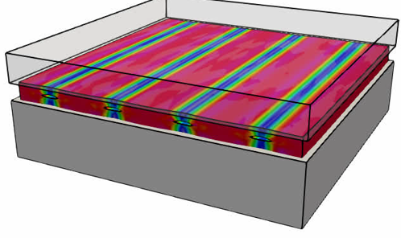
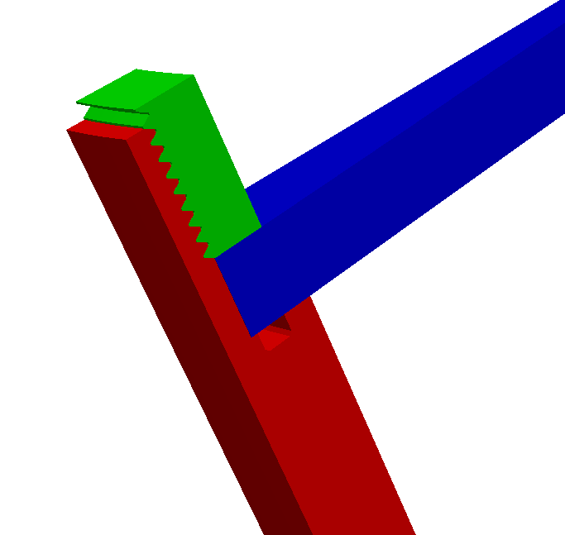
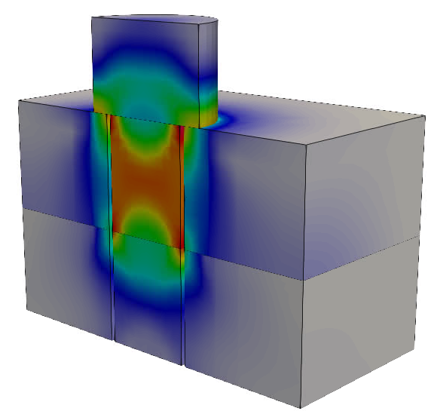

SIERRA204:
SIERRA/SM Preload Analysis
Preloading Techniques for Practical Analysis
SIERRA Solid Mechanics Team
Presented By: Kevin Manktelow, 8755
Scott Gampert, 9376
Date: March 26-27, 2025
Location: SNL/CA, Building 926/Room 249
SAND2024-15760PE

Slide 2
Release Notes
Date | Slide Version | Current Release | Notes
10/7/2024 | 0.8 | 5.20 | Initial version
10/30/2024 | 0.9 | 5.22 | First draft complete for Nov. training
11/11/2024 | 1.0 | 5.22 | Final revision for Nov. training
3/12/2025 | 1.0.1 | 5.22 | Minor edits for March 2025 training

Slide 3
Course Description
This is an in-person course to introduce solid mechanics analysts to preloading in the SIERRA/SM finite element code. We take a hands-on approach where users will run practical examples throughout, supplemented by discussion. The course begins with an overview of preloading and the effects of preload. We then explore a few common topics including automatic bolt preloading in implicit and explicit analyses, as well as preloading pads and gaskets. The course concludes with workflow-related preload topics such as saving and re-using preloads, and multi-step analyses with procedural transfers. We hope that the training provides new users with the skills and confidence to approach preload analysis tasks in SIERRA/SM, while experienced users may gain a new perspective on their existing analysis techniques or learn details about features they may already be using.
Nominal Course Outline
Day 1: (5 hours, ~70 slides, ~7 examples)
Class introduction
Overview of preload and effects
Preloading fasteners
Day 2: (5 hours, ~70 slides, ~7 examples)
Preloading pads and gaskets
Advanced workflows involving preload
Conclusion & special topics (as time permits)

Slide 4
Class survey
By a show of hands …
How many years have you been using SIERRA/SM?
- 0-2 years
- 2-5 years
- 5+ years
What preload topics are most important to you?
- Bolts & fasteners
- Pads, gaskets, and flat things
- Something else

Slide 5

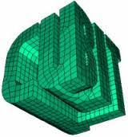
Prerequisites
Previous SIERRA experience (SIERRA100 level)
Read/understand a SIERRA input deck
Execute SIERRA/SM (adagio)
Visualize results (ParaView/EnSight)
Applications used throughout training
SEACAS
module load seacas
Software familiarity
Linux environment or Workbench (edit input decks, run code and visualize results)
SIERRA
module load sierra
ParaView
module load viz
CUBIT
<no module needed>
You are welcome to execute the examples using SAW or a Linux terminal as desired

Slide 6
Class overview
We take a practical approach
Minimal (but sufficient) theory to introduce and anchor concepts
Examples of syntax and their connection to theory
Hands-on examples throughout the course
  May sacrifice realism/correctness/accuracy for speed
  Are mostly ready-to-run, and often contain suggestions for further exploration
  Help us explore tangential code features
Tips, tricks, and commentary on practical usage interleaved throughout
Class materials are mostly standalone, but are intended to be accompanied with live presentation and discussion.

Slide 7
MODULE 1:
What’s Preloading?

Slide 8
Section overview
We will …
Learn why we care about preloading
Learn about a few different ways of preloading
See how preloading can affect our results

Slide 9

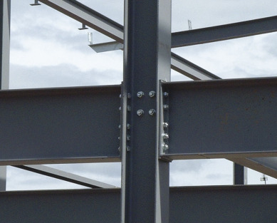
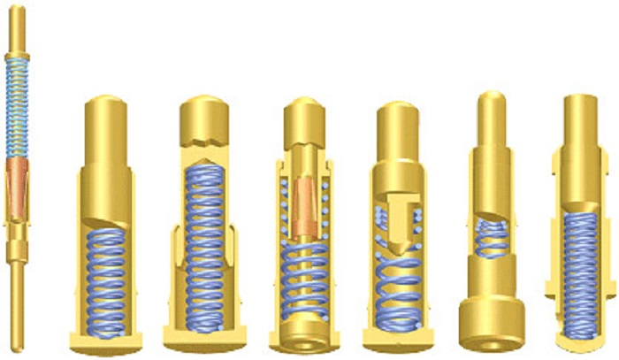
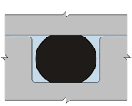
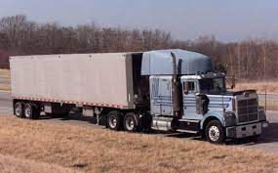
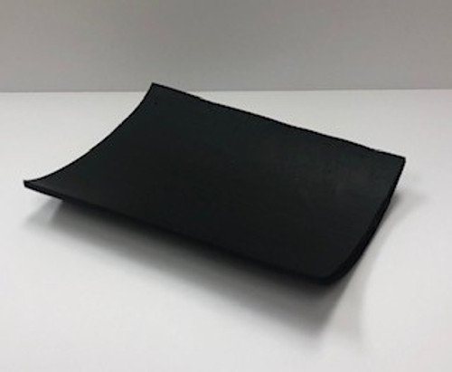
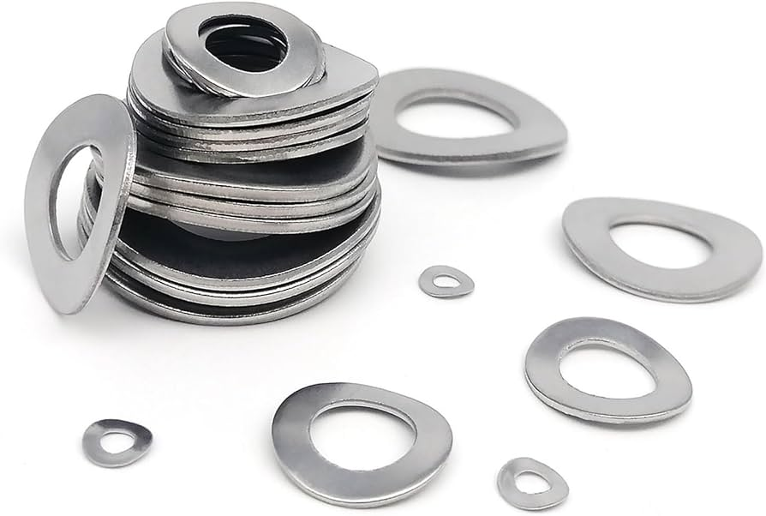
What is preloading, and where do we see it?
Pre-tensioned elements
Bolted joints
Spring-loaded components
Gravity preloads
O-Rings and seals
Spring washers
Pads & gaskets
Preloads come from self-equilibrating stresses and often arise from geometry interference or static loads such as gravity.

Slide 10
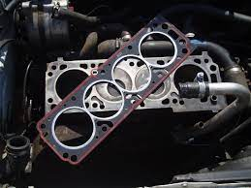
Preload can be split into types (for discussion purposes)
(harder to model)
(easier to model)
Geometry interference-fits
Guitar string
Fasteners – screws, bolts, nails
O-Rings
Pads and gaskets
Static & quasi-static loads
Gravity (e.g. shock isolator or engine mount)
Pressure vessels (GTS reservoir)
Other (Point loads… etc.)
Require “normal” quasi-static solution methods to solve the forward problem:
Apply a load, get the solution.
Require geometry-based solution methods: straining, prescribed deformation, or physical assembly modeling.
(All quasi-static)
Gasket compressed by a series of fasteners
Engine head gasket
In practice, applications or individual joints may include multiple elements or elements from each category. For example, a pad and bolt may become simultaneously preloaded.

Slide 11
Preloading methods
There are a variety of techniques and strategies to introduce preload into a system. In no particular order:
Static loading (gravity, uniform pressures, etc.)
Non-material strains (thermal strains, artificial strains)
Specialized preload algorithms (bolt preload)
Kinematic boundary conditions (direct assembly of parts)
Initial overlap method (use contact solve to assemble)
Implicit quasi-static (preferred solver strategy)
Explicit quasi-static (for difficult nonlinearities, with caution and limits)
Custom user subroutines (the sky’s the limit…)
The strategies to preload are unique to the application, which can be a lot to learn!

Slide 12
Disclaimer
The following first example is deceivingly simple.
We’re going to use this example for exploration and demonstration only.
We will follow up with more specialized examples to learn about individual features in more detail.

Slide 13
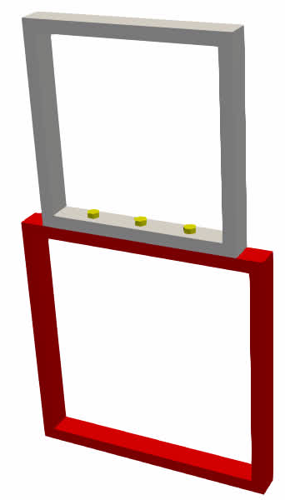
Example 01: Basic preloading with SIERRA
Fixed BC
This test frame will eventually be used to hold a 50lb widget.
The test engineer wants to make sure the bolt loads don’t exceed 180lb.
Are the bolts within a safe range?
50lb
Force
Time
Load placement is simulated as a ramp of weight over time
50 lb
Widget

Slide 14

Example 01: Basic preloading with SIERRA
Directory: ./ex01_preload_matters/
View the input file preload_effects.i. (a) Locate the begin preload command syntax (first procedure). (b) Locate the begin distributed force command (second procedure). (c) Locate the begin procedural transfer commands.
Run the input file.
>> adagio -i preload_effects.i
Plot the net bolt force over time.
>> paraview output_load.e
[ Apply PlotGlobalVariablesOverTime filter ]
[ Select “net_bolt_force” variable ]
Does the initial preload force make sense? Does the peak value make sense?
Estimate the resulting peak bolt force if the initial preload was 100lb.
50 lb
Worth exploring: Use CUBIT to separate the bolts into three separate blocks, and then modify the input deck to preload each bolt individually. Compute and plot the net force in each bolt individually.

Slide 15
Example 01: Results and discussion – the input deck
begin adagio procedure adagio_proc_preload
...
begin adagio region adagio_region_preload
begin preload
preload bolt bolt_shank to target internal force = 10.
end preload
# other BCs ...
end
end
Procedure #1: Preload the bolts
Has its own output file
Preload is simple and powerful
May use BC’s specialized for preload (e.g. remove rigid body modes)
begin adagio procedure adagio_proc_load
begin procedural transfer
include all blocks
end
...
begin adagio region adagio_region_load
begin distributed force
...
end distributed force
# other BCs ...
end
end
Procedure #2: Apply a load
Transfer into a new procedure is simple
Preload is maintained across the transfer and should not be re-defined.
Has its own output file
May change solver (explicit <---> implicit)
May update boundary conditions

Slide 16
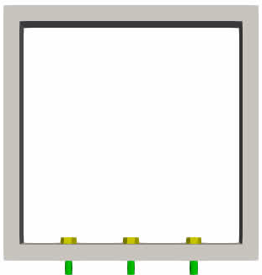
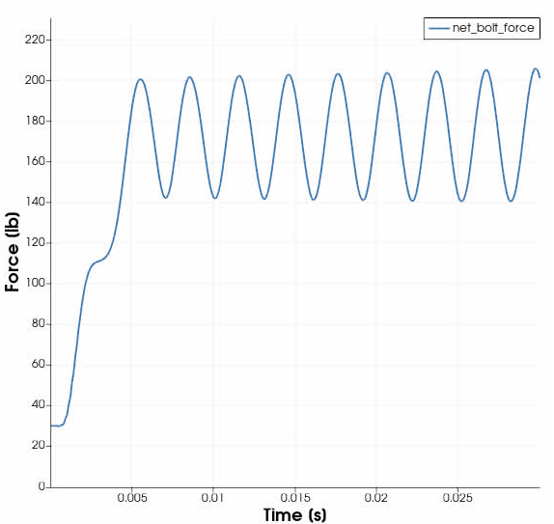

Example 01: Results and discussion – forces @ 10lb/bolt
You might have considered something like this
Peak force (~200 lb)
Quasi-static solution
~170 lb
(preload) 3x10 lb
(load) + 50 lb
(net bolt force) 80 lb
Load fully applied @ t=0.005
Initial preload (30 lb, 3 bolts @ 10lb)
50 lb distributed

Slide 17
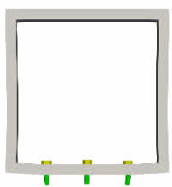
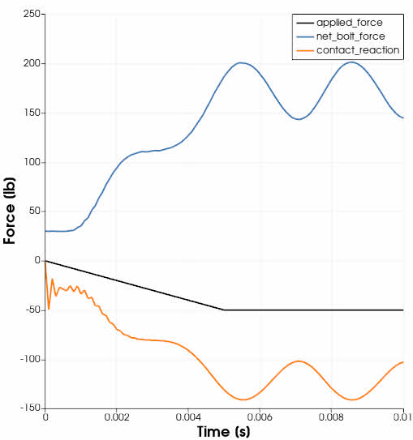

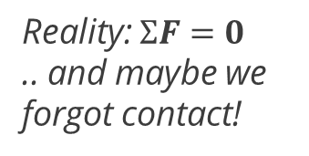
Example 01: Forces @ 10lb/bolt preload
Reality: $ΣF=0$
.. and maybe we forgot contact!
Bolt forces
~10 lb
Regrettable contact algorithm noise from the procedural transfer + implicit dynamics
~95 lb
Applied load
(applied load) -50 lb
(bolt forces) 200 lb
(contact) - 150 lb
0 lb
Contact forces on bottom block
50 lb distributed
Bolt forces nonuniform and change by ~3x applied loads
Contact clamping forces change by ~2x applied loads
Displ. x200

Slide 18
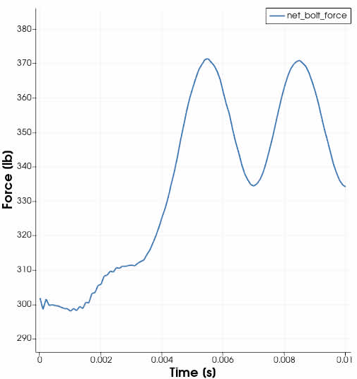
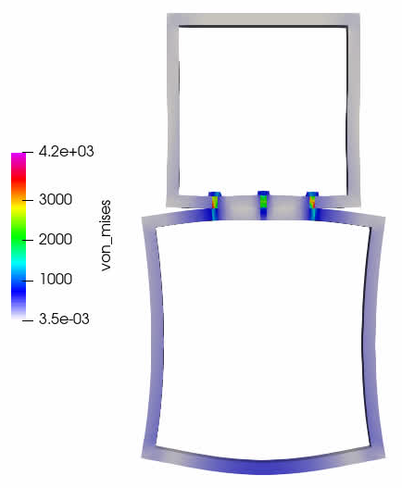
Example 01: Forces @ 100lb/bolt preload
Quasi-static solution
~350 lb
~50 lb
Load fully applied @ t=0.005
Initial preload (300 lb, 3 bolts @ 100lb)
Bolt forces more uniform and change by ~1x applied loads
(Contact clamping forces approximately unchanged)
Displ. x200

Slide 19
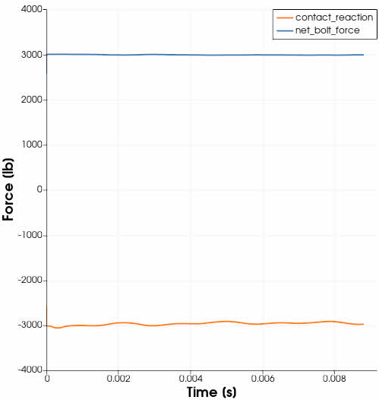
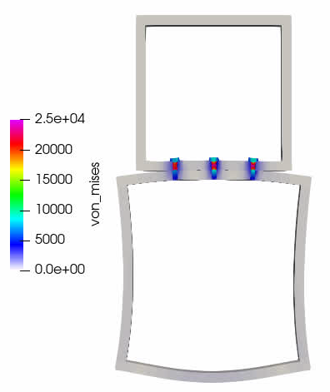
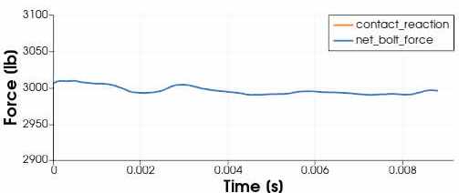
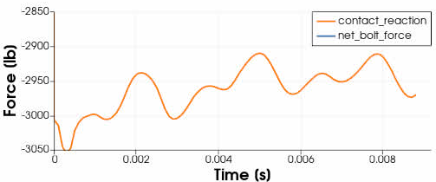
Example 01: Forces @ 1000lb/bolt preload
Bolt forces uniform and do not change (much)
Displ. x200
Contact clamping forces change by ~1x applied loads

Slide 20
Preload introduces complex phenomena
The effects of preload can be complex:
Implications on fatigue analyses (stress cycle amplitude)
May be coupled with geometric effects (contact-dependent deformations)
Fraction of load shared between joint members and bolt can be difficult to predict
But, applying the preload to study these effects is relatively easy!
begin preload
preload bolt bolt_shank to target internal force = 10.
end preload
Next, we’ll look at how some of this actually works.
Initial preload has considerable influence on the behavior of bolted joints, which could be an entire class in itself!

Slide 21


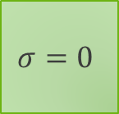
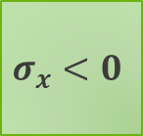
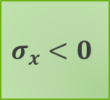

Preloading with “artificial strain”
$$u(t)$$
Change to a fixed boundary
(zero velocity)
The “forward problem:”
Mimics physical assembly or construction, starting with initial geometry. Use knowledge of assembly process (displacements).
$$σ_{x}=0$$
$$E, ν$$
$$σ_{x}<0$$
Apply displacements
Initial position
Final position
Boundary conditions remain unchanged
The “reverse problem:”
Start with an assembled geometry and changes it to arrive at initial geometry.
$$σ=0$$
$$σ_{x}<0$$
Apply “strains”
$$ε(t)$$
Consider the differences & similarities in the final displacement, strain, stress, and MASS.

Slide 22


What does “artificial strain” actually do?
Think of Artificial Strain as a generalized “thermal strain”
(but you don’t have to hijack temperature!)
Lookup strain
Thermal strain
Change
temperature
$$ε_{th}$$
Apply strain
$$Temperature$$
Artificial strain
L
L
Apply strain
L
2L

Slide 23




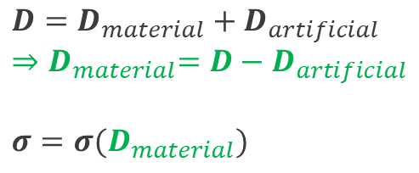




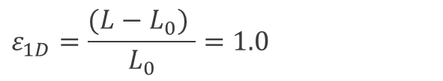

What does “artificial strain” actually do?
(1) Suppose we want to expand this cube by 100%:
L
L
$$ε_{1D}=\frac{(L−L_{0}) }{L_{0}}=1.0$$
(in this example)
L
2L
(2) The user provides strain over time:
(3) We compute a rate of deformation for the artificial strain
(4) Evaluate the constitutive model with only the “material” rate of deformation
$$ε_{n+1}$$
$D$: Rate of deformation tensor
$$ε_{n}$$
$$Strain$$
$$D_{art}≡\frac{ε_{n+1}−ε_{n}}{Δt}$$
$$D=D_{material}+D_{artificial}$$
$${⇒D}_{material}=D−D_{artificial}$$
$${σ=σ(D}_{material})$$
$$Δt$$
$$t_{n}$$
$$t_{n+1}$$
$$Time$$

Slide 24
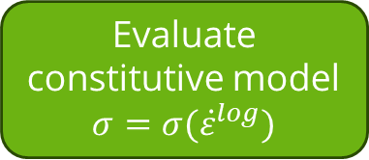
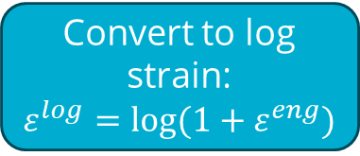

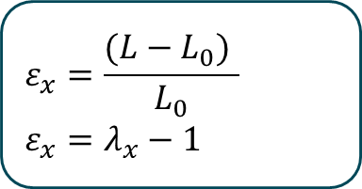
An example calculation in 1D: strain evaluation
Generalizing this concept to 3D is only slightly more complicated and involves an eigenvalue solution to determine principal directions
L
L
L
2L
Convert to log strain:
$$ε^{log}=log(1+ε^{eng})$$
User-input strain function
Engineering
$$ε_{x}=\frac{(L−L_{0}) }{L_{0}}$$
$$ε_{x}=λ_{x}−1$$
Engineering or Log strain?
Compute strain rate ${\dot{ε}}^{log}$
Log
Evaluate constitutive model
$$σ=σ({\dot{ε}}^{log})$$
Stretch
When specifying artificial (or thermal) strain, users are required to describe the strain measure

Slide 25
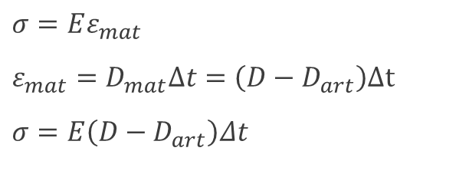

An example calculation in 1D: stress evaluation
L
L
$$ε_{1D}=\frac{(L−L_{0}) }{L_{0}}=1.0$$
(in this example)
L
2L
Dynamic solution: we’ll have a nonzero compressive stress!
$$σ=Eε_{mat}$$
$$ε_{mat}=D_{mat}Δt=\left(D−D_{art}\right)Δt$$
$$σ=E\left(D−D_{art}\right)Δt$$
Nominal elastic material in 1D
Material strain rate
Static solution: with no external forces, we’ll iterate until we have force balance (no stress)
Substitute in for strain
$D=0$ for first explicit step
$D= ?$ for first implicit step
*Evaluate stress, then solve (explicit or implicit)
* We’re being intentional to avoid time stepping and stress update algorithm details. For additional details on the stress update algorithm, the reader is referred to the SIERRA/SM and Lame user manuals that can be found at adagio.sandia.gov. For example, section 4.1 details hypoelastic constitutive models and unrotated stress for an elastic model: $σ_{ij}^{n+1}=R_{ik}^{n+1}R_{mk}^{n}σ_{mn}R_{nl}^{n}R_{jl}^{n+1}+λδ_{ij}ΔtD_{kk}+2μΔtD_{ij}$

Slide 26
The “artificial strain” boundary condition
Define what object(s) get strained.
Artificial strain syntax (region scope)
begin artificial strain
#
# Entity selection
#
include all blocks
block = <string_list>block_names
remove block = <string_list>block_names
#
# Standard strain definitions
#
strain type = log|engineering(engineering)
function = <string>function_name [scale factor = <real>scale]
direction <string>dir_name function = <string>dir_func
[scale factor = <real>scale]
#
# Special-purpose strain definitions
#
direction field <string>field_name function = <string>dir_func
[scale factor = <real>scale]
r function = <string>r_func [scale factor = <real>scale]
s function = <string>r_func [scale factor = <real>scale]
t function = <string>r_func [scale factor = <real>scale]
end
Define how the object(s) get strained: what direction, and how much.
In particular, what strain measure (engineering strain) or (log strain).
“function” is a “shortcut” to isotropic strains.
The direction command may be repeated.
Useful for some more advanced situations, e.g. curved pads and shells/beams

Slide 27
The “artificial strain” material commands
Artificial strain syntax (material scope)
Quickly-define material-specific isotropic strains
begin material <mat_name>
#
# Isotropic strain
#
artificial engineering strain function = <string>func_name
#
# Anisotropic strains (must define all 3)
#
artificial engineering strain x function = <string>func_name_x
artificial engineering strain y function = <string>func_name_y
artificial engineering strain z function = <string>func_name_z
#
# Direction-based strain (multiple directions allowed)
#
artificial engineering strain direction <string>dir function = <string>func
density = ...
begin parameters for model ...
…
end
end
Quickly-define material-specific anisotropic strains in global XYZ coordinates
Direction-based material-specific artificial strains. Command may appear more than once (multiple directions)
In practice, the material-scope commands for artificial strain are far less powerful than region-based commands.

Slide 28
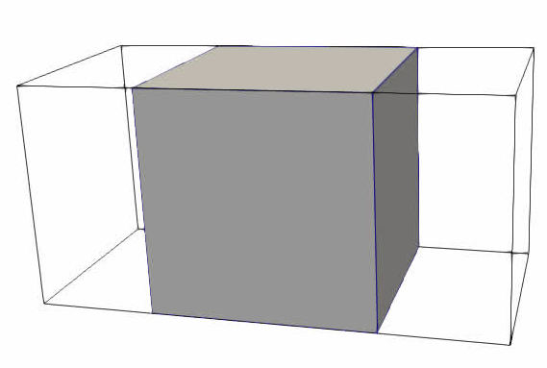

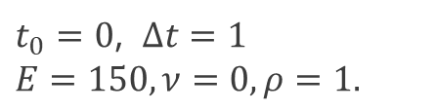

Example 02: Experimenting with artificial strain
Directory: ./ex02_artificial_strain/
Review the input file and read the comments. Locate the begin artificial strain syntax; follow the function to see how much strain is applied.
Run adagio on the input file.
>> adagio –i artificial_strain.i
Visualize the output. Verify the new shape matches your expectations
(Hint: use the “Ruler” filter to measure)
>> paraview output.e
[ Creat Ruler filter ]
[ Use ctrl+1 and ctrl+2 to select endpoints. Apply. ]
Do the values of “artificial_strain” and “artificial_strain_rate_3d” make sense? What about “stress”?
Change the “STRAIN TYPE” to “LOG”. Re-run the analysis; do the results make sense? Compare with a quick hand calculation using the relationship:
$$ε^{log}=log(1+ε^{eng})$$
Worth exploring:
(a) Use a STRONGLY_OBJECTIVE strain incrementation.
(b) Use a selective-deviatoric formulation.
(c) Modify the input deck to solve this problem explicitly.
$t_{0}=0$, $Δt=1$
$$E=150,ν=0, ρ=1.$$
$L_{0}=1$.

Slide 29
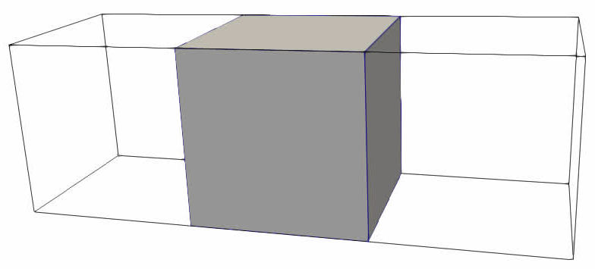

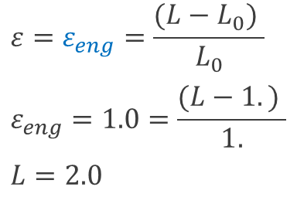
Example 02: Results & discussion
Engineering strain simulation results
Log strain simulation results
L=2.06
L=3.0
$$ε=ε_{log}=log⁡\left(\frac{L}{L_{0}}\right)$$
$$ε_{log}=1.0=log⁡\left(\frac{L}{L_{0}}\right)$$
$$L=L_{0}e^{1}=2.718$$
$$ε=ε_{eng}=\frac{(L−L_{0}) }{L_{0}}$$
$$ε_{eng}=1.0=\frac{(L−1.) }{1.}$$
$$L=2.0$$
Analytical expectation

Slide 30

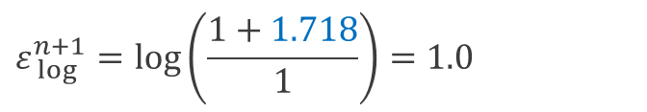
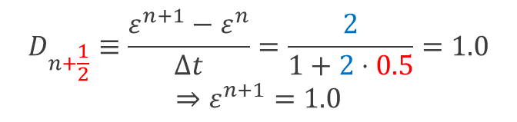

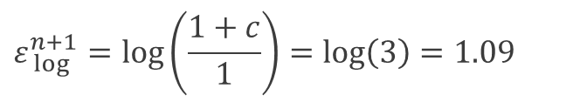
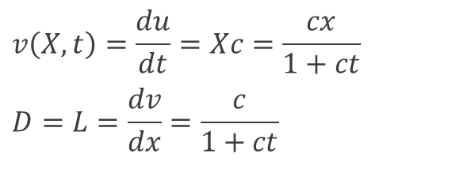



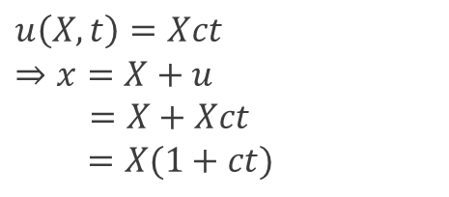
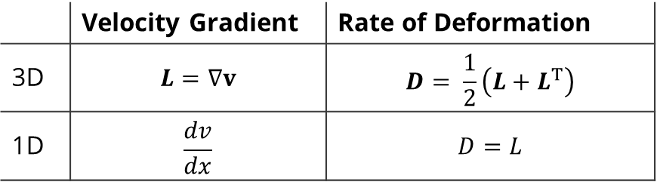

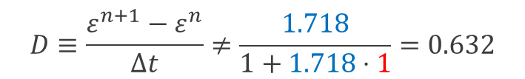
Strain incrementation – a small departure…
 | Velocity Gradient | Rate of Deformation
3D | $$L=∇v$$ | $$D= \frac{1}{2}\left(L+L^{T}\right)$$
1D | $$\frac{dv}{dx}$$ | $$D=L$$
Midpoint increment
$$D_{n+\frac{1}{2}}≡\frac{ε^{n+1}−ε^{n}}{Δt}=\frac{2}{1+2⋅0.5}=1.0$$
$$⇒ε^{n+1}=1.0$$
But …
Diagram of our problem
Kinematics
$$ε_{ log⁡}^{n+1}=\log\left(\frac{1+c}{1}\right)=\log\left(3\right)=1.09$$
$$e_{y}$$
$$u\left(X,t\right)=Xct$$
$$⇒x=X+u$$
$=X+Xct$
$$=X(1+ct)$$
Strongly Objective
$$c$$
$$ε_{ log⁡}^{n+1}=\log\left(\frac{1+1.718}{1}\right)=1.0$$
$$e_{x}$$
$$v\left(X,t\right)=\frac{du}{dt}=Xc=\frac{cx}{1+ct}$$
$$D=L=\frac{dv}{dx}=\frac{c}{1+ct}$$
$$1$$
$$1+c$$
$$D≡\frac{ε^{n+1}−ε^{n}}{Δt}≠\frac{1.718}{1+1.718⋅1}=0.632$$
$c$ is unknown; we are solving for this and we want it to deliver our desired strain!
The details of strain incrementation are beyond the scope of our discussion, but are worth noting here. In general, expect STRONGLY_OBJECTIVE to perform better with larger step sizes.

Slide 31
A few notes, and available outputs:
Artificial strain …
  is constant within an element: it does not vary by integration point.
  does not cause stress without boundary conditions or nonuniform material interfaces
element variables = nonmaterial_strain_3d
element variables = nonmaterial_strain_rate_3d
element variables = artificial_strain
element variables = artificial_strain_rate_3d
element variables = artificial_strain_reference_strain
Combines both thermal and artificial components of strain. “Engineering” strain is reported.
Specific information about artificial strain, combined with thermal strain gives “nonmaterial_strain”.
Reference strain has 3 components, evaluated from X/Y/Z strain functions.

Slide 32
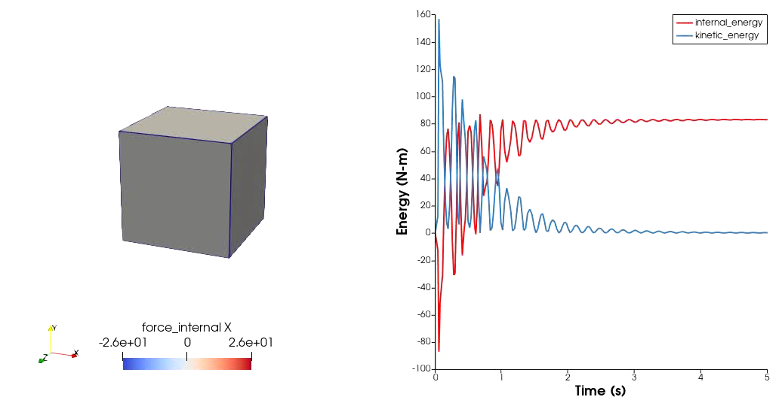
Element type, step size, and an explicit solution
Element type – SD Hex (improves solution)
Time step size – smaller step (improves solution)
Explicit quasi-static solution requires some “babying” to get it right
For this problem in particular: Positive internal energy in quasi-static state can be viewed as the total “dissipated energy” required to get here
At the end, solution oscillates between L ~= 1.9 and 2.1
Some dissipation mechanism required to reduce kinetic energy to near zero
- Default bulk viscosity is helping us out
Opinion: In practice, tuning mass scaling, damping, and other knobs to achieve a good explicit quasi-static solution can be almost as difficult as just solving the “real” implicit problem.

Slide 33
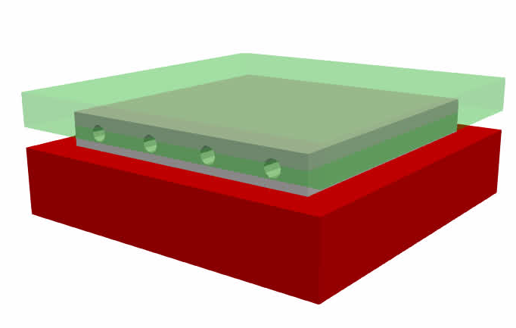
Example 03: Pads & the “true” reference configuration
Soft engineered pad of known initial geometry (0.5” thick)
(initial mesh is overlapping)
4”
Rigid plates, meshed in the assembled position
0.3”
5”
5”
A customer provides geometry for a soft pad which is to be fit between two rigid plates in the assembled configuration. Evaluate the reaction force that will be imparted to the plates by the pad.

Slide 34
Example 03: Pads and their configurations
Directory: ./ex03_reference_configuration/
Direct compression. Solve a pad compression problem using a displacement-based solution that starts with an undeformed (reference) configuration part and ends up at the deformed (current) configuration:
>> adagio –i direct_compression.i
Visualize the results. Plot the “compression_force“ global variable.
In preparation for the next steps, generate a new “starting” mesh:
>> adagio –i reset_configuration.i
Reverse compression (constrained). Start with a pad in the deformed configuration and apply artificial strain to reverse the compression process, returning it to an approximate reference configuration:
>> adagio –i reverse_compression_constrained.i
Visualize the results. Plot the “compression_force“ global variable and compare with step 1.
Reverse compression (unconstrained). Start with a pad in the deformed configuration and use artificial strain to reverse the compression process, returning it to an approximate reference configuration:
>> adagio –i reverse_compression_unconstrained.i
Visualize the results. Compare the final pad with the original mesh geometry.
Worth exploring:
(1) Try the same thing using a hyperelastic (Neo_Hookean) material for the pad.
(2) Try using LOG strain type, rather than ENGINEERING strain type.

Slide 35
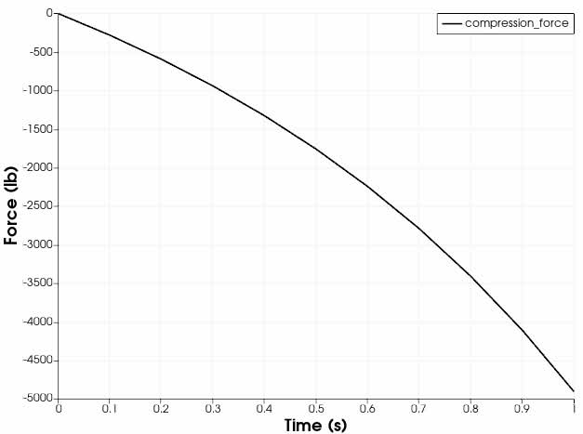
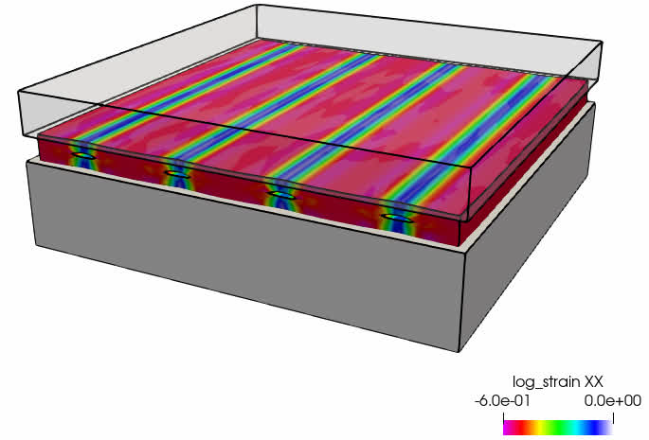
Example 03: Results & discussion
Step 1. Direct compression of the pad (displacements)

Slide 36



Example 03: Results & discussion
Step 2. Reverse compression (artificial strain)
Reverse loading
(artificial strain)
Direct compression (displacement)
Both approaches produce nearly identical compressive forces of ~5000 lbf
Notice how the mesh starts in a deformed-but-unstressed configuration. Stresses develop in this configuration while constrained.

Slide 37







Example 03: Results & discussion
Step 3. Comparison of initial mesh with approximate initial mesh (via “reverse straining”)
t = 0.0
t = 0.5
t = 1.0
$$L_{x}$$
$$L_{z}$$
$$L_{y}$$
Artificial strain amounts were extracted from the direct displacement solution
Notice that we are making an approximation here by uniformly straining the entire block in 3 orthogonal directions. In some cases, this is a very good approximation.

Slide 38





Example 03: Results & discussion
Hypo-elastic vs. Hyper-elastic comparison (also beware of plasticity, damage, etc.!)
Similar to “Elastic” solution
Hypo-elastic
$$σ$$
Hyper-elastic
$$ε$$
Huge disparity with Neo_Hookean in a “reverse” loading!
Beware of sensitivity to initial state, particularly with hyperelastic materials, when loading parts up from an assembled configuration.

Slide 39


Recommended reading
A very readable article from www.boltscience.com, from which example 01 was loosely based
The SIERRA/SM User’s Manual:
- Chapter 7: Boundary Conditions & Initial Conditions
- Artificial Strain
- Bolt Preloading

Slide 40

In summary…
“Preloading” can mean many things
SIERRA/SM provides a wide array of solutions
Preload strategies often have a few key ingredients
  Artificial or thermal strain
  Toggled boundary conditions
  Multiple configurations
  Contact
Preload solution approaches are generally
  Implicit quasi-static → requires solver
  Explicit quasi-static → requires tuning
Preloading means many things to many people, and SIERRA/SM has many solutions!

Slide 41
MODULE 2:
Preloading Bolts

Slide 42
Section overview
We will …
Learn about the preload boundary condition
Learn some nuances for configuring preload options
Explore the differences between implicit and explicit preloads
See how bolt geometry effects preload calculations

Slide 43
Overview of bolt preloading
Possible goal: achieve specific clamping force
Internal stresses developed during assembly
Possible goal: achieve specific stress state (e.g. 70% of yield)
Preloading [bolts] is the analysis step used to achieve an internal stress state representative of a torqued bolt

Slide 44






Overview of bolt preloading
1. Bolt is meshed in the “assembled” or deformed configuration
2. Use SIERRA/SM to return bolt to reference configuration
3. Develop self-equilibrating forces
$$Ω_{0}$$
$$F_{c}$$
$$F_{b}$$
$$F_{c}$$
$$Ω$$
Typically tied or merged nodes at threaded portion (“plug model”)
Reference configuration $Ω_{0}$ is shorter than current configuration $Ω$. Real preload causes bolt elongation.
Bolt preloads are unique in that $Ω≅Ω_{0}$ so often a 1D strain is a great approximation.

Slide 45



Bolt preloading requirements are diverse!
Achieve a target net force in a single bolt
Achieve a target net force in multiple bolts
Reach a desired net clamping force
Achieve 70% --90% of bolt yield stress
  Averaged von Mises stress
  Averaged tensile stress
  Maximum von Mises stress
  Max/Avg. zone includes (excludes) stress concentrations
$$F_{c}$$
$$F_{b}$$
$$F_{c}$$

Slide 46
A basic preload is relatively easy
begin sierra bolt_preload
define direction z_axis with vector 0.0 0.0 1.0
begin function bolt_preload
type = piecewise linear
begin values
0.0 0.0 # preload start time
0.001 -0.05 # random value of 0.05 compressive strain
end
end
## Other Functions ##
## Material Model Definitions ##
## Finite Element Model ##
begin presto procedure Apst_Procedure
## Time Control Block ##
begin presto region presto
## Use finite element model ##
## Define some viscous damping to help##
begin artificial strain
block = bolt_shank
direction z_axis function = bolt_preload
end
end presto region presto
end presto procedure Apst_Procedure
end sierra bolt_preload
(1) Define the axis of your bolt
(2) Define the time-dependence of preload.
(3) Take a wild guess at how much strain to apply.
(4) Define artificial strain to be applied to the bolt
If you know your preload strain, and your part sizes or dimensions never change, it’s not bad.

Slide 47

Example 04: Manual bolt preloading
Merged head, threads, and plates to eliminate contact
Larger threaded area
$$Strain$$
Bolt #1
Apply strain
“Ring-down”
Bolt #2
$$Time$$
Bolt shank x-section area: ~0.271 in2
A286 Bolt Steel yield ~ 100 ksi
Your system contains two bolts of interest, and they are far enough from one another that their mechanical response is uncoupled. We want to preload them to 70% of their nominal yield stress.

Slide 48

Example 04: Manual bolt preloading
Directory: ./ex04_manual_bolt_preload/
Determine the strain. The input deck (preload_bolts.i) is ready to go, except for two scale factors needed to set artificial strain values on the bolts.
  Locate the artificial strain command blocks in the input deck.
  Determine the SCALE FACTOR command values that achieve the desired 70% yield stress preload, within +/- 5%:
  Bolt 1 Axial Strain: _____________________
  Bolt 2 Axial Strain: ______________________
  (answers on next slide, don’t peek!)
Visualize the resulting von Mises stress field by applying a clip filter.
Enable frictional contact by using the “light_friction” model by default in contact. Re-run the analysis to see if preload values are still met. If not, determine new scale factors that achieve the desired 70% preload.
Worth exploring: Enable tied contact and look at the kinetic_energy and internal_energy variables. Does the solution seem quasi-static? Add some damping to reduce the kinetic energy if necessary.

Slide 49


Example 04: Results and discussion
Bolt 1: Strain ~ 0.0051
Bolt 2: Strain ~ 0.0151
Final stress fields are nearly identical; they are independent of our choice to preload a small “pancake” section.
The thinner preload section requires more strain to achieve the same net result
This particular example has very little dynamic “noise”. In practice this is usually not the case, and a small amount of damping can be useful to control the ringing.

Slide 50




Example 04: Results and discussion – with contact
Somebody assembled our system with a tiny gap here!
Try 3: 0.15
Try 5: 0.065
Bolt 1 @ Target 70ksi
Try 1: 0.015
Try 4: 0.06
Try 2: 0.05
Try 2: 0.05
Try 3: 0.15
Try 1: 0.015

Slide 51


Example 04: Results and discussion – quasi-static check
Mass damping coefficient = 2000.
KE (undamped)
KE (lightly damped)
There’s a clear rigid body rotation occurring since there are no boundary conditions constraining it out
IE (undamped)
IE (lightly damped)
It’s always a good idea to verify that your explicit solution is sufficiently quasi-static. There are a variety of techniques available to add dissipation.

Slide 52

Preloading all the bolts in a system model …
A very competent analyst
(been trying for a long time)
It’s painful. And then the bolt sizes change.

Slide 53
The preloading struggle motivated an improved workflow
BEGIN PRELOAD
#
# REQUIRED: PRELOAD DEFINITIONS
#
PRELOAD BOLT <string>block_name1 TO TARGET <string>global_target_var1 = <real>target_value1
[IN DIRECTION <GLOBAL_X|GLOBAL_Y|GLOBAL_Z>]
PRELOAD BOLT <string>block_name2 TO TARGET <string>global_target_var2 = <real>target_value2
[IN DIRECTION <GLOBAL_Y|GLOBAL_Y|GLOBAL_Z>]
...
PRELOAD BOLT <string>block_nameN TO TARGET <string>global_target_varN = <real>target_valueN
[IN DIRECTION <GLOBAL_Z|GLOBAL_Y|GLOBAL_Z>]
(preload command may be repeated multiple times)
#
# OPTIONAL: PRELOAD SOLVER SETTINGS
#
ITERATION TIME = <real>iter_time
INITIAL GUESS = <real>strain_guess
SOLVER ADAPTIVITY = ON|OFF(OFF)
#
# OPTIONAL: ACTIVE PERIOD SETTINGS
#
ACTIVE PERIODS = <string list>period_names
INACTIVE PERIODS = <string list>period_names
END
Some history
Analysts wanted a simplified workflow for preloading bolts
Manual process “works,” but is cumbersome (like digging a ditch with a spoon)
Require better automation
Initial solutions to the problem improved the process substantially via User Subroutines.
User Subroutine process still cumbersome, so the BEGIN PRELOAD command syntax was born.
*** partial syntax, see user guide

Slide 54


Preloading a single bolt: Before and after
begin sierra bolt_preload
define direction x_axis with vector 1.0 0.0 0.0
define direction y_axis with vector 0.0 1.0 0.0
define direction z_axis with vector 0.0 0.0 1.0
begin function bolt_preload
type is analytic
expression variable: v = element applied_strain
evaluate expression = "v"
end
## Other Functions ##
## Material Model Definitions ##
## Finite Element Model ##
begin presto procedure Apst_Procedure
## Time Control Block ##
begin presto region presto
## Use finite element model ##
## Define some viscous damping to help##
begin user output
block = bolt_shank
compute global max_von_mises as max of element von_mises
compute at every step
end
begin artificial strain
block = bolt_shank
direction z_axis function = bolt_preload
end
begin user variable applied_strain
type = element real length = 1
use with restart
end
begin user variable bolt_preload_state
type = element real length = 12
use with restart
end
begin user output
block = bolt_shank
compute global internal_force_shank as internal reaction in direction 0 0 1
compute global bolt_force as magnitude of global internal_force_shank
compute global max_von_mises as max of element von_mises
subroutine real parameter: target_value = 15000.0
subroutine real parameter: initial_guess = -3.06e-4
subroutine real parameter: iteration_time = 1.0e-6
subroutine string parameter: target_variable = global max_von_mises
subroutine string parameter: working_variable = element applied_strain
subroutine string parameter: state_variable = element bolt_preload_state
element block subroutine = aupst_preload_solver
compute at every step
active periods = preload
end
end presto region presto
end presto procedure Apst_Procedure
end sierra bolt_preload
begin sierra bolt_preload
## Other Functions ##
## Material Model Definitions ##
## Finite Element Model ##
begin presto procedure Apst_Procedure
## Time Control Block ##
begin presto region presto
## Use finite element model ##
## Define some viscous damping to help##
begin preload
preload bolt bolt_shank to target max von mises = 15000
end
end presto region presto
end presto procedure Apst_Procedure
end sierra bolt_preload
BEFORE
AFTER
Aside from the verbosity, a “good” initial guess can be hard!
… now consider preloading multiple bolts with different: preload target variable, orientation, or magnitude

Slide 55



An overview of preload automation (explicit solver)
Problem statement: Given a potentially highly-nonlinear problem involving contact, plasticity, and complex geometry – find an artificial strain which, when monotonically increased, causes some desired outcome (e.g. preload)
Hold the artificial strain for a period of time to evaluate the target force/stress/etc., which might be dynamic and noisy
- target force/stress/etc.
- analysis time
ramp
hold
(Evaluate preloads)
Black box algorithm to strategically adjust artificial strain
FEM at $t_{n}$
$$ε_{art}$$
(Increment time)
Increase the artificial strain with a cosine ramp over a finite period of time
$$t$$
- strain to apply
Ideally there is a 1:1 mapping between strain and preload value; in explicit analyses, this is rarely even approximately true due to the “ringing” (dynamic noise) in the system

Slide 56


An overview of the automated preload algorithm
Target preload (force)
Good initial guess
Note: The former “preload subroutine” and newer “begin bolt preload” syntax increment strain in exactly the same way.
solver adaptivity = on
Bad initial guess
X
bolt_shank
begin preload
preload bolt bolt_shank to target internal force = 700
solver adaptivity = on
end
Let’s try this out on a quick example problem …

Slide 57
Example 05: Automatic bolt preloading
Directory: ./ex05_automated_bolt_preload/
Review the input file. Find the “begin preload” syntax; does it make sense? How does it compare to the “begin artificial strain” syntax?
Run the input deck and review the log file. Find the final strains in the log file at the end of the analysis. Consider plotting the avg_von_mises{1,2} global variables to visualize preload over time.
>> adagio –i bolt_preload.i
  Bolt 1 Axial Strain: _____________________
  Bolt 2 Axial Strain: ______________________
  How do these strains compare to your previous solution?
Worth exploring: Enable the “light_friction” friction model as we did before and re-run. See what effect the following two commands have:
(a) solver adaptivity = on
(b) explicit control algorithm = PID
Create an assembly that contains both bolt shanks and preload that instead.

Slide 58
Example 05: Results and discussion – typical log file output
Initialization output:
-------------------------------------------------------------------------------------------------------------------------
Preload Part Name Target Variable Target Value Strain Direction
-------------------------------------------------------------------------------------------------------------------------
block_10 sm_preload_max_von_mises_block_10 4000 1.00, 0.00, 0.00
block_11 sm_preload_max_von_mises_block_11 4000 1.00, 0.00, 0.00
block_12 sm_preload_max_von_mises_block_12 4000 1.00, 0.00, 0.00
block_13 sm_preload_max_von_mises_block_13 4000 1.00, 0.00, 0.00
block_14 sm_preload_max_von_mises_block_14 4000 1.00, 0.00, 0.00
block_15 sm_preload_max_von_mises_block_15 4000 1.00, 0.00, 0.00
-------------------------------------------------------------------------------------------------------------------------
Block name receiving preload strain
Global output variable, useful for monitoring results if desired
Direction – useful if computed from geometry
Useful to directly specify preload on subsequent analyses
Completion output:
Check results
-------------------------------------------------------------------------------------------------------------------------
Preload Part Name Preload Target Final Strain Final Preload Final Preload % Final Overshoot %
-------------------------------------------------------------------------------------------------------------------------
block_10 4000 0.000153559 3999.99 100.00 0.00
block_11 4000 0.000159583 3999.99 100.00 0.00
block_12 4000 0.000162229 4000 100.00 0.00
block_13 4000 0.000152774 4000 100.00 0.00
block_14 4000 0.000154526 4000 100.00 0.00
block_15 4000 0.000166275 4000 100.00 0.00
-------------------------------------------------------------------------------------------------------------------------
*** All preload targets reached to within 5.0% tolerance.
Quick glance go / no-go indicator

Slide 59


Example 05: Results and discussion
Bolt 1: Strain ~ 0.0051
Bolt 2: Strain ~ 0.0151
The results are nearly identical to our manual approach.

Slide 60


Example 05: Results and discussion – contact on
PID: Significant improvements over the default algorithm for both bolts
“Solver Adaptivity = On”, default control algorithm.
Works but risks exceeding yield stress and developing irreversible plasticity!
Incremental + adaptivity:
notice strain amplitude increase on iteration 3
Default (incremental)

Slide 61
Preload command syntax overview
Preload command syntax (region scope)
begin preload
#
# REQUIRED: Preload definitions
#
preload bolt <string>block to target {average|max} von mises = <real>value [in direction <string>dir_name]
preload bolt <string>block to target internal force = <real>value [in direction <string>dir_name]
preload bolt <string>block to target user {stress|force} <string>global_target_var = <real>value [in direction <string>dir_name]
(preload commands may be repeated multiple times)
#
# OPTIONAL: Preload solver & other settings
#
explicit control algorithm = incremental|pid(incremental)
iteration time = <real>iter_time
solver adaptivity = on|off(off)
compute internal reaction outputs = on|off(off)
separate components = on|off(on)
#
# OPTIONAL: Active period settings
#
active periods = <string list>period_names
inactive periods = <string list>period_names
end
Primary preload definitions
Fine-tune the behavior for your specific needs
Control when preload is active
We’ll look at each of these commands in detail, next …

Slide 62
Preload command syntax: Active periods
active periods = <string list>period_names
inactive periods = <string list> period_names
When preload commands are actively updating strains
Most common use: a single preload time period
Can technically be on/off for multiple periods, but no practical use case for this. Don’t do this.
Preload duration and number of steps:
Implicit: ~10 steps is usually sufficient; duration usually does not matter.
Explicit: much harder to know, usually in the range of 1—10ms.
begin time control
begin time stepping block time_block_preload
start time = 0.0
begin parameters for adagio region adagioRegion
number of time steps = 10
end
end
begin time stepping block time_block_load
start time = 1.0
begin parameters for adagio region adagioRegion
number of time steps = 100
end
end
termination time = 10.0
end

Slide 63
Preload command syntax: Primary preload definitions
preload bolt <string>block to target {average|max} von mises = <real>value [in direction <string>dir_name]
preload bolt <string>block to target internal force = <real>value [in direction <string>dir_name]
preload bolt <string>block to target user {stress|force} <string>global_target_var = <real>value [in direction <string>dir_name]
(preload commands may be repeated multiple times)
The set of elements preload will act on.
May be a single block with a single contiguous set of elements (typical, e.g. a bolt shank)
May be a single block with multiple contiguous elements groups (e.g. multiple bolt shanks) – each contiguous grouping of elements will be identified and preloaded separately.
May be an assembly – each block in the assembly will be preloaded separately
May be solid elements or beam elements
The target (global) preload measure.
Specify a preload target value
Several presets available:
  AVERAGE VON MISES
  MAXIMUM VON MISES
  INTERNAL FORCE
May be an arbitrary user-computed value
  Compute with user output
  Must “COMPUTE AT EVERY STEP” because solution depends on it
  Must specify whether the variable represents a stress-like quantity or a force-like quantity (this helps the algorithms start from a good strain estimate)
The direction to strain
Optional and unnecessary, even potentially detrimental
By default, direction automatically determined Preset directions available:
  GLOBAL_X
  GLOBAL_Y
  GLOBAL_Z
May be a direction created at the SIERRA scope with the “define direction” command

Slide 64
Preload command syntax: Algorithm options
Convenient output
Automatically computes global variables named sm_preload_axial_force_<block_name>
Disabled by default for performance
Identical to user output “compute … as internal reaction …”
explicit control algorithm = incremental|pid(incremental)
iteration time = <real>iter_time
solver adaptivity = on|off(off)
compute internal reaction outputs = on|off(off)
separate components = on|off(on)
Preload entity control
If a block contains multiple “components”, treat them as a single block (OFF) or treat them as separate parts (ON)
Automatic global output will get a suffix “_Component<num>”
  sm_preload_strain<block_name>_Component<num>
Algorithm/solver controls
Explicit Control Algorithm
  Incremental: default, same as old subroutine
  PID: proportional-integral-derivative control system; often much faster but less tested currently.
Solver Adaptivity attempts to adjust the incremental algorithm strain increment amplitude and time period if forecasted preload is less than target value.
Iteration Time allows manual setting of the incremental algorithm time-per-increment. Defaults to 20 increments in the allowed preload period.

Slide 65




Incremental preload algorithm (explicit)
INCREMENTAL ALGORITHM
Multiple strain “increments” applied sequentially
Repeated cosine ramp + hold
20 iterations by default
Amplitude determined automatically
solver adaptivity option may adjust strain amplitude and/or increment time period
Decrease the iteration time parameter to effectively increase the preloading rate – may help get to preload faster.
** Technically, we are visualizing the von Mises stress (target preload metric). The increment “amplitude” for the algorithm is actually the strain amplitude. However, in this problem the stress increases monotonically and without much noise, so the effect of the algorithm is very clear here.
In general, the output might be noisy due to contact chatter and other explicit dynamics high frequency content.
As an analyst, you need to monitor the results for noise and potentially extend your preload time and/or increase damping as needed to achieve the desired results.
Increment 1
Increment 2
Increment time
Increment amplitude**
A safe choice and a good default option, for now.

Slide 66













PID preload algorithm (explicit)
PID ALGORITHM
Proportional-Integral-Derivative (PID)
Uses control system theory to rapidly approach preload
Nominally a basic PID algorithm (some customization)
Usually much faster (and less likely to overshoot target)
Can become unstable (invert elements)
Depends on good choice of $K_{p}$, $K_{i}$, $K_{d}$ (automated)
PID
Target value
$$K_{p}e(t)$$
$$Target$$
$$value$$
$$+$$
$$Σ$$
$$e(t)$$
$$K_{i}\int{e(t)}dt$$
$$Σ$$
$$ε(t)$$
Explicit analysis
$$y(t)$$
$$+$$
$$+$$
$$−$$
$$+$$
$$K_{d}\frac{de(t)}{dt}$$
Potentially much faster and better for significant joint nonlinearity

Slide 67





Implicit preload algorithm
Implicit Algorithm: Effectively a (limited) linear extrapolation with provisions to guard against disaster. Usually best with quasistatic (not implicit dynamics).
Preload bolt 1 (no gap)
Preload bolt 2 (large gap)
Hypothetical actual joint behavior
Target preload
$$ε^{(N)}, F^{(N)}$$
$$ε^{(3)}, F^{(3)}$$
Resulting Preload
$$ε^{(2)}, F^{(2)}$$
Assumption of linear joint behavior (bad)
Actual joint behavior
Target preload
$$ε^{(1)}, F^{(1)}$$
Resulting Preload
Required strain
Required strain
Assumption of linear joint behavior (bad)
Applied strain
Applied strain
Dramatically faster preload than explicit when possible.

Slide 68









Preloading bolts: geometry considerations
What started it all… the initial guess: How much strain do I need?
$$σ_{tgt}=Eε_{tgt}→ε_{0}=C(L_{0})\frac{σ_{tgt}}{E}$$
Factors influencing the “right” artificial strain
Target force/stress
Bolt material
Shank area ($A$)
Grip length ($L_{0}$)
Joint compliance
The factor of $A$ (area) here is why you must specify USER STRESS or USER FORCE when creating your own target variable
Readily available
$$F_{tgt}=AEε_{tgt}→ε_{0}=C(L_{0})\frac{F_{tgt}}{AE}$$
Geometry analysis
Scale factor
Rely on algorithm
Preload direction and length estimate ($L$) comes from $I_{1}$ or $I_{3}$
Estimate area ($A$) from the remaining axes
y
x
User-defined preload “shank section” is what SIERRA/SM sees
Preloaded elements
Inertia ellipsoid (eigenvalue problem): $I_{1}<I_{2}<I_{3}$

Slide 69

Pathologies that can require user intervention
Problem: Huge gap(s) in the joint
Solution: Fix the mesh, enable adaptivity or use PID algorithm (explicit)
Problem: Nearly cube/spherical preload section ($I_{1}=I_{2}=I_{3}$)
Solution: Automatic direction won’t work, specify direction manually.
Problem: Really long bolt, tiny preload section
Solution: Include more of the shank, or enable adaptivity controls
(Please don’t create a long bolted joint with gaps that has $I_{1}=I_{2}=I_{3}$ …)

Slide 70










Free body diagrams and internal forces
$$P_{0}$$
$$F_{net}=\sum_{i=1}^{N}{F_{int}^{(i)}}$$
$$N_{0}$$
$$F_{int}$$
$$M_{int}$$
$$M_{net}=\sum_{i=1}^{N}{{r_{0}^{(i)}×F}_{int}^{(i)}}$$
Define a cutting plane at point $P_{0}$ in direction $N_{0}$
Divide elements into two groups (so there should be at least 2 elements!)
Compute reaction forces and moments by summing over exposed nodes

Slide 71
Free body diagrams and internal force syntax
User output syntax for internal reaction/moment calculations
begin user output
#
# Entities to compute forces on
#
include all blocks
block = <blocks>
surface = <sidesets>
nodeset = <nodesets>
#
# Force/moment calculation commands
#
compute global <varName> as internal reaction [vector|transverse|normal(vector)] [at point <x> <y> <z>] [in direction <dx> <dy> <dz>]
compute global <varName> as internal moment [vector|transverse|normal(vector)] [at point <x> <y> <z>] [in direction <dx> <dy> <dz>]
#
# Optional algorithm commands
#
[compute at every step]
end
May also be “… in defined direction <sierra_dir>”, where <sierra_dir> is a direction defined at the SIERRA scope.
By default, point/direction computed from geometry
Vector (default): Full vector force/moment output
Normal: Dot product of vector resultant onto cut plane normal direction (tension positive)
Transverse: Magnitude of vector resultant projected into the cut plane
Computing internal reaction forces is one of the most frequently-used user output calculations. This is also exactly what is done in preload when using the pre-defined “target internal force”, etc.

Slide 72

Bolt preload advanced usage example
top_plate
Shank
Shank
contact_surf
bottom_plate
begin user output
surface = contact_surf
compute global clamping_force as sum of nodal force_contact(z)
compute at every step
end
begin preload
preload bolt shank to target user force clamping_force = 8000
end
We can use (nearly) arbitrary quantities of interest to drive preload. They should usually be “force-like” or “stress-like”.

Slide 73






Caution: Be aware of subtle preload choices
Beware of subtle field variation during mesh refinement
Consider the meaning of your target metric
Typical region of interest for preloading
Max von Mises
$${\overline{σ}}_{avg}≅{\overline{σ}}_{max}$$
Both max & avg likely to work well
$${\overline{σ}}_{avg}≪{\overline{σ}}_{max}$$
Max. unlikely the desired metric
$${\overline{σ}}_{avg}≪{\overline{σ}}_{avg_shank}$$
Max and Avg. unlikely the desired metric
Increasing mesh refinement
Take care when defining your mesh so that your preload meets expectations

Slide 74

Example 06: Explore preload options
Unit under test (nominally steel)
Test fixture bolted to sled
48” x 24” sled (steel)
Sled track
4x rear bolts (0.5” diameter)
4x front bolts
(0.5” diameter)
This sled track system is used to test re-entry vehicles/bodies. The sled is designed to accept an arbitrary fixture, which can be fastened with 4 bolts on either side. Preload the bolts to prepare for further analysis.

Slide 75
Example 06: Explore preload options
Directory: ./ex06_rv_sled/
Define preload. The input deck (rv_sled.i) needs to be finished. Add a command block to preload blocks named “shank1“ and “shank2“:
  Each block has 4x bolts. Add the “separate components = off” command to preload the set of bolts as a group to a target 20,000 lb internal force. The bolts axes are aligned with the global y-direction.
  Run the input deck and look in the log file; record the final strains required to reach the target preload.
    >> adagio –i rv_sled.i
    Plot the “sm_preload_axial_force..” global variables to visualize the preload
Preload only the set of bolts in ”shank1”. Record the strain required to reach the target preload. Repeat for the set of bolts in “shank2”.
Preload the bolts individually. To reach the same net 20,000 lb preload, we can preload each of the 4x bolts individually to 5,000 lb. Add the command “separate components = on” to do this. Use 20 time increments to help resolve the preload. Review the log file output – how is it different?
shank1
(4x bolts)
shank2
(4x bolts)
Worth exploring: Reduce the number of time steps or change solver settings to optimize the solve speed. How fast can you get it to solve? Try explicit. Why is explicit a poor choice for this problem?

Slide 76


Example 06: Results and discussion – multiple solutions
Tip: Use the “Camera Parallel Projection” option in ParaView (located on “Properties” tab) to help visualize these differences
Preload Part | Preload Strain (shank1) | Preload Strain (shank2)
shank1 | 0.0130 | -
shank2 | - | 0.0130
shank1 + shank2 | 0.0065 | 0.0065
Multiple preload solutions
Preload bolts in “shank2”
Locus of potential solutions
Applied Strain (shank2)
Preload bolts in “shank1” and “shank2”
Preload bolts in “shank1”
Applied strain (shank1)
Displacement x40
Notes:
It may be worth noting on this slide that we could preload these in any arbitrary sequence, in an arbitrary order, as desired.

Slide 77




Example 06: Results and discussion – multiple solutions
Preload bolts as a group (4 x 5000lb = 20,000 lb total)
(~30s, 10 load steps)
Technically, 6 load steps is sufficient for this example
Preload bolts individually (5000 lb each)
(~60s, 20 load steps)
N=10 load steps
Tightly coupled forces causes “noise” in implicit preload algorithm
Preload BC recognizes 4 distinct bolts in each block
Each bolt assigned a unique preload strain value
N=20 load steps
Perhaps a few extra steps
The implicit preload algorithm attempts to simultaneously preload all bolts; usually 10 steps is enough but in some cases more time increments may be advantageous.

Slide 78



Example 06: Results and discussion – an explicit attempt
~1300 lb (target = 20,000 lb)
Test article may be heavy and require a long time period to move into the preloaded location
Explicit solutions take time to “propagate” through the system; here we see preload on one side only (not in equilibrium)
Preload algorithm increments
Solve time ~30 min
np=1 on HPWS
~5% of target preload reached
~300x slower than implicit
t = 5ms preload
A 5 ms preload is not nearly enough for this particular geometry to preload explicitly.

Slide 79


Example 07: Explore preload with beams
\
Potential bolt circle for RV attachment (0.25” nominal diameter, but the systems engineer may change this)
We continue to analyze our structure and now turn our attention to the RV attachment. We want to understand the effects of fastener placement and dimension, and the resulting stresses

Slide 80
Example 07: Explore preload with beams
Directory: ./ex07_rapid_bolt_circle/
Construct the mesh. We use a mini workflow to build our mesh by combining our bolt definition with our solid mesh, replacing a tied connection with a bolted joint. Use the SEACAS tool “ejoin” to do this, or CUBIT, or another tool of your choice:
>> module load seacas
>> ejoin –output rv_sled_with_bolts.g rv_sled.g rv_bolt_circle.g
Preload the bolt circle ”rv_attachment”. There are 16 beams, each representing a discrete fastener. Preload so that we achieve a net clamping force of 5000 lb by adding the following to the input deck (in addition to preload for 8x fixture bolts):
begin preload
preload bolt rv_attachment to target internal force = 5000
end
Verify the preload in each bolt by using APREPRO to generate some global outputs. Add the following to the RESULTS OUTPUT block:
${i=0}
{loop(16)}
global sm_preload_axial_force_rv_attachment_component{i++}
{endloop}
Run the code and visualize the results and global variables:
>> adagio –i rv_sled.i
rv_attachment
+
Worth exploring: We also have gravity preload in this problem. Use the INTERNAL REACTION user output and a cut plane through the attachment bolts (centroid at [11.5, 10., 0.0]) to show they support the RV weight.

Slide 81


Example 07: Results and discussion – log file output
Summary: preload block #1
Summary: preload block #2
“_component<#>” suffix used for separated components
Beams always preload along local “X” direction

Slide 82

Example 07: Results and discussion – log file output
Summary: preload block #1
Summary: preload block #2
You will also get two tables output for preload results, one for each preload command block

Slide 83


Example 07: Results and discussion
sm_preload_axial_force_rv_attachment_component<#>
We’ve used beams to rapidly prototype a preloaded connection
Easy to change bolt dimensions
Easy to change number/position of bolts
Use with or without holes
Multiple connection strategies available (MPC, RBE3, Contact, Contiguous mesh, Rigid bars, etc.)
Switch to more accurate geometry when ready
You may also imagine using multiple preload blocks and time periods to set up a preload sequence.
Fixture attachment preload
Gravity preload
Sled bolt preload

Slide 84






Example 07: Results and discussion – Gravity reaction
begin user output
block = rv_attachment
compute global bolt_gravity_reaction as internal reaction transverse at point 0 10 0 in defined direction sierra_direction_y
end
Mass properties available in the log file
$$mg$$
$$F_{gravity}=1.56⋅386.4≅602 lb$$
Internal reaction and moment can be very useful outputs for verification & validation

Slide 85
Preloading tips
A few tips and lessons-learned:
Implicit preloading can be significantly faster, if you can solve it.
  Don’t use implicit dynamics, the preload algorithm assumes quasi-static solution has been reached.
  Solves in about 10 steps, might need more in some cases.
Explicit preloading can be significantly more robust with large, complex nonlinearities
  Be wary of large masses
  Usually 2-5ms is sufficient for small models. Larger models may require 10ms or longer.
  Add some amount of damping to reduce ringing, but not too much that you prevent motion
Once you know the required preload strain, feel free to apply it manually
Don’t worry (much) about preload accuracy (we don’t need +/- 0.005%) – it’s almost never known in real applications. Consider that uncertainty instead.
Use element and global output variables for debugging (sm_preload_*)
Watch out for irreversible plasticity, damage, etc.

Slide 86

In summary…
Preloading bolts in SIERRA/SM is easy and can be done in fewer keystrokes than this bullet point
  … but it’s still extremely powerful
  … and requires a skilled analyst to use effectively.
We can preload using implicit or explicit
  Implicit: can be faster and more accurate
  Explicit: can be more robust and even faster (if model is well-posed!)
  Use damping with explicit to reduce ringing
Preloading bolts involves strategy and technique:
  Custom preload sequences
  Decisions on preload metrics (clamp force, bolt force, stress, etc.
Preloading bolts is so common, it has a special-purpose command syntax.

Slide 87
MODULE 3:
Preloading Pads

Slide 88
Section overview
We will …
Look at why pad preload is important
See some of the unique aspects of preloading pads
Learn about boundary conditions & features that can be used for pads
Compute some useful outputs for pad preload

Slide 89





Preloading “pads” means many things to many people
Flat, shaped gaskets
Engineered pads & metamaterials
Closed-cell foams
Open-cell foams
Curved rubber pads

Slide 90
Preloading pads
Preloading pads is less well-defined than preloading bolts.
Geometries tend to be more varied
QOI tend to be varied (percent compression, total compression force, …)
Material properties tend to be varied (Poisson ratio, hyper/hypo-elastic, …)
  We will be intentionally avoiding complex material models
  Focus instead on the preload process
Therefore, we will focus on techniques and strategies that can be customized for a variety of applications:
Forward deformation & assembly
Reverse strain assembly method
Working with curved geometries
Computing quantities of interest

Slide 91
Techniques for preloading flat & curved pads
There are a variety of techniques that we can use to preload pads:
Forward assembly
  Strain-based
  Displacement-based
Reverse deformation (straining)
Contact overlap method
  Mesh parts in reference configuration
  Parts overlap slightly (must be detected by contact search tolerance)
  Contact detects overlapping parts and applies forces to remove the overlap.
(previously seen)
(previously seen)

Slide 92

Contact overlap method overview
Contact search tolerances
Overlap$δL$
Block 2
Block 2
Pad
Pad
Block 1
Block 1
Contact forces
Initial configuration has parts meshed in an overlapped state; parts must be within the “NORMAL TOLERANCE” for contact.
Use a 1-step implicit quasi-static solution to remove contact by imposing constraining contact forces.

Slide 93



Example 08: Housing gasket preload
Fixed top surface
Overlap
$$δL=0.02$$
Frictional contact
Initial thickness 0.07”
Nominal gap 0.05”
Approximately 25k elements:
- Pad: ~1k Hex8
- Housing: ~24k Tet10
Fixed bottom surface
This housing is to carry precious cargo and a tight seal is necessary to protect it. Experiments have shown that plastic strains of eqps > 0.1 are required for a good seal. Are we safe?

Slide 94

Example 08: Housing gasket preload
Directory: ./ex08_gasket_preload/
Set correct contact tolerances. The input deck needs minor edit before we can run it. Locate the contact interaction for the gasket and housing blocks and add to it the following manual search tolerance, given our knowledge of the initial penetration:
begin interaction int1
...
normal tolerance = 0.1
end
Run the code.
>> adagio –i gasket_preload.i
Visualize the output. Verify the plastic strain in the gasket is sufficiently high (eqps > 0.1). If visualizing with ParaView, turn on the camera parallel projection to visualize the deformation.
Worth exploring: Materials of dissimilar stiffness, such as soft pads contacting stiff steel, often require fine-tuning for their contact interaction. What happens if you remove the AL PENALTY line from the contact interaction definition? Does the default solver converge?

Slide 95
Example 08: Results and discussion – the input deck
Completely unnecessary for this problem. You accidentally copied this from an old input deck. Actually, this has been added to demonstrate the use of “normal tolerance”
begin contact definition
...
begin dash options
search length scaling = 0.05
end
begin interaction int1
side a = housing_top, housing_bottom
side b = gasket
constraint formulation = node_face
friction model = light_friction
normal tolerance = 0.1
al penalty = 100 1
end
end
Manually setting side A/B is frequently necessary for “pad” type problems, and NODE_FACE constraints are often the best choice.
There is a rigid body mode. We rely on friction to keep the pad from sliding out.
Contact needs to see the overlap. If the overlap is too big for the default contact search tolerances, we can “capture” it by increasing the tolerance manually. The value here is an “absolute” distance.
Dissimilar materials frequently need adjustment of the contact stiffness. Adjusting the AL Penalty parameter in the range ~[0.01, 100] is a fine starting point. Default value is 1. The second argument scales the tangential contact forces.

Slide 96


Example 08: Results and discussion
Implicit solution 25k elem (np=1) | Default CG Solver | Full Tangent Precond.
AL Penalty = 1 | 2300 s | 73 s
AL Penalty = 100 1 | 600 s | 26 s
Our solution time is heavily-dependent on our choices.
Plastic strain looks good!
The “contact overlap” method can be a very effective preloading strategy.

Slide 97






Configurations of pad deformation and strain
Final configuration
Multiple potential options for initial pad shape
Part 2
$$δL$$
Pad
$$δL$$
$$Ω_{0A}$$
$$Ω_{0B}$$
$$Ω_{0C}$$
$$Ω$$
Part 1
(2D profile view)
Option A:
Flat pad, bent into final position
Option B:
Initially curved pad with overlap on ID
Option C:
Initially curved pad with overlap on OD
We need detailed knowledge of the initial and final configurations to properly preload a pad.

Slide 98
Techniques for pad preloading
Custom feature
Flexible, customized, modeling strategies is a unique feature of SIERRA/SM:
Start with simple features
Combine with more complex features
Produce a novel solution
Combine
User output
Boundary conditions
Node & Element fields
SIERRA functions
User variables
The diverse geometry and requirements for preloading pads often requires diverse solutions

Slide 99



Techniques for pad preloading: flat pad exemplar
Option A: Use a global SIERRA direction for strain
# in sierra scope ...
define direction pad1normal with vector <nx> <ny> <nz>
# in region scope ...
begin artificial strain
block = pad1
direction pad1normal function = shrink_and_grow scale factor = -0.5
end
$$N_{pad}=[n_{x}, n_{y}, n_{z}]$$
Option B: Use an element field to specify direction
# in region scope ...
begin user variable pad1_dir
block = pad1
type = element vector
initial value = <nx> <ny> <nz>
end
begin artificial strain
block = pad1
direction field pad1_dir function = shrink_and_grow scale factor = -0.5
end
Option A
Option B
Option C
Option C: Same as Option B, but initialize with user output
# keep B above, but also add user output block
begin user output
block = pad1
compute element pad1_dir(x) as function <x_dir_func>
compute element pad1_dir(y) as function <y_dir_func>
compute element pad1_dir(z) as function <z_dir_func>
end

Slide 100
Techniques for curved pad preload
See user variable syntax for complete listing
begin user variable <string>variable_name
# Optionally specify a block
block = <string_list>blocks
#
# Describe the variable type
#
type = <string>node|element [REAL|VECTOR|SYM_TENSOR|FULL_TENSOR]
variable type = node|element
initial value = <real>values
end
Useful for creating generic fields (“variables”) which will be used/referenced in other parts of the analysis.
See user-defined output for complete listing
Can be useful for filling fields.
with particular values
“user output” somewhat of a misnomer.
(Calculations also executed during initialization)
begin user output
#
# One of the most flexible calculations available
#
compute [element|node] <string>variable_name as function <string>function_name
end

Slide 101




Example 09: Flat pad preloading
5” x 5” housing surfaces (fixed on exterior)
Nominal 0.5” gap for pad when installed
$$N_{pad1}=[1, 1, 0]$$
3” square pads, nominally 0.5” thick (free floating)
$$N_{pad2}=[1, 0, 0]$$
$$N_{pad3}=[−1, 1, 0]$$
~1500 elements
Tet10 topology
These vibration isolating pads are part of a larger experimental assembly. Preload them using the easiest technique in preparation for a vibration analysis.

Slide 102

Example 09: Flat pad preloading techniques
Directory: ./ex09_flat_pad_deformations/
Review the input deck (flat_pad.i). It is configured to preload using Option A, preloading via global SIERRA directions. Locate the three ARTIFICIAL STRAIN command blocks and confirm the direction, function, and scale factor parameters make sense.
Run the example and visualize the results (von_mises, force_contact, displacement)
>> adagio –i flat_pad.i
Replace the artificial strain commands with an element field as in Option B or Option C. For each block, define the following:
begin user variable <var_name>
block = <block_name>
type = element vector
initial value = <Nx> <Ny> <Nz>
end
Then, re-run the analysis and verify the results are as expected.
(Hint: Use the “direction field” syntax in the artificial strain block)
Worth exploring: (1) Try a fully-integrated 10-node tetrahedral element. (2) We know the contact AL PENALTY parameter can be important when materials have dissimilar stiffness; delete that parameter and instead add the following to the solver block:
begin control contact
lagrange adaptive penalty = separate
end

Slide 103



Example 09: Results and discussion – Field review
Nice uniform von_mises stress
Nice smooth contact forces
Composite Tet10 (default)
Terrible contact forces, the FI Tet10 has a pathology that causes zero reaction forces at the mid-side nodes. This can be difficult to converge!
Nice uniform von_mises stress
Fully-integrated Tet10

Slide 104
Example 09: Results and discussion – Syntax discussion
begin user variable pad1_dir
block = pad1
type = element vector
initial value = 1 1 0
end
begin user variable pad2_dir
block = pad1
type = element vector
initial value = 1 0 0
end
begin user variable pad3_dir
block = pad1
type = element vector
initial value = -1 1 0
end
begin artificial strain
block = pad1
direction field pad1_dir function = shrink_and_grow scale factor = -0.6
end
begin artificial strain
block = pad2
direction field pad2_dir function = shrink_and_grow scale factor = -0.6
end
begin artificial strain
block = pad3
direction field pad3_dir function = shrink_and_grow scale factor = -0.6
end
Set initial value on every element.
Note we only create this variable on the pad1 block.
As a result, we need 3 separate artificial strain blocks. Ideally, a future version of the code will allow preloading all blocks in a single artificial strain command block.
Fully-contracted state
Applied Strain
Fully-expanded (reference) state
Time (s)

Slide 105



Example 09: Results and discussion – A word on contact
Huge gap (penetration)
No progress on residual
AL Penalty Spot Check
1
2
5
10
Fails to converge
Probably converges
default value
reasonable choice
Ultimately fails to converge
NOTE: In practice the “converge” range is highly variable and depends on a multitude of factors including stiffness, geometry, friction model, load step size, and more!

Slide 106
Example 09: Results and discussion – A word on contact
Contact active periods allow one to toggle contact on only when ready to enforce contact constraints.
This is extremely convenient for enforcing pad preloads, as well as other types of preload.
Typical preload workflow:
Move things that might overlap into their final position
Then, turn on contact to constrain them.
begin contact definition
active periods = grow_pad
...
begin interaction int1
side a = <blocks-that-constrain-pad>
side b = pad
constraint formulation = node_face
...
al penalty = 5
end
end
begin solver
begin control contact
lagrange adaptive penalty = separate # [OFF|UNIFORM|SEPARATE]
end
end
These control the same knob. In one case, you fine-tune the control yourself. In the other, you delegate the task to the solver. Ideally, this is not necessary, and it is only used when it provides a benefit.

Slide 107




Pop Quiz: Which of these shrinks the pad thickness by 50% (pad unit normal is $n={\sqrt{0.5}e}_{x}+\sqrt{0.5}e_{y}$)?
(a)
$$\vec{ε}=−\sqrt{0.5}{(e}_{x}+e_{y})$$
(b)
$ε=−0.5e_{N}e_{N}^{T}$
# in sierra scope:
define direction X with vector 1 0 0
define direction Y with vector 0 1 0
# in region scope:
begin artificial strain
block = pad1
direction X function = shrink scale factor = -{sqrt(0.5)}
direction Y function = shrink scale factor = -{sqrt(0.5)}
end
# in sierra scope:
define direction PAD with vector 1 1 0
# in region scope:
begin artificial strain
block = pad1
direction PAD function = shrink scale factor = -0.5
end
Beware of this common misconception! With active pad constraints it’s hard to see this happening!

Slide 108
Techniques well-suited for curved pad preload
Let’s assume we have a well-defined geometry we need to represent.
The INITIAL CONDITION command block contains some powerful commands, when combined with a USER VARIABLE.
See initial condition syntax for complete listing
begin initial condition
#
# Variable identification commands
#
block = <string_list>blocks
surface = <string_list>surfaces
#
# Variable identification commands
#
initialize variable name = <string>var_name
variable type = node|element
# Specialized initialization method
calculate as closest projection to surface = <string_list>surfaces
end
Detailed example syntax, next …

Slide 109
Techniques well-suited for curved pad preload
1. Populate a nodal variable with desired displacements
begin user variable squish_dir
type = node vector
initial value = 0 0 0
end
begin initial condition
surface = inside_surf
initialize variable name = squish_dir
variable type = node
# Specialized initialization method
calculate as closest projection to surface = inner_cylinder_surface
end
squish_dir
inside_surf
2. Apply displacements (repeat for Y & Z as needed)
begin prescribed displacement
surface = inside_surf
function = squish_x
component = x
scale factor = 2.0
active periods = shrink_pad
end
SIERRA Function (x-component only)
begin function squish_x
type = analytic
expression variable: t = global time
expression variable: val = nodal squish_dir(x)
evaluate expression = “(t/10)*val”
end
inner_cylinder_surface

Slide 110
Techniques well-suited for curved pad preload
Forward assembly (displacement-based) summary:
Create a user variable for directions
Initialize user variable with desired displacement directions
Apply displacements with a function
  Each component individually
  Analytic user function to “read” fields
Use time periods to toggle prescribed displacements off, toggle contact on to activate the final constraint.
Arbitrary pad preload
(contact)
Combine
Initial condition
(set direction)
Prescribed displacement
(node field)
Node field
(squish_dir)
User variables
(squish_dir)
SIERRA function (shrink_x)
The switch between prescribed displacement & contact can be difficult to make at times

Slide 111

Techniques well-suited for curved pad preload
Forward assembly (strain-based) problem statement: Determine the artificial strain field required to achieve the desired fit. Then apply it.
$$ε_{art}(t)$$
Undeformed geometry
(e.g. as received from CAD file)
Desired assembled configuration (notional assuming “semi-rigid”)

Slide 112






















Determine the necessary strain field ($ε_{r}$)
Forward assembly (strain-based) problem statement: Determine the artificial strain field required to achieve the desired fit. Then apply it.
$${\hat{e}}_{r}$$
Initial lengths
Final lengths
$${\hat{e}}_{θ}$$
$$ε_{art}(t)$$
$$B_{0}$$
$$ε_{art}(t)$$
$$B_{f}$$
$$L_{f}$$
$$L_{0}$$
$$L_{0}$$
$$L_{f}$$
$${\hat{e}}_{y}$$
$$θ$$
$$A_{f}$$
$${\hat{e}}_{x}$$
$$R_{Bf}$$
$$A_{0}$$
$$R_{A0}$$
$$R_{B0}$$
$$R_{Af}$$
Radial (engineering) strain
Circumferential (engineering) strain
$$ε_{θ}(r_{inner})=\frac{A_{f}−A_{0}}{A_{0}}$$
$$ε_{θ}(r_{outer})=\frac{B_{f}−B_{0}}{B_{0}}$$
$$ε_{r}\left(x_{0}\right)=\frac{L_{f}−L_{0}}{L_{0}}$$
We know all of this, so this one is ready to go.
Needs a little more work… (cont’d)

Slide 113









Determine the necessary strain field ($ε_{θ}$)
Circumferential strain field. We can consider a uniform strain of the entire pad circumference:
$$ε_{θ}\left({r=R}_{A0}\right)=\frac{A_{f}−A_{0}}{A_{0}} → \frac{R_{Af}−R_{A0}}{R_{A0}}$$
$$\frac{πR_{B0}}{2}$$
Uniform circumferential strain on interior
Uniform circumferential strain on exterior
$$ε_{θ}\left(r=R_{B0}\right)=\frac{B_{f}−B_{0}}{B_{0}} → \frac{R_{Bf}−R_{B0}}{R_{B0}}$$
$$R_{0}$$
$$R_{0}$$
$$ε_{θ}\left(r=R_{0}\right)=0$$
Neutral axis unstrained
$$Δ≡R_{Bf}−R_{B0}=R_{Af}−R_{A0}$$
Symmetric straining
Note: We want the ‘neutral axis’ ${(R}_{0})$ of the pad to remain unchanged before and after straining.
$$ε_{θ}\left(r\right)=\frac{(R_{0}−r)}{0.5L_{0}}\left(\frac{Δ}{r}\right)$$
1 on interior surf
-1 on exterior surf
0 on neutral axis
Engineering strain magnitude

Slide 114




Determine the necessary strain field
Putting it all together, we have our idealized deformation:
Radial strain
$$ε_{R}\left(x_{0}\right)=\frac{L_{f}−L_{0}}{L_{0}}=\frac{2Δ}{L_{0}}$$
$$ε_{art}(t)$$
Theta strain
$$ε_{θ}\left(x_{0}\right)=\frac{(R_{0}−r)}{L_{0}/2}\left(\frac{Δ}{r}\right)$$
We apply it with artificial strain
begin artificial strain
block = cylindrical_pad
strain type = engineering
direction field radial_dir function = strain_radial
direction field theta_dir function = strain_theta
end
Fully-contracted state
Applied Strain
Fully-expanded (reference) state
We need to set these directions, per-element
Time (s)
These functions need to set the correct strain magnitude, per-element, at every time step: $ε=ε(x_{0},t)$

Slide 115












Alternative strain field derivation: continuum mechanics
We first define the motion we desire
Since $F$ is diagonal, there is no rotation ($R=I$) we can easily compute stretch tensors from $F$
$$u\left(r,θ,t\right)=t⋅\frac{Δ(R_{0}−r)}{0.5L} {\hat{e}}_{r}+0{\hat{e}}_{θ}+{0\hat{e}}_{z}$$
$$U=V=\sqrt{F^{T}F}=diag\left(F\right)=diag(\{λ_{r},λ_{θ},λ_{z}\})$$
$$x\left(r,θ,t\right)=X\left(r,θ\right)+u(r,θ,t)$$
\
$$λ_{r}=1−\frac{2Δ}{L}t$$
$$λ_{θ}=1+\frac{t}{r}⋅\left(\frac{Δ(R_{0}−r)}{0.5L}\right)$$
$$F=\frac{∂x}{∂X}=1+\frac{∂u}{∂X}$$
$$λ_{z}=1$$
$$F=\frac{∂x}{∂X}=1+\frac{∂u_{r}}{∂r}{\hat{e}}_{r}{\hat{e}}_{r}+\left(\frac{u_{r}}{r}\right){\hat{e}}_{θ}{\hat{e}}_{θ}$$
Since stretch is diagonal, these are principal stretches and there is a simple relationship with engineering strains:
$$F=\left[\begin{matrix}1−\frac{2Δ}{L}t & 0 & 0 \\ 0 & 1+\frac{t}{r}⋅\left(\frac{Δ(R_{0}−r)}{0.5L}\right) & 0 \\ 0 & 0 & 1\end{matrix}\right]$$
$${ε_{r}^{eng}=1−λ}_{r}=−\frac{2Δ}{L}t$$
$${ε_{z}^{eng}=1−λ}_{z}=0$$
$${ε_{θ}^{eng}=1−λ}_{θ}=\frac{t}{r}⋅\left(\frac{Δ(R_{0}−r)}{0.5L}\right)$$

Slide 116
Techniques well-suited for curved pad preload
Forward assembly (strain-based) summary:
Create a user variables for local coordinate system (if needed)
Initialize directions with user output. Use analytic functions for per-element calculations.
Apply artificial strains to fit the pad
  Radial/circumferential
  Analytic user function to set strain field (over space & ramped w/time)
Toggle contact on when ready.
Cylindrical pad preload
(contact)
Combine
Artificial strains
(via element fields)
Element fields
(theta_dir, radial_dir)
User output (populate theta_dir, radial_dir)
SIERRA functions (apply strains, compute dirs. )
Note that there is no contact kinematic constraint conflict with this approach.

Slide 117









Example 10: Curved pad preload technique
$$2"$$
$$5"$$
$$1"$$
$$2"$$
Nominal 1” gap for pad when installed
Initial pad configuration
Final pad configuration
Cylindrical pad, nominally 5” thick (considerably thicker than surrounding elements)
Applications
Pad between clamp & pressure vessel
Press-fit cylinders
O-ring installations
Composite casing manufacturing
<Your application>
$$R_{A0}=36"$$
$$R_{B0}=41"$$
This cylindrical configuration is found in many structural applications. We are required to preload this soft pad, which requires extreme compression (~400%). How this might this apply in your application?

Slide 118
[OPTIONAL] Example 10: Curved pad preload techniques
Directory: ./ex10_curved_pad_deformation/
The following example is provided as a reference. Please feel free to run this now, or just refer back to it later.
This problem has two input decks designed to show two ways of achieving the same goal:
forward_assembly_strain_based.i
forward_assembly_displacement_based.i
Review the input decks. They are heavily-commented for demonstration purposes and for reference. Review the input deck and comments with particular regard to the following:
  User output calculations
  Analytic functions
  Variable initialization
  Artificial strain application
  Prescribed displacements
Run the examples and visualize the results
>> adagio –i forward_assembly_strain_based.i
>> adagio –i forward_assembly_displacement_based.i
Worth exploring: Percent compression (or similar) is a frequent metric needed for pad preloading. Review the log_strain element variable. Do the values make sense? If not, how does changing the strain incrementation type (e.g. STRONGLY_OBJECTIVE) or decreasing time step size impact that measure?

Slide 119





Example 10: Results and discussion – solutions
Forward assembly,
Displacement-based
Forward assembly,
Strain-based
There are slight differences observable between the two techniques.

Slide 120


Example 10: Results and discussion – deformation technique
Noteworthy:
Solving the contact problem with such significant compression can lead to solution challenges (convergence/implicit and stability/explicit)
Element formulation can become very important.
  Artificial strain does not currently vary in space at a per-integration point level!
  Material properties such as near-incompressibility can become difficult for both implicit & explicit
  Hourglass modes are easily excited in confined compression cases like this.
Various options can have significant impact on your solution:
  Hourglass stiffness
  Hourglass viscosity
  Effective moduli
  Preconditioner
Displacement-based approach computes a squish_dir nodal variable, then applies it.
Strain-based approach computes a local coordinate system for each element, then applies position-dependent strains.

Slide 121
Pad preload technique summary & comparison
Preloading Strategy | General Information | Pros | Cons
Forward assembly (displacement-based) | Use applied displacements and forces to move parts into their assembled position. Constrain in final position (e.g. with contact, MPCs, spot welds, etc.) | The most physically-realistic approach Often the easiest to apply. | Switching “on” contact and turning “off” kinematic constraints can be difficult. May require many time steps or long explicit solves.
Forward assembly (strain-based) | Use applied artificial or thermal strains to move parts into their assembled position. Typically “shrink” to fit and then “grow” to preload. Constrain in final position (e.g. with contact, MPCs, spot welds, etc.) | No kinematic constraint conflict with contact. Convergence while “shrinking” can be quite rapid. Load application rate can be controlled when “growing”. | Determining the “correct” strain field for an application may be challenging.
Reverse deformation (strain-based) | Similar to forward strain-based assembly, but start with a mesh that is already in the deformed configuration. | Very convenient to start with a mesh in the “deformed” configuration already. Good approach for flat (hypoelastic) pads and fasteners. | Does not work correctly with hyperelastic materials. Can be difficult to determine the “correct” strain field.
Contact interference | Meshed parts contain a slight overlap which is removed by contact forces that introduce the preload. | Quasi-static preload reached in a single time step. | Can’t be used when overlap is significantly more than element dimensions.
More exotic approaches | There are limitless approaches one might conceive of to preload a structure, here’s one we didn’t discuss: Run overlap removal and save the results. Replay them to as actual displacements to generate stresses. | The solution can be optimized to your application and workflow. | Can take time to develop a novel approach for a particular application.

Slide 122

In summary…
Preloading pads means the introduction of self-equilibrating forces into an assembly of parts.
Preloading pads often requires a unique solution
  Complex constraint and pad geometries
  Unique loading or assembly
  Exotic material properties can complicate solution strategies
A few preload techniques include
  Forward assembly
  Reverse deformation
  Contact overlap method
SIERRA/SM provides a variety of building blocks to construct highly-optimized approaches to preload
  We’re committed to streamlining things where possible and continue to make improvements.
Preloading pads can often require a custom-built approach.

Slide 123
MODULE 4:
Preload Workflows & Special Topics

Slide 124
Section overview
We will …
See how and why to combine preload with transfers
Learn about some relevant overlap removal details
Re-use our preloaded results with restarts

Slide 125
Preload is often a small part of a bigger workflow
Preload might be the analysis question:
Do these bolts yield correctly when installed?
Does the gasket compress enough to seal the gaps?
What’s the frame/road clearance when loaded down?
But more often, preload is a first stage in a multistage process:
Preload … then drop (or load).
Preload … then rotate … and then drop.
Preload … then assemble to another structure.
And nobody wants to preload more than once. So we restart.

Slide 126









“Procedural transfers” are the key to multi-stage analysis
Procedure 1
$$Δt_{1}$$
$$Δt_{2}$$
Transfer last state of previous procedure to start the next
$$…$$
Procedural transfers
May change the mesh
- add or remove parts
May change the boundary conditions & contact definitions
May change the solver type
- implicit (static, dynamic)
- explicit dynamics
Are not always easy to understand. (We know and we’re working on this).
$$Δt_{N}$$
Procedure 2
$$Δt_{1}$$
$$Δt_{2}$$
$$…$$
$$Δt_{N}$$
…
Procedure N
$$Δt_{1}$$

Slide 127


“Procedural transfers” are the key to multi-stage analysis
Procedure 1
$$Δt_{1}$$
$$Δt_{2}$$
Transfer last state of previous procedure to start the next
$$…$$
Procedural transfers have some overlap with other capabilities.
Time blocks: Both can be used to toggle features & BCs.
- Only procedural transfer can “reinitialize” (e.g. initial velocity)
Omit blocks: Both can be used to toggle mesh parts.
$$Δt_{N}$$
Procedure 2
active
active
inactive
$$Δt_{1}$$
stage1
stage2
stage3
$$Δt_{2}$$
$$…$$
$$Δt_{N}$$
$$±$$
…
Procedure N
$$Δt_{1}$$

Slide 128



Using procedural transfers with a preload analysis
The primary requirement of a procedural transfer is a definition of how to move data from Procedure 1 to Procedure 2.
Procedure 1
(sending)
…
…
…
…
Procedure 2
(receiving)
Same mesh in sending & receiving procedure
Different mesh & blocks in sending & receiving procedure, same volume
Different meshes and totally different space occupied

Slide 129
Using procedural transfers with a preload analysis
In general, user input might be needed for:
What information (mesh, fields) needs to transfer?
If dissimilar meshes, what does field transfer mean?
(copy, interpolate, project, or something more exotic like wedge symmetry)
The relevant input deck commands go in the receiving procedure.
The default works well and is configured for re-using the same mesh.
  “Copy transfer” (fields directly copied: node-by-node and element-by-element)
  Relevant fields automatically setup (displacement, stress, etc.)
  Necessary preload fields are automatically transferred and preload is maintained.
Transfer behavior and syntax is occasionally clunky and unclear – we want to improve this. Please reach out if you’re struggling! We want to help.
…
Defaults syntax is designed for the same mesh in sending & receiving procedure

Slide 130
Input deck syntax for preload + procedural transfer
Procedure #1: Preload the model
Has its own output file
Any type of preload (pad, bolt, gravity, pressure, etc.)
begin adagio procedure adagio_proc_preload
...
begin adagio region adagio_region_preload
#
# Everything you need to preload your model
#
end
end
…
“Copy transfer” all necessary data, for all blocks, before starting the next procedure
A couple “gotchas:”
- Region name must be different in each procedure
- Displacements are absolute, a “fixed” displacement eliminates all prior motion! (Try prescribed velocity instead)
Procedure #2: Do something else
Do almost anything: apply a load, rotate the model, preload something else, change boundary conditions.
Preload is maintained across the transfer and does not need to be re-defined.
Has its own output file
May change solver (explicit <---> implicit)
May update boundary conditions
begin adagio procedure adagio_proc_load
begin procedural transfer
include all blocks
end
...
begin adagio region adagio_region_load
#
# Everything you need to preload your model
#
end
end
See Transfers for complete syntax

Slide 131




Example 11: Preload, rotate, drop
Mesh summary:
8500 elements
15000 nodes
Light preload of 80 lb axial force per bolt
Initially meshed with axis parallel to the floor
Desired drop angle is $θ={45}^{∘}$
Frictionless contact everywhere
Overview of forward/aft case and bolts
6 bolts arranged on bolt circle, through aft flange and merged with forward case
Simple bolt mesh with hex head
A DOE analyst supporting a high velocity drop test of their system needs to include preload effects in their analysis. Preload the case bolts, then rotate the model into position and drop it.

Slide 132
Example 11: Preload, rotate, drop
Directory: ./ex11_preload_rotate_drop/
Review the input decks. This model contains 3 procedures that execute the preload, rotate, and drop actions. Locate them in the input deck (preload_rotate_drop.i):
  The rotate procedure has been extracted into a separate file (rotate_procedure.i) for easier re-use.
  Note that no contact is necessary in the rotation procedure.
Add procedural transfer commands. The procedural transfer commands between procedures 1 (preload) and 2 (rotate) are already in place. Define a procedural transfer for procedure 2 to 3 (drop).
(Hint: review prior slides for syntax).
Run the analysis. Execute in parallel if you wish.
>> adagio –i preload_rotate_drop.i
Visualize the results. Use von Mises stress as a proxy for preload and verify that preload is maintained throughout the procedural transfer sequence.
Worth exploring: (1) Use the conjoin SEACAS tool to combine results files. After loading the “seacas” module, use “conjoin –output <out_file.e> <list_of_files_to_join>” to combine the files. (2) Change the drop angle to 90º. Review how APREPRO is used to “function-ize” the rotation.
Challenge: Write a SIERRA procedure that will translate the preloaded model given an arbitrary (x, y, z).

Slide 133


Example 11: Results and discussion
Procedure | Preload | Rotate | Drop
Runtime (s) | 26.1 | 8.3 | 66.0
Note that bolt preload is maintained “across the transfers!”
Drop
Preload
Rotate
(Video shows extended drop compared to example)

Slide 134





Example 11: Results and discussion – free ParaView tip
Forget to compute data from your model? ParaView has built-in capability for data analysis. (User Output is almost always easier). Instructions refer to ParaView 5.13.1.
3a
Add “Plot Data Over Time” filter
1a
Add “Extract Block” filter
2a
Add “Descriptive Statistics” filter
1c
“Apply”
2c
“Apply”
3c
“Apply”
4
Select fields of interest and view plot
1b
Select block of interest
2b
3b
Select “Rows”, Uncheck “Only Report Selection Statistic”
Select “von_mises” under Point Data

Slide 135




Example 11: Results and discussion – SEACAS tools
Dozens of SEACAS tools can supplement your analysis workflow
(Check out CONJOIN and APREPRO documentation)
>> module load seacas
>> conjoin –output preload_rotate_drop.e output_preload.e output_rotation.e output.e
CONJOIN: Multiple mesh files (“parts”) combine their time steps
Single file output
APREPRO: Huge number of uses, here “functionizing” the model rotation.
Preload()
Rotate($θ,x_{0},r,blocks)$
Drop()

Slide 136


Re-using analysis results with restart files
We frequently want the following workflow:
Save the results
Preload a system
Often computationally expensive
Re-use the results
Multiple parameterizations of an analysis (e.g. drop angle, impact velocity, applied load)
The tool SIERRA provides for this is RESTART DATA.

Slide 137
Re-using analysis results with restart files
Restart data can be used for many purposes, different only by slight nuances
Extend an analysis
Restart a timed-out model
Save a preloaded model state
Dream something else up
Model has completed as desired, but you want to continue the analysis further.
Model termination time is uncertain and you don’t want to lose progress.
You’ve done part of an analysis and don’t want to repeat it later on.
The sky’s the limit … remeshing?
Because the potential use-cases are varied, the relevant input deck syntax has multiple possible options and many are unnecessary for each use-case.
We’ll look at a minimal set of input deck syntax next …

Slide 138
Restart file syntax: Preload use-case
Very few of the complex input/output options available in the Restart Data command syntax are necessary. Here’s what you need to know:
Write a restart file (region scope)
Read a restart file (region scope)
begin restart data <optional_name>
output database name = <string>restart_output_file
additional times = <real>output_time
end
begin restart data <optional_name>
input database name = <string>restart_input_file
restart time = <time>
end
The “additional times” syntax allows to write restart data at a single precise time. For the preload use-case, this time is when preload is complete (often the termination time).
The input/output database name will refer to the same file in the preload use-case.
It is simply an exodus file with a lot of extra data to maintain “restart consistency.”
My preference is to create these files with the “.e” extension. A “.rst” extension is also common.
The “restart time” syntax allows to specify a particular time to restart from. For the preload use-case, this should match the “write” time.
Various levels of automation and customization exist depending on your analysis needs.

Slide 139

Using restart files
Restart files carry with them some nuances that you need to know:
Do use restart files with the same version of the code. Don’t restart 5.20 from a 4.48 restart file. Things change; state data (e.g. material state variables) may be incomplete; algorithms may require different internal data.
Do expect a restarted analysis to behave identically to a non-restarted one. We call it “restart consistency.” If you don’t see this, let us know.
Don’t fundamentally change your input deck. It isn’t supported. Sort of. Except for the things you can do, like change the termination time. Or sometimes solver settings, a benign parameter, or a BC that hasn’t yet been executed. Those things are kind of supported, but it’s informal. We’re working on it.

Slide 140








Using restart files with a procedural transfer
Method 1: Restart into a completed procedure
Method 2: Restart after transferring results
Might be convenient when “downstream” procedures haven’t been written yet.
Might be convenient when working with other analysts and you want to save the “restart file” without details of the input deck that created it.
Preload
Procedure
$$Δt_{1}$$
$$Δt_{2}$$
$$…$$
Read/write restart files
$$Δt_{N}$$
Transfer
Transfer
Read/write restart files
Analysis
Procedure
$$Δt_{1}$$
$$Δt_{2}$$
$$…$$
$$Δt_{N}$$
Don’t mix & match. A restart file from “Preload Procedure” at termination time t=5.0 can’t be used to restart “Analysis Procedure” at start time t=5.0. You need the transfer.
Neither approach is necessarily “better”. Nothing stops you from doing both.

Slide 141






Example 12: Restart from preloaded state
Directory: ./ex12_preload_rotate_drop/
$$θ_{1}$$
Two subdirectories demonstrate different approaches to restarting from a preloaded state.
  📂 method1_restart_inside_preload_proc (navigate to this for step 2)
  📂 method2_restart_after_transfer (navigate to this for step 3)
Method 1: Find the RESTART DATA commands. Uncomment lines to write restart files after preload. Edit the termination time to finish after the preload time block. Run it:
>> adagio –i preload_rotate_drop.i
A restart file “restart_preload_procedure_end.e” is written after preloading. Edit the RESTART DATA to read the restart file. Edit the termination time to finish after the drop. Run the analysis again. [Optionally, change the rotation angle.]
Method 2: The input deck is split into two separate files (both include the “rotate_procedure.i” file, which has been slightly altered from method 1):
  📄 preload.i
  📄 run_rotate_drop.i
Run the preload input deck. After completing preload, the model is transferred to the rotate procedure and a restart file is written. Next, the “run_rotate_drop.i” input deck can read the restart file to restart from a preloaded state.
>> adagio –i preload.i
>> adagio –i run_preload_rotate.i
$$θ_{2}$$
$$θ_{3}$$
Worth exploring: SIERRA products accept a “-D” option to define APREPRO variables. Use it to specify angle $θ.$

Slide 142














Example 12: Results and discussion – Method 1
Preload
Procedure
$$Δt_{1}$$
$$Δt_{2}$$
…
$$…$$
$$Δt_{N}$$
Rotate
Procedure
$$Δt_{1}$$
$$Δt_{2}$$
$$…$$
$$Δt_{N}$$
The procedure starts executing and immediately completes, moving onto subsequent procedures.
Drop
Procedure
$$Δt_{1}$$
$$Δt_{2}$$
$$…$$
$$Δt_{N}$$

Slide 143







Example 12: Results and discussion – Method 2
Preload
Procedure
$$Δt_{1}$$
$$Δt_{2}$$
$$…$$
$$Δt_{N}$$
Rotate
Procedure
$$Δt_{1}$$
$$Δt_{2}$$
$$…$$
$$Δt_{N}$$
The procedure starts executing as normal at the beginning of “Rotate”
Drop
Procedure
$$Δt_{1}$$
$$Δt_{2}$$
$$…$$
Worth exploring:
>> adagio –i <input.i> -D angle=30
Define APREPRO variable in launch command
$$Δt_{N}$$

Slide 144
Overlap removal may require careful consideration
Overlap removal is the primary in-situ analysis option available to resolve minor mesh facet overlap due to discretization or imperfect assembly.
Overlap removal …
Is not designed to remove overlap!
Is designed to eliminate huge velocity/energy spikes from the contact algorithm
Behavior depends on contact constraint formulation (node_face, face_face) and search settings.
Only moves surface nodes
Base material with a faceted circular hole
Circular bolt shaft, faceted by meshing
Huge overlap
Preloaded parts in an unloaded (reference) configuration often significantly overlap adjacent parts. We can’t just turn overlap removal off for the entire model …

Slide 145
Overlap removal input deck syntax
Quickly toggle overlap removal on/off with all default options
Command syntax for general overlap removal and customization of specific interactions
Enable overlap removal with custom set of options (not all shown here).
Allow overlap to remove nodes that are part of a BC (e.g. fixed displacement)
Toggle overlap at the start of a time period (broken as of 5.20)
Output the mesh motion during the overlap removal process for debugging.
begin contact definition
initial overlap removal = <string>ON|OFF(OFF)
begin remove initial overlap
ignore kinematic constraints = <string>ON|OFF(OFF)
remove overlap at start of time periods = <string_list>time_periods
debug iteration plot = <string>ON|OFF(OFF)
end
begin interaction <interaction_name>
surfaces = <...>
side a = <...>
side b = <...>
remove overlap from <string>BOTH|SIDE_A|SIDE_B|NONE(BOTH)
end
end
This is the most useful command for our needs
Fine-grain control for which interactions overlap removal applies to, and to which side of the interaction.
A complete review of the overlap removal commands is regrettably out of the scope of this training.

Slide 146



Example 13: O-ring preload w/overlap removal
Fixed along top & bottom surf
Sub-model of O-ring in channel
2” square top_block
2” square bottom_block
Quarter-symmetry model
oring
w/overlap
O-ring channel
Meshed with initial overlap to introduce preload
You’ve extracted a sub-model of this O-ring to study the fill percentage. The full model needs overlap removal enabled to prevent spurious contact forces. Preload the O-ring in 1 implicit load step.

Slide 147
Example 13: O-ring preload w/overlap removal
Directory: ./ex13_oring_with_overlap/
In this example problem we explore some of the factors that you may encounter while preloading a system with overlap.
Run the analysis, visualize the von Mises stress field. Overlap removal is enabled.
>> adagio –i oring_preload.i
>> paraview oring.e
Disable overlap removal for the O-ring contact interaction. Find the “oring” contact interaction and add the ‘remove overlap from none’ line command. Re-run the preload analysis and visualize the new von Mises stress field.
(Hint: Look closely at the O-ring deformation to understand what happened)
Improve the constraints by increasing the friction coefficient. Set the friction model (“fric”) coefficient to 0.8. Re-run the preload analysis and visualize the new von Mises stress field.
Visualize overlap removal. The mesh file oring_with_overlap.g contains a mesh with overlapping top/bottom plates. Set it as your mesh file and use the “DEBUG ITERATION PLOT = ON” overlap command to visualize the overlap removal process.
Worth exploring:
Try NODE_FACE constraints. Why do they work poorly here? (The answer is a little complicated, but worth exploring!).
The input overlapping_plates_oring_preload.i is setup to solve the initially overlapping plates. Run it and inspect the o-ring deformation. Locate the “oring_to_channel” interaction, uncomment, and try it again.

Slide 148



Example 13: Results and discussion
Overlap removal enabled
Overlap removal disabled
Overlap completely removed
No overlap removed at all!
Overlap is nominally 0.01”, but remember that the distance that matters is at the contact interaction point.

Slide 149



Example 13: Results and discussion
Overlap removal enabled
Overlap removal disabled
Overlap removal disabled + friction
Overlap removed, primarily from the O-ring channel.
No stresses.
Solved immediately!
Overlap removed, but we have a unique rigid body mode!
Solver finds rotation about toroidal axis, no real stresses.
Solves in ~60s
Overlap removed, friction helps constrain the rigid body mode!
Preload achieved!
Solves in ~10s
Tip: use the “Temporal Interpolator” filter in ParaView to add interpolated frames to your animations.

Slide 150



Example 13: Results and discussion – Node_Face Contact
Overlap removal “sees” the penetration but doesn’t initially remove it (as instructed). Later, the “search length” is decreased and contact no longer sees the interaction.
Contact detection is primarily governed by the “MinCharLen”, and these are too small after applying search scale factors. -- our overlap is 0.01”
This was suspiciously easy to solve. We should not expect great things …
Our next move should be to increase the contact tolerance.
begin interaction <name>
...
normal tolerance = 0.02
end

Slide 151


Example 13: Results and discussion – Node_Face Contact
Default search tolerance
Why does an increased tolerance still not work? Consider the following simplified model:
Contact node (side b)
Contact surface (side a)
User-specified
search tolerance
Contact surface (side a)
Contact is doing exactly what we asked it to do. The node is sliding on the contact surface!
Contact nodes (side b)

Slide 152






Example 13: Results and discussion – Overlapped structure
Overlap we want to eliminate
Overlap we want to keep
Contact surface is skinned blocks
Contact surface is restricted to “channel”
Recall that the main difference from our original result is the starting mesh is now less “perfect” due to overlap removal operations.

Slide 153




Duplicating and re-using preloaded components
Imagine a scenario where you may need to preload a part, and then re-use it
Preloaded can
Can w/lid
foams
preload
Output: More complex geometry that uses preloaded results, duplicated N times.

Slide 154

Duplicating and re-using preloaded components
Caution: While this is possible to do, it’s not a streamlined process at this time, and has several potential pitfalls. If this workflow is important to you, please let us know so that we can discuss options with you.
One solution is to use interpolation procedural transfers to duplicate the results. Example workflow:
Mesh of single re-usable part
Preload part analysis
Restart file
Input file #1
Standard preload
Output restart files
Input file #2
Read restart
Procedural transfer interpolates onto all replicates
Equilibrium lost during interpolation, solve to re-establish equilibrium
Be mindful of contact and boundary conditions.
Boundary conditions need to be consistent with preloaded solution
Restart file
Analysis loads preloaded part
Procedural transfer onto all replicates
Equilibrium solution output

Slide 155
Interpolation transfer syntax of interest:
The “interpolation transfer” allows for transferring data from one mesh to another completely different mesh. One possible use-case is replicating a solution in multiple places.
begin procedural transfer
begin interpolation transfer can1
send blocks = can, can_lid, ...
receive blocks = can, can_lid, ...
end
begin interpolation transfer can2
send blocks = can, can_lid, ...
receive blocks = can_2, can_lid_2, ...
end
end
Interpolation transfer “can1”
can1
can
Interpolation transfer “can2”
can2
Note that equilibrium may not be preserved as a result of the interpolation, so expect to re-solve for equilibrium (from a relatively good starting point).

Slide 156
[OPTIONAL] Example 14: Duplicating preload results
Directory: ./ex14_reuse_preloaded_parts/
The following example is provided as a reference. Please feel free to run this now, or just refer back to it later.
This problem has two input decks designed to be run sequentially
preload_canister.i
reuse_canister.i
Review the re-use canister input deck. It is heavily-commented to highlight and describe the necessary syntax. In particular, pay attention to the following:
  Multiple finite element models
  Save/re-load with restart files
  Interpolation procedural transfer
  Assembly using prescribed velocity
  Solver with disabled loadstep predictor
Run the example and visualize the results
>> adagio –i preload_canister.i
>> adagio –i reuse_canister.i
Worth exploring: This one is complicated enough. But if you must do more, enable the loadstep predictor and visualize what happens to can #2 by adding ITERATION PLOT=1 in the CONTROL CONTACT section of the solver.

Slide 157

In summary…
Procedural transfers and restarts are key ingredients for advanced workflows. For example,
  Procedure #1: Preload
  Procedure #2: Rotate
  Procedure #3: Drop
It is possible to save the preloaded state and restart from any point of the analysis using restart files.
Overlap may exist on preloaded parts such as foams, pads, and gaskets, and we must be careful with those interactions.
We can use procedural transfers to replicate a preloaded part in our analysis.
  Limited functionality, and needs to attention to detail.
Procedural transfers and restarts can enable complex workflows

Slide 158
MODULE 5:
Preloading “Other Things”

Slide 159
Section overview
We will …
Continue to add preload example coverage
  Preloading springs (helical, coil, etc.)
  Pressurizing and assembling O-rings
  Preloading with gravity
  SM-to-SD preload transfers
What would be helpful?

Slide 160

Disclaimer
This section is under active construction.
Content may be missing or incomplete.

Slide 161






Threaded preloads
The threaded joint is one of the most common preloads:
Screws
Pipe threads
Lock rings
Etc.
It’s been studied ad-nauseum and we couldn’t possibly provide a sound theoretical basis within the scope of this class. Here’s a few references:
Articles from Bolt Science
Shigley’s: Mechanical Engineering Design
NASA STD-5020: Requirements for threaded fastening systems in spaceflight hardware

Slide 162




Threaded joints simplifications
It is frequently the analyst’s job to simplify the complex elements of a threaded joint for analysis purposes.
No threads
~100s of elements
Axisymmetric threads
~1000s of elements
Complete thread model
~50k+ elements
Complexity and mesh size increases quickly
- Keep only the major structural geometry
- Low element count is advantageous
- Failure modeling must be calibrated
- Add threads, approximate as axisymmetric instead of helical.
- Introduces stress concentrations which introduce strong mesh sensitivity for failure modeling.
- Full helical thread = huge element count
- Preload usually by modeling threading process
- Friction and tribology must be accurate for predictive modeling.

Slide 163

Simplification of threaded joints for FEM analysis
The thread is a helical geometry, effectively acting as a wedge
Joint compression is introduced by contracting a section of the grip length
Compression can also be introduced by expanding a fastening nut or ring
Load typically carried by first 3-6 threads
Attached to structure
Nut/bolt connected by mesh, contact, or MPCs
The Analyst must:
Determine which section of geometry is appropriate to contract or expand
Justify geometry changes (contraction or expansion) with as-manufactured and as-meshed geometry
Correlate preload forces with geometry changes (i.e. torque or preload vs. engineering strain)
Ideally, consider sensitivity to assumptions:
  Preload a different section of the joint
  Adjust the strain distribution
“Artificial Strain” or “Contact Interference” are the best tools to add simplified preload

Slide 164



Example 15: Threaded lock ring
All parts 1” thick wall, nominal
Aluminum
Threaded lock ring
Cap
Cylinder
Thread pitch 0.125”
6”
12”
Hat
6”
Disassembled threaded structure
Assembled configuration
(180º symmetry plane)
The structure shown is to be assembled using two sequential preload stages. First, the hat is inserted and attached with the threaded lock ring. Then, the cap is threaded onto the assembly and tightened. Establish preload at the threaded joint to prepare for subsequent analysis.

Slide 165

Example 15: Threaded lock ring
Directory: ./ex15_threaded_ring/
In this example we’ll consider two approaches to preloading a threaded structure:
Assume preload forces result from compression of the ring against the cylinder and the cap.
Assume preload forces result from elongation of the hat, but only in the region of the threaded joint.
Review the mesh geometry and input deck. In particular:
  The locking ring is split into 3 parts. Separate blocks on the top and bottom allow ordered preload (assembly) of the structure.
  The top and bottom sections of the ring are independently strained to create preload. Positive strains cause expansion and induce joint compression.
Run the analysis and visualize the results. Consider magnifying the displacement. Plot the “ring_to_cap_force” and “ring_to_cylinder_force” global variables.
>> adagio –i threaded_ring.i
Preload by shrinking hat. Edit the input deck to use the “artificial strain” command block which applies strain to the “hat” block. Save any old results or change the output file name. Re-run the analysis, then visualize and plot the results. Compare with the previous approach.
Worth exploring: (1) Run the analysis in parallel (np=8) using refined mesh threaded_ring_r1.g. (2) Use the SEACAS tool exodiff to plot the difference in von Mises stress between the two preloading strategies.

Slide 166





Example 15: Results and discussion – Refined mesh
(Refined mesh shown)
t = 0.0:
Lock ring begins expansion against cylinder
t = 0.5:
Lock ring preloaded against cylinder, shrinking side adjacent to cap allows independent preload
t = 1.0:
Preload against cap now complete. Final preloaded state.
 | Default CG Solver | Full Tangent Preconditioner
Coarse mesh (np=1) | 265 s | 88 s
Refined mesh (np=8) | 303 s | 505 s

Slide 167



Example 15: Results and discussion – Two approaches
(strain grows the “ring” block)
(strain shrinks “hat”)
hat
ring
Method 1: First “tighten” lock ring, then “tighten” cap
Method 2: Uniformly shrink “hat”, “tighten” all at once
Some differences are expected, but results are remarkably similar

Slide 168


Example 15: Results and discussion – Exodiff
The SEACAS tool exodiff enables point-by-point differencing of exodus files:
exodiff <file1> <file2> <diff_file>
Neary-full range color map
Color map zoomed to [0, 1000]

Slide 169







Example 15: Results and discussion – Targeted strain
Strain targeted to region of mesh that will be elongated during the assembly process
$$ε_{zz}=Z\left(z\right)T(t)$$
$$z$$
$$T(t)$$
z=7
-$0.002$
$$Z(z)$$
z=5
$$t$$
Strain faded/ramped to prevent stress concentrations from abrupt transition

Slide 170



Example 15: Results and discussion – The ternary operator
This example demonstrates the ternary operator, which enables complex function evaluations.
value = (condition) ? val_if_true : val_if_false
This can be combined with parenthesis, and line continuation (\#).
begin function func_preload_hat
type = analytic
expression variable: t = global time
expression variable: c = element_vector centroid
evaluate expression = "(c_z > 5 && c_z < 7) ? -0.002*t : \#
( \#
(c_z >= 7) ? -t*max(0.002*(1 - (c_z - 7)), 0.0) : \#
( \#
(c_z <= 5) ? -t*max(0.002*(1 - (5 - c_z)), 0.0) : 0.0 \#
) \#
)"
end
First condition…
Second condition…
Third condition…
$$T(t)$$
$$Z(z)$$
“Else…”
$$ε_{zz}=Z\left(z\right)T(t)$$
Note that this approach can be replaced pre-processing as well, but input deck syntax enables flexibility

Slide 171
In summary…
Preloading takes many forms
  We’ll continue to add examples
  What’s your use-case?
Threaded preloads can typically be simplified
  Knowledge of the assembly process is important
We’ll continue to expand our catalog of examples!

Slide 172
MODULE 6:
Preload Closing Thoughts

Slide 173
Closing thoughts
We’ve covered a lot of topics and you should have a better feeling for a few things
How preload effects results & the importance of equilibrium (implicit or explicit)
How bolt preload works and how to customize its
Multiple strategies for preloading pads/gaskets
How to “build” custom solutions for your preloading needs
How restart and procedural transfers can improve preload workflows
We’ve referenced several locations for further reading about these topics.
We encourage you to explore advanced features in the user guide
Background knowledge of the theoretical underpinnings is very useful (e.g. element technology)

Slide 174



Closing thoughts – Getting help with your analysis
Even though we’ve done an amazing job presenting this material, we expect you’ll still have trouble from time to time!
Please contact us: sierra-help@sandia.gov
Good
Better
Best
It’s broken, please fix it. ComputeInternalForceError element 519238. Can you help?
- SIERRA User
… Or …
Dear SIERRA Support Team,
I am reaching out in frustration as I am encountering a significant issue with my beam deflection solution using SIERRA, and I urgently need your assistance. I have been working on solving an Euler-Bernoulli beam problem to determine the static deflection under a known load. Despite following what I believe to be the correct approach, the deflection results from SIERRA do not match my theoretical calculations. I have meticulously checked my input parameters and boundary conditions, and I am certain that they are correct. This discrepancy is leading me to believe that there might be a bug in the code.
I have been using a very small time step of 1.0e-12 for my analysis, and I stopped the simulation after 8 nanoseconds to check the results. Given the extremely small time step, I expected the solution to be highly accurate. However, the deflection values are still not aligning with my theoretical expectations. I am convinced that my approach should yield the correct results, and I am struggling to understand why the deflection is not matching. The prolonged time and effort I have invested in this analysis are adding to my frustration, and I am at a loss as to what might be going wrong.
Could you please help me identify the issue and guide me on how to obtain the correct deflection results? I am confident in my setup and approach, but the results are not as expected. Any insights or suggestions you can provide would be greatly appreciated, as I am eager to resolve this issue and move forward with my project. Thank you for your prompt attention to this matter.
Sincerely, SIERRA User.
Dear SIERRA developers,
I’ve been struggling with an SM analysis for 8 weeks. Please find the attached notes of everything I’ve tried. My workflow is also attached, along with 18 mesh variations. Some work, some don’t. The workflow only runs on my HPWS machine so you’ll need to customize it for yours. Please run this and tell me why my post-processing scripts aren’t producing the correct results.
- SIERRA User
Dearest SIERRA developers,
I’ve found the UG Hex element results in unexpected deformations in my humongous system model. I’ve tried several other elements including SD & TL Hex8 elements, which work well.
I’ve narrowed down the issue to a single block and reproduced it in the attached example. Please find the small mesh, input, and log file that show the issue.
- SIERRA User
Brief description of the issue
Not enough information for us to help
Lengthy & no useful information for us to help.
Reproduce in smaller example
Complex workflow is difficult to reproduce. No text file, so difficult to respond “at a glance” with suggestions.
1 mesh. 1 input. Log file.
All easy to view “at a glance”.
No attachments, no way to reproduce issue
meshes.tar
workflow1.tar
8_weeks_random_notes.pptx
mesh.g
input.i
input.log
We are a team. We want to work with you (talk! meet!) to find the best solution.

Slide 175
Closing thoughts
There are still dozens of topics we’d love to cover and improve in the future!
Material modeling and calibration for foams & pads
Procedural transfer and model assembly documentation/workflow improvements
SD/SM consistency improvement and handoff options
Thermomechanical coupling & analysis
More …
We hope you’ve found the class useful for your work!

Slide 176
Thank you for your participation!
Any questions?

Slide 177
Use Elements in this Section For Training Slide Design

Slide 178
Slide Snippets
begin sierra
begin material generic
...
end
end
Information text box
Header text
Bulleted list
  Sub-bullet
  Accent text
Another bullet
Bottom line for this section.

Slide 179
Section overview
We will …
Objective 1
Objective 2
Objective 3
Objective 4

Slide 180

Example XY: Descriptive name for example
Image description
SAMPLE IMAGE ONLY
Dimensions (3” thick) materials, and BCs (fixed base) are sometimes useful.
Useful image
A description to help motivate the issue is useful.

Slide 181
Example XY: Example Description
Directory: ./path_to_example/
Text and directions for example
>> console command
SAMPLE IMAGE ONLY
Worth exploring: Do something more …

Slide 182
Example XY: Results and discussion

