Slide 1
SIERRA 100: Solid Mechanics
Capabilities Overview
SIERRA/Solid Mechanics Team
July 2023

Slide 2
Instructor
Mike Veilleux
  Computational Solid Mechanics and Structural Dynamics
  mgveill@sandia.gov
Answering Questions
Tim Shelton
  Computational Solid Mechanics and Structural Dynamics
  trshelt@sandia.gov
Scott Gampert
  Scientific Apps & User Support
  sgamper@sandia.gov
Matt Rand
  Scientific Apps & User Support
  mgrand@sandia.gov
User Manuals
PDFs: compsim.sandia.gov/compsim/Docs/Sierra/5.14/GeneralRelease/index.html
Web Interface: adagio.sandia.gov/docs/
2
Notes:
Each instructor briefly introduces himself/herself.

Slide 3
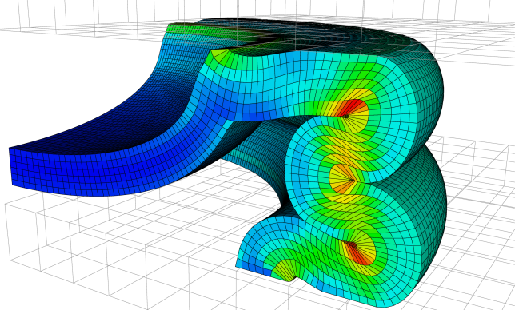
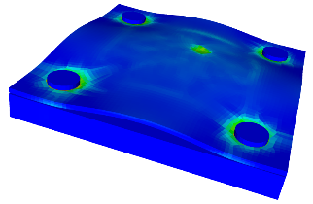
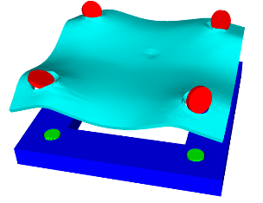
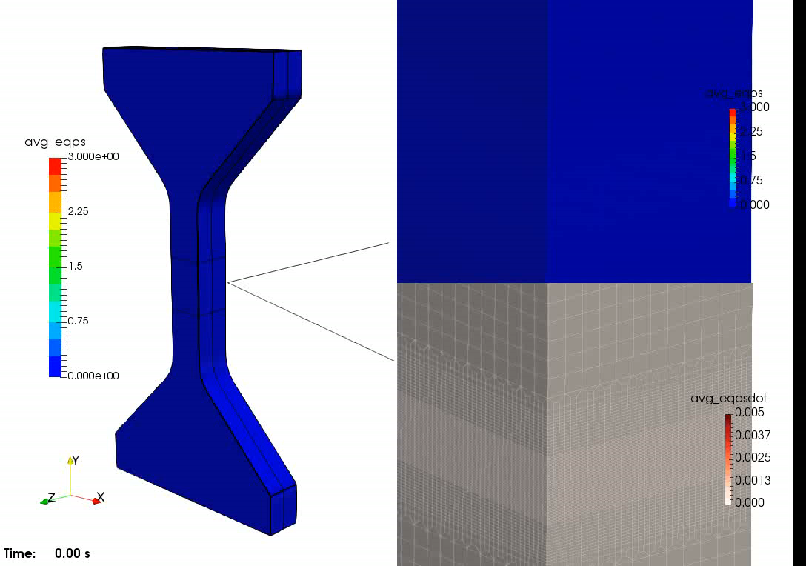
SIERRA 100: Solid Mechanics – Capabilities Overview
Sierra/SM is a Sandia-developed massively parallel nonlinear solid mechanics finite element code.
Capabilities and features include:
Dynamic and quasistatic analysis
  Explicit and implicit time integration
Nonlinear geometries, materials, and contact
Coupling with other physics: structural dynamics,
thermal/fluid, blast, etc.
Wide variety of supported element types
Broad selection of material models
Fracture and failure
Performant and scalable on HPC systems
Customizable outputs
Large Deformation/Contact
Preload
Fastener Failure
Material Failure
3
Notes:
Image: Sandia Fracture Challenge 4 punch problem – cutaway shows element death

Slide 4
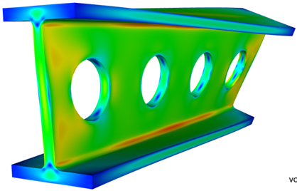

SIERRA 100: Solid Mechanics – Sampling of Capabilities
Nonlinear Boundary Conditions
  Spatially and temporally varying
  Kinematic: displacement, velocity, acceleration
  Loads: force, pressure, traction, gravity, etc.
Element Types
  3D solids: hexahedra, tetrahedra
  Structural: shells, membranes, beams, trusses
  Specialized: rigid bodies, particles, etc.
Material Models
  Metals, composites, polymers, etc.
  Failure: plasticity localization, damage, fracture
  Both production-level and research
4

Slide 5
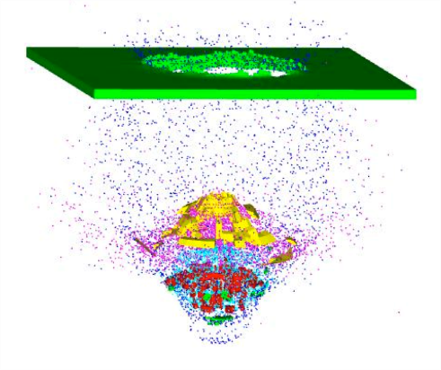
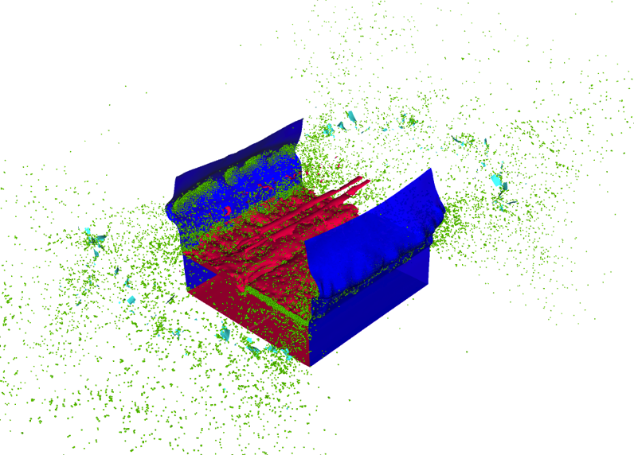
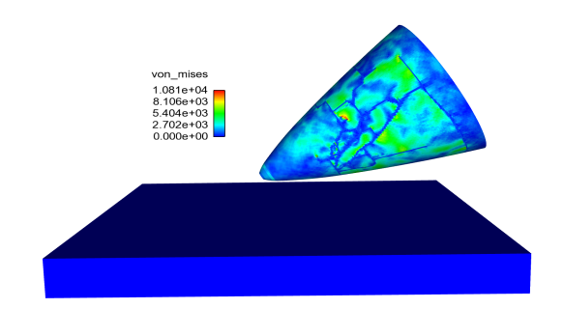
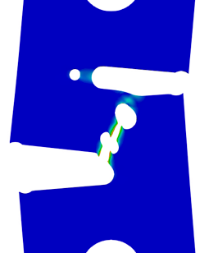
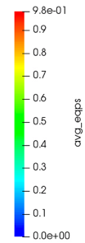
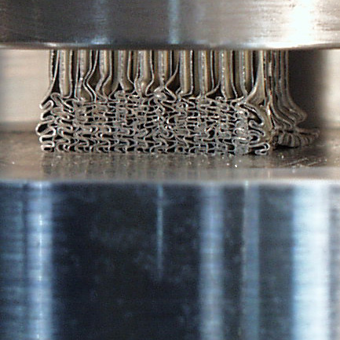
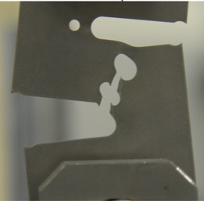
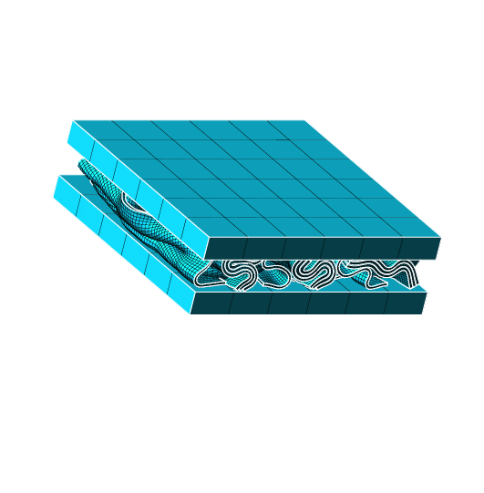
SIERRA/SM: Use Cases
Fragmentation
Impact
Crush
Preload
Fracture/failure
Blast-on-structure
Impact
Crush
Failure
5

Slide 6
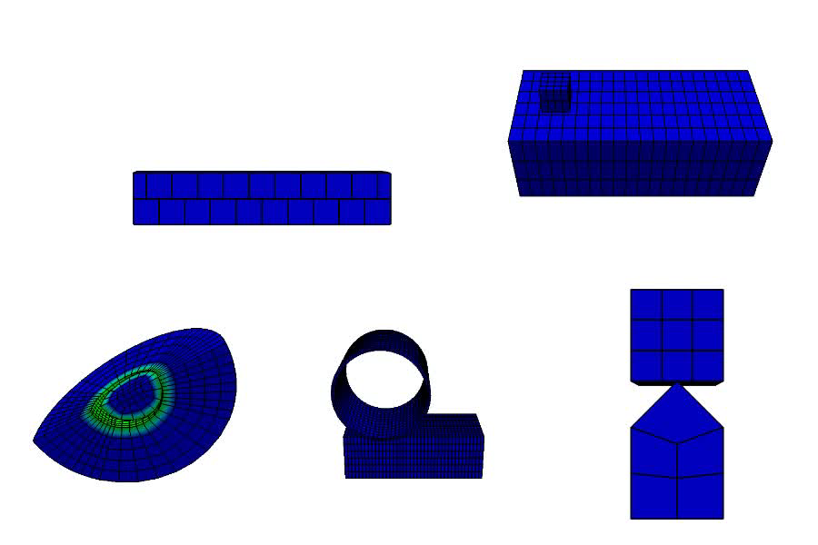
SIERRA/SM: Use Cases
Contact
6

Slide 7
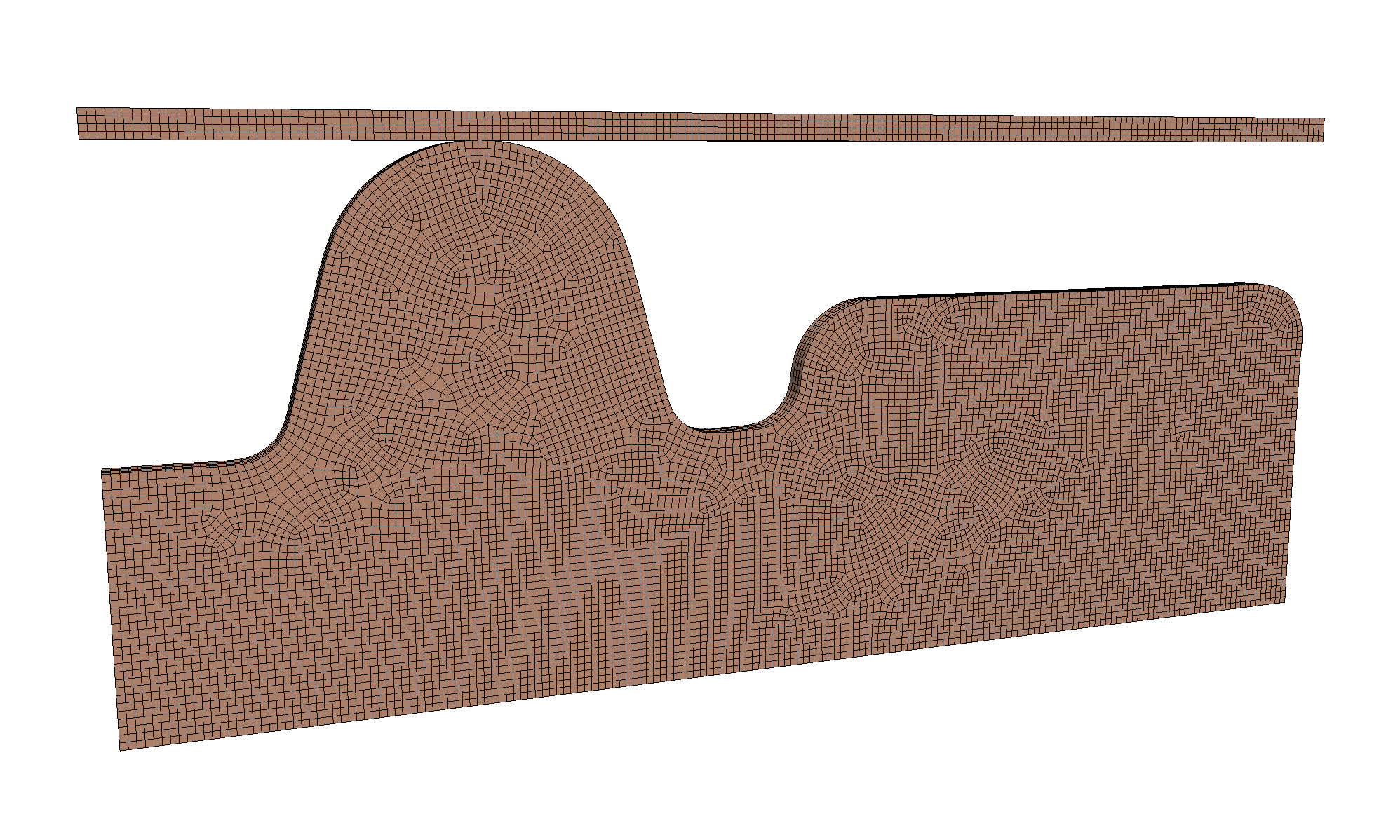
SIERRA/SM: Use Cases
Preload
7

Slide 8
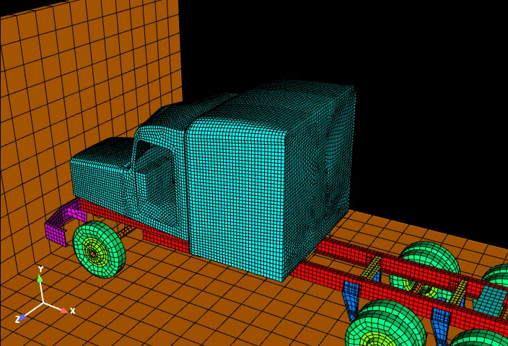
SIERRA/SM: Use Cases
Vehicle Impact Simulation
8

Slide 9
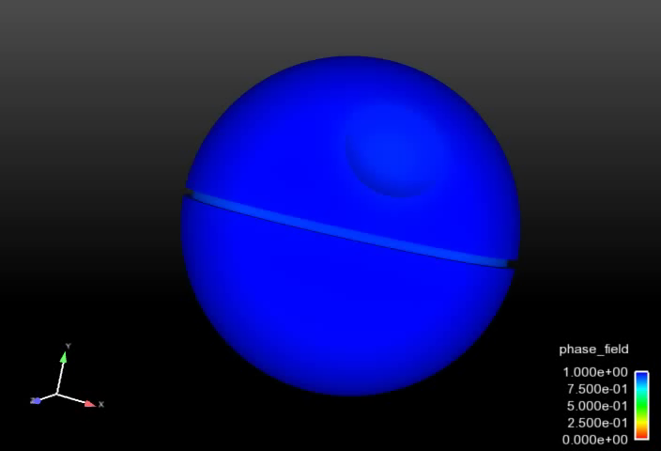
SIERRA/SM: Use Cases
Fracture / Failure
9

