Slide 1

SIERRA/Fuego Interactive Demo
Low-Mach CFD
Sierra/TF Team
SAND2022-4257 TR
UNCLASSIFIED // UNLIMITED RELEASE

Slide 2
Contents
Loading the mesh and input file template in SAW
Setting up and running a basic laminar problem (flow over a cylinder)
Troubleshooting and reading the log file
Adding a turbulence model
Post-processing
Modifying boundary conditions

Slide 3
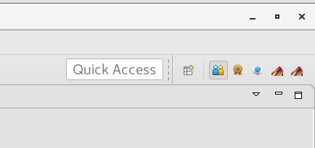
Loading the Problem in SAW
Launch SAW (if it’s not already open)
Click an icon for it if available
Launch from the command line
Pick a SAW perspective
“Team (default)” is often most useful for Fuego
“SIERRA Editing” is also decent (but hides the Project Navigator view)
Add it back with Window » Show View » Other » General » Navigator
Right click on the desktop
Choose “Open Terminal”
Type module load saw and press enter
Type saw and press enter
Using SAW is not required to use Fuego. Most current Fuego users launch commands from the terminal and use a text editor of their choice to edit the input file.
This training will use SAW as a Sierra Editor, but will have terminal commands shown for reference.
example terminal command

Slide 4
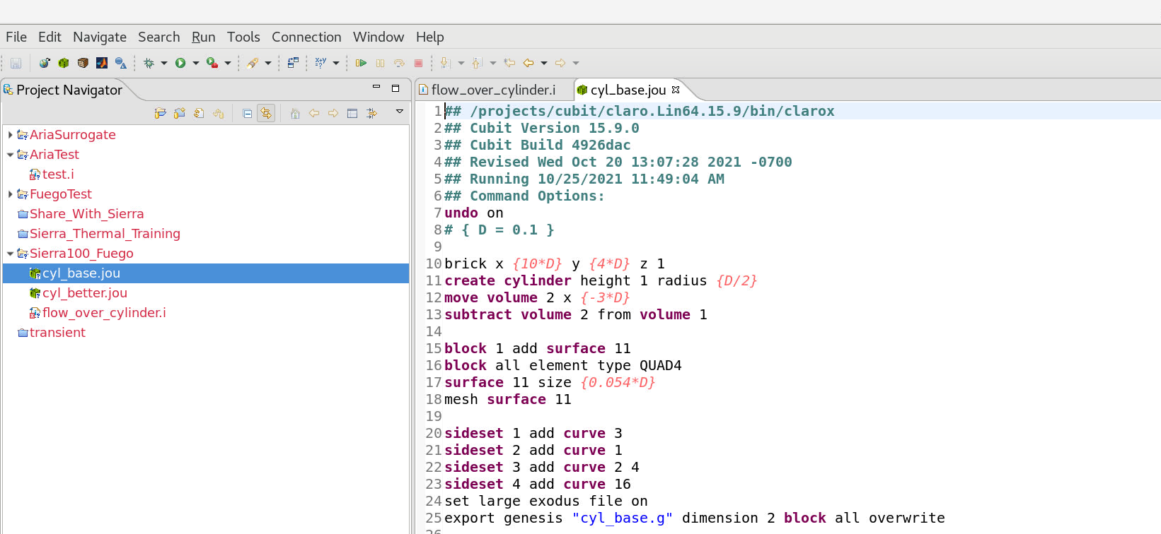
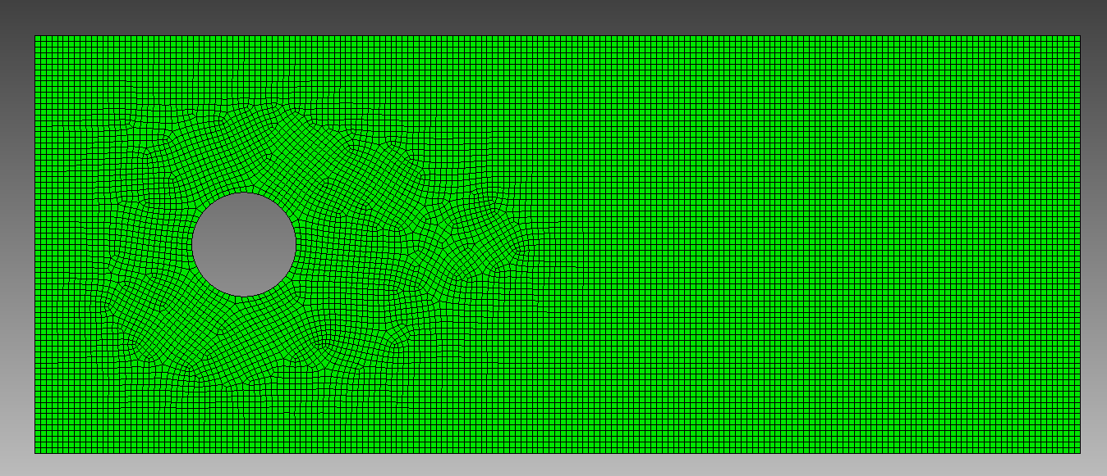
Loading the Problem in SAW
Use the same project we used before
Loaded from /projects/sierra100/TF
Go to the “Fuego” directory
Generate the base mesh
Open journal file (cyl_base.jou)
Click the “Play Journal” button
Make sure it made the correct mesh (sometimes this somehow runs the wrong journal file) – if not, delete the .g file and try again
mesh cyl_base.jou
Add this to your ~/.bashrc file if you want to mesh from the command line easily
alias mesh='/projects/cubit/cubit –nojournal –nographics –batch '
cubit cyl_base.jou

Slide 5
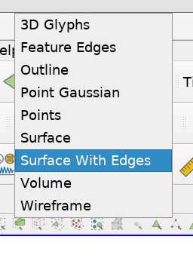
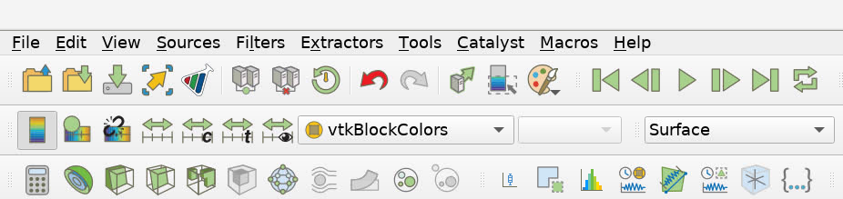
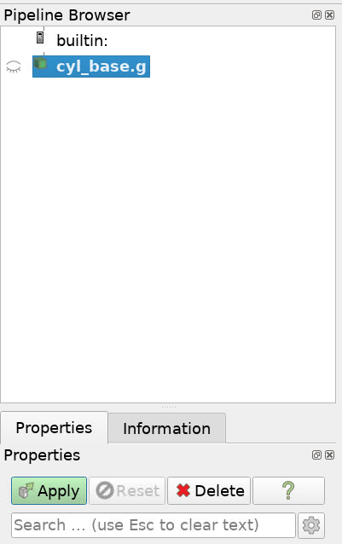
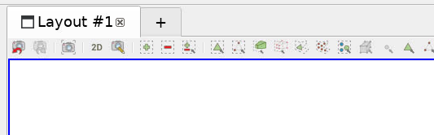
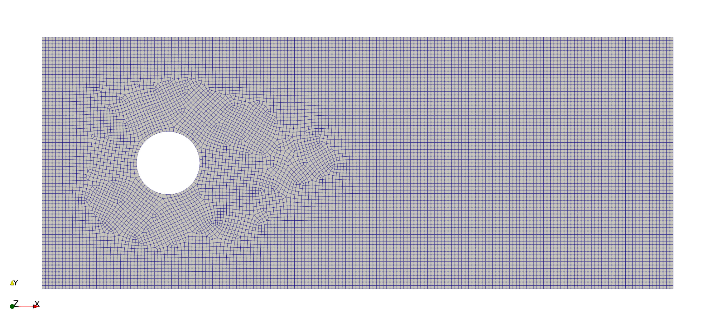
Show the mesh in ParaView
Right click on the mesh file
Visualize » Launch ParaView
Choose “Local” viz and click “Run”
Change the view from “Surface” to “Surface With Edges” to see the mesh grid
Left-click and drag to move the model around
Enable “3D” mode if you want to pan (mesh is 2D)
Sideset 3
Sideset 1
Sideset 2
Click “Apply” to load the mesh
Sideset 4
module load viz
paraview cyl_base.g

Slide 6
Setting up the problem
We will start with the flow_over_cylinder.i template file and fill in the missing sections as we go
If you get lost, the complete version is in flow_over_cylinder_complete.i version
Avoid copying commands from Powerpoint – sometimes special characters get included
Files for later modules are also present (turbulent, post-processor)
Double click on the input file to open it in the SAW editor
The file won’t run as-is, several important parts are missing
Input files can be edited in a standard text editor of your choice as well
gedit flow_over_cylinder.i
emacs flow_over_cylinder.i

Slide 7
Material Properties
Fuego generally only needs one material definition (the fluid)
For isothermal flow, we just need density and viscosity (dynamic)
More complicated fluids often use a Cantera XML file to define material properties
#-----------------------------------------------------------
# DEFINE MATERIAL PROPERTIES
Begin Property Specification for Fuego Material air
Density = 1.2
Viscosity = 1.8e-5
End Property Specification for Fuego Material air
Values here should be in your problem units – defined later. We’ll use MKS here.
One exception is pressure – if required reference pressure in the material block is always in atm

Slide 8
Finite Element - Associate materials with blocks
Each block in the mesh needs a material assigned to it
Typically, there is no reason to have a large number of blocks in Fuego
Elements of different topologies (hex, tet, wedge, pyramid) must go in separate blocks
May want different initial conditions in some places based on block specifications
#-------------------------------------------
# DEFINE MESH AND ASSIGN MATERIALS
Begin Finite Element Model cylMesh
Database Name = cyl_base.g
Database Type = ExodusII
Decomposition Method = RIB
# ASSIGN MATERIALS TO BLOCKS
Begin Parameters for Block block_1
Material air
End Parameters for Block block_1
End Finite Element Model cylMesh
Name of our mesh file
Mesh decomposition method
This is optional, will default to RIB
Fuego will auto-decompose your mesh file for parallel jobs, no need to run “decomp” beforehand
Auto-decomposing runs in parallel and is often significantly faster than “decomp” (> 30x)

Slide 9

Time stepping control
Fuego can use fixed or adaptive time stepping
Most Fuego problems are transient, but steady problems can also be solved using a pseudo-transient approach
#-----------------------------------------------
Begin Fuego Procedure Fuego_procedure
Time Start = 0.0, Stop = 10.0, Status Interval = 10
begin time control
BEGIN TIME STEPPING BLOCK time_block
START TIME IS 0.0
TIME STEP = 1e-3
BEGIN PARAMETERS FOR FUEGO REGION fuego_region
TRANSIENT STEP TYPE IS automatic
CFL LIMIT = 5.0
TIME STEP CHANGE FACTOR = 1.5
END PARAMETERS FOR FUEGO REGION fuego_region
END TIME STEPPING BLOCK time_block
Termination time = 1e6
end time control
Fuego will print extra information to the log file every 10 steps
Automatic time stepping adjusts time step based on the global maximum CFL in any element
$$CFL=\frac{u∆t}{∆x}$$

Slide 10
Region-level parameters
As in other Sierra codes, the “Region” block corresponds to a mesh/physical domain
For this problem it doesn’t actually matter what we set the unit system to here. If we are using Cantera, tabulated chemistry, or pre-defined universal constants we need the unit system to do conversions properly.
#-------------------------------------------------
Begin Fuego Region Fuego_region
# SET THE UNITS
Set unit system to MKS
# DECLARE WHICH MESH/FINITE ELEMENT MODEL TO USE
Use Finite Element Model cylMesh
Fuego supports pre-defined MKS or CGS unit systems
Users can specify custom mass-length-time scaling factors for other unit systems
Defaults to CGS if this is omitted
Indicate which finite element model (mesh) to use
BEGIN FUEGO REGION FLUID
# Does the same thing as “SET UNIT SYSTEM TO MKS”
SET LENGTH UNIT CONVERSION FACTOR = 100.0
SET MASS UNIT CONVERSION FACTOR = 1000.0
SET TIME UNIT CONVERSION FACTOR = 1.0
SET TEMPERATURE UNITS = KELVIN
BEGIN FUEGO REGION FLUID
# use a non-standard mm-g-s unit system
SET LENGTH UNIT CONVERSION FACTOR = 0.1
SET MASS UNIT CONVERSION FACTOR = 1.0
SET TIME UNIT CONVERSION FACTOR = 1.0

Slide 11
Solution Options – Physics models and numerical choices
The “Solution Options” block defines what equations to solve, and sets various numerical algorithm choices
Begin Solution Options
Coordinate System = 2D
Projection Method = Fourth_Order Smoothing with Timestep Scaling
# DEFINE WHAT EQUATIONS TO SOLVE
Activate Equation Continuity
Activate Equation X_Momentum
Activate Equation Y_Momentum
# DEFINE NONLINEAR ITERATION SETTINGS
Minimum Number of Nonlinear Iterations = 1
Maximum Number of Nonlinear Iterations = 2
# DEFINE ADVECTION SCHEME
Upwind Method is MUSCL
UPWIND LIMITER IS SuperBee
End Solution Options
Pressure stabilization method is a topic for a more detailed class – most common choice here works most of the time
For laminar, isothermal flow we just need continuity and momentum equations (X/Y or X/Y/Z for 3D)
Define the number of nonlinear iterations to take
The default nonlinear tolerance is 10⁻¹⁵, which is small enough that Fuego will almost always take the maximum number of iterations
For more advanced control, you can set a target nonlinear tolerance per equation
We must choose which algorithm to use to handle the advection term (“Upwind Method”) in the transport equations
There are a lot of options (for a more detailed class)
UPW = Upwind = More stable, more dissipative, 1st order
MUSCL = Less dissipative, 2nd order, usually needs a limiter
Monotonic Upstream-centered Scheme for Conservation Laws

Slide 12
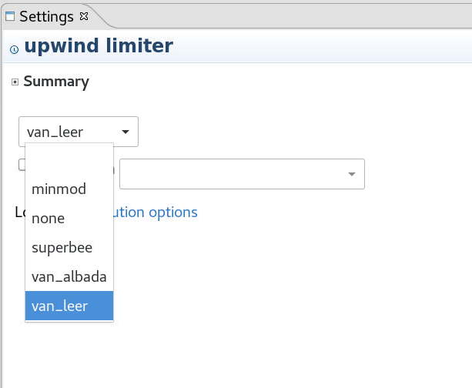
Solution Options – Available Options
Use the “Settings” panel to see available input options
# DEFINE ADVECTION SCHEME
Upwind Method is MUSCL
UPWIND LIMITER IS SuperBee
End Solution Options
Expand the Summary to see the same text that is in the user manual
Click on “SuperBee” and look in the settings to see other limiter options
If you change the options, you have to click “Apply” to apply them back to the input file
If the “Settings” panel is blank, you may need to restart SAW to see entries there. This panel isn’t needed for the training though so you can just ignore it too.

Slide 13
Initial Conditions
The initial conditions block goes in the Fuego region
If you are missing an initial condition for any equation’s variable on any block, Fuego will abort with an error – there are no default initial conditions
Fuego is low-Mach/incompressible (density is not a function of local pressure) so the pressure DOF can be in gauge values
# SET INITIAL CONDITIONS
Begin Initial Condition Block FlowInit
Volume is block_1
Pressure = 0.0
X_Velocity = 0.0
Y_Velocity = 0.0
End
Multiple blocks can be added to this line, or with additional “Volume” lines
You must provide an initial condition for each equation you activated in the prior section. These can be constants, subroutines, or string functions of space/time (t,x,y,z)

Slide 14
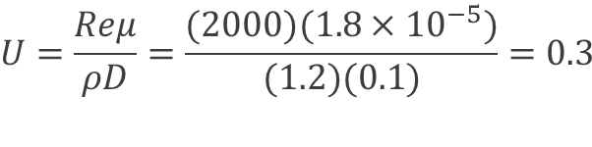
Boundary Conditions
$$U=\frac{Reμ}{ρD}=\frac{(2000)(1.8×{10}^{−5})}{(1.2)(0.1)}=0.3$$
The most common boundary conditions in Fuego are:
Wall
Open
Inflow
Mass Flux
Symmetry
Periodic
All exposed surfaces must have a boundary condition applied. Fuego will throw an error if there are surfaces without a BC
# SET BOUNDARY CONDITIONS
Begin Inflow Boundary Condition on Surface surface_1
X_Velocity = (2000*1.8e-5)/(1.2*0.1)
Y_Velocity = 0.0
End
Begin Open Boundary Condition on Surface surface_2
Pressure = 0.0
End
Begin Symmetry Boundary Condition on Surface surface_3
End
Begin Wall Boundary Condition on Surface surface_4
post process yplus
End
Inflow requires the velocity and any entrained properties (e.g. temperature)
Open requires pressure and any entrained properties (e.g. temperature)
Wall and symmetry require no parameters here
There are optional parameters and post-processors on the wall
Sideset 3
Sideset 1
Sideset 2
Sideset 4

Slide 15
Exodus Output
Fuego uses the same results output format as Aria
Output can be done at time or step increments
Naming vector quantities with x/y/z suffix allows ParaView to display them as a vector
Fuego log file lists all available global, nodal, element, and face variables that can be output
# DEFINE OUTPUT
Begin Results Output Label Fuego_output
Database Name = results/cylinder.e
At Time 0, Interval = 0.1
Title Flow over a cylinder
Nodal Variables = Pressure as P
Nodal Variables = X_Velocity as Ux
Nodal Variables = Y_Velocity as Uy
Nodal Variables = yplus
End
Output directory will be automatically created if it doesn’t exist

Slide 16
Running Fuego
You can launch a Fuego job using SAW or from the command line
Right click the input file » Submit Job » Sierra
Choose the “Run in sub-directory” option if you want to keep jobs from overwriting old results
Choose “Local” for the machine, and set the number of processors on the “Machine” tab
On the “Code Parameters” tab, check only the “Purge Modules” option
Click “Run”
module load sierra
launch –n 4 fuego –i flow_over_cylinder.i

Slide 17
Reading the log file
The job should complete in about 45 seconds on 4 cores. In the meantime, we can look at the log file.
What to look for in the log file:
Error messages (if something went wrong)
Warnings (deprecations, assumed defaults)
Solution progression:
Appropriately small non-linear residual values
Linear solver performance
Max velocity
Log file outline
Run info (code version, number of procs)
Echo of the input file
Problem setup info
List of all global/nodal/element variables
Time Stepping: Time step header (number, step size) Nonlinear iteration BC Summary
Timer summary
Log files can be named manually or automatically
fuego –i myfile.i
fuego –i myfile.i –o stats.log
myfile.log
stats.log

Slide 18
Reading the log file
Max CFL
Step 2 , Time = 3.750e-03, dT = 2.250000e-03, Simulation is 0.0% complete
Fuego Nonlinear Residuals of the Equation Sets Linear Linear
Nonlinear Cell Reynolds number(max) = 250.7 Solver Solver
Iteration CFL(max) = 0.1658 Iterations Residual DOF Min DOF Max
--------- --------------------------------------------- ---------- -------- ---------- ----------
1 of 2 : SubMechanicsManager
1 of 1 : MomentumSubMech
X_Momentum = 7.06e-03 2 2.42e-12 0.00e+00 1.51e+00
Y_Momentum = 7.40e-04 2 5.02e-12 -6.93e-01 6.80e-01
Continuity = 1.45e-04 16 2.83e-09 -9.17e-01 2.33e+00
Velocity pre-correction -----------------------------------> 0.00 1.51
Velocity post-correction ----------------------------------> 0.01 0.68
Fuego Nonlinear Residuals of the Equation Sets Linear Linear
Nonlinear Cell Reynolds number(max) = 250.7 Solver Solver
Iteration CFL(max) = 0.2487 Iterations Residual DOF Min DOF Max
--------- --------------------------------------------- ---------- -------- ---------- ----------
2 of 2 : SubMechanicsManager
1 of 1 : MomentumSubMech
X_Momentum = 4.78e-05 2 3.15e-12 0.00e+00 6.85e-01
Y_Momentum = 1.67e-05 2 4.76e-12 -3.08e-01 3.25e-01
Continuity = 4.98e-05 13 3.24e-09 -3.86e-01 5.83e-01
Velocity pre-correction -----------------------------------> 0.00 0.69
Velocity post-correction ----------------------------------> 0.02 0.62
Linear solver residuals and iteration counts
Min and max DOF values
The change here should get smaller
Check that nonlinear residuals are decreasing

Slide 19
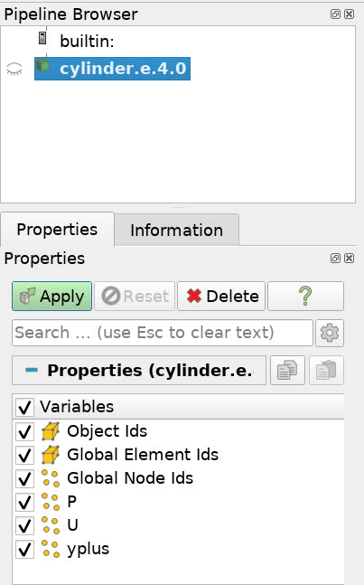
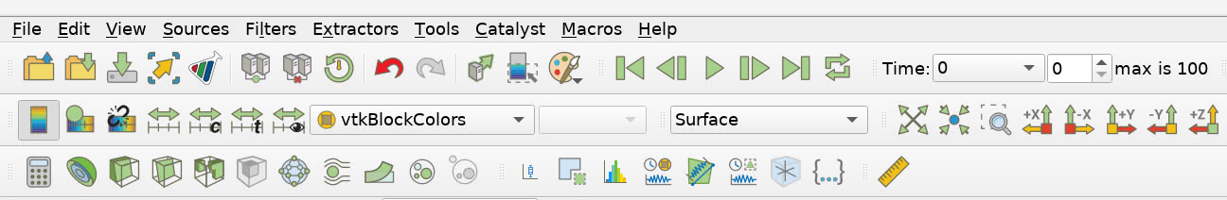
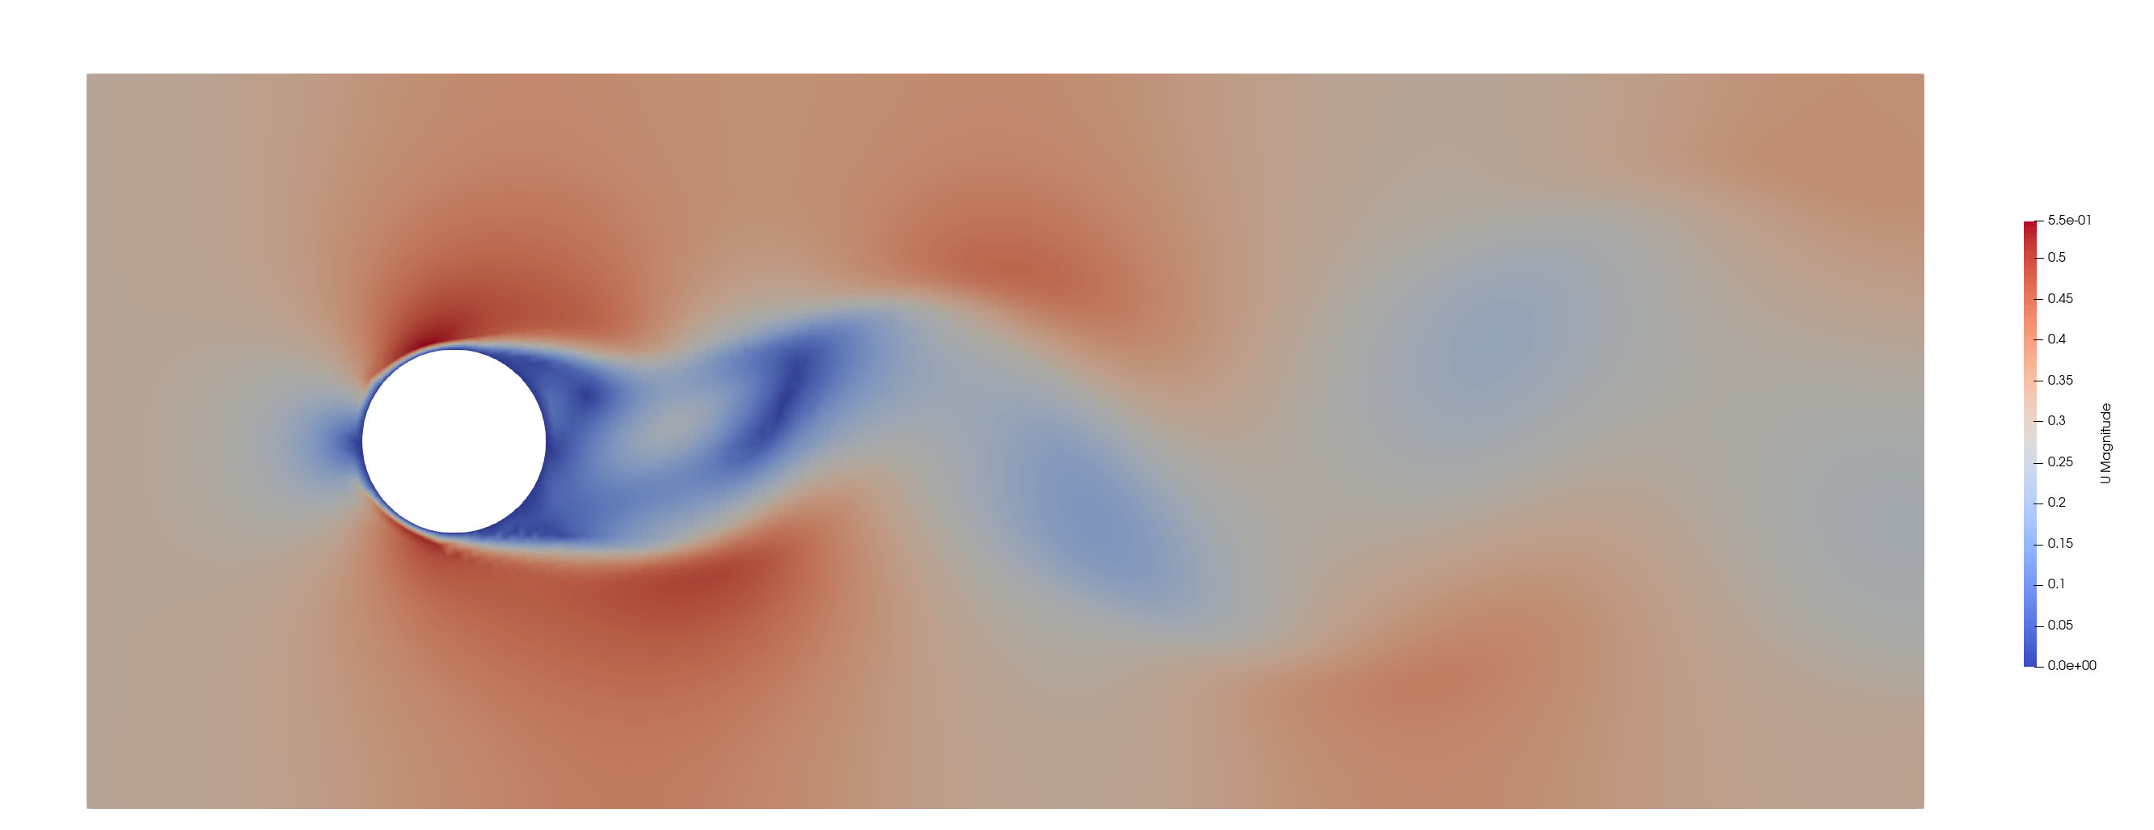
Viewing Results
module load viz
paraview results/cylinder.e.4.0
Find the output files (cylinder.e.4.x) in the Project Navigator
Right click on the root file (.e.4.0) » Visualize » Launch ParaView » Run
4
1
3
2
Go to the last time step (1), then pick “U” to view the velocity vector magnitude (2)
If you show “U” first, the color scale will be off when you go to the final time. Use the “rescale” button (3) to fix it.
Click “Play” (4) to watch the flow evolve.
Select the variables to show and click “Apply”

Slide 20
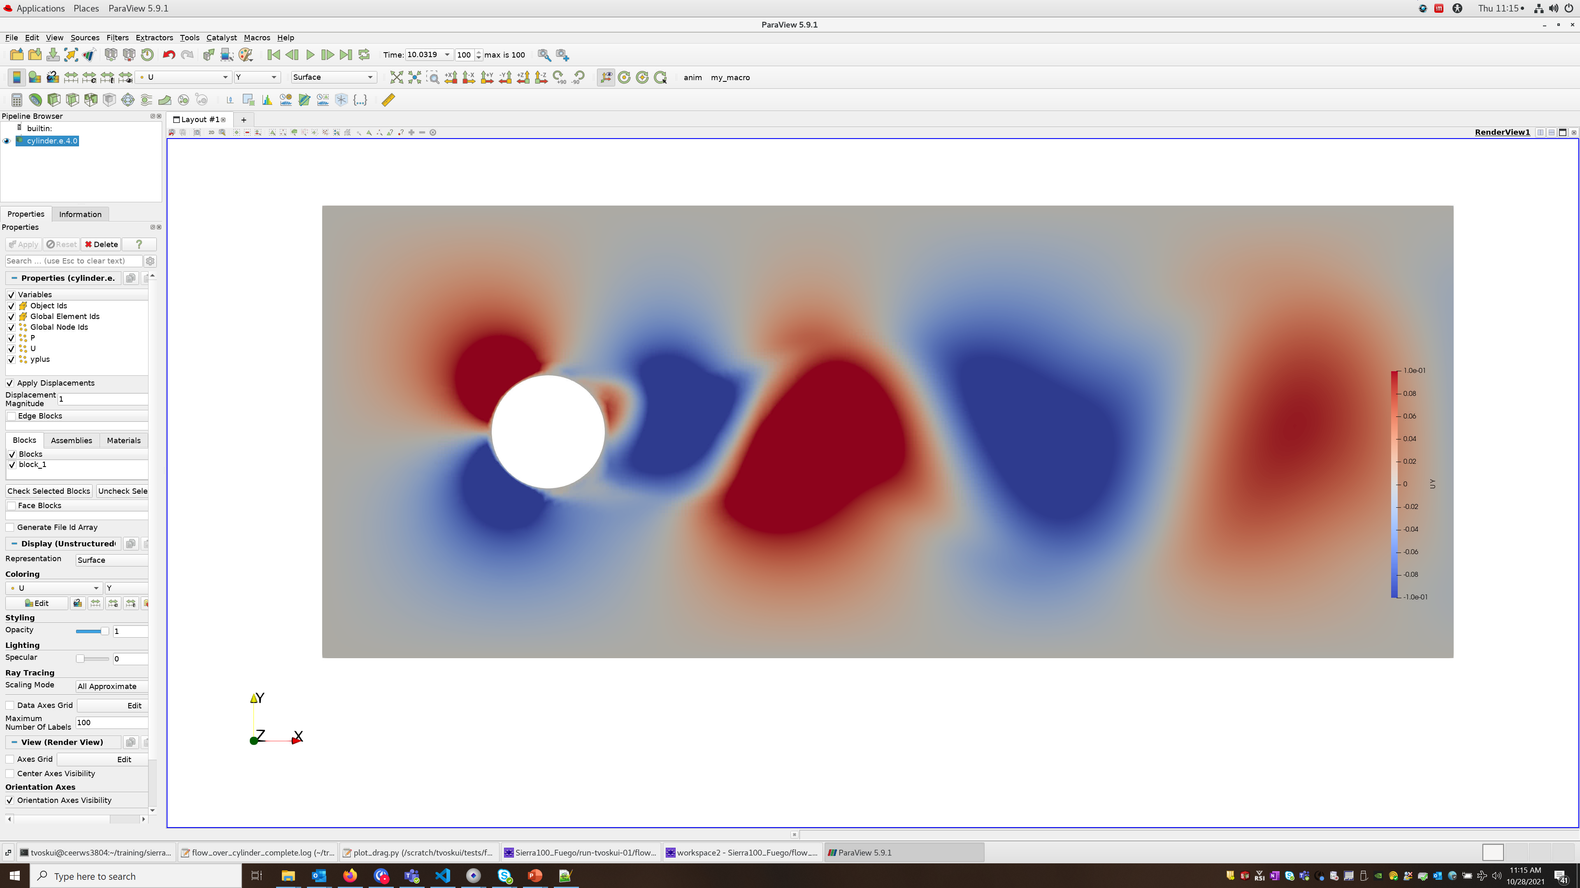
Viewing Results
Try viewing the vortex shedding differently
At what time does the periodic shedding begin?
3
2
1
Change the visualization to show the Y component of velocity instead of magnitude (1)
Rescale the color range to go from -0.1 to 0.1 (2)
Click play (3) to watch the varying upward/downward flow sections

Slide 21
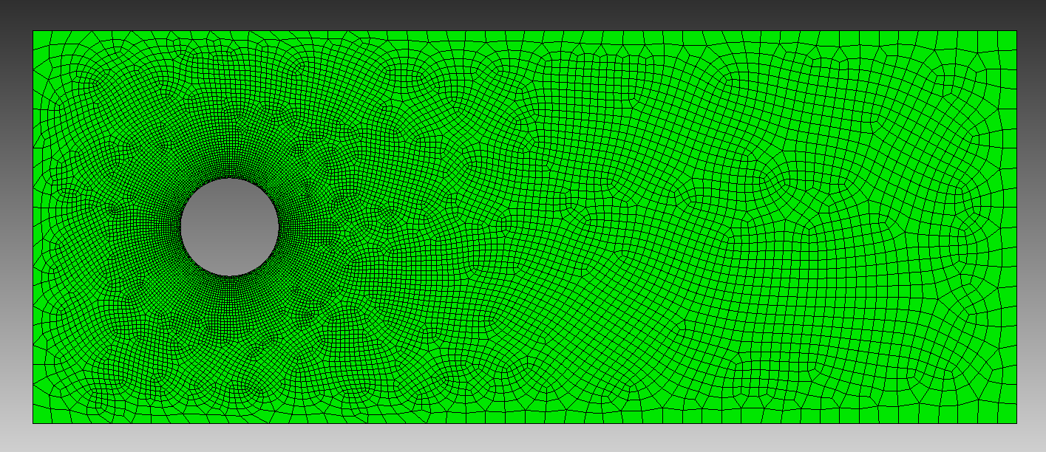
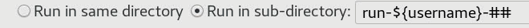
Using a better mesh
Open the other journal file (cyl_better.jou) and click “Play Journal File” to make the mesh
Change the mesh file listed in the “Finite Element Model” block
Launch the job if you want (takes a few minutes, so we won’t wait for it here)
Right click the input file » Submit Job » Sierra
Be sure to select the new mesh file in the list of input files
Run it in a sub-directory
Total element count is about the same, but finer near the cylinder and coarser away from it
mesh cyl_better.jou

Slide 22
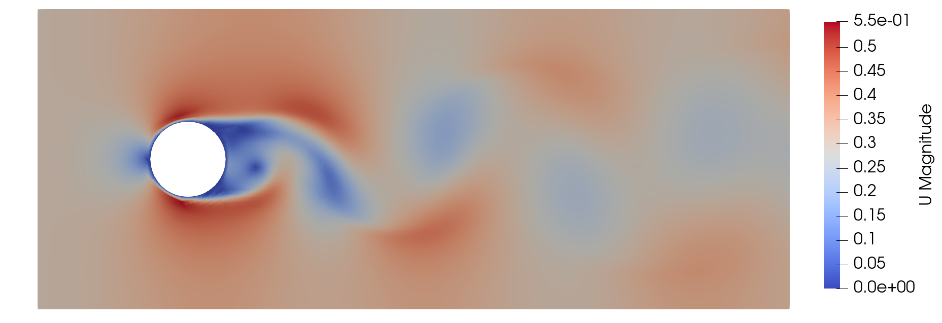
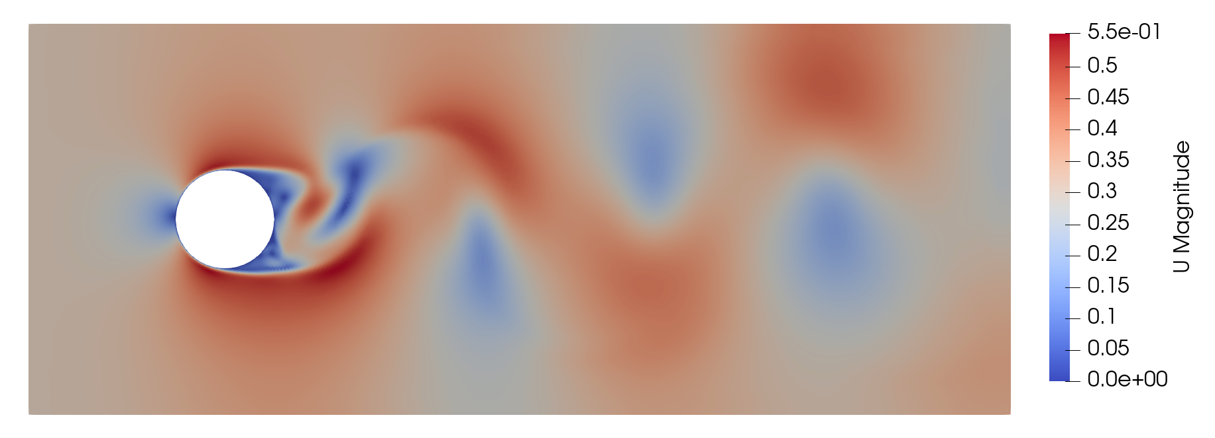

Better Mesh Results
The run on the better mesh takes a bit longer to run
Smaller elements mean smaller time steps at the same CFL limit
Base Mesh
$$CFL=\frac{u∆t}{∆x}$$
Better Mesh

Slide 23
Troubleshooting
In general, if your simulation fails to run correctly, or produces results different from what you expected, here are some steps you can take:
Check if SAW highlighted any syntax in your input file
Check the log file! Look for:
The words “Error” and “Warning”
High max CFL
Linear and nonlinear residual nonconvergence
High maximum velocities, or large velocity corrections
Visualize the solution (ParaView), and look for anomalous regions of flow
Let’s try to create some common errors by editing our input file

Slide 24
Troubleshooting
Common Error #1: Forgetting to specify an initial condition
Try commenting the X_Velocity line in the IC block
Run the simulation, and jump to the end of the log file:
# SET INITIAL CONDITIONS
Begin Initial Condition Block FlowInit
Volume is block_1
Pressure = 0.0
#X_Velocity = 0.0
Y_Velocity = 0.0
End
This is the line number in the input file where you should look.
flow_over_cylinder.i:90: Exception: Missing initial condition for x_velocity on block_1 flow_over_cylinder.i:90: flow_over_cylinder.i:90: in command block INITIAL CONDITION BLOCK FlowInit
SIERRA execution failed during instantiation with the following exception: Missing initial condition for x_velocity on block_1
from int main( int argc, char ** argv )
SIERRA execution failed
This gives us a strong hint.
This is usually your first indication that there was a problem.

Slide 25
Troubleshooting
#-------------------------------------------
# DEFINE MESH AND ASSIGN MATERIALS
Begin Finite Element Model cylMesh
Database Name = cyl_base2.g
Database Type = ExodusII
Decomposition Method = RIB
# ASSIGN MATERIALS TO BLOCKS
Begin Parameters for Block block_1
Material air
End Parameters for Block block_1
End Finite Element Model cylMesh
Common Error #2: Wrong mesh file
Try changing the name of the mesh file to cyl_base2.g
Notice that SAW highlights it!
Run the simulation, and jump to the end of the log file:
flow_over_cylinder.i:54: Exception:
flow_over_cylinder.i:54: ERROR: The finite element mesh ‘yourDir/cyl_base2.g’ flow_over_cylinder.i:54: associated with the finite element model ‘cylMesh’
flow_over_cylinder.i:54:
flow_over_cylinder.i:54: ERROR: Unable to open input exodus database file ‘yourDir/cyl_base2.g’ on processors:
flow_over_cylinder.i:54: 0, 1, 2, 3
flow_over_cylinder.i:54: Check that file(s) on those processors: exist, are readable/writable, and are non-zero size.

Slide 26
Troubleshooting
Common Error #3: Typo in output variable
Try changing the name of the pressure output to Pressure2
SAW doesn’t catch this one, will only see at runtime
Simulation runs fine. Search for warning in the log file.
# DEFINE OUTPUT
Begin Results Output Label Fuego_output
Database Name = results/cylinder.e
At Time 0, Interval = 0.1
Title Flow over a cylinder
Nodal Variables = Pressure2 as P
Nodal Variables = X_Velocity as Ux
Nodal Variables = Y_Velocity as Uy
Nodal Variables = yplus
End
***********************************************************************************************************************
** Warning: ** In region ‘Fuego Region’ Results Output block ‘Label Fuego_output’, Nodal variable ‘Pressure2’ was not found and
** will not be output
***********************************************************************************************************************

Slide 27
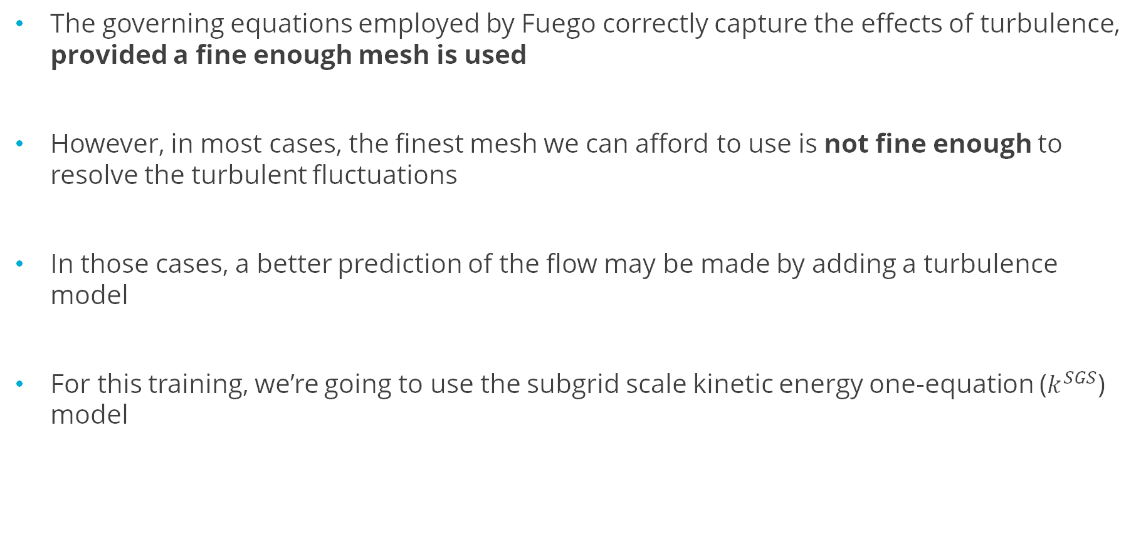
Adding a turbulence model
flow_over_cylinder_turb.i
The governing equations employed by Fuego correctly capture the effects of turbulence, provided a fine enough mesh is used
However, in most cases, the finest mesh we can afford to use is not fine enough to resolve the turbulent fluctuations
In those cases, a better prediction of the flow may be made by adding a turbulence model
For this training, we’re going to use the subgrid scale kinetic energy one-equation ($k^{SGS}$) model

Slide 28
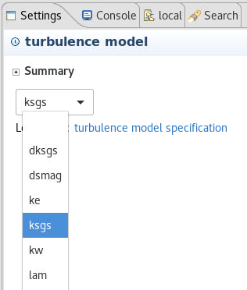
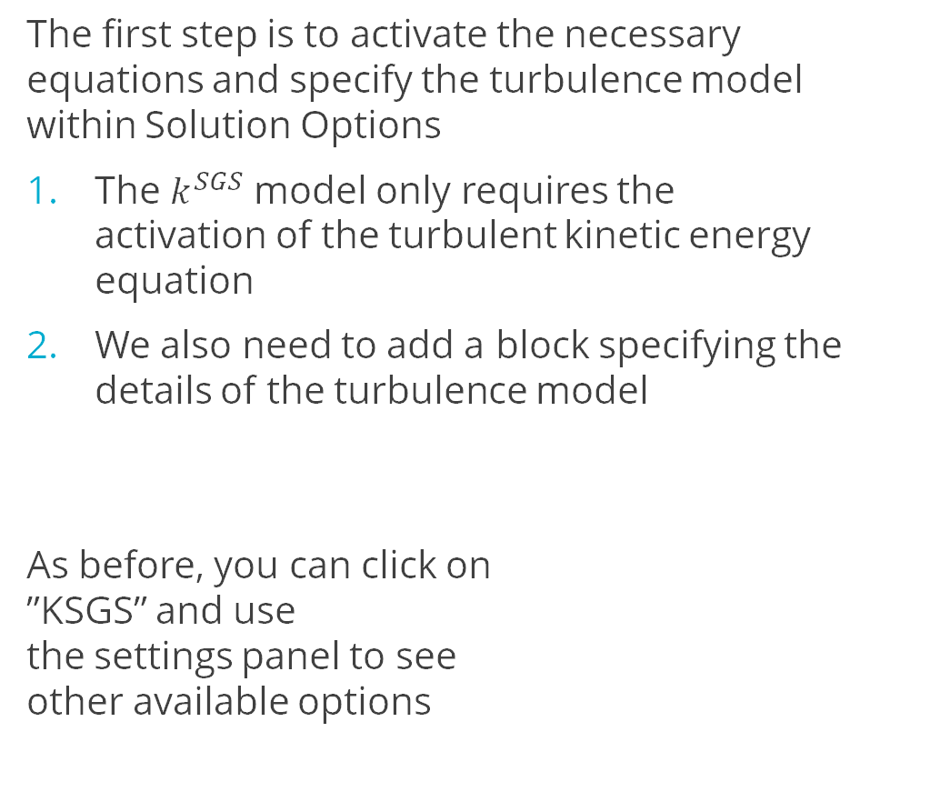
Adding a turbulence model – Equations and model specification
The first step is to activate the necessary equations and specify the turbulence model within Solution Options
The $k^{SGS}$ model only requires the activation of the turbulent kinetic energy equation
We also need to add a block specifying the details of the turbulence model
As before, you can click on ”KSGS” and use the settings panel to see other available options
Begin Solution Options
Coordinate System = 2D
Projection Method = Fourth_Order Smoothing with Timestep Scaling
# DEFINE WHAT EQUATIONS TO SOLVE
Activate Equation Continuity
Activate Equation X_Momentum
Activate Equation Y_Momentum Activate Equation Turbulent_Kinetic_Energy
# DEFINE NONLINEAR ITERATION SETTINGS
Minimum Number of Nonlinear Iterations = 1
Maximum Number of Nonlinear Iterations = 2
# DEFINE ADVECTION SCHEME
Upwind Method is MUSCL
UPWIND LIMITER IS SuperBee
# ADD TURBULENCE MODEL
Begin Turbulence Model Specification
Turbulence Model = KSGS
End
End Solution Options
1
2

Slide 29
Adding a turbulence model – ICs and BCs
# SET INITIAL CONDITIONS
Begin Initial Condition Block FlowInit
Volume is block_1
Pressure = 0.0
X_Velocity = 0.0
Y_Velocity = 0.0
Turbulent_Kinetic_Energy = 1.0e-4
End # SET BOUNDARY CONDITIONS
Begin Inflow Boundary Condition on Surface surface_1
X_Velocity = (2000*1.8e-5)/(1.2*0.1)
Y_Velocity = 0.0
Turbulent_Kinetic_Energy = 1.0e-4
End
Begin Open Boundary Condition on Surface surface_2
Pressure = 0.0
Turbulent_Kinetic_Energy = 1.0e-4
End
Begin Symmetry Boundary Condition on Surface surface_3
End
Begin Wall Boundary Condition on Surface surface_4
post process yplus
End
The next step is to add initial and boundary conditions for turbulent_kinetic_energy
TKE must be positive – Fuego will clip the solution values to guarantee this to a lower limit determined by your problem units
Required anywhere flow can transport TKE into the domain (including outlet)
Not required at wall BC; TKE uses a zero flux condition by default on the wall

Slide 30
Adding a turbulence model – extra output
We have a new field available to output too
Add it to the results output block
Launch the job the usual way
Right click the input file » Submit Job » Sierra
# DEFINE OUTPUT
Begin Results Output Label Fuego_output
Database Name = results/cylinder.e
At Time 0, Interval = 0.1
Title Flow over a cylinder
Nodal Variables = Pressure as P
Nodal Variables = X_Velocity as Ux
Nodal Variables = Y_Velocity as Uy
Nodal Variables = yplus
Nodal Variables = turbulent_kinetic_energy as TKE
End

Slide 31
Adding a turbulence model – Log file
Step 2 , Time = 3.750e-03, dT = 2.250000e-03, Simulation is 0.0% complete
Fuego Nonlinear Residuals of the Equation Sets Linear Linear
Nonlinear Cell Reynolds number(max) = 168.6 Solver Solver
Iteration CFL(max) = 0.1636 Iterations Residual DOF Min DOF Max
--------- --------------------------------------------- ---------- -------- ---------- ----------
1 of 2 : SubMechanicsManager
1 of 1 : MomentumSubMech
X_Momentum = 7.05e-03 2 2.56e-13 7.01e-02 1.51e+00
Y_Momentum = 6.89e-04 1 1.50e-07 -7.18e-01 7.05e-01
Continuity = 1.45e-04 17 3.68e-09 -4.40e-01 8.72e-01
Velocity pre-correction -----------------------------------> 0.07 1.51
Velocity post-correction ----------------------------------> 0.01 0.60
1 of 1 : KSGSSubMech
Turbulent_Kinetic_Energy = 1.99e-06 1 3.69e-08 9.87e-05 1.18e-02
Fuego Nonlinear Residuals of the Equation Sets Linear Linear
Nonlinear Cell Reynolds number(max) = 168.6 Solver Solver
Iteration CFL(max) = 0.2455 Iterations Residual DOF Min DOF Max
--------- --------------------------------------------- ---------- -------- ---------- ----------
2 of 2 : SubMechanicsManager
1 of 1 : MomentumSubMech
X_Momentum = 4.80e-05 1 6.01e-08 1.16e-02 6.12e-01
Y_Momentum = 1.77e-05 1 2.44e-07 -3.01e-01 2.97e-01
Continuity = 4.66e-05 13 8.62e-09 -1.82e-01 4.50e-01
Velocity pre-correction -----------------------------------> 0.01 0.61
Velocity post-correction ----------------------------------> 0.01 0.61
1 of 1 : KSGSSubMech
Turbulent_Kinetic_Energy = 2.42e-07 1 2.72e-08 9.87e-05 1.10e-02
Elapsed wall time = 0.60 seconds (0.21 s this step)
Here’s the info for the new equation we’re solving
Linear iteration count and
residual are small
Nonlinear residual is decreasing

Slide 32
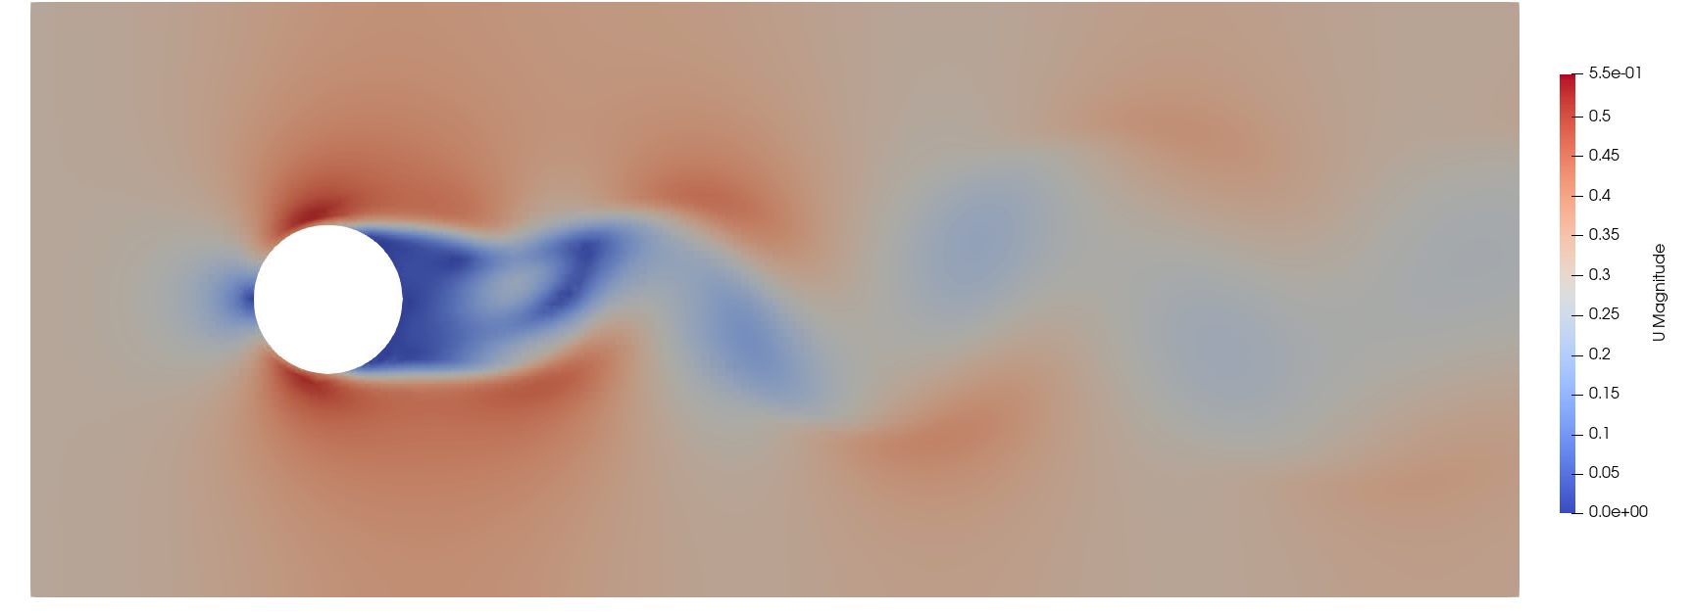
Viewing Add a turbulence model - Visualization
module load viz
paraview results/cylinder.e.4.0
Find the output files (cylinder.e.4.x) in the Project Navigator
Right click on the root file (.e.4.0) » Visualize » Launch ParaView » Run
4
1
3
2
Go to the last time step (1), then pick “U” to view the velocity vector magnitude (2)
If you show “U” first, the color scale will be off when you go to the final time. Use the “rescale” button (3) to fix it.
Click “Play” (4) to watch the flow evolve.
Select the variables to show and click “Apply”

Slide 33
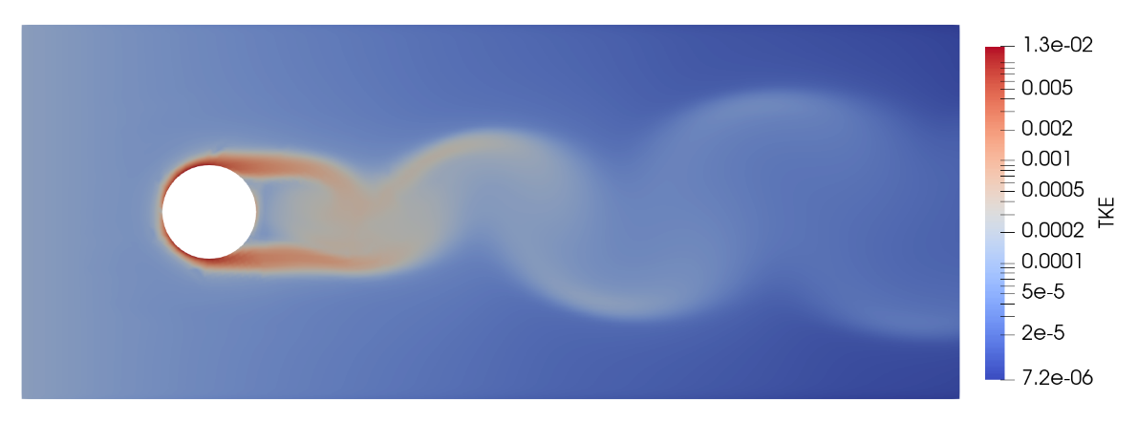
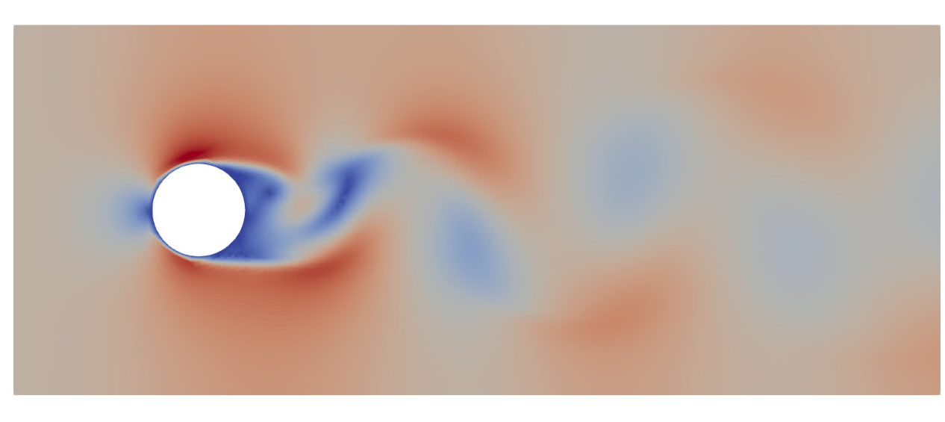
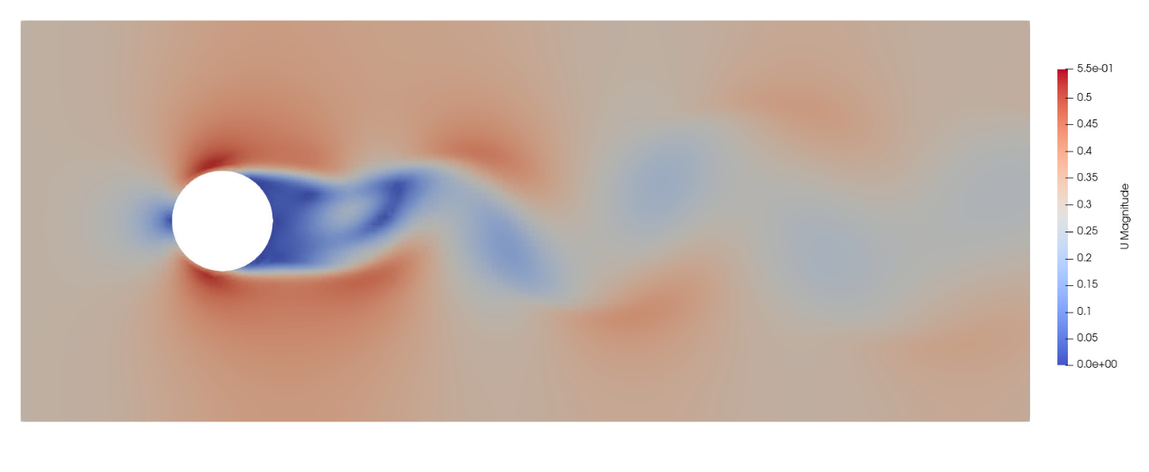
Add a turbulence model - Visualization
Observe:
At what time does the flow break symmetry and start shedding? (Laminar was ~2 s)
Does the wake structure look different?
Does the boundary layer on the upstream side of the cylinder look different?
Look at the new TKE output field. Where is the turbulent kinetic energy highest?
Laminar
Turbulent

Slide 34
Post-processing
flow_over_cylinder_postproc.i
Several types of post-processing are available in Fuego. Let’s try some of the common types.
1) Flux postprocessors (available inside boundary condition blocks)
Postprocess [total|advective|diffusive] flux of [EQUATION] as [SOME_NAME]
# SET BOUNDARY CONDITIONS
Begin Inflow Boundary Condition on Surface surface_1
X_Velocity = {(2000*1.8e-5)/(1.2*0.1)}
Y_Velocity = 0.0
Turbulent_Kinetic_Energy = 1.0e-4
Postprocess total flux of continuity as mdot_in
End
Begin Open Boundary Condition on Surface surface_2
Pressure = 0.0
Turbulent_Kinetic_Energy = 1.0e-4
Postprocess total flux of continuity as mdot_out
End
This creates two new global variables, representing the total mass flux through the inlet and outlet surfaces

Slide 35

Post-processing
2) Postprocessing blocks (in the Fuego Region)
This creates a new global variable, called “p_point”, that contains the pressure at a location in the wake of the cylinder
# POSTPROCESS
Begin Postprocess point
Output name = p_point
Location = 0 0
Function = "pressure"
End
Begin Postprocess integral
Output name = total_x_mom
Location = all_blocks
Function = "density * abs(x_velocity)"
End
(0,0)
Other available operations include min, max, sum, average, L2-norm, nodal_field, global, and a few others
This creates a new global variable, called “total_x_mom”, that contains the integral of the magnitude of the X momentum across the entire domain

Slide 36
Post-processing
These global variables need to be output to a file to be useful. For this, we use the Heartbeat feature to output a text file.
Name of the heartbeat file
# HEARTBEAT
Begin Heartbeat myHeartbeat
Stream Name = heartbeat.csv
Format = csv
At Step 0 increment = 1
Variable is Global time
Variable is Global mdot_in
Variable is Global mdot_out
Variable is Global total_x_mom
Variable is Global p_point as Pressure
End
Outputs every timestep
Names of the global variables we created through postprocessing commands
As with the exodus results output, we have the option of renaming the output variables

Slide 37
Post-processing
Let’s also add our new global variables to the exodus output
Once we’ve done that, let’s re-run our simulation. (Right click the input file » Submit Job » Sierra or press the button)
# DEFINE OUTPUT
Begin Results Output Label Fuego_output
Database Name = results/cylinder.e
At Time 0, Interval = 0.1
Title Flow over a cylinder
Nodal Variables = Pressure as P
Nodal Variables = X_Velocity as Ux
Nodal Variables = Y_Velocity as Uy
Nodal Variables = yplus
Global Variables = mdot_in
Global Variables = mdot_out
Global Variables = total_x_mom
Global Variables = p_point
End

Slide 38
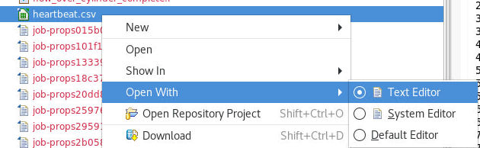
Post-processing
After re-running the simulation, we can examine our new heartbeat output
Find “heartbeat.csv” in the left panel » Open With » Text Editor (or just double-click on it)
The heartbeat file can be visualized using your plotting software of choice (python, Excel, Matlab, even ParaView)
time, mdot_in, mdot_out, total_x_mom, Pressure
0.00000e+00, 0.00000e+00, 0.00000e+00, 0.00000e+00, 0.00000e+00
1.50000e-03, -1.44000e-01, 1.44000e-01, 1.43907e-01, 1.19911e+02
3.75000e-03, -1.44000e-01, 1.44000e-01, 1.44103e-01, 2.36038e-04
7.12500e-03, -1.44000e-01, 1.44000e-01, 1.44069e-01, 5.50133e-04
1.21875e-02, -1.44000e-01, 1.44000e-01, 1.44024e-01, 5.55514e-04
1.97813e-02, -1.44000e-01, 1.44000e-01, 1.44002e-01, 5.55127e-04
3.11719e-02, -1.44000e-01, 1.44000e-01, 1.43996e-01, 5.53956e-04

Slide 39
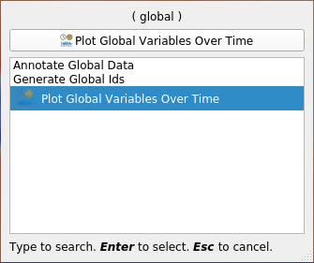
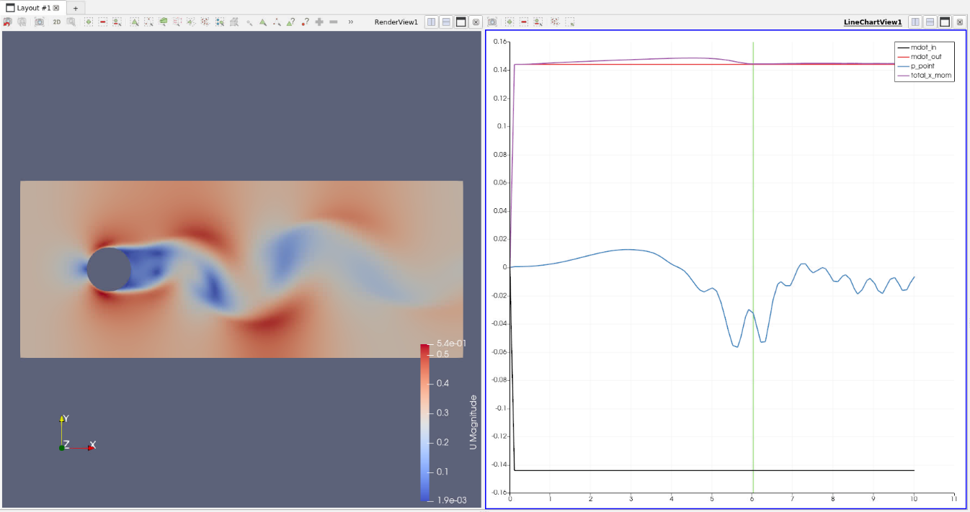
Post-processing
We can also visualize the globals we added to our exodus output
Load the exodus file into ParaView (right click on the root file (.e.4.0) » Visualize » Launch ParaView » Run)
Load all variables, including the new globals, and click apply
Load “U” and scale the contours as before
At the top, find Filters » Data Analysis » Plot Global Variables over Time (or use the filter search tool)
Click ”Apply” on the left panel
Try playing the animation

Slide 40
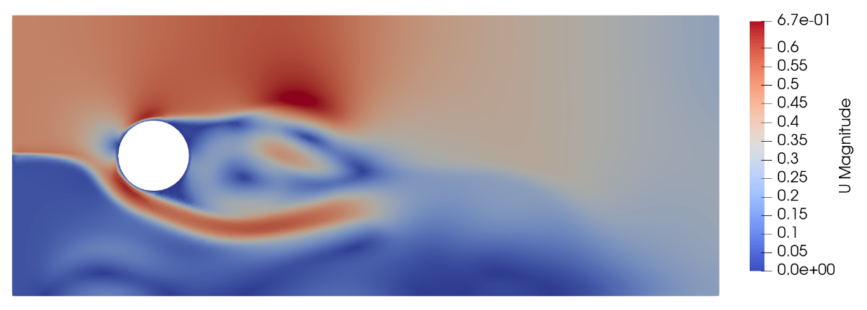
Changing a boundary condition
flow_over_cylinder_newbc.i
Let’s try making our inlet boundary condition more interesting
The string function shown here will make the inlet velocity dependent on both space (shear layer) and time (sinusoidal)
Since our function has spaces, we must enclose it in quotes now
Try running the simulation and animating the results
# SET BOUNDARY CONDITIONS
Begin Inflow Boundary Condition on Surface surface_1
X_Velocity = "0.3*(1+0.75*sin(t)) * (y>0 ? 1 : 0.1)"
Y_Velocity = 0.0
Turbulent_Kinetic_Energy = 1.0e-4
End

Slide 41
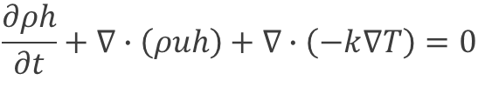

Conjugate Heat Transfer
For problems with solid heat conduction and non-isothermal flow, you can use the combined “fuego_aria” executable to run a conjugate heat transfer simulation
Fuego-Aria runs segregated – one domain solved at a time
Coupling choices at the interface:
Aria sends surface temperature, Fuego sends flux
Aria sends surface temperature, Fuego sends linearized flux
Fuego
$$\frac{∂ρh}{∂t}+∇∙\left(ρuh\right)+∇∙\left(−k∇T\right)=0$$
Aria
$$ρC_{p}\frac{∂T}{∂t}+∇∙\left(−k∇T\right)=0$$
Conditionally stable
Unconditionally stable

Slide 42
Conjugate Heat Transfer – Iteration Procedure
Fuego applies a wall temperature from Aria
T_{wall} = T_{aria}
Aria sends updated T_{wall} to Fuego
Can perform this iteration N times per time step
Solve Fluid Equations
Solve Solid Equation
Fuego calculates heat flux to the wall (q_{out})
Iteration is globally energy conserving when T_{wall} stops changing
Fuego extracts a “near wall” temperature field T_{nw}
Aria applies a convective-like BC
q_{out} = C(T – T_{nw})
“C” should not be confused with a conventional convection coefficient!
Fuego linearizes q_{out}
q_{out} = C(T_{nw} – T_{wall})
Fuego sends nodal fields C and T_{nw} to Aria
Interpolation procedure on dis-similar meshes is also not exact – should get 2nd order convergence in global conservation

Slide 43
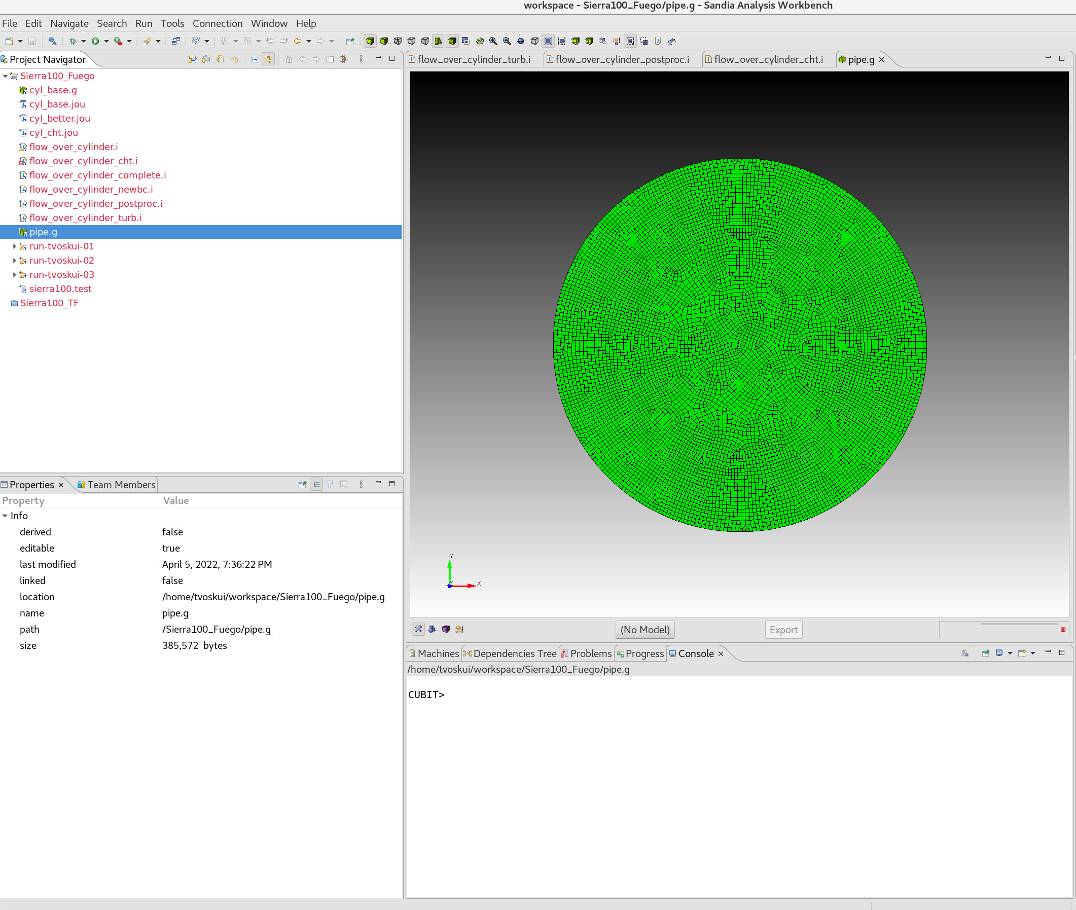
Conjugate Heat Transfer – New Geometry
Generate the base mesh
Open journal file (cyl_cht.jou)
Click the “Play Journal” button
Make sure it made the correct meshes (sometimes this somehow runs the wrong journal file) – if not, delete the .g file and try again
cyl_base.g (same as before)
pipe.g
mesh cyl_cht.jou
cubit cyl_cht.jou

Slide 44
Conjugate Heat Transfer – Input File Changes
flow_over_cylinder_cht.i
We are making three categories of changes to the input file
Activating an enthalpy equation in Fuego for non-isothermal flow
Adding in an Aria region and Aria materials
Defining the coupling and transfers between Fuego and Aria

Slide 45

Activating Enthalpy
For non-isothermal flow, we need enthalpy, specific heat, thermal conductivity, and a reference temperature
#-----------------------------------------------------------
# DEFINE MATERIAL PROPERTIES
Begin Property Specification for Fuego Material air
Density = 1.2
Viscosity = 1.8e-5
Thermal_conductivity = 0.025
Specific_heat = 1000
Function For Enthalpy = Hfunc
Reference Temperature = 300.0
End Property Specification for Fuego Material air
Begin Definition For Function Hfunc
Type Is Piecewise Linear
Abscissa = Temperature
Begin Values
0. {1000*(0-300)}
1000. {1000*(1000-300)}
End
End
Add required new properties
Use a function to define a simple linear enthalpy relationship
$$h=C_{p}(T−T_{ref})$$
Fuego solves for enthalpy transport – temperature is post-processed from enthalpy

Slide 46

Activating Enthalpy
Set ICs and BCs for temperature
# SET INITIAL CONDITIONS
Begin Initial Condition Block FlowInit
Volume is block_1
Pressure = 0.0
X_Velocity = 0.0
Y_Velocity = 0.0
Turbulent_Kinetic_Energy = 1.0e-4
Temperature = 300
End # SET BOUNDARY CONDITIONS
Begin Inflow Boundary Condition on Surface surface_1
X_Velocity = (2000*1.8e-5)/(1.2*0.1)
Y_Velocity = 0.0
Turbulent_Kinetic_Energy = 1.0e-4
Temperature = 300
End
Begin Open Boundary Condition on Surface surface_2
Pressure = 0.0
Turbulent_Kinetic_Energy = 1.0e-4
Temperature = 300
End
Begin Wall Boundary Condition on Surface surface_4
post process yplus
Interface Boundary
Calculate convection coefficient using Tref = 300
End
Begin Solution Options
# DEFINE WHAT EQUATIONS TO SOLVE
Activate Equation Continuity
Activate Equation X_Momentum
Activate Equation Y_Momentum Activate Equation Turbulent_Kinetic_Energy
Activate Equation Enthalpy
Find the solution options block and activate the enthalpy equation
Required anywhere flow can transport energy into the domain (including outlet)
Mark the wall as an interface (wall temperature will be transferred)
Post-process a convection coefficient
$h=Q/(T_{wall}−T_{ref}$)

Slide 47
Activating Enthalpy
Add new output variables to results output
Heat flux at the wall
Wall temperature (transfer from Aria)
Fluid temperature
Post-processed convection coefficient
# DEFINE OUTPUT
Begin Results Output Label Fuego_output
Database Name = results/fluid.e
At Time 0, Interval = 0.1
Title Flow over a cylinder
Nodal Variables = Pressure as P
Nodal Variables = X_Velocity as Ux
Nodal Variables = Y_Velocity as Uy
Nodal Variables = yplus
Nodal Variables = turbulent_kinetic_energy as TKE
Nodal Variables = heat_flux
Nodal Variables = wall_temperature as Twall
Nodal Variables = Temperature as T
Nodal Variables = wall_convection_coefficient as hConv
Global Variables = mdot_in
Global Variables = mdot_out
Global Variables = total_x_mom
Global Variables = p_point
End

Slide 48

Defining Aria Materials
Need to add Aria material blocks
#-----------------------------------------------------------
# DEFINE MATERIAL PROPERTIES
Begin Aria Material aluminum_foam
Density = Constant rho = 50
Thermal Conductivity = Constant k = 1
Specific Heat = Constant cp = 50
Heat Conduction = Generalized
End
Begin Aria Material cht_interface
BC Reference Temperature = user_field name=bc_ref_temp
Heat Transfer Coefficient = user_field name=bc_ref_h
End
Basic material for transient heat conduction problem
Helper material to make applying the coupling BCs easier – letting Aria know that there will be fields defining h and T_{ref} for a BC of the form:
$$Q=h(T−T_{ref})$$

Slide 49
Defining Aria Solver and Mesh
Add a linear solver for Aria and a mesh (finite element model block)
#--------------------------------
# DEFINE THERMAL SOLVER
BEGIN TPETRA EQUATION SOLVER HEAT
BEGIN PRESET SOLVER
SOLVER TYPE = THERMAL
END
END
#-------------------------------------------
# DEFINE MESH AND ASSIGN MATERIALS
Begin Finite Element Model Pipe
Database Name = pipe.g
Database Type = ExodusII
Decomposition Method = RIB
Use material aluminum_foam for block_1
Use material cht_interface for surface_1
End Finite Element Model Pipe

Slide 50

Adding Aria Region
#-------------------------------------------
# DEFINE ARIA REGION
Begin Aria Region Solid_region
Use Linear Solver Heat
Nonlinear Solution Strategy = Newton
Use Dof Averaged Nonlinear Residual
Use Finite Element Model Pipe
EQ Energy For Temperature On all_blocks Using Q1 With Diff Mass
IC for temperature on all_blocks = constant value = 500
User Field Real Node Scalar bc_ref_temp On surface_1
User Field Real Node Scalar bc_ref_h On surface_1
BC Flux for energy on surface_1 = Generalized_Nat_Conv
Begin Results Output Label Aria_output
Database Name = results/solid.e
At Time 0, Interval = 0.1
Title Temperature In The Solid Pipe
Nodal Variables = solution->Temperature As T
End Results Output Label Aria_output
End Aria Region Solid_region
Initially hot object
Define fields for h and T_{ref} to be transferred into from Fuego
Generalized_nat_conv model uses the h and T_{ref} we defined in our surface material (which come from the nodal fields)
$$Q=h(T−T_{ref})$$

Slide 51
Defining Fuego-Aria Transfers
$------------------------------------------------------------------
$ Define transfers
$------------------------------------------------------------------
Begin Transfer solid_to_fluid_init
Interpolate Surface Nodes From Solid_region To Fluid_region
Send Block surface_1 To surface_4
Send Field solution->Temperature State Old To Wall_temperature State None
geometric tolerance = 5e-3
nodes outside region = abort
End
Begin Transfer fluid_to_solid
Interpolate Surface Nodes From Fluid_region To Solid_region
Send Block surface_4 To surface_1
Send Field flux_linearization_coefficient State None To bc_ref_h State None
Send Field flux_linearization_temperature State None To bc_ref_temp State None
geometric tolerance = 5e-3
nodes outside region = abort
End
Begin Transfer solid_to_fluid
Interpolate Surface Nodes From Solid_region To Fluid_region
Send Block surface_1 To surface_4
Send Field solution->Temperature State New To Wall_temperature State None
geometric tolerance = 5e-3
nodes outside region = abort
End
Fuego Side (surface_4)
Aria Side (surface_1)
Interpolation means the meshes do not have to match

Slide 52
Defining Fuego-Aria Coupling
Solution control lets us control when Fuego and Aria are executed, when transfers happen, and when overall nonlinear convergence is met for a time step.
#-------------------------------------------
Begin Solution Control Description
Use System Main
Begin Initialize Mytransient_init
Advance Fluid_region
Advance Solid_region
Transfer solid_to_fluid_init
End
Begin System Main
Use Initialize Mytransient_init
Begin Transient Mytransient
Begin nonlinear CHT
Advance Fluid_region
Transfer fluid_to_solid
Advance Solid_region
Transfer solid_to_fluid
End
End
End
Begin Parameters for Nonlinear CHT
Converged when "(Fluid_region.MaxInitialNonlinearResidual(0) < 1E-1 && \$
Solid_region.MaxInitialNonlinearResidual(0) < 1E-2) || \$
CURRENT_STEP > 1"
End
Initialization is important to make sure that Fuego has a non-zero wall temperature for the first step
Define nonlinear iteration loop
Define convergence criteria based on residuals and/or step count

Slide 53
Defining Fuego-Aria Coupling
#-------------------------------------------
Begin Solution Control Description
...
Begin Parameters For Transient Mytransient
Start Time = 0.0
Initial Deltat = 0.1
Termination Time = 10.0
$-----------------------------------------------------
$ Define Fuego time integration settings
$-----------------------------------------------------
Begin Parameters For Fuego Region Fluid_region
Transient Step Type Is Automatic
Cfl Limit = 5.0
Time Step Change Factor = 1.5
End Parameters For Fuego Region Fluid_region
$-----------------------------------------------------
$ Define Aria time integration settings
$-----------------------------------------------------
Begin Parameters For Aria Region Solid_region
Initial Time Step Size = 0.1
Time Step Variation = Adaptive
Predictor-corrector Tolerance = 1.0e-3
Time Integration Method = BDF2
End Parameters For Aria Region Solid_region
End Parameters For Transient Mytransient
Solution control lets us control when Fuego and Aria are executed, when transfers happen, and when overall nonlinear convergence is met for a time step.
Fuego time step controls
Both Fuego and Aria will request time step sizes, solution control will select the smaller of the two.
Aria time step controls

Slide 54
Log File Details
Launch the job the usual way
Right click the input file » Submit Job » Sierra
Make sure to select both mesh files
Check that SAW detected “fuego_aria” properly
-------------- For equation system name: main --------------
Global predictor error = 4.245e-07
Time step selection: dt <= 8.734e-01 (based on Predictor-Corrector Tolerance).
Time step selection: dt <= 7.224e-02 (based on Maximum Time Step Size Ratio).
Time step selection: dt <= 1.798e+308 (based on Maximum Time Step Size).
Time step selection: dt <= 8.720e-02 (based on Stability limit for dt Ratio).
Time step selection: dt = 7.224e-02 (Adaptive time stepping result).
Global Variable Value
--------------- -----
Region::execute() time for Solid_region: 1.994e-02 sec.
Transfer Solid_To_Fluid, time 2.578, time step 0.03612
Fluid_region.MaxInitialNonlinearResidual:
system -> X_Momentum : 1.59529e-07
system -> Y_Momentum : 1.15093e-07
system -> Continuity : 2.06795e-07
system -> Turbulent_Kinetic_Energy : 2.9319e-09
system -> Enthalpy : 0.0339821
Fluid_region.MaxInitialNonlinearResidual() = 0.0339821
Solid_region.MaxInitialNonlinearResidual:
system -> main : 3.702e-06
Solid_region.MaxInitialNonlinearResidual() = 3.702e-06
Minimum Time Step Selection:
min max
0.000e+00 3.611e-02 Fluid_region
1.000e-16 7.224e-02 Solid_region
0.000e+00 3.611e-02 CHT
Transient Mytransient: dt = 0.03611
Transient Mytransient, step 67, time 2.6144e+00, time step 3.6106e-02, 26.14% complete
CHT residual summary
Time step negotiation

Slide 55
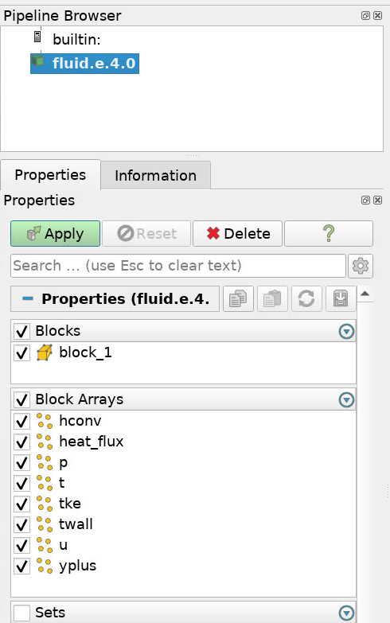
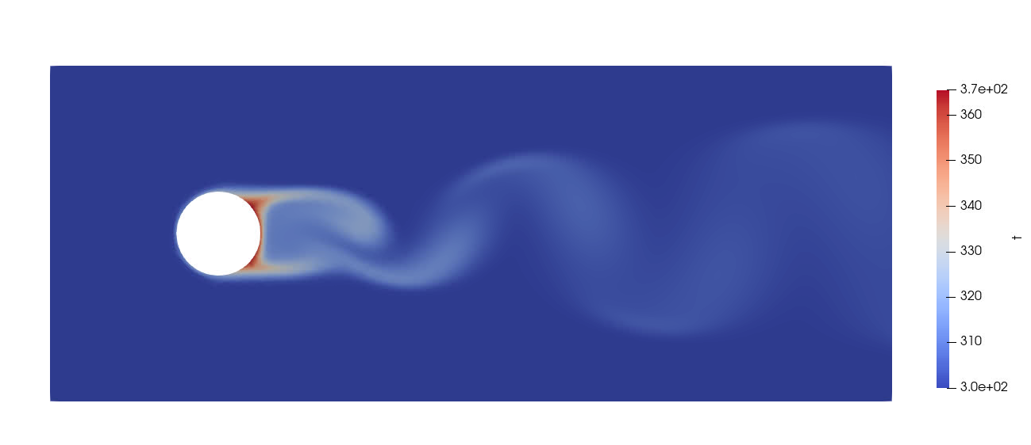
Visualization
module load viz
paraview results/fluid.e.4.0
Find the output files (fluid.e.4.x) in the Project Navigator
Right click on the root file (.e.4.0) » Visualize » Launch ParaView » Run
4
1
3
2
Go to the last time step (1), then pick “T” to view the temperature (2)
If you show “T” first, the color scale will be off when you go to the final time. Use the “rescale” button (3) to fix it.
Click “Play” (4) to watch the flow evolve.
Select the variables to show and click “Apply”

Slide 56
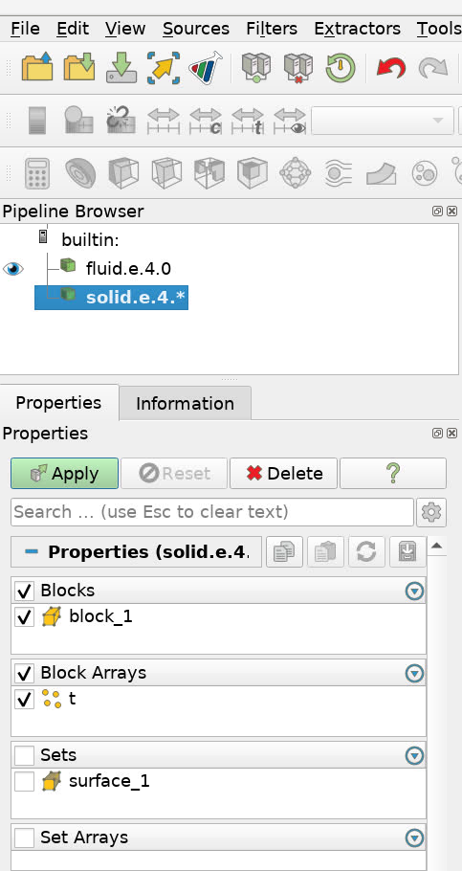
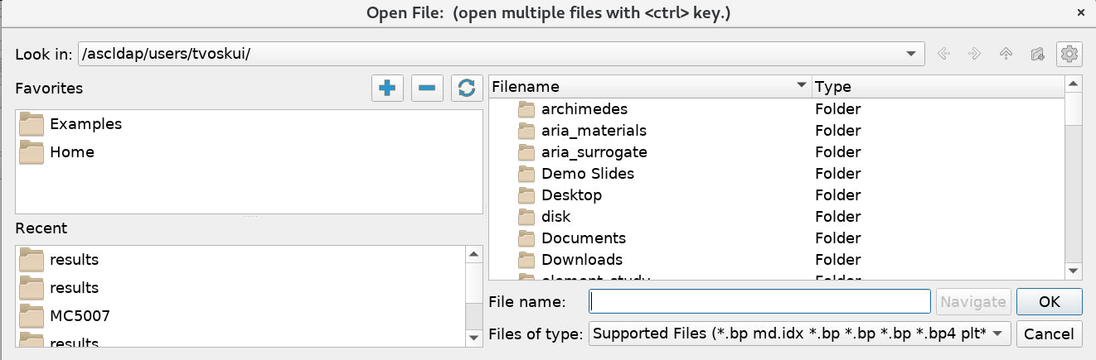
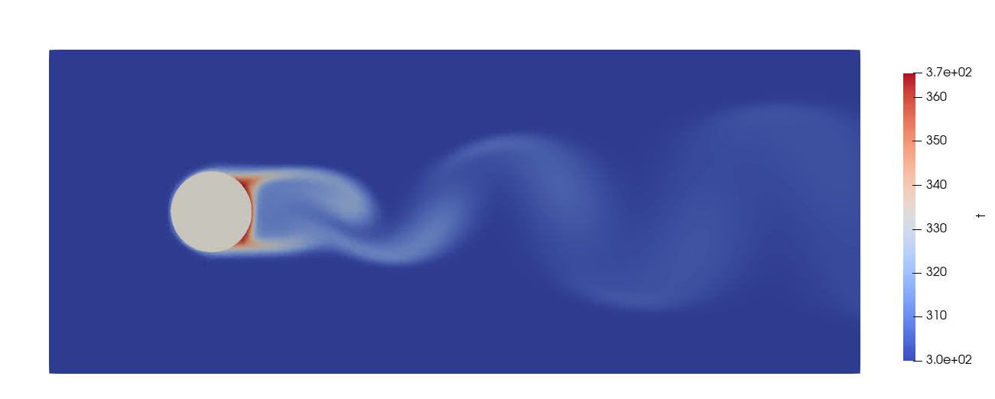
Visualization
Click “Open” (1) and navigate to the results folder (2), select solid.e.4.0, then click Apply (3) to load the solid results
1
2
3
Solid cylinder is now present

Slide 57
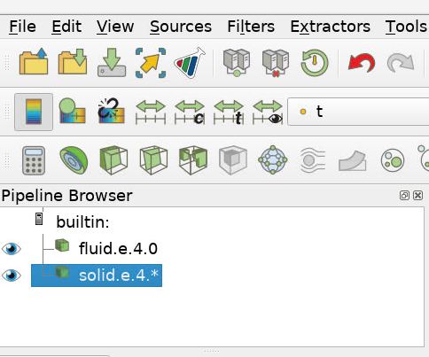
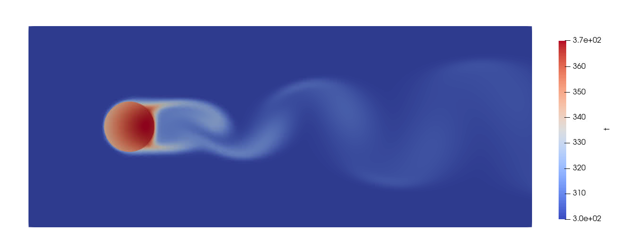
Visualization
Select the solid data set in the pipeline browser (1) then select “T” (2) to show the solid temperature along with the fluid temperature
2
1
Leading edge of the cylinder was cooled more than the trailing edge

Slide 58
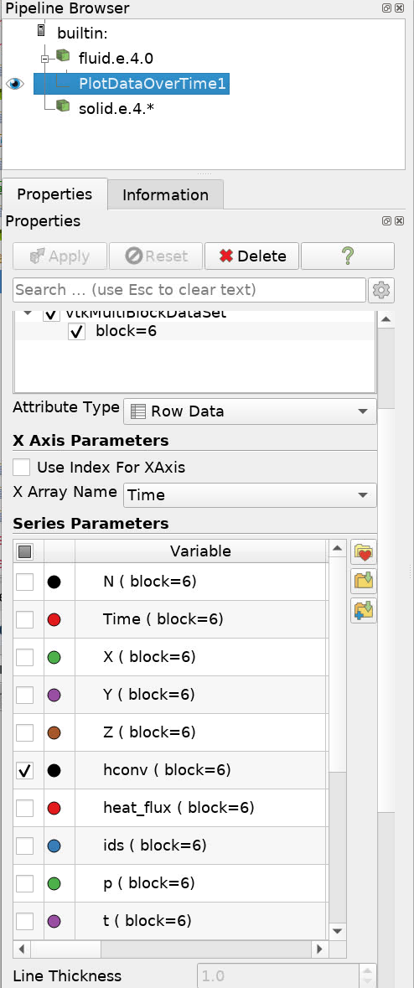
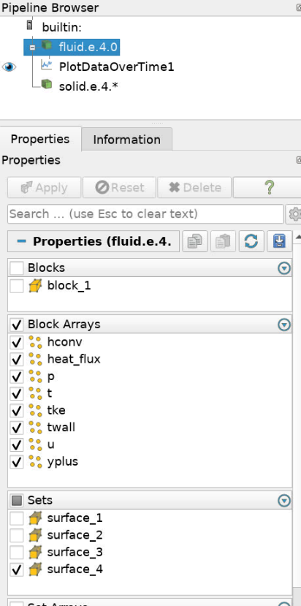
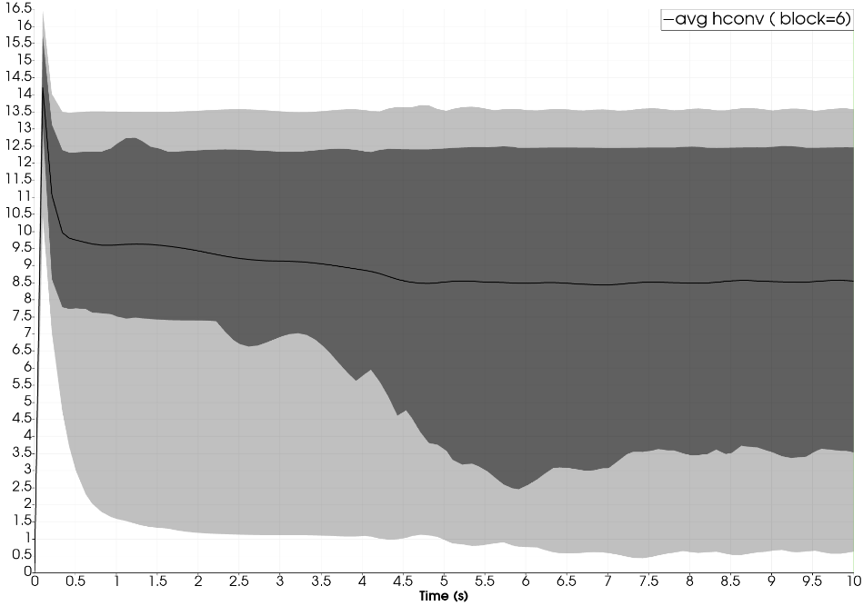
Visualization – Average Convection Coefficient
Select the fluid data set in the pipeline browser (1), de-select the blocks (2), select only surface_4 (3) then click Apply (4)
Choose Filters » Data Analysis » Plot Data Over Time then click Apply
De-select all plotted variables other than “hconv”
1
4
2
3
Shedding begins around 3-5 s
Plot shows mean and quartiles of h over time

Slide 59
Thanks for your attention!
If you run into questions later:
Stop by the TF office hours
Email sierra-help@sandia.gov or visit compsim-help.sandia.gov and make a ticket
Check the Fuego User Manual

