Slide 1

SIERRA/Aria Interactive Demo
Thermal & Multiphysics Analysis
Sierra/TF Team
SAND2022-4258 TR
UNCLASSIFIED // UNLIMITED RELEASE

Slide 2
Contents
Loading the mesh and input files in SAW
Construct several thermal conduction models to demonstrate basic capabilities in Sierra/Aria
  Simple transient heat conduction with fixed temperature boundaries
  Nonlinear properties and custom flux boundary conditions
  Convective flux boundary conditions
  Radiative flux boundary conditions
  Post-processing
  Multi-physics equation coupling
Visualization in Paraview

Slide 3
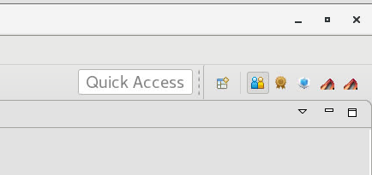
Launching SAW
Add this to your ~/.bashrc file if you are like me and can never remember where SAW is
alias saw='/projects/dart/wb/wb'
Launch SAW (if it’s not already open)
  Click an icon for it if available
  Launch from the command line
Pick a SAW perspective
  “Team (default)” is often most useful for Aria
  “SIERRA Editing” is also decent (but hides the
  Project Navigator view)
    Add it back with Window » Show View » Other »
    General » Navigator
Right click on the desktop
Choose “Open Terminal”
Type /projects/dart/wb/wb and press enter
Using SAW is not required to use Aria. Many current Aria users launch commands from the terminal and use a text editor of their choice to edit the input file.
This training will use SAW as a Sierra Editor, but will have terminal commands shown for reference.
example terminal command

Slide 4
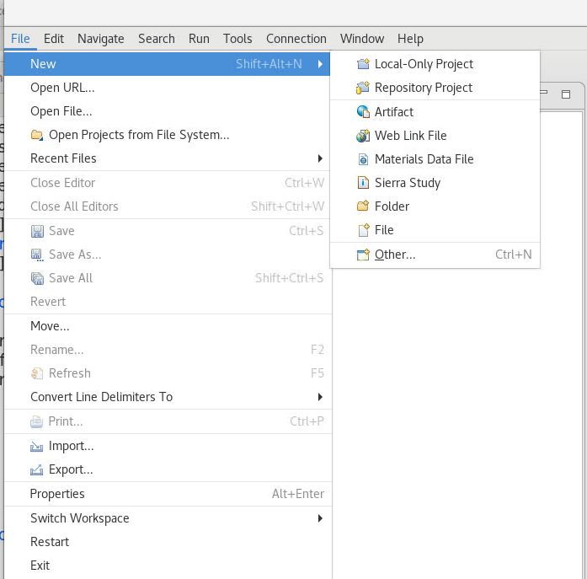
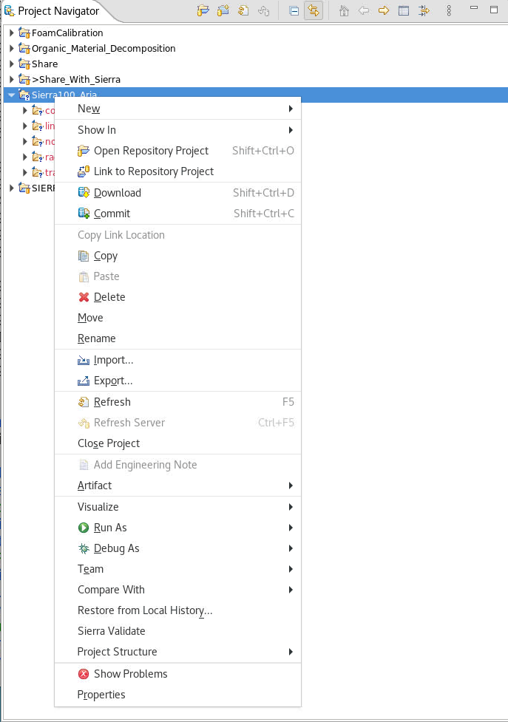
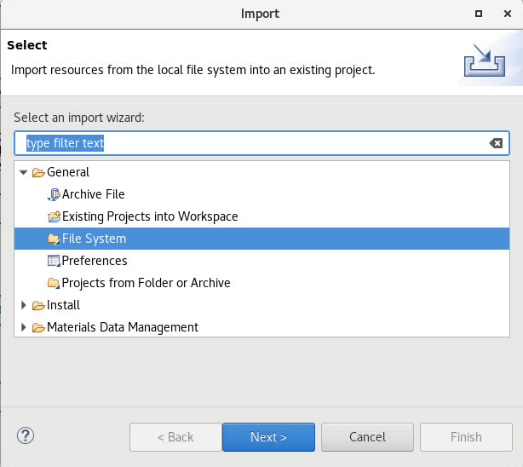
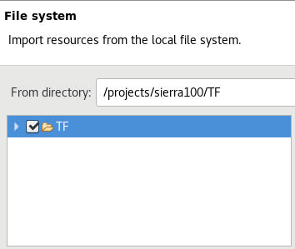
Loading the training files in SAW
Create a new project titled “Sierra100_TF”
1. Click ‘Local-Only Project’ to create an empty project.
2. Right-click on the project and select “Import…”
3. Select the General->File System import option
4. Import from /projects/sierra100/TF directory

Slide 5
Hands-On Session 1: Basic Heat Conduction
We will start with a basic transient heat conduction problem.
  Open the aria folder and double-click on the heat_cond.i template file.
  We will fill in missing sections as we go through this module. Slides with interactive portions will indicate so in the top right with bold red text.
If you fall behind, the complete version is in heat_cond_session1.i.
  The final version has required syntax in order to run an analysis.

Slide 6

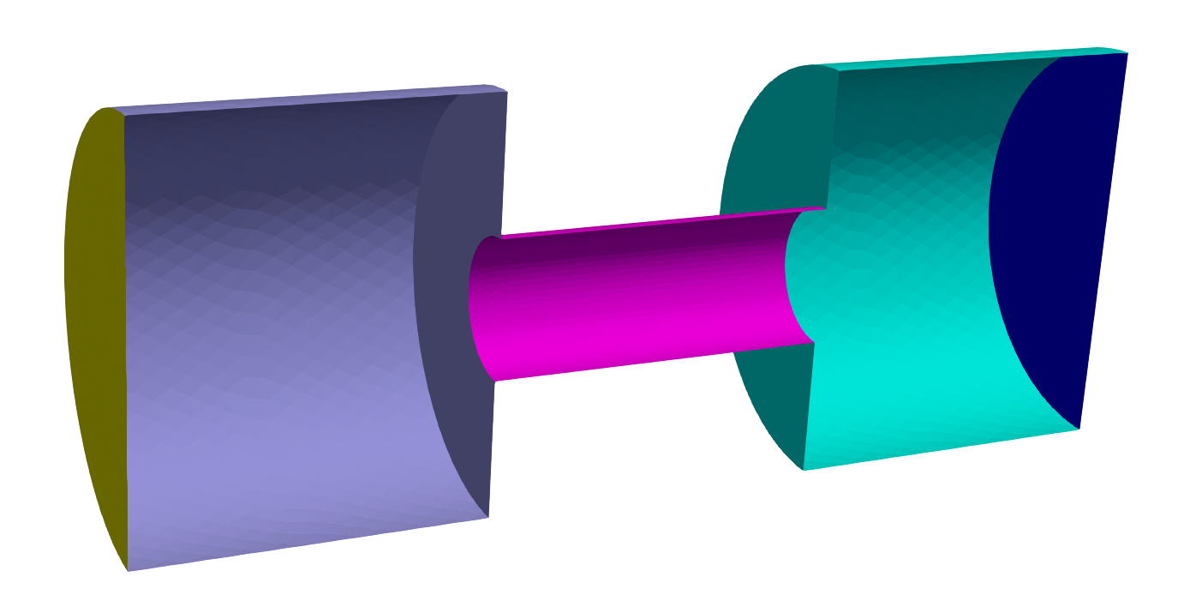
Hands-On Session 1: Basic Heat Conduction
ClampB
ClampA
CenterRod
EndBSides
EndASides
Three named blocks
EndB
Constant properties
Fixed temperatures on ends
Single material on all blocks
EndA
RodSurf
Five named sidesets
Notes:
Using the meshed model we will analyze the Steady-Conduction problem shown.

Slide 7
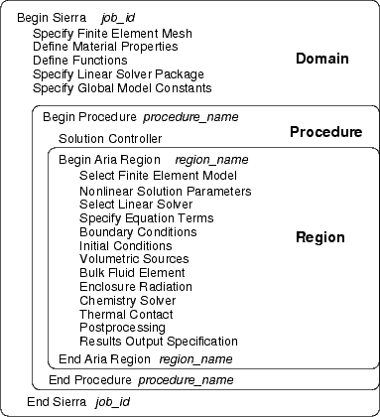
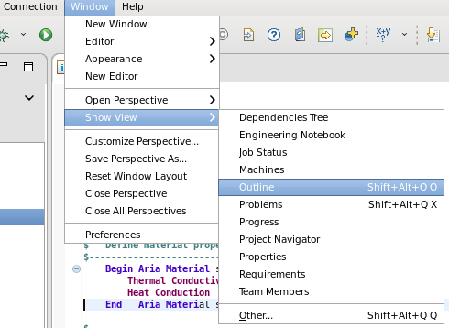
Hands-On Session 1: Input File Structure
All commands lines have
“Scope”
Domain, Procedure or Region
What Scope are we in?
Outline View
Notes:
The domain is the outer scope.
How does one know what scope we’re in? Use the Outline View

Slide 8
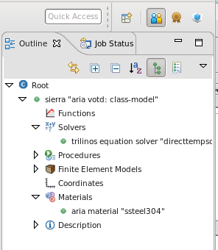
Hands-On Session 1: Domain Level
Domain Level is defined by
“Begin SIERRA - End SIERRA
Begin Sierra Aria
Title Aria Heat Conduction Training Model
Domain Level Will Contain Items
That Pertain to All Sierra Applications
Notes:
The domain

Slide 9

Follow along to add specifications to your input file
Hands-On Session 1: Material Properties
Material Name
#-----------------------------------------------
# Define material properties to be used
#-----------------------------------------------
Begin Aria Material aluminum
Density = Constant value = 2770
Specific Heat = Constant value = 800
Thermal Conductivity = Constant value = 175
Heat Conduction = Generalized
End Aria Material aluminum
$$\vec{F}=−k∇T$$
Transient heat conduction requires
Density
Specific heat
Thermal conductivity
A model for heat flux
Format for material properties
PROPERTY = MODEL [MODEL ARGS]
Density = Constant value = 100
Specific Heat = Polynomial order=1 C0=1 C1=1 variable=density
Thermal conductivity = User_Function name = my_fcn X = time
Viscosity = Scalar_String_Function f = "2*temperature"
Refer to the user manual Chapter 4 for a complete list of all available properties and models
(we’ll cover this in more detail in Session 2)
Notes:
The domain

Slide 10
Follow along to add specifications to your input file
Hands-On Session 1: Domain Level
Associate Materials with Mesh Geometry
Comments
$ or #
$---------------------------------------------------
$ Specify mesh name and settings
$---------------------------------------------------
Begin Finite Element Model FEModel
Database Name = mesh.g
Use Material aluminum for ClampA ClampB CenterRod
End Finite Element Model FEModel
Mesh file
Material to assign to blocks
Notes:
The previous example had one element block but most real problems will contain many element blocks.

Slide 11
Hands-On Session 1: Domain Level
#-----------------------------------------------
# Linear Solver
#-----------------------------------------------
Begin tpetra equation solver solve_temperature
Begin Preset Solver
Solver Type = Thermal_Symmetric
End
End
Solver block name
Many Solvers are Available in Aria
Direct Solvers
Iterative Solvers
Preset Solvers (common configurations)

Slide 12
Hands-On Session 1: Solution Control
$---------------------------------------------------
$ Define temporal solution parameters
$---------------------------------------------------
Begin Solution Control Description
Use System Main
Begin System Main
Begin Transient Solution_block_1
Advance AriaRegion
End
End
$---------------------------------------------------
$ Specify time integration settings
$---------------------------------------------------
Begin Parameters for Transient Solution_Block_1
Start Time = 0.0 # seconds
Termination Time = 600.0 # seconds
Begin Parameters for Aria Region AriaRegion
Time Step Variation = Adaptive
Initial Time Step Size = 0.05
Time Integration Method = BDF2
Maximum Time Step Size = 20.0
Minimum Time Step Size = 0.01
Predictor-Corrector Tolerance = 0.01
End
End
End
Set solution as transient (can use “Begin Sequential” here for a steady state problem)
Set start and end times
Use adaptive time stepping
Time Block
Parameters
Predictor-corrector tolerance controls how the time step size changes
Notes:
The solution of a transient problem is much more complex than that of a steady problem.
Here we are using adaptive time stepping.
A large number of parameters are available for controlling the transient solution and those
can be found in the Aria user manual.

Slide 13
Hands-On Session 1: Aria Region
Define solver settings for this Region
$------------------------------------------------------
$ Region domain - EQs, BCs, ICs, post-processing
$------------------------------------------------------
Begin Aria Region AriaRegion
$---------------------------------------------------
$ Define linear and nonlinear solver parameters
$---------------------------------------------------
Use Linear Solver solve_temperature
Nonlinear Solution Strategy = Newton
Maximum Nonlinear Iterations = 10
Nonlinear Residual Tolerance = 1.e-6
$-----------------------------------------------------------
$ Specify which mesh model to use for this region
$-----------------------------------------------------------
Use Finite Element Model FEModel
References linear solver block defined earlier
Define nonlinear solution strategy (Newton), tolerance, and maximum nonlinear iterations
Define which mesh to use

Slide 14




Follow along to add specifications to your input file
Hands-On Session 1: Governing Equation
Pick equation to solve (Energy)
Select valid DOF for the equation (Temperature)
Select element order (Q1 = linear elements)
Select equation terms
$---------------------------------------------------
$ Specify equations to solve
$---------------------------------------------------
EQ Energy for Temperature on all_blocks using Q1 with Mass Diff
Equation being solved
$$ρC_{p}\frac{∂T}{∂t}+∇∙\vec{F}=0$$
Mass
Diff
Recall that in our material model we defined $\vec{F}$
Heat Conduction = Generalized
$$\vec{F}=−k∇T$$
$$ρC_{p}\frac{∂T}{∂t}+∇∙(−k∇T)=0$$

Slide 15
Hands-On Session 1: Initial Conditions
Follow along to add specifications to your input file
Define the initial condition (required for transient problems)
$---------------------------------------------------
$ Specify initial conditions
$---------------------------------------------------
IC for Temperature on all_blocks = constant value = 300 # K
Select the model to use for the IC
Select where to apply the IC
Select which DOF to apply the IC on
Note: model selection format here is the same pattern as for material properties
[…] = MODEL [MODEL_ARGS]
Check the user manual for a complete list of models, common ones include:
constant, user_function, scalar_string_function

Slide 16

Hands-On Session 1: Boundary Conditions
Follow along to add specifications to your input file
Define fixed temperatures on the end sidesets
EndA
EndB
$---------------------------------------------------
$ Specify boundary conditions
$---------------------------------------------------
BC Dirichlet for temperature on EndA = constant value = 300 # K
BC Dirichlet for temperature on EndB = scalar_string_function f="350+100*sin(t/300)" # K
Select the model to use for the BC
Select where to apply the BC
Select which DOF to apply the Dirichlet BC on
Note: model selection format here is the same pattern as for material properties
[…] = MODEL [MODEL_ARGS]
Check the user manual for a complete list of models, common ones include:
constant, user_function, scalar_string_function

Slide 17
Hands-On Session 1: Solution Output
Specify an Exodus output file
Output file name
$---------------------------------------------------
$ Define contents of Exodus output file
$---------------------------------------------------
Begin Results Output AriaOutput
Title Aria: Transient Training Model
Database Name = heat_cond.e
At Step 0 Interval = 5
Nodal Variables = Solution->Temperature as T
End
Output every 5 steps (can also set output at a time interval)
Variables to output
Notes:
A successful steady state analysis will have one nonlinear solution step.

Slide 18
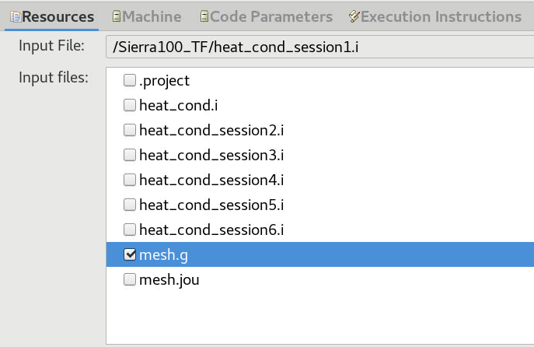
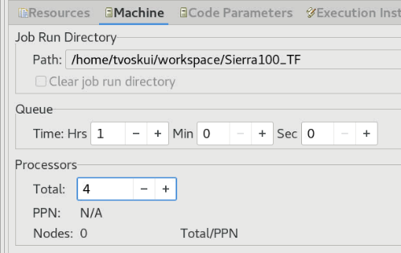
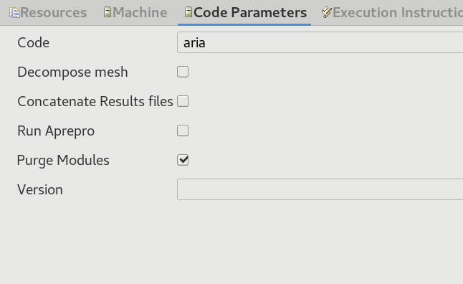
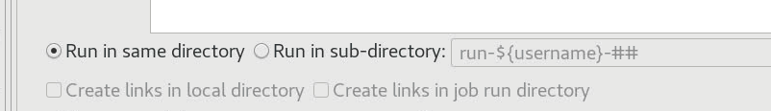
Hands-On Session 1: Launch Aria Job
Let’s launch an Aria job from within the SAW interface:
  Right click the input file » Submit Job » Sierra
  Check the box next to mesh.g to use it with the simulation.
  Choose the “Run in sub-directory” option if you want to keep jobs from overwriting old results
  Choose “Local” for the machine, and set the number of processors on the “Machine” tab
  Select only “Purge Modules” on the “Code Parameters” tab
  Click “Run”
module load sierra
launch –n 4 aria –i heat_cond.i

Slide 19
Hands-On Session 1: Log File Output
Find the log file in your ‘run-<username>-01’ folder and double-click to open it.
Transient solution_block_1: dt = 0.05
Transient Solution_Block_1, step 1, time 5.0000e-02, time step 5.0000e-02, 0.00% complete
Memory Usage: current = 302419968 (288.4 M), high-water-mark = 421240832 (401.7 M)
DEFAULTING PREDICTOR-CORRECTOR_BEGIN_AFTER_STEP = 3.
Equation System AriaRegion->main:
* Step : Transient, Strategy: NEWTON, Time: 5.00e-02, Step: 5.00e-02
* Matrix: Solver: "solve_temperature", Unknowns: 6122, Nonzeros: 83476
* Mesh : Processor 0 of 1: 30689 of 30689 elems, 6122 of 6122 nodes
N O N L I N E A R L I N E A R
---------------------- --------------------------------------
Step Resid Delta Itns Status Resid Asm/Slv Time
---- -------- -------- ---- -------- -------- ---------------
1 2.27e+03 5.80e+02 10 ok 4.07e-07 2.8e-02/2.6e-03
2 9.25e-04 2.83e-04 14 ok 3.20e-07 2.8e-02/2.9e-03
3 2.96e-10 NoOp 2.7e-02
Termination reason: 2.95766e-10 < nonlinear_residual_tolerance(1e-06),
and 0 < nonlinear_correction_tolerance(1e-06)
Nonlinear Residual
Assemble and Solve time
Change from last solution
or initial guess
Solver Residual
Notes:
Open the log file to see details of how the solution went.

Slide 20
Hands-On Session 1: Log File Output
Warning
and
Error
Summary
---------------------------------------------------
There were no errors encountered during parse
There was 1 warning encountered during parse
There were no errors encountered during execution
There were no warnings encountered during execution
+----+----+----+----+----+----+----+----+----+----+----+----+----+----+----+----
SIERRA execution successful.
For region AriaRegion
Number of timesteps (failed) : 0
Number of timesteps ( total) : 190
Number of nonlinear iterations ( total) : 394
Memory Usage: current = 311021568 (296.6 M), high-water-mark = 421838848 (402.3 M)
Ideally no failed steps
Notes:
A good check of how the overall solution went is summarized at the end of transient simulation log file.
Another useful piece of information is the memory usage.

Slide 21
Hands-On Session 1: What Can One Output?
Variables available for output are listed in the log file
preceding the solution step output
Aria Region "Aria_region" has the following fields available for output:
NODE_RANK Fields:
* physical_coordinates
* pp->HEAT_CONDUCTION
* predicted_solution->TEMPERATURE
* solution->TEMPERATURE
* time_derivative_at_time->TEMPERATURE
FACE_RANK Fields:
* thermal_contact_status
ELEMENT_RANK Fields:
* current_element_volume
* volume_change_ratio
Global Variables:
* p_inner

Slide 22
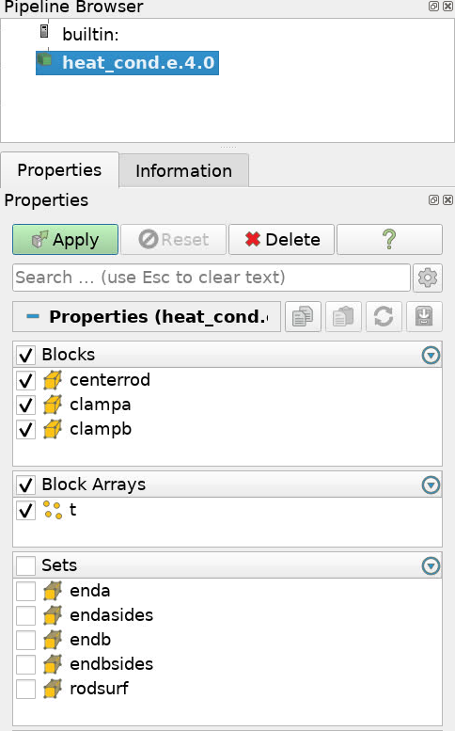
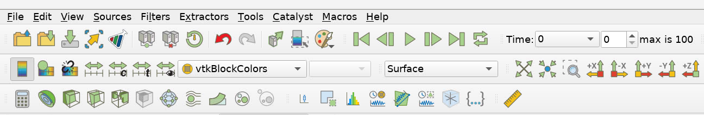
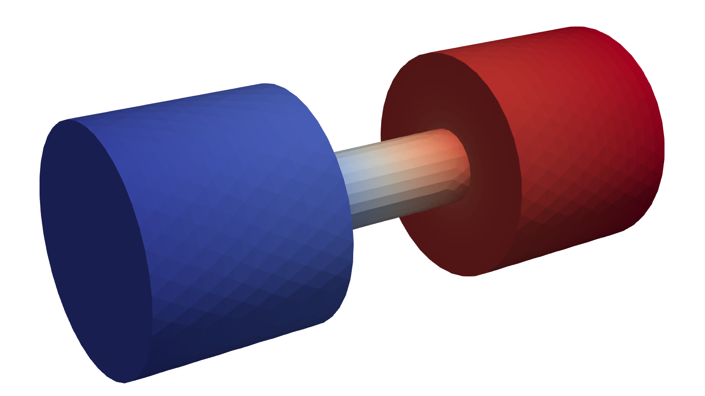
Hands-On Session 1: Visualize Results
module load viz
paraview heat_cond.e.4.0
Find the output files (heat_cond.e.4.x) in the Project Navigator
Right click on the root file (.e.4.0) » Visualize » Launch ParaView » Run
4
1
3
2
Go to the last time step (1), then pick “T” to view the temperature (2)
If you show “T” first, the color scale will be off when you go to the final time. Use the “rescale” button (3) to fix it.
Click “Play” (4) to watch the temperature evolve.
Select the variables to show and click “Apply”

Slide 23
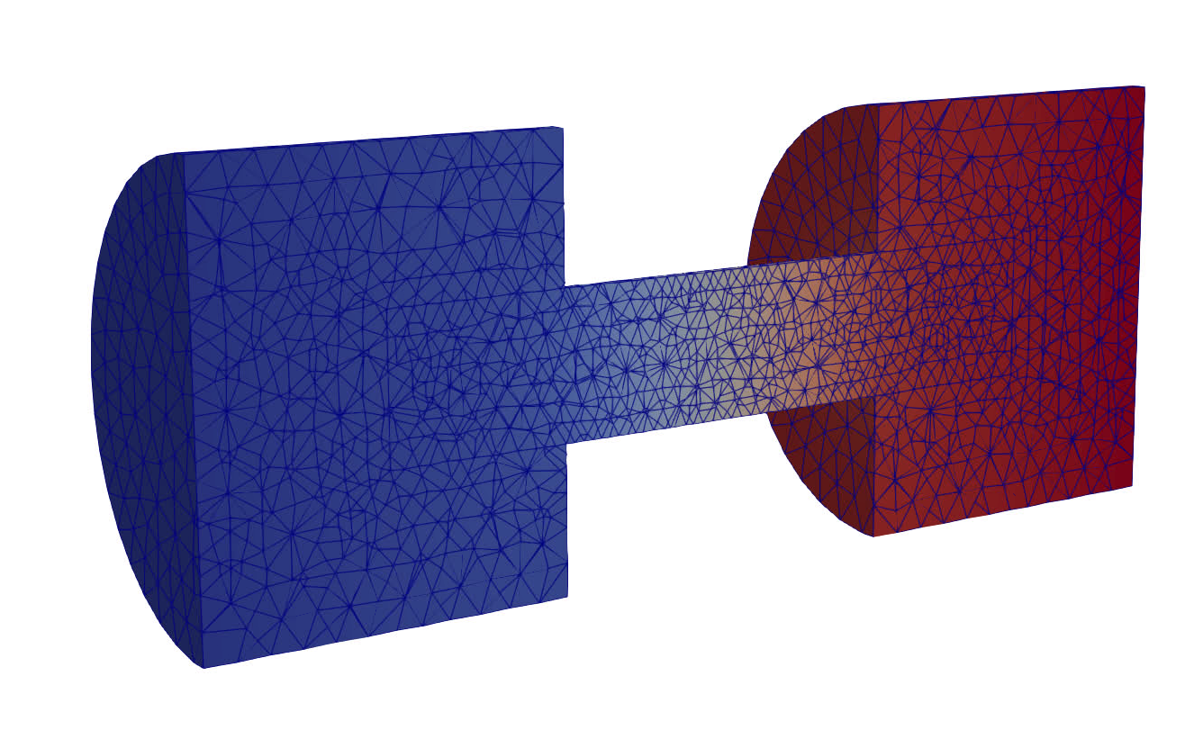

Hands-On Session 1: Visualize Results
2
1
Click the Clip filter (1) then “Apply” to cut the model in half
Select “Surface with Edges” (2) to view the mesh

Slide 24
Hands-On Session 2: Multiple Materials & Flux Boundaries
If you fall behind, the complete version is in heat_cond_session2.i
ClampB
ClampA
CenterRod
EndBSides
EndASides
Three named blocks
EndB
Temperature-dependent properties
Fixed temperatures on one end and varying heat flux on the other
Different material on center rod
EndA
RodSurf
Five named sidesets

Slide 25

Follow along to add specifications to your input file
Hands-On Session 2: Material Properties
Begin Aria Material aluminum
Density = Constant value = 2770
Specific Heat = Constant value = 800
Thermal Conductivity = Constant value = 175
Heat Conduction = Generalized
End Aria Material aluminum
Begin Aria Material ss304
Density = Constant value = 8000
Specific Heat = Polynomial Variable=Temperature order=1 C0=500 C1=0.1
Thermal Conductivity = User_Function name=ssteel_k_function X=temperature
Heat Conduction = Generalized
End Aria Material ss304
Begin Definition for Function ssteel_k_function
Type is Piecewise Linear
Begin Values
#T (K) k (W/mK)
173.15 10.8857
273.15 13.3978
373.15 16.3285
773.15 21.7714
973.15 25.9582
3500.0 25.9582
End Values
End Definition for Function ssteel_k_function
Add a new material, including some more complicated properties
$$C_{p}=500+0.1T$$
Alternate C_{p} Model:
Specific Heat = Scalar_String_Function f = "500 + 0.1*temperature"
Notes:
The domain

Slide 26
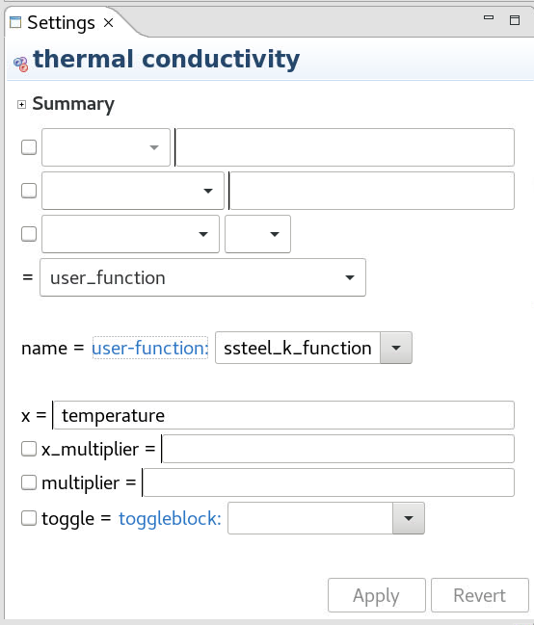
Hands-On Session 2: How to find valid commands?
Option 1: Using SAW
Click on the text of the property you want to find a model for (e.g. “Thermal conductivity”)
Look in the drop-down menu in the SAW “Settings” window

Slide 27
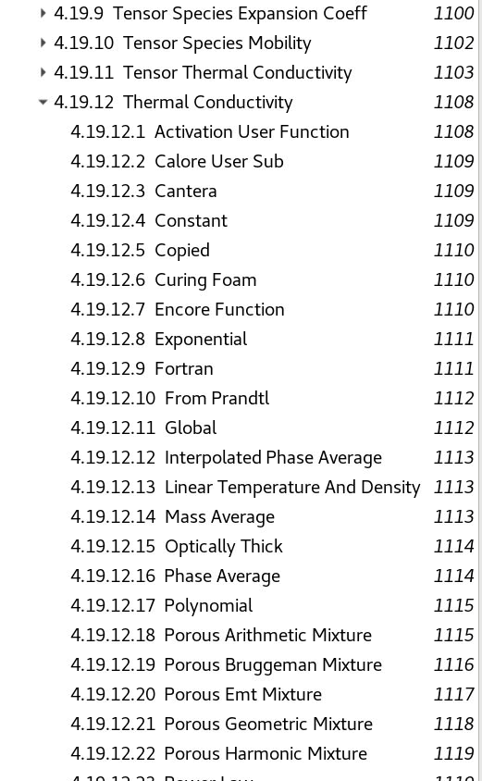
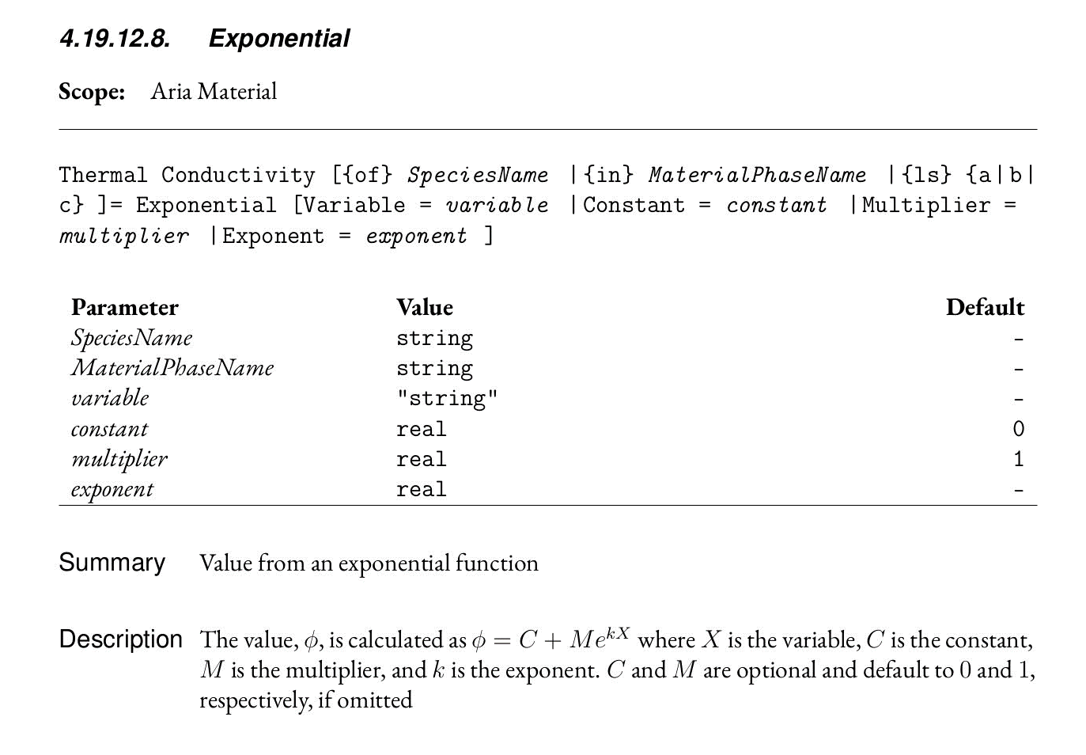
Hands-On Session 2: How to find valid commands?
Option 2: Using the Aria User Manual PDF
Right click in the input file in SAW and choose “View User Guide” or use the link below
Use the PDF menu to go to Chapter 4 – Material Properties » T » Thermal Conductivity
Click on a specific model to read the documentation
https://compsim.sandia.gov/compsim/Docs/Sierra/5.6/GeneralRelease/

Slide 28
Follow along to add specifications to your input file
Hands-On Session 2: Assign Materials
Assign the new material to the “CenterRod” block
$---------------------------------------------------
$ Specify mesh name and settings
$---------------------------------------------------
Begin Finite Element Model FEModel
Database Name = mesh.g
Use Material aluminum for ClampA ClampB
Use Material ss304 for CenterRod
End Finite Element Model FEModel
ClampB
ClampA
CenterRod

Slide 29

Hands-On Session 2: Boundary Conditions
Follow along to add specifications to your input file
Define a sinusoidal function for flux on EndB
$---------------------------------------------------
$ Specify boundary conditions
$---------------------------------------------------
BC Dirichlet for temperature on EndA = constant value = 300 # K
BC Flux for Energy on EndB = scalar_string_function f = "-5e4*sin(t/300)"
EndB
EndA
Select the model to use for the BC
Select which Equation to apply the Flux BC on
Note: Sign convention for flux BCs is positive = outflux
Check the user manual for a complete list of flux BC models, common ones include:
constant, user_function, scalar_string_function

Slide 30
Hands-On Session 2: Post-Process Flux
Follow along to add specifications to your input file
Define the output variable name
$---------------------------------------------------
$ Post-processing
$---------------------------------------------------
Postprocess integrated_flux of equation energy on EndA as FluxA
Postprocess integrated_flux of equation energy on EndB as FluxB
Select which equation to get flux of
Use the integrated_flux post-processor to get a global variable
$---------------------------------------------------
$ Define contents of Exodus output file
$---------------------------------------------------
Begin Results Output AriaOutput
Title Aria: Transient Training Model
Database Name = heat_cond.e
At Step 0 Interval = 5
Nodal Variables = Solution->Temperature as T
Global Variables = FluxA
Global Variables = FluxB
End
Add the globals to output

Slide 31
Hands-On Session 2: Launch Aria Job
Let’s launch an Aria job from within the SAW interface:
  Right click the input file » Submit Job » Sierra
  Check the box next to mesh.g to use it with the simulation.
  Choose the “Run in sub-directory” option if you want to keep jobs from overwriting old results
  Choose “Local” for the machine, and set the number of processors on the “Machine” tab
  Click “Run”

Slide 32
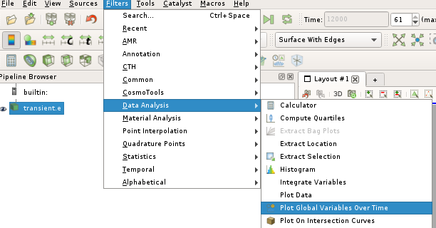
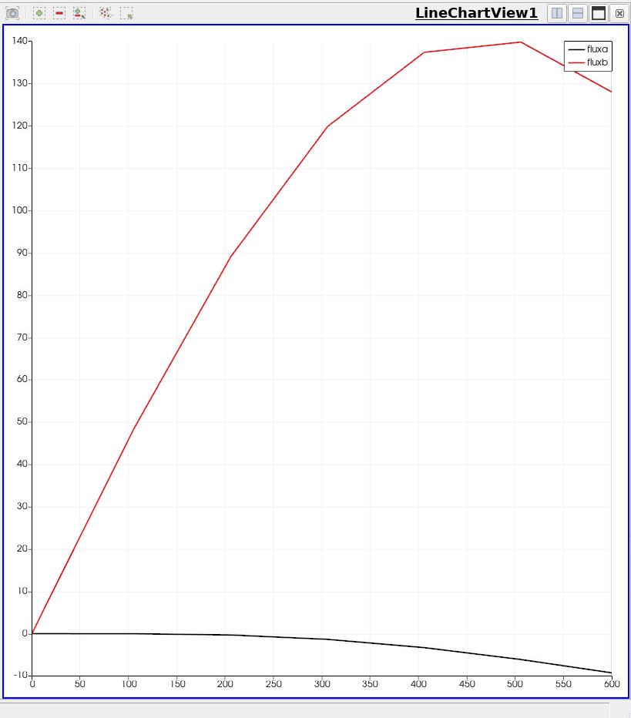
Hands-On Session 2: Visualize Results
Find the output files (heat_cond.e.4.x) in the Project Navigator
Right click on the root file (.e.4.0) » Visualize » Launch ParaView » Run
Plot Global Variables:
Filters » Data Analysis » Plot Global Variables Over Time » Apply
Select the variables to show and click “Apply”

Slide 33
Hands-On Session 3: Convective Flux Boundaries
If you fall behind, the complete version is in heat_cond_session3.i
ClampB
ClampA
CenterRod
EndBSides
EndASides
Three named blocks
EndB
Temperature-dependent properties
Fixed temperatures on one end and flux on the other
Different material on center rod
Convection on outer surfaces
EndA
RodSurf
Five named sidesets

Slide 34
Hands-On Session 3: Convection
Three distinct usages of the engineering model arise:
h (w/m² K)
Buoyancy driven (free/natural convection) flows 5-25
Forced convection flows
  Gases 25-250
  Liquids 50-20,000
Flows with phase change (boiling and condensation) 2,400-100,000
Natural convection and forced convection are currently supported

Slide 35

Hands-On Session 3: Convection
Heat transfer to a surrounding fluid occurs through a thermal boundary layer at the solid surface. Rigorous modeling of this process requires a CFD numerical analysis.
This process is often simulated with a simplified model of
the surface heat flux,
$$q=h\left(T−T_{ref}\right)$$
h - convective coefficient
T - surface temperature
T_{ref} - fluid reference temperature

Slide 36
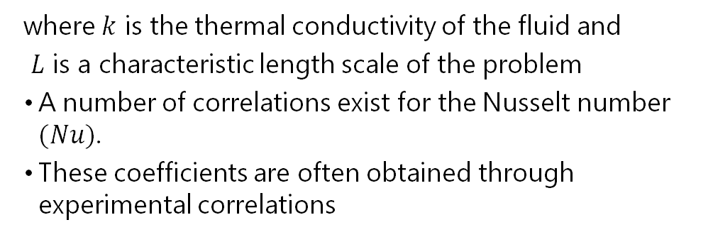
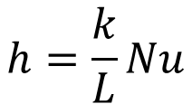
Hands-On Session 3: Convection
Analytically the convective coefficients are shown to be
functions of the Nusselt number, Nu
$$h=\frac{k}{L}Nu$$
where $k$ is the thermal conductivity of the fluid and
$L$ is a characteristic length scale of the problem
A number of correlations exist for the Nusselt number $(Nu)$.
These coefficients are often obtained through experimental correlations
Free/Natural convection – Nu(Ra) Raleigh Number
Forced convection – Nu(RePr) Reynolds and Prandtl Number

Slide 37
Hands-On Session 3: Convection
Aria has several ways of modeling convective flux
Bulk Node + Correlation
Advective Bar + Correlation
Pre-Computed h
Full CFD Solve
Calculate a constant h or use a simple expression.
Use a prescribed reference temperature.
This is what we will do today
Use a convective correlation from the built-in library.
Solve an energy equation for a single fluid temperature.
Use a convective correlation from the built-in library.
Solve an energy equation for varying fluid temperature with a simple 1D flow model.
Couple with a full non-isothermal CFD solve

Slide 38

Hands-On Session 3: Boundary Conditions
Follow along to add specifications to your input file
Use mesh groups to apply a BC to a group of sidesets
RodSurf
EndB
EndA
Change to a constant flux
EndBSides
$---------------------------------------------------
$ Specify boundary conditions
$---------------------------------------------------
BC Dirichlet for temperature on EndA = constant value = 300 # K
BC Flux for Energy on EndB = Constant value = -5e4
Mesh Group clamp_conv = EndASides EndBSides
BC Flux for Energy on clamp_conv = Nat_Conv H=5 T_ref=250
BC Flux for Energy on RodSurf = Nat_Conv H=10 T_ref=250
EndASides
Define a mesh group
“Model” here is “Nat_Conv”
The “Nat_Conv” model takes H and T_Ref parameters
$$q=h\left(T−T_{ref}\right)$$

Slide 39

Hands-On Session 3: Post-Process Flux
Follow along to add specifications to your input file
$---------------------------------------------------
$ Post-processing
$---------------------------------------------------
Postprocess integrated_flux of equation energy on EndA as FluxA
Postprocess integrated_flux of equation energy on EndB as FluxB
Postprocess integrated_flux of equation energy on clamp_conv as ClampConvLoss
Postprocess integrated_flux of equation energy on RodSurf as RodConvLoss
Postprocess value of expression heat_conduction on all_blocks as HeatFlux
Postprocess value of expression energy_flux on RodSurf as ConvFlux
Add new flux post-processors
Post-process some fields
Heat conduction is the quantity defined in the material model (Fourier’s law)
Energy flux is the applied boundary flux (convection)
Recall that in our material model we defined
Heat Conduction = Generalized
$$\vec{F}=−k∇T$$

Slide 40
Hands-On Session 3: Post-Process Flux
Follow along to add specifications to your input file
$---------------------------------------------------
$ Define contents of Exodus output file
$---------------------------------------------------
Begin Results Output AriaOutput
Title Aria: Transient Training Model
Database Name = heat_cond.e
At Step 0 Interval = 5
Nodal Variables = Solution->Temperature as T
Nodal Variables = ConvFlux
Nodal Variables = HeatFlux
Global Variables = FluxA
Global Variables = FluxB
Global Variables = ClampConvLoss
Global Variables = RodConvLoss
End
Add the new fields
Add the globals to output

Slide 41
Hands-On Session 3: Launch Aria Job
Let’s launch an Aria job from within the SAW interface:
  Right click the input file » Submit Job » Sierra
  Check the box next to mesh.g to use it with the simulation.
  Choose the “Run in sub-directory” option if you want to keep jobs from overwriting old results
  Choose “Local” for the machine, and set the number of processors on the “Machine” tab
  Click “Run”

Slide 42
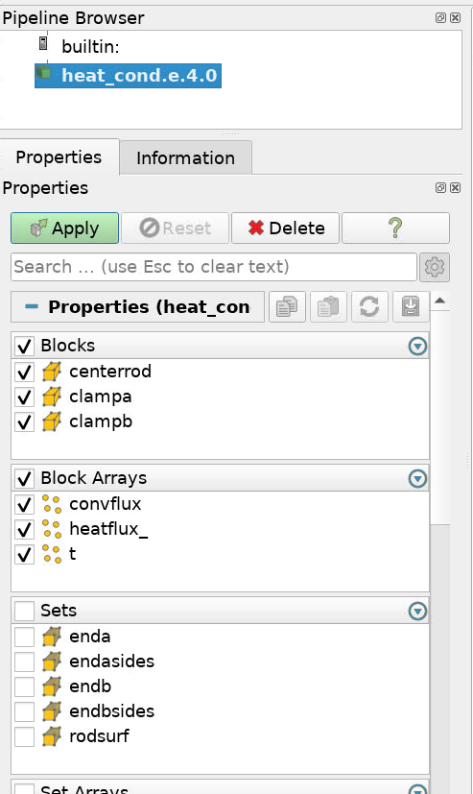
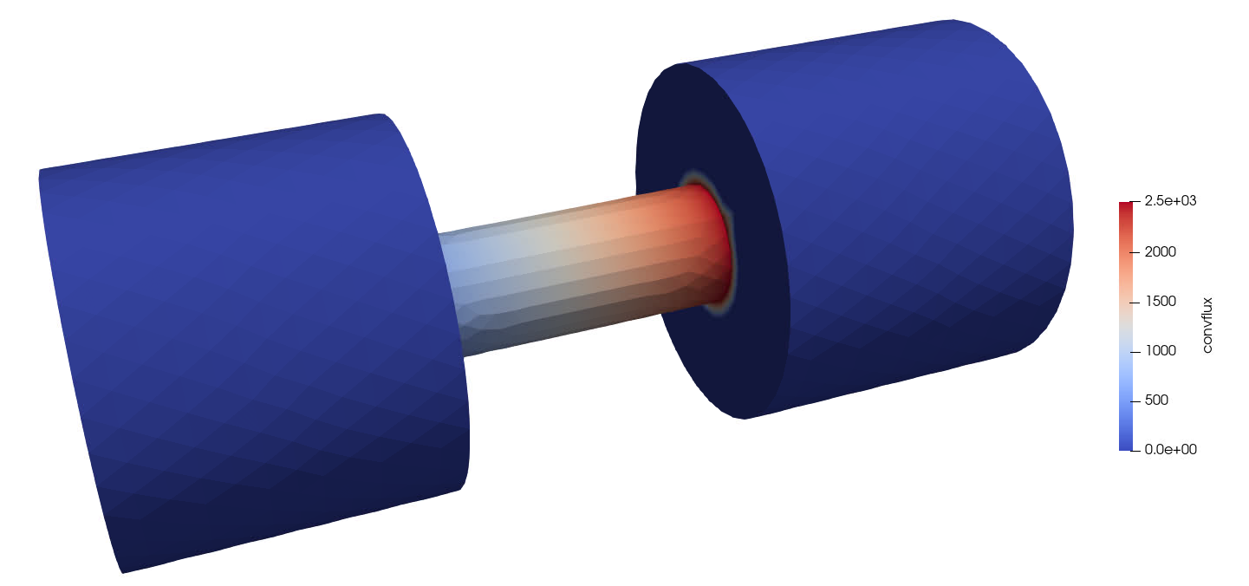
Hands-On Session 3: Visualize Results
Find the output files (heat_cond.e.4.x) in the Project Navigator
Right click on the root file (.e.4.0) » Visualize » Launch ParaView » Run
1
3
2
Go to the last time step (1), then pick “ConvFlux” to view the convective flux (2). Rescale (3) if needed.
Select the variables to show and click “Apply”

Slide 43
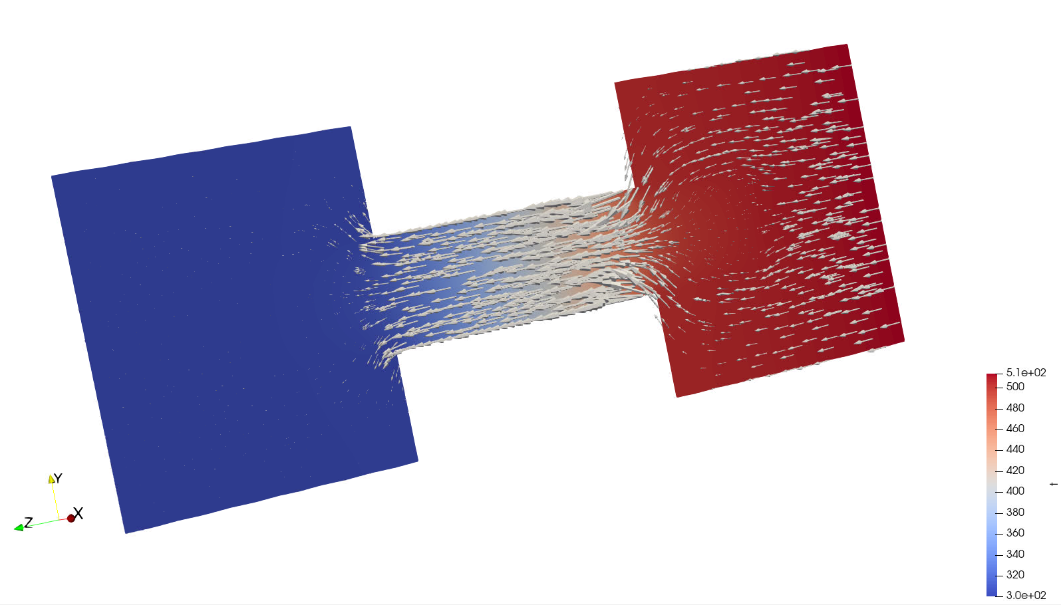
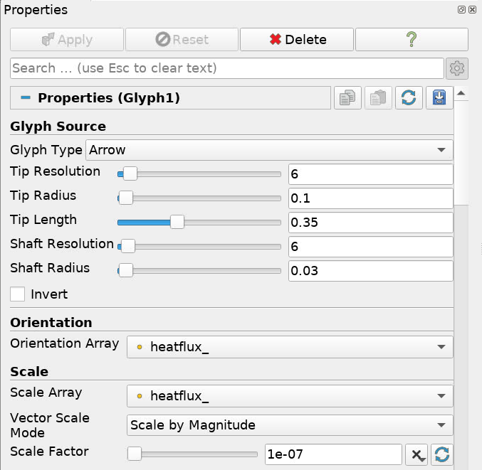
Hands-On Session 3: Visualize Results
1
2
Slice the domain (1) and click “Apply”, then apply a Glyph filter (2)
Choose “heatflux_” for the orientation and scale array, and set a scale factor of 1e-7.
Click “Apply”.

Slide 44
Hands-On Session 4: Radiative Flux Boundaries
If you fall behind, the complete version is in heat_cond_session4.i
ClampB
ClampA
CenterRod
EndBSides
EndASides
Three named blocks
EndB
Temperature-dependent properties
Fixed temperatures on one end and flux on the other
Different material on center rod
Convection & radiation on outer surfaces
EndA
RodSurf
Five named sidesets

Slide 45




Hands-On Session 4: Far-Field Radiative Flux BC
Stefan Boltzmann constant - σ
Emissivity - ε
Form Factor/View Factor - F
Notes:
Most of us are familiar with radiative exchange between two surfaces. This follows directly from
exchange between single facets of the the enclosure. Here the relevant view factor must be known.

Slide 46
Hands-On Session 4: Radiation
Aria has several ways of modeling radiative flux
Pre-Computed View Factor to Uniform Environment
Enclosure Radiation
Participating Media Radiation
Calculate a constant view factor.
Use a prescribed reference temperature.
This is what we will do today
Compute view factors and perform a full radiosity solve on defined enclosures.
Supports closed or partial (open to an external environment) enclosures.
Can be expensive for large enclosures.
Couple with Nalu to use a discrete ordinates approach to solve a participating media radiation equation.
Requires a meshed enclosure.
Least tightly coupled option to energy equation.

Slide 47

Hands-On Session 4: Boundary Conditions
Follow along to add specifications to your input file
Enclose mathematical operations inside {} to have aprepro evaluate them (e.g. {0.9*5.67e-8})
You can also define variables inside {} for aprepro to use
RodSurf
EndB
$---------------------------------------------------
$ Specify boundary conditions
$---------------------------------------------------
BC Dirichlet for temperature on EndA = constant value = 300 # K
BC Flux for Energy on EndB = Constant value = -5e4
Mesh Group clamp_conv = EndASides EndBSides
Mesh Group rad_surfs = all_surfaces - EndA - EndB
BC Flux for Energy on clamp_conv = Nat_Conv H=5 T_ref=250
BC Flux for Energy on rod_conv = Nat_Conv H=10 T_ref=250
# emissivity = {e = 0.9}
# sigma = {sigma = 5.67e-8}
BC Flux for Energy on rad_surfs = Rad T_ref=250 Crad = {e*sigma}
EndA
EndBSides
EndASides
Define a new mesh group
“Model” here is “Rad”
The “Rad” model takes Crad and T_Ref parameters
$$q=Fεσ\left(T^{4}−{T_{ref}}^{4}\right)=C_{rad}\left(T^{4}−{T_{ref}}^{4}\right)$$

Slide 48
Hands-On Session 4: Post-Process Flux
Follow along to add specifications to your input file
$---------------------------------------------------
$ Post-processing
$---------------------------------------------------
Postprocess integrated_flux of equation energy on EndA as FluxA
Postprocess integrated_flux of equation energy on EndB as FluxB
Postprocess integrated_flux of equation energy on clamp_conv as ClampConvLoss
Postprocess integrated_flux of equation energy on RodSurf as RodConvLoss
Postprocess value of expression heat_conduction on all_blocks as HeatFlux
Postprocess value of expression energy_flux on RodSurf Model Nat_Conv as ConvFlux
Postprocess value of expression energy_flux on RodSurf Model Rad as RadFlux
By default “energy_flux” is the sum of all boundary energy fluxes
We can use the “Model” argument to get the flux from specific BC models

Slide 49
Hands-On Session 4: Post-Process Flux
Follow along to add specifications to your input file
$---------------------------------------------------
$ Define contents of Exodus output file
$---------------------------------------------------
Begin Results Output AriaOutput
Title Aria: Transient Training Model
Database Name = heat_cond.e
At Step 0 Interval = 5
Nodal Variables = Solution->Temperature as T
Nodal Variables = ConvFlux
Nodal Variables = HeatFlux
Nodal Variables = RadFlux
Global Variables = FluxA
Global Variables = FluxB
Global Variables = ClampConvLoss
Global Variables = RodConvLoss
End
Add the new field

Slide 50
Hands-On Session 4: Launch Aria Job
Let’s launch an Aria job from within the SAW interface:
  Right click the input file » Submit Job » Sierra
  Check the box next to mesh.g to use it with the simulation.
  Choose the “Run in sub-directory” option if you want to keep jobs from overwriting old results
  Choose “Local” for the machine, and set the number of processors on the “Machine” tab
  Click “Run”

Slide 51
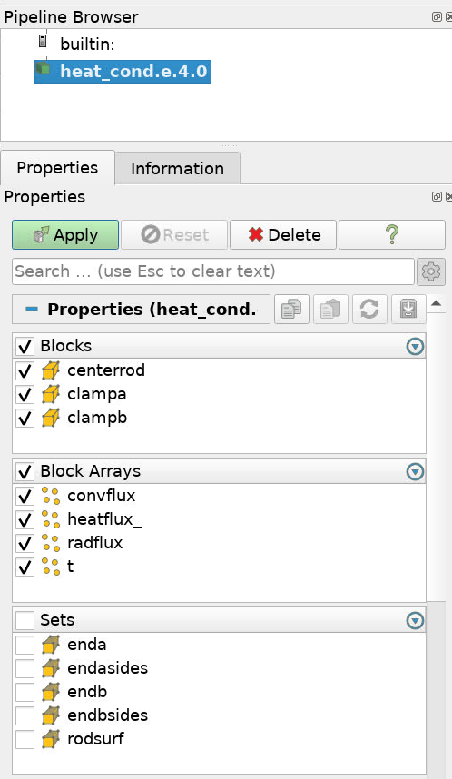
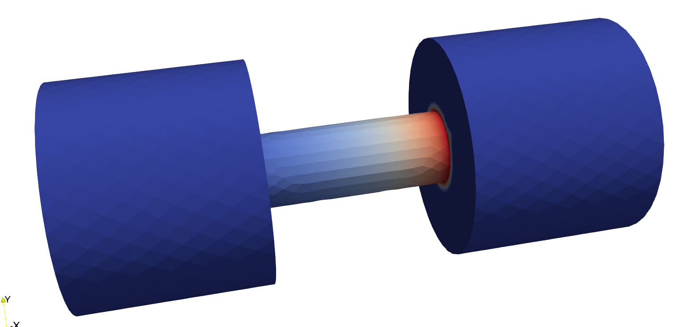
Hands-On Session 4: Visualize Results
Find the output files (heat_cond.e.4.x) in the Project Navigator
Right click on the root file (.e.4.0) » Visualize » Launch ParaView » Run
1
3
2
Go to the last time step (1), then pick “RadFlux” to view the radiative flux (2). Rescale (3) if needed.
Select the variables to show and click “Apply”

Slide 52
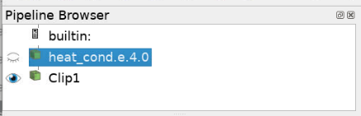
Hands-On Session 4: Visualize Results
1
Choose “Clip” (1) and click “Apply” (clipping normal 1 0 0)
Important: Select the original data set again in the pipeline browser (heat_cond.e.4.0)
1
Choose “Clip” (1) again, change the normal to -1 0 0, then click “Apply”

Slide 53
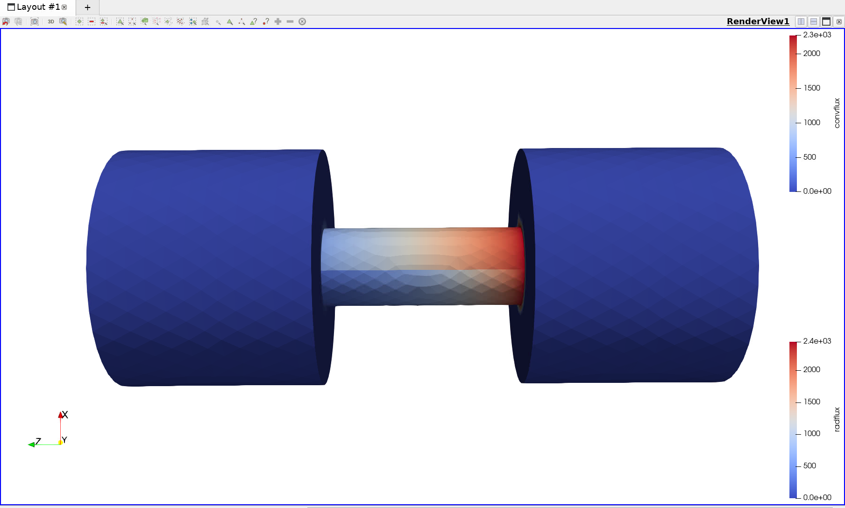
Hands-On Session 4: Visualize Results
Select “ConvFlux” for the second clipped geometry to compare convective and radiative flux along the center rod

Slide 54
Hands-On Session 5: Multiphysics Coupling
If you fall behind, the complete version is in heat_cond_session5.i
ClampB
ClampA
CenterRod
EndBSides
EndASides
Three named blocks
EndB
Temperature-dependent properties
Fixed temperatures on both ends
Different material on center rod
Convection & radiation on outer surfaces
Electrical current and joule heating
EndA
RodSurf
Five named sidesets

Slide 55
Follow along to add specifications to your input file
Hands-On Session 5: Material Properties
Begin Aria Material aluminum
Density = Constant value = 2770
Specific Heat = Constant value = 800
Thermal Conductivity = Constant value = 175
Heat Conduction = Generalized
Electrical Conductivity = Constant Value = 10000 # S/m
Current Density = Ohms_Law
End Aria Material aluminum
Begin Aria Material ss304
Density = Constant value = 8000
Specific Heat = Polynomial Variable=Temperature order=1 C0=500 C1=0.1
Thermal Conductivity = User_Function name=ssteel_k_function X=temperature
Heat Conduction = Generalized
Electrical Conductivity = Constant Value = 0.1 # S/m
Current Density = Ohms_Law
End Aria Material ss304
Electrical transport equation requires an electrical conductivity and a current density (flux) model for each material
Notes:
The domain

Slide 56
Follow along to add specifications to your input file
Hands-On Session 5: Update Solver
#-----------------------------------------------
# Linear Solver
#-----------------------------------------------
Begin tpetra equation solver solve_temperature
Begin Preset Solver
Solver Type = Multiphysics
End
End
The “Thermal” and “Multiphysics” solvers use more robust preconditions – “Multiphysics” does well for this problem.

Slide 57





Follow along to add specifications to your input file
Hands-On Session 5: Governing Equation
Pick equation to solve (Current)
Select valid DOF for the equation (Voltage)
Add source term to energy equation
$---------------------------------------------------
$ Specify equations to solve
$---------------------------------------------------
EQ Energy for Temperature on all_blocks using Q1 with Mass Diff Src
EQ Current for Voltage on all_blocks using Q1 with Diff
Recall that in our material model we defined $i$
$$∇∙i=0$$
Current Density = Ohms_Law
$$i=−σ∇V$$
Equations being solved
Diff
$σ$ = Electrical conductivity
$$ρC_{p}\frac{∂T}{∂t}+∇∙\left(−k∇T\right)=i∙∇V$$
This will construct a single linear system with both equations and all coupling sensitivities.
You can also build multiple linear systems by putting different equations into “Equation System” blocks in the Region. In this case, each equation system will be solved in the order they appear in the input file.
Mass
Diff
Src

Slide 58

Follow along to add specifications to your input file
Hands-On Session 5: Source Term
$---------------------------------------------------
$ Specify source terms
$---------------------------------------------------
Source for Energy on all_blocks = joule_heating
Source model is “joule_heating” – takes no additional arguments
$$S=i∙∇V$$
Check the Aria user manual for a list of all available source models for each equation

Slide 59
Hands-On Session 5: Boundary Conditions
Follow along to add specifications to your input file
Change ends to fixed temperature
Evaluate how much the object is heated by current
RodSurf
EndB
$---------------------------------------------------
$ Specify boundary conditions
$---------------------------------------------------
BC Dirichlet for temperature on EndA = constant value = 300 # K
BC Dirichlet for temperature on EndB = constant value = 300 # K
Mesh Group clamp_conv = EndASides EndBSides
Mesh Group rad_surfs = all_surfaces - EndA - EndB
BC Flux for Energy on clamp_conv = Nat_Conv H=5 T_ref=250
BC Flux for Energy on rod_conv = Nat_Conv H=10 T_ref=250
# emissivity = {e = 0.9}
# sigma = {sigma = 5.67e-8}
BC Flux for Energy on rad_surfs = Rad T_ref=250 Crad = {e*sigma}
BC Dirichlet for Voltage on EndA = constant value = 0
BC Flux for Current on EndB = constant value = -100 # Amps/m2
EndA
EndBSides
EndASides

Slide 60
Hands-On Session 5: Post-Process Energy Source
Follow along to add specifications to your input file
$---------------------------------------------------
$ Post-processing
$---------------------------------------------------
Postprocess integrated_flux of equation energy on EndA as FluxA
Postprocess integrated_flux of equation energy on EndB as FluxB
Postprocess integrated_flux of equation energy on clamp_conv as ClampConvLoss
Postprocess integrated_flux of equation energy on RodSurf as RodConvLoss
Postprocess value of expression heat_conduction on all_blocks as HeatFlux
Postprocess value of expression energy_flux on RodSurf Model Nat_Conv as ConvFlux
Postprocess value of expression energy_flux on RodSurf Model Rad as RadFlux
Postprocess value of expression energy_source on all_blocks as Esrc
Postprocess value of expression current_density on all_blocks as Current
By default “energy_source” is the sum of all energy source terms
We can use the “Model” argument to get specific source models (not needed here)

Slide 61
Hands-On Session 5: Update Output
Follow along to add specifications to your input file
$---------------------------------------------------
$ Define contents of Exodus output file
$---------------------------------------------------
Begin Results Output AriaOutput
Title Aria: Transient Training Model
Database Name = heat_cond.e
At Step 0 Interval = 5
Nodal Variables = Solution->Temperature as T
Nodal Variables = Solution->Voltage as V
Nodal Variables = Current
Nodal Variables = ConvFlux
Nodal Variables = HeatFlux
Nodal Variables = RadFlux
Nodal Variables = Esrc
Global Variables = FluxA
Global Variables = FluxB
Global Variables = ClampConvLoss
Global Variables = RodConvLoss
End
Add the new fields

Slide 62
Hands-On Session 5: Launch Aria Job
Let’s launch an Aria job from within the SAW interface:
  Right click the input file » Submit Job » Sierra
  Check the box next to mesh.g to use it with the simulation.
  Choose the “Run in sub-directory” option if you want to keep jobs from overwriting old results
  Choose “Local” for the machine, and set the number of processors on the “Machine” tab
  Click “Run”

Slide 63
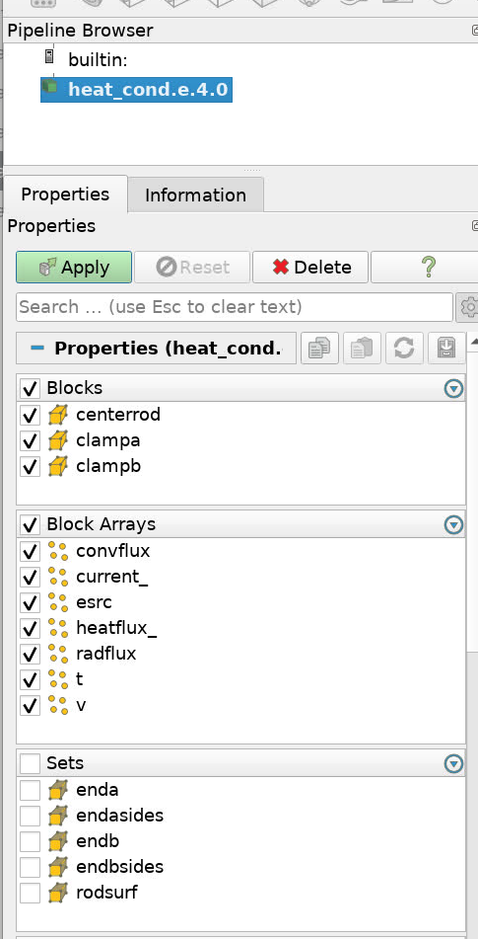
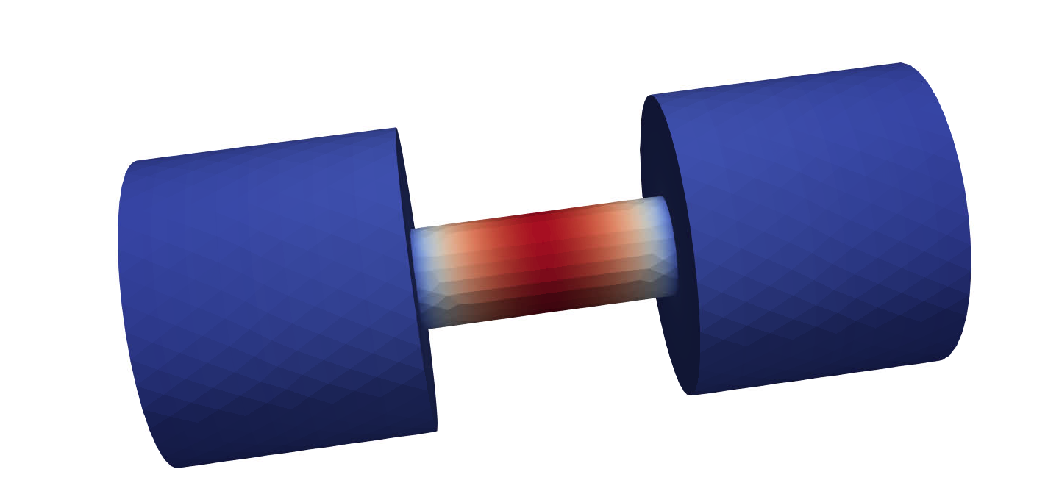
Hands-On Session 5: Visualize Results
Find the output files (heat_cond.e.4.x) in the Project Navigator
Right click on the root file (.e.4.0) » Visualize » Launch ParaView » Run
1
3
2
Go to the last time step (1), then pick “T” to view the temperature (2). Rescale (3) if needed.
Select the variables to show and click “Apply”

Slide 64
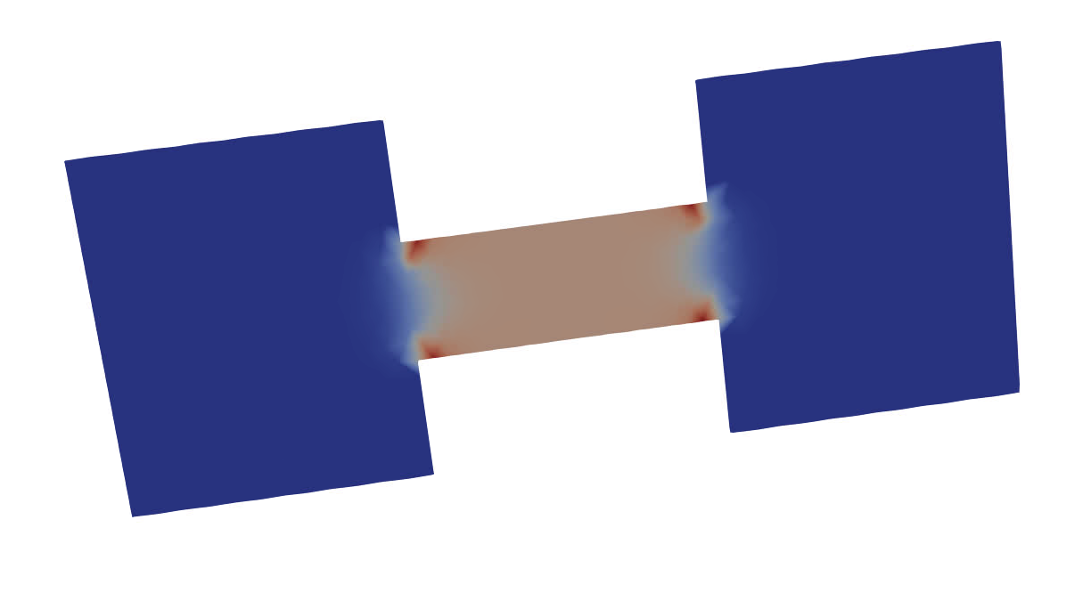
Hands-On Session 5: Visualize Results
2
1
Do a slice (1), click “Apply”, then select the Esrc (2) energy source variable.
As expected, the Joule heating source is concentrated in the low conductivity rod

Slide 65
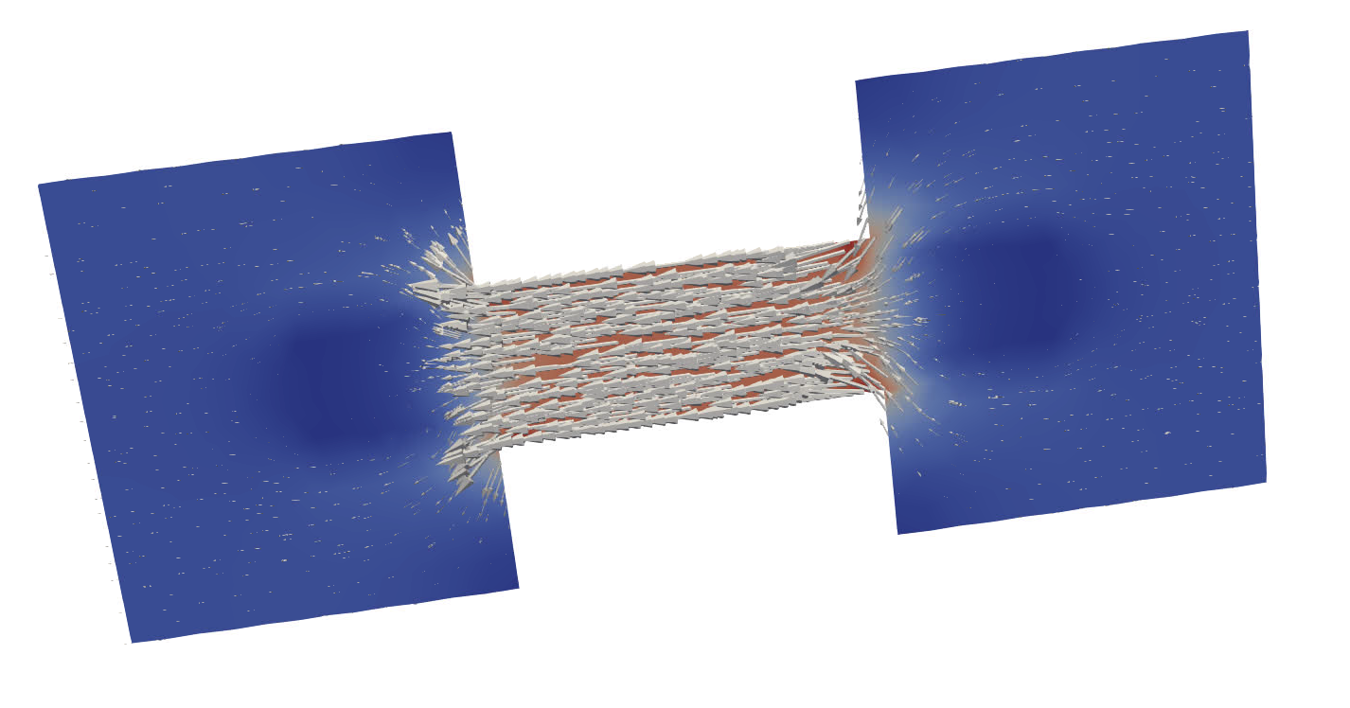
Hands-On Session 5: Visualize Results
1
Make a Glyph (1) of the current vector (set scale factor to 1e-5)
What would the current flow look like if the rod had high conductivity and the clamps had low conductivity?

Slide 66
Hands-On Session 6: Advanced Post-processing
If you fall behind, the complete version is in heat_cond_session6.i
ClampB
ClampA
CenterRod
EndBSides
EndASides
Three named blocks
EndB
Temperature-dependent properties
Fixed temperatures on both ends
Different material on center rod
Convection & radiation on outer surfaces
Electrical current and joule heating
Post-processing points and functions
EndA
RodSurf
Five named sidesets

Slide 67
Hands-On Session 6: Advanced Post-processing
ClampB
ClampA
(0,0,0)
CenterRod
Get temperature at rod center
Get average rod temperature in Celsius
Calculate and output a custom function of voltage and temperature

Slide 68
Hands-On Session 6: Post-Process Point & Function
Follow along to add specifications to your input file
$---------------------------------------------------
$ Post-processing
$---------------------------------------------------
…
Postprocess value of expression energy_source on all_blocks as Esrc
Postprocess value of expression current_density on all_blocks as Current
Begin data probe Tpoints
Nodal_Location solution->temperature location = 0 0 0 label Trod
End
Postprocess average of function "temperature-273.15" on CenterRod as TavgC
Postprocess value of function "voltage / (density*specific_heat*temperature)" on all_blocks as VEratio
Common reduction types: integral, average, min, max
We have used string functions in a few different contexts. What is allowed?
Variables time (t), position (x,y,z), or any provided material property or equation DOF
Many standard math functions (sin/cos/exp/log) plus some non-standard helpers (ramps, smooth transitions, min/max)
Boolean logic
  300 + (x>3)*4
  40 + (y<2 ? 5 : 6)

Slide 69
Hands-On Session 6: Heartbeat Output
Follow along to add specifications to your input file
$---------------------------------------------------
$ Define contents of Exodus output file
$---------------------------------------------------
Begin Results Output AriaOutput
Title Aria: Transient Training Model
…
Nodal Variables = VERatio
End
Begin Heartbeat AriaTxtOutput
Stream name = stats.csv
Format = csv
At Step 0 increment = 1
Variable is Global time
Variable is Global FluxA
Variable is Global FluxB
Variable is Global ClampConvLoss
Variable is Global RodConvLoss
Variable is Global Trod
Variable is Global TavgC
End
Heartbeat block outputs a text file – can include global variables here

Slide 70
Hands-On Session 6: Launch Aria Job
Let’s launch an Aria job from within the SAW interface:
  Right click the input file » Submit Job » Sierra
  Check the box next to mesh.g to use it with the simulation.
  Choose the “Run in sub-directory” option if you want to keep jobs from overwriting old results
  Choose “Local” for the machine, and set the number of processors on the “Machine” tab
  Click “Run”

Slide 71
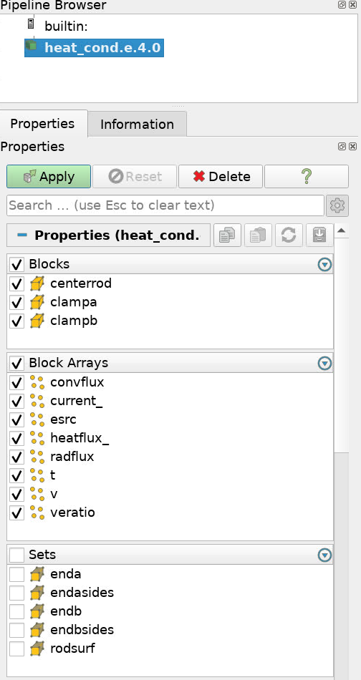
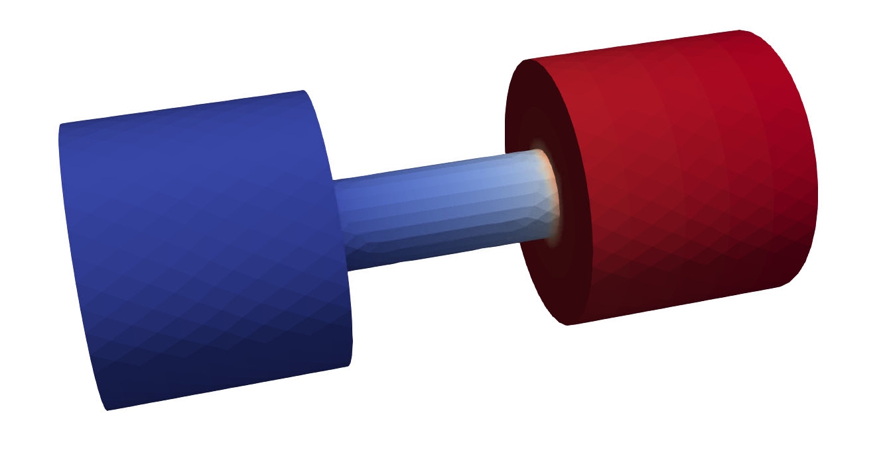
Hands-On Session 6: Visualize Results
Find the output files (heat_cond.e.4.x) in the Project Navigator
Right click on the root file (.e.4.0) » Visualize » Launch ParaView » Run
1
3
2
Go to the last time step (1), then pick “VERatio” to view the custom function (2). Rescale (3) if needed.
Select the variables to show and click “Apply”

Slide 72
Hands-On Session 6: Visualize Results
Check the stats.csv file – includes Trod and TavgC columns
time, FluxA, FluxB, ClampConvLoss, RodConvLoss, Trod, TavgC
0.00000e+00, 0.00000e+00, 0.00000e+00, 0.00000e+00, 0.00000e+00, 3.00000e+02, 2.68500e+01
5.00000e-02, 3.10933e-02, 2.47897e-02, -1.06856e+01, -2.33230e+00, 3.00097e+02, 2.69007e+01
1.00000e-01, 1.06762e-01, 1.00397e-01, -1.05773e+01, -2.33697e+00, 3.00194e+02, 2.69511e+01
1.50000e-01, 1.67032e-01, 1.62250e-01, -1.05090e+01, -2.34161e+00, 3.00291e+02, 2.70015e+01
1.78008e-01, 1.95941e-01, 1.92050e-01, -1.04832e+01, -2.34421e+00, 3.00345e+02, 2.70296e+01
2.34023e-01, 2.48029e-01, 2.45288e-01, -1.04435e+01, -2.34939e+00, 3.00454e+02, 2.70858e+01

Slide 73
Conclusion
Final questions?
Consultation on features you’re interested in?

Slide 74
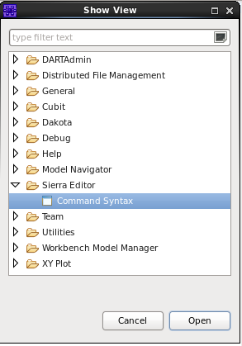
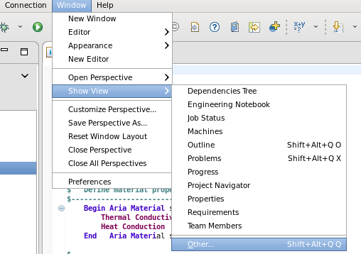
Hands-On Open Session: General Usage
Finding syntax for other features?
User Manual
SAW or Sierra Editor

Slide 75
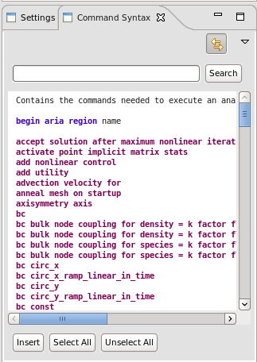
Hands-On Open Session: Command Syntax View
There are a large number of Region level input commands
In the Editor Mode One can
select commands to be
Imported into the input file

