Slide 1
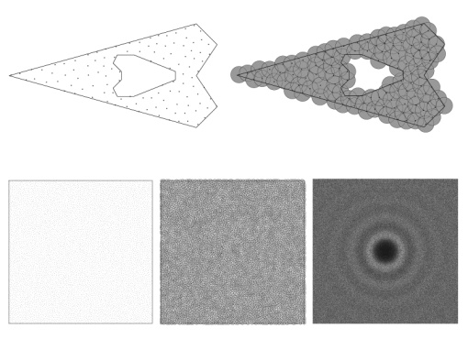
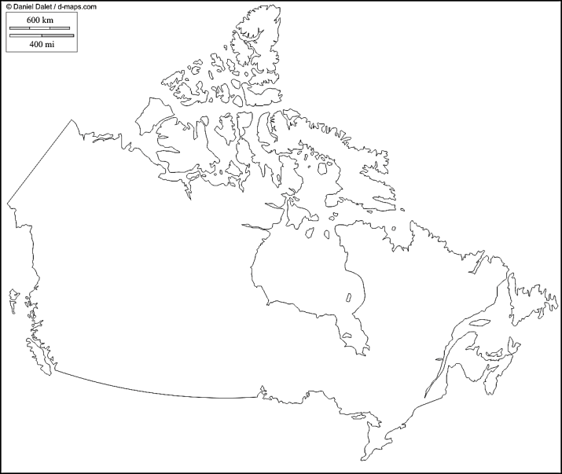
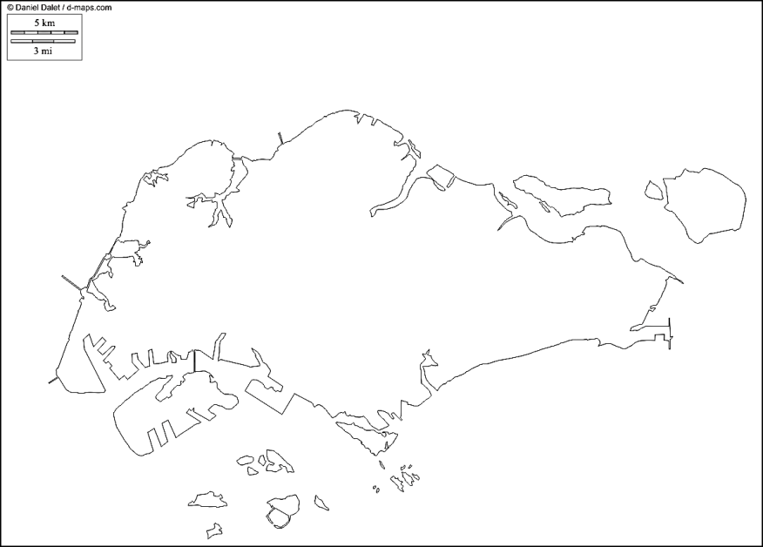
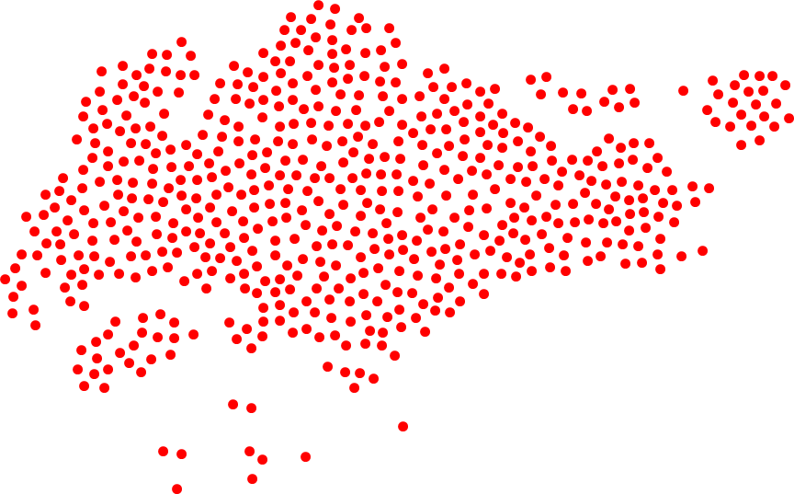

Efficient Maximal Poisson-Disk Sampling
http://d-maps.com/
CPU
GPU
Mohamed S. Ebeida, Anjul Patney, Scott A. Mitchell, Andrew A. Davidson, Patrick M. Knupp, John D. Owens
Sandia National Laboratories, University of California, Davis
Scott - presenter
SIGGRAPH2011
Sandia is a multiprogram laboratory operated by Sandia Corporation, a Lockheed Martin Company,
for the United States Department of Energy’s National Nuclear Security Administration
under contract DE-AC04-94AL85000.
Notes:
I’m talking about uniformly sampling a domain with a random dense packing, as Singapore, rather than Canada with “voids” and a “bias” towards a region

Slide 2
Maximal Poisson-Disk Sampling
What is MPS?
  Dart-throwing
  Insert random points into a domain, build set X
    With the “Poisson” process
Ω
x₄?

Slide 3
MPS a.k.a.
Statistical processes
  Hard-core Strauss disc processes
    Non-overlap: inhibition distance r₁
    cover domain: disc radius r₂
Nature
  Trees in a forest
    Variable disk diameter = tree size
    Points are tree trunks
    Disks are tree leaves or roots
  Given satellite pictures (non-maximal)
    How many trees are there?
    How much lumber?
Random sphere packing
  Non-overlapping r/2 disks
  Atoms in a liquid, crystal
New Mexico
mountains
British Columbia

Slide 4
What is MPS good for?
  Graphics – sample points for texture synthesis
    Generate blue noise distributions for anti-aliasing
    Without Moire and other visible patterns
  Unbiased process leads to points with
    No visible patterns between distant points.
      pairwise distance spectrum close to truncated
      blue noise powerlaw
    Our eyes sensitive to patterns
    Randomness hides imperfections
      stare at dry-wall in your house sometime,
      try to find the seams

Slide 5
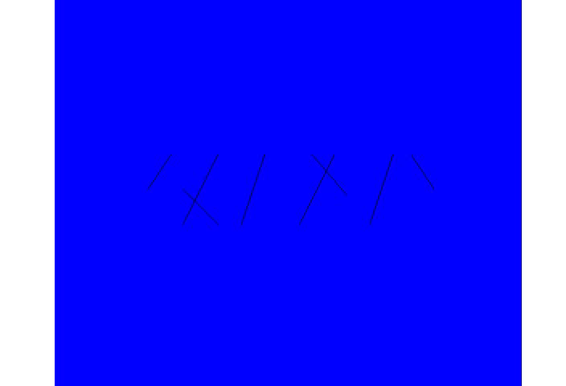
What is MPS good for?
  Physics simulations – why SNL paid for my trip ☺
    Voronoi mesh, cell = points closest to a sample
    Fractures occur on Voronoi cell boundaries
      Mesh variation material strength variation
      CVT, regular lattices give unrealistic cracks
        Unbiased sampling gives realistic cracks
    Ensembles of simulations
    Domains: non-convex, internal boundaries
Fracture Simulations
Courtesy of
Joe Bishop (SNL)
Seismic Simulations
maximal helps Δ quality

Slide 6
Algorithm for MPS
Classic algorithm
  Throw a point, check if disk overlaps, keep/reject
  Fast at first, but slows due to small uncovered area left.
  Can’t get maximal.
quadtree
advancing front
Speedup by targeting just the uncovered area
  Others use quadtrees to approximate the uncovered area
  Others use advancing front to sample locally
  Others use tiles to aid parallelism
Common issues
  Not strictly “unbiased” process
    Outcome may be indistinguishable from
    an unbiased process’s outcome
  Not maximal: dependent on finite precision
  Memory or run-time complexity
  Ours is first provably bias-free, maximal, E(n log n) time O(n) space
independent tiles

Slide 7
Algorithm
Background square grid
  Square diagonal = r
Flood fill
  Build pool of cells C :
  not-exterior to domain
Phase I: quickly cover most of the domain
  Pick a square from pool
  Pick point in square
  If point uncovered (likely)
    Keep point
    Remove square from pool
  Repeat a|C| times
Initial Pool C
End of Phase I: white cells with a point

Slide 8
Algorithm
Target remaining uncovered area
Construct square \ disks
  Polygon easy surrogate for arc-gon
Replace pool of squares by polygons
Phase II: repeat
  Pick polygon from pool
    Weighted by its area (only log n step)
  Pick point in polygon
  If uncovered
    Keep point
    Remove polygon from pool
    Update nearby polygons
Works well because
  Voids are scattered
  Small arc-gons are well approximated by polygons
End of Phase I: white cells with a point
Start of Phase II: dark cells not-covered

Slide 9
Algorithm Nuance - Phase II stages
“Algorithm is simple,… in a good way” - Reviewer
Lazy update of polygons’ areas and pool, in “stages”
  More simple datastructures
  No tree needed, flat array for pool, fewer pointers
  Run-time proof gets more complicated
Prior slide
Lazy update
Phase II: repeat
  Pick polygon from pool
    Weighted by its area (only log n step)
  Pick point in polygon
  If uncovered
    Keep point
    Remove polygon from pool
    Update nearby polygons
Phase II: repeat
Repeat c|Pool| times
  Pick polygon from pool
    Weighted by its area (only log n step)
  Pick point in polygon
  If uncovered
    Keep point
New stage - update all polygons
Rebuild pool and weights

Slide 10
Complexity Proofs Sketch
WTS constant time & space per point
  Everything is local, and constant size
#squares = θ(#points_in_sample)
Sid Meier Civilization template
  21 nearby squares, 0 or 1 disks per square
    By geometry, ≤ 4 voids per cell
    By geometry, ≤ 9 (8?) disks bounding a void
Constant time to check if point is uncovered
Polygons are constant size, time to build
Four voids

Slide 11
Complexity Proofs Sketch
Constant work per generated point,
but what about the rejected (covered) points?
  Phase I, O(|C|) throws
  Phase II
  Via weighted Voronoi cell of a circle
    Constant curvature and number of edges
covered fraction of polygon
uncovered arcgon

Slide 12
Fewer Rejected Points Later
Polygons ➔ arcgon as voids get smaller
  We get more efficient (contrast)
Algorithm progress

Slide 13
Complexity
Complexity – everything is local, all steps constant time
  except log(n) to select a polygon, weighted by area
  that is a relatively inexpensive step
  constructing geometric primitives is the expensive part
  Constant fraction of generated points are output points

Slide 14
Runtime – Why we do Phase I
Phase I
  73% of points
  26% of runtime
slight uptick from log

Slide 15
Serial Memory Use
Geometric polygons are relatively expensive
73% points
22% memory 26% time
27% points
78% memory
74% time
Saw-tooth from lazy update “stages”

Slide 16
GPU Algorithm
Points generated in parallel, conflicts resolved in an unbiased way
Point buffers: candidate and final
Phase I
  Iterate: synchronize at start of iteration
    Generate |C|/5 candidate points
    Square states: empty, test, accepted, done
      Done = Point from prior iterations
      Test = Point doesn’t conflict with nearby “done” points, compute in parallel
      Accepted = Point is earlier (id) than conflicting “test” points, compute in parallel
    Migrate accepted points to done, otherwise remove
Phase II
  Construct polygons, compute in parallel
    Squares “rejected” if covered by prior disks, has no polygon, no work to do
    Split polygons into triangles
  Proceed as Phase I, with triangles playing role of squares

Slide 17
GPU Performance
NVIDIA GTX 460
2.4x speedup over serial (6.7x memory bandwidth)
1 million points in 1 GB RAM

Slide 18

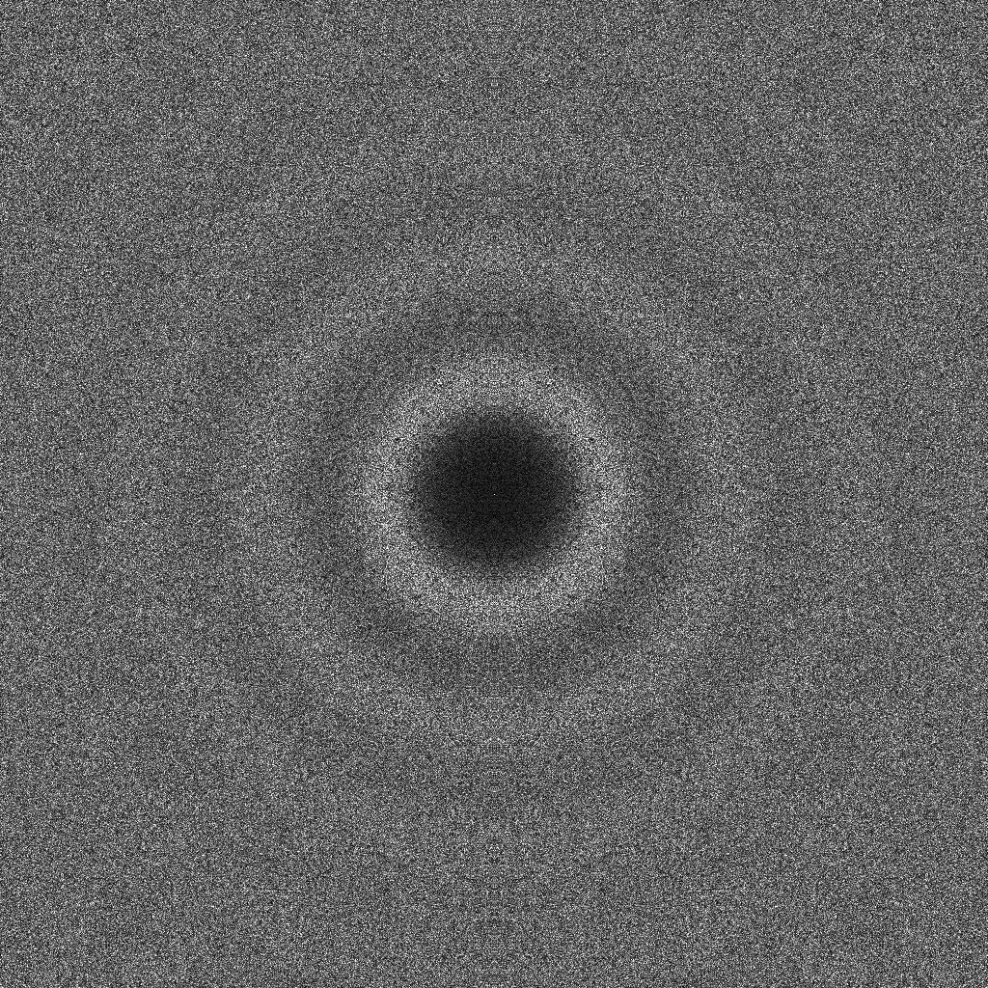
Unbiased Parallel Sample
10k pts
Rings from
inhibition
radius
Fourier spectrum

Slide 19
“Unbiased” Opinion
Unbiased as a description of (serial) process
  insertion probability independent of location
Unbaised as a description of outcome
  pairwise distance spectra, blue noise
Unbiased process leads to unbiased outcome,
but so might other processes
  Opinion: need something beyond “viewgraph norm”
  Need metrics for “how unbiased is it”
    Define spectrum S that is the limit distribution of unbiased sampling, and standard deviations.
    Our process generated S’, and |S-S’| < 0.4 std dev (S)
Ω
x_{i}?

Slide 20
Synopsis of Contribution
Poisson-disk distributions
  Simple, efficient implementation
  Provable guarantees
    Maximal
    Unbiased
    O(n) space
    time
Domains
  2d
  Polygons with holes, non-convex
Algorithmic innovations
  Two phases
    I. fast to cover most of domain
    II. careful to cover remainder
  Approximate uncovered “voids”, square circles,
  with polygons. Careful weighting and selection
Notes:
For those of you who are already experts in Poisson-disk sampling,

Slide 21
Future
Extensions
  Could do away with polygonal approximation and weight and sample directly – every dart is a hit! (w/ Thouis Ray Jones)
Higher dimensions
  geometric primitives unappealing
  prefer just use hypercubes
Thouis Ray Jones, jgt accepted paper
  model explicit time-of-arrival for each point
  synchronize locally as needed
  vs. unbiased by one dart at a time, inherently serial

