Slide 1
Not So Hot Triangulations
International Meshing Roundtable June 2021
Scott A. Mitchell, Patrick Knupp,
Sarah Mackay, Michael F. Deakin
Center for Computing Research, Sandia National Labs
Dihedral, LLC.

Slide 2
Not So HOT Triangulations — Overview
Mesh optimization for weighted primal-dual meshes
  Better meshes for primal-dual simulations, e.g. electro-magnetism, fluid flow; divergence and curl
“HOT Triangulations” optimized the “HOT” metric directly
  There are issues; HOT optimization is “not so hot”
We define new metrics with barriers
  Not the same as HOT, so “not so hot,” but optima are qualitatively similar
We do discrete changes
  Edge collapse
We optimize
  More reliable and robust to starting mesh and parameter choices
Title = triple entendre

Slide 3
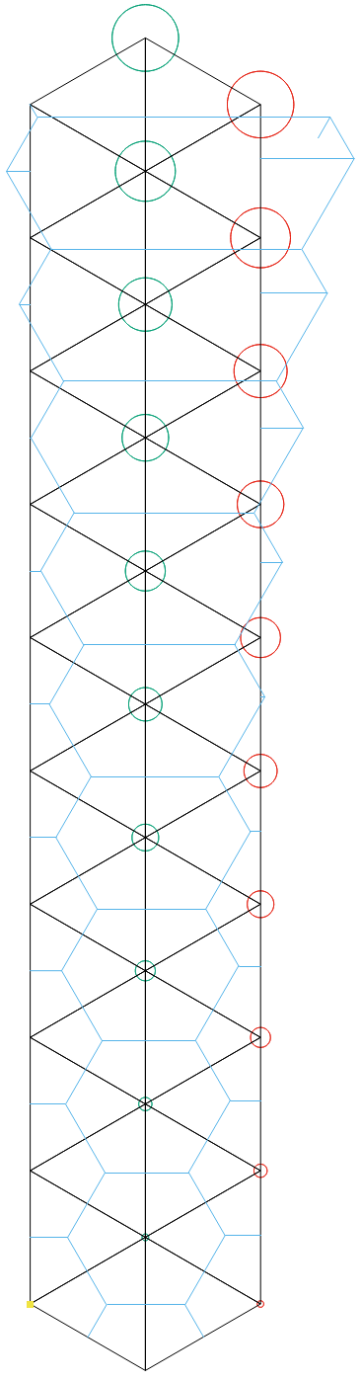
What is a Primal-Dual mesh?
Positive weight
pushes midpoint out
Primal-dual meshes
  Duality
    Delaunay—Voronoi
    Regular Triangulations — Power Diagrams
  Shape of primal and dual matters
  distance between primal and dual matters
    ∇∘ Divergence stored on primal edge midpoint
    ∇× Curl stored on dual edge midpoint
    Midpoints ⟷ , then discretization error ↑
    HOT energy formula > discretization error
Goal: mesh optimization to reduce discretization error
  Optimization of positions and weights
    Weight moves midpoints, additional degrees of freedom
Negative weight
pulls midpoint in
Far apart
➔ large error
∇×
∇∘
∇×
∇∘
Close together
➔ small error
∇×
∇∘

Slide 4
HOT Energy
o
negative h
“HOT energy” bounds the discretization error
for diagonalized Delaunay Hodge star operator
  HOT = Hodge-Optimized Triangulations
negative d
o
Negative h or d →
negative terms in HOT.
These can dominate

Slide 5
Problems with HOT Weight Optimization
HOT paper used HOT energy as optimization objective
That approach is “not-so-hot”
  Weight optimization, fixed positions
o
Two h<0
HOT < 0
d<0
HOT > 0
Shallow local minima
Minima with d_{ij}<0, unusable
unbounded

Slide 6
Problems with HOT Position Optimization
HOT paper used HOT energy as optimization objective
That approach is “not-so-hot”
  Position optimization
    Collapsed elements (or inverted depending on functional form)
o
Collapsed triangles have HOT = 0
Remaining triangles are better shaped
Shrink to point
Two vertices

Slide 7
Problems with HOT position and weight optimization
“HOT mess!”
Inverted triangles
Large weights
large negative energies

Slide 8
Our Solution: Discrete Collapses
  Collapse vertices: discrete algorithms fix
    If HOT would collapse or invert, remove vertex instead
p*
p
Optimize position p with HOT
If short edge compared to perimeter edge then remove p

Slide 9
Success Story: Opt + Discrete Collapse
7
8
Unweighted works = HOT mesh ☺
8
8
Weighted unreliable = HOT mess ☹ sometimes
8
6
6
7
8
7

Slide 10
Our Solution: Metrics with Barriers, required when opt weights
Contribution of 1 of 6 sub-triangles
  Problems
    Units length⁴ not scale invariant
    No barrier to d_{ij} < 0
    No barrier to h_{k} < 0
o
  HOT/area² normalization
    Unitless, scale invariant
    Collapsed triangle ⬄ Area 0
  HOT / area²( ⃤ ) whole triangle
    Doesn’t capture dual, position of o
    No barrier to d_{ij}<0, nor h_{k}<0
✗
✗
✗
o

Slide 11
Our Solution: Metrics with Barriers
Contribution of 1 of 6 sub-triangles
  Problems
    Units length⁴ not scale invariant
    No barrier to d_{ij} < 0
    No barrier to h_{k} < 0
o
Barrier to h_{k}<0
  HOT/area² normalization
    Unitless, scale invariant
    Collapsed triangle ⬄ Area 0
No barrier to d_{ij}<0
  HOT / area²( ⃤ ) 1-of-3 triangle
    Captures dual position of o
    Barrier to h_{k}<0
✓
✓
✗
No barrier to dij<0
o

Slide 12
Our Solution: Metrics with Barriers
Contribution of 1 of 6 sub-triangles
  Problems
    Units length⁴ not scale invariant
    No barrier to d_{ij} < 0
    No barrier to h_{k} < 0
Barrier to h_{k}<0
Barrier to d_{ij}<0
o
= condition number of each 1-of-6 triangle
Works well. Not in paper for brevity …
  HOT/area² normalization
    Unitless, scale invariant
    Collapsed triangle ⬄ Area 0
  HOT / area²( ⃤ ) 1-of-6 triangle
    Captures dual, position of o
    Barrier to h_{k}<0
    Barrier to d_{ij}<0
✓
o
✓
✗
✓
But that can’t happen for all 6 triangles simultaneously (unless ⃤ ➝0)

Slide 13
Our Solution: Metrics with Barriers
  Problem with hard barrier
    h_{k}>0 only for acute triangulations in unweighted case
    can’t start the optimization outside the barrier
  Solution: pseudo-barrier metric E_{BP}
    Replace h_{k} with phi in denominator
    But that destroys d_{ij}<0 barrier
    So replace d_{ij} with sqrt(d_{ij}d_{ji}) to restore d_{ij}<0 barrier
o
✗
✗
And that can happen while other triangles h_{k}→0 and E→0

Slide 14
Barrier-Metric Optimization, position and weights
pseudo-barrier
opt weight, opt position
radii ¼ scale

Slide 15
Barrier-Metric Optimization, position and collapses
Optimize HOT to collapse
Optimize barrier to collapse
opposite goals
Surprise!
Can do both, alternating optimization steps
pseudo-barrier
collapse + opt position

Slide 16
Barrier-Metric Optimization, pos & collapse
& weight
¼ radii
pseudo-barrier
collapse + opt position
+ opt weight

Slide 17
Optimization Algorithm

Slide 18
Problems with non-Regular Triangulations
Hodge operator is only defined for Regular (Delaunay) triangulations
Final mesh must be flipped to restore regularity
  E.g. it needs a flip if a dual edge has negative length
If the mesh needs flips, then any Energy is an extrapolation
  HOT paper showed HOT energy is a continuous extrapolation
  We propose other extrapolations that avoid some unbounded solutions, are more accurate, but not perfect

Slide 19
Opt + Discrete Collapse + Flips and Repeat
optimal but not regular
regular but not optimal

Slide 20
Outer loop Optimization after Restoring Regularity
Inaccurate extrapolation:
Energy (HOT, or our energy) can go up after flips
+
Want energy decrease
but can increase
-
-
+
Opt decreases energy
Collapse can increase or decrease

Slide 21
Summary
HOT
HOT + collapse
E_{BP}
E_{BP} + collapse
input
opt
positions only
unstable:
HOT mess
or
good
opt
positions & weights
- infinity energy
“HOT mess”
Inner optimization
  Collapsing is sufficient for optimization to be reliable if no weights
  Delaying weight optimization speeds convergence, better meshes,
  but not enough to make it always reliable
  Pseudo-barrier metrics are enough to make optimization reliable
  Best is all three: barrier metrics, collapses, weight optimization after iteration 4
Outer optimization (re-optimize after flips restore regularity)
  Improves final mesh
  Cycles possible, need termination criteria

Slide 22
Future Work
HOT
HOT + collapse
E_{BP}
E_{BP} + collapse
input
opt
positions only
unstable:
HOT mess
or
good
opt
positions & weights
- infinity energy
“HOT mess”
Future work
  Additional collapsing rules
  Insertion rules
  Dual motivated rules
  Lots of algorithm parameters and options
    What’s the best mix?

Slide 23
Open Problems
Discover an algorithm that can find a set of weights so all d_{ij} >0 and h_{k} >0, if any
  Could then optimize the hard barrier metric
  No such weights exists for this mesh:

Slide 24
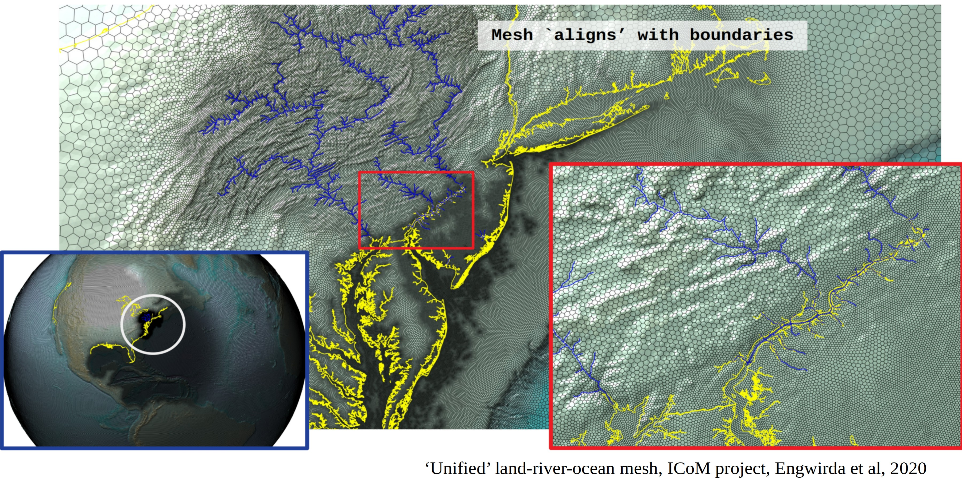
Primal-Dual Metrics for Different Operators
Is HOT what we should be optimizing?
  HOT comes from the diagonalized Delaunay Hodge star operator from Discrete Exterior Calculus
  Mimetic formulation
  Darren Engwirda
  Different discretization error than HOT
  Objective: distances between midpoints, centroids and orthocenters
  “Tight bounds on the difference and relative difference of the circumradius and orthoradius of a weighted triangle”
  Michelle Hummel, this IMR
Alternative to mesh optimization
  Change discretization to match the mesh
JIGSAW meshing library

