Slide 1
HPC Workflow (Ecosystem Impact & Challenges)
Unclassified
Robert L. Clay
Salishan HPC Conference
Gleneden Beach, OR
April 23-27, 2018

Slide 2
Outline
The Changing Environment
Enabling Impact of Workflows
Key Challenges for HPC Workflows

Slide 3
The Changing Environment
What’s new?
Workflows are becoming commonplace
V&V is the new normal – parametric runs
… and different?
HPC runs are being democratized
HPC is part of the compute environment for workflow, not *the* environment
Workflows simplify a lot of things, giving rise to new complications

Slide 4
Enabling Impact of Workflows
It’s easy to build complex workflows
It’s easy to run (and re-run) them too
It’s easy to share them
It’s ‘easy’ to access HPC machines
Leading to more [HPC] jobs run by more people on more machines with more complex workflows

Slide 5

Creating a Simple Workflow

Slide 6
Key Challenges for HPC Workflows
Meta-scheduling Problem
Workflow Resilience
Data Flow at Scale
First, let’s consider a realistic use case (courtesy of George Orient) …

Slide 7


Multi-Platform Analysis Workflow
Tools Repository (QoI Extractors)
Signal Processing
Model Parameters
CAD
STEP file
Mesher
FEM
QoIs
Visualizer
Constitutive Model Repository
Viz. Media
Electronic product definition/tolerances in CAD/PLM system– Windows
All other Comp/Sim components of the workflow available on Linux HPC
Report
Executed hundreds of times; must be robust and resilient

Slide 8
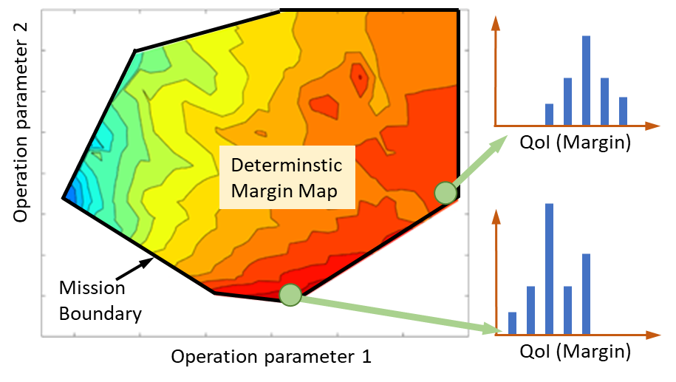
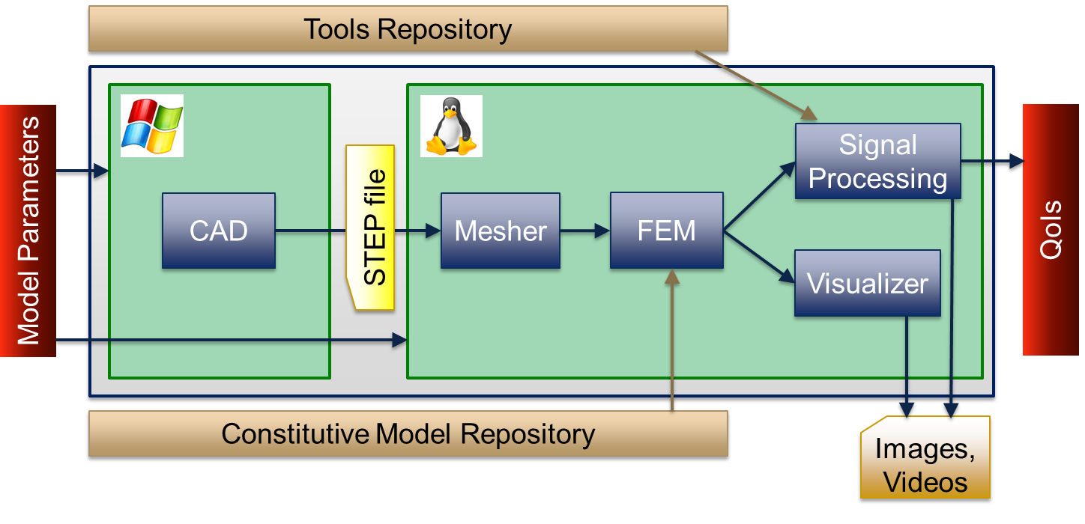
Notional Qualification/UQ Workflow
Deliverable
Supporting Workflow
Dakota
Parametric Study
Slycat
Dakota
UQ Studies
Deterministic parameter study maps out system response over the mission space
SMEs examine response characteristics (graphs, videos) with Slycat to define conditions for UQ (look for low margin areas)
Sampling based UQ and statistical post processing to perform QMU
Process has been done previously by “anointed ones’. Must be democratized.

Slide 9
Meta-scheduling Problem
George’s use case features:
Design on CAD on Windows machine
Problem setup on Linux workstation
Solver run on Unix HPC machine
Post processing – who knows
How do we schedule hundreds of workflow runs that span multiple platforms (for each run)?

Slide 10
Workflow Resilience
HPC simulations/solvers are prone to faults
Workflows are complex compositions of tasks, including HPC components
Modern workflow engines have provisions for fault management, but are not well mapped to our HPC systems
How do we provide resilience for complex workflows that span fault-prone multi-platform environments?

Slide 11
Workflow Resilience
Resume / restart / retry needed at multiple levels
Study level
Evaluation level
Steering
Evaluation reuse
Task level
Hardware failure
Network issues
Task reuse
I/O Failure
Hardware failure
Scheduling issues
Convergence
Maintaining transparency without burdening user is an important challenge.
Notes:
A ”task” here is a single workflow node, like running an analysis code. Challenges here are either very hardware-specific (node failures, Lustre filesystem problems,) system-specific (running out of queue time, can’t get a Matlab license) or software-specific (failure to converge, known software limitations or bugs).
An “evaluation” is a “single workflow run”, or a bunch of tasks – a workflow without any kind of loop or iteration. Besides all the problems from the task level necessitating retry, we also have reuse issues: an evaluation consists of many tasks and for efficiency we want evaluations to share results of identical tasks. Complicated since “results” includes partial state, restart files, etc.
A “study” is a set of evaluations; like Dakota driving a workflow. We want to be able to reuse evaluations, which may be simpler than reusing tasks, since the result of an evaluation is probably less complicated than the result of a task. But there are new challenges, because Dakota or a human wants to steer the study based on the evaluations as they come in: back up, halt, restart.

Slide 12
Workflow Resilience
Different levels require different solutions
Study level
Evaluation level
User control
Deep understanding
Evaluation database
Task level
Preserved state
Task database
Polymorphism
Automated diagnosis
Restart files
Scheduler interaction
Workflow resilience requires multiple solutions, baked into system at every level.
Notes:
Task-level solutions are task-specific -- ”polymorphic”. Workflow node implementors have to be able to add necessary code to detect possible failures based on observing analysis code behavior, and understand how to use any code-specific restart capabilities.
At the evaluation level, the workflow system has to preserve enough state so that it can restart an aborted workflow to recover partial results. A database of past task results (perhaps only at the study level, or perhaps broader) will facilitate this.
At the study level, we need a database of past evaluations, although again, this is probably an easier problem. Users need to be able to see how a study is progressing and potentially influence it.

Slide 13
Data Flow at Scale
The problem is simple; the solution may not be
If tasks are executables, and tasks input/output things like meshes, how can we exchange the data between tasks w/o hitting the disk
Or, for that matter, w/o using files
Functionally, we’d like something like a persistent object pointer that is handed off between tasks as the workflow progresses.

Slide 14
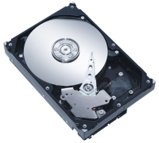
Data Flow at Scale: Today
Today’s workflows pass data through the file system
Signal Processing
Mesher
FEM
Easy
Multiple Overheads
File Database Conversions
Synchronization
Disk I/O
Visualizer
Parallel File System

Slide 15
Data Flow at Scale: Emerging
Modern I/O uses distributed memory and NVM
Signal Processing
Mesher
FEM
Performance Benefits
Remove intermediate I/O
Keep data in native structures
Cache
Sandia: Kelpie/FAODEL
Distributed Key/Blob Service
Job-to-Job RDMAs
Cray, InfiniBand, …
Visualizer
Distributed Volatile/Nonvolatile Memory
Parallel File System

Slide 16
Data Flow at Scale: Future
Workflows shouldn’t have to “reload” from anything
Can we keep data distributed in one job and have other jobs access it via local shared memory?
Node 1
Node 1
Node N
Launch a distributed mesh job to house a workflow’s mesh.
Distributed
Mesh Job

Slide 17
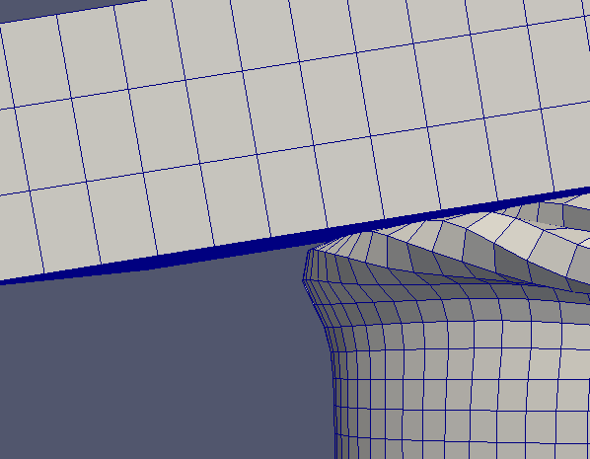
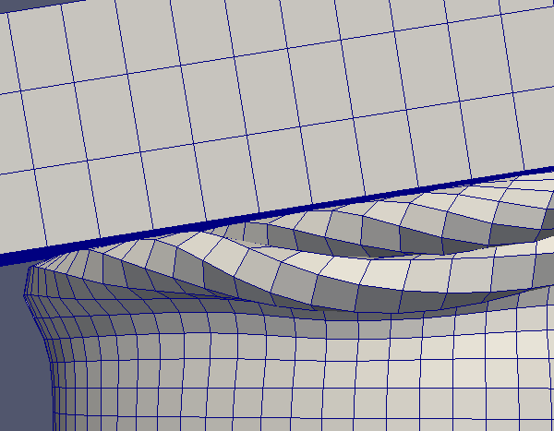
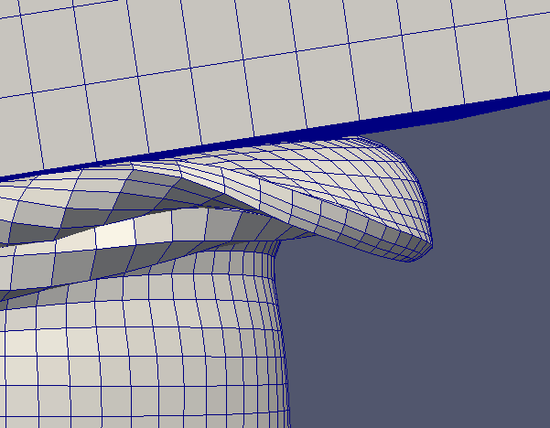
Data Flow at Scale: Future
Workflows shouldn’t have to “reload” from anything
Can we keep data distributed in one job and have other jobs access it via local shared memory?
Node 1
Node 1
Node N
*mesh
*mesh
*mesh
Mesher Job
A meshing job populates the mesh. Each rank uses local IPC and shared memory for updates
Distributed
Mesh Job

Slide 18
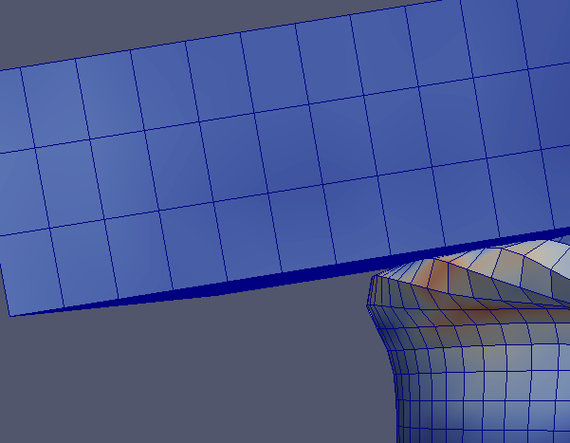
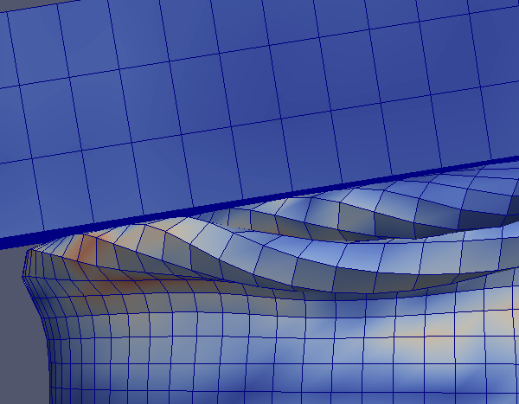
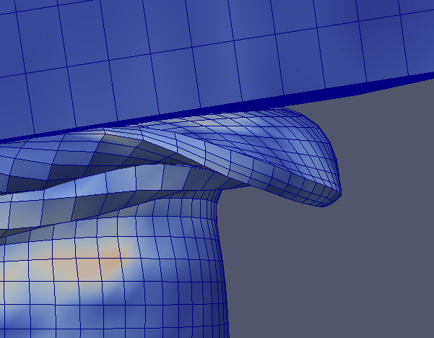
Data Flow at Scale: Future
Workflows shouldn’t have to “reload” from anything
Can we keep data distributed in one job and have other jobs access it via local shared memory?
Node 1
Node 1
Node N
FEM
Job
*mesh
*mesh
*mesh
A simulation job then runs on the nodes, using IPC and shared memory to read and supplement the mesh.
Distributed
Mesh Job

Slide 19
Data Flow at Scale: Future
This is an open research problem in need of fresh ideas.
The greatest challenge may be adapting our existing software to do something different than file I/O.
Workflows shouldn’t have to “reload” from anything
Can we keep data distributed in one job and have other jobs access it via local shared memory?
Node 1
Node 1
Node N
FEM
Job
*mesh
*mesh
*mesh
A simulation job then runs on the nodes, using IPC and shared memory to read and supplement the mesh.
Distributed
Mesh Job

Slide 20
Key Take-Away Points
HPC systems are part of a larger ecosystem
The workflow trend will continue, democratizing HPC usage
Running single simulations will always matter, but running parametric, automated workflows is becoming the norm
We need solutions that enable complex, multi-platform scheduling, resilience, and data flow (at scale)

Slide 21
Acknowledgements
Ernest Friedman-Hill
Jay Lofstead
Ron Oldfield
George Orient (QMU use case)
Craig Ulmer

Slide 22
Thank You
rlclay@sandia.gov
https://www.sandia.gov/workflow

