Slide 1
IWF/SAW ‘NextGen’ workflow SYSTEM
Robert L. Clay
CSCS
Sept 3, 2018
SAND2018-9725 PE

Slide 2
Acknowledgements
Ernest Friedman-Hill (SAW PI, video)
Ed Hoffman (IWF PO)
Jay Lofstead (Scalable I/O)
George Orient (QMU use case)
Craig Ulmer (Scalable I/O)

Slide 3
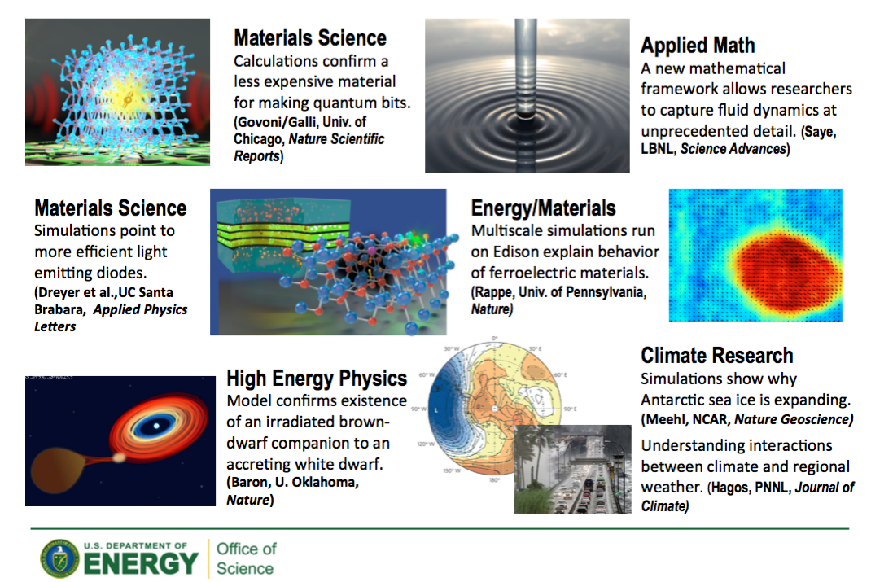
Department of Energy: What do we do?
National Energy Research Scientific Computing Center
Notes:
Introducing overview of DOE domains for non-DOE people

Slide 4
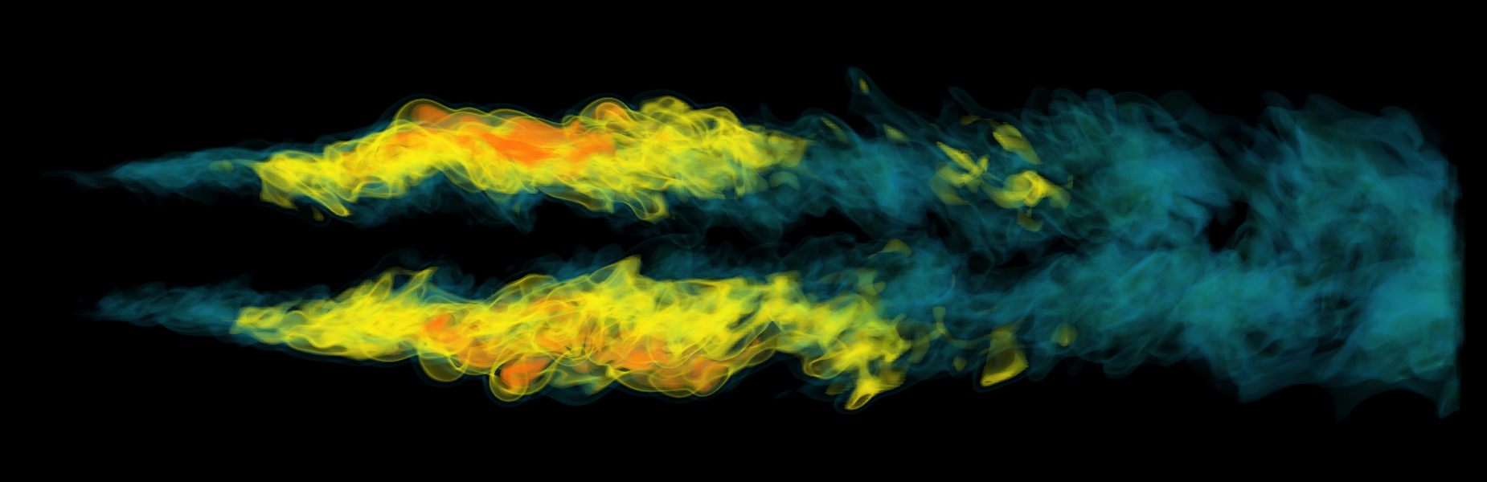
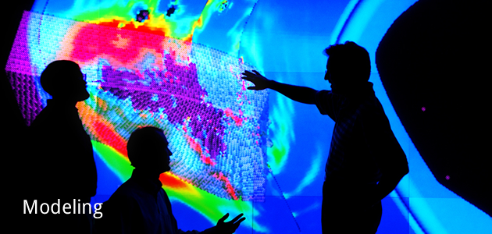
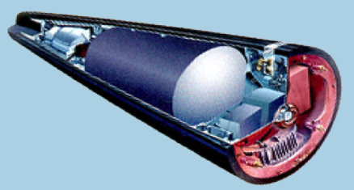
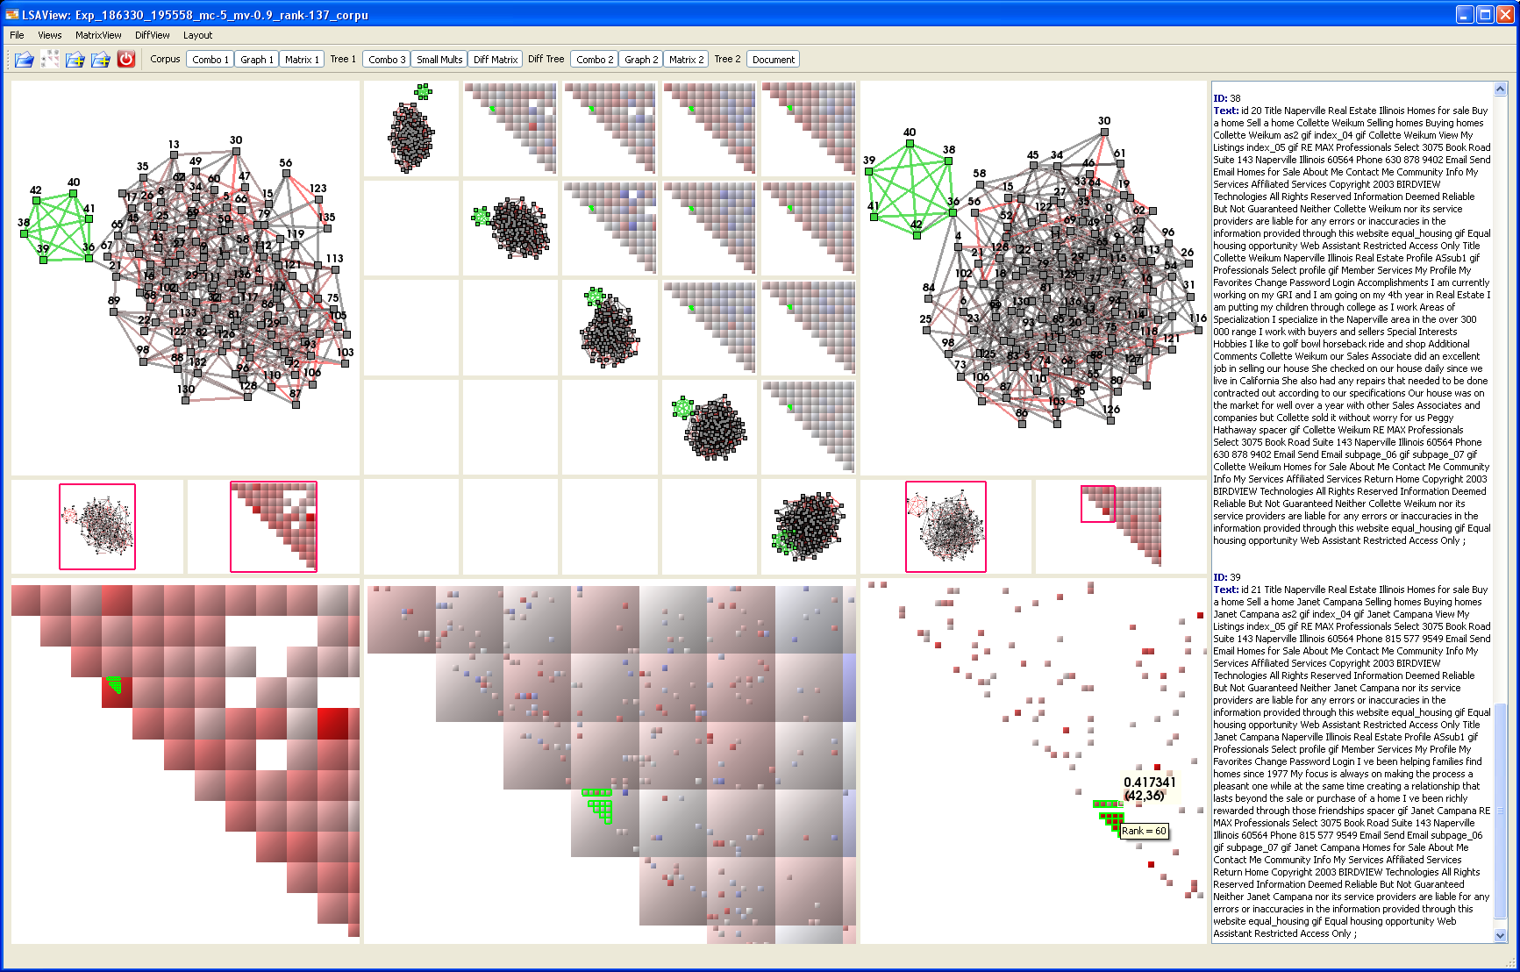
Sandia performs scientific computing research in support of national security policy and decision making
Energy: Reduce U.S. reliance on foreign energy, reduce carbon footprint
Climate change: Understand, mitigate, and adapt to the effects of global warming
National Nuclear Security: Maintain a safe, secure, and reliable nuclear stockpile
Cyber: Shore up our nation’s cyber defenses, provide more fundamental understanding of cyber environment

Slide 5
Outline
Motivating Example Problem
NGW Architecture
Workflow Demo
Key Challenges
Brief Look (Backward &) Forward

Slide 6
Outline
Motivating Example Problem
NGW Architecture
Workflow Demo
Key Challenges
Brief Look (Backward &) Forward

Slide 7
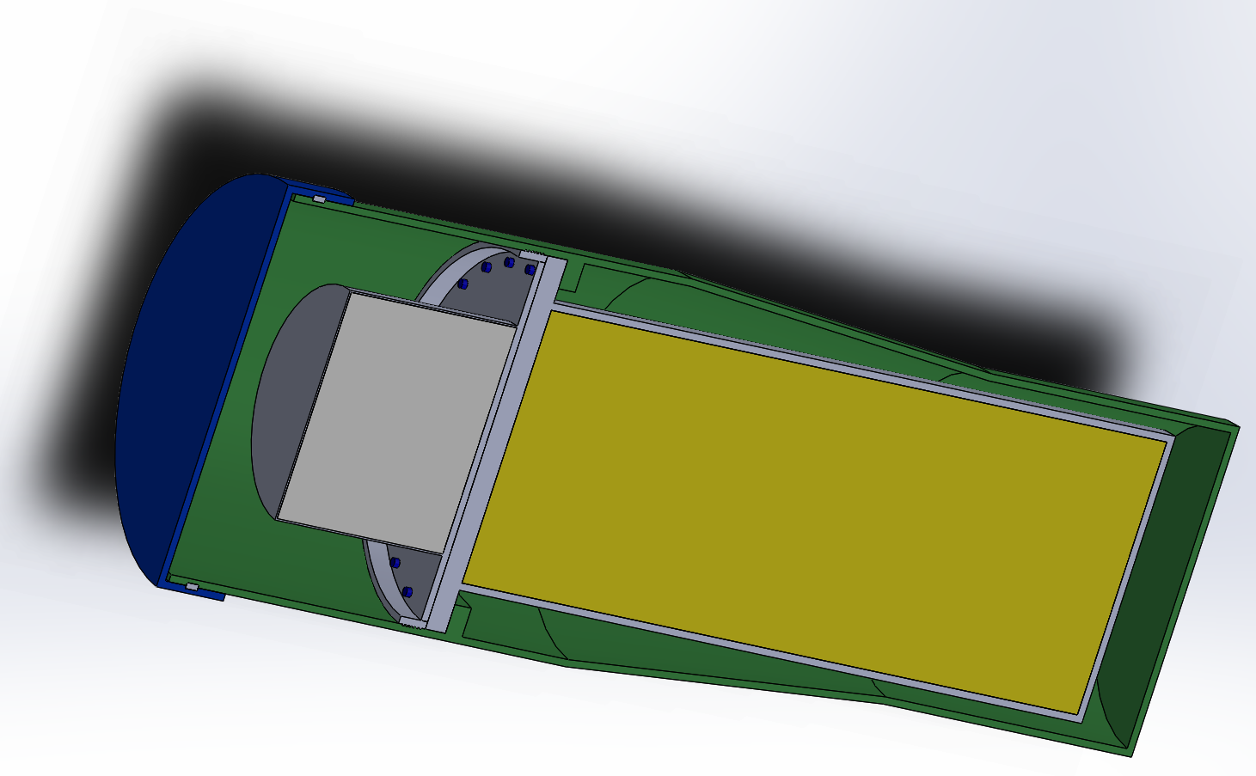
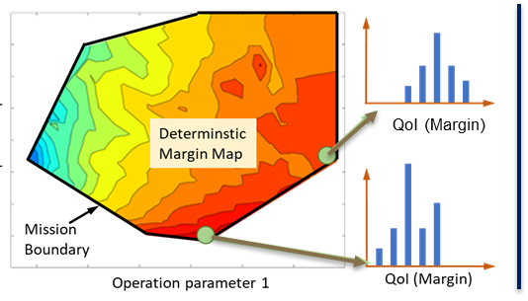
QMU of System Design
Design coupled to detailed analysis
Understand design margins and uncertainties
IWF
Difficult problem with real program impact

Slide 8
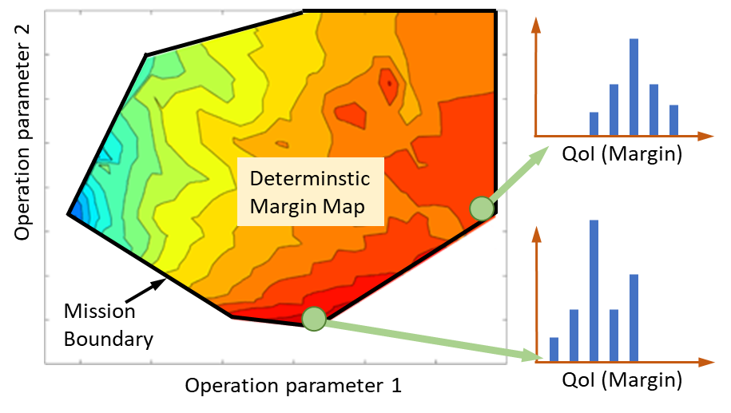
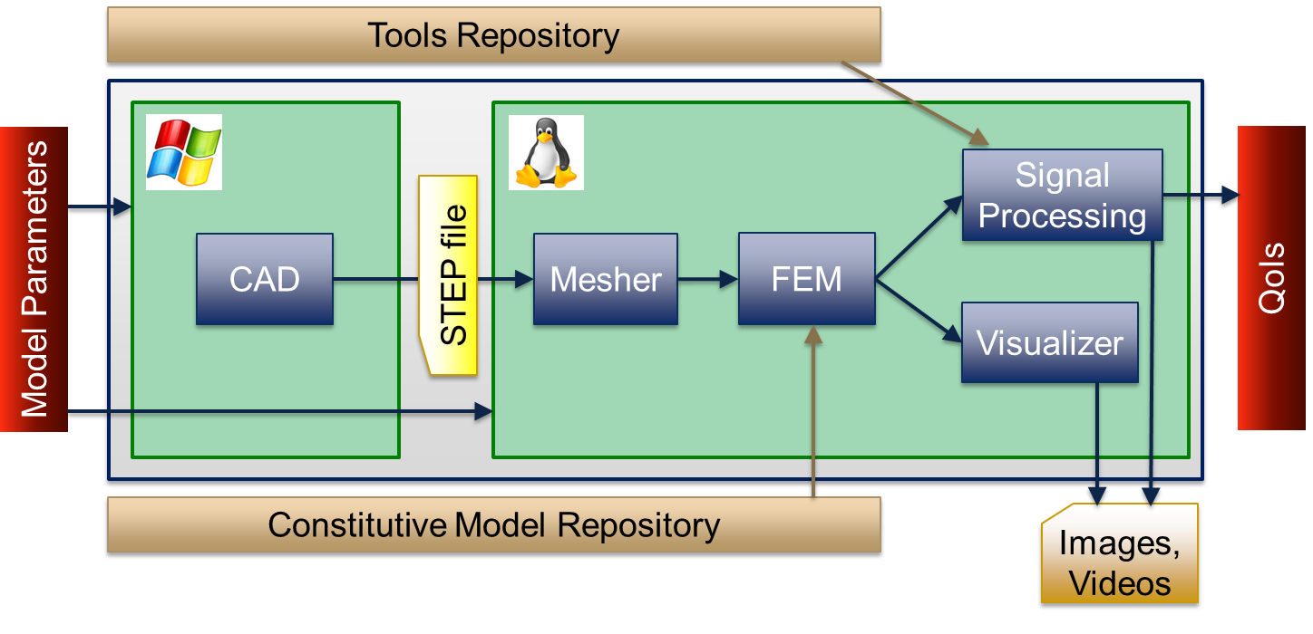
Notional Qualification/UQ Workflow
Deliverable
Supporting Workflow
Dakota
Parametric Study
Slycat
Dakota
UQ Studies
Deterministic parameter study maps out system response over the mission space
SMEs examine response characteristics (graphs, videos) to define conditions for UQ (look for low margin areas)
Sampling based UQ and statistical post processing to perform QMU

Slide 9


Notional Qualification/UQ Workflow
Tools Repository (QoI Extractors)
Signal Processing
Model Parameters
CAD
STEP file
Mesher
FEM
QoIs
Visualizer
Constitutive Model Repository
Viz. Media
Report
Electronic product definition/tolerances in CAD/PLM system– Windows
All other Comp/Sim components of the workflow available on Linux HPC
Executed hundreds of times; must be robust and resilient

Slide 10
Outline
Motivating Example Problem
NGW Architecture
Workflow Demo
Key Challenges
Brief Look (Backward &) Forward

Slide 11
Basic ‘Workflow’ Definitions
A workflow is a graph of connected components
A component represents an activity
Executing an external code
Components are user-configurable
Some very specific, some very generic
Typically implies macro scale in this context
Connections represent data interchange
Can be data flow and/or control flow
E.g., a set of numbers, a path to a file, or an identifier for a shared memory segment
Connections are configurable (e.g., how to transfer data)

Slide 12
NGW System Requirements
Low cognitive load
Users think in the domain, not about the workflow system
Transparent and escapable
It’s always obvious what the system is doing
It’s always possible for user to customize behavior
Flexible system architecture
Executes anywhere
Zero-install
Can’t assume root access on runtime system
Can’t install a persistent server
Workflow engine independence
Can be implemented on multiple products
Notes:
Workflow engine independence. Choosing a workflow engine has turned out to be a political and technical minefield. "Vendor independence" has been one of SAW's selling points, so I have continued to embrace this principle here. The choice of engine is invisible on the client and should have minimal impact on the server.
Minimal server installation. We shouldn't need admin privileges to set up workflow on an HPC machine; we should be able to execute it and interact with it using only user mechanisms. Footprint should be small and unobtrusive.
Flexible system architecture. We have documented multiple desirable system architectures involving one, two, or more machines, with the workflow engine running on various operating systems, locally and remotely. Our architecture needs to enable this kind of flexibiity.
Low cognitive load. We want a powerful system for our users, but we want them to be able to think about the domain, not the software. Therefore the successful workflow system will be nearly invisible and will not require an understanding of many or any new concepts.
Transparent and escapable. The system should hide complexity by default, but the user who wants or needs to "look under the hood" can do so. If a user wants to override default behavior this should be possible.

Slide 13
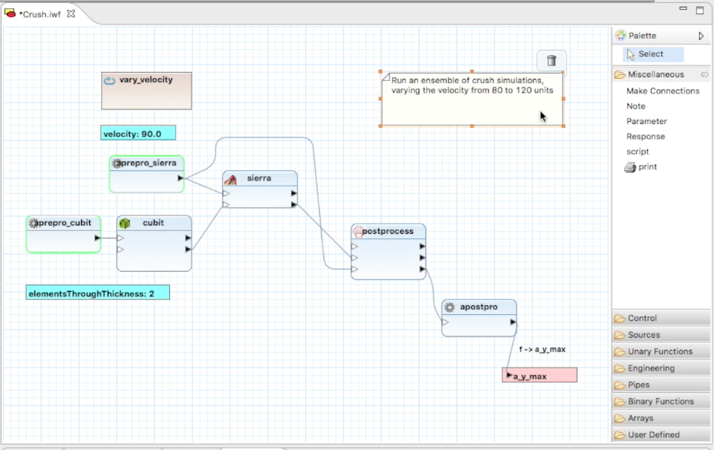
Next-Gen Workflow Architecture
Communications and Utilities
Workflow Nodes
Node Compatibility
Third-party Workflow Engine
Launcher
Graphical Editor
Workflow File
Layered Runtime
Graphical editor and runtime are independent and can be used separately in time and space. Editor runs on desktop, while runtime can execute anywhere from desktop to HPC clusters.
Notes:
The important point here is that the graphical system is completely separate from the runtime system. Although you can run workflows interactively on the desktop, the runtime system itself is independent of any GUI and of Eclipse. It has no external dependencies other than the third-party codes you want to access with it.

Slide 14
NGW Graphical Editor
Based on Eclipse IDE framework
Graphiti / EMF
Borrows some ideas from Triquetrum/ESWG
Data-driven
XML file to describe available component types
Easy to extend
Can add component types
Can add component-specific editing
Can add special behaviors for embedded execution
Programmers work with editor’s EMF model
Notes:
Graphiti is a graph-editing framework, EMF is the Eclipse Modeling Framework. We leverage as much third-party code as we can
Our editor borrows concepts and a little code from Triquetrum and the Eclipse Science Working Group, but unlike that product ours is not tied to a specific workflow engine (Triquetrum is Ptolemy based.)
Data-driven: All information about available workflow building blocks is in configuration files that can be dynamically loaded, saved and shared. Our server can generate such a file describing the nodes it knows about.

Slide 15
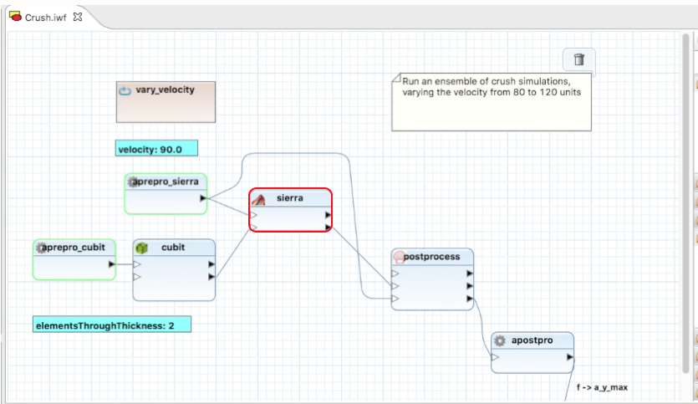
NGW Graphical Editor
Eclipse integration
Ease of use
Drag file from project, creates appropriate component to use that file
File-type-specific editors automatically invoked
Works with other Eclipse tools
SAW, Sandia’s Eclipse-based model-building environment
Notes:
Our editor borrows concepts and a little code from Triquetrum and the Eclipse Science Working Group, but unlike that product ours is not tied to a specific workflow engine.
Data-driven: All information about available workflow building blocks is in configuration files that can be dynamically loaded, saved and shared. Our server can generate such a file describing the nodes it knows about.

Slide 16
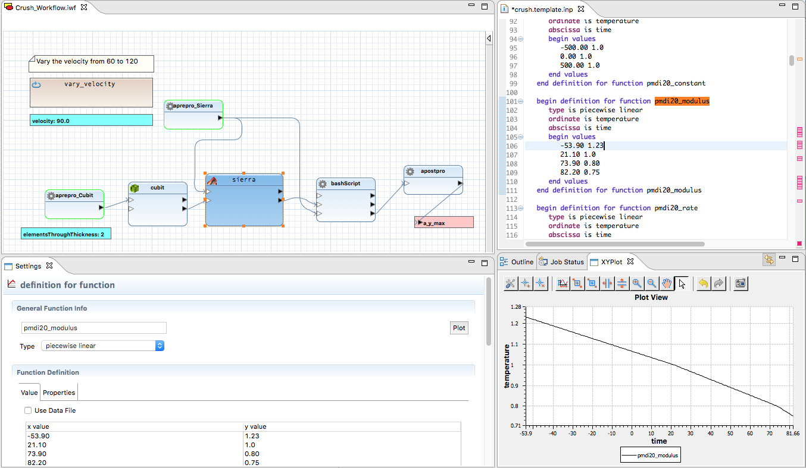
Integrated Model Building
Edit model components naturally using familiar tools
Notes:
This slide and the next three are just about how nicely the workflow editor is integrated with the rest of SAW, building on the “Works with other Ecliose tools” bullet on the previous slide. You can drop them if you want.

Slide 17
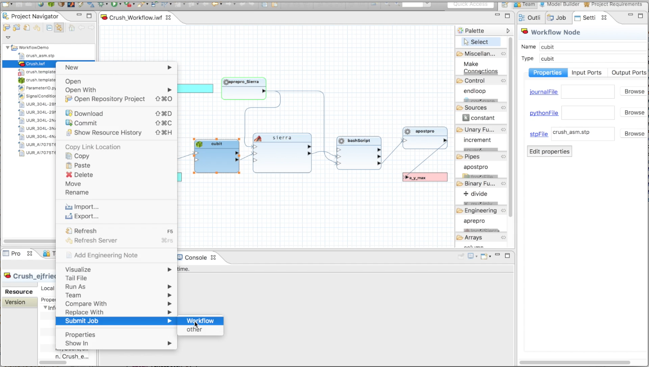
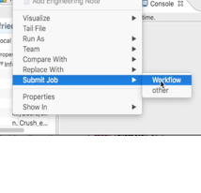
Job Submission
Workflow executed locally or remotely using SAW job submission

Slide 18
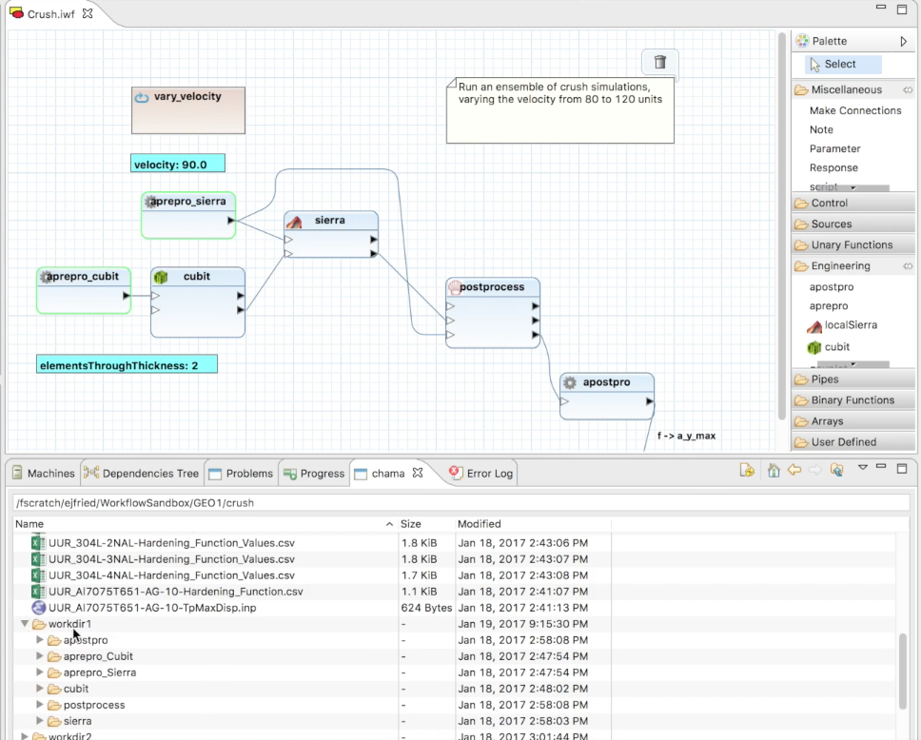
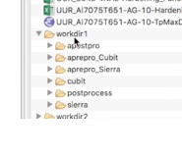
Job Monitoring & Distributed File Mngmt
Workflow status reported graphically using standard views; clicking a workflow node opens its runtime data directory

Slide 19
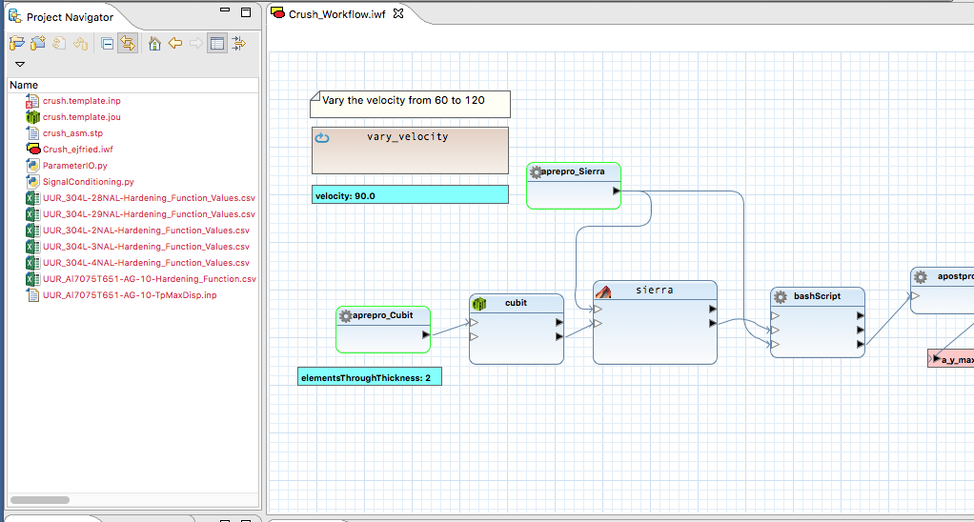

Simulation Data Management
A workflow is represented as a file, and it can be stored along with all the data it uses

Slide 20
Workflow File Format
Based on EMF native format
Simple File format contains
… component configuration
… connectivity
… optional graphical (layout) information
Does not contain component implementations
Different runtime implementations can execute the same workflow definition
Does not contain rendering information
Appearance of components easy to change
Can be generated or consumed by any code
i.e., workflows can be defined by code or scripts
Notes:
One key point of this slide is that unlike some systems, the description of a workflow in this file remains somewhat abstract. It is more a declaration of what is to be done, rather than how to do it. One workflow file could be interpreted differently on a cluster vs. on a desktop, for example. The implementation is all in the runtime system which comes in variant versions.

Slide 21
Layered Runtime Architecture
NGW Components are written in Java to a vendor-neutral API. The compatibility layer adapts to a third-party rule engine
Variant component implementations can be provided for different host environments
Communications and Utilities
Workflow Components
Portable
Component Compatibility
Third-party Workflow Engine
Not portable
Launcher
By using a thin compatibility layer, we can deploy on arbitrary third-party Java workflow engines with little effort
Notes:
Right now we’re using the Sarasvati rule engine, but will be able to deploy using Pegasus and other engines as well. The workflow components themselves will port from one engine to another with no changes – only the yellow parts need to be rewritten

Slide 22
NGW Abstract Dataflow
Connections between components are configurable. Configuration options determine how data is exchanged at runtime.
Current work involves adding support for more data exchange mechanisms.
In this notional diagram, the blue connection is configured to exchange data via a file, while the red is using a shared memory segment.
Port properties:
Name (“Flow Field”)
Data type (“CSV”)
Connection types (“FILE”, “NVRAM”)
Connection properties:
Type (“FILE”)
Parameters
PATH=“/gscratch3/user”
NAME=“field.csv”
In
Action 1
Out
In
Action 2
Out
In
Out
In
Out
Port properties:
Name (“Result”)
Data type (“EXODUS”)
Connection types (“FILE”, “NVRAM”)
Connection properties:
Type (“NVRAM”)
Parameters
SEGMENT=“0x00004332”
OFFSET=“0x00002200”
field.csv
Tool 1
Tool 2
0x00004332
0x00002200
Notes:
Many components interface with external tools. As a result we have to communicate with these tools using whatever mechanisms they support, and this often means files.
Right now connection options include the ability to copy or link a given file, to read the data from a file, write the data to a file, expand path wildcards, etc. Basically each component can make its own assumptions about where data is coming from, and the connection configurations and the runtime system combine to satisfy these expectations.
The metadata= describes, at least, the set of inputs and outputs for an action. Each I/O “port” has a name, a data type, and a list of possible connection types. When a connection is created in the workflow, the software helps you figure out which communication method(s) can be used, and the connection carries parameters that tell how the chosen method will be used (in the diagram, a path and filename, but could be a UNIX file descriptor or any other kind of symbolic description. The actions know how to convey those parameters to the external tool in some way appropriate to the tools; it’s up to the tools to actually use that information to rendezvous. So in the diagram, the workflow engine indirectly tells Tool 1 to put one of its output in a named file, and Tool 2 to read one of its inputs from the same file.
This design actually borrows from the “CCA” (Common Component Architecture) first developed at Sandia. Members of the SAW team wrote the first CCA implementation in Java, and the first that could load C++ components into Java and work on both Windows and Linux.

Slide 23
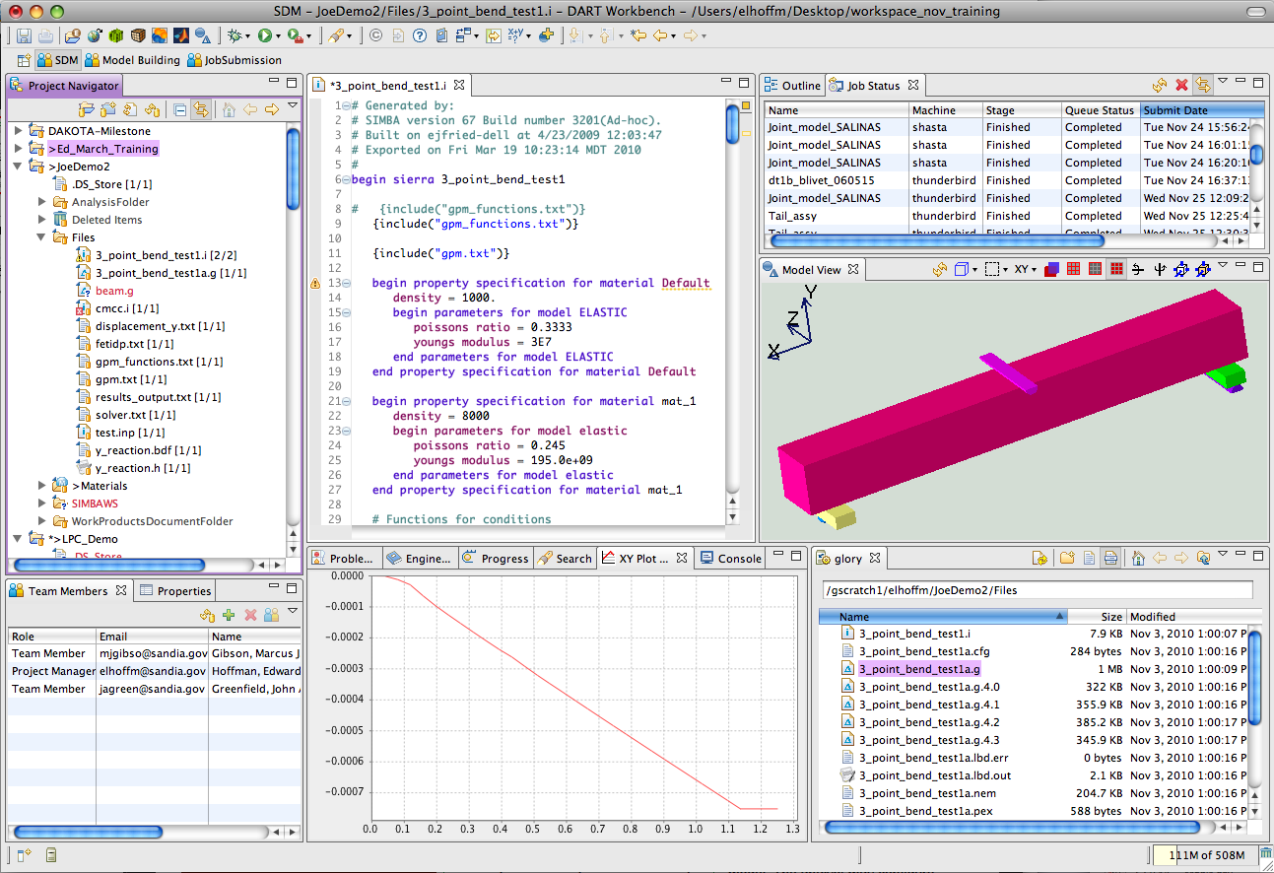
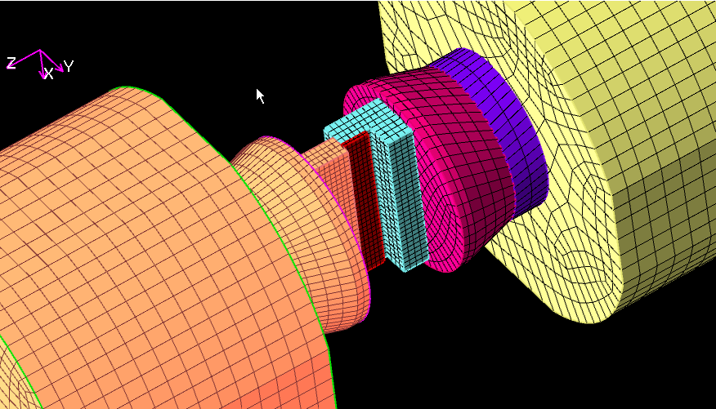
Flexible Architecture
The same workflow can run in multiple environments. We leverage our existing job submission and monitoring tools to implement this.
Interactive
Server
Batch
Distributed

Slide 24
Outline
Motivating Example Problem
NGW Architecture
Workflow Demo
Key Challenges
Brief Look (Backward &) Forward

Slide 25

Creating and Running a Simple Workflow

Slide 26
Outline
Motivating Example Problem
NGW Architecture
Workflow Demo
Key Challenges
Brief Look (Backward &) Forward

Slide 27
Key Challenges
Meta-Scheduling Problem
Distributed Execution
Workflow Resilience
Data Flow at Scale
Workflow V&V

Slide 28
Meta-Scheduling Problem
GEO’s use case features:
Design on CAD on Windows machine
Problem setup on Linux workstation
Solver run on Unix HPC machine (Trinity)
Post processing – who knows
How do we schedule hundreds of workflow runs that span multiple platforms (for each run)?

Slide 29
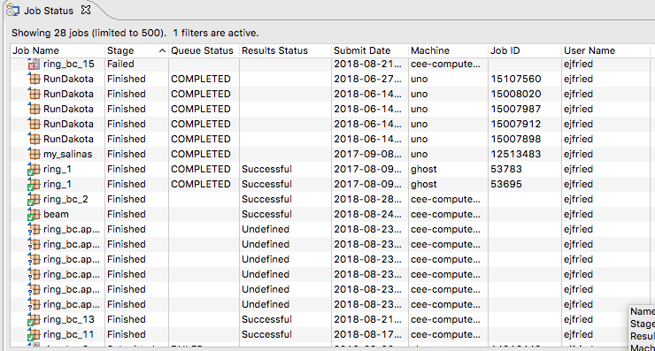
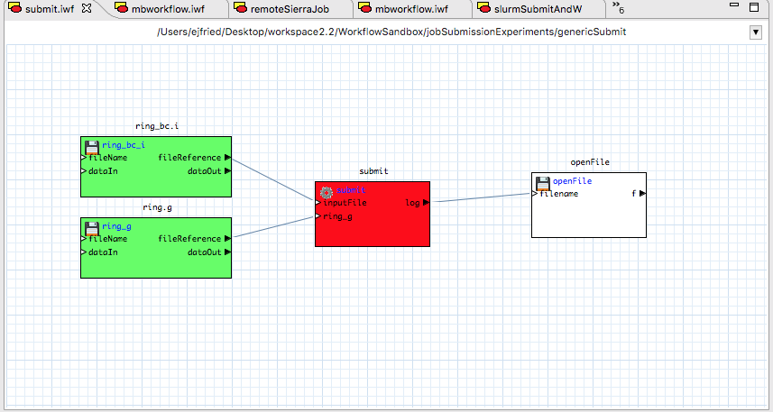
Distributed Execution
Heterogeneous resources
Different OS
Different installed codes
No admin rights: need zero install
Reasons for distributed tasks
Load balancing / parallelism
Take advantage of capabilities
Our solution
SAW Job Submission capability
Template-driven (per machine and code)
Status monitoring
Ssh and flexible authentication
Automatic data transfers based on workflow
Can remotely execute tasks or subworkflows
Notes:
We get parallelism and load balancing from clusters and queuing systems, so this is not a big driver for us; instead, taking advantage of diverse software and hardware capabilities is the driver for distributed workflows. We need some components to run local to the user, some to run on specific operating systems due to the availability of specific software (Creo, née ProENGINEER, now runs only on Windows), and compute-intensive tasks to run on clusters.
Most heterogeneous distributed computing designs assume every machine can have some kind of server installed to listen for commands; this is a nonstarter for classified environments and especially multilab classified environments. Our system uses the remote shell capabilities we’re given, and requires no installation or special permissions to use.
We’re using our very mature template-driven SAW “job submission” system, which is really a general system for scripting data transfers and remote commands, to implement remote tasks and subworkflows. For workflows running on the desktop, it automatically offers detailed status monitoring and the ability to easily abort remote tasks. Templates define how to connect to each machine and how to run specific codes. An “inheritance” system for the templates allows reuse and eliminates redundancy.

Slide 30
Workflow Resilience
HPC simulations/solvers are prone to faults
Workflows are complex compositions of tasks, including HPC components
Modern workflow engines have provisions for fault management, but are not well mapped to our HPC systems
How do we provide resilience for complex workflows that span fault-prone multi-platform environments?

Slide 31
Workflow Resilience
Resume / restart / retry needed at multiple levels
Study level
Evaluation level
Steering
Evaluation reuse
Task level
Hardware failure
Network issues
Task reuse
I/O Failure
Hardware failure
Scheduling issues
Convergence
Maintaining transparency without burdening user is an important challenge.
Notes:
A ”task” here is a single workflow node, like running an analysis code. Challenges here are either very hardware-specific (node failures, Lustre filesystem problems,) system-specific (running out of queue time, can’t get a Matlab license) or software-specific (failure to converge, known software limitations or bugs).
An “evaluation” is a “single workflow run”, or a bunch of tasks – a workflow without any kind of loop or iteration. Besides all the problems from the task level necessitating retry, we also have reuse issues: an evaluation consists of many tasks and for efficiency we want evaluations to share results of identical tasks. Complicated since “results” includes partial state, restart files, etc.
A “study” is a set of evaluations; like Dakota driving a workflow. We want to be able to reuse evaluations, which may be simpler than reusing tasks, since the result of an evaluation is probably less complicated than the result of a task. But there are new challenges, because Dakota or a human wants to steer the study based on the evaluations as they come in: back up, halt, restart.

Slide 32
Workflow Resilience
Different levels require different solutions
Study level
Evaluation level
User control
Deep understanding
Evaluation database
Task level
Preserved state
Task database
Polymorphism
Automated diagnosis
Restart files
Scheduler interaction
Workflow resilience requires multiple solutions, baked into system at every level.
Notes:
Task-level solutions are task-specific -- ”polymorphic”. Workflow node implementors have to be able to add necessary code to detect possible failures based on observing analysis code behavior, and understand how to use any code-specific restart capabilities.
At the evaluation level, the workflow system has to preserve enough state so that it can restart an aborted workflow to recover partial results. A database of past task results (perhaps only at the study level, or perhaps broader) will facilitate this.
At the study level, we need a database of past evaluations, although again, this is probably an easier problem. Users need to be able to see how a study is progressing and potentially influence it.

Slide 33
Data Flow at Scale
The problem is simple; the solution may not be
If tasks are executables, and tasks input/output things like meshes, how can we exchange the data between tasks w/o hitting the disk
Or, for that matter, w/o using files
Functionally, we’d like something like a persistent object pointer that is handed off between tasks as the workflow progresses.

Slide 34
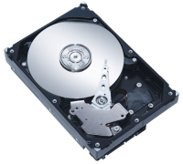
Data Flow at Scale: Today
Today’s workflows pass data through the file system
Signal Processing
Mesher
FEM
Easy
Multiple Overheads
File Database Conversions
Synchronization
Disk I/O
Visualizer
Parallel File System

Slide 35
Data Flow at Scale: Emerging
Modern I/O uses distributed memory and NVM
Signal Processing
Mesher
FEM
Performance Benefits
Remove intermediate I/O
Keep data in native structures
Cache
Sandia: Kelpie/FAODEL
Distributed Key/Blob Service
Job-to-Job RDMAs
Cray, InfiniBand, …
Visualizer
Distributed Volatile/Nonvolatile Memory
Parallel File System

Slide 36
Data Flow at Scale: Future
Workflows shouldn’t have to “reload” from anything
Can we keep data distributed in one job and have other jobs access it via local shared memory?
Node 1
Node 1
Node N
Launch a distributed mesh job to house a workflow’s mesh.
Distributed
Mesh Job

Slide 37
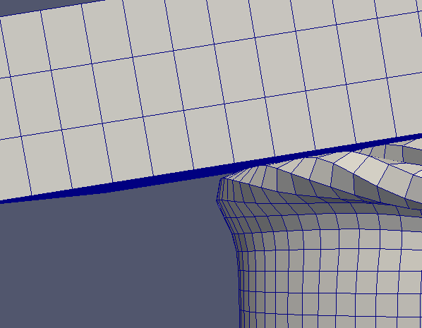
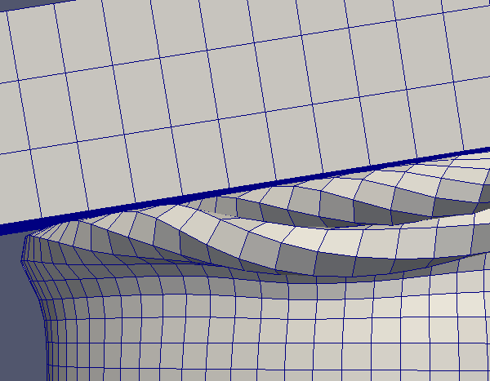
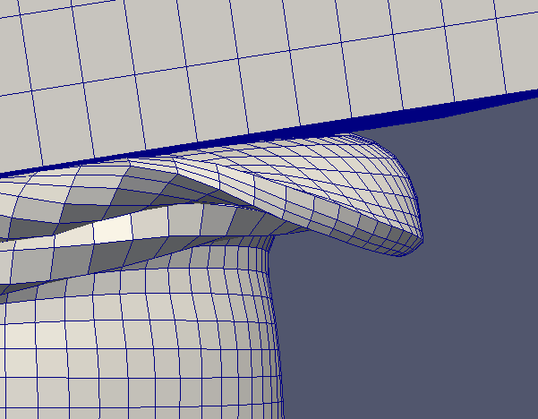
Data Flow at Scale: Future
Workflows shouldn’t have to “reload” from anything
Can we keep data distributed in one job and have other jobs access it via local shared memory?
Node 1
Node 1
Node N
*mesh
*mesh
*mesh
Mesher Job
A meshing job populates the mesh. Each rank uses local IPC and shared memory for updates
Distributed
Mesh Job
Notes:
IPC – Inter Processor Communication

Slide 38
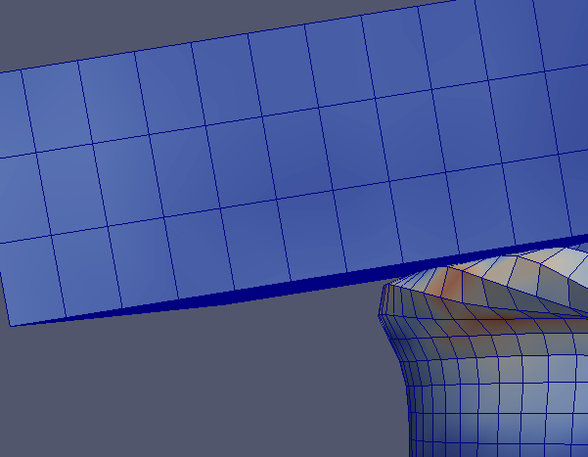
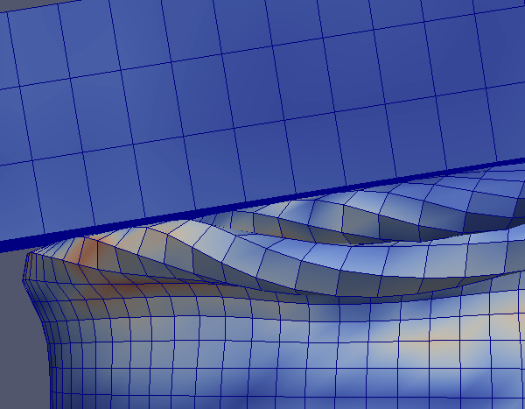
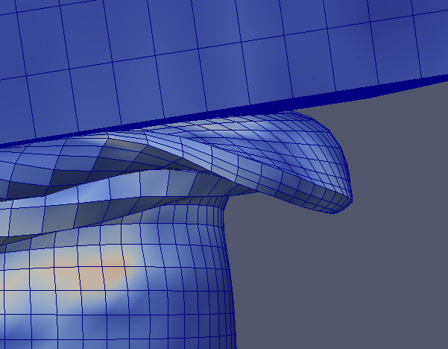
Data Flow at Scale: Future
Workflows shouldn’t have to “reload” from anything
Can we keep data distributed in one job and have other jobs access it via local shared memory?
Node 1
Node 1
Node N
FEM
Job
*mesh
*mesh
*mesh
A simulation job then runs on the nodes, using IPC and shared memory to read and supplement the mesh.
Distributed
Mesh Job
Notes:
IPC – Inter Processor Communication

Slide 39
Data Flow at Scale: Future
This is an open research problem in need of fresh ideas.
The greatest challenge may be adapting our existing software to do something different than file I/O.
Workflows shouldn’t have to “reload” from anything
Can we keep data distributed in one job and have other jobs access it via local shared memory?
Node 1
Node 1
Node N
FEM
Job
*mesh
*mesh
*mesh
A simulation job then runs on the nodes, using IPC and shared memory to read and supplement the mesh.
Distributed
Mesh Job

Slide 40
Outline
Motivating Example Problem
NGW Architecture
Workflow Demo
Key Challenges
Brief Look (Backward &) Forward

Slide 41
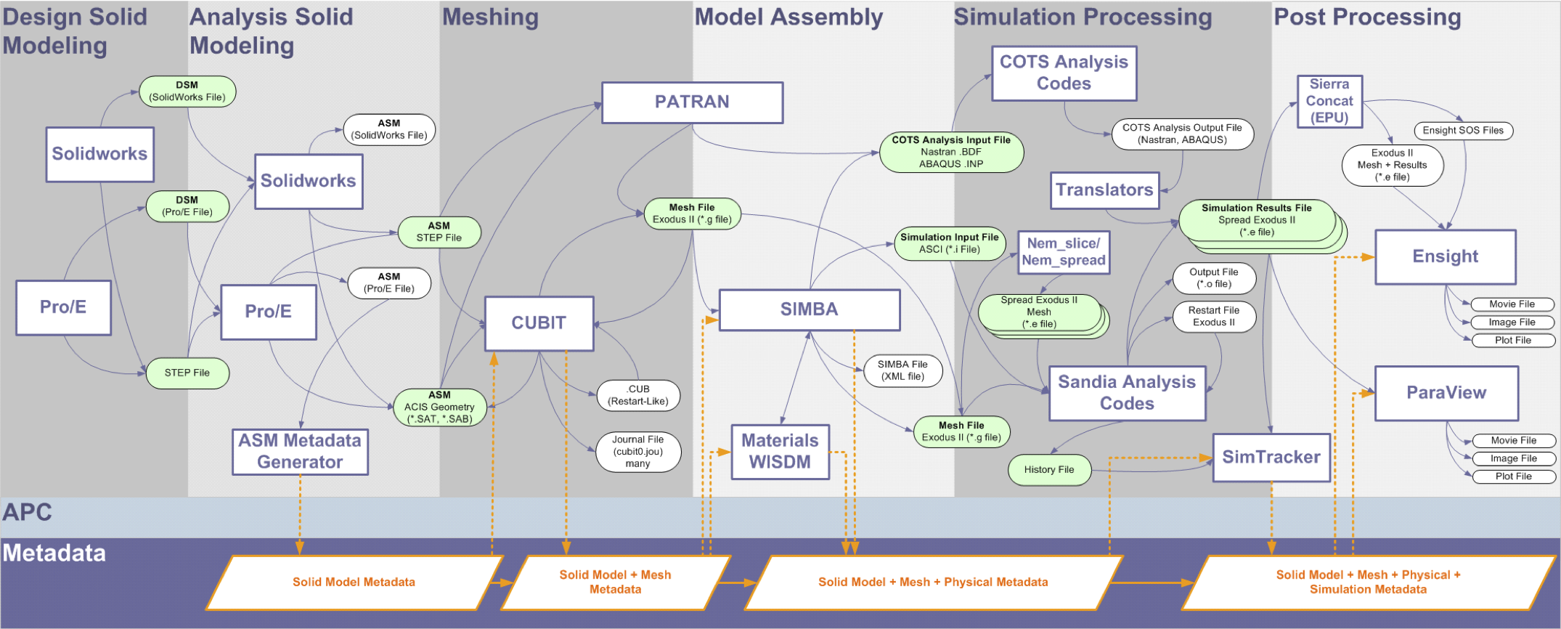
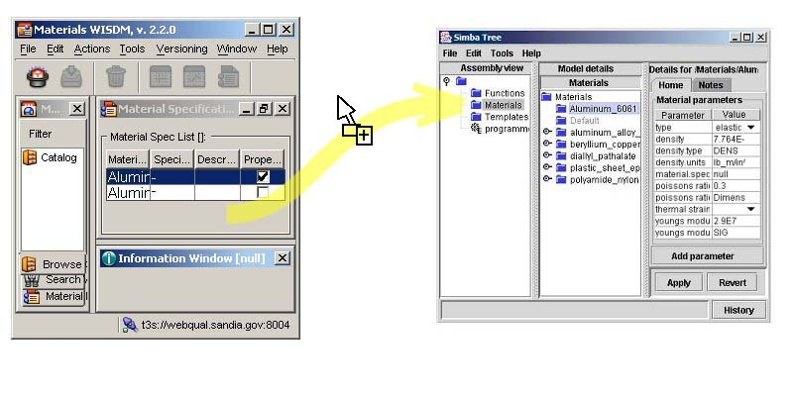
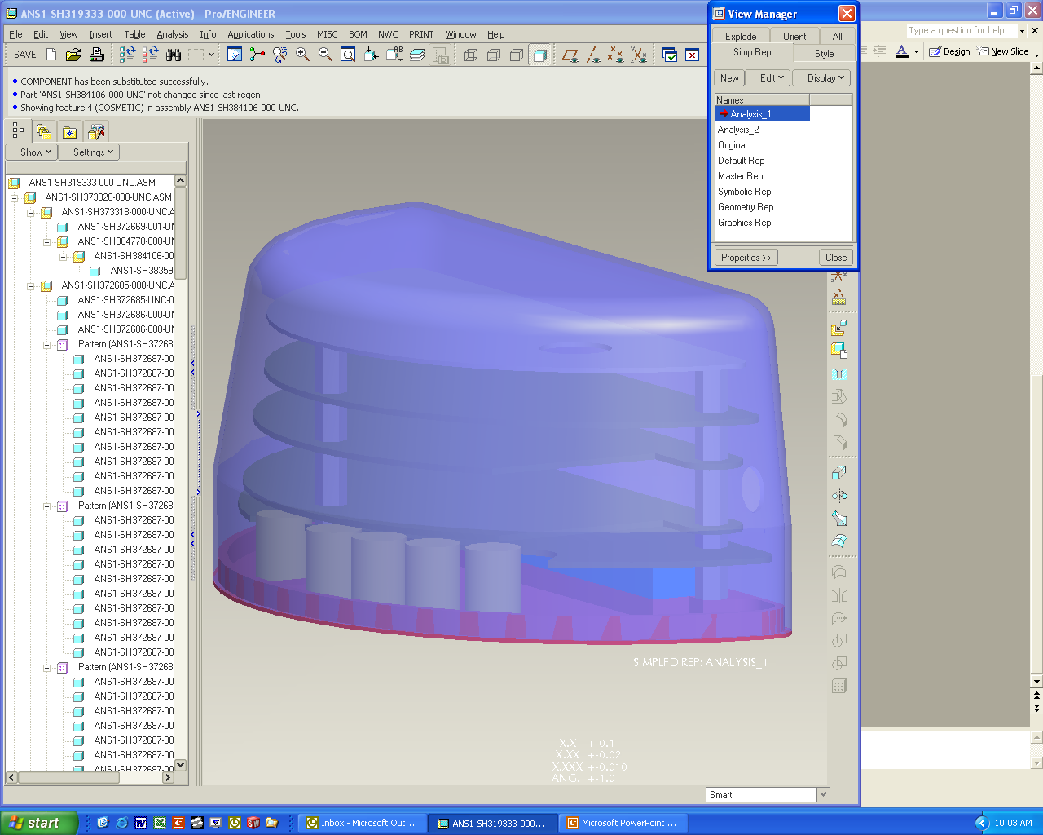
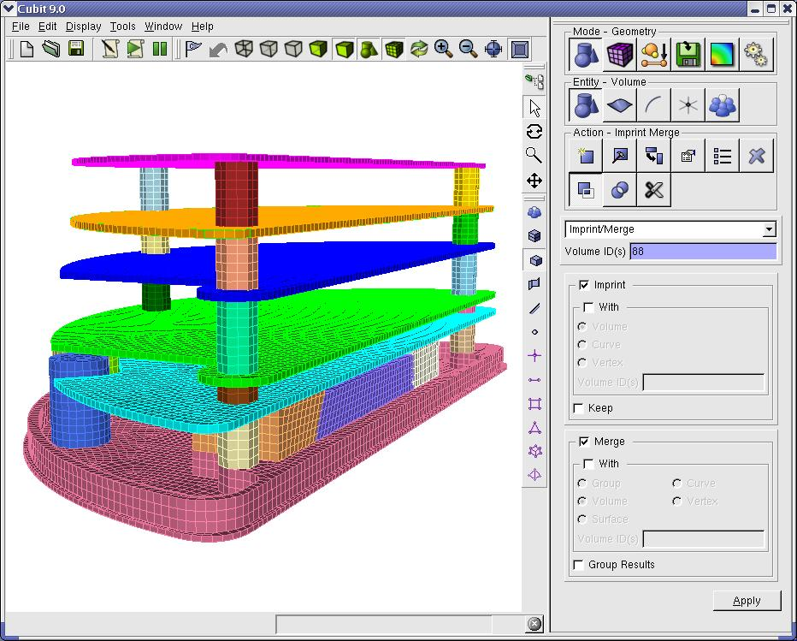
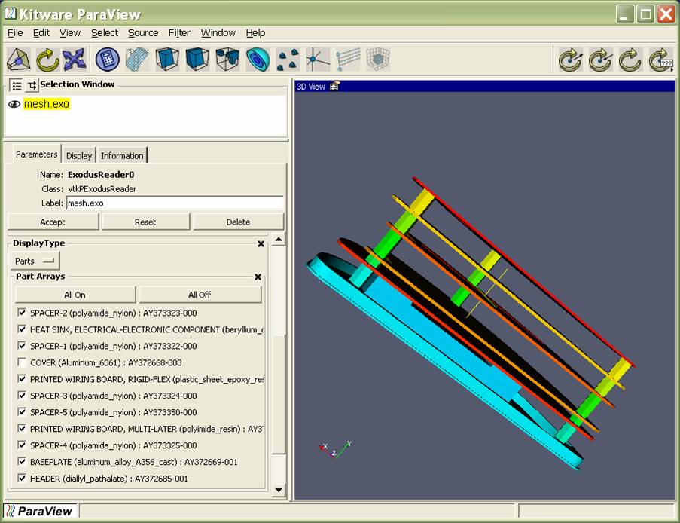
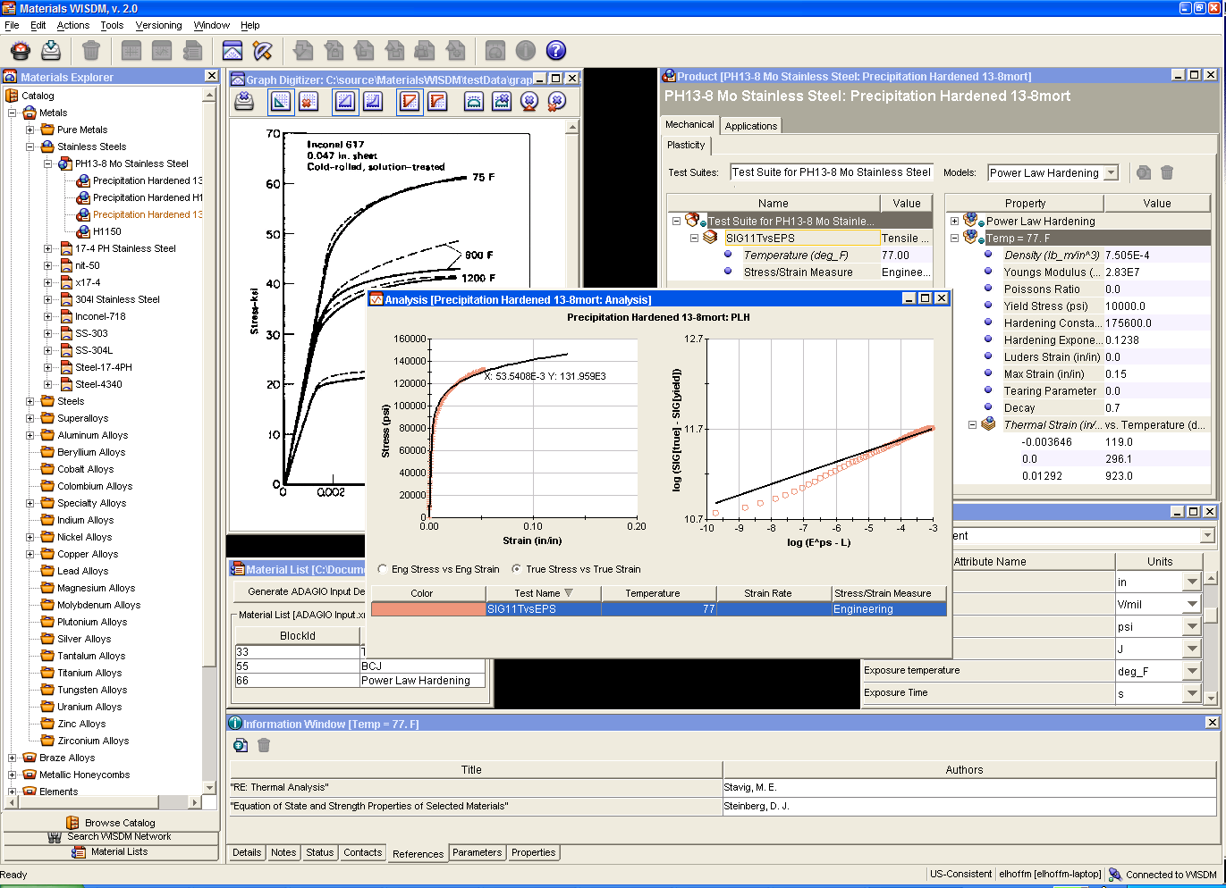

Analysis Process – Past
Complex, Manual, Disorganized
Job Submission
SIMBA
Pro/E
CUBIT
Archive
WISDM
ParaView
Metadata
Notes:
Before SAW
This is how we found things (truth be told, this is after we’d been working the problem for a while already, originally it was even worse.) All the arcs represent data transfers and virtually all of them were one-way manual processes.
Sandia has developed tools to help analysts with each step in the analysis process. This slide shows only a few of them in what is a relatively simple workflow.
While these tools can be very effective at their task
Multiple tools in an ad-hoc process
Inconsistent UI look and feel
Import/export → lots of files
Valuable metadata is lost (post-it-notes)

Slide 42
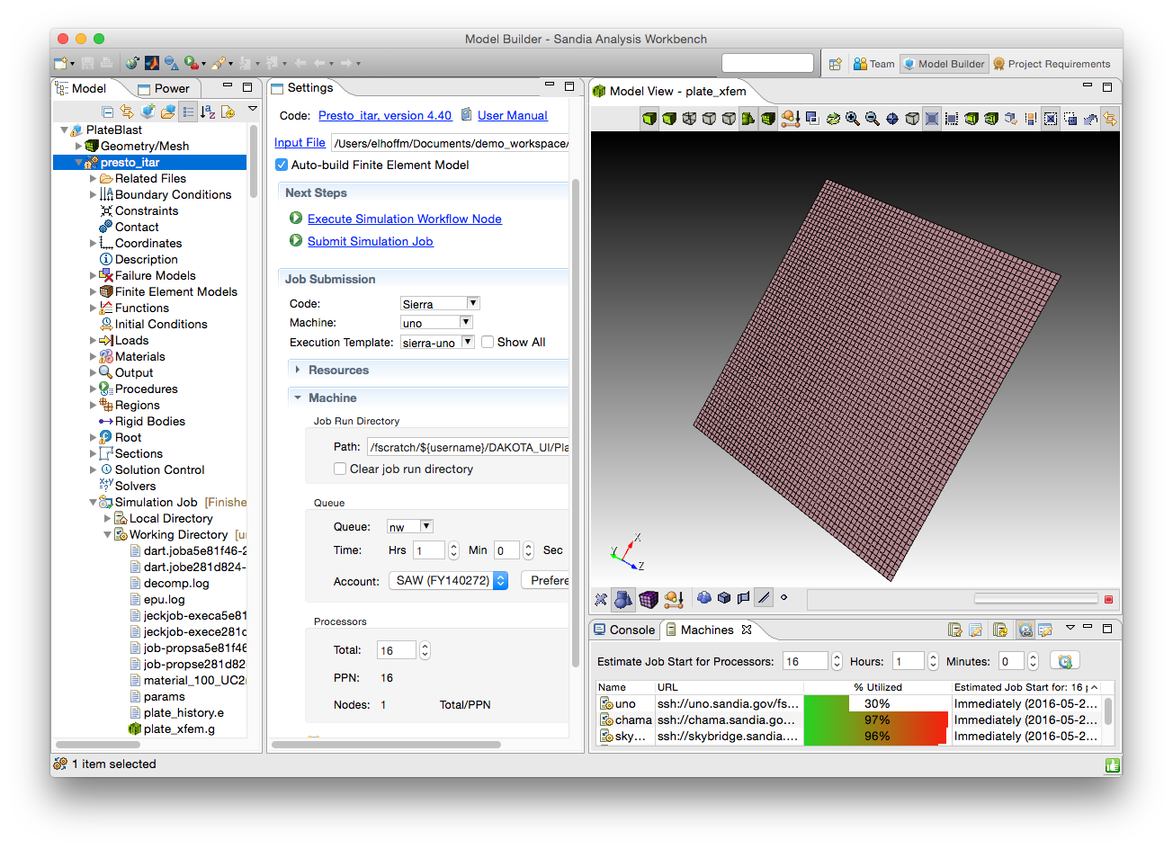
Analysis Process – Present
Integrated, Interactive, Archived Data
Archive
Notes:
Before SAW
This is how we found things (truth be told, this is after we’d been working the problem for a while already, originally it was even worse.) All the arcs represent data transfers and virtually all of them were one-way manual processes.
Sandia has developed tools to help analysts with each step in the analysis process. This slide shows only a few of them in what is a relatively simple workflow.
While these tools can be very effective at their task
Multiple tools in an ad-hoc process
Inconsistent UI look and feel
Import/export → lots of files
Valuable metadata is lost (post-it-notes)

Slide 43
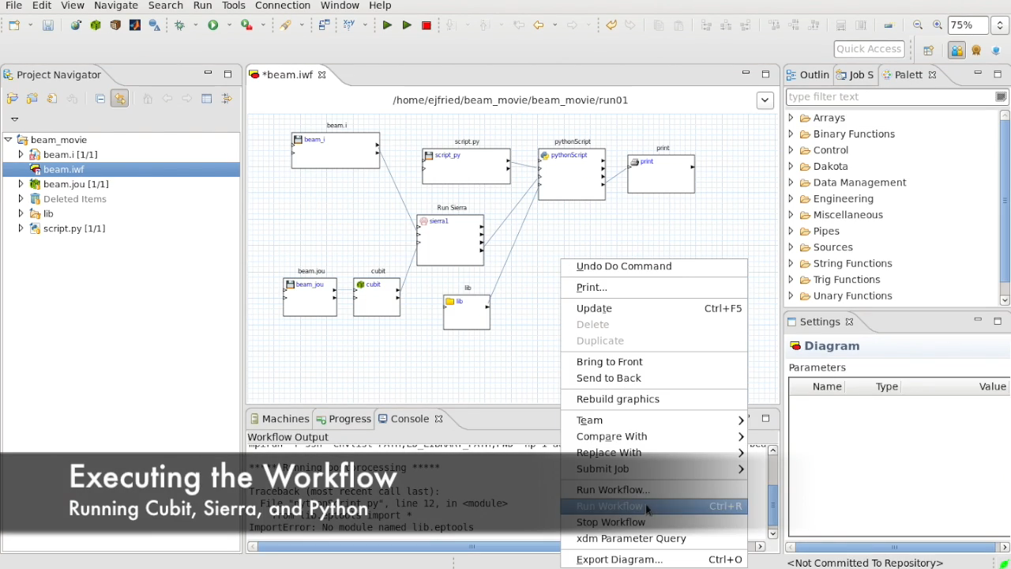
Analysis Process – Near Future
Automated, Self-Documented, Archived Process and Data
Archive
Notes:
Before SAW
This is how we found things (truth be told, this is after we’d been working the problem for a while already, originally it was even worse.) All the arcs represent data transfers and virtually all of them were one-way manual processes.
Sandia has developed tools to help analysts with each step in the analysis process. This slide shows only a few of them in what is a relatively simple workflow.
While these tools can be very effective at their task
Multiple tools in an ad-hoc process
Inconsistent UI look and feel
Import/export → lots of files
Valuable metadata is lost (post-it-notes)

Slide 44
IWF Project Path Forward
Open-sourcing IWF/SAW components
NGW, ARG, SDM, …
GibLab ‘iwf’ project
Looking for collaborations to advance community capability
Major milestone demonstrating GEO’s app spanning CAD design on Windows to QMU analysis on Trinity in 2019
Phase 2 of IWF proposed to start in 2020
3-yr effort
Major component of electrical analysis
Alignment with Sierra/RAMSES ‘NGS’ (name to change)

Slide 45
Enabling Impact of Workflows
It’s easy to build complex workflows
It’s easy to run (and re-run) them too
It’s easy to share them
It’s ‘easy’ to access HPC machines
Leading to more [HPC] jobs run by more people on more machines with more complex workflows

Slide 46
Thank You
rlclay@sandia.gov
https://www.sandia.gov/workflow

