Slide 1
Addressing Interfacial Complexities in Pb-acid Batteries to Enable Higher Cycle Life
Vijay Murugesan

Slide 2
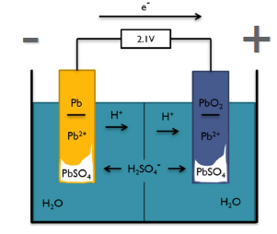
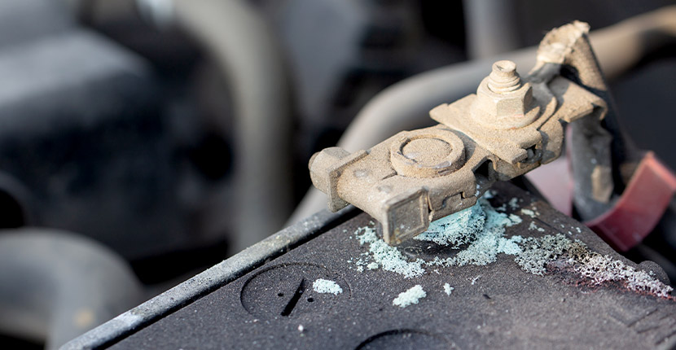
Challenging Interfacial Evolution in Pb-acid Battery Needs Multimodal Analysis
Sulfation
Brining Expertise from PNNL and ANL together to Pb-acid battery designs

Slide 3
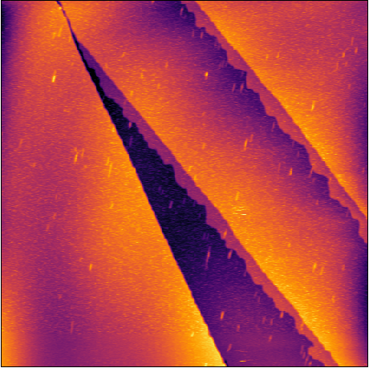
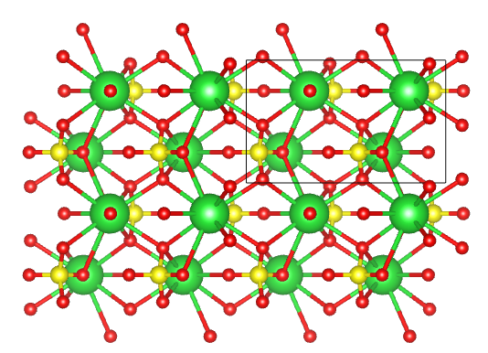
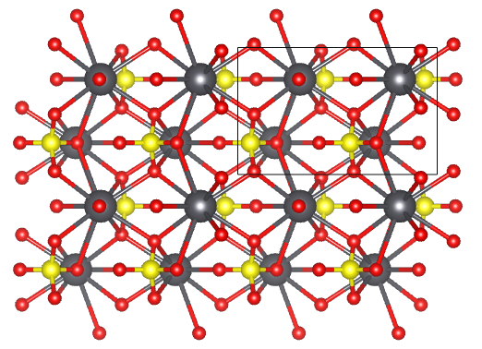
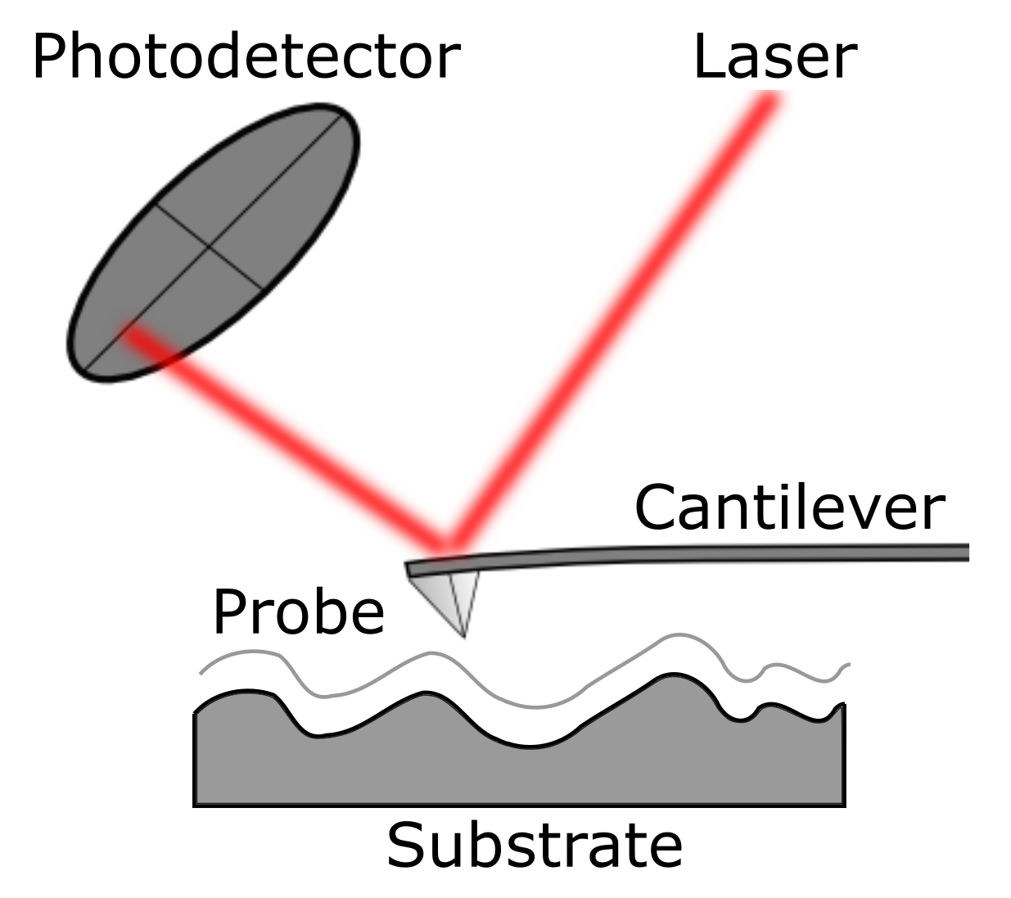
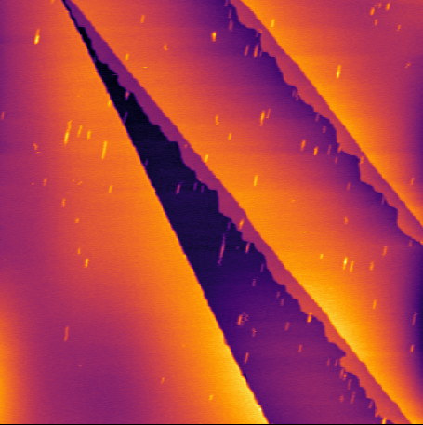
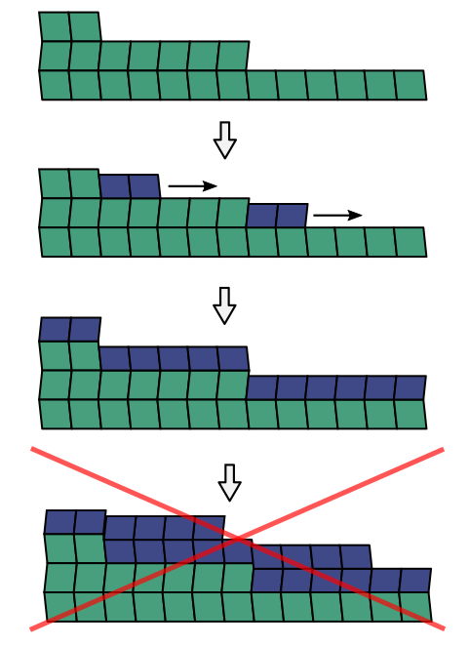
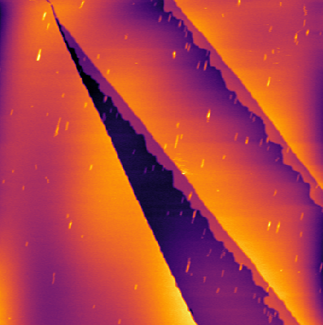
In-situ AFM provides unique insights into sulfation
Barite (BaSO₄) is added as a nucleating agent for PbSO₄ .
9 μM Pb²⁺
Barite (BaSO₄)
Anglesite (PbSO₄)
54 μM Pb²⁺
First layer forms at ~ 6 uM. But a 50x increase in Pb²⁺ concentration still doesn’t form multilayers on (001)
But at concentrations above 90 μM, we see macroscopic particles forming in solution, and on macroscopic surface defects.
Second-layer epitaxial growth is suppressed, even when highly supersaturated
360 μM Pb²⁺

Slide 4
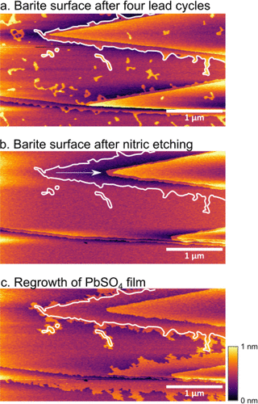
Surface chemistry limits the repeated PbSO₄ nucleation - implications in battery cycling!
The Pb-exposed nucleation surfaces had been altered by etching in situ with 100 mM nitric acid exposing fresh barite surfaces.
Reintroducing Pb-solution caused rapid film growth over the freshly exposed surface, but the growth front slowed dramatically once it reached regions that had previously been exposed to lead.
This demonstrated clearly that previous lead exposure had altered the ability of the surface to host future PbSO₄ films.

Slide 5
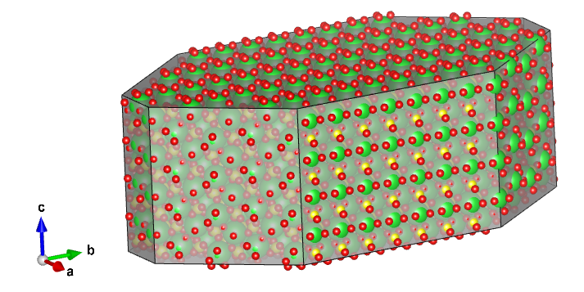
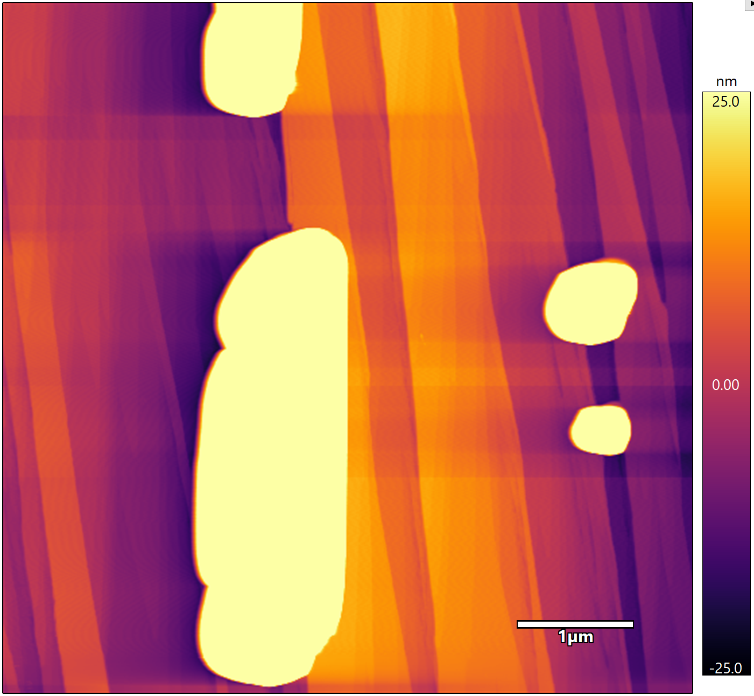
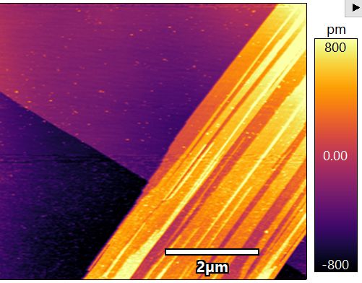
Leveraging nucleation mechanism to create improved battery additives
U_{max} | mJ/m²
(001) | ~9.7
(010) | ~7.8
(100) | ~3.8
Can we reduce strain energy?
Epitaxial misfit energy
Barite (BaSO₄)
Anglesite (PbSO₄)
a = 8.88 Å
b = 5.46 Å
c = 7.16 Å
a = 8.48 Å (4.7% misfit)
b = 5.40 Å (1.1% misfit)
c = 6.96 Å (2.8% misfit)
ε_{i} strain (lattice mismatch)
c_{ij} stiffness tensor
Multilayer growth on Barite (210)
5

Slide 6
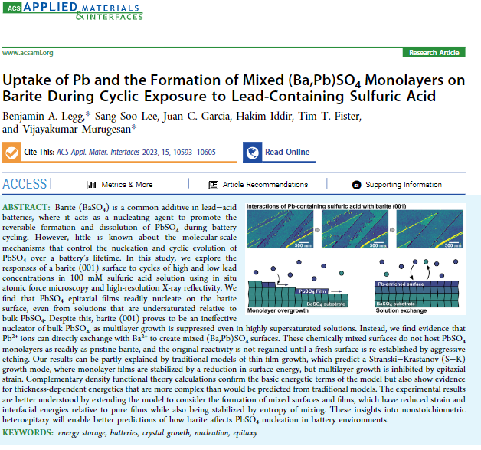
In situ AFM analysis reveals PbSO₄ nucleation mechanisms and limitations of Barite
Barite(001) is highly effective at supporting 2D monolayer films of PbSO₄, even from subsaturated solutions but it is not effective at supporting multilayer film growth due to stress and strain factors.
Additives for Pb-acid electrodes need to consider about stress and strain evolution between nucleating agents (such as barite) and lead sulfate.

Slide 7
Sr-substituted Barite as nucleation promoter for Pb-acid Cells
Pure SrSO₄ unsuitable for nucleation promoter usage in Pb-acid cells, likely due to its solubility and PbSO₄ tendency for Sr incorporation.
Sr:BaSO₄ should have reduced mismatch with anglesite and low, barite-like solubility.
Anglesite (PbSO₄)
a-axis: 8.48 Å
b-axis: 5.40 Å
c-axis: 6.96 Å
Barite (BaSO₄)
a-axis: 8.88 Å (+4.8% mismatch)
b-axis: 5.46 Å (+1.1% mismatch)
c-axis: 7.16 Å (+2.9% mismatch)
Celestite (SrSO₄)
a-axis: 8.37 Å (-1.3% mismatch)
b-axis: 5.36 Å (-0.8% mismatch)
c-axis: 6.87 Å (-1.3% mismatch)
[1]: H. Vermesan, N. Hirai, M. Shiota, T. Tanaka; Journal of Power Sources 133 (2004) 52–58
[2]: Rollog, M., Cook, N.J., Guagliardo, P. et al. Intermobility of barium, strontium, and lead in chloride and sulfate leach solutions. Geochem Trans 20, 4 (2019). https://doi.org/10.1186/s12932-019-0064-0
Notes:
“Now, pure strontium sulfate has been tested before as a nucleation promoter, and is not suitable for this function. The deposits grown on strontium sulfate require significantly longer to remove during a charging process, and the fact that strontium sulfate is more soluble means it has poor lifetime in a battery. However, a solid solution between barite and celestite should maintain barite’s low solubility at low doping fraction, while achieving a better lattice match with anglesite.”
See barite-celestite solid solutions paper!
To the end of examining the effect of lattice mismatch on the properties of the barite nucleating agent, samples of barite with a strontium dopant concentration were prepared. While strontium doping suggests a more favorable lattice match with anglesite than pure barite, previous efforts to use strontium sulfate as a nucleation promoter have resulted in sluggish dissolution rates and low nucleation promoter lifetimes due to the increased solubility of strontium sulfate.

Slide 8
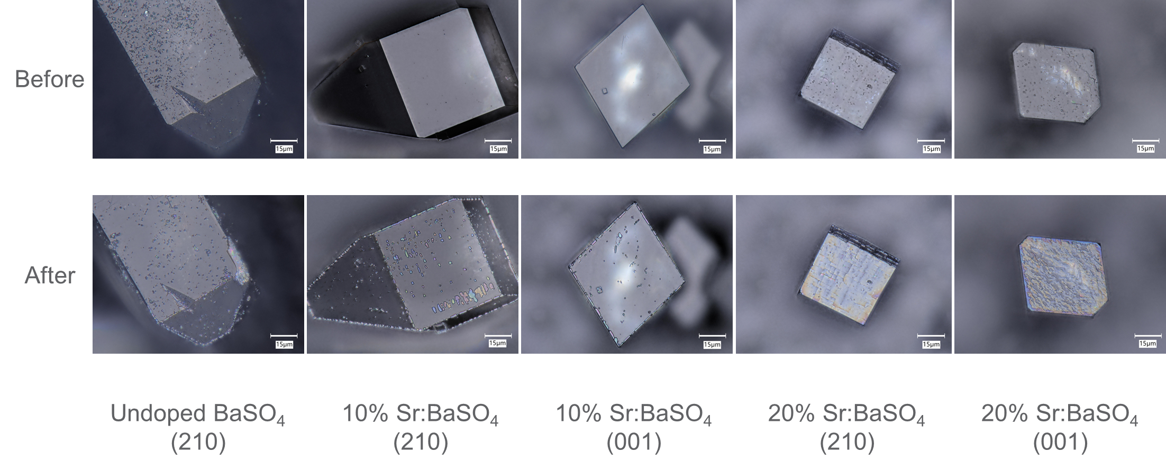
PbSO₄ nucleation on BaSO₄ Substrate 24-hour Growth on 210 and 001 Normal Faces
200 μM Pb(NO₃)₂ and 200 mM H₂SO₄ Precipitation Reaction

Slide 9
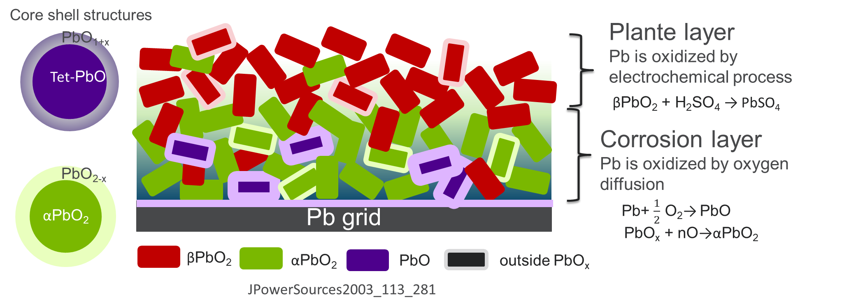
Challenging Interfacial Evolution in Pb-acid Battery
Positive failure mechanisms are often tied to the interface between the Pb current collector (grid) and the PbO₂ active material.
This region, the “corrosion layer,” is thought to have PbO or PbO_{x} (x = 1-2) phases that chemically bond Pb and PbO₂.
These nonstoichiometric PbO_{x} phases have been identified by SEM, thermal gravimetric analysis, and color, but the crystal structure is not known.

Slide 10
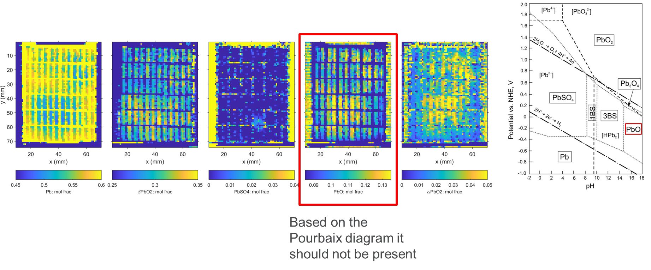
PbO evolution in Pb-acid battery cycling process
Corrosion layer evolution: Pb is oxidized by oxygen diffusion
Pb+ $\frac{1}{2}$ O₂→ PbO
PbO_{x} + nO→αPbO₂

Slide 11
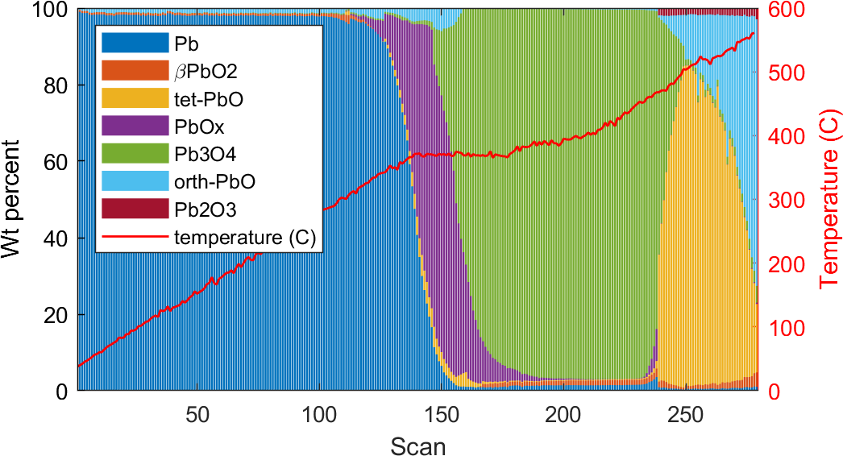
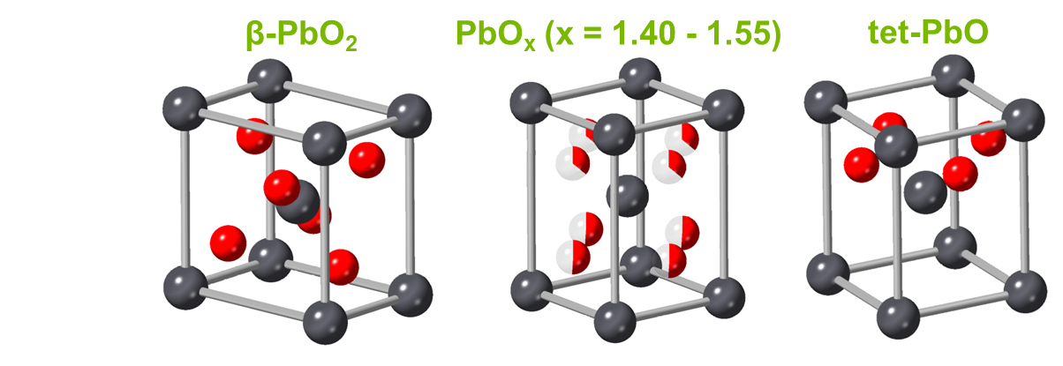
Complexities of PbO Thermal Transition
PbO phases could arise in manufacturing (lead oxide production, paste curing) or even early formation and influence cycling performance.
PbO₂ undergoes a well-known reduction to Pb₃O₄ and PbO at elevated temperature.
XRD shows the presence of these phases and a new PbO_{x} phase which resembles tet-PbO.
XAS shows similar phase change, and provides independent measure of oxygen stoichiometry.

Slide 12
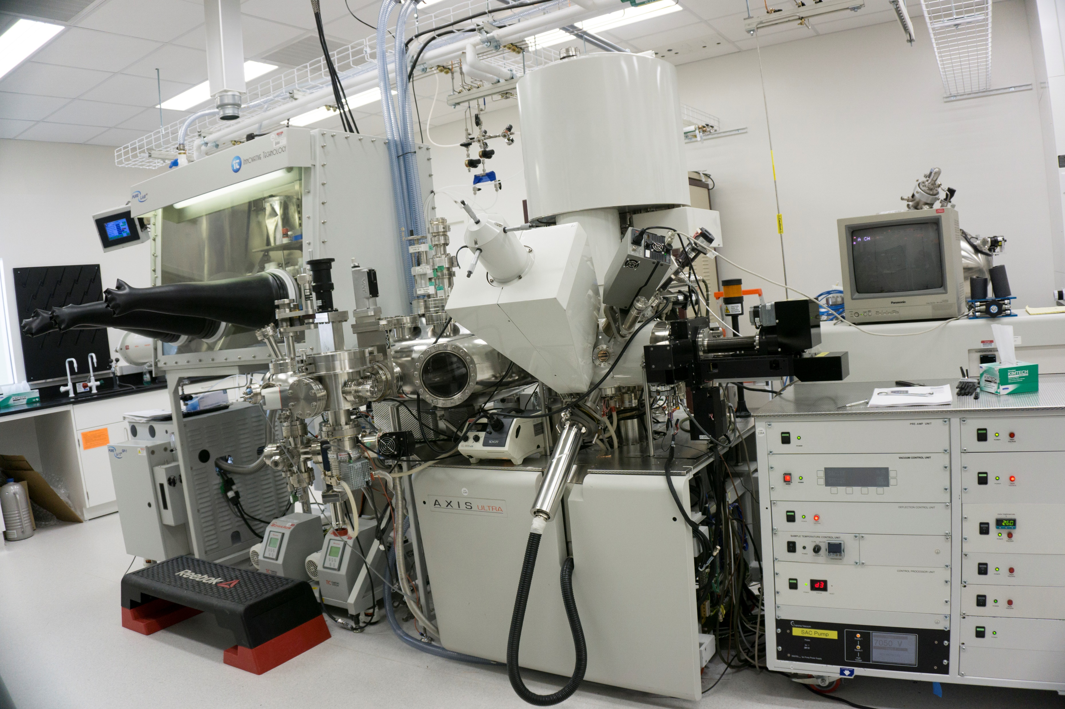
In Operando XPS to detect chemical evolution of PbO_{x} - Understanding Positive Electrodes
In-situ sample holder
Heating from 100 – 500 ºC
Vacuum – 10⁻⁸ torr
RGA for gas analysis

Slide 13
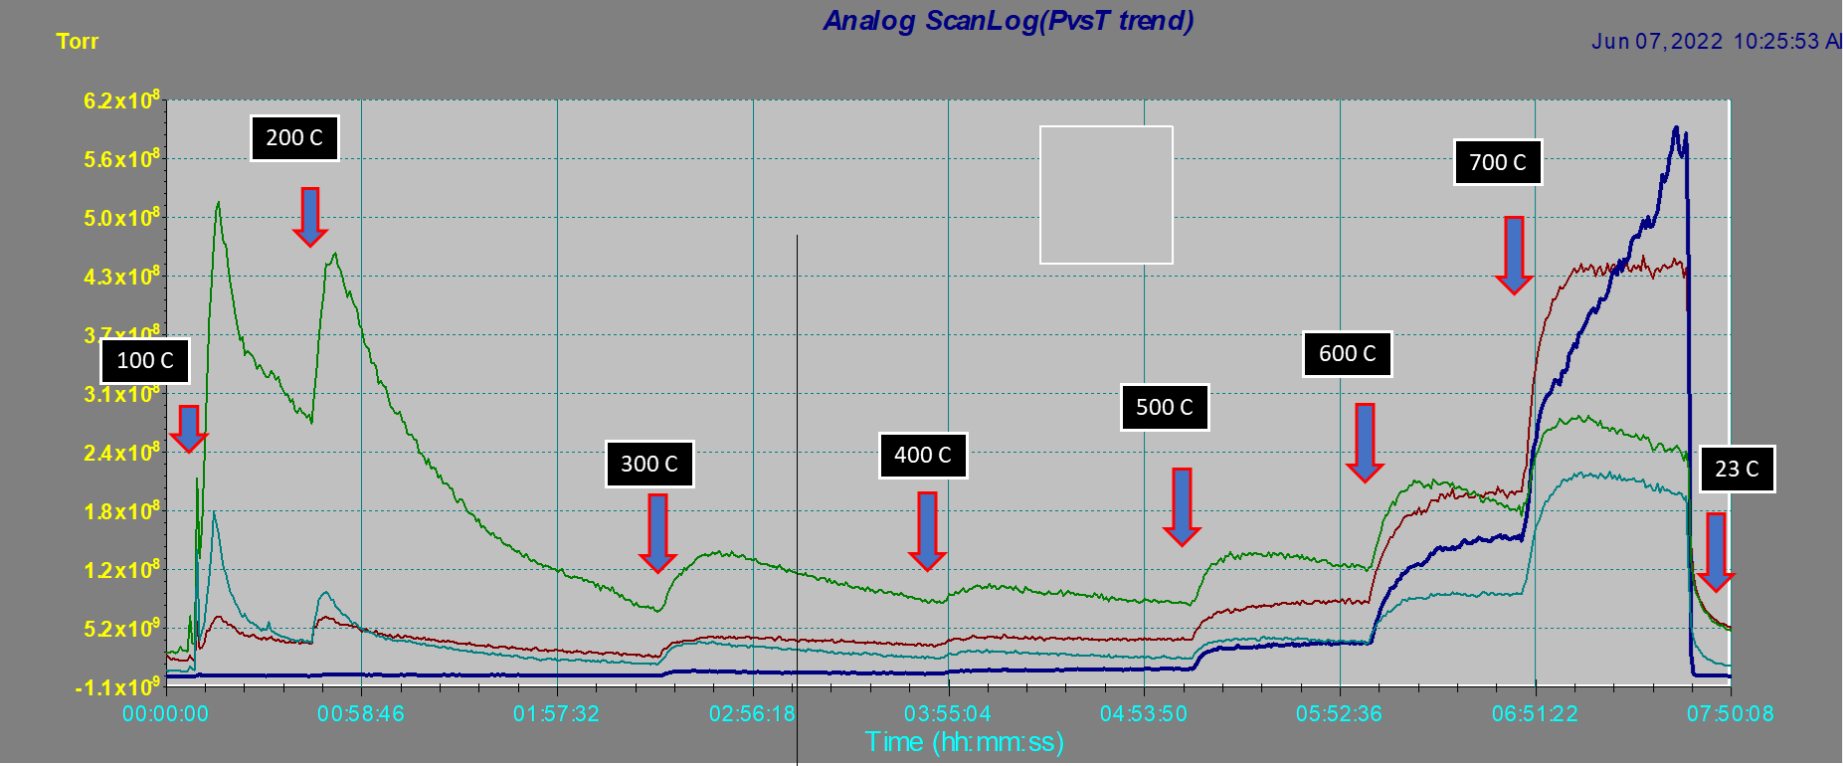
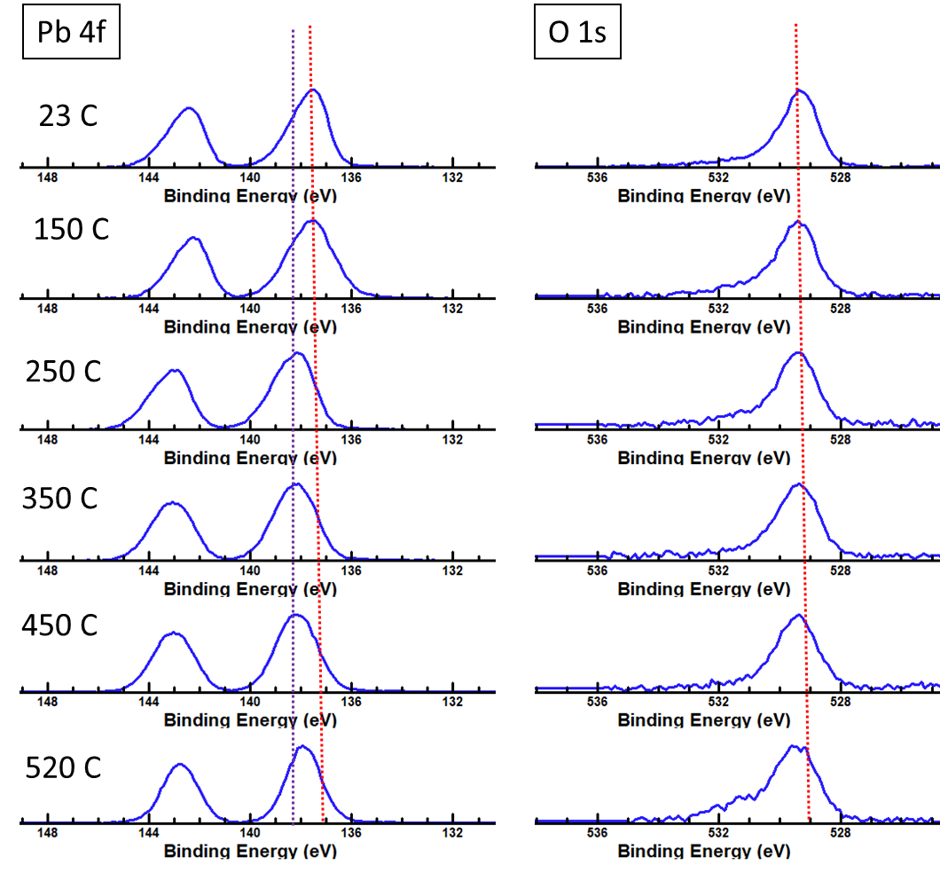
Temperature dependent changes during in-situ heating of PbO₂ – XPS analysis
PbO₂ – Pb⁴⁺; PbO – Pb²⁺
Oxygen release during thermally driven phase transition of PbO_{x} is detected
Most of oxygen release happens before 300C, suggesting the onset of phase transition under vacuum condition might be different

Slide 14
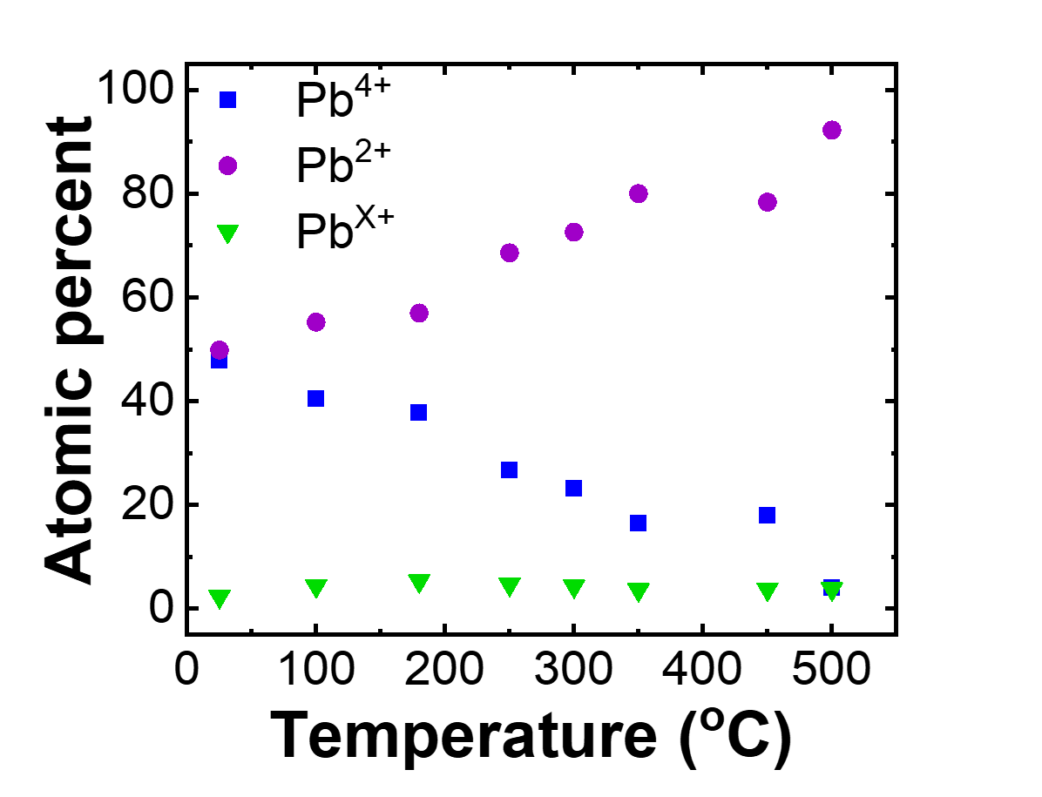
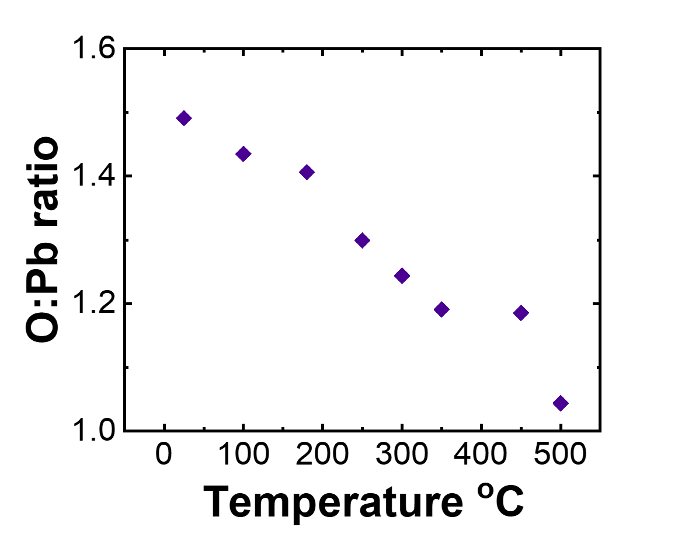
Temperature dependent changes during in-situ heating of PbO₂ – XPS analysis
UHV conditions and X-ray damage could impact the oxygen release during thermally driven phase transition of PbO_{x}
Most of oxygen release happens before 300C, suggesting the onset of phase transition under vacuum condition might be different

Slide 15
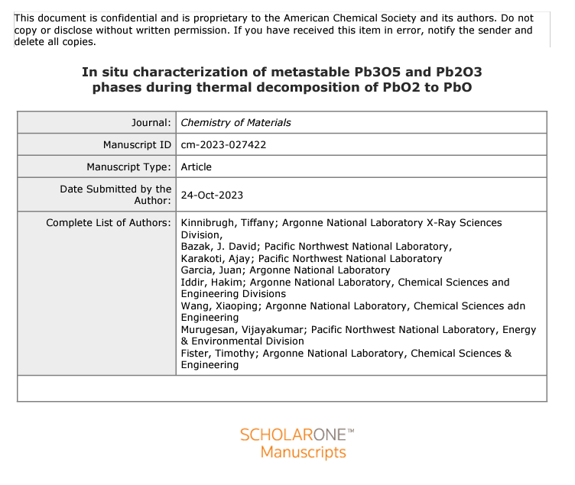
Metastable Phases of PbO_{x} were identified
The first PbO_{x} (PbO_{1.70}) phase forms within 3 hours and slowly transitions into a second PbO_{x} (PbO_{1.61}) phase between 3-15 hours.
A long-range structural order is obtained by ordering of the oxygen vacancies leading to (PbO_{1.70})
With continued increase in oxygen vacancies, a shorter-range order occurs leading to PbO_{1.61}
The structure of PbO_{1.61} was found to be a lower symmetry structure of tet-PbO
The PbO_{1.61} phase slowly decomposes into Pb₃O₄

Slide 16
Enabling Pb-acid batteries for LDES
Focused on identifying failure modes and new electrolyte & electrode materials for enabling deep cycling of Pb-acid battery
On-going Impactful Science for Pb-acid Technology
Co-refinement of electrode and electrolyte species during formation and cycling to evaluate cell performance
Greater depth of discharge accelerates positive failure, eliminating ‘alkaline phases’ like PbOx and α-PbO₂ for β-PbO₂
Mechanism of sulfation (PbSO₄ ripening), pore-clogging at surface (ORR) at negative electrode limits performance
Positive electrode failure mechanisms tied to Paste adhesion, the interfacial phase evolution between the Pb-PbO₂
Publications: 1. https://doi.org/10.1021/acs.jpcb.1c01177 ; 2. https://doi.org/10.1021/acs.jpcb.2c00523 ; 3. https://doi.org/10.1021/acsami.2c18399

Slide 17
Acknowledgements
We acknowledge the support of Dr. Imre Gyuk and the OE Energy Storage Program for this work”
Team Members Working Towards Enabling Pb-acid batteries for LDES
ANL
PNNL
Ajay Karakoti
David Bazak
Ben Legg
Sang Soo Lee
Collin Campbell
Tiffany Kinnibrugh
Tim Fister

