Slide 1


Vermont Wind Curtailment Mitigation
Battery Energy Storage System
October 24, 2023
Craig Kieny (Vermont Electric Cooperative)
Kirk Shields (Green Mountain Power)

Slide 2
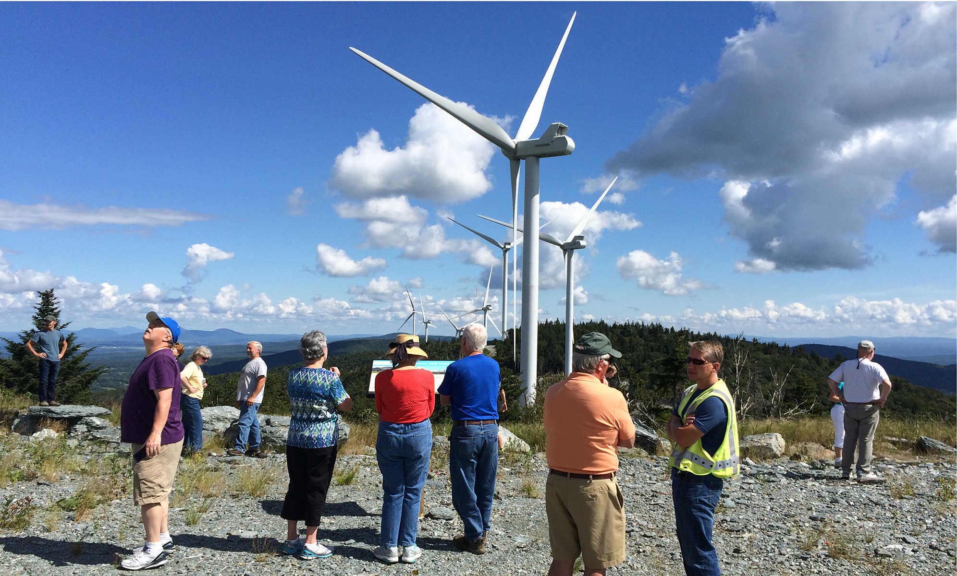
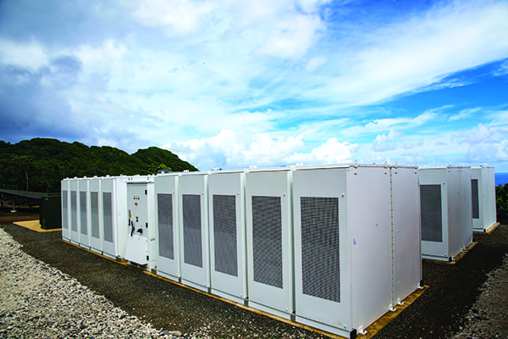
Project Description and Purpose
Who: Green Mountain Power, Vermont Electric Coop
Where: North Troy, VT
What: 3MW / 12 MWh BESS
Purpose: To LEARN how to use battery storage to manage energy from Renewable resources that would otherwise be curtailed because of too much generation with respect to load and transmission facilities in Northern Vermont.

Slide 3
Situation Analysis
Problem Statement:
over 400 MW of generation, virtually all of it renewable and much of it intermittent,
30-50 MW of load
approximately 250 MW of Transmission export capability.
In 10%-15% of the hours in a year, the generation in the area exceeds load and current transmission system export capability leading to:
  Curtailment of wind resources
  Millions of $ of increased costs to utility customers due to lower Locational Marginal Prices for all resources in the area.
Proposed Solutions:
Transmission system upgrades
  Expected to eliminate approximately 80% of the impacts
Battery Storage
  To capture renewable energy that otherwise would have been curtailed and gone unused.
  Dispatch energy when generation in the area is relatively low loads are high.

Slide 4
Project Partners
Green Mountain Power
  Investor-Owned Utility
  Approx. 255,000 customers
  Owner of 63 MW Kingdom Community Wind (KCW) Project
  50% ownership in Battery project
  $2.25 Million capital investment
Vermont Electric Cooperative
  Consumer-owned Utility
  Approximately 34,000 customers
  PPA for 13% of KCW output
  Host utility for battery project and KCW
  50% ownership in Battery project
  $2.25 Million capital investment
Department of Energy/Sandia National Labs
  DOE/Sandia providing $2.0 Million Cost-Share Funding
  Sandia providing project oversight
Project would not have moved forward without the Cost-Share Funding.

Slide 5
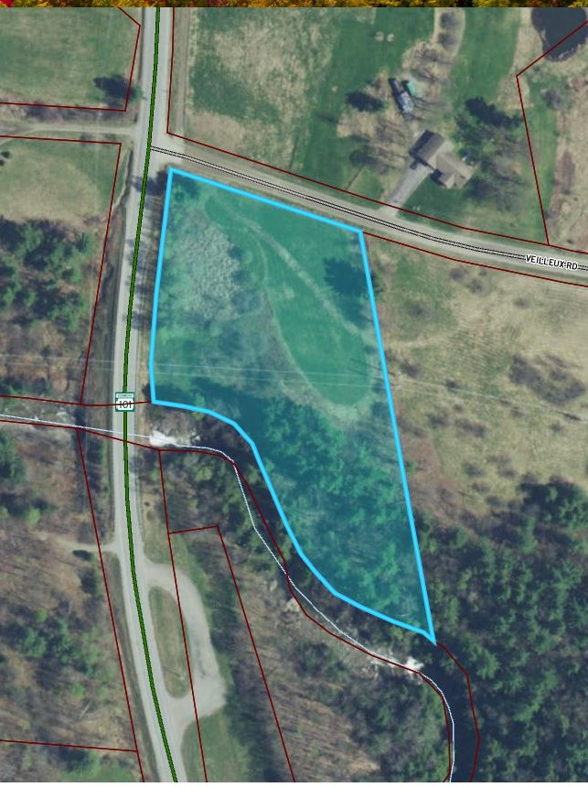
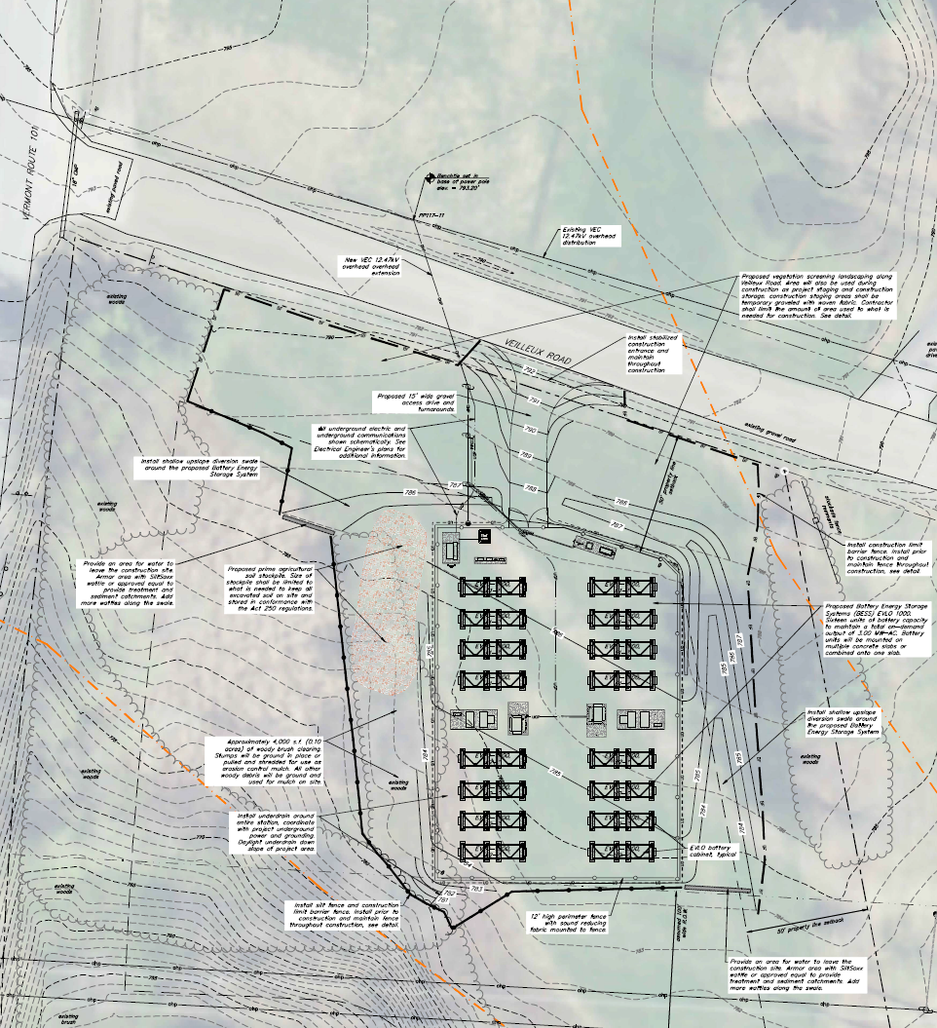
Site Layout

Slide 6
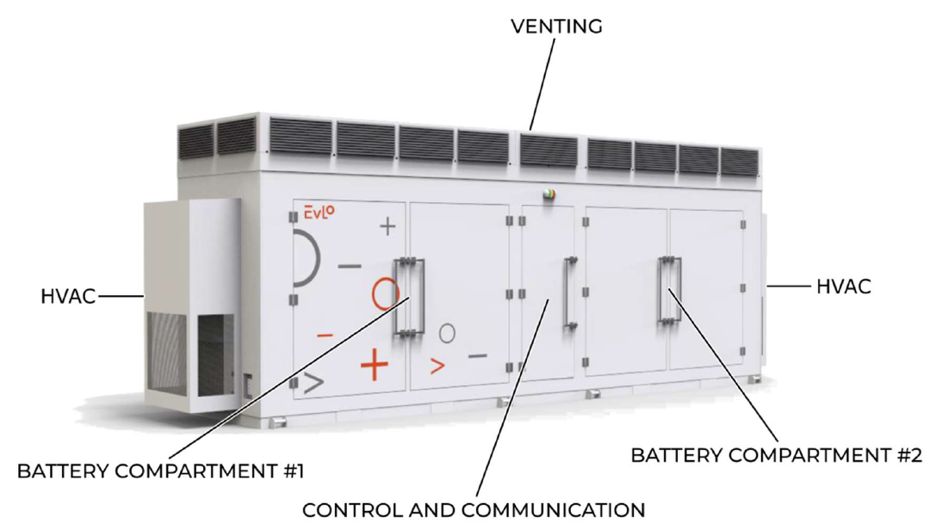

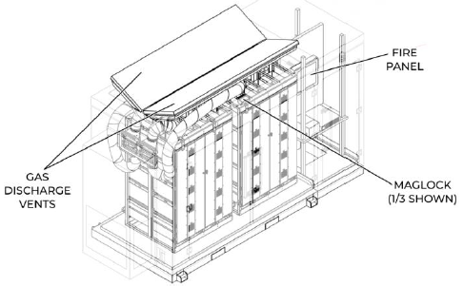
System
EVLO – Hydro-Quebec subsidiary
EVLO 1000 – 1MWh modular BESS
Chemistry: Lithium Iron Phosphate
Passive & active gas venting
Ambient Temp Range:
-30°C to +55°C -22°F to 131°F
Beg-Of-Life: 3.6MW / 14.29 MWh
End-Of-Life: 3.6MW / 12.1 MWh

Slide 7
Use Cases
Ranked by Learning Potential | Ranked by Financial Benefit
Capture otherwise-curtailed energy | Peak Reduction
Peak Reduction | Provide Frequency Regulation service to ISO-NE
Provide Frequency Regulation service to ISO-NE | Capture Otherwise Curtailed Energy
Energy Arbitrage | Energy Arbitrage

Slide 8
Important Milestones Completed
Milestone | Date Completed
RFP Issued | February 2022
EVLO Selected as Battery Vendor | April 2022
Permit Applications Filed | September 2022
Permits Received | March 2023
Electrical and Civil Design Drawings | April 2023
Electrical and Civil Contractors Selected | June 2023
Construction Began | August 2023
Initial Use Case Decision Making Strategy | September 2023
Platforms Delivered | September 2023
Conduit Installation and Cables Pulled | October 2023

Slide 9
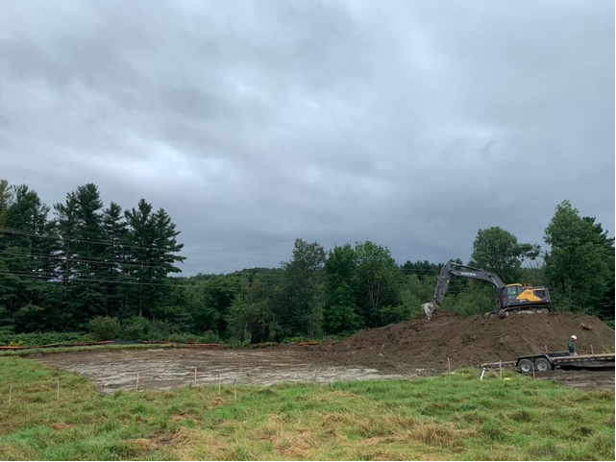
Construction Update – August 17

Slide 10
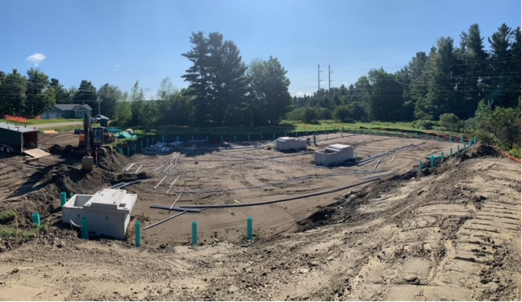
Construction Update – August 31

Slide 11
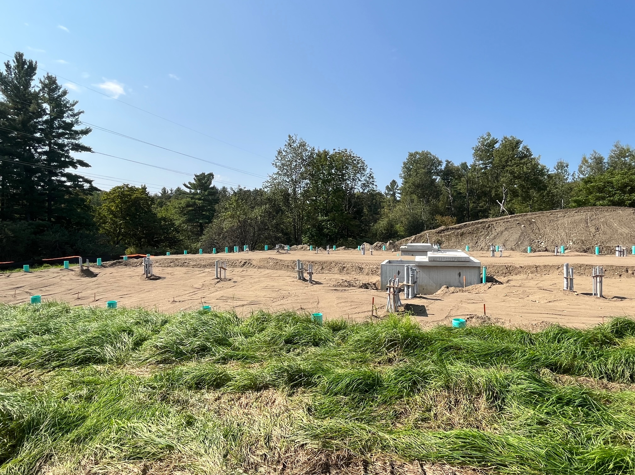
Construction Update – September 22

Slide 12
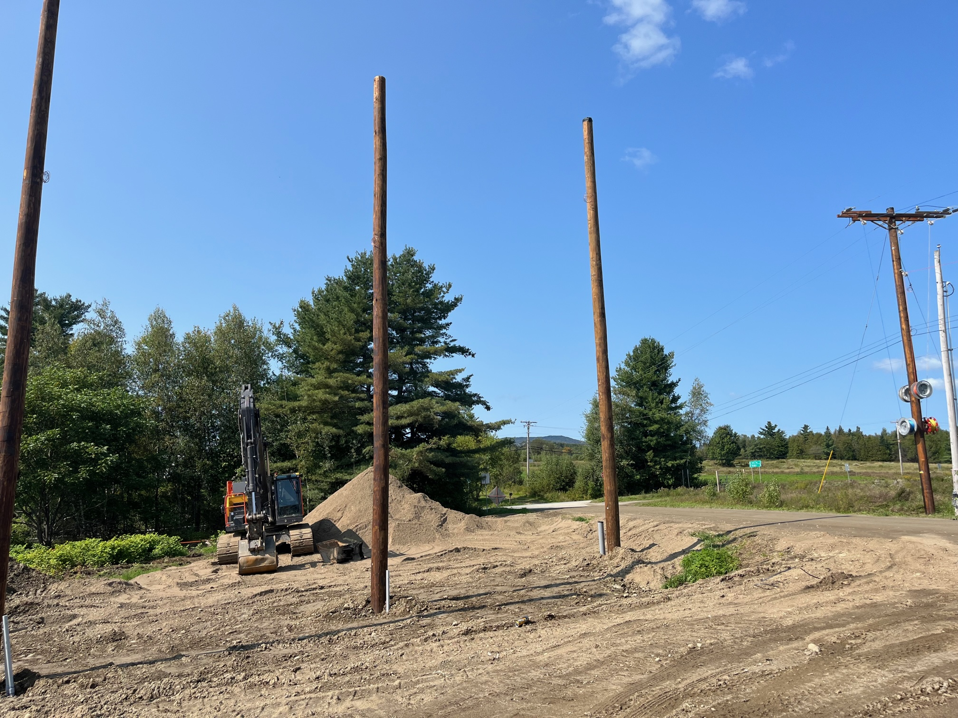
Construction Update – September 22

Slide 13
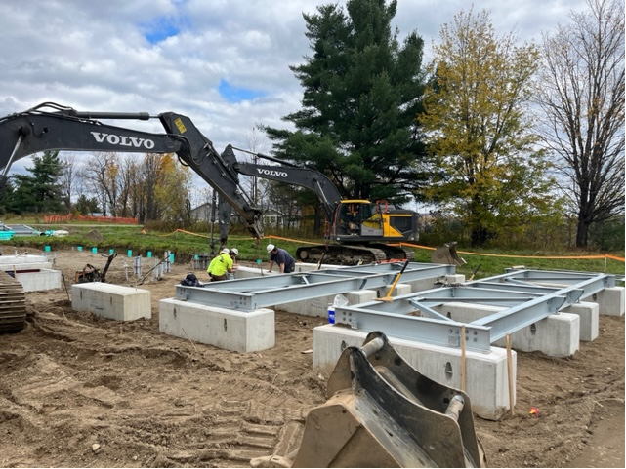
Construction Update – October 19

Slide 14
Important Milestones To Be Completed
Milestone | Status | Target Completion Date
Battery Foundations | In progress | End of October 2023
Dry Run for Operating Batteries | Pending | TBD
Batteries Delivered | Pending | 11/1-11/7 2023
Batteries Set | Pending | Mid-Nov 2023
Construction Complete | Pending | Mid-Dec 2023
Commercial Operation |  | Late-Dec 2023 – Early Jan 2024
Register for ISO-NE Regulation Market | In Progress | Late-Feb 2024

Slide 15
Remaining Risks Have Been Significantly Reduced
Milestone
Timing of Battery Delivery
Battery Functionality
Weather

Slide 16
Thank You
Kirk Shields, kirk.shields@greenmountainpower.com
Craig Kieny, ckieny@vermontelectric.coop
  This work is funded by the DOE OE Stationary Energy Storage program directed by Dr. Imre Gyuk.

