Slide 1
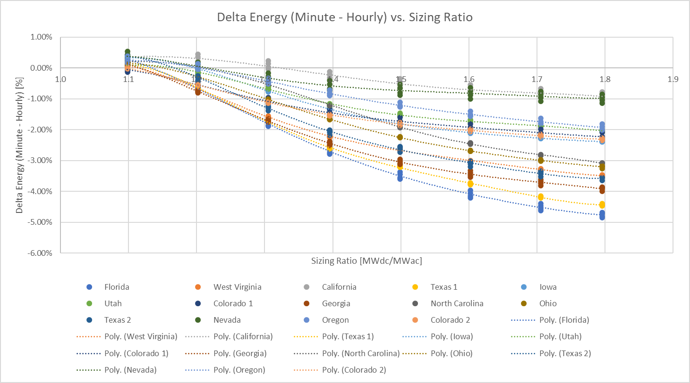
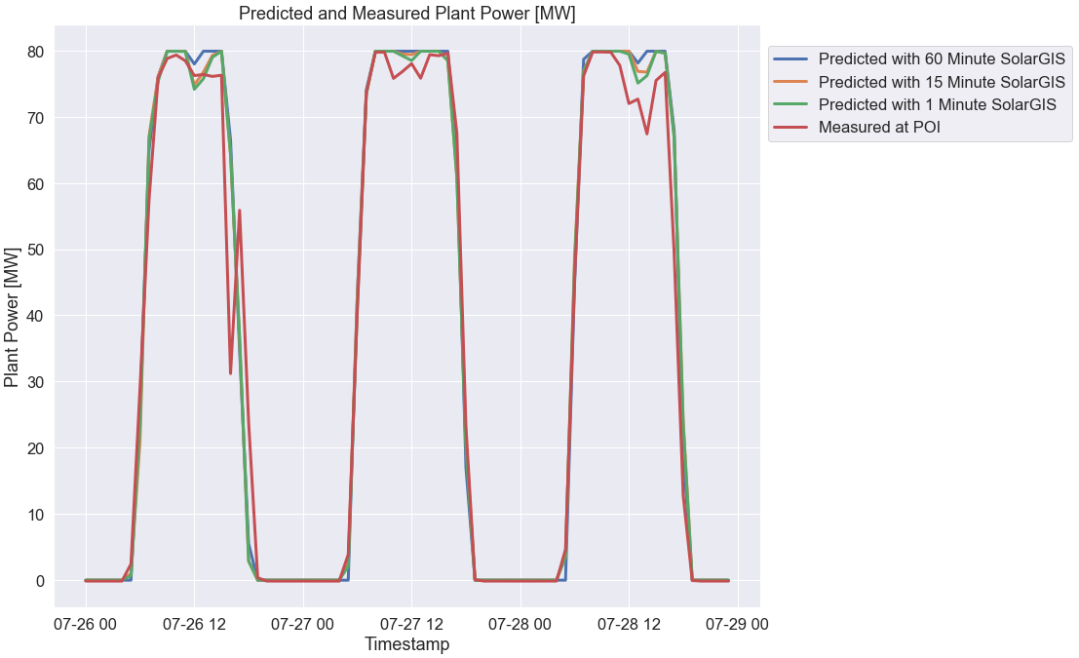
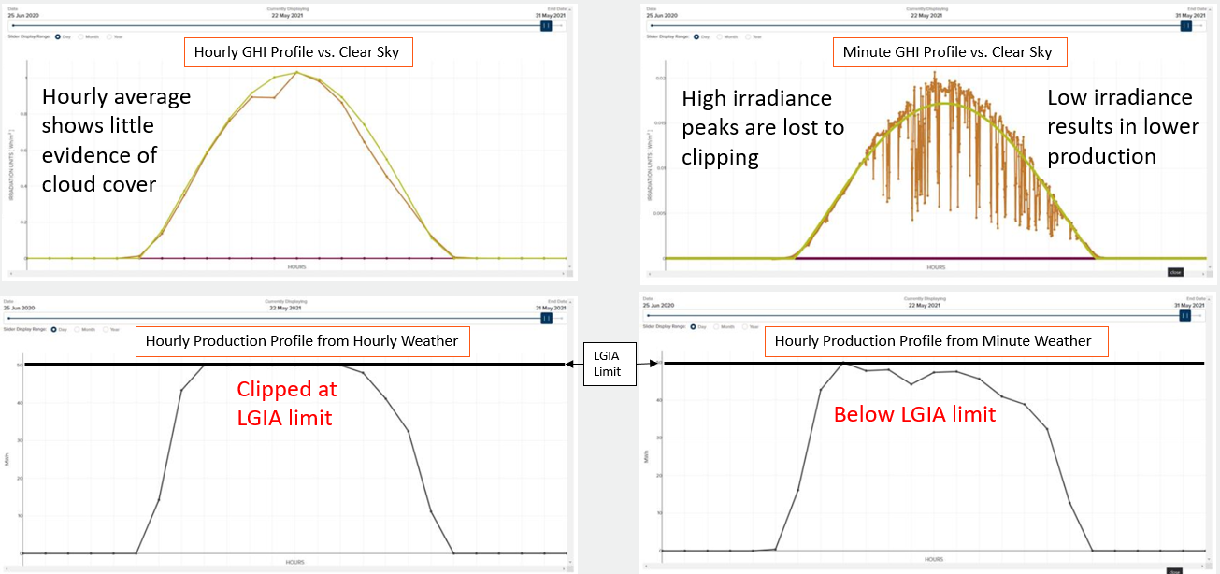
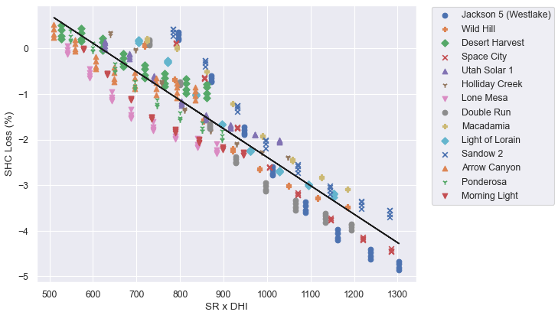
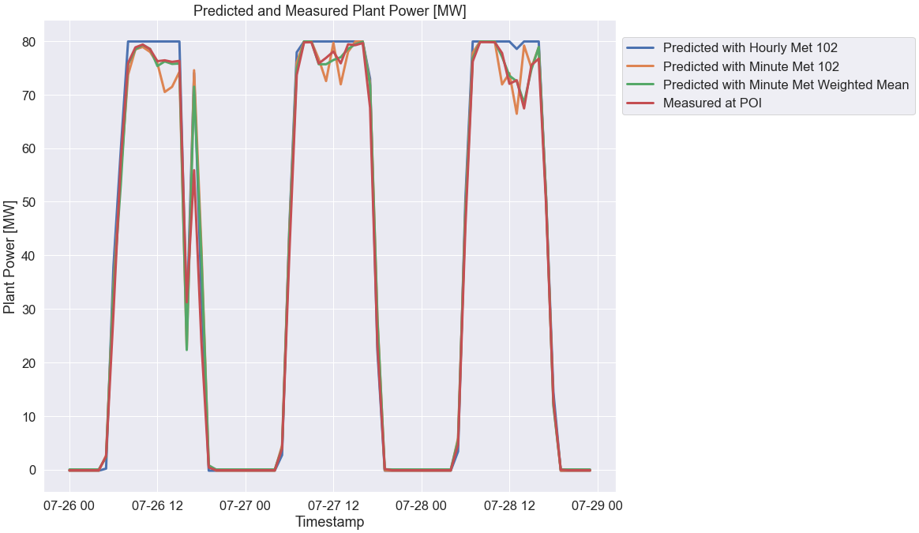
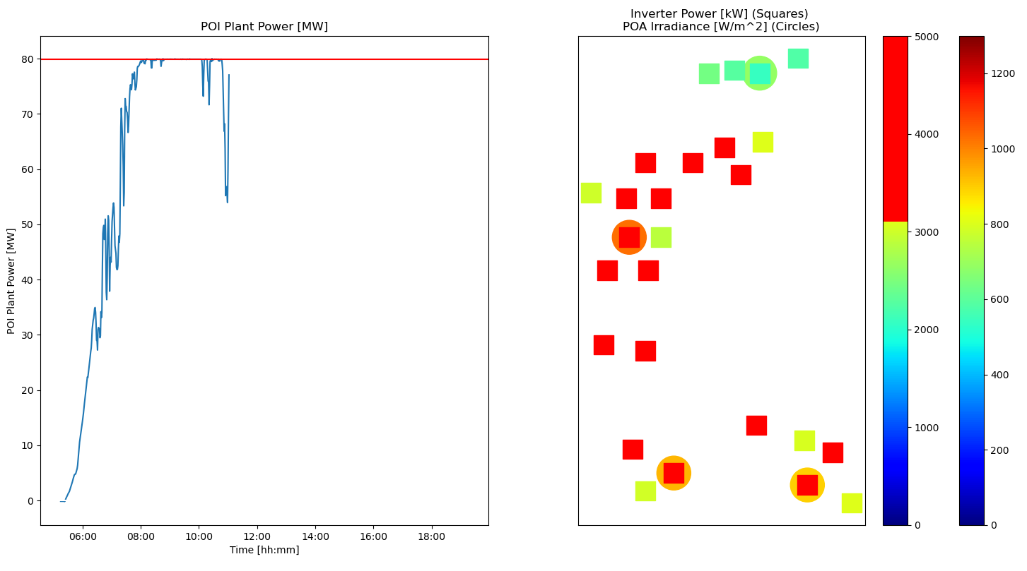
Modeling Estimated Sub-Hourly Clipping Losses
Abstract
Hourly averages of irradiance mask the sub-hourly fluctuations which can push a PV system into and out of clipping. Failure to account for this leads to an overestimation of energy production, typically in the range of 0-3% for utility-scale solar plants. Sub-hourly clipping losses are most pronounced under rapidly changing cloud conditions (higher annual diffuse irradiance) for projects with higher sizing ratios (DC capacity / AC interconnection limit).
Using measured data from a single GHI pyranometer, one can run energy predictions at different time intervals to determine a worst-case estimate for the sub-hourly clipping losses. This is worst case because a pyranometer will measure data at a single point, which will show greater irradiance fluctuations than a power plant spread across a wide area (averaging areas of high and low irradiance). Interestingly, as the time step becomes smaller, the gain from transposition increases, which offsets some of the sub-hourly clipping loss. Running these simulations for various locations at different sizing ratios allowed us to develop a simple model for estimating the sub-hourly clipping loss.
For operational projects, the best approach to predict the plant power output is to create separate weather files/predictions per block based on one-minute weighted averages of all available met stations (inverse square of the distance from the block to each met station). Satellite data tended to be too coarse to capture the irradiance fluctuations required to get significant sub-hourly clipping losses in the predictions, though higher temporal resolution data showed some improvement compared to hourly.
Background
Running a PV simulation with minute data rather than hourly can yield very different results. Below is an example of a single day with a large amount of intermittent cloud cover. Using the hourly data, the PV plant appears to clip at the LGIA limit for most of the day. However, using minute weather data, the output falls well below this level.
Visualization: North Carolina Project
Simulated Loss Profile
Shown below is the difference in plant energy for PV simulations completed using ground measured minute and hourly average weather data. Because a single GHI pyranometer was used per location, the results demonstrate the worst-case loss scenario because the irradiance fluctuations will be greatest for a point measurement, capturing large peaks from cloud enhancement as well as low troughs as clouds block the light. This effect will be attenuated by a large utility-scale project that is spread over a wide area, so discretion must be applied to scale these results down based on the project’s layout. Still, this chart shows that sizing ratio plays a big role in the amount of expected sub-hourly clipping loss.
Modeled Loss
From the results above, a simple model is proposed for estimating the difference in predicted energy based solely on annual diffuse horizontal irradiance (kWh/m²) and project sizing ratio (DC capacity / AC interconnection limit).
Spatial Multiplier
An insufficient number of data sources were reviewed to appropriately model the impact of project size and spatial configuration. As a project is spread over a larger geographical area, the sub-hourly clipping loss will be smaller than what is modeled above since cloud coverage and enhancement may only impact certain sections of a project at a given time. We typically apply a multiplier of 0.6 to the modeled result above for utility-scale projects, though it would make sense to scale this based on the geographic footprint of the project. Sub-Hourly Clipping Loss = Spatial Multiplier * Modeled Loss
Temporal Resolution of Satellite Data
When predicting plant output using satellite weather data, it is preferable to use higher temporal resolution data. However, even at 15-minutes, the predicted output still tends to be higher than what is measured, albeit trending better than hourly predictions. We have also done some evaluation using 1-minute stochastically-generated weather files, though these seem to only provide marginal benefit because the magnitude of irradiance peaks and troughs are not significant enough to drive much additional clipping losses (perhaps due to spatial resolution differences).
Method for Modeling Operational Projects with Multiple Met Stations
An approach was developed for predicting plant output when multiple met stations are available. Even minute data from a single met station does a poor job of predicting plant output due to its location and size with respect to the larger project. By taking all met stations and their locations into account, separate weather files can be created for each inverter block. The values should be weighted using the inverse square of the distances from the inverter block to each met station. Each block then gets its own PV simulation, after which the results are aggregated and the LGIA limit is applied. While cumbersome, this process results in a predicted energy which closely tracks measured energy output.
Conclusions
Including sub-hourly clipping losses in hourly energy prediction estimates is essential, especially at higher sizing ratios and in areas with highly diffuse irradiance. Spatial considerations should be applied based upon the geographic footprint of the layout. For operational projects, it is possible to accurately model plant output based on weighted averages of multiple met stations.
R² = 0.8369
Delta Energy (Minute – Hourly) [%]
Plant output is reduced below the LGIA limit as small/variable clouds pass over the project
Clouds reducing output for northern inverters (green)
Most other inverters are clipping (red), though some are experiencing reduced output from cloud coverage (yellow)
Delta Energy (%) = -0.006258 * (SR * DHI) + 3.8715
Sizing Ratio x Annual Diffuse Horizontal Insolation [MWdc/MWac x kWh/m²]
Presenter: Paul Wolffersdorff (Paul.Wolffersdorff@edf-re.com)
Contributors: James Alfi, Phil Timm, Sabrinna Rios Romero, Abhishek Parikh

