Slide 1
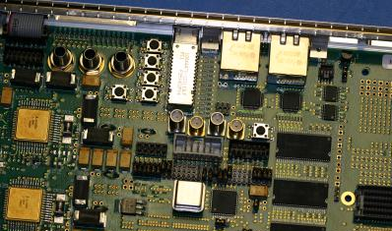
Joint Architecture Standard
UNCLASSIFIED UNLIMITED RELEASE
Quick Start Guide
SAND2018-9952 TR
UNCLASSIFIED UNLIMITED RELEASE

Slide 2
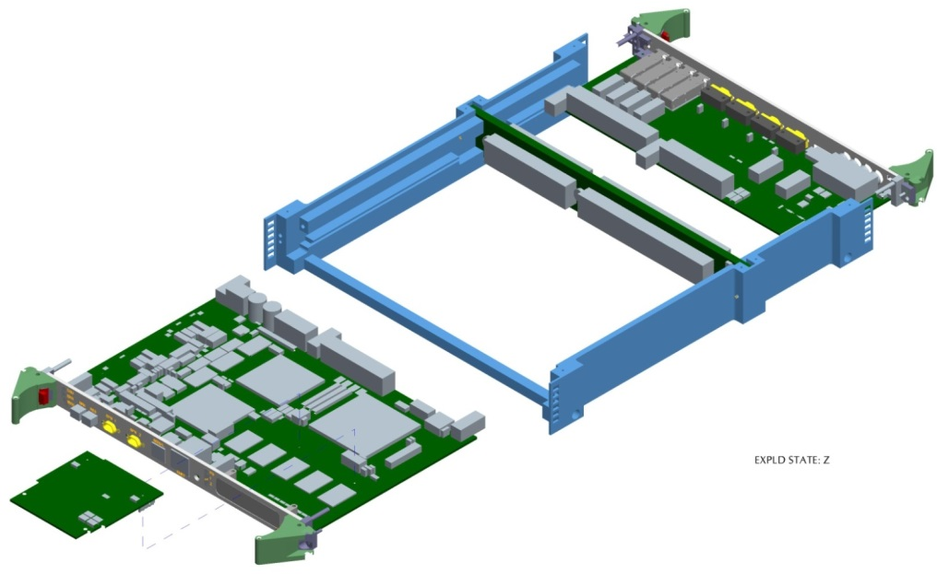
Objective of this Guide
UNCLASSIFIED UNLIMITED RELEASE
The Joint Architecture Standard (JAS) offers an adaptable, scalable solution for space-based processing applications that emphasizes the following principles:
Node-based approach utilizing reconfigurable hardware
Communications utilizing industry-standard protocols
Modular design to support a wide range of requirements
Easy integration of new technologies with minimal impact to established interfaces
This guide is designed to introduce JAS and demonstrate the mapping of mission requirements to a JAS-based system using the JAS Toolbox (JT)
The information contained in this guide will cover:
An overview of JAS
A description of essential hardware elements
JAS software approach
System design example
UNCLASSIFIED UNLIMITED RELEASE

Slide 3
JAS Overview
UNCLASSIFIED UNLIMITED RELEASE
The JAS standard emphasizes the following key principles:
Reusability | General-purpose nodes with reconfigurable processing hardware support multiple applications
 | Layered software approach allows applications to be abstracted from hardware interfaces and encourages re-use of common software services
 | Significant reduction in NRE resulting in lower cost and shorter schedules
Scalability | Processing capability scales by adding nodes based on requirements
 | Mission-specific needs can be accommodated using expansion modules, such as mezzanines on node hardware
 | Parameterized mechanical designs adapt to arbitrary node counts
Interoperability | Standard communications protocols ease integration of hardware from multiple vendors, and permits the use of COTS for evaluation, testing, and prototyping
 | Generic hardware designs for nodes can readily map functionality to COTS hardware to streamline development
 | Standard hardware functions provides a common front-end interface to every node
Reliability | M-of-N redundancy reduces the penalty of additional hardware compared to traditional A-B redundancy schemes
UNCLASSIFIED UNLIMITED RELEASE

Slide 4
JAS Essential Elements
UNCLASSIFIED UNLIMITED RELEASE
Mission requirements drive the selection of JAS elements to include within a system instance
The following essential elements must be included:
Communication Interfaces (physical, preferably serial)
Protocols to communicate over the physical interface
Network-connected nodes that implement the communication interface and protocols
Network routing and addressing scheme(s)
Realization of these elements can be achieved through instances of hardware profiles in the JT
Standard node types (e.g., CH, RP, PS)
Expansion modules (e.g. mezzanines and rear transition modules)
System Monitoring and Communications (SMAC) functions
UNCLASSIFIED UNLIMITED RELEASE
Notes:
The idea is to not shoe-horn the design, and to allow some flexibility on the designer.
The following slides will introduce and define what is meant by the elements that realize the system instance.

Slide 5
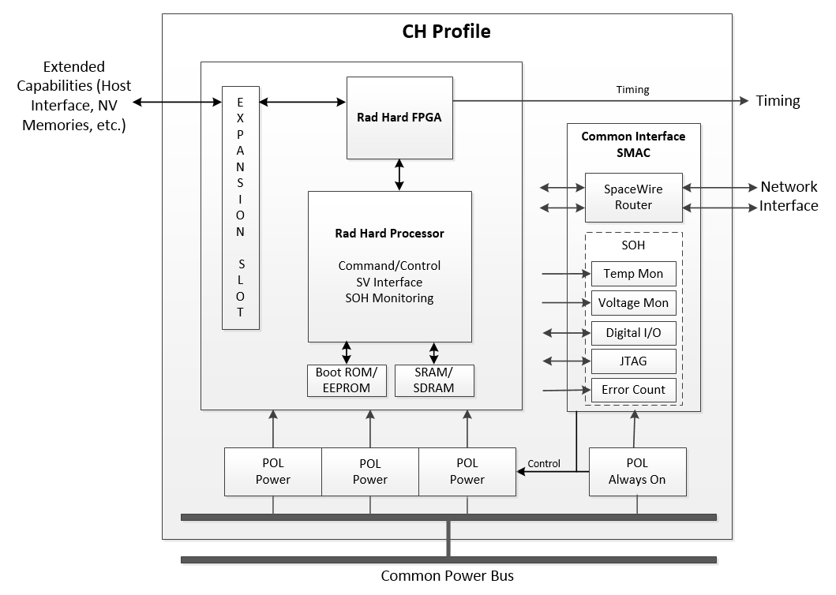
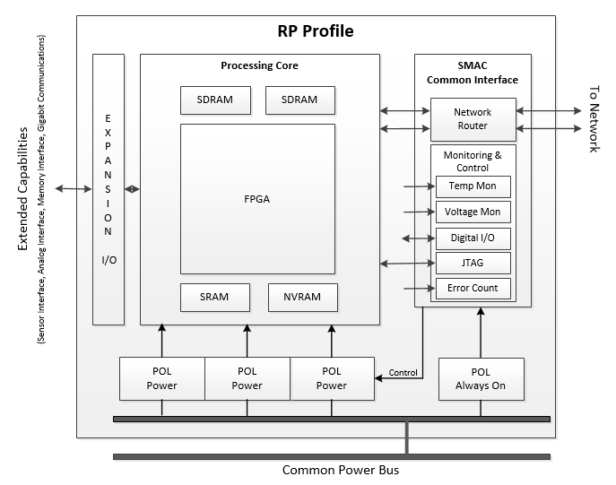
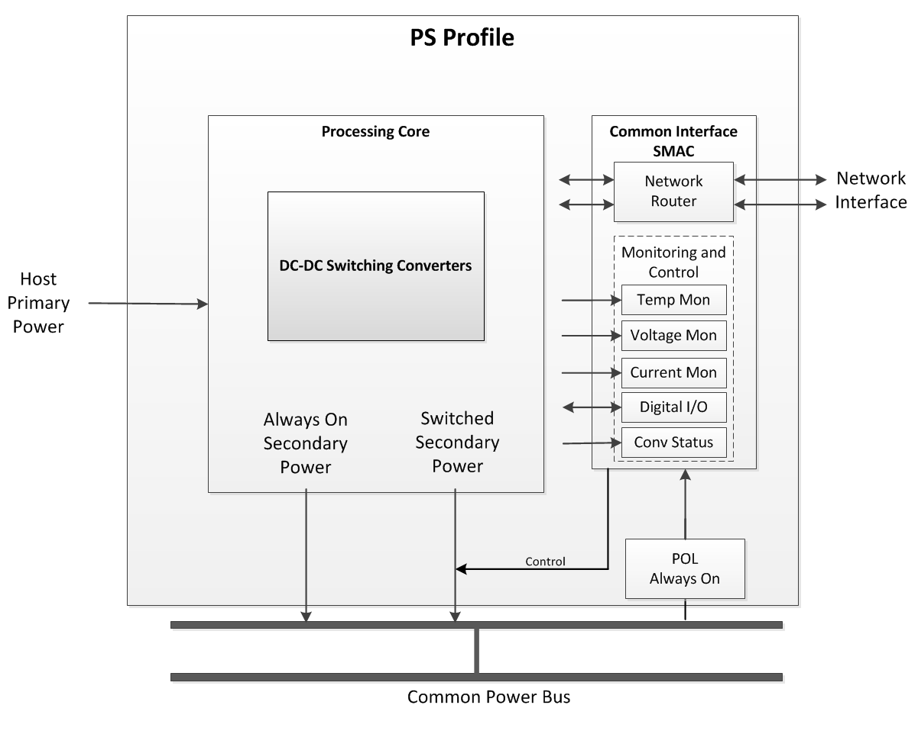
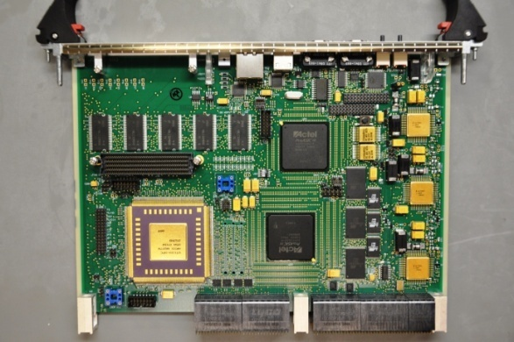
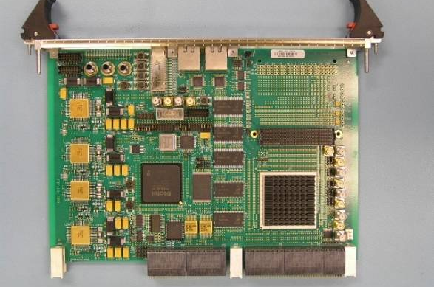
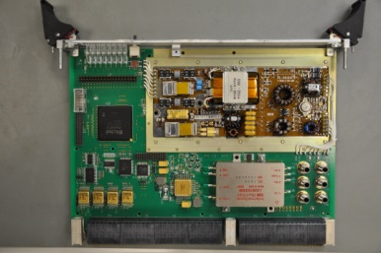
JAS Nodes
UNCLASSIFIED UNLIMITED RELEASE
Three general-purpose node types, two for processing and one for power
Processing nodes are reconfigurable and have expansion capability to support mission-specific functions
Configuration and Host (CH)
Microprocessor-based processing
Reconfigurable Processing (RP)
FPGA-based processing
Power Supply (PS)
Note: The example nodes shown here utilize the VPX standard, but any interconnect standard may be used.
UNCLASSIFIED UNLIMITED RELEASE
Notes:
CH Node:
Microprocessor-based node
Flash memory for program and data storage
SDRAM and SRAM for operational memory
Rad-hard local power conversion (POL)
Mezzanine slot for expansion
Common network front-end (SMAC)
RP Node:
FPGA-based node, programmed by network
SDRAM and SRAM for operational memory
Rad-hard local power conversion (POL)
Mezzanine slot for expansion
Common network front-end (SMAC)
PS Node:
Rad-hard spacecraft-to-system voltage conversion
Distributes common power voltage (usually 5V) to nodes
Generates any needed specialized analog voltages
Networked, but no processing capability
Common network front-end (SMAC)

Slide 6
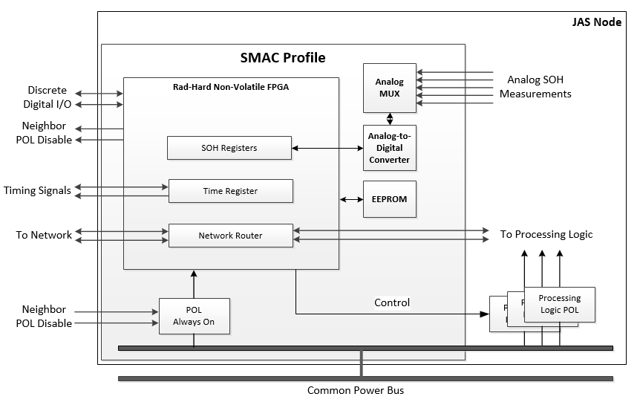
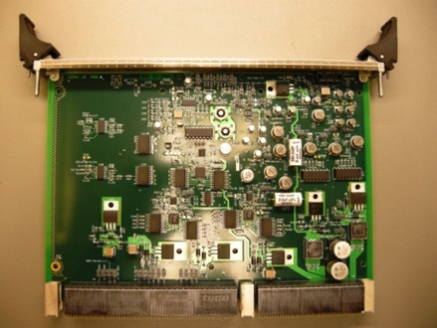
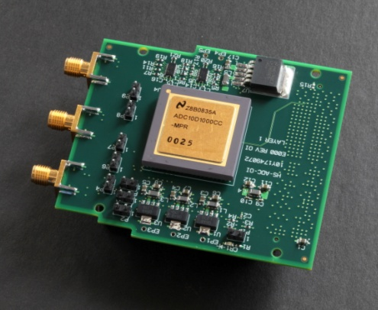
JAS SMAC and Expansion Capabilities
UNCLASSIFIED UNLIMITED RELEASE
The System Monitoring and Communications (SMAC) functions are implemented on every node
Provides network connectivity between processing elements, controls node power and discrete signals, and provides state of health for node hardware
Having a common SMAC design on every node provides a consistent front-end interface that reduces software complexity
SMAC functions can be implemented in either hardware or software
Expansion capabilities provide mission-specific hardware and interfaces to standard nodes
Expansion boards may take the form of mezzanines, Rear Transition Modules (RTMs)¹, backplane-integrated cards, etc.
Systems can be instantiated using two or three node types and expansion capabilities for specialized functions
¹ Note: The example expansion modules shown here utilize VITA standards, but any standard may be used.
UNCLASSIFIED UNLIMITED RELEASE

Slide 7
JAS Software and Communications
UNCLASSIFIED UNLIMITED RELEASE
JAS provides a standard set of software and communication services to applications
A layered architecture abstracts applications from data links, making them more reusable
Software services interface to network protocols based on communication needs
JAS packet service for sending messages between applications
Memory access service for remote access to hardware
Synchronization service for broadcasting events such as time
Application Layer
Subnetwork Service Layer
JAS Packet service
Memory access service
Synchronization service
JAS Provided
Network Protocol Layer
JRDDP, JEEP, RMAP, SRIO, UDP
Data Link Layer
SpaceWire, RapidIO, Ethernet
UNCLASSIFIED UNLIMITED RELEASE
Notes:
JAS Reliable Data Delivery Protocol (JRDDP), JAS Efficient Exchange Protocol (JEEP), Remote Memory Access Protocol (RMAP), Serial RapidIO (SRIO), User Datagram Protocol (UDP)

Slide 8
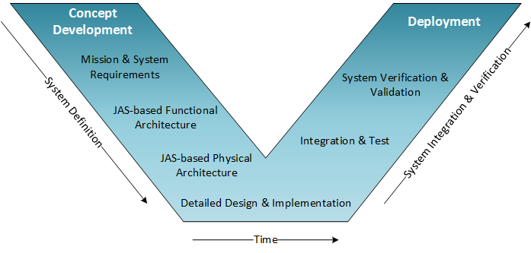
Mapping System Requirements to JAS
UNCLASSIFIED UNLIMITED RELEASE
First step is to identify high-level system characteristics:
Data flow into (e.g. sensors) and out of (e.g. downlink) the system
Processing algorithms
Long-term data storage needs
Command and telemetry interfaces
Reliability considerations
Environments
UNCLASSIFIED UNLIMITED RELEASE
Notes:
Entry Criteria: JAS is assumed to be the implementation solution for the system instance

Slide 9
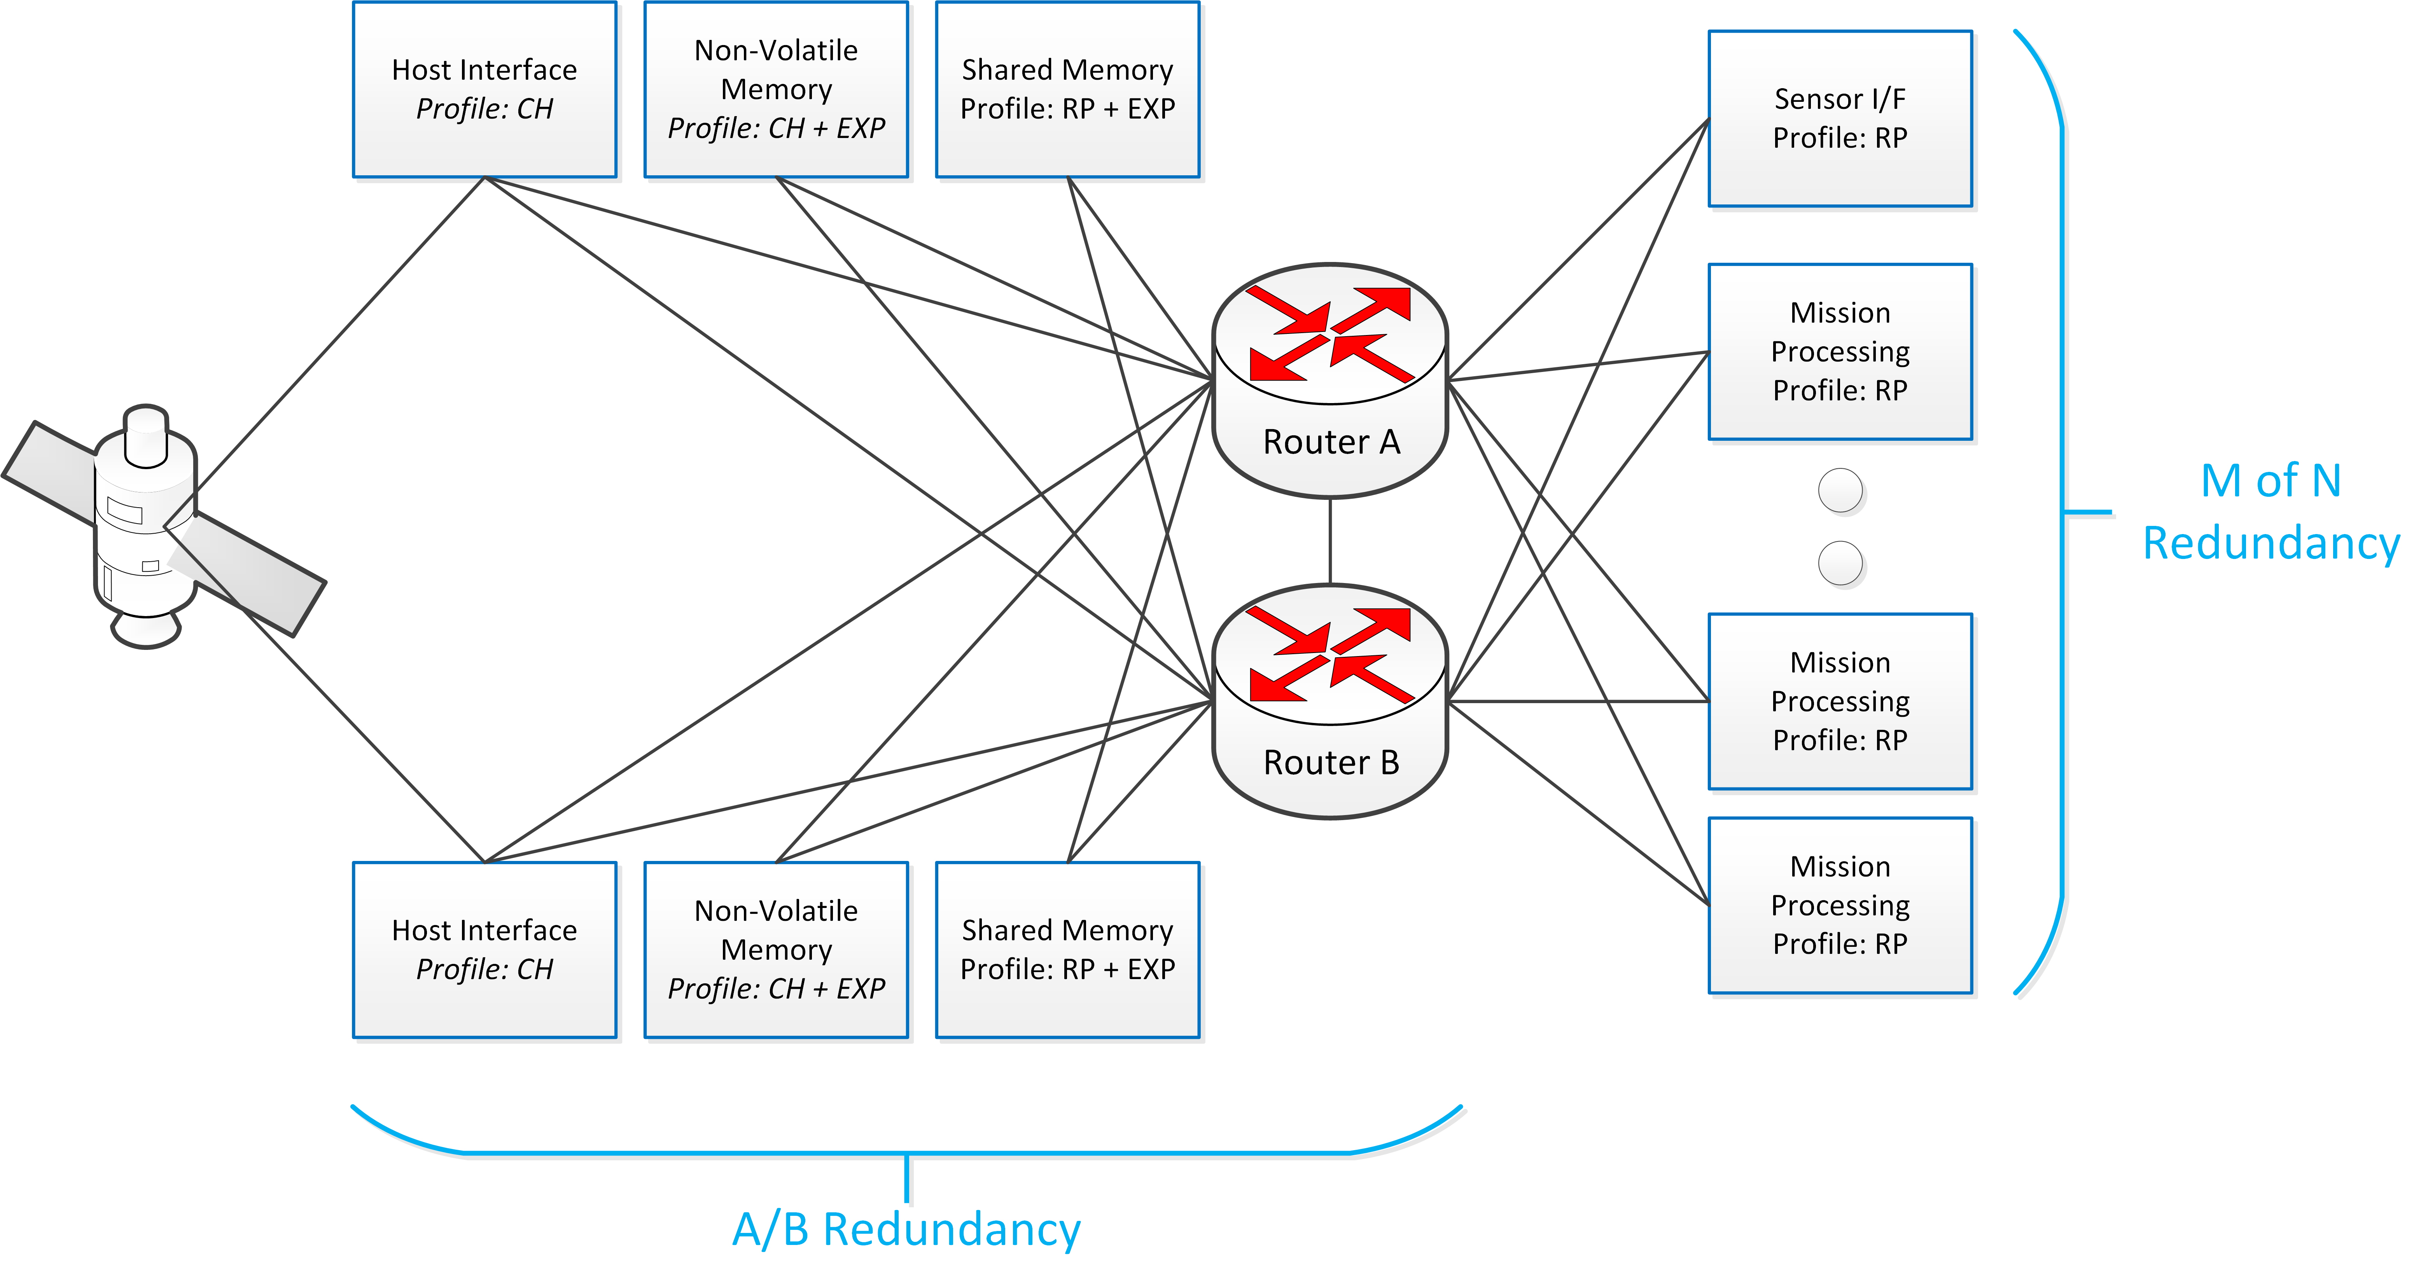
Identifying Required Hardware
UNCLASSIFIED UNLIMITED RELEASE
Identify the required number and types of nodes:
At least one CH node is needed for a spacecraft/host interface
Dedicated nodes may be needed to interface to sensors
Map implementation of processing algorithms to CH and/or RP nodes
Additional nodes for reliability
Identify expansion capabilities that augment existing CH or RP capabilities
Mezzanines, RTM, or dedicated cards
Additional memory capacity
Host spacecraft or sensor interfaces
Model the data flow within the system to identify any limiting factors
Sensor to data processing algorithms
Minimum required memory bandwidth
Ensure sufficient network throughput, especially in cases of node failure where additional routing of mission data to spare nodes is needed
UNCLASSIFIED UNLIMITED RELEASE

Slide 10
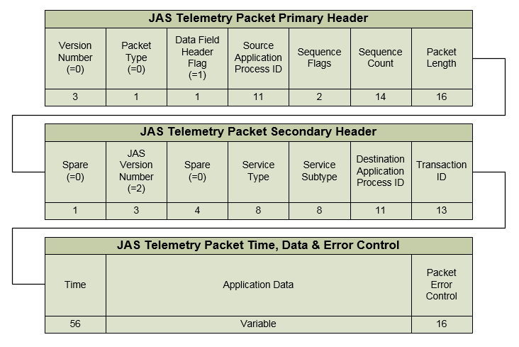
Mapping Communications
UNCLASSIFIED UNLIMITED RELEASE
Communication interfaces will be driven by ICDs:
Sensor, Host Vehicle, Flight-to-Ground, etc.
Intra-payload communication links use network protocols for routing data
Quality-of-service resources can be used as needed (reliability, priority, guaranteed bandwidth)
Multiple networks can be used within the same system (e.g. SpaceWire, Serial RapidIO (SRIO), etc.)
Standard packet formats enable applications to communicate across any network
Coordinate packet definitions as needed
Command, Control, and SOH reporting
Mission data and telemetry
Network topology selection affects reliability in the event of failures
Redundant links in the right topology is a key factor
Modeling tools aid in evaluating tradeoffs
UNCLASSIFIED UNLIMITED RELEASE
Notes:
Interface Control Document (ICD)

Slide 11
Simple Mission Example
UNCLASSIFIED UNLIMITED RELEASE
Let’s go through a simple mission example assuming basic system requirements:
The Customer requires a payload with two focal plane arrays (FPA)
Each FPA has a maximum output bandwidth of 5 Gbps
Host vehicle provides 28V power and a MIL-STD-1553 interface for communications
Payload performs target tracking and recognition by classifying targets against pre-determined signatures
UNCLASSIFIED UNLIMITED RELEASE

Slide 12
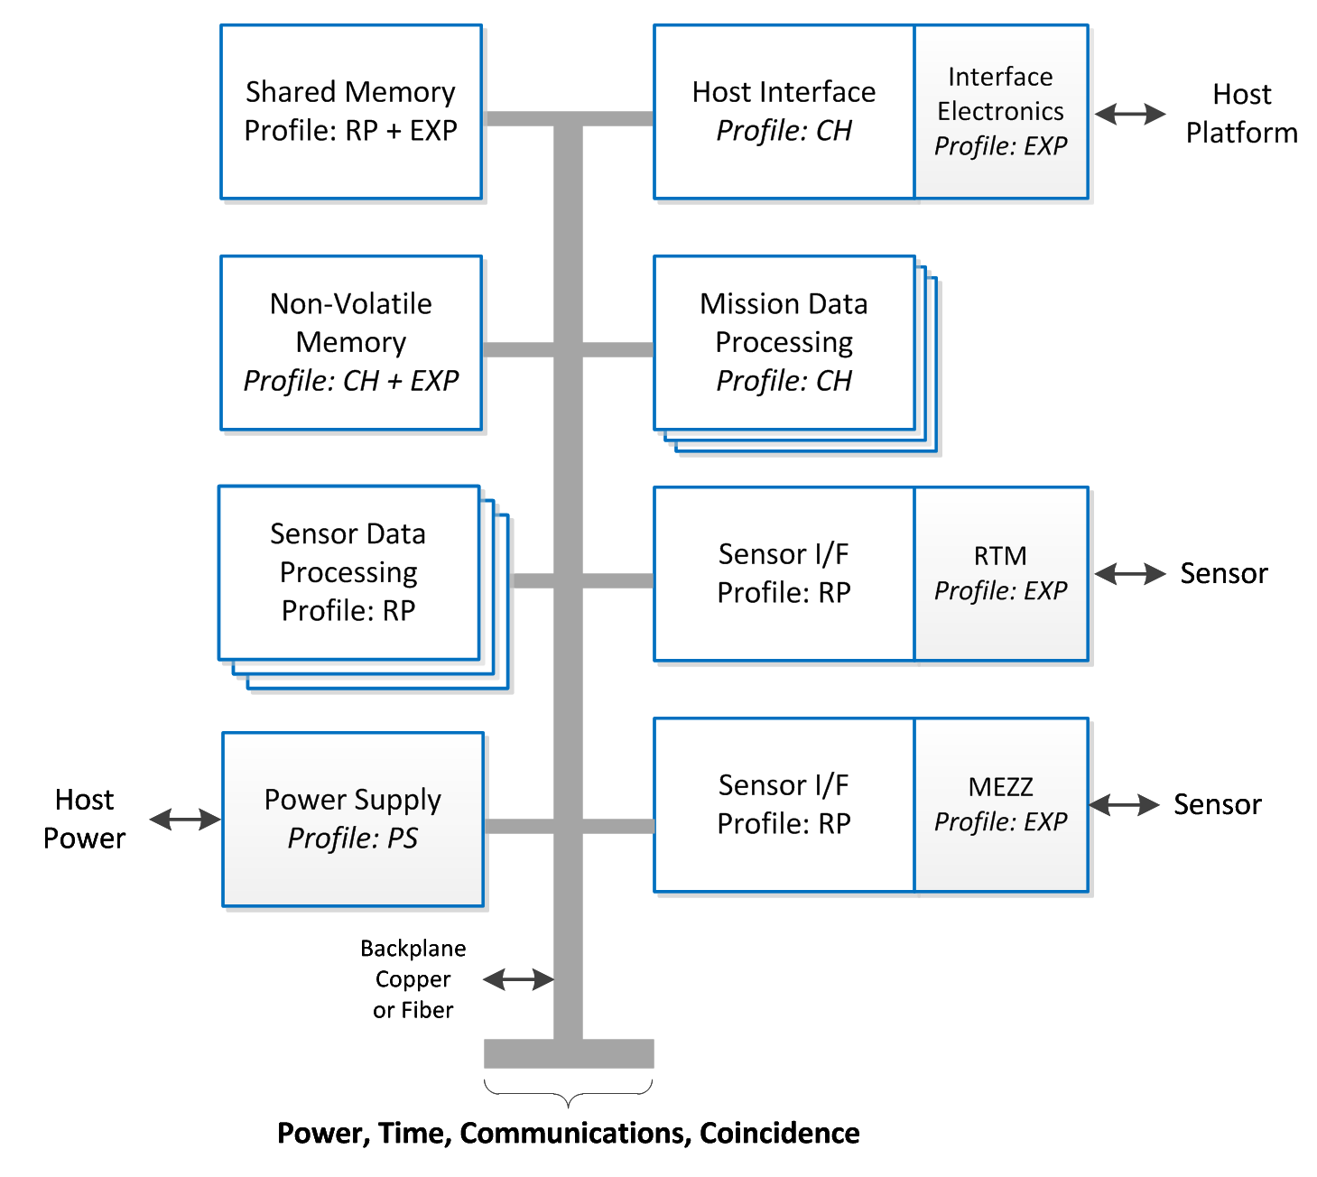
Host Interface and Power
UNCLASSIFIED UNLIMITED RELEASE
Host interface uses an instantiation of a CH node
A mezzanine is added to support MIL-STD-1553
CH handles host communications, SOH collection, node command & configuration, and data downlink
Software library for SpaceWire communication
Communication Protocols
Memory Access and Packet services
PS node instantiation converts 28V power provided by the host vehicle to usable levels for distribution to the nodes
SpaceWire
CH Profile defines processor-based modules
EXP Profile defines mezzanine card
PS Profile defines power supply node
COMM Profile defines protocols
UNCLASSIFIED UNLIMITED RELEASE

Slide 13
FPA Interface
UNCLASSIFIED UNLIMITED RELEASE
FPA interfaces are instantiations of RP nodes
FPA 1 requires multiple external biases
FPA bias generation on RTM
FPA 2 requires a single 5V supply
FPA bias generation on mezzanine card
High-Speed network based on SRIO
Transfer image data from sensors to sensor data processing nodes
SRIO
RP Profile defines FPGA-based modules
EXP Profile defines RTM & mezzanine card
UNCLASSIFIED UNLIMITED RELEASE

Slide 14
Sensor Data Processing
UNCLASSIFIED UNLIMITED RELEASE
Sensor processing nodes are an instantiation of a RP node
Determine the number of nodes based on bandwidth requirements
Estimated using SE Tools
Shared memory node is an instantiation of a RP node
Used for storing intermediate or final results
A mezzanine card provides the required memory size and type
Nodes are interconnected via SRIO
SRIO
RP Profile defines FPGA-based modules
EXP Profile defines RTM & mezzanine card
UNCLASSIFIED UNLIMITED RELEASE

Slide 15
Mission Data Processing
UNCLASSIFIED UNLIMITED RELEASE
Event/target classification algorithms developed in C are best suited for a processor
Multiple CH nodes are used to perform classification in parallel
Data is read from shared memory node via SpaceWire
Results are sent to host interface node via SpaceWire for downlink
Non-Volatile memory node (comprised of CH node plus non-volatile memory mezzanine card) may store results if downlink is not immediately available
SpaceWire
CH Profile defines processor-based modules
UNCLASSIFIED UNLIMITED RELEASE

Slide 16
Next Steps
UNCLASSIFIED UNLIMITED RELEASE
Utilize the JAS Toolbox to implement your mission requirements into a JAS-based instance https://jastoolbox.sandia.gov
For further system examples and modeling tools, see the Systems Engineering Toolbox https://collaborate.sandia.gov/sites/JAS_SE_Toolbox
Contact for questions and/or feedback:
Mellisa Heller, mmhelle@sandia.gov
David Lee, dslee@sandia.gov
Mathew Napier, mpnapie@sandia.gov
UNCLASSIFIED UNLIMITED RELEASE

