Slide 1
Pre-industrial Control and Historical Simulations for CLDERA-E3SMv2: an Earth System Model with Prognostic Volcanic Aerosol
Presenter | Benjamin Moore Wagman
Team | Hunter Brown, Kara Peterson, Xiaohong Liu, Diana Bull Special thanks to: Allen Hu, Mike Mills, Ziming Ke, Daniel Krofcheck, Ben Hillman
American Meteorological Society 103rd Annual Meeting
January 10, 2023
SAND2023-10528C
Notes:
https://ams.confex.com/ams/103ANNUAL/meetingapp.cgi/Session/63418
Joint Session J5C - Upper Tropospheric and Stratospheric Processes IV
15 minutes

Slide 2
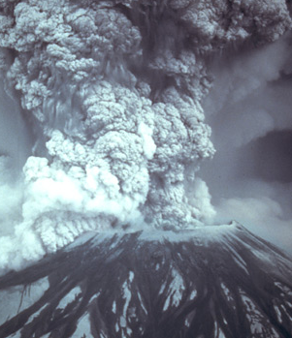

Motivation: E3SMv2 modeling for CLDERA Grand Challenge
CLDERA
CLDERA: develop new tools to enable attribution from geographically and temporally localized source forcings in the climate.
  Exemplar: 1991 Mt. Pinatubo eruption.
Requires ensembles of E3SMv2 simulations with varied initial conditions and eruption characteristics.
sandia.gov/cldera/
credit Photo: Austin Post/USGS; https://www.wired.com/2008/09/gallery-volcanoes/
Notes:
CLimate impact: Determining Etiology thRough pAthways
- 3-yr Sandia-funded internal project.

Slide 3

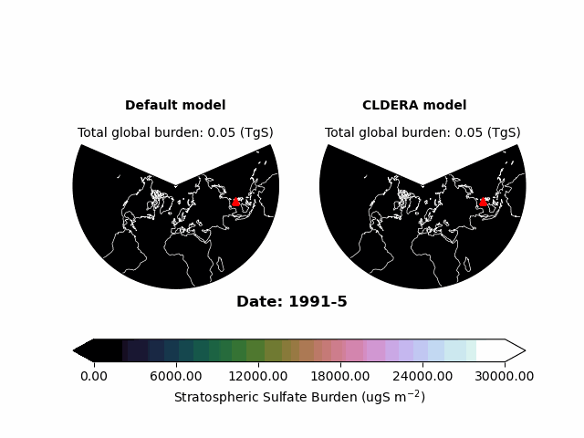
Goal: Simulate stratospheric volcanic aerosol in E3SMv2 from SO₂ emissions
E3SMv2 prescribes volcanic aerosol in the stratosphere.
CLDERA demands prognostic stratospheric volcanic aerosol
  SO₂ gas → H₂SO₄ aerosol
How can we simulate prognostic stratospheric volcanic aerosol with E3SMv2?
  Time frame: < 1yr.
Challenge
Turn off prescribed volcanic aerosol in stratosphere.
Emit SO₂ into the stratosphere.
Hijack one of the four modes of the aerosol module (MAM4) to simulate stratospheric sulfate aerosol.
Tuning.
Approach
E3SMv2 stratospheric sulfate burden for the Mt. Pinatubo eruption without (left) and with (right) CLDERA prognostic aerosol code modifications. Credit: Hunter Brown.
Notes:
Say: Informed by WACCM (Mills) and Xiaohong Liu (TAMU).
Trying to do minimal model development because of our time frame.

Slide 4
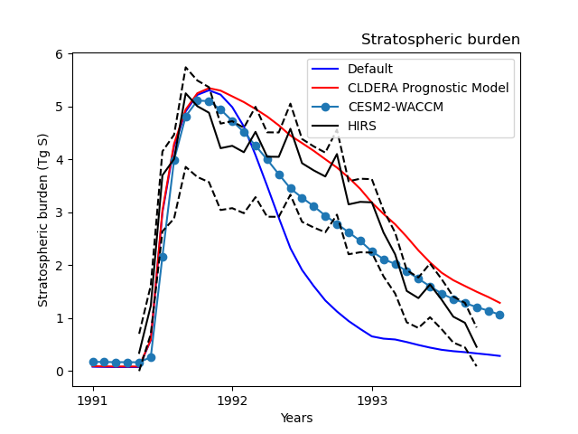
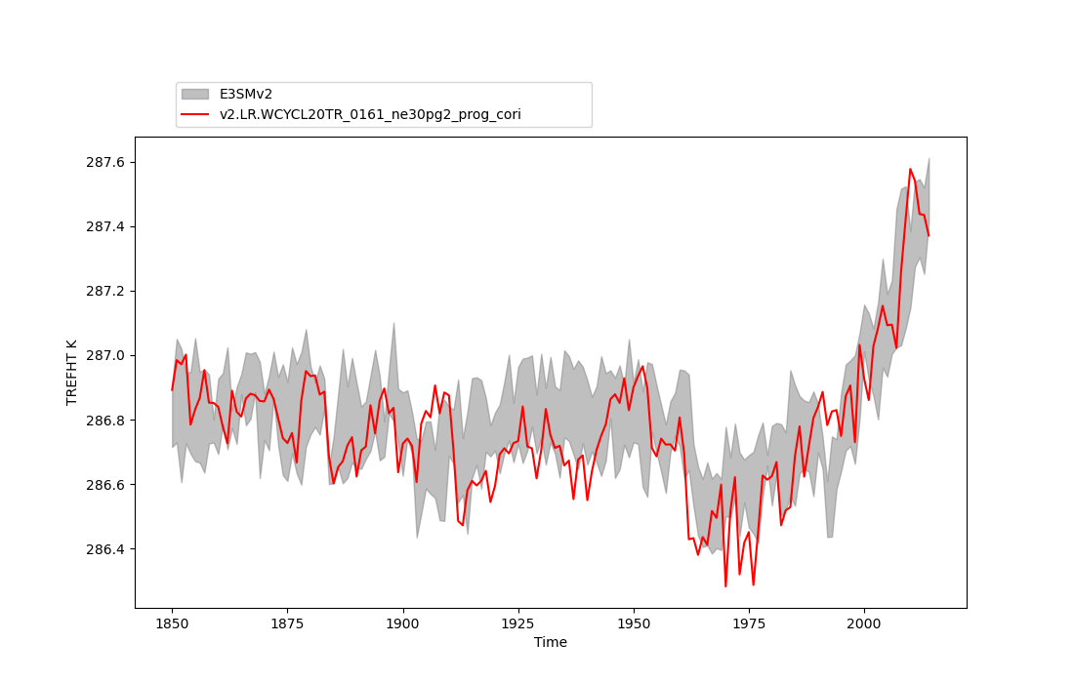
Key Advances
Created “E3SMv2-PA” (Prognostic [stratospheric volcanic] Aerosol)
Pre-industrial and historical simulations with volcanic SO₂ emissions with E3SMv2-PA
CLDERA Prognostic Model (E3SMv2-PA)
E3SMv2 5-member ensemble
Global mean surface temperature [K]
Year
Stratospheric sulfate burden from observations (black) and nudged simulations of the Mt. Pinatubo eruption as an emission of SO₂ . CESM2-WACCM from Ziming Ke. Figure credit: Hunter Brown.
Global mean reference height temperature for coupled historical simulations.
Notes:
HIRS=High Resolution Infrared Radiation Sounder (mounted on satellite).

Slide 5
Background on Approach: Prescribed vs. Prognostic Volcanic Aerosol
Most Earth System Models (e.g. E3SMv2) treat stratospheric volcanic sulfate aerosol as a forcing which is read into the model from an input file.
E3SMv2-PA simulates the formation and evolution of stratospheric sulfate aerosol from a volcanic SO2 emission, albeit with some biases due to missing processes.
VolMIP overview figure [Zanchettin et al., 2016].
Notes:
Our goal is to simulate the downstream climate impacts, so our primary target is the aerosol forcing. We don’t try to get ozone right.
Depending on your perspective, what we’ve done is either a resourceful extension of an earth system model, or an abomination.

Slide 6
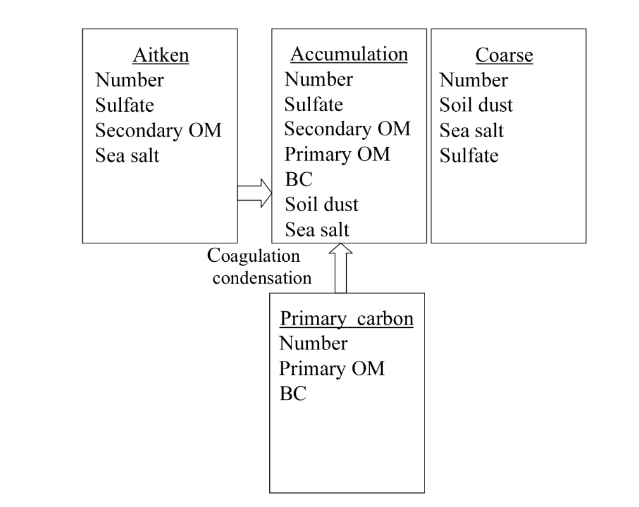
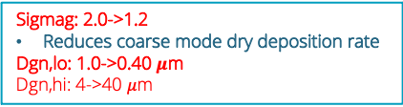

E3SMv2-PA modifications: MAM4 Aerosol Module
E3SMv2 problem:
Volcanic emission of SO₂ causes rapid condensation of accumulation mode sulfate aerosol
  Excessive growth, artificially short aerosol lifetime
E3SMv2-PA solution:
Renaming: enable sulfate to grow into the coarse mode in the stratosphere
Tuning: coarse mode lognormal parameters
  Most important: narrow the geometric standard deviation of the coarse mode lognormal distribution
Sigmag: 2.0->1.2
Reduces coarse mode dry deposition rate
Dgn,lo: 1.0->0.40 $μ$m
Dgn,hi: 4->40 $μ$m
$σ_{g}$: 1.8->1.6
Dgn,hi: 0.44->0.48 $μ$m
Renaming*
*stratosphere only
Figure Modified from Liu et al., 2016
Notes:
From components/eam/src/chemistry/modal_aero/modal_aero_data.F90
dgnumlo_amode(m), dgnumhi_amode(m) = lower and upper limits on the geometric dry mean diameter (m) of the number distribution
sigmag_amode(m) = geometric standard deviation for aerosol mode m

Slide 7
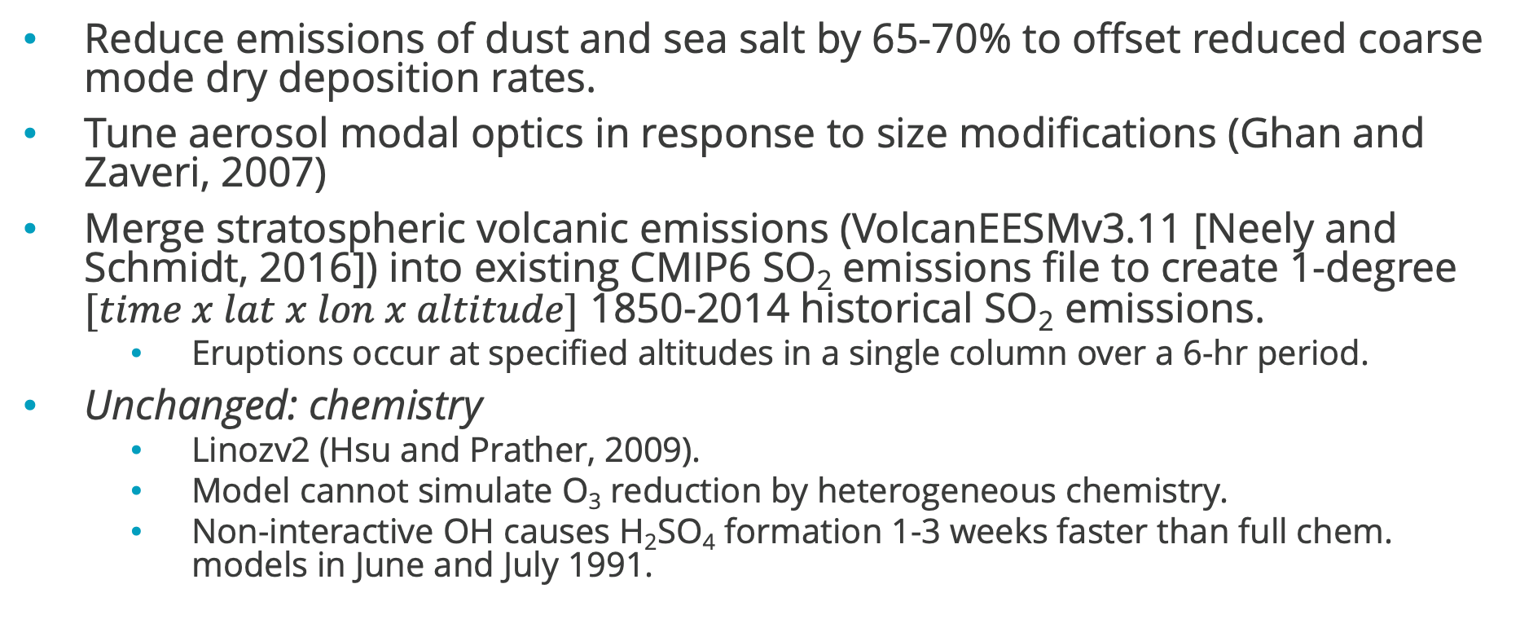
CLDERA-E3SM Modifications
Reduce emissions of dust and sea salt by 65-70% to offset reduced coarse mode dry deposition rates.
Tune aerosol modal optics in response to size modifications (Ghan and Zaveri, 2007)
Merge stratospheric volcanic emissions (VolcanEESMv3.11 [Neely and Schmidt, 2016]) into existing CMIP6 SO₂ emissions file to create 1-degree $[time x lat x lon x altitude]$ 1850-2014 historical SO₂ emissions.
  Eruptions occur at specified altitudes in a single column over a 6-hr period.
Unchanged: chemistry
  Linozv2 (Hsu and Prather, 2009).
  Model cannot simulate O₃ reduction by heterogeneous chemistry.
  Non-interactive OH causes H₂SO₄ formation 1-3 weeks faster than full chem. models in June and July 1991.
Notes:
Eruptions > 15 Tg are scaled by a factor of 0.55 to isolate the climatically-relevant portion.
Pinatubo: 15.130 N 120.350 E 18.000-20.000 km 10.0000 Tg SO2 (scaled down).
Aerosol modal optics: (ncdump):
dimensions:
lw_band = 16 ;
sw_band = 14 ;
refindex_real = 7 ;
refindex_im = 10 ;
mode = 1 ;
coef_number = 5 ;
opticsmethod_len = 32 ;
variables:
double absplw(lw_band, mode, refindex_im, refindex_real, coef_number) ;
absplw:long_name = "coefficients of polynomial expression for longwave absorption" ;
absplw:units = "meter^2 kilogram^-1" ;
double asmpsw(sw_band, mode, refindex_im, refindex_real, coef_number) ;
asmpsw:long_name = "coefficients of polynomial expression for shortwave asymmetry parameter" ;
asmpsw:units = "fraction" ;
double extpsw(sw_band, mode, refindex_im, refindex_real, coef_number) ;
extpsw:long_name = "coefficients of polynomial expression for shortwave extinction" ;
extpsw:units = "meter^2 kilogram^-1" ;
double abspsw(sw_band, mode, refindex_im, refindex_real, coef_number) ;
abspsw:long_name = "coefficients of polynomial expression for shortwave absorption" ;
abspsw:units = "meter^2 kilogram^-1" ;
double refindex_real_sw(sw_band, refindex_real) ;
refindex_real_sw:long_name = "real refractive index of aerosol - shortwave" ;
double refindex_im_sw(sw_band, refindex_im) ;
refindex_im_sw:long_name = "imaginary refractive index of aerosol - shortwave" ;
double refindex_real_lw(lw_band, refindex_real) ;
refindex_real_lw:long_name = "real refractive index of aerosol - longwave" ;
double refindex_im_lw(lw_band, refindex_im) ;
refindex_im_lw:long_name = "imaginary refractive index of aerosol - longwave" ;
double sigmag ;
sigmag:long_name = "geometric standard deviation of aerosol" ;
sigmag:units = "-" ;
char opticsmethod(opticsmethod_len) ;
double dgnum ;
dgnum:long_name = "nominal geometric mean diameter for number distribution" ;
dgnum:units = "m" ;
double dgnumlo ;
dgnumlo:long_name = "lower bound on geometric mean diameter for number distribution" ;
dgnumlo:units = "m" ;
double dgnumhi ;
dgnumhi:long_name = "upper bound on geometric mean diameter for number distribution" ;
dgnumhi:units = "m" ;
double rhcrystal ;
rhcrystal:long_name = "crystalization relative humidity" ;
rhcrystal:units = "-" ;
double rhdeliques ;
rhdeliques:long_name = "deliquesence relative humidity" ;
rhdeliques:units = "-" ;
// global attributes:
:source = "OPAC + miev0" ;
:history = "Ghan and Zaveri, JGR 2007" ;
}

Slide 8
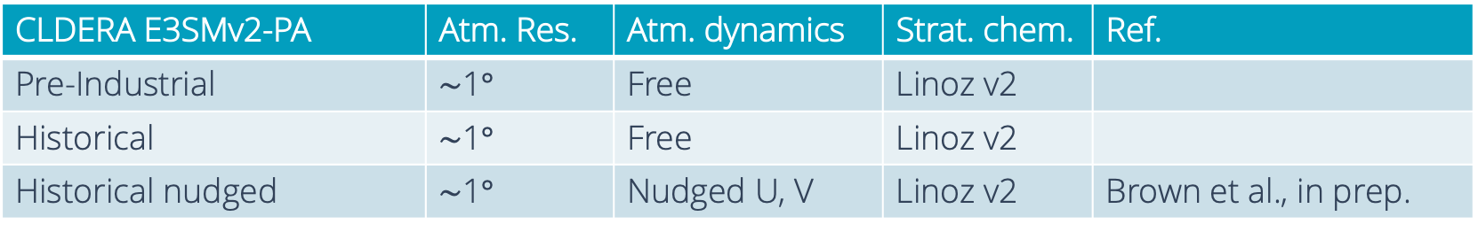
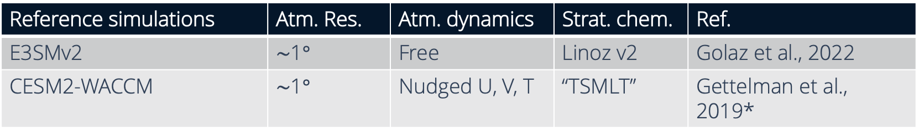
Simulations
CLDERA E3SMv2-PA | Atm. Res. | Atm. dynamics | Strat. chem. | Ref.
Pre-Industrial | $\sim$1$°$ | Free | Linoz v2
Historical | $\sim$1$°$ | Free | Linoz v2
Historical nudged | $\sim$1$°$ | Nudged U, V | Linoz v2 | Brown et al., in prep.
Reference simulations | Atm. Res. | Atm. dynamics | Strat. chem. | Ref.
E3SMv2 | $\sim$1$°$ | Free | Linoz v2 | Golaz et al., 2022
CESM2-WACCM | $\sim$1$°$ | Nudged U, V, T | “TSMLT” | Gettelman et al., 2019*
*Simulation data courtesy of Ximing Ke (personal communication)

Slide 9
Results

Slide 10
Evaluation of CLDERA-E3SM: Mt. Pinatubo
Stratospheric mass burden
Stratospheric sulfate mass burden agrees well with HIRS observations, especially in 1992
  Tends to overestimate in late 1991 and in 1993
Stratospheric sulfate burden from observations (black) and nudged simulations of the Mt. Pinatubo eruption as a 10 Tg emission of SO₂ . CESM2-WACCM from Ziming Ke. Figure credit: Hunter Brown.
E3SMv2 stratospheric sulfate burden for the Mt. Pinatubo eruption without (left) and with (right) CLDERA prognostic aerosol code modifications. Credit: Hunter Brown.
Notes:
Mention that we might be able to improve this comparison by spreading out the Mt. Pinatubo emission from 0-15 N like Mills et al., 2017. Our current emissions file is a ~2-degree WACCM file remapped to 1-degree, not spread out.
Ziming nudged U,V,T for WACCM.
We nudged U,V 6-hourly from MERRA.

Slide 11
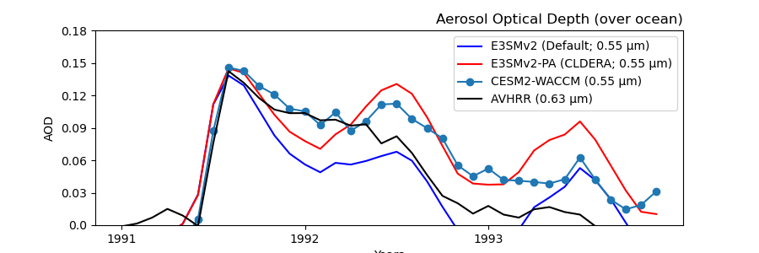
Evaluation of CLDERA-E3SM: Mt. Pinatubo
Aerosol optical depth (AOD)
E3SMv2.PA-WACCM discrepancy likely related to aerosol size
Nudged simulations
Aerosol optical depth (AOD) over the ocean. Models report AOD at 0.55 µm wavelengths, while AVHRR reports AOD at 0.63 µm. The respective annual averages from 1990 are subtracted from the models and AVHRR (hence the negative values in E3SMv2). Model data has been masked to reflect the same temporal and spatial data sampling as AVHRR. CESM2-WACCM from Ziming Ke. Figure credit: Hunter Brown.
E3SMv2.PA-WACCM discrepancy likely related to OH chemistry
Notes:
Mention that differences between

Slide 12
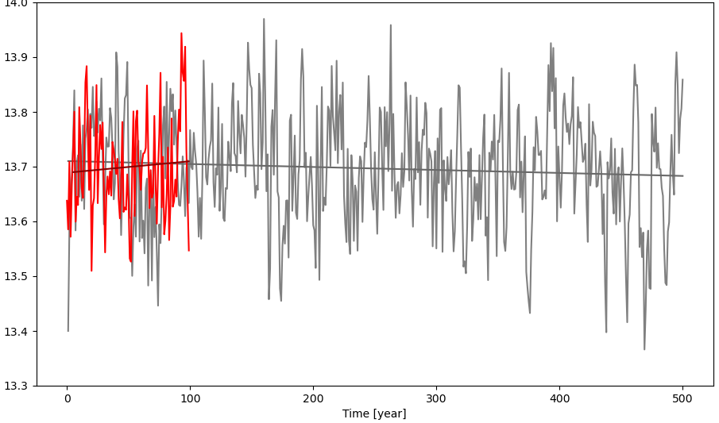
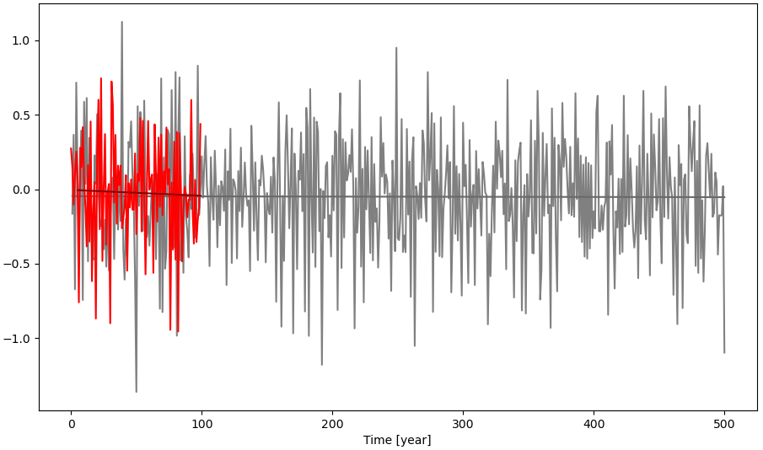
Pre-industrial simulation (perpetual 1850)
TREFHT [C]
Cannot assume that E3SMv2-PA can be initialized from E3SMv2 in 1991 to simulate the Mt. Pinatubo eruption.
  The two models could have different equilibrium climates or transient climate responses.
We ran 1 pre-industrial (PI) E3SMv2-PA simulation and 1 historical simulation to spin up E3SMv2-PA to simulate Mt. Pinatubo in 1991.
  Pi: CMIP6 protocol for PI: historical average of monthly-varying stratospheric SO₂ emissions.
  Historical: Initialized from year 60 of the E3SMv2-PA pre-industrial.
When is E3SMv2-PA PI simulation equilibrated?
    We made the decision after 60 years to branch an historical run, but continued the PI simulation to year 100.
    Later, we tested whether the apparent trends in E3SMv2-PA PI simulation are real or internal variability by comparing to the E3SMv2 500-year PI sim.
      Conclusion: The 100-yr E3SMv2-PA PI sim. has statistically real but negligible trends in RESTOM, TREFHT.
E3SMv2 (500 years) E3SMv2-PA (100 years)
RESTOM [Wm⁻²]
Annual mean global mean temperature (top) and residual top of model radiation (bottom) for E3SMv2 and E3SMv2-PA pre-industrial simulations.
Notes:
Link to E3SM-diags model vs. model
https://portal.nersc.gov/cfs/e3sm/wagmanbe/CLDERA/v2.LR.piControl_ne30pg2_prog_cori_spinup_cmip6_revised/e3sm_diags/atm_monthly_180x360_aave/model_vs_model_0111-0200/viewer/

Slide 13
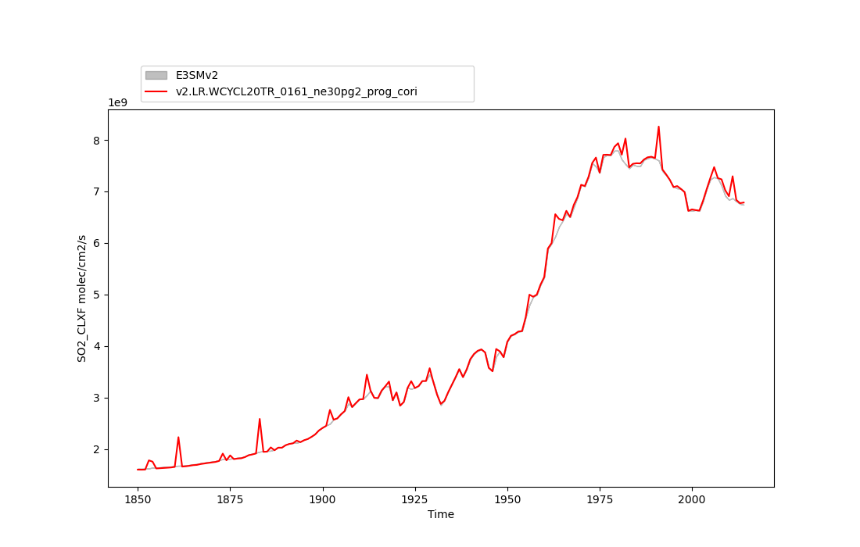
Historical coupled simulation (1850-2014)
SO₂ emission
Historical comparison of E3SMv2-PA to 5-member E3SMv2 ensemble. with Figure credit: Benjamin Wagman.

Slide 14
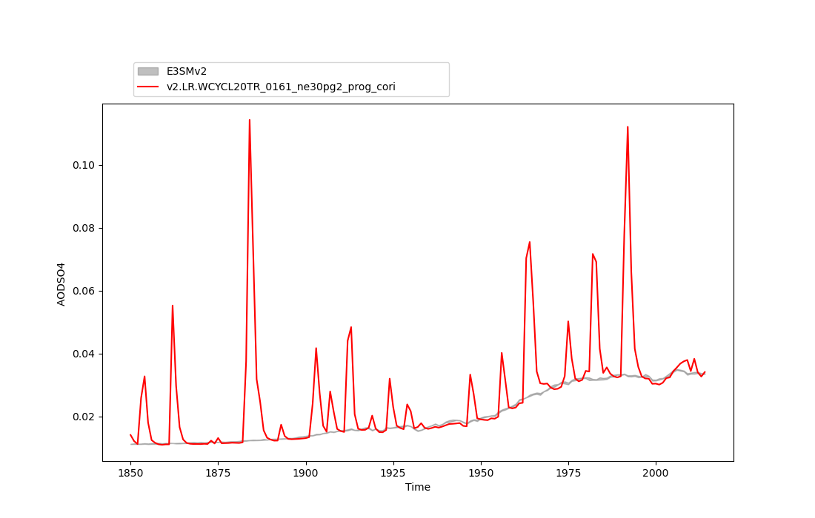
Historical coupled simulation (1850-2014)
AOD SO₄
Historical comparison of E3SMv2-PA to 5-member E3SMv2 ensemble. with Figure credit: Benjamin Wagman.

Slide 15
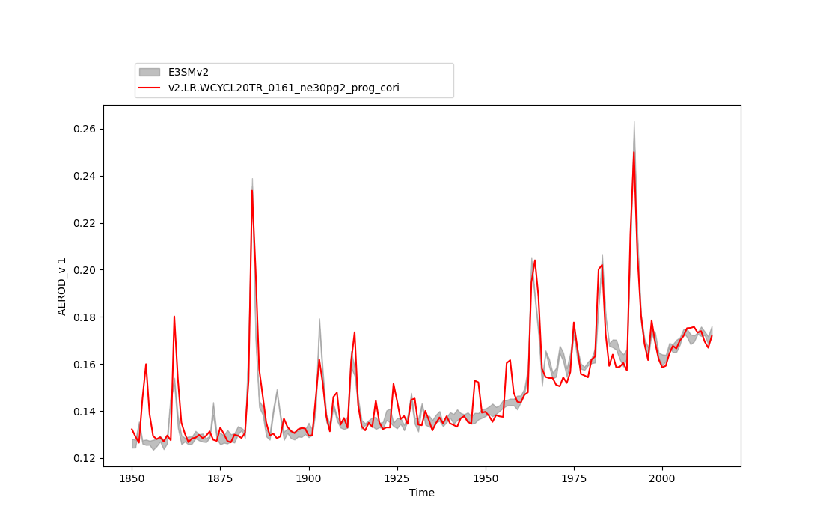
Historical coupled simulation (1850-2014)
AEROD_v
Historical comparison of E3SMv2-PA to 5-member E3SMv2 ensemble. with Figure credit: Benjamin Wagman.

Slide 16
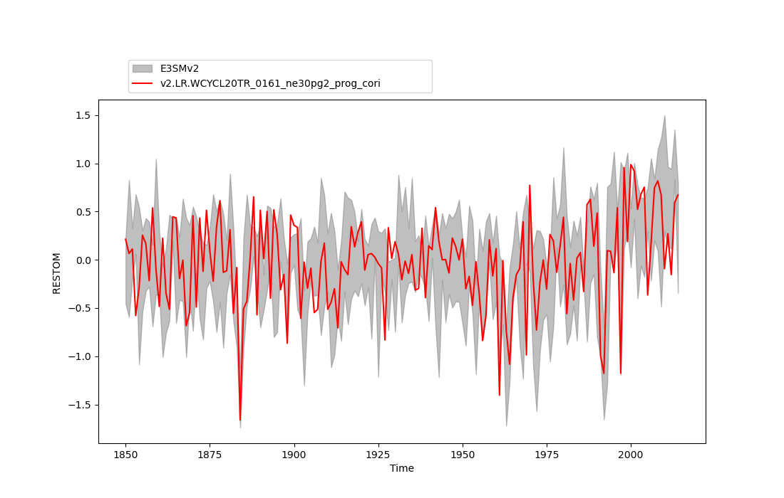
Historical coupled simulation (1850-2014)
Top of Model Radiative balance
Historical comparison of E3SMv2-PA to 5-member E3SMv2 ensemble. with Figure credit: Benjamin Wagman.

Slide 17
Historical coupled simulation (1850-2014)
Global mean 2-m temperature
Historical comparison of E3SMv2-PA to 5-member E3SMv2 ensemble. with Figure credit: Benjamin Wagman.
Notes:
Still a lot more to look at…
-Pinatubo transient cooling
-Clouds
-Heating rates

Slide 18
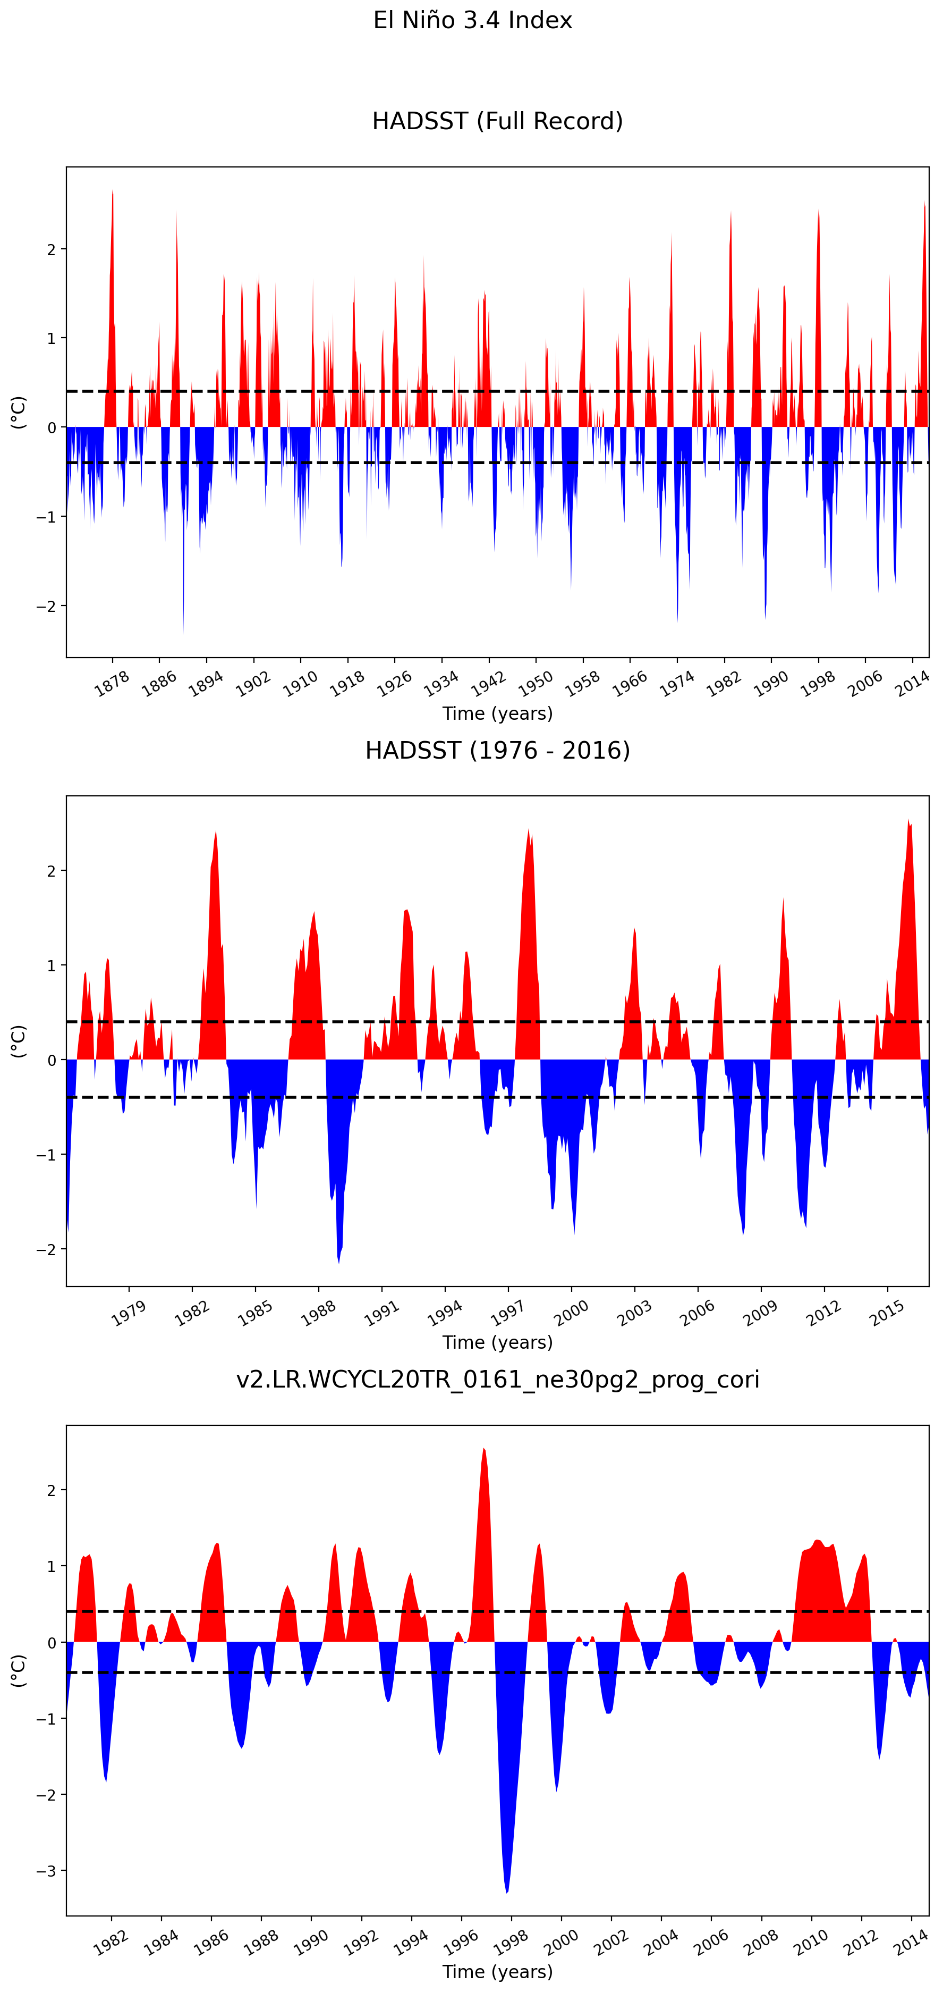
Historical coupled simulation: ENSO and Mt. Pinatubo
Global mean 2-m temperature
El Niño 3.4 Index
Mt. Pinatubo cooling offset by El Niño in the E3SMv2-PA historical simulation.
Additional ensemble members to come.
Notes:
Still a lot more to look at…
-Pinatubo transient cooling
-Clouds
-Heating rates

Slide 19
Summary and next steps
E3SMv2 aerosol and emissions modifications to simulate prognostic stratospheric volcanic aerosol (E3SMv-PA).
  The good:
    Prognostic volc. aerosol with improved long-term simulated Pinatubo H₂SO₄ burden and increased AOD.
    Negligible additional computational expense.
  The compromises:
    Neglects OH depletion, forms H₂SO₄ faster than full chem models.
    No O₃ destruction by heterogeneous chemistry.
    MAM4 tuning at expense of coarse mode tropospheric aerosols
100-year E3SMv2-PA pre-industrial simulation
  Statistically real but negligible trends in TREFHT, RESTOM.
1850-2014 E3SMv2-PA historical simulation
  Prognostic model historical climate is E3SMv2-like but with simulated aerosol from stratospheric volcanic eruptions.
Next: Ensembles of Mt. Pinatubo with modified eruption characteristics.

Slide 20
References
Gettelman, A., Mills, M. J., Kinnison, D. E., Garcia, R. R., Smith, A. K., Marsh, D. R., et al. (2019). The whole atmosphere community climate model version 6 (WACCM6). Journal of Geophysical Research: Atmospheres, 124, 12380– 12403. https://doi.org/10.1029/2019JD030943
Ghan, S. J., and Zaveri, R. A. (2007), Parameterization of optical properties for hydrated internally mixed aerosol, J. Geophys. Res., 112, D10201, doi:10.1029/2006JD007927.
Golaz, J.-C., Van Roekel, L. P., Zheng, X., Roberts, A. F., Wolfe, J. D., Lin, W., et al. (2022). The DOE E3SM Model version 2: Overview of the physical model and initial model evaluation. Journal of Advances in Modeling Earth Systems, 14, e2022MS003156. https://doi.org/10.1029/2022MS003156
Hsu, J., and Prather, M. J. (2009), Stratospheric variability and tropospheric ozone, J. Geophys. Res., 114, D06102, doi:10.1029/2008JD010942.
Mills, M. J., Schmidt, A., Easter, R., Solomon, S., Kinnison, D. E., Ghan, S. J., III Neely, R. R., Marsh, D. R., Conley, A., Bardeen, C. G., et al. (2016), Global volcanic aerosol properties derived from emissions, 1990–2014, using CESM1(WACCM), J. Geophys. Res. Atmos., 121, 2332– 2348, doi:10.1002/2015JD024290.
Mills, M. J., Richter, J. H., Tilmes, S., Kravitz, B., MacMartin, D. G., Glanville, A. A., … Kinnison, D. E. (2017). Radiative and chemical response to interactive stratospheric sulfate aerosols in fully coupled CESM1(WACCM). Journal of Geophysical Research: Atmospheres, 122, 13,061– 13,078. https://doi.org/10.1002/2017JD027006
Neely III, R.R.; Schmidt, A. (2016): VolcanEESM: Global volcanic sulphur dioxide (SO2) emissions database from 1850 to present - Version 1.0. Centre for Environmental Data Analysis, 04 February 2016. doi:10.5285/76ebdc0b-0eed-4f70-b89e-55e606bcd568. http://dx.doi.org/10.5285/76ebdc0b-0eed-4f70-b89e-55e606bcd568. Obtained from CESM inputdata server: https://svn-ccsm-inputdata.cgd.ucar.edu/trunk/inputdata/atm/cam/chem/stratvolc/
Zanchettin, D. et al., : The Model Intercomparison Project on the climatic response to Volcanic forcing (VolMIP): experimental design and forcing input data for CMIP6, Geosci. Model Dev., 9, 2701–2719, https://doi.org/10.5194/gmd-9-2701-2016, 2016. https://gmd.copernicus.org/articles/9/2701/2016/
20

Slide 21
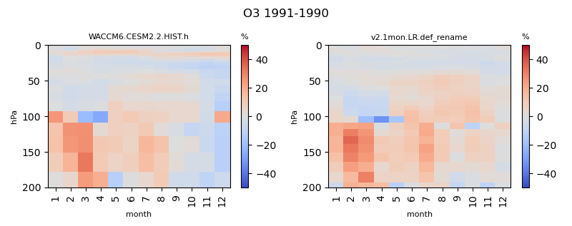
Ozone
O₃ differences between nudged simulations are mainly due to chemistry.
More ozone depletion in CESM2-WACCM likely due to heterogeneous chemistry.
CESM2-WACCM
E3SMv2-PA
Nudged U, V, T
Nudged U, V
Stratospheric ozone (mol/mol) averaged from 60$°$S to 60$°N$. Percent difference for 1991 minus 1990 for each month.
Notes:
Extend to 1992

Slide 22
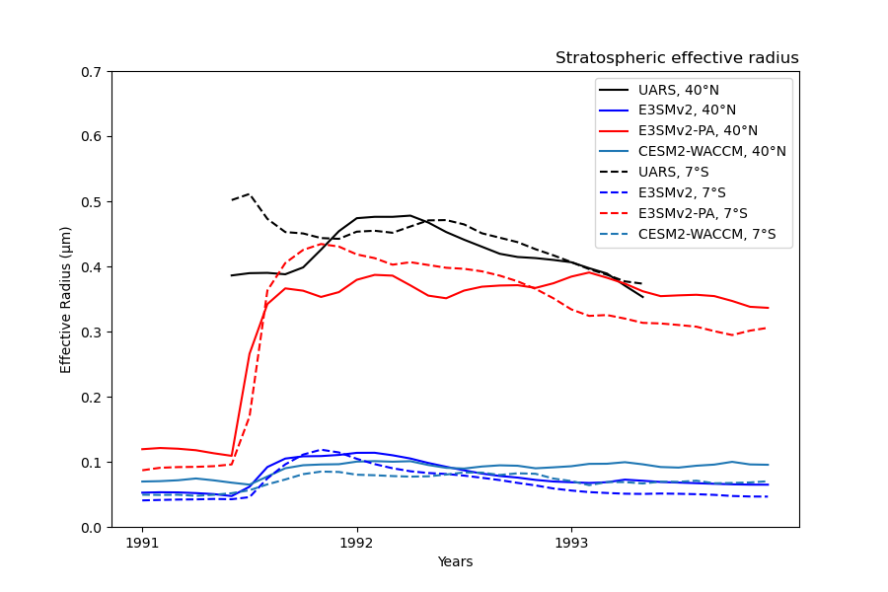
Effective Radius

Slide 23
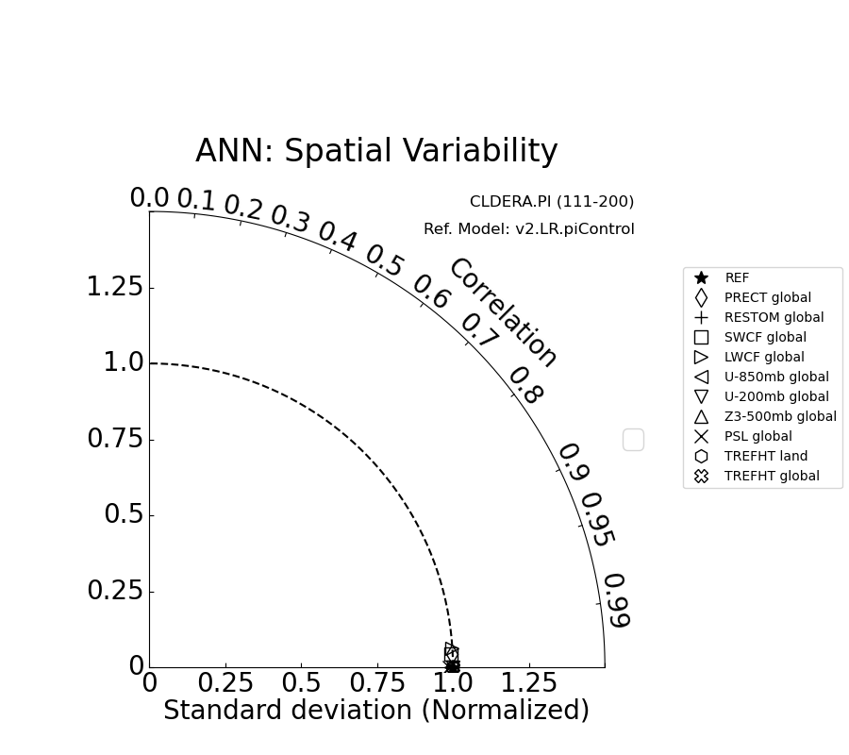
Pre-industrial simulation (diagnostics)
Notes:
https://portal.nersc.gov/cfs/e3sm/wagmanbe/CLDERA/v2.LR.piControl_ne30pg2_prog_cori_spinup_cmip6_revised/e3sm_diags/atm_monthly_180x360_aave/model_vs_model_0111-0200/viewer/taylor/summary-taylor-diagrams/selected-variables-for-cmip6-historical-comparison/ann.html

Slide 24
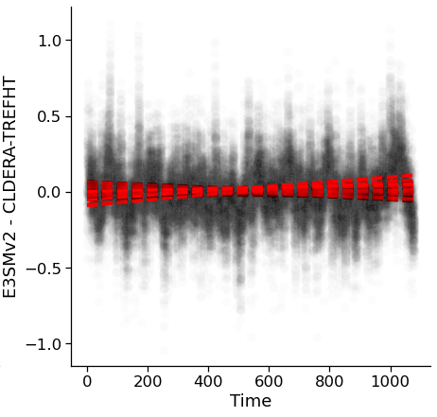
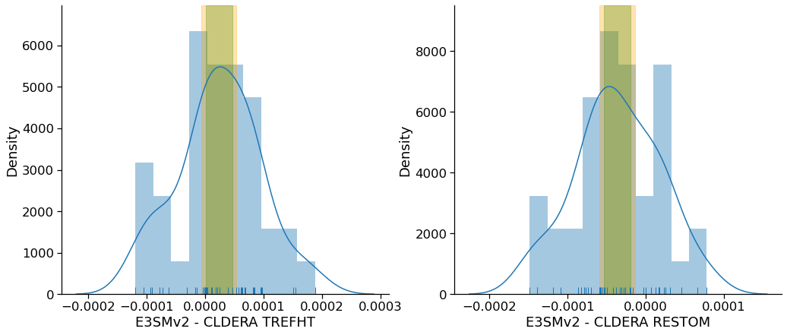
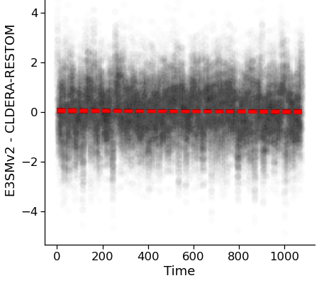
Pre-industrial simulation (perpetual 1850): Trend or no trend?
Conclusions
Statistically, there are small but real trends in E3SMv2-PA pre-industrial RESTOM and TREFHT
The magnitudes of both trends are insignificant relative to changes over the historical period.
  Estimate of RESTOM trend: ~-3x10⁻⁵ Wm⁻² month⁻¹
  Estimate of RESTOM trend over 164 year historical period: ~-0.06 Wm⁻²
  Change in anthropogenic CO₂ forcing over historical period: ~1.7 Wm⁻²
  In other words the E3SMv2-PA model may not be fully equilibrated but it is “good enough.”
TREFHT [C]
Slope of E3SMv2-PA minus E3SMv2
95 and 99% confidence intervals of the
estimate of the mean difference in slopes
E3SMv2 (500 years) E3SMv2-PA (100 years)
RESTOM [Wm⁻²]
Slopes of E3SMv2 – E3SMv2-PA residuals for 90-year windows. Figure credit: Daniel Krofcheck.
Estimate of the mean of the slopes. Figure credit: Daniel Krofcheck.

Slide 25
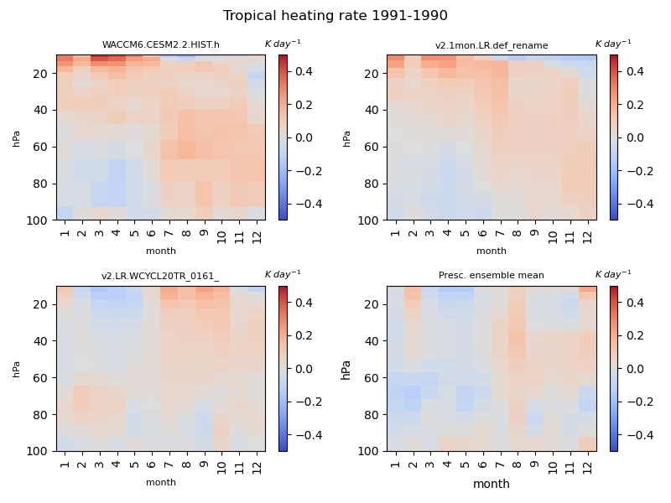
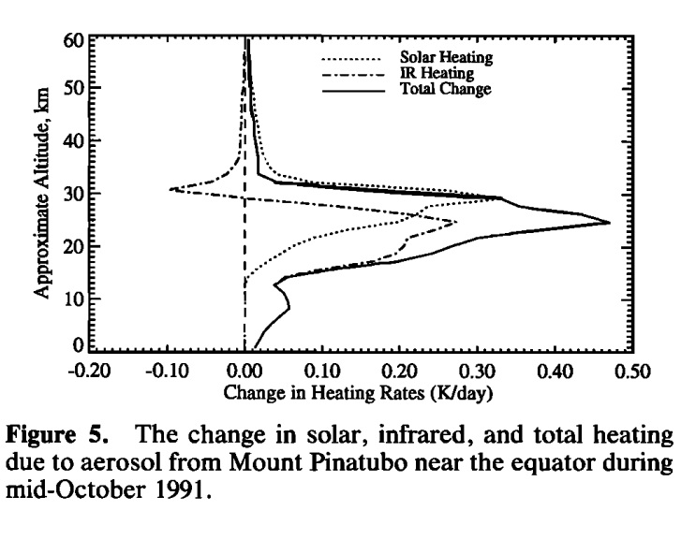
Heating rate
Kinnison et al. (1994)
Notes:
https://acomstaff.acom.ucar.edu/dkin/Documents/Kinnison_94JD02318_mtp.pdf
https://agupubs.onlinelibrary.wiley.com/doi/epdf/10.1029/94JD02318

