Slide 1
Scientific Machine Learning needs in climate attribution: an application example
Laura Swiler | CLDERA - CLIMATE IMPACT DETERMINing ETIOLOGY THROUGH PATHWAYS
Sandia Team members: Joseph Hart, Mamikon Gulian, Indu Manikam, Benjamin Wagman, Mark Smith, Jake Nichol
Academic partners: Kate Marvel, Columbia University
Santa Fe Institute Workshop: Scientific Machine Learning for Inference and Optimization of Complex Systems
October 10-12, 2022
SAND2022-13599 C

Slide 2




Attribution in Climate
CLDERA
How do rising concentrations of GHGs in the atmosphere affect climate state variables?
What are the relative contributions of different sectors, activities, and entities to concentrations of GHGs in the atmosphere?
How do changes in the global climate system affect the relative frequency and severity of extreme events ?
What are the downstream impacts from large, spatio-temporally localized sources within the climate?
What is the question?
What is the
source?
Long-term, slowly accumulating GHG emissions
Changes to global climate system
Geographically and temporally localized source forcings in the climate
Sector-specific emissions
Examples
Working group 1 and 2 IPCC reports
Cement industry, transportation
Likelihood of Hurricane Katrina
Volcanic eruptions, wildfires
Is the attribution direct / quantitative?
WG1- yes (temp/precip/…)
WG2 – notional linkage
yes, linked through multiple process-nodes
yes
no, notional connection
The goal of CLDERA is to develop new tools to enable downstream impact attribution from geographically and temporally localized source forcings in the climate.
4

Slide 3

CLDERA: a novel foundational approach focusing on why impacts arise
Detection: the process of demonstrating that climate has changed in some defined statistical sense without providing a reason for that change.
Attribution: the process of evaluating the relative contributions of multiple causal factors to a change or impact with an assignment of statistical confidence
External forcing: a forcing factor outside the climate system that causes a change in the climate system. Examples: Volcanic eruptions, solar variations, anthropogenic changes in atmospheric composition and land-use.
Counterfactual: A counterfactual world refers to a hypothetical “control” world that has only been impacted by natural forcings and internal variability.
Objective: Demonstrate detection and attribution for an individual SAI event that is not a long-term forcing
Hegerl et al. (2010), NAS (2016), Santer et al. (1995), Hasselman (1997).
Notes:
Hegerl, G. C., O. Hoegh-Guldberg, G. Casassa, M. P. Hoerling, R. S. Kovats, C. Parmesan, D. W. Pierce and P. A. Stott. 2010. Good Practice Guidance Paper on Detection and Attribution Related to Anthropogenic Climate Change. In Meeting Report of the IPCC Expert Meeting on Detection and Attribution of Anthropogenic Climate Change. https://archive.ipcc.ch/pdf/supporting-material/ipcc_good_practice_guidance_paper_anthropogenic.pdf
National Academies Press Report, 2016. Attribution of Extreme Weather Events in the Context of Climate Change. http://www.nap.edu/21852
Santer B.D. et al. (1995), “Towards the Detection and Attribution of an Anthropogenic Effect on Climate,” Climate Dynamics, Volume 12, Number 2, 77-100.
Hasselmann, K. (1997) Multi-pattern fingerprint method for detection and attribution of climate change.” Climate Dynamics. Vol. 13, 601-611

Slide 4
ATTRIBUTION finding predominant source driving impact
Research Composition:
SOURCE
Atmospheric Circulation
IMPACTS
Enhanced Fingerprinting: use pathway information to expand multi-variate analyses, sharpening the signal-to-noise ratios and enabling significant correlations between source-impact
Inverse Optimization: develop deep operator neural networks (DONNs) to model parts of E3SM to enable PDE-constrained optimization without intrusion into the E3SM code directly
Causal Modeling: identify causal relationships and dominant pathways by developing structural equation models and causal networks
Other
Source
Event
Air
Temperature
Sea
Level
Dust
Storms
Radiative
Flux
Aerosol
Sedimentation
Sulfate
Aerosol
Production
H₂O
Nuclei
Volcanic
Eruption
Cloud
Brightness
Combustion
Aerosols
Radiation
Diffusivity
Net Primary
Productivity
Other
Source
Event
What precipitates the impact?
4

Slide 5
Fingerprinting
A fingerprint is a spatial and/or temporal pattern that highlights an impact
Commonly, a fingerprint is the first principal component or empirical orthogonal function (EOF) from a singular value decomposition of a data matrix.
Detection involves identifying if the signal projected back onto the EOF goes out of 2𝜎 limits.
Attribution involves examining the magnitude of the fingerprint in a regression formulation and checking its significance.
Fingerprinting is a very established technique and the one used for attribution by the IPCC.
Notes:
B. M. Wagman, L. P. Swiler, K. Chowdhary, B. Hillman. “The Fingerprints of Stratospheric Aerosol Injection in E3SM.” LDRD project 224535 final report, Sept. 2021.

Slide 6
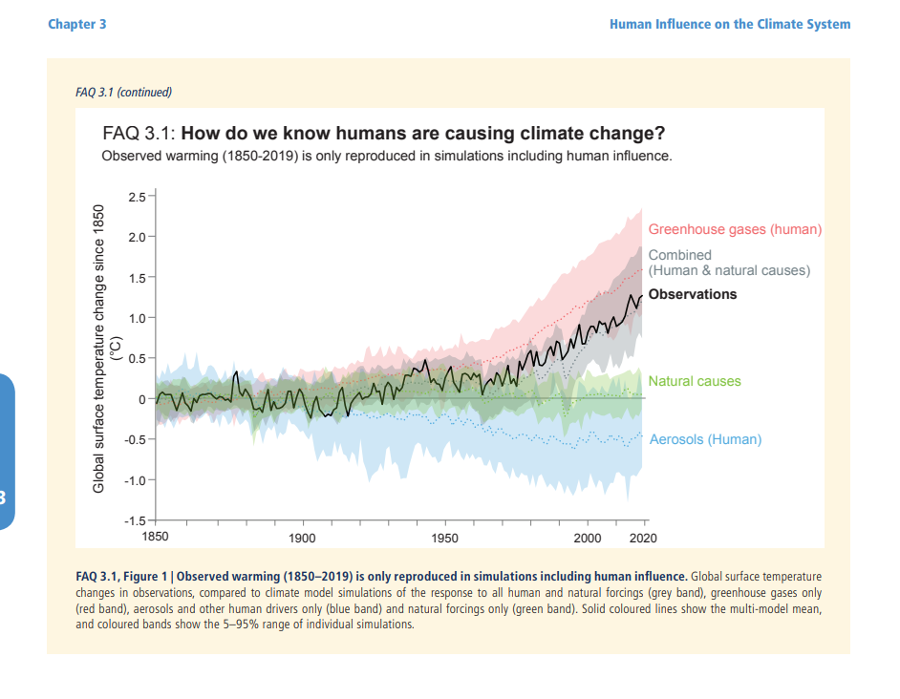
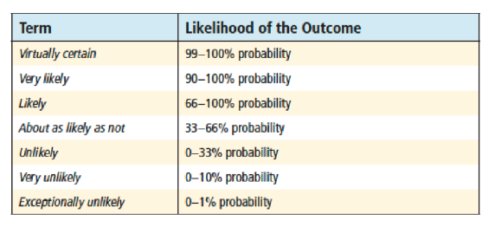
Attribution: calculate the slope of the fingerprint β from initial time (e.g. 1900) to various times (1950, 1960, etc.)
Calculate the uncertainty in the slope and the S/N ratio β/σ.
σ(β) is the standard deviation of this trend (the noise). This is calculated with a long pre-industrial run (1000 years).
The S/N ratio is assumed to be normally distributed: assess the probably and use the table below (IPCC, AR5 and AR6)
From IPCC AR6 WGI, Chapter 3: Human Influence on the climate system. https://www.ipcc.ch/report/ar6/wg1/downloads/report/IPCC_AR6_WGI_Chapter03.pdf

Slide 7
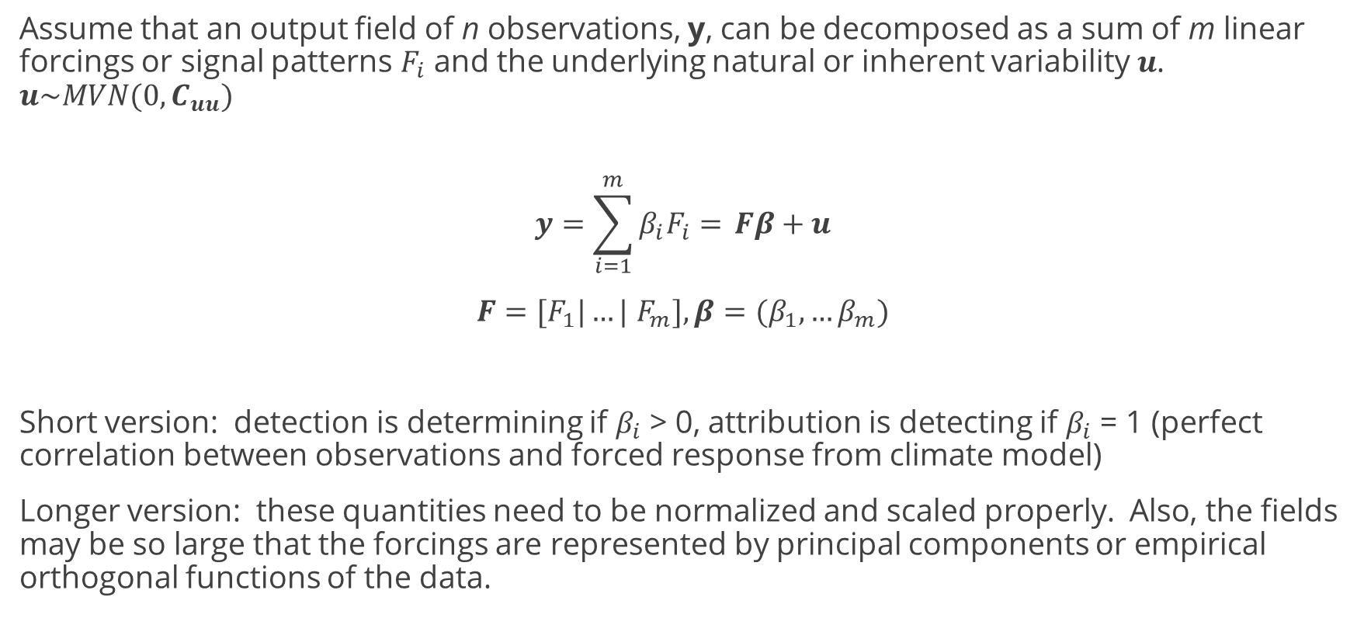
Climate attribution: Regression approach
Assume that an output field of n observations, y, can be decomposed as a sum of m linear forcings or signal patterns $F_{i}$ and the underlying natural or inherent variability$u$. $u\sim MVN(0,C_{uu})$
$$y=\sum_{i=1}^{m}{β_{i}F_{i}= }Fβ+u$$
$F=[F_{1}|…|$ $F_{m}],β=(β_{1},…β_{m})$
Short version: detection is determining if $β_{i}$ > 0, attribution is detecting if $β_{i}$ = 1 (perfect correlation between observations and forced response from climate model)
Longer version: these quantities need to be normalized and scaled properly. Also, the fields may be so large that the forcings are represented by principal components or empirical orthogonal functions of the data.
Additive forcing assumption
Estimating inherent variability is critical

Slide 8
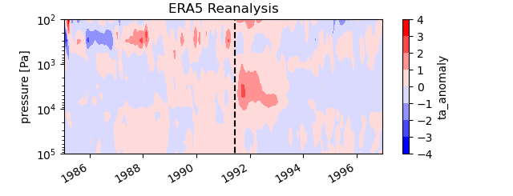
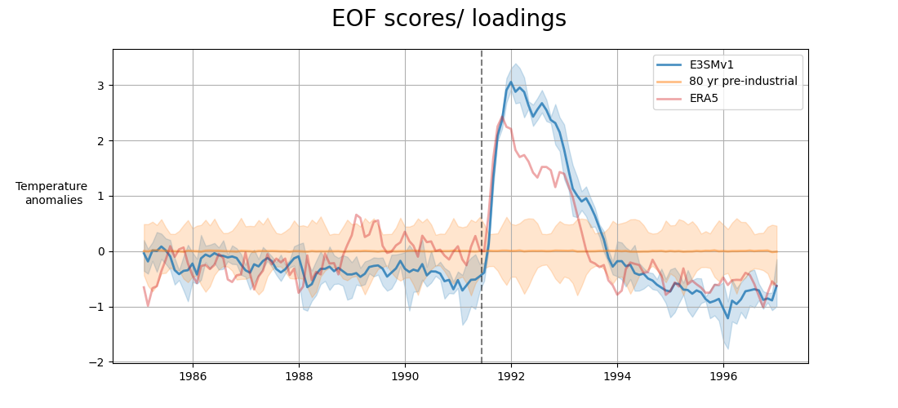
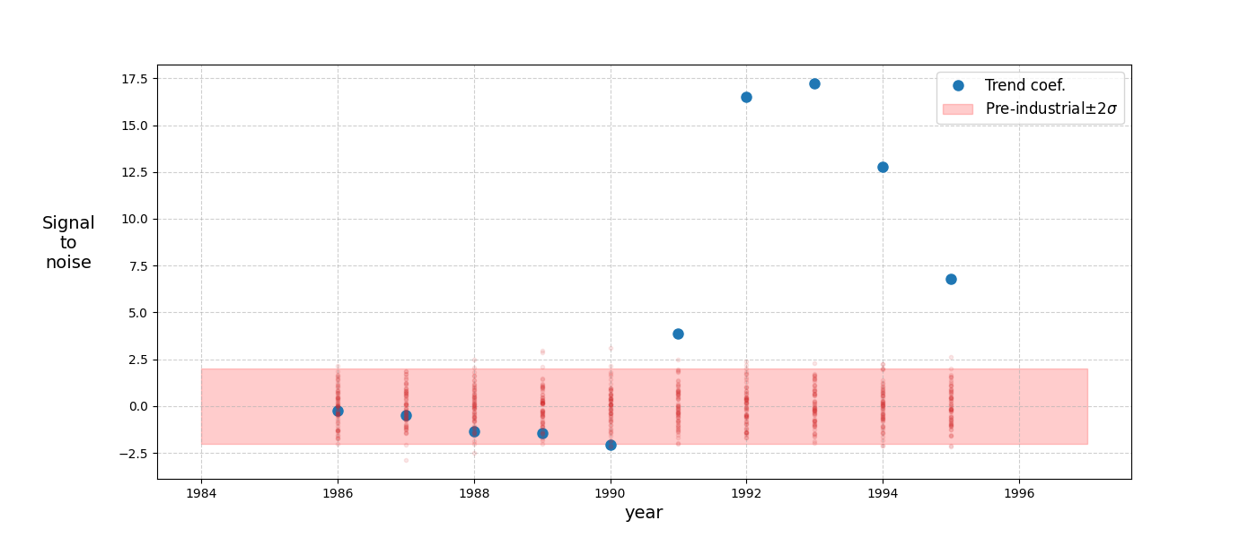
Detection and Attribution of temperature anomaly to Mt. Pinatubo
Stratospheric heating: Area-averaged temperature anomalies. The data are detrended and the annual cycle removed. The Mt. Pinatubo eruption is marked by the dashed black line.
Attribution of temperature signal change to Pinatubo: S/N ratio > 10
Traditional Fingerprint: Projection of Data onto EOF 1
EOF Scores
Notes:
Fingerprinting: Establish we can reproduce SoA analysis. Establish workflow.
Developed workflow and applied to both the detection of a change in temperature (lat, lon average over a month & detrended per pressure level) (EOF represents data at every pressure level, the projection of the data onto the EOF gives the amplitudes as a time series. BLUE line represents the data projected onto the first EOF (first principal component) from the singular value decomposition of the data.
Still using late start data. E3smv1. UNTUNED to the strat prognostic.
And in attributing that change back to Pinatubo. attribution – signal is linear trend (blue line) (cumulative trend coefficients from 1985 to the data pt. year) and noise is from the PI –repeat the linear trend analysis -- normalized the cumulative trend value with noise. When move outside 2sigma then are attributing
For every dot, using more data to complete trend.

Slide 9
Scientific ML needs and opportunities relating to fingerprinting (and causal modeling)
Use of Scientific ML to identify fingerprints
  Large data problem: 3-D spatial fields, 65K grid cells, daily or monthly data, hundreds of variables
  We can’t just “mine the data”: need mechanistic models to address scientific questions
  We want to identify quantities with a high S/N ratio. There is a huge amount of noise in the data: we need to measure and remove inherent variability
  Better dimension reduction methods: PCA -> ISOMAP, Autoencoder NN, etc.
  Go beyond linear regression, relax the assumption of independent forcing behavior
  Need enough ensemble members to account for differences in climatic state (ENSO, QBO, AMO): Emulators
Most of the attribution literature focuses on long, global forcings: CO2 concentrations. Short-term forcings have a “known” behavior. How to embed this “causality” into our modeling?
Emission/Aerosol formation → Change in Radiation Flux → Temperature Change
SO2
Sulfate Aerosols
AOD
RadFlux
TempChange
June 1991: Immediate H2SO4-HO 1.5 year Max Sept 91-Apr 92 Max TOA anomaly Surface vs. troposphere
22 days zonal transport 3-4 months meridional transport to poles Sept 91-Apr 92 Peak June-Sept 92, Oct 91 for tropo+

Slide 10
The inverse problem in climate attribution
Can we identify the magnitude, height, and location of a source emissions like SAI based on downstream observations?
Note that in contrast to some inverse problems where the source and observations are the same quantity (e.g. concentration), here the downstream quantity may represent a process further along the pathway: AOD, radiation flux, or temperature.
We have so few runs of the forward E3SM (Energy Exascale Earth Systems Model) that we need to employ emulators or surrogates for the inverse optimization.
Overall approach:
  Use operator neural networks to approximate the PDE operators in the system.
  Use gradient-based optimization algorithms within Sandia’s Rapid Optimization library (ROL) to determine the MAP point.
  Use the Laplace approximation or MCMC methods to generate posterior distribution estimates

Slide 11
${SO}_{2}$ Plume Model Problem
Change in SO₂ concentration with respect to time
Diffusion
Wind
Gravity
Chemistry
Volcano source
No outflow
Zero initial SO₂ concentration
The Plume inverse problem: given observations of SO₂ concentration c, can we infer the volcanic source term f?
NOTE: c is a function of space and time; f is only a function of time (source magnitude injected at a point).

Slide 12
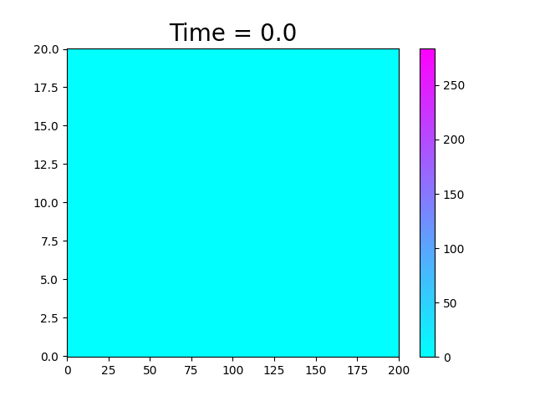
An Example of the Data
Atmosphere SO₂ Concentration
Altitude (km)
Volcano
Downrange Longitude (km)

Slide 13
Data Generation
Training data from 3 different source terms.
Validation data from a 4th source term.
Testing data from a 5th source term.
Train flow map approximation to infer testing data source.

Slide 14
Overview of the Workflow
Simulation Data
Operator Approximation
Observed Data
Likelihood
Unobserved Source
Expert Knowledge
Prior
Posterior

Slide 15
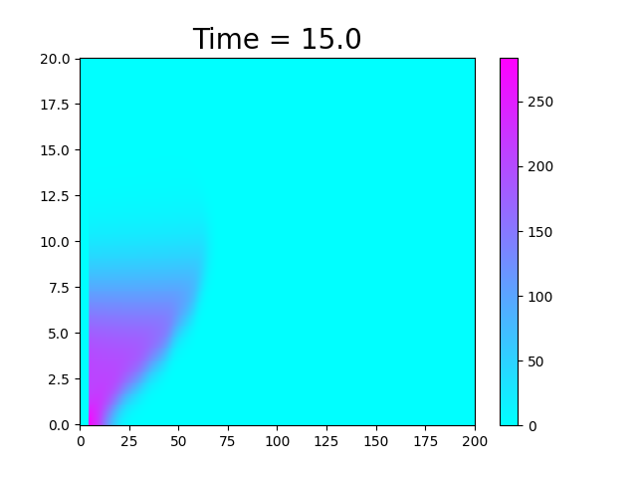
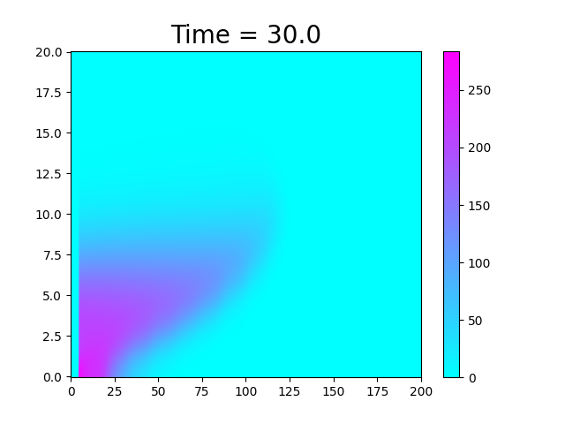
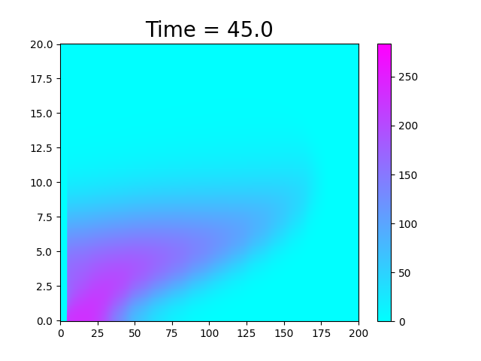


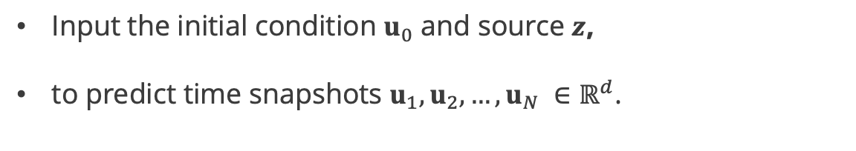
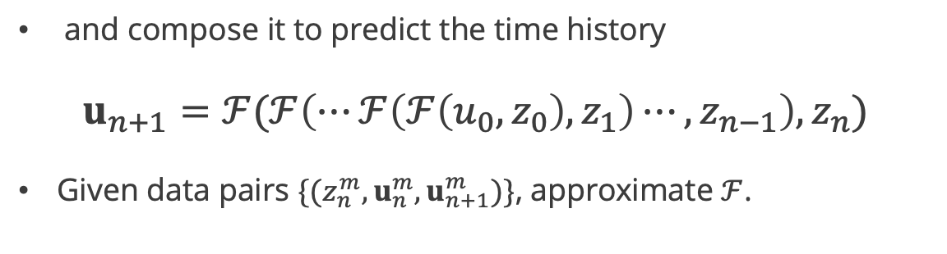
Operator Approximation: Learning Formulation
Input the initial condition $u_{0}$ and source $z$,
to predict time snapshots $u_{1},u_{2},…,u_{N} ∈ℝ^{d}$.
Approximate the flow map
$$u_{n+1}=ℱ(u_{n},z_{n})$$
$$ℱ$$
and compose it to predict the time history
$$u_{n+1}=ℱ(ℱ\left(⋯ℱ\left(ℱ\left(u_{0},z_{0}\right),z_{1}\right)⋯,z_{n−1}\right),z_{n})$$
Given data pairs $\{({z_{n}^{m},u}_{n}^{m},u_{n+1}^{m})\}$, approximate $ℱ$.
$$ℱ$$

Slide 16
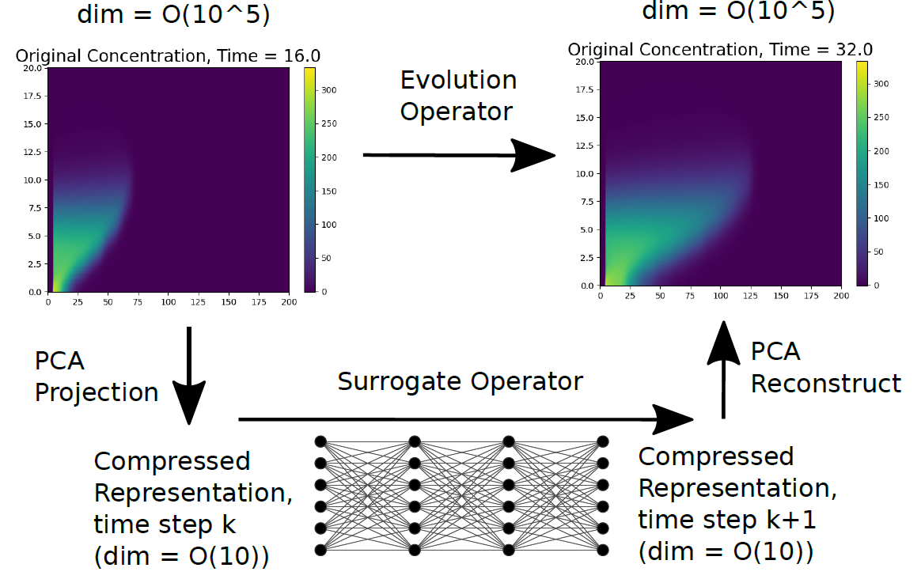
PCA for Dimension Reduction

Slide 17
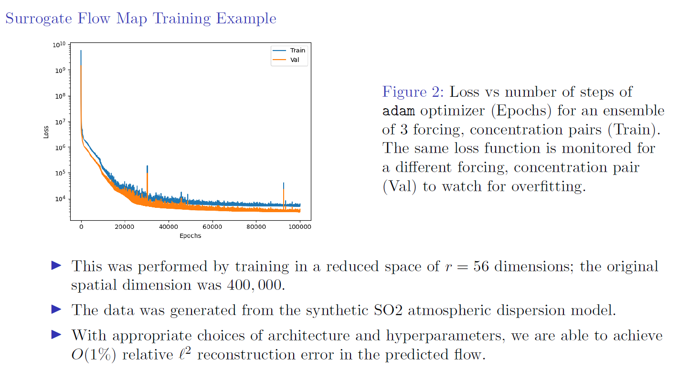
Deep Neural Network performance

Slide 18
Overview of the Workflow
Simulation Data
Operator Approximation
Observed Data
Likelihood
Unobserved Source
Expert Knowledge
Prior
Posterior

Slide 19

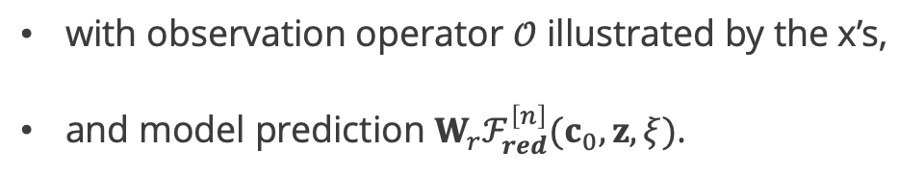

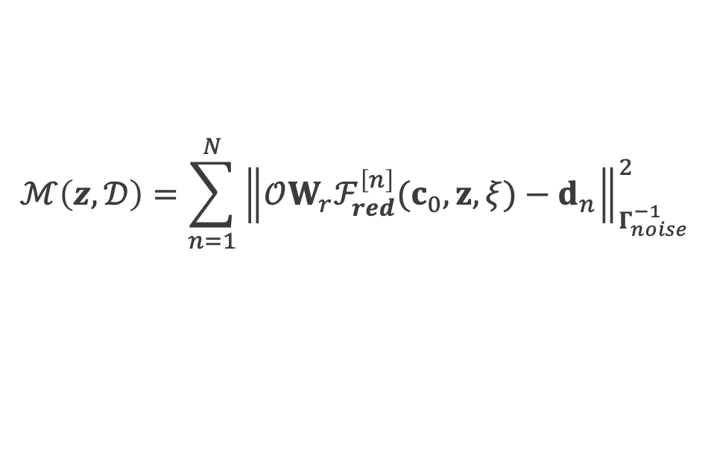
Prior and Likelihood
Assume Gaussian prior and noise models: ${ π}_{post}(z)∝$ $π_{prior}\left(z\right)∗π_{like}(z,𝒟)$
$$π_{prior}(z)∝exp(−\frac{1}{2}{\left\|z−\overline{z}\right\|}_{Γ_{prior}^{−1}}^{2})$$
$$π_{like}(z,𝒟)∝exp(−\frac{1}{2}ℳ(z,𝒟))$$
the misfit $ℳ$ depends on data $𝒟=\left[d_{1},d_{2},…,d_{N}\right]$ as
$$ℳ\left(z,𝒟\right)=\sum_{n=1}^{N}{{\left\|𝒪W_{r}ℱ_{red}^{\left[n\right]}(c_{0},z,ξ)−d_{n}\right\|}_{Γ_{noise}^{−1}}^{2}}$$
with observation operator $𝒪$ illustrated by the x’s,
and model prediction $W_{r}ℱ_{red}^{\left[n\right]}(c_{0},z,ξ)$.

Slide 20

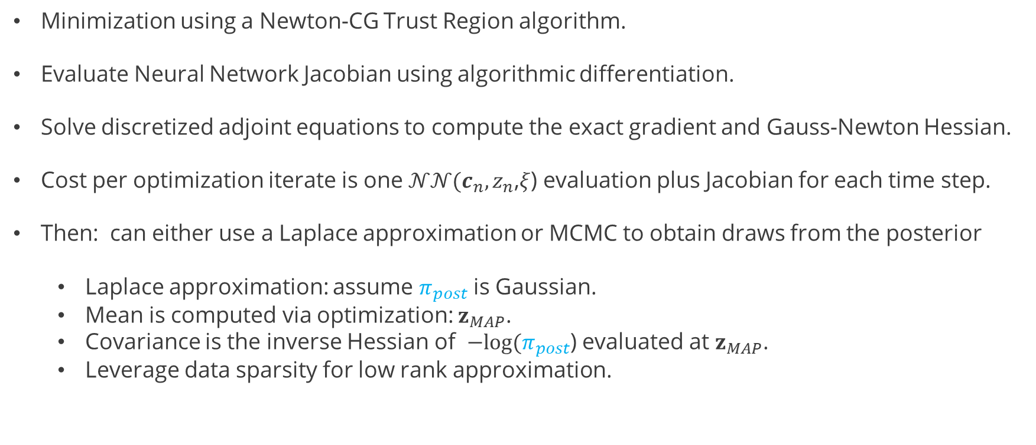

Maximum A Posteriori Probability (MAP) Point
$z_{MAP}=\underset{z}{argmin}{\frac{1}{2}M\left(z\right)+\frac{1}{2}}$ ${\left\|z−\overline{z}\right\|}_{Γ_{prior}^{−1}}^{2}$
Minimization using a Newton-CG Trust Region algorithm.
Evaluate Neural Network Jacobian using algorithmic differentiation.
Solve discretized adjoint equations to compute the exact gradient and Gauss-Newton Hessian.
Cost per optimization iterate is one $𝒩𝒩(c_{n},z_{n}$,$ξ$) evaluation plus Jacobian for each time step.
Then: can either use a Laplace approximation or MCMC to obtain draws from the posterior
  Laplace approximation: assume $π_{post}$ is Gaussian.
  Mean is computed via optimization: $z_{MAP}$.
  Covariance is the inverse Hessian of $−log⁡(π_{post}$) evaluated at $z_{MAP}$.
  Leverage data sparsity for low rank approximation.

Slide 21
Posterior Samples
Black curve is the testing data.
Blue curve is the MAP point.
Grey curves are approximate posterior samples.
Capture source well.
Overestimates uncertainty later in time.

Slide 22
The inverse problem: Scientific ML needs and opportunities
We have seen a big focus on operator learning using deep neural networks in recent years: deep operator learning is becoming a widely applicable area of scientific computing.
Deep operator learning methods vary based on the discretizations of function spaces inherent in each method as well as the architecture and training of the DNN: modal methods, graph based methods, PCA based methods, meshless methods, time-stepping methods.
However, this is NOT a solved problem!
  There are many heuristics used for formulation and training. How do we improve these and make the approach more robust?
  How can we formulate and train DNNs to capture a range of uncertainty in the training data? E.g., the plume problem is more challenging when we add significant variation in wind fields and source magnitude.
  How robust are the DNNs to capture parameterizations far from the data?
  There are many questions about data size, dimension reduction, hyperparameter estimation.
  There are also unexplored questions about the range of error in the operator approximation vs. the error in the inverse solution.

