Slide 1

Hyper-differential sensitivity analysis with respect to model discrepancy
Joseph Hart and Bart van Bloemen Waanders
Sandia National Laboratories
Scientific Machine Learning for Complex Systems: Beyond Forward Simulation to Inference and Optimization
October 10, 2022
SAND2022-13812 C

Slide 2

Decision-making for complex systems
Goals
Calibrate models
Determine optimal designs/controllers
Quantify uncertainty
Challenges:
Computation cost
Incomplete models and data
Large decision and uncertainty spaces
Strategy:
Fuse data, models, decisions with:
  Robust performance to address uncertainties
  Interpretability to support decision-making
  Scalable methods to overcome high dimensionality
  Efficient algorithms to mitigate cost

Slide 3
Scientific ML – Data, physics, and decisions
Data summarizes what has happened (past)
Data is noisy and sparse
Physics describes what will happen (future)
Models are approximate, uncertain, and incomplete
Predictions are plagued by uncertainties
Computational support for decisions is limited
Accurate prediction requires fusing information sources
SciML should synthesize physics, data, and decisions

Slide 4
PDE/ODE-constrained optimization foundation
Challenges:
Infinite dimensional state and possibly decision variables
Matrix-free linear algebra
Iterative solvers needed
Preconditioning essential
Parallelism necessary
Large sensitivity requirements

Slide 5
PDE-constrained optimization solution
Solution strategy:
Reduced space
Adjoints
Newton-Krylov solvers
MPI based communication
Trust-region globalization

Slide 6
Optimization of Approximate Models
6

Slide 7




Learning Optimal Solution Updates
7
Approximate Optimal Solution
$$J(\tilde{S}(z),z)$$
$$\tilde{z}=$$
argmin
$$z$$
High-fidelity Data
$$S\left(z_{l}\right)−\tilde{S}(z_{l})$$

Slide 8







Learning Optimal Solution Updates
8
Discrepancy Parameterization
$$δ\left(z,θ\right)≈S\left(z\right)−\tilde{S}(z)$$
Approximate Optimal Solution
Post-Optimality Sensitivity
Optimal Solution Posterior
$$J(\tilde{S}(z)+δ(z,θ),z)$$
$$\frac{∂\tilde{z}}{∂θ}Δθ=−H^{−1}B∆θ$$
$$Θ∼π_{post}⟹z^{∗}≈\frac{∂\tilde{z}}{∂θ}Θ$$
$$\tilde{z(}θ)=$$
argmin
$$z$$
High-fidelity Data
Bayesian Inversion
$$S\left(z_{l}\right)−\tilde{S}(z_{l})$$
$$π_{post}∝π_{likelihood}π_{prior}$$
Prior Discrepancy
$$π_{prior}=$$
Laws, length scales, etc.

Slide 9
Illustrative Example
9

Slide 10
Optimal Solution Posterior
10
Optimal solution with approximate model
Posterior samples
Updated solution
High fidelity solution

Slide 11
Learning Optimal Solution Updates
11
Discrepancy Parameterization
$$δ\left(z,θ\right)≈S\left(z\right)−\tilde{S}(z)$$
Approximate Optimal Solution
Post-Optimality Sensitivity
Optimal Solution Posterior
$$J(\tilde{S}(z)+δ(z,θ),z)$$
$$\frac{∂\tilde{z}}{∂θ}Δθ=−H^{−1}B∆θ$$
$$Θ∼π_{post}⟹z^{∗}≈\frac{∂\tilde{z}}{∂θ}Θ$$
$$\tilde{z(}θ)=$$
argmin
$$z$$
High-fidelity Data
Bayesian Inversion
$$S\left(z_{l}\right)−\tilde{S}(z_{l})$$
$$π_{post}∝π_{likelihood}π_{prior}$$
Prior Discrepancy
$$π_{prior}=$$
Laws, length scales, etc.

Slide 12
Model Discrepancy Representation
12

Slide 13

Learning Optimal Solution Updates
13
Discrepancy Parameterization
$$δ\left(z,θ\right)≈S\left(z\right)−\tilde{S}(z)$$
Approximate Optimal Solution
Post-Optimality Sensitivity
Optimal Solution Posterior
$$J(\tilde{S}(z)+δ(z,θ),z)$$
$$\frac{∂\tilde{z}}{∂θ}Δθ=−H^{−1}B∆θ$$
$$Θ∼π_{post}⟹z^{∗}≈\frac{∂\tilde{z}}{∂θ}Θ$$
$$\tilde{z(}θ)=$$
argmin
$$z$$
High-fidelity Data
Bayesian Inversion
$$S\left(z_{l}\right)−\tilde{S}(z_{l})$$
$$π_{post}∝π_{likelihood}π_{prior}$$
Prior Discrepancy
$$π_{prior}=$$
Laws, length scales, etc.

Slide 14
Post-optimality Sensitivities
14
(1)

Slide 15
Post-optimality Sensitivities
15

Slide 16
16
Discrepancy Parameterization
$$δ\left(z,θ\right)≈S\left(z\right)−\tilde{S}(z)$$
Approximate Optimal Solution
Post-Optimality Sensitivity
Optimal Solution Posterior
$$J(\tilde{S}(z)+δ(z,θ),z)$$
$$\frac{∂\tilde{z}}{∂θ}Δθ=−H^{−1}B∆θ$$
$$Θ∼π_{post}⟹z^{∗}≈\frac{∂\tilde{z}}{∂θ}Θ$$
$$\tilde{z(}θ)=$$
argmin
$$z$$
High-fidelity Data
Bayesian Inversion
$$S\left(z_{l}\right)−\tilde{S}(z_{l})$$
$$π_{post}∝π_{likelihood}π_{prior}$$
Prior Discrepancy
$$π_{prior}=$$
Laws, length scales, etc.

Slide 17
Bayesian Inverse Problem - Prior Discrepancy
17

Slide 18
Bayesian Inversion Problem
18

Slide 19
Bayesian Inversion Problem – Enabling Sampling
19

Slide 20
Posterior Samples for Discrepancy
20

Slide 21
Learning Optimal Solution Updates
21
Discrepancy Parameterization
$$δ\left(z,θ\right)≈S\left(z\right)−\tilde{S}(z)$$
Approximate Optimal Solution
Post-Optimality Sensitivity
Optimal Solution Posterior
$$J(\tilde{S}(z)+δ(z,θ),z)$$
$$\frac{∂\tilde{z}}{∂θ}Δθ=−H^{−1}B∆θ$$
$$Θ∼π_{post}⟹z^{∗}≈\frac{∂\tilde{z}}{∂θ}Θ$$
$$\tilde{z(}θ)=$$
argmin
$$z$$
High-fidelity Data
Bayesian Inversion
$$S\left(z_{l}\right)−\tilde{S}(z_{l})$$
$$π_{post}∝π_{likelihood}π_{prior}$$
Prior Discrepancy
$$π_{prior}=$$
Laws, length scales, etc.

Slide 22
Propagating Samples Through Post-optimality Sensitivities
22
High-fidelity data
Approximate model
Prior
Optimization

Slide 23
Propagating Samples Through Post-optimality Sensitivities
23
High-fidelity data
Approximate model
Prior
Optimization

Slide 24
Propagating Samples Through Post-optimality Sensitivities
24
High-fidelity data
Approximate model
Prior
Optimization

Slide 25
Propagating Samples Through Post-optimality Sensitivities
25
High-fidelity data
Approximate model
Prior
Optimization

Slide 26
Propagating Samples Through Post-optimality Sensitivities
26
High-fidelity data
Approximate model
Prior
Optimization

Slide 27
A Fluid Flow Example
27
Inflow
Gravity

Slide 28
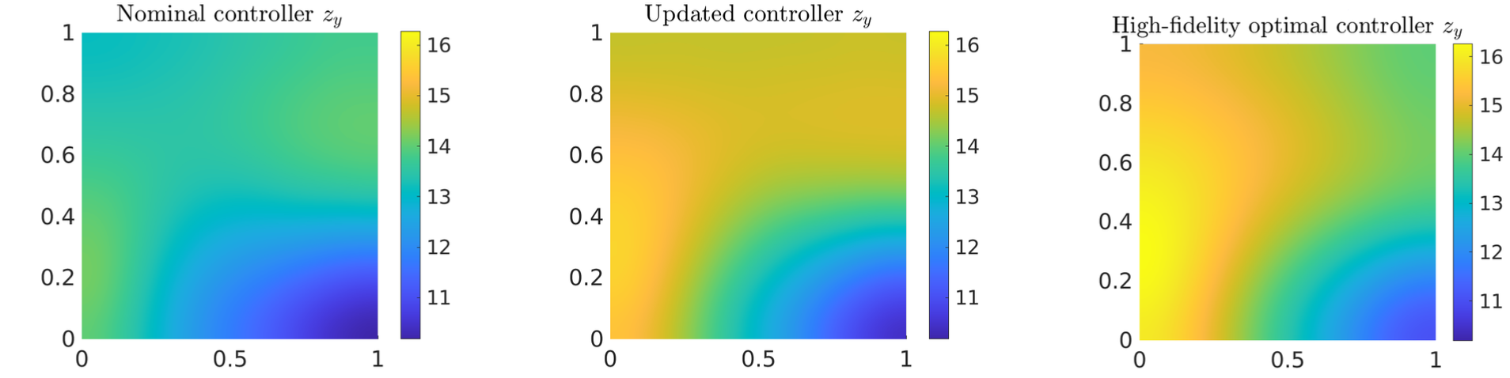
Comparison of Controllers
28
Using only Stokes
Using Stokes + 1 NS forward solve
Using NS – “Ground Truth”

Slide 29
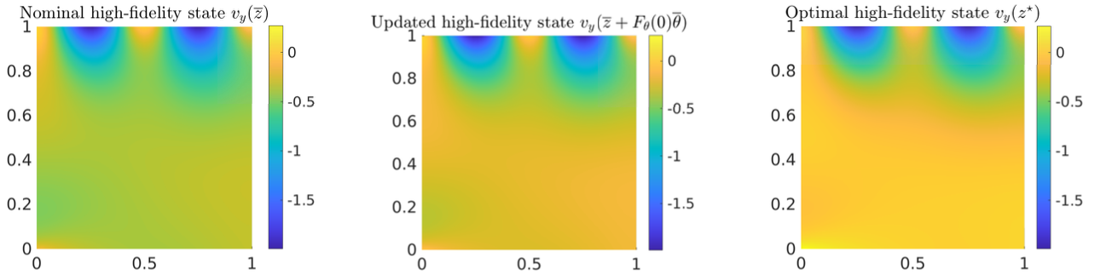



Comparison of States
29
Navier-Stokes solve with nominal control
Navier-Stokes solve with updated control
Navier-Stokes solve with optimal control
$J=3×{10}^{0}$
$J=1×{10}^{−2}$
$J=2×{10}^{−3}$

Slide 30
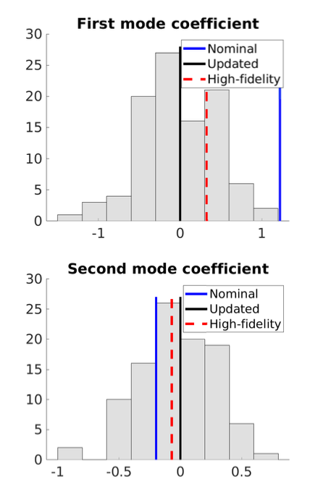
Posterior Controller Uncertainty
30
KL representation
Histogram of posterior
Goal is for updated to be as close as possible to high-fidelity

Slide 31
Conclusions
31
Joseph Hart and Bart van Bloemen Waanders, “Hyper-Differential Sensitivity Analysis With Respect to Model Discrepancy: Mathematics and Computation” (in preparation)
Joseph Hart and Bart van Bloemen Waanders, ”Hyper-differential sensitivity analysis with respect to model discrepancy: Calibration and Optimal Solution Updating” (in preparation)
Robustness: UQ for optimal controller
Interpretability: prior, optimization, data, and physics in the controller update
Scalability: leveraging computational efficiency from PDECO methods
Efficiency: Kronecker product and closed form solutions to controller updates

