Slide 1
IN22A-07: Systematic Comparison of Ground-Based and Satellite Measurements using TOVS and Radiosonde Data
Justin D. Li
AGU Fall Meeting
December 13, 2022
SAND2022-16602 C

Slide 2
Motivation
Comparisons between instruments (data products) would ideally have matching spatial and temporal resolution, sampling, and coverage
Characteristics of the unaltered data informs the validity of comparisons and transformations (e.g., data completion)
How do data observation from different systems compare?
Spatial Sampling
Spatial Sampling
t=+0
t=+7
versus
Time Coverage
IDEAL
REALITY
Time Coverage
t=+0
t=+1

Slide 3
Background
Part of a larger research project looking at climate pathways, using the 1991 Mount Pinatubo eruption as the exemplar
GC25H-0769, “CLDERA: A Novel Foundational Approach for Attributing Impacts to Localized Source Forcings in the Climate”, 12/13 at 14:45 – 18:15 CST
While newer data are more complete and at higher spatial and temporal resolutions, the described challenges remain relevant
Focus on an earlier period of the ”Satellite Era” to highlight data coverage gaps and data resolution challenges
Compare satellite data from TOVS and radiosonde data from IGRA
Apply statistical properties to characterize the comparison between data products
Comparisons at the daily, pointwise (station) level, examining effects of the spatial precision, pressure levels, and timing offset

Slide 4
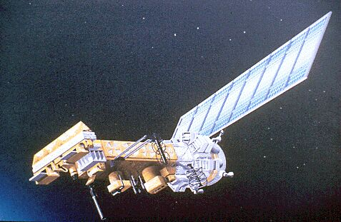
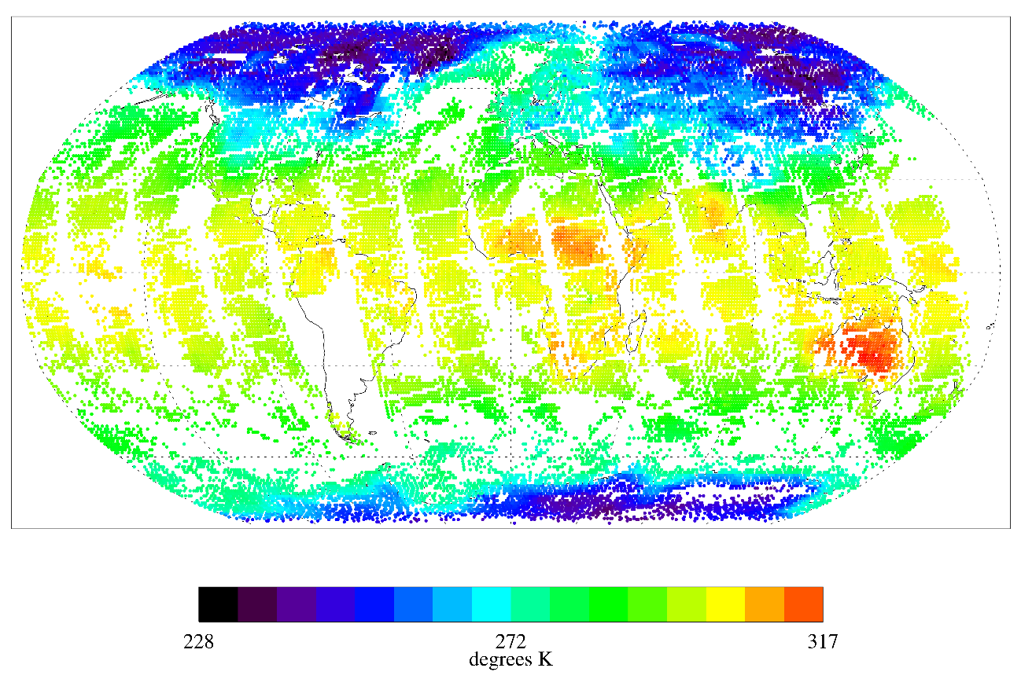
TIROS Operational Vertical Sounder (TOVS)
On-board TIROS (Television InfraRed Observation Satellite) series, NOAA-6 through 14
Using NOAA-11 data: ~2x daily measurements for 1988–1994, at 1° x 1° gridded resolution, with 12 pressure levels from surface to 30 mb
Product derived from suite of three component sensors (MSU, HIRS/2, SSU)
Image Credit: NOAA / NESDIS Center for Satellite Applications and Research
Image Credit: NASA EarthData GES DISC, TOVSADNH Dataset
Notes:
https://www.star.nesdis.noaa.gov/star/productdisclaimer.php
“Users are free to use the images or information hosted on this site as they wish, as long as credit is given to the NOAA / NESDIS Center for Satellite Applications and Research.”

Slide 5
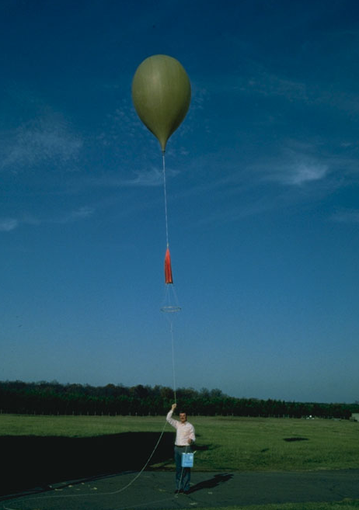
Integrated Global Radiosonde Archive (IGRA)
Archive of radiosonde and pilot balloon measurements from 1905 – present
Using 874 stations, compiled from 33 data sources (w/ quality control)
1 – 4 measurements each day, standard pressure levels
Image Credit: NOAA / NCEI IGRA Data Product
Image Credits: NWS Upper-Air Photo Gallery
Notes:
Photo from https://www.weather.gov/upperair/photo, https://www.weather.gov/disclaimer
“The information on National Weather Service (NWS) Web pages are in the public domain, unless specifically noted otherwise, and may be used without charge for any lawful purpose ”

Slide 6
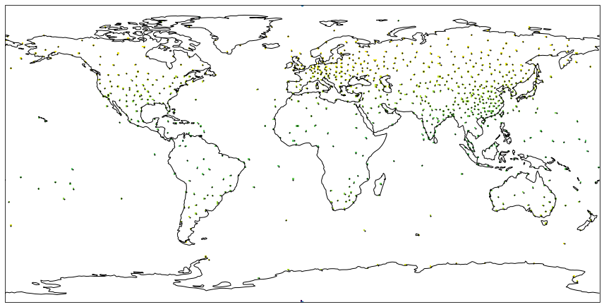
TOVS and IGRA Collocations

Slide 7
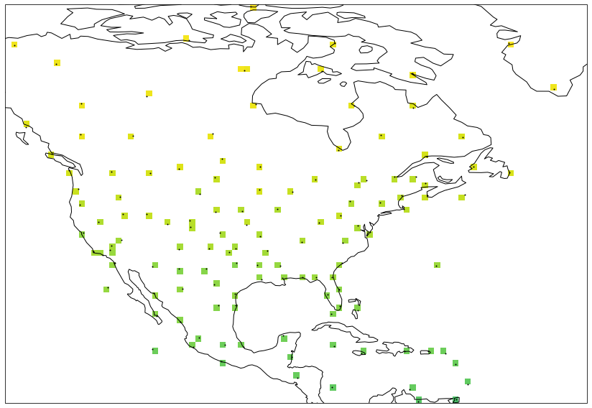
TOVS and IGRA Collocations
Evident spatial ambiguity due to spatial resolution

Slide 8
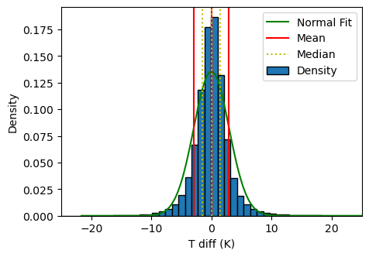
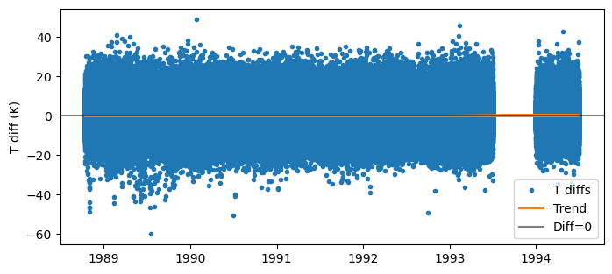
Overall TOVS and IGRA Comparison
Differenced daily data over all stations and pressure levels (within 12-hour window of co-occurrence) shows good agreement
Characterized using statistical properties of the difference between the measurements
(+σ)
(+IQR)

Slide 9
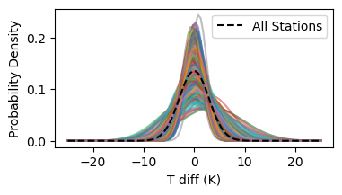
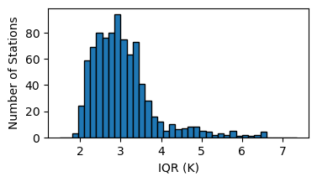
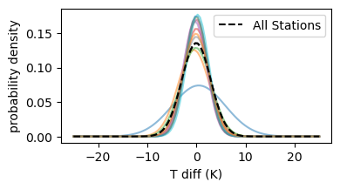
Variability from Radiosonde Stations and Pressure Levels
Differences by Radiosonde-TOVS Collocations (stations)
Differences by Pressure Levels
Not all stations are equally well behaved, with higher spread in the difference compared to the overall dataset
Limitations of the dataset, in vertical resolution by pressure level, show greater differences in near surface air temperature measurements

Slide 10
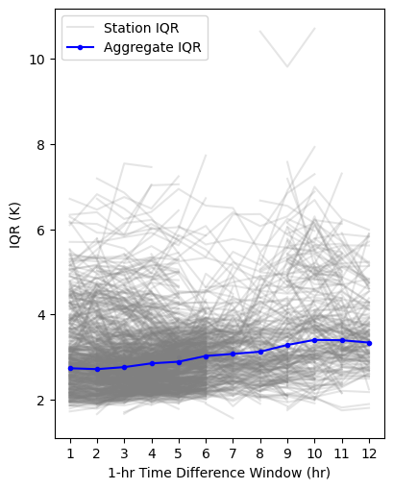
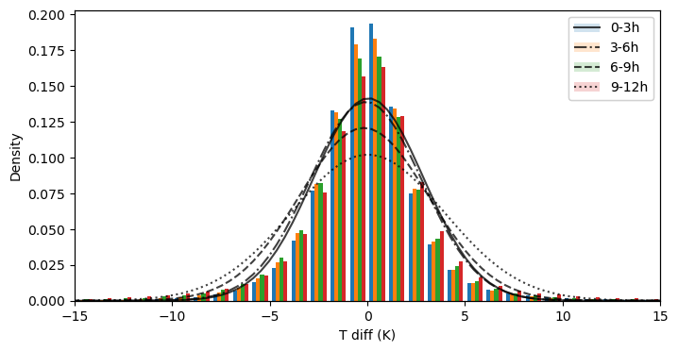
Effects of Co-incident Measurements
Distribution in temperature difference for different duration time windows for co-incident measurements
Variability due to radiosonde station has a dominant effect
Tighter time window still reduces the variability, with the 1h window IQR being 10% smaller than that for 6h

Slide 11
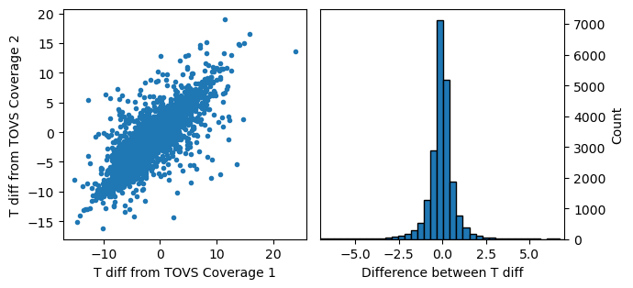
Variability due to Spatial Ambiguity
Consider pairs of radiosonde station and adjacent TOVS coverage
Example comparison; distribution over all comparison pairs (21 station pairs)
Unbiased behavior indicates spatially-smooth temperature behavior, while the variability highlights spatial resolution limitations

Slide 12
Conclusions
Direct examination of radiosonde and TOVS air temperatures shows overall agreement, which matches with past comparisons
Statistical metrics for measurement differences show significant variability in comparing at daily (compared with monthly) timescales
Outlier radiosonde station data, or periods of outlier behavior for radiosonde stations, contribute significantly to the variability
Closer time windows reduce the variability, but not as significantly as compared with improvements resulting from higher spatial resolution

Slide 13
Thanks for Listening!
sandia.gov/cldera

