Slide 1
Facilitating Atmospheric Source Inversion via Operator Regression
Joseph Hart, Mamikon Gulian, Indu Manickam, Laura Swiler
Sandia National Laboratories
SIAM Mathematics of Planet Earth
July 15, 2022
SAND2022-9339 C

Slide 2
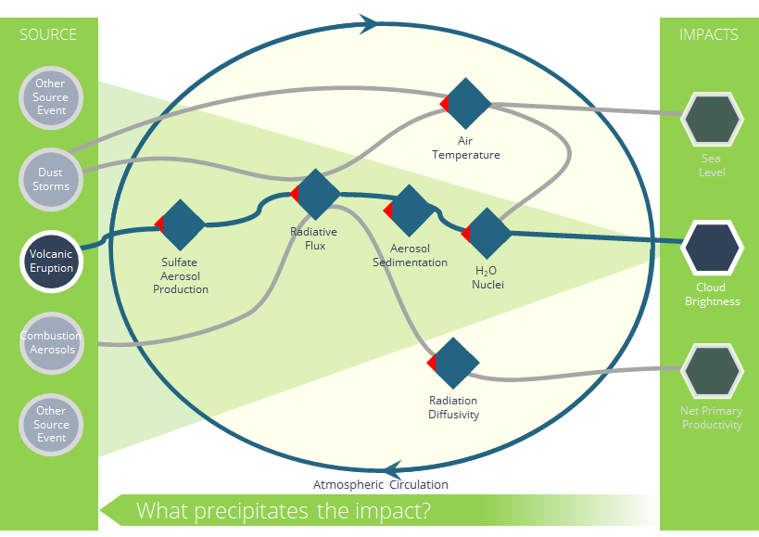
Atmospheric Source Inversion
Inferring sources from impacts is ill-posed.
Spatially localized sources create global impacts.
Climate model complexity prohibits direct inversion.
Operator surrogates may enable inversion.
Spatiotemporal data improves information content.

Slide 3
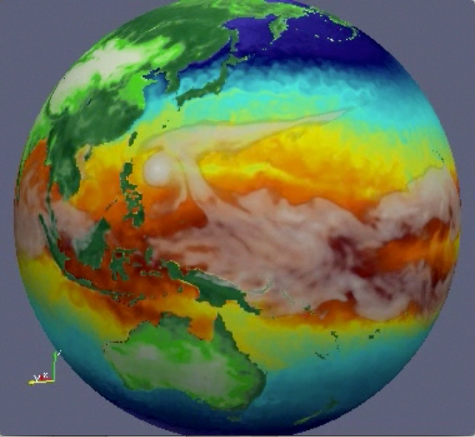
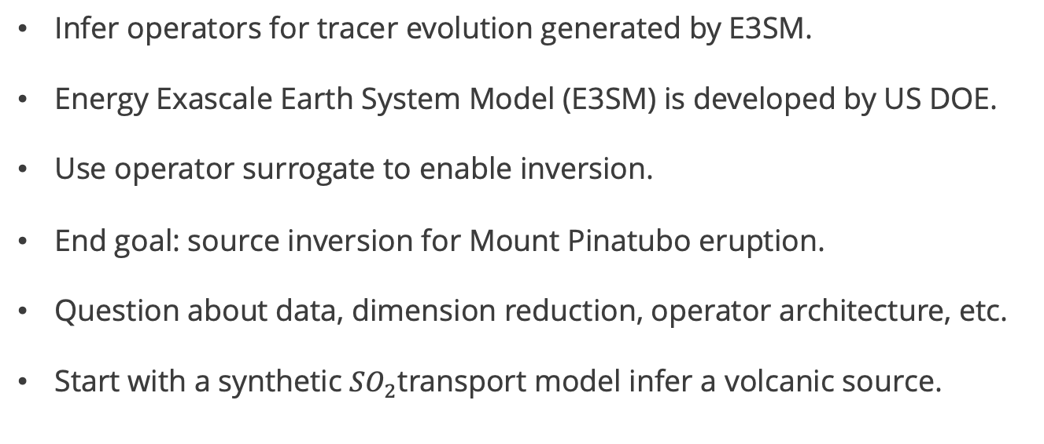
Goals and Tiered Verification
Infer operators for tracer evolution generated by E3SM.
Energy Exascale Earth System Model (E3SM) is developed by US DOE.
Use operator surrogate to enable inversion.
End goal: source inversion for Mount Pinatubo eruption.
Question about data, dimension reduction, operator architecture, etc.
Start with a synthetic ${SO}_{2}$transport model infer a volcanic source.
Atmosphere
(EAM)
Ocean
(MPAS-O)
Sea Ice
(MPAS-SI)
Land
(ALM)
Land Ice
(MALI)

Slide 4
Overview of the Workflow
Simulation Data
Operator Approximation
Observed Data
Likelihood
Unobserved Source
Expert Knowledge
Prior
Posterior

Slide 5
Overview of the Workflow
Simulation Data
Operator Approximation
Observed Data
Likelihood
Unobserved Source
Expert Knowledge
Prior
Posterior

Slide 6





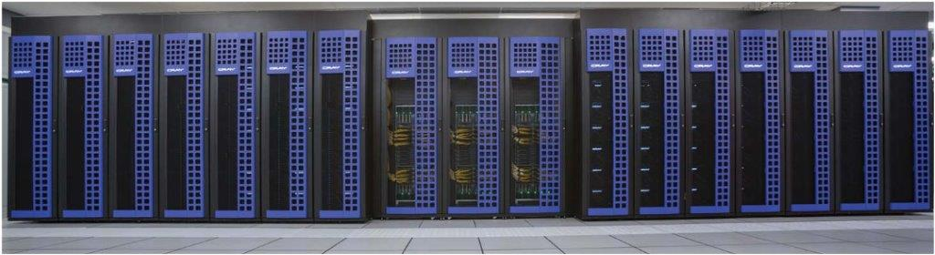
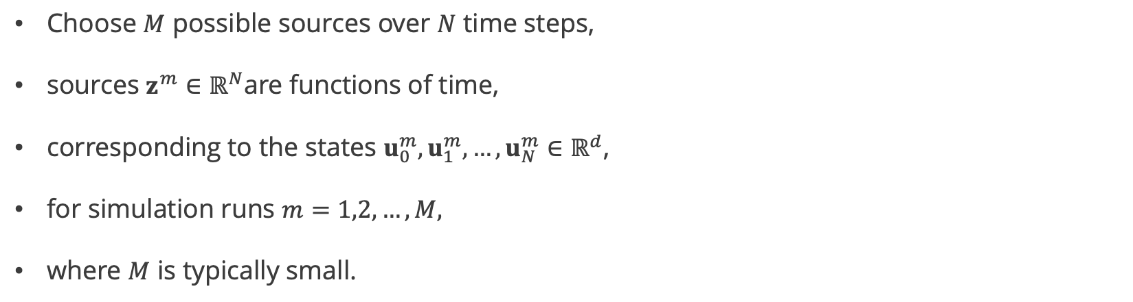
Simulation Data Generation
Choose $M$ possible sources over $N$ time steps,
sources $z^{m}∈ℝ^{N}$are functions of time,
corresponding to the states $u_{0}^{m},u_{1}^{m},…,u_{N}^{m}∈ℝ^{d}$,
for simulation runs $m=1,2,…,M,$
where $M$ is typically small.

Slide 7
Overview of the Workflow
Simulation Data
Operator Approximation
Observed Data
Likelihood
Unobserved Source
Expert Knowledge
Prior
Posterior

Slide 8
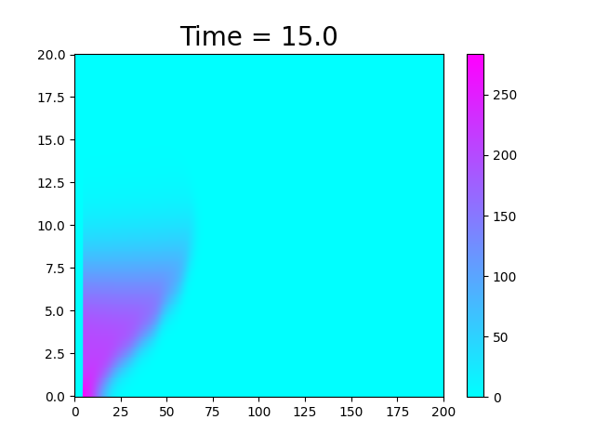
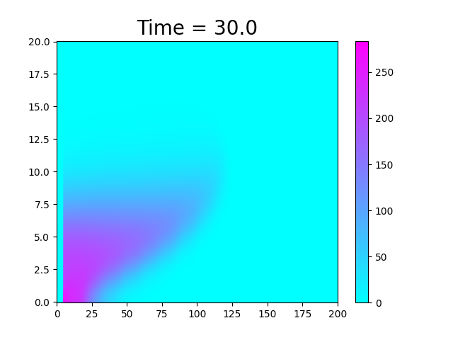
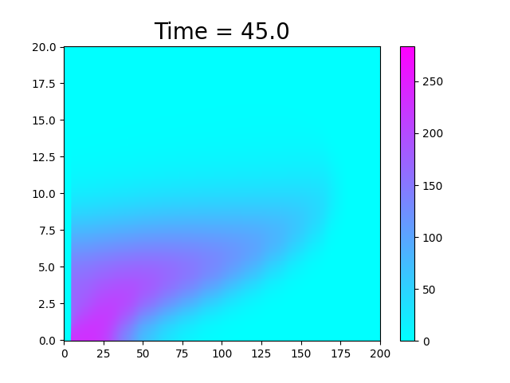


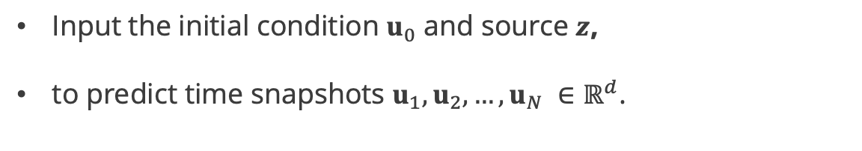
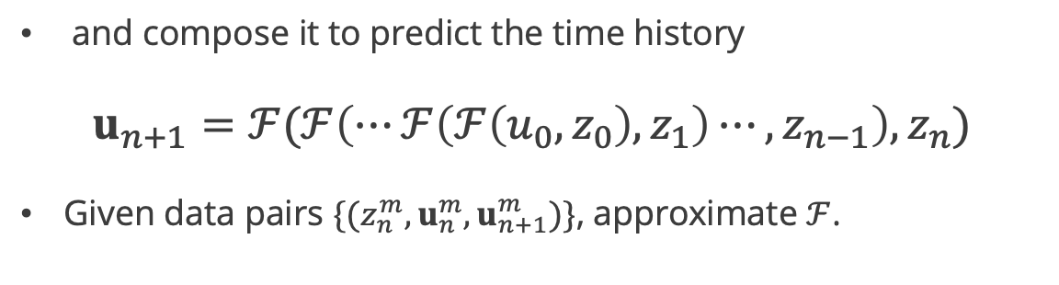
Operator Approximation: Learning Formulation
Input the initial condition $u_{0}$ and source $z$,
to predict time snapshots $u_{1},u_{2},…,u_{N} ∈ℝ^{d}$.
Approximate the flow map
$$u_{n+1}=ℱ(u_{n},z_{n})$$
$$ℱ$$
and compose it to predict the time history
$$u_{n+1}=ℱ(ℱ\left(⋯ℱ\left(ℱ\left(u_{0},z_{0}\right),z_{1}\right)⋯,z_{n−1}\right),z_{n})$$
Given data pairs $\{({z_{n}^{m},u}_{n}^{m},u_{n+1}^{m})\}$, approximate $ℱ$.
$$ℱ$$

Slide 9








Operator Approximation: Dimension Reduction
Principal component analysis (PCA) to compress the spatial dimension.
State Snapshots
Modes
number
of spatial nodes
d
$$Σ_{r}$$
$$V_{r}^{T}$$
$$u_{0}^{1}{ u}_{1}^{1} ⋯u_{N}^{1}{ u}_{0}^{2}⋯u_{N}^{2}⋯u_{N}^{M}$$
$$≈$$
$$W_{r}$$
Coordinates
number
Of
PCA modes
r
$$c_{0}^{1}{ c}_{1}^{1} ⋯c_{N}^{1}{ c}_{0}^{2}⋯c_{N}^{2}⋯c_{N}^{M}$$
$$=$$
$$W_{r}^{T}$$

Slide 10
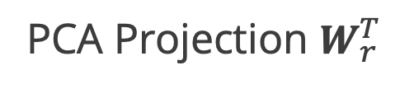





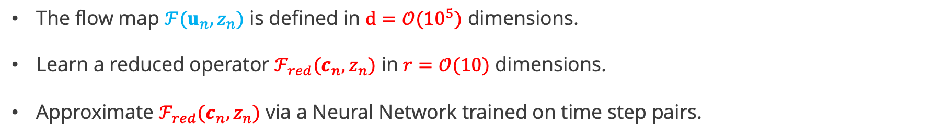


Operator Approximation: Reduced Operator
$$u_{n}$$
$$u_{n+1}$$
$$ℱ(u_{n},z_{n})$$
PCA Projection $W_{r}^{T}$
PCA Reconstruction $W_{r}$
$$ℱ_{red}(c_{n},z_{n})$$
$$c_{n}$$
$$c_{n+1}$$
The flow map $ℱ(u_{n},z_{n})$ is defined in $d=𝒪({10}^{5})$ dimensions.
Learn a reduced operator $ℱ_{red}(c_{n},z_{n})$ in $r=𝒪(10)$ dimensions.
Approximate $ℱ_{red}(c_{n},z_{n})$ via a Neural Network trained on time step pairs.

Slide 11


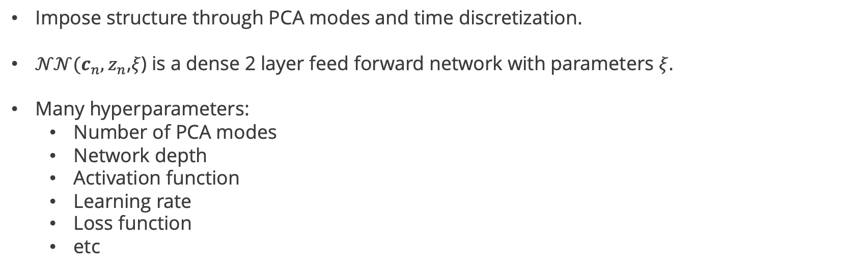
Operator Approximation: Network Architecture
${c_{n+1 }= ℱ}_{red}\left(c_{n},z_{n}\right)=c_{n}+ Δt 𝒩𝒩(c_{n},z_{n}$,$ξ$)
Impose structure through PCA modes and time discretization.
$𝒩𝒩(c_{n},z_{n}$,$ξ$) is a dense 2 layer feed forward network with parameters $ξ$.
Many hyperparameters:
  Number of PCA modes
  Network depth
  Activation function
  Learning rate
  Loss function
  etc

Slide 12
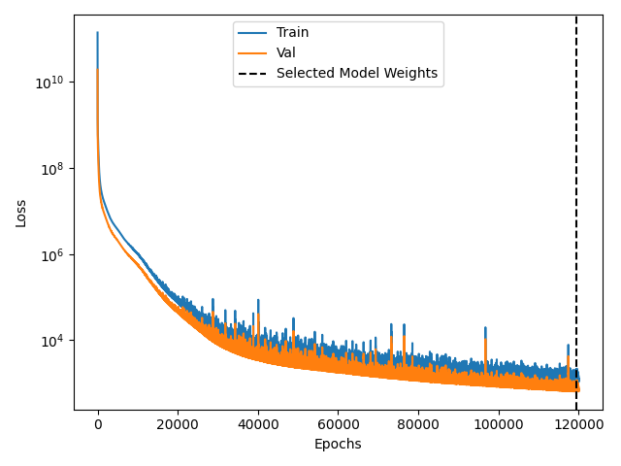
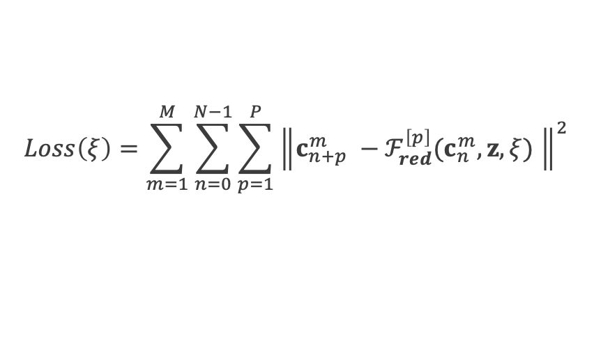
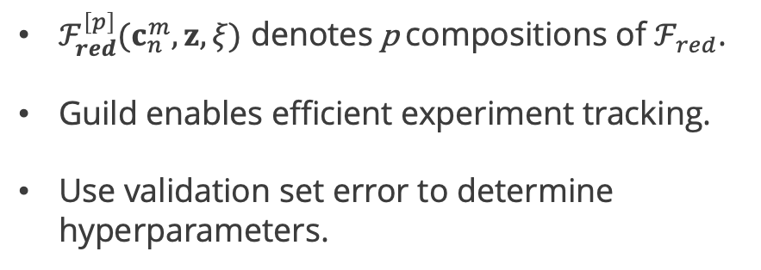
Operator Approximation: Prediction, Loss, and Training
Training data is all time steps $\left\{\left({z_{n}^{m},c}_{n}^{m},c_{n+1}^{m}\right)\right\}.$
Training loss is prediction error for p time steps:
$$Loss\left(ξ\right)=\sum_{m=1}^{M}{\sum_{n=0}^{N−1}{\sum_{p=1}^{P}{{\left\|c_{n+p}^{m} −ℱ_{red}^{\left[p\right]}(c_{n}^{m},z,ξ) \right\|}^{2}}}}$$
$ℱ_{red}^{\left[p\right]}(c_{n}^{m},z,ξ)$ denotes p compositions of $ℱ_{red}$.
Guild enables efficient experiment tracking.
Use validation set error to determine hyperparameters.

Slide 13
Operator Approximation: Experiment Tracker
Error variability over 10 runs.
Increasing P decreases variability.
Validation set relative error.
Automation many training instances.
Number of loss compositions is crucial.

Slide 14
Overview of the Workflow
Simulation Data
Operator Approximation
Observed Data
Likelihood
Unobserved Source
Expert Knowledge
Prior
Posterior

Slide 15


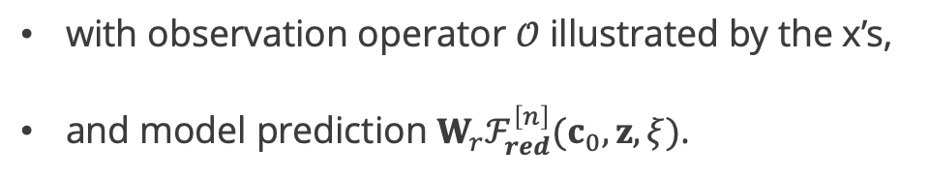
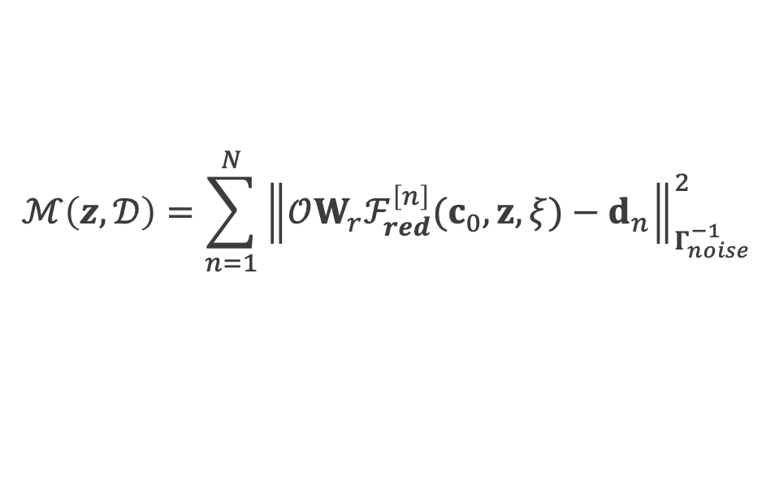
Prior and Likelihood
Assume Gaussian prior and noise models:
$$π_{prior}(z)∝exp(−\frac{1}{2}{\left\|z−\overline{z}\right\|}_{Γ_{prior}^{−1}}^{2})$$
$$π_{like}(z,𝒟)∝exp(−\frac{1}{2}ℳ(z,𝒟))$$
the misfit $ℳ$ depends on data $𝒟=\left[d_{1},d_{2},…,d_{N}\right]$ as
$$ℳ\left(z,𝒟\right)=\sum_{n=1}^{N}{{\left\|𝒪W_{r}ℱ_{red}^{\left[n\right]}(c_{0},z,ξ)−d_{n}\right\|}_{Γ_{noise}^{−1}}^{2}}$$
with observation operator $𝒪$ illustrated by the x’s,
and model prediction $W_{r}ℱ_{red}^{\left[n\right]}(c_{0},z,ξ)$.

Slide 16



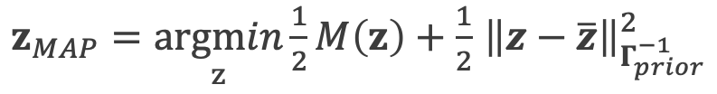
Maximum A Posteriori Probability (MAP) Point
Bayes rule gives the posterior distribution,
$$z_{MAP}$$
$$π_{post}∝π_{prior}π_{like}$$
to characterize the probability of the possible sources.
Determine the maximum probability point,
$$z_{MAP}=\underset{z}{argmax}{π_{post}(z)}$$
or equivalently minimize the negative log of the posterior
$z_{MAP}=\underset{z}{argmin}{\frac{1}{2}M\left(z\right)+\frac{1}{2}}$ ${\left\|z−\overline{z}\right\|}_{Γ_{prior}^{−1}}^{2}$

Slide 17


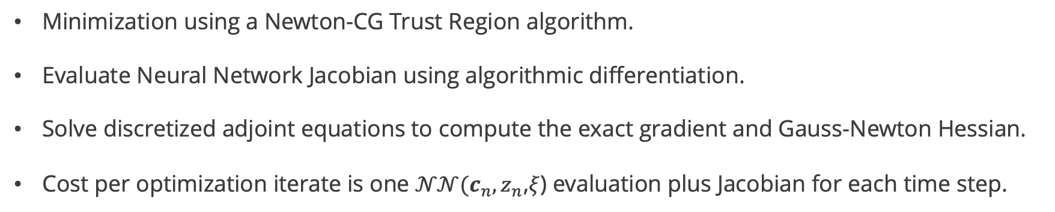

Maximum A Posteriori Probability (MAP) Point
$z_{MAP}=\underset{z}{argmin}{\frac{1}{2}M\left(z\right)+\frac{1}{2}}$ ${\left\|z−\overline{z}\right\|}_{Γ_{prior}^{−1}}^{2}$
Minimization using a Newton-CG Trust Region algorithm.
Evaluate Neural Network Jacobian using algorithmic differentiation.
Solve discretized adjoint equations to compute the exact gradient and Gauss-Newton Hessian.
Cost per optimization iterate is one $𝒩𝒩(c_{n},z_{n}$,$ξ$) evaluation plus Jacobian for each time step.

Slide 18

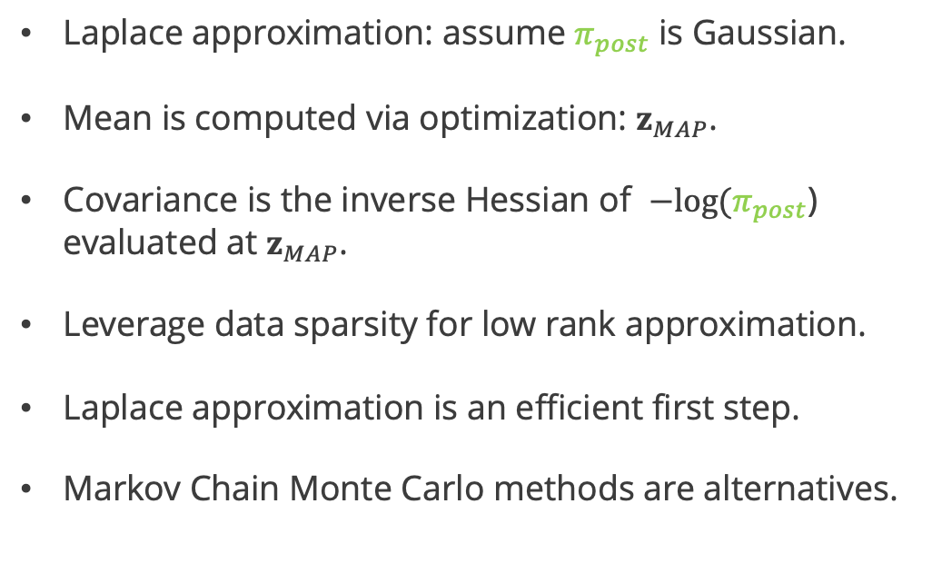
Posterior Sampling
$$π_{post}∝π_{prior}π_{like}$$
$$z_{MAP}$$
Laplace approximation: assume $π_{post}$ is Gaussian.
Mean is computed via optimization: $z_{MAP}$.
Covariance is the inverse Hessian of $−log⁡(π_{post}$) evaluated at $z_{MAP}$.
Leverage data sparsity for low rank approximation.
Laplace approximation is an efficient first step.
Markov Chain Monte Carlo methods are alternatives.

Slide 19
Overview of the Workflow
Simulation Data
Operator Approximation
Observed Data
Likelihood
Unobserved Source
Expert Knowledge
Prior
Posterior

Slide 20
${SO}_{2}$ Plume Model Problem
Change in SO2 concentration with respect to time
Diffusion
Wind
Gravity
Chemistry
Volcano source
No outflow
Zero initial SO2 concentration

Slide 21
Data Generation
Training data from 3 different source terms.
Validation data from a 4th source term.
Testing data from a 5th source term.
Train flow map approximation to infer testing data source.

Slide 22
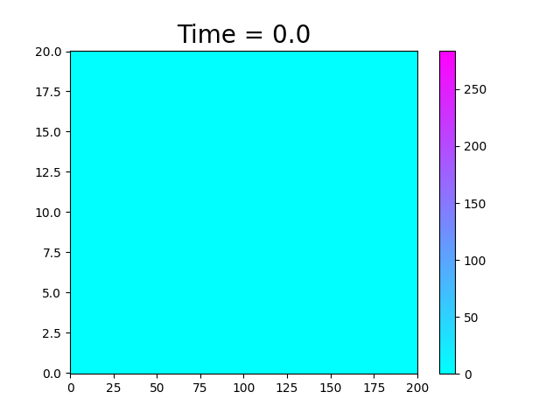
An Example of the Data
Atmosphere SO2 Concentration
Altitude (km)
Volcano
Downrange Longitude (km)

Slide 23
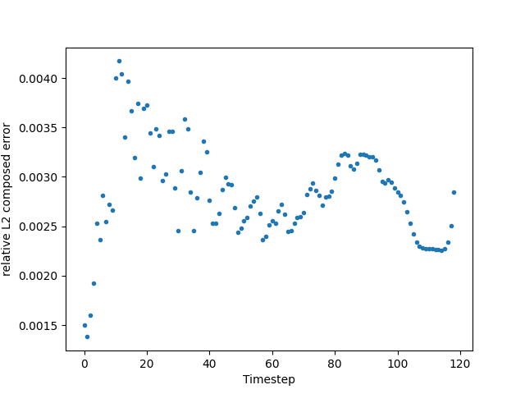
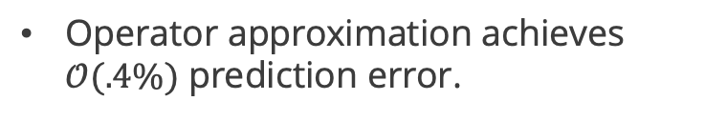
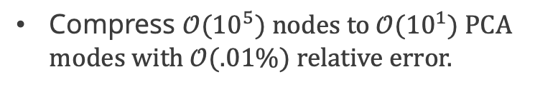
Operator Approximation
Compress $𝒪({10}^{5})$ nodes to $𝒪({10}^{1})$ PCA modes with $𝒪(.01\%)$ relative error.
Operator approximation achieves $𝒪(.4\%)$ prediction error.

Slide 24
Posterior Samples
Black curve is the testing data.
Blue curve is the MAP point.
Grey curves are approximate posterior samples.
Capture source well.
Overestimates uncertainty later in time.

Slide 25
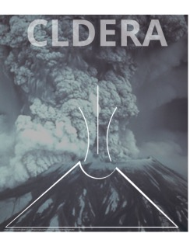
Conclusions and Ongoing Work
Next Steps
Maturing hyperparameter optimization.
Transitioning toward climate models and data.
Advanced samplers for non-Gaussian posteriors.
End Goals
Capturing spatial structure to better inform inversion.
Identification of pathways to identify a reduced climate system.
Final demonstration to characterize Mount Pinatubo eruption.

