Slide 1
Global Multivariate Causal Discovery
For the Analysis of Emergent Properties in Earth System Models
J. Jake Nichol, University of New Mexico and Sandia National Laboratories
Pilsen, Czech Republic, ESCO 2022
SAND2022-7523 C

Slide 2



Introduction
This work is motivated by fundamental questions in science: how and why do certain phenomena occur?
How can we answer these when randomized experiments are infeasible?
Given some observational data from a dynamical system, can we identify the generating dynamics?
Correlation does not imply causation, but given data from a closed system, what can we learn from correlated observations?
  If all causal effects produce some observable correlated data, then we only need to disentangle causal correlations from spurious correlations.
  If the correlation is not causal, i.e. spurious, then confounding must exist.
2
Notes:
The icons on the right represent a few of the main ways we study the world: looking, acting, and modeling. These also represent Judea Pearl’s ladder of causation: seeing, doing, and imagining (correlating, intervening, and considering counterfactuals).

Slide 3
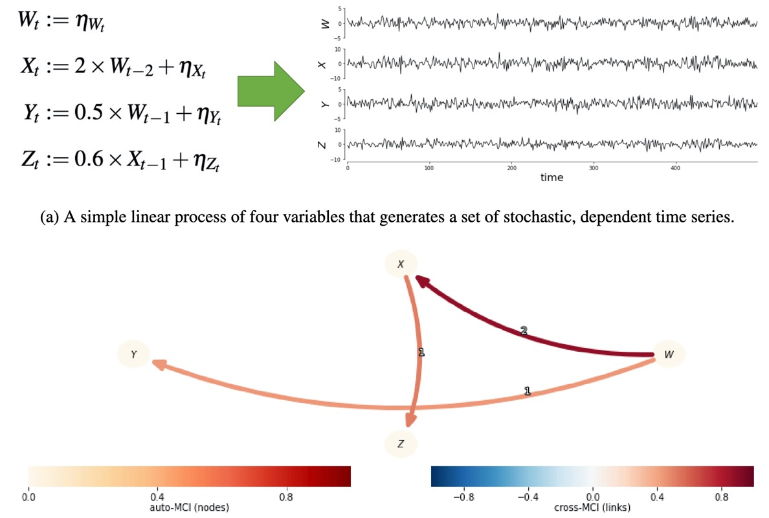
Causal Network Discovery
Intends to reconstruct the causal graph of a system using observational data and key causal inference assumptions.

Slide 4
Conditional Independence-Based Causal Discovery
Also known as constraint-based causal discovery
Iteratively computes conditional independence between all combinations of variables.
Leverages causal assumptions to determine the hypothesized causal dependence between variables.
Returns a causal graph.

Slide 5
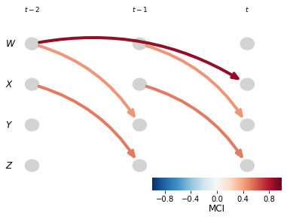
Causal Discovery Algorithm
Time series causal discovery
Peter-Clark algorithm & Momentary Conditional Independence (PCMCI) [4]

Slide 6
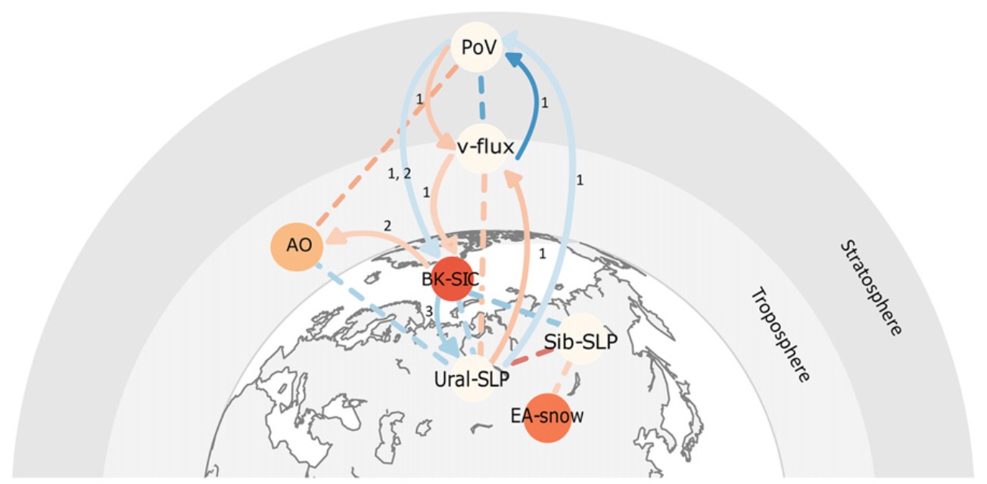
Why Causal Discovery?
Successful in other climate domains:
Arctic climate drivers [1]
Estimating biosphere-atmosphere interactions [2]
Global sea level pressure anomaly dependencies [3]
Identifying tropical surface pressure anomaly dependencies between the West, central and East Pacific [4]
Image Credit: Kretschmer, M., Coumou, D., Donges, J. F. & Runge, J. Using Causal Effect Networks to Analyze Different Arctic Drivers of Midlatitude Winter Circulation. J Climate 29, 4069–4081 (2016).
Notes:
Causal discovery has several useful applications for Earth system sciences. The one I am working on is in panel (d) here, causal model evaluation.

Slide 7
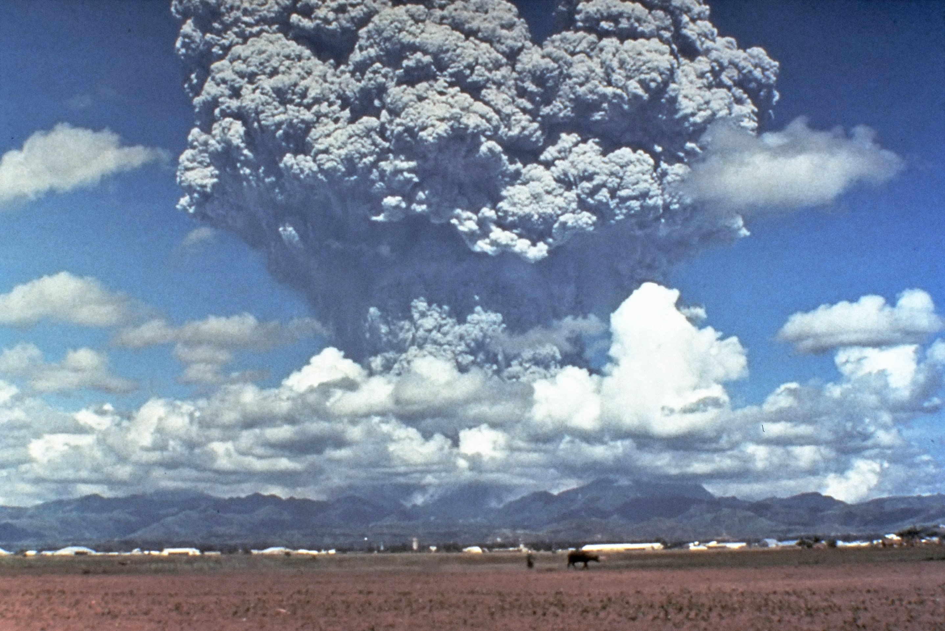
1991 Mount Pinatubo Eruption
Known impacts
Description of data
Processing spatio-temporal data
Image credit: Wikipedia contributors. (2022, May 13). Mount Pinatubo. In Wikipedia, The Free Encyclopedia. Retrieved 20:43, May 27, 2022, from https://en.wikipedia.org/w/index.php?title=Mount_Pinatubo&oldid=1087628755

Slide 8
CLDERA: Mt. Pinatubo
Stratospheric Aerosol Injection
SOURCE
Atmospheric Circulation
IMPACTS
20 million tons of SO2 injected into the stratosphere caused global stratospheric warming of ~3º C
The source forcing is external to the feedbacks within the Earth’s climate
The impacts are large enough to rise above internal variability in simulations
Other
Source
Event
Air
Temperature
Sea
Level
Dust
Storms
Radiative
Flux
Aerosol
Sedimentation
Sulfate
Aerosol
Production
H₂O
Nuclei
Volcanic
Eruption
Cloud
Brightness
Combustion
Aerosols
Radiation
Diffusivity
Net Primary
Productivity
Other
Source
Event
General Pathway
Aerosol Direct Effect
Aerosol Indirect Effect
Downstream Impacts
Notional Representation of a Subset of Physical Processes
Goal: attribute climate impacts from a localized source using an approach to represent evolving chain of physical processes.
Notes:
Mt. Pinatubo injected 5-10 Tg of sulfur [18], primarily as SO₂ gas, into the stratosphere where the gas reacted with water to form a hazy layer of aerosol particles composed mostly of sulfuric acid droplets (H₂SO₄) [19].
The volcanic stratospheric sulfate aerosols increased the aerosol optical depth by a factor of five over the tropical Pacific in mid-August [15], resulting in a decrease in monthly mean clear-sky total solar irradiance over the first 10 months [21]. This aerosol direct effect, notionally shown in Figure 1 as the red dashed line, is responsible for the scattering of incoming shortwave radiation and absorption of longwave outgoing radiation [14, 20-22], which led to negative forcing observed until mid-1993 [18]. This change in radiative flux caused a 0.6$°$ C global cooling of the lower troposphere [16, 23], but also a warming of the stratosphere where the particles resided [14, 16] (the dark orange dash-dot downstream impact shown in Figure 1).
Further downstream impacts from the eruption of Mt. Pinatubo have been documented to include reductions in precipitation [27] and global mean sea level [28]. These downstream impacts are triggered by the overall cooling resulting in decreased evaporation [28], and lower sea surface temperatures / ocean heat content [29] that—due to thermal expansion—decreased the global sea level [30].
Aerosol indirect effects occur when sulfate aerosols enter the troposphere via stratosphere-troposphere exchange and sedimentation. . Here there are multiple processes by which sulfate aerosols can then affect clouds through the microphysics, MG2 [34],and chemistry parameterizations. Aerosol activation (acting as nuclei for condensation) can affect cloud reflectivity and lifetime [35]. Ice homogenous nucleation (the formation of ice from supercooled liquid) affects cirrus clouds and their forcing with high uncertainty [36].

Slide 9
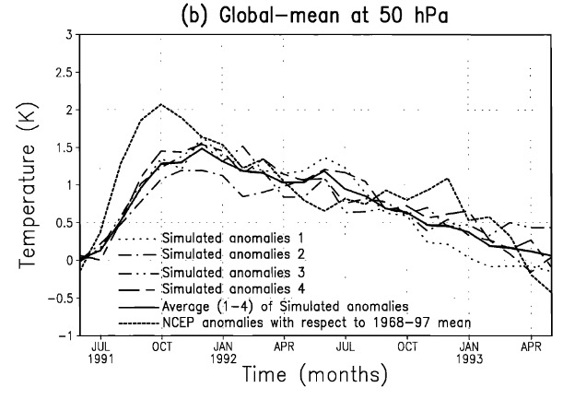
Known Impacts
Global Mean Upper Stratosphere Temperature
Ramachandran et al. [3]

Slide 10
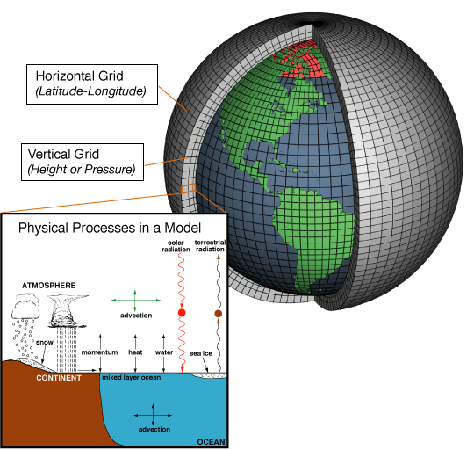
Description of Data
Atmospheric simulation models take the form of a 3-dimensional grid in time
Natural data is collected and often discretized into a comparable grid for analysis.
Image Credit: Wikipedia contributors. (2022, May 4). General circulation model. In Wikipedia, The Free Encyclopedia. Retrieved 17:34, May 25, 2022, from https://en.wikipedia.org/w/index.php?title=General_circulation_model&oldid=1086142088
General Circulation Model (GCM)
10

Slide 11
Preprocessing Climate Data
The spatial area of grid cells gets smaller closer to the poles
The values in each grid cell are scaled according to their area
PCMCI ingests 1-dimensional time series
Dimensionality reduction is necessary – spatial means or principal component analysis (PCA)
Image Credit: Wikipedia contributors. (2022, May 4). General circulation model. In Wikipedia, The Free Encyclopedia. Retrieved 17:34, May 25, 2022, from https://en.wikipedia.org/w/index.php?title=General_circulation_model&oldid=1086142088
11

Slide 12
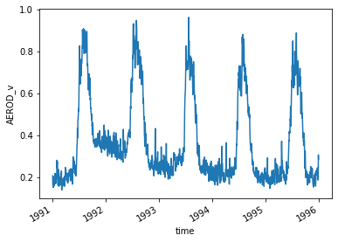
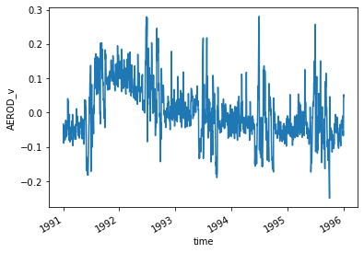
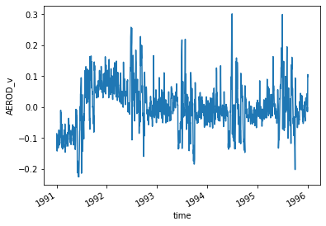
Preprocessing Climate Data
Raw
PCMCI requires stationary data – does not vary in mean or variance with time.
Highly seasonal data or a strong autocorrelation
Typically adjusted for by computing monthly anomalies:
Compute monthly means and subtract those from the raw signal.
Remove trends by fitting a linear regression and subtracting it from the signal.
These transformations are grid-cell-wise.
Anomalies
Detrended anomalies

Slide 13

Regional Means: preliminary data
Considered data of regional means with multiple quantities along the pathway from SO2 to radiative flux to temperature:
Simple data extraction method
12 years of monthly data – 144 data points on a 24x48 grid
Prognostic aerosols
Climate model output:
Energy Exascale Earth System Model (E3SM)
Physics-based fully coupled model
Data is preliminary
Enables validation of the causal discovery framework
Global
Tropics

Slide 14
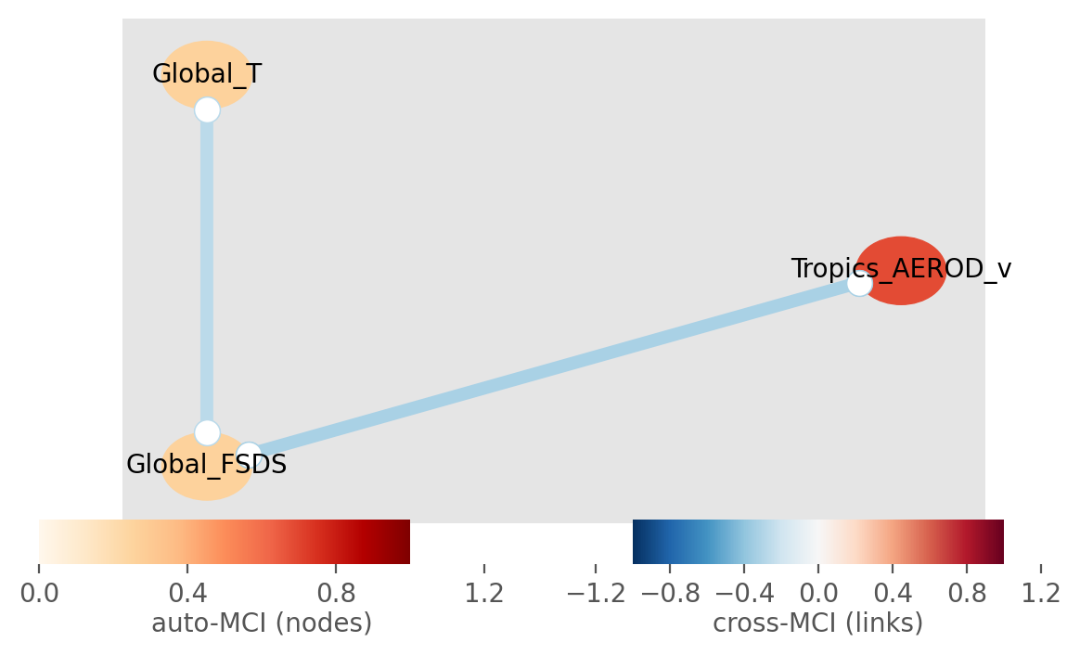
Regional Means Results: preliminary
A
Global_FSDS: global mean solar radiative flux at the surface
Global_T: global mean surface temperature
Tropics_AEROD_v: tropical mean aerosol optical depth in the visible band
Tropics_TMH2SO4: tropical mean H2SO4 particles in the atmosphere
Triopics_TMSO2: tropical mean SO2 aerosols in the atmosphere

Slide 15
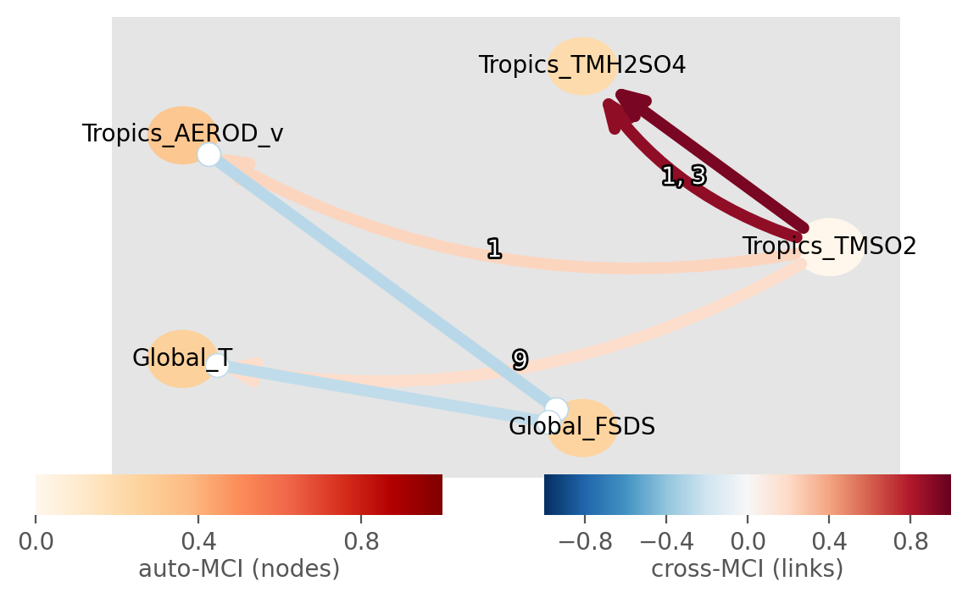
Regional Means Results: preliminary
A
B
Global_FSDS: global mean solar radiative flux at the surface
Global_T: global mean surface temperature
Tropics_AEROD_v: tropical mean aerosol optical depth in the visible band
Tropics_TMH2SO4: tropical mean H2SO4 particles in the atmosphere
Triopics_TMSO2: tropical mean SO2 aerosols in the atmosphere

Slide 16
PCA and PCA-Varimax
Results from Principal Components Analysis (PCA) and PCA-varimax dimensionality reduction
More complex data extraction method
5 years of daily data – 1,825 data points on a 180x360 grid
Prescribed aerosols (E3SM)
PCA is a variance-based decomposition method.
PCA components are referred to as Empirical Orthogonal Functions (EOFs) in climate science contexts.
EOFs highlight spatial and/or temporal patterns in climate data.
Notes:
PCA is a singular value decomposition of the covariance of a data matrix obtains principal components
PCA reduces the data’s dimensionality into dominant EOFs, representing the majority of the variance.
You can see that the first EOF captures a decent amount of variance, and the projected time series shows a clear increase in aerosols after the eruption.
However, the EOF seems to capture a lot of variance over Africa where large dust storms generate a lot of aerosols.

Slide 17
PCA and PCA-Varimax – daily, 1991-1995
Not varimax-rotated aerosols
Varimax-rotated aerosols
Notes:
Here I selected the fourth EOF, which largely focuses near the Philippines.
After the varimax rotation, the EOF very clearly localizes near the Phillipines.
The projected time series is dramatically changed as well. There is a noticeable eruption signal after June 1991.

Slide 18
Aerosols to Temperature Pathway Discovery – daily, 1991-1995
Varimax-rotated aerosols
Varimax-rotated stratospheric temperature
Notes:
Our plan was to find the dependence between this Mount Pinatubo aerosol signal and regional temperatures around the globe.
Unfortunately we ran into several problems with this approach.
Independence tests find low dependence between these two time series at any lag.
Selecting a lag interval on data of this resolution is difficult because if we want to consider dependence within 1-3 months, we have to include 30-90 lagged time series in the analysis. This blows up dimensionality, reducing performance and speed to compute.
However, we only considered one altitude level in this analysis. It is possible that a detectable dependence exists at another altitude level or aggregation of pressure levels.
In similar work they consider 50 localized EOFs. We can do the same and perhaps find more dependence.

Slide 19
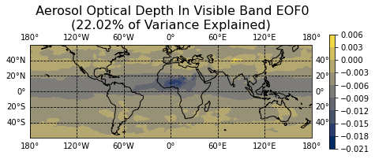
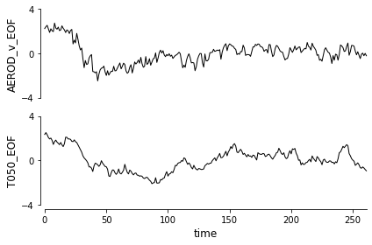
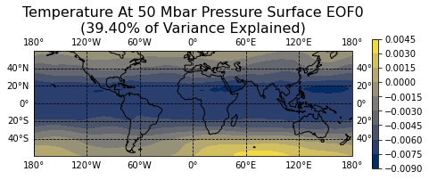
Non-Localized Aerosols and Stratospheric Temperature – weekly, 1991-1995
Aerosols
Temperature
Not varimax-rotated
Notes:
So, we decided to step back and only consider global quantities again but with PCA.
Perhaps with higher resolution data, a lag of a few weeks could be detected between aerosols and temperature.
Daily data is still too fine grained to search lags effectively, so we downsampled the data to weekly.

Slide 20
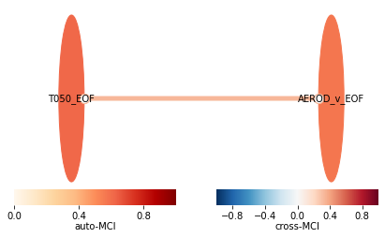
Non-Localized Aerosols and Stratospheric Temperature Results – weekly, 1991-1995, preliminary
Aerosols
Temperature
Notes:
Unfortunately, a contemporaneous link is all that was found in this case after searching 12 weeks of lags.

Slide 21
Challenges of the Current Approach
Weak dependence between aerosol optical depth impact near Pinatubo and more persistent temperature impacts around the globe.
Time series have few observations prior to the eruption.
Highlights a limitation of causal discovery: that the data needs to be on a higher temporal resolution than the cause-effect mechanism.
The daily time resolution makes testing many lags a high dimensional problem.
In general, global quantities only result in contemporaneous effects and regional quantities have low dependence.

Slide 22
Next steps
Consider monthly data from the full post-industrial era, 1850-2015
Extend the PCMCI algorithm to consider specified lags rather than a full interval
Validate the method on simpler generating dynamics
Simple autoregressive spatio-temporal models
PDE constrained two-variable models
Held-Suarez-Williamson model
Fully coupled climate model such as E3SM
Evaluate the resolution and length of time series necessary to identify dependencies

Slide 23
References
Kretschmer, M., Coumou, D., Donges, J. F. & Runge, J. Using Causal Effect Networks to Analyze Different Arctic Drivers of Midlatitude Winter Circulation. J Climate 29, 4069–4081 (2016).
Krich, C. et al. Estimating causal networks in biosphere–atmosphere interaction with the PCMCI approach. Biogeosciences 17, 1033–1061 (2020).
Ramachandran, S., Ramaswamy, V., Stenchikov, G. L. & Robock, A. Radiative impact of the Mount Pinatubo volcanic eruption: Lower stratospheric response. J Geophys Res Atmospheres 105, 24409–24429 (2000).
Runge, J., Nowack, P., Kretschmer, M., Flaxman, S. & Sejdinovic, D. Detecting and quantifying causal associations in large nonlinear time series datasets. Science Advances 5, 4996--5023 (2019).
Runge, J. et al. Inferring causation from time series in Earth system sciences. Nat Commun 10, (2019).
Shimizu, S., Hoyer, P. O., Hyvarinen, A. & Kerminen, A. A Linear Non-Gaussian Acyclic Model for Causal Discovery. jmlr 7, 2003−2030 (2006).
Spirtes, P., Glymour, C. & Scheines, R. Causation, Prediction, and Search. Lect Notes Stat (1993) doi:10.1007/978-1-4612-2748-9
Sugihara, G. et al. Detecting Causality in Complex Ecosystems. Science 338, 496–500 (2012).
Thompson, D. W. J., Wallace, J. M., Jones, P. D. & Kennedy, J. J. Identifying Signatures of Natural Climate Variability in Time Series of Global-Mean Surface Temperature: Methodology and Insights. J Climate 22, 6120–6141 (2009).

Slide 24
Questions?

Slide 25
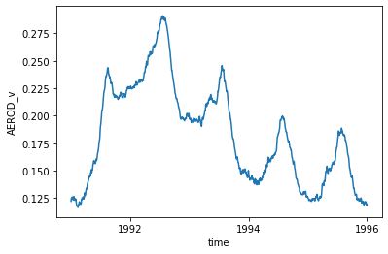
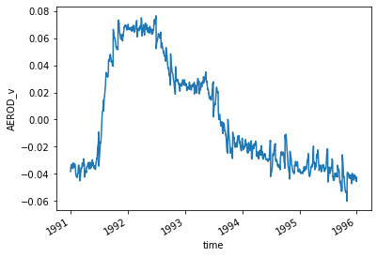
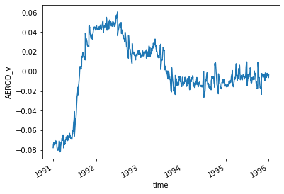
Global Mean Time Series
Raw
Anomalies
Detrended Anomalies
Grid-Cell Time Series

Slide 26
Problems Addressed
Global
Northern
Considered data of zonal means with multiple quantities along the pathway from SO2 to radiative flux to temperature:
Relatively simple data extraction method
12 years of monthly data – 144 data points on a 24x48x36 grid
Prognostic aerosols
Results from PCA and PCA-varimax dimensionality reduction
More complex data extraction method
5 years of daily data – 1,825 data points on a 180x360 grid
Prescribed aerosols
Tropics
Southern

Slide 27
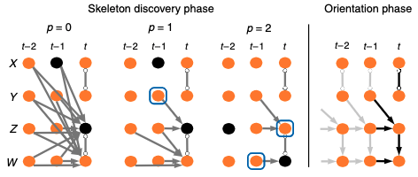
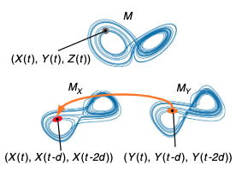
Algorithms
Peter Spirtes & Clark Glymour (PC) algorithm [7]
  Causal network learning algorithm
PC & Momentary Conditional Independence (PCMCI) [4]
  Extension to PC to handle false positives & high dimensionality
Fast Causal Inference (FCI) algorithm [7]
  Generalization of PC that does not require Causal Sufficiency
LiNGAM [6]
  For identifying Linear, Non-Gaussian, Acyclic causal Models based on purely observational, continuous-valued data
  Structural Equation/Causal Modeling (SEM or SCM)
Convergent cross mapping [8]
  Uses Taken’s theorem of Lorenz attractors to deconstruct a dynamical system’s state space and infer causal pairs.
Image credit: Jakob Runge, et al. 2019. Inferring causation from time series in Earth system sciences. Nat Commun 10, 1 (2019). DOI:https://doi.org/10.1038/s41467-019-10105-3

Slide 28
PC Algorithm Overview
Ground Truth
A
B
C
D
E

Slide 29
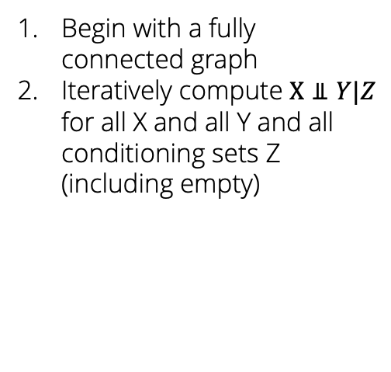
PC Algorithm Overview
Ground Truth
1. Initial Graph
A
B
A
B
C
C
D
E
D
E
Begin with a fully connected graph
Iteratively compute $X⫫Y|Z$ for all X and all Y and all conditioning sets Z (including empty)

Slide 30
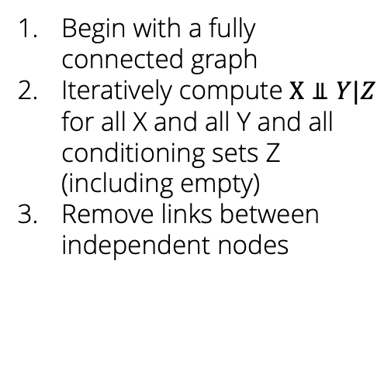
PC Algorithm Overview
Ground Truth
1. Initial Graph
2. Skeleton Identification
A
B
A
B
A
B
C
C
C
D
E
D
E
D
E
Begin with a fully connected graph
Iteratively compute $X⫫Y|Z$ for all X and all Y and all conditioning sets Z (including empty)
Remove links between independent nodes

Slide 31
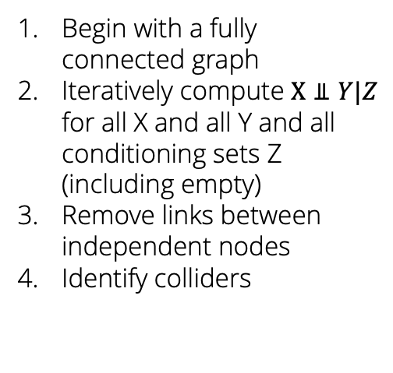
PC Algorithm Overview
Ground Truth
1. Initial Graph
2. Skeleton Identification
A
B
A
B
A
B
C
C
C
D
E
D
E
D
E
Begin with a fully connected graph
Iteratively compute $X⫫Y|Z$ for all X and all Y and all conditioning sets Z (including empty)
Remove links between independent nodes
Identify colliders
3. Detect Colliders
A
B
C
D
E

Slide 32
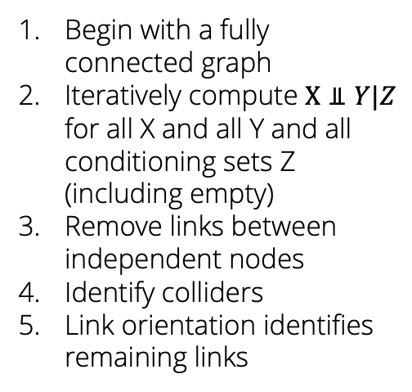
PC Algorithm Overview
Ground Truth
1. Initial Graph
2. Skeleton Identification
A
B
A
B
A
B
C
C
C
D
E
D
E
D
E
Begin with a fully connected graph
Iteratively compute $X⫫Y|Z$ for all X and all Y and all conditioning sets Z (including empty)
Remove links between independent nodes
Identify colliders
Link orientation identifies remaining links
3. Detect Colliders
4. Orientation
A
B
A
B
C
C
D
E
D
E

Slide 33
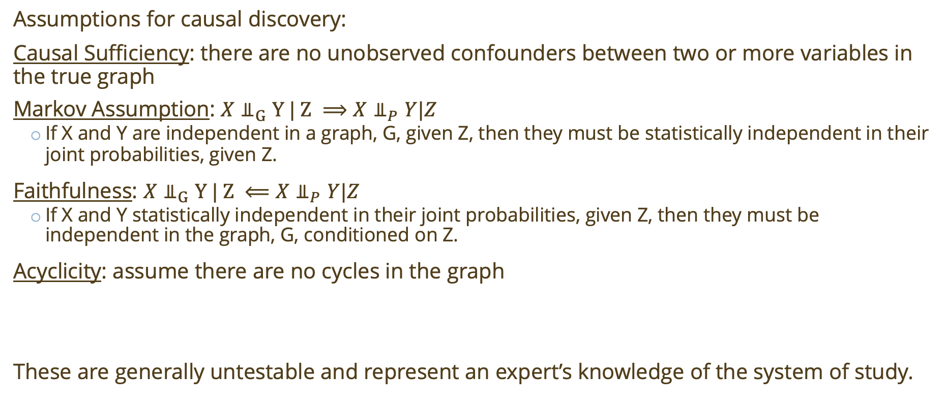
Causal Network Discovery
Assumptions for causal discovery:
Causal Sufficiency: there are no unobserved confounders between two or more variables in the true graph
Markov Assumption: $X⫫_{G}Y | Z ⟹X{\text{⫫}}_{P}Y|Z$
  If X and Y are independent in a graph, G, given Z, then they must be statistically independent in their joint probabilities, given Z.
Faithfulness: $X⫫_{G}Y | Z ⟸X{\text{⫫}}_{P}Y|Z$
  If X and Y statistically independent in their joint probabilities, given Z, then they must be independent in the graph, G, conditioned on Z.
Acyclicity: assume there are no cycles in the graph
These are generally untestable and represent an expert’s knowledge of the system of study.

Slide 34
Why Causal Discovery?
Causal discovery is not predictive like machine learning techniques.
Predictability is useful but it is a correlated quantity and not inherently causal.
Causal discovery is a method for answer why we observe the data as it is.
Its goal is to identify and explain the dynamics that generated the data.
Causal discovery can identify that A causes B, or that C is mediating the effect of A on B.
Cause
Mediating Effect
Effect

Slide 35
Why Causal Discovery?
Causal discovery is not predictive like machine learning techniques.
Predictability is useful but it is a correlated quantity and not inherently causal.
Causal discovery is a method for answer why we observe the data as it is.
Its goal is to identify and explain the dynamics that generated the data.
Causal discovery can identify the lag of causal effect between quantities.
Cause
Mediating Effect
Effect
12 days
2 days

Slide 36
Why Causal Discovery?
Causal discovery is not predictive like machine learning techniques.
Predictability is useful but it is a correlated quantity and not inherently causal.
Causal discovery is a method for answer why we observe the data as it is.
Its goal is to identify and explain the dynamics that generated the data.
Causal discovery can identify spurious correlations through conditional dependence.
Mediating Effect
Cause
Effect

Slide 37
Why Causal Discovery?
Causal discovery is not predictive like machine learning techniques.
Predictability is useful but it is a correlated quantity and not inherently causal.
Causal discovery is a method for answer why we observe the data as it is.
Its goal is to identify and explain the dynamics that generated the data.
Causal discovery can identify spurious correlations through conditional dependence.
Mediating Effect
Cause
Effect

Slide 38
Why Causal Discovery?
Causal discovery is not predictive like machine learning techniques.
Predictability is useful but it is a correlated quantity and not inherently causal.
Causal discovery is a method for answer why we observe the data as it is.
Its goal is to identify and explain the dynamics that generated the data.
Causal discovery can identify spurious correlations through conditional dependence.
Effect
Cause
Effect

Slide 39
Conditional Independence-Based Causal Discovery
Also known as constraint-based causal discovery
Linear gaussian additive noise:
  Partial correlation
Nonlinear gaussian additive noise:
  Gaussian Process Regression and Distance Correlation (GPDC)
Nonparametric (capable of identifying nonlinear with multiplicative noise):
  Conditional mutual information and k-nearest-neighbors (CMIknn)
Other nonlinear tests include using radial basis vectors and random forests

Slide 40
Algorithms
Independence/Constraint-Based Causal Network Learning
Peter Spirtes & Clark Glymour (PC) algorithm [7]
  Causal network learning algorithm
PC & Momentary Conditional Independence (PCMCI) [4]
  Extension to PC to handle false positives & high dimensionality
Fast Causal Inference (FCI) algorithm [7]
  Generalization of PC that does not require Causal Sufficiency
Image credit: Jakob Runge, et al. 2019. Inferring causation from time series in Earth system sciences. Nat Commun 10, 1 (2019). DOI:https://doi.org/10.1038/s41467-019-10105-3

Slide 41
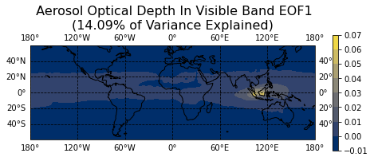
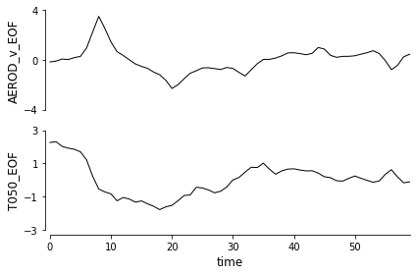
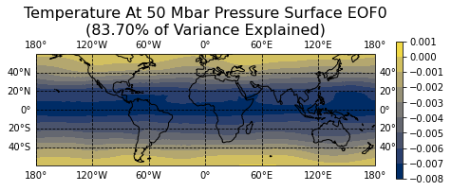
Aerosols and Stratospheric Temperature
Not varimax-rotated

Slide 42
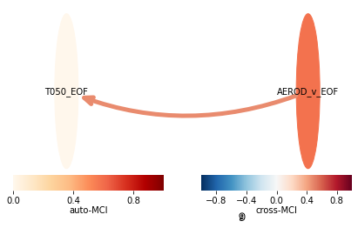
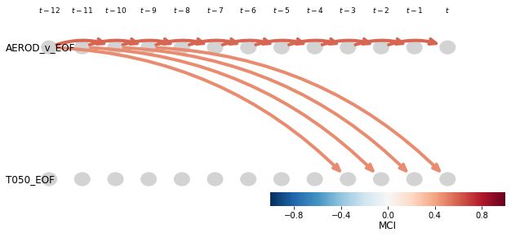
Monthly Results
9 Months

