Slide 1
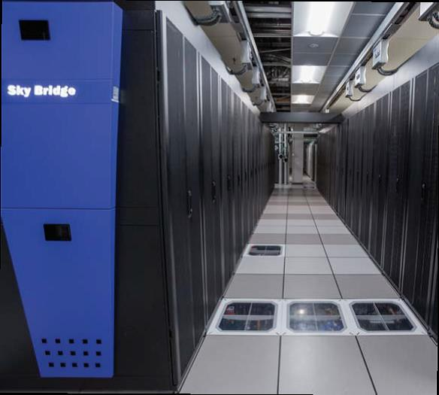

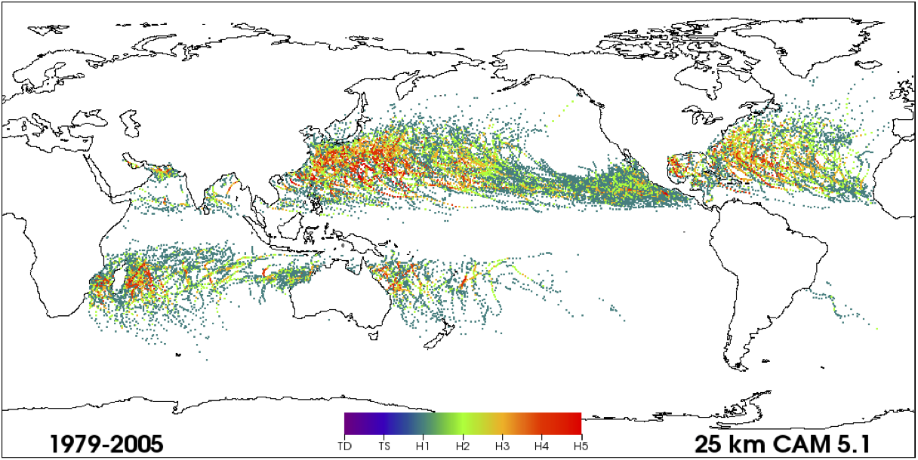
In-Situ Machine Learning (ISML) for Climate Simulation Analysis and Discovery
Warren L. Davis IV
Collaborators: Hemanth Kolla, Irina Tezaur, Max Carlson, Philip Kegelmeyer
ESCO, June 15, 2022
SAND 2022-7874 C

Slide 2
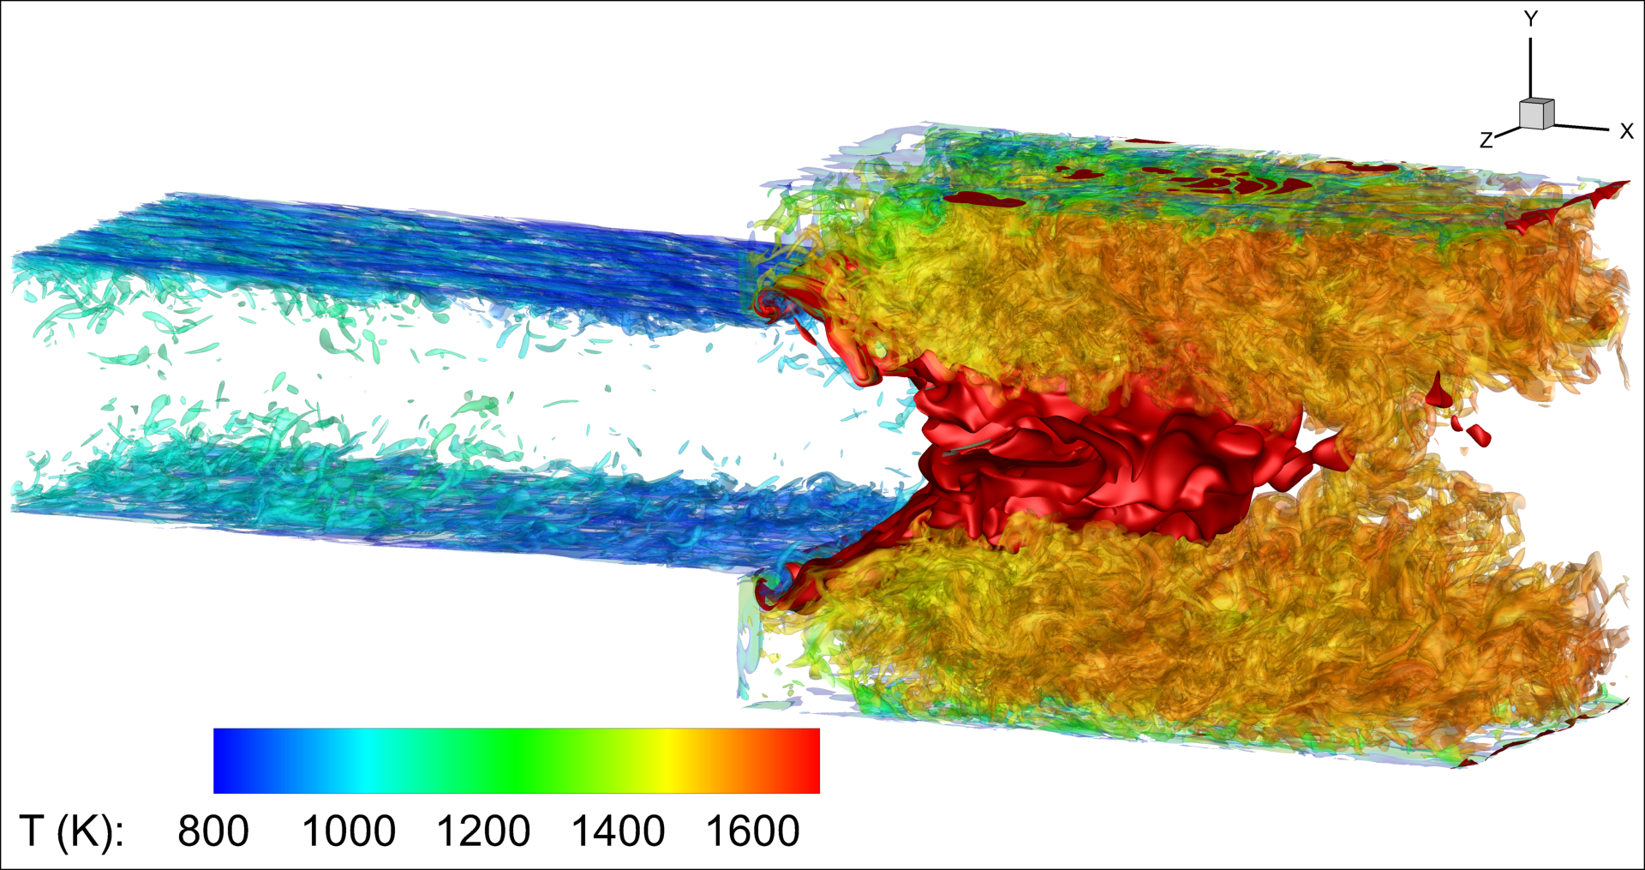
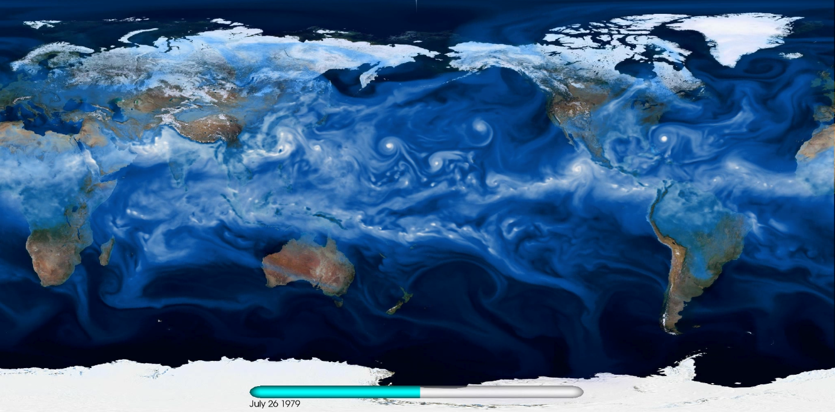
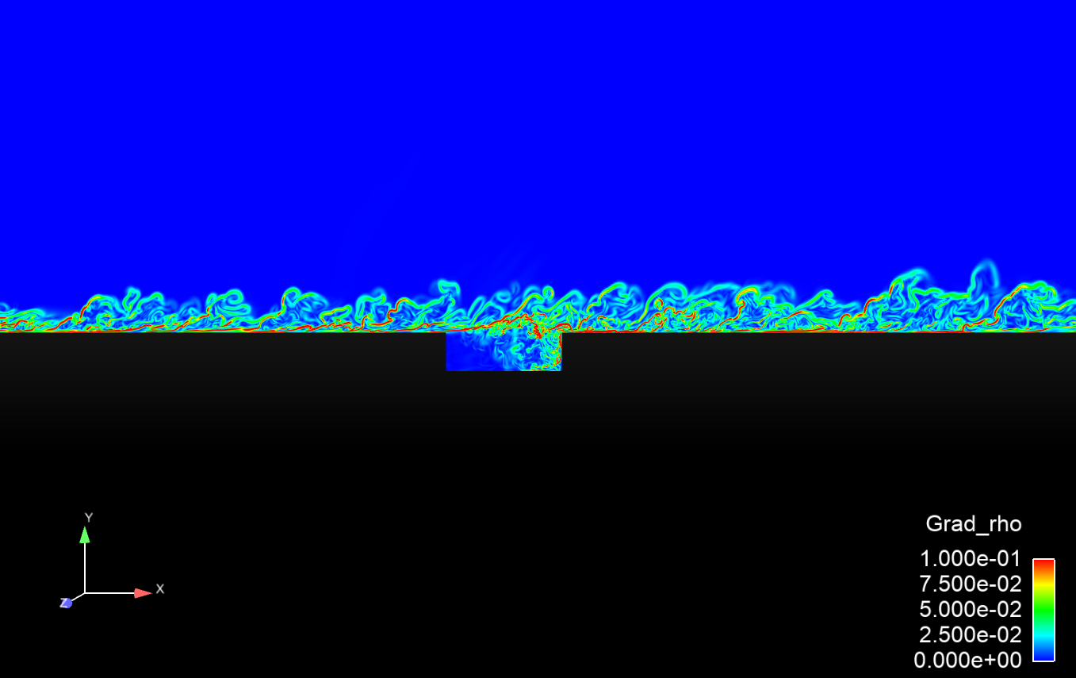
Motivation and Context
U.S. DOE is interested in many problems that require high-fidelity physics-based HPC simulations
Want to find “interesting” events, anomalies, state changes, etc.
  Examples may include cyclones, onset of combustion, or other things that the scientists may not prescribe a priori and may be difficult to discover via rule-based detection
Desired solution would be to take all the data and run the appropriate detection algorithms (e.g., LOF, isolation forests, clustering)
These simulations produce massive amounts of data (problems for storage capacity, bandwidth)
Combustion
Climate Modeling
Fluid Dynamics
Notes:
To overcome limitations in storage capacity/bandwidth, there has to be some data reduction

Slide 3
Current state-of-the-art for HPC simulation analysis
Take “snapshots” in space and time (1/1000th or 1/10000th)
Post-process snapshot data with standard algorithms
Problems with the current methods:
Interesting events may happen between or outside of these snapshots
Important information leading up to the captured event could be lost
Rerunning simulations to capture lost information is expensive
This problem will only get worse as the amount of data and fidelity of the simulations increases
Is there a way to detect the anomalies in-situ,
thus facilitating more precisely targeted event capture?

Slide 4
Changing the Paradigm with In-Situ Event Detection
Develop techniques to detect interesting spatial and temporal events in-situ for HPC physics simulations
Scalable : Can’t significantly hinder the runtime of the application
Unsupervised : To enable discovery, should not require labeling of interesting events
Generalizable : Not focused on one specific event or domain
Online : Don’t require having access to all the data from every time step (post-processing)
This is foundational research, with a focus on algorithms that can motivate changes to simulation code and facilitate more intelligent, focused data capture

Slide 5
Vehicles for Exploration and Experimentation
Sandia 3D Direct Numerical Solver (S3D)
  Used for reacting flows (e.g., combustion)
Python Interpreter
In-Situ code has access to state variables.
Enabled immediate use of OTS algorithms
and facilitated the development of new
algorithms
Tested algorithms on combustion in-situ, climate offline
(e.g., LOF, DBSCAN, i-Forests)
Application
Application
MPI
Python
Python
In-situ code
MPI
In-situ code
Embedded Python interpreter enables execution of algorithms inside HPC applications.
Timothy M. Shead et al. “Embedding Python for In-Situ Analysis.” SAND2018-9009. August 2018.
Notes:
Tried various OTS methods
E.g., Local Outlier Factor, iNN, i-Forest
Limited success for detection
Not tuned to in-situ processing

Slide 6
New, Effective In-Situ Anomaly Detection Algorithms
Ling et al. “Using feature importance metrics to detect events of interest in scientific computing applications.” 2017 IEEE 7th Symposium on Large Data Analysis and Visualization (LDAV) (2017): 55-63.
  Aditya et al. "Anomaly detection in scientific data using joint statistical moments", Journal of Computational Physics, Vol 387, June 15 2019, pp. 522-538.

Slide 7
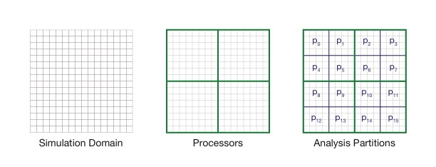
A New Anomaly Detection Framework: Signatures, Measures, and Decisions
Communication is a constraint for In-Situ HPC Anomaly Detection

Slide 8
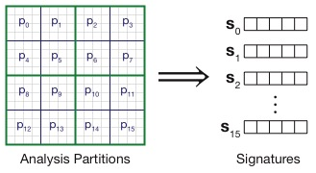


Signatures Represent the Data on a Partition
Individual mesh attributes for P₀
Density | Pressure | Vx | Vy
10 | 4 | 2 | 4
20 | 10 | 8 | 8
30 | 8 | 8 | 12
40 | 6 | 2 | 16
p₀
.
.
.
40 | 6 | 2 | 16
m Number of mesh points
a Attributes per mesh point
t m*a, the total number of values on a partition
Signatures can be shorter or longer than a, as long as they are shorter than t
Signature Function
P₀ signature
25 | 7 | 5 | 10

Slide 9
Signatures Can Take Many Forms
Individual mesh attributes for P₀
Examples
Mean
  Individual attribute mean values over the mesh points on a partition
FIEDA Feature Importance Metric (FIM) scores *
  First, kernel-density estimation to produce a probability distribution over
  the state variables
  Next, random forests to predict the pdf given the state variables
  Lastly, extract feature importance values from the random forest and
  use as a signature
Density | Pressure | Vx | Vy
10 | 4 | 2 | 4
20 | 10 | 8 | 8
30 | 8 | 8 | 12
40 | 6 | 2 | 16
.
.
.
40 | 6 | 2 | 16
Signature Function
*Ling et al. “Using feature importance metrics to detect events of interest in scientific computing applications.” 2017 IEEE 7th Symposium on Large Data Analysis and Visualization (LDAV) (2017): 55-63.
P₀ signature
Signatures are significantly smaller than all the data on a partition, and can be communicated with little cost, comparatively.
25 | 7 | 5 | 10

Slide 10
Measures Indicate the Distance of a Signature From Neighbors
Measures take as input a list of T P × S matrices where T is the number of elapsed timesteps and each P × S matrix contains the signatures for the partitions at a given timestep.
Measures can be specific to a type of signature, or general measures, including typical anomaly detection algorithms
Examples
Mean-Squared Distance
DBSCAN
FIEDA M1*
*Ling et al. “Using feature importance metrics to detect events of interest in scientific computing applications.” 2017 IEEE 7th Symposium on Large Data Analysis and Visualization (LDAV) (2017): 55-63.

Slide 11
Decisions Allow for Customization
Measures are scalar values that do not, by themselves, answer whether something is anomalous.
Different applications can decide an appropriate anomalousness point
Examples
Threshold
Percentile-Change
Memory / Feathering
Decision functions are meant to be adjustable to fit application needs and are the final arbiter of what is “interesting” in a simulation.

Slide 12

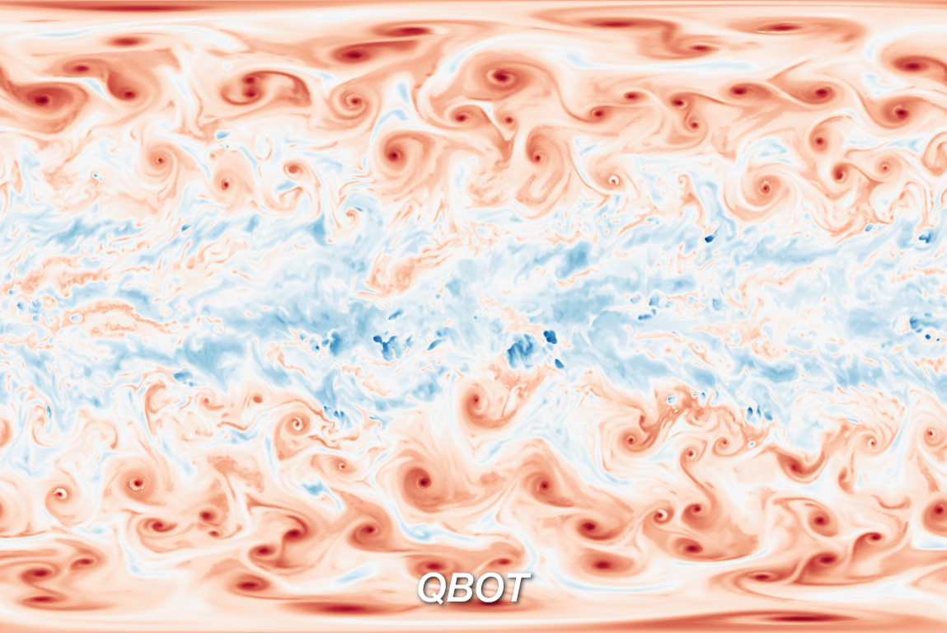
Example simulations/datasets
Bouyant fluids
(Mantaflow)
Tropical cyclones
(CESM)

Slide 13
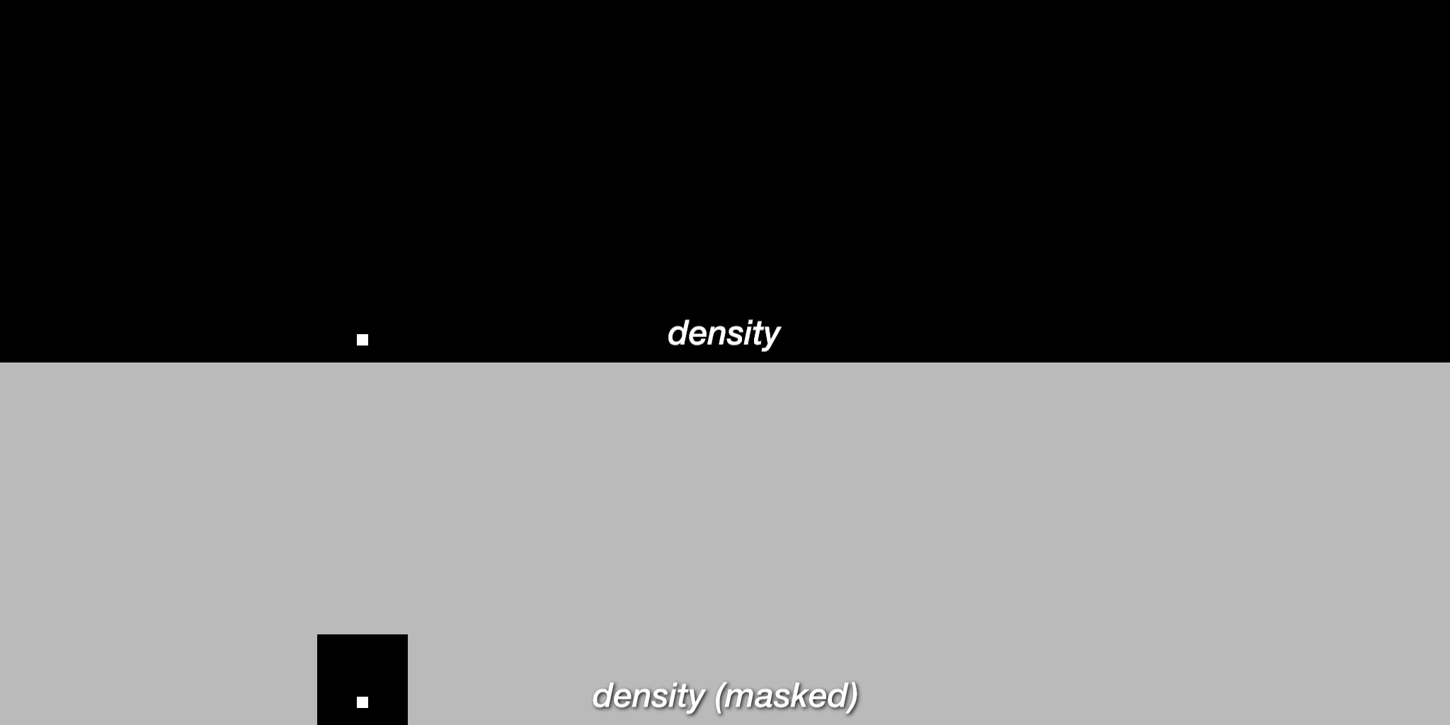
Example simulations/datasets: buoyant flows (Mantaflow)

Slide 14
In-Situ Detection is More Accurate and Efficient
Conventional
In-Situ Detection
Recall: 10%
Recall: 98%
Notes:
Low TRL work, foundational, discovery
Experience developing deployable tools

Slide 15

Example simulations/datasets: tropical cyclones (CESM)
ISML algorithms achieved 88.9% recall while exporting 5.2% of the simulation
Notes:
Low TRL work, foundational, discovery
Experience developing deployable tools

Slide 16
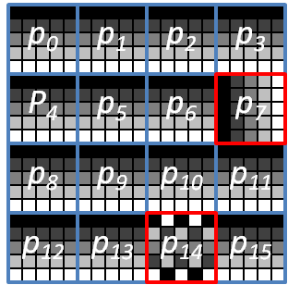


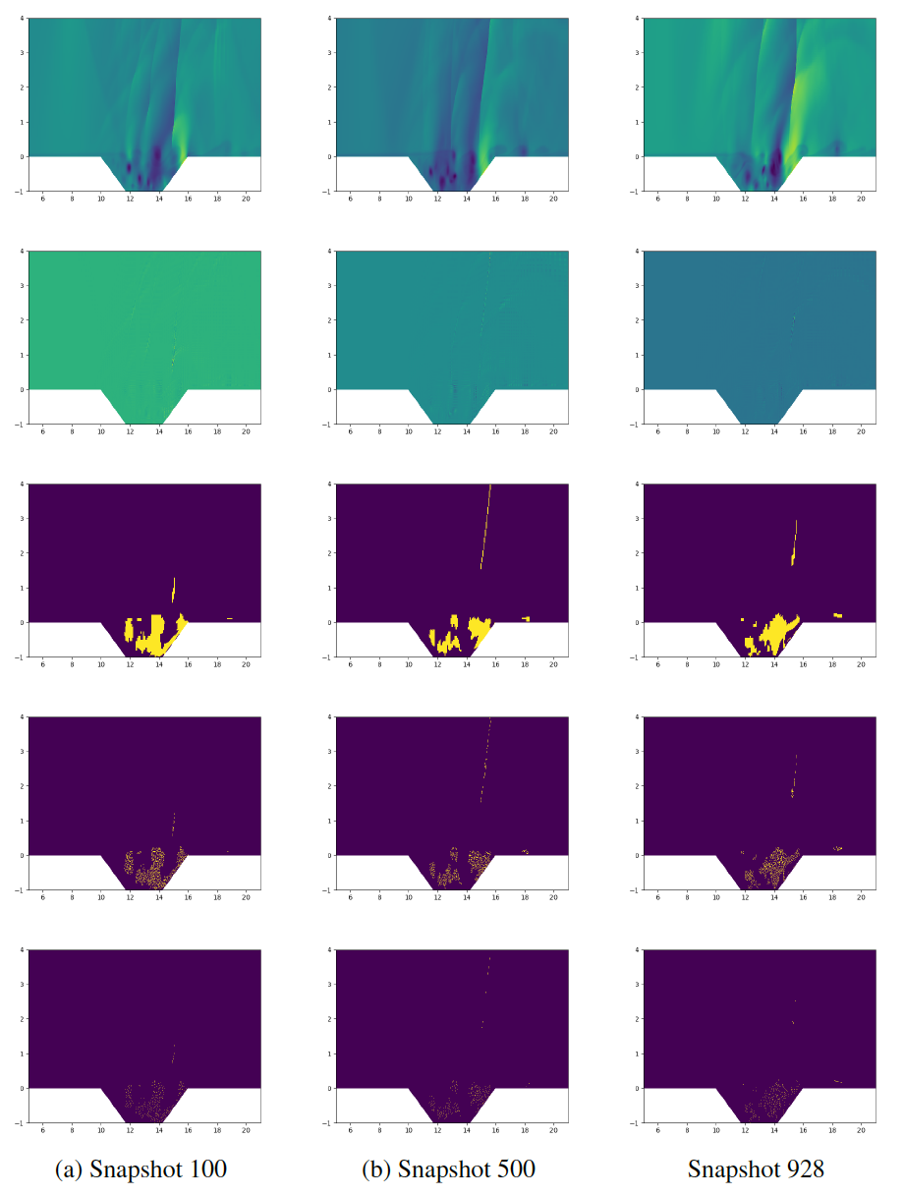
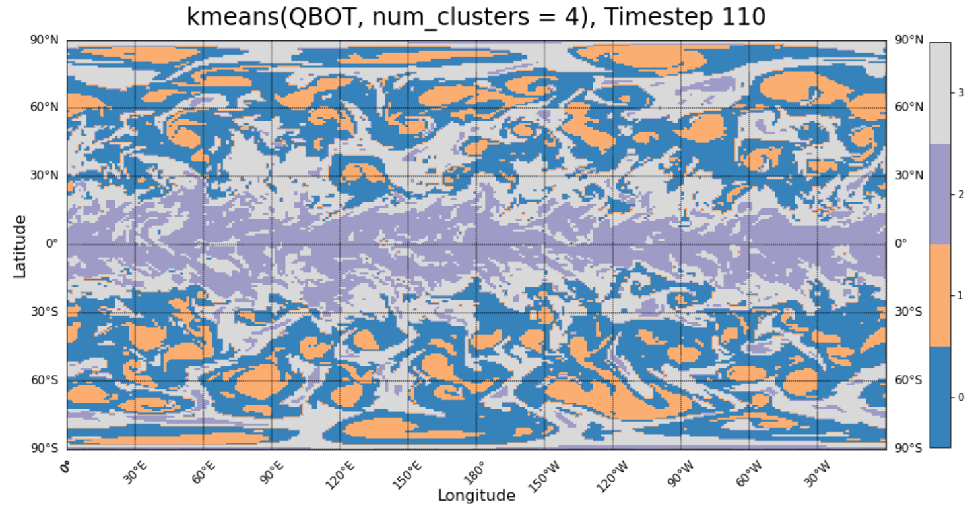
Ongoing Research Areas and Additional Applications
Signature families
Partition/time-window effects
Reduced Order Modeling
Offline use of simulation data
Minimize the Residual
Notes:
ROMS (reduced order models) are physics-based surrogates tied directly to a “full-order model” (FOM) that can enable full-field predictions in real time
For non-linear problems, residual minimization requires operations scaling like FOM.
Solution is hyper-reduction: compute the residual on a small subset of the mesh, represented by matrix $A$.
A single “sample mesh” is typically computed using a simple greedy algorithm that minimizes reconstruction error of the non-linear function being approximated and that same sample mesh is used for hyper-reduction at all time-steps.

Slide 17
Clustering Signatures for Climate Analysis (CLDERA- PI: Diana Bull)

Slide 18
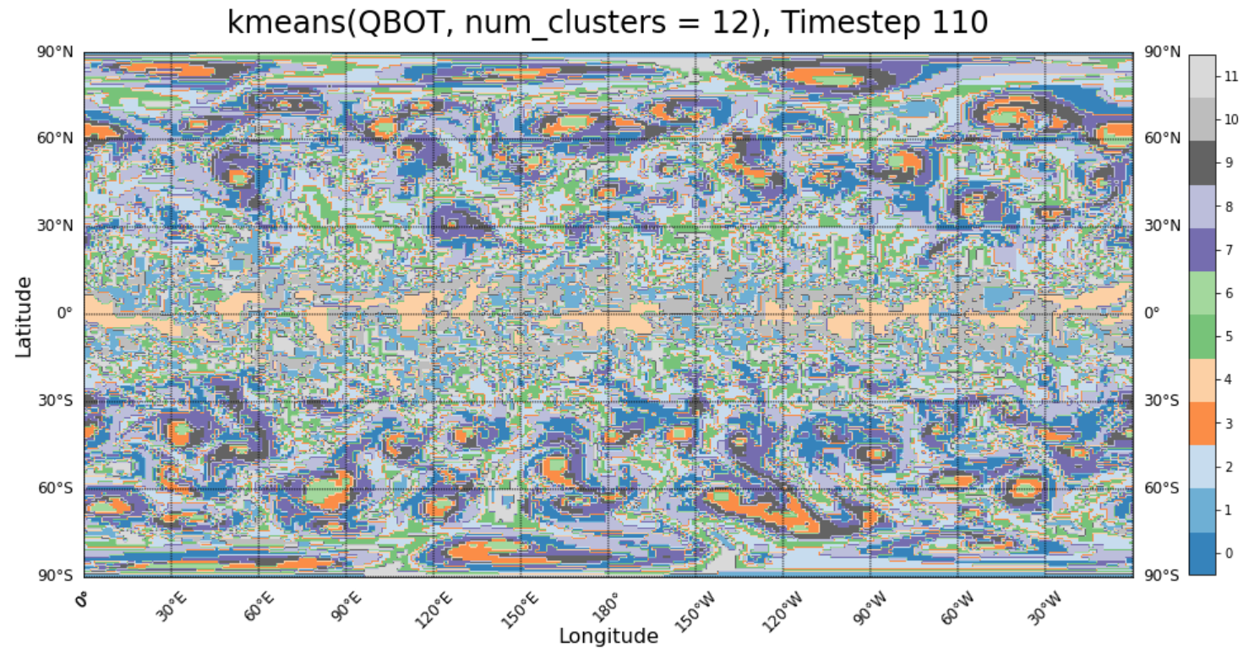
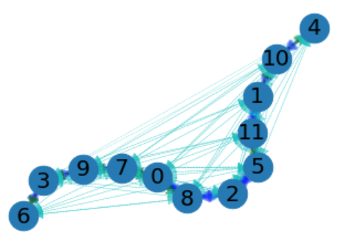
Climate Pathway Discovery – Cluster Evolution
Notes:
Cluster-state-changes between partitions are recorded, and the statistics can be used to make a force-directed layout.

Slide 19
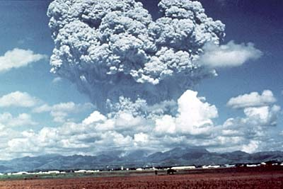
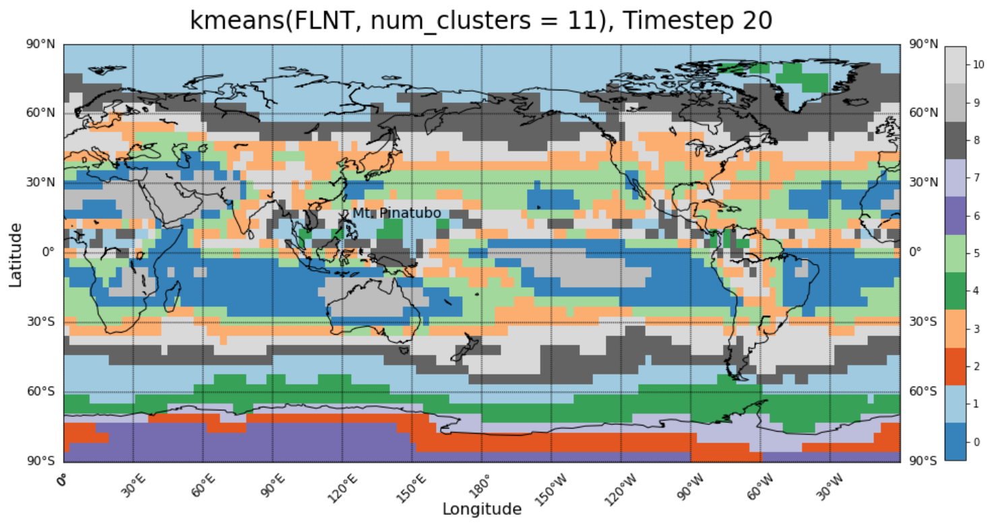
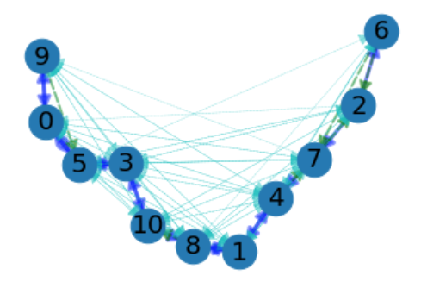
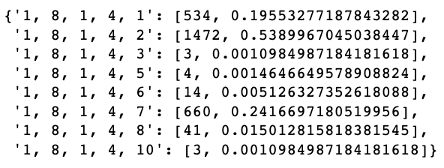
Climate Pathway Discovery – Mt. Pinatubo

Slide 20
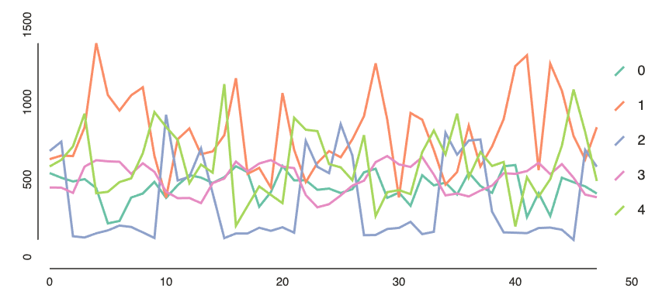
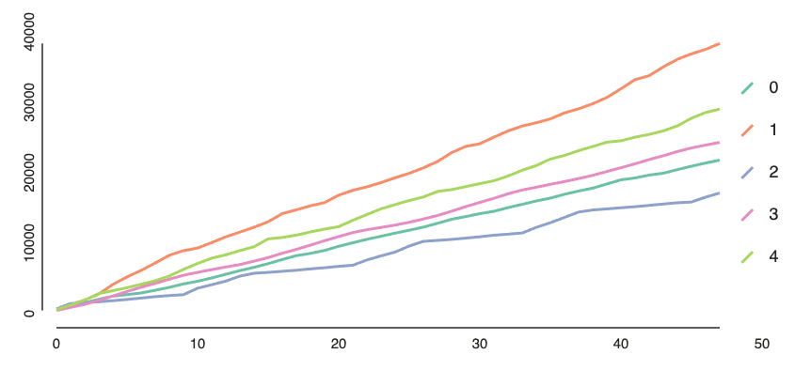
Cluster Distribution over Time
Supports
Cumulative Supports

Slide 21
Publications and Presentations
Ling, Julia, W. Philip Kegelmeyer, Aditya Konduri, Hemanth Kolla, Kevin A. Reed, Timothy M. Shead and Warren L. Davis IV. “Using feature importance metrics to detect events of interest in scientific computing applications.” 2017 IEEE 7th Symposium on Large Data Analysis and Visualization (LDAV) (2017): 55-63.
Kolla, Hemanth, Aditya Konduri, Prashant Rai, Tamara G. Kolda, Warren Leon Davis. “Tensor Decomposition to Perform Change of Basis in Multi-Variate HPC Data to Preserve Higher Order Statistical Moments,” Presentation, SIAM Parallel Processing 2018, March 2018.
Konduri, Aditya, Hemanth Kolla, Julia Ling, W. Philip Kegelmeyer, Timothy Shead, Daniel Dunlavy, Warren Leon Davis. Event Detection in Multi-Variate Scientific Simulations Using Feature Anomaly Metrics," Presentation, SIAM Parallel Processing 2018, March 2018.
Timothy M. Shead, Konduri Aditya, Hemanth Kolla, Daniel M. Dunlavy, W. Philip Kegelmeyer, Warren L. Davis IV. “Embedding Python for In-Situ Analysis.” SAND2018-9009. August 2018.
Aditya K, Kolla H, Kegelmeyer WP, Shead TM, Ling J, Davis IV, Warren L. “Anomaly detection in scientific data using joint statistical moments”, Journal of Computational Physics, Vol 387.
Davis, Warren Leon, Timothy Shead, Hemanth Kolla, Kevin Reed, Gabriel Popoola, W. Philip Kegelmeyer, Aditya Konduri, “The Potential of Integrated Machine Learning Algorithms for Tropical Cyclone Detection in Advanced Climate Modeling,” Poster, American Geophysical Union Fall Conference 2019 in San Francisco, CA, USA, December 2019.
Davis, Warren Leon, Timothy Shead, Hemanth Kolla, Kevin Reed, W. Philip Kegelmeyer, Gabriel Popoola. “In-Situ Machine Learning for Intelligent Data Capture on Exascale Platforms.” Presentation, Artificial Intelligence for Robust Engineering & Science Workshop (AIRES), January 22-24, 2020.
Davis, Warren Leon, Timothy Shead, Hemanth Kolla, Kevin Reed, W. Philip Kegelmeyer, Gabriel Popoola. “In-Situ Machine Learning for Intelligent Data Capture on Exascale Platforms.” Presentation, Platform for Advanced Scientific Computing (PASC21), July 5-9, 2021.
For more information, contact: Warren L. Davis IV (wldavis@sandia.gov)

Slide 22
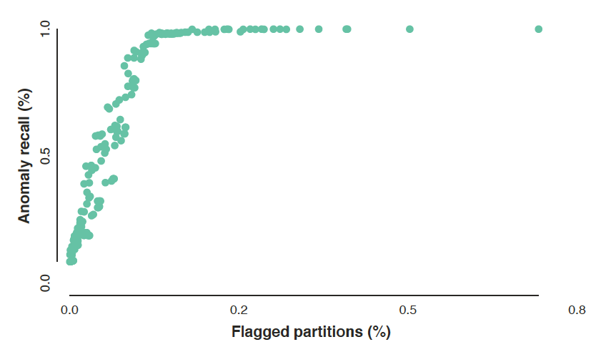
Flagged Partitions vs. Recall for Buoyant Fluids Experiment

