Slide 1
CLDERA CLimate impact: Determining Etiology thRough pAthways
A Novel Foundational Approach for Attributing Climate Impacts
Diana Bull, Kara Peterson, Irina Tezaur, Lyndsay Shand, Laura Swiler
Sandia National Laboratories
8th European Seminar on Computing (ESCO)
June 14, 2022
SAND2022-7561 C

Slide 2

Tools to identify source-impact relationships are needed
The ability to distinguish the impacts of intervention, anthropogenic climate change, and natural variability will become increasingly important as the effects of climate change compound.
Complex coupling of processes can obscure the relationships between sources and impacts.
Observations can be limited and are often not used in a synthesized way.
Attributing a predominant source to an impact is an ill-conditioned problem due to many possible sources leading to similar climate impacts.
Modified from: http://www.thesourgrapevine.com/2019/11/the-ball-of-string-theory-for-learning.html
These limitations create a significant barrier to developing quantitative relationships between sources and impacts.

Slide 3




Attribution in Climate
CLDERA
How do rising concentrations of GHGs in the atmosphere affect climate state variables?
What are the relative contributions of different sectors, activities, and entities to concentrations of GHGs in the atmosphere?
How do changes in the global climate system affect the relative frequency and severity of extreme events ?
What are the downstream impacts from large, spatio-temporally localized sources within the climate?
What is the question?
What is the
source?
Long-term, slowly accumulating GHG emissions
Changes to global climate system
Geographically and temporally localized source forcings in the climate
Sector-specific emissions
Examples
WG1 and WG2 IPCC reports
Cement industry, transportation
Likelihood of Hurricane Katrina
Volcanic eruptions, wildfires
Is the attribution direct / quantitative?
WG1- yes (temp/precip/…)
WG2 – normally no, notional linkage
yes, linked through multiple process-nodes
yes
no, notional connection
The goal of CLDERA is to develop new tools to enable downstream impact attribution from geographically and temporally localized source forcings in the climate.
4
Notes:
Climate attribution is a difficult problem that many researchers have worked on over the years. The primary focus has been the problem in the first column, attribution of impact due to rising greenhouse gas emissions, there has also been work on attribution of emissions from various sectors, and attribution of extreme events to anthropogenic forcing. In our project we are focusing on the final column which relates to the downstream impact of large, localized climate perturbations like volcanoes, wildfires, and potentially geoengineering events.

Slide 4

Establishing Connective Relationships in Earth’s Climate:
Current Approaches
Confounding characteristics of the climate attribution problem:
High internal variability in the Earth system;
Limited simulation ensembles;
Historically limited observational data;
Multiple sources contributing to an impact.
Techniques currently applied to climate attribution:
Fingerprinting (e.g. Hasselmann, 1997; Hegerl & North, 1997; Marvel et al., 2020)
Causal Inference (e.g. Runge et al., 2019; Nowack et al., 2020)
Emergent constraints (e.g. Hall et al., 2019; Williamson et al., 2021)
Connective relationships are often unbounded from etiological relationships allowing physically meaningless source-impact correlations.
(Caldwell et al., 2014)
“Pecking Order”, Edgar Hunt
Moving beyond a correlative approach – establishing connective relationships.

Slide 5
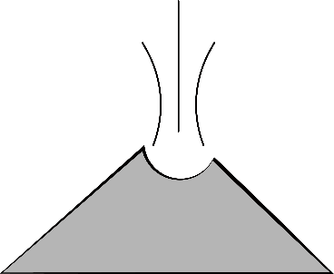
CLDERA a novel foundational approach
Need
Hypothesis
Determine how a geographically and temporally localized source drives the climate system to respond with particular impacts to enable downstream impact attribution
Tracing pathways between source and impacts will increase certainty of attribution and deepen understanding of dependent causal-like relationships
Pathways represent the spatio-temporally evolving chain of physical processes that connects a source to impacts.
observed pathways
simulated pathways
attribution
Technical Approach
CLDERA
Outcome
Build upon key strengths of Sandia (modeling & simulation, detection & attribution, risk analysis)
Develop novel methods and tools in 3 cross-validating thrusts
1991 explosion of Mt. Pinatubo as exemplar
Advance climate attribution science by identifying impacts from localized sources.
Formalize pathways and establish robustness
Ranking of sources to impact
Attribution of source characteristics

Slide 6
Mt. Pinatubo
Stratospheric Aerosol Injection
A strong working example:
SOURCE
Atmospheric Circulation
IMPACTS
The source is an analog for a climate intervention technique
  1 Tg SO2/yr may produce on the order of 0.1°C cooling (Kravitz et al., 2017)
The source forcing is external to the feedbacks within the Earth’s climate
The impacts are large enough to rise above internal variability in the simulations
It provides ample observational data and, because the impacts and pathways are relatively well characterized it offers validation of our analysis techniques within the approach
Other
Source
Event
Air
Temperature
Sea
Level
Dust
Storms
Radiative
Flux
Aerosol
Sedimentation
Sulfate
Aerosol
Production
H₂O
Nuclei
Volcanic
Eruption
Cloud
Brightness
Combustion
Aerosols
Radiation
Diffusivity
Net Primary
Productivity
Other
Source
Event
General Pathway
Aerosol Direct Effect
Aerosol Indirect Effect
Downstream Impacts
Notional Representation of Subset of Processes

Slide 7


Energy Exascale Earth System Model (E3SM)
:
US DOE funded Earth system model.
Collaboration among 8 National Labs and 12 academic institutions.
Designed to run on DOE’s advanced computing platforms and address energy-relevant science questions.
Capabilities to model Mt. Pinatubo eruption and impacts.
  Resolves stratosphere: 72 vertical levels with 0.1hPa (64 km) model top.
  Includes key process models for clouds, ozone, and aerosols [Golaz, et al. 2019].
www.e3sm.org

Slide 8
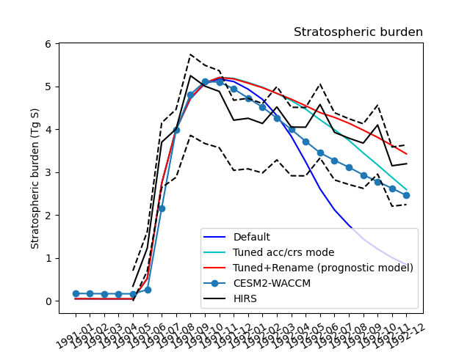
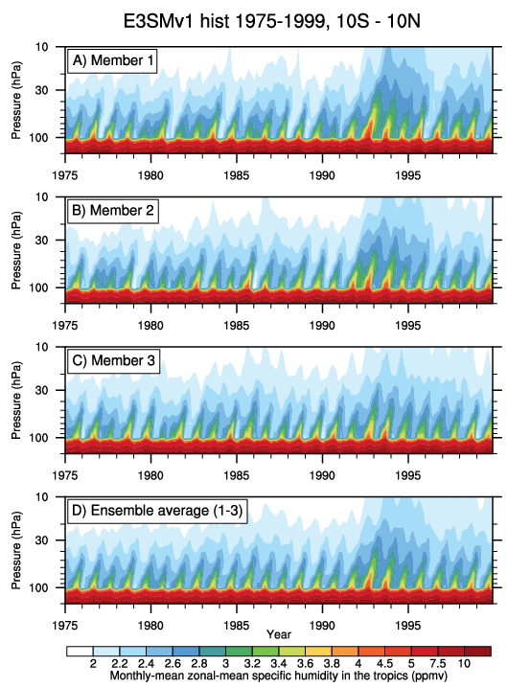
Simulating Mt. Pinatubo
:
Implemented prognostic volcanic aerosols in E3SMv2
  Change aerosol coarse and accumulation mode properties to match stratospheric size distributions
  Validated against High resolution Infrared Radiation Sounder (HIRS) data
Evaluating E3SM simulation capabilities
  Assess Quasi-Biennial Oscillation (QBO) and realism of E3SM’s stratospheric circulation
  Evaluate E3SM’s Brewer Dobson circulation and water vapor tape recorder
X. Liu Impacts of Model Resolution on Simulated Aerosol and Aerosol Effects on Climate Over East Asia With NCAR CESM, CM5 Wed. 18:00.
Water vapor tape recorder: E3SMv1 CMIP6
Mt. Pinatubo
Team: B. Wagman, H. Brown (SNL), X. Liu, A. Hu (TAMU), C. Jablonowski, J. Hollowed (U Michigan)

Slide 9
SIMULATED Pathways finding impacts from a source
Research Composition:
SOURCE
Atmospheric Circulation
IMPACTS
Statistical Approaches: use and extend sensitivity analyses and Random Forest Regression to identify and rank physical pathways while establishing susceptibility to initial conditions and E3SM representations
Computational Monitoring: instrument E3SM with tracers and profiling capabilities to enable pathway detection; additionally deploy novel simulation strategies to elucidate Mt. Pinatubo impacts on climate
Anomaly Detection: define pathways through extensions to existing anomaly detection algorithms in order to spatio-temporally trace anomaly progression
Other
Source
Event
Air
Temperature
Sea
Level
Dust
Storms
Radiative
Flux
Aerosol
Sedimentation
Sulfate
Aerosol
Production
H₂O
Nuclei
Volcanic
Eruption
Cloud
Brightness
Combustion
Aerosols
Radiation
Diffusivity
Net Primary
Productivity
Other
Source
Event
IDENTIFY Driving Pathways
9
9

Slide 10
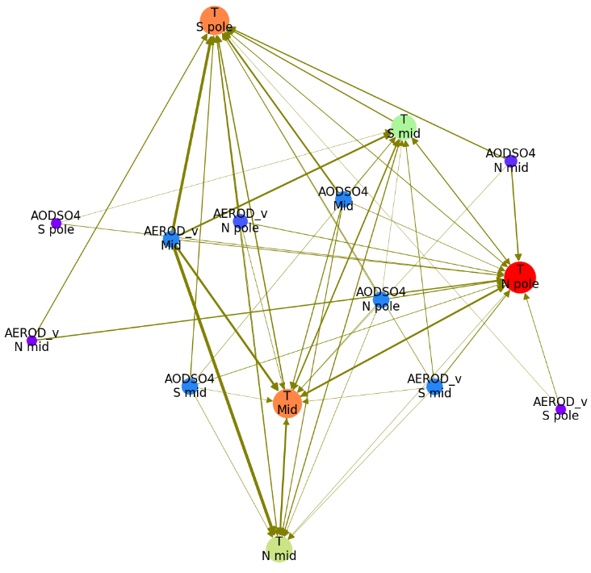
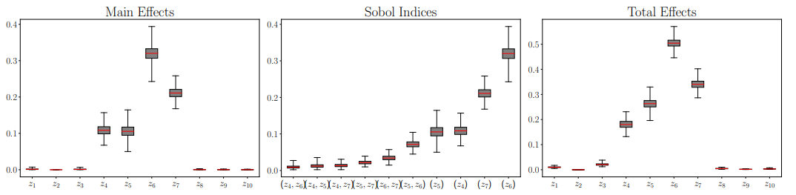

Statistical Methods
Random Forest Regression
  Use feature importances from Random Forests (RFs) to identify weighted pathways from one variable (or feature) to another
:
Sensitivity Analyses
  Determine robustness of pathways to changes in SAI-/model-related inputs
  Two kinds of sensitivity studies using different resolutions of E3SM:
  Vary eruption elements, e.g., mass, time, height, location (how Mt. Pinatubo could have been $–$ “how low can you go”)
  Vary MAM4 aerosol and MG2 cloud microphysics model parameters
Pruned feature importance graph using latitudinal bands
Thick edge = important feature
Global sensitivity analysis (GSA) results for surface temperature QOI from [Tezaur et al., 2021]
I. Tezaur, Global Sensitivity Analysis Using the Ultra-low Resolution Energy Exascale Earth System Model, Tues. CM3 15:30.
Team: M. Peterson, I. Tezaur, K. Peterson
10

Slide 11


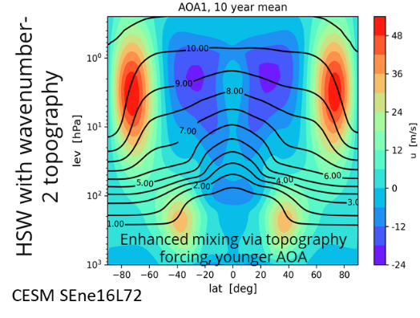
Computational Monitoring
Profiling – in situ pathways
  Instrument E3SM and develop Directed Acyclic Graphs (DAGs) of process interactions executed within code
:
:
Subroutine DAG
E3SM function dependencies
A. Steyer- Detecting Physical Pathways With Software Profiling, Tues. CM3 15:30.
Base DAG
Relevant physics dependencies
Pathway DAG
Anomalous dependency chain
CLDERA-tools
In situ Operation
Team A. Steyer, J. Watkins, L. Bertagna, G. Harper, I. Tezaur (SNL)
Tracers
  Passive: Evaluate climatological dynamics (like “Age of Air”) and changes to those dynamics.
  Active: enable tracking of relative contributions along nodes in pathway.
Team B. Hillman, A. Steyer, I. Tezaur (SNL), C. Jablonowsi, J. Hollowed (U. Michigan)
11

Slide 12
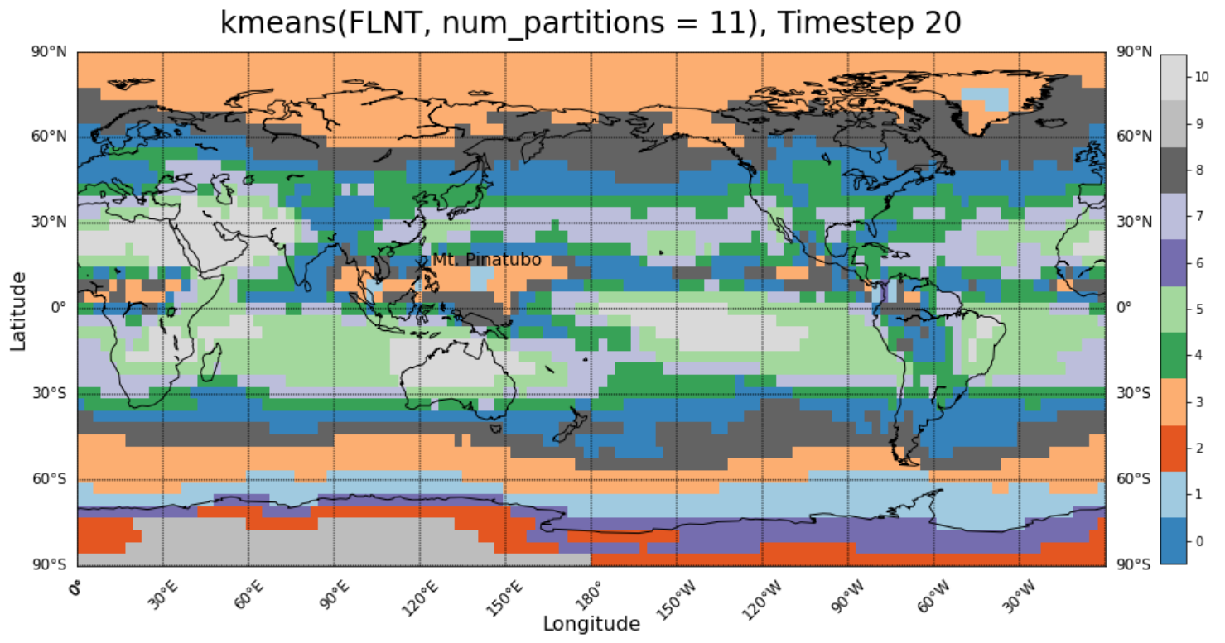
Anomaly Detection
:
Extend existing anomaly (event) detection algorithms [Davis et al., 2021] to enable spatio-temporal anomaly progression, defining pathways
  Signature-measure-decision-based approach
  Communication-minimizing
  Unsupervised (extensions to supervised possible)
  Leverages “In-Situ Machine Learning for Intelligent Data Capture on Exascale Platforms” (ISML) project (PI: W. Davis)
Signature Clustering Approach:
use compressed ISML signatures for clustering
use clusters to inform pathway analyses
W. Davis - In Situ Machine Learning for Intelligent Data Capture in HPC Simulations, Wed. CM5 18:00.
Team: W. Davis, M. Carlson, I. Tezaur (SNL)
12

Slide 13
OBSERVED Pathways finding impacts from a source
Research Composition:
SOURCE
Atmospheric Circulation
IMPACTS
Data Fusion: strategically source and fuse relevant data of varying resolutions and fidelities to create a “near-global” picture of the relevant processes
Change Point: identify the underlying fundamental shifts in climate processes
Space-Time Statistical Methods: adapt Bayesian hierarchical approaches to represent process dependencies and their dynamic spatio-temporal evolution over the first 3-4months post eruption
Hybrid Statistical & Deep Learning Methods: develop hierarchical statistical approaches embedded with DL techniques to trace secondary and tertiary temporally-lagged effects
Other
Source
Event
Air
Temperature
Sea
Level
Dust
Storms
Radiative
Flux
Aerosol
Sedimentation
Aerosol
Optical
Depth
H₂O
Nuclei
Volcanic
Eruption
Cloud
Brightness
Combustion
Aerosols
Radiation
Diffusivity
Net Primary
Productivity
Other
Source
Event
IDENTIFY Driving Pathways
13

Slide 14
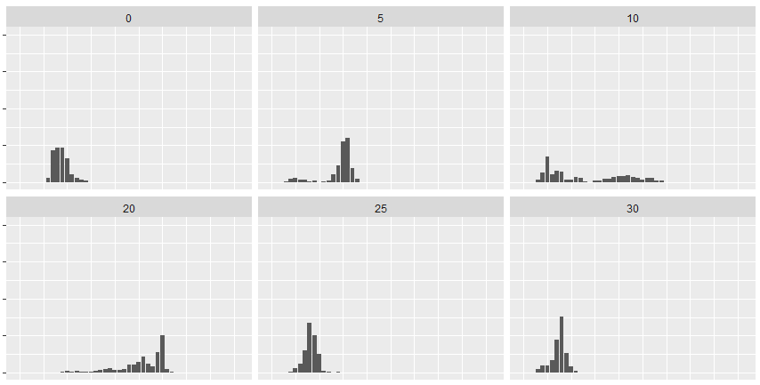
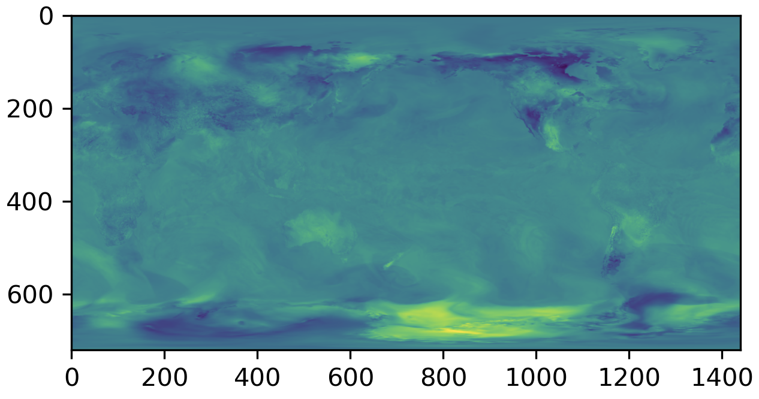
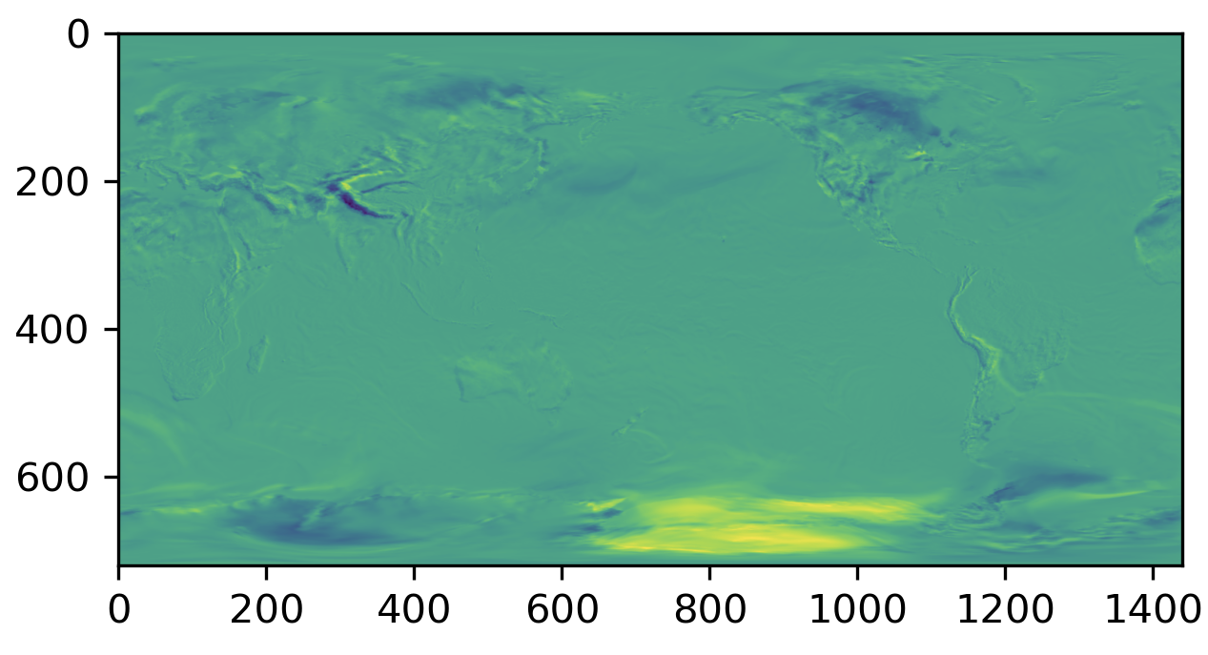
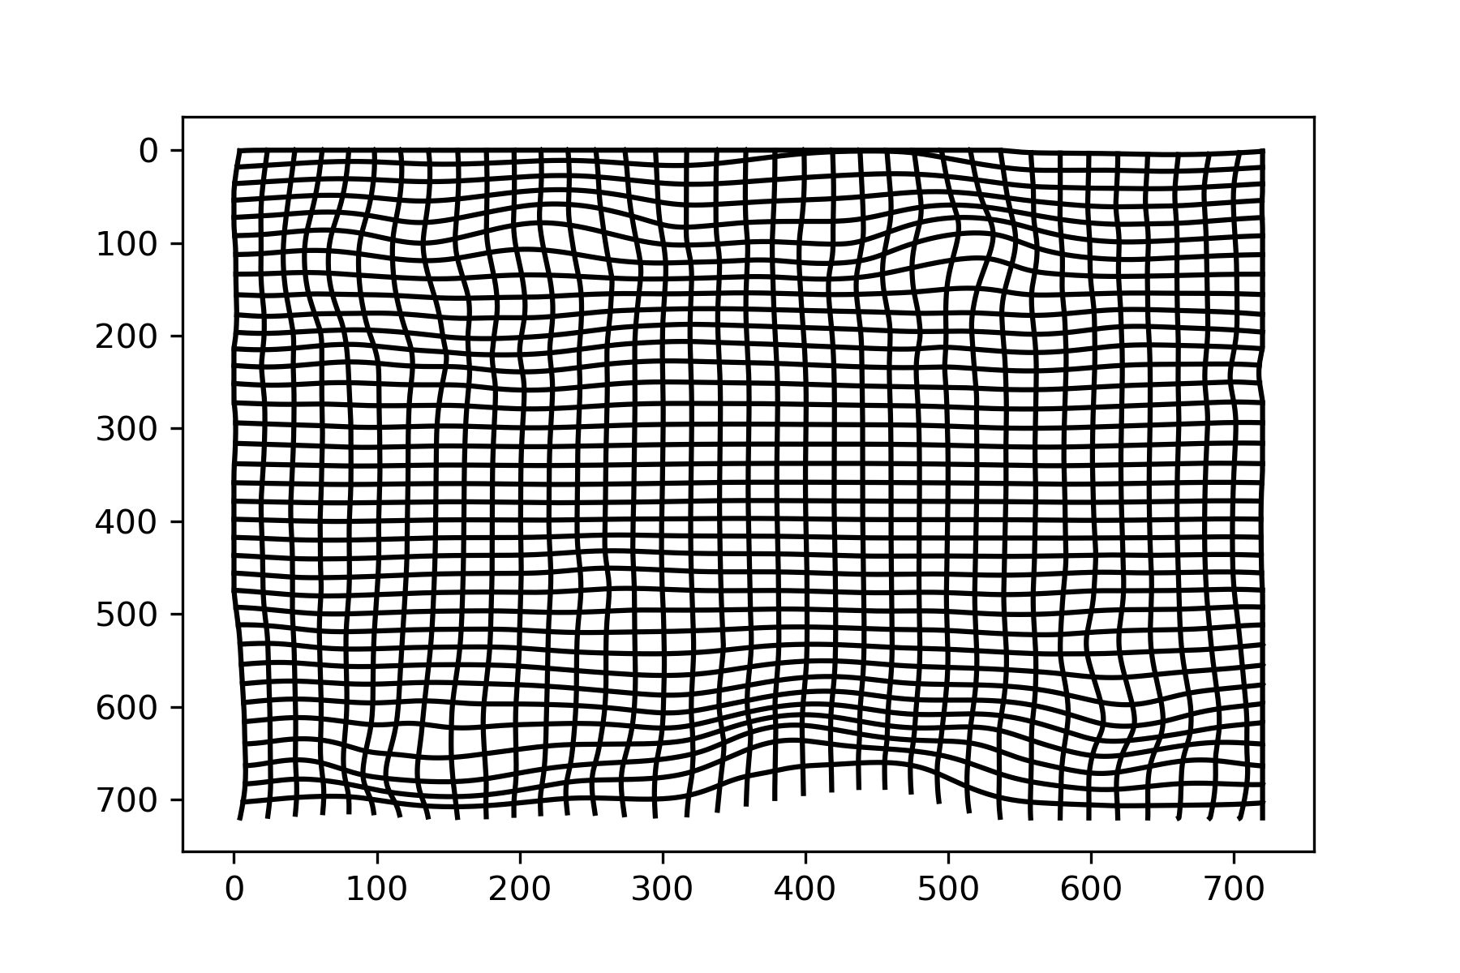
Change Point Methods
Elastic Functional Warping Methods can be leveraged to identify change points in the underlying spatio-temporal process by isolating shifts that are not due to expected weather patterns.
Space-time methods stablish climate shifts and relationship to distance from source.
Difference between time 0 to time N
Before alignment
After alignment
Posterior distribution of estimated spatially-varying changepoint at different latitudes (using simulated data)
The diffeomorphism gives a measure of the bending/ stretching to align spatial data at time 0 and N.
Team: B. Li, S. Jun (U Illinois), D. Tucker, L. Shand (SNL)
14
Notes:
Changepoint
Space-time changepoint methods can detect when and where climate shifts are observed.
Developed novel framework dependent on distance from event.
Tested on synthetic data

Slide 15
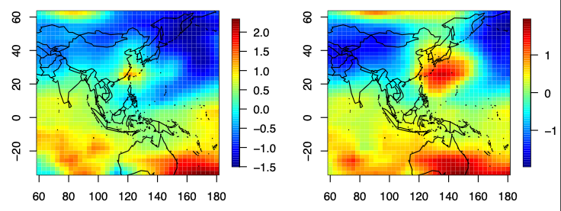


Spatio-Temporal Statistics
June 1991 – March 1992
Stratosphere
Dynamic spatio-temporal models are intuitive and interpretable ways to represent complex, dependent, physical processes that change across space and time simultaneously.
Implementation of Finley et al. (2012) to reanalysis temperatures at multiple pressure levels reveal evidence of Mt Pinatubo impact.
$$σ^{2}$$
Surface
$$σ^{2}$$
June 1991
July 1991
Time-varying variance parameter estimates with red line representing time of event (above) and estimated spatial dynamic components (below) of the dynamic model applied to stratospheric temps.
Team: K. Goode, B. Hillman, G. Huerta, J. Li, L. Shand (SNL)
15

Slide 16
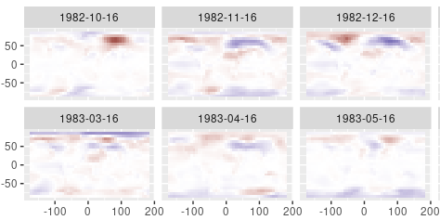
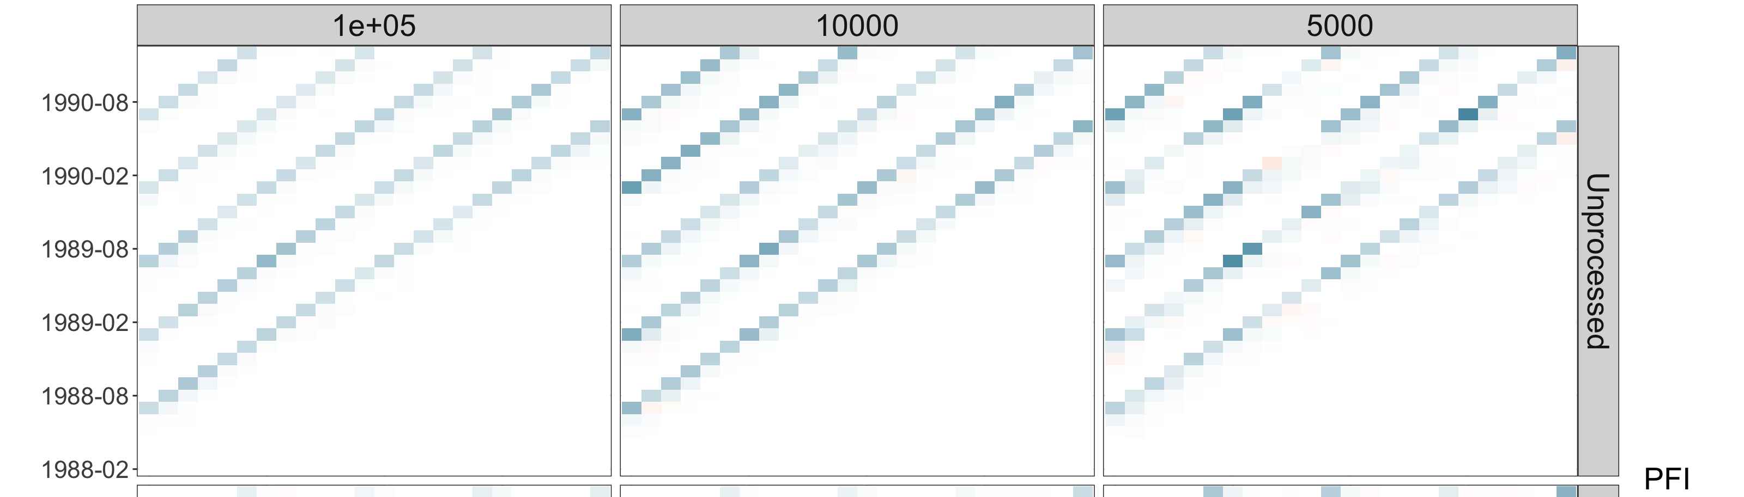
Hybrid Stat-DL Methods
Quadratic ESN Residuals – Need for increased spatial fidelity to correctly account for high latitude temperatures
Echo-State Networks (ESNs)
  Use reservoir computing to efficiently estimate recurrent neural networks (RNN).
  Represent dependent processes occurring over different time scales by increasing interpretability through introducing spatially dependent parameters.
  McDermott and Wikle [2018]
Permutation Feature Importance
  Novel method to increase explainability of existing ESNs.
  Leverages Goode et al. [2020].
PFI – identifying how ESN’s make use of historical temperatures by investigating the influence of lagged temperature on forecast temperatures
Team: K. Goode, B. Hillman, G. Huerta, J. Li, L. Shand (SNL)
16

Slide 17
ATTRIBUTION finding predominant source driving impact
Research Composition
SOURCE
Atmospheric Circulation
IMPACTS
Enhanced Fingerprinting: use pathway information to expand multi-variate analyses, sharpening the signal-to-noise ratios and enabling significant correlations between source-impact
Inverse Optimization: develop deep operator neural networks (DONNs) to model parts of E3SM to enable PDE-constrained optimization without intrusion into the E3SM code directly; pathways will act as penalty terms or constraints
Causal Modeling: identify causal relationships and dominant pathways by developing causal networks through iterative independence tests and the resulting directed acyclic graphs
Other
Source
Event
Air
Temperature
Sea
Level
Dust
Storms
Radiative
Flux
Aerosol
Sedimentation
Sulfate
Aerosol
Production
H₂O
Nuclei
Volcanic
Eruption
Cloud
Brightness
Combustion
Aerosols
Radiation
Diffusivity
Net Primary
Productivity
Other
Source
Event
What precipitates the impact?
17

Slide 18
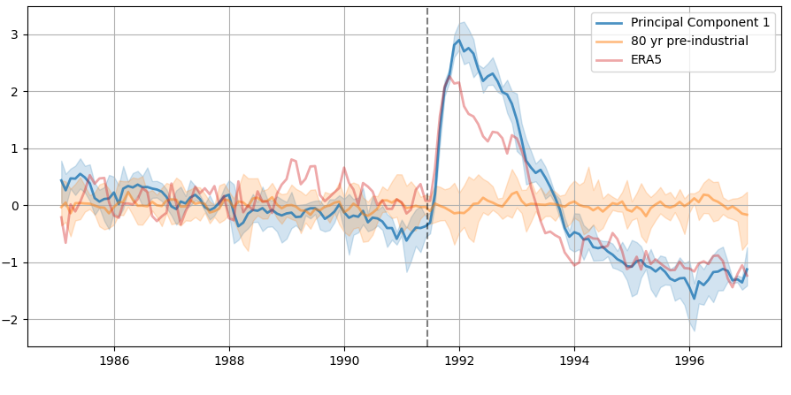
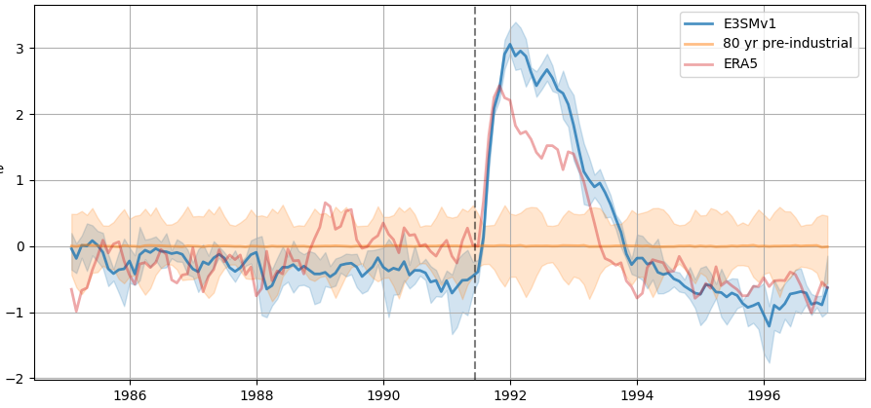
Enhanced Fingerprinting
A fingerprint is a spatial and/or temporal pattern that highlights an impact
Commonly, a fingerprint is the first principal component or empirical orthogonal function (EOF) from a singular value decomposition of a data matrix.
Detection involves identifying if the signal projected back onto the EOF goes out of 2𝜎 limits.
Attribution involves examining the magnitude of the fingerprint in a regression formulation and checking its significance.
Traditional Fingerprint – Detection of Pinatubo
Temperature Anomalies
Leverages Wagman et al. 2021
K. Chowdhary, E3SM Atmosphere Surrogate Construction Using Data-driven Reduced Order Modeling, Wed. CM5 18:00.
Team: B. Wagman, K. Chowdhary, L. Swiler (SNL); K. Marvel (Columbia)

Slide 19
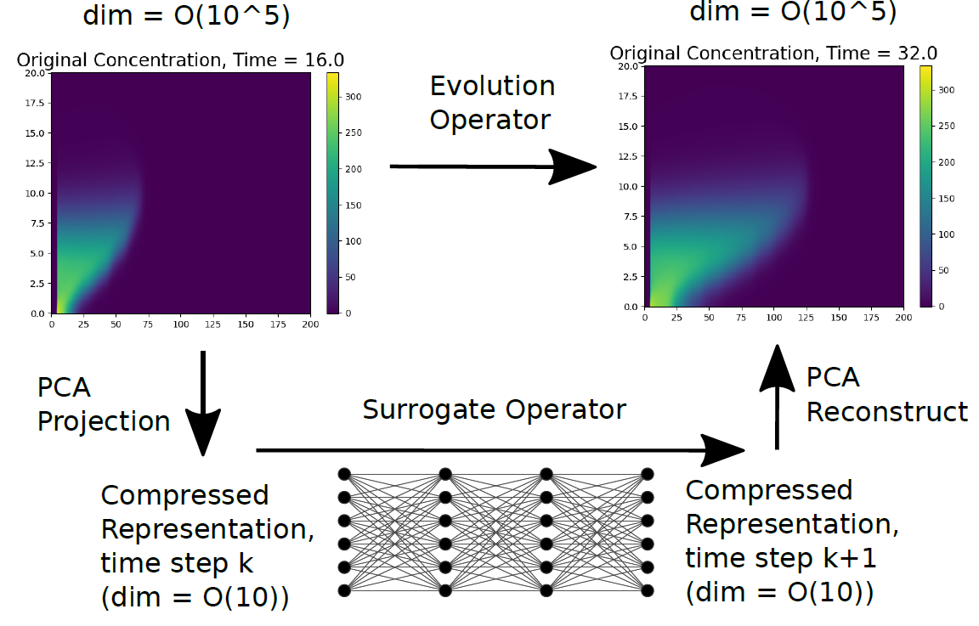
Inverse Optimization
The identification of magnitude, height, and location of the source is a large-scale, PDE constrained inverse problem.
  Find source parameters θ which minimize the difference between aerosol concentrations (c_{sim}) and observations (c_{obs}) subject to the atmospheric physics constraints
Core idea: develop deep operator neural networks (DONNs) to model parts of E3SM to enable PDE-constrained optimization without intrusion into the E3SM code directly.
Add pathway information as penalty terms in the objective and/or additional constraints.
Advection-diffusion reaction with Gaussian plume source
M. Gulian Facilitating Atmospheric Source Inversion via Deep Operator Network Surrogates, CM4 Wed. 10:30.
Team: J. Hart, M. Gulian, I. Manickam, L. Swiler (SNL)

Slide 20
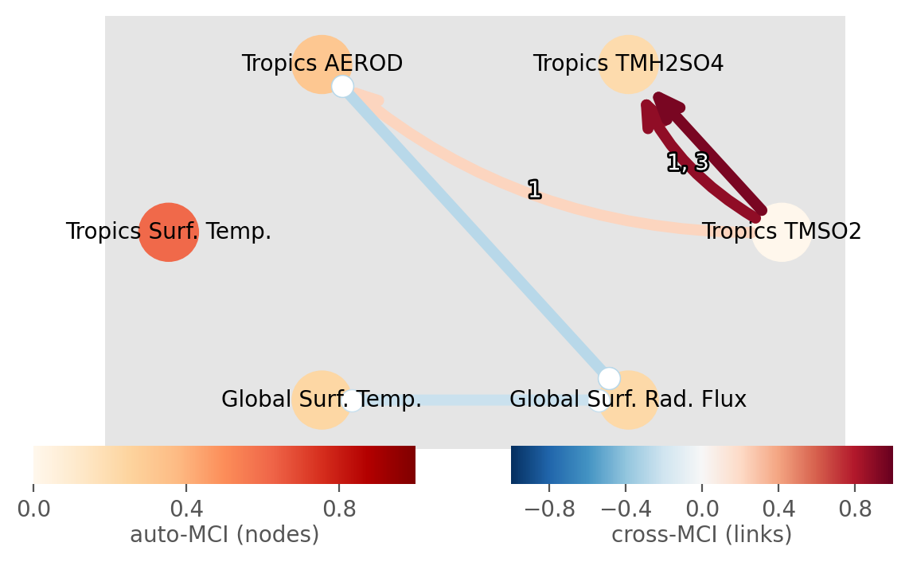
Causal Modeling
Establish relationships between a set of variables to confirm a hypothesized casual relationship
Causal network learning
    Fits a graphical model of covariates by iterative conditional independence tests.
    PCMCI algorithm: Peter Clark Momentary Conditional Independence. [Runge, 2019]
    Allows for and detects contemporaneous dependencies.
Tropical SO2 causes Tropical H2SO4 (over a 1 and 3 month lag)
Tropical SO2 causes a change in optical aerosol depth (AEROD)
Tropical AEROD shows a negative contemporaneous dependence with global surface radiation flux.
J. Nichol Global Multivariate Causal Discovery for the Analysis of Emergent Properties in Earth System Models, Wed. CM4 10:30.
Team: J. Nichol, M. Smith, L. Swiler (SNL)

Slide 21
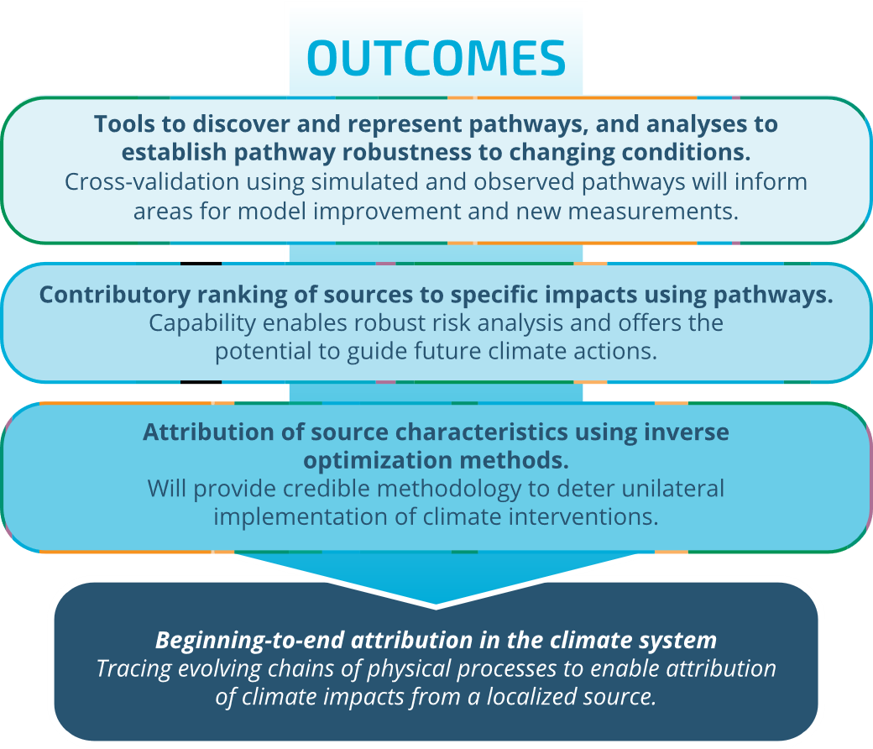
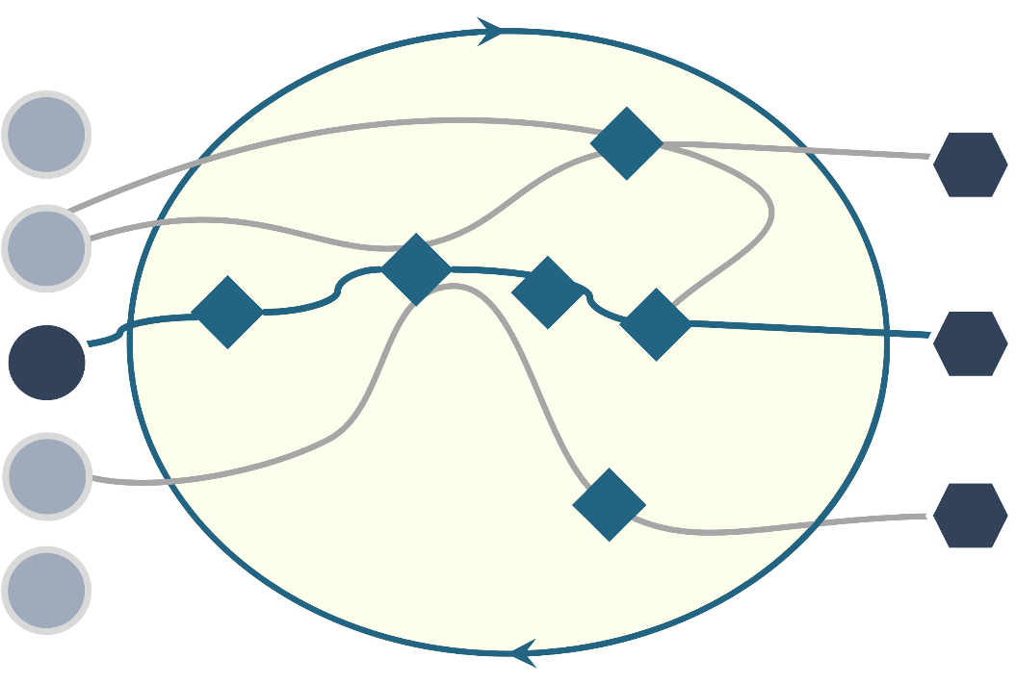
Summing CLDERA
Simulated Pathways
Observed Pathways
SOURCE FORCINGS IN THE CLIMATE
IMPACTS ARISING FROM SOURCES
Attribution

Slide 22
References
Caldwell, P., et al., Statistical significance of climate sensitivity predictors obtained by data mining. Geophysical Research Letters, 2014. 41.
Finley, Andrew, Banerjee, Sudipto,Gelfand, Alan. (2012). Bayesian Dynamic Modeling for Large Space–Time Datasets Using Gaussian Predictive Processes. Journal of Geographical Systems. 14. 29-47.
Golaz, J.-C., et al., The DOE E3SM Coupled Model Version 1: Overview and Evaluation at Standard Resolution. Journal of Advances in Modeling Earth Systems, 2019. 11(7): p. 2089-2129.
Goode, K., Ries, D., and Zollweg, J. “Explaining Neural Networks with Functional Data Using PCA and Feature Importance”. AAAI 2020 Fall Symposium on AI in the Government and Public Sector. November 13-14, 2020. https://arxiv.org/abs/2010.12063.
Hall, A. et al., Progressing emergent constraints on future climate change. Nature Climate Change, 2019. 9, p 269-278.
Hasselmann, K., Multi-pattern fingerprint method for detection and attribution of climate change. Climate Dynamics, 1997. 13(9): p. 601-611.
Hegerl, G.C. and G.R. North, Comparison of Statistically Optimal Approaches to Detecting Anthropogenic Climate Change. Journal of Climate, 1997. 10(5): p. 1125-1133.
Kravitz, B., et al., First Simulations of Designing Stratospheric Sulfate Aerosol Geoengineering to Meet Multiple Simultaneous Climate Objectives. Journal of Geophysical Research: Atmospheres, 2017. 122(23): p. 12,616-12,634.
Marvel, K., M. Biasutti, and C. Bonfils, Fingerprints of external forcings on Sahel rainfall: aerosols, greenhouse gases, and model-observation discrepancies. Environmental Research Letters, 2020: p. Medium: ED; Size: Article No. 084023.
McDermott, Patrick & Wikle, Christopher. (2018). Deep echo state networks with uncertainty quantification for spatio‐temporal forecasting. Environmetrics. 30. 10.1002/env.2553.
National Academies of Sciences Engineering Medicine (NASEM), Reflecting Sunlight: Recommendations for Solar Geoengineering Research and Research Governance. 2021, Washington, DC: The National Academies Press. 328.
Nowack, P., et al., Causal networks for climate model evaluation and constrained projections. Nature Communications, 2020. 11(1): p. 1415.
Runge, J., et al., Inferring causation from time series in Earth system sciences. Nature Communications 2019. 10(1).
Tezaur, I., et al., Global sensitivity analysis of ultra-low resolution E3SM. Submitted to JAMES, 2022.
Wagman, B. M., L. P. Swiler, K. Chowdhary, B. Hillman. “The Fingerprints of Stratospheric Aerosol Injection in E3SM.” LDRD project 224535 final report, Sept. 2021.
Williamson, MS et al., Emergent constraints on climate sensitivities. Reviews of Modern Physics, 2021. 93 (2)
22

Slide 23
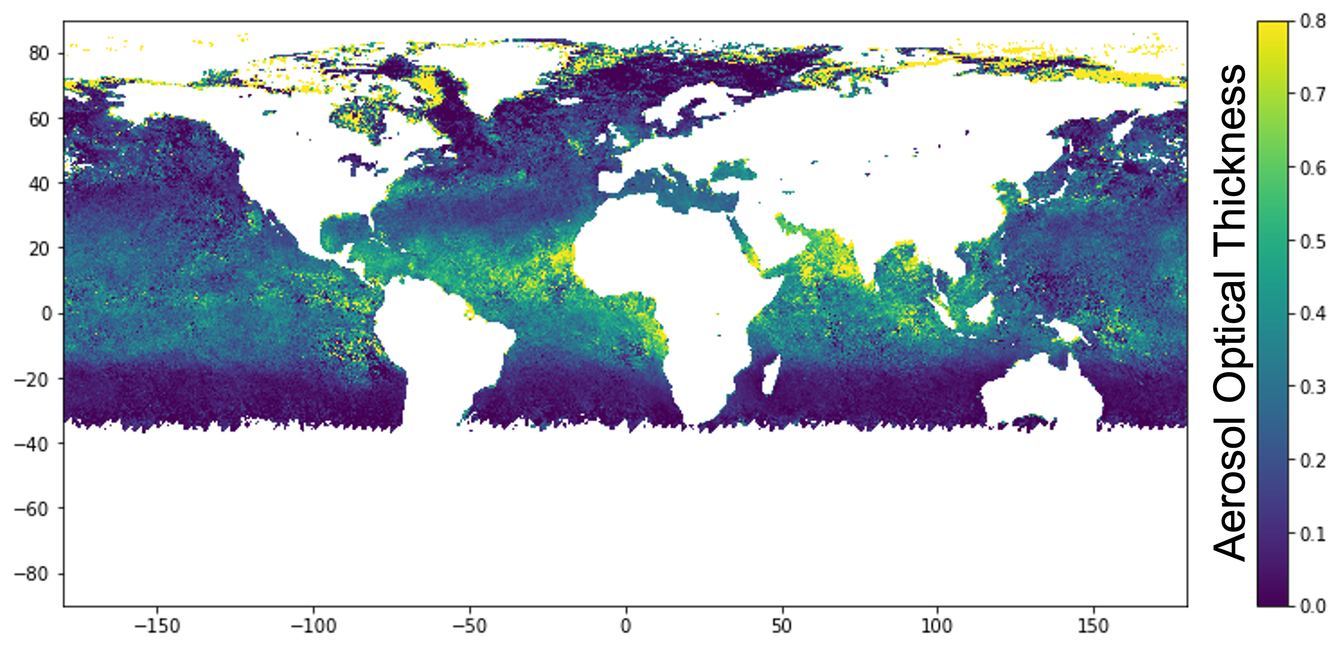
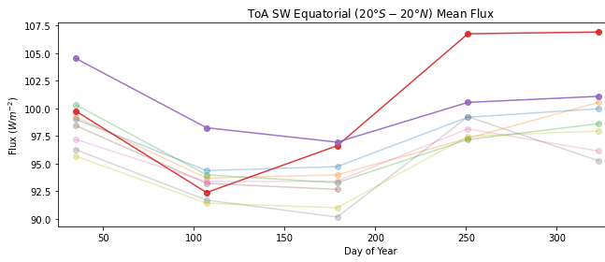
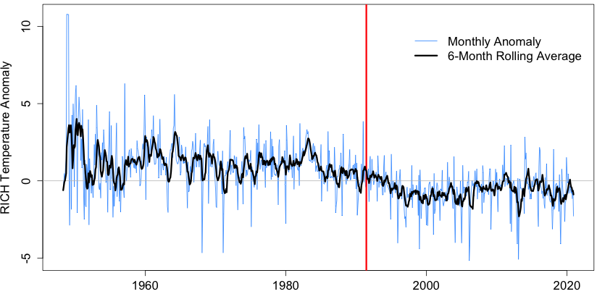

Temperature Impacts from Mt. Pinatubo
Emission/Aerosol formation
Aerosol Optical depth
Change in Radiation Flux
Net shortwave & longwave
Temperature Change
2m and 50hPa
Pinatubo Eruption
1991 SW in red
continuing into 1992
Reduced temperatures lasting several years
Map shows 1.5 months post-eruption
Stratosphere
Troposphere
NH Winter Warming
Absorption of terrestrial LW and incident solar near-IR radiation by sulfate aerosols
Reduction in solar radiation at surface due to scattering by sulfate aerosols
Water vapor feedback [Soden et al., 2002]
Tropical stratospheric warming intensifies polar vortex and induces a strong positive phase in the NAO
Mechanism
Confounding factors: ozone changes
Confounding factors: ENSO, LW radiation, aerosol indirect effects, climate dynamics
Disputed: natural variability or forced by eruption
Impact
Observed ~3 C warming at 50-hPa, [Angell 1997]
Observed 0.4 C global mean cooling [McCormick et al., 1995]
    Warming in NH first winter after tropical eruption [Robock & Mao, 1992]

