Slide 1
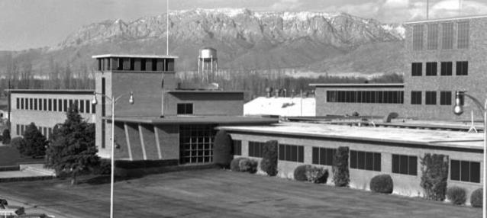
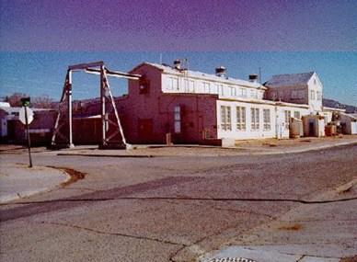
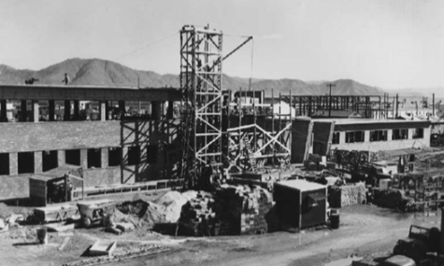
Origins:
The Early History of Sandia National Laboratories
Rebecca Ullrich
December 11, 2014

Slide 2
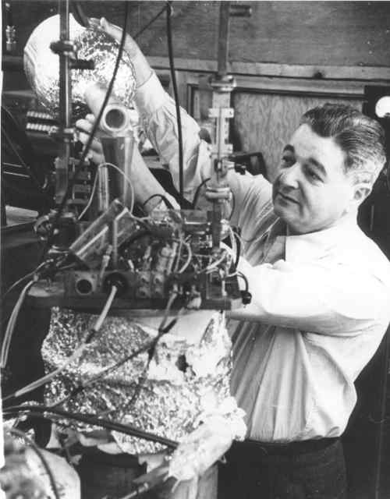
Creating Z Division
J. Robert Oppenheimer
Jerrold R. Zacharias

Slide 3
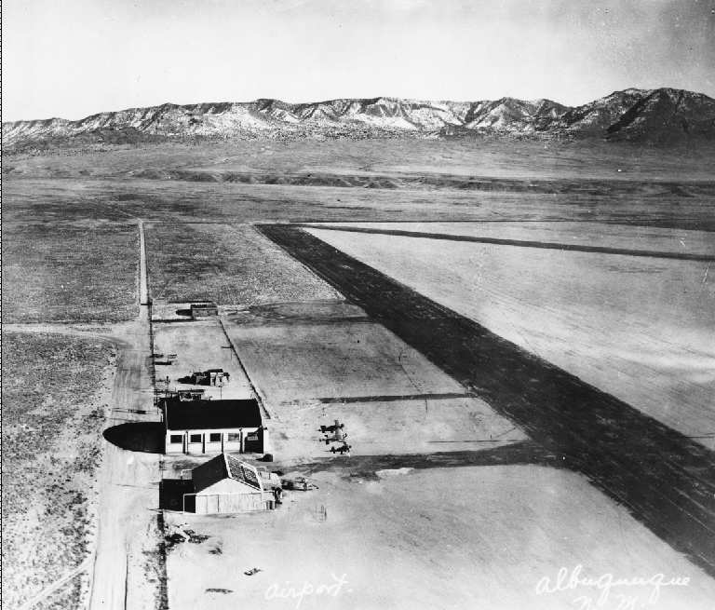
Z Division: Site Selection
Oxnard Field, 1928

Slide 4
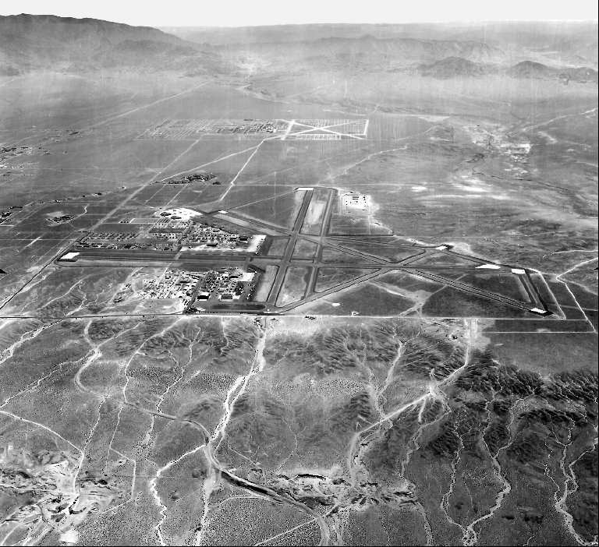
Z Division: Site Selection

Slide 5
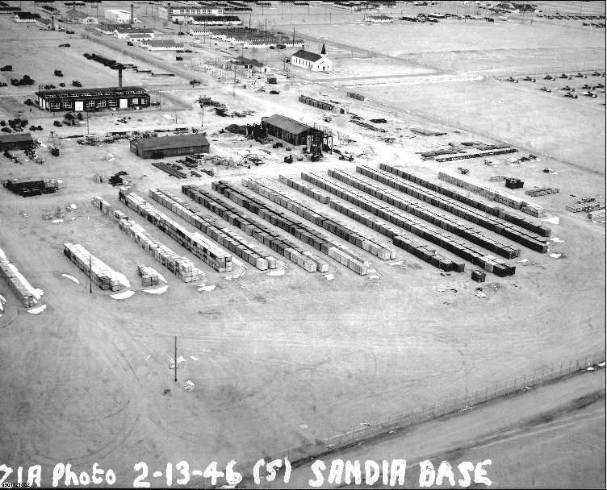
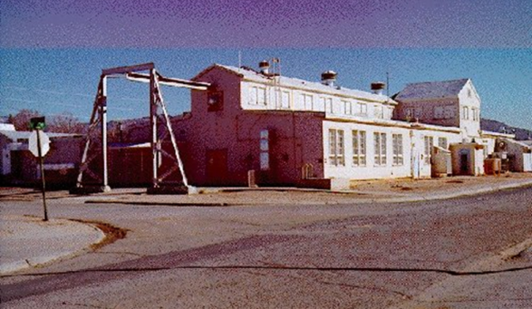
Z Division: Building a Lab
Roger Warner

Slide 6
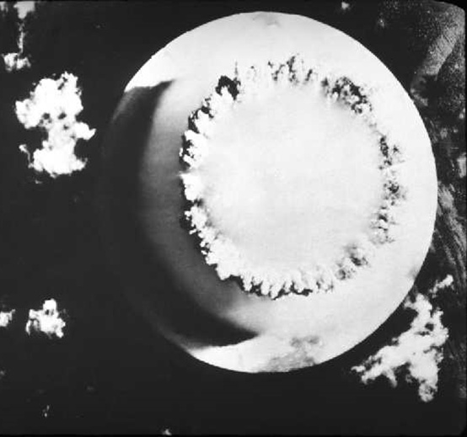
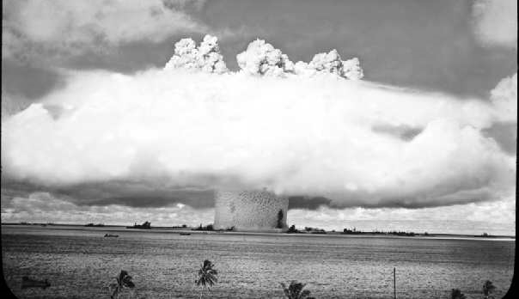
JTF-1 Operation Crossroads
21 kt Baker Shot; July 24, 1946

Slide 7
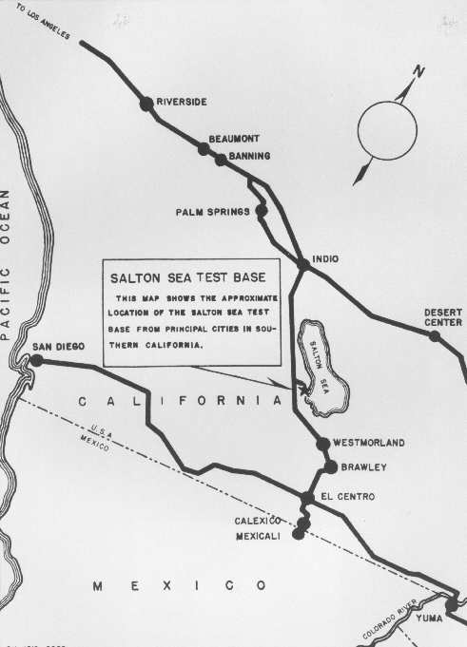
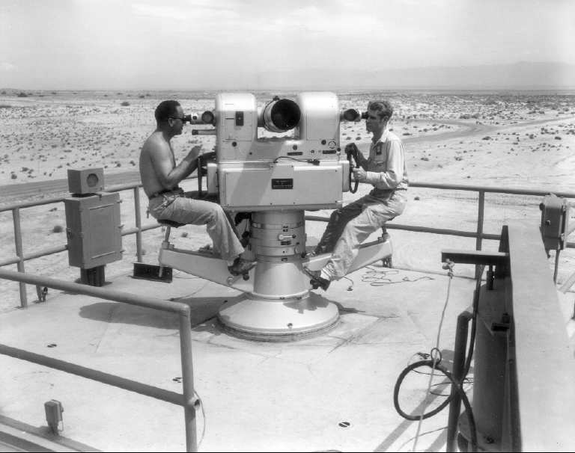
Salton Sea Test Base
Glenn Fowler

Slide 8
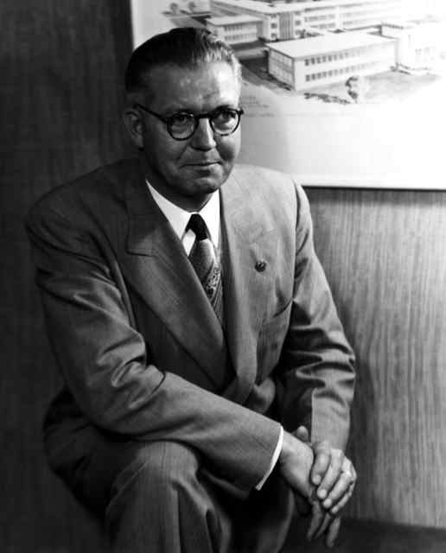
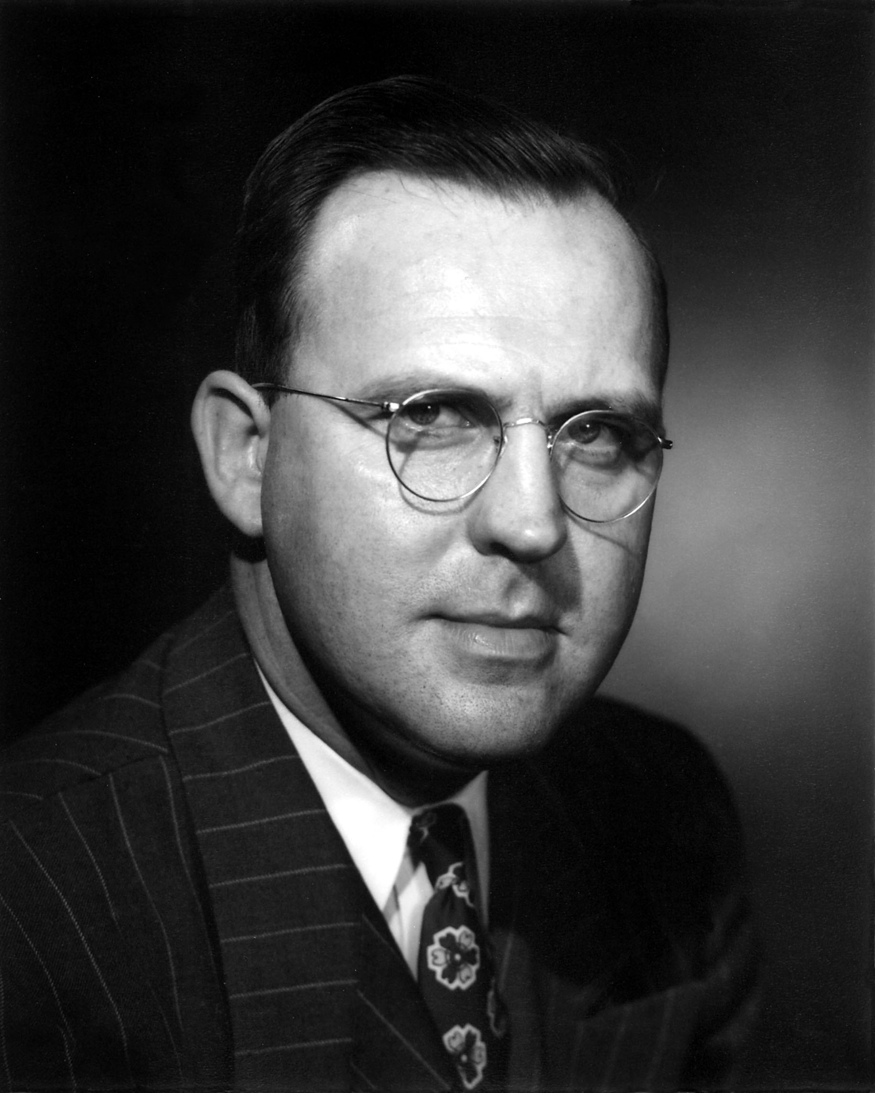
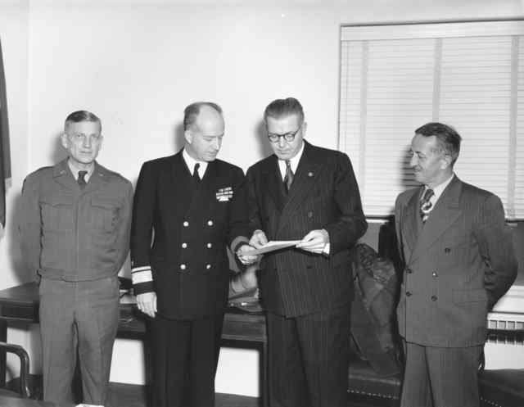
Leadership
Paul J. Larsen
Robert W. Henderson

Slide 9
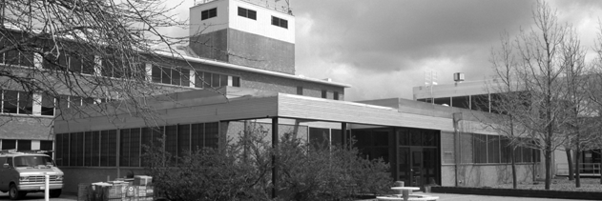
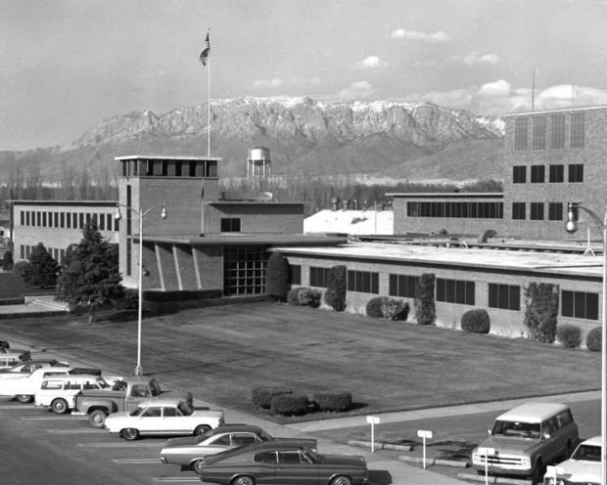
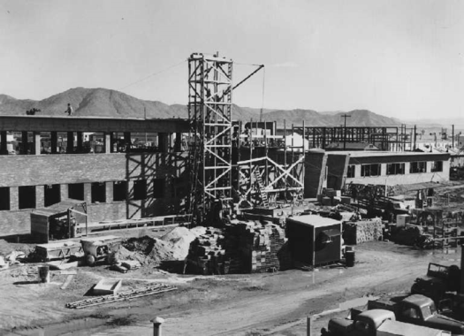
1948: Traction and Growth

Slide 10
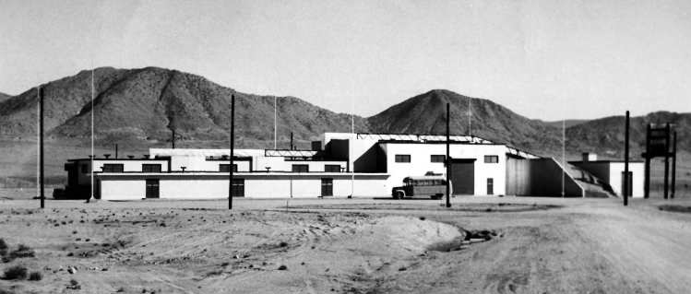
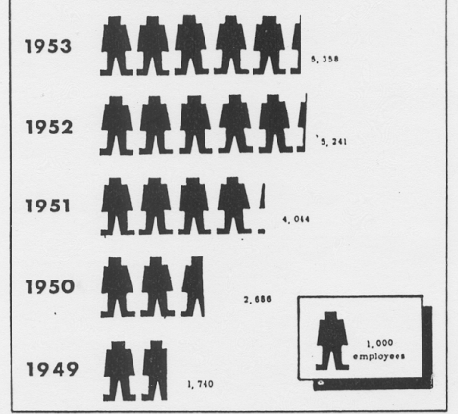
1948: Traction and Growth
Tech Area II: Early Assembly Facilities
In the Pacific for Sandstone, 1948

Slide 11
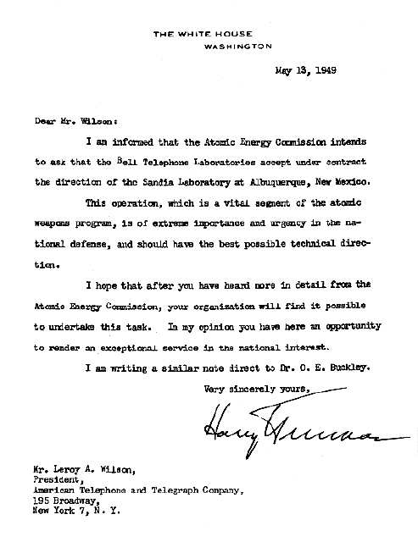
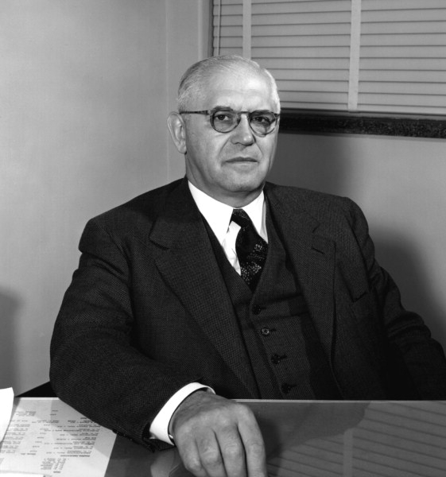
1949: Transition in Sandia Lab Status
First Sandia Corporation President, George Landry

Slide 12
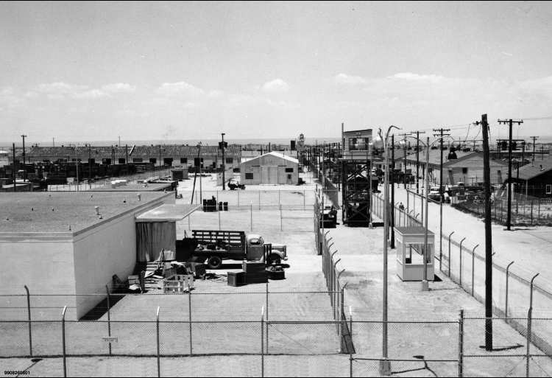
1949: Main Sandia Tech Area

Slide 13
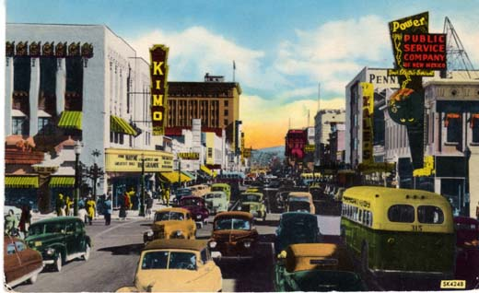
Albuquerque: 1940s

Slide 14
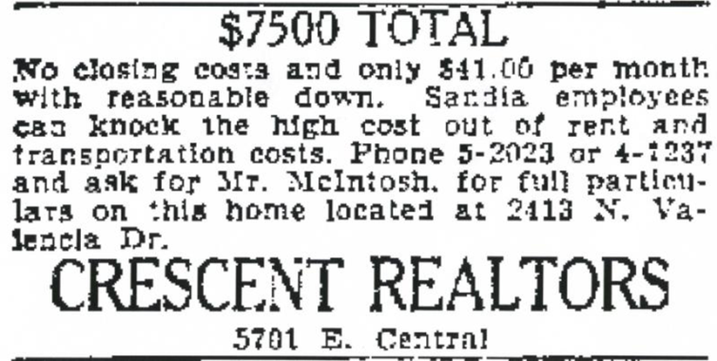
Populations
Year | Albuquerque Population | Bernalillo County Population | Sandia Workforce | Base Workforce
1930 | 26,570
1940 | 35,449 | 69,391
1946 |  |  | 100 | 979
1949 |  |  | 1,740 | 1,627
1950 | 96,815 | 145,673 | >2,100 | 2,723
1954 |  | 185,800 | >5,600 | 6,025
1955 | 150,000 | 205,500 | 5,725 | 5,414
1957 |  |  | 7,064
1960 | 201,189 | 262,199
Year | Housing Permit $
1940 | >2.3 million
1949 | 20.4 million
1952 | >25 million
1954 | <37.4 million
Real Estate Advertisement, Albuquerque Journal, 6 March 1952.

Slide 15
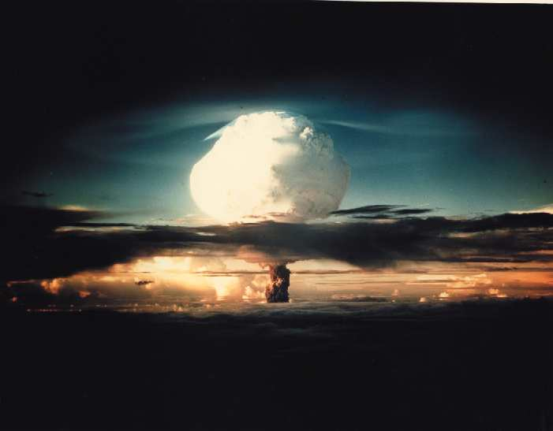
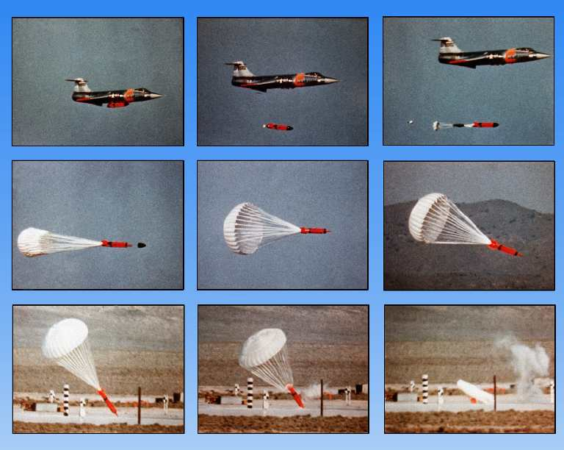
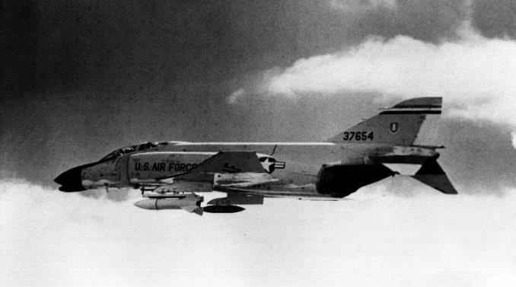
Stockpile Growth and Change

Slide 16
Capabilities: Sandia Livermore
Teller, McRae, and Howard

Slide 17
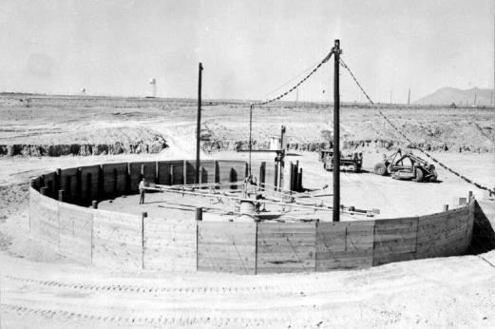
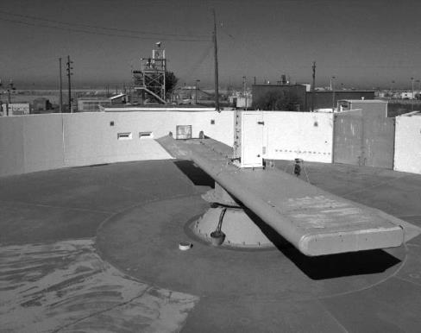
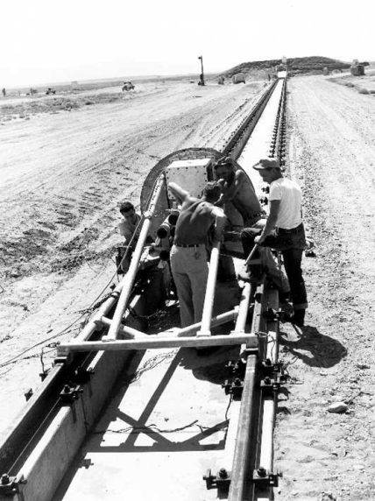
Capabilities: Environmental Testing
1952
1954
1953
1957
1956

Slide 18
Capabilities: Environmental Testing
Tech Area III Text Facilities (extant and proposed) 1958

Slide 19
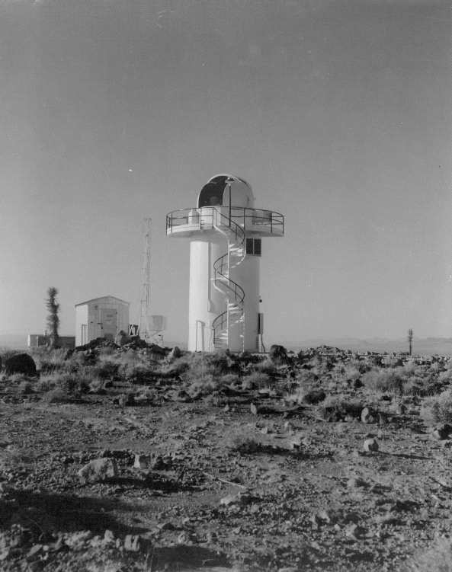
Capabilities: Testing at SSTB and TTR

Slide 20
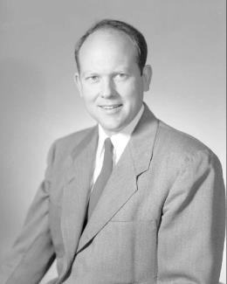
Capabilities: Research Depth
Julius Molnar and James McRae
SERF nearing completion, 1960
R.S. Neiman and Ruth Whan with Van de Graaff
Glenn Fowler, VP Research
Dick Claassen, Director Research

Slide 21
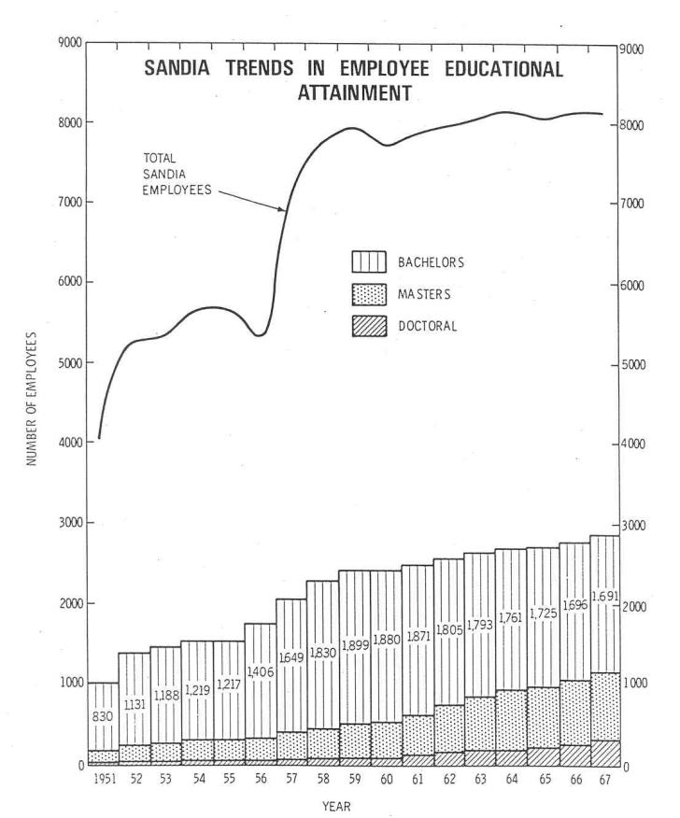
Capabilities: Education
20 members of the original 1960 TDP class of the 37 still on-roll in 1985

Slide 22
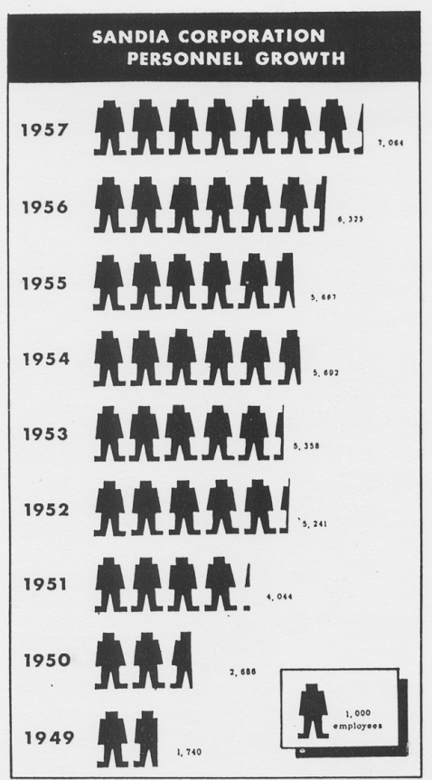
Results: Growth

Slide 23
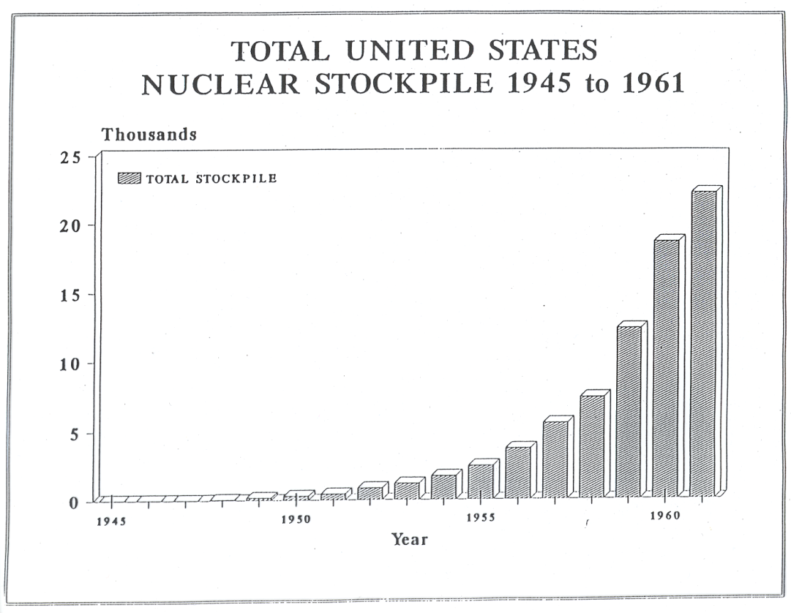
Results: Product

Slide 24
Thank you
Notes:
Thank you for your time and attention.
Questions?

