Slide 1
Origins of a New Site:
The Early History of Sandia California
Rebecca Ullrich
April 15, 2015
SAND2015-2863PE

Slide 2
Today’s Scope
The decisions leading up to the creation of this site and the early years of its development
Origins of Sandia
Nuclear Weapons Complex in the early 1950s
Creation of UCRL Livermore (LLNL)
Need for ordnance engineering support for LLNL
AEC decision: Sandia to support LLNL designs
Establishing the new Sandia site (construction, personnel, and direction)
Growth
Early programs

Slide 3
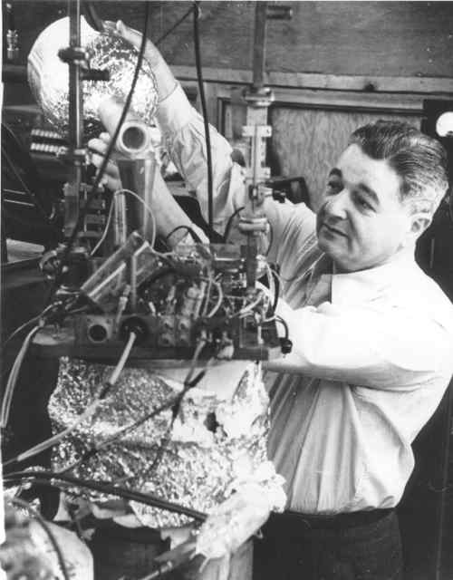
Origins of Sandia
J. Robert Oppenheimer
Jerrold R. Zacharias

Slide 4
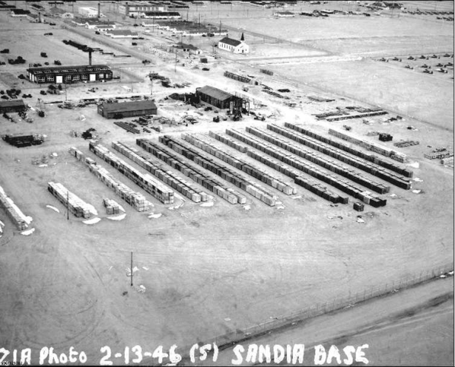
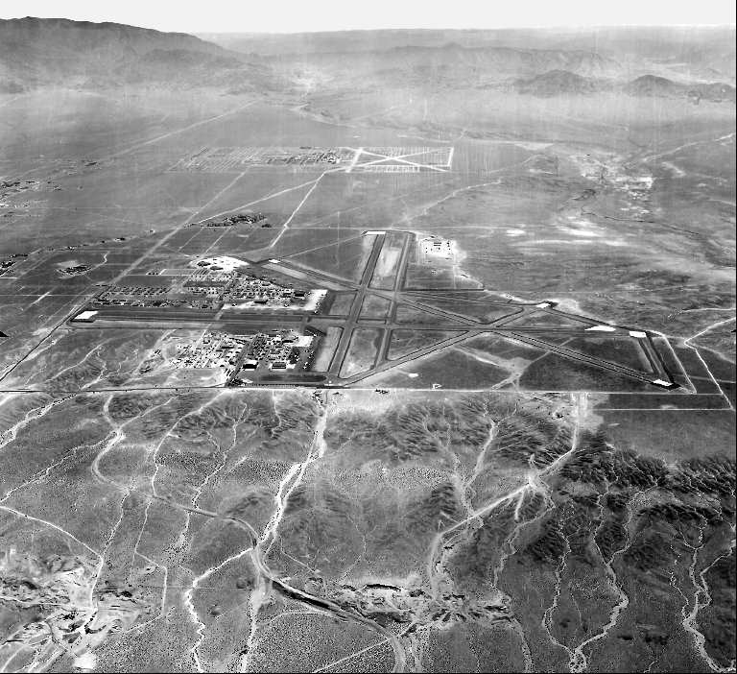
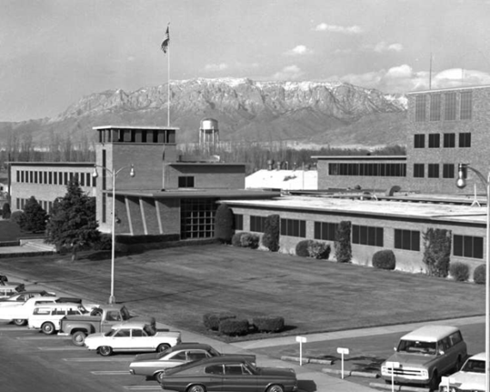
The New Mexico Site

Slide 5
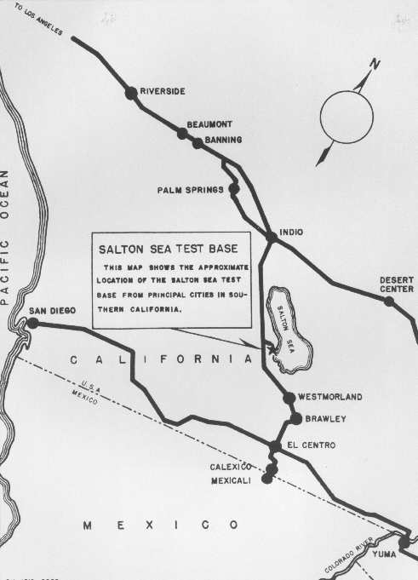
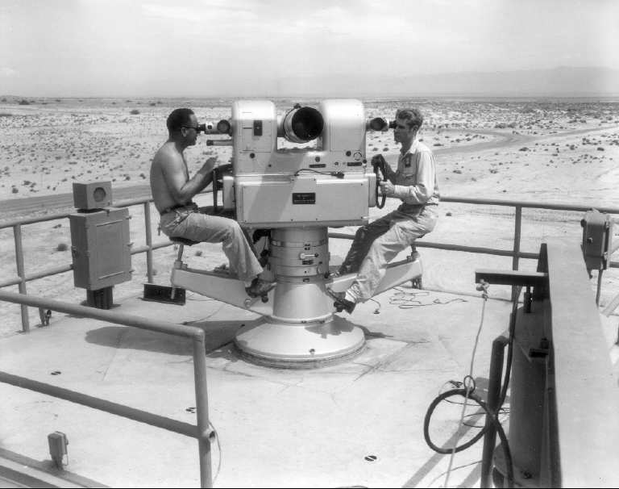
Early Growth: SSTB
Glenn Fowler

Slide 6
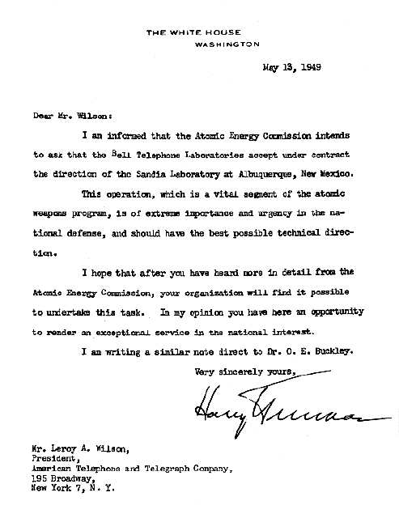
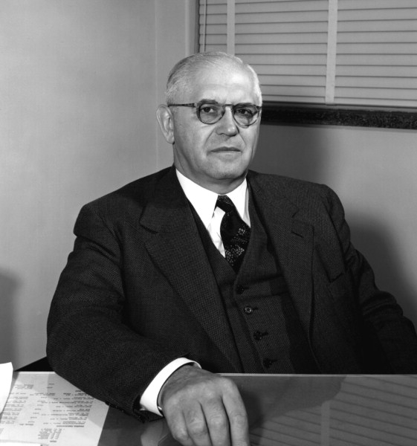
1949: Transition in Sandia Lab Status
First Sandia Corporation President, George Landry

Slide 7
Nuclear Weapons Complex, MED,1949, 1951, 1953
Los Alamos
Livermore
Sandia
Oak Ridge
Y-12
Oak Ridge
K-25
Hanford
Kansas City
Burlington
Mound
Rock Island
Inyokern
Picatinny
Pantex
NTS
Rocky Flats
Savannah
River
Fernald
Paducah
Albuquerque
Portsmouth

Slide 8
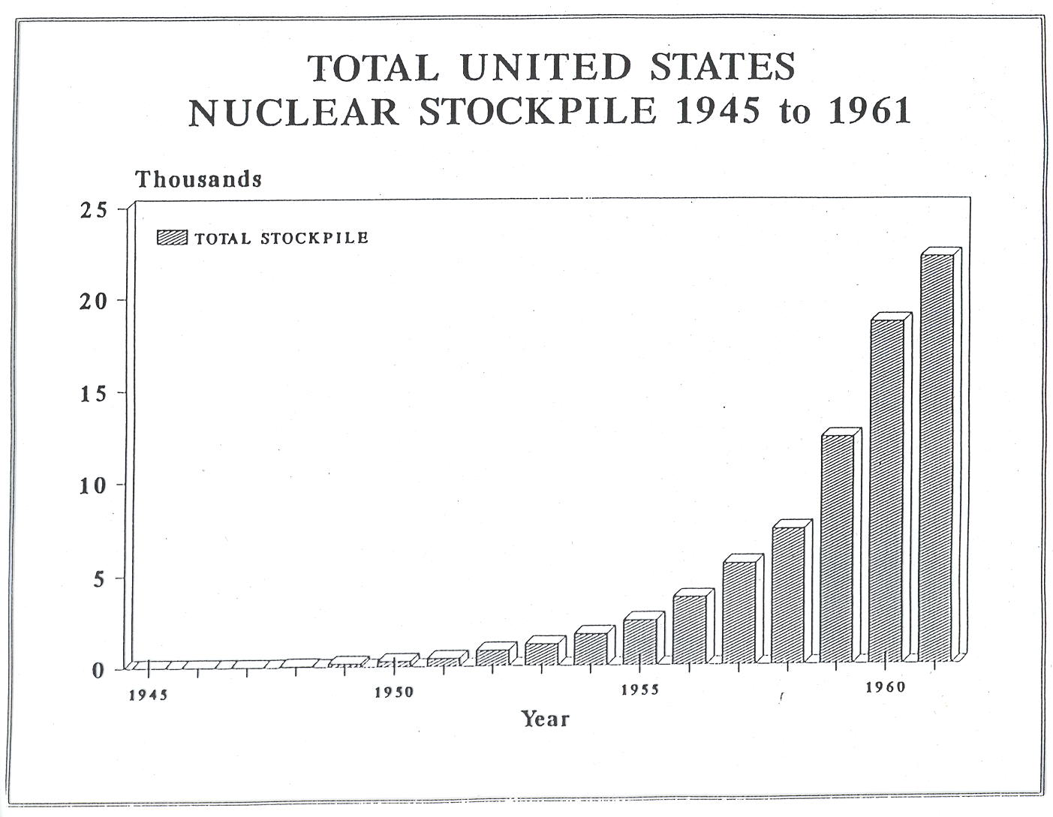
Results: Product

Slide 9
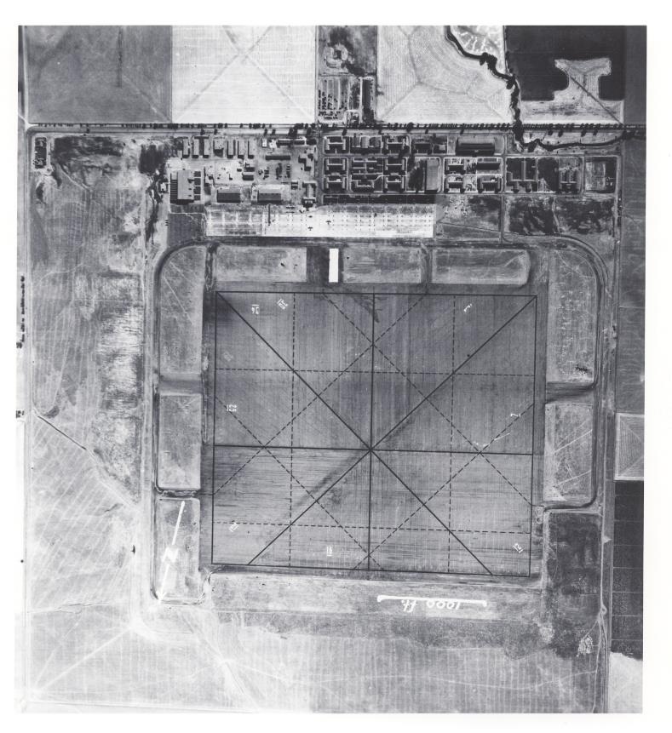
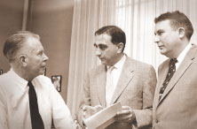
University of California Rad Lab: A Second Site
E. O. Lawrence, Edward Teller, Herb York
Naval Air Station Livermore, 1943

Slide 10
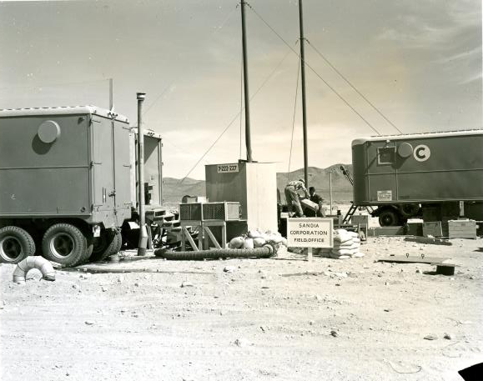
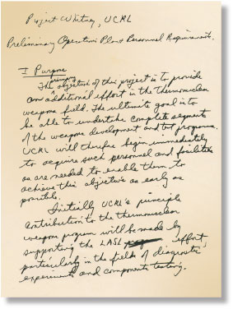
Sandia Support for UCRL, Livermore
Sandia at
Operation
Upshot-Knothole
NAS WAVEs barracks used as offices
York’s draft plan for UCRL Livermore

Slide 11
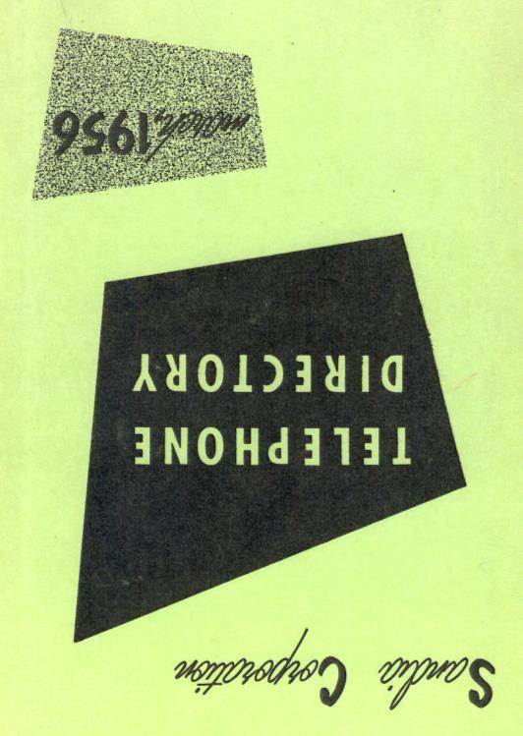
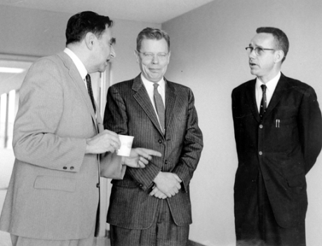
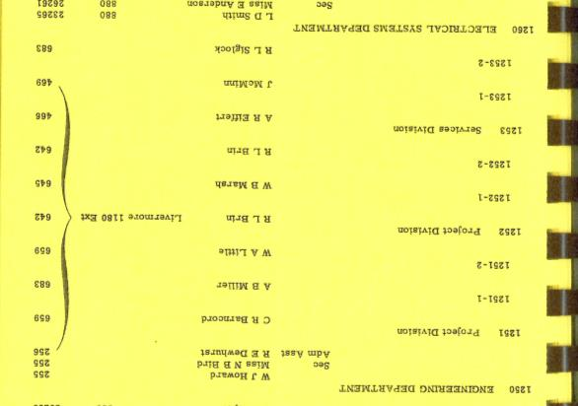
Announcing a New Sandia Site
Teller, McRae, and Howard

Slide 12
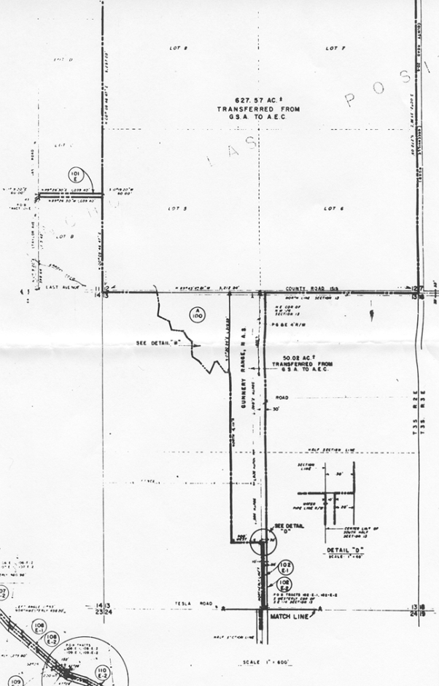
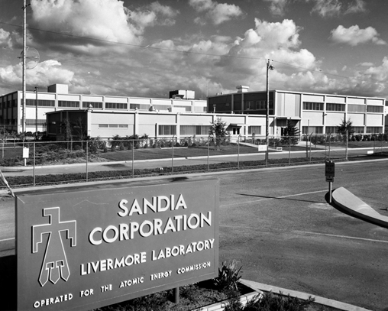
Location

Slide 13
Facilities Plan

Slide 14
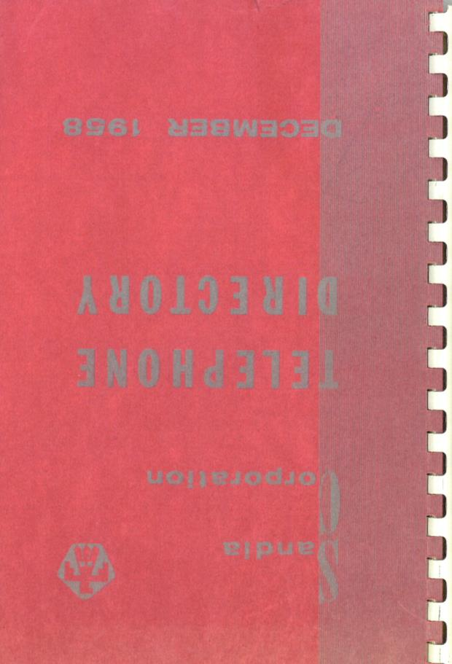
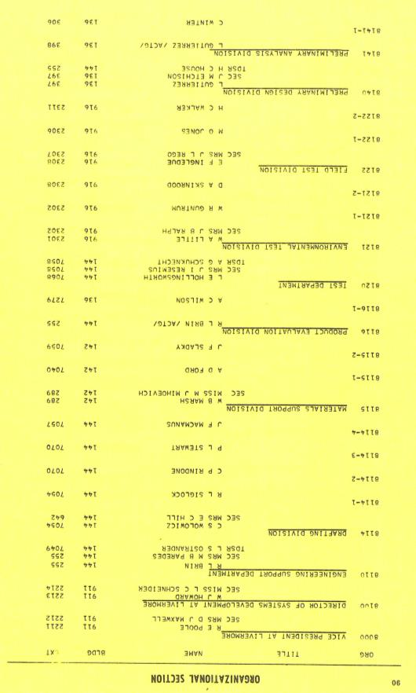
Expansion and Reorganization
Howard, Poole, Molnar, and Campbell, 1958

Slide 15
Capabilities

Slide 16
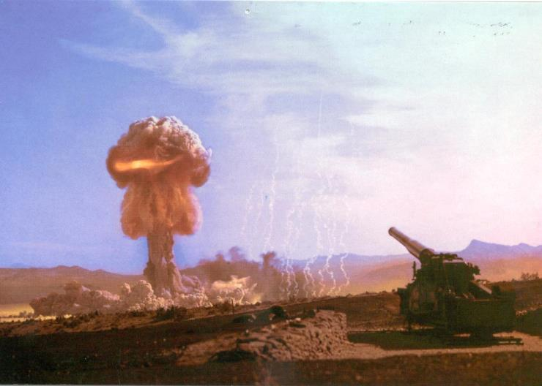
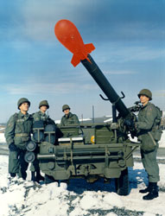
Early Work
W48
155mm cannon
W54
Davy Crockett

Slide 17
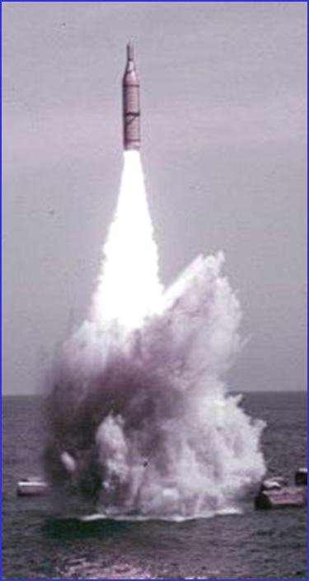
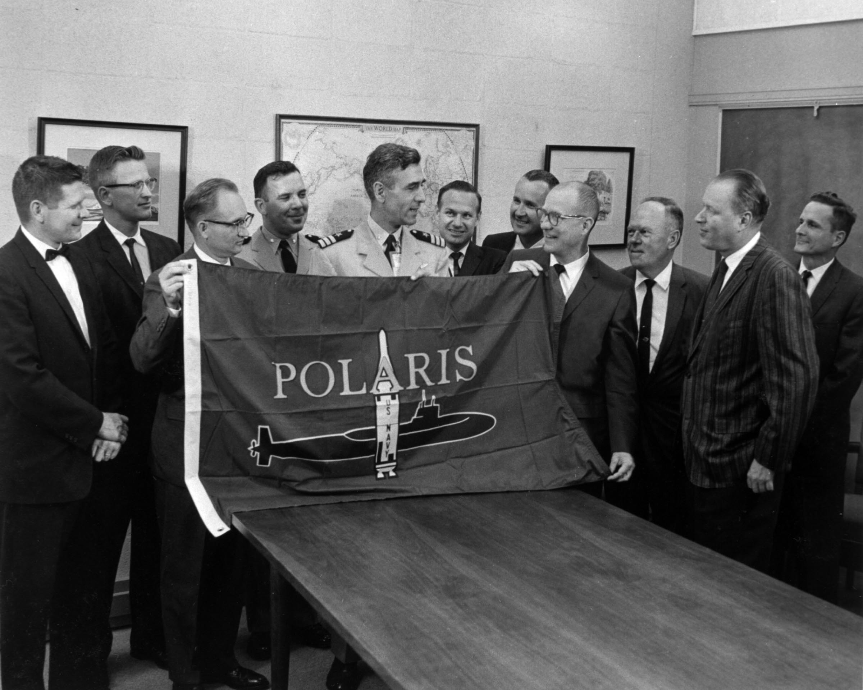
Polaris
W47
Polaris
SLBM

Slide 18
Accomplishments

Slide 19
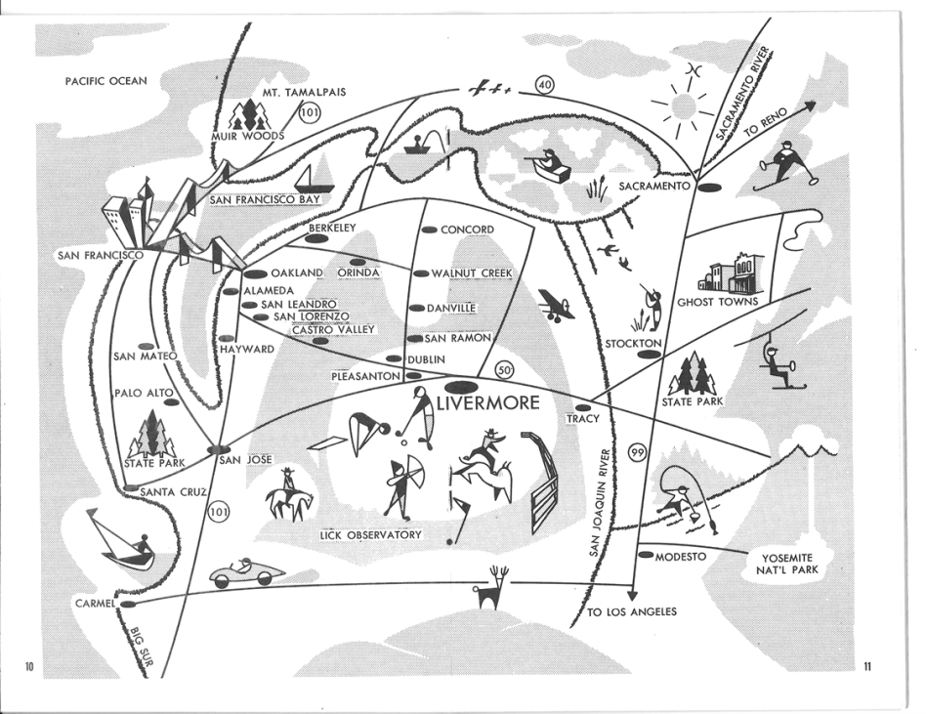
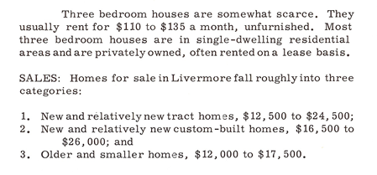
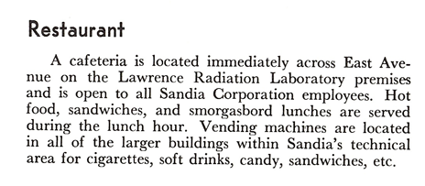
Livermore, California

Slide 20
Community

Slide 21
Thank you

