Slide 1
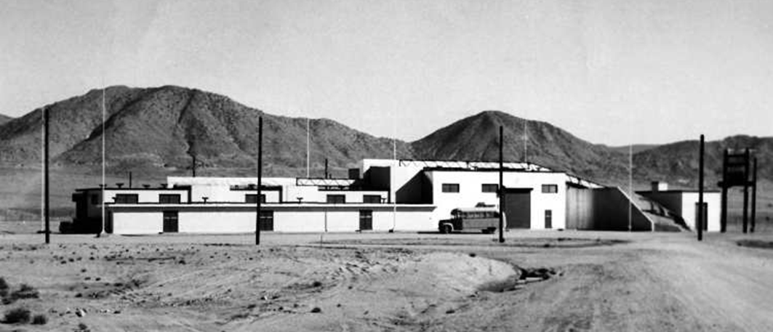
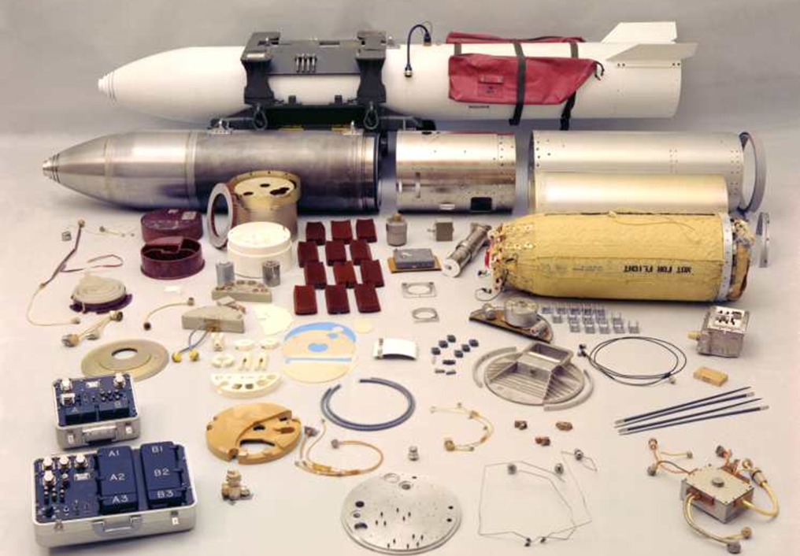
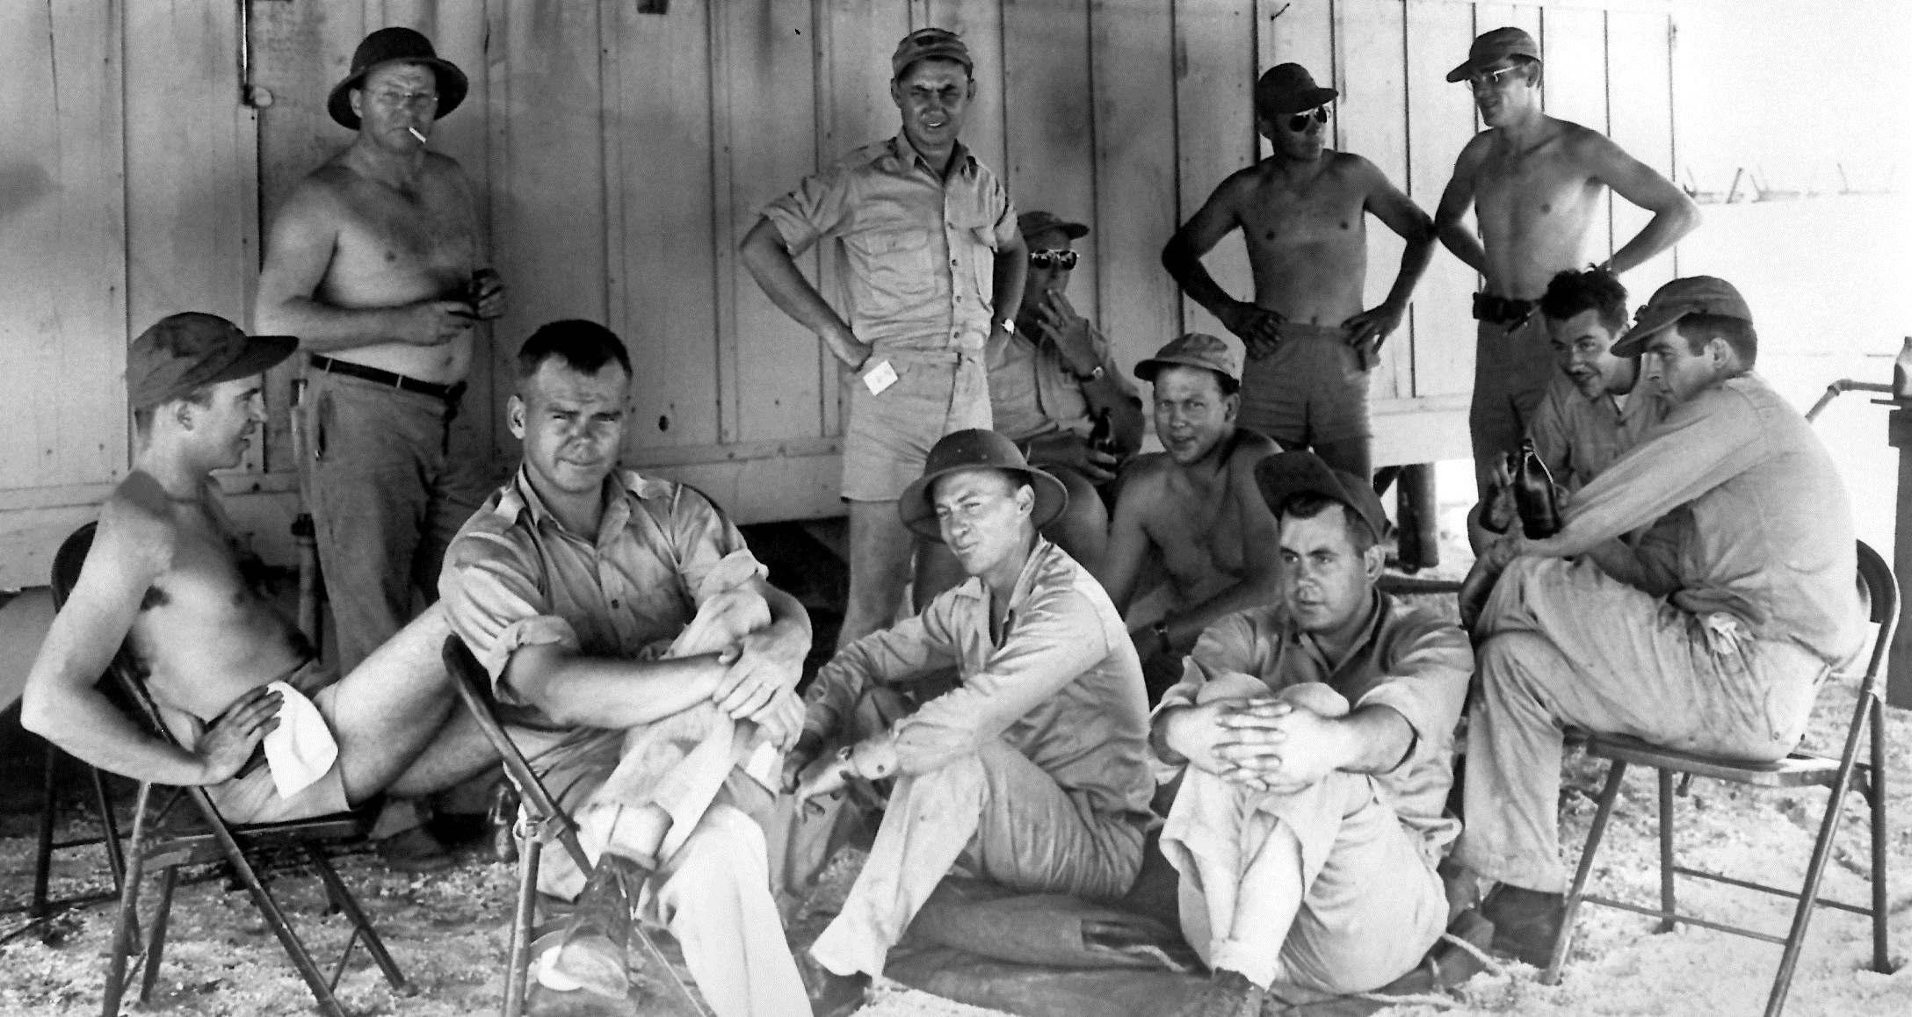
Building a Nuclear Ordnance Engineering Lab:
A History of Sandia
Rebecca Ullrich
Corporate Historian
SAND2005-6126C

Slide 2
What’s in a Weapon?

Slide 3
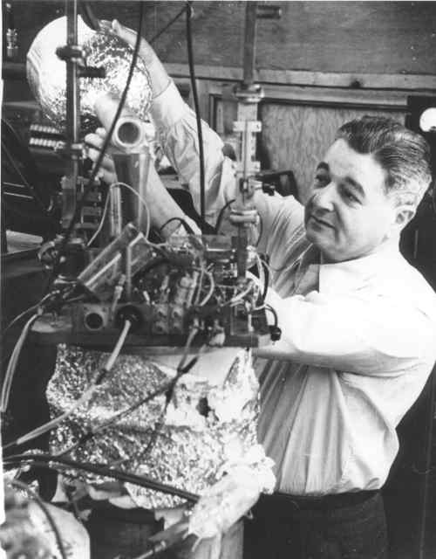
Origins: Creating Z Division
J. Robert Oppenheimer
Jerrold R. Zacharias

Slide 4
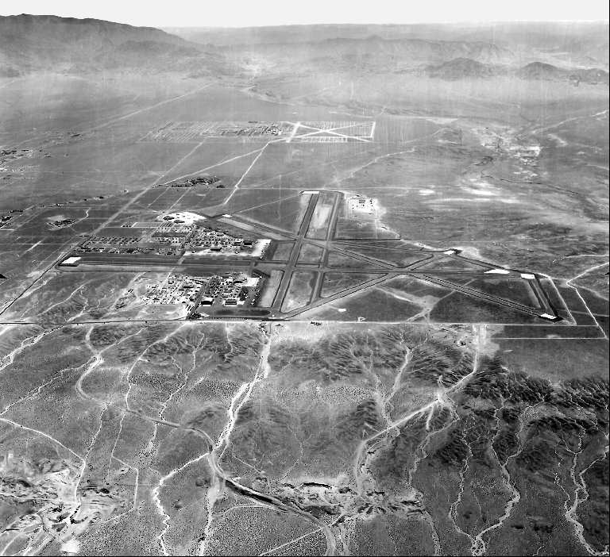
Origins: Choosing a Site

Slide 5
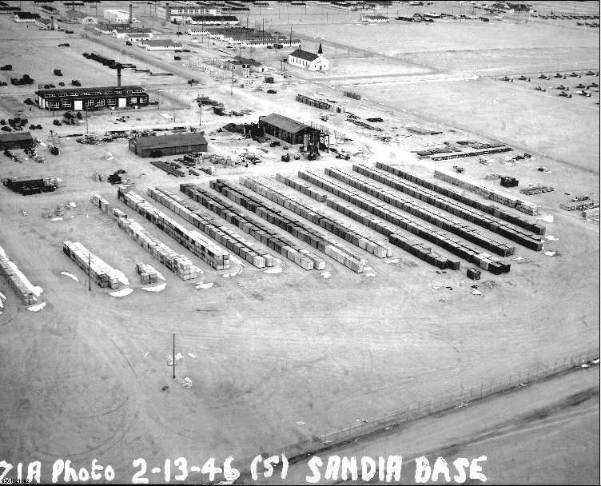
Origins: Building a Lab

Slide 6
JTF-1 Operation Crossroads

Slide 7
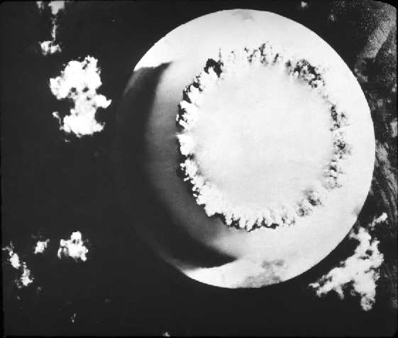
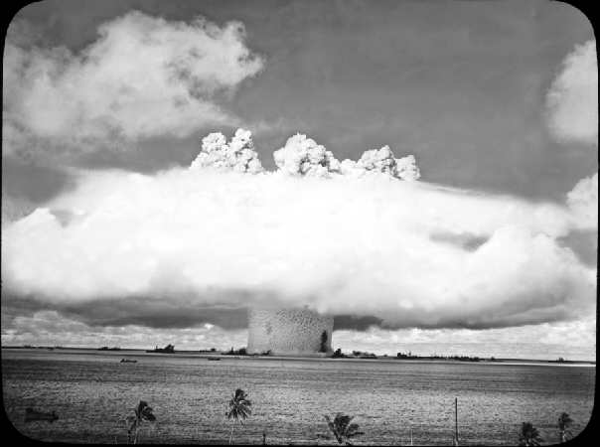
Operation Crossroads
21 kt Baker Shot; July 24, 1946

Slide 8
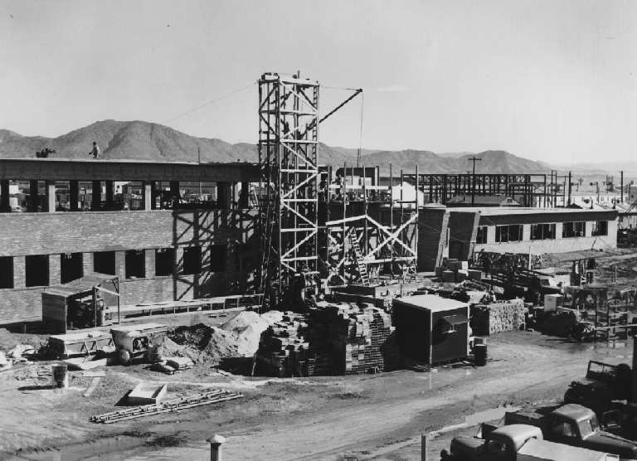
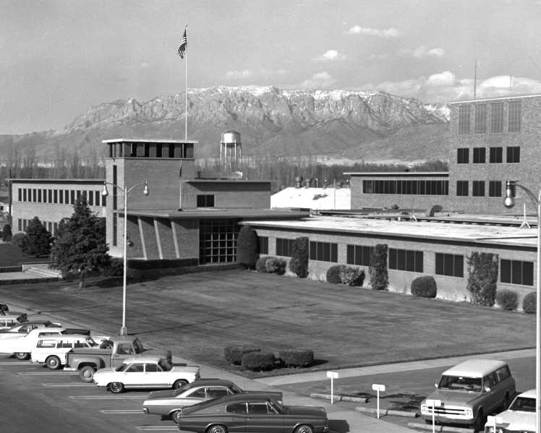
Building 800—Kruger Design

Slide 9
Early Assembly Facilities

Slide 10
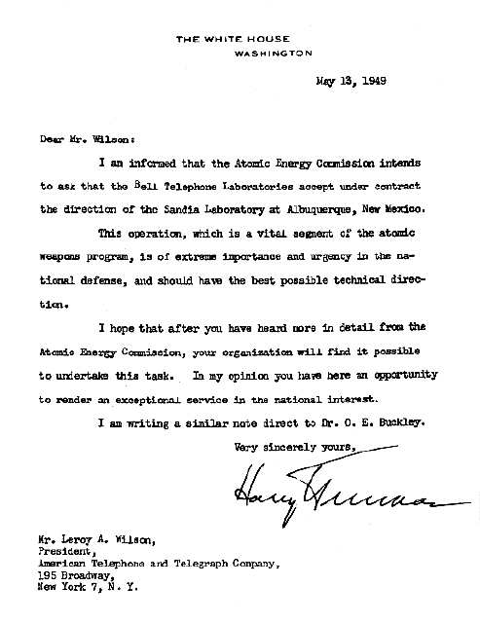
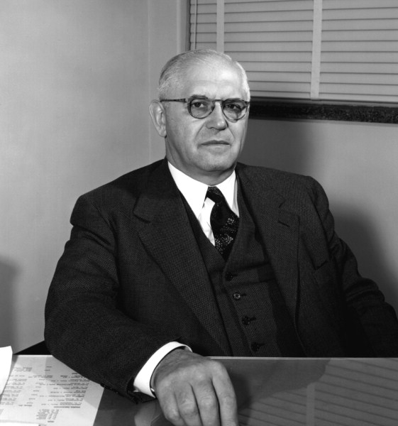
Transition in Sandia Lab Status
First Sandia Corporation President, George Landry

Slide 11
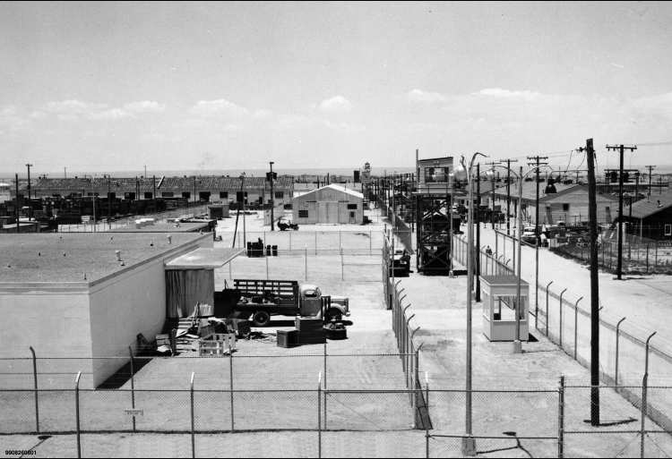
Main Sandia Tech Area: 1949

Slide 12
The Nuclear Weapons Complex 1949
Los Alamos
Sandia
Oak Ridge
Y-12
Kansas City
Burlington
Hanford
Mound
Oak Ridge
K-25
Rock Island
Inyokern
Picatinny

Slide 13
The Nuclear Weapons Complex 1950-1951
Los Alamos
Sandia
Oak Ridge
Y-12
Pantex
NTS
Burlington
Hanford
Mound
Rocky Flats
Savannah
River
Fernald
Oak Ridge
K-25
Rock Island
Kansas City
Inyokern
Picatinny

Slide 14
The Nuclear Weapons Complex 1952-1953
Los Alamos
Livermore
Sandia
Oak Ridge
Y-12
Pantex
Nevada
(NTS)
Burlington
Hanford
Mound
Rocky Flats
Savannah
River
Fernald
Oak Ridge
K-25
Albuquerque
Portsmouth
Kansas City
Inyokern
(Salt Wells)
Picatinny
Paducah

Slide 15
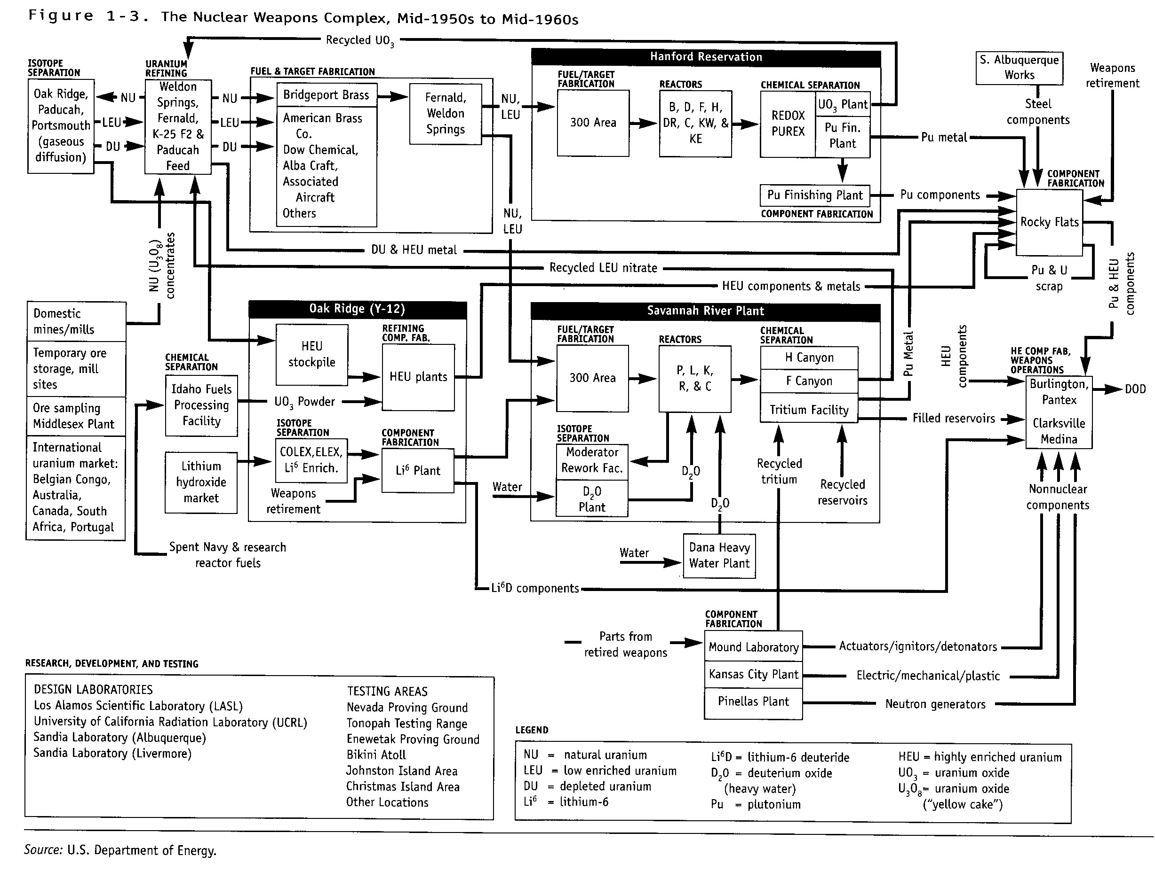
From: Linking Legacies: Connecting the Cold War Nuclear Weapons Production Processes to Their Environmental Consequences, DOE/EM-0319
(U.S. Department of Energy, Office of Environmental Management, 1997), 122.

Slide 16
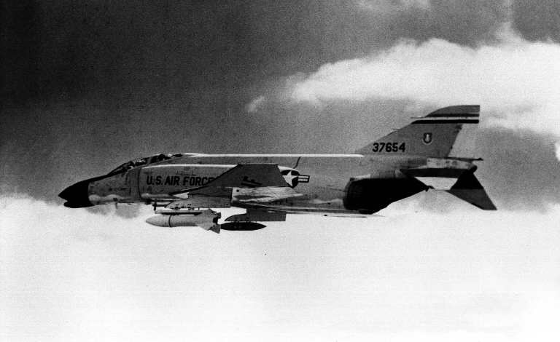
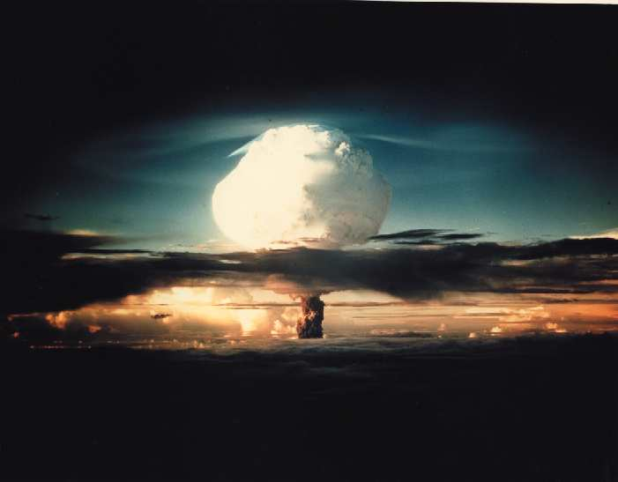
Pushing for Variety in Weapons Designs

Slide 17
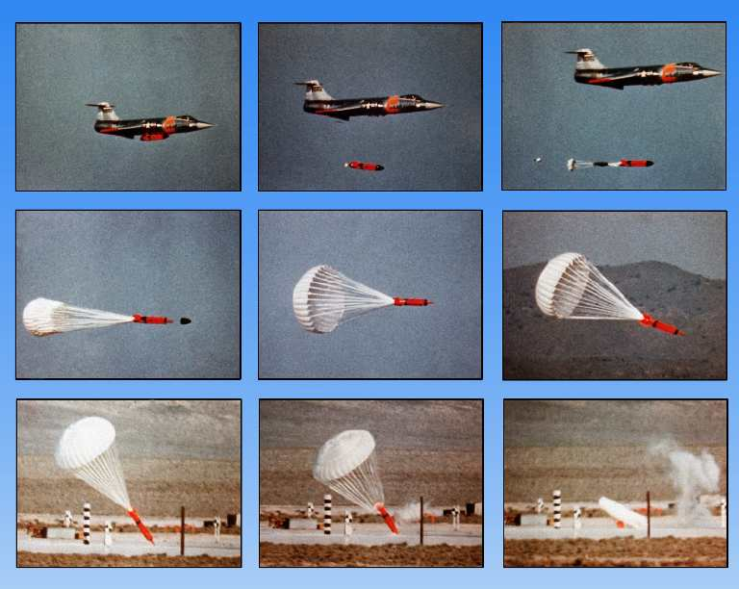
Laydown Weapons

Slide 18
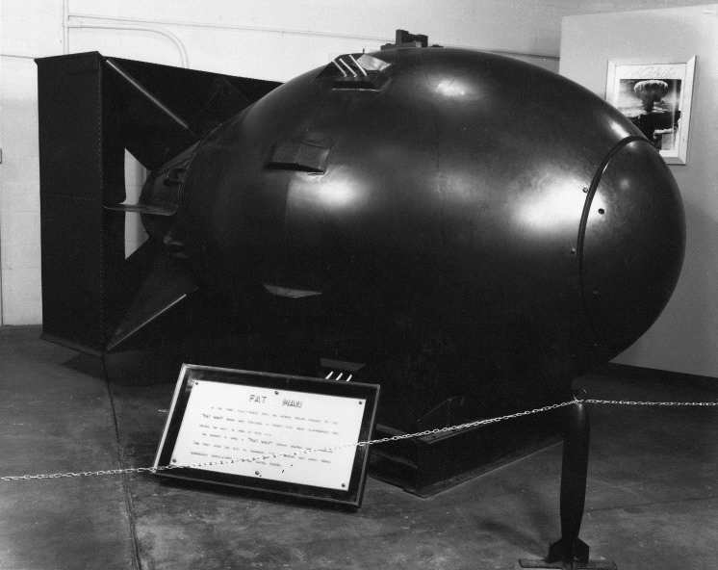
Fat Man

Slide 19
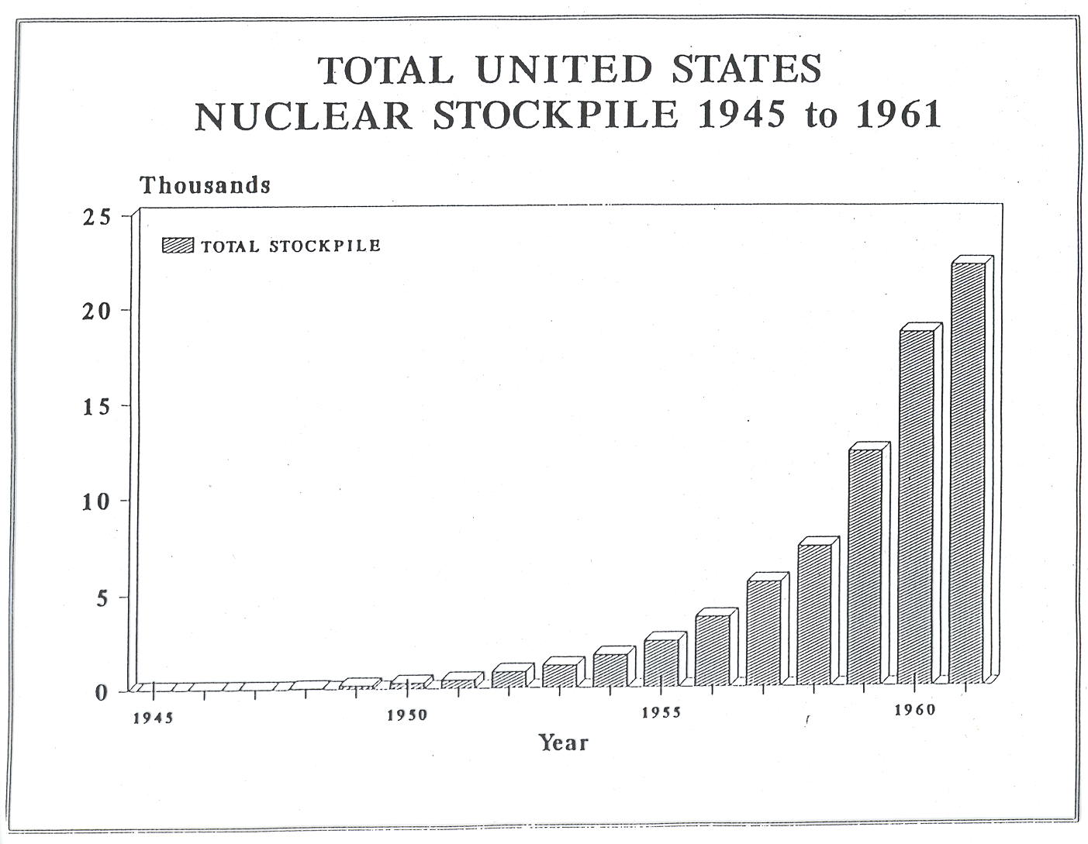
Result of Growth: Complex

Slide 20
Result of Growth: Complex

Slide 21
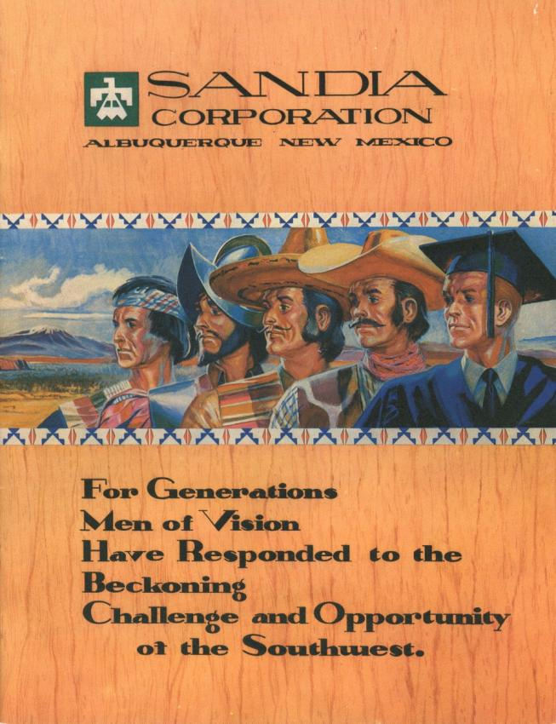
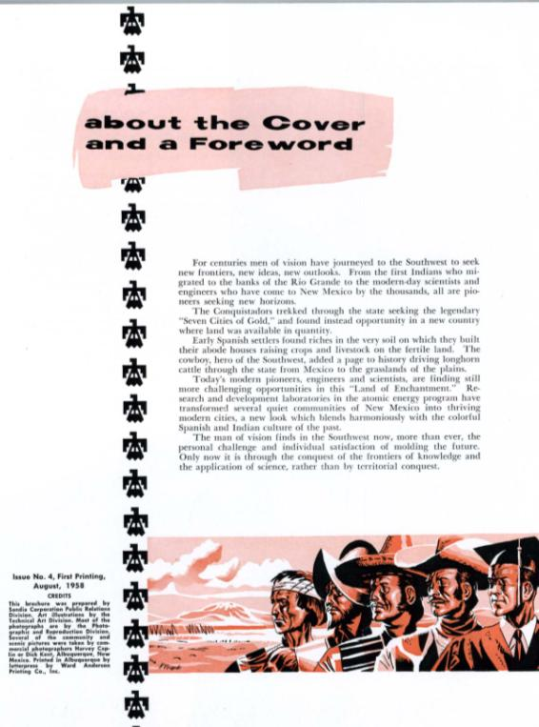
1958 Employee Brochure

Slide 22
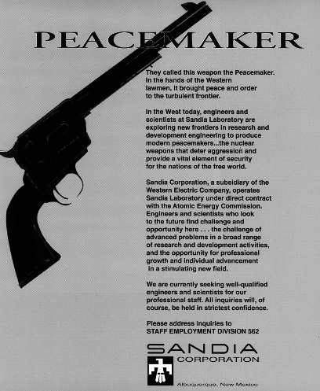
Reflecting Policy and Place (1958)
Notes:
1958 recruiting ad

Slide 23
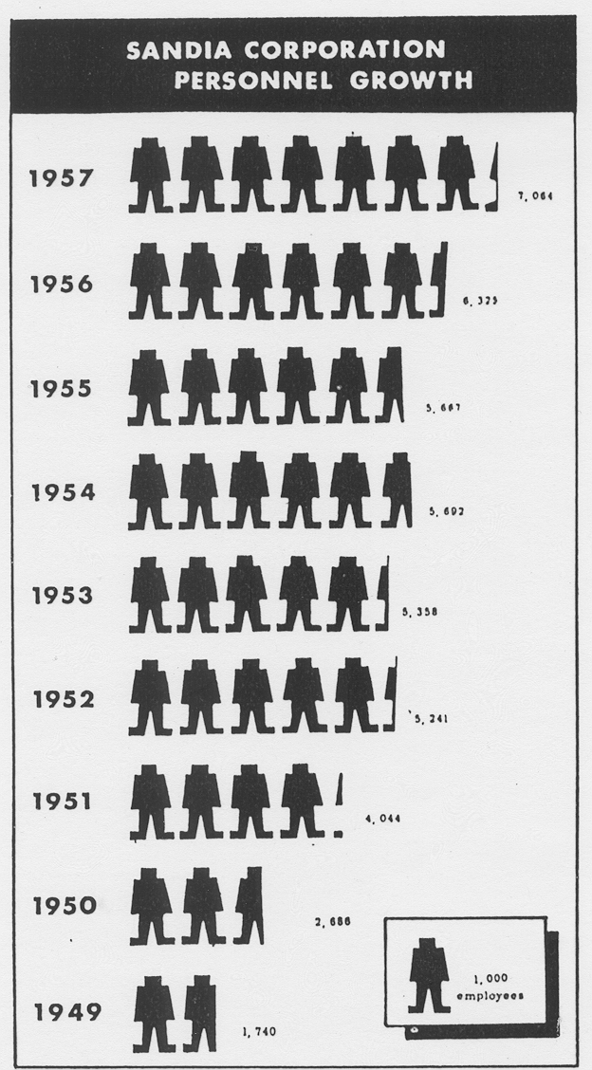
Result of Growth: Sandia

Slide 24
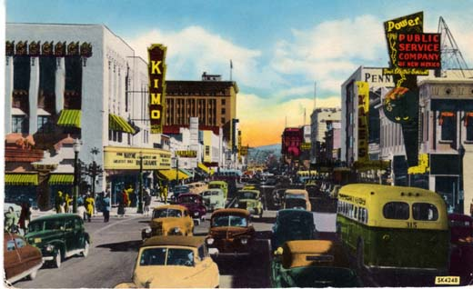
Result of Growth: Albuquerque

Slide 25
Populations
Year | Albuquerque Population | Bernalillo County Population | Sandia Workforce | Base Workforce
1930 | 26,570
1940 | 35,449 | 69,391
1946 |  |  | 100 | 979
1949 |  |  | 1,740 | 1,627
1950 | 96,815 | 145,673 | >2,100 | 2,723
1954 |  | 185,800 | >5,600 | 6,025
1955 | 150,000 | 205,500 | 5,725 | 5,414
1957 |  |  | 7,064
1960 | 201,189 | 262,199

Slide 26
Sandia Purchasing in New Mexico

Slide 27
Housing Permits, 1940-1954
Year | Housing Permit $
1940 | >2.3 million
1949 | 20.4 million
1952 | >25 million
1954 | <37.4 million

Slide 28
Conclusions

Slide 29
Questions?
Thank you!

