Slide 1
Hands-On Minds-On Technologies
A Brief Conversation About Cybersecurity
Chris Jenkins
George Thompson
June 24, 2023
SAND2021-12744 PE

Slide 2
Agenda
Introduction
What is cybersecurity?
Let’s look at your home network
Cybersecurity in the news
Networking devices
Summary

Slide 3
Background
Name: Chris Jenkins
Title: R&D S&E Cybersecurity
Degree: B.S. Computer Engineering, PhD, Electrical Engineering (Computer Architecture, Minor: Computer Science)
Originally From: Peoria, IL
How I got to SNL: Peoria -> UIUC -> UW Madison → Taiwan → San Diego → UW Madison → ABQ
First role at Sandia: EC-LDRD
1st patent
1st conference
Cryptography on a MSP 430 (microcontroller)
Hypervisor work on ARMv7 processors

Slide 4
Current Role
Research project for protecting military & space systems
Moving target defense for 3 non-IP network communication protocols
2.5 year project
Patent, 3 publications, career recognition
High Performance Computing
Qthreads – multithreading library
Port library over to ARMv8 architecture
Cyber Assessments
Variety of customers
Analyze devices & systems for vulnerabilities and design flaws
Recruiter
Interviewed over 100+ students
UIUC, UW Madison, UC Berkeley, NSBE Conferences, CCD internship program

Slide 5
Background
Name: George Thompson
Title: R&D S&E Cybersecurity
Degree: B.S. Computer Science, M.S, Computer Science(Secure Software Development)
Originally From: Colon, Panama (Grew up in Hampton, VA)
How I got to SNL: NSU -> ABQ -> NCAT→ ABQ
First role at Sandia: Summer Intern
Web Developer for a web app that visualizes complex data
Developer of a Cybersecurity Interactive event to teach students about Linux

Slide 6
Current Role
Secure Software Developer
Develop tools to help ensure the security of software
Create new capabilities and develop innovative technologies and methods to secure data and software from cyber attacks.
Fuzzing
Identifying Fuzzing tools that provide security value to applications
Consult and educate other team members at Sandia about Fuzzing and its benefits
Penetration Testing
Analyze Web and Cloud applications for vulnerabilities and design flaws
Variety of customers
Recruiter
Helped Organize Hack-a-Thons at HBCUs in order to recruit students

Slide 7
What is Cybersecurity?

Slide 8
Consumer / Enterprise
Consumer
Enterprise
Desktop
Laptop
Tablet
Phone
Store personal data
Credit cards
Passwords
Photos
Social Media
Key to my house/hotel room
Cloud Computing
Data Center
Stores IP
Financial statements
Trade secrets
Implementations
Weaknesses
Financial records
Services

Slide 9
Consumer / Enterprise
Industrial Internet
Internet of Things
Coined by GE
Power plaints
Oil refineries
Water treatment
Traffic lights
Smart Building
IIoT
Smart Thermostat
Wi-Fi washer/dryer
Heart monitoring implants
Biochip transponders on farm animals
Automobiles with built-in sensors
Field operation devices that assist fire-fighters in S&R

Slide 10
Passwords
Used to access your account
Paired with username or email address
Typical length is 8 to 16 characters
Different one for each site
Use password manager
Password
Passowrd!
1Password
Sundaylight
Morningbrew
#$j3)jdr3J
HMT3ch2*2e

Slide 11
Hashing
Coverts a set a data into a fixed size
Used for password storage
1Password! → 8e5682f9a6972e47a76717314f8bc0a76b836bb41310d346ca9306a92d3d4390
Very hard (impossible) to determine password from hash

Slide 12
Activity: Passwords
How long does it take to break a password?

Slide 13
How secure is my password
How many password combinations are there for a password with these attributes:
8 characters in length
Each character can be
Uppercase
Lowercase
Digit
One of 7 special characters
How many unique hashes?
10 characters
16 characters
Does requiring uppercase, lowercase, digit, and special character increase or decrease password space?
How fast can a computer compute hashes?
How to increase computation?
How to slow down computation?
Notes:
Uppercase = 26, Lowercase = 26, Digit = 10, Special chars = 7
26 + 26 + 10 + 7 = 69
69^8 = number of possible combinations = number of possible hashes = 513,798,374,428,641 = 513 Trillion
69^10 = 2,446,194,060,654,759,801 = 2.5 Quintillion
69^16 = 263,988,769,565,513,973,843,201,106,881= 263 octillion
Increase by multithreading, GPU, HPC, or anything which allows multiple computation in parallel
Slow down by using different hash function or personal modifier

Slide 14
Typical Hashing Speeds
513,798,374,428,641 hashes
How fast to check every hash (or combination) using:
CPU: 10kh/s (10,000)
GPU: 40mh/s (40,000,000)
ASIC: 90 th/s (90,000,000,000,000)
Notes:
https://www.gemini.com/cryptopedia/crypto-mining-rig-bitcoin-mining-calculator-asic-miner#section-gpu-mining-takes-over
69^8 = number of possible combinations = number of possible hashes = 513,798,374,428,641 / 10kh / s = 51,379,837,443s / 3600s = 14,272,177hrs / 24hrs = 594,674 days / 365 = 1,629 years
513,798,374,428,641 / 40mh/s = 12,844,959s / 86,400 s/day = 149 days
513,798,374,428,641 / 90th/s = 57s

Slide 15
Improve using HPC
Astra Supercomputer
Fastest Arm-based supercomputer (2018)
2,592 nodes
2 CPUs per node
28 processing cores per CPU
How fast to check every hash using Astra?
Notes:
69^8 = number of possible combinations = number of possible hashes = 513,798,374,428,641 / 51,840,000h / s = 9,911,234s / 86,400 s/day = 115 days
2,592*2 * 10,000 = 51,840,000h/s

Slide 16
Encryption / Decryption
Turn data from readable to unreadable
Symmetric uses same key
Asymmetric uses different keys but the keys are related
This is used to turn the lock in your browser green
This is used to protect banking transactions when you log in

Slide 17
Activity: Encryption
Can you break my encryption algorithm?

Slide 18
Can you break my encryption?
Can you decrypt the following?:
Jfilyzljbypaf pz mbu huk lejpapun! OTAljo pz aol ilza!
Hints:
2 sentences
Uses alphabet
Shifts letter by a certain amount (a → d, a → f)
Start with a small word and then move onto larger words
Notes:
Cybersecurity is fun and exciting! HMTech is the best!
https://cryptii.com/pipes/caesar-cipher

Slide 19
Your Home Network
Let’s think about cybersecurity of your home network

Slide 20
Applicability Discussion
Remote work / WFH
How many of you have consumer-grade
Cable/DSL modems, whether you rent or own?
Wi-Fi routers?
IP cameras?
NASes?
Knowingly or otherwise, do you trust these devices?
Do you rely on your Wi-Fi router to firewall you from the Internet?
How often do you update the firmware on your devices?

Slide 21
The Typical Consumer Setup

Slide 22
An Advanced Consumer Setup

Slide 23
The Security Mirage

Slide 24
The Security Mirage

Slide 25
Cybersecurity in the news
Let’s discuss events in the news

Slide 26
Cybersecurity in the news
Source: https://youtu.be/ER5iAyu3Wfk

Slide 27
In the News – HPE iLO4
Notes:
https://www.bleepingcomputer.com/news/security/you-can-bypass-authentication-on-hpe-ilo4-servers-with-29-a-characters/
https://airbus-seclab.github.io/ilo/SSTIC2018-Article-subverting_your_server_through_its_bmc_the_hpe_ilo4_case-gazet_perigaud_czarny.pdf

Slide 28
In the News – HPE iLO4

Slide 29
In the News – HPE iLO4

Slide 30
In the News – HS Student Hack
Notes:
https://www.bleepingcomputer.com/news/security/students-hack-high-school-to-change-grades-get-lunch-refunds/

Slide 31
In the News – HS Student Hack
School employee logged into his account a noticed an error
They tried to disguise their identity by modifying the records for 20 students
School employees with the help of forensic data experts managed to track down the two culprits
Patched the vulnerability students used to get into their MISTAR system.
Overall, we're seriously impressed with the way the high school's staff handed the hack. They've hired a forensic investigator, set up a dedicated FAQ page, prepared password resets, and got the superintendent to apologize in a YouTube video, à la Equifax. Much better and clearer at communicating the incident's details than many Fortune 500 companies.

Slide 32
In the News – Colonial Pipeline
Supplies half of all fuel on the east coast of the US
Stole 100 GBs of files in about 2 hours
Took certain systems offline
Collect and exfiltrate documents of 5,810 individuals
Contains items such as SSN, DoB, license, health-info
Notes:
https://www.bleepingcomputer.com/news/security/colonial-pipeline-reports-data-breach-after-may-ransomware-attack/
https://www.bleepingcomputer.com/news/security/largest-us-pipeline-shuts-down-operations-after-ransomware-attack/

Slide 33
Summary
Final Thoughts

Slide 34
My Fundamental Law of Cybersecurity

Slide 35
How to protect yourself
Use virtual credit cards online
Use a password manager
Encrypt sensitive data at rest
Backup to online storage (use encryption)
Have a backup policy / strategy for your household and let the member know what it is
Use a virtual phone number
Shred sensitive documents (after scanning?)
Use physical security where needed

Slide 36
Further reading – Website hacking
Tactics are considered old, but excellent read
Shows how you a simple flaw can gain great privilege
Consider what mitigations could stop the attack and why
Notes:
https://www.practicalnetworking.net/index/networking-fundamentals-how-data-moves-through-the-internet/

Slide 37
Questions?

Slide 38
Networking Background
How do computers talk to each other?

Slide 39
Networking Background
OSI (interconnection) model
Switches
Routers
Wireless LAN

Slide 40
OSI Model
7 layers (4 layers sometimes)
Hub – layer 1
Bridge – layer 2
Routers – layer 3
WAP – layer 2
Switches – layer 2
NAT – layer 4
Web browser – layer 7
SSH – layers 5, 6 7
Source: https://www.cloudflare.com/learning/ddos/glossary/open-systems-interconnection-model-osi/

Slide 41
Switches
Layer 2
Unmanaged
Plug-n-play
No controllable features
Managed
VLAN
QoS
Web interface / SSH/ Console
Source: https://www.lifewire.com/definition-of-network-switch-817588
Notes:
https://www.lifewire.com/definition-of-network-switch-817588

Slide 42
Routers
Layer 3
Routes IP packets between networks
Connects to ISP equipment
May be combined with other features:
Firewall
VLANs
Switch
Source: https://www.lifewire.com/what-is-a-router-2618162
Notes:
https://www.lifewire.com/definition-of-network-switch-817588

Slide 43
Wireless LAN
No wires needed!!
Decent speeds (Mbps or Gbps)
Not as fast as wired (1 / 2.5 / 5 / 10 Gbps)
Has interference (beware of channels)
Popular for mobile devices (e.g. tablets, laptops, phones)
Common access point for hackers

Slide 44
Backup

Slide 45
Target Breach
December 2013
40 million credit cards stolen
Found information about network design on a Microsoft website
A Google search turned up a list of HVAC and refrigeration companies
Compromised 3rd-party vendor via phishing email
Alarms received but the warning was ignored
Access to all point-of-sale systems for any Target store
BMC software installed an admin user only used for batch jobs
Notes:
https://www.sans.org/white-papers/35412/
https://www.zdnet.com/article/anatomy-of-the-target-data-breach-missed-opportunities-and-lessons-learned/
https://securityintelligence.com/target-breach-protect-against-similar-attacks-retailers
https://krebsonsecurity.com/2014/01/new-clues-in-the-target-breach

Slide 46
Target Breach – Attack Anatomy
Notes:
https://securityintelligence.com/target-breach-protect-against-similar-attacks-retailers/

Slide 47
Target Breach – How did it happen?
Had password policy but not being followed
Some services had default or weak passwords
File containing valid network credentials being stored
Within one week, the security consultants reported that they were able to crack 472,308 of Target’s 547,470 passwords (86 percent) that allowed access to various internal networks, including; target.com, corp.target.com; email.target.com; stores.target.com; hq.target.com; labs.target.com; and olk.target.com.
Notes:
https://krebsonsecurity.com/2015/09/inside-target-corp-days-after-2013-breach/

Slide 48
Target Breach - Mitigations
Improved monitoring and logging of system activity
Installed application whitelisting POS systems and
Implemented POS management tools
Improved firewall rules and policies
Limited or disabled vendor access to their network
Disabled, reset, or reduced privileges on over 445,000 Target personnel and contractor accounts
Expanded the use of two-factor authentication and password vaults
Trained individuals on password rotation
Notes:
https://www.zdnet.com/article/anatomy-of-the-target-data-breach-missed-opportunities-and-lessons-learned/

Slide 49
Target Breach – How did it happen?
Notes:
https://krebsonsecurity.com/2015/09/inside-target-corp-days-after-2013-breach/

Slide 50
Target Breach – Let me show you something!
Notes:
https://krebsonsecurity.com/2015/09/inside-target-corp-days-after-2013-breach/

Slide 51
Target Breach – More information

Slide 52
Some Specific Security Issues
SNMP service in Atmel 802.11b VNET-B Access Point 1.3 and earlier, as used in Netgear ME102 and Linksys WAP11, accepts arbitrary community strings with requested MIB modifications, which allows remote attackers to obtain sensitive information such as WEP keys, cause a denial of service, or gain access to the network.
This is like accepting any password, not just a valid one.

Slide 53
Some Specific Security Issues
Linksys EtherFast BEFSR41 Cable/DSL routers running firmware before 1.39.3 Beta allows a remote attacker to view administration and user passwords by connecting to the router and viewing the HTML source for (1) index.htm and (2) Password.htm.
This is like giving the password to an attacker, then asking them for it to login.

Slide 54
Some Root Causes
Why all these problems?
The bar is set low: security stinks, in general
With embedded systems, security smells particularly foul
There is little incentive to fix identified problems
You get what you pay for: low-cost mean low(er) quality
There is little investment in engineering and development
Vendors tend to just hastily glue together third-party hardware and software to build “their” consumer-grade products
Vendors don’t assign their “A game” to developing these products
There has not been, and likely never will be, consumer outcry

Slide 55
Some Specific Security Issues
VPN Server module in Linksys EtherFast BEFVP41 Cable/DSL VPN Router before 1.40.1 reduces the key lengths for keys that are supplied via manual key entry, which makes it easier for attackers to crack the keys.
This is like accepting a 20 character password, but only checking the first 8 characters at login.

Slide 56
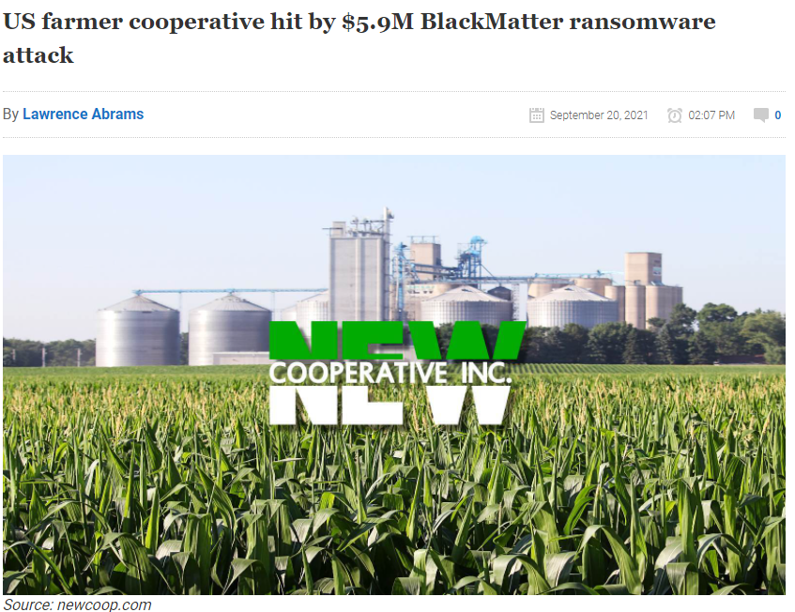
In the News – US farmer cooperative
$5.9M ransom, increase to $11.8M if not paid in 5 days
Feed and grain cooperative with over 60 locations in Iowa
Took systems offline to contain the attack
Stole these items:
soilmap.com project
R&D results
Sensitive employee information
Financial documents
Exported password manager dbase
Notes:
https://www.bleepingcomputer.com/news/security/us-farmer-cooperative-hit-by-59m-blackmatter-ransomware-attack/

Slide 57
In the News – SWIFT Attack
Notes:
https://www.bleepingcomputer.com/news/security/hackers-crashed-a-bank-s-computers-while-attempting-a-swift-hack/

Slide 58
In the News – SWIFT Attack
KillDisk variant
Wipes MBR
Banco de Chile
“This new KillDisk variant didn't bother showing a ransom note and just wiped computer's MBRs, leaving them in a non-bootable state.”
How to recover?

Slide 59
Some Specific Security Issues
$ strings GS105PE_V1.2.0.5.bin | grep -i passw
$ strings GS105PE_V1.2.0.5.bin | grep -i debug
In the Netgear ProSafe GS105PE firmware v1.2.0.5 and earlier, there is a built-in debug username ("ntgruser") and password ("debugpassword"); turns out it cannot be disabled.

Slide 60
Further reading – VLAN network setup
3 part series
Covers VLAN setup with Wi-Fi
Concepts can be applied to business networks
https://netosec.com/protect-home-network/
Notes:
https://netosec.com/protect-home-network/

Slide 61
Further reading – How data moves through the Internet
Describes the realities of moving data around the Internet
Helps understand networks and network design
Could assist with troubleshooting or penetration testing background
Notes:
https://www.practicalnetworking.net/index/networking-fundamentals-how-data-moves-through-the-internet/

Slide 62
Further reading - Admirer
Capture the flag
Understand the variety of tools an attack has access to
What tools do you have to defend?

Slide 63
In the News – Casino Hacked by Fish Tank
North American casino
Internet-connected fish tank (IoT)
Purpose
Remote monitoring
Adjust temperature
Adjust salinity
Feeding
10GB of data stolen
Fish tank used VPN
Used A/V protocol to transfer data
Notes:
https://www.washingtonpost.com/news/innovations/wp/2017/07/21/how-a-fish-tank-helped-hack-a-casino/
https://www.forbes.com/sites/leemathews/2017/07/27/criminals-hacked-a-fish-tank-to-steal-data-from-a-casino/?sh=2a8e2ab032b9
https://money.cnn.com/2017/07/19/technology/fish-tank-hack-darktrace/index.html
https://cdn2.hubspot.net/hubfs/2784256/1_nat_2017_recap/Presentations/Darktrace%20-%20Global%20Threat%20Report%202017.pdf?t=1528334118161

Slide 64
Computer Background
How do computers work?

Slide 65
Background - Modern CPU Rings
Rings
Concept
Lower number = higher privilege
Higher privilege means:
More instructions
Set memory access perms
Access system level registers
How to design a system?

Slide 66
Background - Computer Design
Rings and Code
Concept
Divide code into two levels
Portable across architectures
Userspace
Application
OS libraries
Issues system calls
Operating System
Handles system calls
Devices / Peripherals
Memory management
User Apps
User Apps / Libs
Libraries
Drivers
Kernel
Drivers / Kernel

Slide 67
Background – Operating Systems
User programs use API
Generic interfaces
Separates programs into address spaces
Implements system calls
Manages underlying system resources
http://i.stack.imgur.com/swJir.png

Slide 68
Background – Hypervisors
Type 2
Type 1
http://cdn.ttgtmedia.com/ITKE/uploads/blogs.dir/28/files/2009/10/whatisvirt12.jpg

Slide 69
Cybersecurity Essentials
Let’s discuss how to protect our networks

Slide 70
My Fundamental Law of Cybersecurity

Slide 71
Cybersecurity essentials: Application / Data
Use key-based authentication or password
Use MFA authentication for all (critical) systems
Zero-trust
Principle of least privilege
Backup (frequently)
Encryption
Anti-virus
Keep software update
Email server authentication
DKIM
SPF
DMARC
Email encryption
Password Manager

Slide 72
Cybersecurity essentials: People in the loop
Security Audit
Access is given to assessors by the owner/operator
Check for rogue equipment and unauthorized use
Vulnerability Assessment
Examine hardware and software components for known flaws (e.g., buffer overflows)
Penetration Test
Authorization to attack, but no access, is given to assessors by the owner/operator
Attempt to insert rogue equipment and bypass security controls
Red Team
Those activities enumerated for penetration tests
Determine criticality of systems to target missions

Slide 73
Cybersecurity essentials: Wireless LAN
No wires needed!!
Decent speeds (Mbps or Gbps)
Has interference (beware of channels)
Popular for mobile devices (e.g. tablets, laptops, phones)
Common access point for hackers
Hide WAP SSID
WPA2 or WPA3 (pre-shared)
RADIUS server or similar
MAC-filtering
WAP power level
AP Isolation
On separate subnet / VLAN
Separate purpose of WAP (Guest / Staff / etc.)

Slide 74
Cybersecurity essentials: Firewall
OS-based or network-based
Suggest deny all policy to start (default policy)
Open up firewall based on company needs
Backup configuration
Limited management access to single VLAN or specific IP or local access
Mini PC vs appliance
Open source vs proprietary

Slide 75
Cybersecurity essentials: Variety of attacks
Code Injection
Buffer overflow
Return-to-libc
Return-oriented programming (ROP)
Jump-oriented programming (JOP)
Web
Cross-site scripting (XSS)
Cross-site request forgery (CSRF)
SQL Injection
Ransomware
Brute force
Credential stuffing
Traffic sniffing
DoS
Spoofing
Phishing

Slide 76
Cybersecurity essentials: Basic Security Concepts
Budget / Document
Employee training
Zero-trust
VPNs
Network segmentation
ACL
Use firewalls
Use key-based authentication or password
Use MFA authentication for all (critical) systems
Principle of least privilege
Keep software update
Backup (frequently)
(Automatic) auditing
Use HTTPS & SSH
Strong passwords
Physical security
Email authentication

Slide 77
Cybersecurity essentials: Networking
Encrypted transport (e.g., SSH, HTTPS, VPN, IPSec, etc.)
Network segmentation (i.e. VLANs or physical)
Traffic shaping
Use (multiple) firewalls

Slide 78
Cybersecurity essentials: Cyber-security budget
NAS (backups)
(VLAN-aware) Switches
(VLAN-aware) Routers
(Next-generation) Firewalls
Servers
Clients
Cyber-security software
Auditing
Penetration testing
Backup testing
Documentation
Employee Training
Line item

Slide 79
VLAN
Virtual Local Access Network
Operates at layer 2
Segments broadcast domains (performance)
Isolates computers into a local network (security)
Source: https://www.practicalnetworking.net/stand-alone/vlans/
Notes:
https://www.practicalnetworking.net/stand-alone/vlans/

Slide 80
Notional Network
Let’s analyze a SMB network

Slide 81
ABC Business, Inc. – Network Diagram

Slide 82
Your task
Describe what cyber security issues you see
Describe fixes to the network
Take 10 minutes to think about it

Slide 83
Basic Changes
You can always do more!
Add firewall to protect internal network
Employ network segmentation (physical or virtual)
Add (detailed) firewall rules
Audit every 6 months
Backup f/w, router, and switch configs (using company backup policy)
This is a nominal example, consult with a certified or experienced professional to assist with your specific business needs

Slide 84
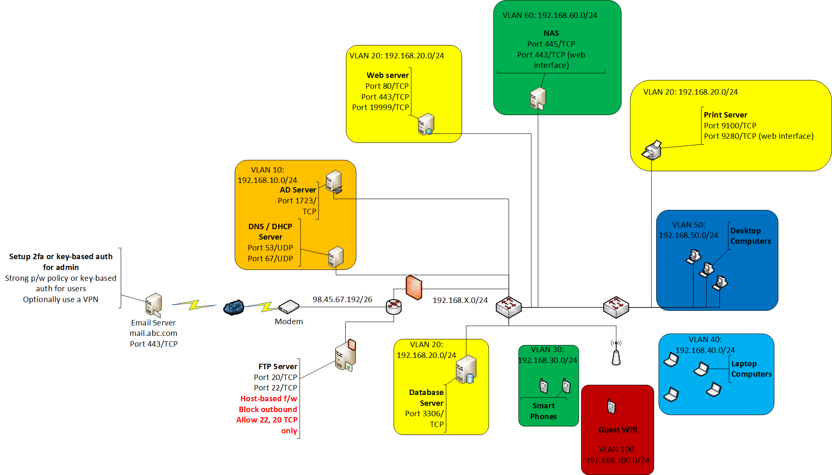
Suggested Network

Slide 85
Suggested Network from GAIC Report
GAIC Report (2003)
Nominal network
Uses
Multiple firewalls
Breaks up internal IP space
Before the cloud (on-premise)
Network segmentation is obvious
Notes:
Stan Jenkins. Secure Network Architecture: Best Practices for Small Business and Government
Entities. Global Information Assurance Certification Paper. April 3, 2003

