Slide 1
Intro to the Linux Command Line
Networking Basics and Hacking Simulation
Charles Reinke & Warren Davis
Hands-on, Minds-on Technology (HMTech) 2023

Slide 2
Why Command Line?
Text interface to your computer
Referred to as the shell, terminal, console, or prompt
Allows copy and paste of commands from other sources, such as a website
Preferred interface for mainframes and supercomputers
Compared with graphics, text is very light on resources

Slide 3
Why Command Line?
Efficient file management and system maintenance
Shell provides user commands and environment variables
Shell scripting automates long shell commands to make complex tasks easier

Slide 4
What is Linux
Alternative Operating System, like Windows or Macintosh
Inspired by Unix
Open source
Only used on 2.6% of all desktop computers
But, used on over 96% of webservers and 100% of the world's 500 fastest supercomputers!

Slide 5
What is Linux
Alternative Operating System, like Windows or Macintosh
Inspired by Unix
Open source
Only used on 2.6% of all desktop computers
But, used on over 96% of webservers and 100% of the world's 500 fastest supercomputers!
Also underpins ChromeOS (20% of all sub-$300 laptops)
Android is Linux-based, making Linux the
most-used general-purpose operating system!

Slide 6
Opening a Command Prompt
Click the Windows button and type powershell
Click on the “Windows PowerShell” app
Prompt tells you the computer is ready to accept a command
Not a Linux environment yet; we’re still in Windows

Slide 7
Connecting to a Linux Server
Type ssh bandit0@bandit.labs.overthewire.org –p 2220 and hit Enter
If you get a “Are you sure you want to continue connecting […]” message, type yes and hit Enter
Enter bandit0 for the password
Now we are in a Linux environment!
Let’s try running some basic commands…

Slide 8
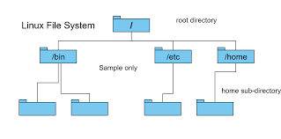
Basic Linux Commands
Type pwd and press the Enter or Return key
Case matters, PWD or Pwd won’t work
Prints out the shell’s current working directory
Try a few other commands:
ls
Lists the contents of the a directory
cd
Allows you to change your current directory
mkdir
Make a new directory
exit
Closes the terminal
Do you remember how to log back in? ☺

Slide 9
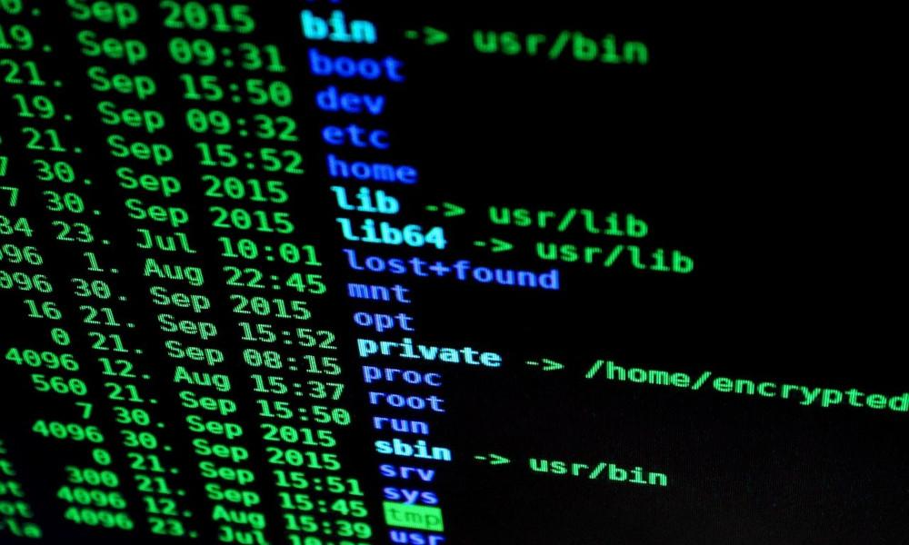
Basic Linux Commands, cont.
echo
Prints its arguments back out again
cat
Concatenate file contents (and print them out)
mv
Move or rename a file or directory
rmdir
Remove (or delete) an empty directory
rm
Remove (or delete) a file
Does not move files to a folder called “trash” or similar; deletes them totally, utterly, and irrevocably!

Slide 10
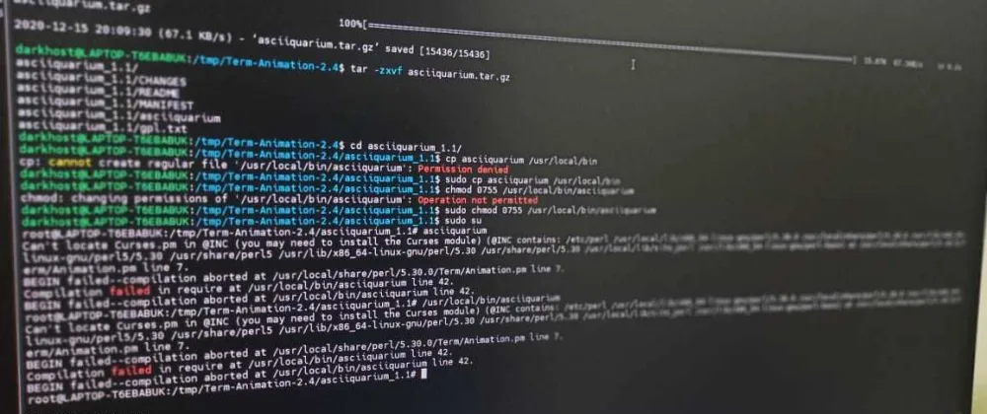
Useful Commands
man
Displays the instruction manual for a command
grep
Searches files for lines matching a given pattern
find
Search for files in a directory hierarchy
vi, emacs
Text file editors
ls -al
List all files, including “hidden” files

Slide 11
Useful Commands, cont.
ssh
Secure shell connection to a remote client
We know this one already √ (more secure than telnet)
more, less
Displays files one screenful at a time
diff
Prints the differences between two or more files
sort
Sorts lines of text files
strings
Prints the strings of printable characters in a file

Slide 12
Wargames: Bandit
Exercises beginner command line usage and hacking skills
The goal of each level is to find the password for the next level
Often, this will involve finding the correct file, opening it, and reading the contents
You get to play the hacker!
If you have no idea what you are supposed to do, Don’t panic! Don’t give up!
Asking for help is encouraged (the instructor, a TA, your neighbor)

Slide 13
Bandit, Cont.
Navigate in your browser to: https://overthewire.org/wargames/bandit
Read the instructions, then click the link for Level 0
We have already completed this level; click the link for Level 1
Read the instructions for hints on how to complete each level
Use the listed commands
Try man <command> or <command> --help for more information
See how far you can get!

Slide 14
Next Steps
Learn a programming language
Python is a great option → free, and lots of online tutorials
Try Linux on your own
Ubuntu is a great option → free, and lots of online support
Learn networking basics
Next week…
Learn cybersecurity basics
Third week…

