Slide 1
Exaflops the Final Frontier
Presentation to the 7th Workshop on Distributed Supercomputing:
Thomas Sterling
California Institute of Technology
and
NASA Jet Propulsion Laboratory
March 4, 2003

Slide 2
Susan: “There’s another email message from Neil Pundit”
Pundit: we would like to invite you to SOS-7
Sterling: Humbly accept this high honor.
Pundit: since you are going to be there, we would like you to give a technical talk.
Sterling: uh, sure. (quick, do I have an old talk he hasn’t seen?)
Pundit: since you are going to be giving a technical talk, we would like you to further expand on your ideas on a panel.
Sterling: errrrr…, of course, I’m glad to serve. (How bad can it be?)
Pundit: since you are going to be on the panel anyway, we thought you would enjoy being the panel chair, and …
Pundit: by the way, your research grant is up for renewal
Sterling: sigh, I mean yes. (one of Sterling’s laws is never chair panels)
Pundit: since you are going to be giving a technical talk anyway, we thought you would be honored to give it, …
Pundit: while everyone else is eating, and anxious to leave.
Sterling: <connection closed, please try again later>
(another one of Sterling’s laws of survival is never give banquet talks)

Slide 3
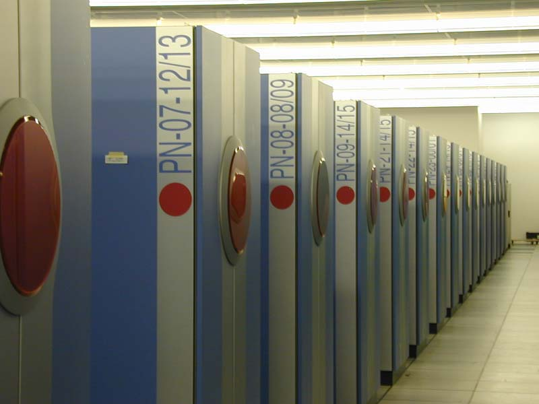
What is an Exaflops
Exa fl o p s
10¹⁸
seconds
floating
point
per
operations
10¹⁸ = 1,000,000,000,000,000,000 = billion billion or million million million
25,000 X the performance of the Japanese Earth Simulator, or
1000 X a Petaflops
Not interested in just one Exaflops, but the entire trans-Exaflops performance regime

Slide 4

10¹¹

Slide 5
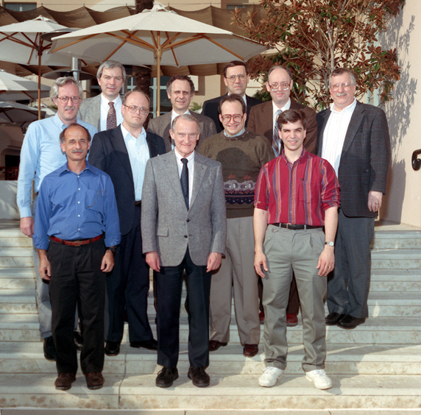
1st Petaflops Workshop
Pflops are needed now
Enough chips can be glued together by 2010
Open issues of cost, power, and efficiency
Innovative technologies & architectures
Algorithms to play an important role
Adaptive control critical to effective resource management and task allocation/scheduling
Strategic Conferences
  Petaflops I & II
In-depth Workshops
  PASS, PetaSoft, MiniSoft, PAWS, PAL, POWR
Point-Design Studies
Determine Future Directions for HEC R&D
Explore Opportunities and Challenges
  technology, architecture, systems software, applications

Slide 6
Trends according to Linpack Top500
1 Pflop/s
293 TF/s
100 Tflop/s
SUM
35.8 TF/s
10 Tflop/s
NEC
1.17 TF/s
N=1
Earth Simulator
1 Tflop/s
IBM ASCI White
59.7 GF/s
Intel ASCI Red
LLNL
Sandia
100 Gflop/s
Fujitsu
196 GF/s
'NWT' NAL
10 Gflop/s
N=500
1 Gflop/s
0.4 GF/s
100 Mflop/s
1993
1994
1995
1996
1997
1998
1999
2000
2001
2002

Slide 7
Projected Performance Development

Slide 8
To Exaflops and Beyond
10 Eflops
1 Eflops
100 Pflops
10 Pflops
SUM
1 Pflops
100 Tflops
N=1
10 Tflops
N=500
1 Tflops
100 Gflops
10 Gflops
1 Gflops
100 Mflops
1993
1995
2000
2005
2010
2015
2020
2023

Slide 9
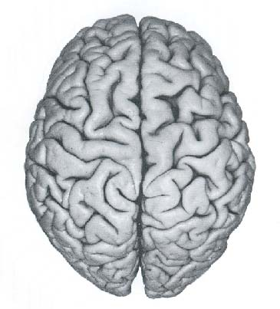
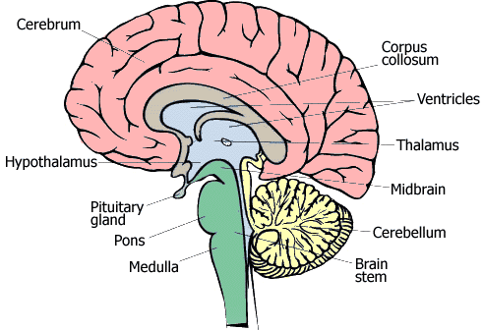
BRAINIAC: An Exaflops Computer

Slide 10
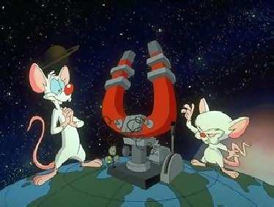
To Google: “brain pictures”

Slide 11
The Neo Cortex
10¹² neurons
10² to 10⁴ synaptic junctions per neuron
  At the end of the dendrites
  And incident upon the axon body
Pulse repetition rate is between 50 to 200 pulses per second
Firing time is approximately 1 millisecond
Firing criterion determined by sum of axonal input signals and time varying threshold
Synaptic Outputs
Axon
Synaptic Inputs
Threshold
4 Exaflops

Slide 12
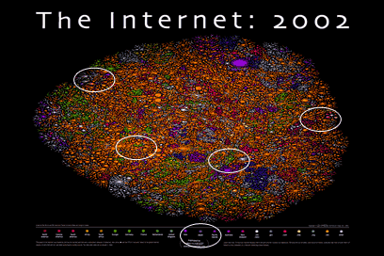
The 1st Exaflops Computer

Slide 13
The Net of Nets
Approximately 200,000 networks
Approximately 100,000,000 computers
Aggregate capability > 100 Petaflops or 0.1 Exaflops
Modest growth in US and old Europe
Rapid growth in third world, e.g. China, India, South America
Biggest growth in internet integrated embedded computing
  Indoor climate control, e.g. air and heat management, doors
  Traffic flow control including active gating and real time imaging
  Sanitation

Slide 14
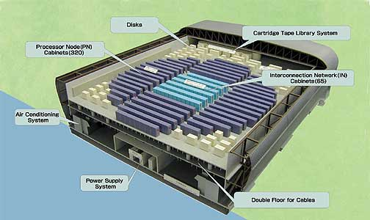
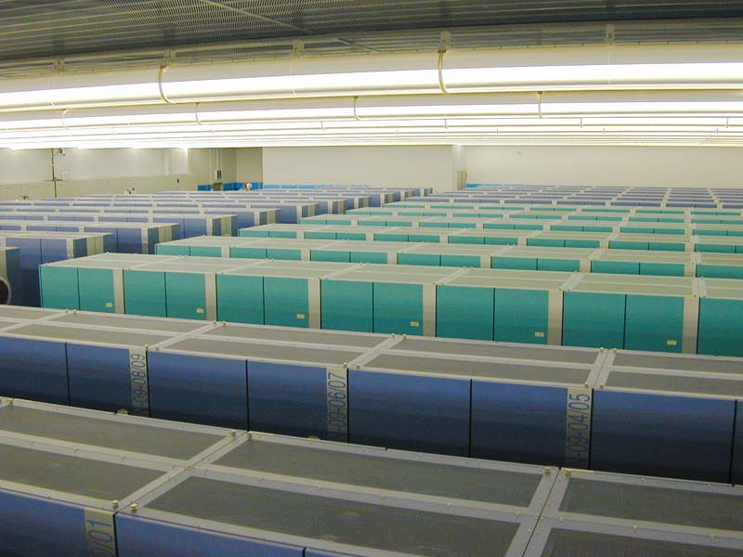
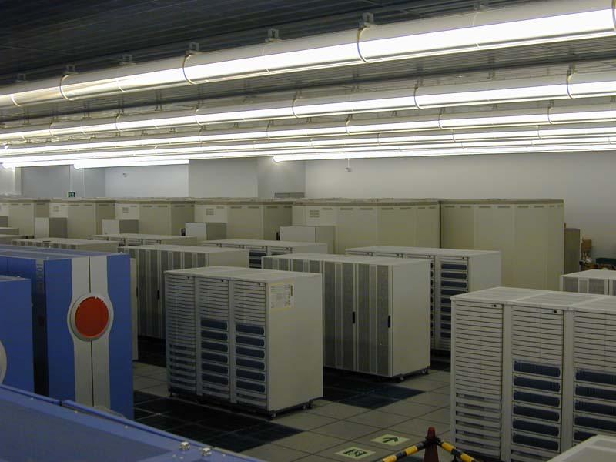
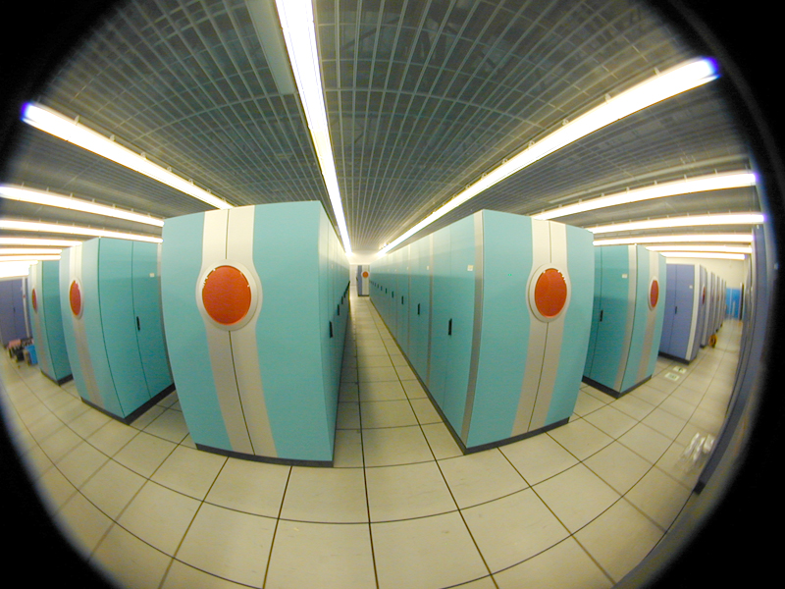
An Exaflops Today an Earth Simulator View
Cost: $8 Trillion
Footpad: 600,000,000 square feet
  100,000 tennis courts
  21.5 square miles
Power: almost 100 Gwatts
3000 X Sum(all Top-500 machines)

Slide 15
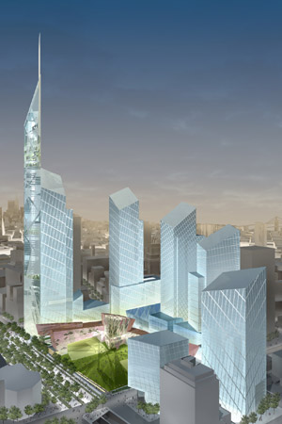
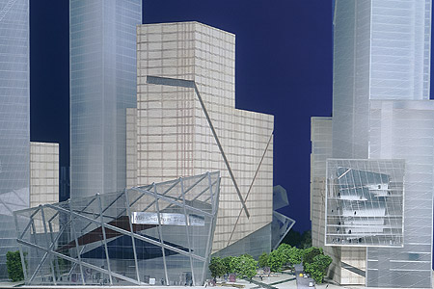
The Exaflops Commodity Cluster by mid decade
1 Teraflops rack based on blades technology
Foot pad of approximately 10,000,000 square feet
The equivalence of all of the office space of the proposed replacement to the World Trade Center in NYC

Slide 16
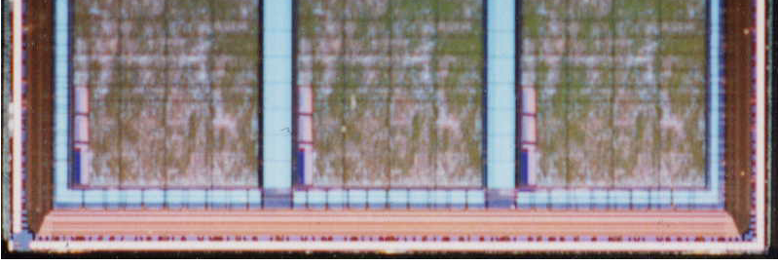
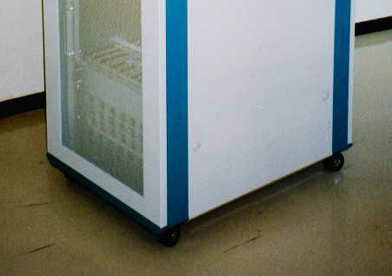
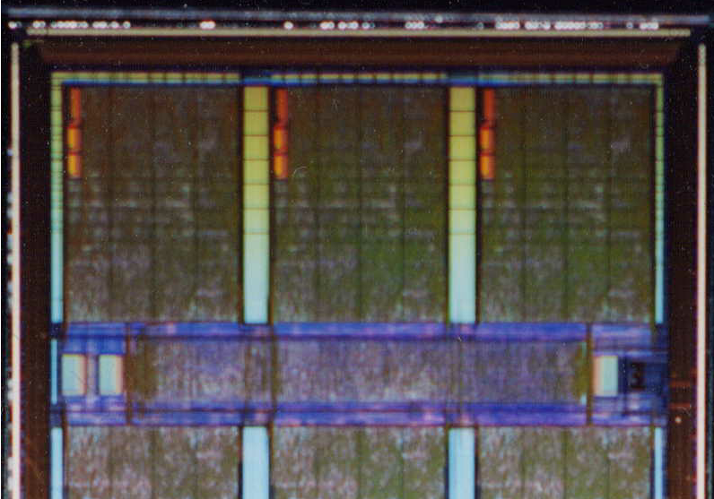
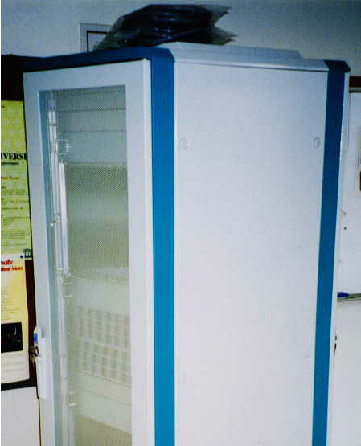
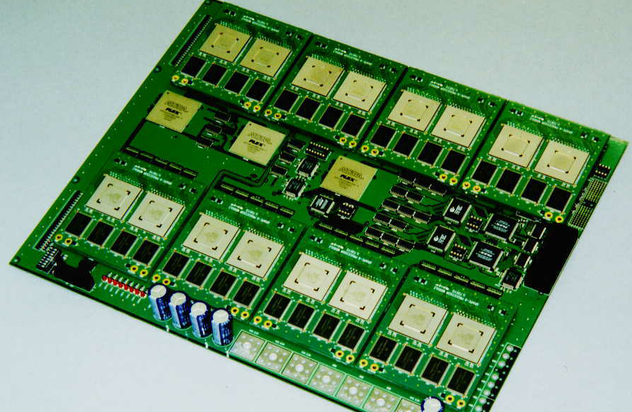
Special Purpose Devices: Grape

Slide 17
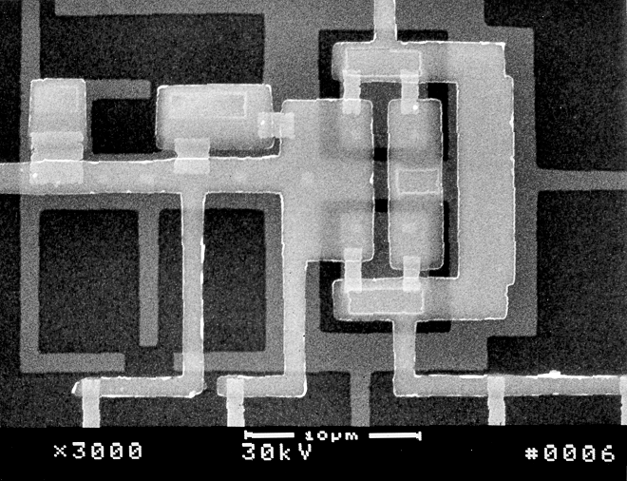
Technologies: Superconductor RSFQ the world’s fastest digital logic
1 THz
    HTS RSFQ (??)
100 GHz 30M JJ
    3M JJ 0.4 um
300K JJ 0.8 um
10K JJ 1.5 um
3.5 um
10 GHz 0.05 um 0.07 um
      0.10 um
      0.12 um
0.14 um
0.20 um
1 GHz
"no known solutions"
optical lithography
100 MHz
1995 1998 2001 2004 2007 2010
Year
L1
JJ1
JJ2

Slide 18
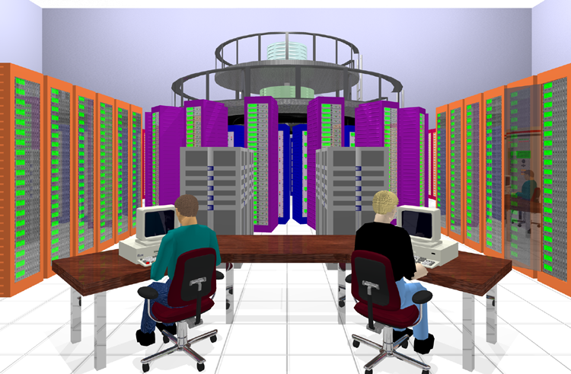
HTMT Petaflops Computer

Slide 19
1.4 m
0.3 m
77ºK
4ºK
50 W
1 m
SIDE VIEW
Fiber/Wire Interconnects
1 m
3 m
0.5 m

Slide 20
But what about an Exa-Hertz Technology
An ExaHertz clock would radiate X-rays
The distance of a signal propagating in a single cycle would traverse 3 Angstroms
You would have to build your processor with about 100 atoms
Conclusion, parallelism at unprecedented scale would be required in any real system
Will require a million memory chips in 2020 for 1 Exabyte but requires cells a few Angstroms on a side

Slide 21
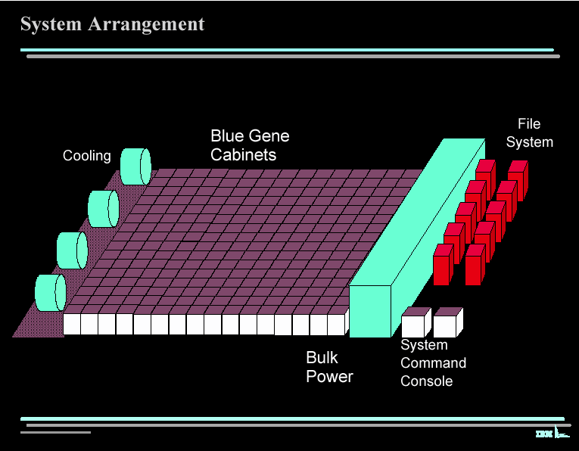
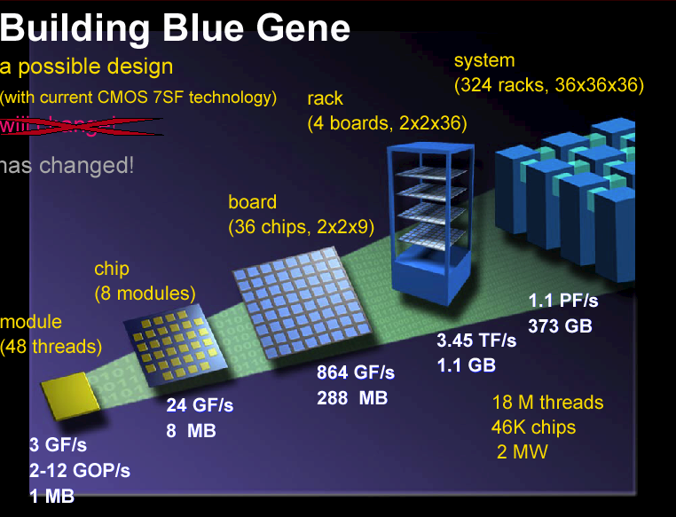
PIM as a Path across trans-Petaflops Performance Regime

Slide 22
Microprocessor with PIMs
PIM Node 1
Microprocessor
Memory
T_{ML}
T_{Lcycle}
ALU
%W_{H}
T_{RR}
Contrl
PIM processor
Cache
T_{MH}
Reg
T_{Hcycle}
mix_{l/s}
%W_{L}
Metrics
mix_{l/s}
T_{CH}
P_{miss}
PIM Node 2
PIM Node 3
PIM Node N

Slide 23
Speedup with PIM versus HWT-only
# PIM Nodes
Performance Gain
PIM Workload

Slide 24
Some Observations
Exaflops is almost beyond consideration
Its time to start considering it
Everything changes – locality of action will dominate
Efficiency should be measured against application ideal execution, not peak flops
ALUs should be valued for their available bandwidth, not peak flops
Memory is the biggest barrier for both capacity and bandwidth
The number of sites of action will grow roughly proportional to scale of throughput – parallelism dominates
Lessons:
  Permeate memory with ALUs
    Today, Pflops of ALU in 1 sq meter, Pbyte in 800 sq meters
  Don’t stop execution of one action due to latency incursion of another
  Information migration is everything, move work to data or data to work whatever is best
  Reliability must be derived through graceful degradation which means that virtual abstraction required between hardware and software.

Slide 25
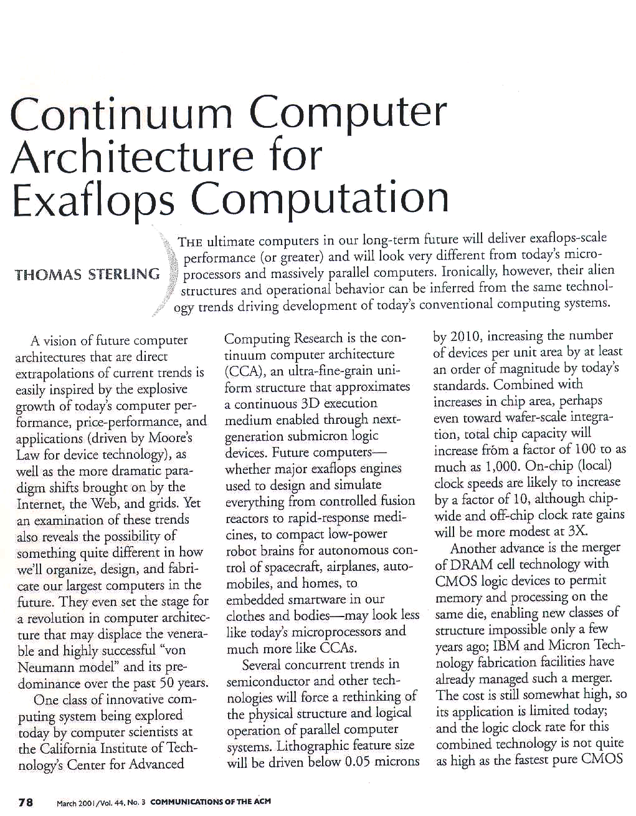
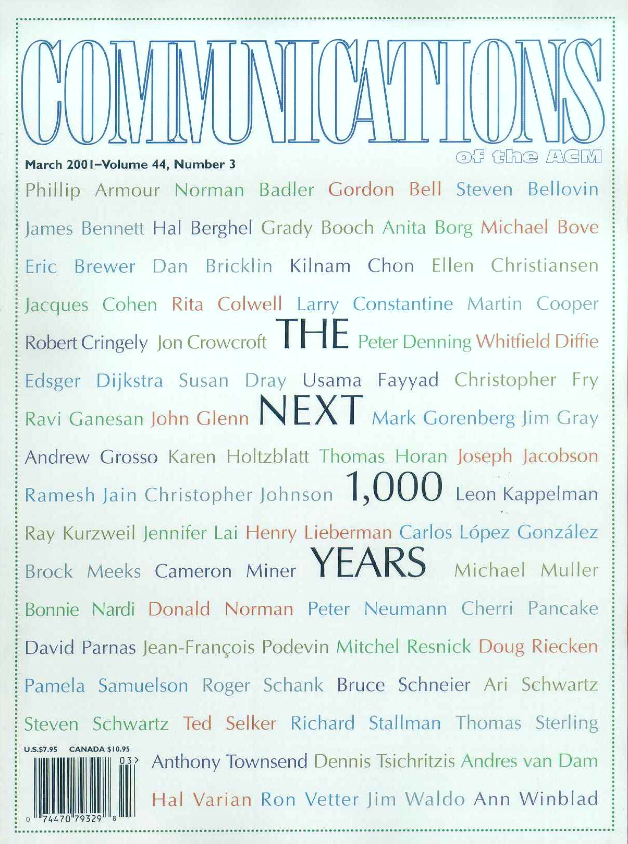
Google: “exaflops”

Slide 26
Continuum Computer Architecture
Fundamental Concepts
Peak Resources
  X100 arithmetic/logic units
  massive bisection and memory bandwidth
Merge functionality into a single simple block (fonton)
  communications
  memory
  logic
Global cellular structure, 2.5 or 3-D mesh
Data/instruction structures distributed across fontons
Local rules determine fonton operations
Synergism among fontons yields emergent global behavior of general parallel computing model

Slide 27
CCA Structure: Fontons & Simultac
Associative Memory :
Fontons
Small block of fully associative tagged memory
Basic logical and arithmetic unit
Instruction register directs control to set data paths
Nearest neighbor communications with switching
Mesh Network :
Assoc. Memory
ALU
ALU
ALU
ALU
ALU
ALU
Inst. Reg.
ALU
ALU
ALU
ALU
ALU
ALU
ALU
ALU
ALU
ALU
ALU
ALU
ALU
Control
ALU
ALU
ALU
ALU
ALU
ALU
Packet Switched Systolic Array

Slide 28
Principal Mechanisms
Virtual address translation and object locating
Cellular client-server relationship
Resource allocation (load balancing) by diffusion (adjacent copying)
Data objects & structures distributed across fields of fontons
Vectors are mobile data structures (workhole routing type I)
  Can move across software pipelines with separate instructions in each fonton pipeline stage
Instruction threads are mobile data structures (workhole routing type II)
  Can move across ephemeral vector register with separate datum in each fonton of register bank (“Parcels”)
“Futures” coordinate time synchronization and space utilization
Irregular data structure pointers direct n-furcating
Fault isolation (reconfigurable?, at least On-Off)
Asynchronous interfaces

Slide 29
So In Conclusion
Exaflops will push Moore’s Law until it flatlines
Parallelism and architecture will dominate new directions
Machines will operate at the fine grain
Hardware will be fully virtualized offering an abstract, slowly degrading machines
Programming will be easier than today because system will have to take on responsibility of resource management.
New technologies will have to be revisited.
Perhaps there is a miracle like quantum computing but I can not predict that.
We should be prepared to think differently about computing structures

