Slide 1
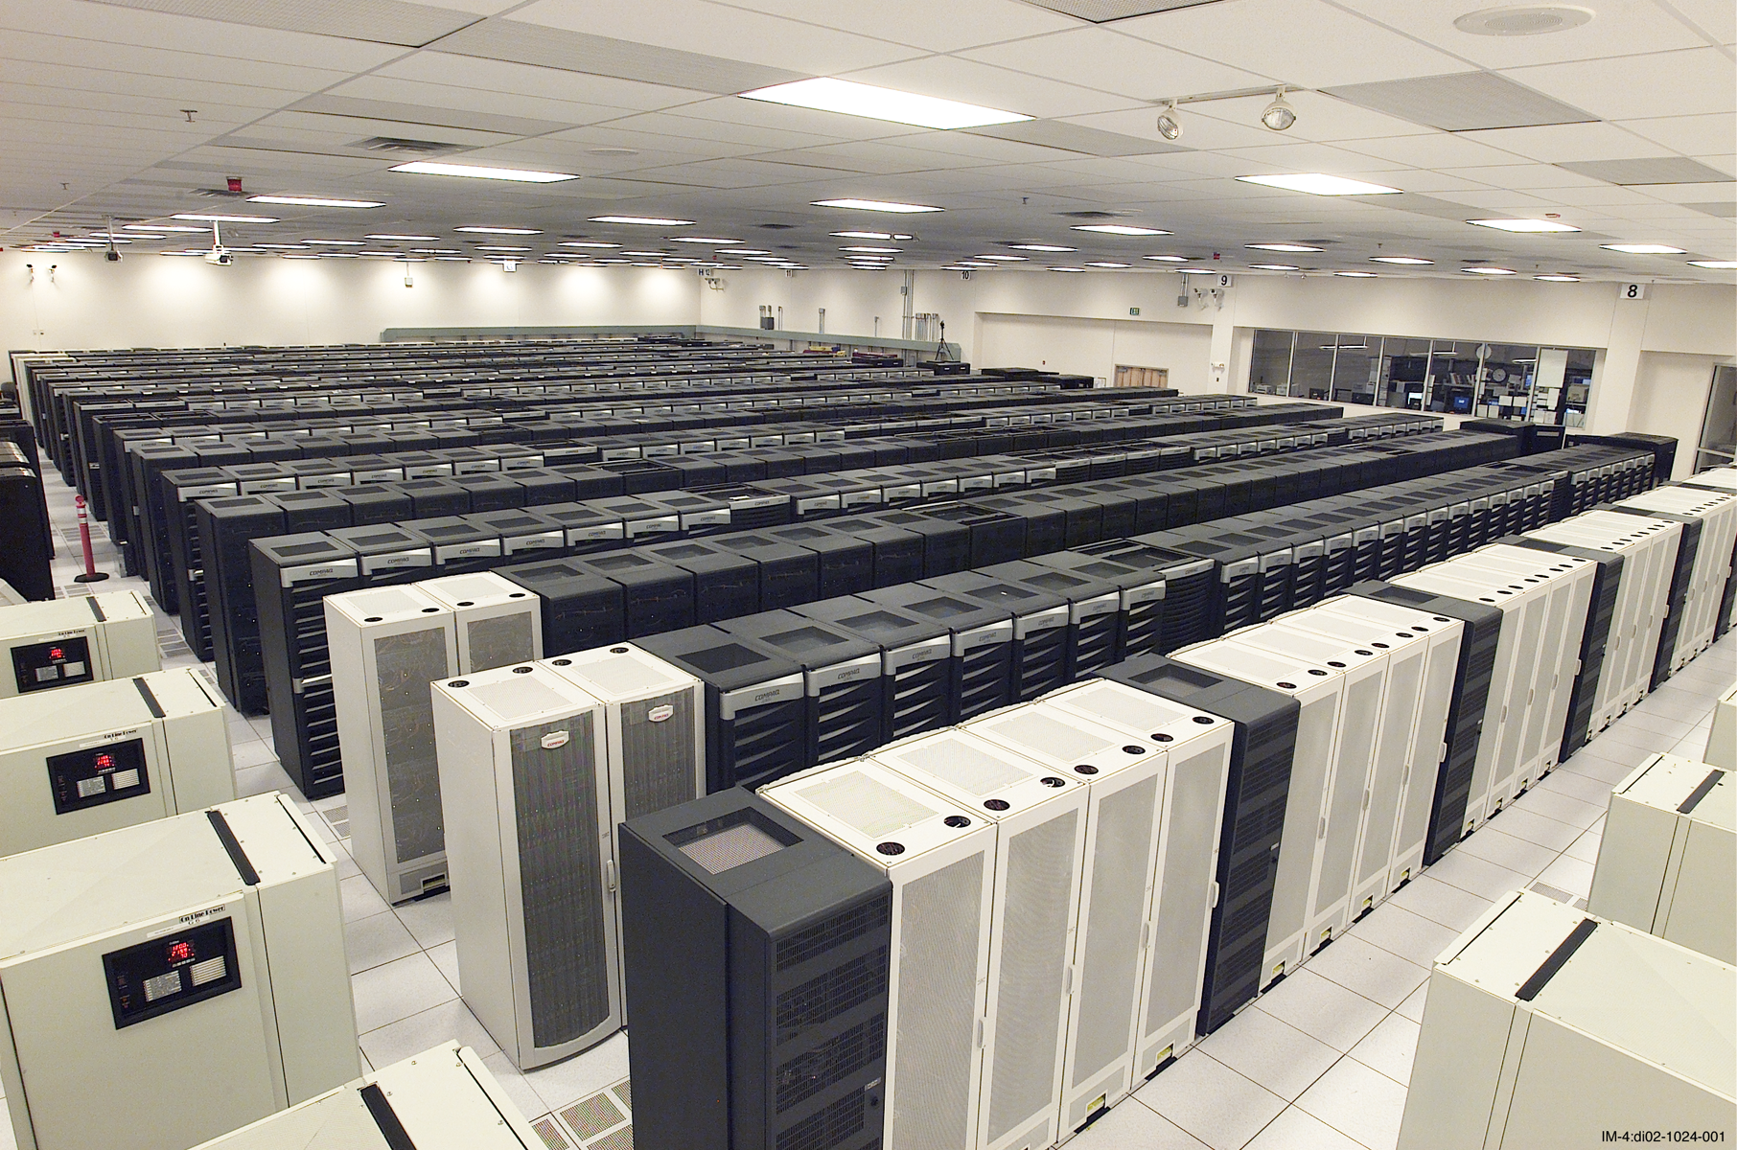
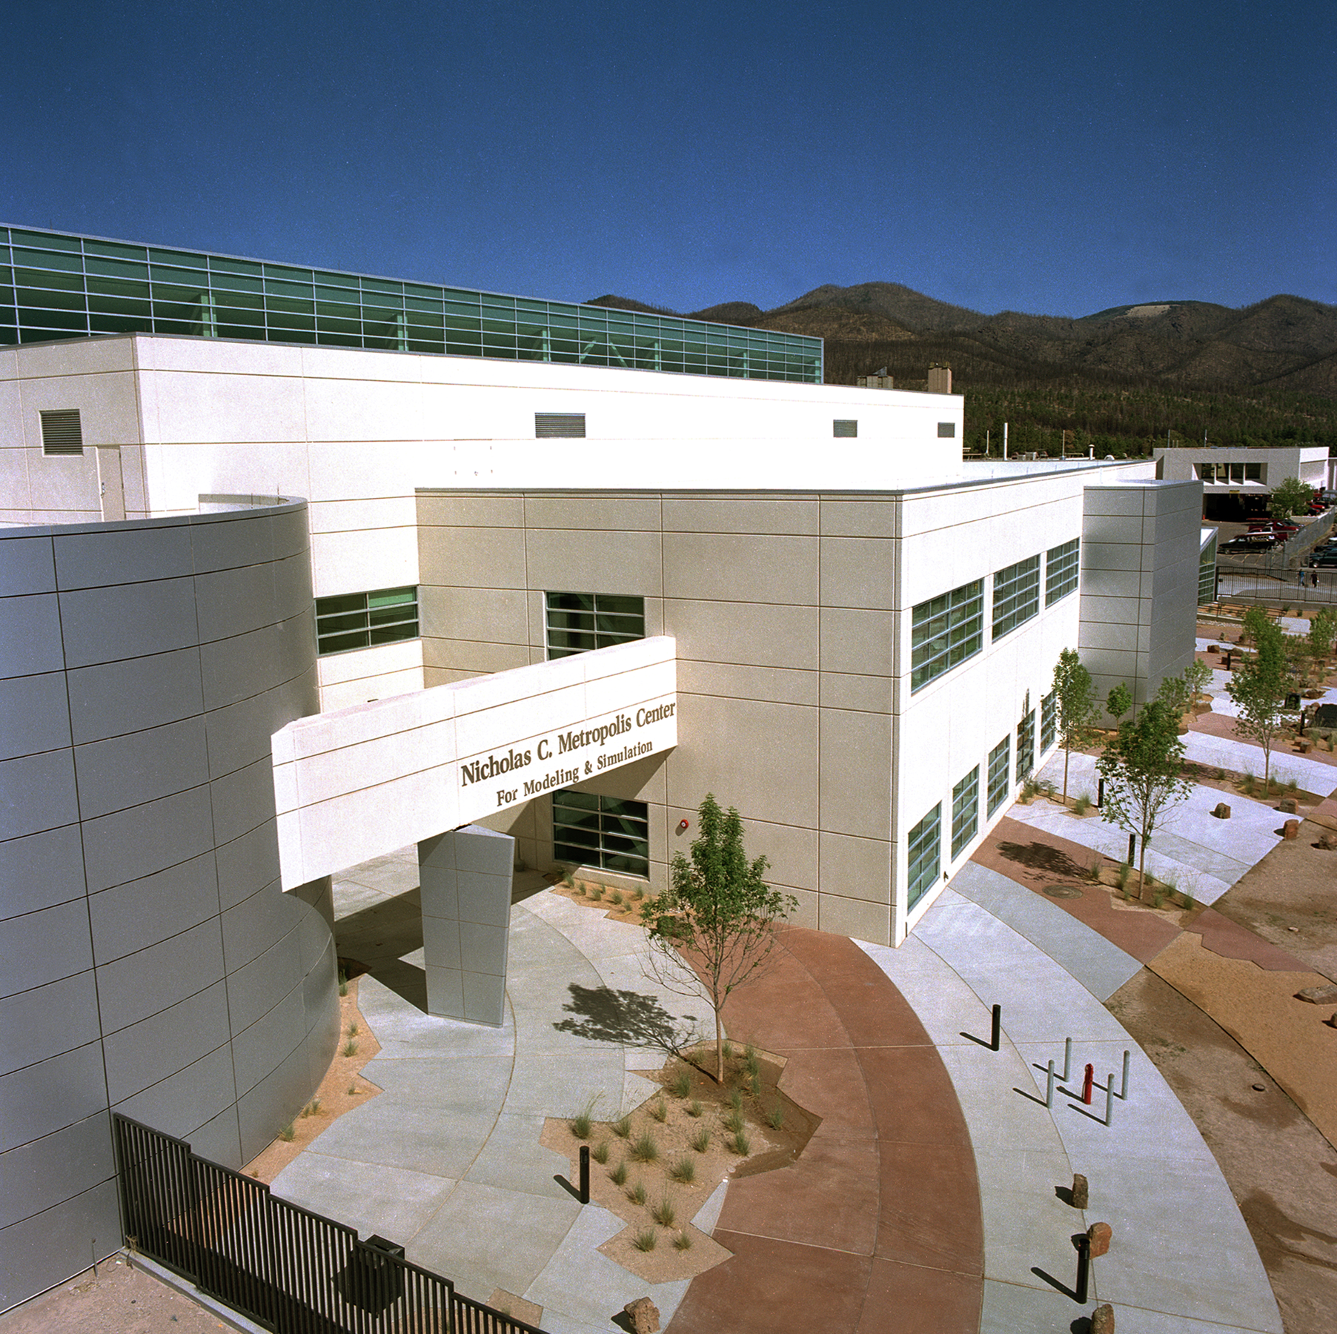
The ASCI Q System at Los Alamos
7th Workshop on Distributed Supercomputing
March 4, 2003
ASCI Q
Nicholas C. Metropolis Center
for Modeling and Simulation
John Morrison
CCN Division Leader
LA-UR-03-0541
Notes:
1

Slide 2
Q is operational for stewardship applications (1st 10T)
  Many ASCI applications are experiencing significant performance increases over Blue Mountain.
  Linpack performance run of 7.727 TeraOps (more than 75% efficiency)
  Initial user response is very positive (with some issues!)
    (Users want more cycles…)
  Users from the tri-lab community are also using the system
Available to users for Classified ASCI codes since August 2002
  Smaller initial system available since April 2002
Los Alamos has run its December 2002 ASCI Milestone calculation on Q

Slide 3
Question 1:
Is your machine living up to the performance expectations? If yes, how? If not, what is the root cause?

Slide 4
Performance Comparison
Q vs. White vs. Blue Mountain
Cycle-time : lower is better
Weak-scaling of SAGE (problem per processor is constant )
-> ideal cycle-time is a constant for all PEs (but have parallel overheads)

Slide 5
Performance Comparison
Q vs. White vs. Blue Mountain
Ratio: Higher the better
i.e. ASCI Q is between 5 and 6.5 times better than Blue Mountain
ASCI Q is between 2 and 2.8 times better than ASCI White

Slide 6
Modeled and Measured Performance
Unique capability for performance prediction developed in the Performance and Architecture Lab (PAL) at Los Alamos
Latest two sets of measurements are consistent
(~70% longer than model)
There is a difference why ?
Lower is
better!

Slide 7
Using fewer PEs per Node
Test performance using 1,2,3 and 4 PEs per node
Reduces the number of compute processors available
Performance degradation appears when using all 4 procs in a node!

Slide 8
Performance Variability
Lots of noise on the nodes: daemons and kernel activity
This noise was analyzed, quantified, modeled, and included back in the application model
This system activity has structure: it was identified and modeled
Cycle-time varies from cycle to cycle
Notes:
This is time to perform a very well calibrated operation: it’s all over the place, whereas it should be the red line

Slide 9
Performance Variability (2)
Histogram of cycle-time over 1000 cycles
Minimum cycle-time is very close to model! (0.75 vs 0.70)
Performance is variable (some cycles are not affected!)

Slide 10
Modeled and Experimental Data
The model is a close approximation of the experimental data
The primary bottleneck is the noise generated by the compute nodes (Tru64)
Lower
Is better
Notes:
Performance if we were to remove (or optimize or reduce) various kinds of system activity

Slide 11
Performance after System Optimization
After system mods (both kernel and daemons and Quadrics RMS:
right on target! After these optimizations, Q will deliver the performance
that it’s supposed to. Modeling works!
Notes:
This is where the performance is going to be after HP will include out mods in the official system software release: exactly where it should be!

Slide 12
Resources
Performance and Architecture Lab (PAL in CCS-3
Work by Petrini, Kerbyson, Hoisie
Publications on this work and other architecture and performance topics at
www.c3.lanl.gov/par_arch

Slide 13
Plan of Attack
  Find low hanging fruit (common problems with high payback) to attack first
    Kill unnecessary daemons
    Look at member 1 and 2 for CFS related activities
    Member 31 noise!!

Slide 14
Kill Daemons
Daemons | status
envmond | /sbin/init.d/envmon stop
insightd | sbin/init.d/insightd stop
snmpd | /sbin/init.d/snmpd stop
advfsd | Not running at LANL
smsd | Not running at LANL
lat | Already off
lpd | /sbin/init.d/lpd stop
xlogin | Not running at LANL
niff | /sbin/init.d/niffd stop
HP SC engineering is checking that there are no operational problems with permanently switching them off.

Slide 15
Summary on Performance
Performance of Q machine is meeting and exceeding performance expectations
Performance Modeling Integral part of Q machine system deployment
Performance testing done at each major contractual milestone
FS-QB used in the unclassified environment for performance variability testing.
Approach is to systematically evaluate and implement recommendations of performance variability testing

Slide 16
Question 2: What is the MTBI? What are the topmost reasons for interrupts? What is the average utilization rate?

Slide 17
Machine Q Interrupts and Overall MTBI

Slide 18
Topmost Reasons for HW interrupts

Slide 19
Interrupts for CPUs

Slide 20
Scientific Investigation of Cosmic Rays Impact on CPU Failures
L2 Btag memory parity checked but not corrected
  At altitude at Los Alamos the number of neutrons is about 6-10 times higher than at sea level
  With large number of ES45 systems and altitude we could be finding neutron induced CPU failures due to single bit soft errors
Neutron Monitors installed with Q to measure neutron flux
LANSCE Beam line testing of different memories
  Two classes of programs used
  Some discrepancies between results, trying to figure out
  Only testing for neutron impact, other particles being evaulated
Statistical analysis for predicted error rates
Attempting to map beam line test output to predicted # of CPU failures on Q based on neutron flux at SCC

Slide 21
Scientific Investigation of Cosmic Rays Impact on CPU Failures - continued
Initial results seem to indicate that the system is being impacted by neutrons hitting the L2 btag memory
Mapping of beam line results to predict # of CPU failures is not yet fully understood
We are managing around this problem from an applications perspective as demonstrated by the recent success of the milestone runs.

Slide 22
Memory Interrupts

Slide 23
Overall utilization rate for initial
Few months is between 50-60%

Slide 24
Over 4.3 Million processor hours for Science Runs
System Utilization over 85% some weeks

Slide 25
Question 3:
What is the primary complaint, if any, from the users?

Slide 26
Historical Top Issues
Reliability and Availability
Message Passing Interface (MPI)
LSF integration
File systems
Code development tools

Slide 27
Current Top User Issues
October 2002 Q Technical Quarterly Review
Highest Priority
  File system problems
  System Availability & Reliability
  HPSS “store” performance
Note the absence of MPI issues

Slide 28
Current Top User Issues
October, 2002
Medium Priority
  Serial jobs (& login sessions) on QA
  Q file system performance poor for many small serial files
  Formal change control and preventative maintenance on all Q systems
  QA viz users need non-purged file system

Slide 29
Current Top User Issues
October, 2002
Lower Priority
  LSF configurations on all Q systems
  Early-Beta nature of QA versus User count
  White-to-LANL(Q & HPSS) connectivity
  DFS on Q (for Sandia users)
  MPI CRC on Q
  Q “devq” 2-login limit

Slide 30
Highest Priority
  File system problems
    Loss of all /scratch files (multiple times)
    Local component failures impact entire file system
    Files not always visible (PFS & NFS)
    Slow performance (e.g. simple “ls” command)
  System Availability & Reliability
    Whole machine impact
    Long (4-8 hr) reboot time!
    Many hung “services” require reboots

Slide 31
Highest Priority
  HPSS “store” performance
    HPSS rates too low for QA capability
      < 50MB/s
      100’s GB (not unusual) require hours to store
    SW & HW upgrades (relief is coming)
      150MB/s Nov. target; 600MB/s Jan. target
      Parallel clients; new HW & 4- & 16-way stripes
  Totalview & F90 data in modules on Q
    Can’t see F90 data located in modules
    Workaround cumbersome & sometimes even crashes
    Issue is over 1yr old!

Slide 32
Medium Priority
  Serial jobs (& login sessions) on QA
    4 PE minimum due to RMS/LSF config
  Q file system performance poor for many small serial files
    Many codes write serial files from 1 PE
    Some codes write 1 serial file per PE per dump time
    Some codes write multiple sets of files at each dump time
  Formal change control and preventative maintenance on all Q systems
    Machine needs to move to more production-like status
  QA viz users need non-purged file system
    Interactive viz requires all files be resident simultaneously
    No special “viz” file systems as on BlueMtn

