Slide 1
Technology Confluence and National Security
Rob Leland
Sandia National Laboratories

Slide 2
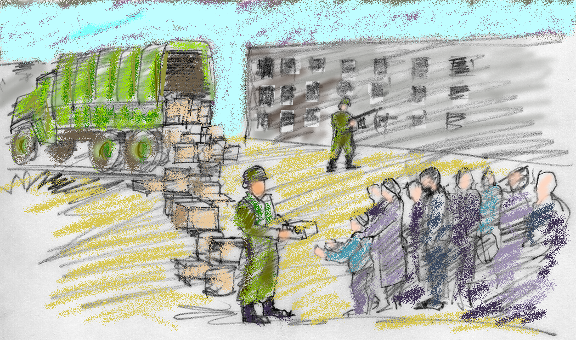
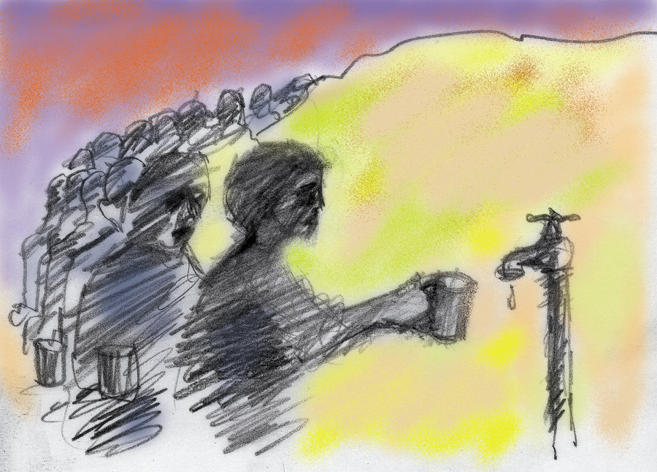
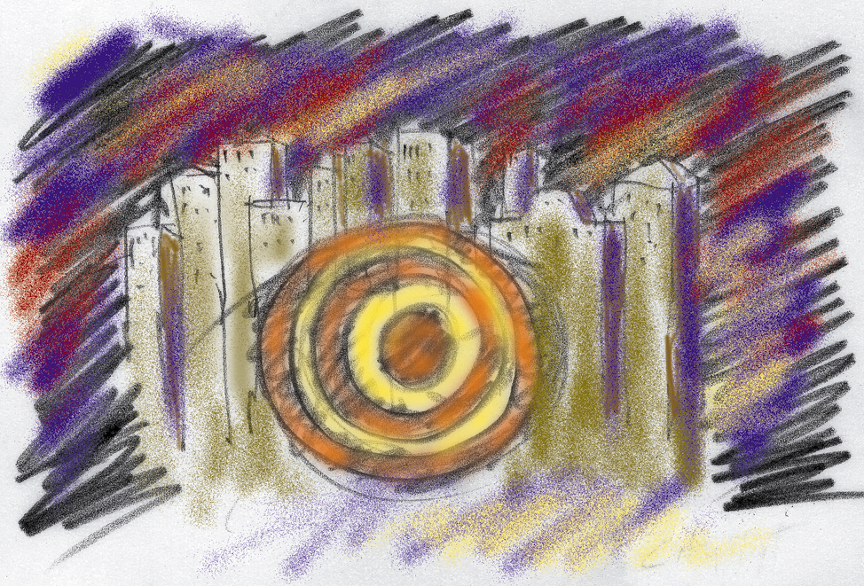
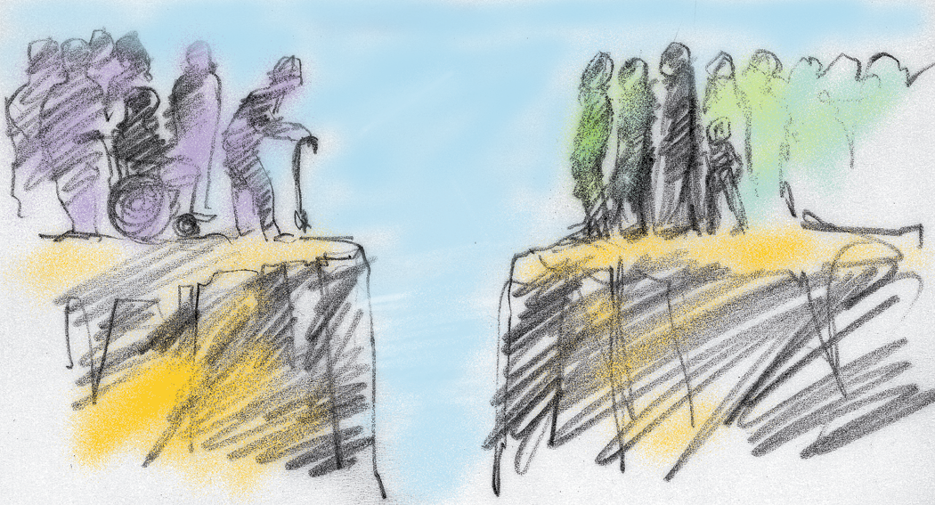
What is national security?
Global
War
Environmental
Conventional engage.
Nuclear deterrence
Military containment
Resource conflicts
Sustainable dev.
Ecomigration
Destructive
Constructive
Homeland
Human need
Terrorism
Crime
Prosperity
Health care
Education
Local
Notes:
Skethes are
Top left – a soldier engaged in peace keeping work (didn’t have a nuclear strike picture)
Lower left – a target painted on a city
Upper right – long line of people waiting for water
Lower right a large gap between the elderly and young in our society
Points are we put most of our attention in the black quadrant, maybe now will be a fair amount in gray. A more balanced approach (increased activity in gray, green and red, not lowered in black) might lead to greater security. We aspire to prevent black and gray conflict by addressing problems in green and red sooner. How do we couple our computing prowess to *this* problem space?

Slide 3
Red: Some perspective
Deaths worldwide, 1900-2000

Slide 4
Green: The Malthus challenge
2000: 6B people, $30T economic output
2025: 8B people, $60T economic output
2100: Expect ~2X as many people,
Expect ~5X per capita consumption
Implies an order of magnitude greater environmental stress on the planet

Slide 5
Black: An intriguing pattern
Era | Crisis | Period | Peak | Yrs. since previous
Late Medieval | Wars of Roses | 1459-1487 | 1485
Reformation | Armada Crisis | 1569-1594 | 1588 | 103
New World | Glorious Revolution | 1675-1704 | 1689 | 101
Revolutionary | American Revolution | 1773-1794 | 1781 | 92
Civil War | Civil War | 1860-1865 | 1863 | 82
Great Power | Depression & WWII | 1929-1946 | 1944 | 81
Millennial | Millennial | 2005-2026? | 2024? | 80?

Slide 6
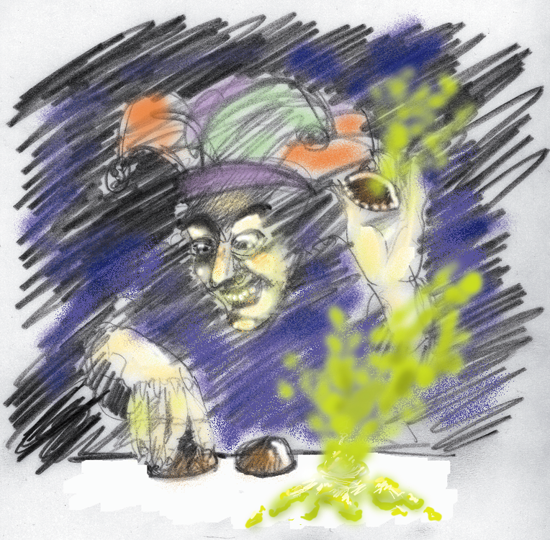
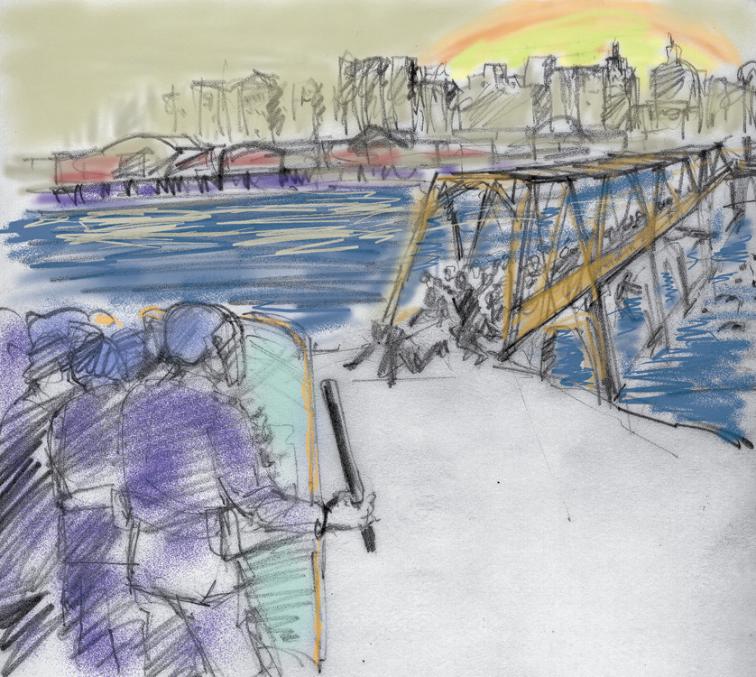
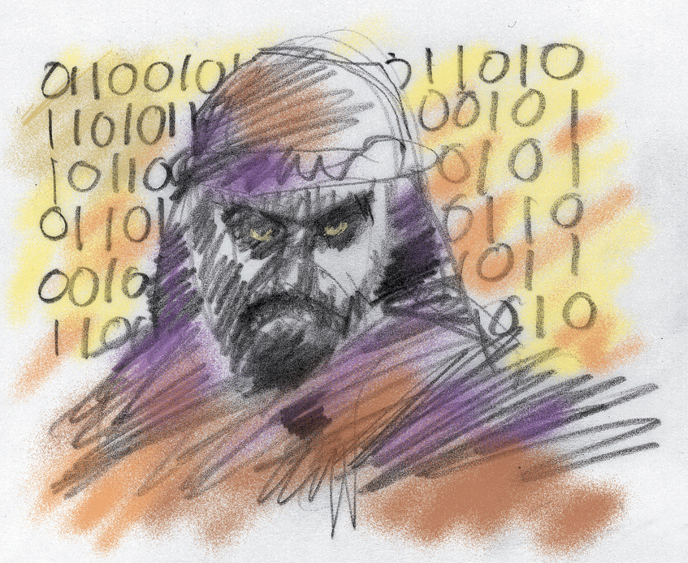
Gray: Clear and Present

Slide 7
What is confluence?
Generation index | Technological Event
-10,000 | Tool use
-500 | Drawing
-400 | Agriculture, writing
-40 | Universities
-24 | Printing
-16 | Modern scientific method, accurate clocks
-10 | Industry
-5 | Telephone
-4 | Radio
-3 | Television
-2 | Digital computers
-1 | Space age, microbiology
-.5 | Internet, nanoscience
0 | ?

Slide 8
One answer
The little “BANG”
Cogno
Cogno
Bits
Atoms
Neurons
Genes
NBIC
Nano
Nano
Bio
Bio
Info
Info
Notes:
This is just a metaphor to stimulate thinking and discussion; it’s not a specific plan. It includes a lot of at this point science fiction.
The gray are examples of interdisciplinary work that is or might be going on between the two fields connected by edges.
The Yellow involve three things connected in a plane.
The purple are meant to indicate something within the volume.
Overall point is our competence is in physical realm, but many key problems are in behavioral realm. This metaphor suggests a transition path.

Slide 9
Edge examples
Cogno
Neural interface
Neural hardware
Neural networks
Nano
Cellular instrumentation
Cellular sensors
Bio
Cellular signaling
Info
Notes:
This is just a metaphor to stimulate thinking and discussion; it’s not a specific plan. It includes a lot of at this point science fiction.
The gray are examples of interdisciplinary work that is or might be going on between the two fields connected by edges.
The Yellow involve three things connected in a plane.
The purple are meant to indicate something within the volume.
Overall point is our competence is in physical realm, but many key problems are in behavioral realm. This metaphor suggests a transition path.

Slide 10
Plane examples
Cogno
Neural interface
Neural “nMOS” architecture (Tokyo U)
Live neural net (Cornell)
Neural hardware
Neural networks
Nano
Cellular instrumentation
Cellular sensors
Bio
Cellular signaling model
Info
Neuron “tunnel” (SNL)
“Digital” antibodies … viral sized logic chips (HP)
Tissue based and in-vivo sensors
  - nanotube monitors in brain blood vessels (NYU)
  - optical nanosensors for chemical analysis within cells (U Mich.)
DNA regulated nano assembly of circuit devices (U Minn.)
Notes:
This is just a metaphor to stimulate thinking and discussion; it’s not a specific plan. It includes a lot of at this point science fiction.
The gray are examples of interdisciplinary work that is or might be going on between the two fields connected by edges.
The Yellow involve three things connected in a plane.
The purple are meant to indicate something within the volume.
Overall point is our competence is in physical realm, but many key problems are in behavioral realm. This metaphor suggests a transition path.

Slide 11
The “cognohedron”
Behavioral
Cogno
Synthetic intelligence
Cognitive prosthetics
Neural interface
Neural “nMOS” architecture (Tokyo U)
Live neural net (Cornell)
Neural hardware
Neural networks
Nano
Cellular instrumentation
Brain-machine interface
Cellular sensors
Artificial immune system
Bio
Cellular signaling model
Info
Neuron “tunnel” (SNL)
“Digital” antibodies … viral sized logic chips (HP)
Tissue based and in-vivo sensors
  - nanotube monitors in brain blood vessels (NYU)
  - optical nanosensors for chemical analysis within cells (U Mich.)
DNA regulated nano assembly of circuit devices (U Minn.)
Physical
Notes:
This is just a metaphor to stimulate thinking and discussion; it’s not a specific plan. It includes a lot of at this point science fiction.
The gray are examples of interdisciplinary work that is or might be going on between the two fields connected by edges.
The Yellow involve three things connected in a plane.
The purple are meant to indicate something within the volume.
Overall point is our competence is in physical realm, but many key problems are in behavioral realm. This metaphor suggests a transition path.

Slide 12
An assessment of the need
“Nothing will be more important to the success of the campaign against terrorism than meaningfully improving the intelligence community’s capabilities and performance” -CSIS
Interpreters and analysts with language skills
Better intelligence filtering and fusion
Automated conversion of intelligence from paper to electronic form
Greater use of open sources for intelligence
More use of red teaming
Greater investment in technology research and development
More staff and resources to cover simultaneous threats
… etc.

Slide 13
Terrorism detection architecture
Database of Possible Planned Events
Hypothetical
actions
Capabilities
Database of
DetectedActivities
Plausibility
evidence
Inclinations
Proposed new hypotheses
Refine
Collection
Interdict/prepare
Notes:
Behavior modeling needed in “Inclinations” & “Hypothetical actions”.
Pattern recognition and AI needed in “Detected activities”.
Natural language processing needed to scan open sources and detect activities.
Human machine interface needed in “interdict/prepare”.
AI needed to nominate new hypothesis.

Slide 14
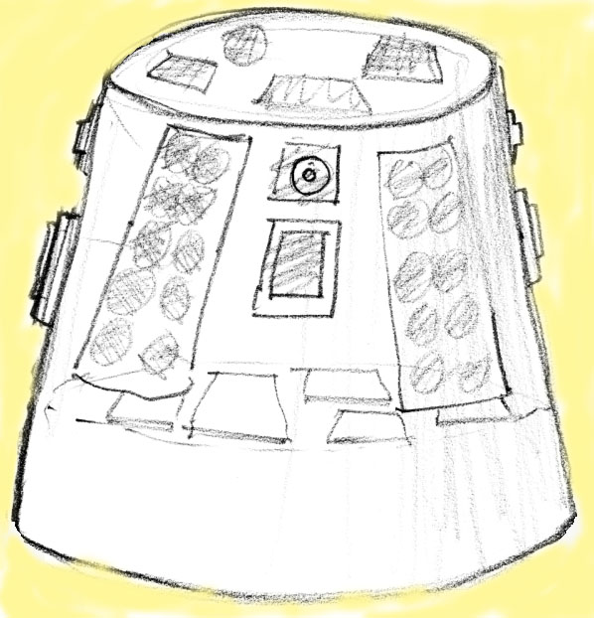
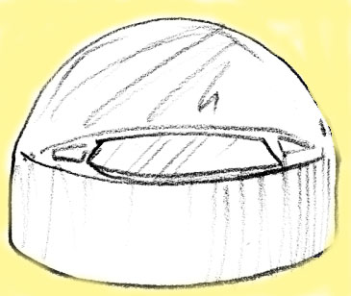
Notional sensor element
Acoustic
Transducer
GPS Antenna
SatComm Antenna
(optional)
Chem/Bio
Imager (optical &/or IR)
System Migration
In 2-3 years
8x volume
reduction
2 1/2”
8x weight
reduction
< 200 cm³
400 g
4 - mo
$2K
Internal
Circuitry
(inc. Seismic
Transducer)
Wafer-level Integration
3-D Stacked Packaging
Advanced μelec & MEMS
RF Comms
Antennas
Batteries
PV Array Panels
(optional
Notes:
Challenges of distributed computing.
What if one is captured and spoofed?
How do you ensure that hasn’t happened?

Slide 15
Social prediction challenge
How to model behavioral phenomena computationally?
Group
Actor
Physiology/ biology
Religion Models
Language models
Gender roles
Ethnicity
Values and Beliefs
Psychological Models
Cognitions, Behaviors, and Emotions
Network analysis

Slide 16
Summary thoughts
Our concept and sense of national security will change dramatically over the next decade
An emerging confluence of key technologies will prove vital in addressing the coming challenges
Our community has a pivotal role to play in that confluence.
We need to think more broadly and creatively, and to understand better the “softer” sciences.

Slide 17
Acknowledgements
Slide | Reference/Credit
2 | Threat space mapping – SNL Advanced Concepts Group/Gerry Yonas
3 | Conflict deaths - The Economist; Disease deaths- Al Zelicoff; total deaths - a simple exponential growth model
4 | Population/Economic figures for 2000/2025 – WorldWatch/Homer-Dixson
5 | Historical crisis chart (adapted) - The Fourth Turning, Strauss & Howe
6 | Threat illustrations – ACG/Ken Miller
7 | Convergence in time - NSF NBIC report
8-11 | The cognohedron/NIBC – ACG/Rob Leland
8 | The Big Down, ETC Group – BANG name for NIBC
12 | To Prevail: An American Strategy for the Campaign Against Terrorism; Campbell and Flournoy, CSIS.
13 | Terrorism detection architecture – ACG
14 | Sensor element concept – ACG/Ron Pate
15 | Behavior modeling paradigm – ACG/Ben Wu

