Slide 1
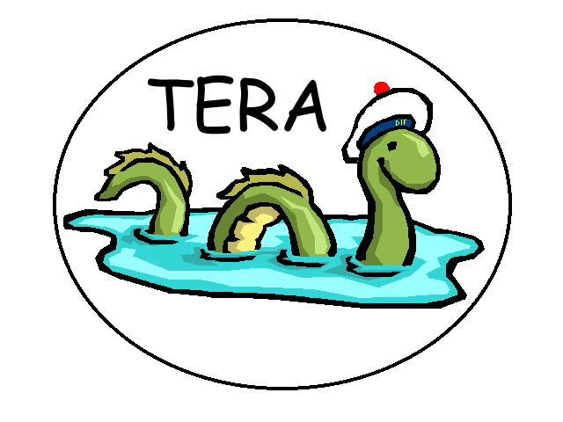
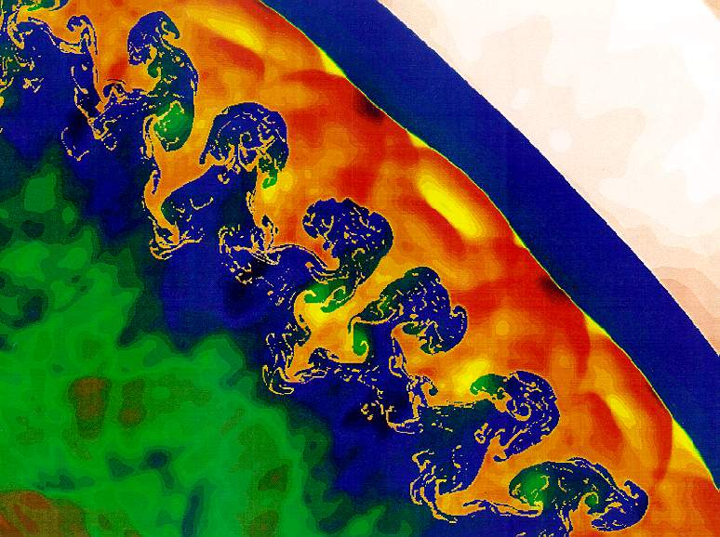
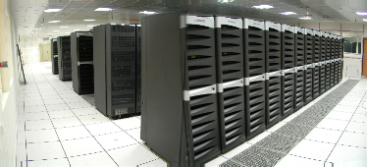
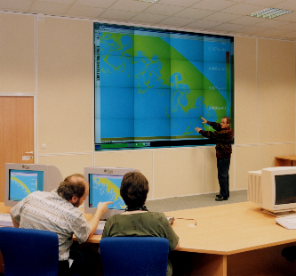
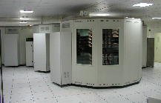
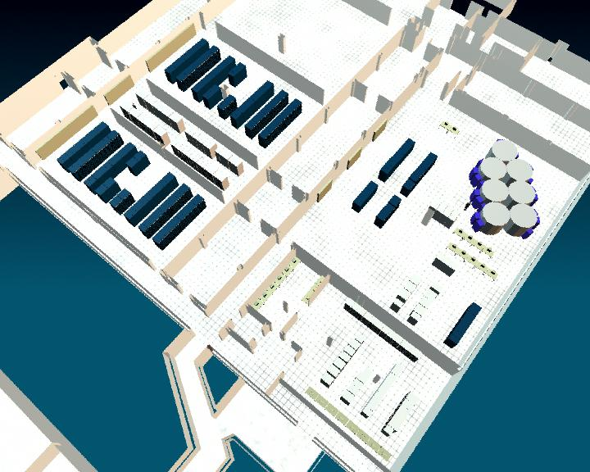
HPC at CEA/DAM
The TERA 1 super computer
RFP 06/1999
Order to COMPAQ 02/2000
Intermediary machine .5 Tflops
delivered 12/2000
open to use 02/2001
fully operational 06/2001
(CRAY T90 stoped)
Final machine 5 peak teraflops
power on 4/12/2001
1.13 TF sustained 13/12/2001
3.98 LINPACK 04/2002 4 on TOP500
open to all users 09/2002
fully operational 12/2002
(Intermediary machine stoped)
Jean Gonnord
Program Director for Numerical Simulation
CEA/DAM
Thanks to Pierre Leca, François Robin
And all CEA/DAM/DSSI Team

Slide 2
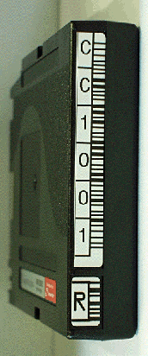
TERA 1 Supercomputer
50 TB of disks
Main features
Installation
Nodes
Peak performance
(sustained requested)
Main Memory
Disks
(Bandwidth)
Power
December 2001
608(+32)*4 (1 Ghz)
5 Tflops
(1 Tflops)
3 TB
50 TB
(7.5 GB/s)
600 kW
I/O
Node
I/O
Node
I/O
Node
32 I/O nodes
Compute
Node
Compute
Node
Compute
Node
Compute
Node
Compute
Node
Compute
Node
608 compute nodes
170 frames, 90 km of cables

Slide 3
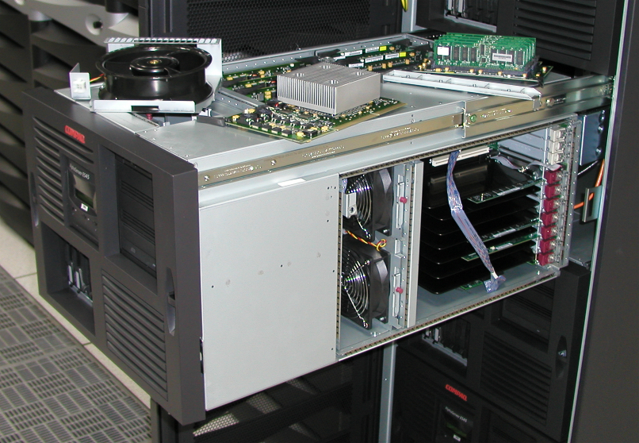
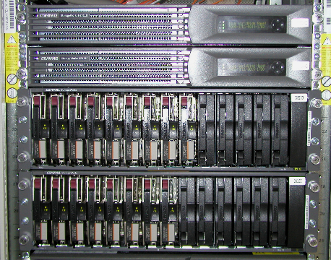
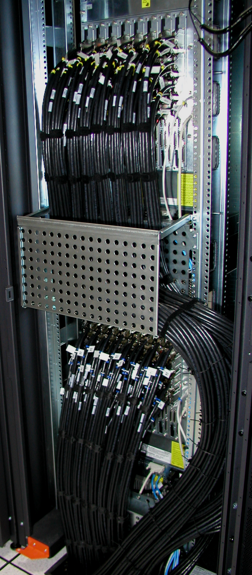
Key elements of the TERA computer
36 switches
2560 links at 400 Mb/s
608 computational nodes – 8 Glops
(4 processors per node)
800 disks
72 Gb

Slide 4
QSW Networks (dual rail)
80 ports
to lower
level
Each link
represents
8 cables
(400 MB/s)
64 ports
to higher
level
64 ports
to nodes
36 switches (128 ports) - 2560 links

Slide 5
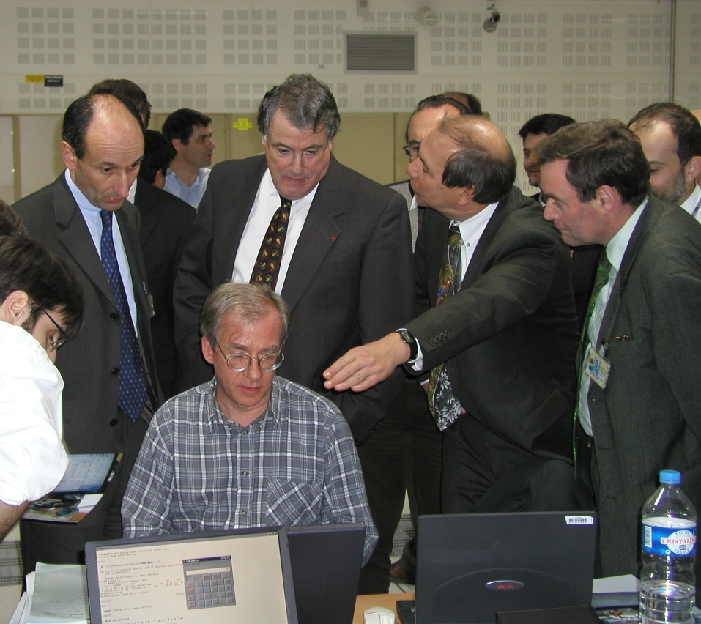
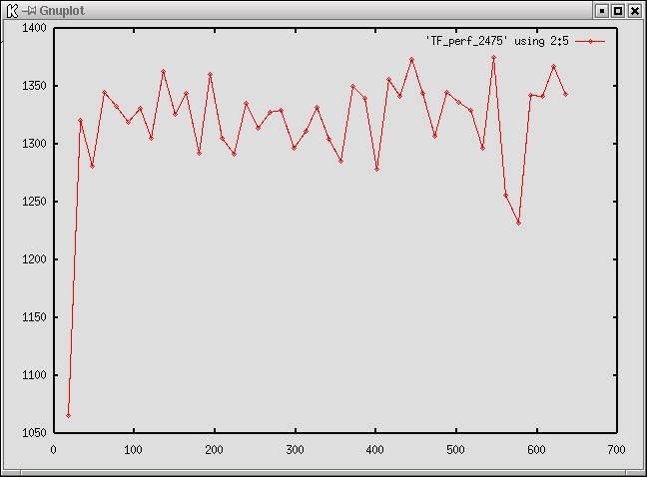
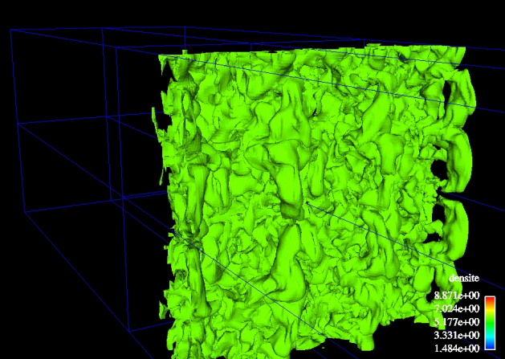
TERA Benchmark
Show what really means 1 sustained Tflops !
A "demo applicaction" able to reach very high performances
Show that the whole system
can be used by a single application
B. Meltz
December 12, 2001 : 1,32 Tflops on 2475 processors 10 billion cells
Euler Equations of gaz dynamics solved in a 3D Eulerian mesh
11 million cells
16 proc EV7
35 hours

Slide 6
One year after - First Return of Experience (key words : robustness and scalability)

Slide 7
Production Codes (1)
Four important codes requires a large part of computing power :
Currently : A,B,C, D (D under construction)
Old codes have been thrown away with the CRAY T90
A, B and D have been designed from the start for parallel systems (MPI)
C has been designed for vector machines
With minor modifications it has been possible to produce an MPI version scalable to 8 processors

Slide 8
Production Codes (2)
Relative performance to T90 (1 proc to 1 proc) is between 0.5 and 2
Good speed-up for A and B up to 64/128 procs depending on problem size
Speed-up of C reaches 4 for 8 processors
D scales to 1000+ processors
For users, it is now possible to work much faster than before :
Availability of a large number of processors + Good code performances
From weeks to days, from days to hours
More computations in parallel (parametric studies)

Slide 9
Advances in weapon simulation
Computation time (est.) CRAY T90 : more than 300 hours
Two nights on 64 processors TERA = 1 month on CRAY T90

Slide 10
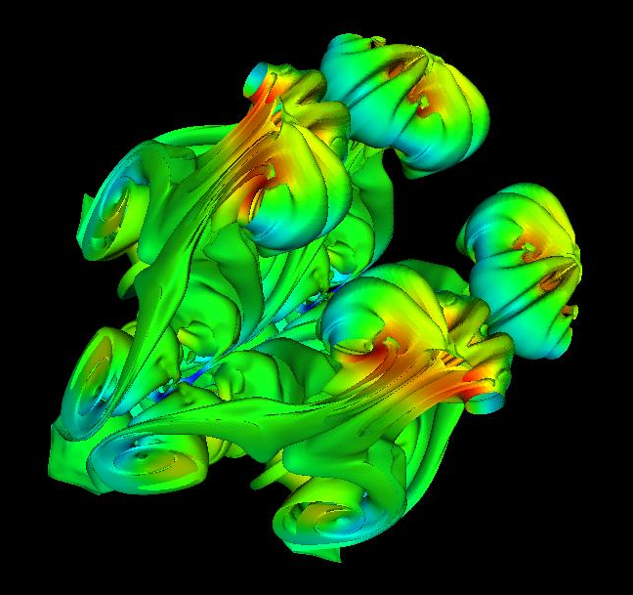
Advances in simulation of instabilities
2000
0.5 millions of cells
400h*12 processors
IBM SP2
2001
15 millions of cells
300h*32 processors
COMPAQ
2000
6 millions of cells
450h*16 processors
COMPAQ
2002
150 millions of cells
180h*512 processors
HP
Author : M. Boulet

Slide 11
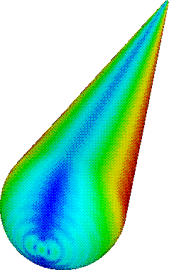
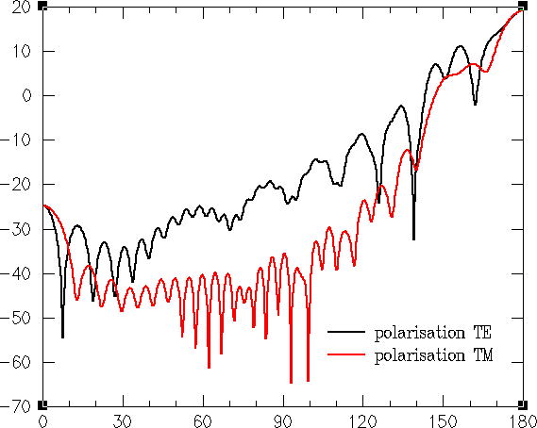
Advances in RCS computation
Number of
Unknown
Cone shaped object at 2 Ghz :
104 000 unknown
Matrix size : 85.5 GB
TERA
ODYSSEE
30 000 000
□ New numerical methods
⇨ EID formulation
⇨ Multipoles
⇨ Domain decomposition
⇨ Direct/iterative solver
ARLENE
ARLAS
TERA
500 000
ARLENE
ARLAS
CRAY T3D/T3E
30 000
CRAY
YMP
ARLENE
□ Parallelism
2000
1990
1997
2003
Authors : M. Sesques, M. Mandallena (CESTA)

Slide 12
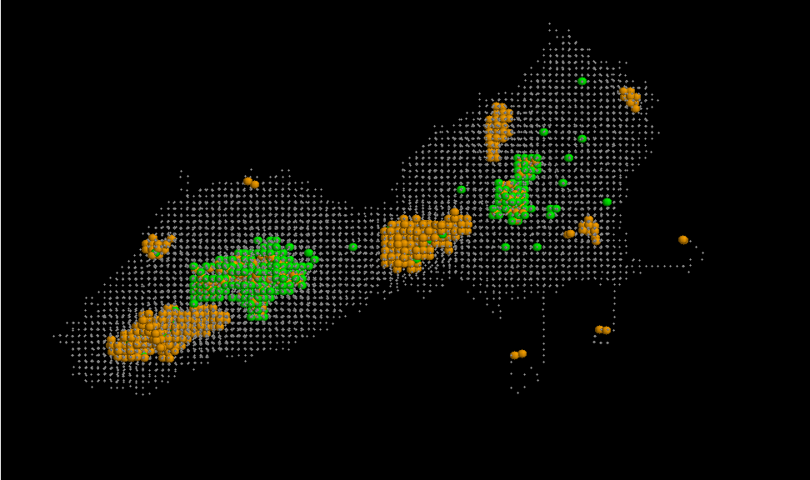
Physics code : Plutonium Ageing
Pu²³⁹ --> U²³⁵ (88 keV) + He (5.2 MeV)
=> Default creation : type and number ?
Tool : Molecular dynamics (DEN/SRMP ; DAM/DSSI)
9 M atomes
20 keV
85 ps
200 000 time steps
4 weeks of computation
32 processors of TERA
Also 20 10⁶ atoms on 128 procs
5 nm
lacune
interstitiel
remplacement
Author : P. Pochet (CVA)

Slide 13
Physics codes
00:57:36
00:50:24
00:43:12
Simulation of laser beam propagation in LMJ (D. Nassiet)
2.5 day for 1 processor
Less than 1 hour for 64 procs
Laser-Plasma interaction (E. Lefebvre)
2D scalable to 256 procs
3D for the future
And many others …in material simulation, wave propagation ...
Temps (HH:MM:SS)
00:36:00
00:28:48
00:21:36
00:14:24
00:07:12
00:00:00
64
128
256
512
1024
Nombre de processeurs

Slide 14
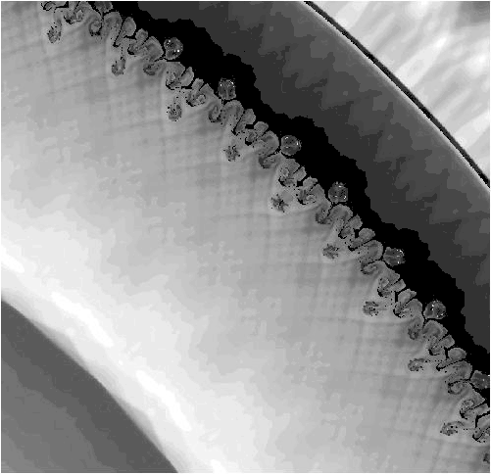
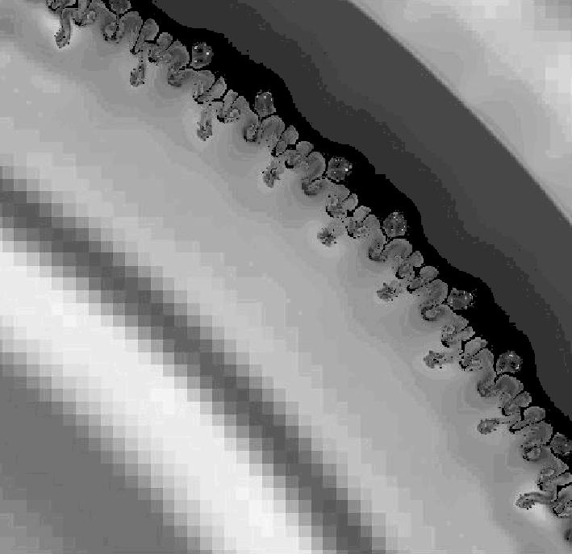
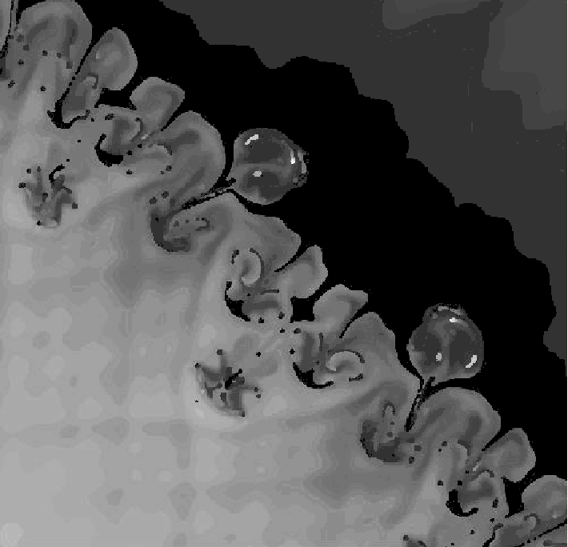
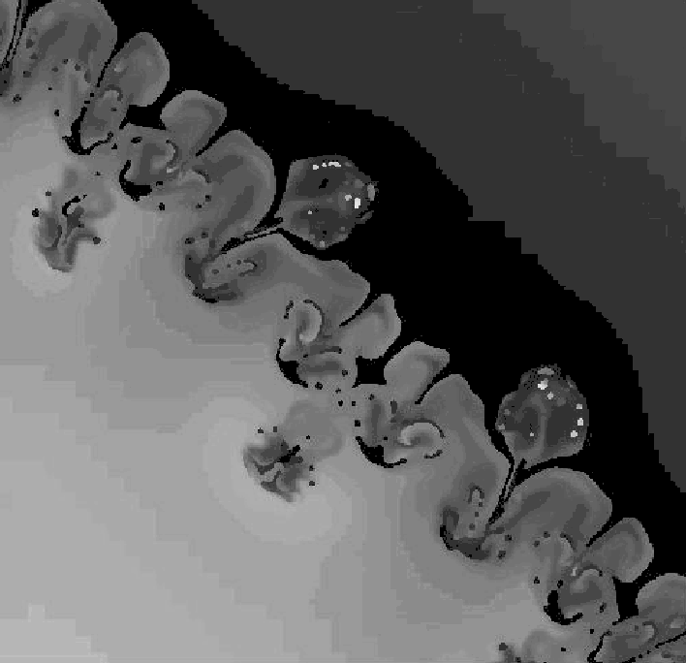
HERA hydro computation : 15 µm mesh (15,5 cm x 15,5 cm)
Reference computation EULER
100 millions cells
AMR Computation
~3,5 millions cells
20 732 CPU hours
256 processors
81 h
140 CPU hours
1 processor
140 h
Auteurs : H. Jourdren - Ph. Ballereau - D. Dureau (DIF)

Slide 15
Major technical issues
Global File System
Reliability
Performances
Hardware reliability
Adapt simulation codes and environnement tools to :
Unreliable environment
Cluster Architecture
System administration
Network security

Slide 16
Global File System (1)
Reliability :
Intermediate system (Sierra 2.0)
Since April 2002 a lot of file corruptions (at that time parallel load had greatly increased on the machine, 1+TB/day)
The major bug was fixed September 2002, others remain we are waiting for other bug fixes
Very long time to get a fix
Problem difficult to reproduce + Galway/Bristol
Same bugs exist on the final system (Sierra 2.5)
Apparently corrected with Sierra 2.5
But re appearing (at a low level) with the very heavy load of the machine during the last weeks

Slide 17
Global File System (2)
Performances
For large IO, we are almost at contractual level (6.5 GB/s vs 7.5 GB/s).
HP can solve the problem by adding more hardware or by having Ios use both rails
For small IO, performances are VERY far from contractual level (0,07 GB/s vs 1.5 GB/s !)
It is probably necessary to work a lot on PFS to solve this problem

Slide 18
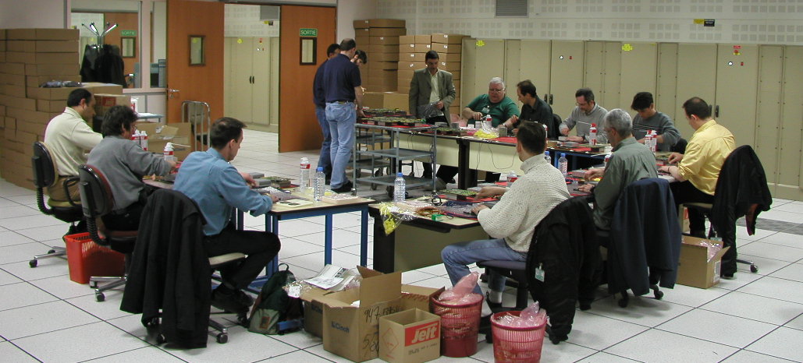
Hardware Reliability
Interposer Change on EV68 (Final system)
Major problem with EV68 processorts starting end of 2001
Up to 30 CPUs failure per day
Interposer change : April 4 to April 9
(2560 processors + spare)
Now : less than 2 CPU per week
DIMM failures
HSV110 failures
Still some SOPF :
Administration network
Quadrics Rails

Slide 19
Predicted Weekly Failure Rate
for this System Configuration
1.25 Modules/Week
Rev F Upgrade
Completed 4/11
Weekly CPU Average Failure Rate
(For first 7 weeks = 4.4 Modules/Week)
(Total of 31 CPU Modules)

Slide 20
Adapt tools to new environment
Make CEA/DAM software as "bullet proof" as possible
Check all IO operations
If problem, wait and retry
Use the "commit" paradigm as much as possible
Log all messages on central logs (don't rely on users for reporting the problems)
If everything goes wrong : try to inform the user as efficiently as possible of the damages

Slide 21
System Administration
Boot, shutdown, system update (patches), …
Too long
Global commands, system update
Unreliable
Need tools to check software level on all nodes
Even maintain global date
Need tools to monitor the load of the system

Slide 22
A real success, but ...
CONCLUSION
Necessity to adapt simulation codes and environnement software to Cluster Architecture (make it bullet proof !)
IO and Global File System
Reliability
Performances (scalability)
System administration

