Slide 1
SOS 13
13th Workshop on Distributed Supercomputing
March 9-12, 2009, Hilton Head, South Carolina
Interconnects
Jim Tomkins: “Exascale System Interconnect Requirements”
Jeff Vetter: “IAA Interconnect Workshop Recap and HPC Application Communication Characteristics”
Ronald Luijten: “A New Simulation Approach for HPC Interconnects”
Keren Bergman: “Optical Interconnection Networks in Multicore Computing”

Slide 2
Optical Interconnection Networks in Multicore Computing
Keren Bergman
Columbia University
SOS 13
13th Workshop on Distributed Supercomputing
March 9-12, 2009, Hilton Head, South Carolina

Slide 3
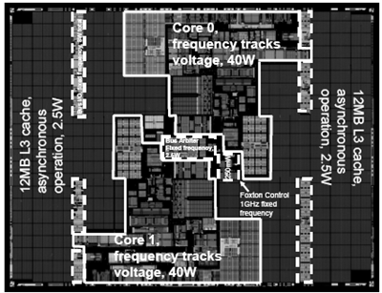
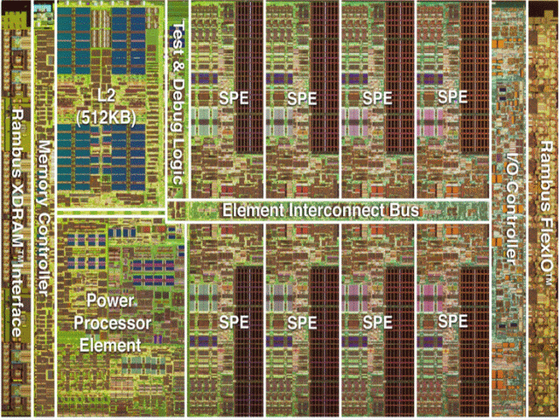
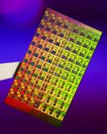
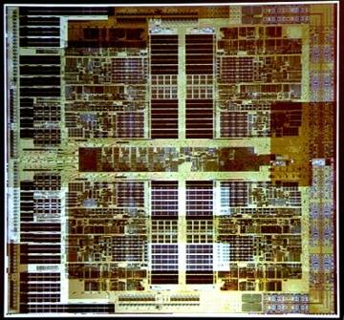
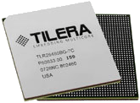
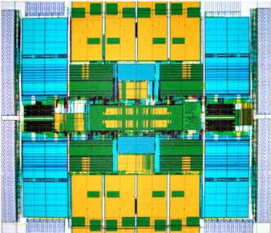
CMPs: motivation for photonic interconnect
Growing multi-core architectures straining on-chip and chip-to-chip electronic interconnects
Montecito
2 cores
Intel 2004
CELL BE
9 cores
IBM 2005
Niagara
8 cores
Sun 2004
Barcelona
4 cores
AMD 2007
Terascale
80 cores
Intel Polaris 2007
Tile64
64 cores
Tilera 2007
Photonics provide solution to bandwidth demand for on- and off-chip communication
Silicon on insulator platform for photonic interconnection networks features high index contrast and compatibility with CMOS fabrication

Slide 4
Global On-Chip Communications
Growing number of cores → Networks-on-Chip (NoC)
Shared, packet-switched, optimized for communications
  Resource efficiency
  Design simplicity
  IP reusability
  High performance
But no true relief in power dissipation
IBM Cell ~30-50% of chip power budget
allocated to global interconnect

Slide 5
Off-Chip Communications
Higher on-chip bandwidths → more off-chip communication
Off-chip bandwidth scales through pin count & signaling rate
  Pin counts limited by packaging constraints, chip size, and crosstalk
  Power scales badly with signaling rates
Memory Interface
Controller
25.6 GB/s @ 3.2GHz
I/O
Controller
25 GB/s @ 3.2GHz
(inbound)
[Kistler et al., IEEE Micro 26 (3) 10–23 (2006)]

Slide 6
Off-Chip Communications
Element Interconnect Bus
(on-chip communications)
delivers nearly an order of magnitude more bandwidth:
205 GB/s @ 3.2 GHz
Memory Interface
Controller
25.6 GB/s @ 3.2GHz
I/O
Controller
25 GB/s @ 3.2GHz
(inbound)
[Kistler et al., IEEE Micro 26 (3) 10–23 (2006)]

Slide 7
Why Photonics?
Photonics changes the rules for Bandwidth-per-Watt.
Photonics:
Modulate/receive ultra-high bandwidth data stream once per communication event.
Broadband switch routes entire multi-wavelength stream.
Off-chip BW = on-chip BW for nearly same power.
ELECTRONICS:
Buffer, receive and re-transmit at every router.
Each bus lane routed independently. (P ∝ N_{LANES})
Off-chip BW requires much more power than on-chip BW.
TX
RX
TX
RX
RX
RX
RX
RX
TX
TX
TX
TX

Slide 8
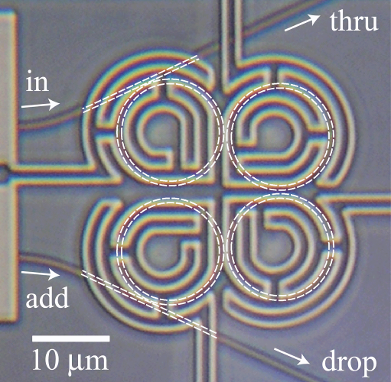
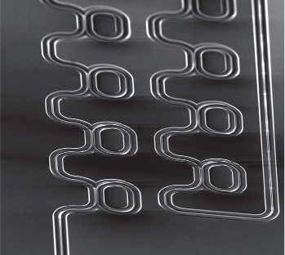
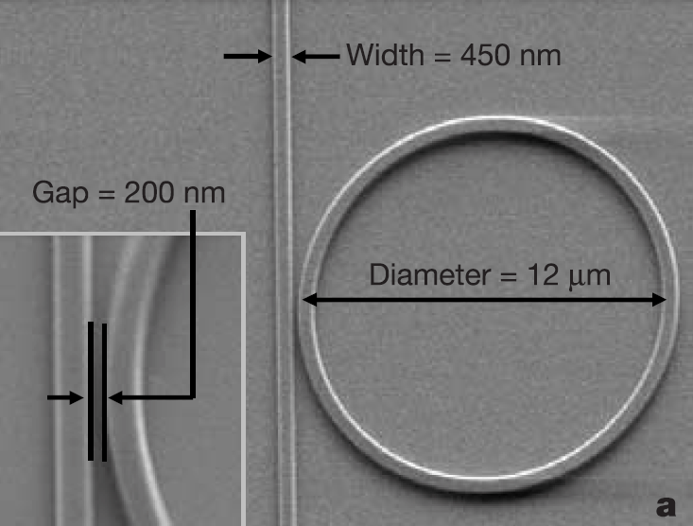
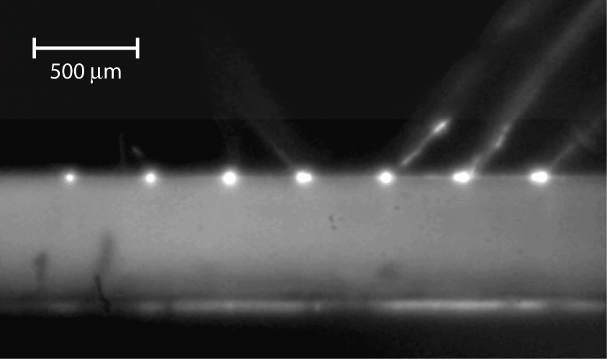
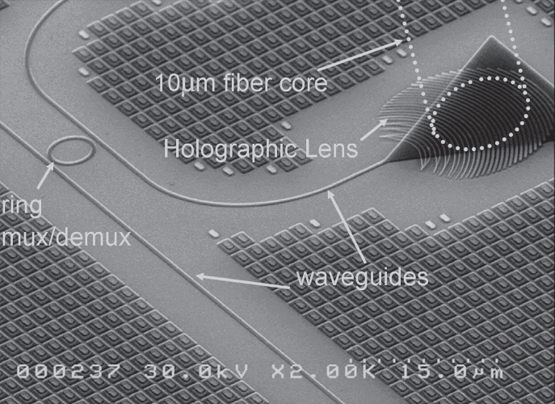
Silicon Photonic Integration
MIT, 2008
Cornell, 2005
IBM, 2007
Luxtera, 2005
UCSB, 2006

Slide 9
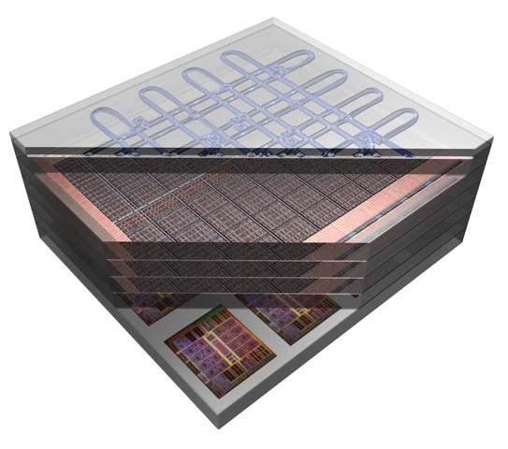
Vision of Photonic NoC Integration
photonic NoC
3D memory
layers
multi-core
processor layer

Slide 10
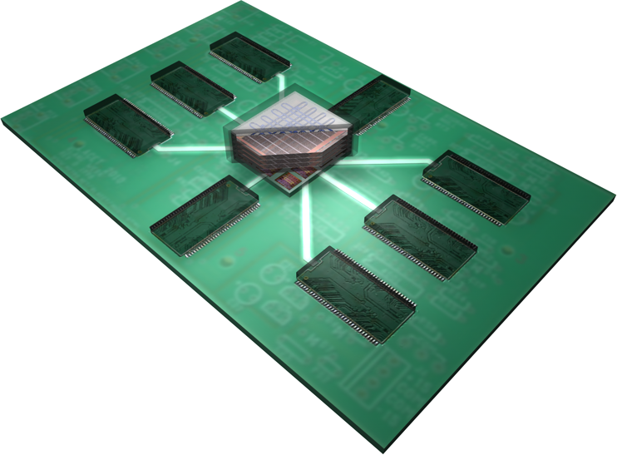
Nanophotonic Interconnected Compute/DRAM Node
DRAM
DRAM
DRAM
DRAM
DRAM
DRAM
DRAM
DRAM

Slide 11
Hybrid NoC Approach
Electronics
  Integration density → abundant buffering and processing
  Power dissipation grows with data rate and distance
Photonics
  Low loss/power, high bandwidth,
  bit-rate transparent
  Limited processing, no buffers
Our solution: a hybrid approach
  Data transmission
  in a photonic network
  Control in an electronic network
  Circuit switched → paths reserved
  before transmission
  (no optical buffering required)
P
P
P
G
G
G
P
P
P
G
G
G
P
P
P
G
G
G

Slide 12
Hybrid NoC Demo
P
P
P
Processing Core
(on processor plane)
Gateway to Photonic NoC
(between processor & photonic planes)
G
G
G
P
P
P
Thin Electrical Control Network
(~1% BW, small messages)
Photonic NoC
Deflection Switch
G
G
G
P
P
P
G
G
G
DARPA phase I ICON project

Slide 13

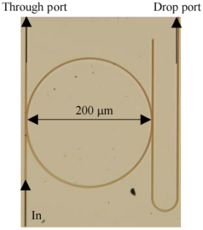
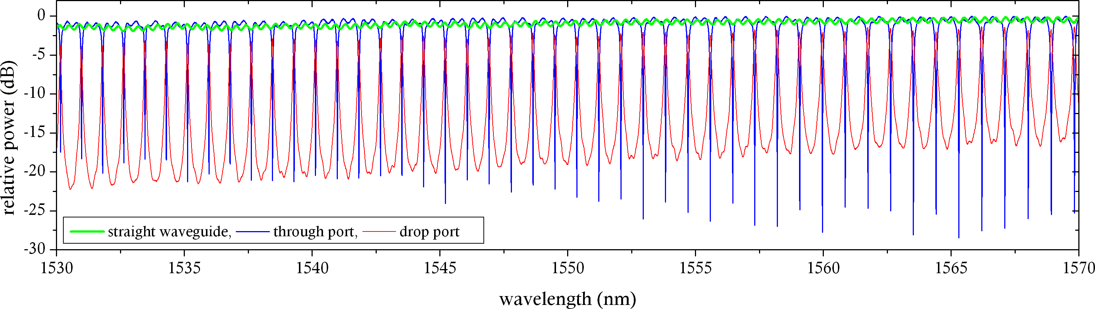
Key Building Blocks
HIGH-SPEED RECEIVER
LOW LOSS BROADBAND NANO-WIRES
5cm SOI nanowire
1.28Tb/s (32 λ x 40Gb/s)
IBM
IBM/Columbia
BROADBAND MULTI-λ ROUTER SWITCH
HIGH-SPEED MODULATOR
Cornell/
Columbia
IBM
Cornell

Slide 14
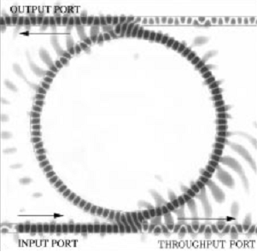
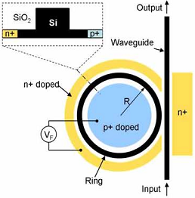

Microring Resonators
Valuable building blocks for SOI-based systems
  Passive operations
    Filtering and multiplexing
  Active functions
    Electro-optic, thermo-optic, all-optical switching/modulation
B. E. Little et al., PTL, Apr 1998
Q. Xu et al., Opt. Express, Jan 2007
P. Dong et al., CLEO, May 2007

Slide 15
Basic Switching Building Blocks
Broadband 1×2 Switch
Through State
Drop State
A. Biberman, OFC 2008
Broadband 2×2 Switch
Cross State
Bar State
B. G. Lee, ECOC 2008

Slide 16
Switch Operation
bar
in0
out0
cross
PUMPING
in1
out1
Transmission
λ

Slide 17
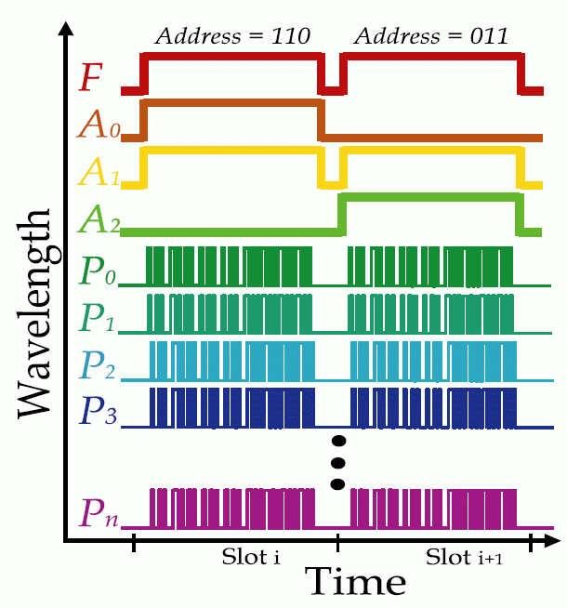
Multi-wavelength Switch Block
Truly broadband switching of multi-wavelength packets using a single switch
Single Wavelength Switch
P _{dissipated,single wavelength} = P _{dissipated,multi-wavelength}
Multi-Wavelength Switch

Slide 18
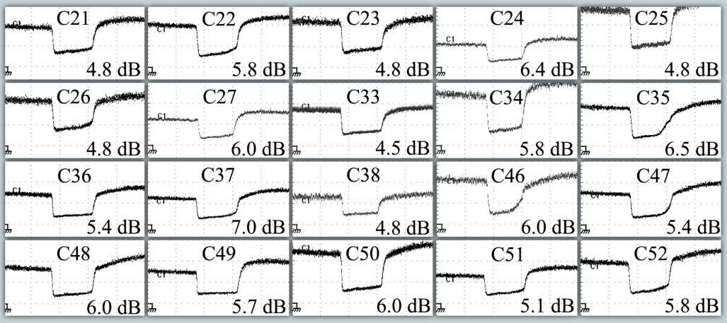
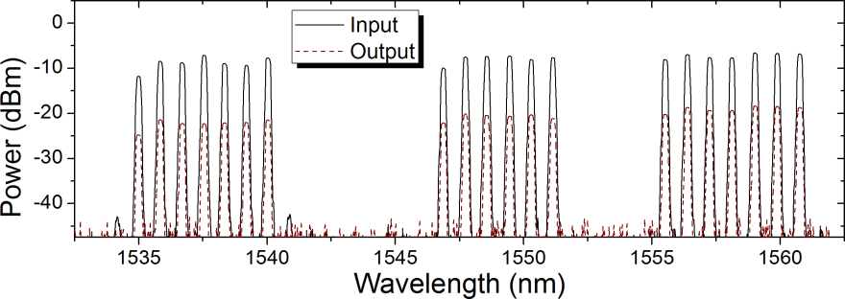
Broadband Switching
A. Biberman, LEOS 2007
•••
•••
•••
Wavelength
•••
•••
•••
•••
Ring FSR
•••
•••
Time
A. Biberman, ECOC 2008
A. Biberman, OFC 2008
Broadband data signal

Slide 19
Non-Blocking 4×4 Switch Design
N
Original switch:
internally blocking
New design:
  Strictly non-blocking*
  Same number of rings
  Negligible additional loss
  Larger area
* U-turns not allowed
N
W
W
E
E
S
S

Slide 20
16-Node Non-Blocking Torus
Notes:
Another non-blocking topology can be realized using non-blocking switches, having again just two cores injecting on each row and two cores ejecting from each column.
The advantage of this topology is that the cores can be distributed on the plane more uniformely and there aren’t long electronic wires...
20

Slide 21
Simulation Environment
Highest level of simulation – enables system-level analysis
Composed of functional components and building blocks
Source plane – Traffic generator for application specific studies
Enables system performance analysis based on physical layer attributes
Plug-ins for simulator
  ORION – Electronic Energy Model
  DRAMSim – Memory Simulator
  SESC – Architecture
Simulation Planes
Photonic Plane
Control Plane
Source Plane

Slide 22
Photonic Elemental Building Blocks
Crossing
1×2 Switch
Foundation of Simulation Structure
Accurate physical layer model
Parameterized – current and projected performance
2×2 Switch
Parameter Space
Latency
Insertion loss
Crosstalk
Resonance profile
Thermal dependence
Modulator

Slide 23
2x2 Photonic Switching Element

Slide 24

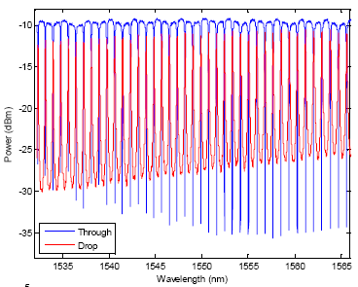
1x2 Photonic Switching Element
75 μm
50 μm
Insertion Loss and Crosstalk Measurements
75 μm
Through Port
Insertion Loss:* 0.063 dB
Extinction Ratio: 25 dB
Propagation Latency: 1 ps
Drop Port
Insertion Loss*: 0.513 dB
Extinction Ratio: 20 dB
Propagation Latency: 4.1 ps
[P. Dong, Opt. Exp., July 2007]
* includes crossing and propagation loss

Slide 25
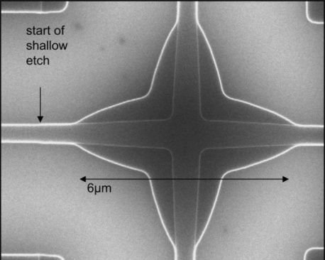
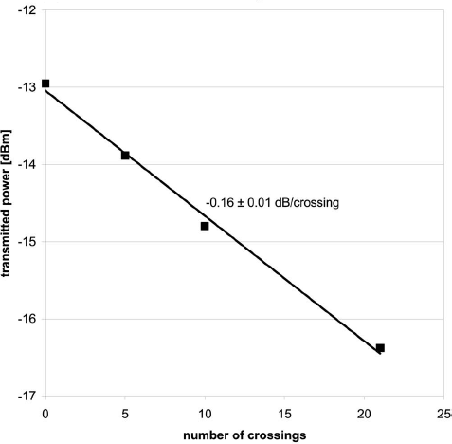
Waveguide Crossing
50 μm
Insertion Loss Measurements
50 μm
Insertion Loss*: 0.058 dB
Propagation Latency: 0.6 ps
* includes crossing and propagation loss
Reflection Loss: -22.5 dB
Reflection Latency (from Original Signal Injection): 0.6 ps
[W. Bogaerts, Opt. Let., Oct. 2007]

Slide 26
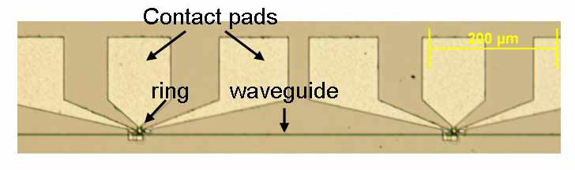
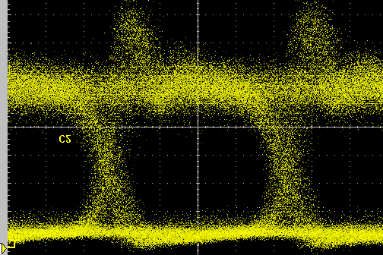
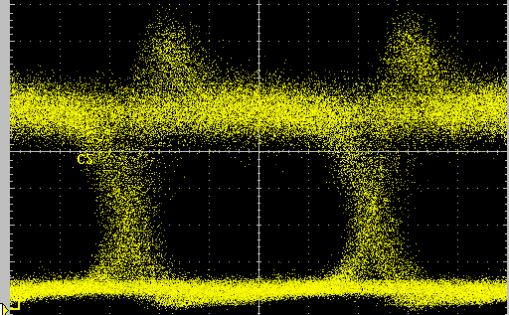
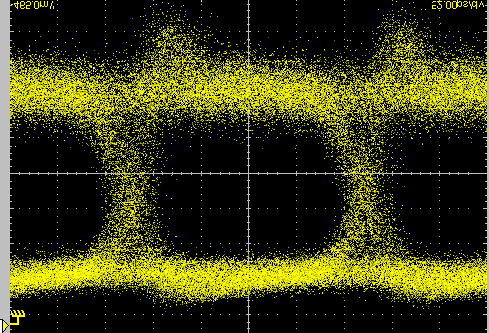
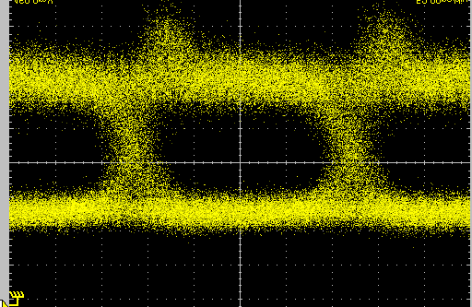
Modulator
Cascaded Wavelength-Parallel Micro-Ring Modulators
11 μm
3 μm
4-λ × 4-Gb/s Eye Diagrams
13 μm
Ideal energy dissipation: 25 fJ/bit
Peak Power Insertion Loss*: 0.002 dB
Average Power Insertion Loss*: 3.002 dB
Extinction Ratio: 20 dB
Propagation Latency: 100 fs
[Q. Xu et al., Opt. Exp., Oct. 2006]

Slide 27
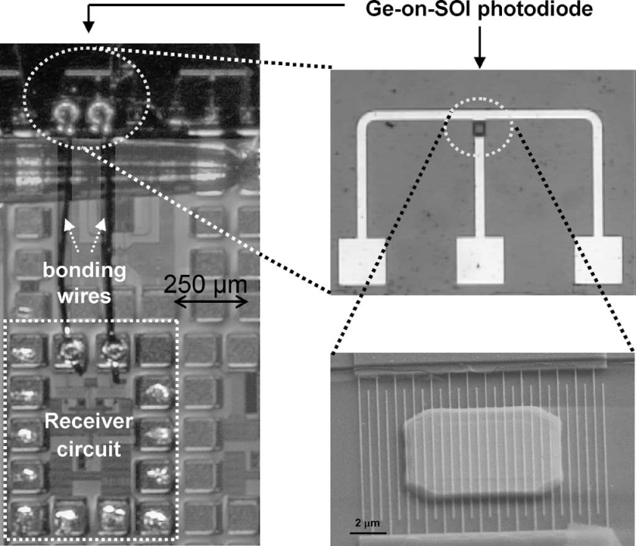
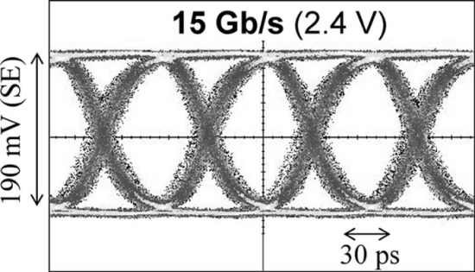
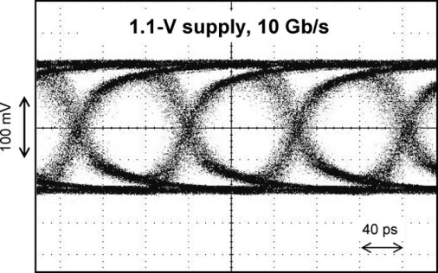
Detector/Receiver
Detector Sensitivity: -20 dBm
Energy dissipation: 50 fJ/bit
[Koester et al., JLT, Jan. 2007]

Slide 28
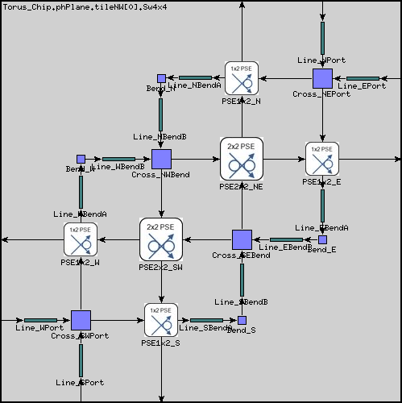
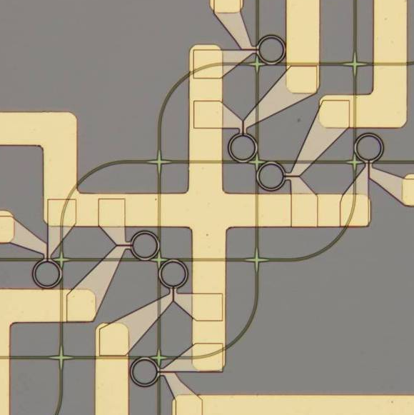
Modeling Functional Components
Higher order structures made from building blocks
Underlying logic for switching functionality
Size and position of blocks specified at this level
Physical layer captured by aggregate performance of blocks
[M. Lipson et al., Cornell University]

Slide 29
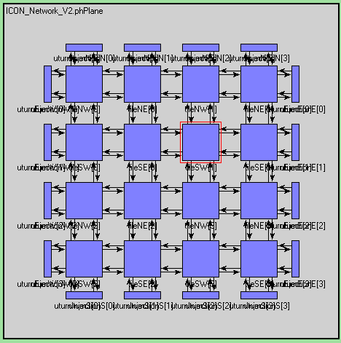
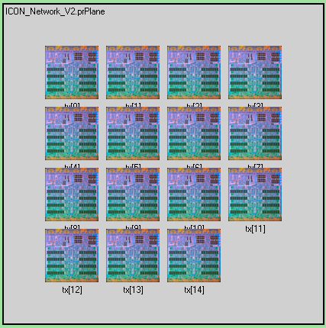
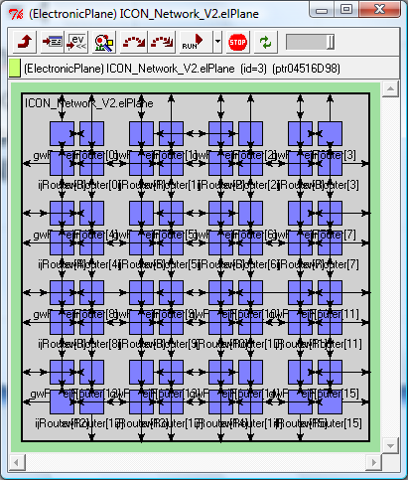
Optical Interconnection Network Simulator
Photonic Plane
Processing Element
Plane
Electronic Plane
Notes:
29

Slide 30
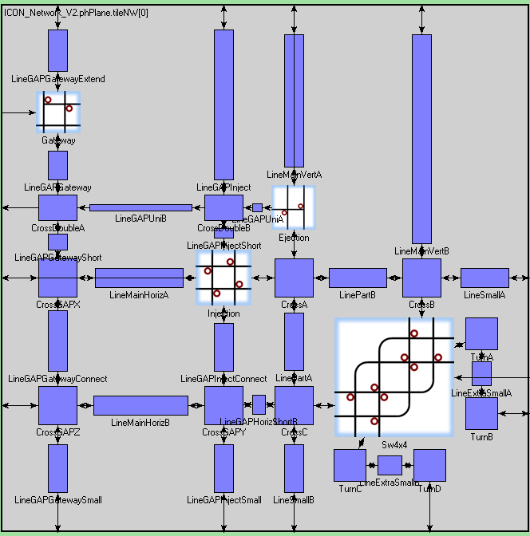
Optical Interconnect Simulator:
Photonic Plane -- Tile

Slide 31
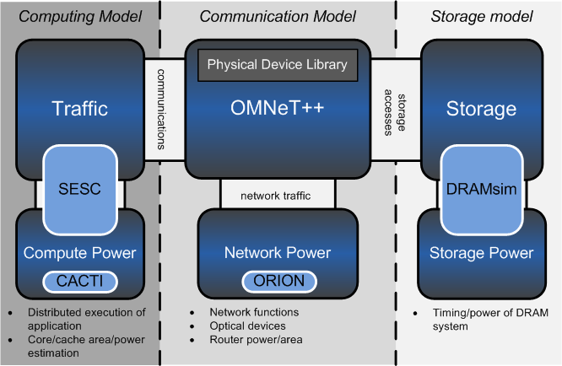
The Simulation Framework

Slide 32
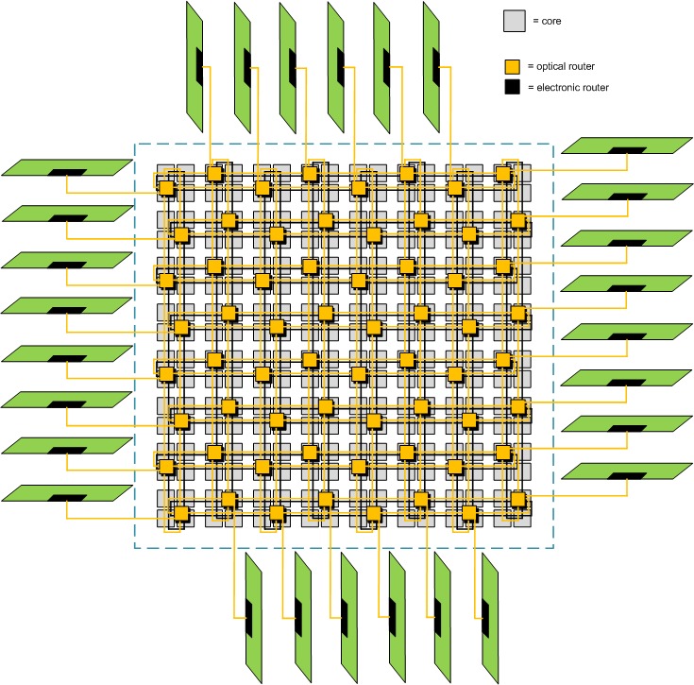
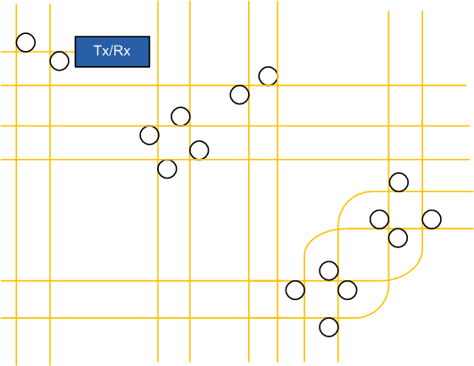
Photonic Plane
Detailed layouts of WG’s, crossings, ring resonators, modulators and detectors
Characterization of devices by measurement in lab, including insertion loss, extinction ratio, and power dissipation
Automated insertion loss analysis, and power consumption tabulating

Slide 33
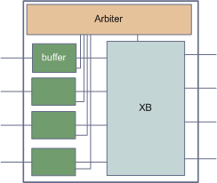
Electronic Plane
Router functions in cycle-accurate OMNeT++
Router power and area calculated with ORION power model
Approximate layout based on die size and router area yielding lengths of wires, affecting power dissipation

Slide 34
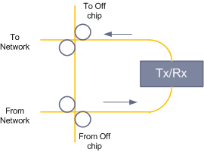
Optical I/O
Gateway modified at the periphery to allow switching off chip from either the local access node or the external network

Slide 35
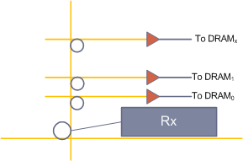
Optical DRAM Access
DRAM interface – a detector bank controls a multi-wavelength switch for writing using striped wavelengths across multiple DRAM chips. Reading is similar.
Functional and power modeling of DRAM accomplished by integrating DRAMsim (UMD)

Slide 36
Network Performance: Random traffic
8x8 network with random traffic (poisson arrival, uniform src-dest)
Photonic network = blocking torus with 20 wavelengths
Conclusions:
A blocking torus out-performs an electronic network around ~250B messages
A size filter is useful for utilizing the electronic network for small messages

Slide 37
Network Performance - Power

Slide 38
Network Performance Results
Optical loss budget, dependent on device limitations:
  Injected optical power (device nonlinear threshold)
  Network insertion loss
  Receiver sensitivity
Physical performance drives system performance:
  Bandwidth (related through the number of allowed wavelengths and injection power)
  Network scaling (due to limitations on insertion loss)
Network size/performance scales with technology improvements
Blocking Torus Network Scaling with 65% Improvement in Crossing Loss
Blocking Torus Network Scaling with Current Parameters
Number of Wavelengths
Number of Network Nodes
Notes:
Plot shows how improving the crossing loss (physical layer) can affect the network design (system layer)

Slide 39
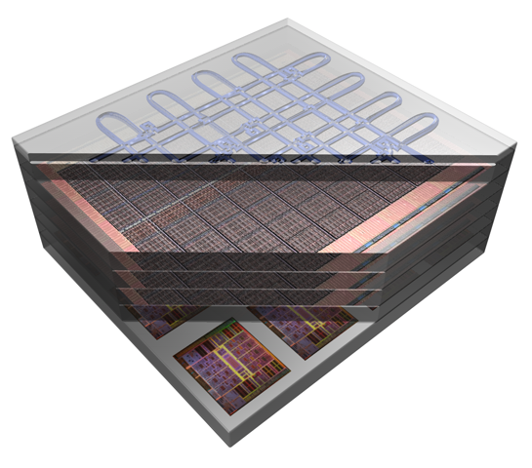
Summary and Next Steps
Nanoscale silicon photonics opportunity
  System wide uniform bw
  Energy efficiency
Vast design space across:
  Photonic and electronic phy layer
  Network architecture
  System performance
Building library of components with accurate capture of physical layer in integrated simulation platform
Simulator environment for interconnection network which is critical middle layer:
  Design exploration of networking architectures with functional building blocks – CAD-like environment
  Direct interface to system/application performance evaluation
Integrated system-network-device design exploration tool set

