Slide 1
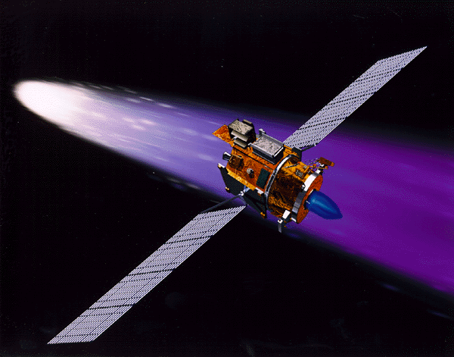
Rapid Paths to Petaflops Computing and Beyond
4th Workshop on Distributed Supercomputers
Thomas Sterling
California Institute of Technology
NASA Jet Propulsion Laboratory
March 10, 2000

Slide 2
Predictions and Insights
Punch cards are for ever
Video monitors are a fad
Apple is dead
SGI is alive
Everyone will want an IBM 360 on a chip
Parallel programmers won’t tolerate message passing
Linux will last maybe two years at most
You can’t make money selling a magazine (or books) about free software
You can’t make money selling CDs of software you can download off the net for free
Java, you can’t be serious

Slide 3
Prediction Paradigms
Crystal ball reflection
  seeing your own reflection
Road Kill
  staring in to the headlights
Yellow brick road
  don’t look behind the curtain
Ballistic trajectory
  e.g. Moore’s Law
Surfs Up
  catch the wave
Chapter 11
  give up

Slide 4
Algorithms Provide the Abstract Medium to Match the Computing Requirements of Applications to the Attributes of the System Architecture to Deliver Sustained Performance
APPLICATIONS
ALGORITHMS
SYSTEM ARCHITECTURE
Algorithmic Solutions Driven by and Respond to Assumptions about Underlying System Architecture Properties
TECHNOLOGY
PERFORMANCE

Slide 5
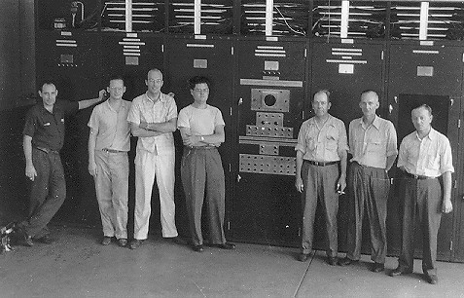
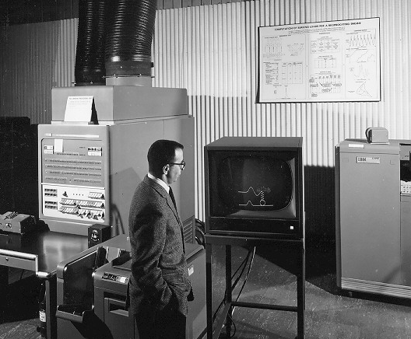
Points of Inflection Computing
Heroic Era (1950)
  technology: vacuum tubes, mercury delay lines, pulse transformers
  architecture: accumulator based
  model: von-Neumann, sequential instruction execution
  examples: Whirlwind, EDSAC
Mainframe (1960)
  technology: transistors, core memory, disk drives
  architecture: register bank based
  model: reentrant concurrent processes
  examples: IBM 7042, 7090, PDP-1
Scientific Computer(1970)
  technology: earliest SSI logic gate modules
  architecture: virtual memory
  model: parallel processing
  examples: CDC 6600, Goodyear STARAN

Slide 6
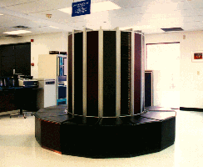
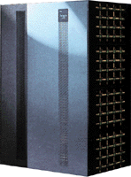
Points of Inflection in the History of Computing
Supercomputers (1980)
  technology: ECL, semiconductor integration, RAM
  architecture: pipelined
  model: vector
  example: Cray-1
Massively Parallel Processing (1990)
  technology: VLSI, microprocessor,
  architecture: MIMD
  model: Communicating Sequential Processes, Message passing
  examples: TMC CM-5, Intel Paragon
? (2000)
  trans-teraflops epoch

Slide 7
Challenges
Bandwidth/throughput
  PBps
Parallelism
  100 million-way
Latency
  time of flight, cycle time disparity
  thousand to a million-way
Overhead
Data set size/Memory capacity
  Pbyte down to a Terabyte (or less, severely domain specific)
Resource and task management
  O/S, languages, compilers, runtime nucleus
Power, complexity, cost, and reliability

Slide 8
CMOS Technology Projections
2001
  logic: 0.15 um, 38 Mtr, 1.4 GHz
  memory: 1.7 Gbits, 1.18 access
2005
  logic: 0.10 um, 250 Mtr, 2.0 GHz
  memory: 17.2 Gbits, 1.45 access
2008
  logic: 0.07 um, 500 Mtr, 2.5 GHz
  memory: 68.7 Gbits, 1.63 access
2011
  logic: 0.05 um, 1300 Mtr, 3.0 GHz
  memory: 275 Gbits, 1.85 access

Slide 9
Opportunity Drivers
Technology
  optical communications
  optical storage
  merged logic and DRAM
  very high speed logic
Architecture
  System On a Chip
  Multithreaded
  Processor in Memory (PIM)
  Dynamic adaptive resource management
Open Source Software Framework
  for ISV target stability
  low entry level cost of new systems

Slide 10
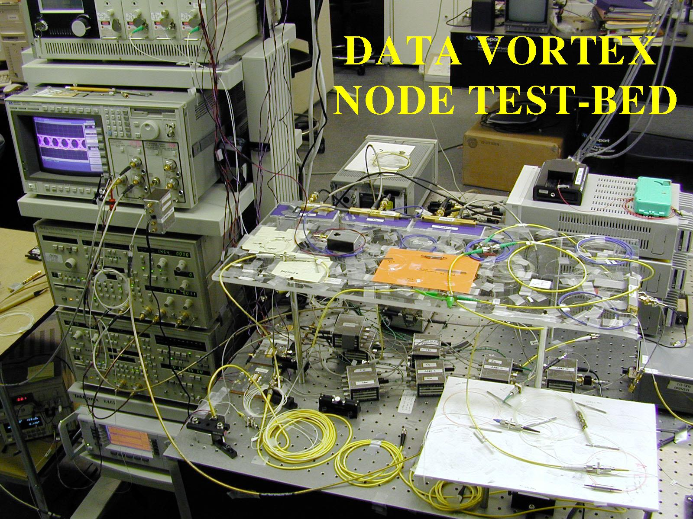
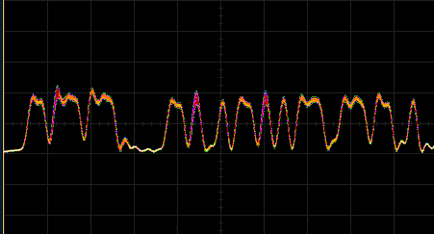
Technologies: Data Vortex Network
Optical Communication Technology
640 Gbps per fiber
Time/Wave Division Multiplexing
Pure Optical Data Switching
1 Nanosecond Packet Switching

Slide 11
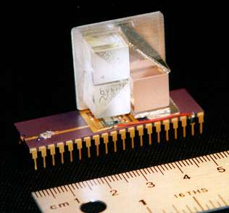
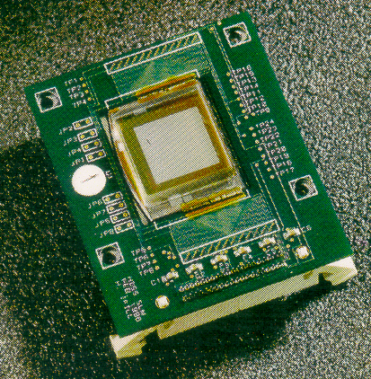
Technologies: Holographic Storage
VCSEL array
Mirror
SLM
Detector
Mirror

Slide 12
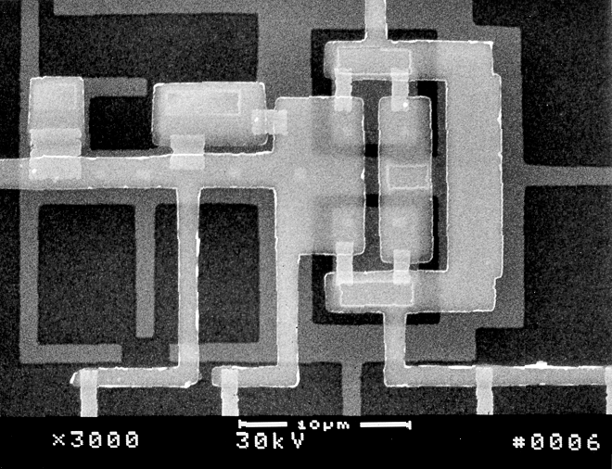
Technologies: Superconductor RSFQ the world’s fastest digital logic
1 THz
    HTS RSFQ (??)
100 GHz 30M JJ
    3M JJ 0.4 um
300K JJ 0.8 um
10K JJ 1.5 um
3.5 um
10 GHz 0.05 um 0.07 um
      0.10 um
      0.12 um
0.14 um
0.20 um
1 GHz
"no known solutions"
optical lithography
100 MHz
1995 1998 2001 2004 2007 2010
Year

Slide 13
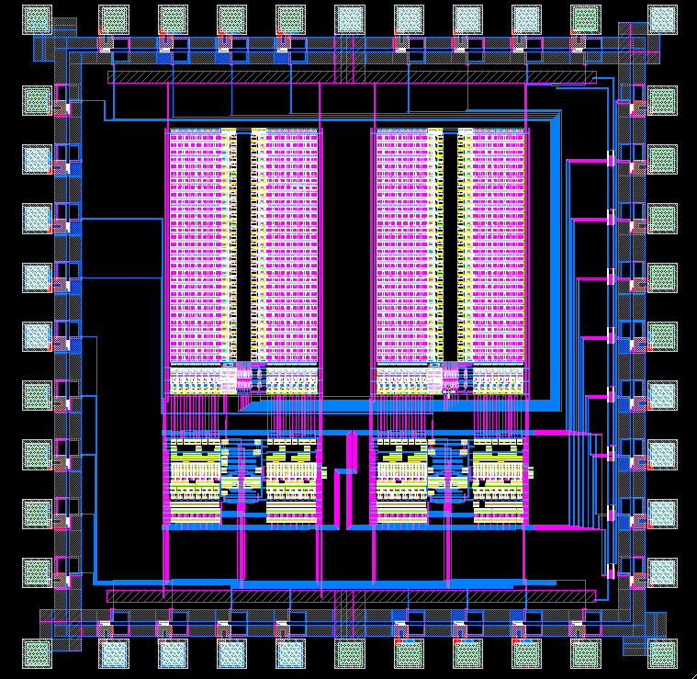
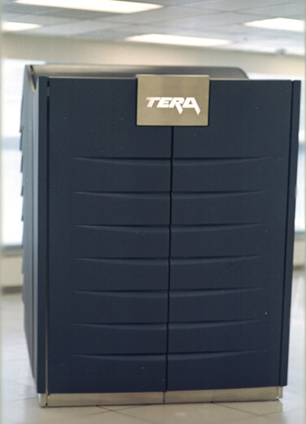
Architecture Opportunities for Petaflops in the 21st Century
PC Clusters
  e.g. Beowulf
Constellations of SMPs or DSMs
Multithreaded Architecture
  e.g. Tera MTA
Processor in Memory
  e.g. IRAM, DIVA, Blue Gene
Dynamic Adaptive
  e.g. HTMT

Slide 14
Percolation and Parcels
Resources to perform available tasks, not wait for future work
Pre-instantiated tasks register precedent constraints
Distinguish between high utilization (high cost) and high availability (low cost)
The right tool for the right job:
  numeric intensive calculations performed on high throughput engines
  data manipulations performed on high bandwidth storage
Pro-active prestaging of task state at compute site
Task results returned through independent write back and synchronization

Slide 15
The Beowulf Delta looking forward
6 years
Clock rate: X 4
flops (per chip): X 50 (2-4 proc/chip, 4-8 way ILP/proc)
#processors: 32
Networking: X 32 (32 - 64 Gbps)
Memory: X 10 (4 Gbytes)
Disk: X 100
price-performance: X 50
system performance: 50 Tflops

Slide 16
