Slide 1
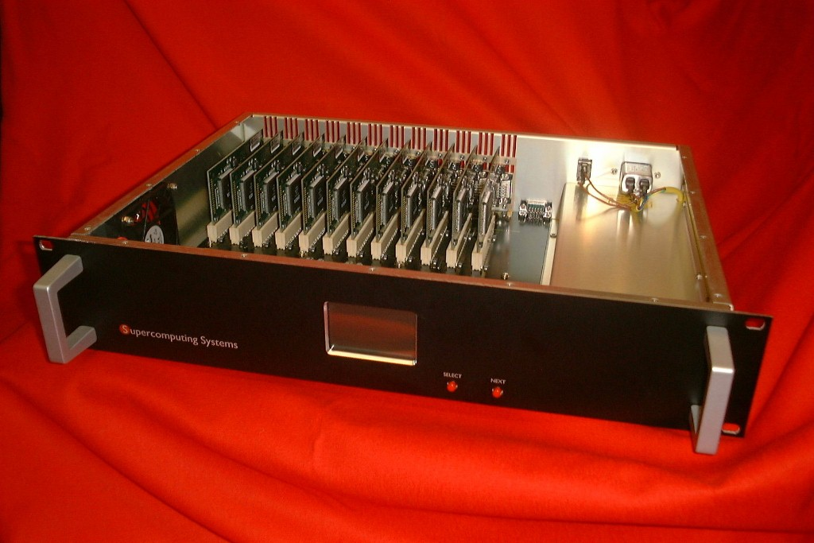
SOS Workshop 2000 Interconnect Technology Session
Tnet
Roland Paul
Supercomputing Systems AG

Slide 2
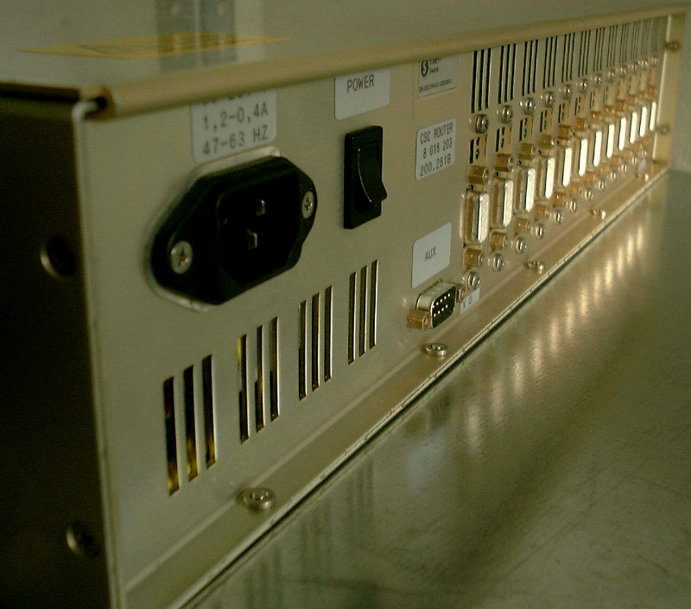
Tnet Switch: Technical data
12 port full crossbar switch
100 + 100 MB/s per link (MPI data)
Micropackets (max. 128 Bytes)
64k computational nodes
Very low error rate (BER <10⁻¹⁹)
Multicast routing
Any topology possible (switch prevents deadlocks)
Remote configurable
Network performance monitoring

Slide 3
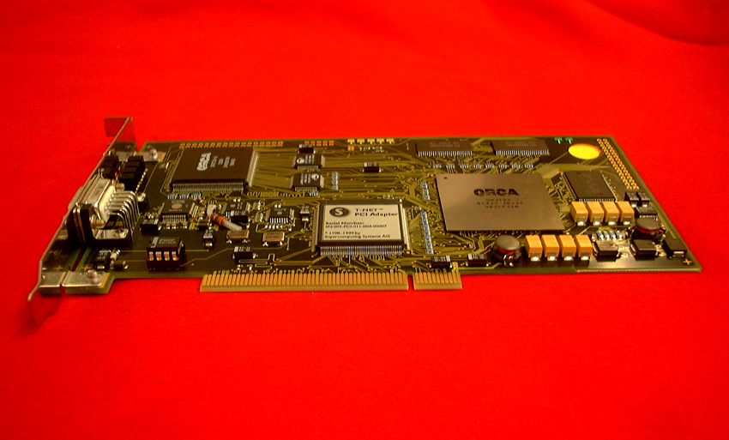
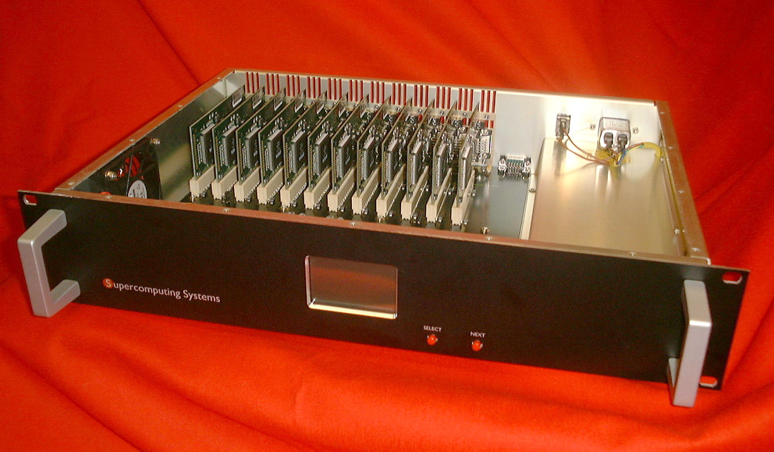
Tnet Features
Reliability
The T-Net retransmission protocol
Performance
MPI multicast on the network
Address translation on NIC
micropackets
Flexibility
Any Network topology possible
Expandability
Standard electrical to optical Adapters
Remote managebility
Switch can be updated and configured remotely
One communication subsystem
MPI and Hardware developed together

Slide 4
Tnet retransmission protocol
Gigabit
Transmission
Buffer
Buffer
Transmission
Data
Received
Data
CRCC
Buffer
Controller
Buffer
Controller
Virtual backchannel
for Acknowledges or Retransmission commands

Slide 5
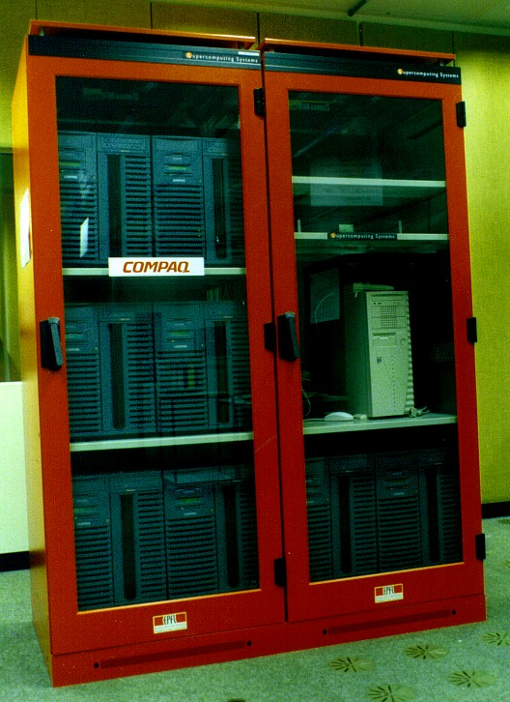
Swiss-T1 Baby
Reliability:
Installed: August 99
Accepted: October 99
Crashes since acc.: 0
unscheduled downtime: 0 %
Performance:
MPI bandwidth: 50 MB/s
MPI latency: 20 μs
The application performance measured was equal to CPlant/Siberia and close to Quadrics/AlphaServer SC

Slide 6
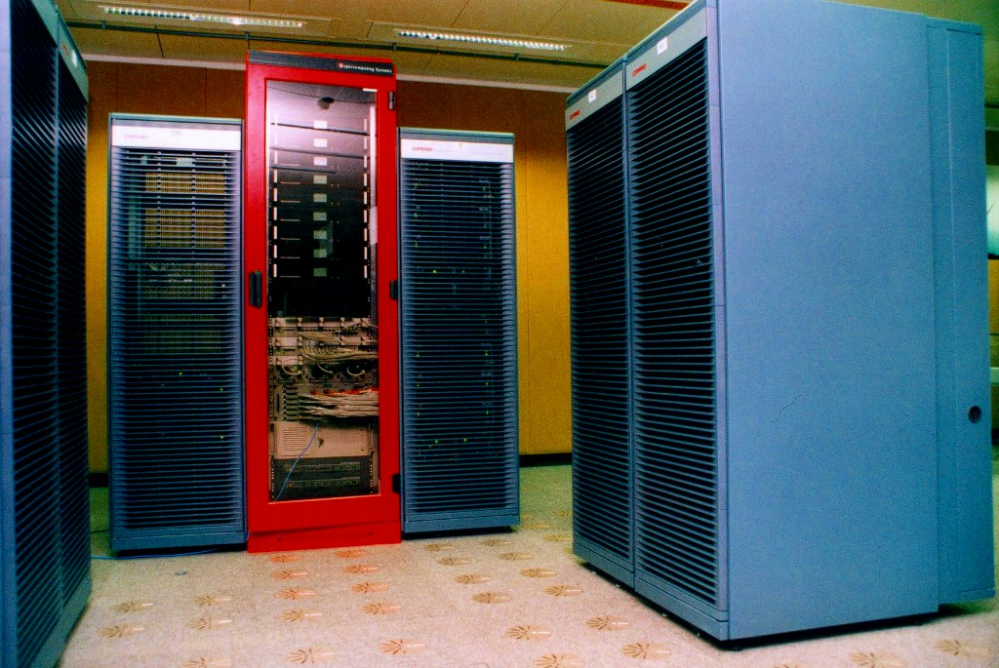
Swiss-T1: Current Tnet machine
64 21264@500MHz
32 GB Main Memory
32 Bit TNet NIC:
75 MB/s
18 μs
64 Bit TNet NIC:
180 MB/s bidir.
13 μs

Slide 7
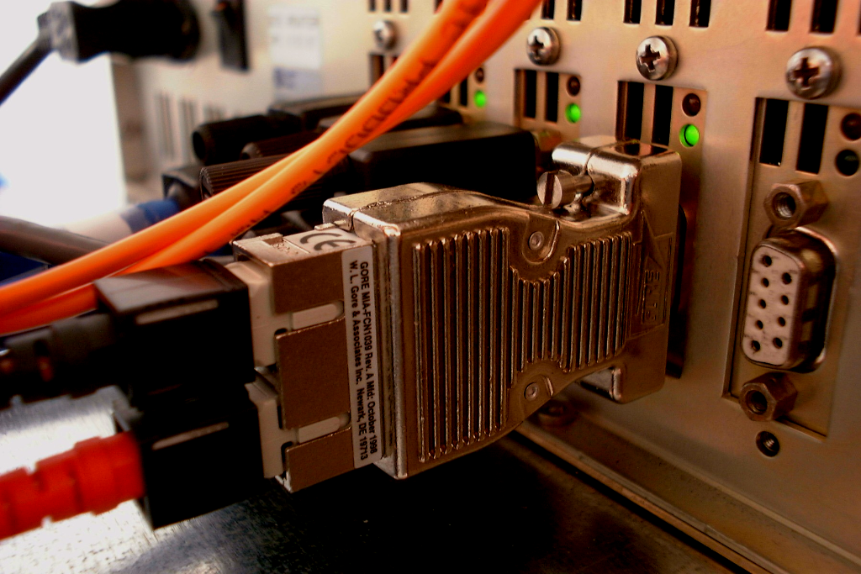
Tnet Expandability
Plug and play electrical to optical interface (MIA)

Slide 8
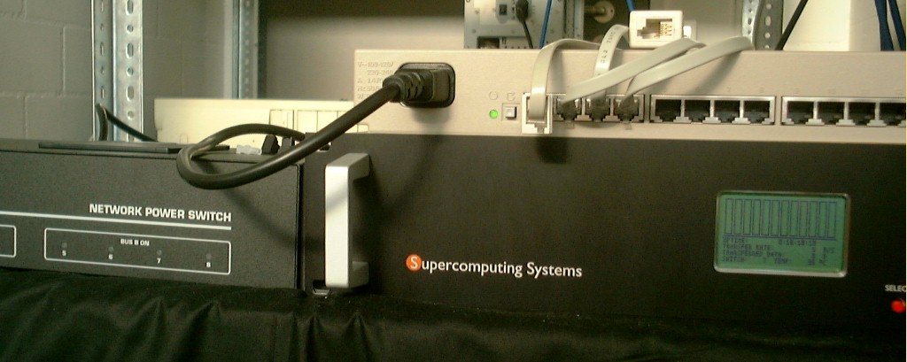
Tnet Remote managebility
Terminal server
Powerswitch
Tnet Switch

Slide 9
Tnet Summary
A high reliability of the Tnet HW and SW was shown on the Swiss-T1 Baby
The Application performance in Swiss-T1 Baby is comparable to other clusters
The Network performance of Swiss-T1 with Tnet64 NIC will be 300% higher than Baby
MPI implementation verified with Intel suite
Going optical is easy and relatively inexpensive
The network topologies with rings are allowed and actually work

