Slide 1
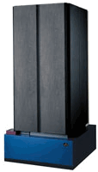
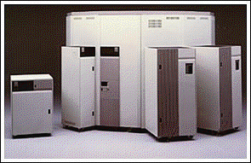
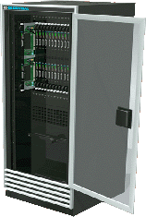
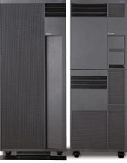
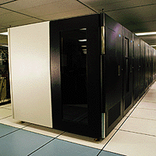
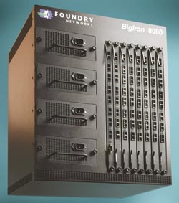
ORNL Computing Resources
TeraFLOPS
Computing
High Speed
Networking
High Performance
Storage
(360 TB)
GSN
Gigabyte/sec
IBM
SP
Fiber
Channel
STK Tape Robots
IBM S80
IBM H70
IBM F50
Compaq
Sierra
Probe
Storage Testbed
IBM Tape Robots
Gigabit
Ethernet
(20 TB)
IBM SSA Disks
HighTORC
PC Cluster
High Speed
Wide Area Networks
Notes:
I am Buddy Bland, Director of operations for the ORNL Center for Computational Sciences. I manage the high performance computers and storage for the Lab.
John has described his applications, I will describe the computing resources.
Our computing resources include an SP, a Compaq Alphaserver, and SGI Origin 2000, and a Linux PC cluster
We link these systems together using various high speed networks including FDDI, Gigabit Ethernet, and we are installing GSN.
Our we have a large storage system, running HPSS and a new storage testbed for prototyping data intensive applications and experimenting with storage HW & SW

Slide 2
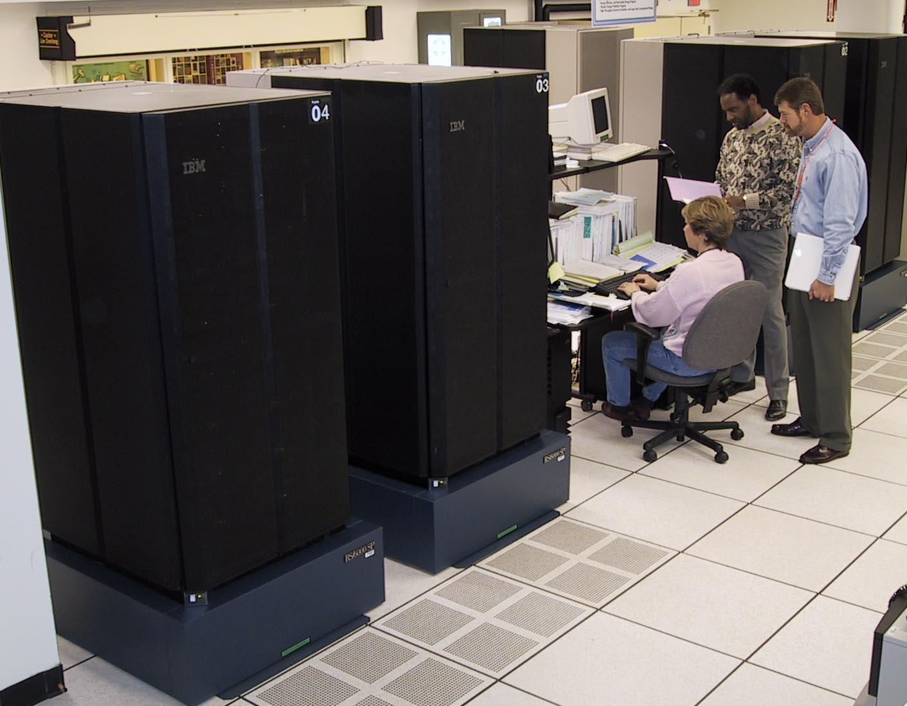
IBM RS/6000 SP
April 1999 – XPS150 turned off
Installed 100 GFLOP
Winterhawk-1
GRS Switch
September 1999
Added Nighhawk-2 Cabinet
Early evaluation system
December 1999
Upgraded to 425 TFLOP
Winterhawk-2 nodes
and doubled memory
April 2000
Upgrade to 1 TFLOP
By adding 7 more Cabinets (total 12)

Slide 3
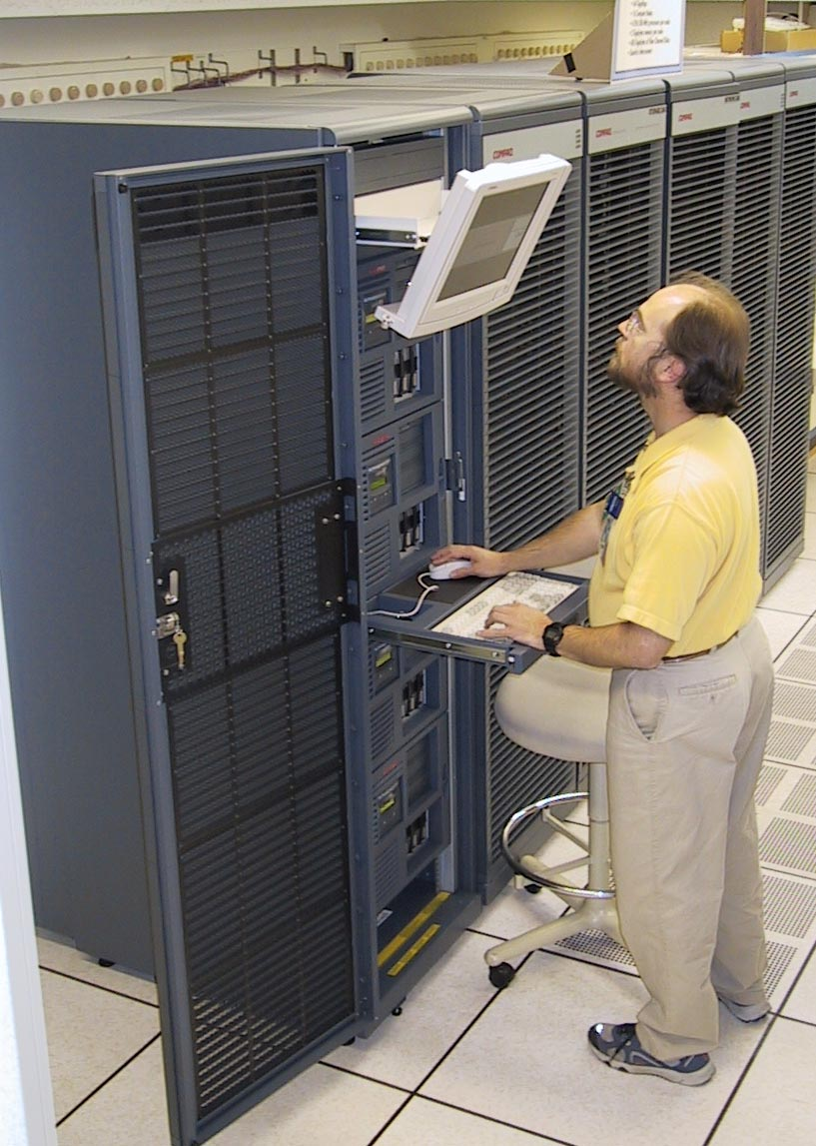
Compaq Sierra Cluster
December 1999
Installed 16 ES40 nodes, each
with four 500 MHz processors.
Quadrics switch.
64 GFLOPS
March 2000
Upgrade 16 nodes to EV67 and
add 64 additional nodes,
each with four 667 MHz EV67
428 GFLOPS
Fall 2000
Option to upgrade to 1 TFLOP
128 nodes 882 Mhz EV7

Slide 4
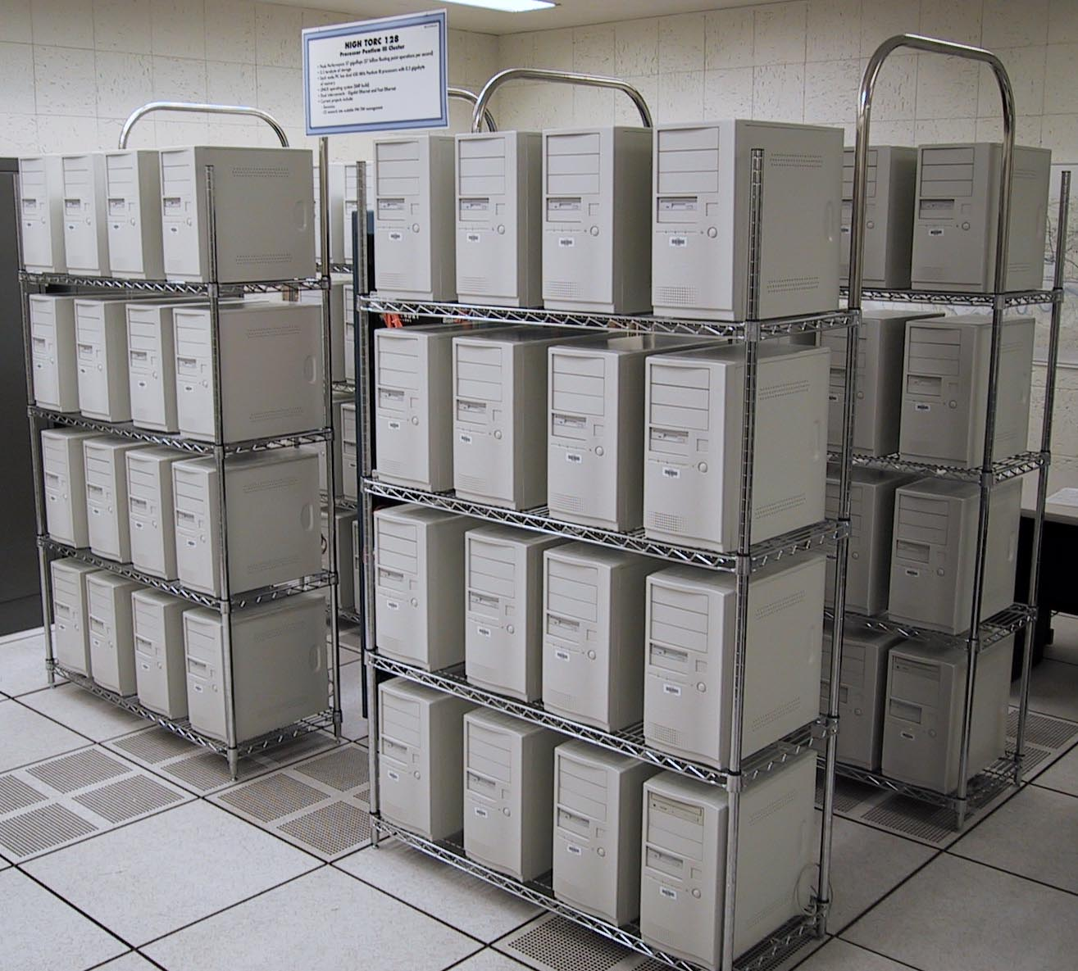
High TORC Linux Cluster
July 1999
128 Pentium III proc. (450Mhz)
512 MB per node
Gigabit ethernet (Foundary)
64 nonblocking switch ports
Syskonnect NIC
Fast ethernet for control
TORC 1 (UTK)
66 Pentium III proc. (500Mhz)
Myrinet and Fast ethernet
TORC 2 (ORNL)
Heterogeneous cluster testbed
36 proc. Pentium, Alpha, Sparc
Myrinet, gigabit, giganet, fast-e
Chem
Tech
CPED
Solid
State
Plus
CSMD
ESD
SNS

Slide 5
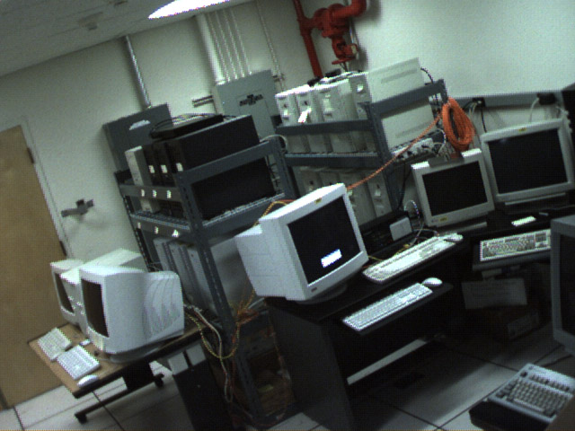
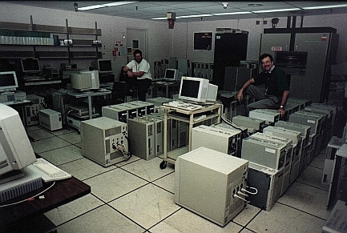
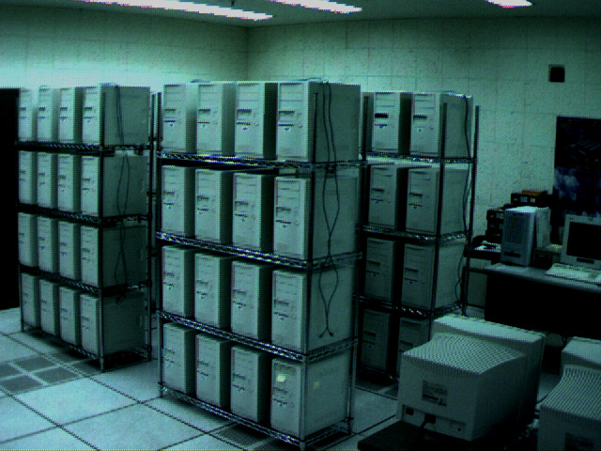
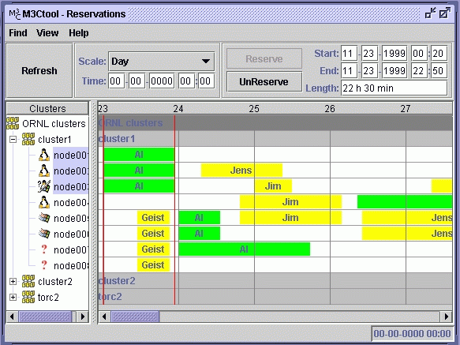
Cluster Software
Harness (Next Generation PVM)
www.csm.ornl.gov/harness
Scalable Intracampus
Research Grid (SInRG)
Collaborating VMs
www.cs.utk.edu/sinrg
FT-MPI
PVM
VIA
Distributed control
Parallel Plug-ins
Cluster Computing Tools
www.csm.ornl.gov/torc
NetSolve 1.2
NWS/AppLES
EveryWare
Fault tolerance
IBP, other…
M3C tool suite
Monitoring and Managing
Multiple clusters

