Slide 1
The Future of the Top500 “Prediction is hard. Especially the future . . .” Yogi Berra, American philosopher in the Baseball Hall of Fame
Jack Dongarra
University of Tennessee
And
Oak Ridge National Laboratory
http://www.cs.utk.edu/~dongarra/

Slide 2
Background Information
- Started in 6/93 by JD,Hans W. Meuer and Erich Strohmaier
TOP500 Motivation
- Basis for analyzing the HCP market
- Quantify observations
- Detection of trends
(market, architecture, technology)

Slide 3
TOP500 Procedure
- Listing of the 500 most powerful
Computers in the World
- Yardstick: Rmax from LINPACK MPP
Ax=b, dense problem
- Updated twice a year
SC‘xy in November
Meeting in Mannheim in June
- All data available from www.top500.org
TPP performance
Rate
Size

Slide 4
TOP-500 List
A way for tracking trends
in performance
in market
in classes of HPC systems
Architecture
Technology
Original classes of machines
Sequential
SMPs
MPPs
SIMDs
Two new classes
Beowulf-class systems
Clustering of SMPs and DSMs
Requires additional terminology
“Constellation”

Slide 5
“Constellation” Cluster of Clusters
An ensemble of N nodes each comprising p computing elements
The p elements are tightly bound shared memory (e.g. smp, dsm)
The N nodes are loosely coupled, i.e.: distributed memory
p is greater than N
Distinction is which layer gives us the most power through parallelism
4TF Blue Pacific SST
3 x 480 4-way SMP nodes
3.9 TF peak performance
2.6 TB memory
2.5 Tb/s bisectional bandwidth
62 TB disk
6.4 GB/s delivered I/O bandwidth

Slide 6
Gflop/s
Intel ASCI Red Xeon (9632)
2000
ASCI Blue Pacific SST(5808)
Linpack-HPC Benchmark Over Time
1500
SGI ASCI Blue Mountain (5040)
1000
Intel ASCI Red (9152)
750
Hitachi CP-PACS (2040)
500
Intel Paragon (6788)
Fujitsu VPP-500 (140)
TMC CM-5 (1024)
250
TMC CM-2 (2048)
NEC SX-3 (4)
Fujitsu VP-2600
100
Cray Y-MP (8)
0
91
93
95
97
99
Year

Slide 7
TOP10 11/99

Slide 8
Performance Development
[60G - 400 M][2.4 Tflop/s 33 Gflop/s],[1 40 Tf] Schwab #12, 1/2 each year, 100 > 100 Gf, faster than Moore’s law

Slide 9
Performance Development
ASCI
Earth Simulator
Entry 1 T 2005 and 1 P 2010

Slide 10
Architectures

Slide 11
Manufacturer

Slide 12
Chip Technology
Inmos Transputer

Slide 13
Customer Type

Slide 14
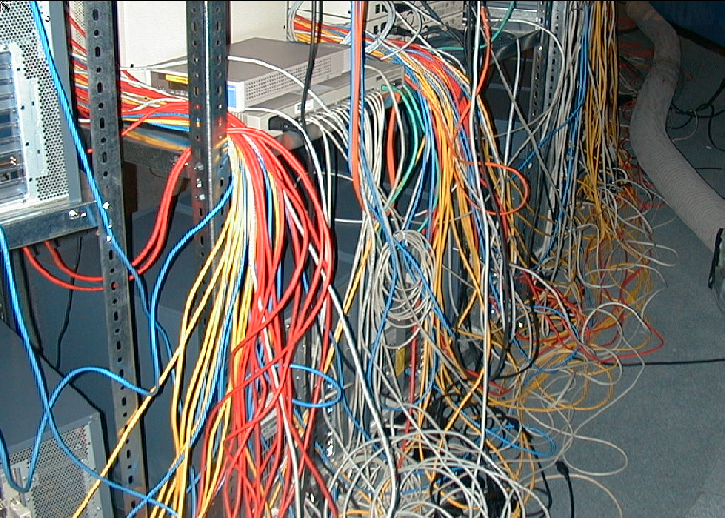
High-Performance Computing Directions
Clustering of shared memory machines for scalability
Emergence of PC commodity systems
Pentium/Alpha based, Linux or NT driven
“Supercomputer performance at mail-order prices”
Beowulf-Class Systems (Linux+PC)
Distributed Shared Memory (clusters of processors connected)
Shared address space w/deep memory hierarchy
Efficiency of message passing and data parallel programming
Helped by standards efforts such as PVM, MPI, Open-MP and HPF
Many of the machines as a single user environments
Pure COTS

Slide 15
Clusters on the TOP500

Slide 16
Futures
List of Top 100 Clusters
IEEE Task Force on Cluster Computing
Interested in assembling a list of the Top n Clusters
Based on current metric
Starting to put together software to facilitate running and collection of data.
Sparse Benchmark
Look at the performance in terms of sparse matrix operations
Iterative solvers
Beginning to collect data

