Slide 1
Vision for System and Resource Management of the Swiss-Tx class of Supercomputers
Josef Nemecek
ETH Zürich & Supercomputing Systems AG

Slide 2
Agenda
The Supercomputer Lifecycle then and now
The Swiss-T1 Management SW: COSMOS
Commodity Supercomputer Management Operating System
  The goals of COSMOS
  The concept of COSMOS
  Implementation of COSMOS
Software Integration with existing Parts
Roadmap of COSMOS

Slide 3
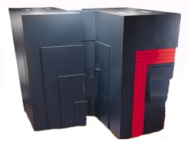
Supercomputers – Then and Now
Development by vendor
  Hardware was hand-made
  Software was tailored for hardware
Customers just had to order
out of the vendor’s catalogue
$$$
Need
Order
Test
Manage

Slide 4
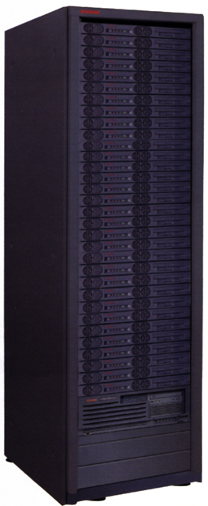
Supercomputers – Then and Now
System looks like a puzzle
  Commodity parts, multiple vendors
  Zoo of interacting software components
Individual system management
  Millions of lines of code (scripts, daemons)
Architecture
Needs
$$$ & t→∞
Thought
Design
Simulation
Manage
Topology
Specification

Slide 5
COSMOS – Goals
Integrated management for whole lifecycle
  Design the supercomputer on-line
  Simulate the supercomputer performance on-line
  Build the designed and simulated supercomputer
  Manage the built supercomputer
Complete run-time system management
  Fault-tolerance on all (or most) system levels
  Remote manageability of the whole supercomputer
  Low run-time overhead for the system management

Slide 6
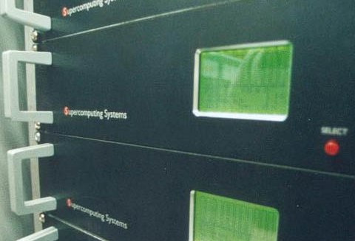
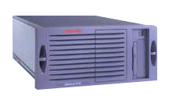
COSMOS – Supercomputer Design
Architecture selection
  SAN technology
  Nodes technology
Topology selection
  Every topology has it’s +/–
Resource usage
  Cost of the supercomputer
  Space, electrical power
Performance estimation

Slide 7
COSMOS – Supercomputer Design
Architecture selection
  SAN technology
  Nodes technology
Topology selection
  Every topology has it’s +/–
Resource usage
  Cost of the supercomputer
  Space, electrical power
Performance estimation

Slide 8
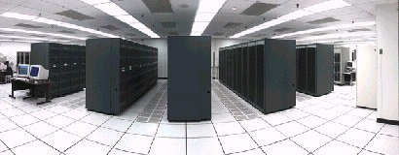

COSMOS – Supercomputer Design
Architecture selection
  SAN technology
  Nodes technology
Topology selection
  Every topology has it’s +/–
Resource usage
  Cost of the supercomputer
  Space, electrical power
Performance estimation

Slide 9
COSMOS – Supercomputer Design
Architecture selection
  SAN technology
  Nodes technology
Topology selection
  Every topology has it’s +/–
Resource usage
  Cost of the supercomputer
  Space, electrical power
Performance estimation

Slide 10
COSMOS – Goals
Single-system view of whole system
  Allows one-point system management
  Allows remote system management
High availability of the system management
  Allows high over-all system up-times
  Allows dynamic configuration changes
Modular software design
  System-independent concept & design
  Interfaces to existing management software modules

Slide 11
COSMOS – Concept
Configuration
  Control the system
Monitoring
  Observe the system
Planning
  When? Who? What?
Security
  Stability & independence
Faults & Traps
  Help the system
Accounting
  Charge the usage
Complete, integrated system management
Remote management from everywhere
No administrative programming necessary

Slide 12
COSMOS – Implementation
User Interface
User-privilege-based
management and monitoring
System Management
Node Management
State control and monitoring
of the nodes, accounting
SAN Management
SAN-dependent management
and monitoring, accounting
Resource Management
Resource management:
Priorities, allocation, queues
Process Management
Support of and co-operation with
parallel environments as MPI/FCI
LAN Management
SNMP-based management of
used LAN components
Storage Management
Vendor-dependent storage
management software

Slide 13
COSMOS – Implementation
Node 3
Management Center
Node 0
COSMOS Agent
COSMOS Center
COSMOS Agent
Process 6
Management Center
Process 0
Process 7
COSMOS Center
Process 1
Node 2
Management Center
Node 1
COSMOS Agent
COSMOS Center
COSMOS Agent
Process 4
Process 2
Process 5
Process 3

Slide 14


Gridware GRD/Codine
Powerful resource management
  Integrates resource and batch management
  Ticket-based job scheduling scheme
  Well-defined interfaces
Some drawbacks at this moment
  GRD/Codine is not topology-aware
  GRD/Codine is a commercial product

Slide 15
COSMOS – Interaction with GRD/Codine
User Interface
User Interface
System Management
GRD/Codine
Node Management
Node Monitoring
SAN Management
Accounting
Resource Management
Resource Management
Process Management
Process Monitoring
LAN Management
Storage Management

Slide 16
Roadmap of COSMOS Development
Prototype release plan for COSMOS
  1Q2000 – Centralised process and SAN management
  2Q2000 – Distributed system management framework
  3Q2000 – Complete non-interactive management
  4Q2000 – Complete interactive management
Interaction between COSMOS & GRD/Codine
  Transfer of topology and configuration information
  Exchange of monitoring information

Slide 17
Vision for System and Resource Management of the Swiss-Tx class of Supercomputers
Josef Nemecek
ETH Zürich & Supercomputing Systems AG

