Slide 1
Poisson-response Tensor-on-Tensor Regression and Applications
Carlos Llosa and Daniel Dunlavy
SAND2023-05481C

Slide 2
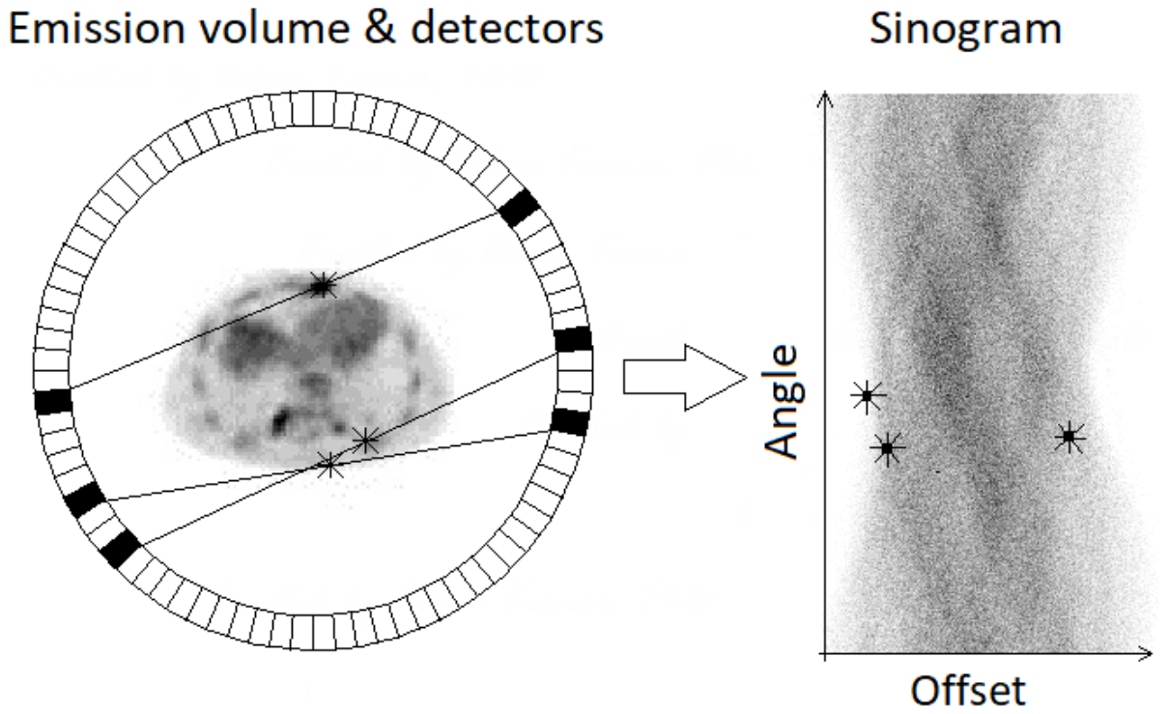
Motivating problems
[4]
Temporal prediction of dyadic relationships
ICEWS database [1]
Countries as receivers and senders
Events such as threats or aid
Can we predict future relations?
Change-point detection for multi-way relationships
Enron email database [2]
Employees as senders and receivers
Events such as words or topics of conversation
Are there changes in communication at different times?
Positron emission tomography (PET) reconstruction [3]
Poisson distribution commonly used for photon counts in emission tomography
Statistical model for PET reconstruction is ill-posed without restrictions
Can we reformulate and improve the model using low-rank tensors?
[1] O’Brien, Crisis Early Warning and Decision Support: Contemporary Approaches and Thoughts on Future Research, ISR, 2010.
[2] Enron Email Dataset: https://www.cs.cmu.edu/~enron/
[3] Shepp and Vardi, Maximum Likelihood Reconstruction for Emission Tomography, IEEE TIM, 1982.
[4] Kupcikevicius, PET Image Reconstruction using Convolutional Neural Network […] , Masters thesis, Aalborg University, 2019

Slide 3
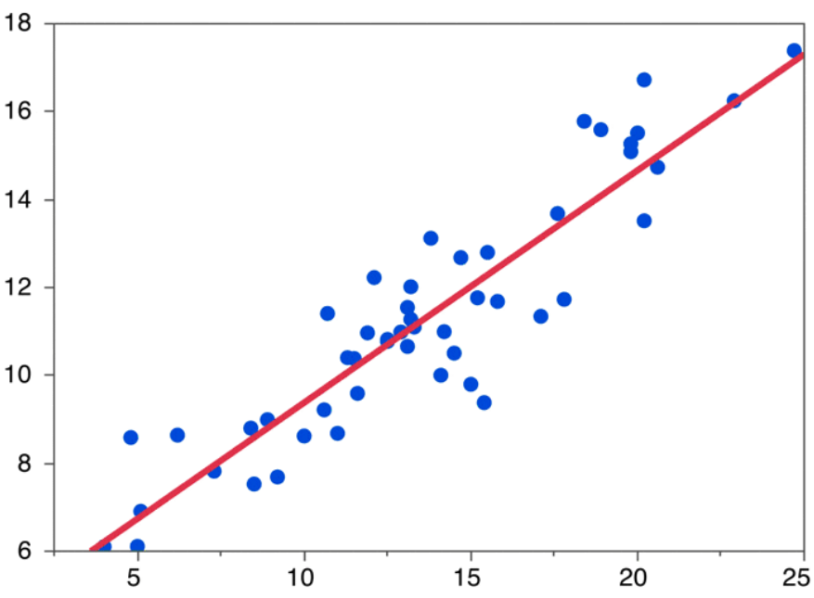
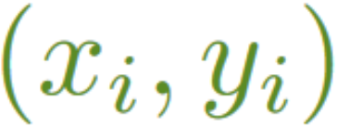
From Linear to Multilinear Regression
Linear regression:
Tensor regression:
Multivariate
linear regression:
Linear regression example
Tensor-on-Tensor
regression [4]:
$$m_{1}×…×m_{p}$$
$$h_{1}×…×h_{l}$$
$$h_{1}×…×h_{l}×m_{1}×…×m_{p}$$
Tensor models not tractable without using a very large sample size
[4] Llosa and Maitra, Reduced-Rank Tensor-on-Tensor Regression and Tensor-Variate Analysis of Variance, IEEE TPAMI 2022.

Slide 4
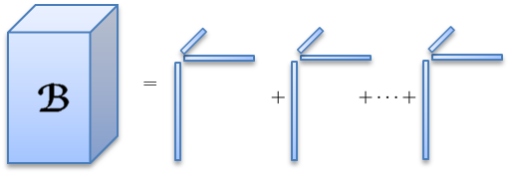
Tensor-on-Tensor Regression (ToTR)
Canonical polyadic (CP) ToTR :
Each rank-1 tensor is the outer product of $p+q$ vector
3-dimensional tensor example
Rank-1 tensor
Rank summation
Make the model tractable with low-rank tensors!

Slide 5
Existing: Gaussian ToTR
New: Poisson ToTR (PToTR)
Likelihood-based loss function:
Likelihood-based loss function:
Update rules extend those in the CP-alternating Poisson regression (CP-APR) algorithm [5]:
Loglikelihood
non-decreasing under:
Now we have the tools for tackling our three PToTR applications!
[5] Chi and Kolda, On Tensors, Sparsity, and Nonnegative Factorizations, SIMAX 2012.

Slide 6
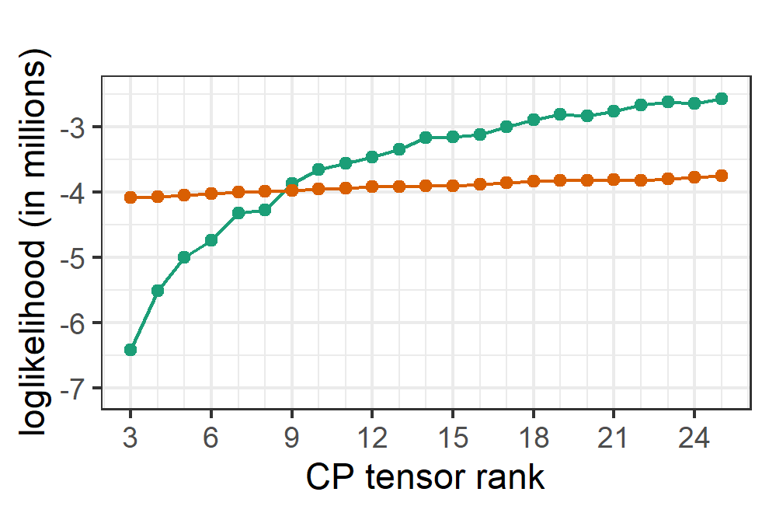
ICEWS Database: Poisson vs Gaussian
Poisson ToTR :
$𝒴_{t}(i_{1},i_{2},i_{3})$ = # times action $i_{3}$ was taken by country $i_{1}$ on country $i_{2}$ at week $t$.
$ℬ(i_{1},i_{2},i_{3},j_{1},j_{2},j_{3})$ = Effect that the previous $i_{3}$ event from $i_{1}$ towards $i_{2}$ has on current $j_{3}$ event from $j_{1}$ towards $j_{2}$.
Gaussian ToTR$:$
Our Poisson model fits the count data better!

Slide 7
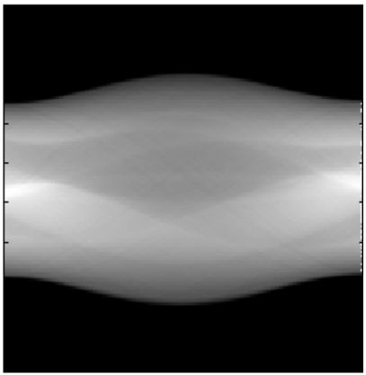
Poisson model for Positron Emission Tomography [3]
Radon transform of B
Poisson for number of photon coincidences in sinogram
Radon basis is a 4D tensor with combined dimensions
Observed sinogram
containing counts
Element-wise formulated as:
Image to reconstruct
Here is one matrix slice of the tensor
Projection distance $r$
The Poisson distribution is appropriate for the number of photon coincidences in PET!
Projection angle $θ$
[3] Shepp and Vardi, Maximum Likelihood Reconstruction for Emission Tomography, IEEE TIM, 1982.

Slide 8
From 2D to 4D PET: problems and solutions
2D PET model – elementwise
4D PET model : volume across time
Same model as before
Reconstructs 2D image B
Scalar-response, matrix-predictor
2D image to reconstruct
Ill-posed without additional restrictions [6]
Extension of 2D PET for depth and time
Reconstruct 4D image
Matrix-response, matrix-predictor
4D image to reconstruct
Ill-posed without additional restrictions [6]
Low-rank image reconstruction stabilizes the estimation !
[6] Snyder et. al., Noise and Edge Artifacts in Maximum-Likelihood Reconstructions for Emission Tomography, IEEE TIM, 1987.

Slide 9
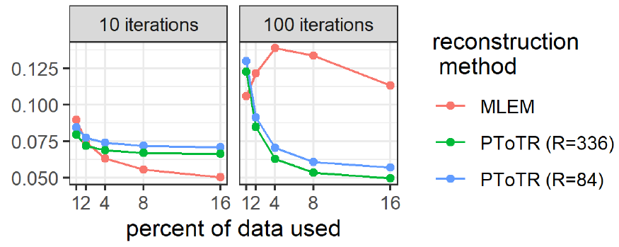
Low-rank 4D PET: A Simulation
True 4D image : four MRI measurements on the same subject and scanner [7]
256 x 256 matrix slices $→$ 256 x 1024 sinograms
We use 1%, 2%, 8% and 16% of the data.
We implement 3 methods:
Full MLEM: no restrictions on :
number of parameters: ~ 63 million
PToTR: CP-restricted with rank 84:
Number of parameters: ~ 63 thousand
PToTR: CP-restricted with rank 336
Number of parameters: ~ 252 thousand
Our method improves with both sample size and number of iterations!
[7] Hawco, et. al., A longitudinal multi-scanner multimodal human neuroimaging dataset, Scientific Data, 2022

Slide 10
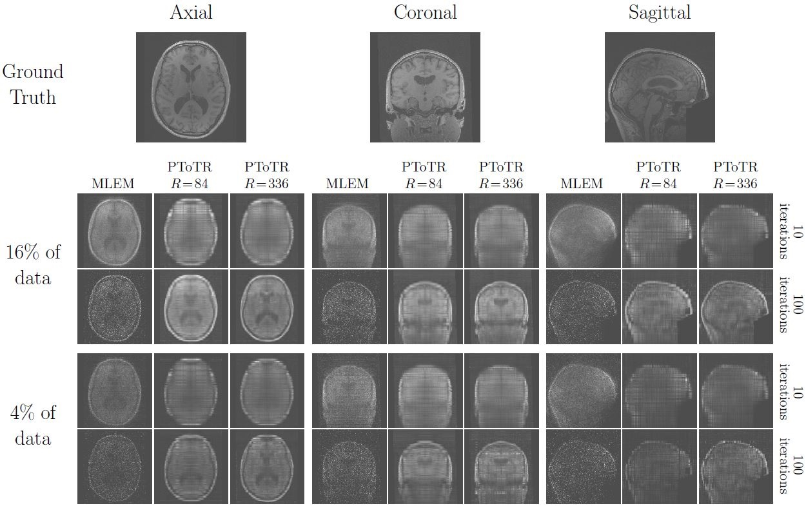

Slide 11
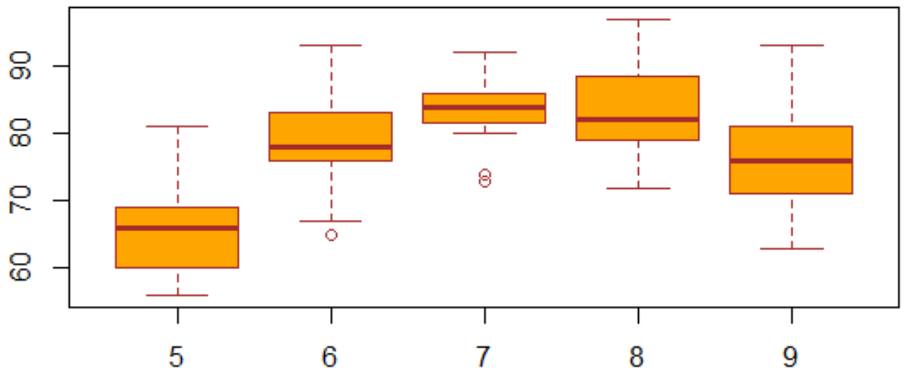
A path towards change-point detection
Analysis of variance (ANOVA):
Tool for distinguishing between groups in scalar data.
Multivariate ANOVA (MANOVA):
Tool for distinguishing between groups in vector data.
Tensor-variate ANOVA (TANOVA):
Tool for distinguishing between groups in tensor data,
and across multiple factors.
ANOVA example
Change-point detection:
Group data before and after some point in time
Poisson-response TANOVA (PTANOVA):
Tool for distinguishing between groups in tensor count data,
and across multiple factors.
Let’s go through the math in the same way we did for regression

Slide 12
Tensor-Variate Analysis of Variance (TANOVA)[4]
TANOVA is a special case of ToTR ( are indicator tensors) that generalizes ANOVA
General Model Definition Special Case (Indicator )
Linear regression (LR)
ANOVA
Multivariate LR
MANOVA
Tensor regression
Factorial designs
Tensor-on-tensor regression
TANOVA
Poisson ToTR (PToTR)
Poisson TANOVA
We can do change-point detection through PTANOVA!
[4] Llosa and Maitra, Reduced-Rank Tensor-on-Tensor Regression and Tensor-Variate Analysis of Variance, IEEE TPAMI 2022.

Slide 13
PTANOVA and Change-Point Detection
Poisson-tensor change-point detection
Equivalent PTANOVA formulation
changes in mean at time
Mean before change-point:
Mean after change-point:
Change-point location:
Mean before change-point:
Mean after change-point:
Change-point location:

Slide 14
Experiment:
Student $j$
Topics
Student $i$
$$t=1$$
$$t=2$$
$$t=3$$
$$t=14$$
10 Students talking about 15 topics over 14 time-steps: 14 count tensors of size 10 x 10 x 15.
Event occurs at time $τ$ that changes communication pattern:
All conversation generated independently from Poisson($λ$), $λ=5.$
One topic changes to Poisson($λ×a)$ after time $τ$, where $a=1, 2, 3, 5, 20, 100$.
loglikelihood
$$τ=8$$
$$τ=13$$
$$τ=4$$
$$τ=5$$
$$τ=11$$
change-point time

Slide 15
Conclusions and path forward
Modelling: Linear regression $→$ Tensor regression $→$ Poisson tensor regression
Application: tensor-prediction problems on count data
Modelling: ANOVA $→$ TANOVA $→$ PTANOVA
Application: change-point detection for tensor count data
Modelling: 2D PET $→$ 4D PET
Application: Stable multidimensional PET reconstruction
Where we are going
Efficient model-fitting algorithms
Multiple change-point detection

Slide 16
Thank You!
For follow-up questions reach out to:
Carlos Llosa cjllosa@sandia.gov,
Danny Dunlavy dmdunla@sandia.gov
Notes:
(15) Additional info

