Slide 1
Probabilistic Neural Data Fusion for Learning from an Arbitrary Number of Multi-fidelity Data Sets
​Carlos Mora Sardiña
PhD student
Mechanical and Aerospace Engineering
University of California, Irvine
cmorasar@uci.edu
Advisor: Dr. Ramin Bostanabad
raminb@uci.edu
2023 Sandia MLDL Workshop

Slide 2
Data fusion: Motivational example 1
Materials modeling
Goal: accelerate multiscale damage simulations of cast aluminum alloys by replacing Direct Numerical Simulations (DNS) with Reduced Order Models (ROMs)
Cost, accuracy
Source 1: DNS
Source $i=2,…,N−1$: ROM with $k_{i−1}$ clusters
1. How can we leverage inaccurate but cheap simulations from ROMs?
2. How can we effectively capture various sources of uncertainty?
Deng, S., Mora, C., Apelian, D., & Bostanabad, R. (2023). Data-Driven Calibration of Multifidelity Multiscale Fracture Models Via Latent Map Gaussian Process. Journal of Mechanical Design, 145(1), 011705.

Slide 3
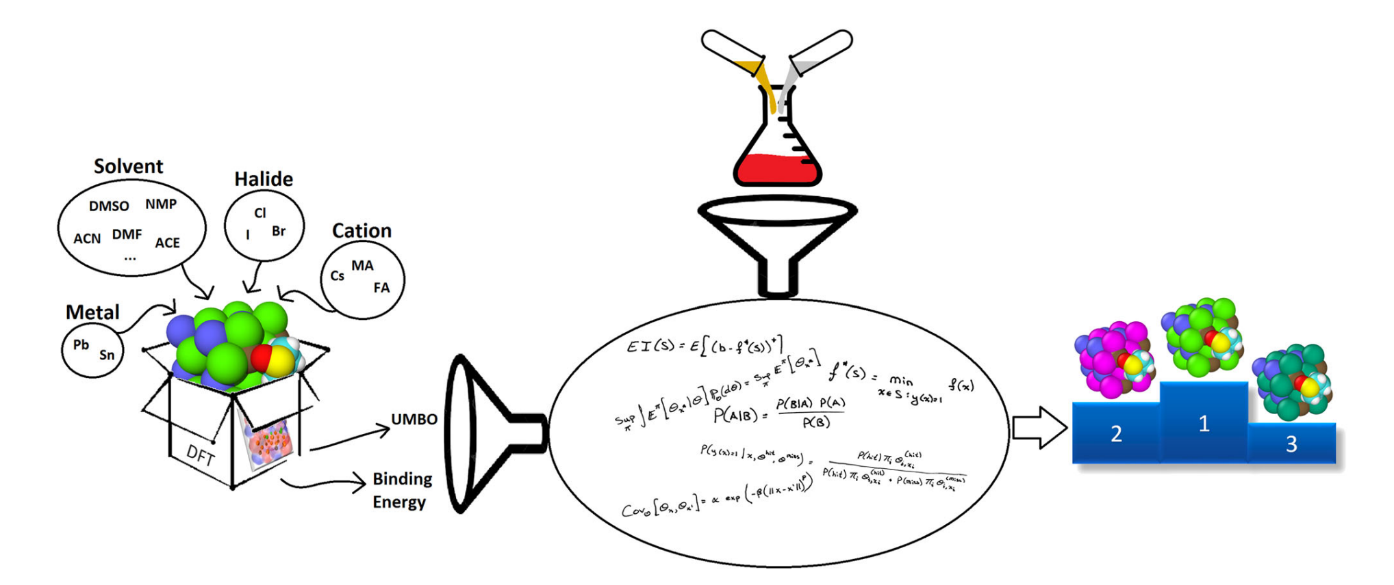
Data fusion: Motivational example 2
Materials discovery
Goal: design Hybrid Organic-Inorganic Perovskite (HOIPs) with the structural formula $ABX_{3}$ that exhibit the maximum intermolecular binding energy
Experiments
Organic/inorganic cation $A→10$ levels
Inorganic metal cation $B→3$ levels
Halide combination $X_{3}→16$ levels
Simulations
480 possible combinations
Predictions
1. How can we find the components that maximize the intermolecular binding energy?
2. Can we use inaccurate but cheap molecular simulations with unknown fidelities?
Herbol, Henry C., et al. "Efficient search of compositional space for hybrid organic–inorganic perovskites via Bayesian optimization." npj Computational Materials 4.1 (2018): 51.

Slide 4
Existing technologies
Kennedy and O’Hagan’s (KOH) method:
$$\boxed{y^{p}\left(x\right)=ρy^{s}\left(x\text{,}θ^{p}\right)+δ\left(x\right)+e}$$
$δ(x)$: unknown discrepancy (or bias) function
$ρ$: unknown regression coefficient
Physical response: $y^{p}\left(x_{i}\right)=ζ\left(x_{i}\right)+e_{i}$
Computer simulation: $y^{s}\left(x,θ\right)$
Many recent works inherit KOH’s limitations:
Probabilistic Neural Data Fusion (Pro-NDF)
(1) Can only handle 2 sources of data
(1) Can accommodate an arbitrary number of sources
(2) Hierarchical approach
(2) Non-hierarchical approach
(3) Assume trivial biases, e.g., additive
(3) Can learn non-trivial biases, e.g., non-additive
(4) Can’t handle categorical data
(4) Can handle categorical data
Kennedy, Marc C., and Anthony O'Hagan. "Bayesian calibration of computer models." Journal of the Royal Statistical Society: Series B (Statistical Methodology) 63.3 (2001): 425-464.

Slide 5
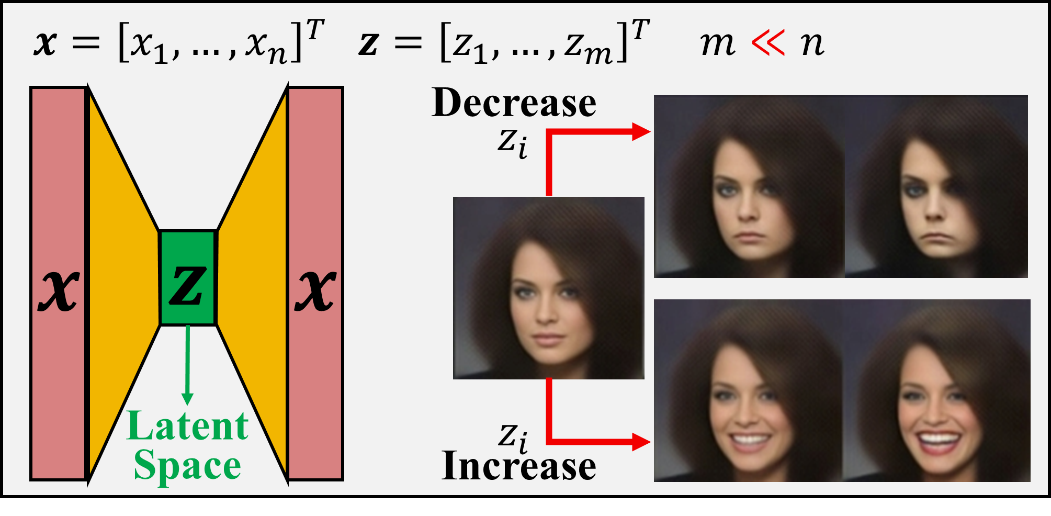
Convert data fusion to manifold learning
Complex relations are easier to learn in nonlinear manifolds (latent spaces)
Original space
Latent space
Eweis-Labolle, J., N. Oune, and R. Bostanabad, Data Fusion with Latent Map Gaussian Processes. Journal of Mechanical Design, 2022: p. 1-41.
By employing neural networks, with Pro-NDF we aim to:
(1) Convert data fusion to a manifold learning problem
(2) Capture and decouple various sources of uncertainty, i.e., aleatoric and epistemic

Slide 6
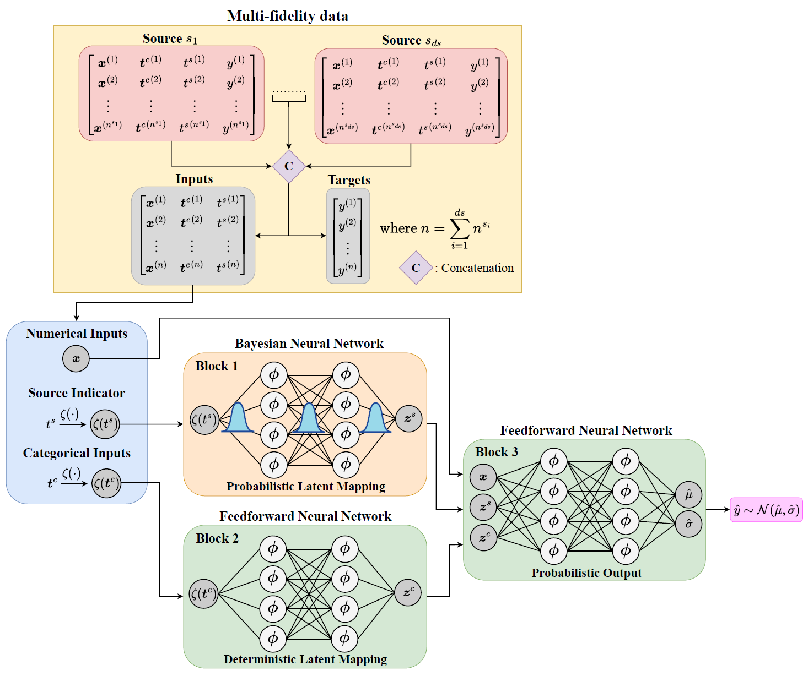
Pro-ndf: General overview
Fuse all multi-fidelity data sets at once
Emulate all data sources
Capture and decouple various sources of uncertainty
Tailored multi-term loss function
Mora, C., Eweis-Labolle, J. T., Johnson, T., Gadde, L., and Bostanabad, R. Probabilistic Neural Data Fusion for Learning from an Arbitrary Number of Multi-fidelity Data Sets. In Computer Methods in Applied Mechanics and Engineering (2023), accepted.

Slide 7
Data fusion with pro-ndf: Pre-processing
1
Augment Inputs with a Data Source Index $t^{s}=\{HF,LF1,LF2\}$ (assuming 3 sources)
$$\left[x_{h},t_{h}^{c}\right]$$
$$\left[\begin{matrix}x_{h} & t_{h}^{c} & HF\end{matrix}\right]$$
$$\left[x_{l_{1}},t_{l_{1}}^{c}\right]$$
$$\left[\begin{matrix}x_{l_{1}} & t_{l_{1}}^{c} & LF1\end{matrix}\right]$$
$$\left[x_{l_{2}},t_{l_{2}}^{c}\right]$$
$$\left[\begin{matrix}x_{l_{2}} & t_{l_{2}}^{c} & LF2\end{matrix}\right]$$
2
Concatenate Datasets
$X=\left[\begin{matrix}x_{h} & t_{h}^{c} & HF \\ x_{l_{1}} & t_{l_{1}}^{c} & LF1 \\ x_{l_{2}} & t_{l_{2}}^{c} & LF2\end{matrix}\right]$
$Y=\left[\begin{matrix}y_{h} \\ y_{l_{1}} \\ y_{l_{2}}\end{matrix}\right]$
Mora, C., Eweis-Labolle, J. T., Johnson, T., Gadde, L., and Bostanabad, R. Probabilistic Neural Data Fusion for Learning from an Arbitrary Number of Multi-fidelity Data Sets. In Computer Methods in Applied Mechanics and Engineering (2023), accepted.

Slide 8
Data fusion with pro-ndf: preprocessing (cont.)
3
Put a Quantitative Prior on Each Combination of Categorical Variables and on Each Data Source Index
$$x$$
$$t^{c}$$
$$t^{s}$$
$$x$$
$$ζ(t^{c})$$
$$ζ(t^{s})$$
$${\left[\begin{matrix}\begin{matrix}x_{1}^{1} & x_{2}^{1} \\ x_{1}^{2} & x_{2}^{2}\end{matrix} & \begin{matrix}G & S & HF \\ F & S & HF\end{matrix} \\ \begin{matrix}\begin{matrix}x_{1}^{3} \\ ⋮\end{matrix} & \begin{matrix}x_{2}^{3} \\ ⋮\end{matrix} \\ x_{1}^{N} & x_{2}^{N}\end{matrix} & \begin{matrix}\begin{matrix}F \\ ⋮\end{matrix} & \begin{matrix}W \\ ⋮\end{matrix} & \begin{matrix}LF1 \\ ⋮\end{matrix} \\ T & S & LF2\end{matrix}\end{matrix}\right]}_{N×5}$$
$$\left[\begin{matrix}x^{1} & ζ_{GS} & ζ(HF) \\ x^{2} & ζ_{FS} & ζ(HF) \\ x^{3} & ζ_{FW} & ζ(LF1) \\ ⋮ & ⋮ & ⋮ \\ x^{N} & ζ_{TS} & ζ(LF2)\end{matrix}\right]$$
Mora, C., Eweis-Labolle, J. T., Johnson, T., Gadde, L., and Bostanabad, R. Probabilistic Neural Data Fusion for Learning from an Arbitrary Number of Multi-fidelity Data Sets. In Computer Methods in Applied Mechanics and Engineering (2023), accepted.

Slide 9
Data fusion with pro-ndF: architecture
4
Fit Pro-NDF to ALL data
Block 1 : BNN that maps $ζ(t^{s})$ to a continuous manifold $z^{s}$
Block 2 : FFNN that maps $ζ(t^{c})$ to a continuous manifold $z^{c}$
Block 3 : FFNN that maps $\left[x,z^{s},z^{c}\right]$ to the parametric distribution of the output, i.e., $\hat{y} \sim 𝒩(\hat{μ},\hat{σ})$
Obtaining $\hat{y} \sim 𝒩(\hat{μ},\hat{σ})$ at the input $u=[x,{t^{c},t}^{s}]$:
$$\hat{μ}\left(u\right)=\frac{1}{M}\sum_{j=1}^{M}{{\hat{μ}}_{j}(u)}$$
$$\hat{σ}\left(u\right)=\frac{1}{M}\sum_{j=1}^{M}{\left({\hat{σ}}_{j}^{2}\left(u\right)+{\hat{μ}}_{j}^{2}\left(u\right)\right)}−{\hat{μ}}^{2}\left(u\right)$$
$M$: number of realizations
Mora, C., Eweis-Labolle, J. T., Johnson, T., Gadde, L., and Bostanabad, R. Probabilistic Neural Data Fusion for Learning from an Arbitrary Number of Multi-fidelity Data Sets. In Computer Methods in Applied Mechanics and Engineering (2023), accepted.

Slide 10
Data fusion with pro-ndf: Loss function
Multi-term loss function:
$$ℒ=ℒ_{NLL}+α_{1}ℒ_{KL}+α_{2}ℒ_{IS}+α_{3}ℒ_{2}$$
$$ℒ_{NLL}=−\frac{1}{N}\sum_{i=1}^{N}{\log{𝒩(y^{\left(i\right)};{\hat{μ}}^{\left(i\right)},{\left({\hat{σ}}^{\left(i\right)}\right)}^{2})}}$$
Negative log-likelihood:
KL divergence:
$ℒ_{KL}=KL[q(θ|φ)||P\left(θ\right)]$ (only for Block 1)
$$ℒ_{IS}=\frac{1}{N}\sum_{i=1}^{N}{[\left({\hat{u}}^{\left(i\right)}−{\hat{l}}^{\left(i\right)}\right)+\frac{2}{γ}\left({\hat{l}}^{\left(i\right)}−y^{\left(i\right)}\right)1\left\{y^{\left(i\right)}<{\hat{l}}^{\left(i\right)}\right\}+}$$
Interval score:
$$+\frac{2}{γ}\left(y^{\left(i\right)}−{\hat{u}}^{\left(i\right)}\right)1\{y^{\left(i\right)}>{\hat{u}}^{(i)}\}]]$$
L2 regularization:
$ℒ_{2}={\left|θ\right|}^{2}$ (only for Blocks 2 and 3)
Mora, C., Eweis-Labolle, J. T., Johnson, T., Gadde, L., and Bostanabad, R. Probabilistic Neural Data Fusion for Learning from an Arbitrary Number of Multi-fidelity Data Sets. In Computer Methods in Applied Mechanics and Engineering (2023), accepted.

Slide 11
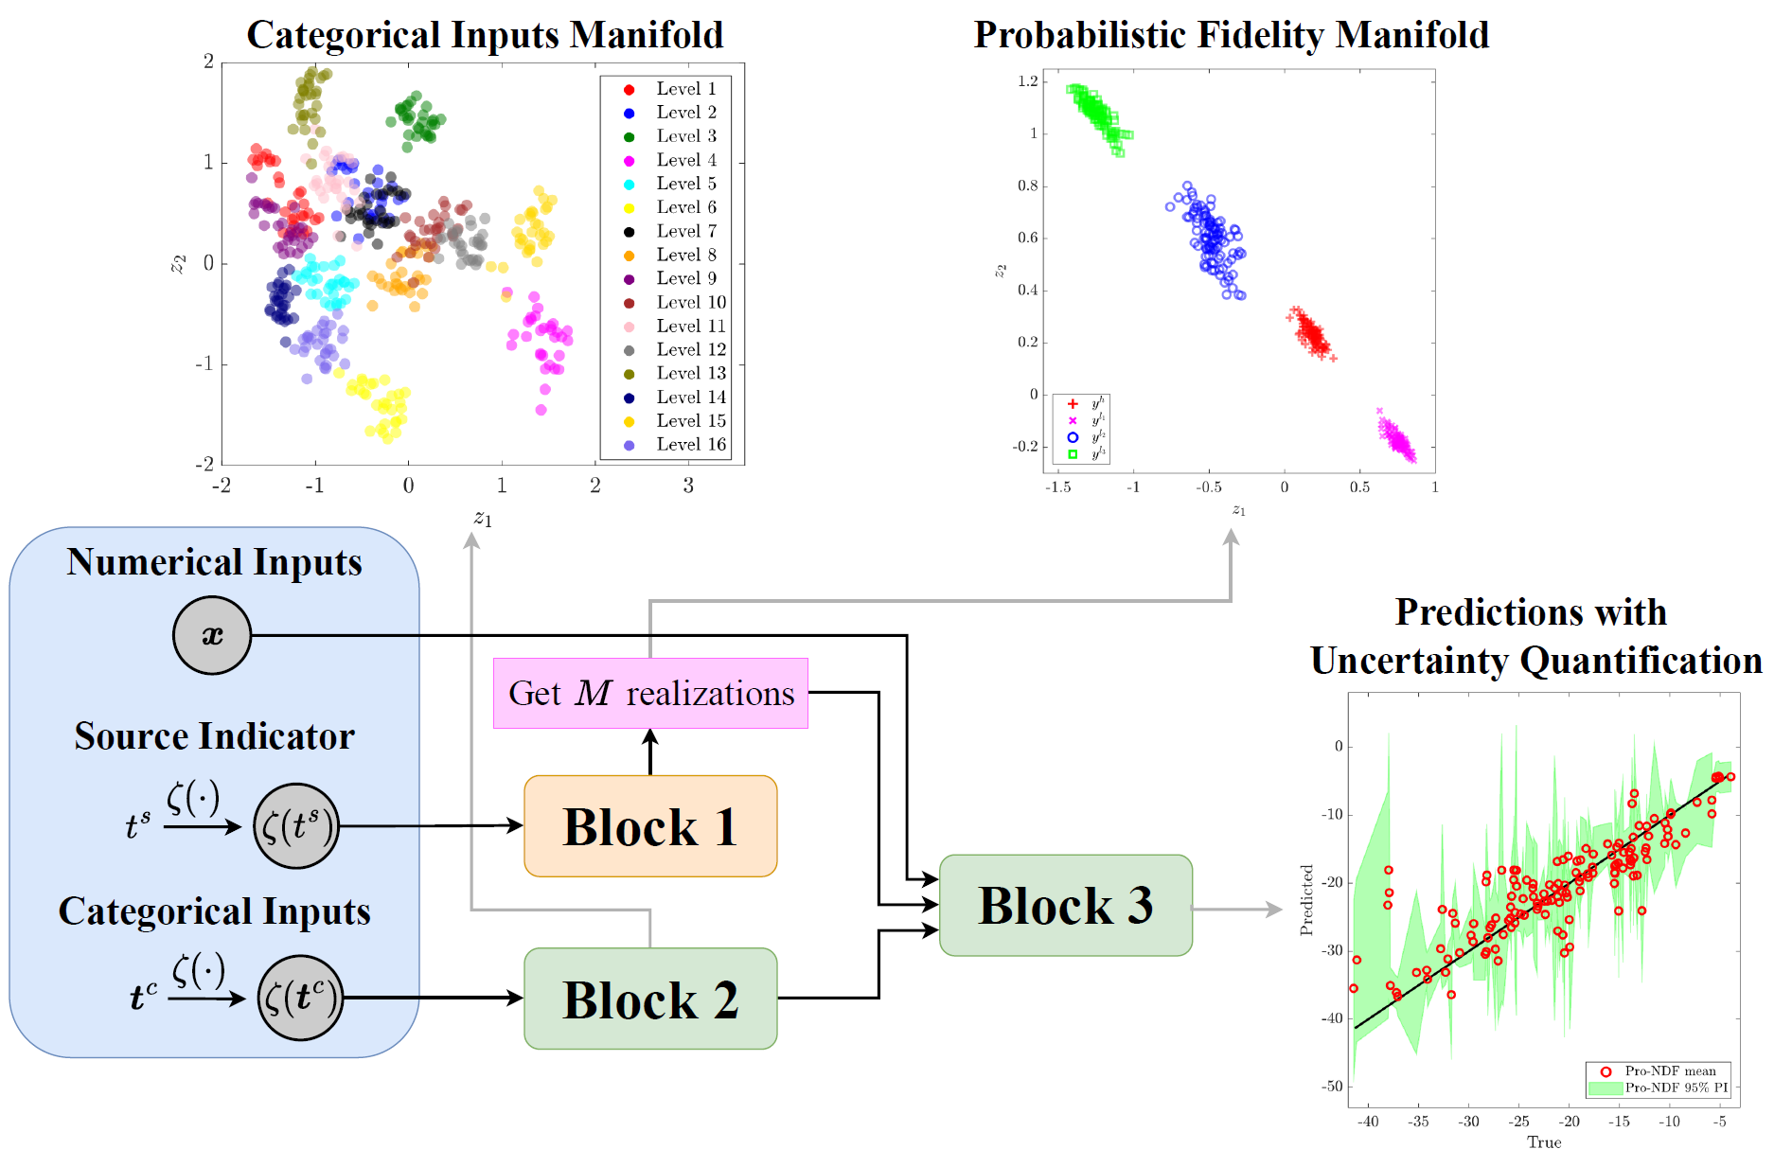
Expected results in a glance
3
2
1 HF and 3 LF data sources with unknown fidelity levels
Numerical and categorical inputs
1
Mora, C., Eweis-Labolle, J. T., Johnson, T., Gadde, L., and Bostanabad, R. Probabilistic Neural Data Fusion for Learning from an Arbitrary Number of Multi-fidelity Data Sets. In Computer Methods in Applied Mechanics and Engineering (2023), accepted.

Slide 12
Why should this work?
In particular…
Why are we converting data fusion to a manifold learning problem?
Mora, C., Eweis-Labolle, J. T., Johnson, T., Gadde, L., and Bostanabad, R. Probabilistic Neural Data Fusion for Learning from an Arbitrary Number of Multi-fidelity Data Sets. In Computer Methods in Applied Mechanics and Engineering (2023), accepted.

Slide 13
Why convert df to manifold learning?
Categorical variables $t^{c}$
Prior representation ${ζ\text{(}t}^{c})$
Learned 2D latent space
$$t_{3}^{c}$$
$$z_{2}$$
$$1$$
$$1$$
$$\{outdoor\}$$
$$[1,0,1,0,1,0]$$
$$0$$
$$1$$
$$\{indoor\}$$
$$\{steel, AM, indoor\}$$
$$1$$
$$\{AM\}$$
$$1$$
$$1$$
$$z_{1}$$
$$\{titanium\}$$
$$\{casting\}$$
$$\{steel\}$$
Learned maps by Pro-NDF
$$t_{1}^{c}$$
$$t_{2}^{c}$$
Probabilistically learn biases of the LF sources in a separate 2D fidelity manifold
Data fusion via Pro-NDF:
Prior representation ${ζ\text{(}t}^{s})$
$$z_{2}$$
Treat data sources as a categorical variable $t^{s}$
$$1$$
$$\{HF\}$$
$$\{LF_{1}\}$$
$$\{LF_{2}\}$$
$$1$$
$$t^{s}$$
$$0$$
$$1$$
$$[1,0,0]$$
$$z_{1}$$

Slide 14
engineering application 1: dns-rom
Cost, accuracy
Source 1: DNS
Source $i=2,3,4$: ROM with $k_{i−1}$ clusters
Multi-fidelity data sets
$4$ data sources (1 HF and 3 LF)
$70$ HF samples from DNS
$110, 170$ and $250$ LF samples from ROM with $k_{1}=3200, k_{2}=1600$ and $k_{3}=800$ clusters
Training-test split for each source: 80-20%
Data overview
A data point $[x^{\left(i\right)},{t^{s}}^{\left(i\right)},y^{\left(i\right)}]$ contains:
Inputs:
$x^{\left(i\right)}$: four microstructural descriptors $x_{1}^{\left(i\right)},…,x_{4}^{\left(i\right)}$ and two material properties $x_{5}^{\left(i\right)},x_{6}^{\left(i\right)}$
${t^{s}}^{(i)}$: source indicator
Output:
$y^{\left(i\right)}$: microstructure toughness
Deng, S., Mora, C., Apelian, D., & Bostanabad, R. (2023). Data-Driven Calibration of Multifidelity Multiscale Fracture Models Via Latent Map Gaussian Process. Journal of Mechanical Design, 145(1), 011705.

Slide 15
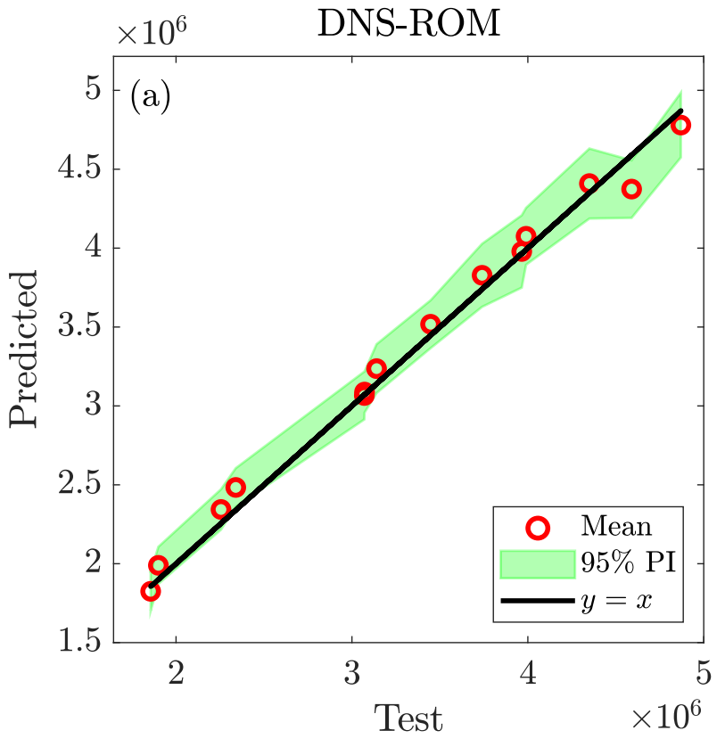
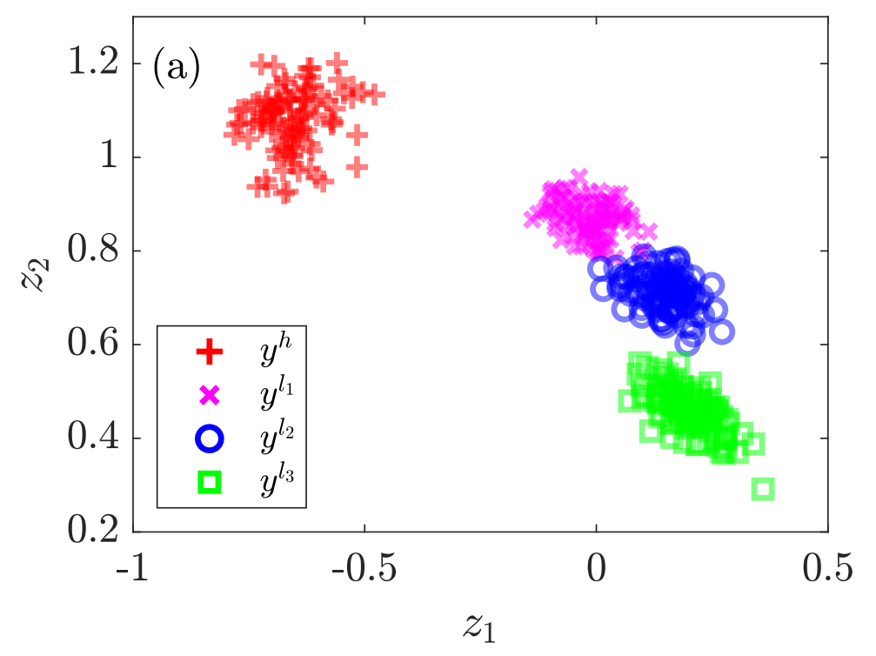
DNS-ROM: results
Comparison against other data fusion approaches:
HF Predictions VS Test values:
Probabilistic fidelity manifold:
Model | NRMSE | NIS
Pro-NDF | 0.101 | 0.520
LMGP | 0.105 | 0.706
MF-DGP | 0.140 | 0.791
SF-GP | 0.123 | 0.653
FFNN | 0.113 | -
SMF | 0.130 | -
ROM with $k_{2}=1600$
DNS
ROM with $k_{1}=3200$
ROM with $k_{3}=800$
NRMSE and NIS is lower than competing methods
Usefulness of the learned manifold
Mora, C., Eweis-Labolle, J. T., Johnson, T., Gadde, L., and Bostanabad, R. Probabilistic Neural Data Fusion for Learning from an Arbitrary Number of Multi-fidelity Data Sets. In Computer Methods in Applied Mechanics and Engineering (2023), accepted.

Slide 16
engineering application 2: HOIP
Organic/inorganic cation $A→10$ levels
Inorganic metal cation $B→3$ levels
Halide combination $X_{3}→16$ levels
Experiments
480 possible combinations
Simulations
Predictions
Herbol, Henry C., et al. "Efficient search of compositional space for hybrid organic–inorganic perovskites via Bayesian optimization." npj Computational Materials 4.1 (2018): 51
Multi-fidelity data sets
$4$ data sources (1 HF and 3 LF with unknown fidelity levels)
$480$ samples from HF source
$480, 179, 240$samples from the LF sources
Training-test split for each source: 90-10%
Data overview
A data point$[{t^{c}}^{\left(i\right)},{t^{s}}^{\left(i\right)},y^{\left(i\right)}]$ contains:
Inputs:
${t^{c}}^{\left(i\right)}$: compounds used in $A, B$ and $X_{3}$
${t^{s}}^{(i)}$: source indicator
Output:
$y^{\left(i\right)}$: inter-molecular binding energy between a HOIP and solvent pair used in a solar cell

Slide 17
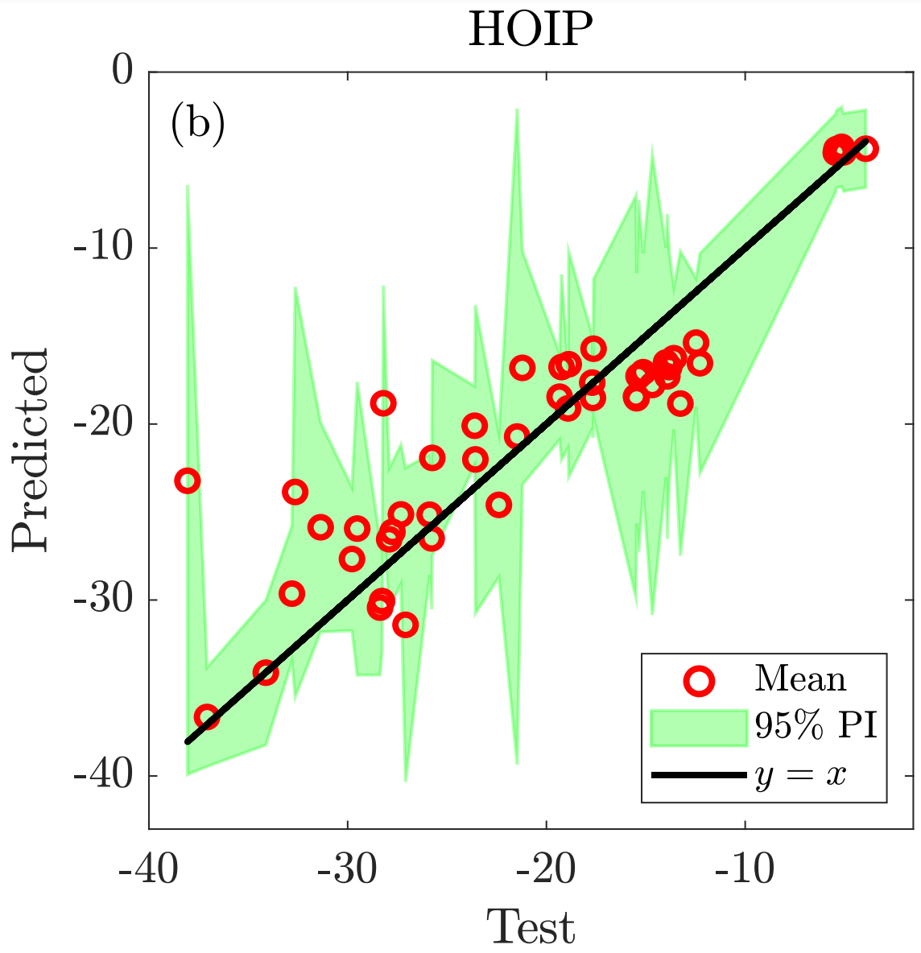
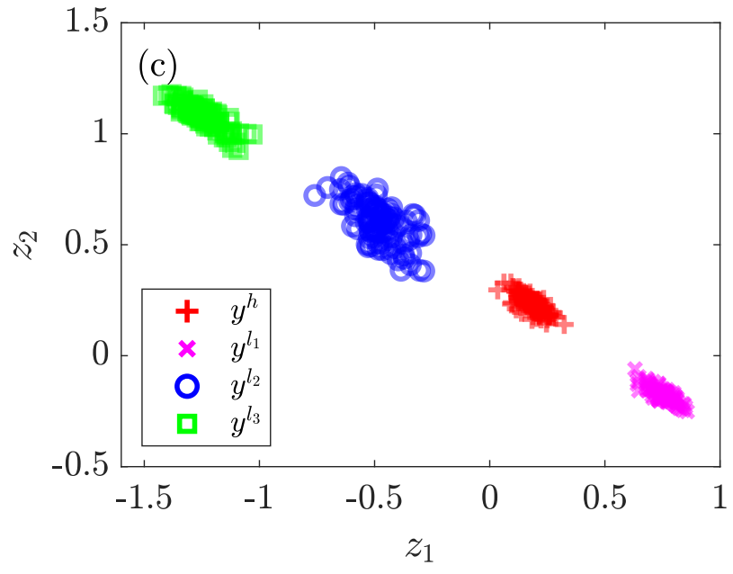
HOIP: results
Comparison against other data fusion approaches:
HF Predictions VS Test values:
Probabilistic fidelity manifold:
Model | NRMSE | NIS
Pro-NDF | 0.470 | 1.855
LMGP | 0.473 | 2.510
MF-DGP | - | -
SF-GP | 0.779 | 5.923
FFNN | 0.580 | -
SMF | 0.663 | -
LF3
LF2
HF
LF1
NRMSE and NIS is lower than competing methods
Usefulness of the learned manifolds
Mora, C., Eweis-Labolle, J. T., Johnson, T., Gadde, L., and Bostanabad, R. Probabilistic Neural Data Fusion for Learning from an Arbitrary Number of Multi-fidelity Data Sets. In Computer Methods in Applied Mechanics and Engineering (2023), accepted.

Slide 18
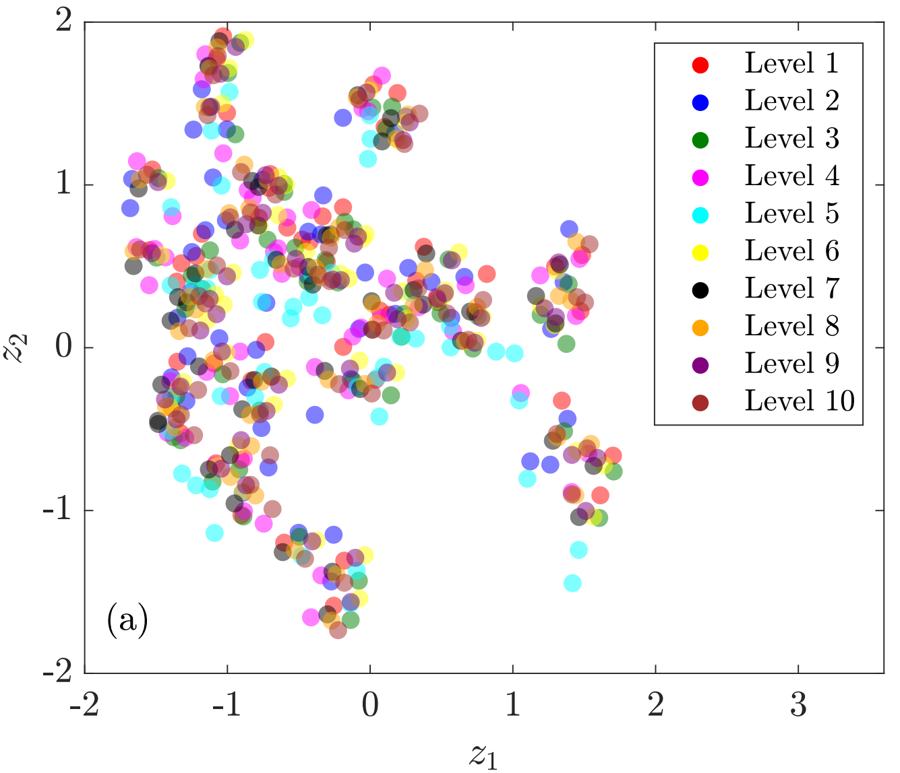
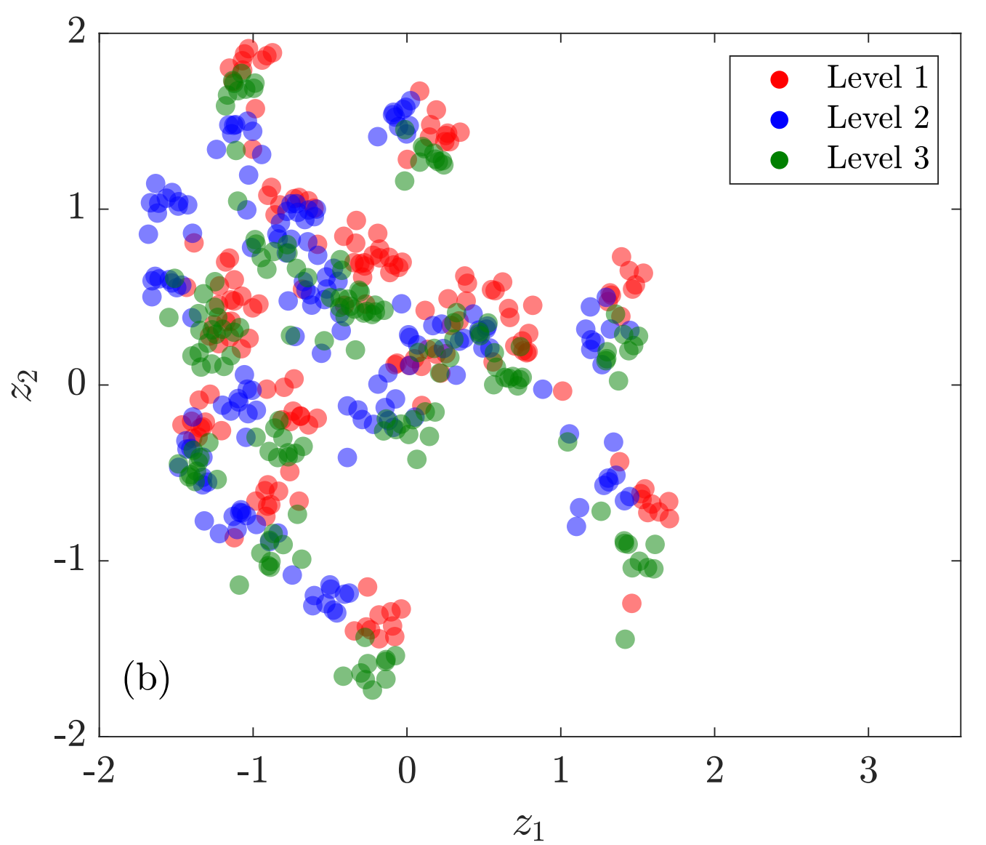
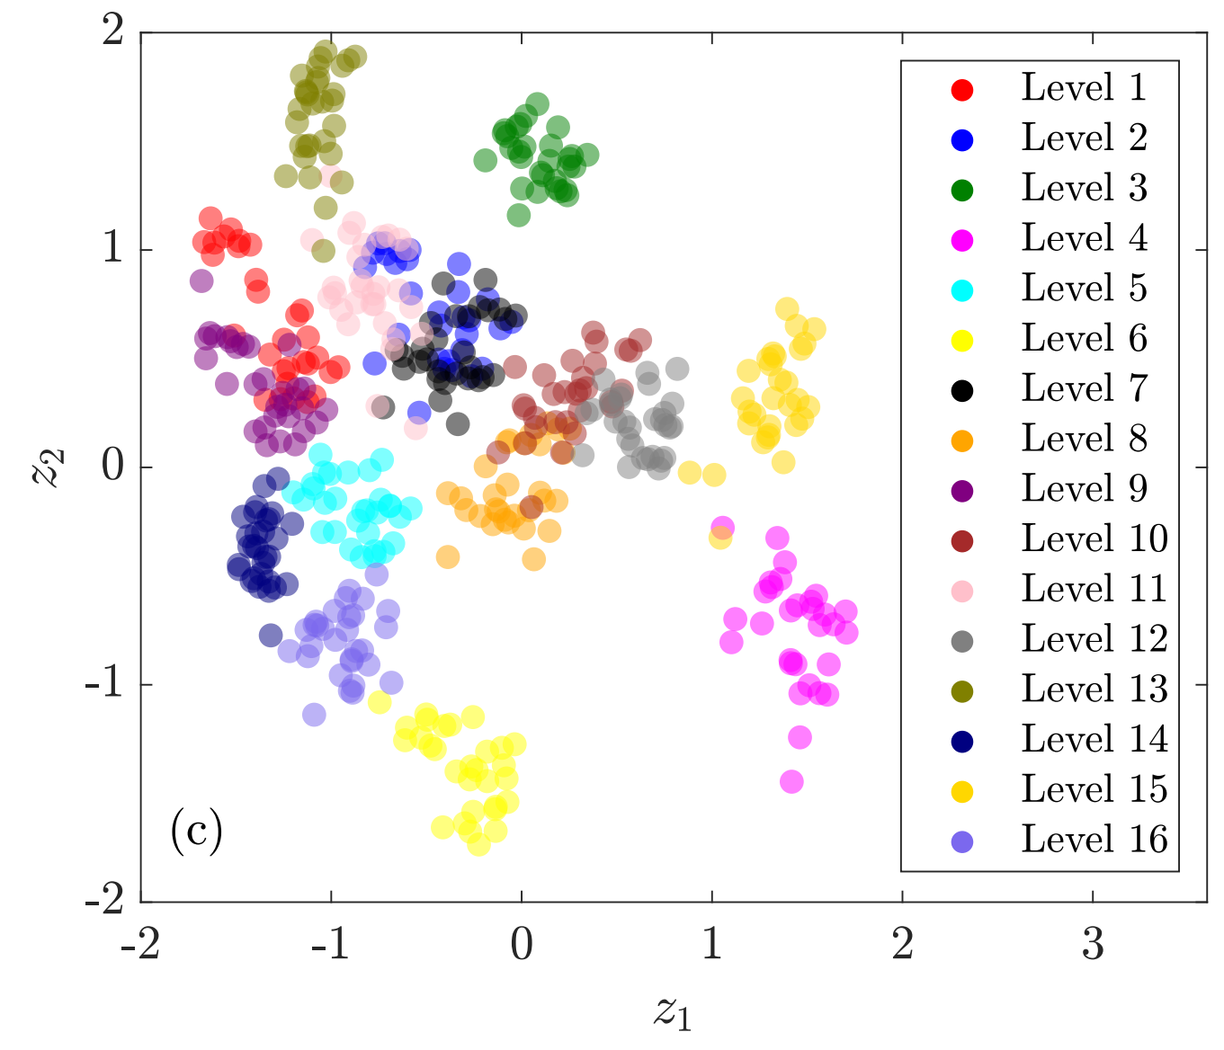
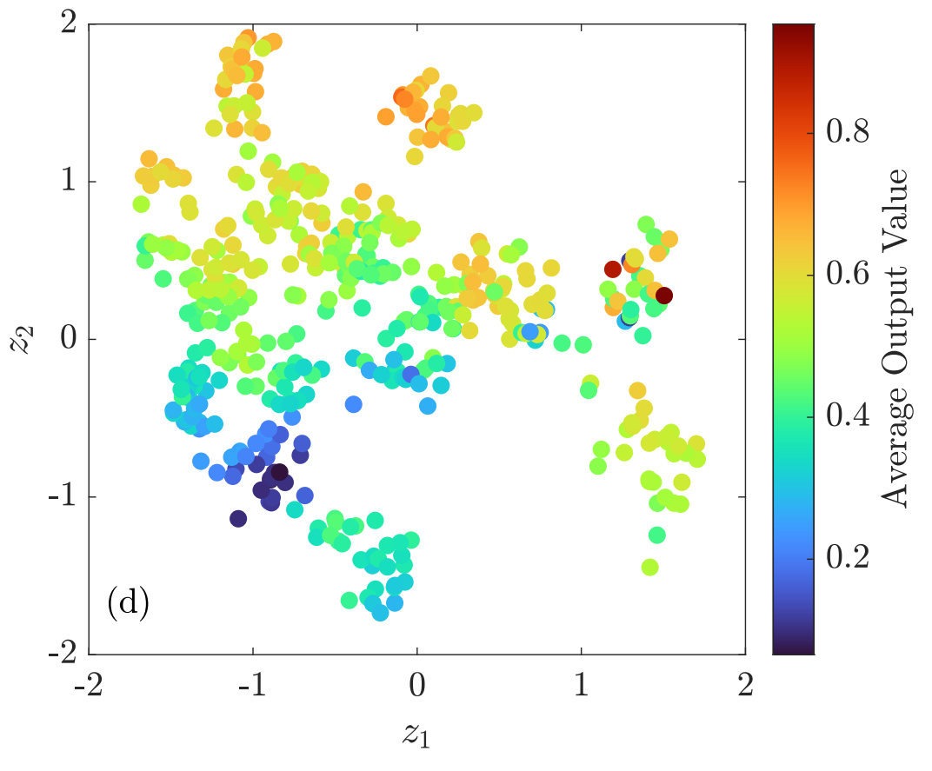
HOIP: results (Cont.)
Categorical inputs manifold:
Color-coded based on $A$
Color-coded based on $B$
Color-coded based on $X_{3}$
Identify optimal HOIP $ABX_{3}$
Color-coded based on average output value:
Mora, C., Eweis-Labolle, J. T., Johnson, T., Gadde, L., and Bostanabad, R. Probabilistic Neural Data Fusion for Learning from an Arbitrary Number of Multi-fidelity Data Sets. In Computer Methods in Applied Mechanics and Engineering (2023), accepted.

Slide 19
Concluding remarks
Decision-making processes in complex physical systems typically involve:
Scarcity of high-fidelity data
Fusing an arbitrary number sources of information with unknown levels of fidelity and complex relations
Considering various sources of uncertainty due to lack of data, noise, etc.
Handling categorical data
Probabilistic Neural Data Fusion (Pro-NDF)
Code and paper available on arXiv

Slide 20
acknowledgment
Collaborators:
Jonathan Tammer Eweis-Labolle
PhD Student
Tyler Johnson
PhD Student
Likith Gadde
High School Student
Funding agencies:
Early Career Faculty grant from NASA’s Space Technology Research Grants Program
National Science Foundation
Thank you! Questions?

