Slide 1
A Semi-Supervised Model for
Multi-Label Radioisotope Classification and
Out-Of-Distribution Detection
Master’s Thesis Defense
Alan Van Omen
MS Student
avanomen@umich.edu
Dr. Clayton Scott
Professor/Advisor
clayscot@umich.edu

Slide 2
Overview
This thesis investigates a variant of multi-label classification applied to gamma spectra, where we would estimate a proportion for each class label.
Both the problem formulation and approach rely on the idea that spectra and class labels can be viewed as probability distributions.
Overall goals:
Label Proportion Estimation: estimate proportions of different sources contributing to a spectrum
Out-of-Distribution Detection: simultaneously detect when a sample is OOD due to an anomalous source, and thus cannot be trusted
This is accomplished using novel semi-supervised learning objective which combines a traditional supervised loss with an unsupervised reconstruction error penalty.

Slide 3
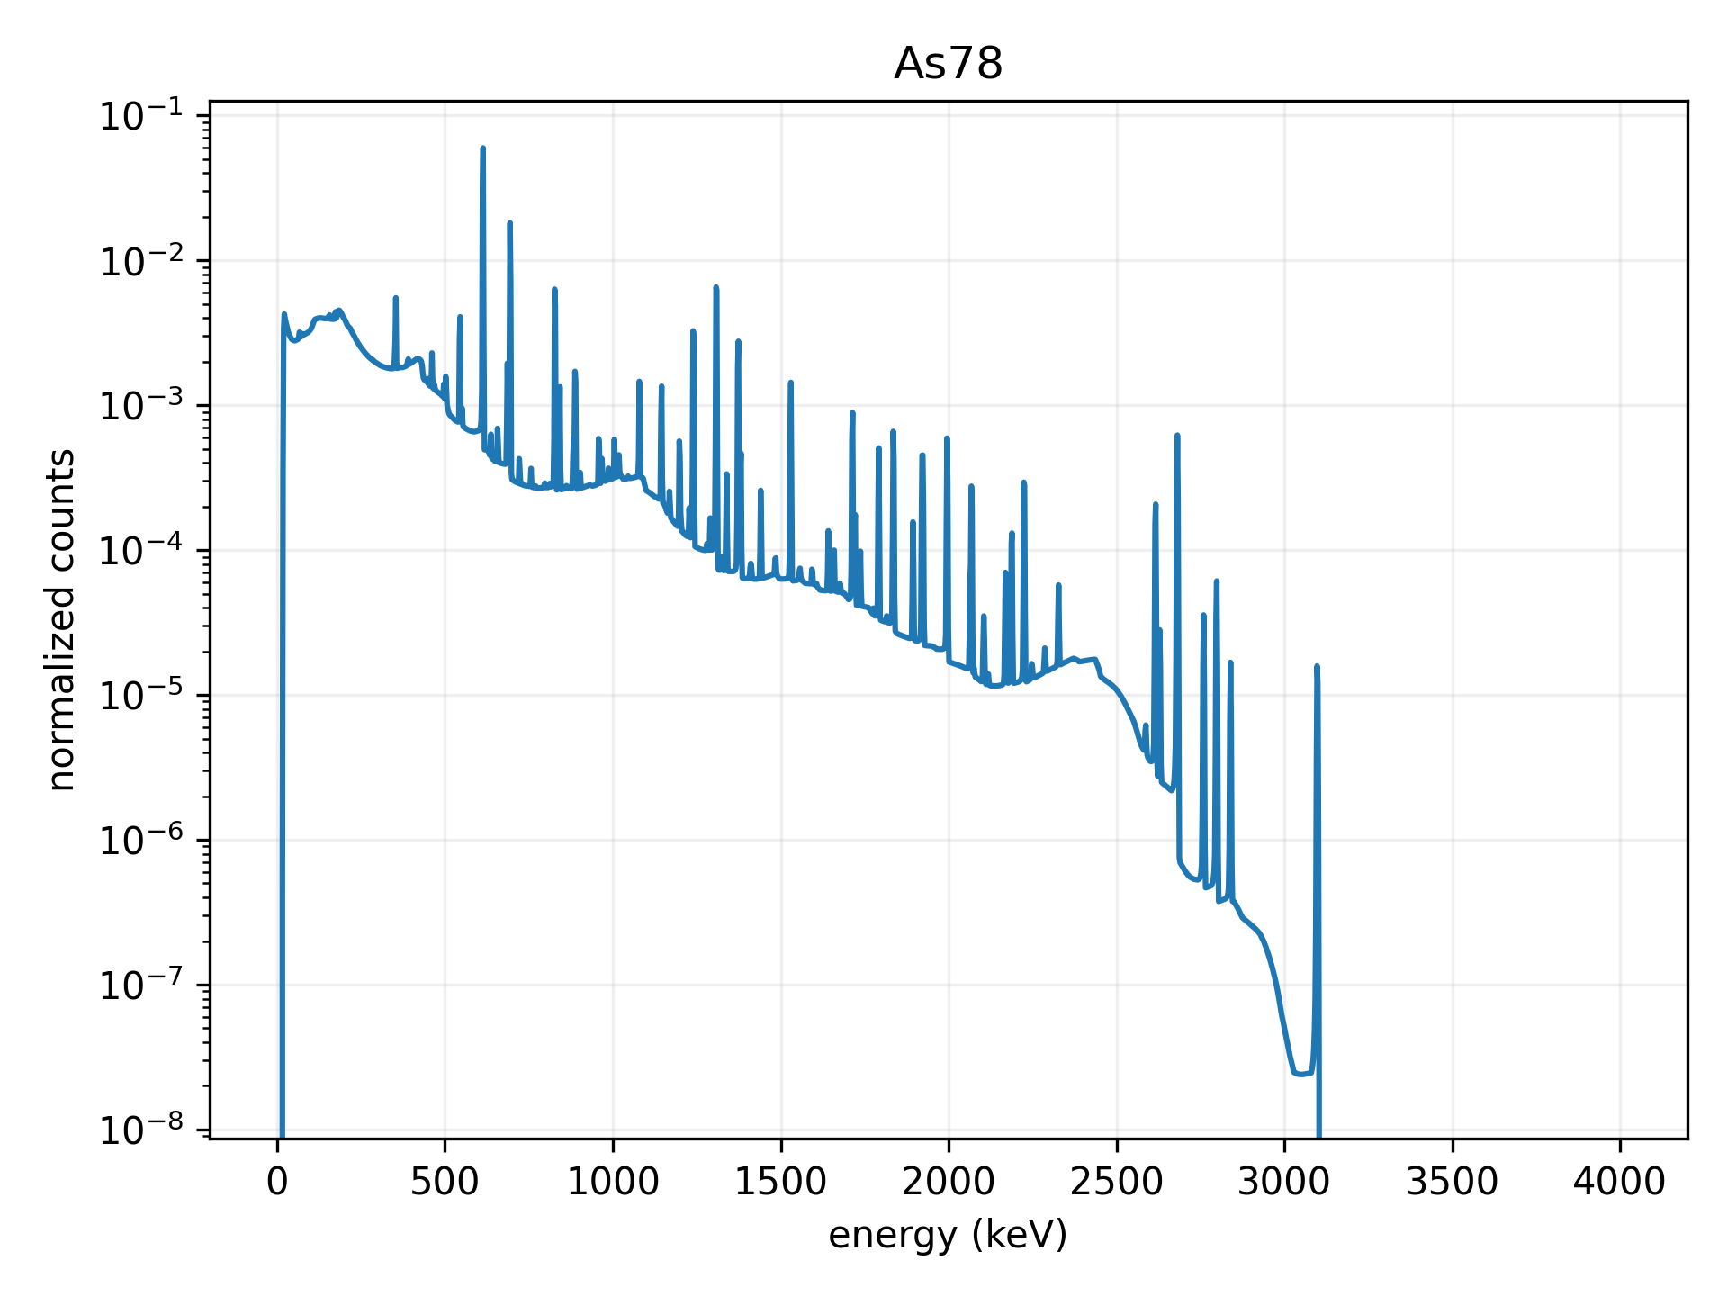
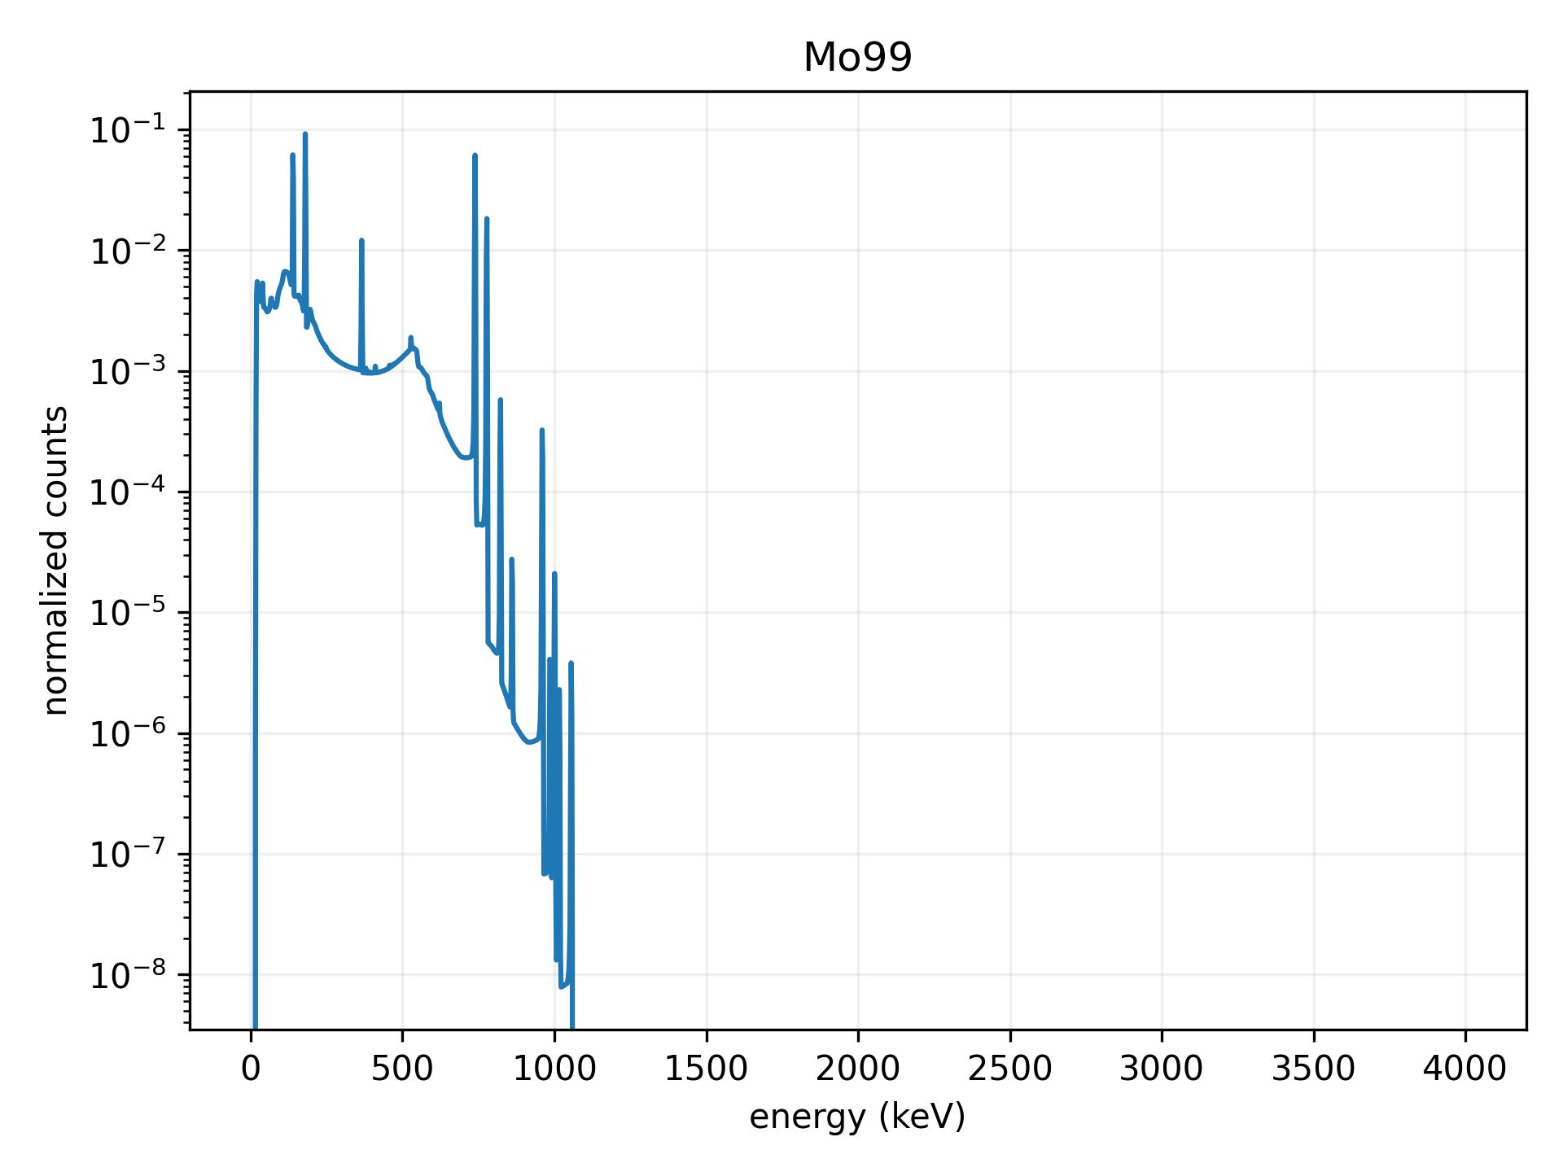
Gamma Spectra
Gamma radiation is emitted when a radioactive nucleus decays.
Energies of emitted particles individually resolved via spectrometer.
Every isotope decays at unique, characterizable energy levels.
Can be interpreted as probability distributions.
Not always easy to analyze.

Slide 4
Radioisotope Identification Problems
Binary classification: predict whether or not isotope of interest is present in a spectrum)
Multi-class classification: pick a single isotope out of a list of sources
Multi-label classification: identify potentially multiple contributing isotopes in a spectrum
Label proportion estimation (LPE): identify contributing isotopes in a spectrum, along with their relative contributions

Slide 5
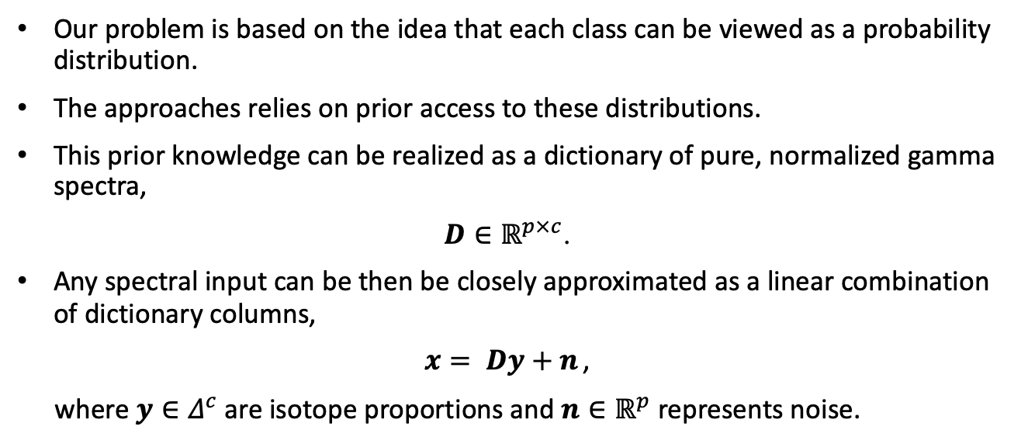
Problem Setup – Distributional Assumption
Our problem is based on the idea that each class can be viewed as a probability distribution.
The approaches relies on prior access to these distributions.
This prior knowledge can be realized as a dictionary of pure, normalized gamma spectra,
$D∈ℝ^{p×c}$.
Any spectral input can be then be closely approximated as a linear combination of dictionary columns,
$x= Dy+n$ ,
where $y∈Δ^{c}$ are isotope proportions and $n∈ℝ^{p}$ represents noise.

Slide 6

Problem Setup - Training Data
Let $𝒳∈ℝ^{p}$ denote the input space and $𝒴∈Δ^{c−1}$ denote the label space. Then assume access to a training set with $n$ samples,
$𝒟 := {\left\{\left(x_{i}, y_{i}\right)\right\}}_{i=1}^{n}$,
where each sample is drawn i.i.d. from the joint distribution $ℙ_{𝒳𝒴}$.

Slide 7
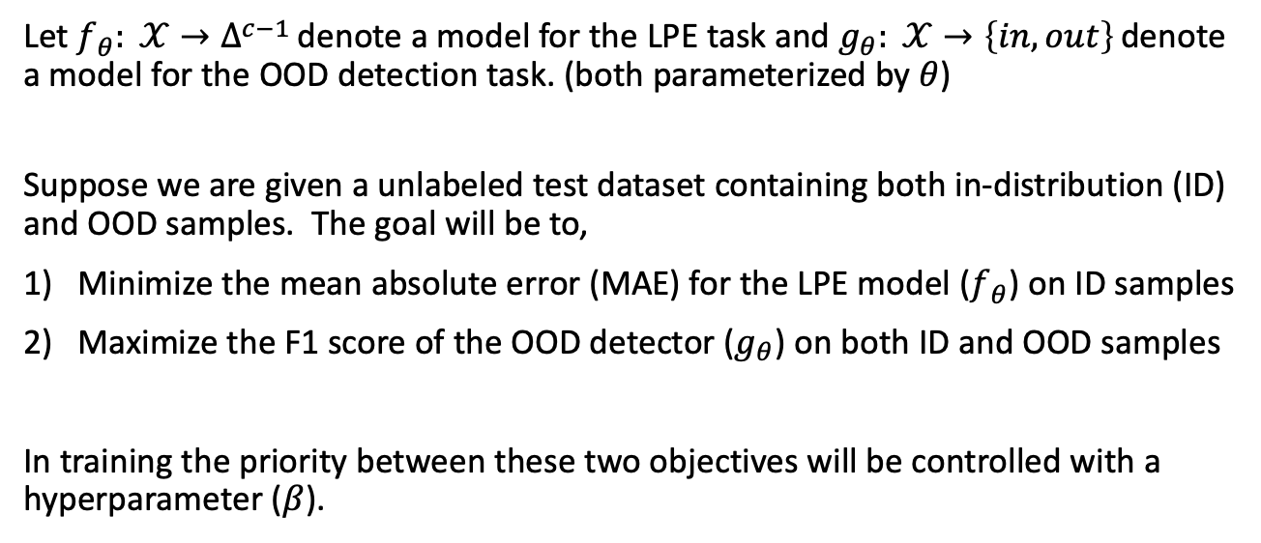
Problem Setup - Goal
Let $f_{θ}: 𝒳→Δ^{c−1}$ denote a model for the LPE task and $g_{θ}: 𝒳→\left\{in, out\right\}$ denote a model for the OOD detection task. (both parameterized by $θ$)
Suppose we are given a unlabeled test dataset containing both in-distribution (ID) and OOD samples. The goal will be to,
Minimize the mean absolute error (MAE) for the LPE model ($f_{θ}$) on ID samples
Maximize the F1 score of the OOD detector ($g_{θ}$) on both ID and OOD samples
In training the priority between these two objectives will be controlled with a hyperparameter ($β$).

Slide 8

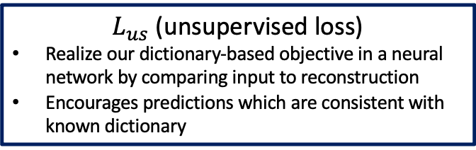
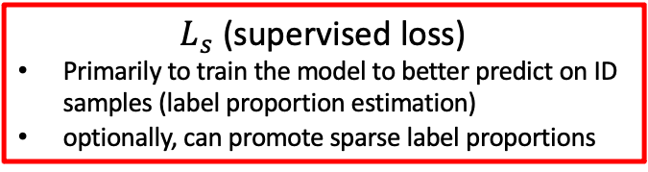
Semi-Supervised Method
Use a neural network to minimize the empirical risk associated with a loss function, combines a supervised and unsupervised term. For the training dataset $𝒟 := {\left\{\left(x_{i}, y_{i}\right)\right\}}_{i=1}^{n}$, define the learning objective as, (where $β$ is a trade-off parameter)
$$\min_{θ}{\sum_{i=1}^{n}{L_{s}\left(f_{θ}\left(x_{i}\right), y_{i}\right)+{βL}_{us}(Df_{θ}(x_{i})}, x_{i})}$$
$L_{s}$ (supervised loss)
Primarily to train the model to better predict on ID samples (label proportion estimation)
optionally, can promote sparse label proportions
$L_{us}$ (unsupervised loss)
Realize our dictionary-based objective in a neural network by comparing input to reconstruction
Encourages predictions which are consistent with known dictionary

Slide 9
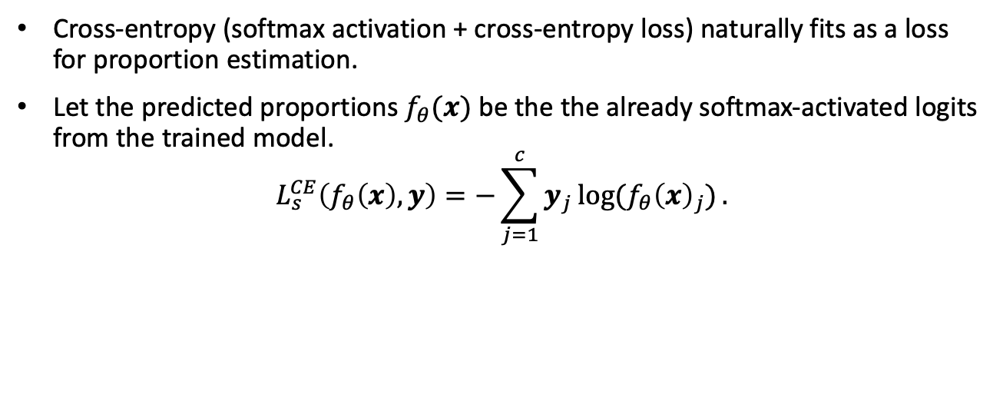
Supervised Term: Cross-Entropy
Cross-entropy (softmax activation + cross-entropy loss) naturally fits as a loss for proportion estimation.
Let the predicted proportions $f_{θ}(x)$ be the the already softmax-activated logits from the trained model.
$$L_{s}^{CE}\left(f_{θ}\left(x\right), y\right)=−\sum_{j=1}^{c}{y_{j}\log{(f_{θ}{\left(x\right)}_{j})}.}$$

Slide 10
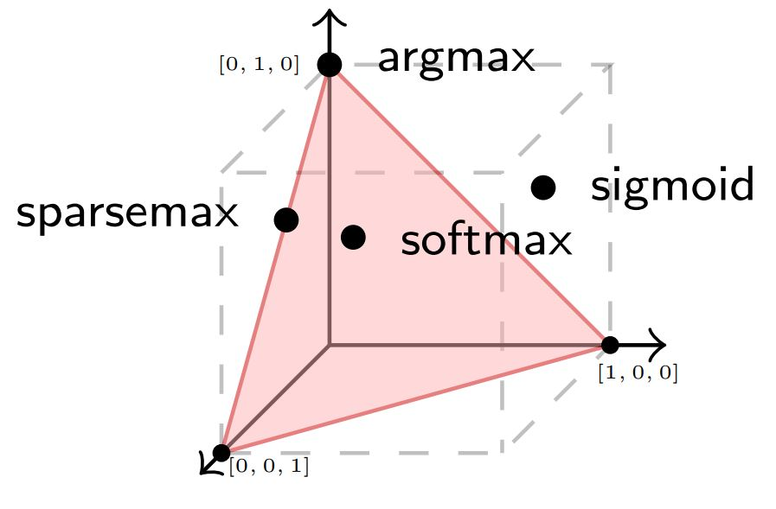
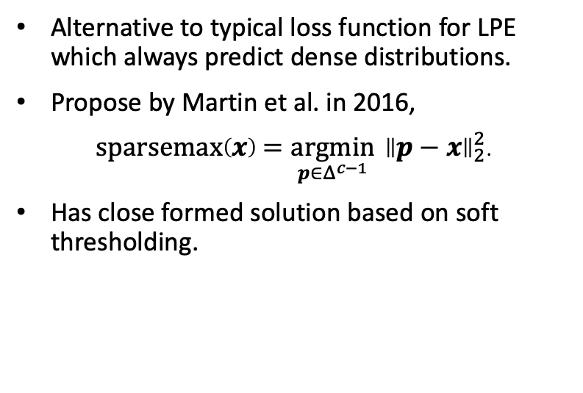
Alternative Supervised Term: Sparsemax
Alternative to typical loss function for LPE which always predict dense distributions.
Propose by Martin et al. in 2016,
$\text{sparsemax}\left(x\right)={\underset{p∈Δ^{c−1}}{argmin}{ \left\|p−x\right\|}}_{2}^{2}$.
Has close formed solution based on soft thresholding.

Slide 11
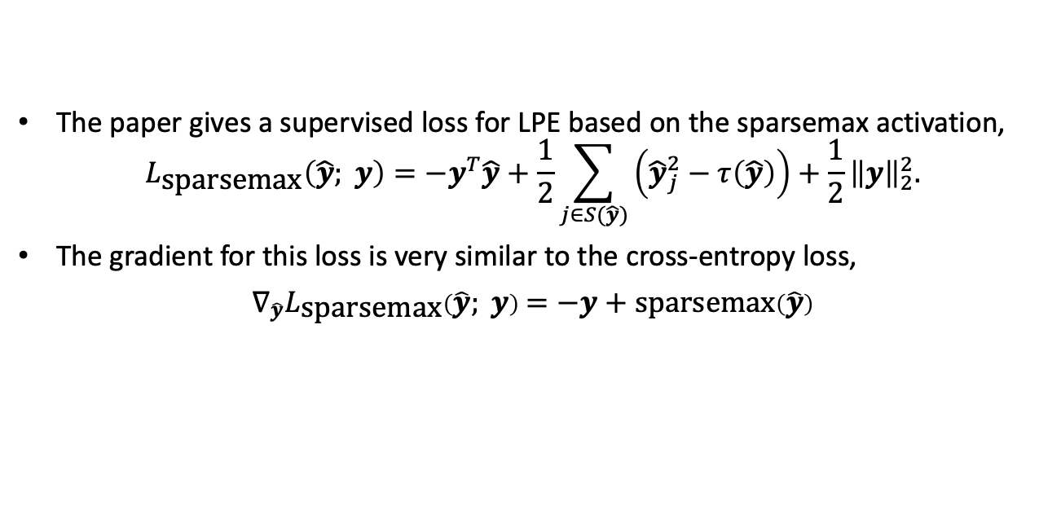
Alternative Supervised Term: Sparsemax (cont.)
The paper gives a supervised loss for LPE based on the sparsemax activation,
$$L_{\text{sparsemax}}\left(\hat{y}; y\right)=−y^{T}\hat{y}+\frac{1}{2}\sum_{j∈S(\hat{y})}{\left({\hat{y}}_{j}^{2}−τ\left(\hat{y}\right)\right)+\frac{1}{2}{\left\|y\right\|}_{2}^{2}.}$$
The gradient for this loss is very similar to the cross-entropy loss,
$∇_{\hat{y}}L_{\text{sparsemax}}\left(\hat{y}; y\right)=−y+\text{sparsemax}\left(\hat{y}\right)$

Slide 12
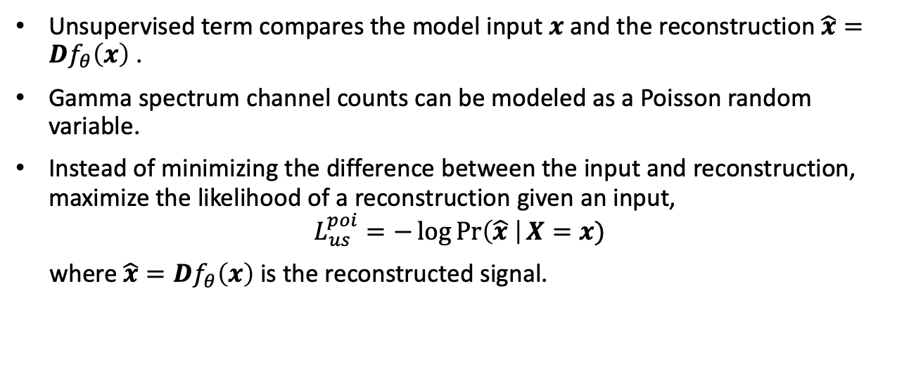
Unsupervised Term: PNLL
Unsupervised term compares the model input $x$ and the reconstruction $\hat{x}=Df_{θ}\left(x\right)$ .
Gamma spectrum channel counts can be modeled as a Poisson random variable.
Instead of minimizing the difference between the input and reconstruction, maximize the likelihood of a reconstruction given an input,
$$L_{us}^{poi}=−\log{\operatorname{Pr}\left(\hat{x} \right|X=x)}$$
where $\hat{x}=Df_{θ}\left(x\right)$ is the reconstructed signal.

Slide 13
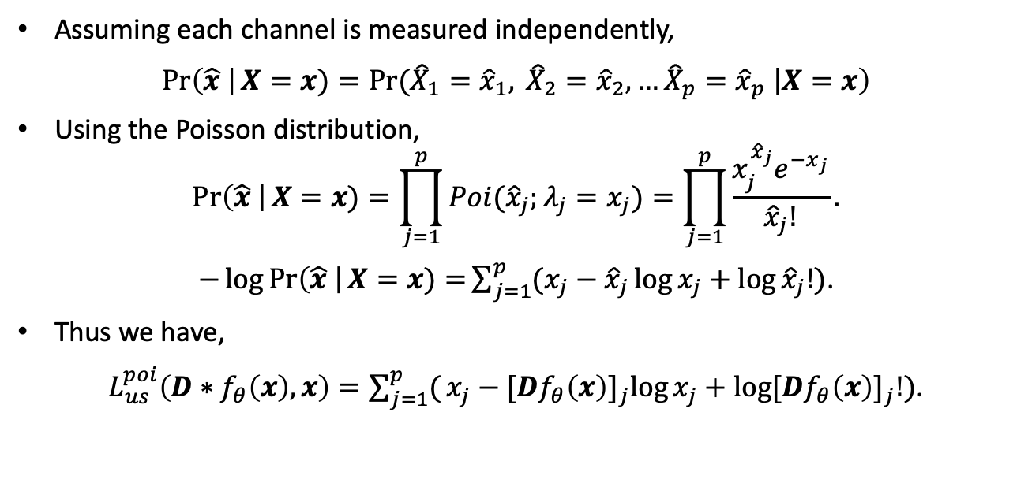
Unsupervised Term: PNLL (cont)
Assuming each channel is measured independently,
$\operatorname{Pr}\left(\hat{x} \right|X=x)=\operatorname{Pr}{({\hat{X}}_{1}={\hat{x}}_{1}, } {\hat{X}}_{2}={\hat{x}}_{2}, …{\hat{X}}_{p}={\hat{x}}_{p} \left|X=x\right)$
Using the Poisson distribution,
$$\operatorname{Pr}\left(\hat{x} \right|X=x)=\prod_{j=1}^{p}{Poi({\hat{x}}_{j};λ_{j}=x_{j})}=\prod_{j=1}^{p}{\frac{x_{j}^{{\hat{x}}_{j}}e^{−x_{j}}}{{\hat{x}}_{j}!}.}$$
$−\log{\operatorname{Pr}\left(\hat{x} \right|X=x)=}\sum_{j=1}^{p}{(x_{j}}−{\hat{x}}_{j}\log{x_{j}}+\log{{\hat{x}}_{j}!})$.
Thus we have,
$L_{us}^{poi}\left(D∗f_{θ}\left(x\right), x\right)=\sum_{j=1}^{p}{(}x_{j}−{[Df_{θ}\left(x\right)]}_{j}\log{x_{j}}+\log{{[Df_{θ}\left(x\right)]}_{j}!})$.

Slide 14
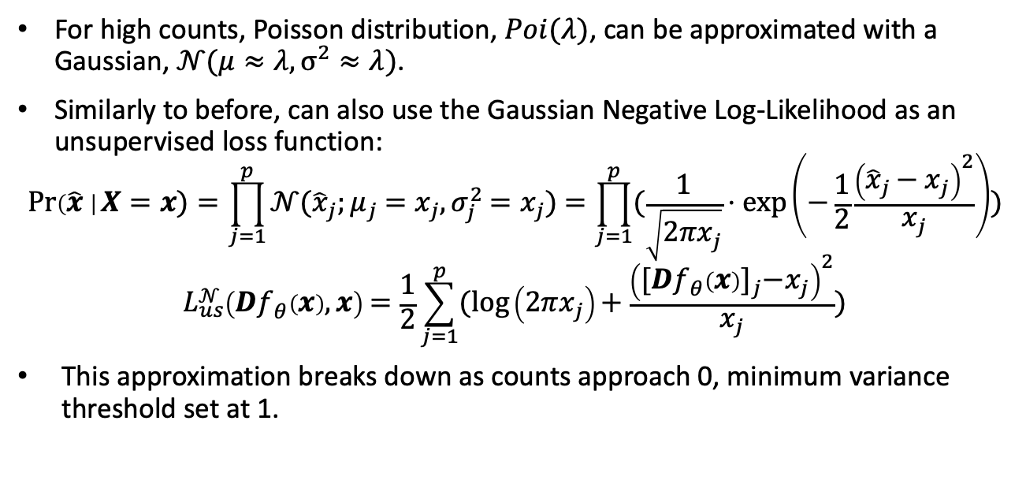
Unsupervised Term: GNLL
For high counts, Poisson distribution, $Poi(λ)$, can be approximated with a Gaussian, $𝒩(μ≈λ, σ^{2}≈λ)$.
Similarly to before, can also use the Gaussian Negative Log-Likelihood as an unsupervised loss function:
$$\operatorname{Pr}\left(\hat{x} \right|X=x)=\prod_{j=1}^{p}{𝒩({\hat{x}}_{j};μ_{j}=x_{j}, σ_{j}^{2}=x_{j})}=\prod_{j=1}^{p}{(\frac{1}{\sqrt{2πx_{j}}}⋅\exp\left(−\frac{1}{2}\frac{{\left({\hat{x}}_{j}−x_{j}\right)}^{2}}{x_{j}}\right))}$$
$$L_{us}^{𝒩}\left(Df_{θ}\left(x\right), x\right)=\frac{1}{2}\sum_{j=1}^{p}{(\log\left(2πx_{j}\right)}+\frac{{\left({[Df_{θ}\left(x\right)]}_{j}−x_{j}\right)}^{2}}{x_{j}})$$
This approximation breaks down as counts approach 0, minimum variance threshold set at 1.

Slide 15
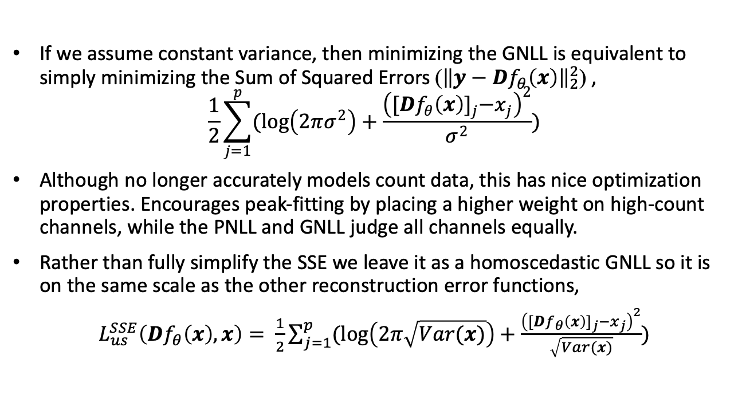
Unsupervised Term: SSE
If we assume constant variance, then minimizing the GNLL is equivalent to simply minimizing the Sum of Squared Errors (${\left\|y−Df_{θ}\left(x\right)\right\|}_{2}^{2}$) ,
$$\frac{1}{2}\sum_{j=1}^{p}{(\log\left(2πσ^{2}\right)}+\frac{{\left({[Df_{θ}\left(x\right)]}_{j}−x_{j}\right)}^{2}}{σ^{2}})$$
Although no longer accurately models count data, this has nice optimization properties. Encourages peak-fitting by placing a higher weight on high-count channels, while the PNLL and GNLL judge all channels equally.
Rather than fully simplify the SSE we leave it as a homoscedastic GNLL so it is on the same scale as the other reconstruction error functions,
$L_{us}^{SSE}\left(Df_{θ}\left(x\right), x\right)= \frac{1}{2}\sum_{j=1}^{p}{(\log\left(2π\sqrt{Var(x)}\right)}+\frac{{\left({[Df_{θ}\left(x\right)]}_{j}−x_{j}\right)}^{2}}{\sqrt{Var(x)}})$

Slide 16
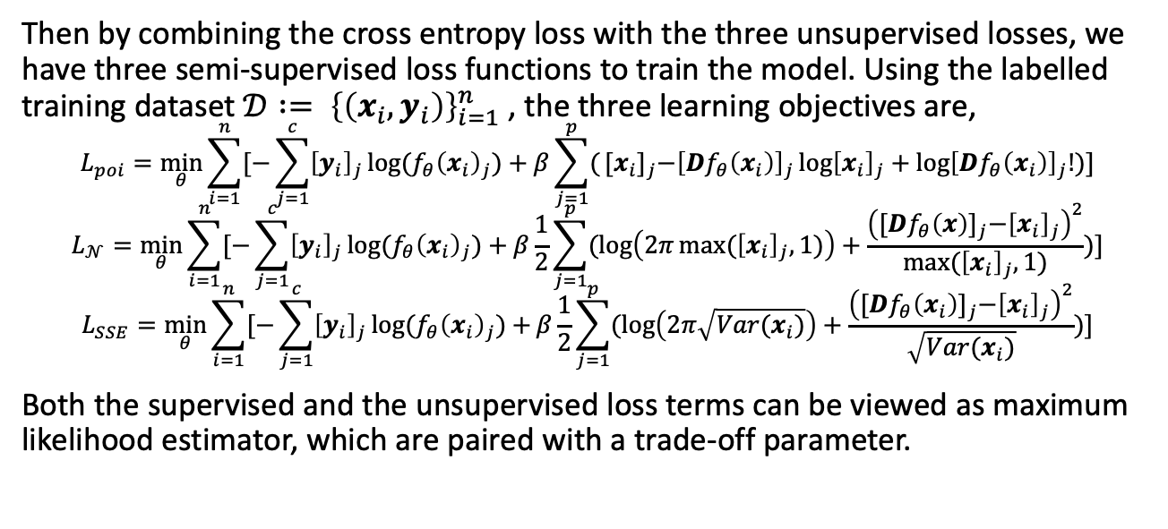
Tying it All Together
Then by combining the cross entropy loss with the three unsupervised losses, we have three semi-supervised loss functions to train the model. Using the labelled training dataset $𝒟 := {\left\{\left(x_{i}, y_{i}\right)\right\}}_{i=1}^{n}$ , the three learning objectives are,
$$L_{poi}=\min_{θ}{\sum_{i=1}^{n}{[−\sum_{j=1}^{c}{{\left[y_{i}\right]}_{j}\log{(f_{θ}{\left(x_{i}\right)}_{j})}}}+β}\sum_{j=1}^{p}{(}{[x_{i}]}_{j}−{\left[Df_{θ}\left(x_{i}\right)\right]}_{j}\log{{\left[x_{i}\right]}_{j}}+\log{{\left[Df_{θ}\left(x_{i}\right)\right]}_{j}!})]$$
$$L_{𝒩}=\min_{θ}{\sum_{i=1}^{n}{[−\sum_{j=1}^{c}{{\left[y_{i}\right]}_{j}\log{(f_{θ}{\left(x_{i}\right)}_{j})}}}+β}\frac{1}{2}\sum_{j=1}^{p}{(\log\left(2π\max{({\left[x_{i}\right]}_{j}, 1)}\right)}+\frac{{\left({[Df_{θ}\left(x\right)]}_{j}−{\left[x_{i}\right]}_{j}\right)}^{2}}{\text{max}{({\left[x_{i}\right]}_{j}, 1)}})]$$
$$L_{SSE}=\min_{θ}{\sum_{i=1}^{n}{[−\sum_{j=1}^{c}{{\left[y_{i}\right]}_{j}\log{(f_{θ}{\left(x_{i}\right)}_{j})}}}+}β\frac{1}{2}\sum_{j=1}^{p}{(\log\left(2π\sqrt{Var(x_{i})}\right)}+\frac{{\left({[Df_{θ}\left(x_{i}\right)]}_{j}−{\left[x_{i}\right]}_{j}\right)}^{2}}{\sqrt{Var(x_{i})}})]$$
Both the supervised and the unsupervised loss terms can be viewed as maximum likelihood estimator, which are paired with a trade-off parameter.

Slide 17
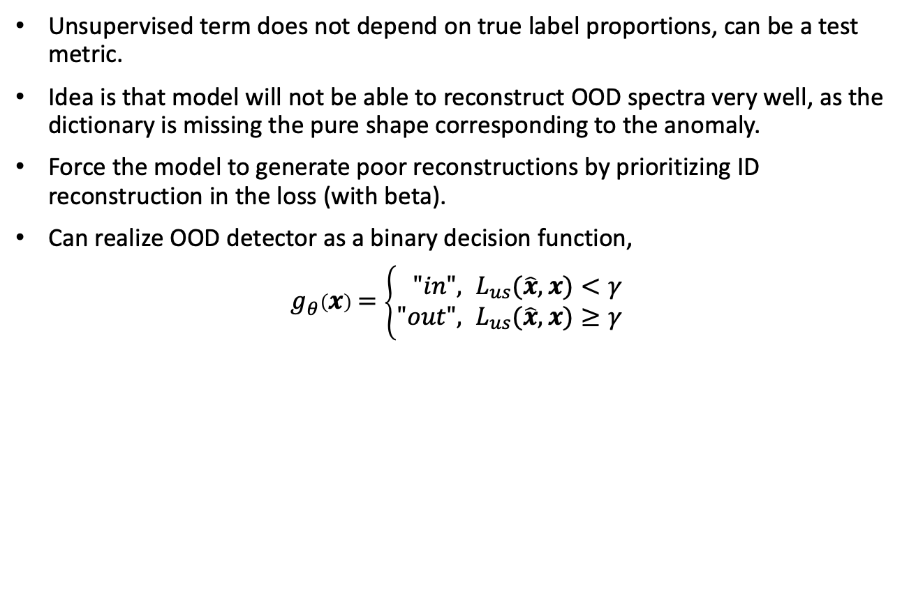
OOD Detector
Unsupervised term does not depend on true label proportions, can be a test metric.
Idea is that model will not be able to reconstruct OOD spectra very well, as the dictionary is missing the pure shape corresponding to the anomaly.
Force the model to generate poor reconstructions by prioritizing ID reconstruction in the loss (with beta).
Can realize OOD detector as a binary decision function,
$g_{θ}\left(x\right)=\left\{\begin{aligned}"in", &L_{us}(\hat{x},x)<γ \\ "out", &L_{us}(\hat{x},x)≥γ\end{aligned}\right.$

Slide 18
Generating Synthetic Data
Training data is synthetic gamma spectra on mixtures of 30 sources based on a real, measured fission source [1].
Training process generated in the following steps:
Pure spectral signature for each source (seeds) obtained via GADRAS.
Pure mixtures are created using PyRIID (open source Python package for synthetically generating gamma spectra)
PyRIID is used to generate realistic, synthetic spectra from pure mixtures by randomly varying the SNR and adding Poisson noise and imperfect background subtraction.
Generated 500k training samples (10k random mixture with 50 random samples/mixture varying SNR from 1 to 100).
[1] Finn, Erin C., Metz, Lori A., Payne, Rosara F., Friese, Judah I., Greenwood, Lawrence R., Kephart, Jeremy D., Pierson, Bruce D., and Ellis, Tere A.. Methods to Collect, Compile, and Analyze Observed Short-lived Fission Product Gamma Data. United States: N. p., 2011. Web. doi:10.2172/1028568.

Slide 19
Overview of Data Generation and Testing Framework

Slide 20
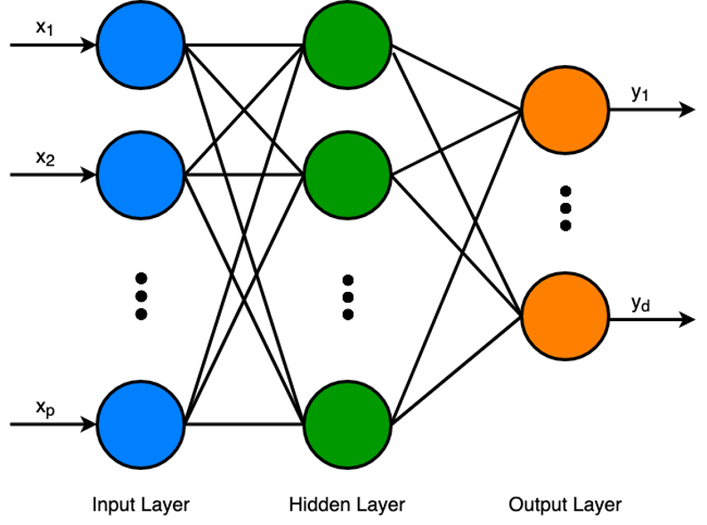
Neural Network Model
To train we use a simple neural network implemented in TensorFlow
Optimizer: Adam
Initial learning rate: 1e-3
Layers: (2048, 512, 30)
Epochs: 50
Batch size: 100
Dropout: 0.05
Train/Val split: 80/20

Slide 21
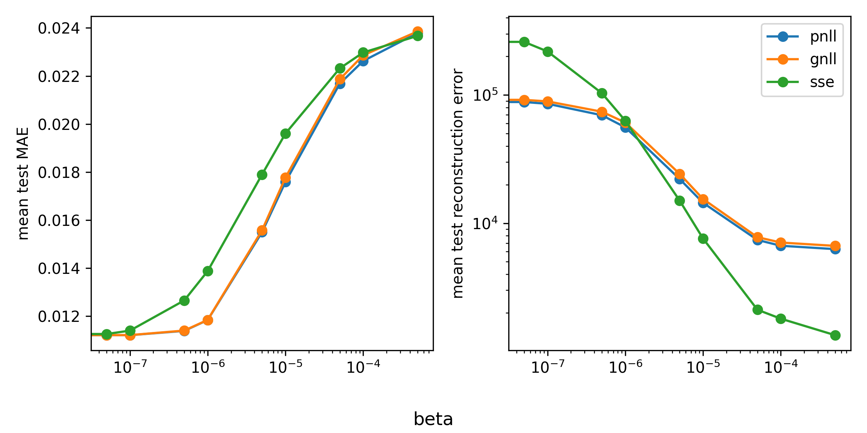
Effect of Beta on ID Performance
We train models for each of the 3 unsupervised losses with betas ranging from 0 to 5e-4, with a total of 30 trained models
The results here are shown for an ID test set

Slide 22
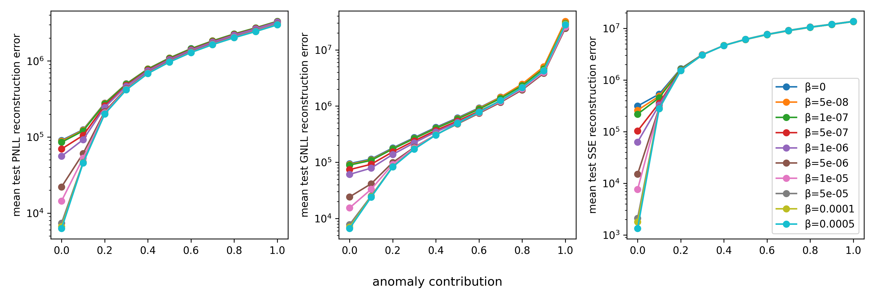
Effect of Beta for OOD Data
We simulate an OOD test dataset by adding in an anomaly (Co57) with various proportions from 0.0 to 1.0 to the ID dataset

Slide 23
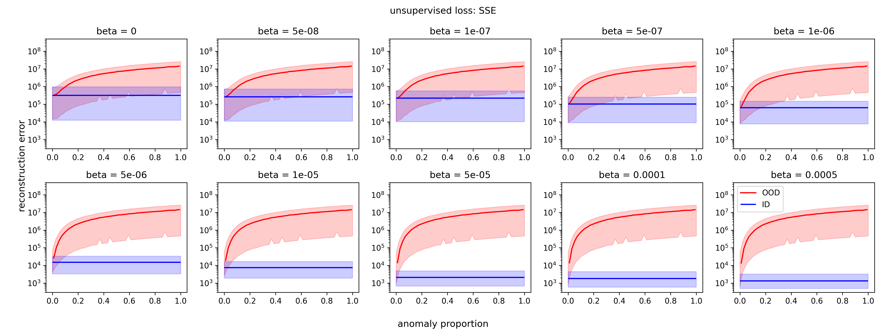
OOD Reconstruction Errors (cont)

Slide 24
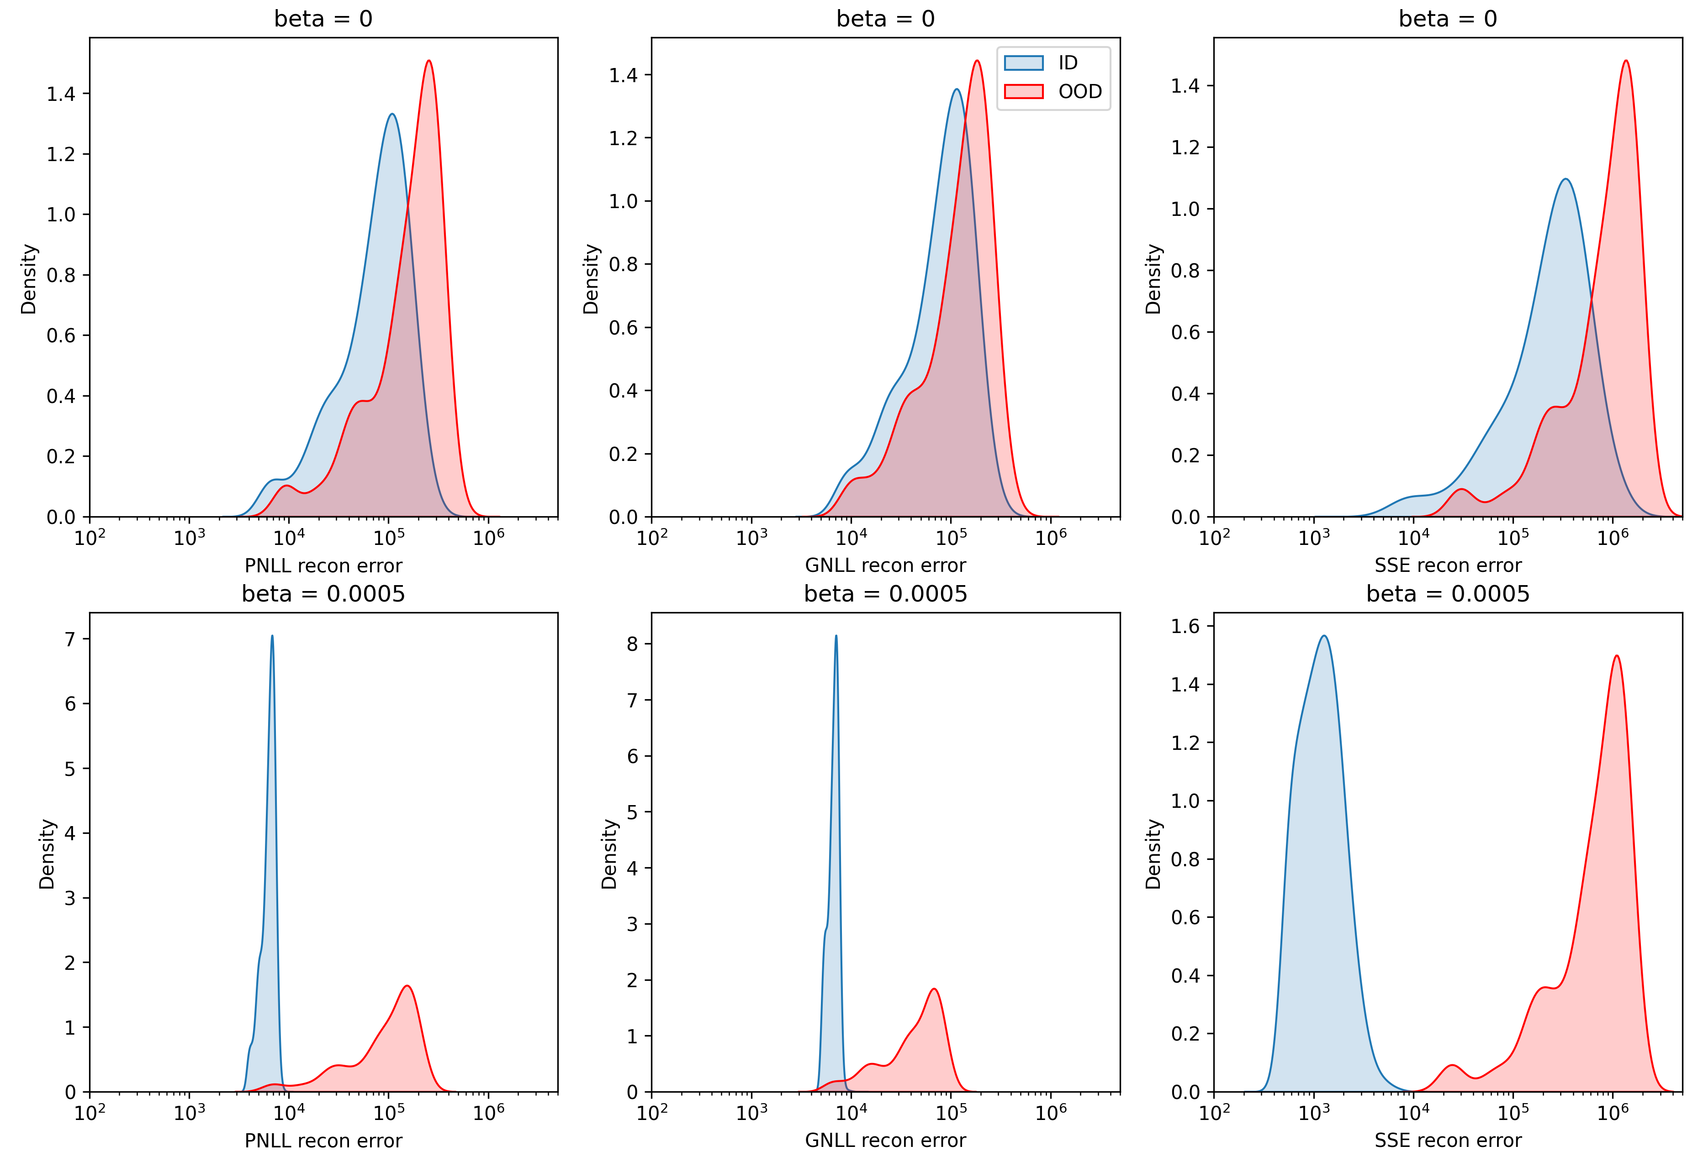
OOD Detector
To eliminate the effect of anomaly contribution on reconstruction error, the following results use a new OOD dataset with a constant anomaly contribution of 10%.
To pick a reconstruction error threshold for OOD detection, should be set at the intersection of ID and OOD recon error distributions.

Slide 25
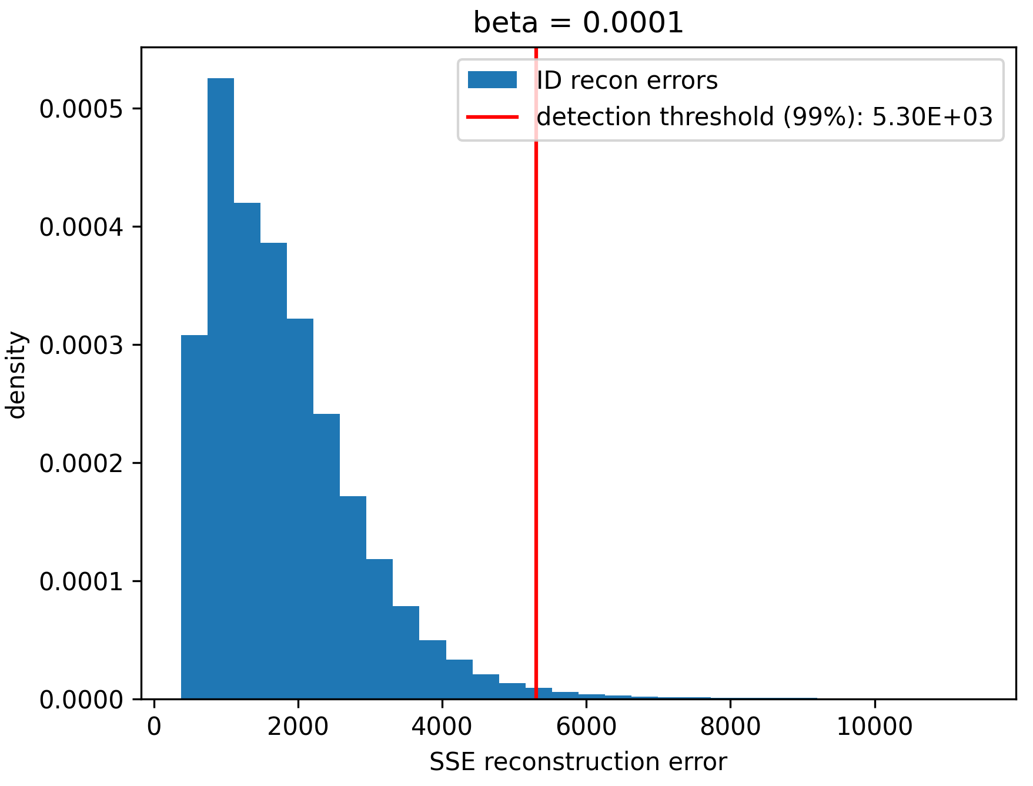
Choosing Threshold for OOD Detector
Thus we choose a reconstruction error threshold by selecting a value that corresponding with a specific quantile of the ID reconstruction errors.
We chose the 99% quantile for this experiment, or in other words for a threshold corresponding with a 1% FP rate.

Slide 26
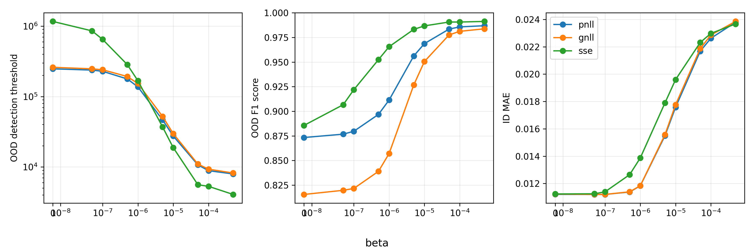
OOD Detector Results

Slide 27
Conclusion
Model learned to minimize both the supervised LPE objective as well as the unsupervised reconstruction errors
Increasing the priority given to the unsupervised learning objective resulting in lower ID reconstruction -> better OOD detection (in terms of F1 score)
Having both models using the same neural network parameters gives lower computational costs (training time, model complexity)
The model architecture and learning framework have been added to the PyRIID package

Slide 28
Future Work
Differentiate what type of OOD input, whether due to a semantic distribution shift (novel label) or a covariate distribution shift (change in sensory conditions)
Combine the unsupervised and supervised terms in a more intuitive way, and adaptively change beta to keep the trade-off constant
Use covariance between energy channels when computing the PNLL loss
Try other reconstruction error functions (e.g., KL or Mahalanobis)
Implement an OOD detector without negatively affecting the LPE task, maybe through using separate models
Incorporate aged fission sources. This can be done to introduce greater ID sparsity and/or used to test current OOD detector.

Slide 29

Acknowledgements
Thank you to the following individuals for their invaluable support:
Dr. Clayton Scott (University of Michigan)
Tyler Morrow (Sandia National Laboratories)
Elliott Leonard (Sandia National Laboratories)
Paul Thelen (Sandia National Laboratories)
I would also like to thank Sandia National Laboratories via the Critical Skills Master’s Program as well as the U.S. Department of Energy, National Nuclear Security Administration, Office of Defense Nuclear Nonproliferation Research and Development (DNN R&D) for funding this work.
Sandia National Laboratories is a multimission laboratory managed and operated by National Technology & Engineering Solutions of Sandia, LLC, a wholly owned subsidiary of Honeywell International Inc., for the U.S. Department of Energy’s National Nuclear Security Administration under contract DE-NA0003525.
SAND2023-01160PE

