Slide 1
Manifold Learning & Equations of State: Conservation of Energy as Regularization for Neural Networks
MLDL 2023
LA-UR-23-27589
George A. Kevrekidis, Joshua Burby, Dan Serino, Marc Klasky

Slide 2
Definitions
Thermodynamic Variables
a collection of real-valued observables associated with a chemical element/compound:
Temperature (T), Pressure (P), Volume (V), Entropy (S), Internal Energy (U), Enthalpy (H)…
Thermodynamic Phase Space
The Euclidean space $ℝ^{4}$ parametrized by the variables $(T,V,S,P)$

Slide 3
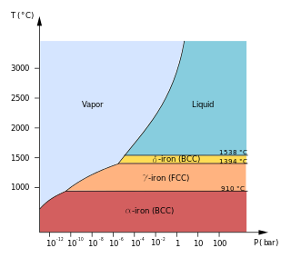
Definitions
Equations of State (EOS)
Functional relationships between thermodynamic variables
$$f\left(T,V,P,S\right)=0$$
Ideal Gas Law, Mie Gruneisen, Tabular Data
May capture phase transition information
Tabular EOS
Tables of points of thermodynamic variables
Generated experimentally or using “hydrocodes”
More accurate, less interpretable
https://en.wikipedia.org/wiki/Allotropes_of_iron#/media/File:Pure_iron_phase_diagram_(EN).svg

Slide 4
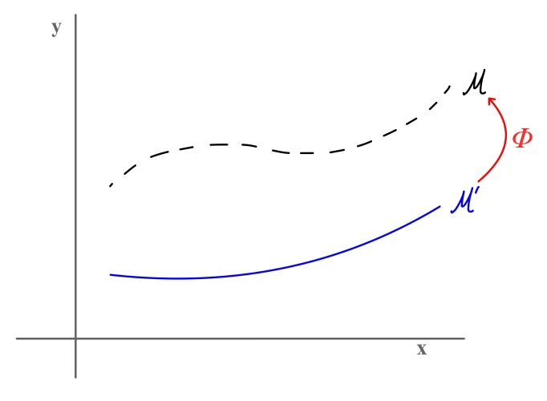
Goals
Neural Network (NN) Approximations
Approximate continuous EOS
Interpolate between tabular data
Exactly satisfy 1st Law of Thermodynamics
Manifold Correction
Match two submanifolds of Thermodynamic Phase Space
correspondence between
high-accuracy, non-interpretable table
low-accuracy, interpretable (analytic EOS)
match sampled submanifolds of $ℝ^{4}$

Slide 5
Differential Geometry
Thermodynamic Phase Space ($Φ)$
$$\left(T,V,P,S\right)∈Φ⊆ℝ^{4}$$
Observations:
$Φ$ is symplectic, with $ω=dT∧dS+dV∧dP$
For a given chemical element/compound, $\left(T,V,P,S\right)∈ℳ$ lie on a 2-dimensional Lagrangian submanifold of $Φ$

Slide 6
Differential Geometry
Thermodynamic Phase Space ($Φ)$
$$\left(T,V,P,S\right)∈Φ⊆ℝ^{4}$$
First Law of Thermodynamics (Conservation of Energy)
$$dU=TdS−PdV$$
By taking exterior derivative
$$0=\left(\frac{∂T}{∂V}−\frac{∂P}{∂S}\right)dS∧dV$$

Slide 7
Differential Geometry
$$0=\left(\frac{∂T}{∂V}−\frac{∂P}{∂S}\right)dS∧dV$$
If $T\left(V,S\right), P(V,S)$ are twice differentiable, Equation vanishes by equality of mixed partials
$$T=\frac{∂U}{∂S}, P=\frac{∂U}{∂V}$$
U is internal energy up to additive constant

Slide 8
NN Algorithm 1
1. Estimate $\hat{U} =f_{NN}(V,S)$
2. Estimate $\hat{T}=\frac{∂\hat{U}}{∂S},\hat{P}=\frac{∂\hat{U}}{∂V}$ with autodiff
3. Then $\left(\hat{T},V,\hat{P},S\right)∈\hat{ℳ}$ is “energy-consistent”
This approach is outlined in Resenberger et al. (2022)
Cons:
Does not work well near a phase transition
Does not work well in multiple scales

Slide 9
NN Algorithm 1.1
1. Estimate $δ\hat{U} =f_{NN}(V,S)$
2. Estimate $\hat{T}=T+\frac{∂δ\hat{U}}{∂S},\hat{P}=P+\frac{∂δ\hat{U}}{∂V}$ with autodiff
3. Then $\left(\hat{T},V,\hat{P},S\right)∈\hat{ℳ}$ is “energy-consistent”
Pros:
Works near a phase transition, but not exactly on one
Cons:
Does not work well in multiple scales
(Does not allow for straightforward interpolation)

Slide 10
Symplectomorphism Approach
Definition:
A symplectomorphism on $ℳ$ is a diffeomorphism $f:ℳ→ℳ$ that preserves the symplectic form $ω$.
Observation
The image of a Lagrangian submanifold under a symplectomorphism is Lagrangian.
I.e. if a low-fidelity submanifold is energy-consistent, then its image under a symplectomorphism of the ambient space must also be energy-consistent.

Slide 11
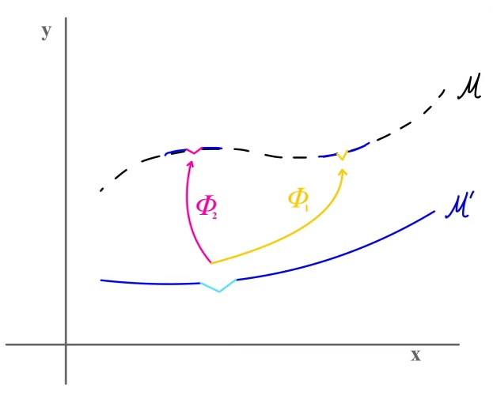
Henon Networks
Universal parametrization of symplectic diffeomorphisms using Neural Networks is outlined in Jin et. Al (2020) and Burby et al (2020), based on a characterization by Turaev (2002)
We use Henon-Networks in this work.
Pros:
Handles phase transitions
Works with either L2
or manifold distance loss functions
Cons:
Does not work well in multiple scales

Slide 12
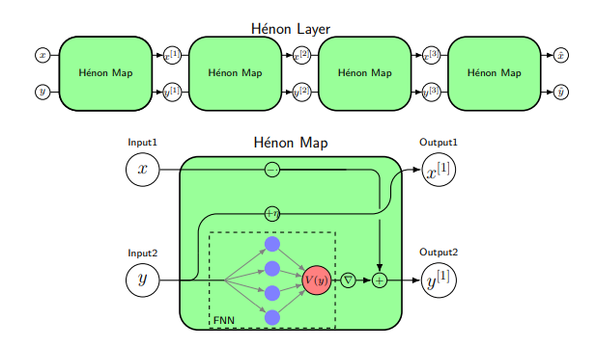
Properties of HenonNetworks
They have a closed form inverse
They preserve the topological character of discontinuities in the derivative
Furthermore, their Lipschitz constant can be controlled

Slide 13
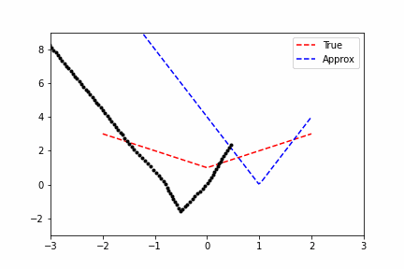
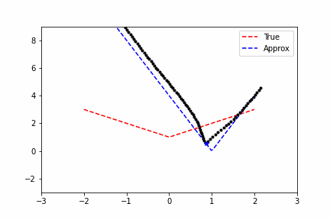
Toy Examples
Blue input is mapped to Red target using Henon Network
Loss: Manifold Metric
Loss: X + Manifold Metric

Slide 14
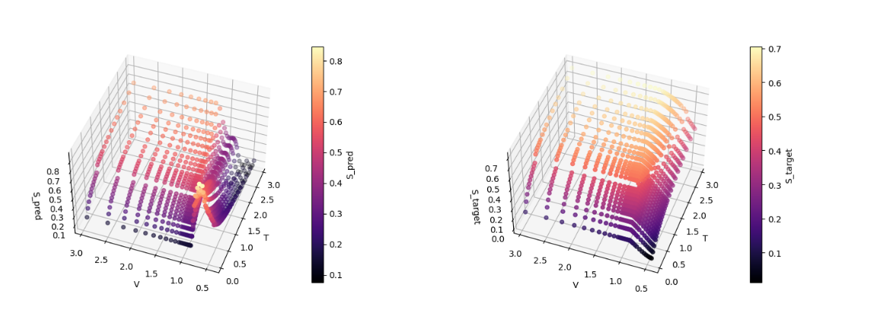
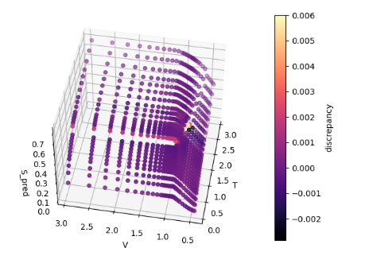
Toy Examples
Correction near phase transition
Estimated Entropy
True Entropy
Estimated Entropy
Full estimation of $U$
Additive correction for $U$

Slide 15
Future Work
Research for multiscale models
* Required by most full EOS data sets
* Only global Symplectomorphisms are parametrized by NNs
Mentzer et al. (2023) address this issue by using different models at different scales, determined by phases

Slide 16
References
Symplectic Networks
Burby, Joshua William, Qi Tang, and R. Maulik. "Fast neural Poincaré maps for toroidal magnetic fields." Plasma Physics and Controlled Fusion 63.2 (2020): 024001.
Jin, Pengzhan, et al. "SympNets: Intrinsic structure-preserving symplectic networks for identifying Hamiltonian systems." Neural Networks 132 (2020): 166-179.
Turaev, Dmitry. "Polynomial approximations of symplectic dynamics and richness of chaos in non-hyperbolic area-preserving maps." Nonlinearity 16.1 (2002): 123.
EOS Modelling
Rosenberger, David, et al. "Machine learning of consistent thermodynamic models using automatic differentiation." Physical Review E 105.4 (2022): 045301.
Mentzer, Katherine L., and J. Luc Peterson. "Neural network surrogate models for equations of state." Physics of Plasmas 30.3 (2023).

Slide 17
Thank you!

