Slide 1
AI-enhanced simulation of operational requirements management with a knowledge graph-based digital twin
2023 ML/DL Workshop
erhtjhtyhy
Matthew T. Dearing
Faming Li
Joseph Cook
Colin Mcdonald
AIOps Center Technical Lead
OAISIS, BIS ESS
mdearing@anl.gov
Machine Learning Engineer
OAISIS, BIS ESS
fli@anl.gov
Machine Learning Engineer
OAISIS, BIS ESS
joseph.cook@anl.gov
Professional Career Intern
OAISIS, BIS ESS
cmcdonald@anl.gov
July 17, 2023

Slide 2
Just an outline
Brief intro to AI for Operations at Argonne.
The operational business challenge: Managing operational requirements. Decentralized laboratory policy documents increases risks in maintaining requirements mandated by the Prime Contract and other DOE directives.
Strategic progress through student collaboration.
Overview our approach.
What’s next?

Slide 3
Why AI in operations?
little ideas to Big Ideas … all include similar ideas
Recommendations to support business process decisions.
Predictions for operational next steps, assignments, and proactive issue resolutions.
Automating routine processes that require excessive person-hours.
Mining of related valuable information not otherwise discoverable.
Detection of anomalies and errors in operations and processes not otherwise observable.
Assisted decision-making through advanced data and text-based analytics.
Monitoring of performance risks and system issues before occurrence.

Slide 4
An operational business challenge
Managing Operational Requirements
Decentralized laboratory policy documents increases risks in maintaining requirements mandated by the Prime Contract and other DOE directives.
Gap analysis in Lab Performance Management 2019 project identified challenges in the process to map Prime Contract-driven requirements to individual Argonne policies and procedures.
Difficult to track compliance with all Prime Contract requirements.
Current requirements management function is ad hoc.
Limitations in tracing evidence that requirements are being met.
A few goals to mature Argonne LPM processes:
Provide transparency across the board.
Improve compliance monitoring for all requirements in the Prime Contract.
Eliminate redundant, duplicate, or out-of-date requirements.

Slide 5
lab performance management
Improving LPM – Current manual efforts and risks
Decentralized collection of policy documents without cataloged relationships.
Increased risks in maintaining current and accurate requirements as mandated by the Prime Contract and other DOE directives.
Significant manual effort is required by FTEs
Receive, identify, disseminate, and coordinate necessary changes in policies.
High risk of failing compliance audits due to missed requirement changes.

Slide 6
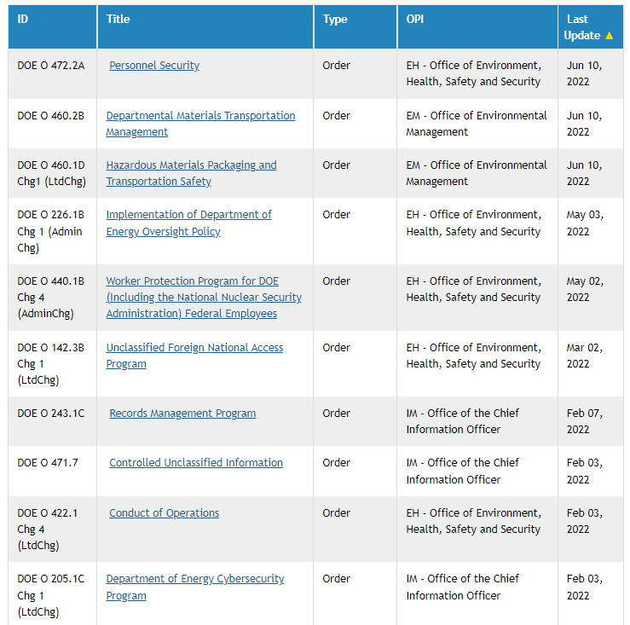
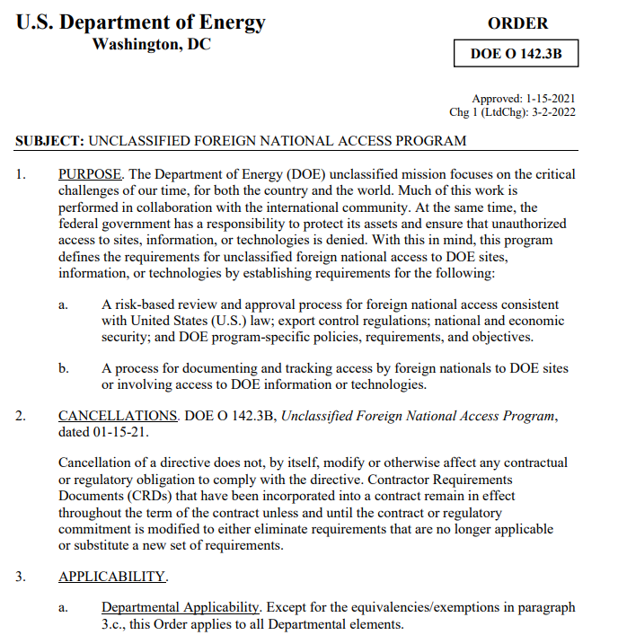
DOE directives are dynamic
Spoiler alert: the govt is not a static entity.
The “data” is widely varied
formatted text in PDF documents.

Slide 7
What can we do with ai?
A tricky problem. A big challenge. A massive operational value.
Can we develop an AI-enhanced requirements management system to augment many of the processes involved in implementing policy changes?
Enhance the laboratory’s ability to facilitate comprehensive and up-to-date compliance with its wide-ranging obligations.
Reduce significant manual effort by staff in the discovery, dissemination, and coordination of implementing requirements changes.
Eliminate corrective actions issued for after-the-fact realizations of missed changes in policy requirements.

Slide 8
Win-win with Student collaborations

Slide 9
Partnering with academia
Student-driven R&D offers win-win collaborations for national lab ops
UChicago teams via course capstone projects
Data Science Institute, MSc in Analytics
Xijie Liu, Cece Li, Katherine Tu, Peter Wang, Neal Xu, Jade Yuan, Richard Huang, Soren Dunn, Grace Shao, Annabel Mendoza, Kekun Han, Ken Kliesner
Mentors: Rahim Rasool, Patricia Chiril, Christian Jordan
Multiple groups since Fall 2021.
University of Illinois Springfield team
Department of Computer Science
Prof. Elham Buxton, Matt Pavlik
Notes:
Why should the science programs have all the fun?

Slide 10
Using nlp to “model” operational docs

Slide 11
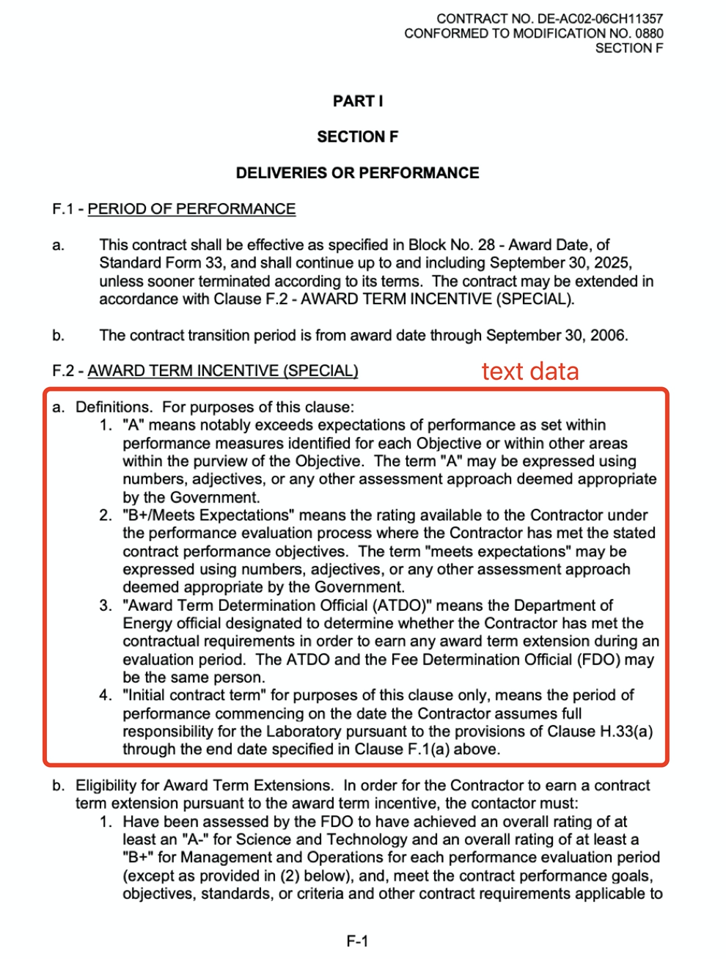
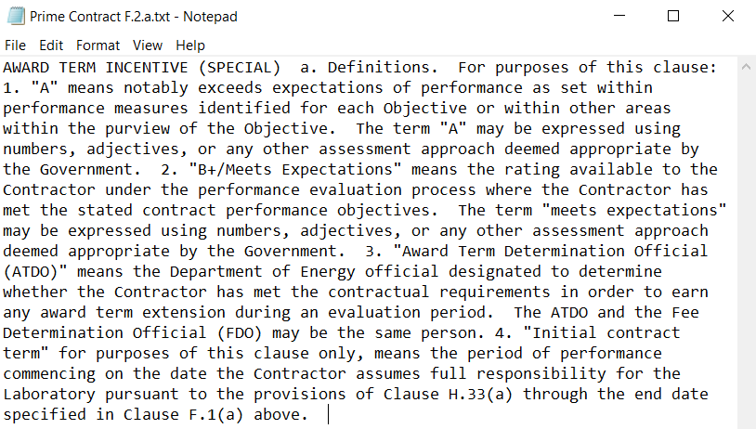
The prime contract
https://www.anl.gov/prime-contract
PDF to plain text to embeddings: words to numbers
‘determination official’ =
Notes:
The embedding values depend on the language model applied.

Slide 12
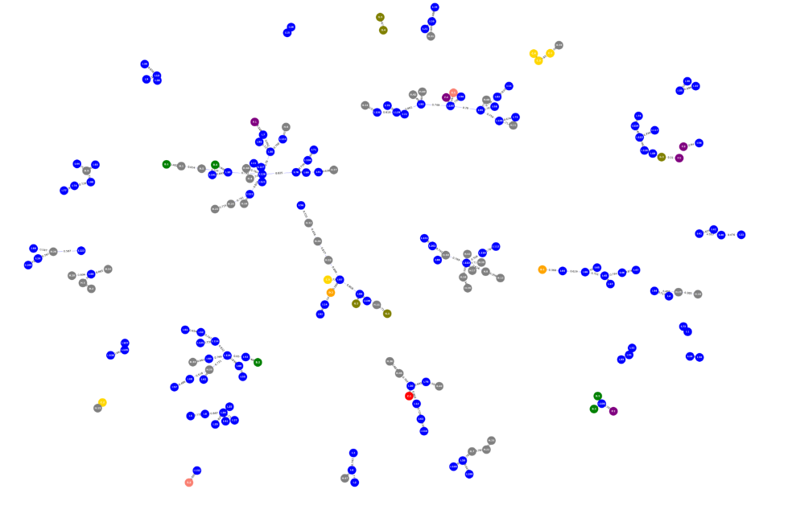
prime contract knowledge ecosystem
First, we build a model to understand operational relationships
First feature: create a “knowledge graph” that captures the semantic relationships within the Prime Contract.
Each “node” represents a clause.
Each “edge” represents a similarity relationship between clauses.

Slide 13
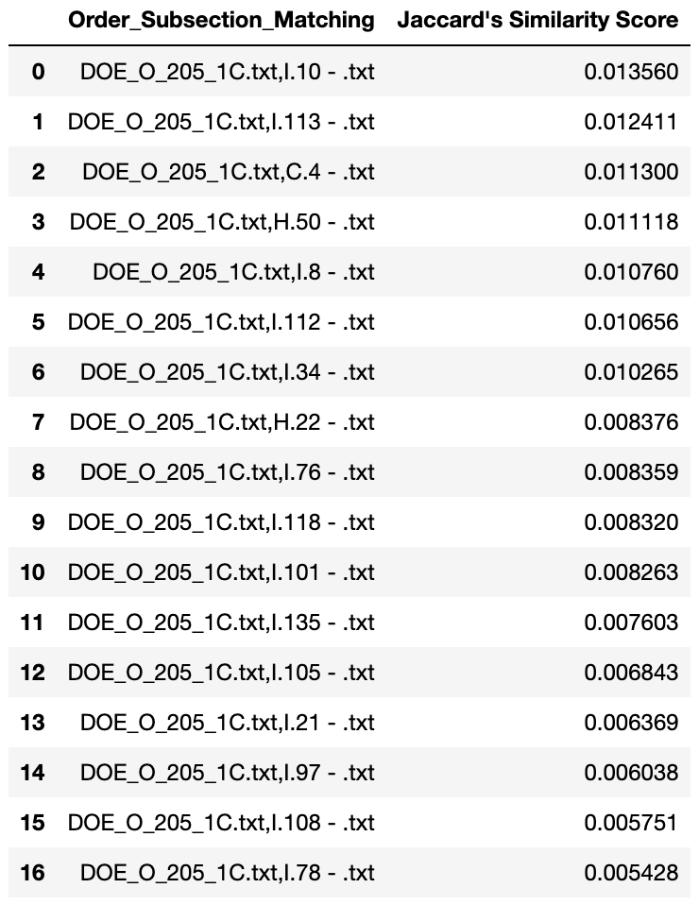
prime contract knowledge ecosystem
Then, we can simulate operational changes within a policy document
Second feature: map DOE orders and Argonne policies into the Prime Contract knowledge graph to understand extended relationships.
Similarity scores between documents are ranked.

Slide 14
prime contract knowledge ecosystem
Then, we can simulate operational changes within a policy document

Slide 15
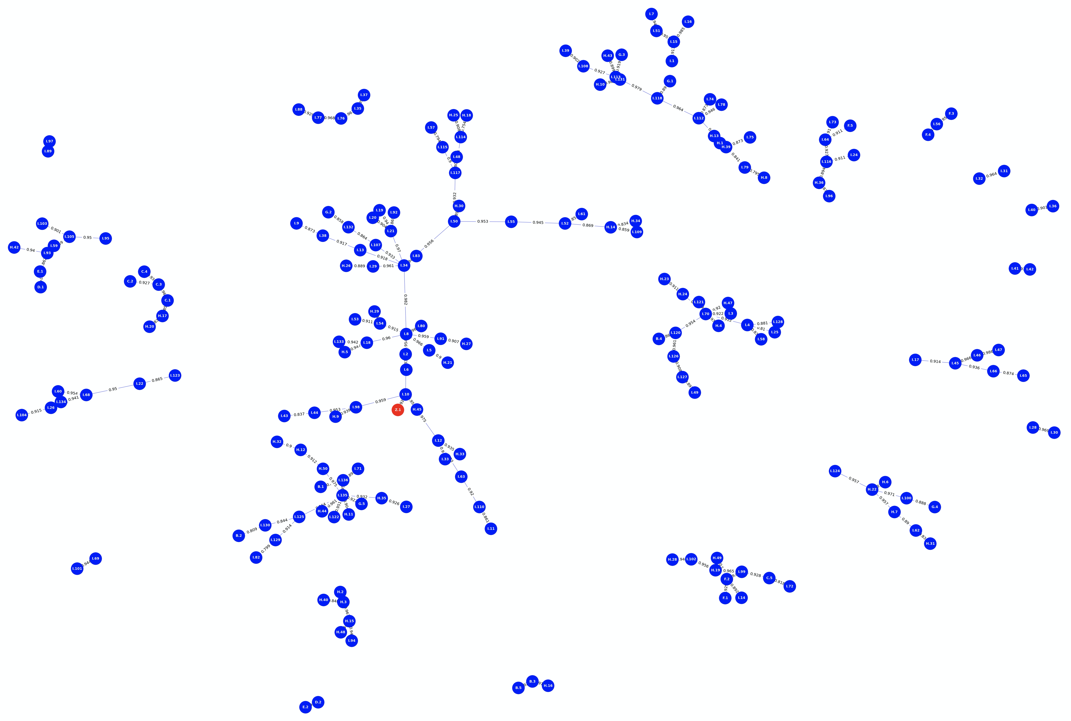
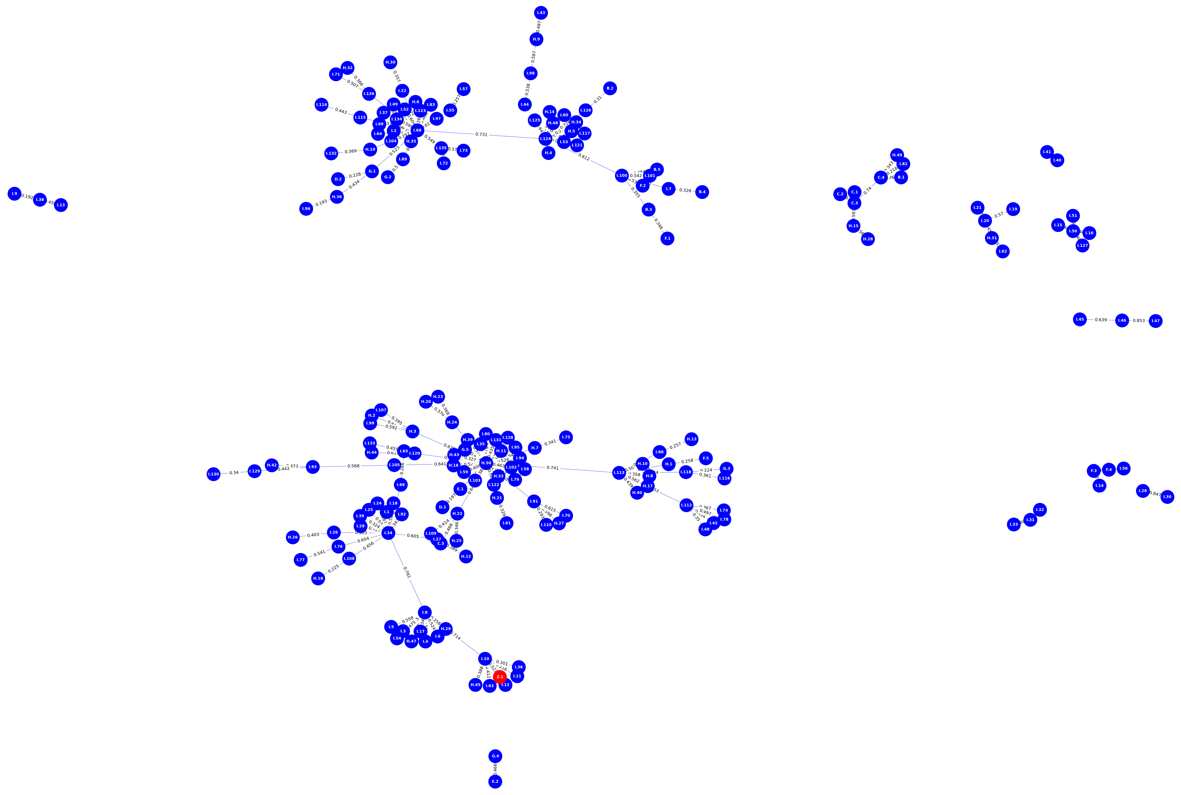
prime contract knowledge ecosystem
Then, we can simulate operational changes within a policy document

Slide 16
prime contract knowledge ecosystem
Next, we can interact with operational policies and procedures
Third feature: develop interactive language models that can extract relevant information across the policy landscape from general queries.
An interactive knowledge agent for cross-domain information extraction.
Ask: “What are the standards of contractor performance evaluation?”
Answer: Periodic appraisals of contractor performance with respect to the Contractors’ Total Compensation System. Score: 0.228501 Context: Prime Contact Clause H.22 (a) Total Compensation System
Ask: “What are the standards of contractor performance evaluation?”
Answer: Periodic appraisals of contractor performance with respect to the Contractors’ Total Compensation System. Score: 0.228501 Context: Prime Contact Clause H.22 (a) Total Compensation System
The knowledge graph will augment chat-based responses.

Slide 17
Phase 0 – proof of concept results

Slide 18
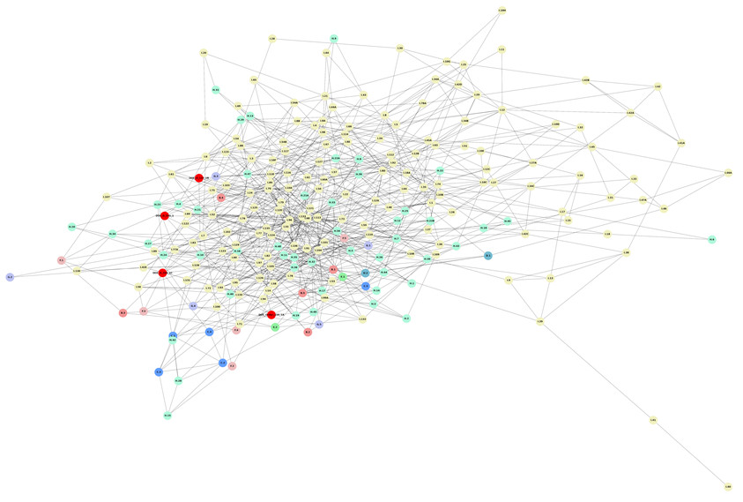
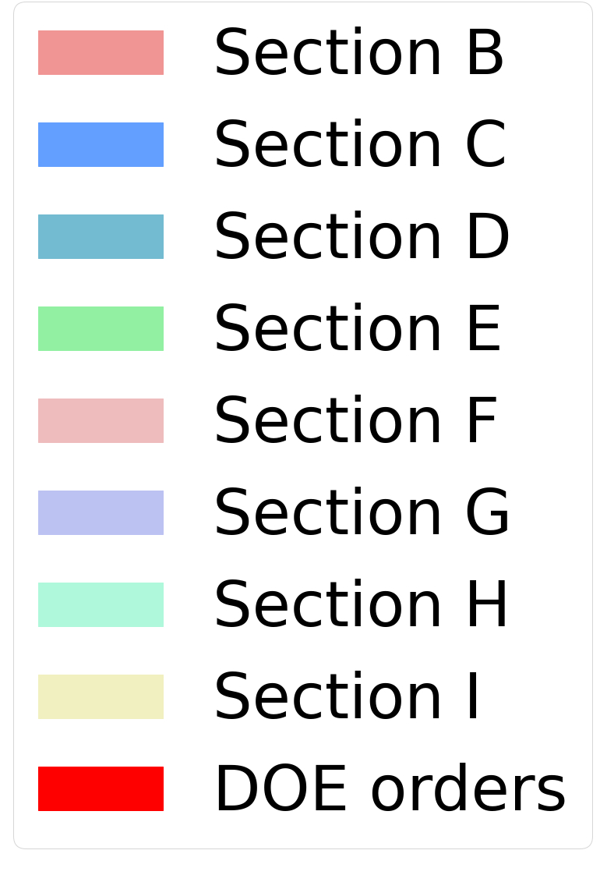
Opreq-ai | Information extraction
Knowledge graph model of the Prime Contract
Developed foundational code base:
Curated text blocks from document.
Calculated contextual similarity between all pairs of text.
Constructed relationship graph with highest scores as edges.
Code is reusable and extendable for other document sources.

Slide 19
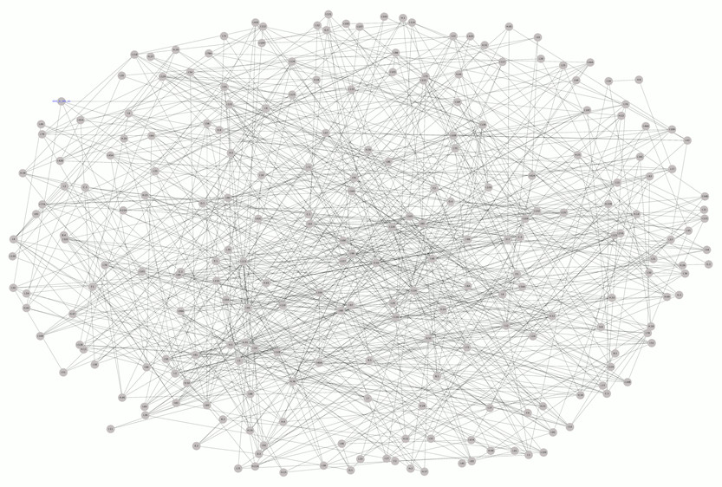
Opreq-ai | Information extraction
Simulating operational change impact in the Prime Contract
A graph representing contextual relationships between sections of the Prime Contract.
Node: granular document section
Edge: NLP-base similarity metric above heuristic threshold.

Slide 20
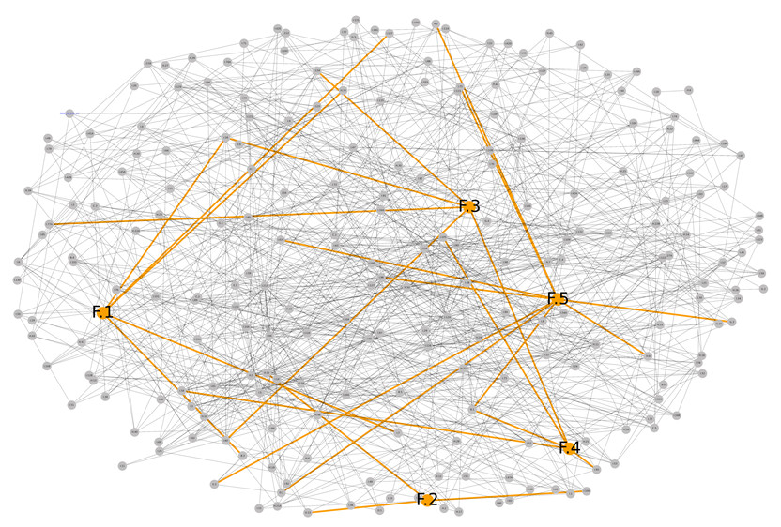
Opreq-ai | Information extraction
Simulating operational change impact in the Prime Contract
Highlighting Section “F” nodes with relationships to other subsections.

Slide 21
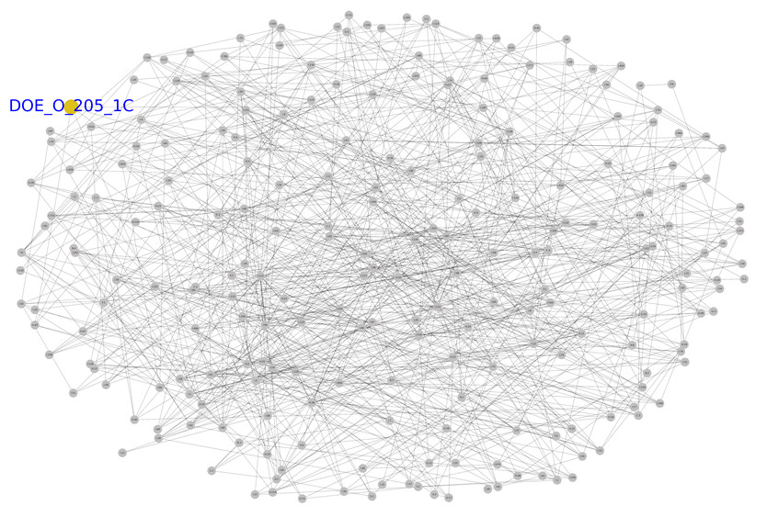
Opreq-ai | Information extraction
Simulating operational change impact in the Prime Contract
Insert a DOE order document (a new node)
Now, we can simulate how the content of this new document may impact other Prime Contract sections.
We identify new edges that correspond to NLP-modeled similar content.

Slide 22
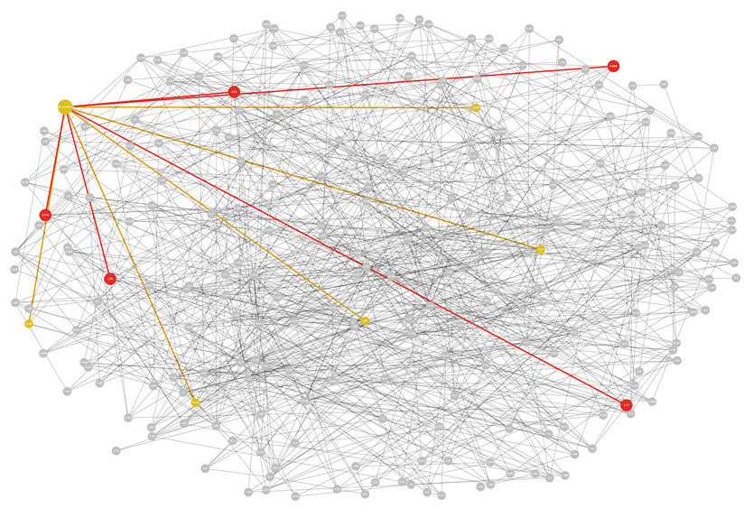
Opreq-ai | Information extraction
Simulating operational change impact in the Prime Contract
Highlight edges with direct similarity to the DOE order document (i.e., one step away).
Suggests that these Prime Contract sections may be impacted by the operational changes required by the DOE order.
Graph augments “Ask Argonne”:
the “red” edges are identified by our Ask Argonne prototype.
the “yellow” edges are identified by the knowledge graph.

Slide 23
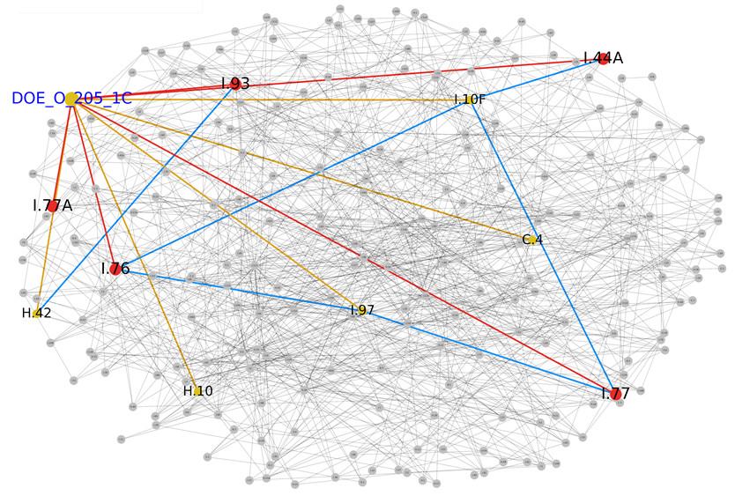
Opreq-ai | Information extraction
Simulating operational change impact in the Prime Contract
Using the knowledge graph structure, we can discover new relationships (the “blue” edges).
These are contextual relationships two steps away from the DOE order that we may not have seen before.
However, these sections could still be indirectly impacted by the DOE change requirements.

Slide 24
Opreq-AI | solution overview

Slide 25
Designed by the UChicago student research teams.

Slide 26
Designed by the UChicago student research teams.

Slide 27
Next steps

Slide 28
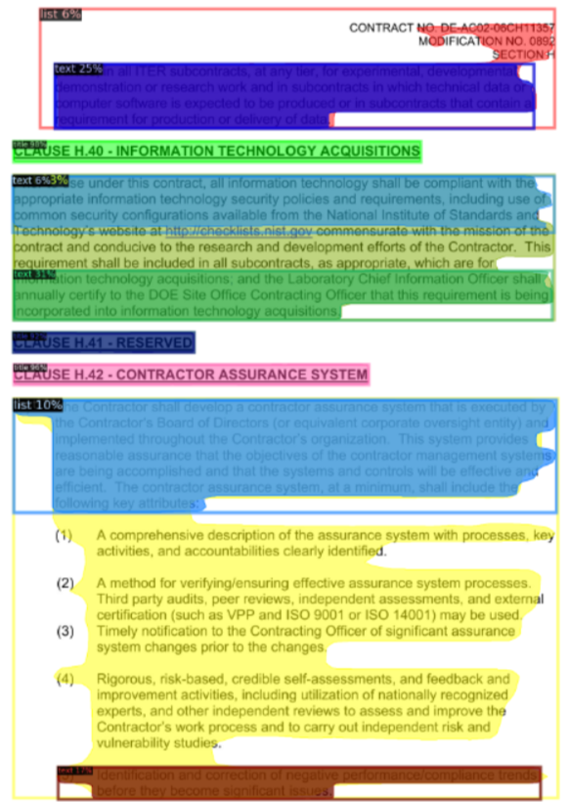
Intelligent Ops management
We are just getting started – with a solid foundation.
Refine graph construction algorithms to improve document content comparisons.
Automate section-level text extraction with trained image detection models.
Expand scope to model more operational documents (e.g., LMS-MNL-3 Travel and FAR).
Integrate with “Ask Argonne”:
Incorporate multi-level relationships from knowledge graph.
Develop a ‘what-if’ decision simulation solution.
Incorporate generative AI – this will transform our approach and capabilities.

Slide 29
This ending is just the beginning.

