Slide 1
The cost of Large language Models Solutions
Henry Wong (5683)
July 17, 2023
2023 MLDL Workshop

Slide 2
So you want an LLM?
Training a LLM from scratch
Running an existing model
Fine-Tuning an existing model
Using an API Service

Slide 3
Training your own LLM

Slide 4
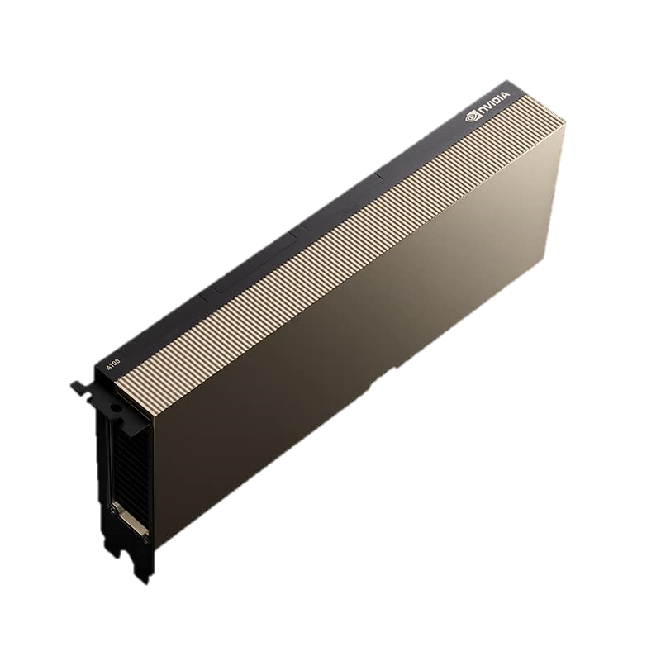
How much would it cost to train my own LLM
ChatGPT can take 34 days of training on 1,024 Nvidia A100 Graphic Cards
~$10k for each Graphic Card
Electricity costs and maintenance will cost upwards of $5 Million a year
Does not include labor costs
Meta’s model, Llama, took 2,480 Nvidia A100 Graphic Cards
Theoretical 355 years to train GPT-3 on a single Nvidia V100 Graphic Cards
Nvidia Tesla A100 Graphics Card

Slide 5
How much would it cost to train my own LLM
An alternative option is to use cloud services (AWS, Azure, Google Cloud)
Pd4.24xlarge instance run at $32.77 an hour for 8 Nvidia A100 GPU’s
34 days of training would run at $3.4 Million (on 1,024 GPU’s)
This assume you get the model right on the first try
There are smaller models you can train
Numbers shown reflect the most expensive models

Slide 6
Running an existing model

Slide 7
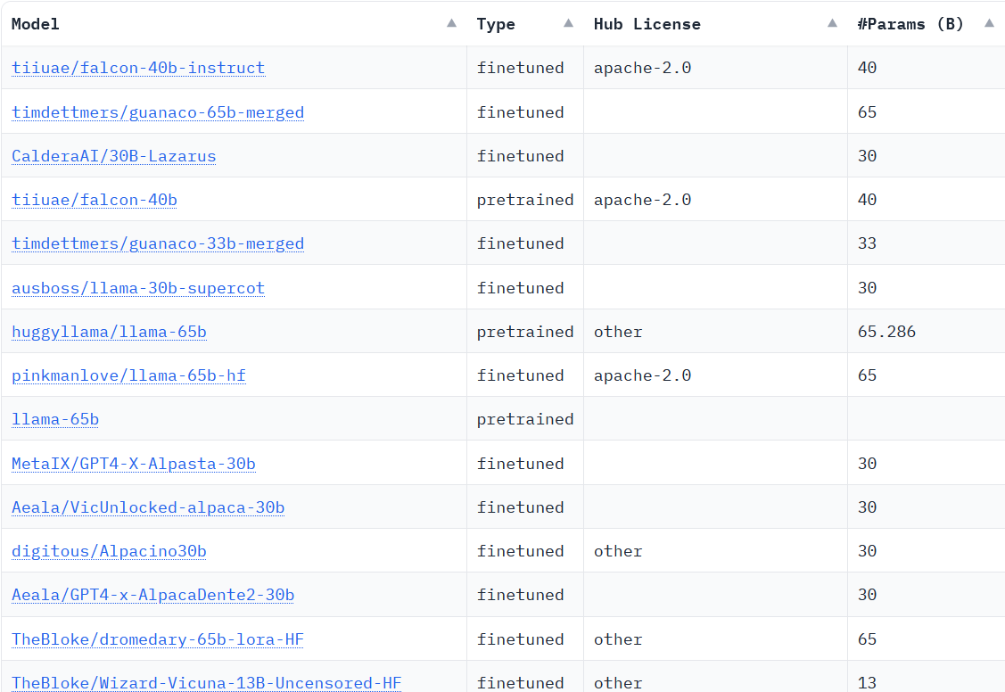
Running an existing Opensource Model
Alpaca
BLOOM
Dolly
Falcon
Galactica
Guanaco
GPT-J
GPT-NEO
Lazarus
Lamma.cpp
OPT
Pythia
Vicuna
Notes:
When running a large language model, you have to choose an opensource model to run. There’s a lot of choose from and there’s new models coming out every week. The list here is the Hugging Face Leaderboard, a ranking list for open-source Large Language Models. Llama tends to be a popular option because of oh how easy it is to customize due to the weights of the model being leaked shortly after release. There are other models on the leaderboard, like Alpaca, that are trained on top of Llama. Falcon tends to be a popular option as well due to it’s #1 placement on the ranking list, however, the model does require quite a bit of resources at 40 billion parameters. However, notice the model below it uses 65 Billion parameters. A bigger model does not necessarily mean a better model. The chances are that a bigger model is going to be accurate, but a model could also apply a few tricks to be more efficient with the data given.

Slide 8
Things to Consider
Number of parameters
How many resources you have
GPU’s
Memory
Quantization
Resource needed to run Llama under 8-bit Quantization
Size (in Parameters) | Minimum Total VRAM | GPU Examples (Nvidia) | RAM/Swap to Load | GPU Cost
7 Billion | 10 GB | 3060 12GB | 24 GB | ~$400
13 Billion | 20 GB | 3090, 4090 | 32 GB | ~$1,500
30 Billion | 40GB | A600, A100 | 64 GB | ~$4,500
65 Billion | 80 GB | A100 80GB | 128 GB | ~$15,000
Note: These are needed to run the model. Training the model would make more resources.
Notes:
Things to consider when running your own LLM is how big you want your model to be, how many resources you have, and quantization, which will be talked about in the next slide.
Looking at this table, we see 4 different sizes for the Llama model, each with it’s own VRAM requirement. VRAM, being a special type of RAM within a GPU. The more VRAM, the bigger the model you can store. Like I mentioned before, the bigger the model does not necessarily mean the model will perform better. But the ability to hold more data can lead to better performance. We can see that the 7 billion parameter model will only require a Nvidia 3060 12GB, a consumer grade GPU. The performance of the 7 billion parameter model may work for your use case, but if you are looking for an experience closest to chatGPT, you will most likely need to run the 30 billion or 65 billion parameter models. Although, OpenAI does not publish their model sizes, most likely GPT-4 is much larger than 65 billion parameters.

Slide 9
Quantization
Machine Learning models typically represent data by 32bit and 16bit floating points
We compress each data point into 8bit or 4bit representations (data is lost)
8bit Quantization methods have been found that provide almost 0 degradation to LLM’s
However, 4bit Quantization degrades quality by quite a bit
4bit models are more accessible
Dettmers, Tim, et al. "Llm. int8 (): 8-bit matrix multiplication for transformers at scale." arXiv preprint arXiv:2208.07339 (2022).

Slide 10
Resource needed to run Llama under 8-bit Quantization
Size (in Parameters) | Minimum Total VRAM | GPU Examples (Nvidia) | RAM/Swap to Load | GPU Cost
7 Billion | 10 GB | 3060 12GB | 24 GB | ~$400
13 Billion | 20 GB | 3090, 4090 | 32 GB | ~$1,500
30 Billion | 40 GB | A600, A100 | 64 GB | ~$4,500
65 Billion | 80 GB | A100 80GB | 128 GB | ~$15,000
Resource needed to run Llama under 4-bit Quantization
Size (in Parameters) | Minimum Total VRAM | GPU Examples (Nvidia) | RAM/Swap to Load | GPU Cost
7 Billion | 6 GB | 3050 12GB | 24 GB | ~$300
13 Billion | 10 GB | 3060,3080 | 32 GB | ~$500
30 Billion | 20 GB | 3080,4090 | 64 GB | ~$1,500
65 Billion | 40 GB | A100 40GB | 128 GB | ~$7,000

Slide 11
Using API’s
Notes:
Let’s say running your own model is a bit pricey for you. Or you only want to develop a prototype and don’t have a use for a graphics card after the project. In that case an API might be the solution for you.

Slide 12
Application Programming Interface (API)
Let’s you use third-party tech (if they let you)
Not a viable option if you need to send data that other people shouldn’t see
i.e classified documents/projects

Slide 13
Different API’s
OpenAI
ChatGPT
GPT-3, GPT-3.5, GPT-4
Hugging Face
Easy to use API for opensource models

Slide 14
Tokenization
Cost of using API’s typically are related to number of tokens you use
Each input is split into tokens for processing
Each token is then “embedded”
“Hello World!”
Tokenization
“
Hello
World
!
“

Slide 15
Costs
Costs based on how many “tokens” are used
GPT-4
Model | Input | Output
8K context | $0.03 / 1K tokens | $0.06 / 1K tokens
32K context | $0.06 / 1K tokens | $0.12 / 1K tokens
Chat
Model | Input | Output
4K context | $0.0015 / 1K tokens | $0.002 / 1K tokens
16K context | $0.003 / 1K tokens | $0.004 / 1K tokens
Notes:
1 token = ¾ word

Slide 16
Context
Context allows you to add examples before giving the LLM a task
When will Tesla Inc (TSLA) stock hit $300 a share?
Prompt
As an AI language model, I cannot predict the future with certainty, especially with regards to complex economic systems. However, I can provide you with some information and perspectives that may help you understand the current situation.
ChatGPT Response

Slide 17
Context
Context allows you to add examples before giving the LLM a task
When will Tesla Inc (TSLA) stock hit $300 a share?
Source | Tokens | Cost
Prompt | 16 | < $0.003
Tesla Wikipedia Page | 19,408 | $0.057

Slide 18
Fine-tuning
Fine-tuning retrains parts of an existing LLM to take more information in
Typically used if context is not enough
Model | Training | Usage
Ada | $0.0004 / 1k tokens | $0.0016 / 1k tokens
Babbage | $0.0006 / 1k tokens | $0.0024 / 1K tokens
Curie | $0.0030 / 1K tokens | $0.0120 / 1K tokens
Davinci | $0.0300 / 1K tokens | $0.1200 / 1K tokens

Slide 19
Conclusion

Slide 20
Pros and Cons of Training your own model
Pros
Very customizable
Cons
Expensive compared to other options
Only specific use cases where this is more beneficial than fine-tuning
Requires specific hardware

Slide 21
Pros and Cons of running An open source model
Pros
Cheaper when running a lot of queries
Customizable
All data run on model can be local
Cons
Takes work to spin up
Requires specific hardware

Slide 22
Pros and Cons of Using API’s
Pros
Low upfront cost
Support
Easy to use
Almost out of the box
Cons
High cost if running many queries
Limited topics
i.e Cannot ask for gambling odds
Susceptible to outages
Harder to customize
Third-party sees all of your data

Slide 23
Summary
For prototyping and use cases with low amount of messages: API
For large and long term projects: Running an opensource model
If data cannot be sourced to a third party: Running an opensource model
If knowledge needs to be incredibly specific with a lot of data: Train your own model

Slide 24
Thank you!

