Slide 1
AI-enabled conflict simulation
20 July 2023
Ephraim Rusu – rusu1@llnl.gov
Computational Scientist

Slide 2
JCATS – Joint Conflict And Tactical Simulation Simulating real conflict scenarios in real time with real data
Discrete event, agent-based conflict simulator
Land, air, and sea agent in open scenarios
User control ranges from a single agent to the entire task force

Slide 3
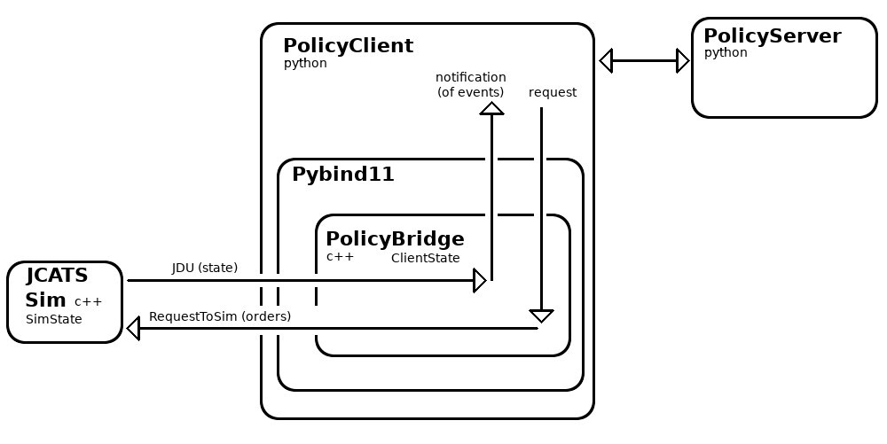
Policy Client infrastructure enables JCATS to connect with external (RL) libraries
JCATS Human-interactive mode
Humans interact with JCATS via a GUI
Simulation state graphically rendered
Human provides commands through GUI
Too slow for RL
JCATS Batch-mode
Pre-scripted plan files
Cannot change action sequence mid-game
Unthrottled runtime
JCATS PolicyClient
Interactive interface for connecting with external libraries
Requires wrappings for each JDU and IPC
Estimate ~80 JDUs and ~200 IPCs needed
Notes:
Emphasize that the completion of PolicyClient is a good feature addition to JCATS

Slide 4
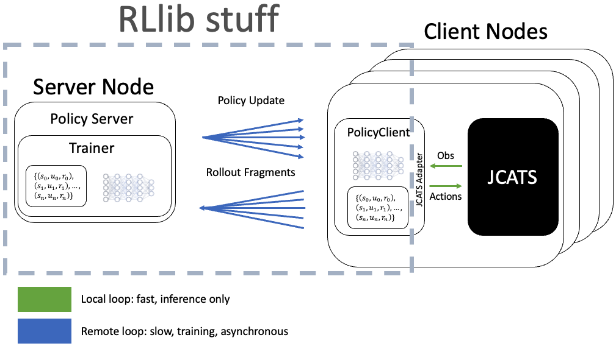
Scalable Training With RLLib

Slide 5
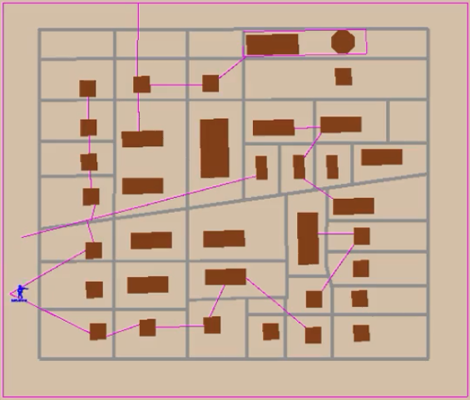
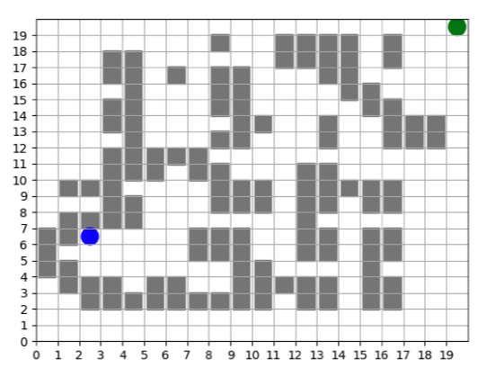
Using Abmarl as a JCATS proxy provides rapid insight to RL experiment design
JCATS Maze
Continuous environments: 2100x2100 map
Continuous movements up to 100 units away
1 simulation step -> ~ 1 second
Abmarl Maze
Discrete environments: 20x20 grid
Discrete movements to nearby cells
1 simulation step -> ~ 0.003 seconds
Building
Building
Agent
Agent
Fencing
Target
Target
Abmarl is ~300x faster -> faster experiment iteration for researchers

Slide 6
Abmarl experiments were critical for balancing JCATS implementation complexity with learnability of environment
Regional Awareness
Agent observes surrounding region
Reward at target, penalize bad moves
Easy to learn, hard to implement
Position with soft reward
Agent only observes its position
Only reward at target
Easy to implement, easy to learn
(X,Y)
Only Position
Agent only observes its position
Reward at target, penalize bad moves
Easy to implement, doesn’t learn
 | Training Time | Simulation Steps
Regional awareness | 1 minute | 132,000
Only position | 30 minutes | 2.5 million
Position with soft reward | 2 minutes | 300,000
(X,Y)
Notes:
Wanted to work with structured information coming out of JCATS rather than treating it as a computer vision learning approach. We realized that some of that was not explicitly represented in JCATS, so we were initially limited to positional information.
This is more of a mitigation than our actual plan.

Slide 7
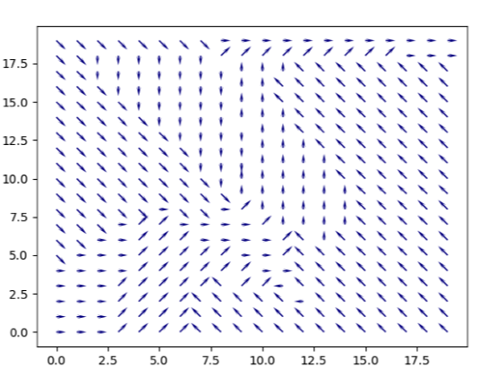
Decision Field Of A Fully Converged Policy
Abmarl position-only maze
The policy is fully converged
Decision field of last checkpoint
Policy is well defined along agent’s preferred route

Slide 8
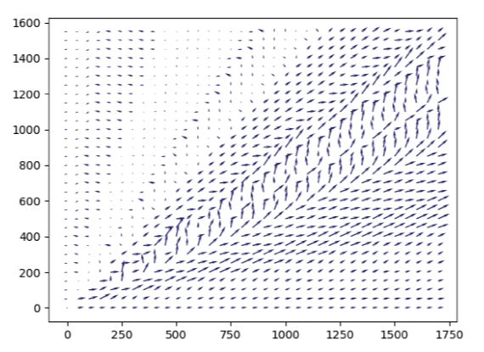
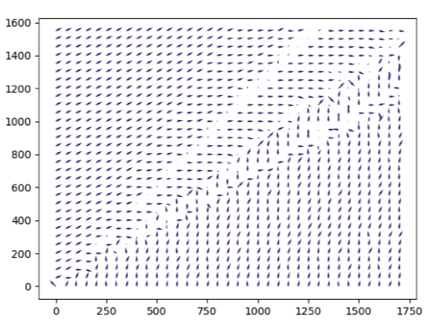
Successful distributed policy learning for JCATS maze via PPO
Results from training in RLLib
10 days, 4 nodes, and 256 data collectors => 61,440 core hours on HPC system
136M training steps
Decision field after ~1hr
Decision field after 10 days
Notes:
Agent started reaching goal within 1 hour of training.
In the beginning, agent was taking about 1000 steps to reach goal.
Towards the end, the agent started reaching it within dozens of steps.
The agent learned the core structure early on. We kept running it to flex our infrastructure to see how close we could get to the optimal solution. Change the tone of this slide to be positive about what we’ve done with the infrastructure
Didn’t need 10 days to solve maze to a satisfactory level. We ran for 10 days because a much more complicated scenario of interest would require about that much compute and we wanted to prove that we could do it.
100-agent maze: 50 sim seconds per second (1 steps per second)
Invincible maze runner: 25 sim seconds per second (1/2 steps per second)

