Slide 1
detecting anomalous event timings in cybersecurity logs
Alex Foss*, Toya Acharya, Shawn Martin, Mayuri Shakamuri, Kristin Adair
ML/DL 2023, Sandia National Laboratories
SAND2023-05908C, SAND2023-06444V

Slide 2
BackGround

Slide 3
Process trees
A process is a computer program or executable
Process creation events are often logged by cybersecurity monitoring systems
Process creation logs may log the parent process that spawned them
Process trees/chains can be built from parent-child process information
userinit.exe
explorer.exe
acrobat.exe
firefox.exe
firefox.exe

Slide 4
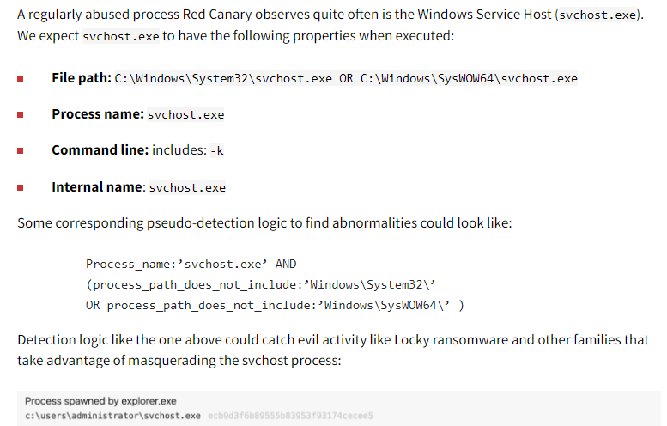
Process Masquerading
Common tool used to evade cybersecurity defenses
A malicious process declares itself to be a benign process
https://redcanary.com/blog/process-masquerading/

Slide 5
Process Masquerading
userinit.exe
explorer.exe
acrobat.exe
firefox.exe
"firefox.exe"

Slide 6
Living off the land
Common tool to avoid cybersecurity defenses
“…uses built-in network administration tools to perform their objectives.”
“…allows the actor to evade detection by blending in with normal Windows system and network activities…”
https://www.cisa.gov/news-events/cybersecurity-advisories/aa23-144a

Slide 7
Living off the Land
userinit.exe
explorer.exe
firefox.exe
acrobat.exe
powershell.exe
firefox.exe

Slide 8
Detection of Malicious Activity Using Host Logs
These and many other attacks are commonly used
Can be difficult to detect
Some existing detection strategies
Fixed indicators (e.g. svchost.exe not run from known pathways, file hashes)
Heuristics (e.g. inspecting unique process chains)
Analyst intuition
Behavioral analysis: Find chains in which process X does not behave like process X
Core question of this project:
Can we use timing to improve behavioral analysis of process chains?
Specifically, we seek to use inter-process creation times
Can obtain this from process creation logs (e.g. Sysmon)

Slide 9
Methods

Slide 10
Statistical Modeling of Process Chains
Basic requirements
Must be fast (ideally faster than the chain-building step)
Limited to conjugate priors (no MCMC)
Sparsity: Must handle processes & chains that have never been observed
We use an empirical Bayes approach
Inspired by Bayesian context trees (e.g. Kontoyiannis et al. 2022)
Kontoyiannis et al. (2022), "Bayesian Context Trees: Modelling and exact inference for discrete time series," arXiv:2007.14900.

Slide 11
Statistical Modeling of Process Chains
Let $X_{ab}$ denote a R.V. describing the log-time elapsed from parent process $a$ to child process $b$, where
$$X_{ab}∼Normal\left(μ_{ab}, 1/τ_{ab}\right)$$
With mean $μ_{ab}$ and precision $τ_{ab}$.
Assume a normal-gamma conjugate prior
$$\left(μ_{ab}, τ_{ab}\right)∼NormalGamma\left(μ=μ_{0}, λ=n_{0},α=\frac{n_{0}}{2},β=\frac{n_{0}}{2τ_{0}}\right)$$
with priors $n_{0}$, $μ_{0}$, and $τ_{0}$ calculated from log-times between any process and process $b$
a.exe
b.exe
$$X_{ab}=log\left(\frac{1}{x},\frac{1}{x},\frac{1}{x}\right)$$
a.exe
d.exe
b.exe
b.exe
...
c.exe

Slide 12
Statistical Modeling of Process Chains
This leads to the closed-form posterior distribution
$$\left(μ_{ab}, τ_{ab}\right)|x_{ab1},x_{ab2},…, x_{abn_{ab}}∼NormalGamma\left(\begin{aligned}μ= \frac{n_{0}μ_{0}+n_{ab}{\overline{x}}_{ab}}{n_{0}+n_{ab}}, λ=n_{0}+n_{ab}, α=\frac{n_{0}+n_{ab}}{2}, \\ β=\frac{1}{2}\left(\frac{n_{0}}{τ_{0}}+\frac{n_{ab}}{{1/\hat{σ^{2}}}_{ab}}+\frac{n_{0}n_{ab}{\left({\overline{x}}_{ab}−μ_{0}\right)}^{2}}{n_{0}+n_{ab}}\right)\end{aligned}\right)$$
with similar closed-form expressions for ${\hat{μ}}_{ab}=E[μ_{ab}]$ and ${\hat{τ}}_{ab}=E[τ_{ab}]$.
This describes process pairs. How about chains?

Slide 13
Statistical Modeling of Process Chains
Now, let $X_{abc}$ denote a R.V. describing the log-time elapsed from progenitor sequence $ab$ to child process $c$, where
$$X_{abc}∼Normal\left(μ_{abc}, 1/τ_{abc}\right)$$
with a normal-gamma conjugate prior
$$\left(μ_{abc}, τ_{abc}\right)∼NormalGamma\left(μ={\hat{μ}}_{bc}, λ=n_{bc},α=\frac{n_{bc}}{2},β=\frac{n_{bc}}{2{\hat{τ}}_{bc}}\right)$$
a.exe
b.exe
c.exe
$$X_{abc}=log\left(\frac{1}{x},\frac{1}{x},\frac{1}{x}\right)$$
…and so on for higher order sequences (e.g. $X_{abcdef…}$).

Slide 14
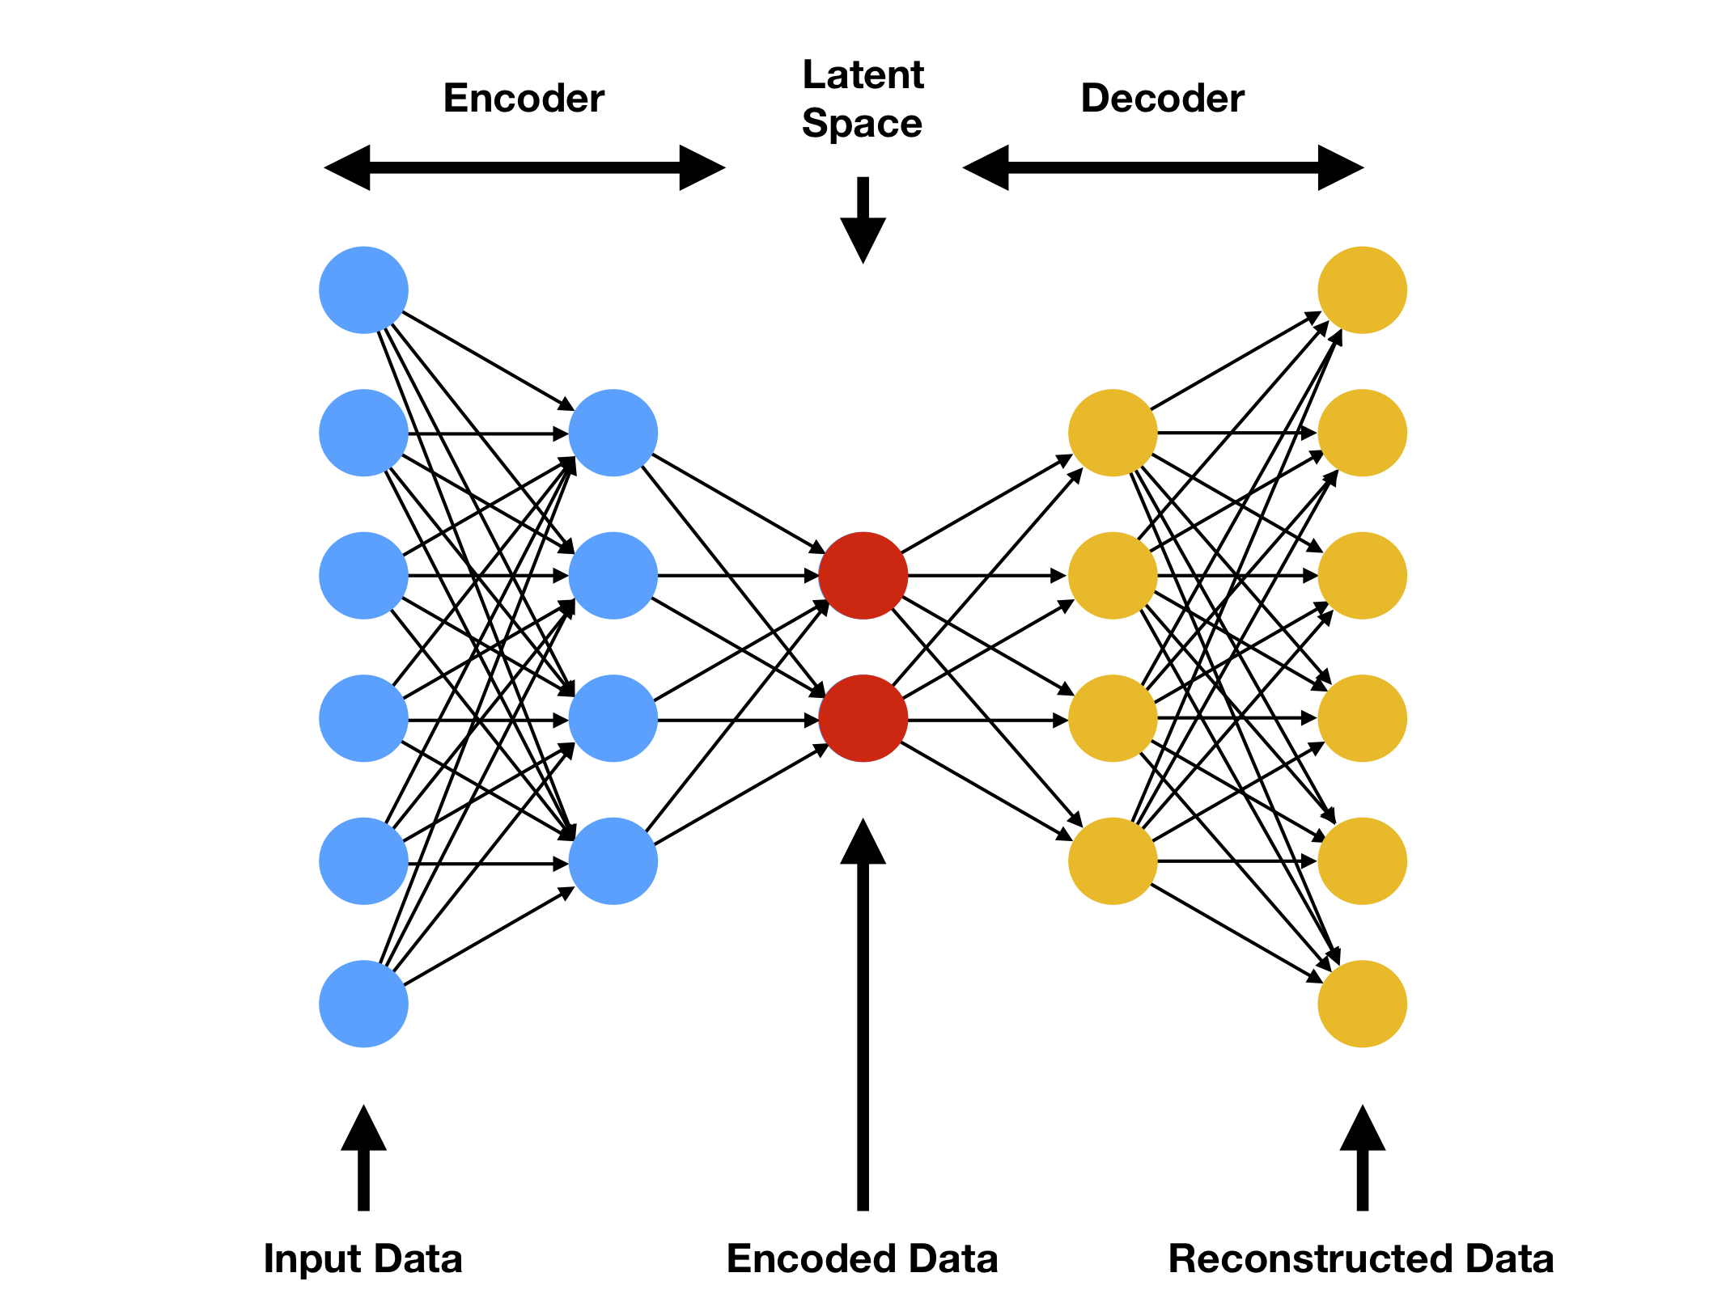
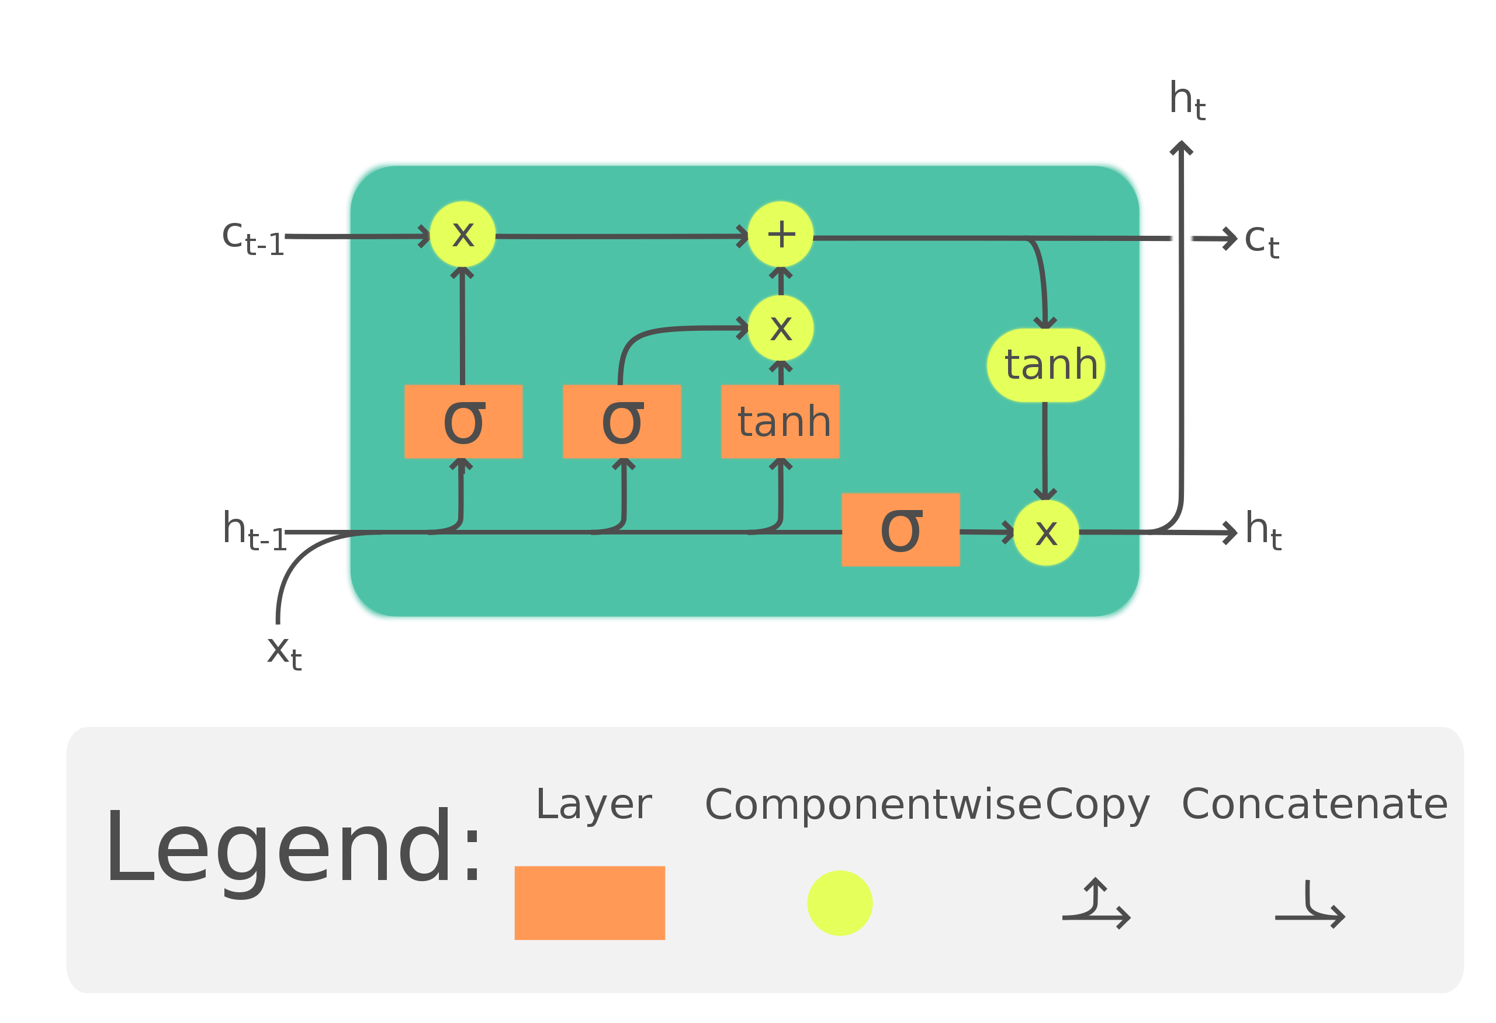
LSTM Autoencoders
Autoencoders
Common neural network-based technique
Unsupervised anomaly detection
Map each item back to itself, passing through a low-dimensional "bottleneck" layer
High reconstruction error can indicate anomaly
LSTM
Long short-term memory
Common approach for sequential data
https://www.compthree.com/blog/autoencoder/
https://en.wikipedia.org/wiki/Long_short-term_memory#/media/File:LSTM_Cell.svg

Slide 15
Experiments

Slide 16
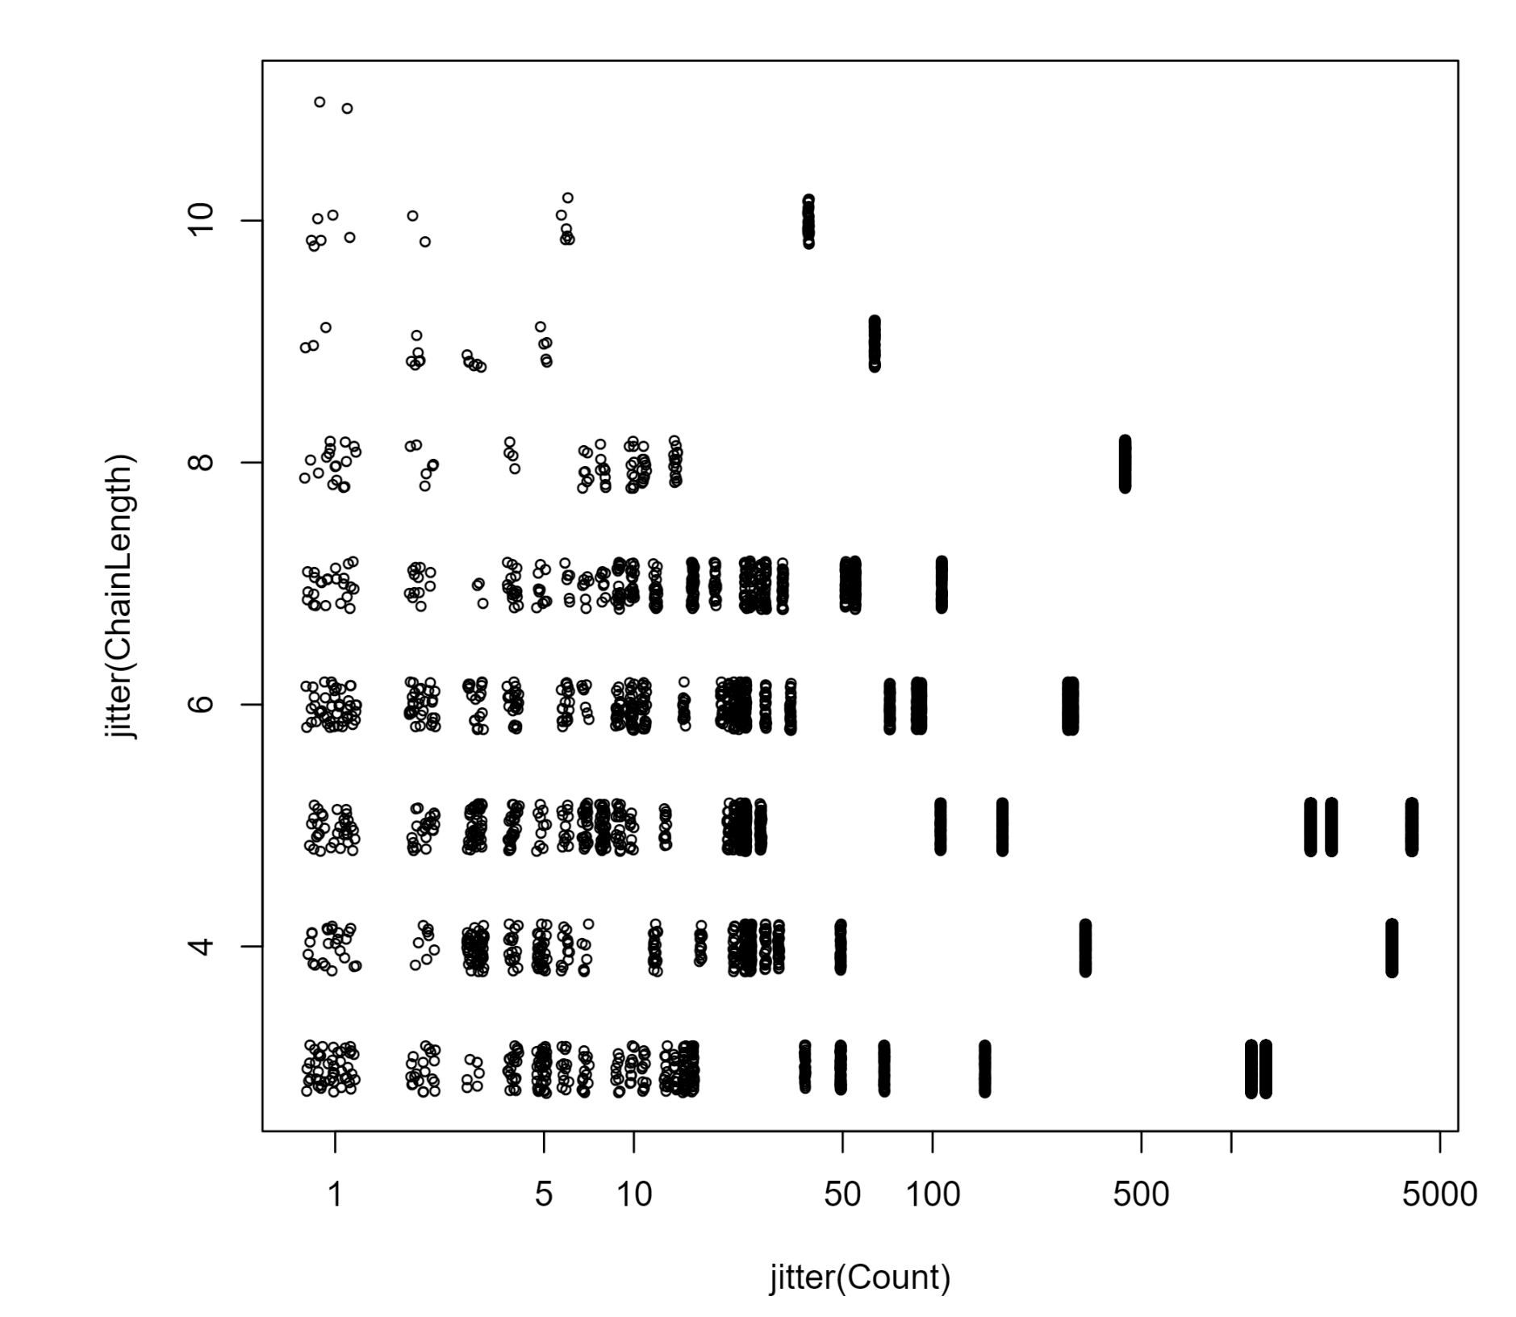
Tracer FIRE data
Publicly available cybersecurity exercises
Tracer Fire versions 9 and 10 used here
Some issues in interpretation of labels for version 9
Labeled malicious activity
Can build process chains from Sysmon logs
TF10:
Nearly 90k logs
About 19k process chains produced
Tracer FIRE 10 Chain Length/Uniqueness
TF10 Data

Slide 17
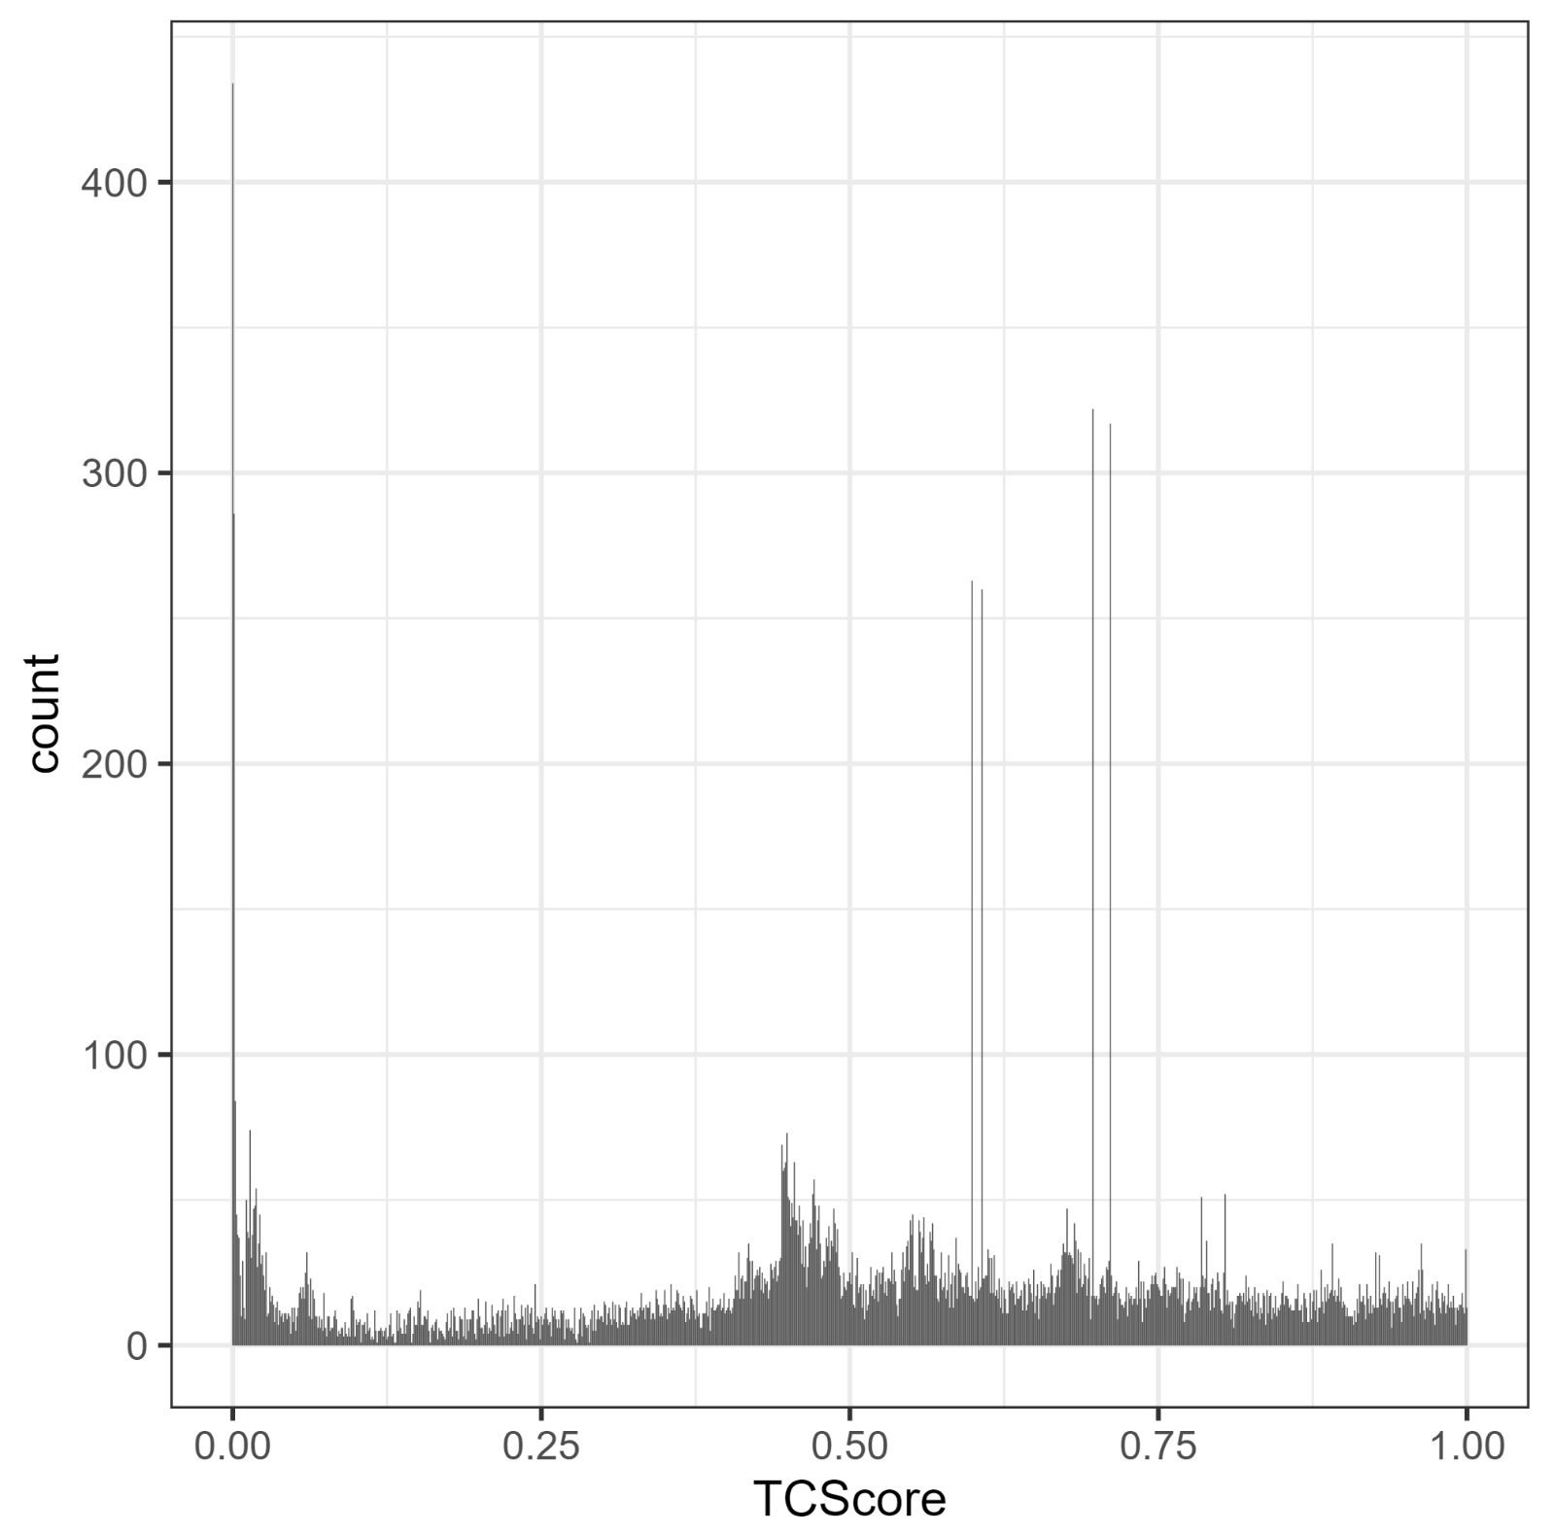
Anomaly Scores from Hierarchical Model
TF10 Data

Slide 18
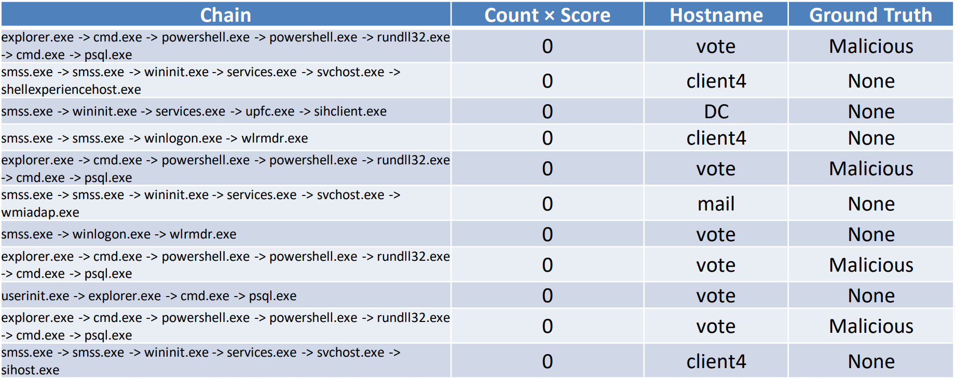
Top Nominations from Hierarchical Model

Slide 19
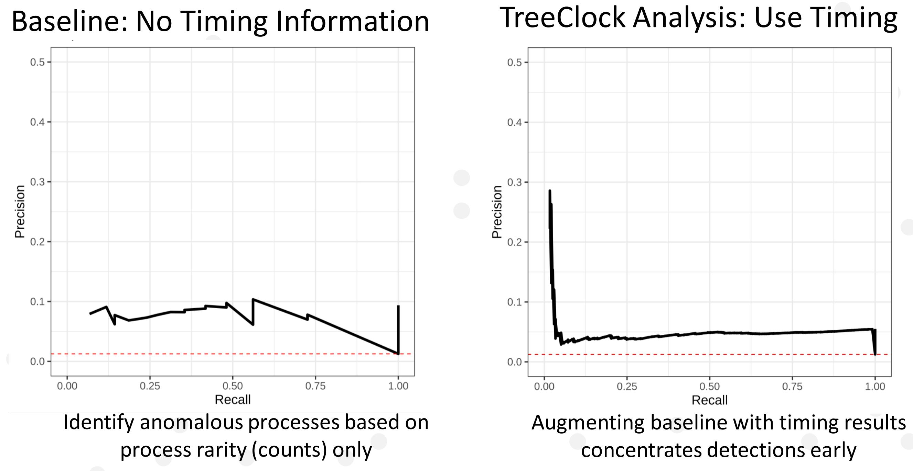
Experiment: Simple Count Baseline vs. Bayesian-informed Analysis
TF10 Data

Slide 20
Experiment: Autoencoder with and without Bayesian Anomaly Scores
Pairwise comparison of various LSTM autoencoder models
Performance metric: $F_{1}$ score @5% of top nominations
All models include basic process name information
C: Process count (simple metric of rarity)
T: Raw time information
TCS: Bayesian timing-based anomaly score
CXS: C $×$ TCS
TF9 Data

Slide 21
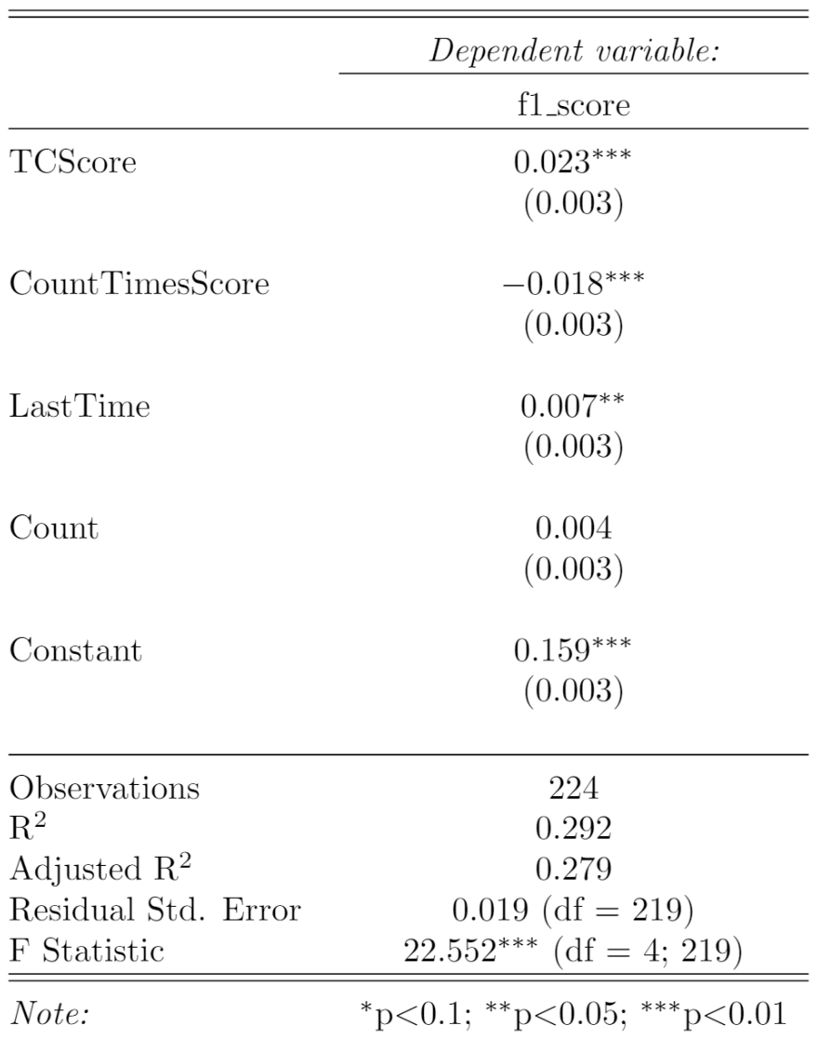
Experiment: Autoencoder with and without Bayesian Anomaly Scores
Regression analysis across all Autoencoder results
Performance metric: $F_{1}$ score @5% of top nominations
C: Process count (simple metric of rarity)
T: Raw time information
TCS: Bayesian timing-based anomaly score
CXS: C $×$ TCS
F1 scores show improvement when Bayesian scores are included
TF9 Data

Slide 22
Next Steps
Experiment with different baseline (non-timing) models
Different ways to handle chains in autoencoder
Variable-length Markov models
More sophisticated Bayesian models?
Even the simple Normal-Gamma model is giving promising results
Must be fast enough to scale to large datasets
Ideally exploit conjugacy
Test on real log data
Thanks for listening!
Questions?

