Slide 1
Parameter estimation using statistical machine learning for dynamic radiography
Soumi De
Los Alamos National Laboratory
In collaboration with: Marc Klasky & Oleg Korobkin
Sandia National Lab MLDL conference 2023
LA-UR-23-27282

Slide 2
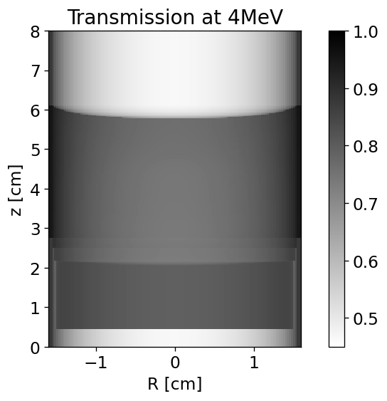
Problem statement: Dynamic radiography
Radiographic image
Given a system undergoing strong deformations, we want to use its radiographic image to
reliably characterize its material properties, such as equation of state and crush model properties
reconstruct the system (full image)

Slide 3
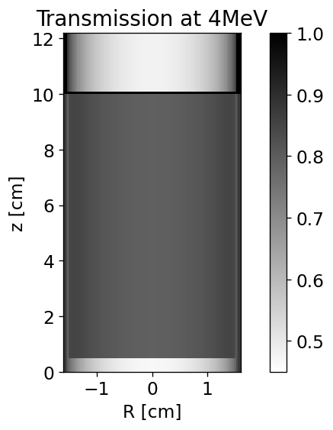
Problem initial configuration
Aluminium oxide porous powder in a vessel impacted by a steel flyer plate.
Parameters :
r0: Initial density for Hugoniot rp: initial density of porous material
cs: sound speed s: linear coefficient of US-UP g0: Mie-Gruneisen equation of state parameter ps: compaction pressure pe: elastic pressure ce: sound speed in elastic pore compaction regime μ: distention ratio
eos
slope of Hugoniot
crush
model

Slide 4
Data analysis challenges
Analyzing radiographs from real experiments are challenging due to our inability to accurately model noise.
Therefore our strategy is to use prominent physical features that are robust to noise as inputs for parameter estimation for material properties and reconstruction of shock phenomena.
This work involves analyzing data from impact simulations - mimicking physics in the real experiment.
Simulations help us decide which kind of features in the data contain necessary and sufficient information to solve the physics problem in question.

Slide 5
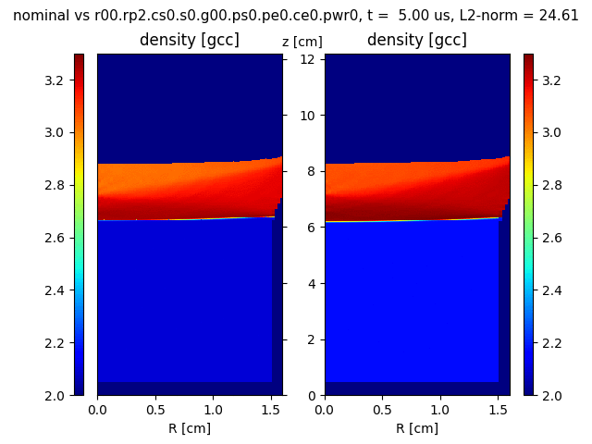
Flyer plate simulations
Aluminium oxide porous powder in a vessel impacted by a steel flyer plate.
A shock propagates inside the powder.
Powder gets compressed, heat generated, a release/rarefaction wave is generated.

Slide 6
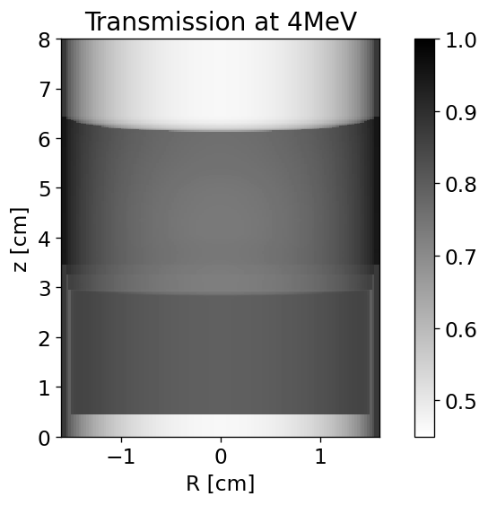
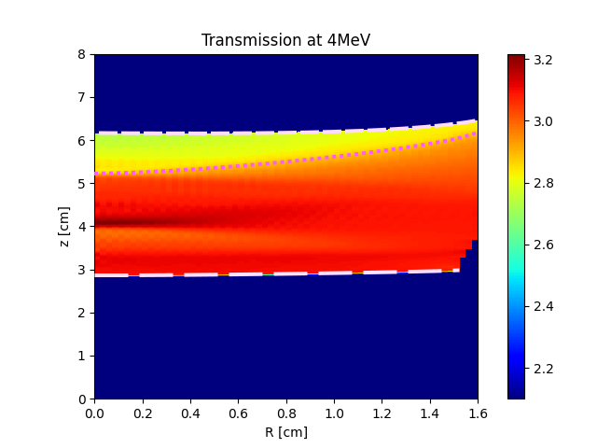
Synthetic radiographic data
Currently we train and test deep learning algorithms with features extracted from densities produced by impact simulations
As a long term goal, we want to train and test with features from radiographic images
Density [g/cc]
back edge
release
/ rarefaction
front shock

Slide 7
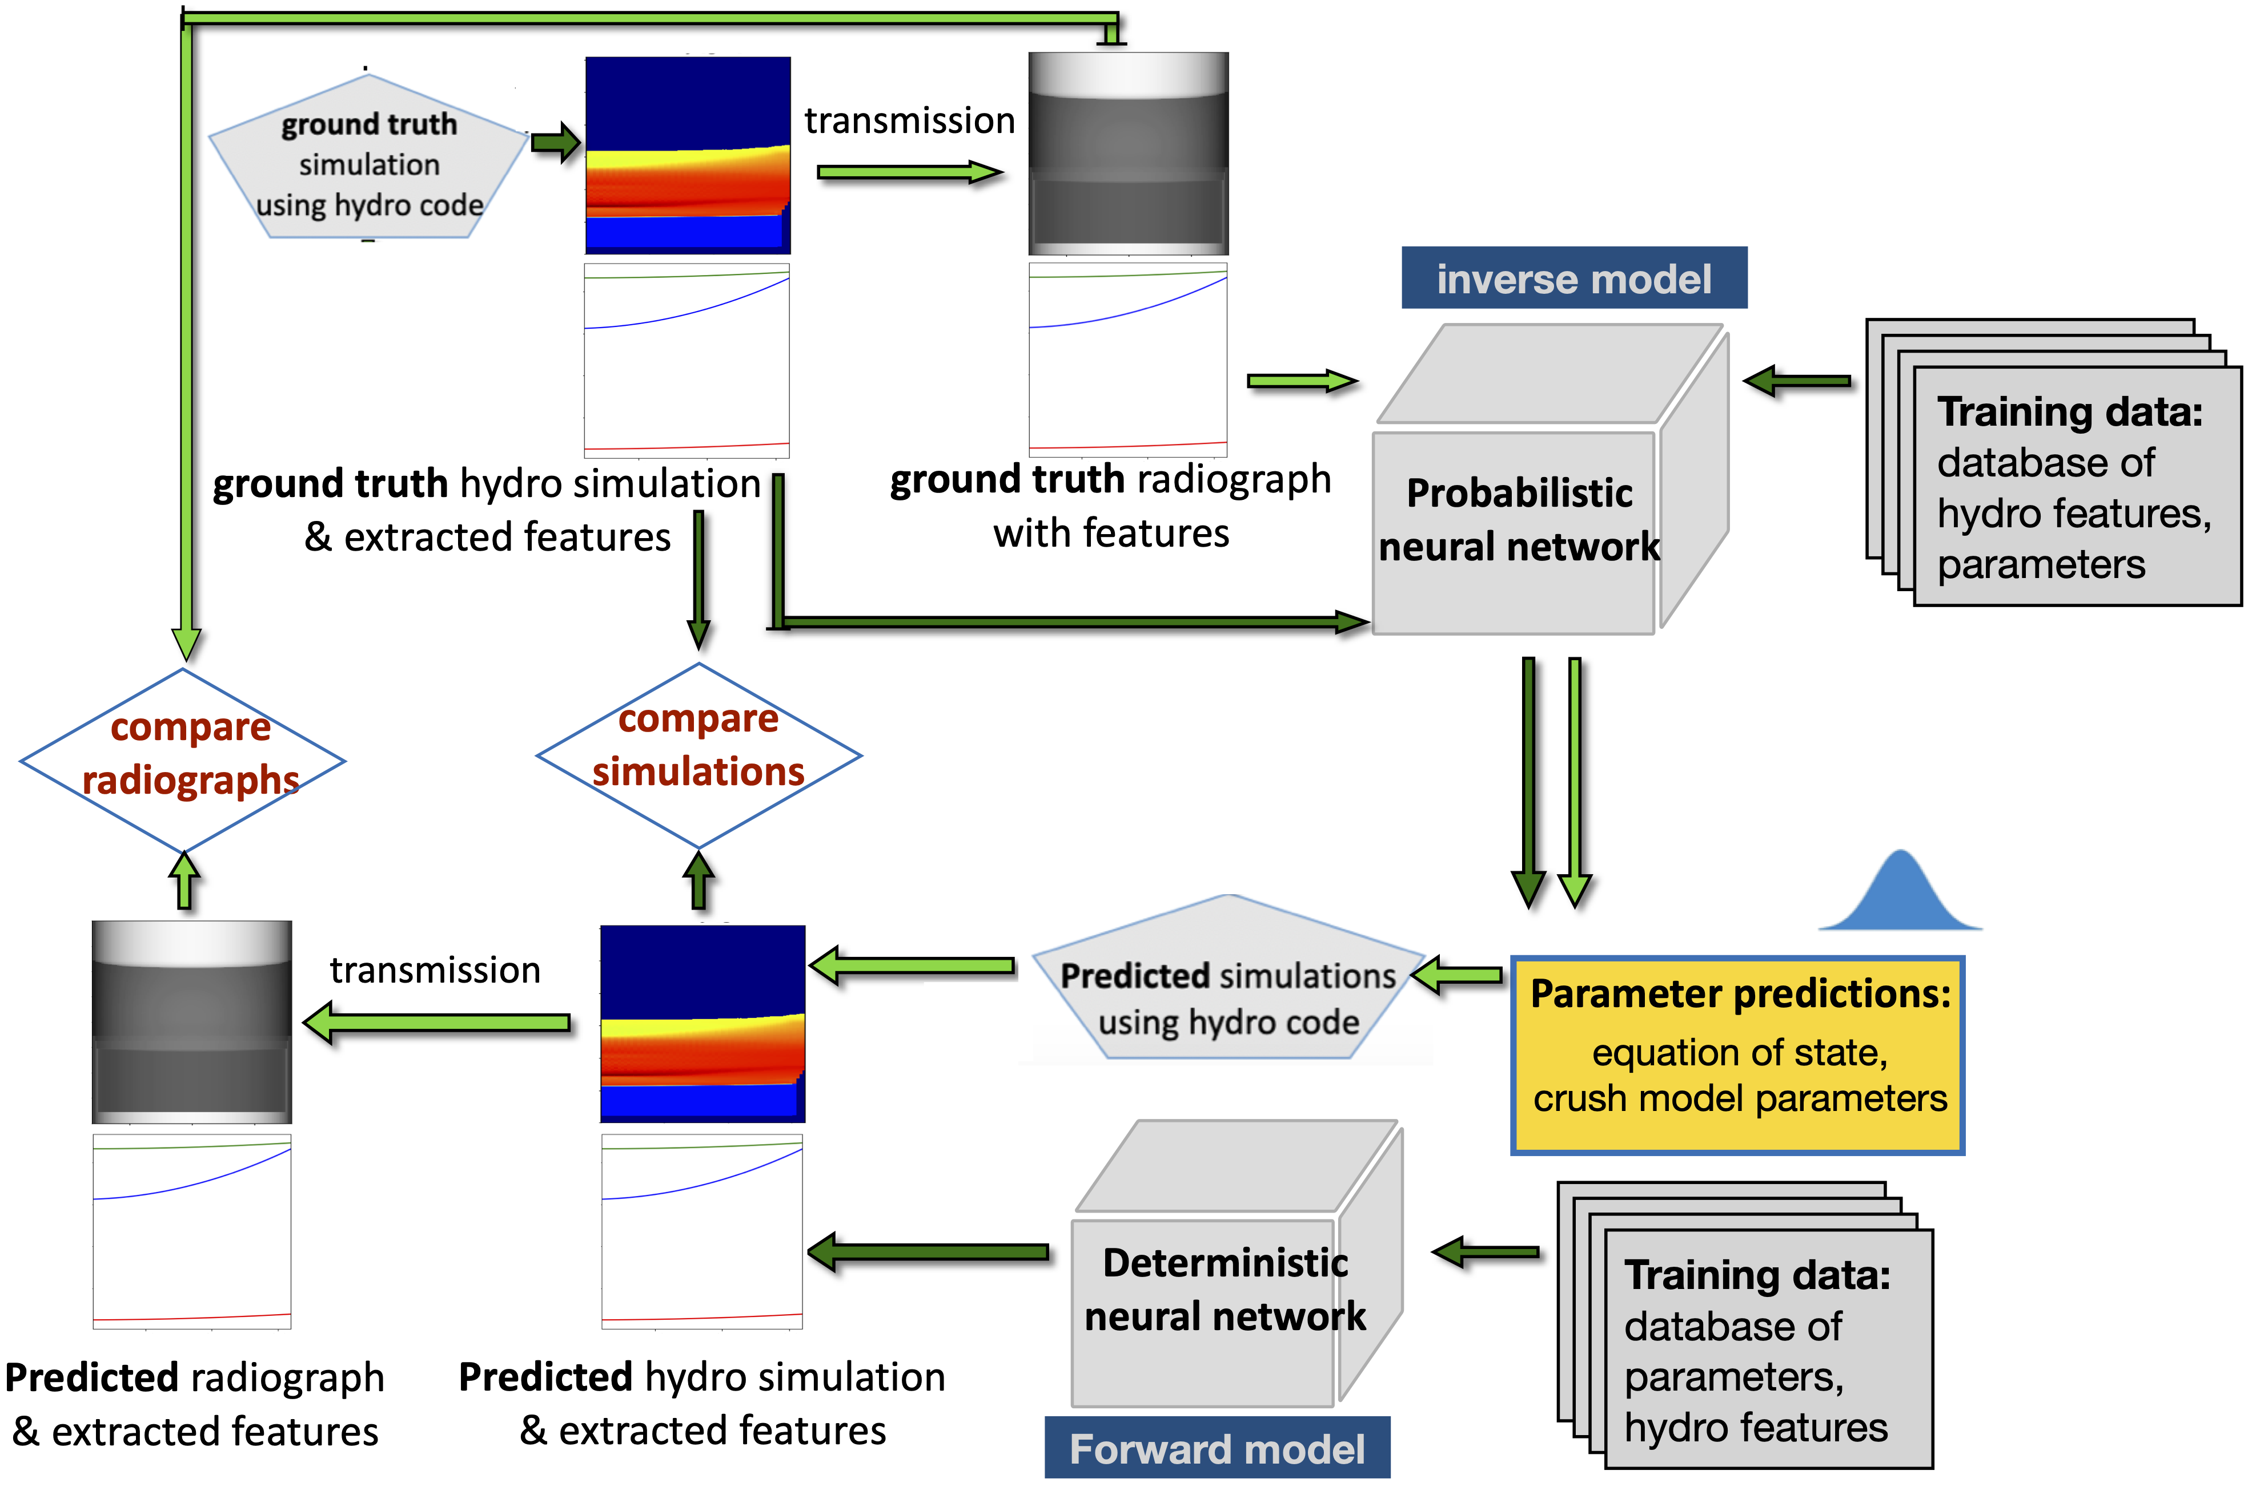
Parameter estimation pipelines
density
densities

Slide 8
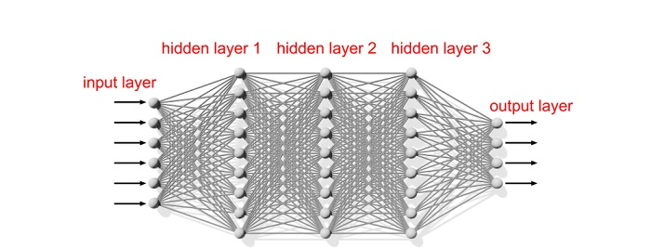
Standard neural network
A neural network maps to by minimizing a loss function
$$(X,Y)$$
$$\overline{Y}$$
$$L(w)$$
When we use “rms” as our loss function, we pick weights, such that we maximize the likelihood of observing ($X,Y$)
Our prediction is a single point picked from
$$p(Y|X,w)$$
But it might not be the true optimum value
data
predictions
$$X,Y$$
$$\overline{Y}$$
$$w_{1}$$
$$w_{2}$$
$$w_{3}$$
Parameters:= $w$ weights

Slide 9
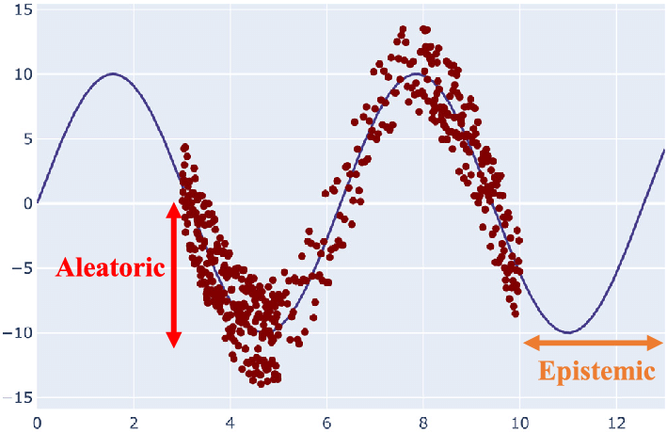
But standard neural networks don’t propagate uncertainties
There are two kinds of uncertainties in neural network predictions — aleatoric and epistemic uncertainties
Aleatoric uncertainties are data uncertainties, cannot be reduced by adding more data
Epistemic uncertainties are model uncertainties, can be reduced by adding more data

Slide 10
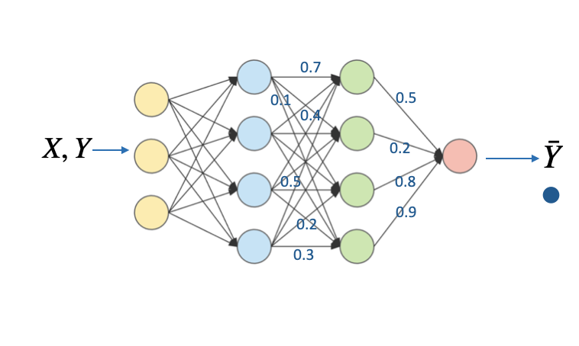
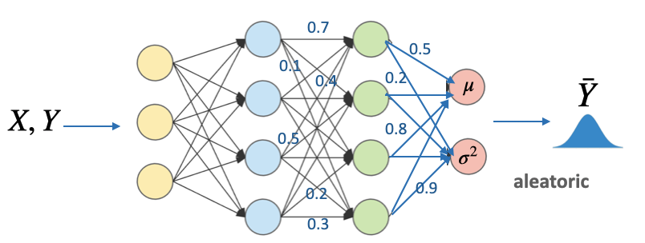
Probabilistic network: includes aleatoric uncertainties
Now the network outputs not just a point from $p(Y|X,w)$ but a probability distribution capturing training data characteristics.
Such a network includes aleatoric uncertainties implemented in this work.
deterministic neural network
probabilistic neural network

Slide 11
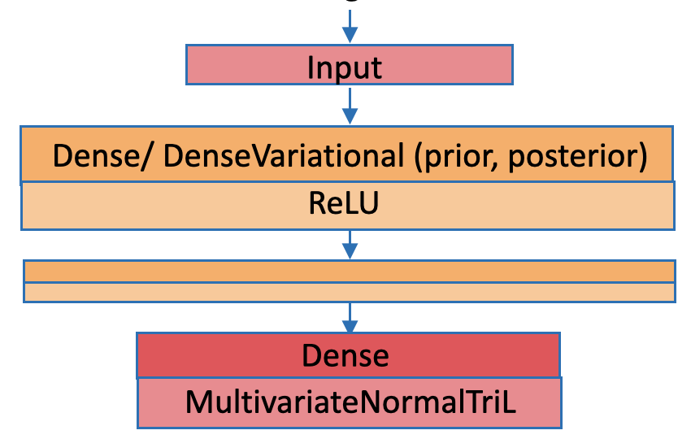
Inverse model: for mapping features to parameters
We solve the inverse problem using a probabilistic neural network capturing aleatoric uncertainties
The final layer of the network turns the output into a probability distribution, assumed to be a multivariate normal distribution
Loss function is the “negative log likelihood” distribution for the given training data
Minimizing the negative log likelihood is equivalent to maximizing the likelihood of observing the true data
neg_log_likelihood is: $-{log(PDF)}_{normal}=log({\overline{Y}}_{σ^{2}})+\frac{(Y-{\overline{Y}}_{μ})^{2}}{2{\overline{Y}}_{σ^{2}}}$
minimize loss:
-ve log likelihood

Slide 12
Forward model: for mapping parameters to features
We solve the forward modeling problem, i.e., mapping parameters to features using a deterministic neural network
Loss function here is mean square error
minimize loss:
mse

Slide 13
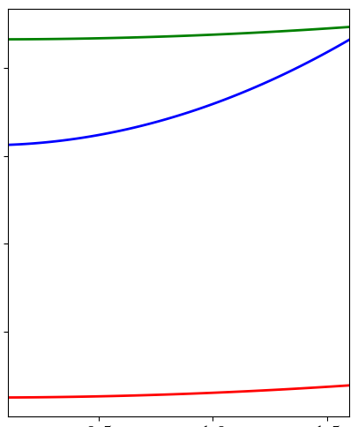
Training data
Out of the three distinct features in the simulations, the leading shock wave and back edge carry strong information content
Our training data comprises of parameterizations of the leading shock, back edge, and release extracted from a single snapshot from ~21000 flyer plate simulations
{
{
,
parameters: p1, p2, p3, …
Training dataset for
inverse model
Labels
(probabilistic)
{
Features
{
Training dataset for
forward model
21,000 simulations
parameters: p1, p2, p3, …
,
(deterministic)
Features
Labels

Slide 14
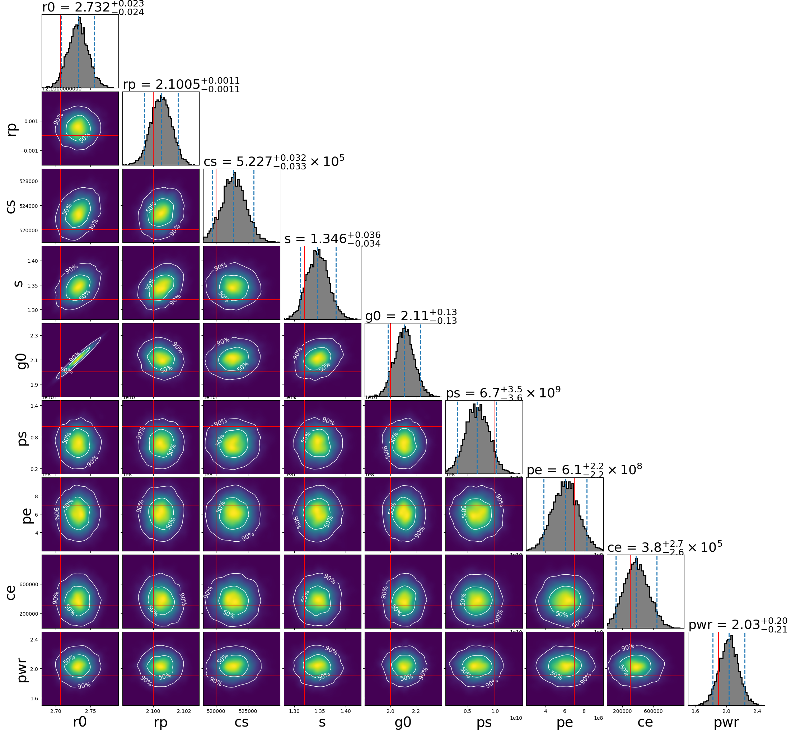
inverse model
Results: predicted parameters for 1 ground truth from inverse model
predicted 1D and 2D marginalized histograms for EoS and crush model parameters

Slide 15
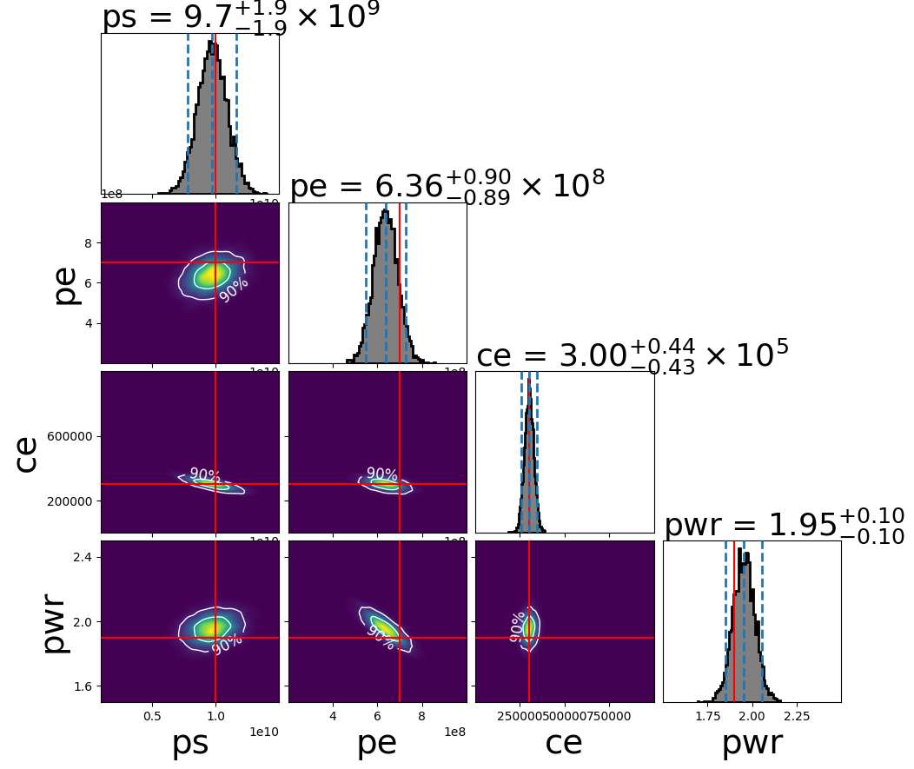
inverse model
Results: predicted parameters for 1 ground truth from inverse model
predicted 1D and 2D marginalized histograms for EoS and crush model parameters
predicted 1D and 2D marginalized histograms for crush model parameters fixing EoS parameters

Slide 16
inverse model
Results: predicted parameters for 1 ground truth from inverse model
predicted 1D and 2D marginalized histograms for EoS and crush model parameters
predicted 1D and 2D marginalized histograms for crush model parameters fixing EoS parameters
Measurements of crush model parameters become more accurate with narrower uncertainties, upon fixing EoS parameters

Slide 17
Results: predicted features for 1 ground truth feature
Spread in predictions for primary shock reduces when training with crush parameters only, keeping equation of state parameters constant
Measuring EoS and crush model parameters
Ground truth feature
Predicted feature
1 pixel width on either side
of ground truth
3 pixel width on either side
of ground truth
Measuring crush model parameters, EoS parameters fixed

Slide 18
Conclusions
We have implemented a probabilistic neural network to map physical features to equation of state and crush model parameters for aluminum flyer plate impact simulations.
The probabilistic network predicts distributions of degenerate parameters, capturing uncertainties from the training data.
We pass parameter estimations from the probabilistic network to a deterministic network mapping parameters back to features.
Predictions for the sharpest features have minor differences with the ground truth, verifying degeneracies in the problem, i.e., wide range of parameter configurations map to similar shock (feature) locations.
Shock locations are measured more accurately when fixing equation of state parameters and measuring only crush model parameters.
Future study: Can we use features from radiographs to perform parameter estimation and reconstruction?
Thank you

