Slide 1
Sensor and Actuator Attacks on Hierarchical Control Systems with Domain-Aware Operator Theory
Craig Bakker
Research Scientist
Notes:
Stock Image: Abstract Data Visualization Grid

Slide 2
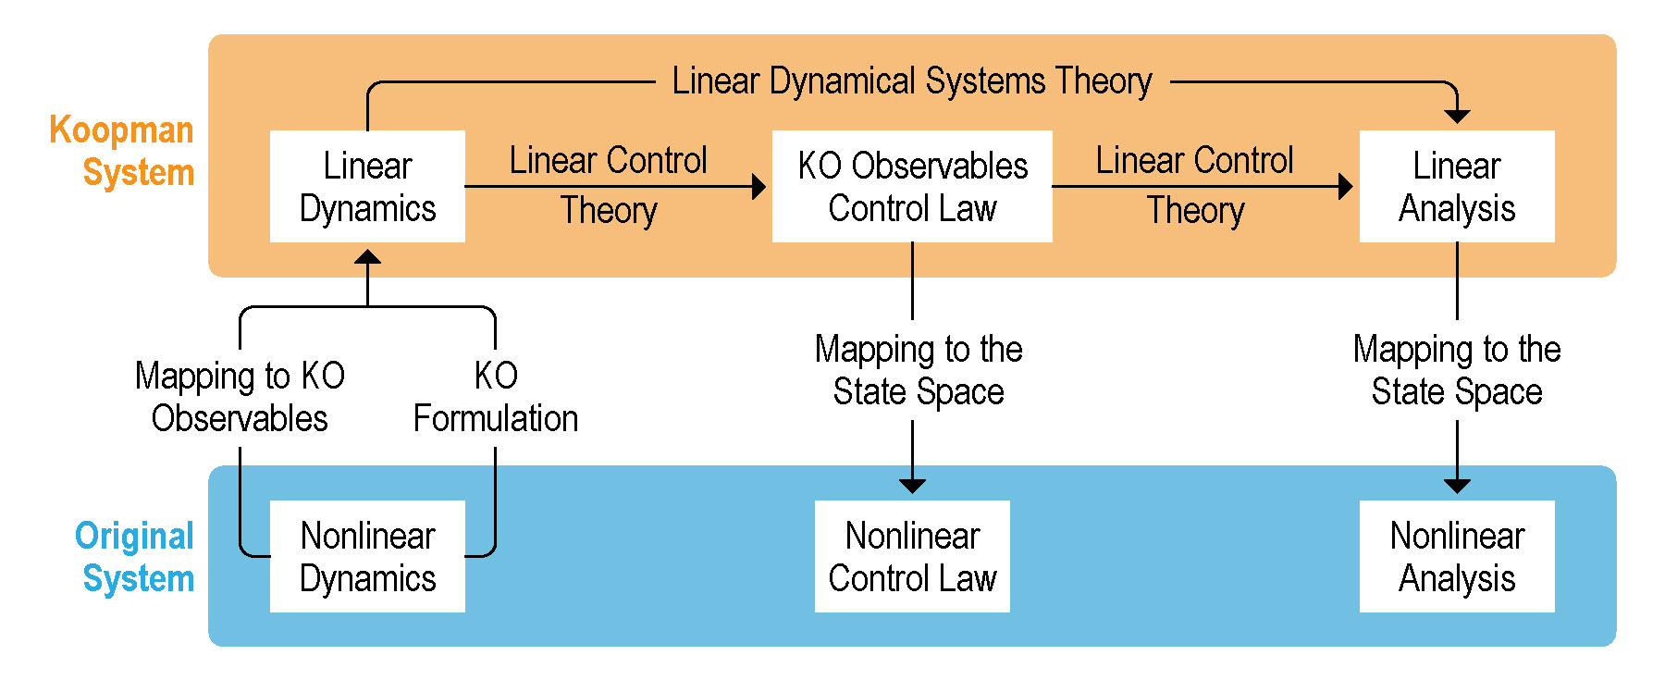
Introduction
Cyber-Physical Security and Industrial Control Systems
The Koopman Operator and Machine Learning

Slide 3
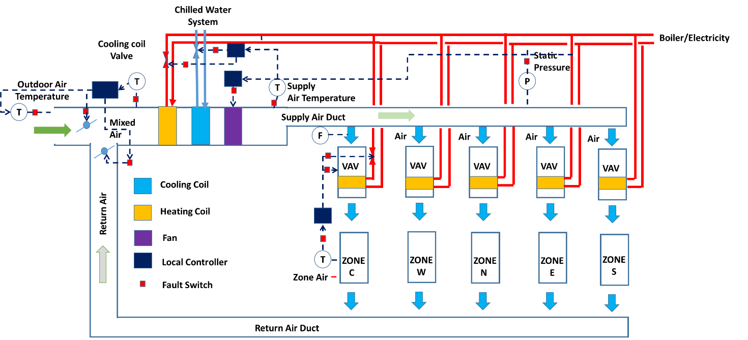
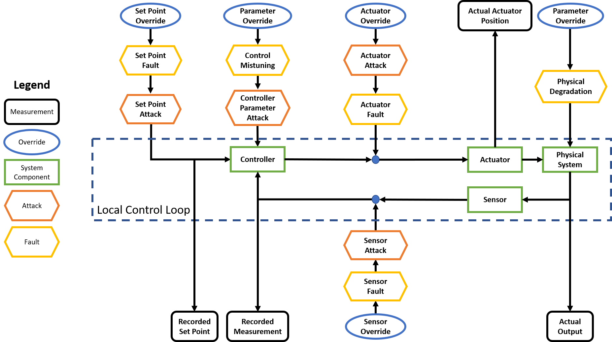
Emulator Description
Commercial Building HVAC
Hierarchical Control
Fault and Attack Implementation

Slide 4
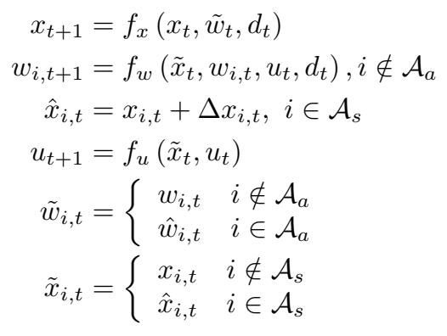
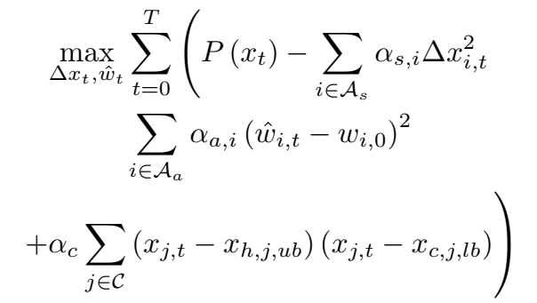
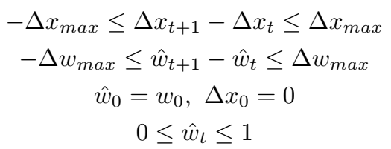
Attack Formulation
Separation of Dynamics
Objective Function
Attacker Stealth
Supervisory Control

Slide 5
Koopman Model and Domain Knowledge
Affine Mapping
Stability-Enforcing Formulation
Variable Separation and Dependencies
Previous Work
 | Set Point | Actuator | Sensors
AHU | AHU SAT | Cooling Coil Valve | MAT, AHU SAT
AHU | AHU MAT | Economizer Damper | OAT, RAT, MAT
AHU | Duct Static Pressure | Fan Speed | Duct Static Pressure
VAV | VAV Air Flow Rate | VAV Damper | Supply Air Flow Rate
VAV | VAV SAT | Heating Coil Valve | VAV SAT

Slide 6
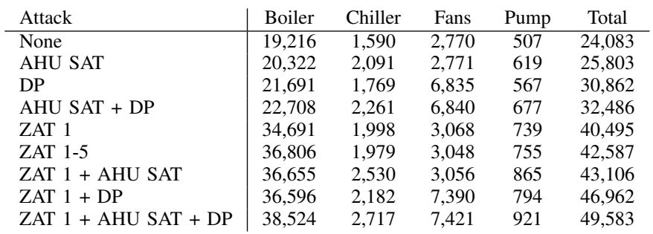
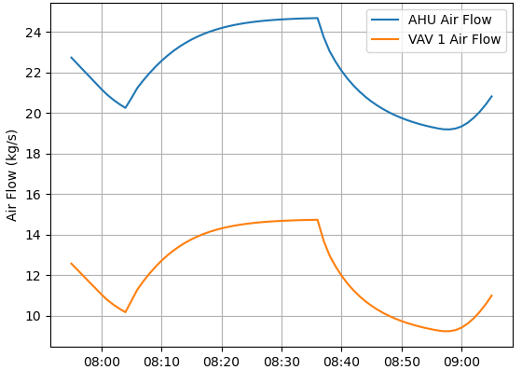
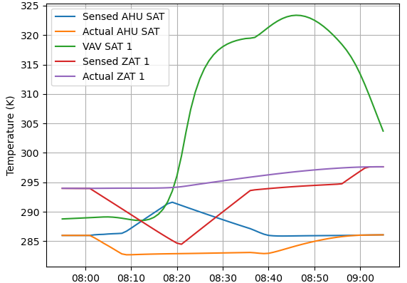
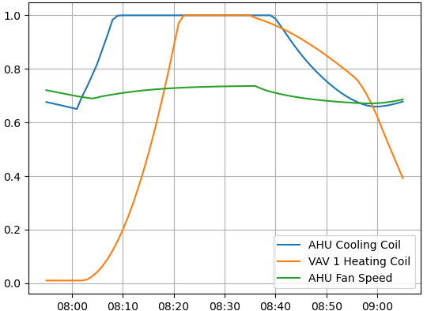
Results – Sensors Only
Power Consumption
Attack Synergies

Slide 7
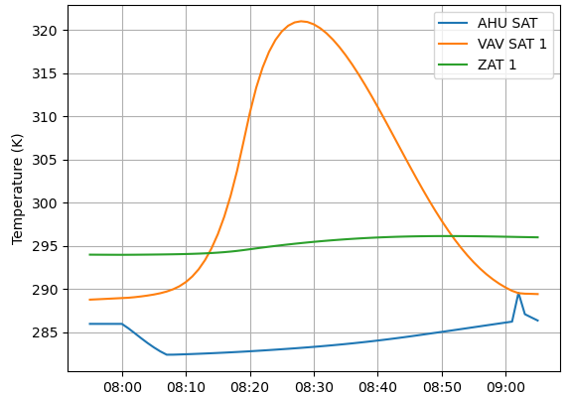
Results – Including Actuators
Actuator-Only Attacks
Combined Attacks

Slide 8
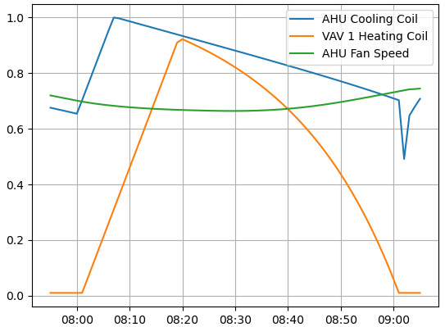
Discussion
Multiple vs Single Attacks
Sensors vs Actuators
Detection and Defense

Slide 9
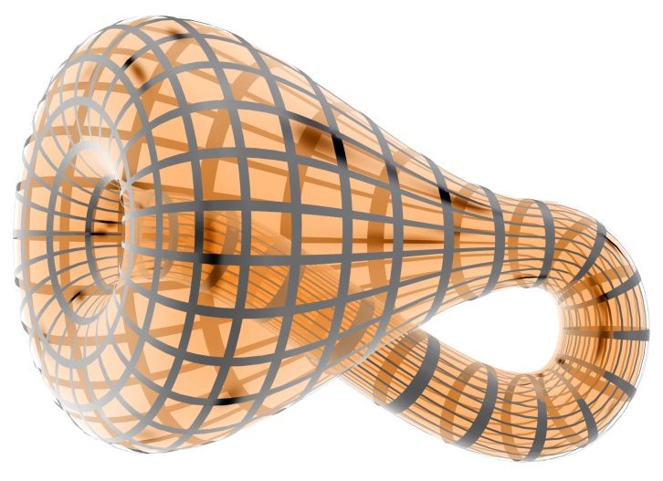
Questions
Banchoff, T., Beall, J.: kbc1.jpg. URL http://alem3d.obidos.org/en/struik/kbottle/

